Slide 1
sPHENIX/MAPS Pre-Proposal Outline
Executive Summary (~1 pages)
Mission Need (~1 page)
Physics Goals (~2 pages)
  B-jet physics at intermediate pT (>10 GeV)
  B-hadron physics at low pT (<10 GeV)
Detector Requirements (1~2 pages)
  Tracking impact parameter resolutoin
  B-tagging in AuAu
  Readout rate
Physics Performance (~2 pages)
  B-tagging
Technical Scope and Deliverables (~2 pages)
  Stave assembly and testing
  Readout
  Mechanical structures
Organization (~2pages)
Schedule and Cost Baseline (3~5 pages)

Slide 2
Proposed Tasks and Timeline
A MAPS detector subgroup to identify and work on
  Tasks, Resources and Responsibilities for each institution
  Agreement on each institution’s interest and available resource
  Start joint R&D on critical tasks
    LDRD, associate members and other R&D fund etc
Pre-proposal writing?
  Identify required resources ($$ and manpower) and timeline
  Intended contributions from all institutions
  Electronics and readout – LANL
  Mechanic system and integration – MIT
  Physics simulations - LBNL
  Ancillary and other systems – other collaborators
  A draft by January 2017? Discussions with DOE during Feb budget meeting
More communications with DOE
  Based on updated resource loaded Cost and Schedule from pre-proposal
  Then decide on next step
    either go forward or not, work out a plan with DOE
  Get more support from ALD & DOE on CERN-SPHENIX agreement etc.

Slide 3
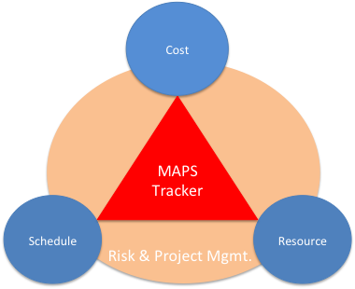
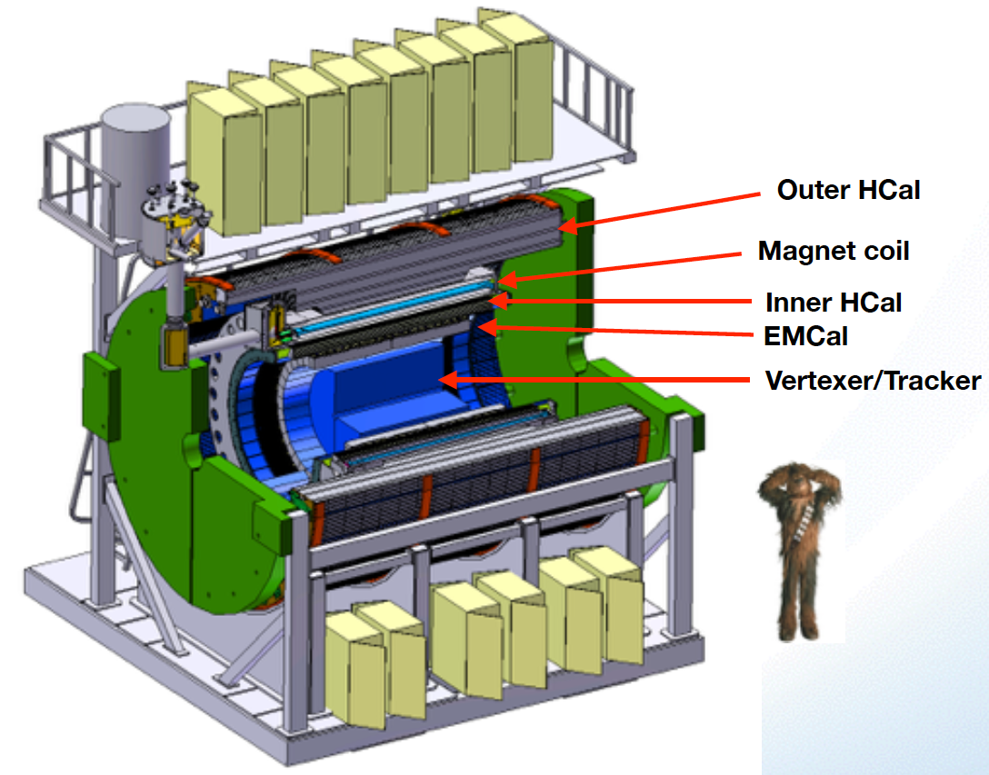

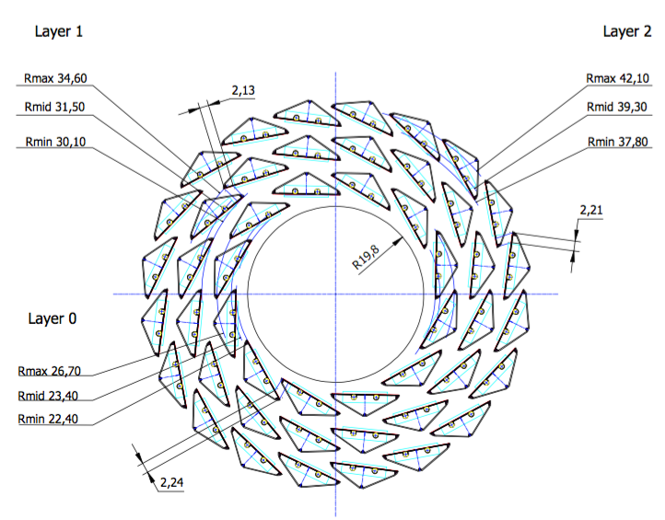
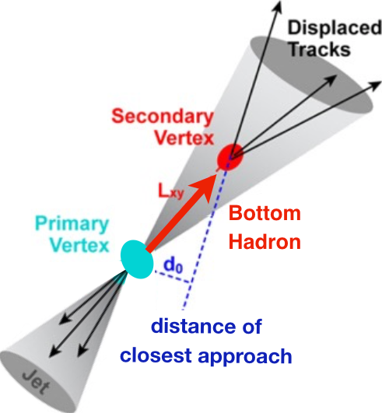
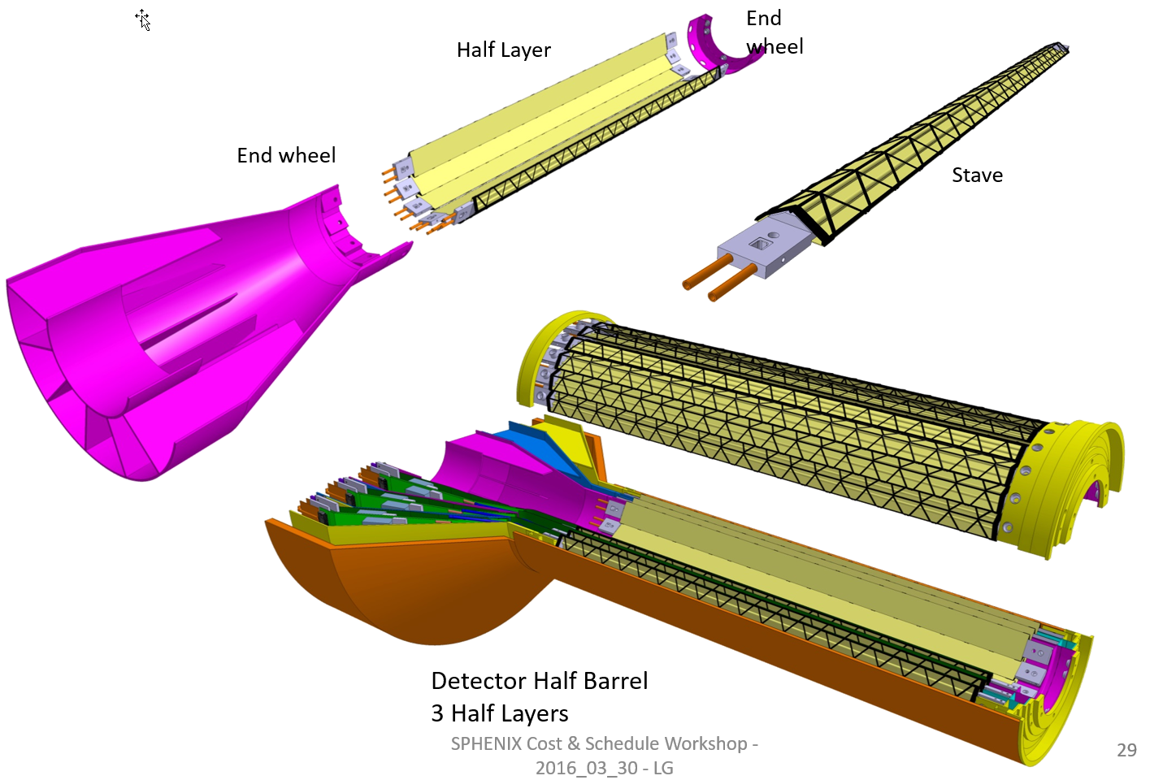
sPHENIX MAPS Inner Tracker
ALICE ITS;
Inner Tracker System
Key issues:
- Readout
- Mechanics
sPHENIX Inner Tracking
Copy of ITS Inner Tracker

Slide 4
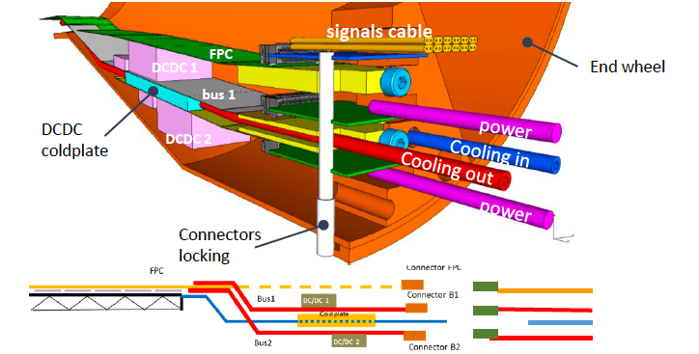
sPHENIX MAPS Inner Tracker
~1mm gap in R

Slide 5
Scope of the Project
MAPS & Electronics
  MAPS Detectors
    MoU to build 68 ITS MAPS staves (40% spares)
    No modification
  Readout Electronics
    Use ALICE/ITS, RDO + CRU
    Modify/reprogram CRU for sPHENIX
      Plan-B: build a custom board to convert ALICE/ITS into sPHENIX DAQ format
    R&D by LANL LDRD
  Production
    Extend ALICE/ITS MAPS stave production
    Train sPHENIX personnel for assembly and testing staves at CERN
    Reproduce additional ALICE RDO+CRU for sPHENIX
  Ancillary systems
    LV, cables, crates, racks etc.
    Slow control, safety and monitoring
Mechanics & Cooling
  No/(some) changes to ALICE/ITS inner tracker mechanical structures
    End Wheels
    Cylindrical structure shells
    Detector half barrels
    Service half barrels
    Detector and Service half barrels
    Half support structures
  Mechanics Integration
    Conceptual design by LANL LDRD
    Prototype by sPHENIX R&D
    Design integration frames
    Cage etc.
    Installation tooling etc.
  Copy ALICE cooling plant design
    Minor modification to fit sPHENIX
    Smaller heat load than ALICE ITS
  Metrology and Survey

Slide 6
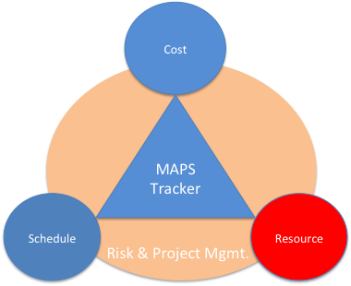
Participating and Interested Institutions
LANL - Readout & FEMs, Mechanics
MIT - Assembly and testing, cooling…
LBNL – Mechanical carbon structures, simulations
BNL – Integration and services, safety and monitoring
UT-Austin – MAPS readout electronics and testing
Univ. of Colorado – sPHENIX DAQ/DCM-II integration
Univ. of New Mexico – LV, cabling & connectors
New Mexico State University – Tracking algorithm and simulations
Univ. of IL of Chicago – Stave assembly and testing, offline analysis
Iowa State University – Assembly and testing, simulations
Georgia State University - Slow control and monitoring
Florida State University - Offline and simulations
Univ. of California, Los Angeles – Assembly and testing, simulations
Univ. of California, Riverside – Assembly and testing, simulations
RIKEN/RBRC, Japan – Assembly and testing, integration
Yonsei, Korea – MAPS QA and readout, simulations
Czech Republic - Miroslav/Mike Finger, Caclav Vrba et al , tasks TBD
Peking Univ. – many good students (already on CMS)
CCNU – already working on ALICE/ITS 5th layer, many students
Potential collaborators

Slide 7
Organization Chart
BNL Program Manager
sPHENIX Project Office
Manager: Ed O’Brien
From Sep. 2016
Tracker Review
sPHENIX Management
Spokespersons
Gunther Roland
David Morrison
sPHENIX MAPS Project Office
Project Manager: Ming Liu (LANL)
Deputy Project Manager: Mike McCumber (LANL)
Electrical Engineer:TBD
Mechanical Engineer: Walt Sondheim? /MIT?
Readout
UT/LANL
MAPS Sensor
ALICE
Stave
ALICE
Cabling
UNM
Mechanics
MIT/LBNL
Integration
MIT
Electrical
BNL
Software
UIC/FSU
FEM
M. Prokop LANL
Sensor Design
ALICE
Stave Design
ALICE
High density cables
UNM
Structure Design
LANL/MIT
Cooling
MIT
Low Voltage
UNM/NMSU
Simulation
ISU/GSU/
Slow Control &
Monitoring
BNL
Sensor Production
TowerJAZZ
Stave Assembly
MIT/UIC/LANL
LV
UNM/NMSU
Assembly
BNL/MIT
Alignment
BNL/UIC
Offline
NMSU/FSU
DCM Integration
Colorado
Sensor QA
Yonsei(Korea)
Stave QA
MIT/ISU
Fibers
UNM
Installation
BNL/MIT
Mechanical Stability
BNL
B-jet tagging
LANL,NMSU
Safety System
BNL

