Slide 1
sPHENIX/MAPS Pre-Proposal Outline
Executive Summary (1~2 pages)
  Science highlights
  Mission Need
Physics Goals (~2 pages)
  B-jet physics at intermediate pT (>10 GeV)
  B-hadron physics at low pT (<10 GeV)
Detector Requirements (~2 pages)
  Tracking impact parameter resolutoin
  B-tagging in AuAu
  Readout rate
Physics Performance (~2 pages)
  B-tagging
Technical Scope and Deliverables (~2 pages)
  Stave assembly and testing
  Readout
  Mechanical structures
Organization and Collaboration (1~2pages)
Schedule and Cost Baseline (3~5 pages)

Slide 2
Tasks and Timeline
Pre-proposal writing
  Identify required resources and timeline
    Intended contributions from each institution
  Electronics and readout – LANL
  Mechanic system, cooling and integration – MIT
  Mechanical carbon structures and simulations – LBNL?
  Ancillary and other systems – other collaborators
  Frist draft by mid December 2016, for sPHENIX collaboration meeting, discuss future path
  A draft by January 2017? Discussions with DOE during Feb budget meeting
MAPS detector subgroup to identify and work on:
  Tasks, Resources and Responsibilities for each institution
  Agreement on each institution’s interest and available resource
  Starting joint R&D on critical tasks
    LDRD, associate members and other R&D fund etc
    readout
More communications with DOE
  Based on updated resource loaded Cost and Schedule from pre-proposal
  Then decide on next step
    either go forward or not, work out a plan with DOE
  Get more support from ALD & DOE on CERN-SPHENIX agreement etc.
Full proposal writing after discussion with DOE in Feb 2017?
  Submission, ~May 2017?
  Reviews, by CD-1
  Aiming for Fed. Budget FY2020 start up?
Can we do it for an earlier startup, FY19?
  MOU/Agreement with CERN on MAPS production ? ---- DOE – CERN Agreement?

Slide 4
CERN-BNL “MoU” for sPHENIX Production: a Proposal
Defined the minimal scope of the project in the MoU
  A 3-layer MAPS detector identical to ITS/IB
    48 staves + 40% spares = 68
  MAPS chips
    68 fully tested staves, 68x9=612 chips
    20% fully tested spare MAPS chips, 612x20% = 122 chips
    Total 734 MAPS chips
  Flexible PC boards (FPC) with connectors and cables
    One per stave, 68 of them
    Cables and connectors customized to meet CERN safety rules
      Luciano/CERN will send documents to confirm they also meet BNL safety standards
  Fully assembled and tested Staves
    Preparation and cleaning of MAPS, FPCs and frames etc.
    Alignment and gluing
    Wire bonding
    Assembly work mostly done by CERN techs
    Final testing mostly by sPHENIX students/postdocs/techs
  Mount staves on the ITS/IB space frame, ship fully tested space frame to BNL
    Space frames to mount staves
    Cold plates
    Electrical connectors etc.
    Mechanical tubes/connectors
    Metrology done at CERN
  Setup a construction DB for sPHENIX production
    Traveler documents
    All produced at CERN by ALICE ITS production lines
      CERN technicians and facilities
      With help frpm sPHENIX students/postdoc + some Techs

Slide 5
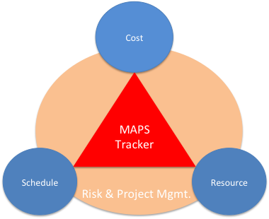
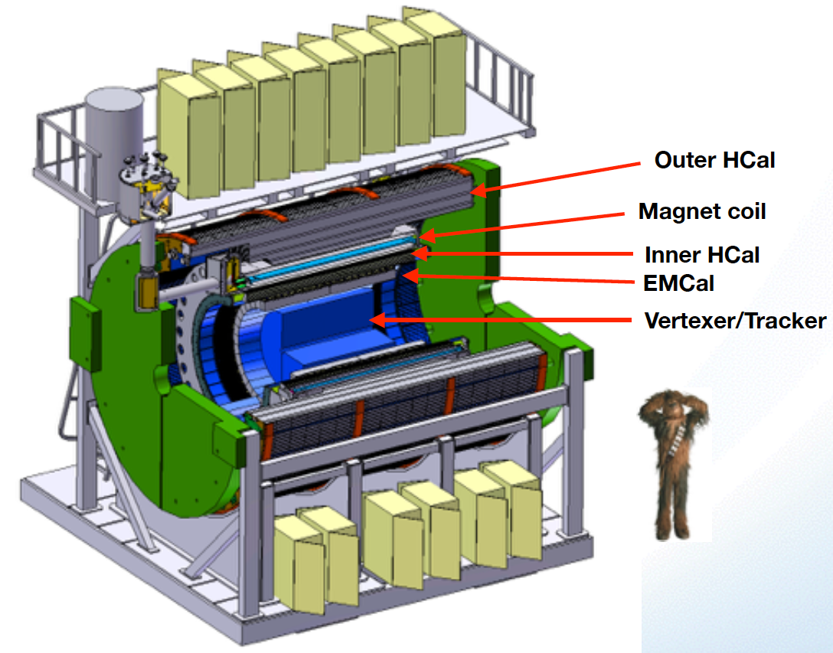

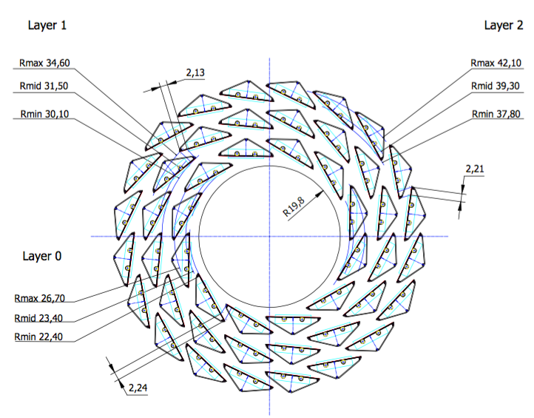
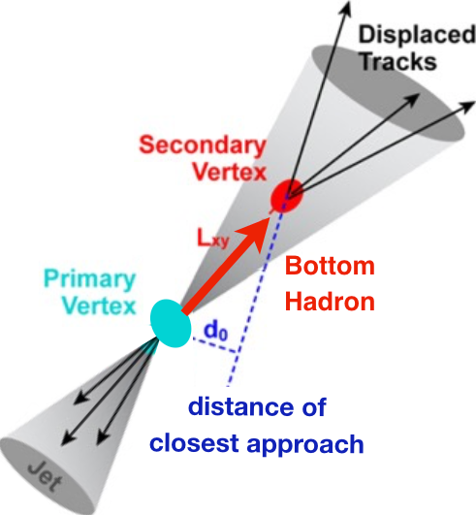
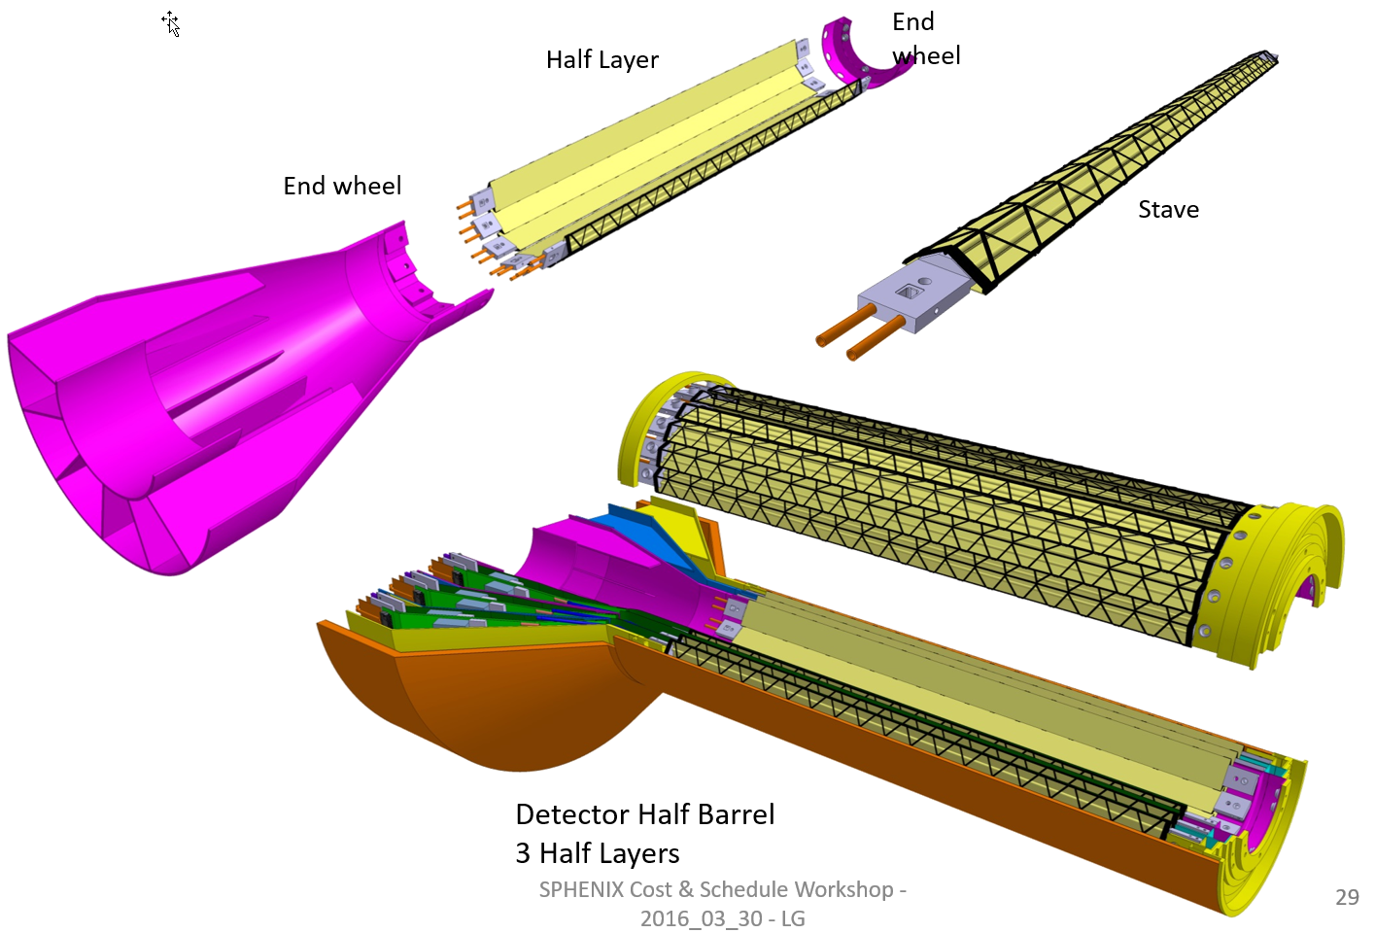
sPHENIX MAPS Inner Tracker
ALICE ITS;
Inner Tracker System
Key issues:
- Readout
- Mechanics
sPHENIX Inner Tracking
Copy of ITS Inner Tracker

Slide 6
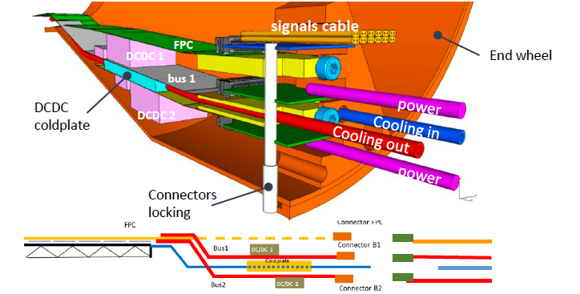
sPHENIX MAPS Inner Tracker
~1mm gap in R

Slide 7
Scope of the Project
MAPS & Electronics
  MAPS Detectors
    MoU to build 68 ITS MAPS staves (40% spares)
    No modification
  Readout Electronics
    Use ALICE/ITS, RDO + CRU
    Modify/reprogram CRU for sPHENIX
      Plan-B: build a custom board to convert ALICE/ITS into sPHENIX DAQ format
    R&D by LANL LDRD
  Production
    Extend ALICE/ITS MAPS stave production
    Train sPHENIX personnel for assembly and testing staves at CERN
    Reproduce additional ALICE RDO+CRU for sPHENIX
  Ancillary systems
    LV, cables, crates, racks etc.
    Slow control, safety and monitoring
Mechanics & Cooling
  No/(some) changes to ALICE/ITS inner tracker mechanical structures
    End Wheels
    Cylindrical structure shells
    Detector half barrels
    Service half barrels
    Detector and Service half barrels
    Half support structures
  Mechanics Integration
    Conceptual design by LANL LDRD
    Prototype by sPHENIX R&D
    Design integration frames
    Cage etc.
    Installation tooling etc.
  Copy ALICE cooling plant design
    Minor modification to fit sPHENIX
    Smaller heat load than ALICE ITS
  Metrology and Survey

Slide 8
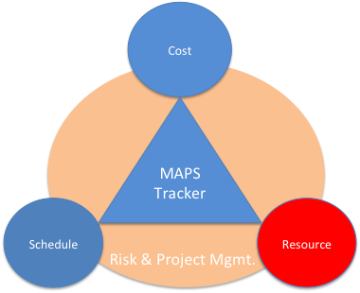
Participating and Interested Institutions
LANL - Readout & FEMs, Mechanics
MIT - Assembly and testing, cooling…
LBNL – Mechanical carbon structures, simulations
BNL – Integration and services, safety and monitoring
UT-Austin – MAPS readout electronics and testing
Univ. of Colorado – sPHENIX DAQ/DCM-II integration
Univ. of New Mexico – LV, cabling & connectors
New Mexico State University – Tracking algorithm and simulations
Univ. of IL of Chicago – Stave assembly and testing, offline analysis
Iowa State University – Assembly and testing, simulations
Georgia State University - Slow control and monitoring
Florida State University - Offline and simulations
Univ. of California, Los Angeles – Assembly and testing, simulations
Univ. of California, Riverside – Assembly and testing, simulations
RIKEN/RBRC, Japan – Assembly and testing, integration
Yonsei, Korea – MAPS QA and readout, simulations
Czech Republic - Miroslav/Mike Finger, Caclav Vrba et al , tasks TBD
Peking Univ. – many good students (already on CMS)
CCNU – already working on ALICE/ITS 5th layer, many students
Potential collaborators

Slide 9
Organization Chart
BNL Program Manager
sPHENIX Project Office
Manager: Ed O’Brien
From Sep. 2016
Tracker Review
sPHENIX Management
Spokespersons
Gunther Roland
David Morrison
sPHENIX MAPS Project Office
Project Manager: Ming Liu (LANL)
Deputy Project Manager: Mike McCumber (LANL)
Electrical Engineer:TBD
Mechanical Engineer: Walt Sondheim? /MIT?
Readout
UT/LANL
MAPS Sensor
ALICE
Stave
ALICE
Cabling
UNM
Mechanics
LBNL/MIT
Integration
MIT
Electrical
BNL
Software
UIC/FSU
FEM
M. Prokop LANL
Sensor Design
ALICE
Stave Design
ALICE
High density cables
UNM
Structure Design
LBNL/MIT
Cooling
MIT
Low Voltage
UNM/NMSU
Simulation
ISU/GSU/LBNL
Slow Control &
Monitoring
BNL
Sensor Production
TowerJAZZ
Stave Assembly
MIT/UIC/LANL
LV
UNM/NMSU
Assembly
LBNL/MIT
Alignment
BNL/UIC
Offline
NMSU/FSU
DCM Integration
Colorado
Sensor QA
Yonsei(Korea)
Stave QA
MIT/ISU
Fibers
UNM
Installation
MIT/LBNL
Mechanical Stability
BNL
B-jet tagging
LANL,NMSU
Safety System
BNL

