Slide 1
CAEN Power System
Jo Schambach

Slide 2
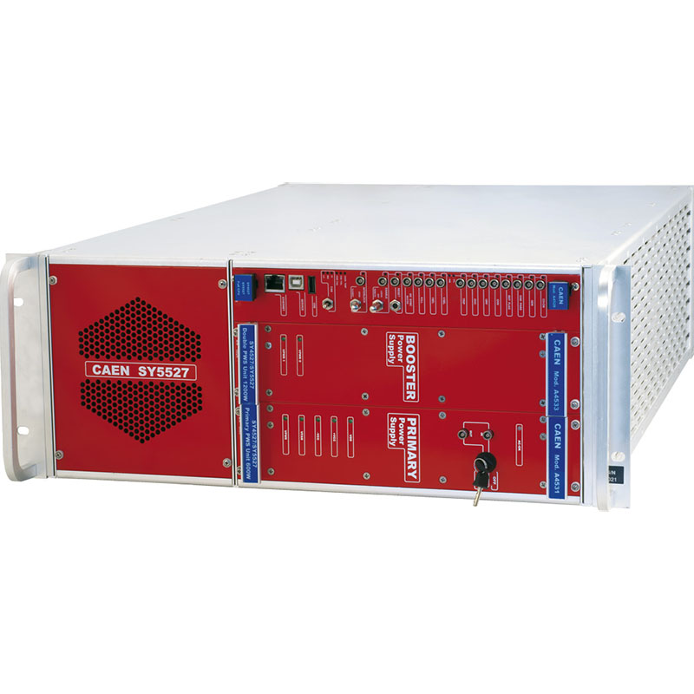
Mainframe SY5527
Need 1 of those
Also houses Branch Controller A1676
Also houses 2 BB Supplies A2518

Slide 3
Branch Controller A1676
Need 1 of those

Slide 4
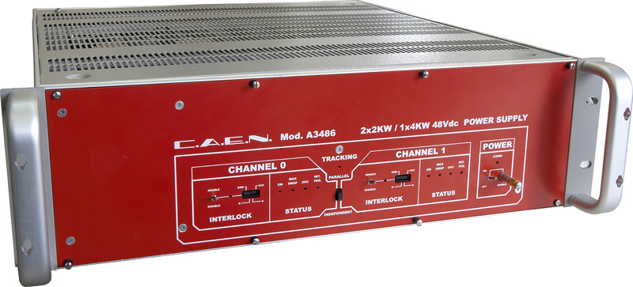
Bulk Supply/Converter A3486
Need 1 of those
Supplies 2 channels

Slide 5
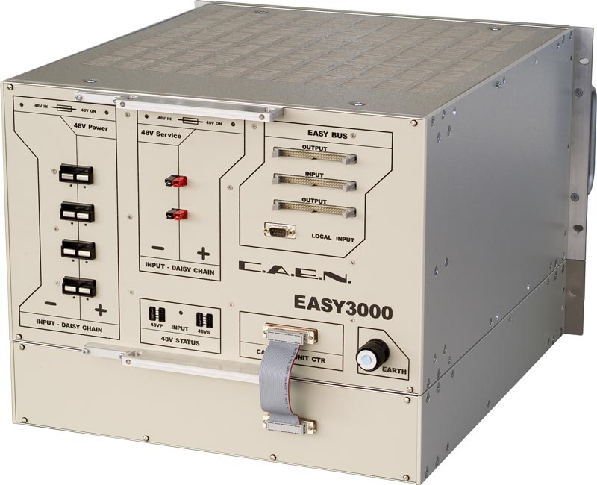
Easy Crate
Each crate for 5 devices
Need 2 of those (8 – 10 LV supplies)

Slide 6
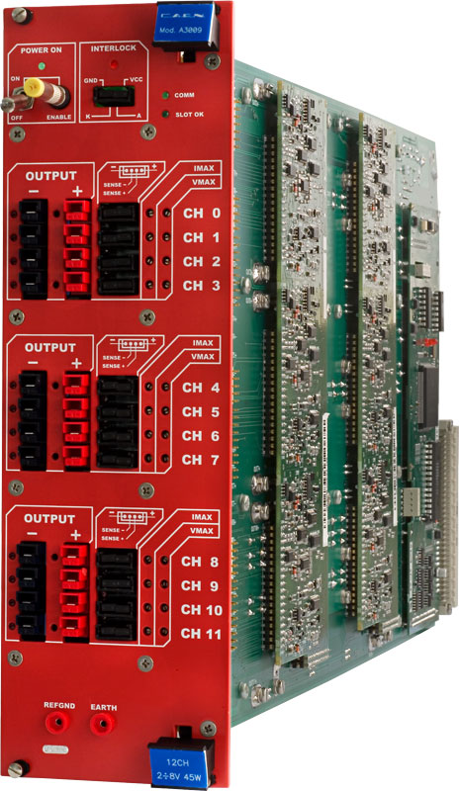
LV Supply A3009R
12 Channel, 8V supply, with sense wires
48 channels needed for RUs
48 channels needed for PUs (2 per Power Board)
Total: 96 channels
Need 8 of those, 2 for reserve (?), total 10 needed

Slide 7
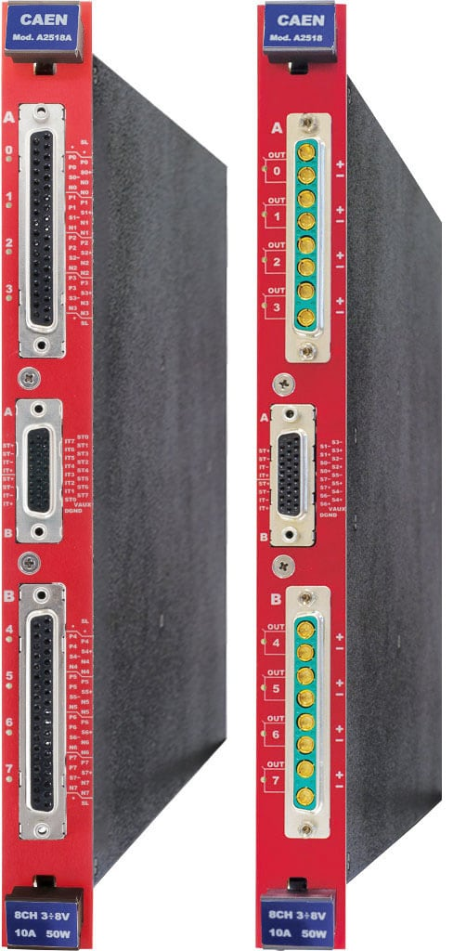
LV supply A2518
Each provides 8 channels
6 BB channels chained together
Need 8 channels (i.e. 1 of those)
1 for reserve
Need 2 total

Slide 8
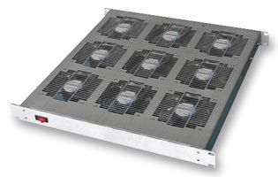
Fan Trays used in ITS
https://uk.farnell.com/ebm-papst/ft900sp30-01/fan-tray-9-fans-iec-plug-switch/dp/1698068?st=fan%20tray
Rack Fan Tray, 9 Fans, 1440 m³/h, 230 Vac, 179 W

Slide 9
Power Calculations
 |  |  |  |  | Comments
 |  |  | channels | 48
 |  |  | RU | 48 | 1 per ch
 |  |  | PU | 48 | 1 per ch
 |  |  | LV CAEN ch | 96 | ch needed
 |  |  | BB CAEN | 8 | 6 IB per ch
 |  |  | service Pw | 20 | 20W per dev
 |  |  | IB HIC Pw | 5 | 3.3V*1.5A per HIC incl PU
 |  |  | RU Pw | 12 | 7V*1.7A per RU
CAEN | Comments | # devices | ch/dev | ch total | max pow/ch | service power | chann pow
SY4527 | Mainframe (incl A1676 and A2518) | 1 |  |  |  | 200
 | Integrated Mainframe Fans | 9 |  |  | 20 | 180
A1676 | branch Controller | 1 |  |  |  | 0
A3486 | bulk power | 1 | 2 | 2 | 2000 | 40
EasyCrate | 5 dev/crate | 2 | 5 | 10 |  | 40
A3009R | LV: 12W / ch (RU), 5W/ch PU | 10 | 12 | 120 | 45 | 200 | 816 | PU+RU
A2518 | LV in Mainframe | 2 | 8 | 8 | 45 | 0 | 4 | BB
 |  |  |  |  |  | 660 | 820
FAN Trays |  | 3 |  |  | 180 |  | 540
 |  |  |  |  |  | TOTAL | 2020
 |  |  |  |  |  | Cable Loss | 300
 |  |  |  |  |  | TOTAL + LOSS | 2320

