Slide 1
Milli-Charged Particle (mCP) Search in p+N Collisions - 09/24/2021
DM particle candidate, “21cm anomaly” by EDGES (Nature, 2018), possible mCP with mass O(10-100) MeV
Coupled to dark photon
Weakly interact electromagnetically with SM
Dark “QED”:
Dark photon, A’
Dark fermion with milli-charge,
electromagnetic interaction with SM particles

Slide 2
Discovery Science of BSM: - Search for milli-charged particle at LANSCE & FNAL
LANSCE high intensity 800MeV
proton beam: POT > 10^20
Beam Dump
Multiple scintillator modules, placed behind the beam dump along the beam direction, scalable;
Sensitive to single photons;
ML approach with multi-variables for classification: timing, pulse shape, position etc. to improve S/N

Slide 3
MiniQuest @ LANSCE and FNAL
Multiple scintillator modules, scalable
High statistics search
New multi-variable ML approach for better signal/background with signal timing, shape, position etc.
Best sensitivity to “21cm anomaly” region @LANSCE
LANSCE

Slide 4
Fermilab: 120 GeV proton, 10^18 POT

Slide 5
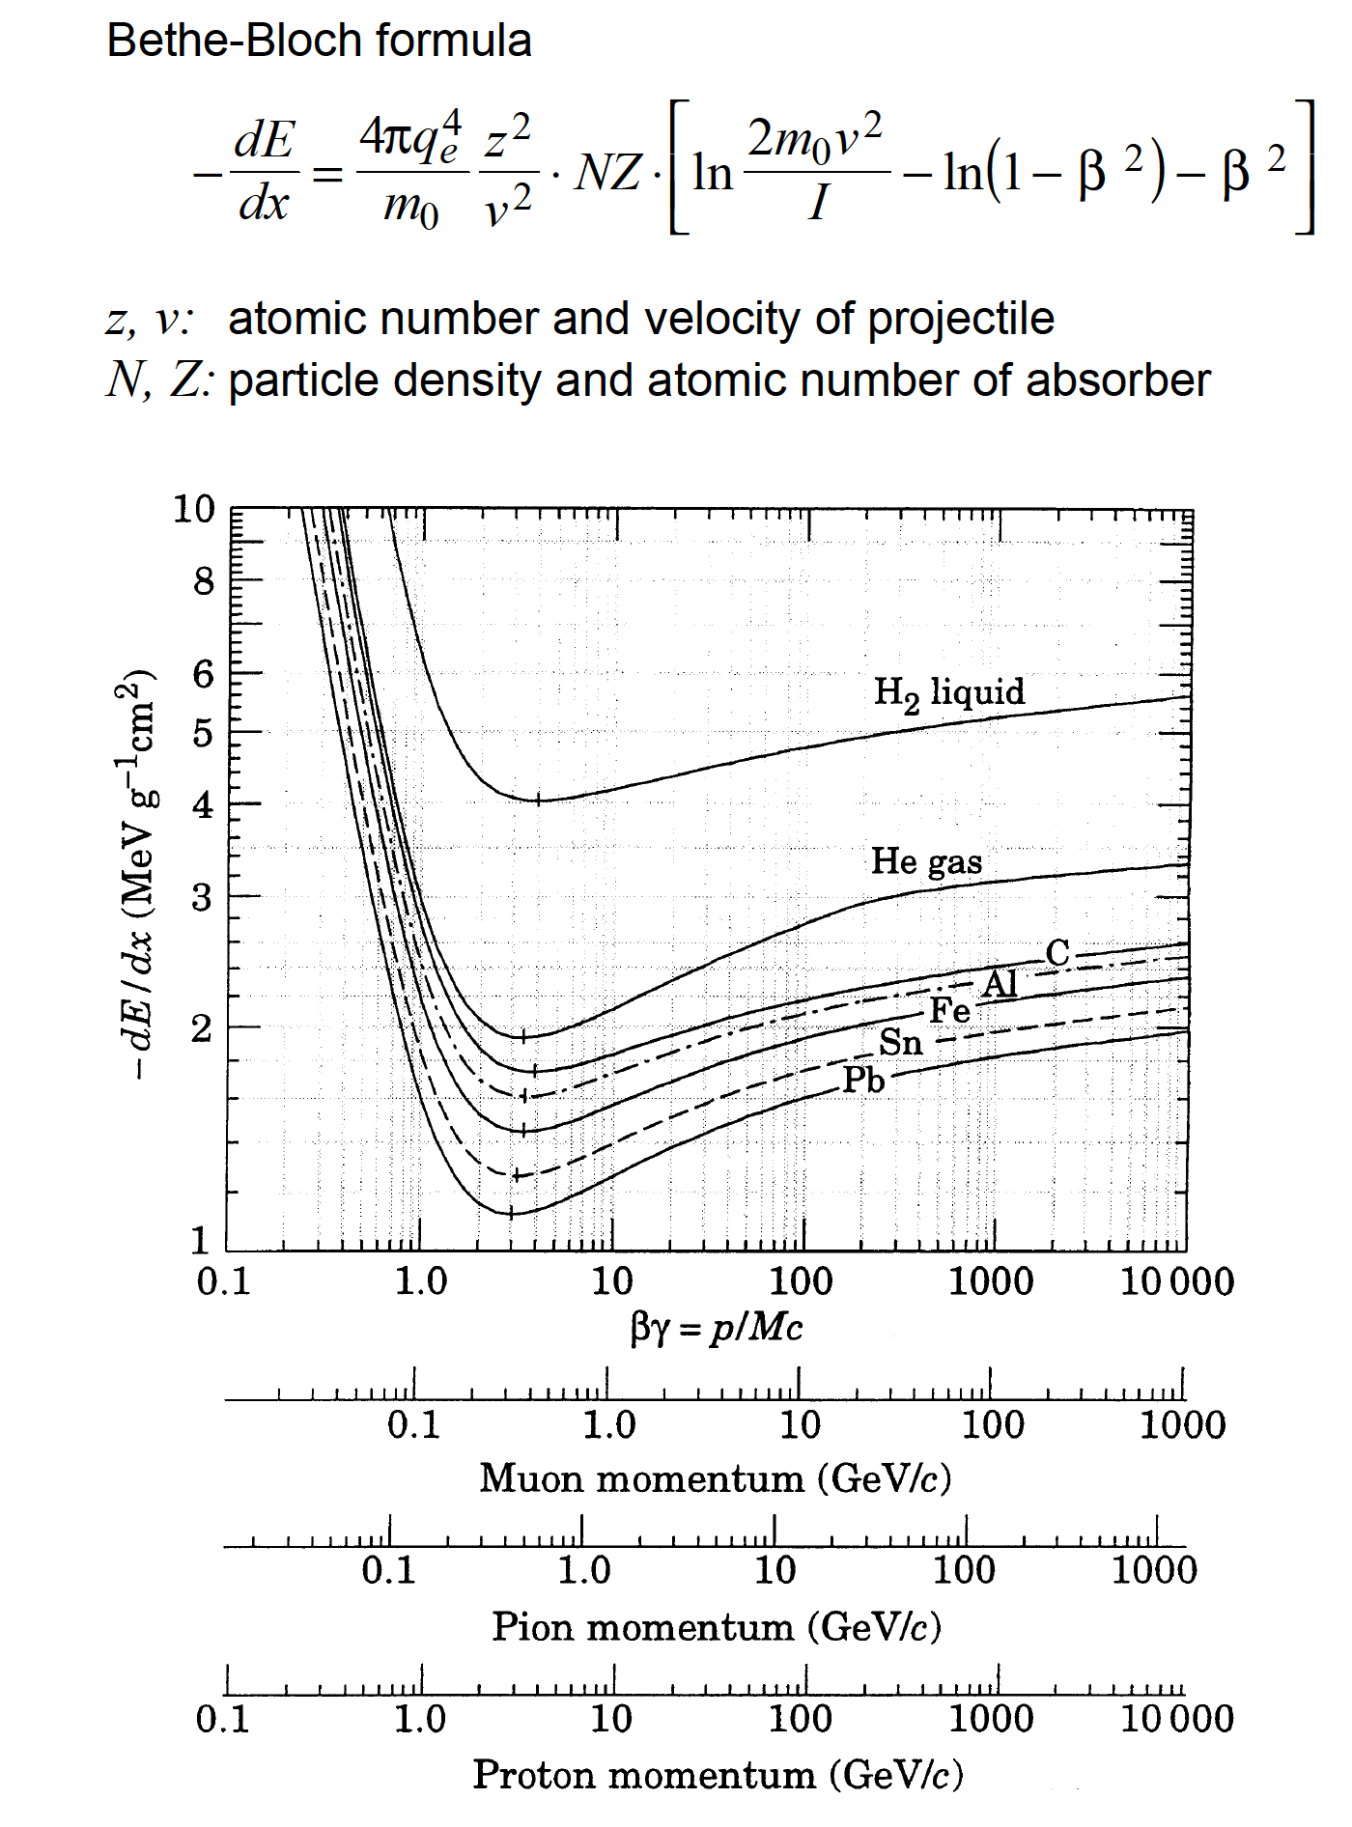
Plastic Scintillators: dE/dx ~ 2MeV/cm, MIP
dE/dx ~ 2 MeV/cm
WLSF to convert UV light to “Green light”
Attenuation length: 3 ~ 4m
BC412:
L = 112 mm, dE = 50MeV
For mQ particles: epsilon = 10^-3
dE/dx ~ 10^-6 x 2 MeV/cm = 2 eV/cm

Slide 6
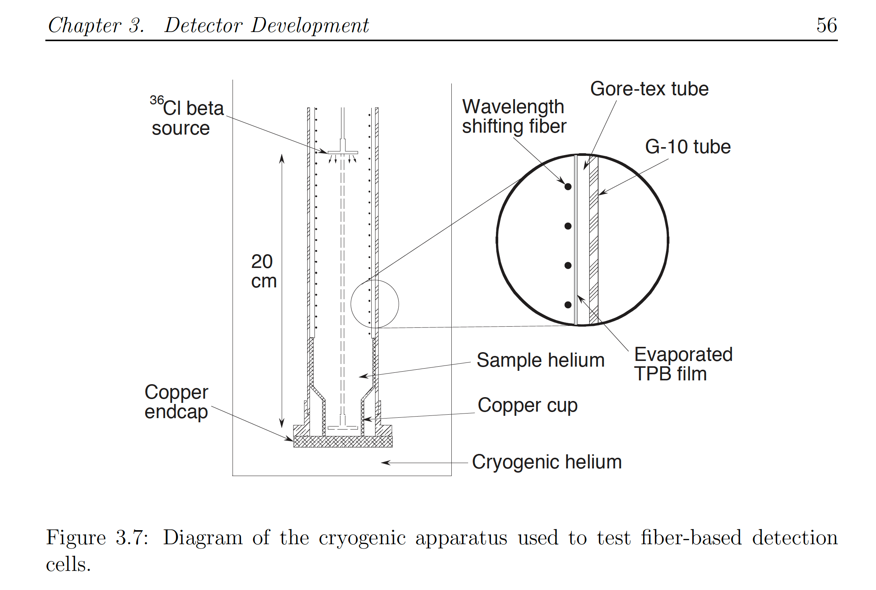
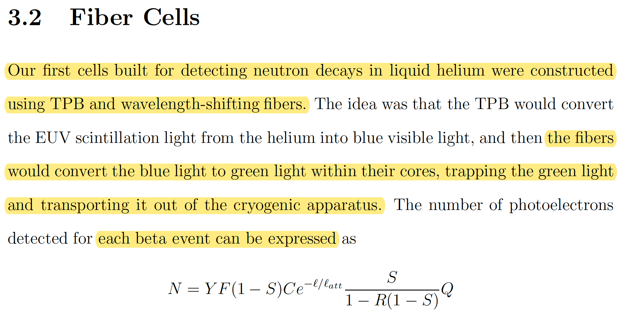
Liquid Scintillators for mQ Search?
Liquid He
~4 photoelectrons per 250keV
N ~ 4, in the test setup

