Slide 1
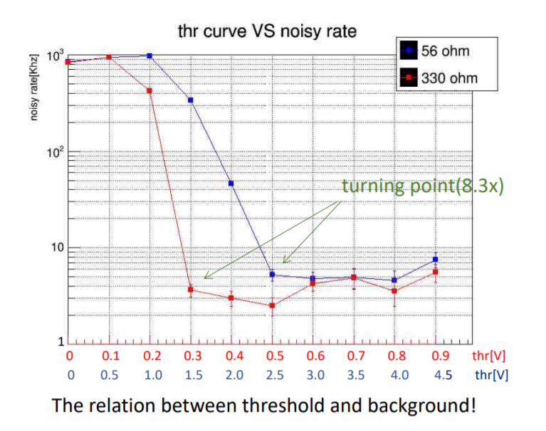
Averaged Threshold Scan (from Helen)
https://seaquest-docdb.fnal.gov/cgi-bin/private/RetrieveFile?docid=7512&filename=Prop%20tube_colla.0305.pdf&version=1

Slide 2
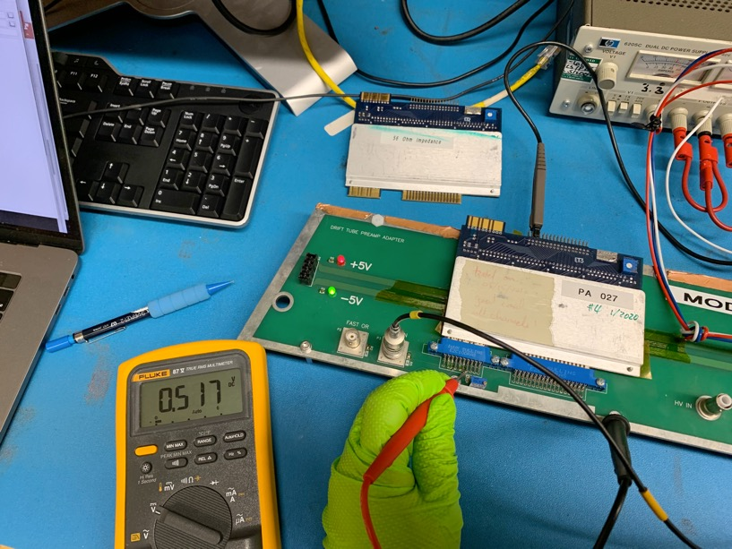
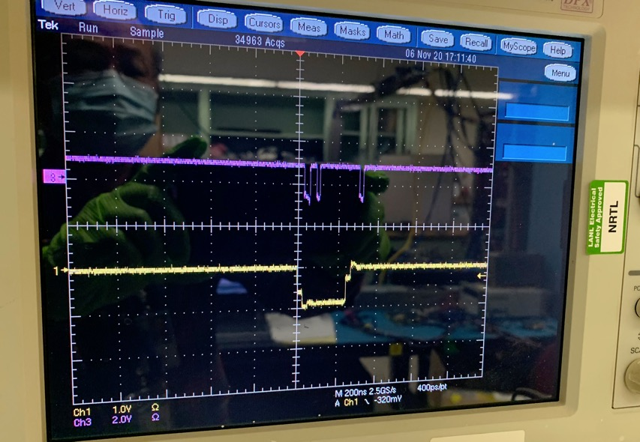
Proptube Preamp Card Threshold & Noise Study @LANL Lab. 11/6/2020
330 Ohm Card: Thr = 0.517V, Card ID = 027
Clean signal seen;
Input = NIM @1kHz
NIM input

Slide 3
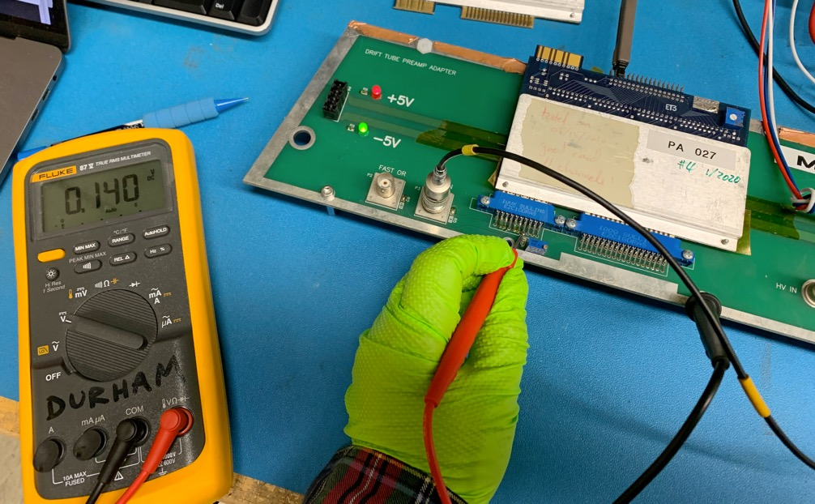
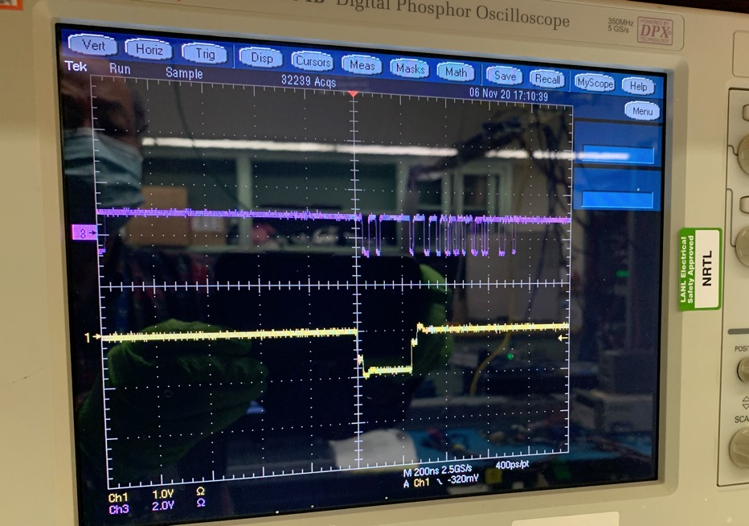
Proptube Preamp Card Threshold & Noise Study
330 Ohm Card: Thr = 0.14V, Card ID = 027
Clean signal seen, followed by after pulse ringing
Input = NIM at 1kHz
NIM input

Slide 4
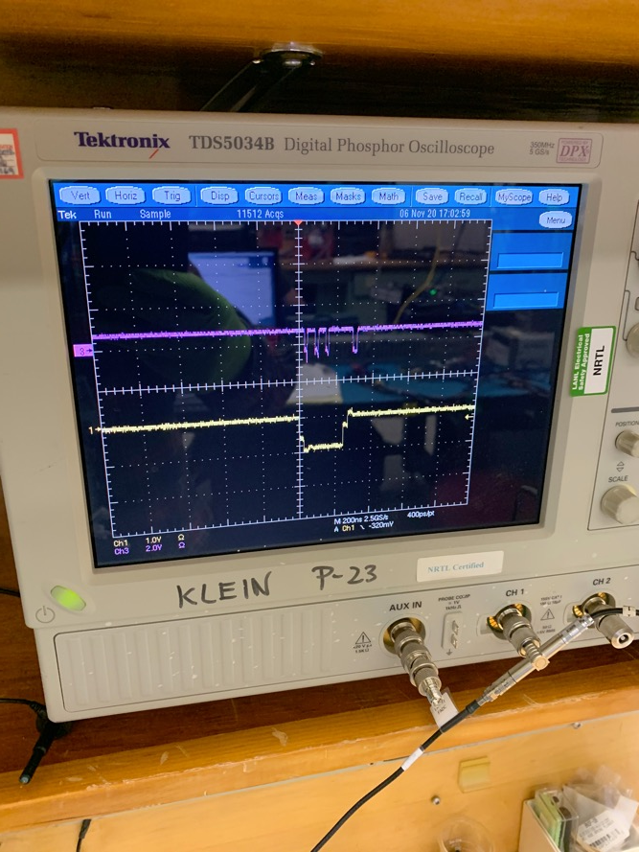
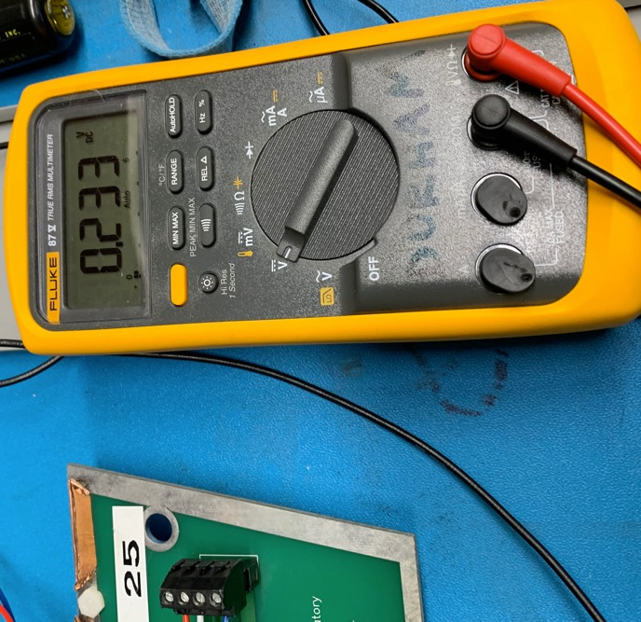
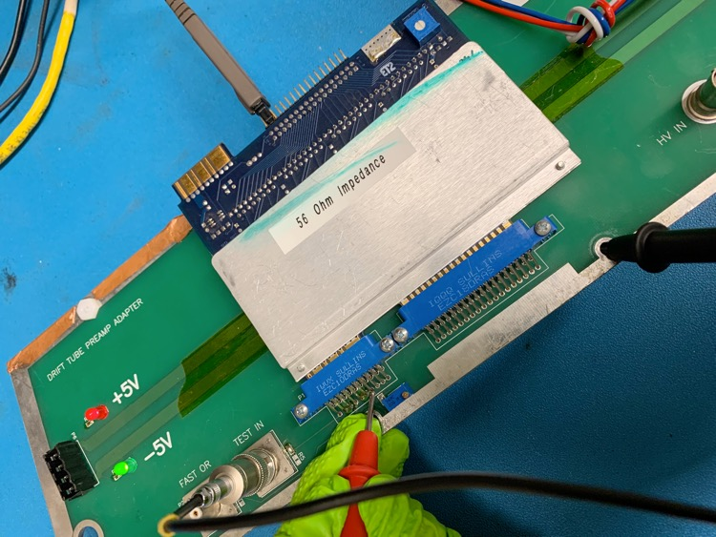
Proptube Preamp Card Threshold & Noise Study
56 Ohm Card: Thr = 0.23V,
Clean signal seen, Input = NIM at 1kHz
NIM input

Slide 5
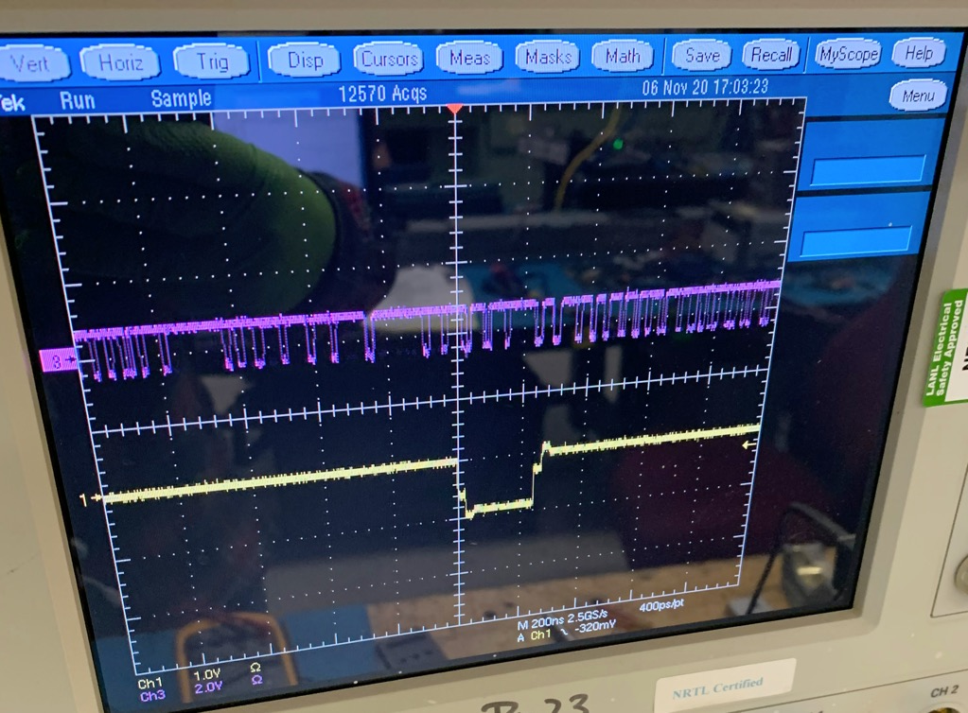
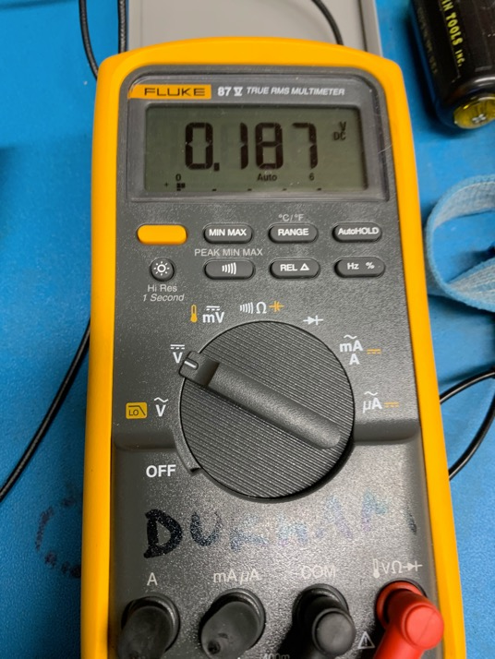
Proptube Preamp Card Threshold & Noise Study
56 Ohm Card: Thr = 0.187V,
No clean signal, rining
NIM input

