Slide 1
DP Status
Halen, Zongwei, Kun, Andrew, Sho, Cristina, Dylan, Ming et al
07/19/2019

Slide 2
Progress on 7/19/2019
Cristina and Dylan visited the hall and
discussed future work plan with Kun et al:
Cristina will be the local expert
for DP detector! Thank you!
ST1/Rack
PS layout plan developed, calibration fibers are ready for installation
installed all CAMAC modules
Installed VME crate to host 6 Calib boards
Connected all ST-2 calibration fibers (6 x 2) to the calib boards
A NIM crate is ready for installation
St-1 readout cables are ready to be connected to CAMAC modules
ST-2/Rack
Rack-2 is fully instumented
ST-2 calib fibers all plugged into the cailb boards installed in Rack-1
ST-2 PS are installed and connected, including the master node;
ST-2 readout cables being plugged into CAMAC module
TDC rack
A good/previous VME with 4 V1495 installed
A good VME is ready for installation
TDCs and controllers available (Andrew/Kun)

Slide 3
To Do List for Coming Weeks
Connect St-1 readout cables to CAMAC modules
Install St-1 4 PS slaves
Install St-1 calibration fibers
Install a NIM crate in Rack-1, setup trigger/pulser for calib boards;
Install cable trays under Kmag
Build/find a Al support frame for ST-1 PS slave nodes
Connect remaining St-2 readout cables to CAMAC modules
TDC crate
Install all TDC modules, a VME crate will be shipped from LANL
Connect ribbon cables to both TDC and V1495 modules
Complete simulation for DP trigger
DP signal
DY & J/Psi signals from target
ORC review in late ~July
Test DP detector
Run DP with rest of other
subsystem in Aug-Sep

Slide 4
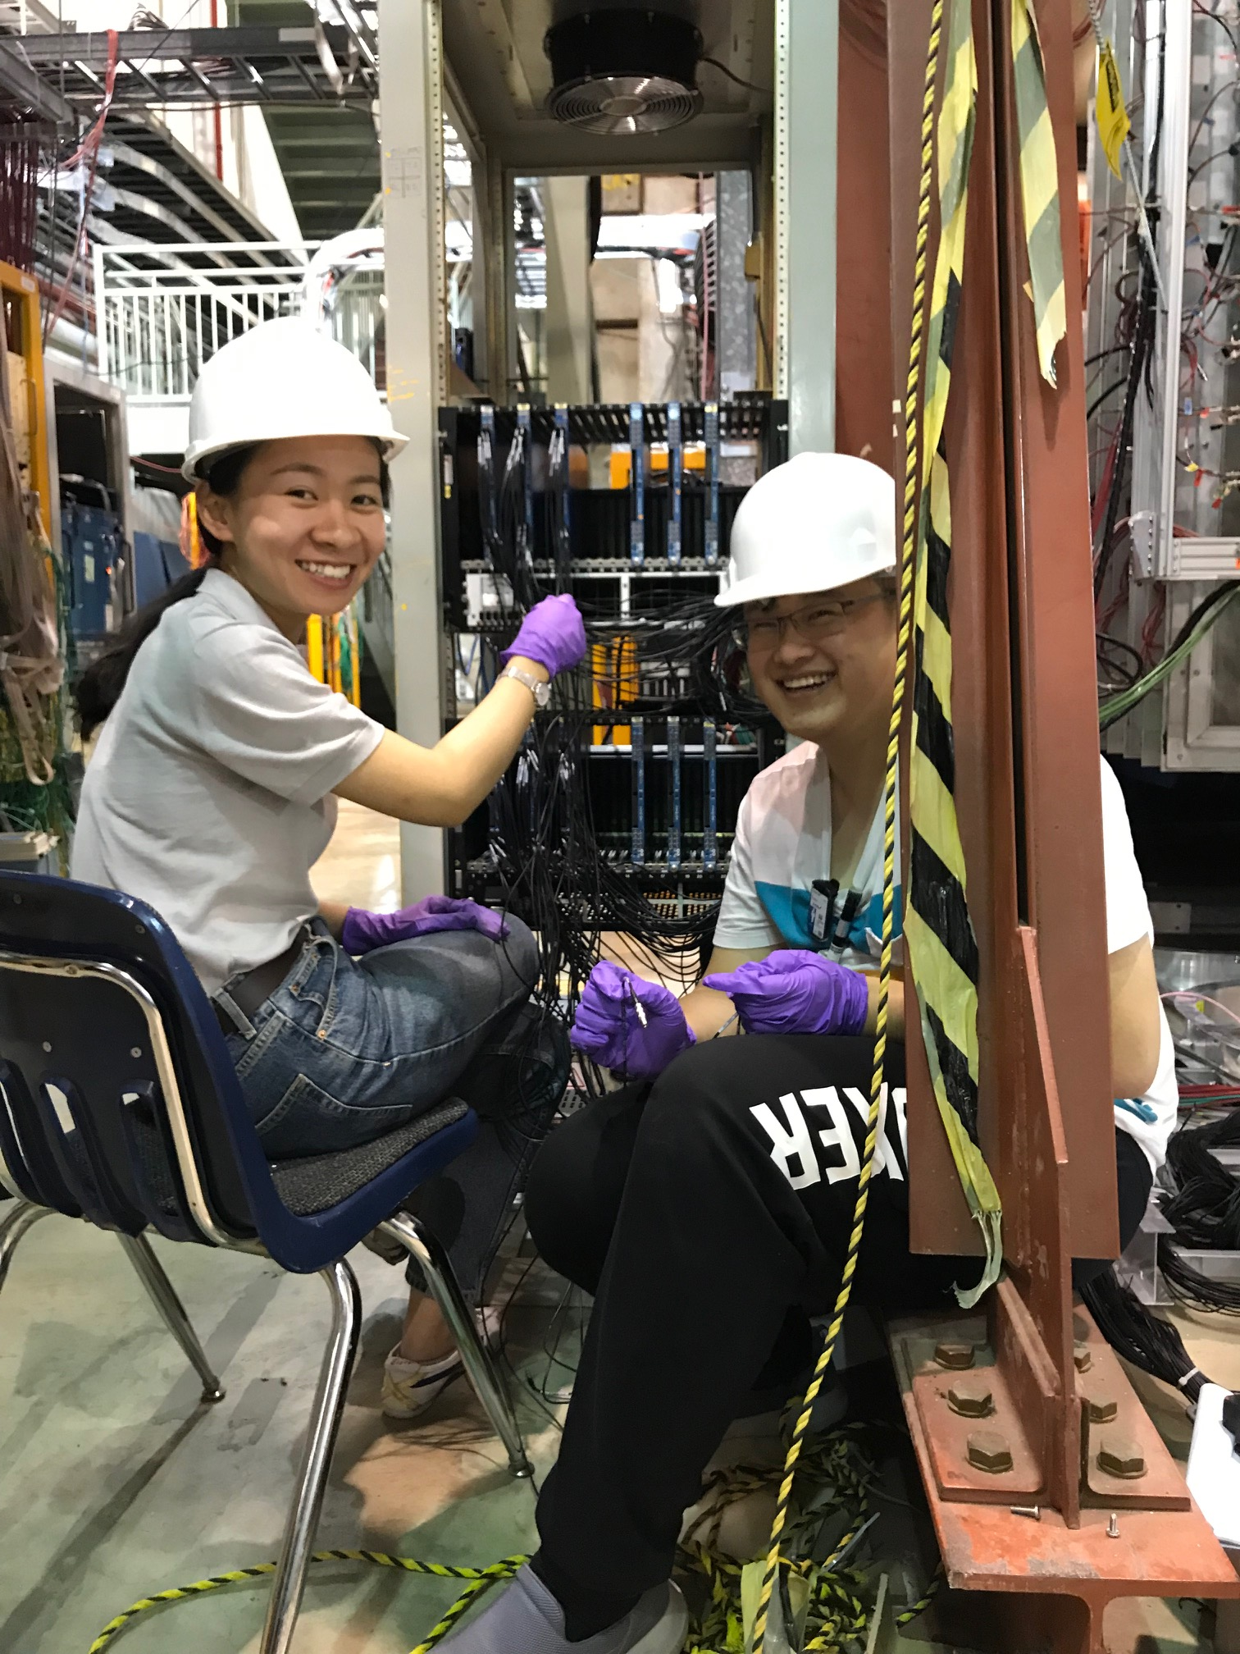
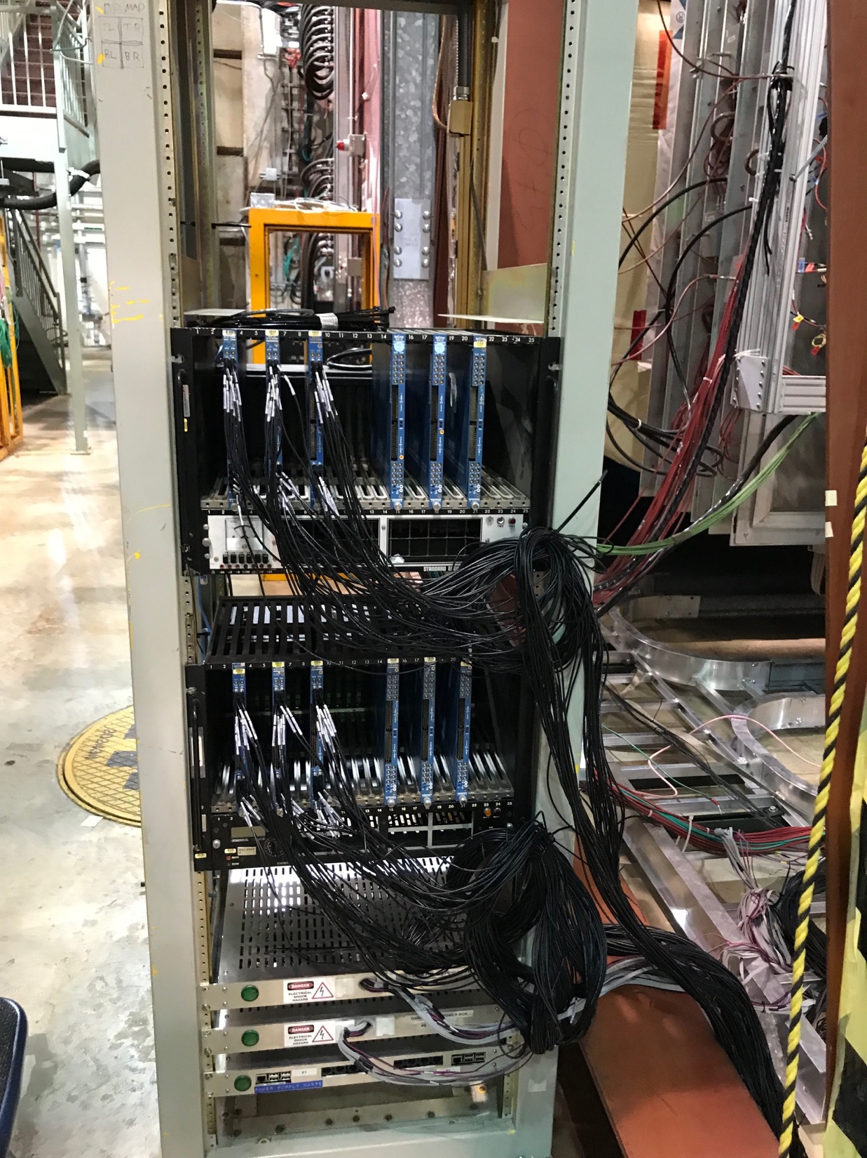

Slide 5
DP Detector Work Update
07/18/2019
Halen, Zong-Wei, Kun, Dylan, Ming

Slide 6
Status as of Today: 7/18/2019
ST-1:
Rack wheels removed
Rack in the location good for both ST-1 readout cables and ST-2 calibration fibers
Calibration system will be installed at the bottom of Rack-1.
To Do’s
Install CAMAC modules
Install readout cables
Install PS cables, leave PS boxes on the floor, build z box to hold 4 PS boxes under the KMag
Install calibration optical fibers
Identify and install a VME crate at the bottom of Rack-1 for Calib system (need backplane power)
Order two cable trays
ST-2:
Rack-2 wheels removed
V1495 crate moved to the TDC rack (bottom)
Installed ST-2 Power supplies, including Master mode
To-Do’s
Install CAMAC modules, install readout cables
Install calibration optical fibers
TDC rack:
Installed VME crate with 4 V1495 modules
Removed unused panel
To-Do’s
Install 2 VME crates
Install Ribbon cables for TDC and V1495
Identified all misc. items
Calibration fibers, 25’ ribbon cables (26+26+24, 4th box is missing)
7 PS boxes, with cables (25~29’ long)
LeCroy 4413 modules
Calibration fibers : ~40’ long

Slide 7
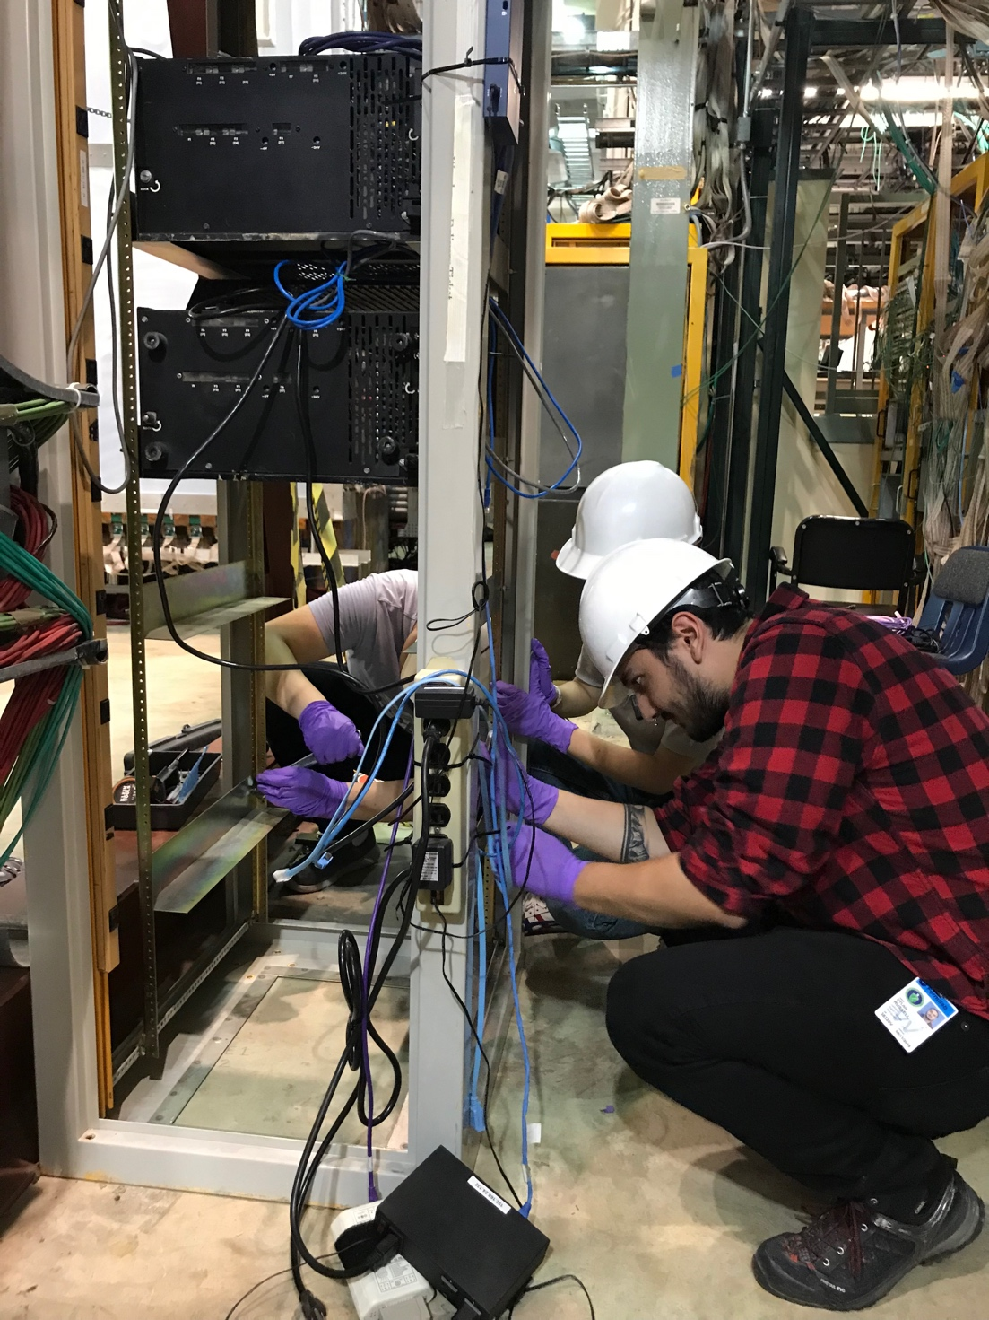
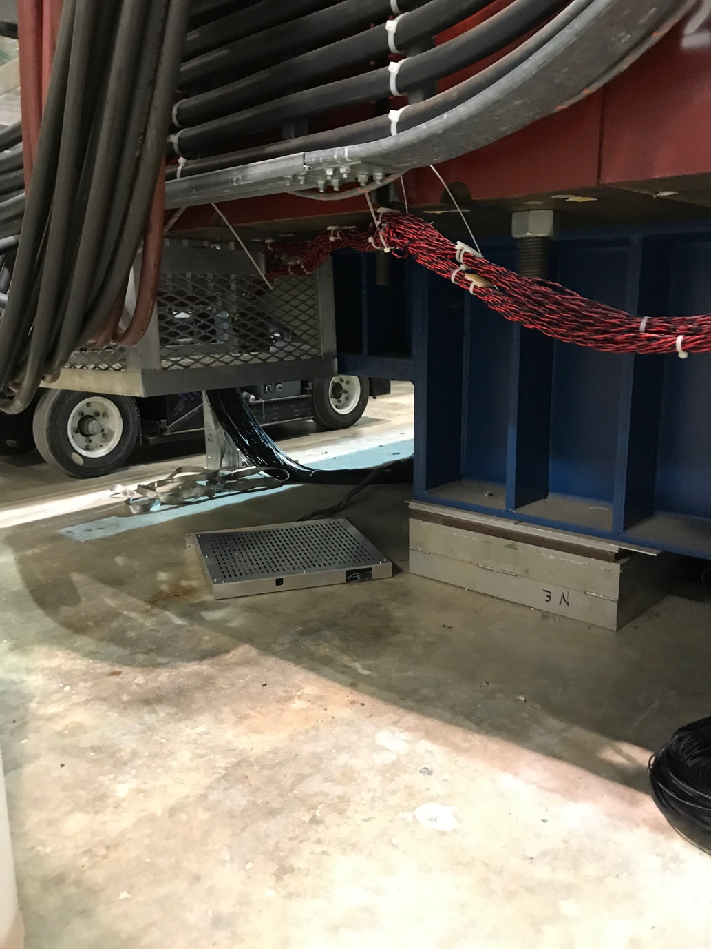
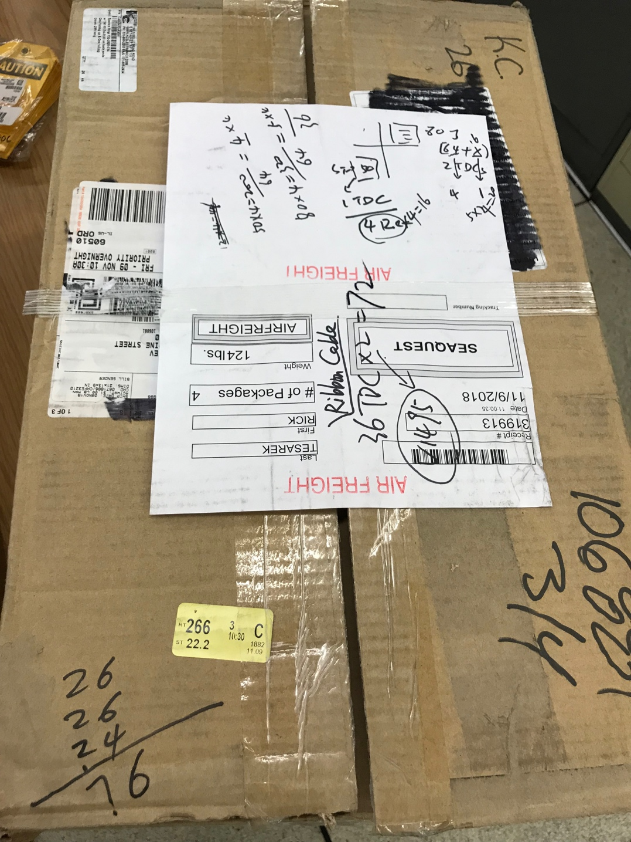
Photos of the Day : 7/18/2019
ST-2 rack reconfigured
VME/V1495 and Calib removed
PS master + 2 slaves installed
4 PS and 25-29’ Cables
Under KMag, for ST-1
Zong-Wei, Halen & Dylan at work
25’ ribbon cables
Identified: 76 cables
- one more box of cables

Slide 8
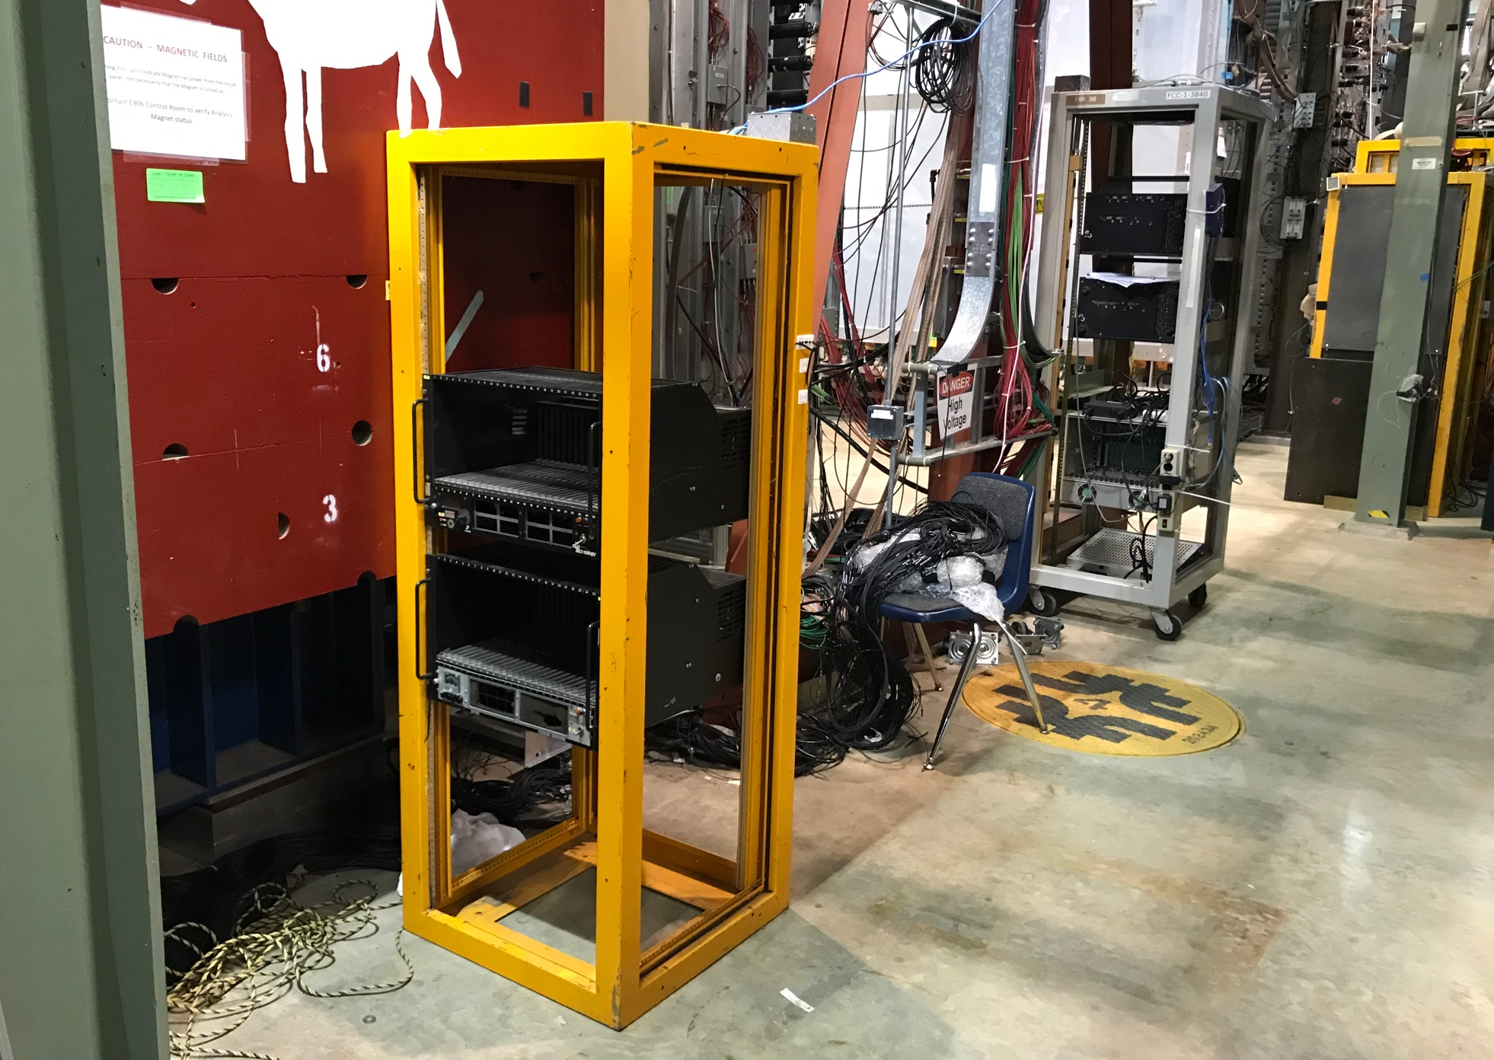
New Rack Locations: ST-1 & ST-2
Rack-1, removed wheels, against the kMag;
Readout cables are long enough,
no need of extensions!
Readout cables are run under the kMag now; but not connected
SiPM cables are short, 27’~29’ only; a new location for PS?
Rack-2 moved close to ST-2
Readout cables are long enough
SiPM power cables are short, but long enough to reach the new Rack-2 location
ST-2
ST-1

Slide 9
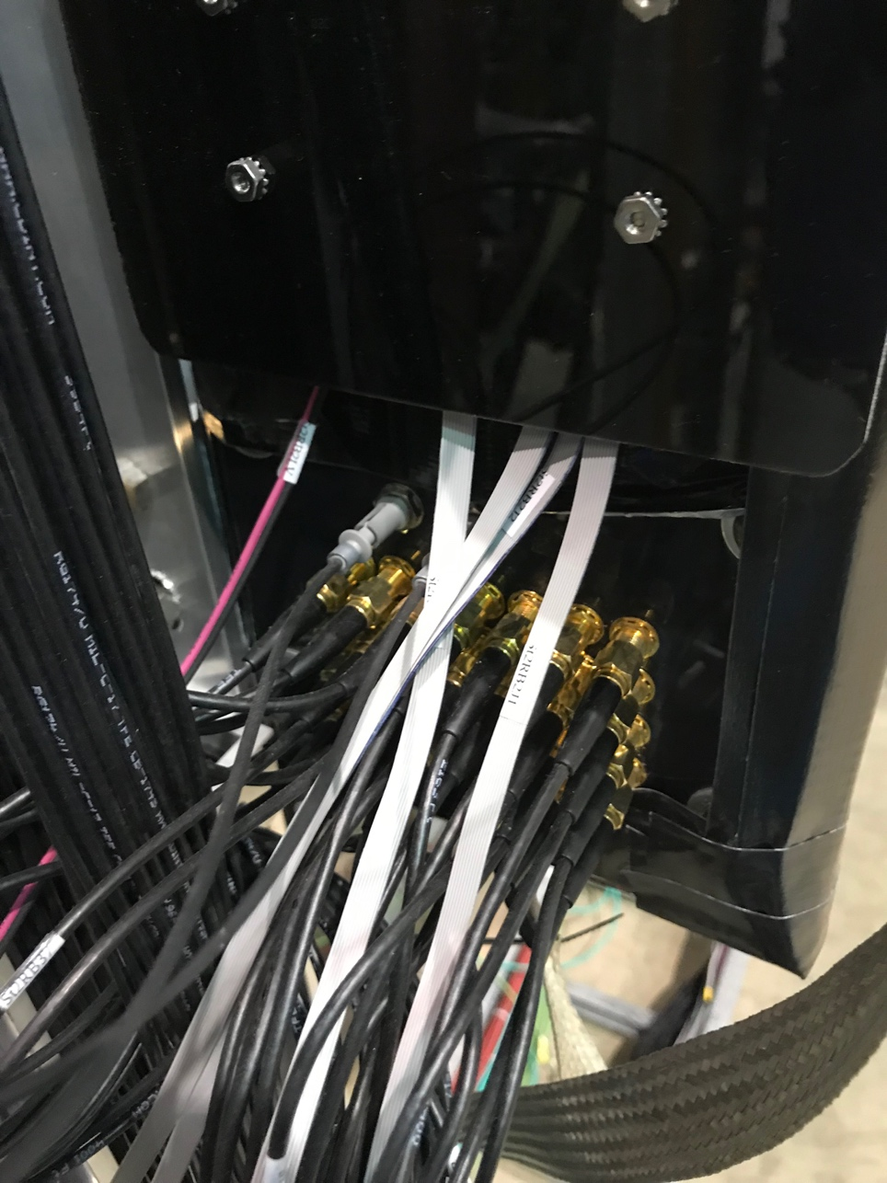
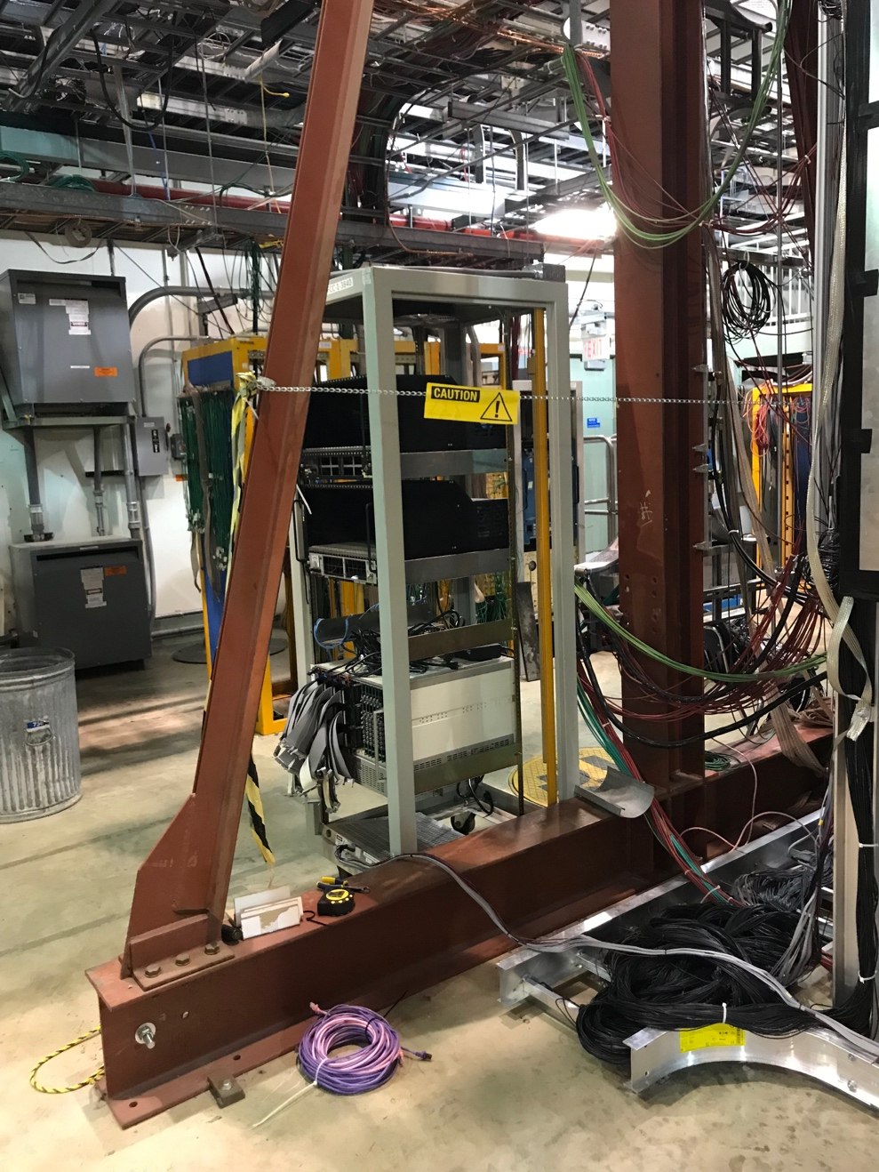
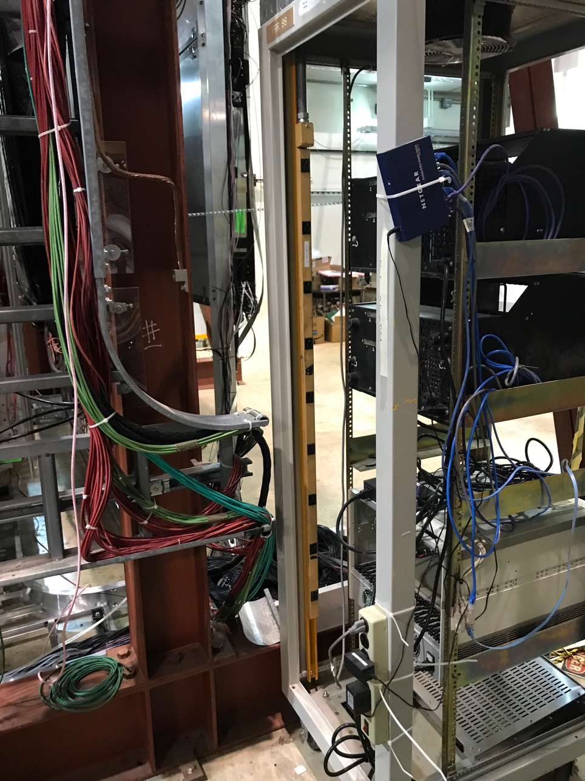
ST-2 Rack and Cables

Slide 10
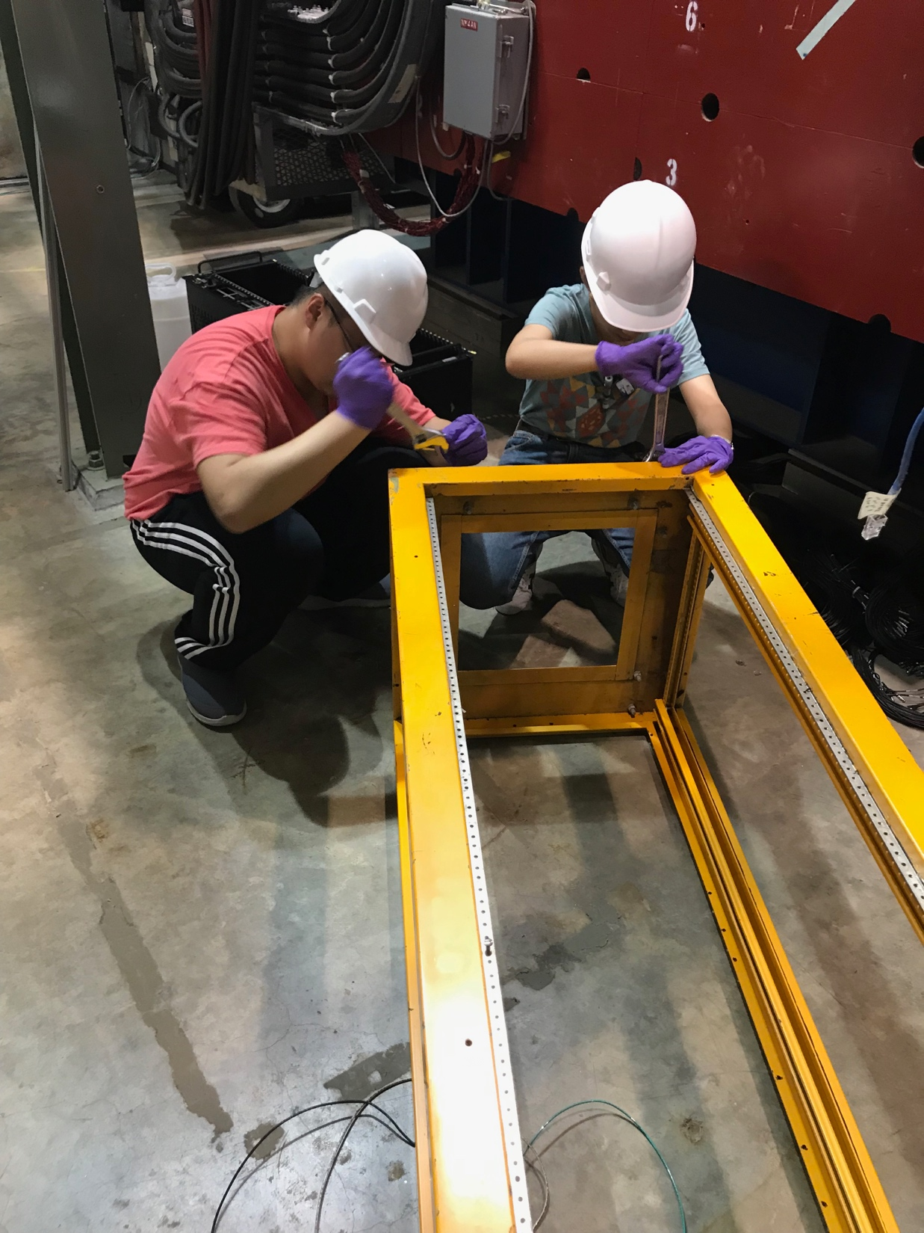
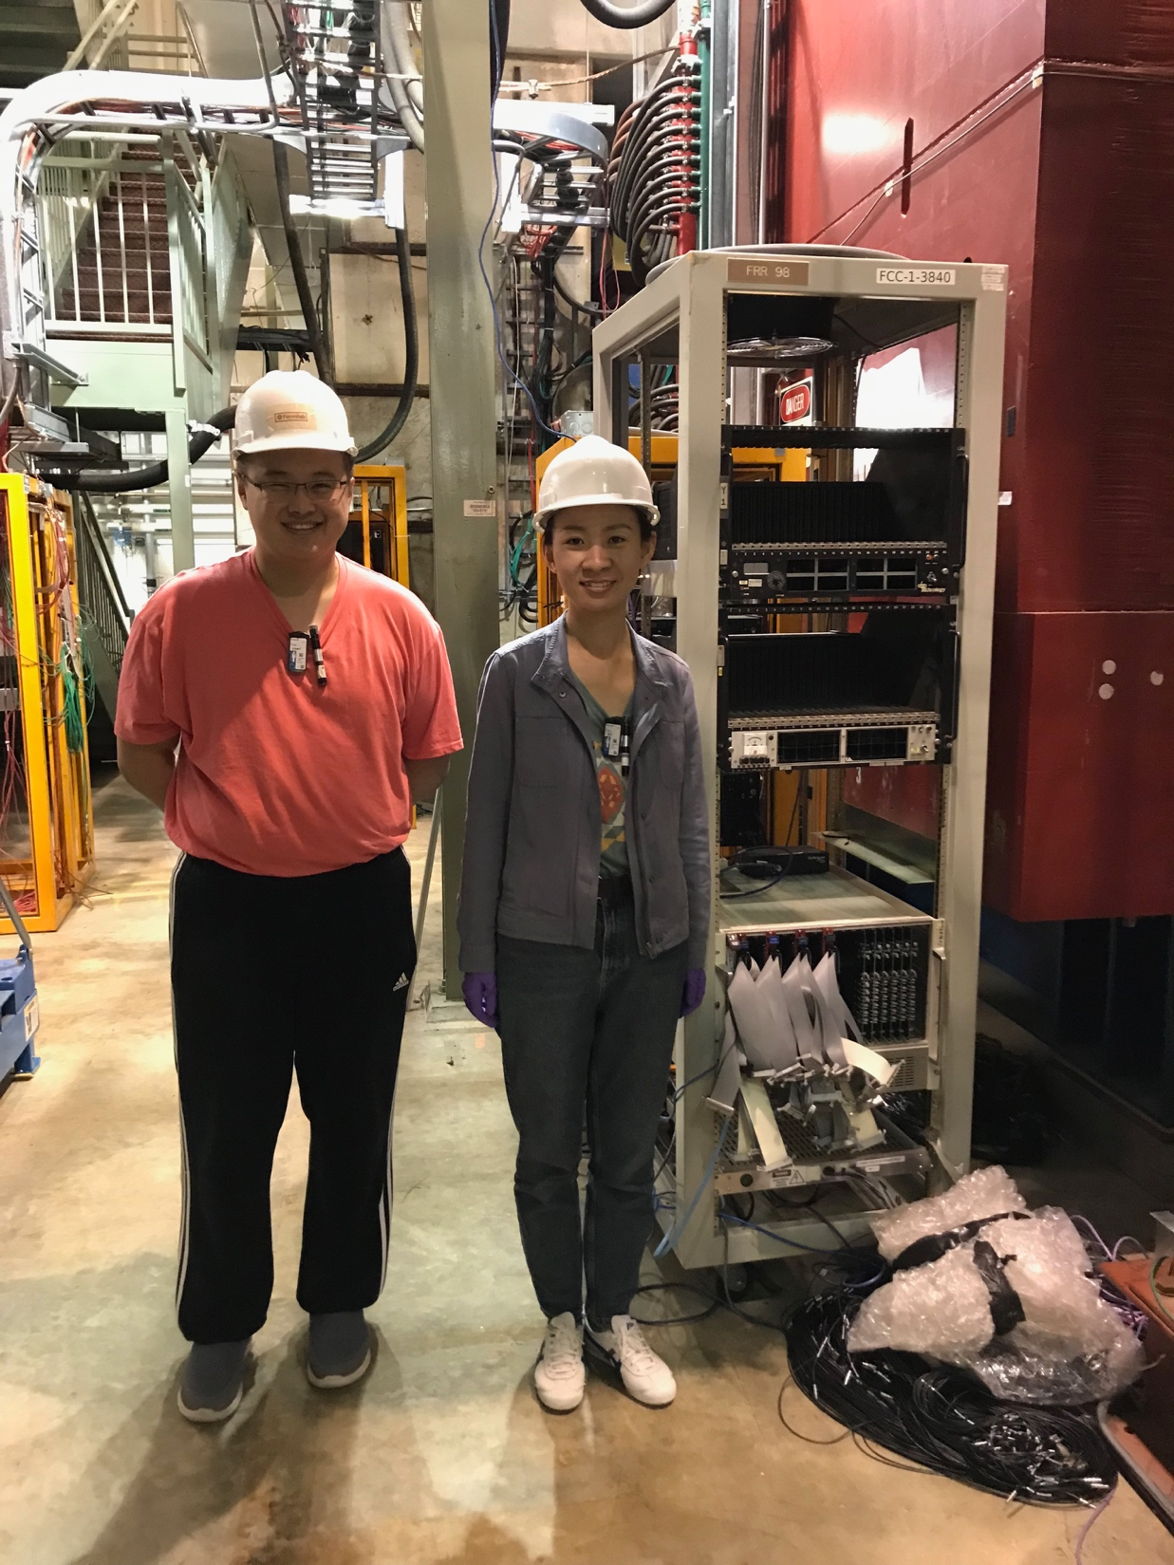

Slide 11
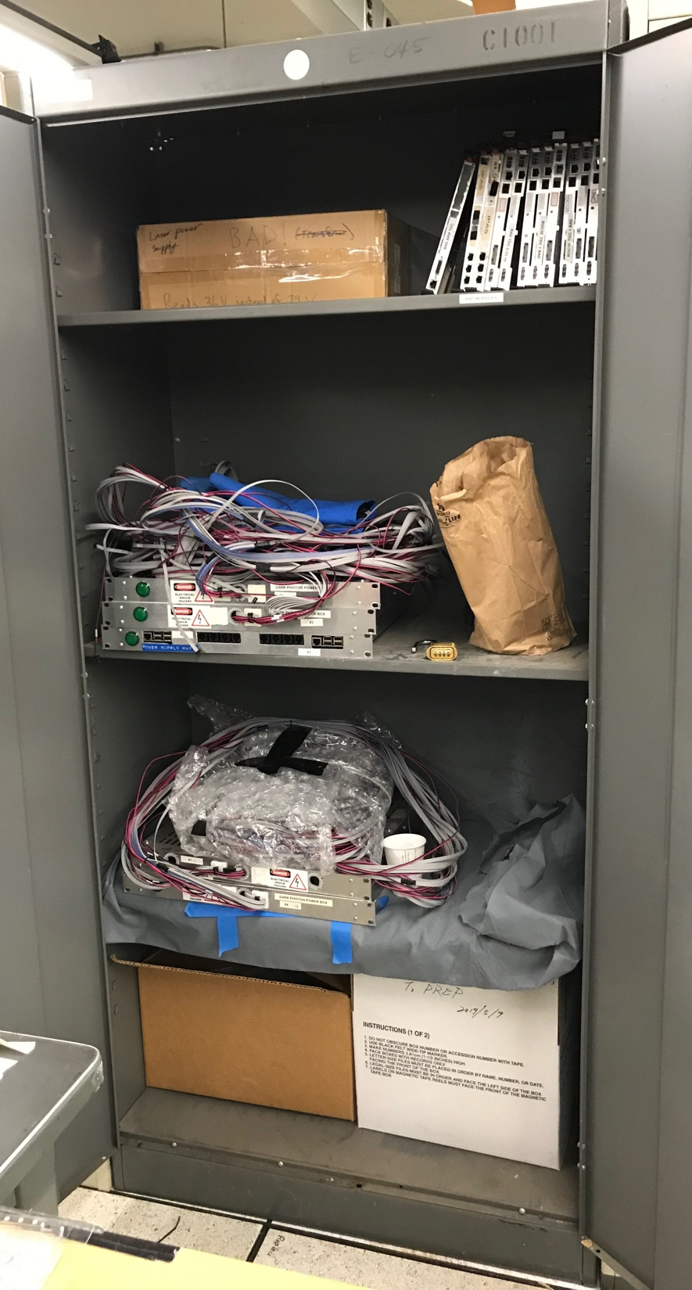
SiPM Power Boxes & Cables
SIPM power box provide LV and HV for SiPM and preamps
LV = +5V
HV = 52V(various from SiPM to SiPM)
ST-2 power cables are already installed
Length ~ 280” ~ 24’
ST-1 power canbles are in the CH dark photon cabinet;
One Master node
4 salves nodes, for each quadrant;
Only 25~29’ long, can’t reach the current ST-1 rack

Slide 12
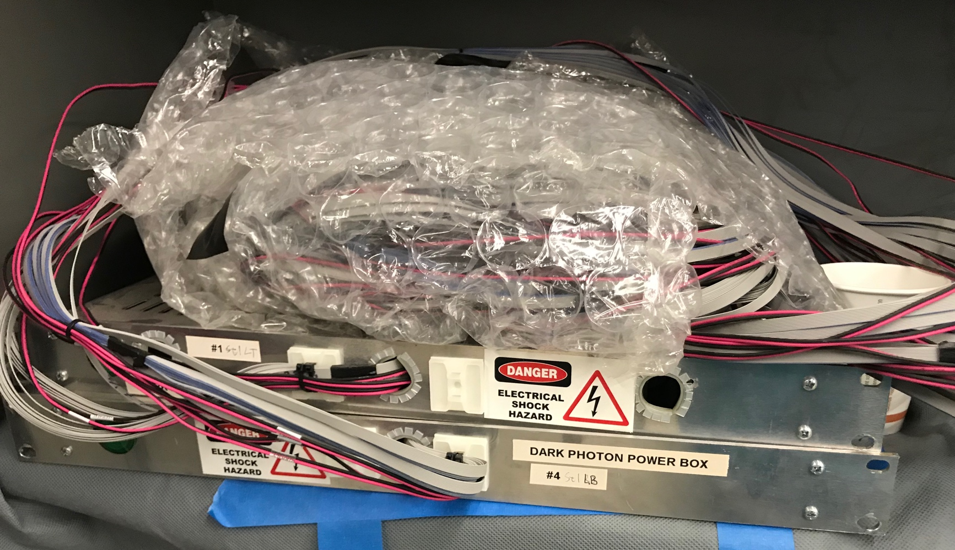
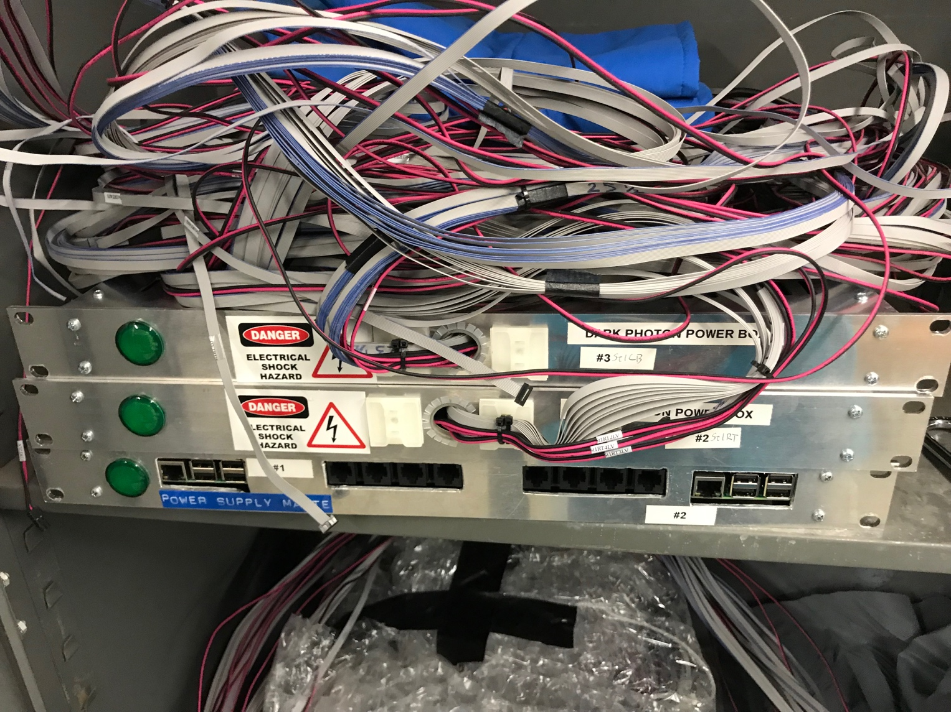
- 1 Master node
4 power boxes for ST-1
Cable length: 25~29’
Need to make a small Al-frame to hold 4 ST-1
PS boxes under the kMag;
(2+1)” x 4 = 12” toal;
Clearance under kMag = 30”

Slide 13
DP Trigger New Layout (7/18/2019)
beam
- Run all cables under
the KMag, with cable tray
Cable trays
St-1 SiPM PS(4),
under kMag
DP-1
KMAG
RACK-4 (exists)
VME/TDC (6)
VME/TDC (6)
RACK-1
Signal cables (40’), under kMag
DC-2
Existing cable
tray
Rack-3/DP Trigger
(L2 rack)
-VME:
4xV1495
L1 trigger
DC-2
RACK-3 (exists)
DP/V1495
RACK-2
DP-2
New Rack-2, SMA-Lemo unchanged, cable tray, new power to Rack-1,2
(4 Qs)
Rack-1/ST-1: 4x 80 ch
-NIM/trigger logic
-CAMAC (10 x LeCroy 4413)
-CAMAC (10 x LeCroy 4413)
-VME/Calibration
Rack-2/ST-2: 4x 50ch
-NIM/trigger logic
-CAMAC (8 x LeCroy 4413)
-CAMAC (8 x LeCroy 4413)
-SiPM PS for ST-2 only + Master
L2 rack/V1495 (Rack-3)
DP trig(OR)
DY trig(AND FPGA trig’s)

Slide 14
To Do List 7/18/2019
Find a new location for ST-1 SIPM power boxes:
Within 25’ cable length
Remove Rack-2 wheels
Reinstall SiPM PS (Master + 2 slaves), 2 CAMAC, 1 VME/Calib, 1 NIM crate
Put 2 cable trays under KMag, (Kun will get two AL cable trays deon Lab 16/?)
Run all cables under the kMag
Install power system and cables
Install optical calibration system
Run calibration system
Check the signal yield for all channels, with a scope
Install all CAMAC modules
Connect all readout cables to CAMAC
Install 2 VME crates (to be shipped from LANL?) and all TDCs, with CPUS
Install 4 V1495
Connect ribbon cables, CAMAC -> TDC, V1495
Integrate TDC into DAQ
Integrate DP trigger into E1039 global trigger

Slide 15
Misc. Items
LeCroy 4413 discriminators (in downstairs)
ST1: 10 + 10
ST2: 8 + 8
Check with Marshall
2 VME crates for TDC boards - TDC(64ch)
ST-1: 2x8
ST-2: 1x4
2 VME controllers (check with Andrew)
(2 at LANL, ship one to Fermilab; use the current V1495 crate for the 2nd TDC, and add one VME to provide Power to Calib.)
New ribbon cables for TDC and V1495 from CAMAC
25’ 17-chan twist-pair ribbon cables
Found 3 boxes in CH (26+26+24 = 76 cables), Kun will search for the 4th one.
Calibration optical fiber length = 40’

Slide 16
Cable Mapping Docs
CAMAC crate = 12”;
VME crate = 14”, with fan;
NIM crate = 9”
Power box = 2”
LANL Dark Photon home page:
General information about the dark photon trigger detector:
https://p25ext.lanl.gov/darkphoton/
General note from Sho:
https://docs.google.com/document/d/1GCfWciYzyofXXVpVOjkVvYq3BZp9g7cztyc5k015Yp4/edit?usp=sharing
Detector patch panel mapping,
https://p25ext.lanl.gov/darkphoton/hardware/cable_mappings.html

Slide 18
E1039 Summer Work Plan
Kun, Mindy, Andrew, Xuan, Matt, Zongze, Ming
5/26/2019
Updated 5/28/29
- DP trigger system
- Prop tubes

Slide 19
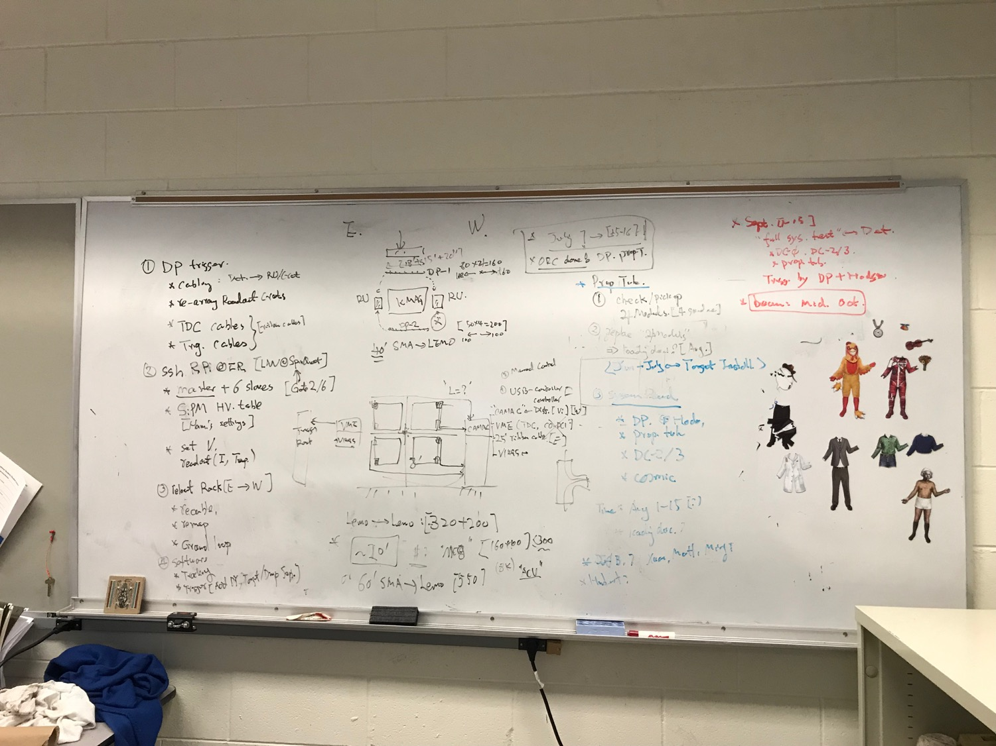

Slide 20
DP Trigger New Layout (5/28/2019)
beam
- Run all cables under
the KMag, with cable tray
Possible extended SMA-Lemo, ~5’; cable tray
DP-1
KMAG
RACK-4 (exists)
VME/TDC (6)
VME/TDC (6)
RACK-1
Signal cables (40’), under kMag
DC-2
Existing cable
tray
Rack-3/DP Trigger
(L2 rack)
-VME:
4xV1495
L1 trigger
DC-2
RACK-3 (exists)
DP/V1495
RACK-2
DP-2
New Rack-2, SMA-Lemo unchanged, cable tray, new power to Rack-2
(4 Qs)
Rack-1/ST-1: 4x 80 ch
-CAMAC (10 x LeCroy 4413)
-CAMAC (10 x LeCroy 4413)
-NIM/BlueLogic trigger
Calibration
SiPM PS
Rack-2/ST-2: 4x 50ch
-CAMAC (8 x LeCroy 4413)
-CAMAC (8 x LeCroy 4413)
-NIM
-SiPM PS
L2 rack/V1495 (Rack-3)
DP trig(OR)
DY trig(AND FPGA trig’s)

Slide 21
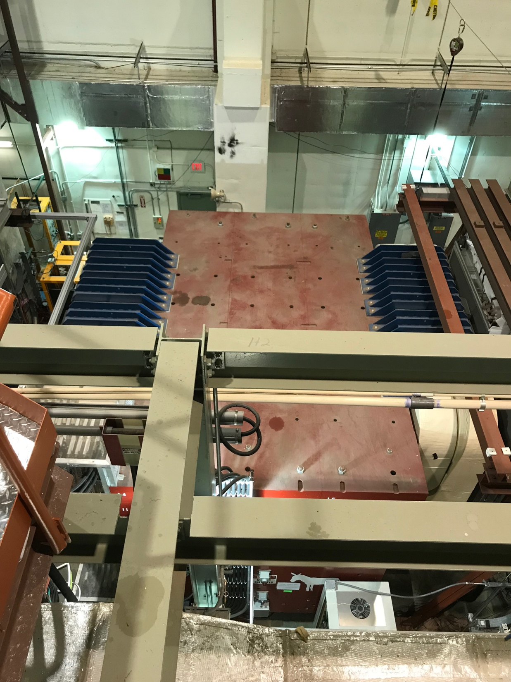
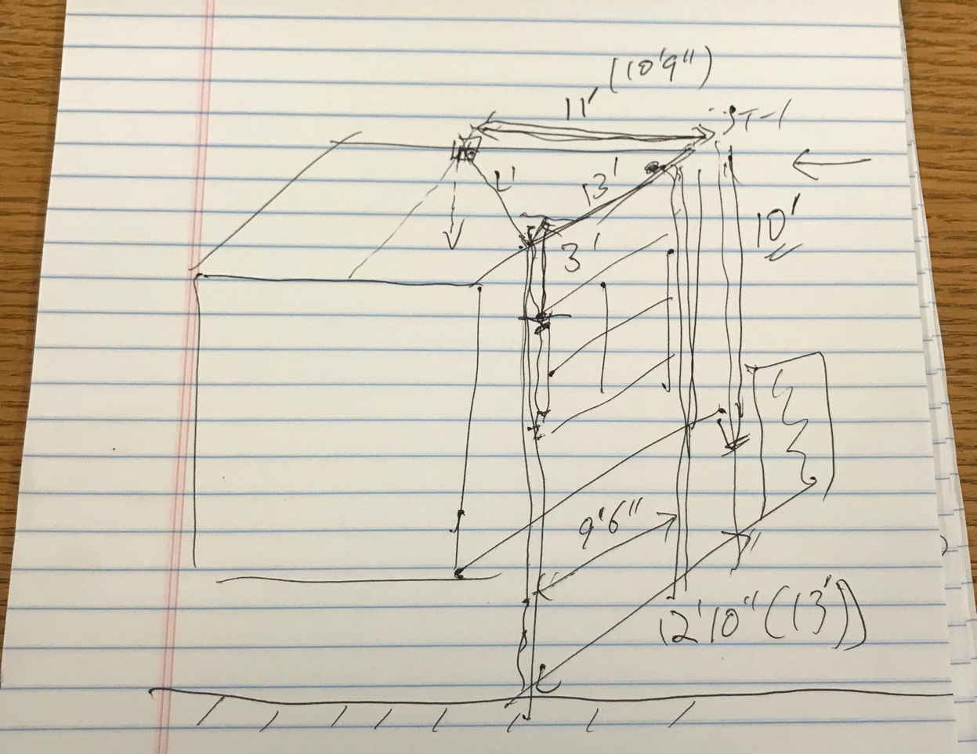
ST-1 Cables: 40’ long
Run all cables under the Kmag?
Length = (8+4)/down + 17 + 6/up
= 35’ to CAMAC crates
ST-1 cables:
40’ SMA-Lemo
(under KMag)
Rack-1

Slide 22
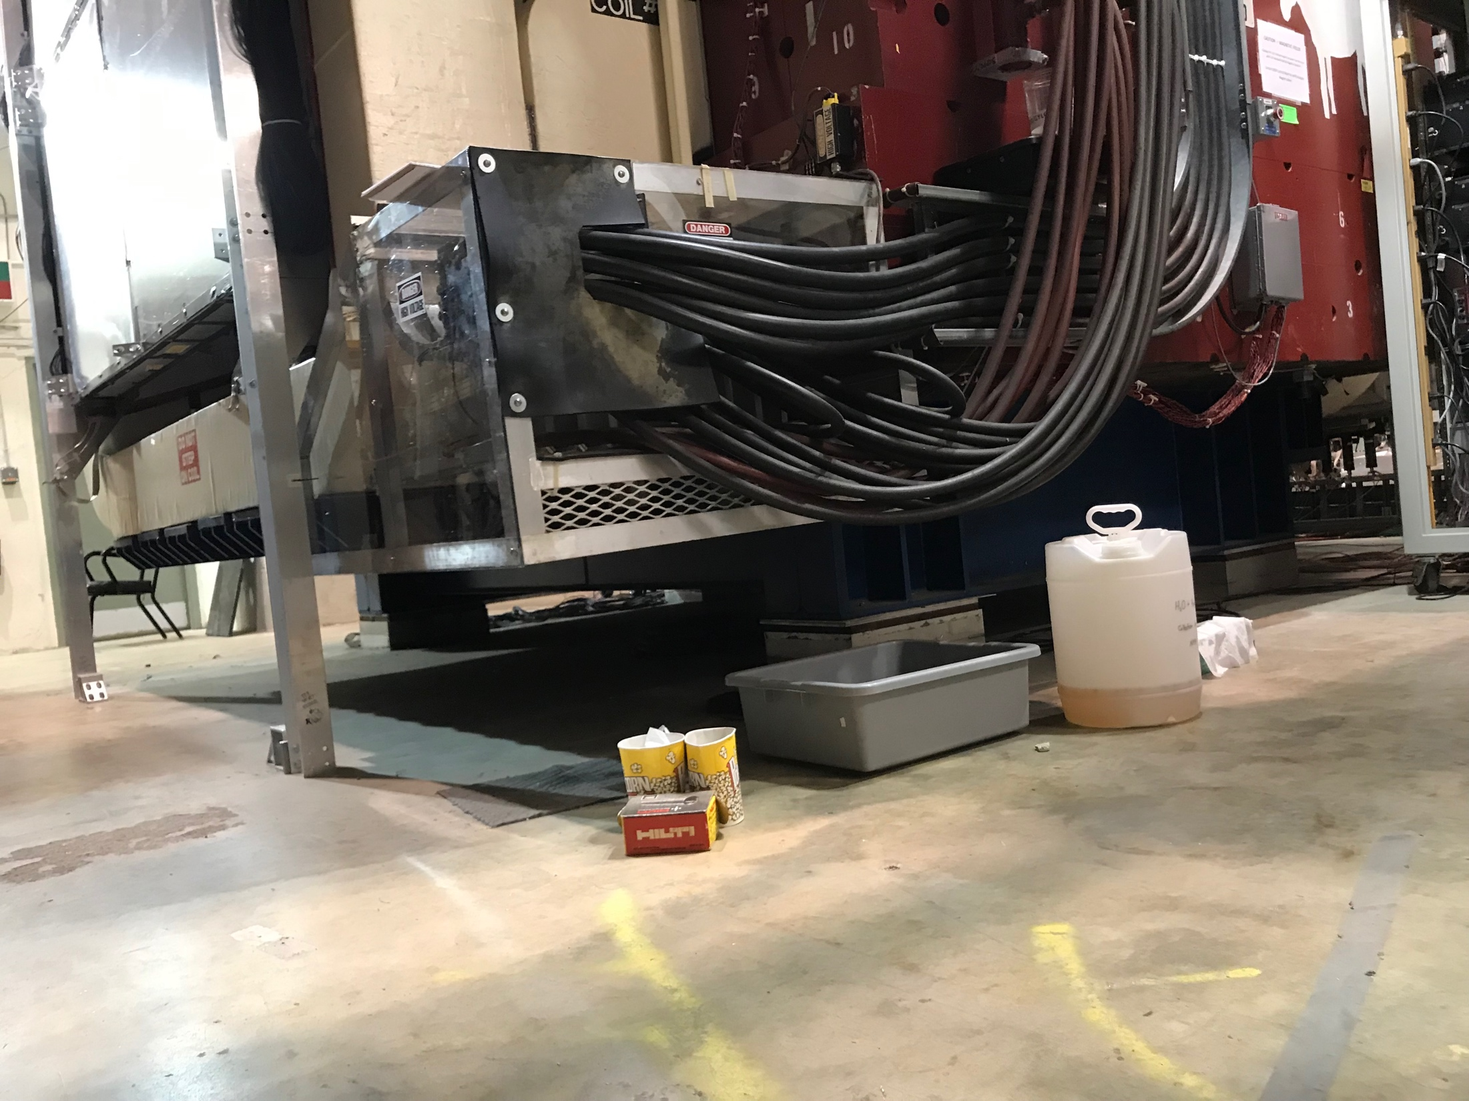
Signal cables

Slide 23
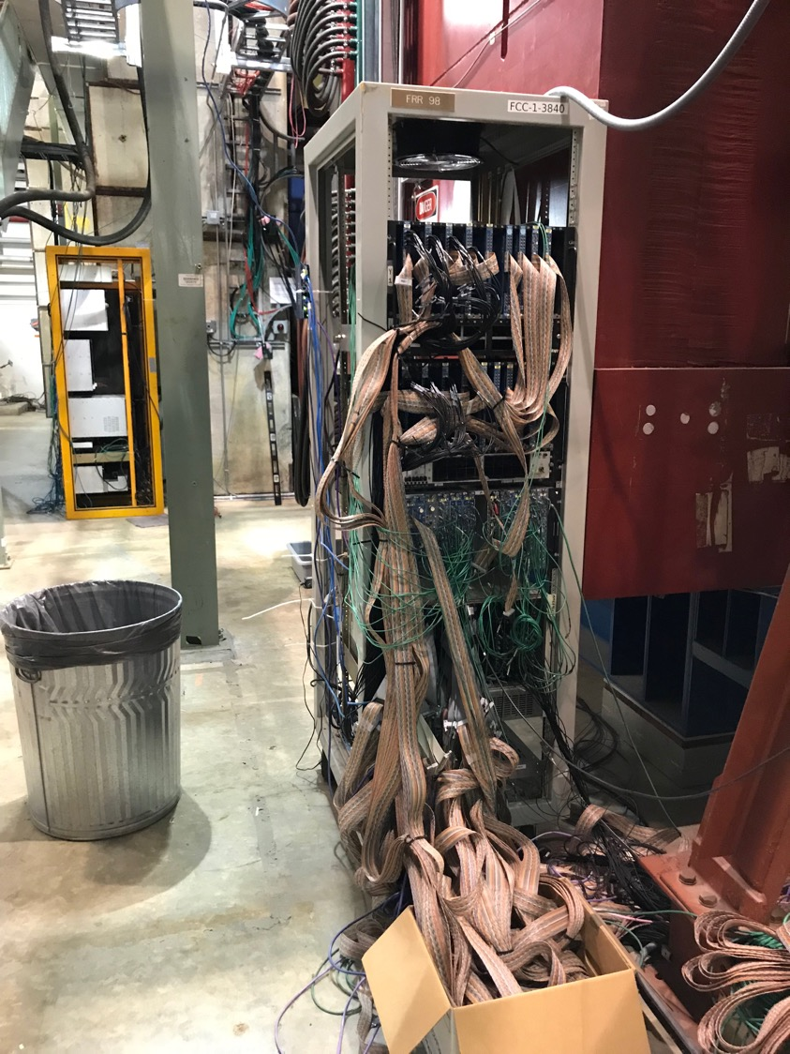
Rack-1: Station-1
Rack -1:
- DP/V1495 move to
East L2 trigger rack
Bring all ST-1 CAMAC (2) to here
Keep NIM
Keep SiPM PS
Rotate the rack 180dgr, cables facing beam
To reduce the overall length of ST-1 readout cables
Install cable tray:
run all power/signal cables over the KMAG
36’ required (cables = 40’)
Layout: top-down (remove 4 V1495 module )
CAMAC, 10 LeCroy 4413 discriminators
CAMAC, 10 LeCroy 4413
NIM for blue logics
VME for calibration system
SiPM power and control system
Power & Cooling:
2 CAMAC,
NIM
VME
SiPM PS

Slide 24
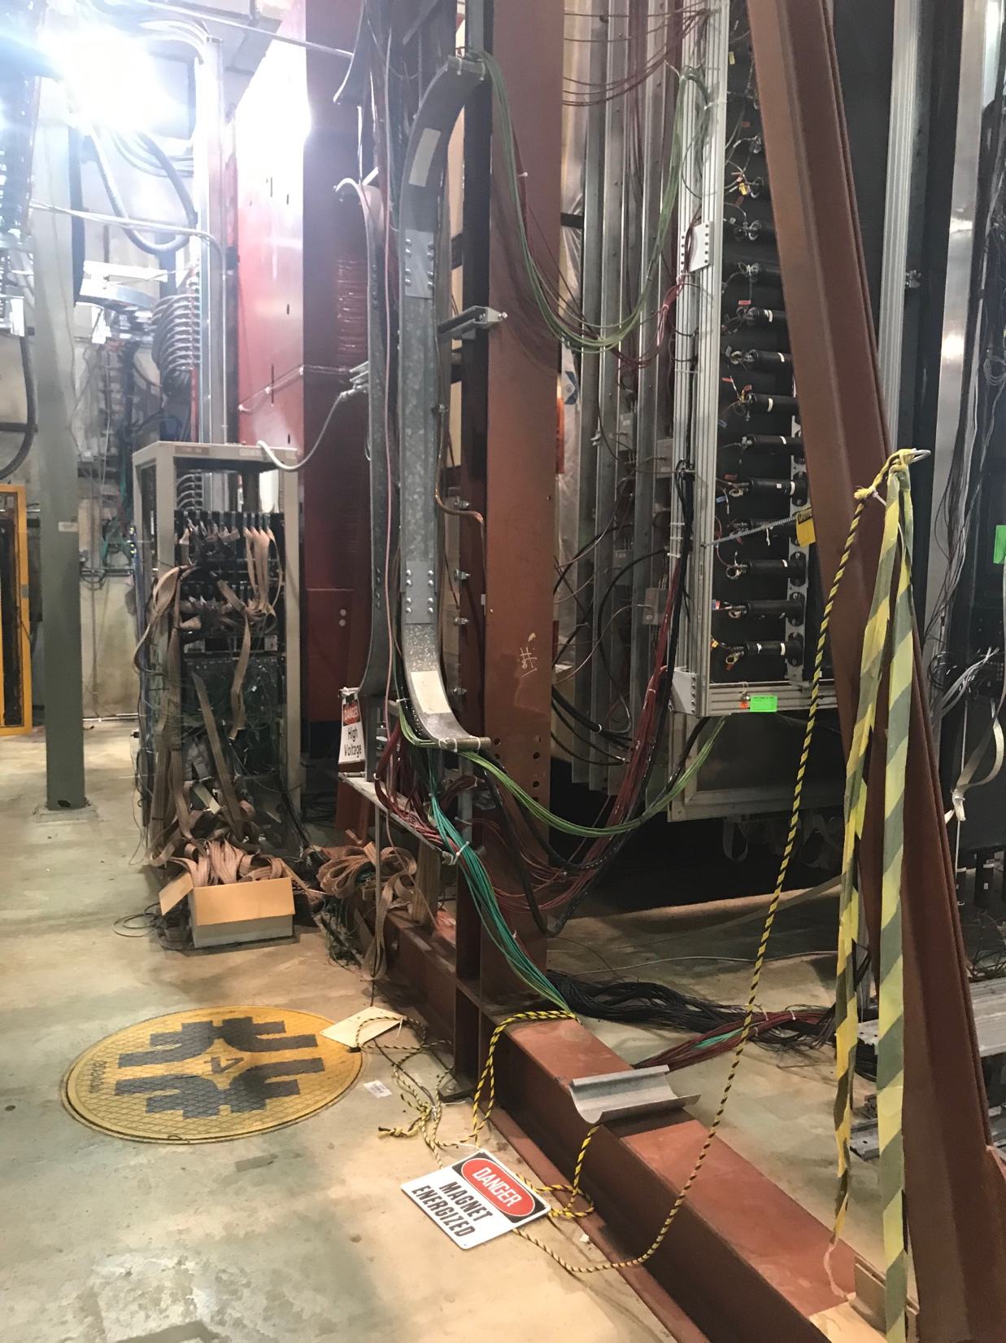
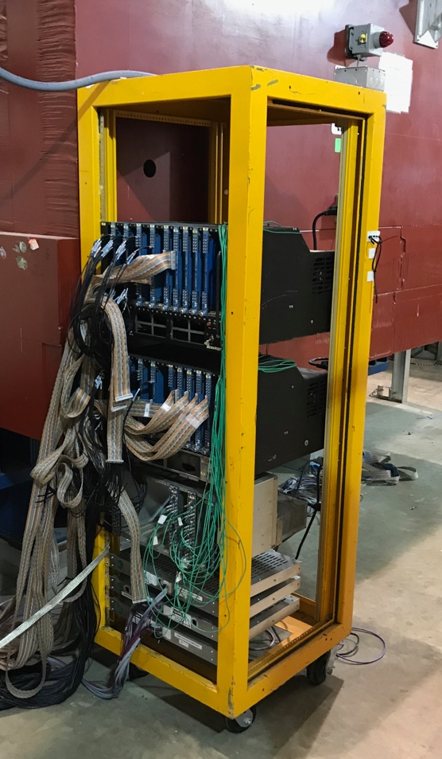
Rack-2 for Station 2
Move from West to East side, close to DP-2
(no change of configuration )
Layout: top-down
CAMAC, 9 LeCroy 4413 modules
CAMAC, 9 LeCroy 4413 modules
NIM logics
SiPM PS and control
Rack-1
Rack-2

Slide 25
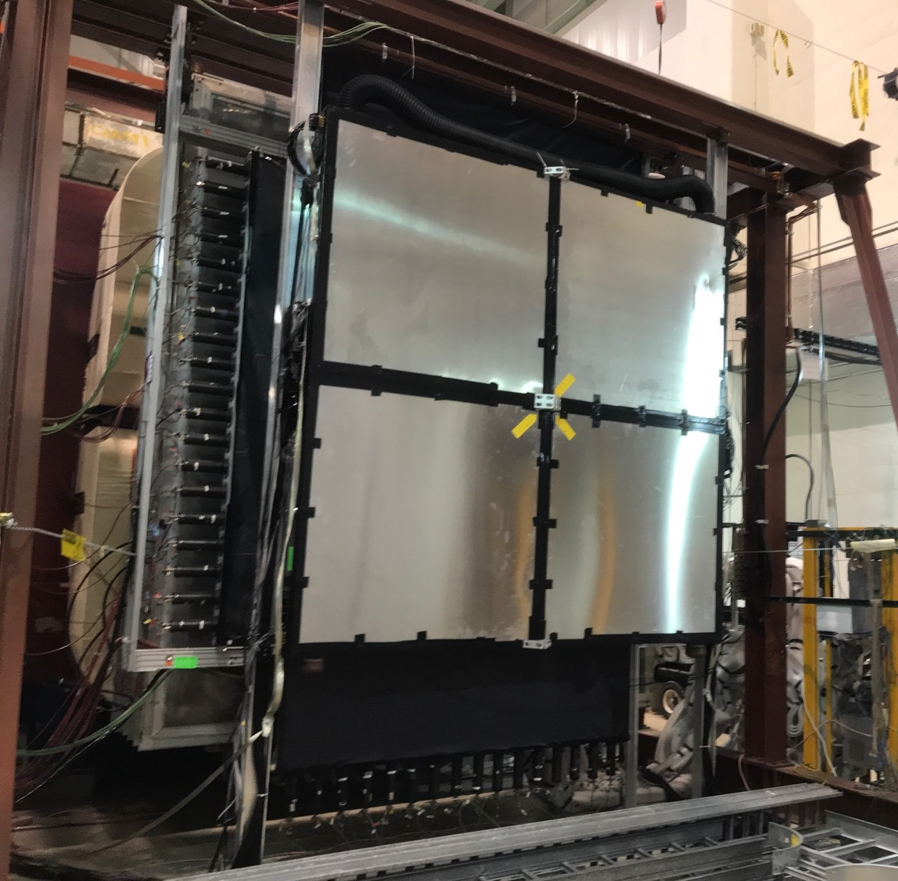
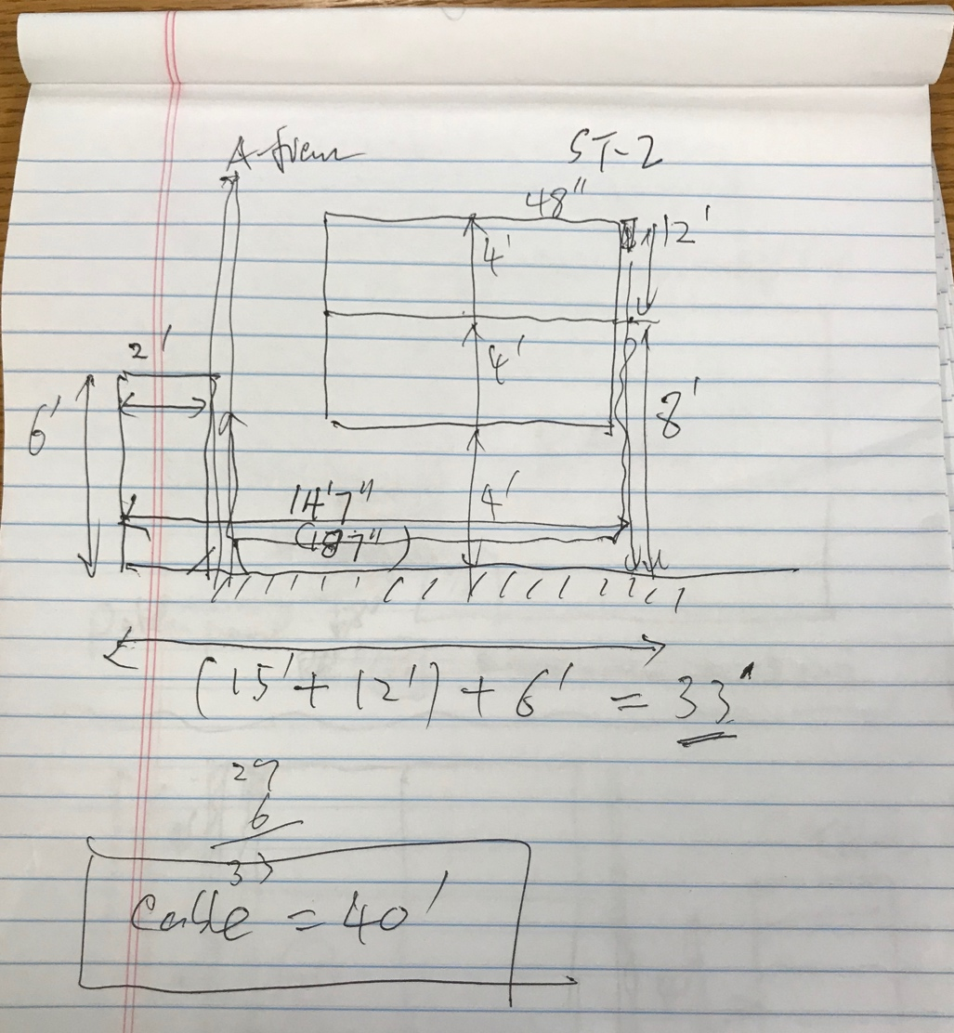
Install Station-2 Cable Tray
Cable length = 12 + 15 + 6 = 33’. (40’ cables)
48”
New DP ST-2 rack
here
New DP cable tray on ground

Slide 26
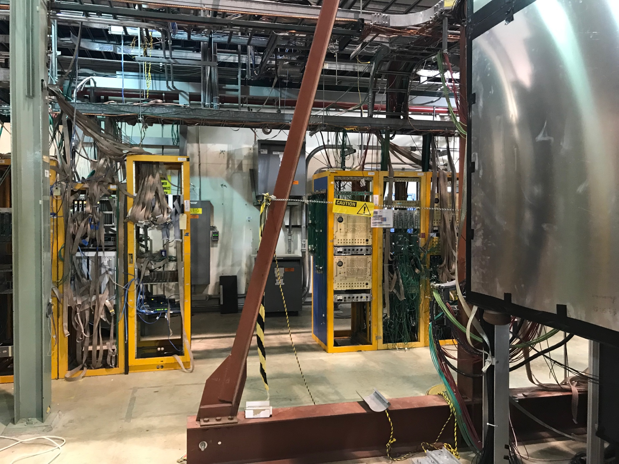
Rack-3/4: DP V1496 L1 Trigger & TDCs
Run 25’ 17-chan ribbon cables :
CAMAC -> TDC;
CAMAC -> V1495;
25’ 17-chan twist-pair ribbon cables
Rack-4
Rack-3
DP
2 VMEs
(12 TDCs)
DP
V1495

Slide 27
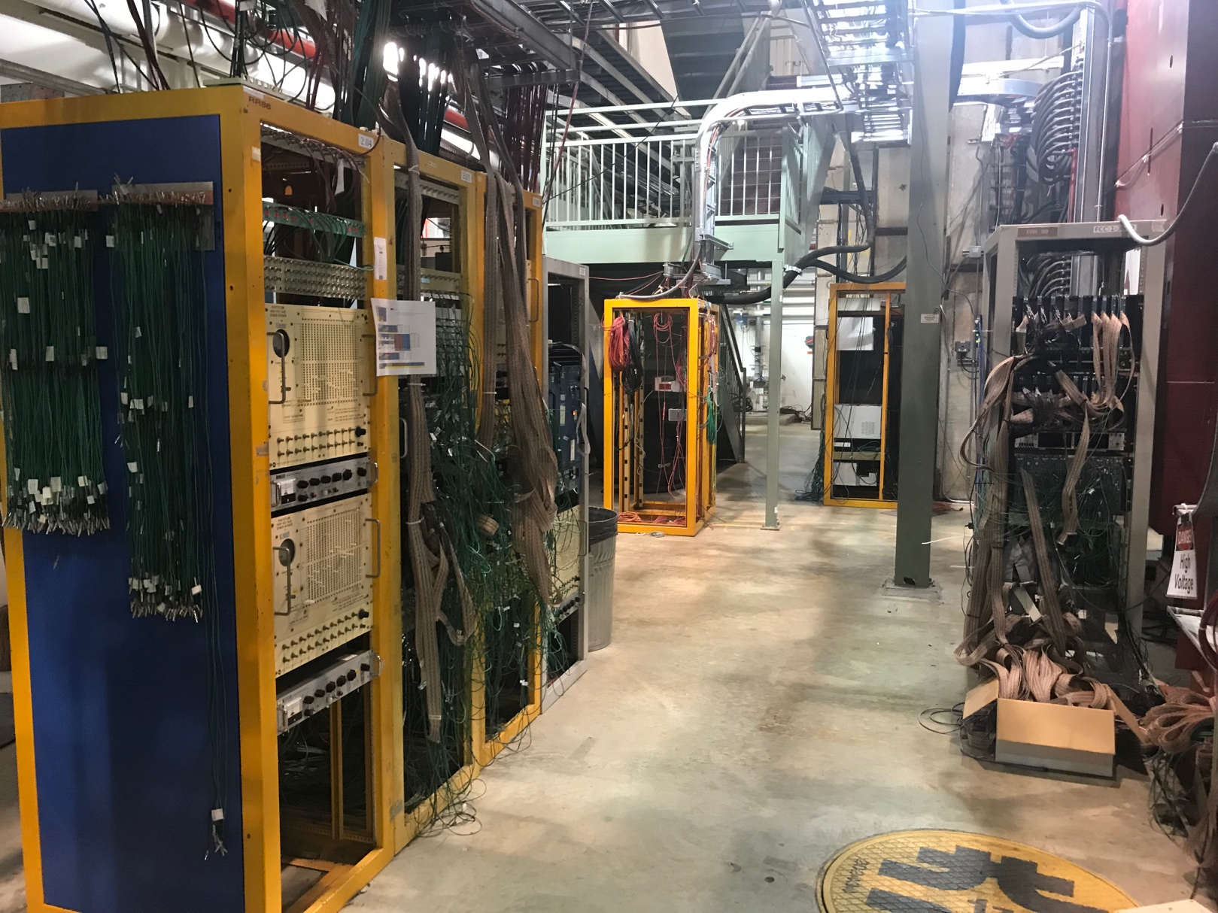
Rack-4: TDC Crates
25’ ribbon cables
Install 2 VME for 12 TDC modules in this rack
VME: CPU +6TDCs + TS
VME: CPU +6TDCs + TS
Run ribbon cables from ST-1/ST-2 CAMAC modules
Rack-1

Slide 28
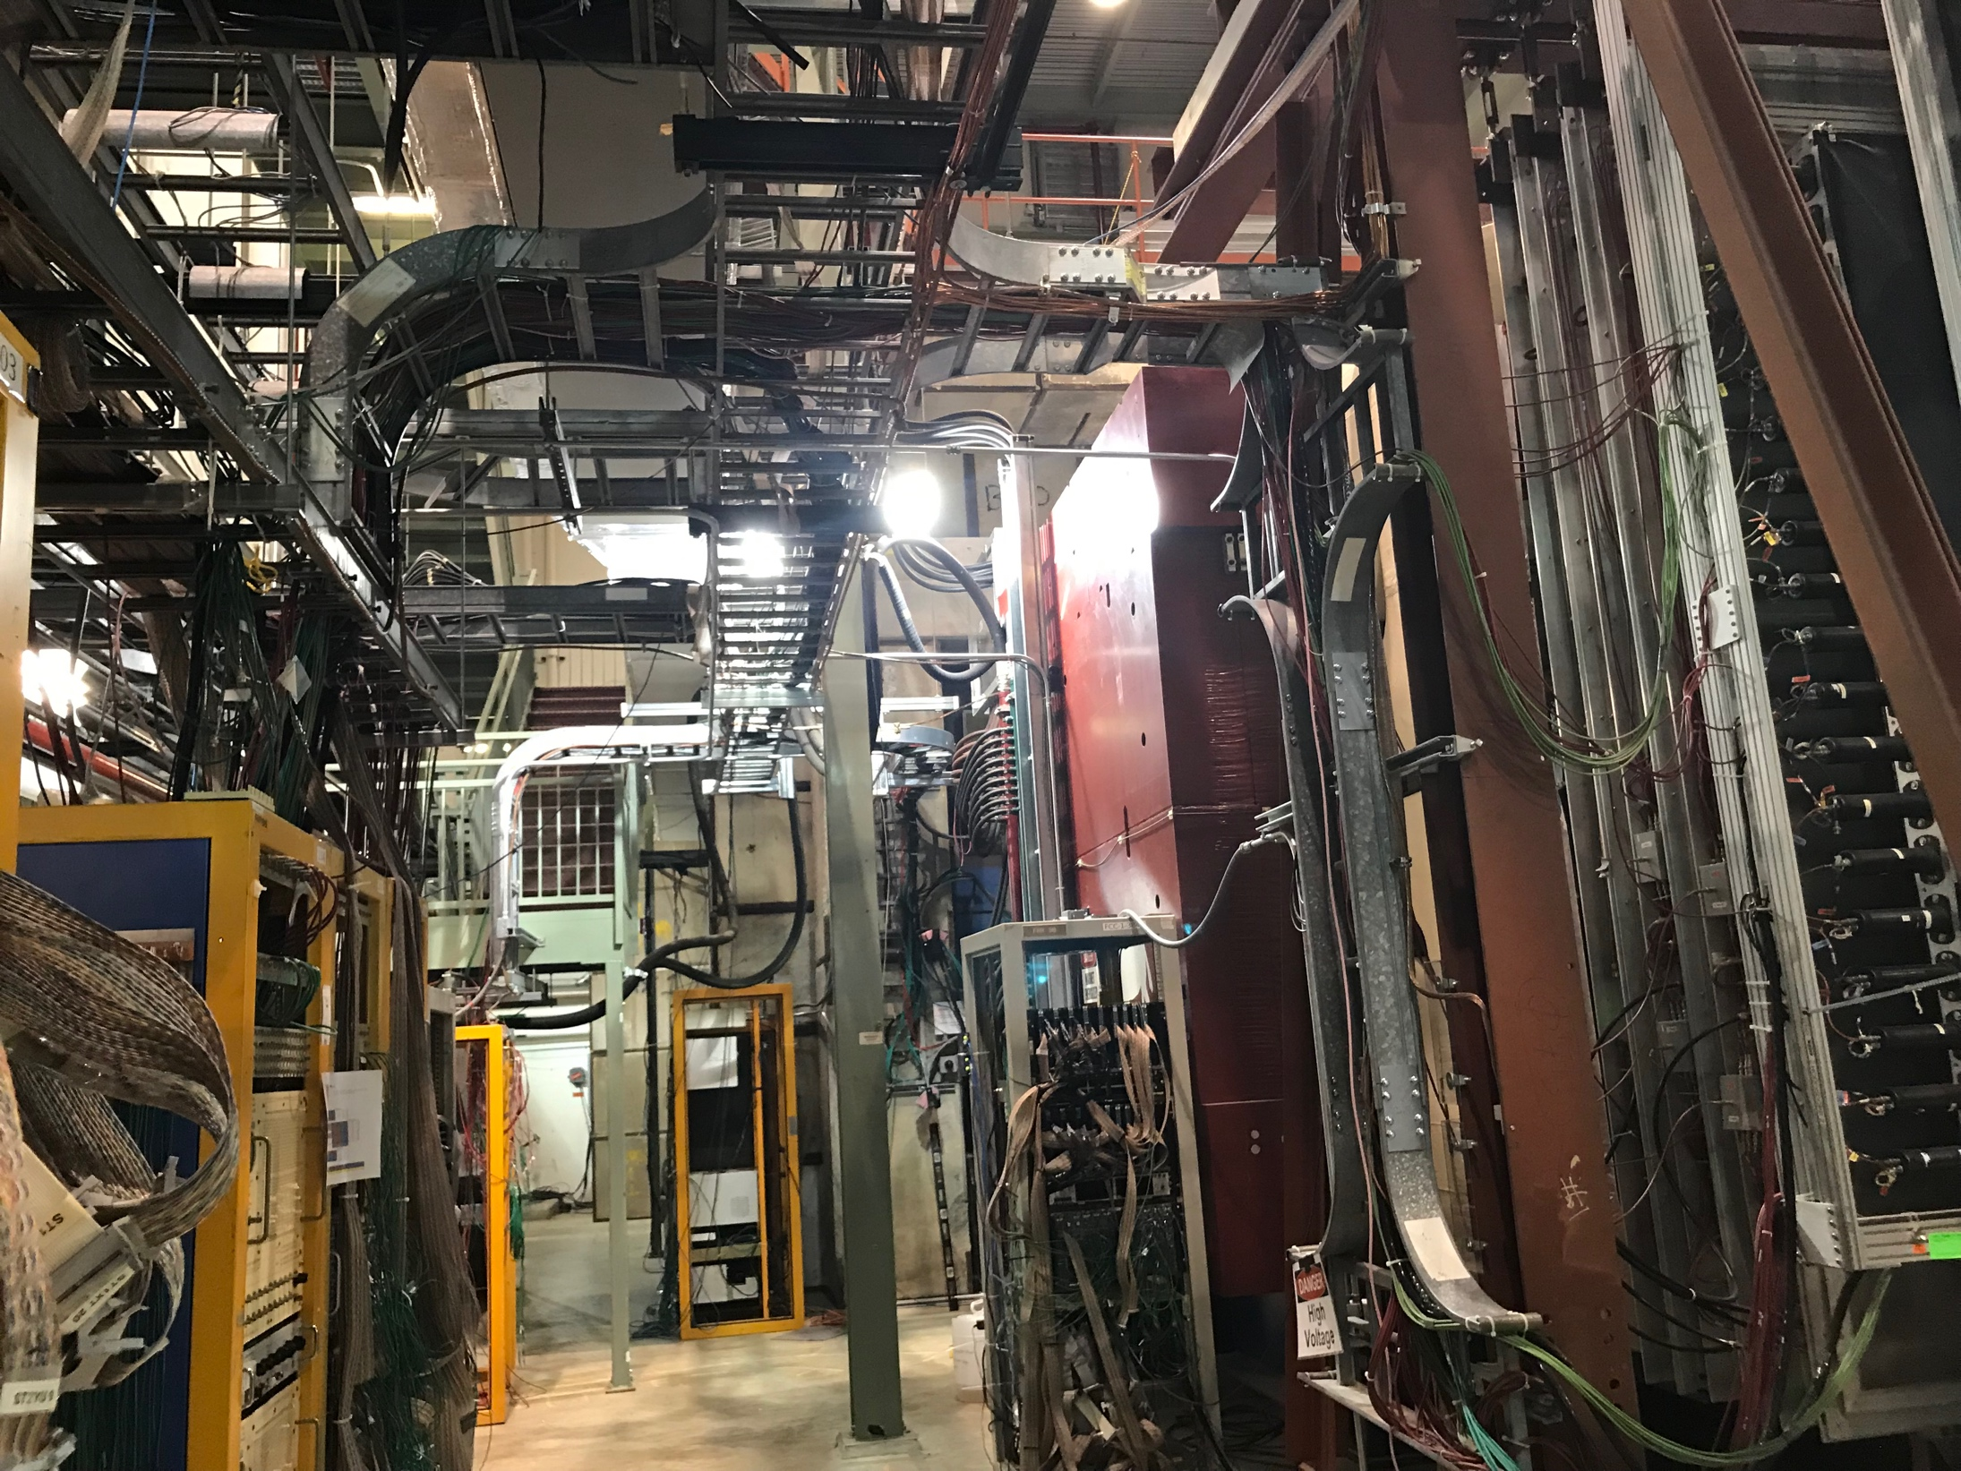
Overhead Cable Tray:
TDC ribbon cables

Slide 29
Prop-tube Plan
4 good modules are available
Shortage of readout cards
Install 4 bubblers
Schedule

Slide 30
DP Work Plan – To Do’s
DP trigger detector work
Re-arrange Readout Crates
All CAMAC on East
Discriminates: 10x2 + 8 x 2
All TDC/VME on East
8+4 TDCs
All VME on East (TDC & V1495)
V1495: 4
Calibration system:
Re-cabling
TDC ribbon cables (25’+)
SMA-Lemo cables (40’)
Check channel mapping
Check grand loop
SMA-Lemo cable extension
160+100=260, 5~10’ cables for St-1(?)
ACU students help installation and mapping
Slow control
Resb. Pi @IR
1 Master + 6 slaves
ssh link from counting house
SpinQuest LAN/Gate2 access
One command
SiPM HV table
Set HV, readback (I, T) for each SiPM
Online monitoring?
(I,V,T) of SiPM
TDC boards: 64 chan/TDC
2(80)+ 1(50) = 3 each quadrant
Total 12 TDCs
2 VME crates (6+6)
V1495: 4
SMA-Lemo cable = 40’

Slide 31
DP Work Schedule
May 26-29
Move CAMAC crates from W->E
Re-cable SMA-Leom, ST1, determine extension length
Re-cable Control cables (R. Pi) for ST-1
Plan cable tray for ST-1, ST-2
Lemo extension cables
10~20’/TBD, 320 ? From Fermilab?
ACU student?
New cables? $$?
July 8 – 19
Collab. Meeting 7/15-16(Mon-Tue)
Install and map cables
Operation and calibration
Aug 1-15
Cosmic run?
Provide trigger to readout other detectors
DC 2/3..
Prop-tube
Software work
Integrate into global tracking
Include DP hits in the tracking code (masking)
Slow control display
SiPM (V, I, T) for all DC, PorpTubes
Physics & detector simulation
DY & J/Psi target
DY & J/Psi beam dump
Lookup tables

Slide 32
Prop Tube Plan & Schedule, and more
Replaced 2 modules
July 8-19
Coll. Meeting @FNAL 7/15-16
Jeff B. or Hubert
Xuan, Matt, Ming et al
Commissioning with cosmic trigger (DP + Hodos)
August 1-15?
DP+Hodc trigger
Readout Prop-Tube + DC2/33
E1039 detector commissioning
9/1-15?
Full spectrometer,
all chambers
Slow control system
Beam @SpinQuest
Mid October 2019

Slide 34
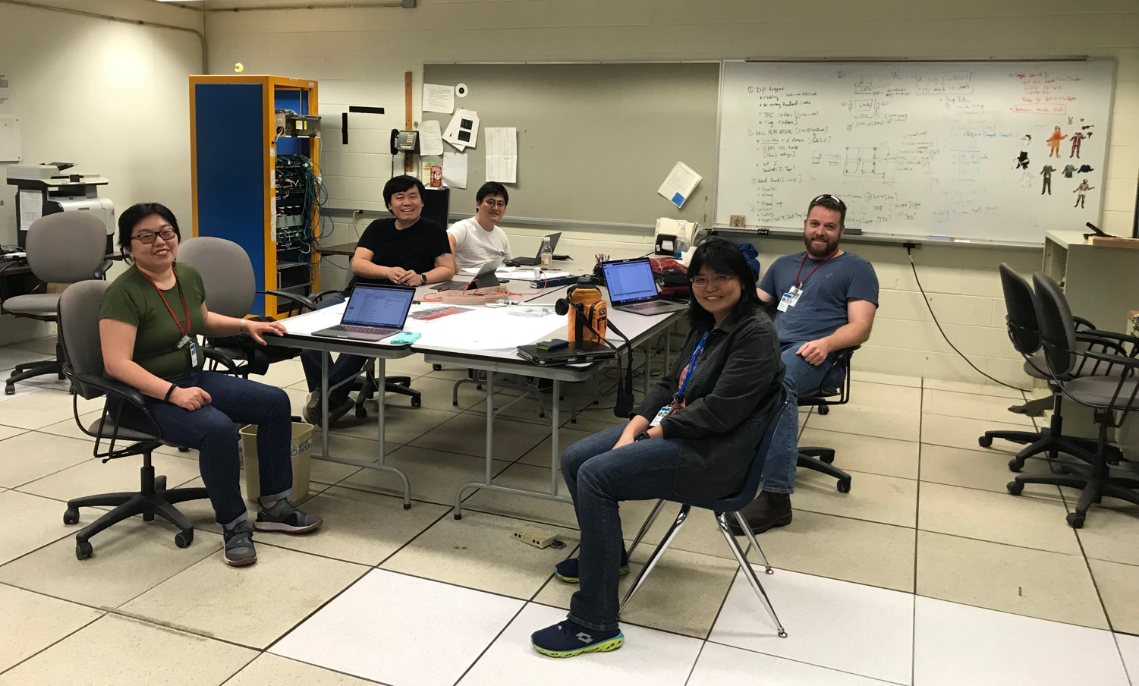
DP Trigger & PropTube Work Plan

Slide 35
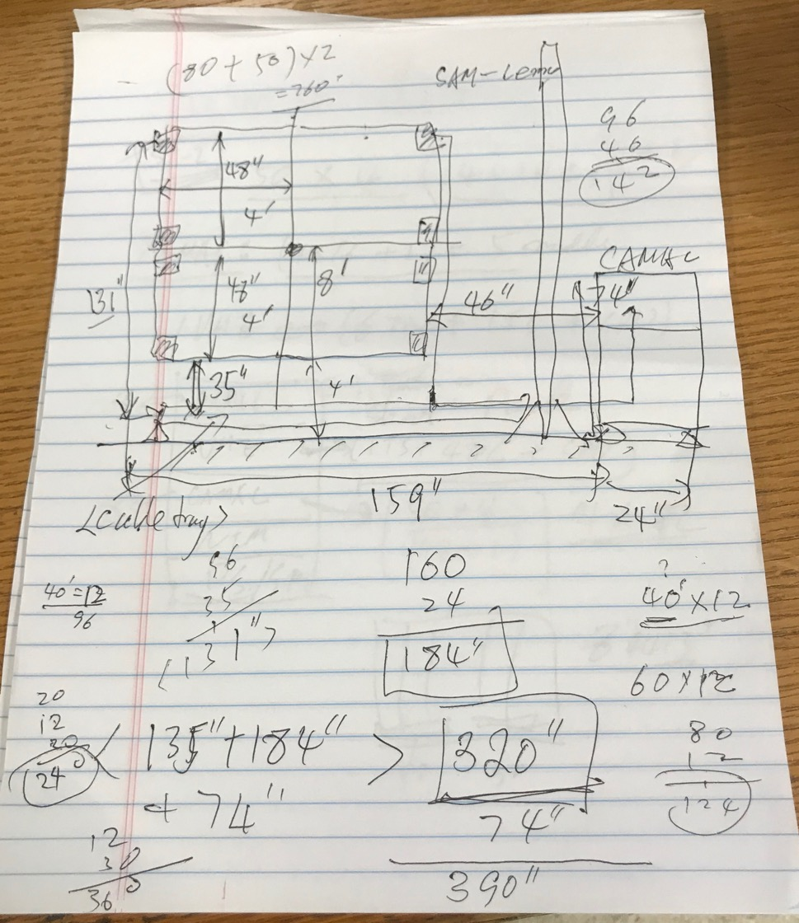
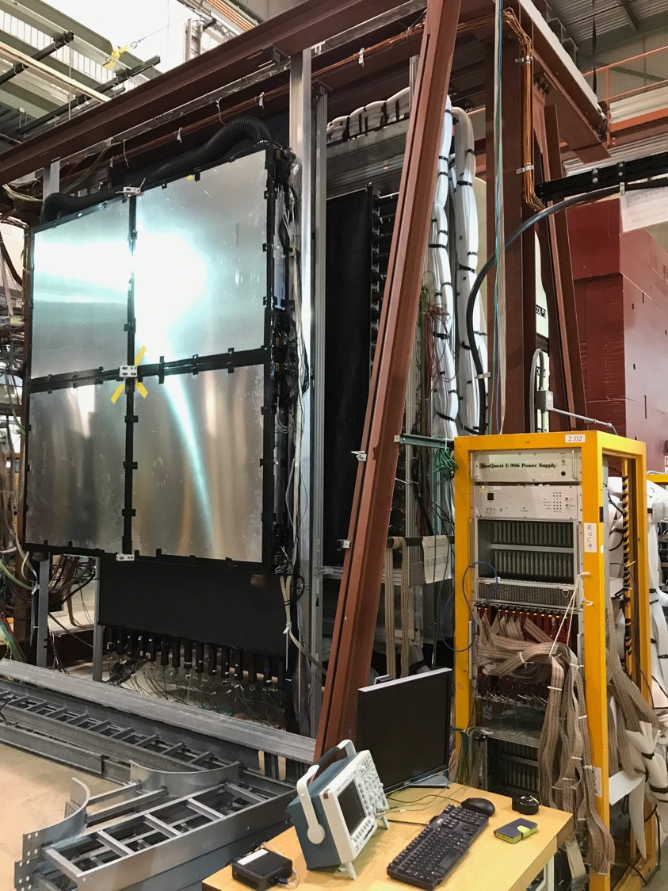
SMA-Lemo cable:
2x(48 + 48) + (46 + 12) + “12” = 262”
= 21.8’
For ST-1:
Additional a few ft to ST-1 rack
DP ST-2 rack?
Move
DC-2 rack upstream
DP cable tray above ground

Slide 36
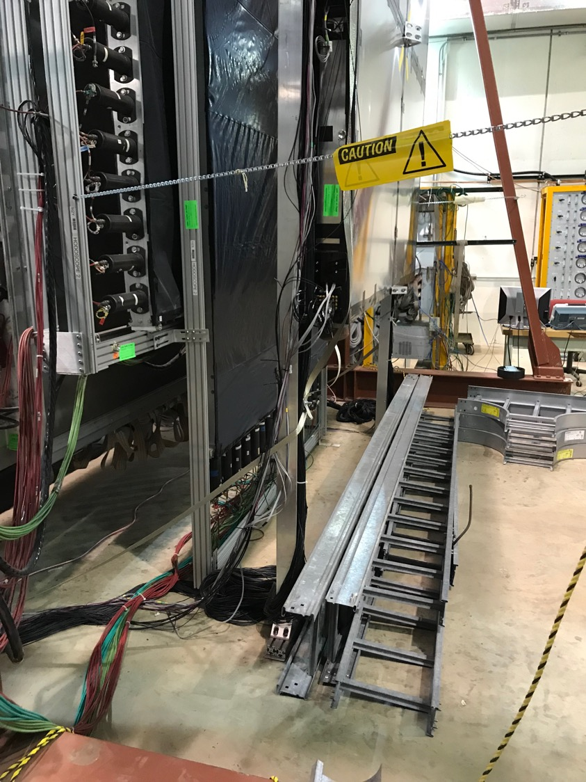
DP/V1495 move to
East L2 trigger rack
Bring ST-1 CAMAC
& TDC to here
Keep SiPM PS
New DP cable tray above ground

Slide 37
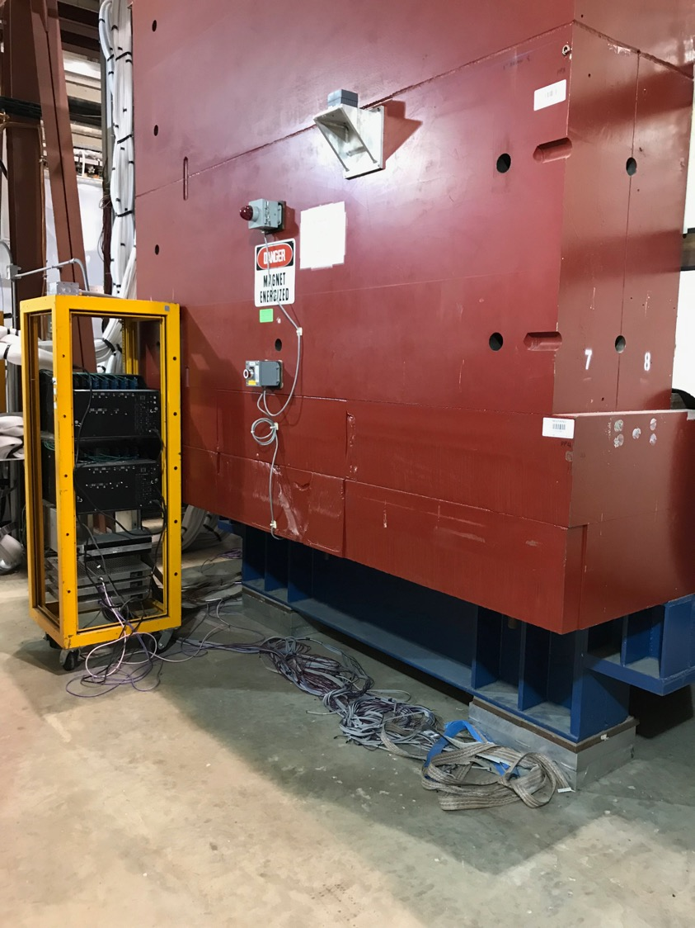
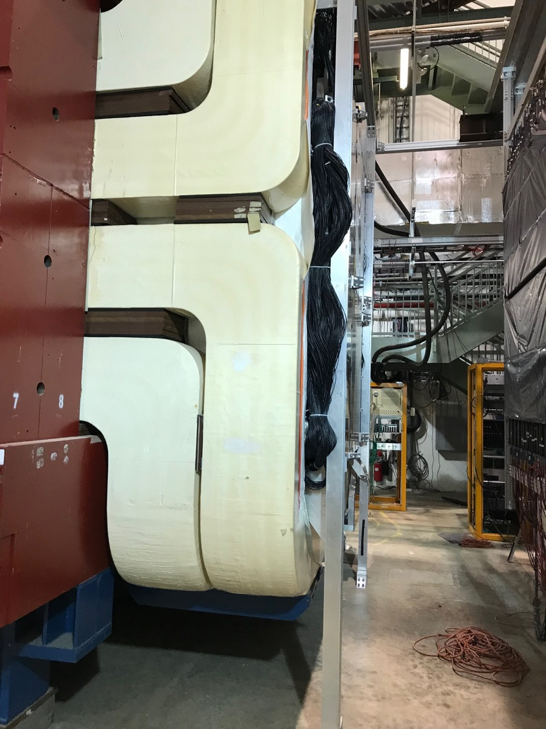
CAMAC, SiPM PS
move to East

Slide 38
DP Trigger New Layout-2
West
East
beam
DP Trigger
-VME:
4xV1495 L1 trigger
Calibration
-NIM/BlueLogic
Trigger
DP-1
RACK-1
Location?
ST0-1: 4x 80 ch
-CAMAC (10 x LeCroy 4413)
-VME/TDC(CPU+TS+4TDC)
-VME/TDC(CPU+TS+4TDC)
-CAMAC (10 x LeCroy 4413)
-NIM/BlueLogic trigger
-SiPM PS
KMAG
RACK-3
DC-2
DC-2
RACK-2
ST-2: 4x 50ch
-CAMAC (8 x LeCroy 4413)
-VME/TDC (CPU+TS+4TDC)
-CAMAC (8 x LeCroy 4413)
-NIM
-SiPM PS
(4 Qs)
DP-2
L2/V1495
DP trig(OR)
DY trig(AND FPGA trig’s)

