Slide 1
E1039 Summer Work Plan
Kun, Mindy, Andrew, Xuan, Matt, Zongze, Ming
5/26/2019
Updated 5/28/29
- DP trigger system
- Prop tubes

Slide 2
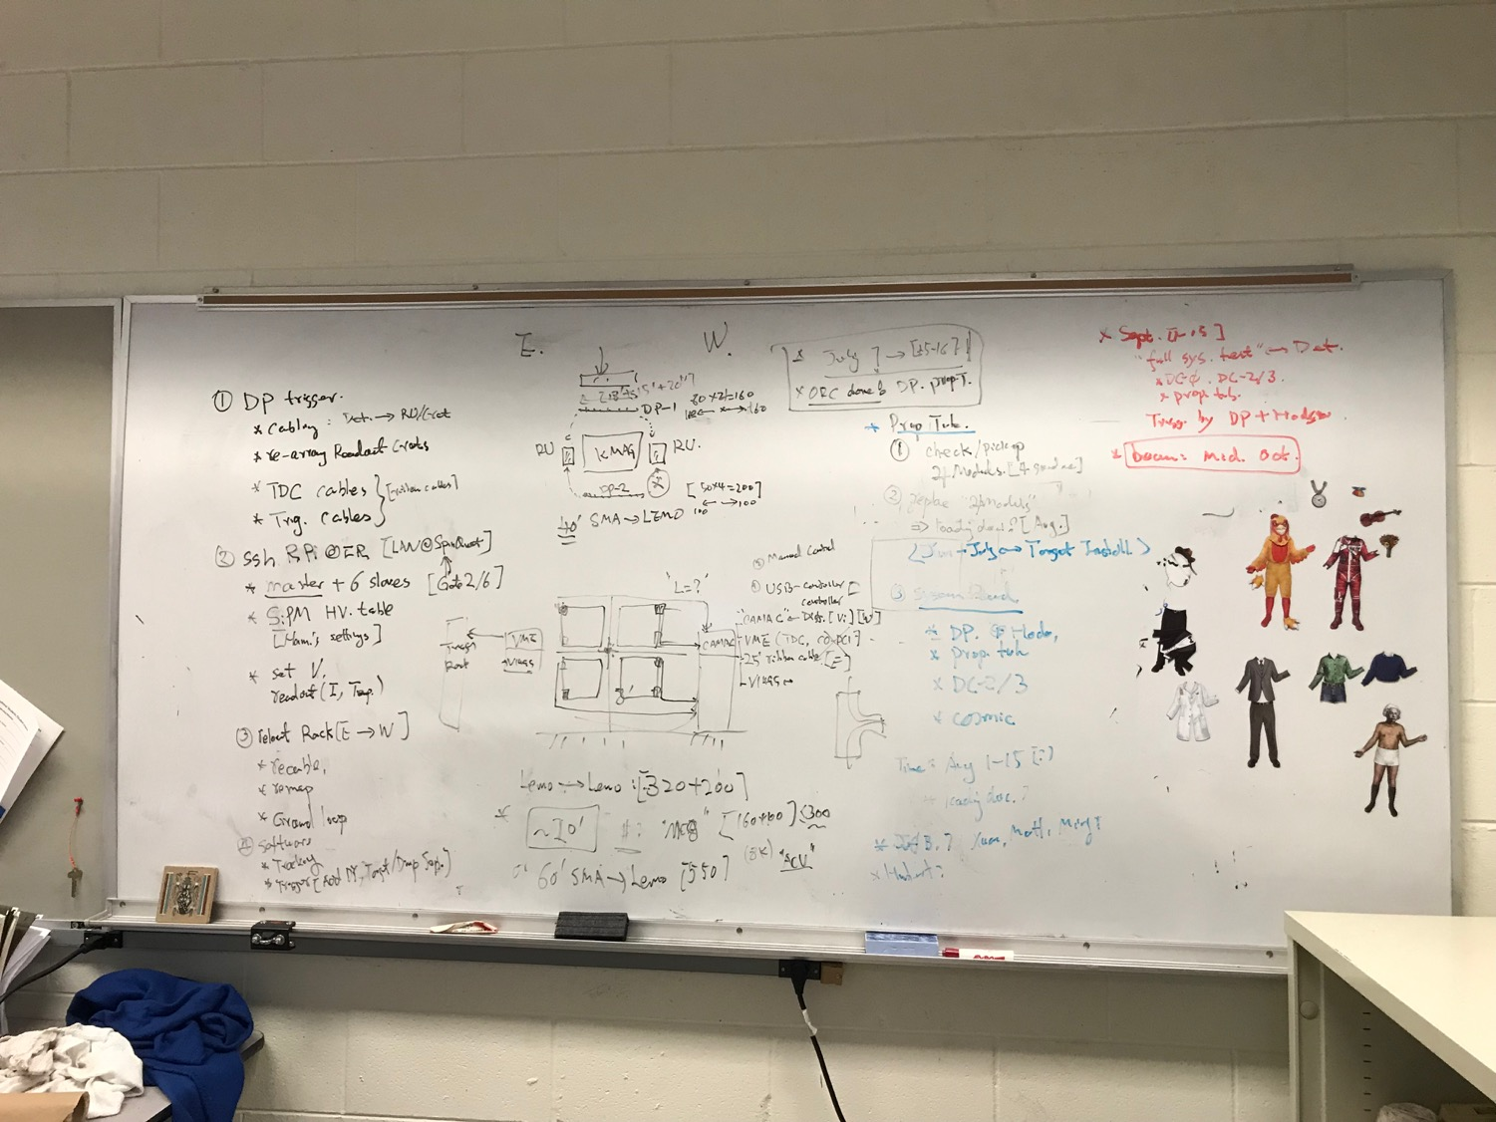

Slide 3
DP Trigger New Layout (5/28/2019)
beam
- Run all cables under
the KMag, with cable tray
Possible extended SMA-Lemo, ~5’; cable tray
DP-1
KMAG
RACK-4 (exists)
VME/TDC (6)
VME/TDC (6)
RACK-1
Signal cables (40’), under kMag
DC-2
Existing cable
tray
Rack-3/DP Trigger
(L2 rack)
-VME:
4xV1495
L1 trigger
DC-2
RACK-3 (exists)
DP/V1495
RACK-2
DP-2
New Rack-2, SMA-Lemo unchanged, cable tray, new power to Rack-2
(4 Qs)
Rack-1/ST-1: 4x 80 ch
-CAMAC (10 x LeCroy 4413)
-CAMAC (10 x LeCroy 4413)
-NIM/BlueLogic trigger
Calibration
SiPM PS
Rack-2/ST-2: 4x 50ch
-CAMAC (8 x LeCroy 4413)
-CAMAC (8 x LeCroy 4413)
-NIM
-SiPM PS
L2 rack/V1495 (Rack-3)
DP trig(OR)
DY trig(AND FPGA trig’s)

Slide 4
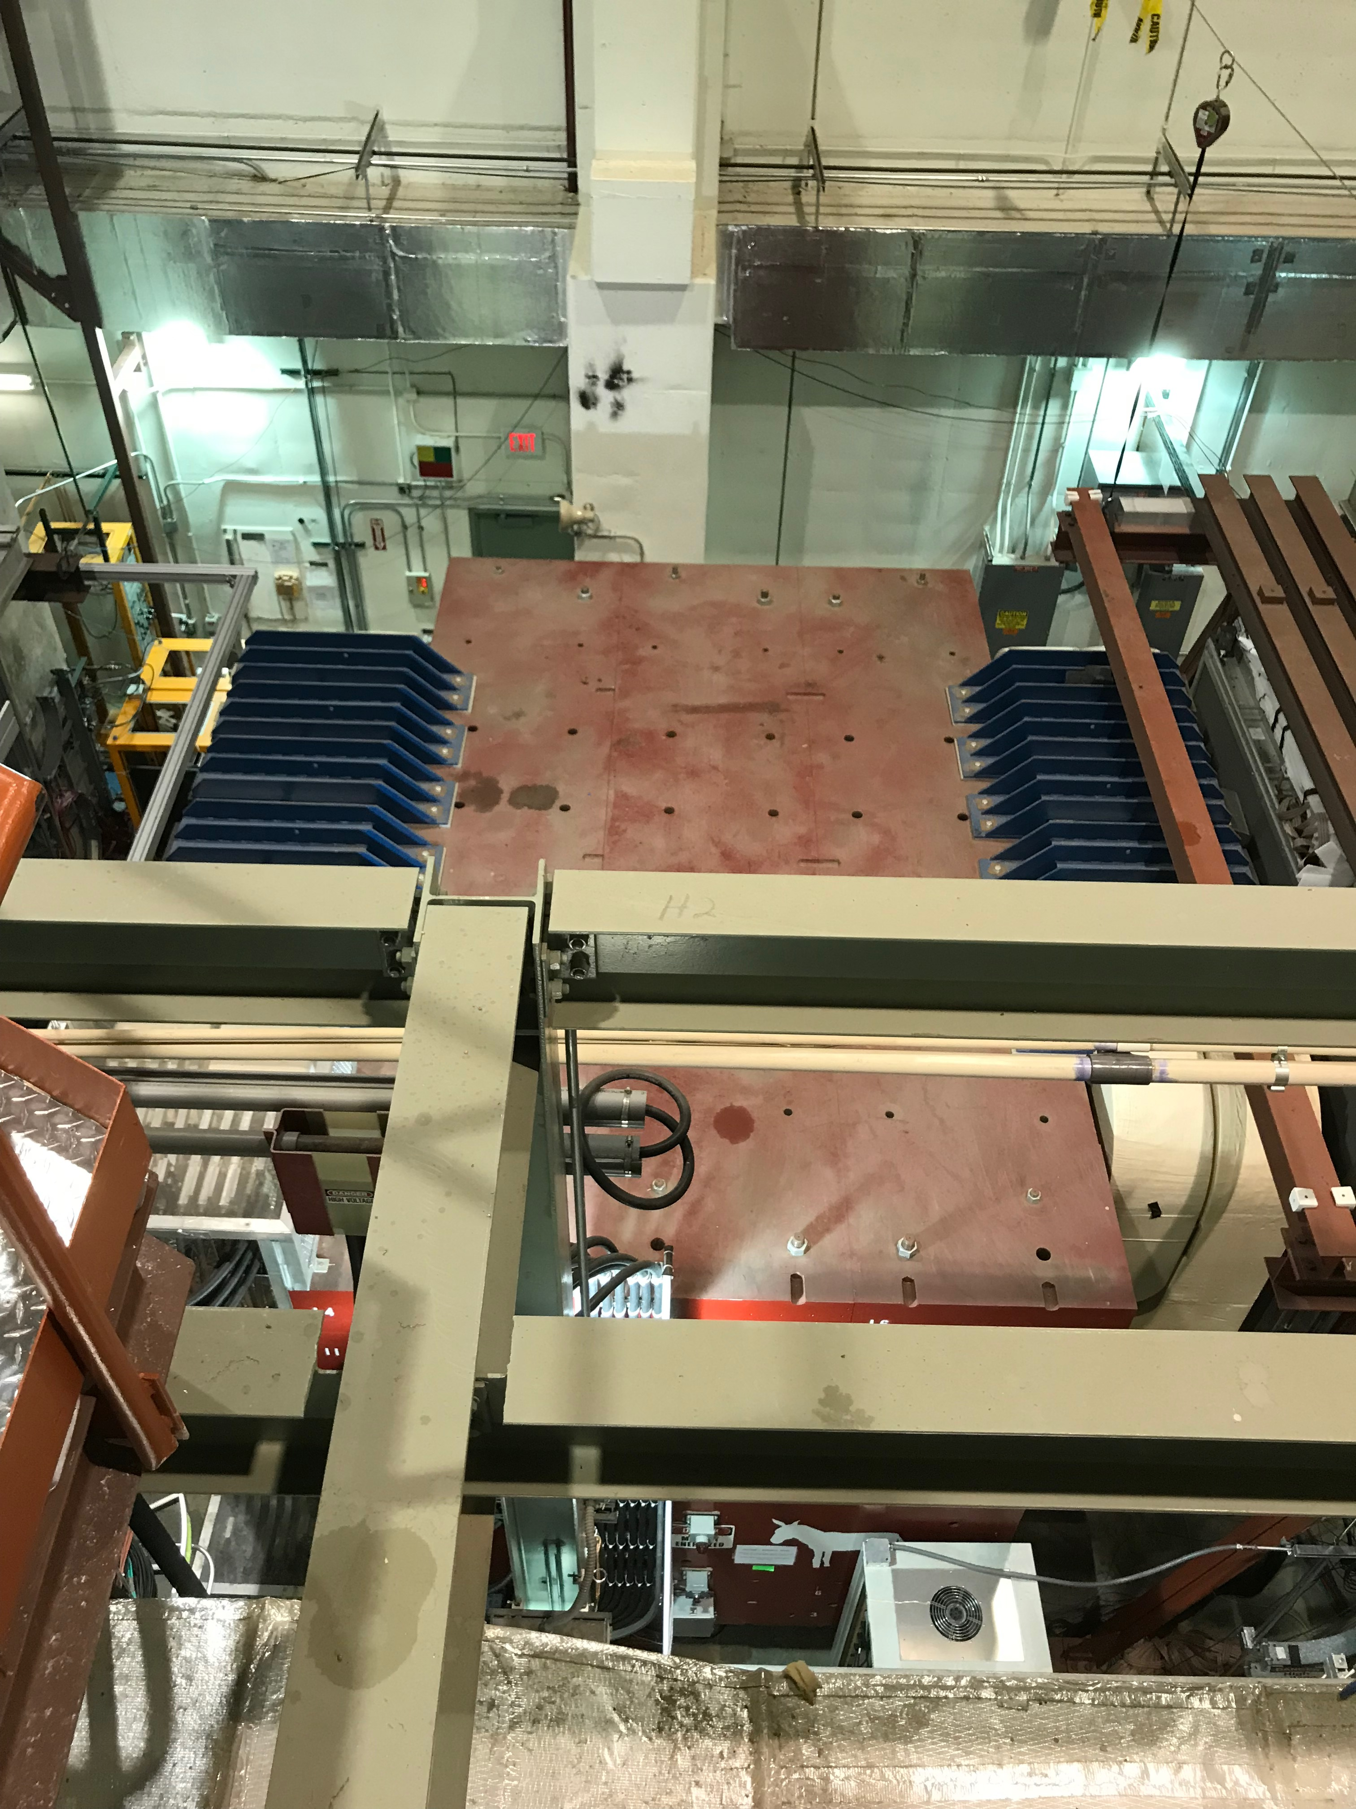
ST-1 Cables: 40’ long
Run all cables under the Kmag?
Length = (8+4)/down + 17 + 6/up
= 35’ to CAMAC crates
ST-1 cables:
40’ SMA-Lemo
(under KMag)
Rack-1

Slide 5
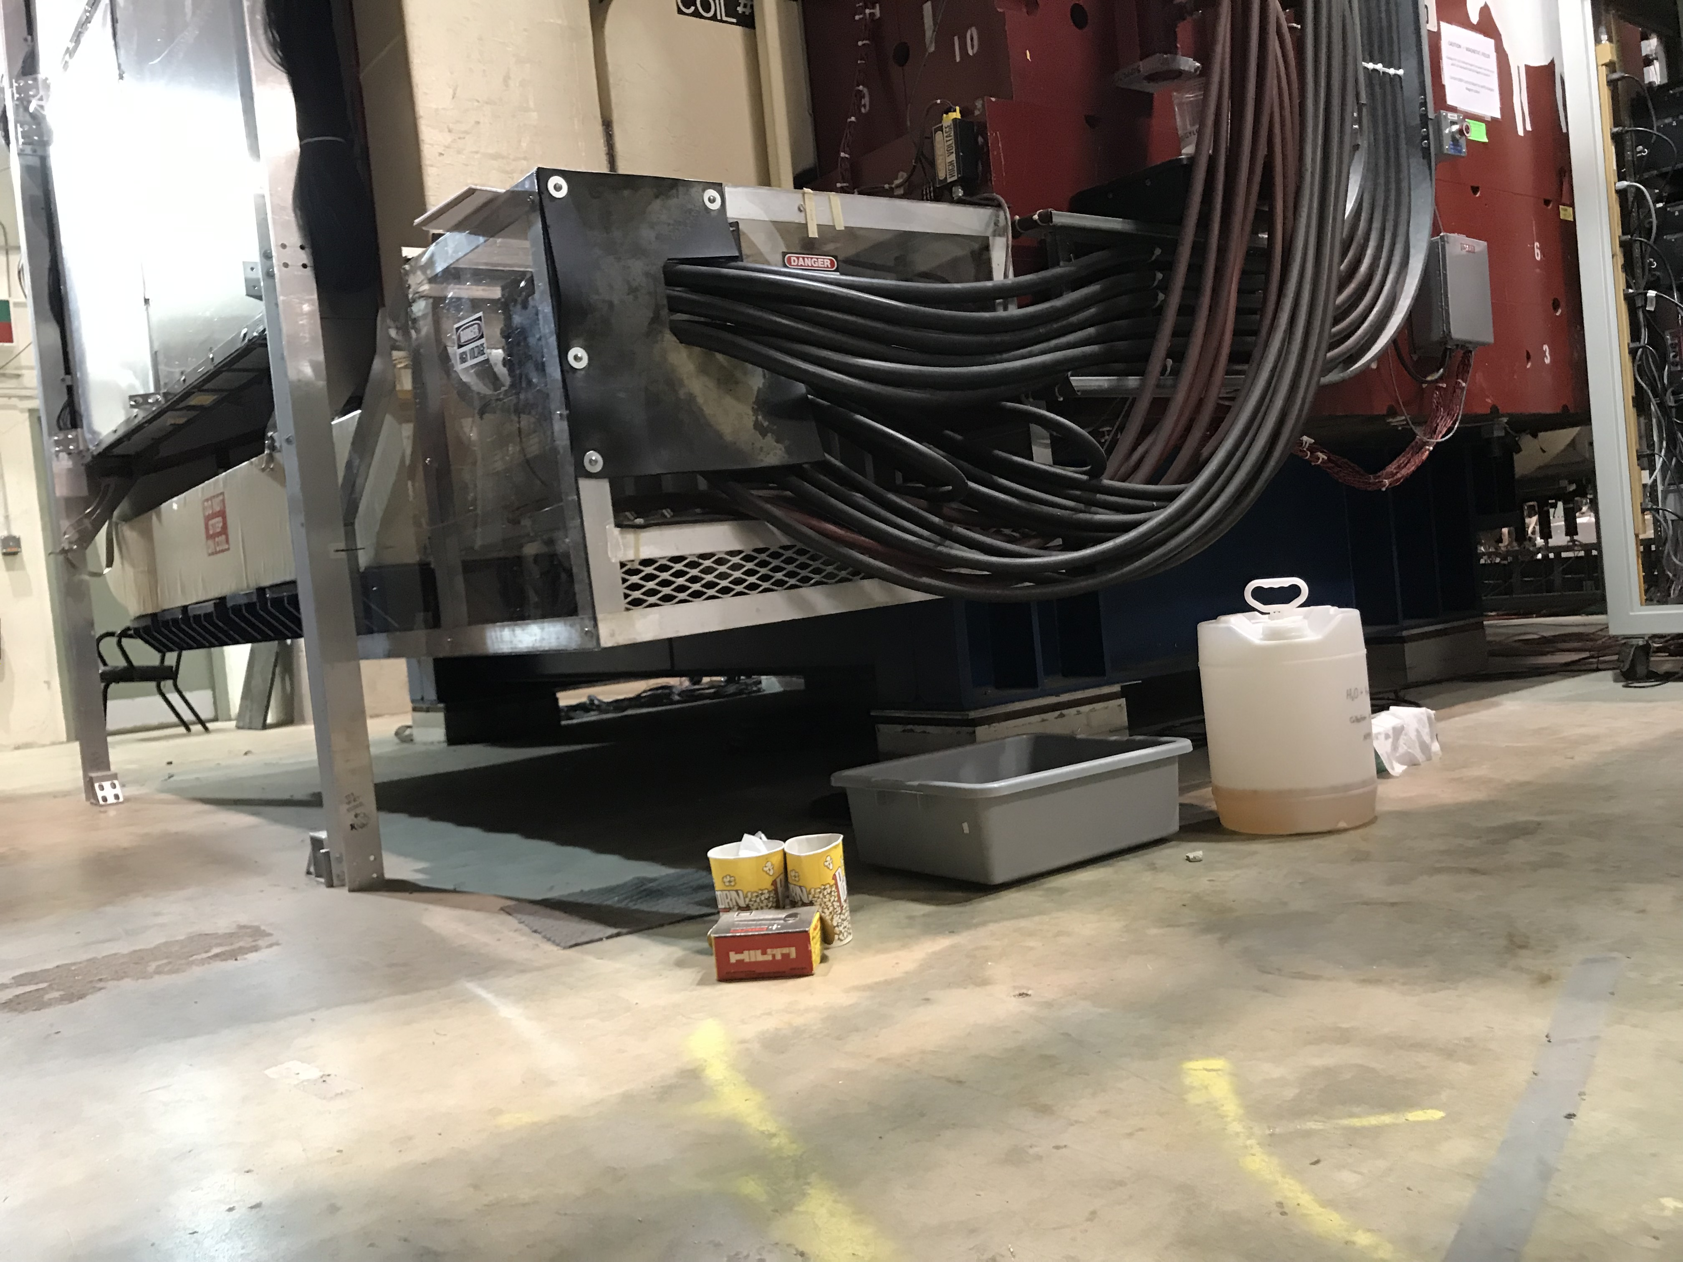
Signal cables

Slide 6
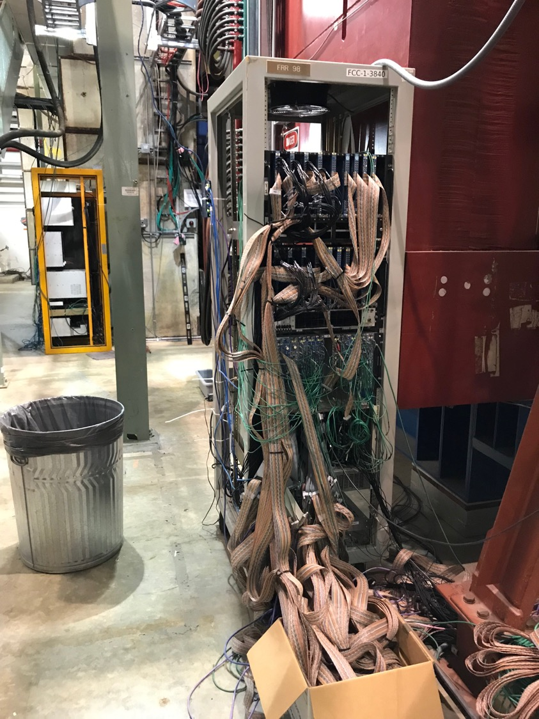
Rack-1: Station-1
Rack -1:
- DP/V1495 move to
East L2 trigger rack
Bring all ST-1 CAMAC (2) to here
Keep NIM
Keep SiPM PS
Rotate the rack 180dgr, cables facing beam
To reduce the overall length of ST-1 readout cables
Install cable tray:
run all power/signal cables over the KMAG
36’ required (cables = 40’)
Layout: top-down (remove 4 V1495 module )
CAMAC, 10 LeCroy 4413 discriminators
CAMAC, 10 LeCroy 4413
NIM for blue logics
VME for calibration system
SiPM power and control system
Power & Cooling:
2 CAMAC,
NIM
VME
SiPM PS

Slide 7
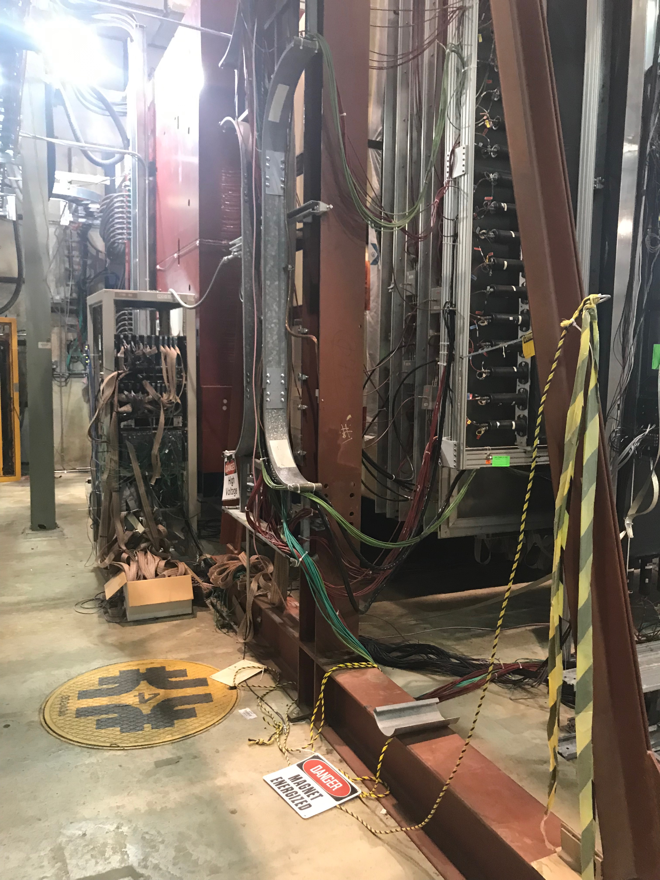
Rack-2 for Station 2
Move from West to East side, close to DP-2
(no change of configuration )
Layout: top-down
CAMAC, 9 LeCroy 4413 modules
CAMAC, 9 LeCroy 4413 modules
NIM logics
SiPM PS and control
Rack-1
Rack-2

Slide 8
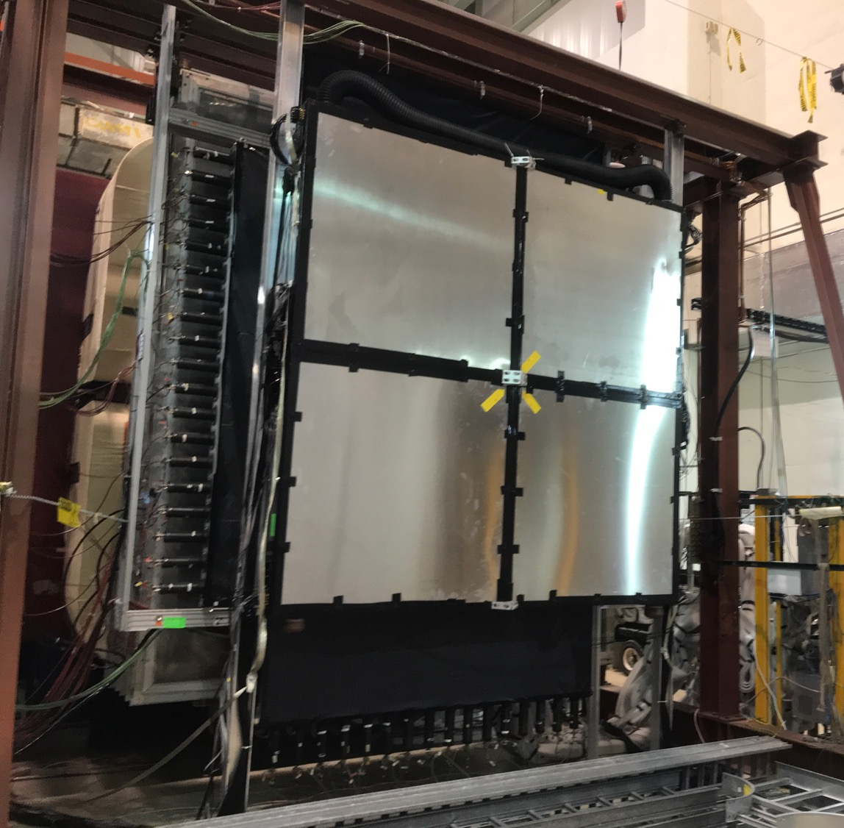
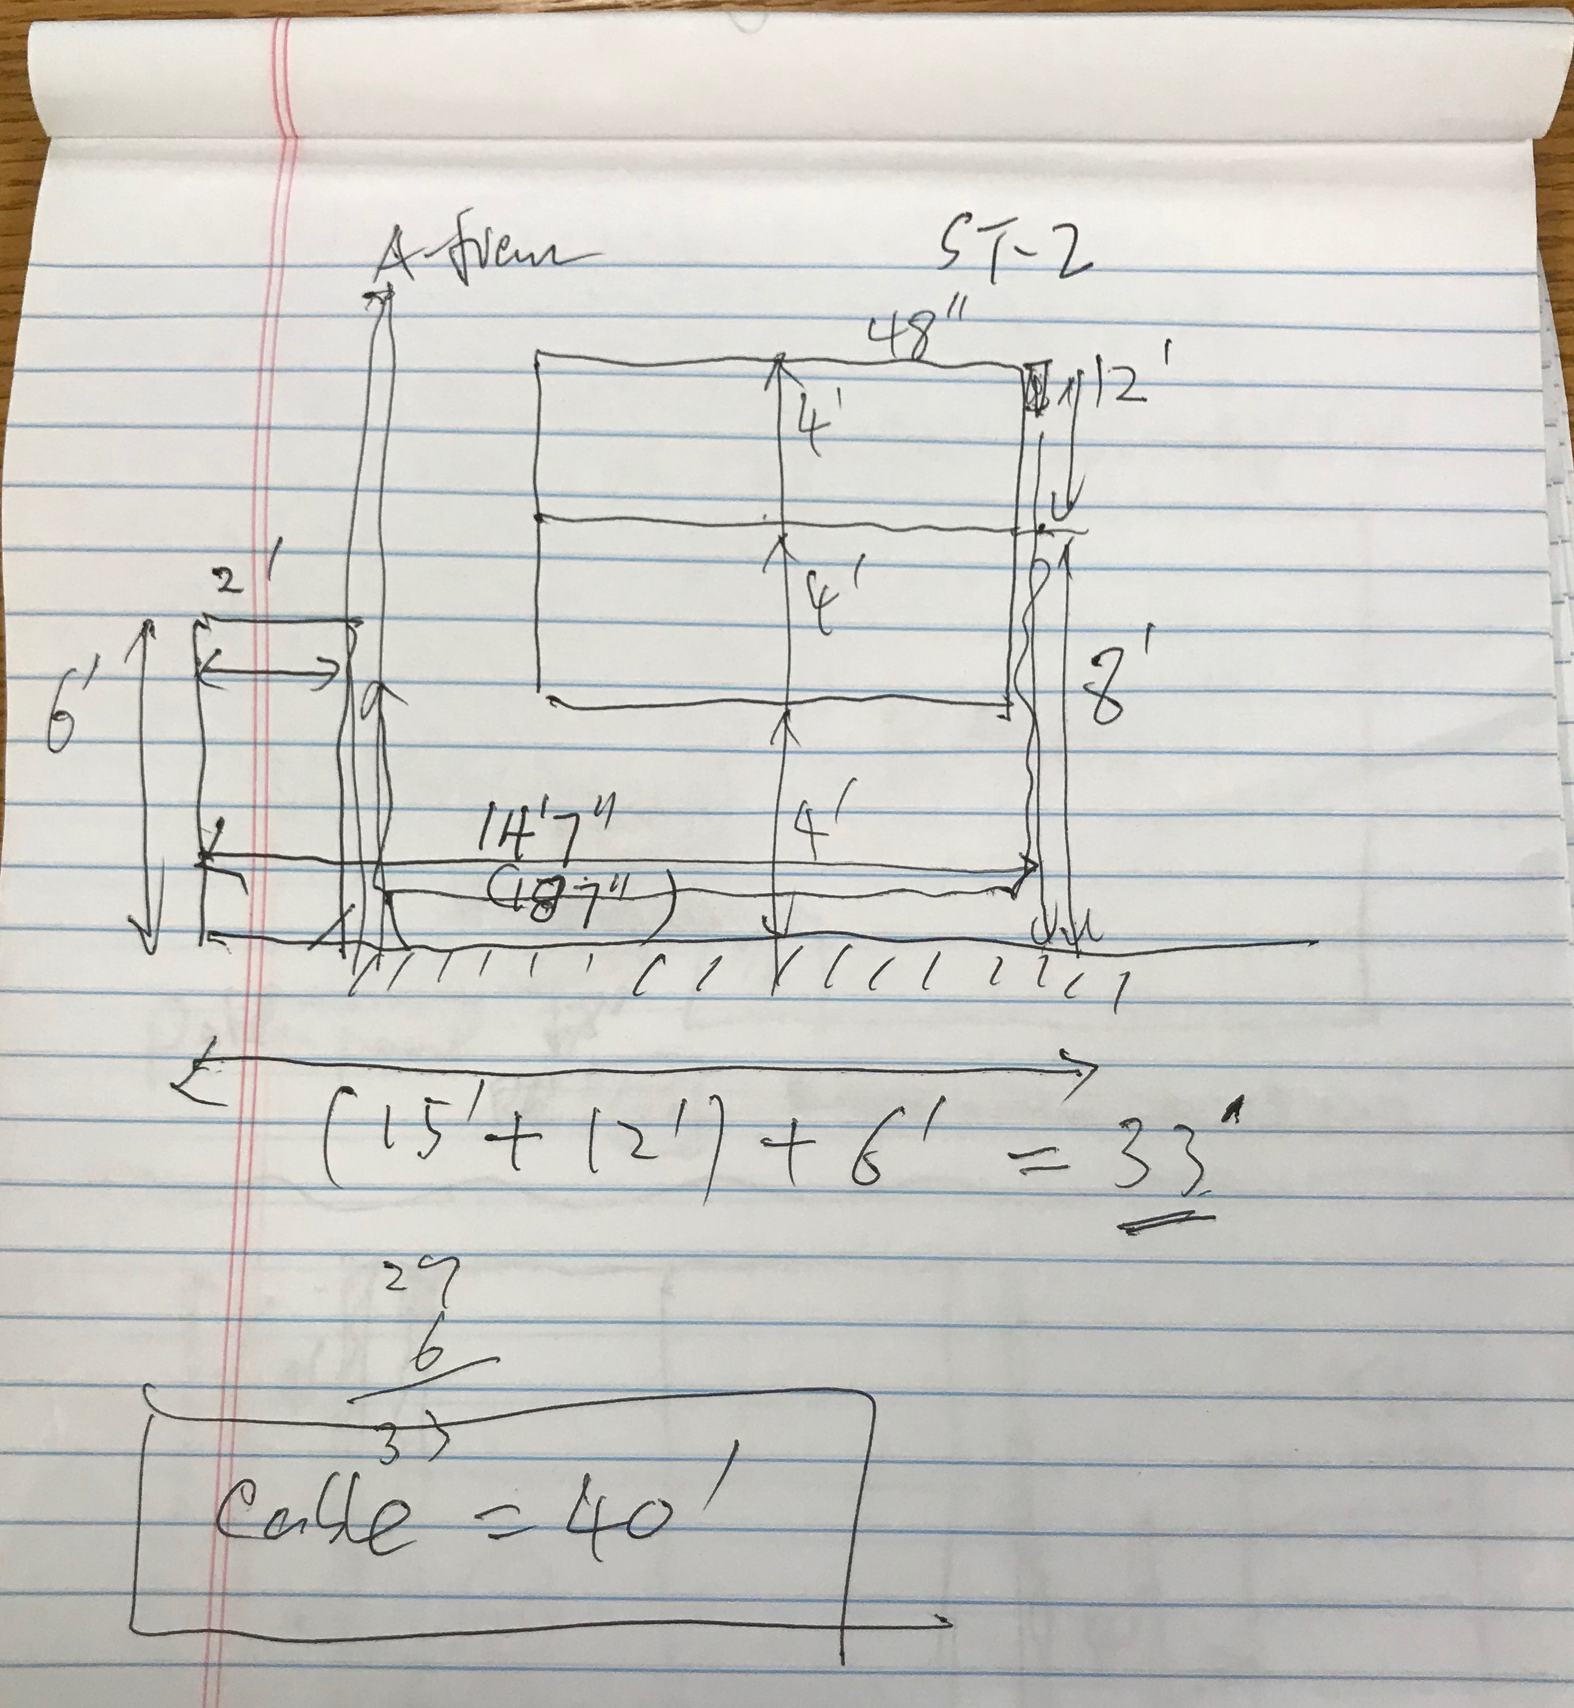
Install Station-2 Cable Tray
Cable length = 12 + 15 + 6 = 33’. (40’ cables)
48”
New DP ST-2 rack
here
New DP cable tray on ground

Slide 9
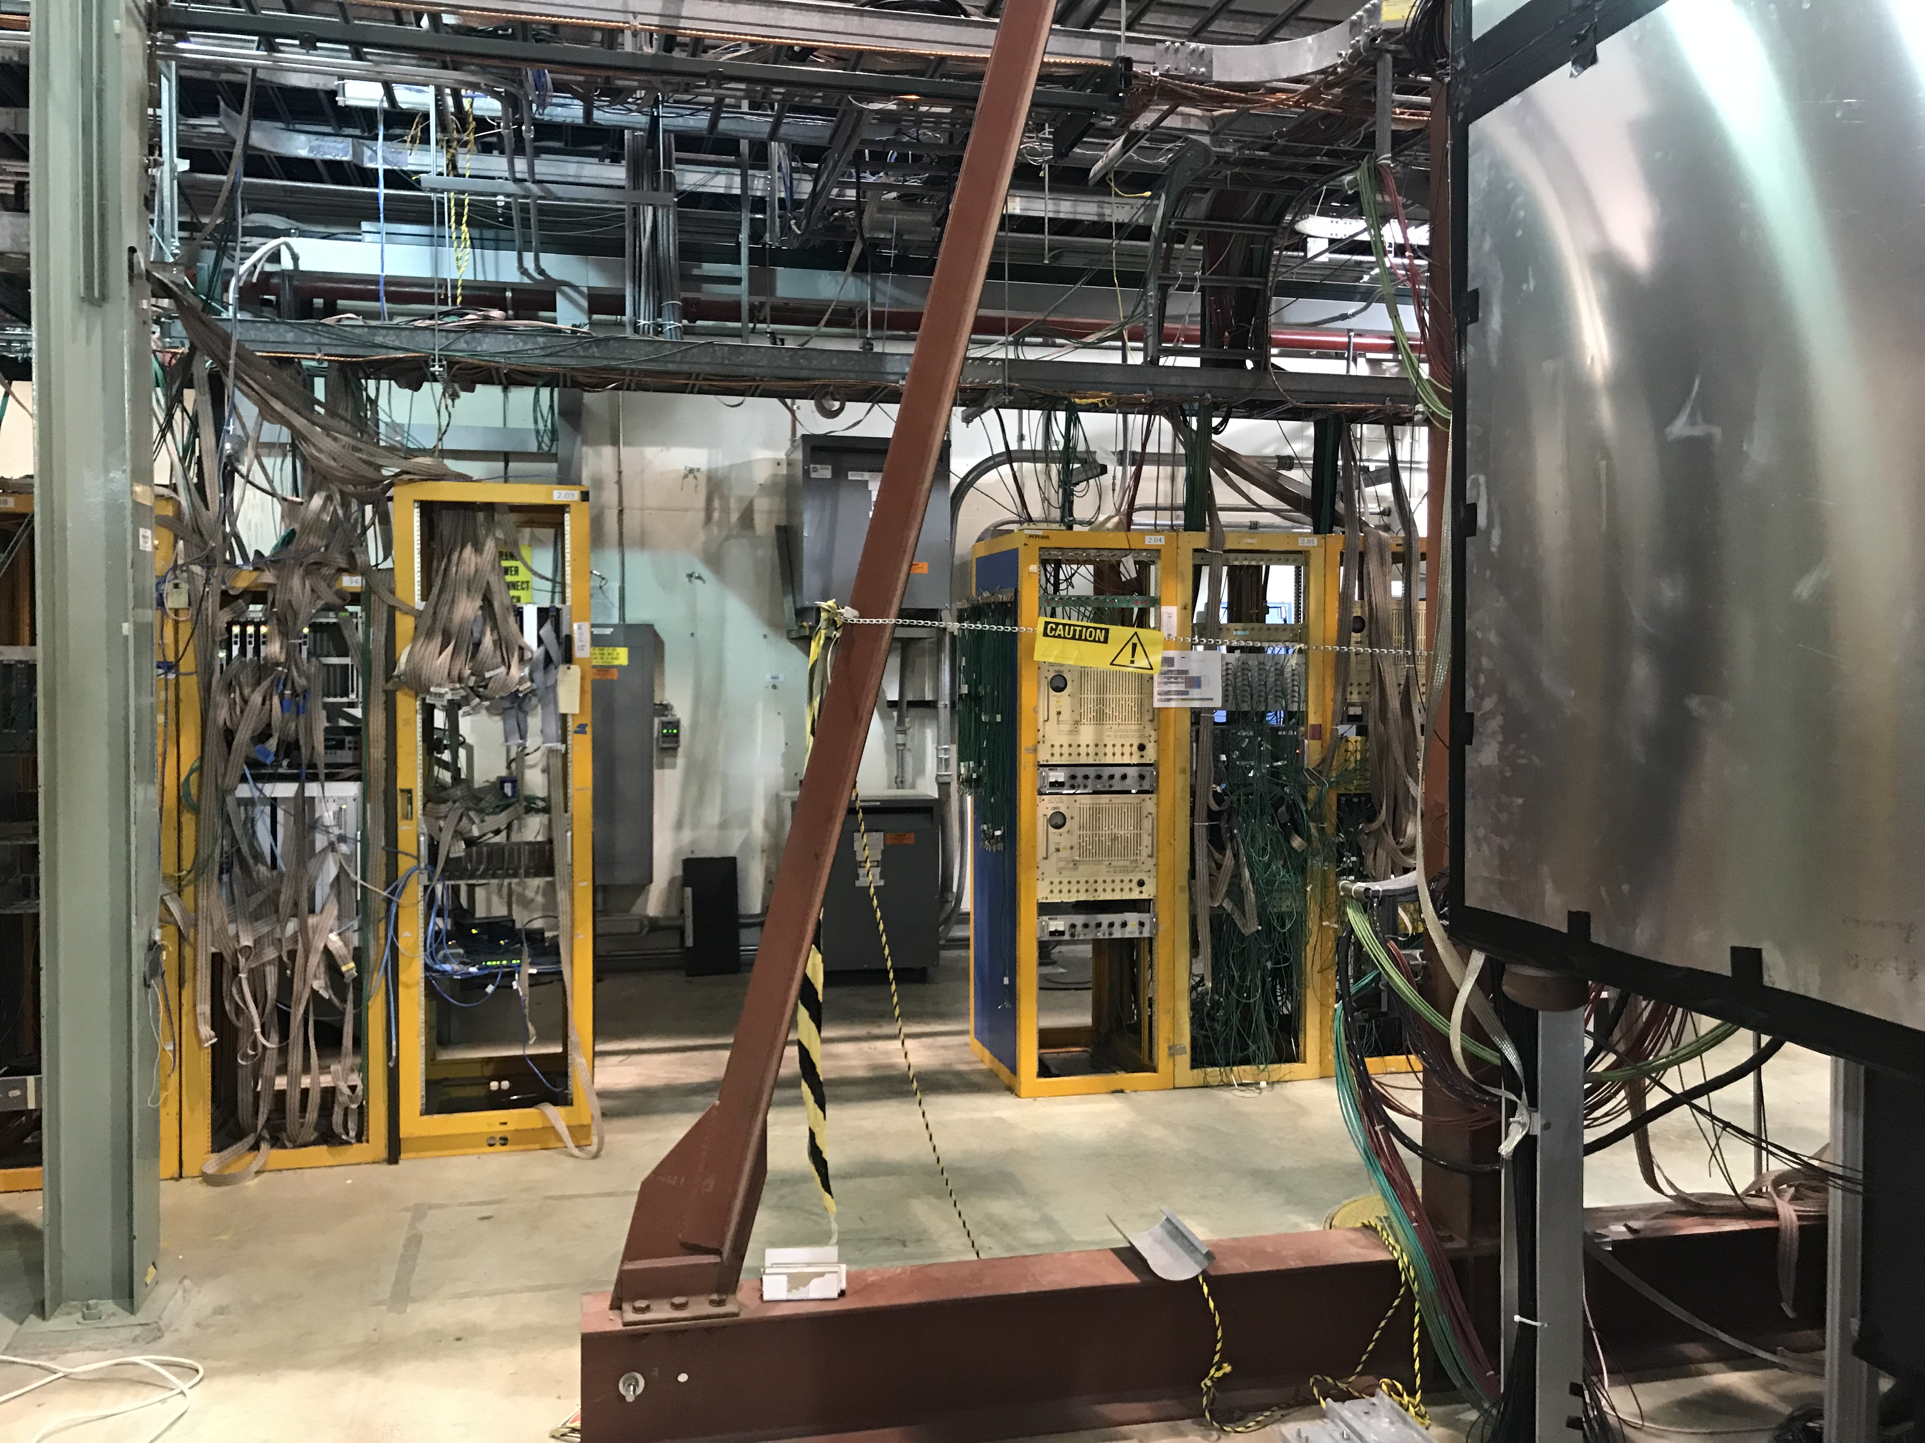
Rack-3/4: DP V1496 L1 Trigger & TDCs
Run 25’ 17-chan ribbon cables :
CAMAC -> TDC;
CAMAC -> V1495;
25’ 17-chan twist-pair ribbon cables
Rack-4
Rack-3
DP
2 VMEs
(12 TDCs)
DP
V1495

Slide 10
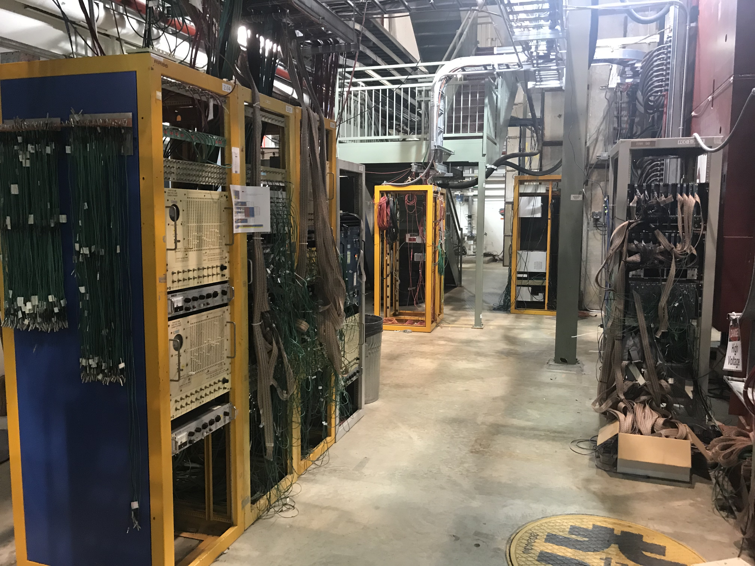
Rack-4: TDC Crates
25’ ribbon cables
Install 2 VME for 12 TDC modules in this rack
VME: CPU +6TDCs + TS
VME: CPU +6TDCs + TS
Run ribbon cables from ST-1/ST-2 CAMAC modules
Rack-1

Slide 11
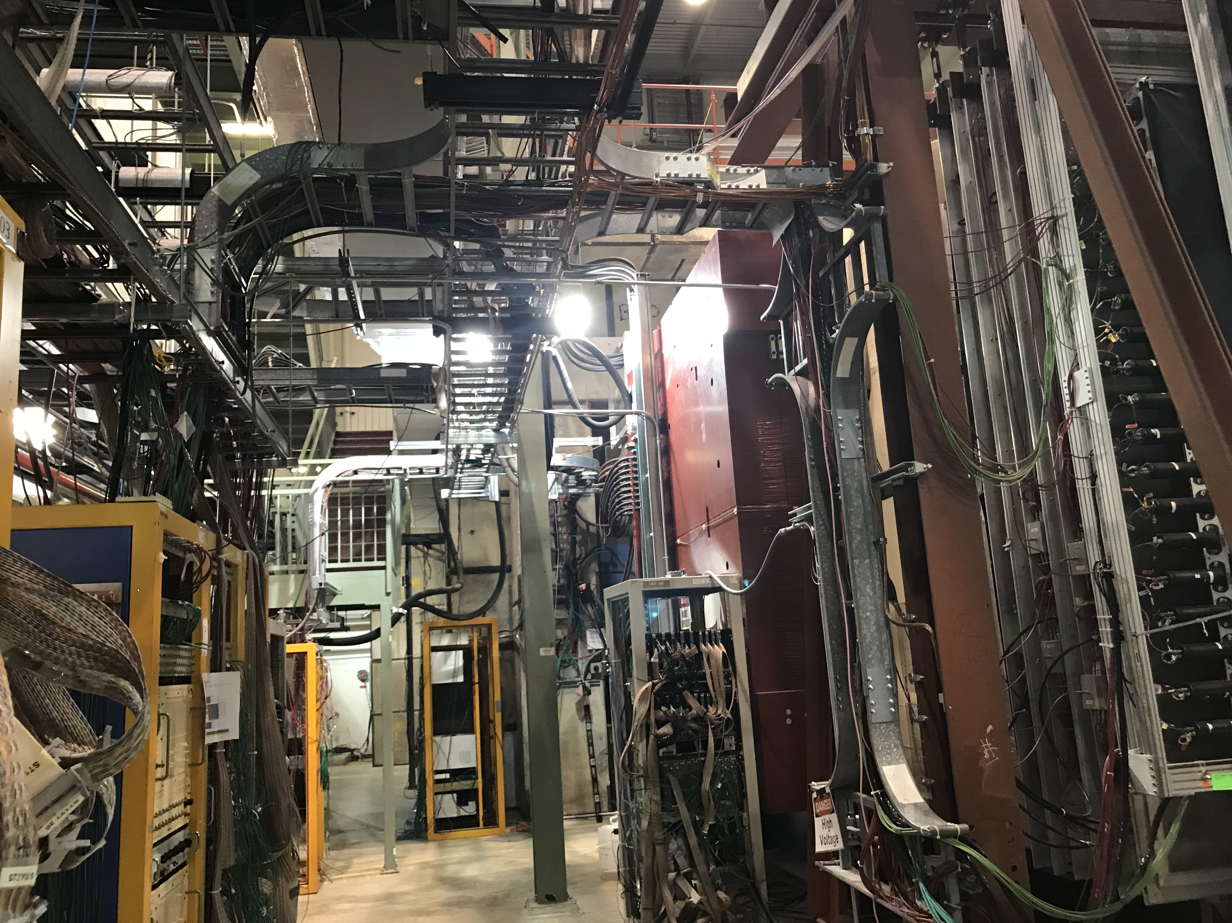
Overhead Cable Tray:
TDC ribbon cables

Slide 12
Prop-tube Plan
4 good modules are available
Shortage of readout cards
Install 4 bubblers
Schedule

Slide 13
DP Work Plan – To Do’s
DP trigger detector work
Re-arrange Readout Crates
All CAMAC on East
Discriminates: 10x2 + 8 x 2
All TDC/VME on East
8+4 TDCs
All VME on East (TDC & V1495)
V1495: 4
Calibration system:
Re-cabling
TDC ribbon cables (25’+)
SMA-Lemo cables (40’)
Check channel mapping
Check grand loop
SMA-Lemo cable extension
160+100=260, 5~10’ cables for St-1(?)
ACU students help installation and mapping
Slow control
Resb. Pi @IR
1 Master + 6 slaves
ssh link from counting house
SpinQuest LAN/Gate2 access
One command
SiPM HV table
Set HV, readback (I, T) for each SiPM
Online monitoring?
(I,V,T) of SiPM
TDC boards: 64 chan/TDC
2(80)+ 1(50) = 3 each quadrant
Total 12 TDCs
2 VME crates (6+6)
V1495: 4
SMA-Lemo cable = 40’

Slide 14
DP Work Schedule
May 26-29
Move CAMAC crates from W->E
Re-cable SMA-Leom, ST1, determine extension length
Re-cable Control cables (R. Pi) for ST-1
Plan cable tray for ST-1, ST-2
Lemo extension cables
10~20’/TBD, 320 ? From Fermilab?
ACU student?
New cables? $$?
July 8 – 19
Collab. Meeting 7/15-16(Mon-Tue)
Install and map cables
Operation and calibration
Aug 1-15
Cosmic run?
Provide trigger to readout other detectors
DC 2/3..
Prop-tube
Software work
Integrate into global tracking
Include DP hits in the tracking code (masking)
Slow control display
SiPM (V, I, T) for all DC, PorpTubes
Physics & detector simulation
DY & J/Psi target
DY & J/Psi beam dump
Lookup tables

Slide 15
Prop Tube Plan & Schedule, and more
Replaced 2 modules
July 8-19
Coll. Meeting @FNAL 7/15-16
Jeff B. or Hubert
Xuan, Matt, Ming et al
Commissioning with cosmic trigger (DP + Hodos)
August 1-15?
DP+Hodc trigger
Readout Prop-Tube + DC2/33
E1039 detector commissioning
9/1-15?
Full spectrometer,
all chambers
Slow control system
Beam @SpinQuest
Mid October 2019

Slide 17
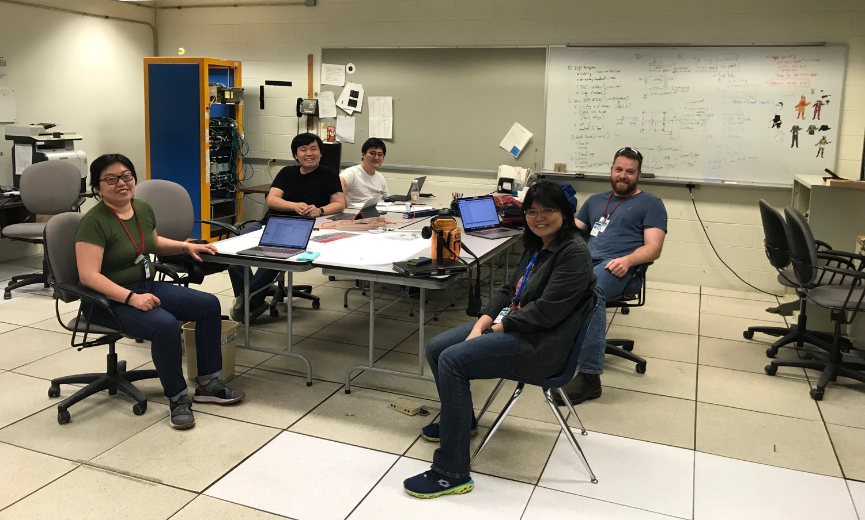
DP Trigger & PropTube Work Plan

Slide 18
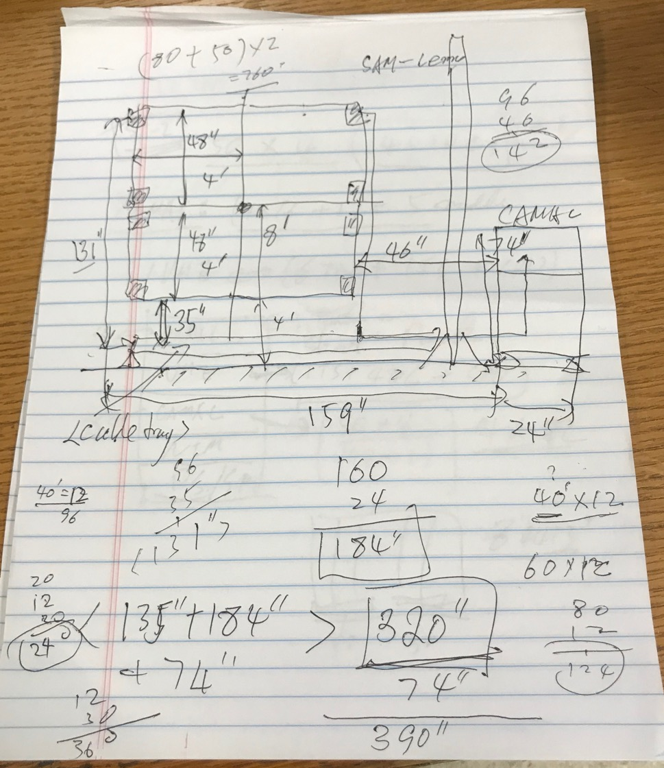
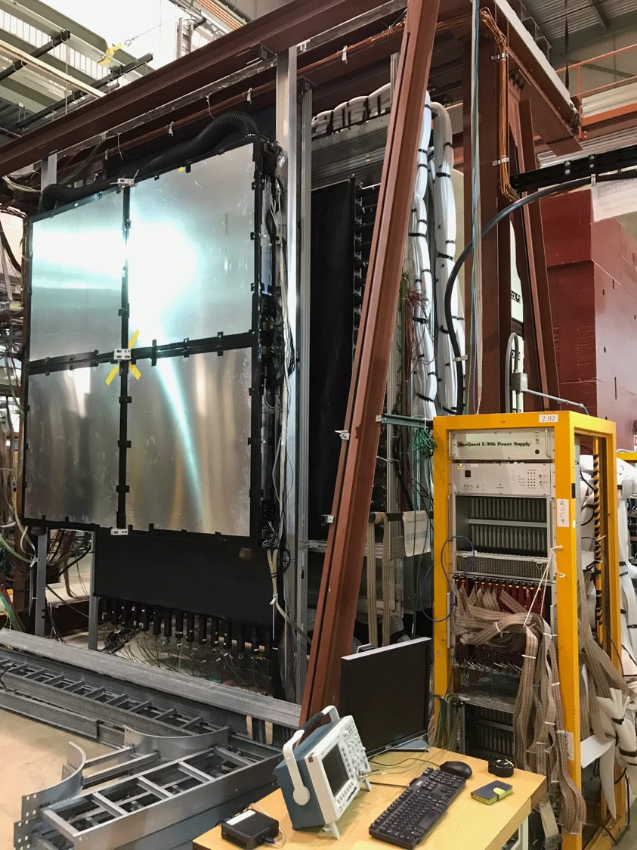
SMA-Lemo cable:
2x(48 + 48) + (46 + 12) + “12” = 262”
= 21.8’
For ST-1:
Additional a few ft to ST-1 rack
DP ST-2 rack?
Move
DC-2 rack upstream
DP cable tray above ground

Slide 19
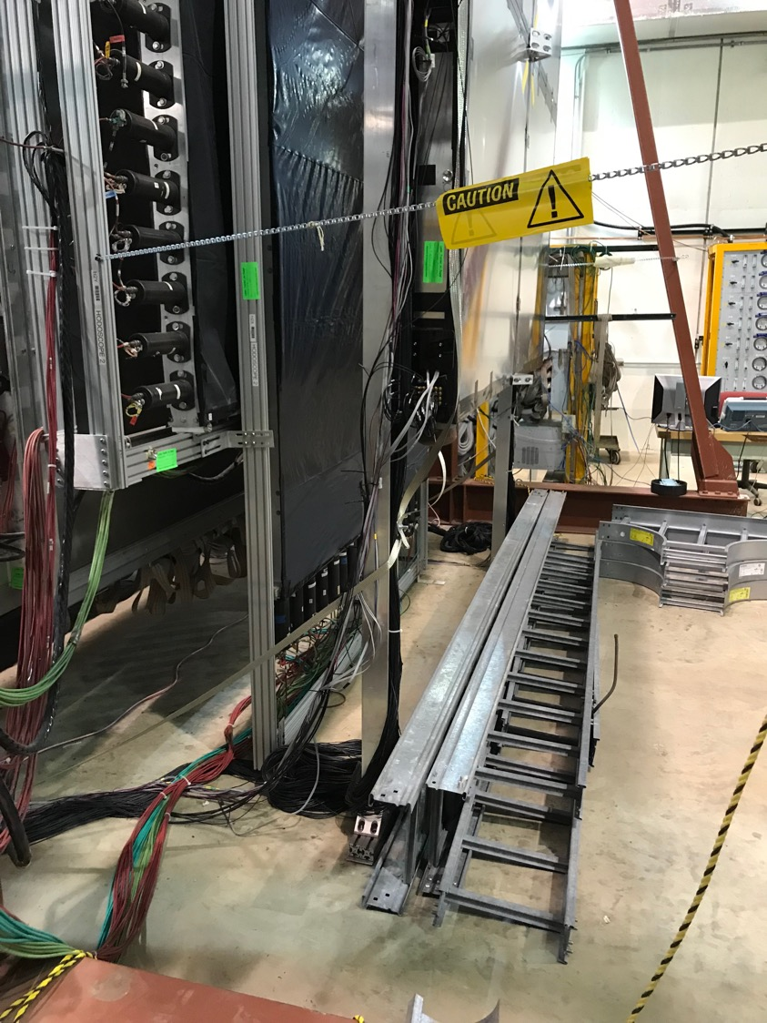
DP/V1495 move to
East L2 trigger rack
Bring ST-1 CAMAC
& TDC to here
Keep SiPM PS
New DP cable tray above ground

Slide 20
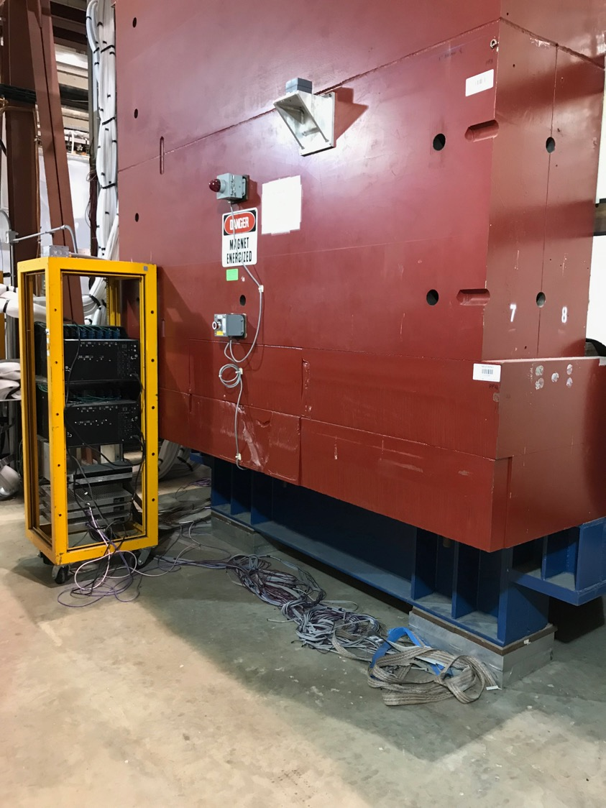
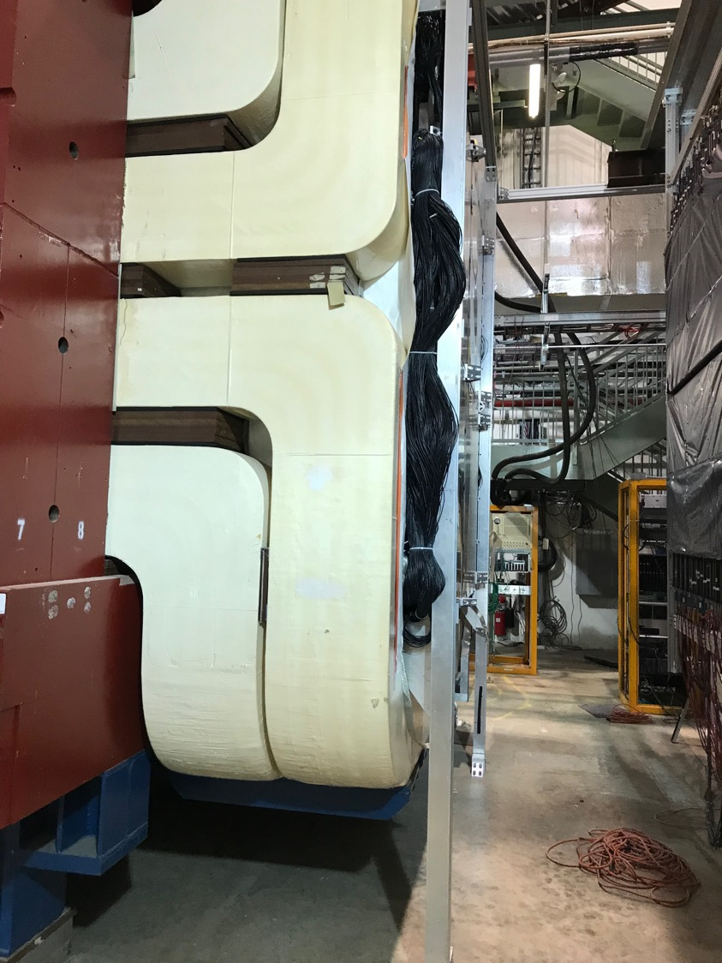
CAMAC, SiPM PS
move to East

Slide 21
DP Trigger New Layout-2
West
East
beam
DP Trigger
-VME:
4xV1495 L1 trigger
Calibration
-NIM/BlueLogic
Trigger
DP-1
RACK-1
Location?
ST0-1: 4x 80 ch
-CAMAC (10 x LeCroy 4413)
-VME/TDC(CPU+TS+4TDC)
-VME/TDC(CPU+TS+4TDC)
-CAMAC (10 x LeCroy 4413)
-NIM/BlueLogic trigger
-SiPM PS
KMAG
RACK-3
DC-2
DC-2
RACK-2
ST-2: 4x 50ch
-CAMAC (8 x LeCroy 4413)
-VME/TDC (CPU+TS+4TDC)
-CAMAC (8 x LeCroy 4413)
-NIM
-SiPM PS
(4 Qs)
DP-2
L2/V1495
DP trig(OR)
DY trig(AND FPGA trig’s)

