Slide 1
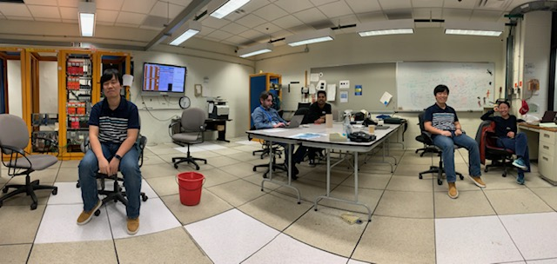
E1039 DP & PropTube Work Plan 1/13-17, 2020
DP detector commissioning
ORC recommendations
Detector check out and operation
DAQ integration of Taiwan TDCs
Timing-in DP detectors
Prop tube commissioning
Fix 3 bad modules
Improving readout with new preamp cards
9 working spare preamp cards available now
Threshold scan & optimization
Cristina, Ming, Kun et al
Helen, Ming et al
Misha, Sho, Zongwei, Kenichi
Mindy, Forhad, Rick et al

Slide 2
End of the Week Summary – a Great Success 1/17/2020
Proptube detectors
all 3 bad modules recovered, as good as before
P1X, M9 and M3
P1Y, M8
Threshold scan for optimization
Check noise rate vs threshold - In progress
Dark photon detectors
All detectors are working
3 low light yield channels
Integrated Taiwan TDCs into main DAQ
initial TDC spectrum show DP detectors are timed in.
Work by:
Helen and Ming, with help from
Mindy, Forhad, Rick, Kun et al
Crisitina, Sho, Zongwei, Kenichi, Kun, Ming et al

Slide 3
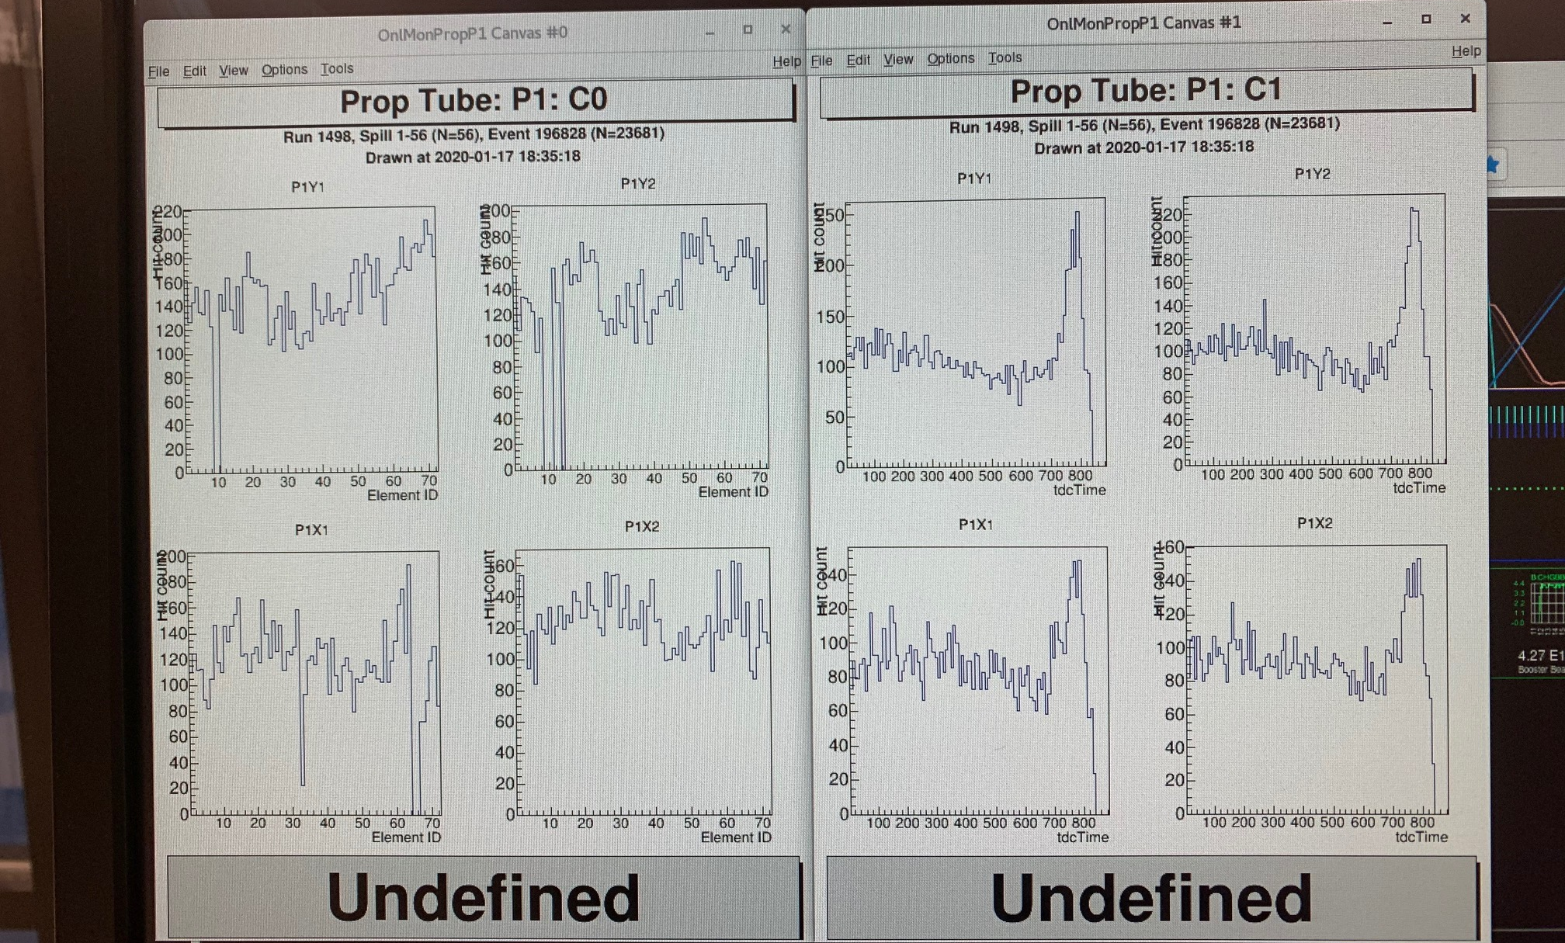
Accomplished – Fixed all bad prop tube moudles
Checked hits and TDC timing distributions
Ready for beam commissioning!

Slide 4
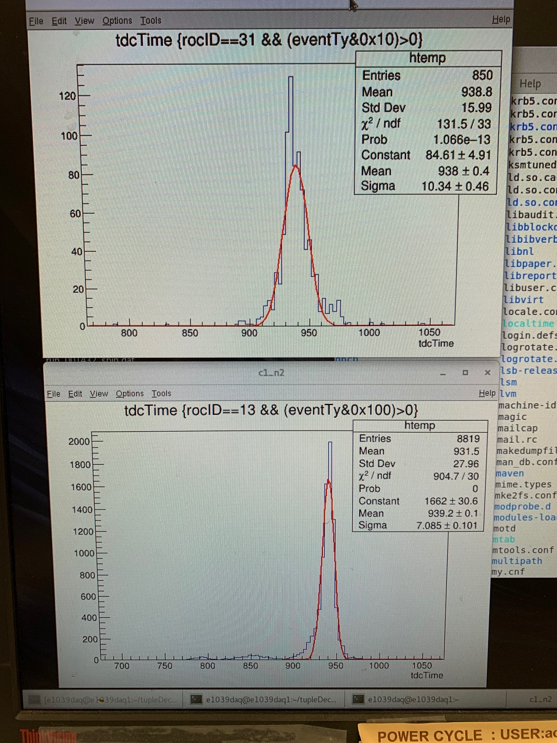
Accomplished - DP commissioning
DP St-1 TDC
Completed ORC recommendations
Turned on the whole detector
Checked all channels with calib LED
Fixed all lose/disconnected cables
Setup the LDE pulsar system
Integrated Taiwan TDC into the main DAQ
Took data with cosmic, with E1039 Hodo Triggers, with the rest of the E1039 detectors
Ready for beam commissioning!
DP St-2 TDC

Slide 5
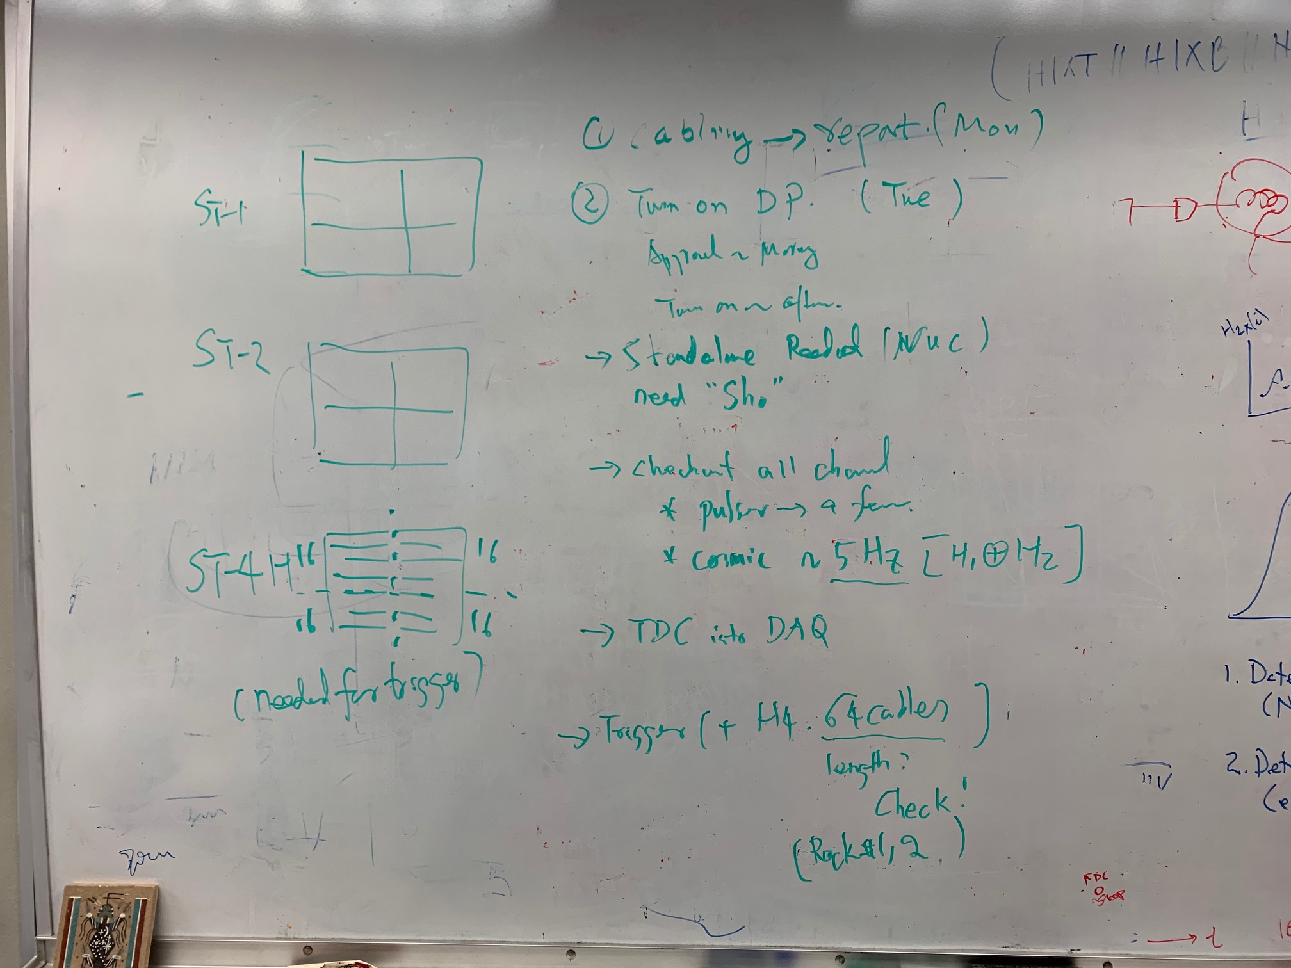
Day-1: DP Commissioning Work Plan – 1/13/2020
Address recommendations from ORC
Rearrange power cables etc.
Done today, see photos
To turn on DP detectors
Standalone readout with NUC
Use calibration system to check all channels
Use V1495 to do “TDC” in standalone mode
Integrate TDC readout into DAQ
By the end of this week
Trigger integration next week
Work with Michigan Trigger group
Cristina + Michigan
Cristia, Sho, Zongwei, Misha, Kun, Ming

Slide 6
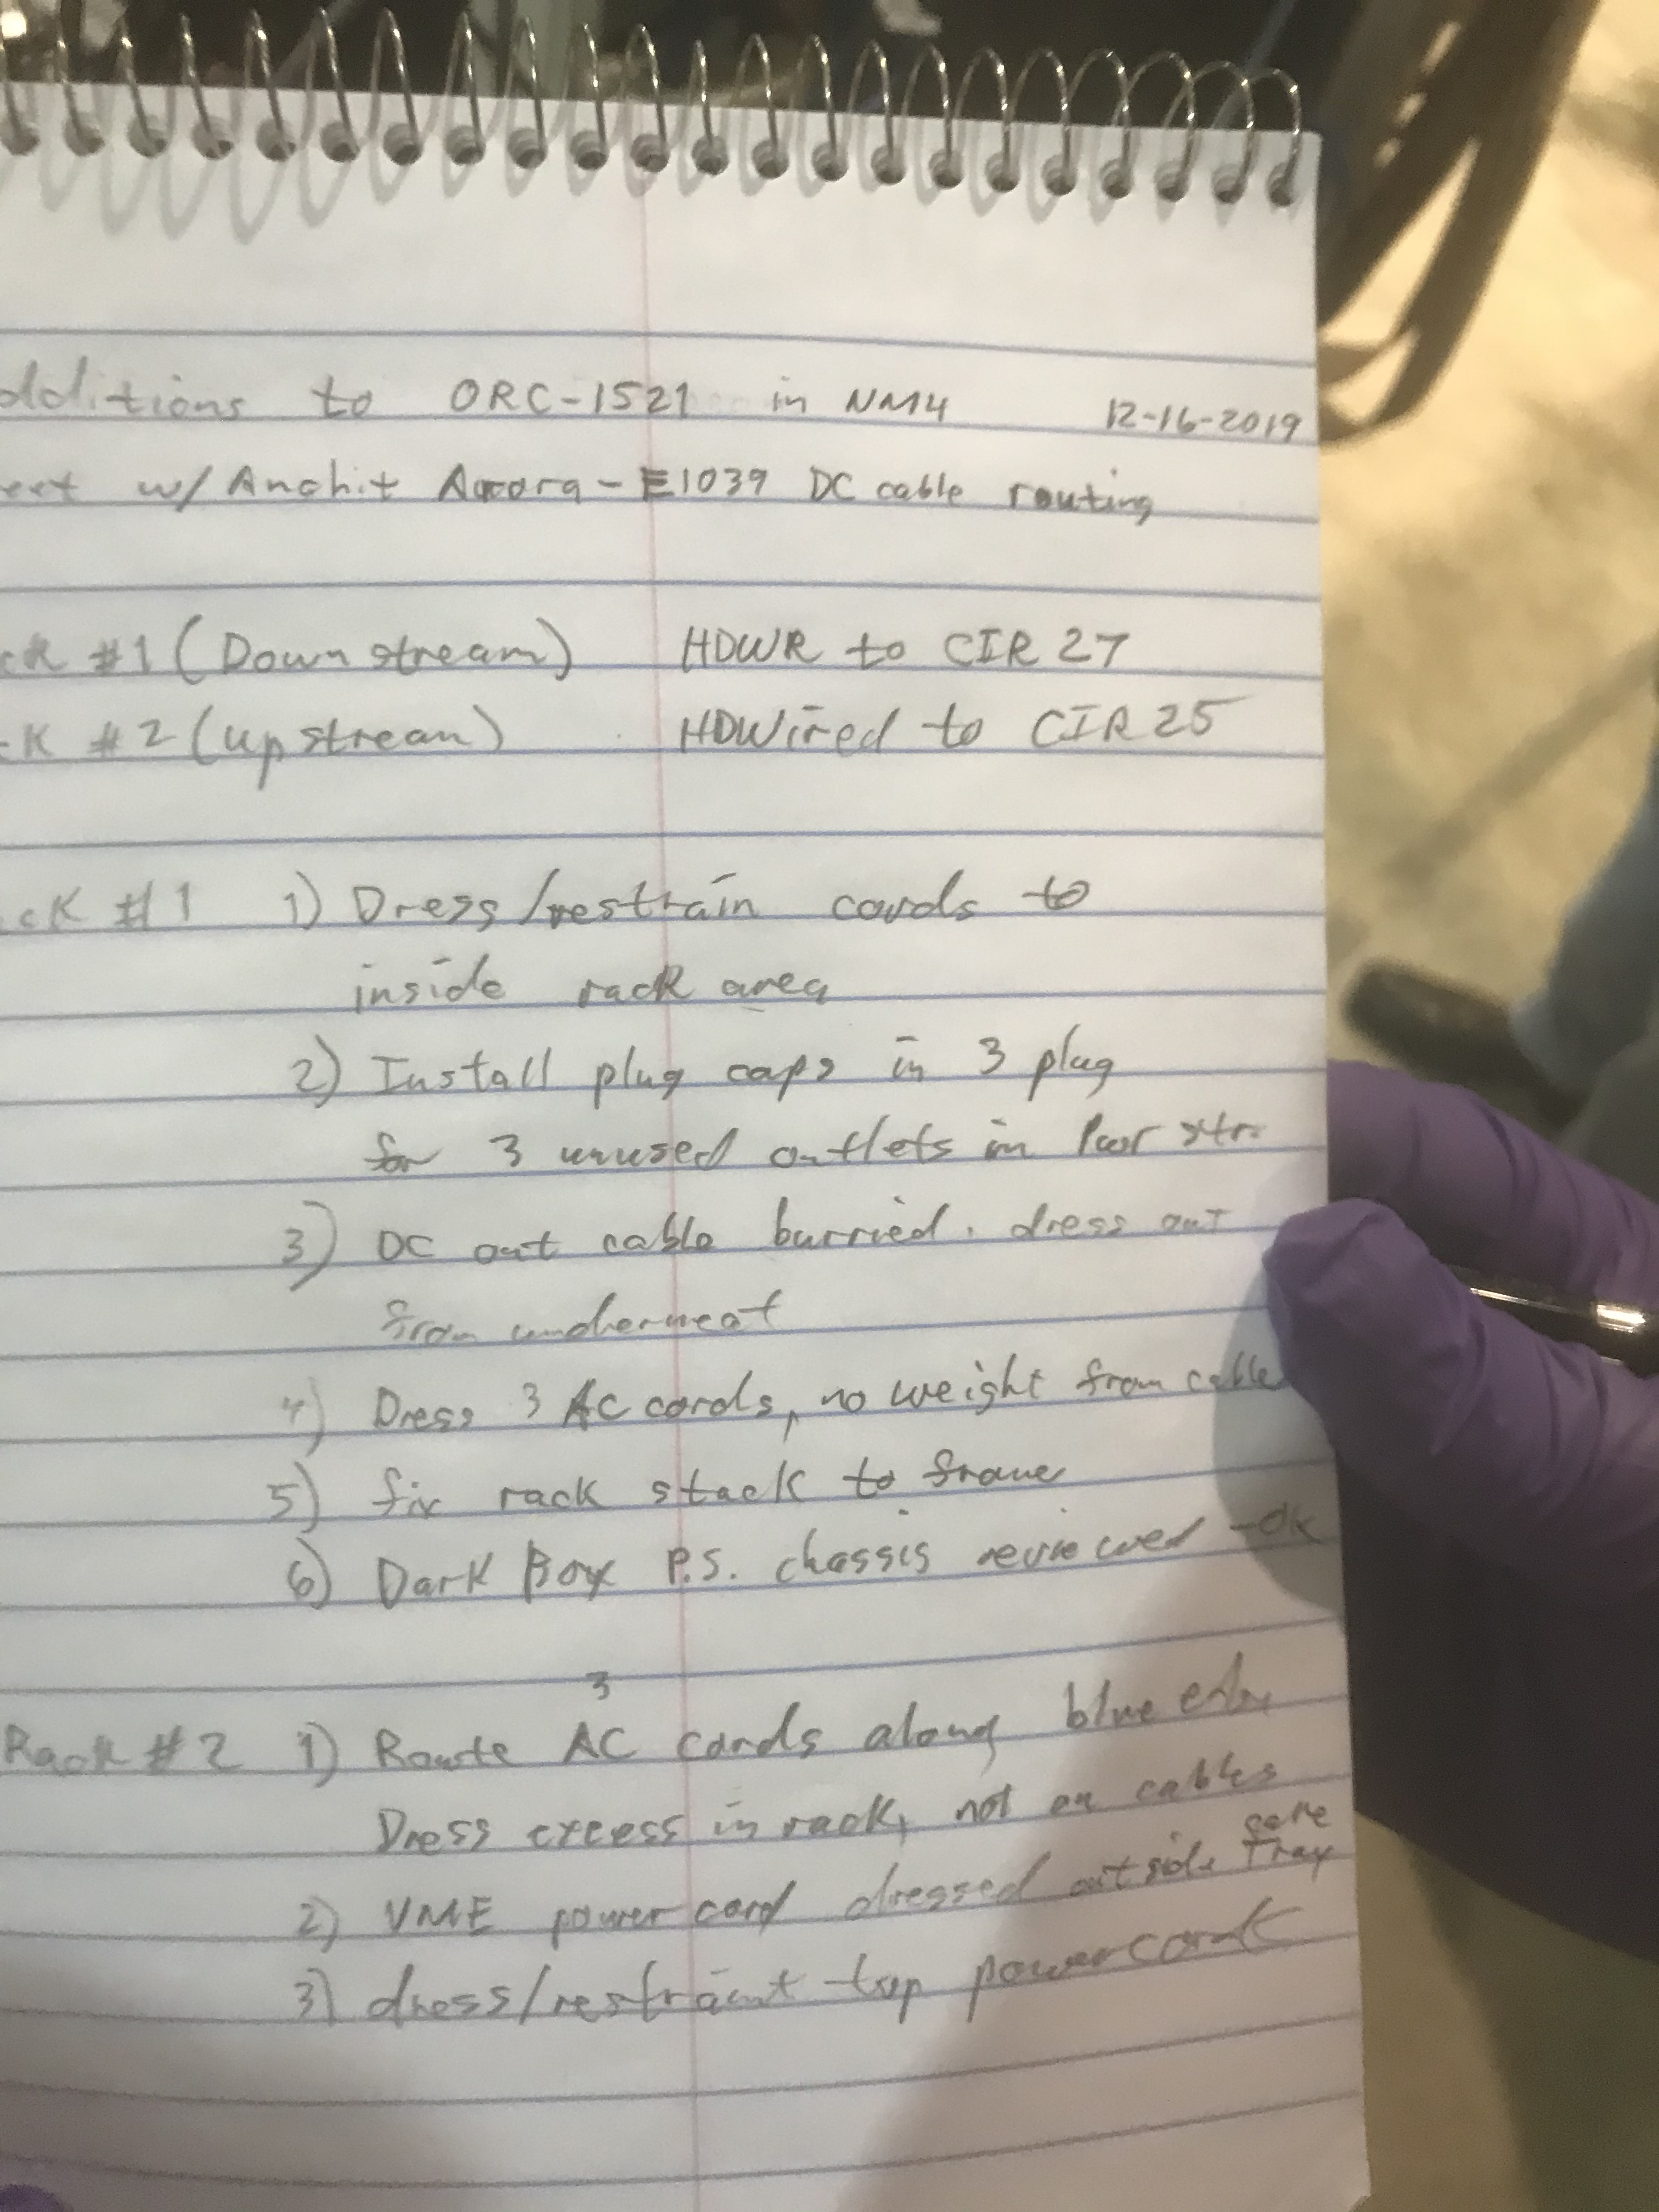
DP ORC Recommendations

Slide 7
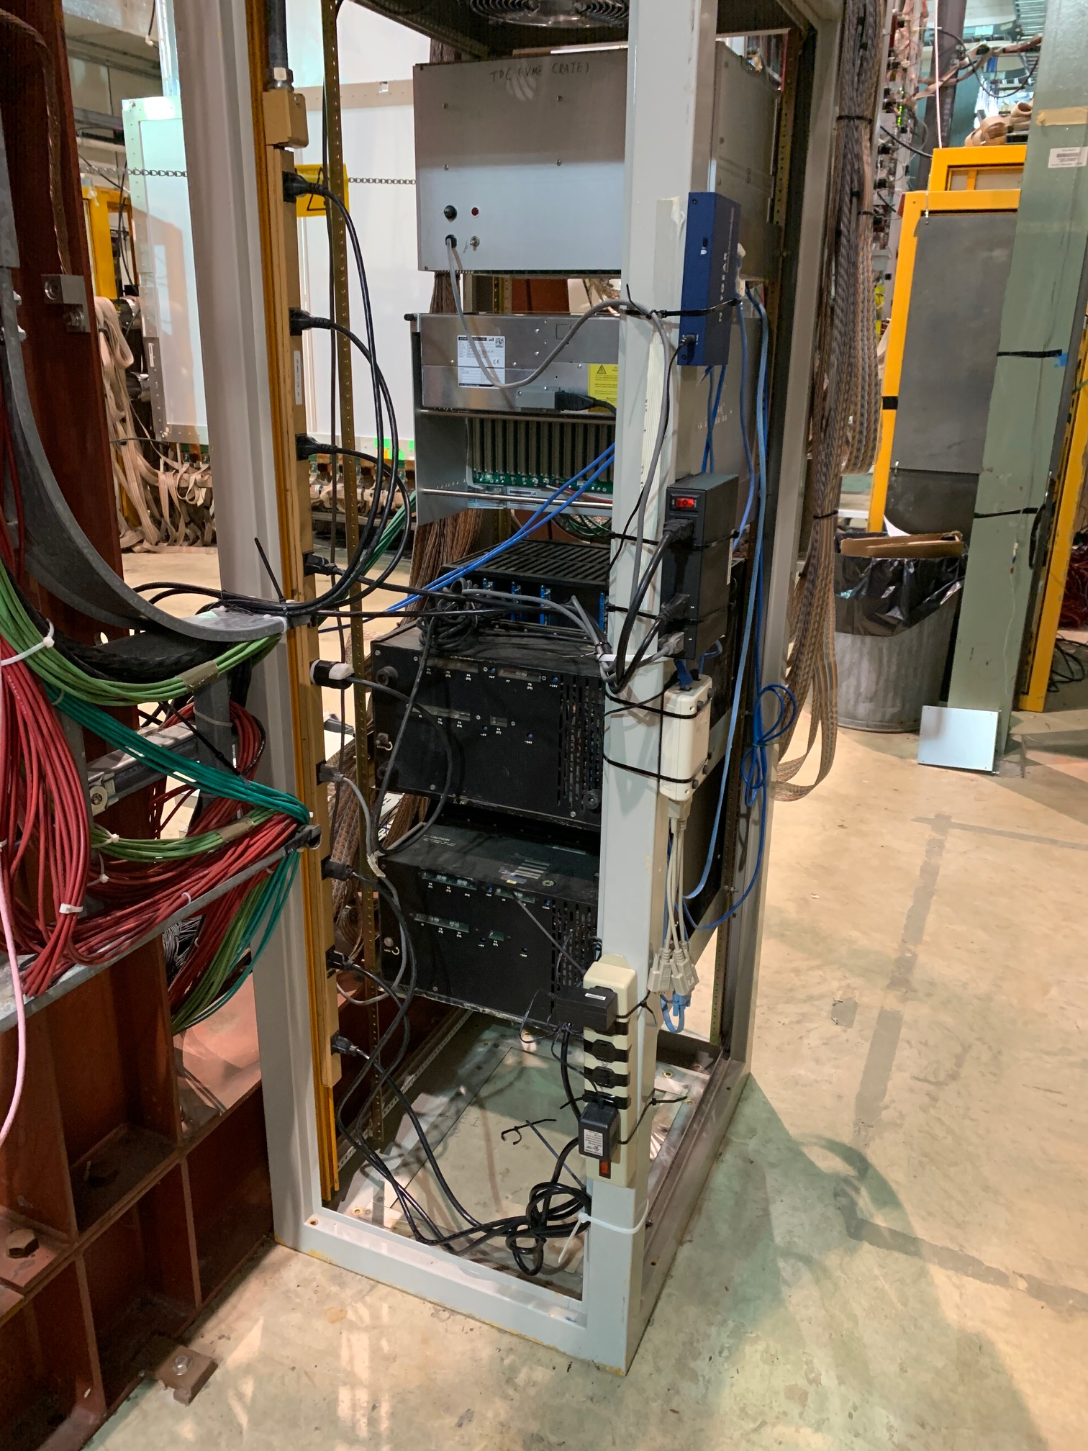
ST-2 Rack: #1, #2, #4 and #5 - Put ST-2 Rack Power Cables inside the Rack, all cable tied to the rack frame - Covered 3 unused outlets with electrical tape

Slide 8
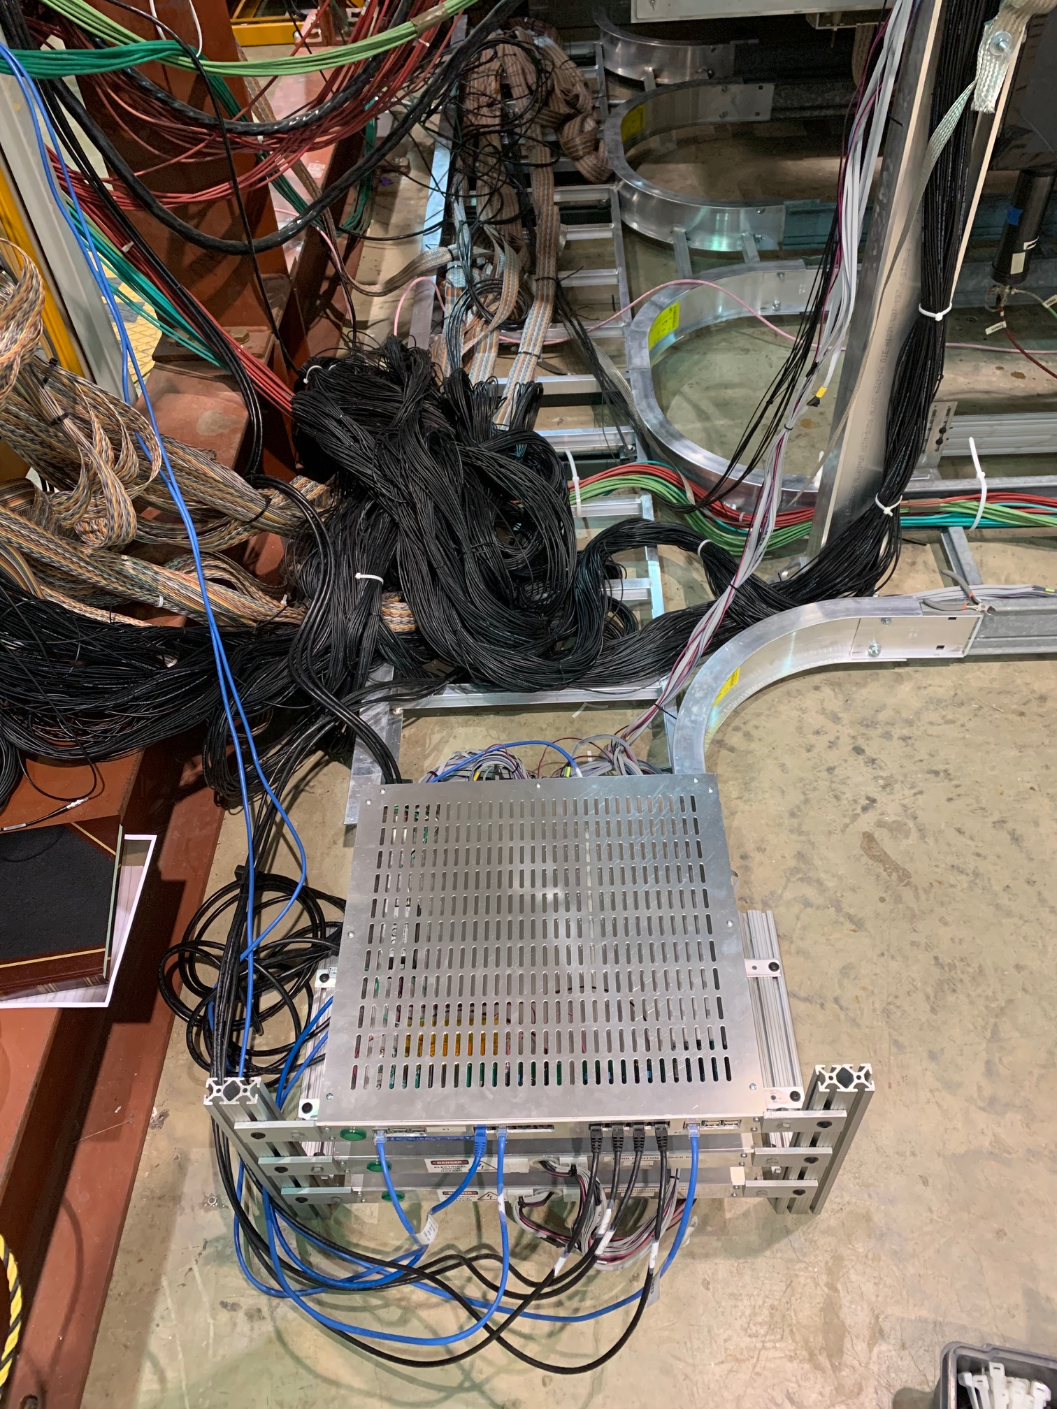
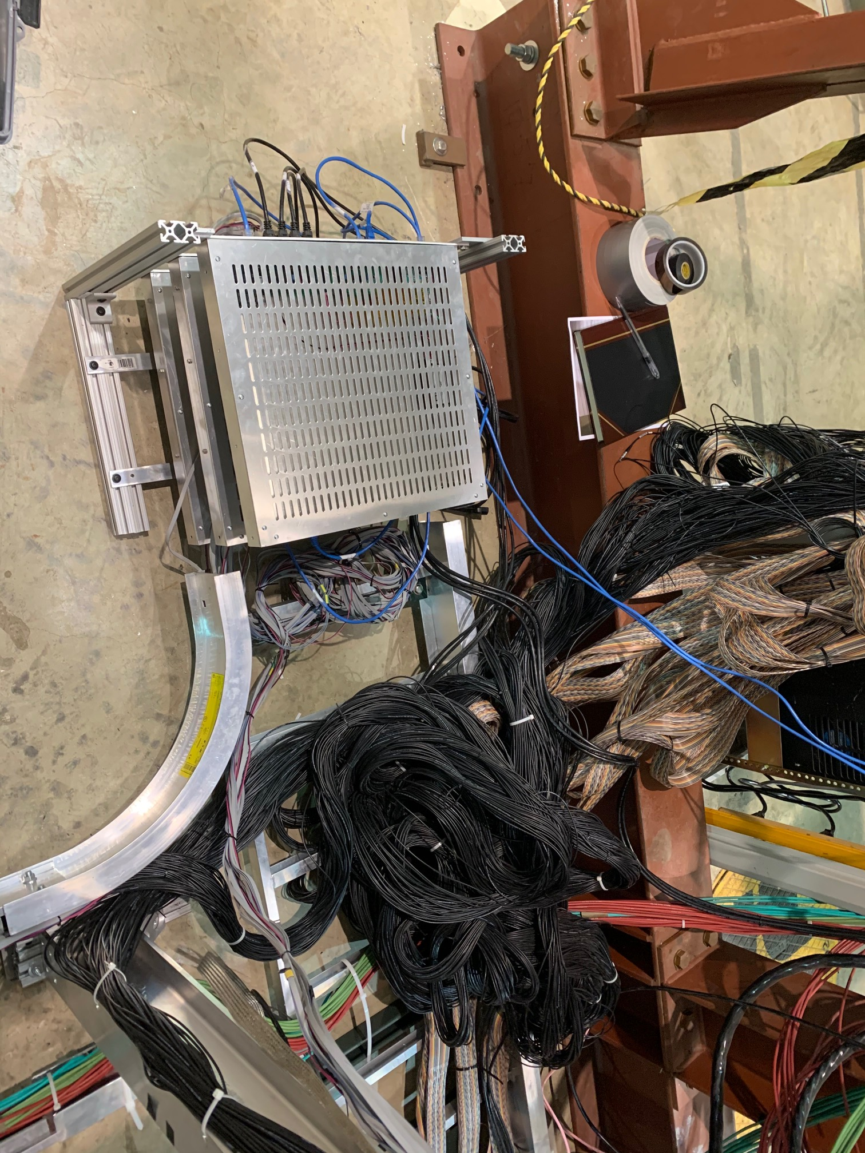
#3 and #6 Moved DC power cables separated out from other signal cables

Slide 9
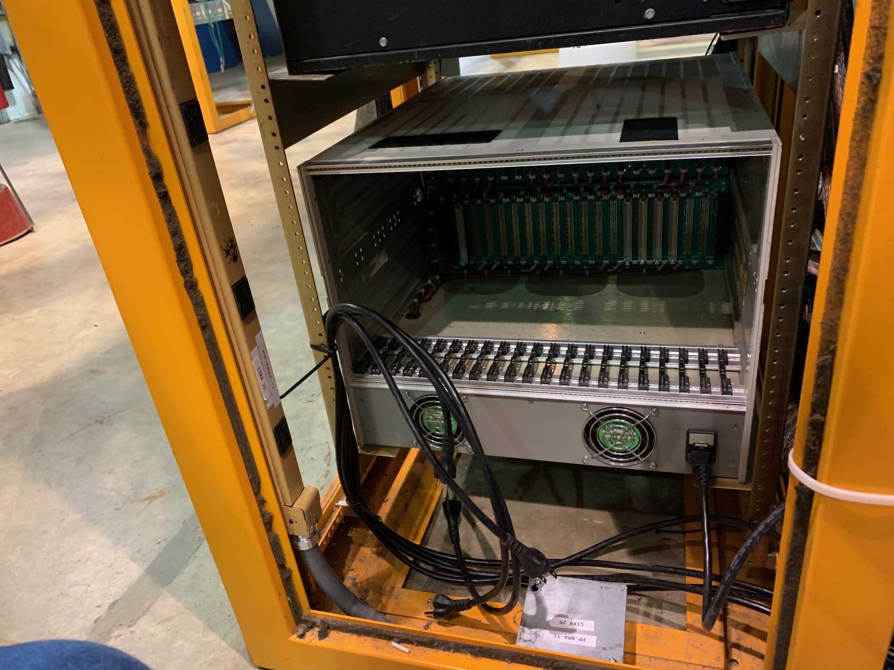
St-1 Rack: #1 - AC power cords tied to the rack frame

Slide 10
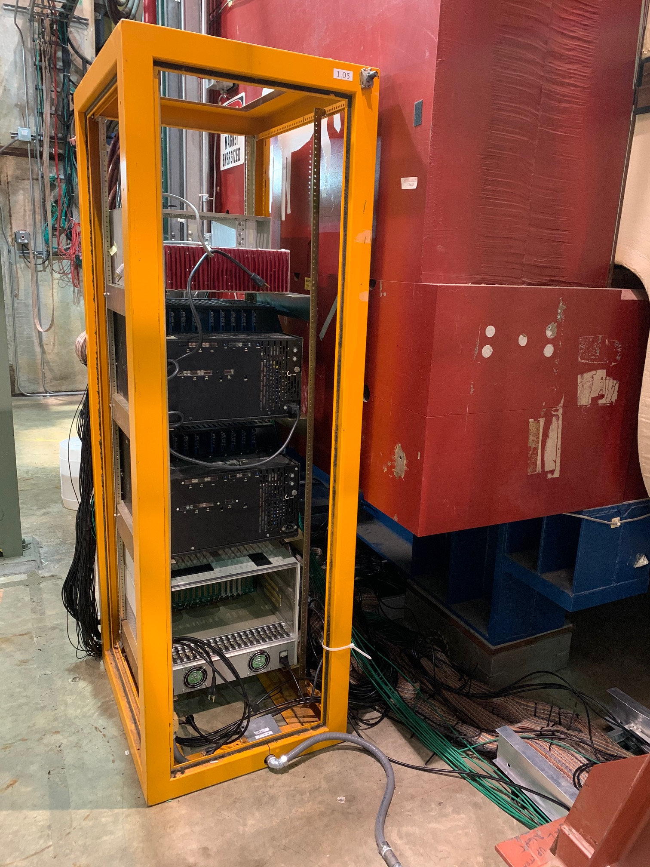
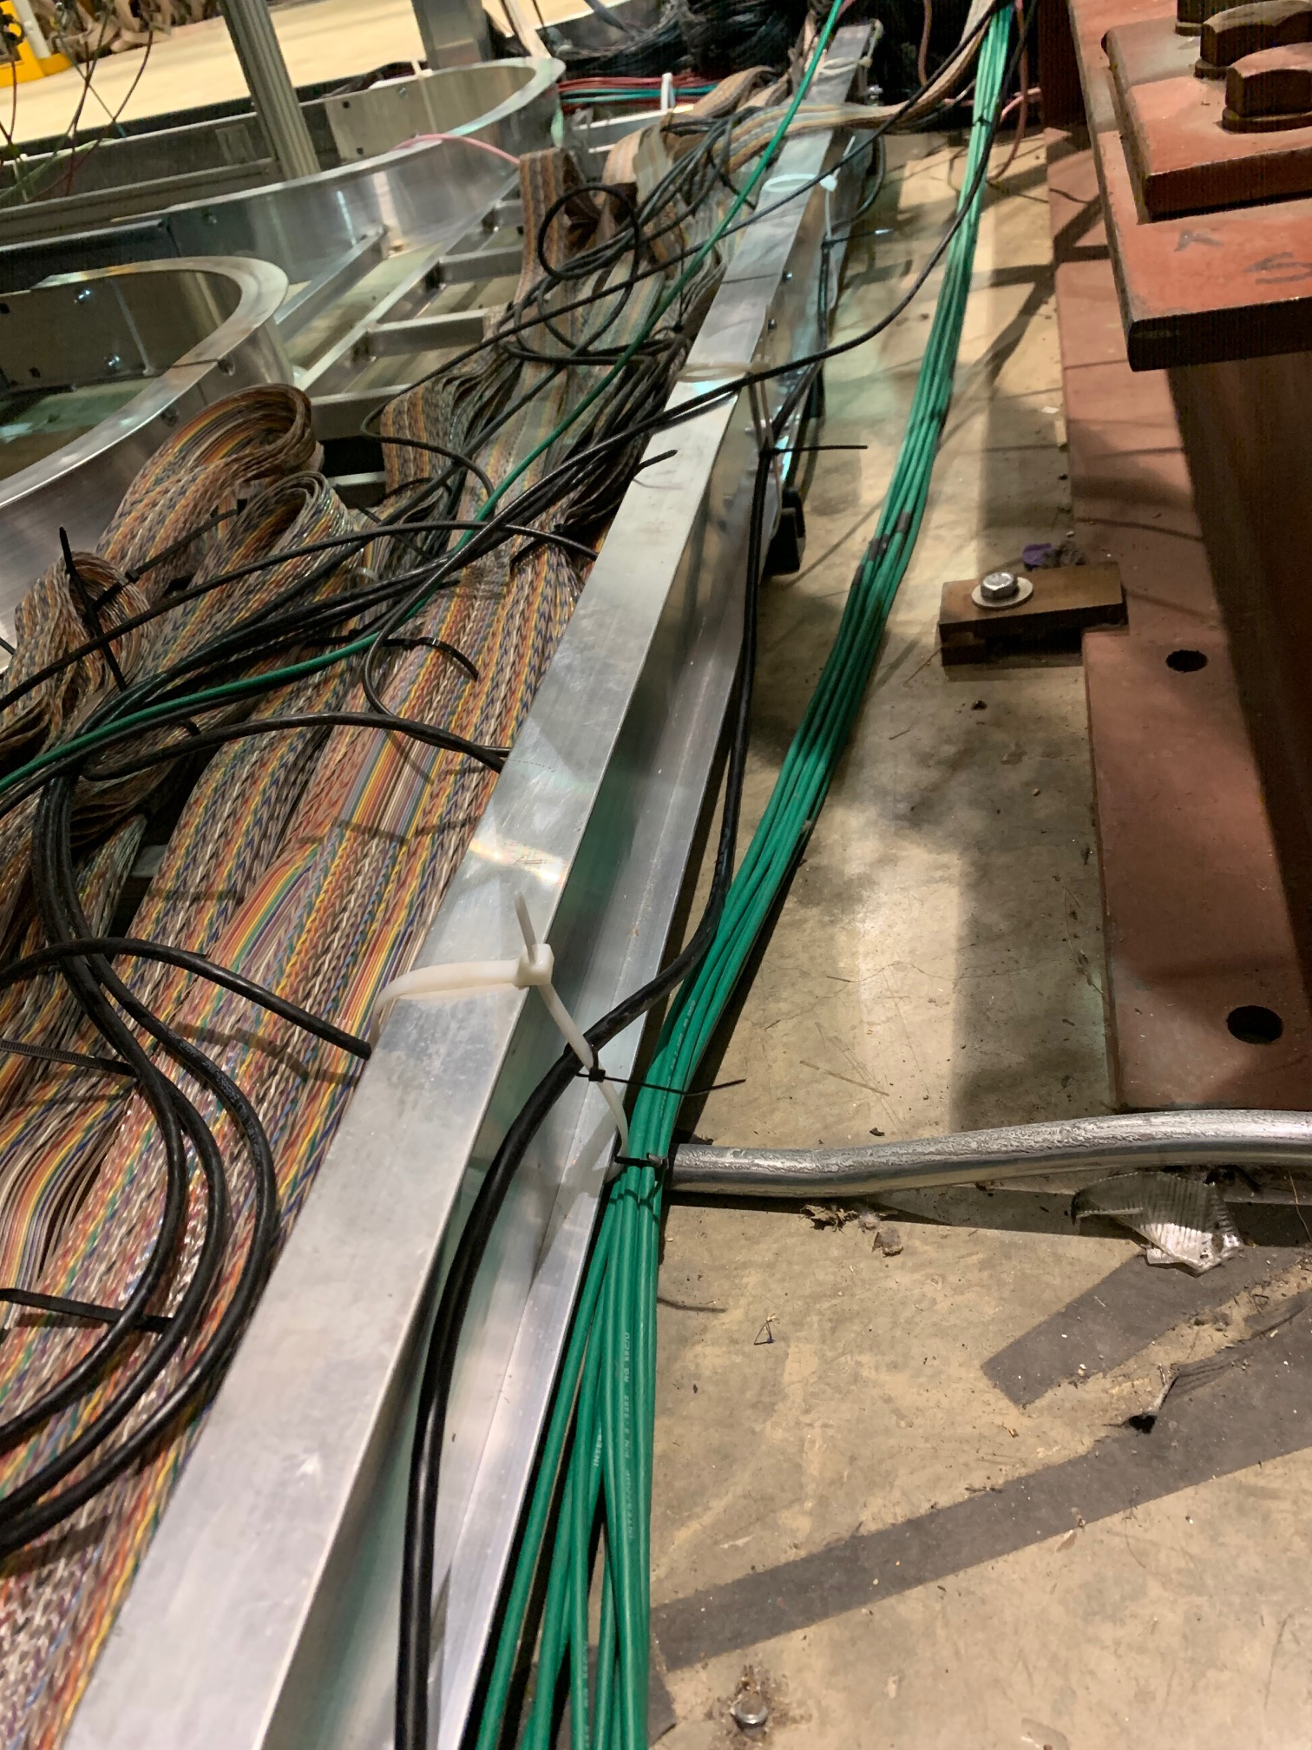
#2 VME power cables tied to the Rack frame and Al-frame

Slide 11
#3 Top power cord tied to the rack frame - Could take a better picture to show the tie

Slide 12
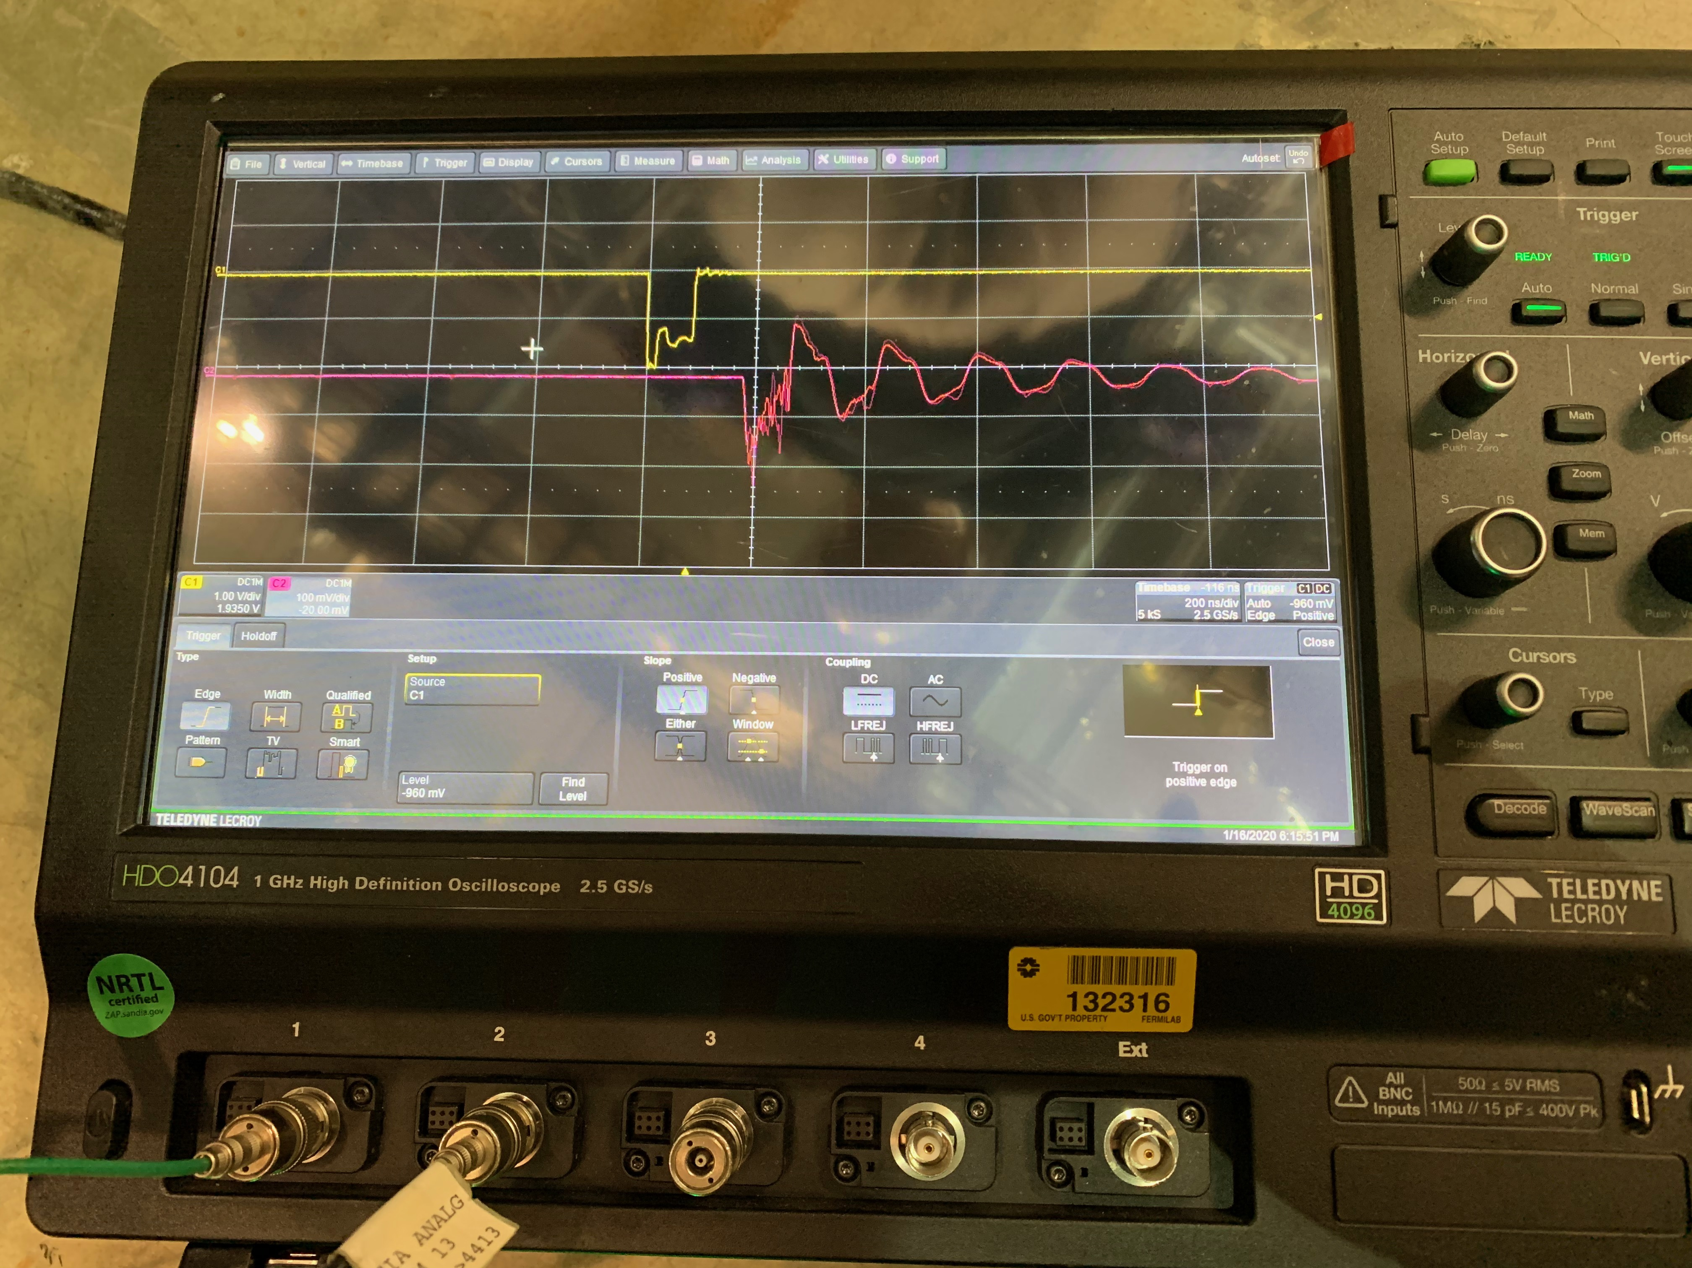
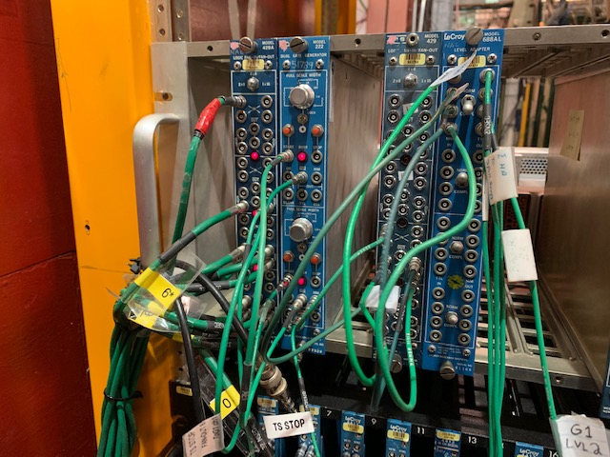
DP detector response to the external pulsar
NIM (trigger) -> TTL (~10kHz, 100nS wide) -> lights ->SiPM signal

Slide 13
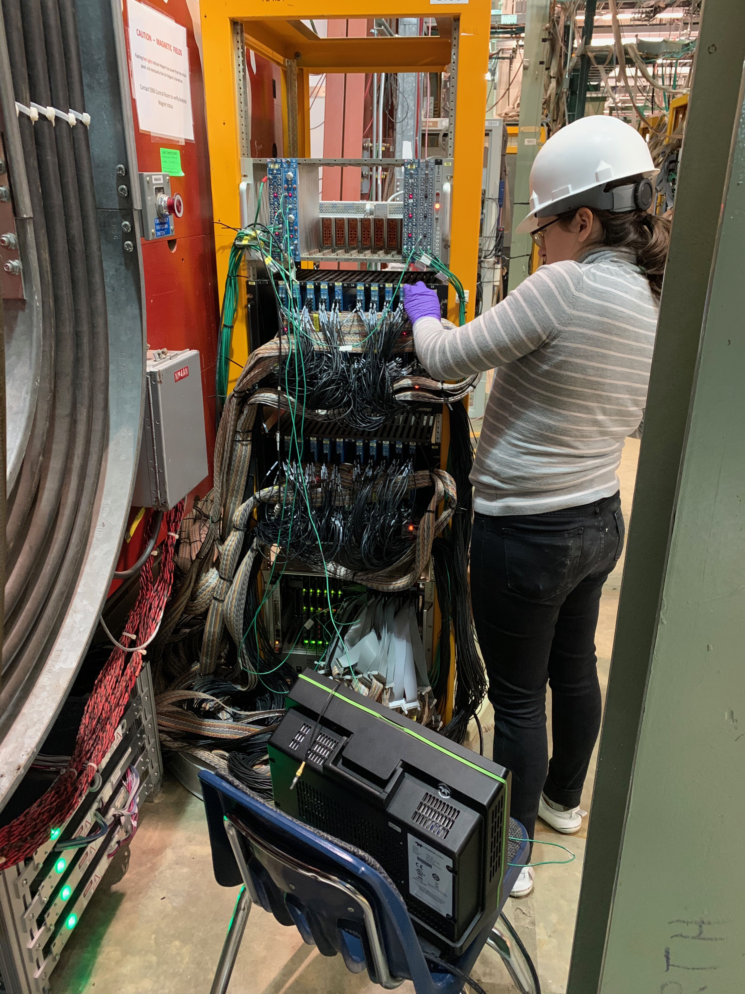
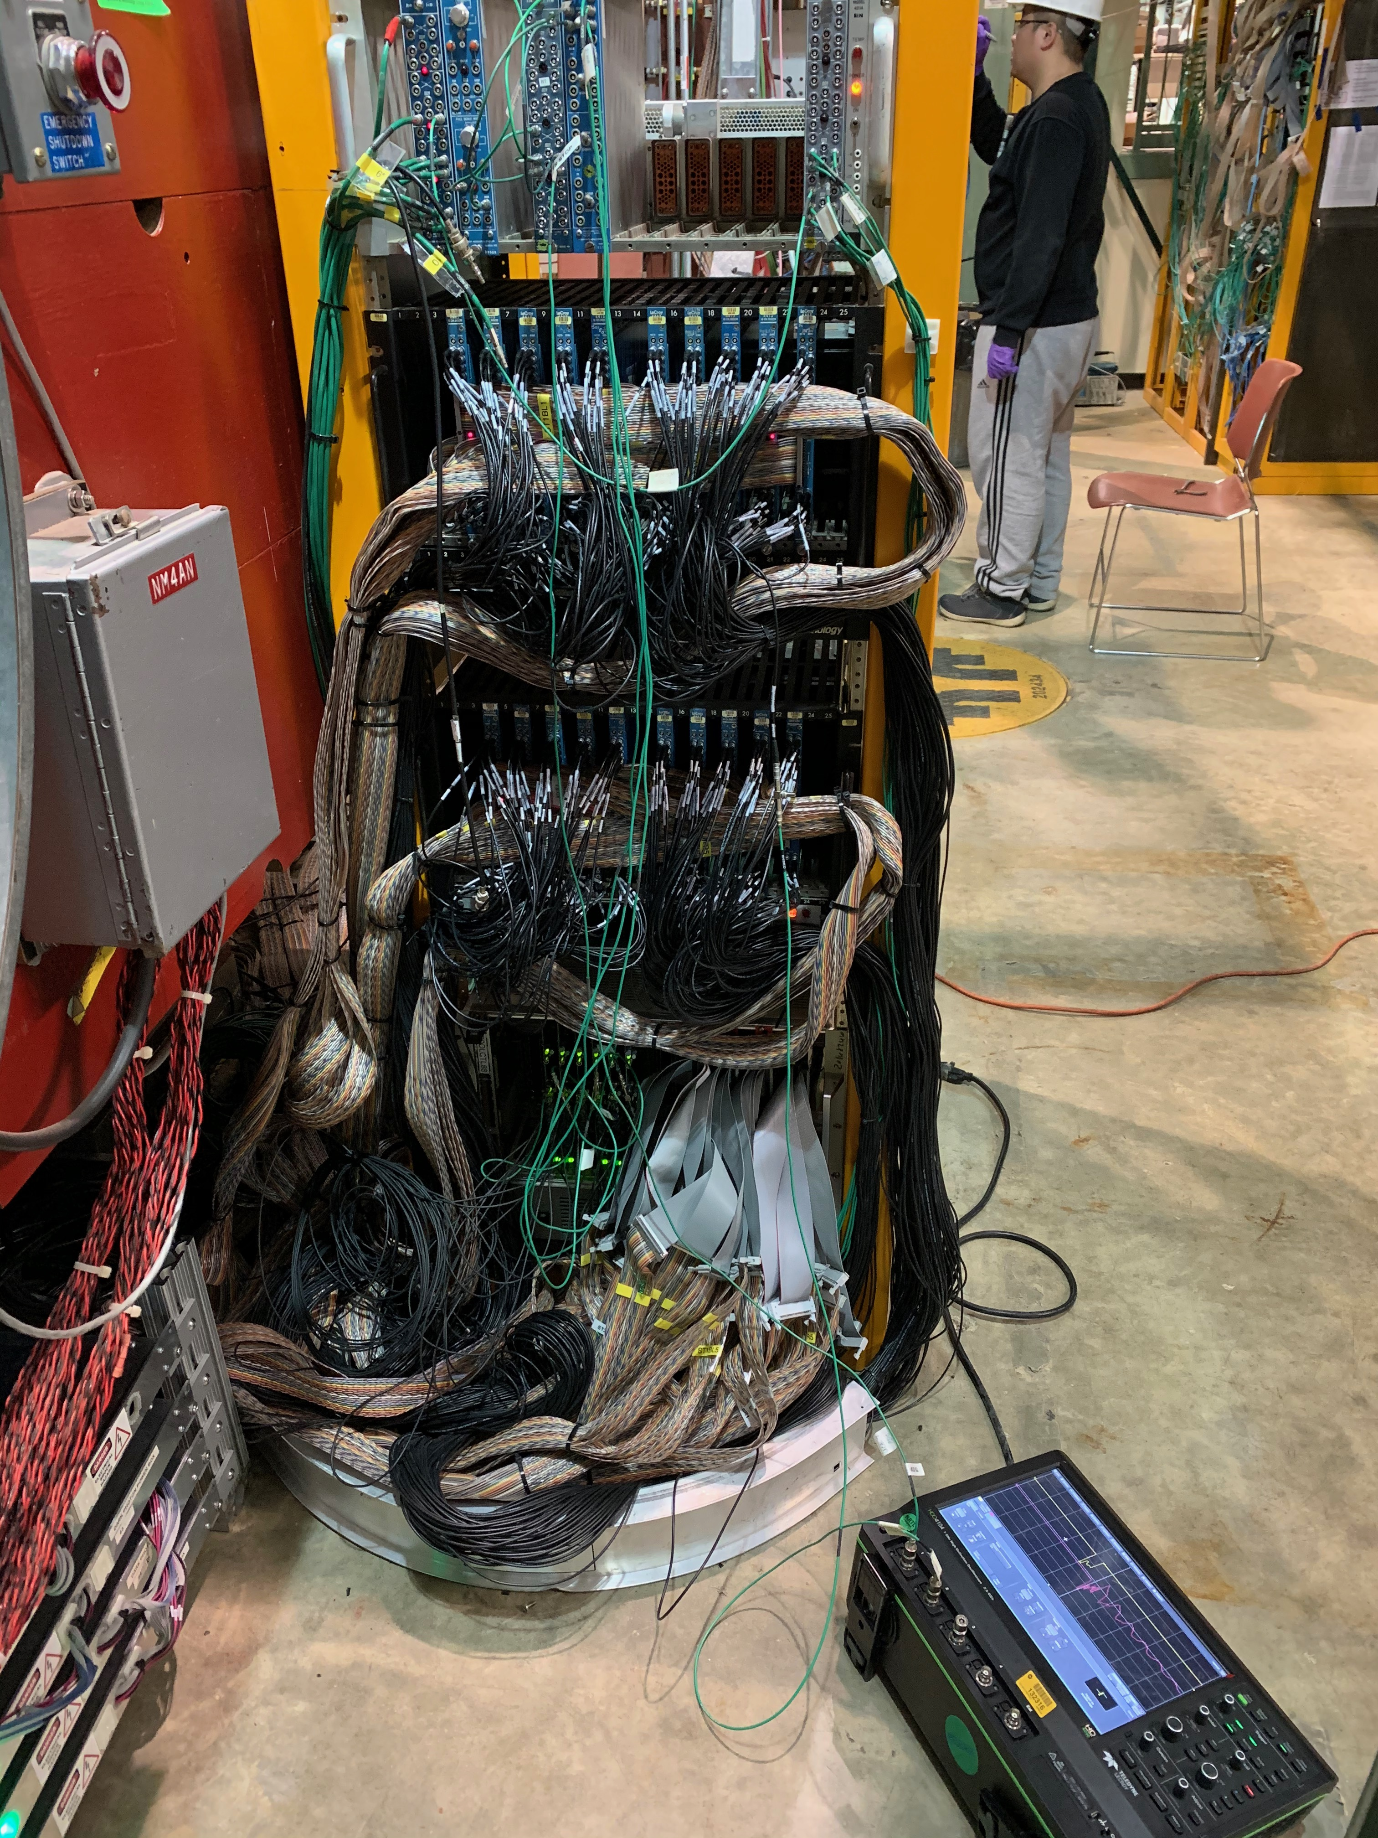
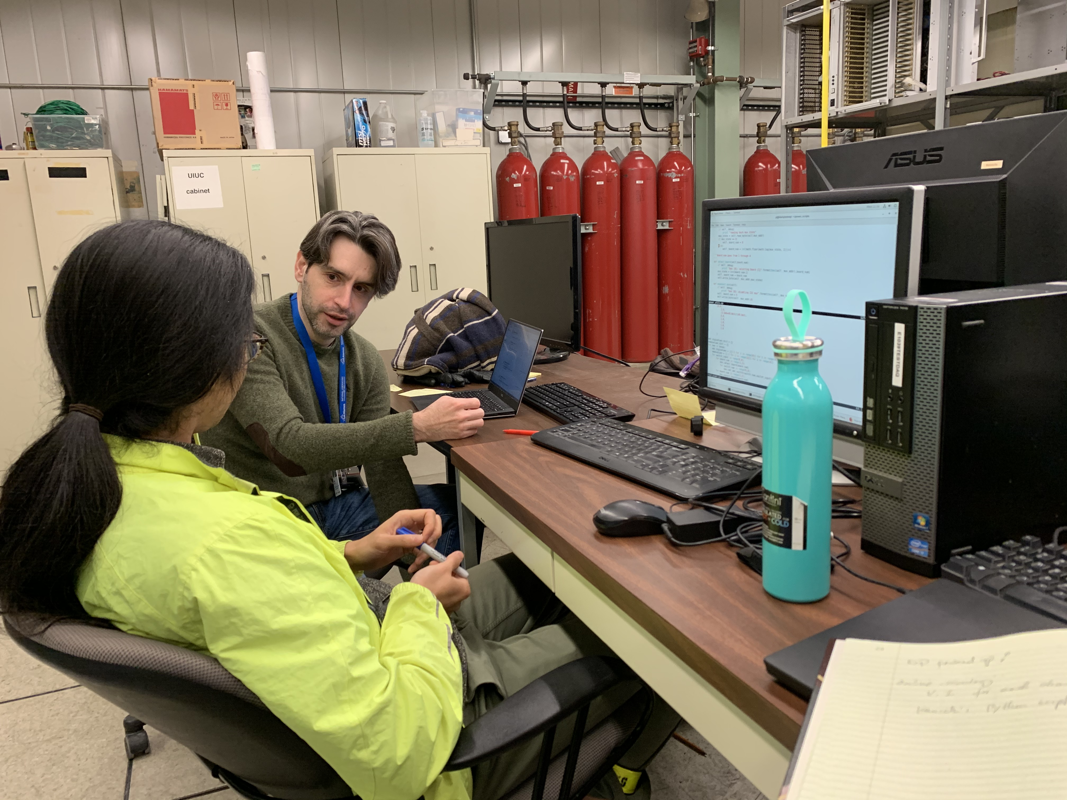
DP Work Photos

Slide 14
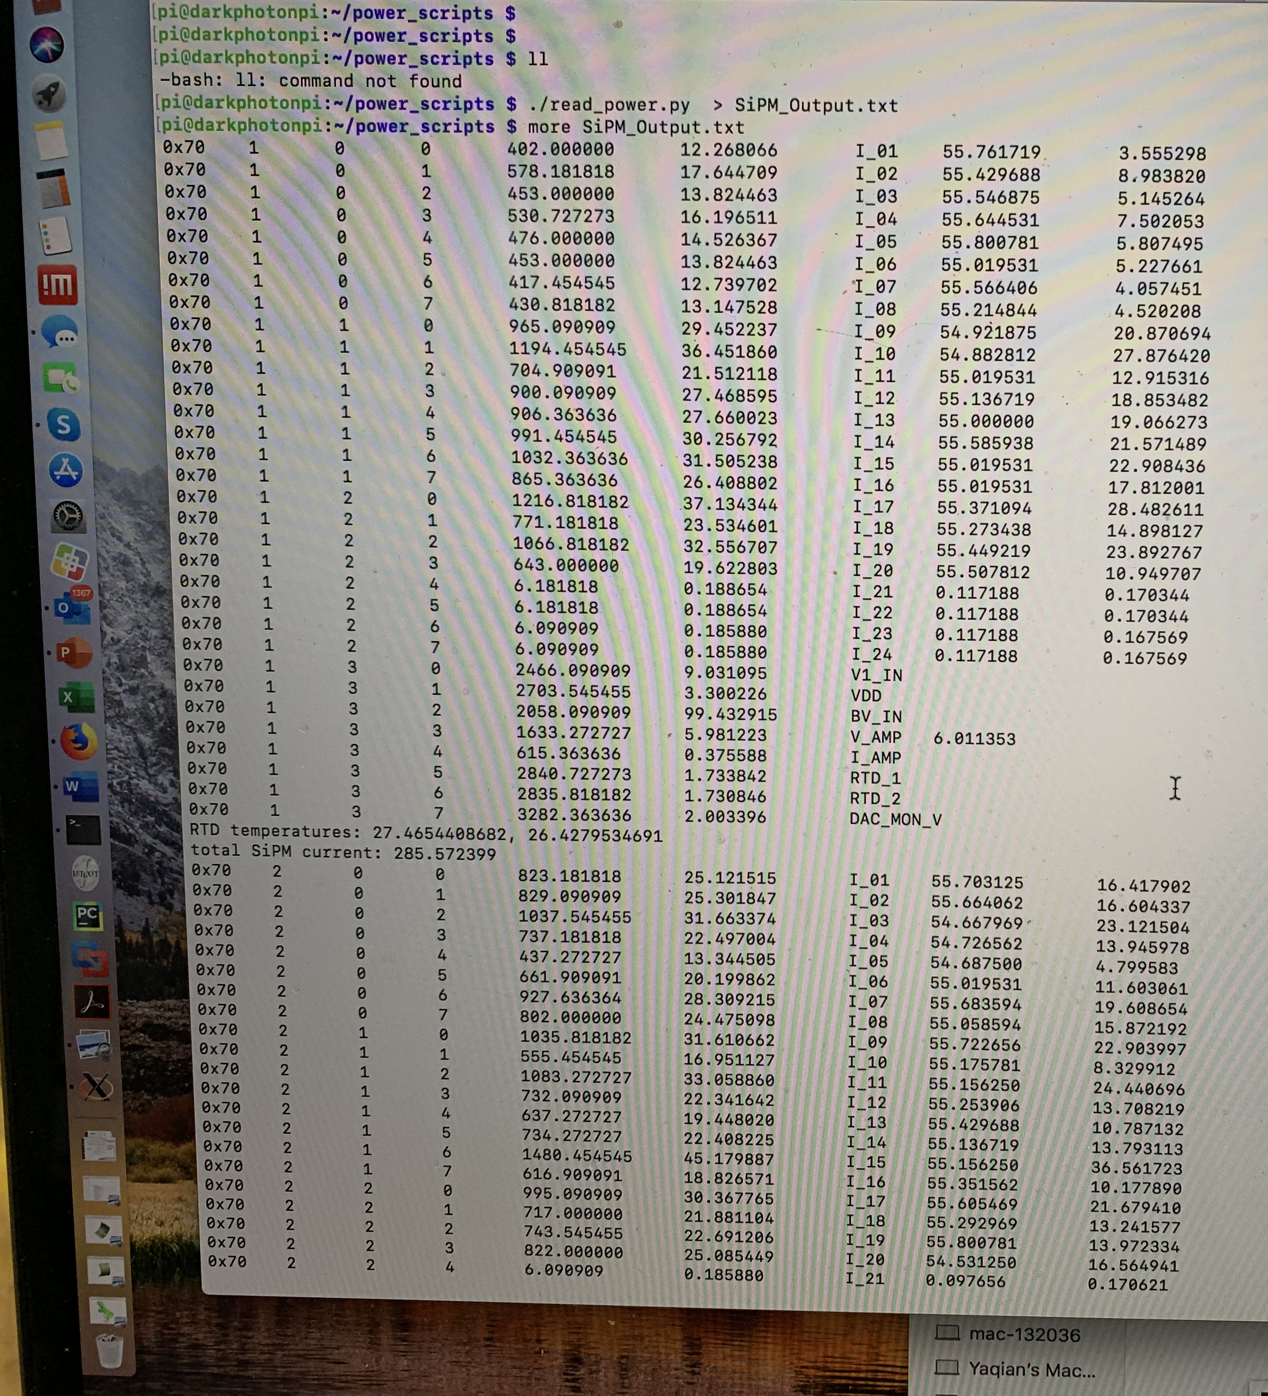
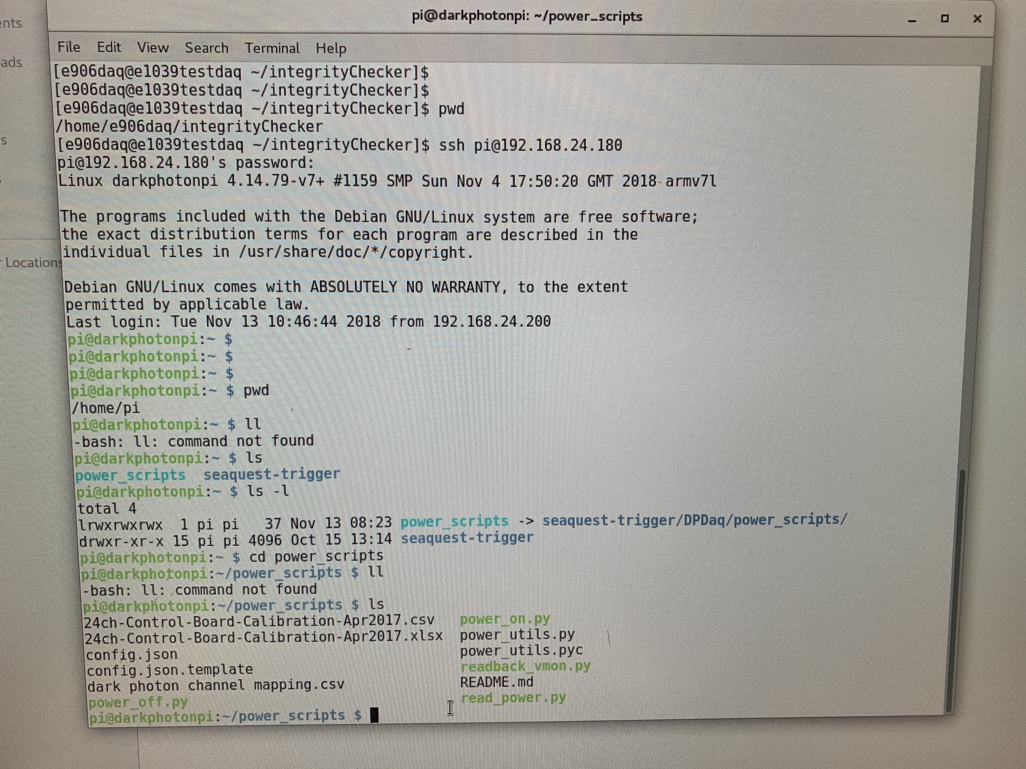
DP Operation and Monitoring

Slide 15
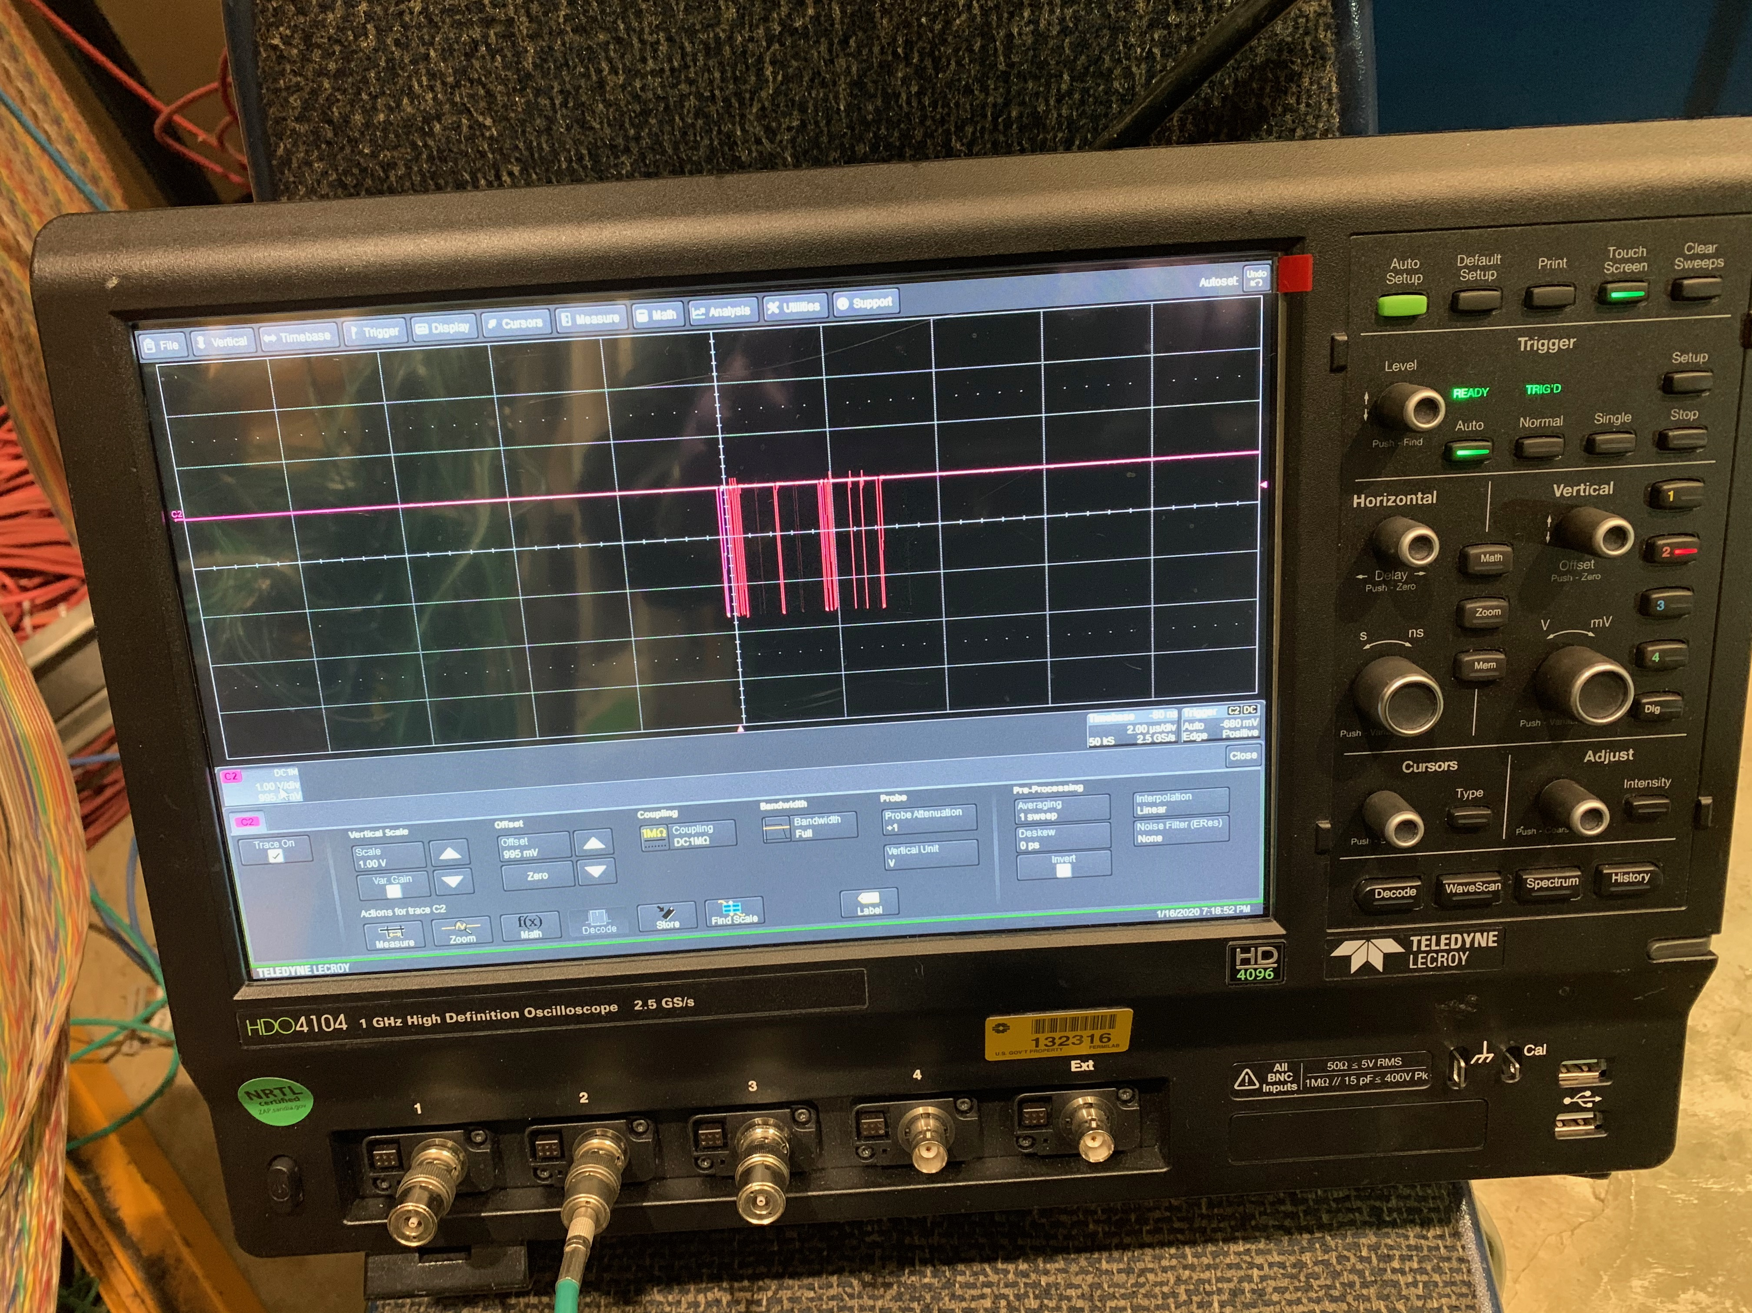
Prop Tube Work, Tuesday +
Replace front panel for threshold
Replace preamp cards to improve “noise” & “oscillations”
Retune or scan threshold for each module
Scanning
Check existing data
Do HV scan
Cosmic data with H2 (H3) & H4 trigger
Helen, Mindy, Kun, Ming et al
Prop tube cosmic signal

Slide 16
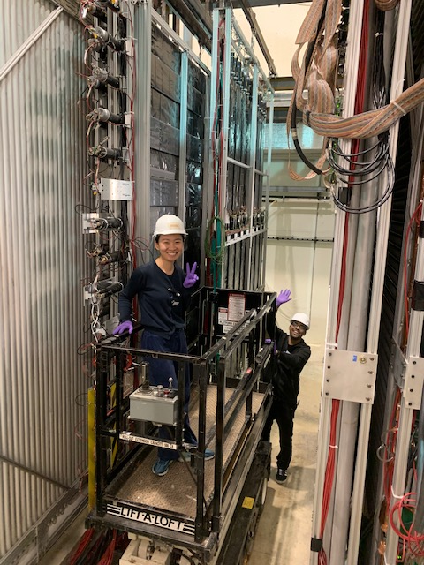
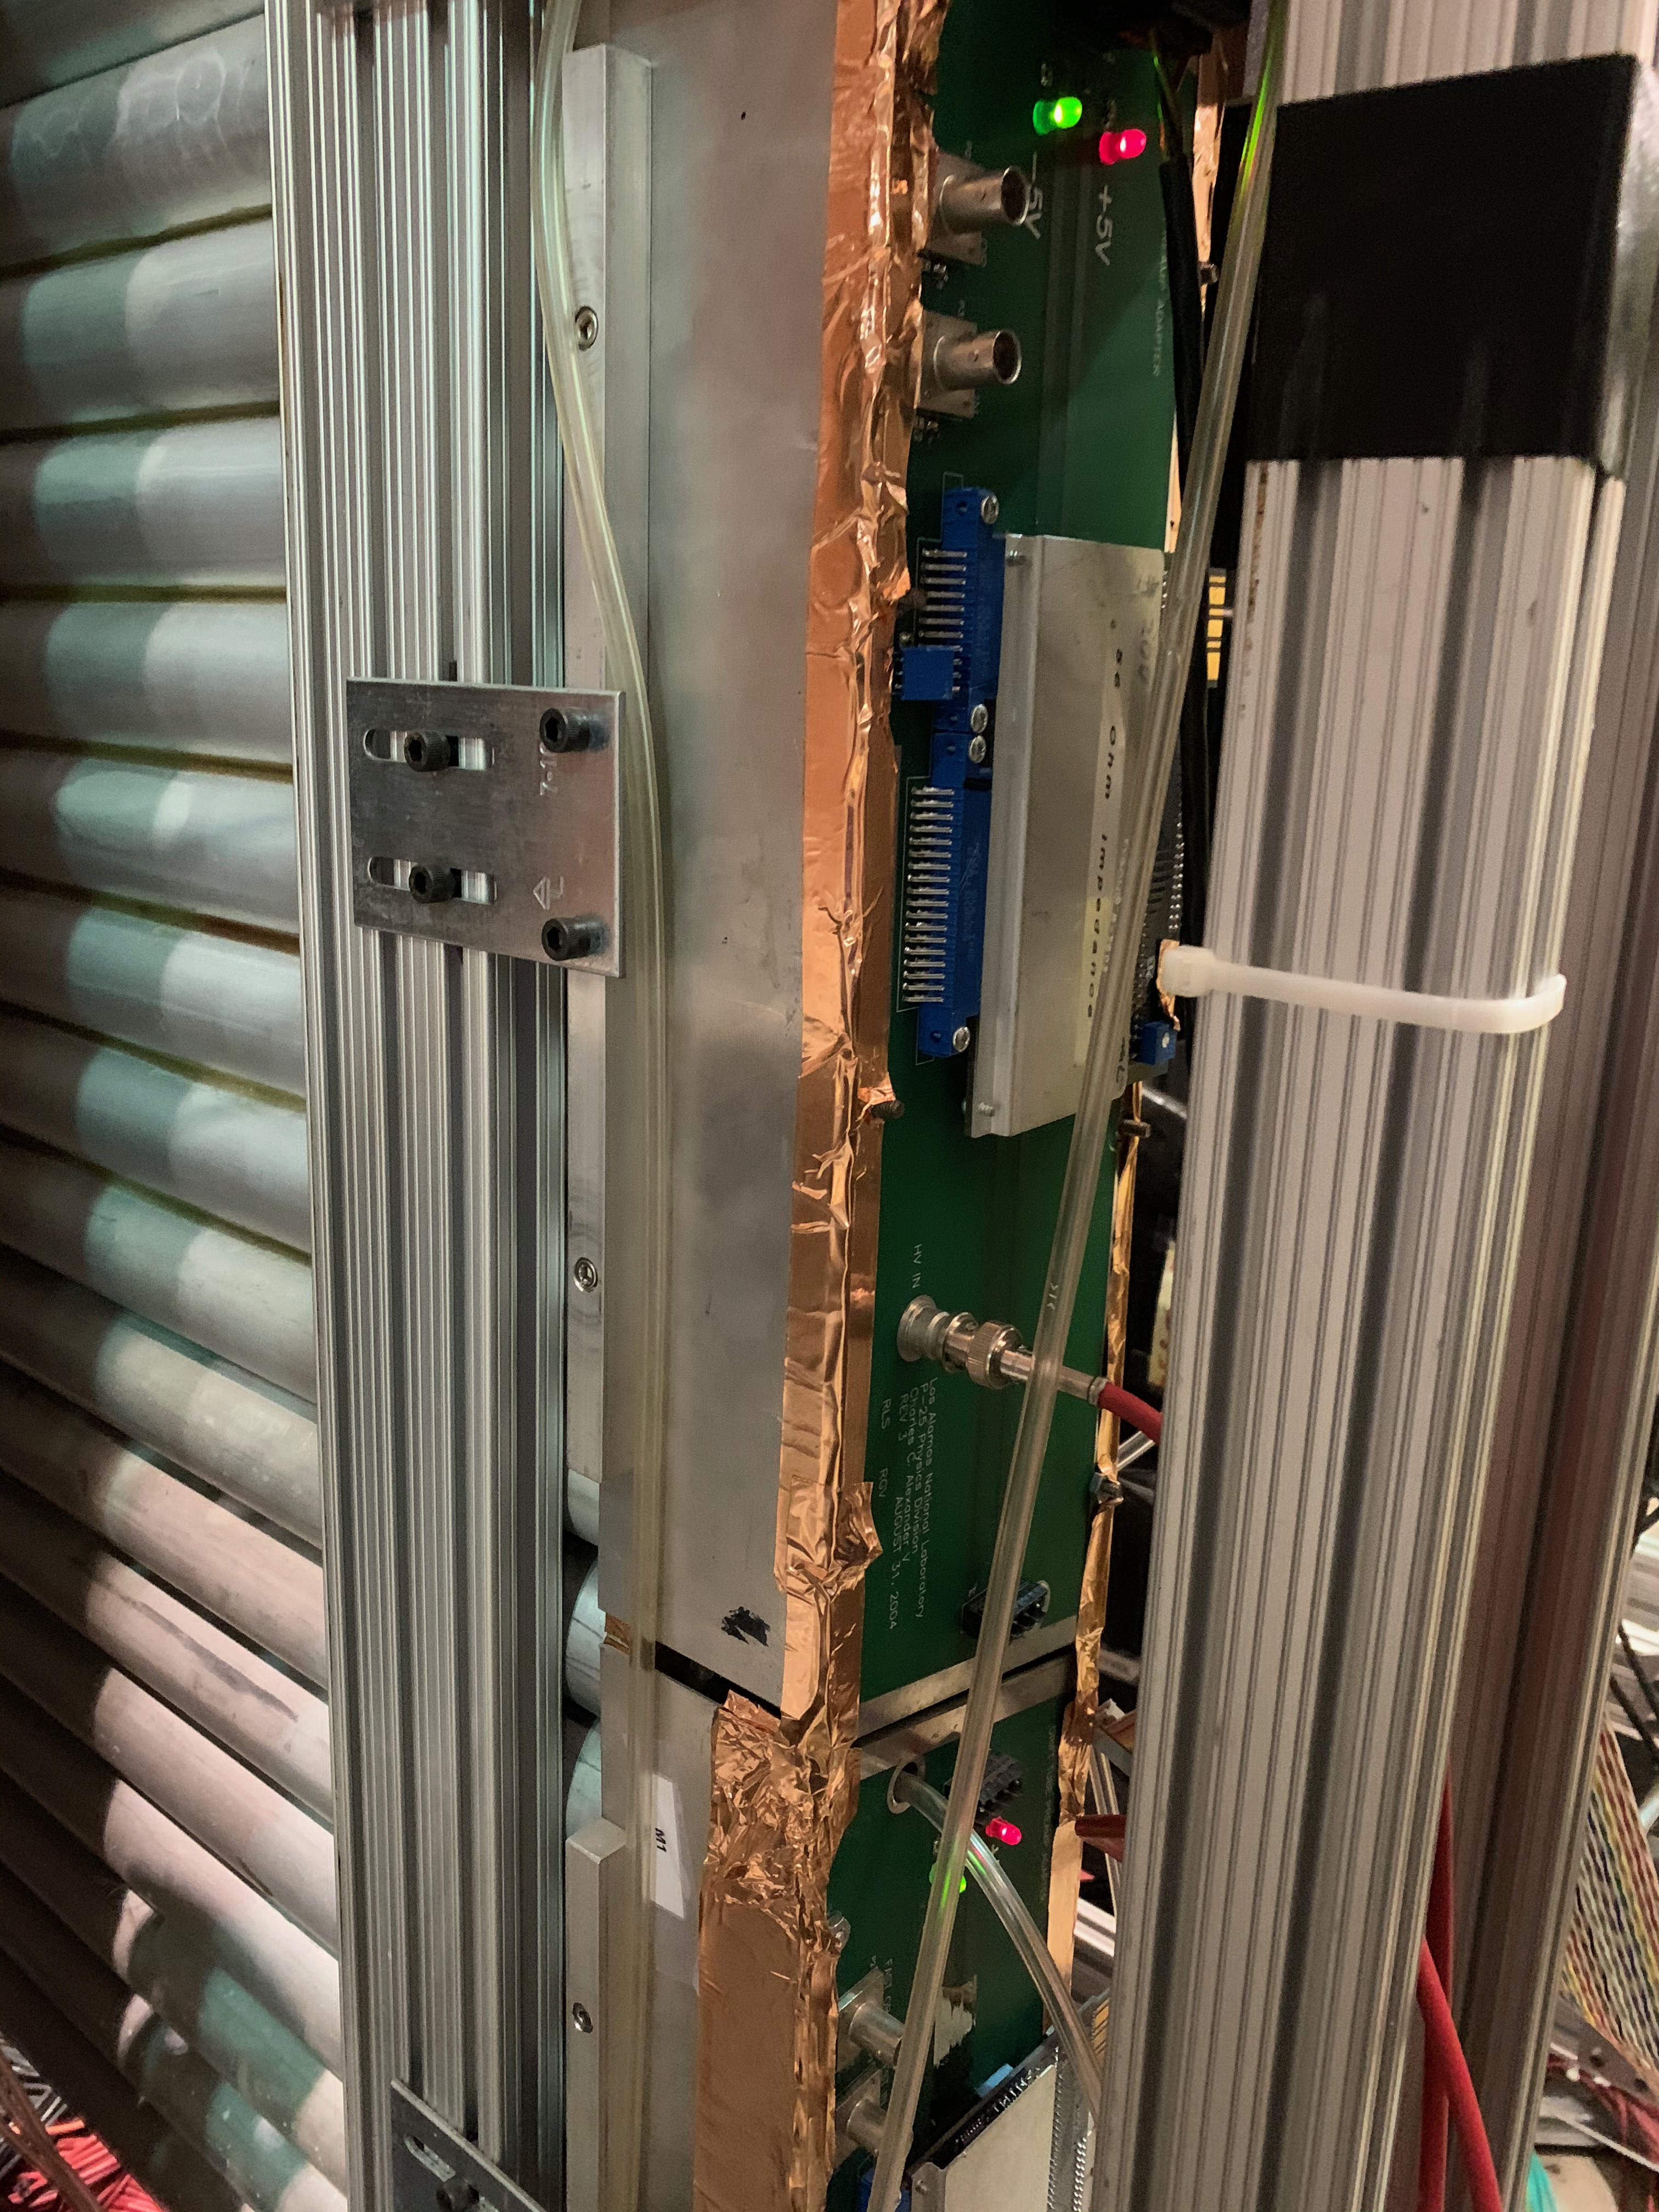
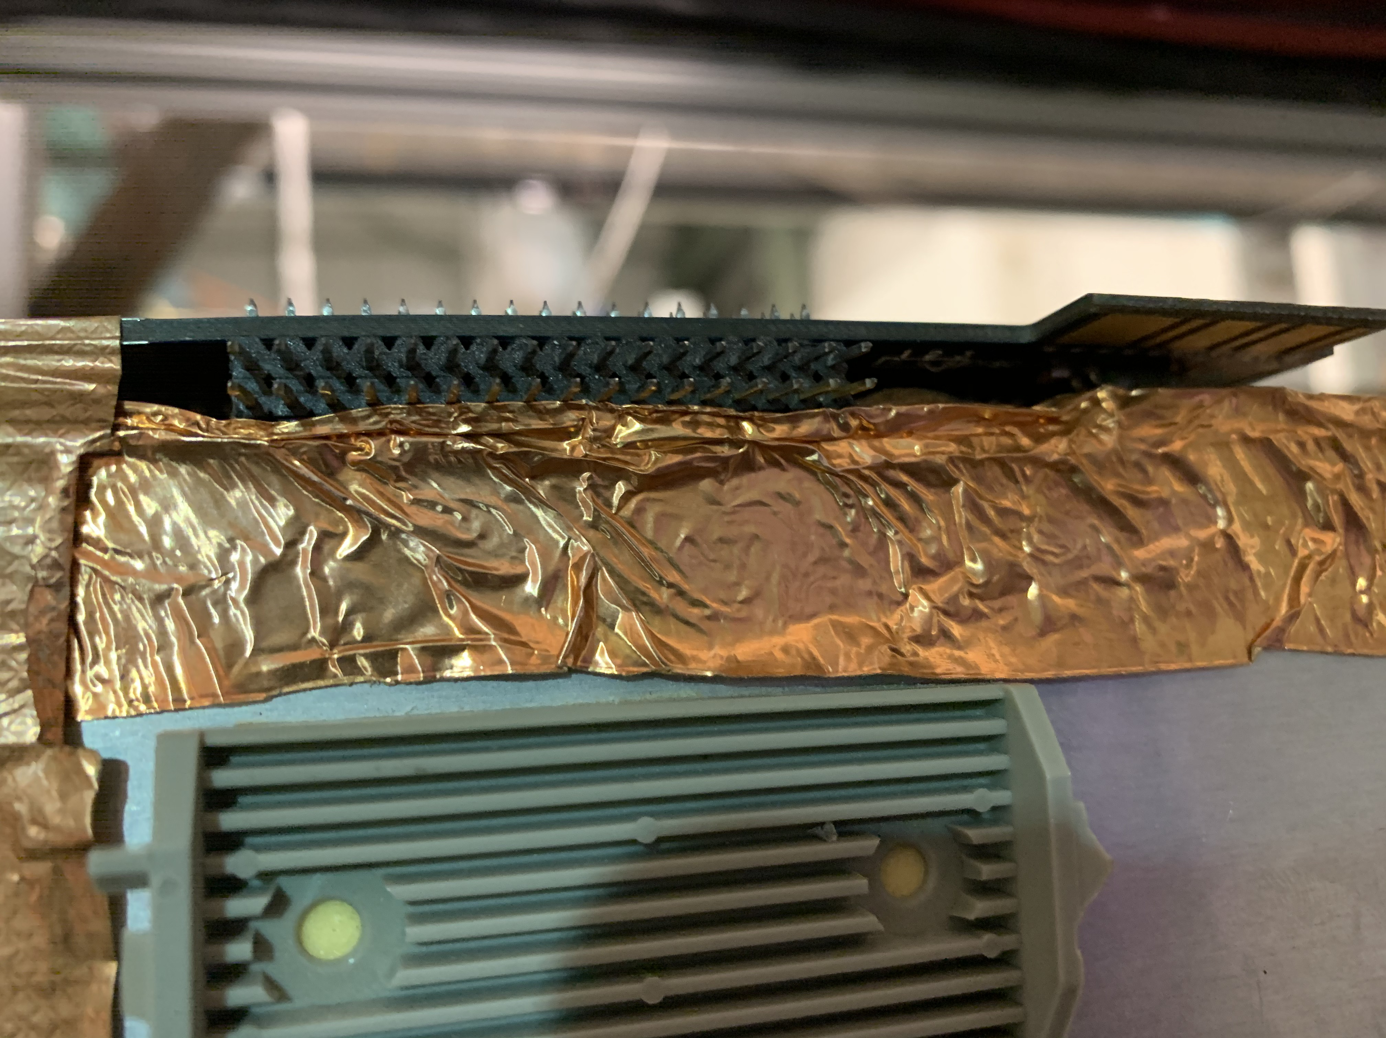
Prop Tube Work Photos
P1Y, M8
P1X, M9

Slide 17
Trigger Hodoscope Timing Study - Later this week if possible
Kun, Forhad, Ming et al
Use DP calibration system to send light to all 4 Hodo planes
Long fibers are needed, 4+,
Check timing
Setup DP calibration self pulse generator
10kHz trigger rate, can be adjusted through the top gate generator
100nS TTL pulse to LED board, can be adjusted through the bottom gate generator
4 LED spares for the HODO timing check
The system is ready for this 1/17/2020
Will do it at next trip to Fermilab

