Slide 1
E1039 DP Work
Helen, Zong-Wei, Cristina, Mindy, Andrew, Kun, Ming et al
10/14-17, 2019

Slide 2
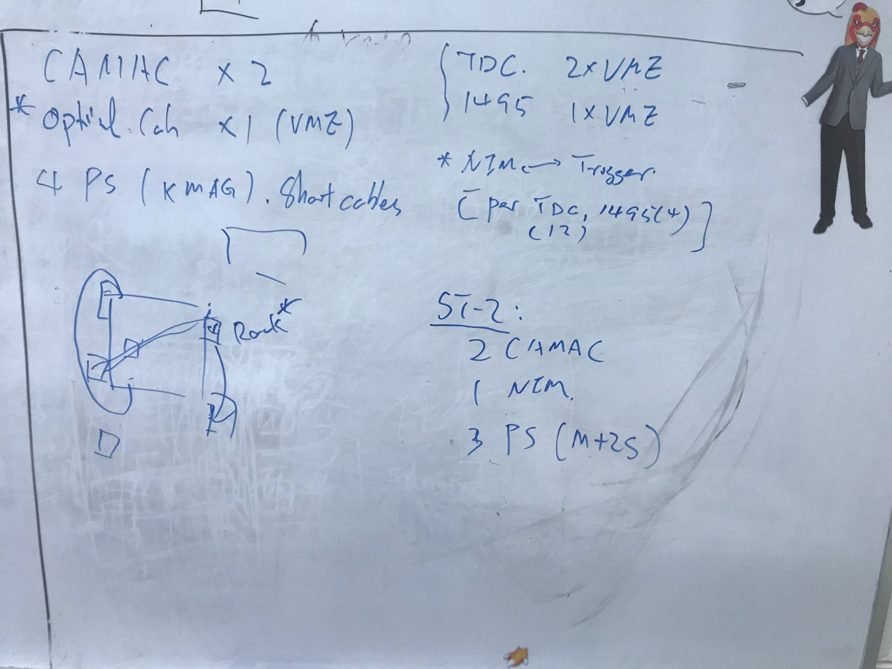
Initial Planning – To Do’s

Slide 3
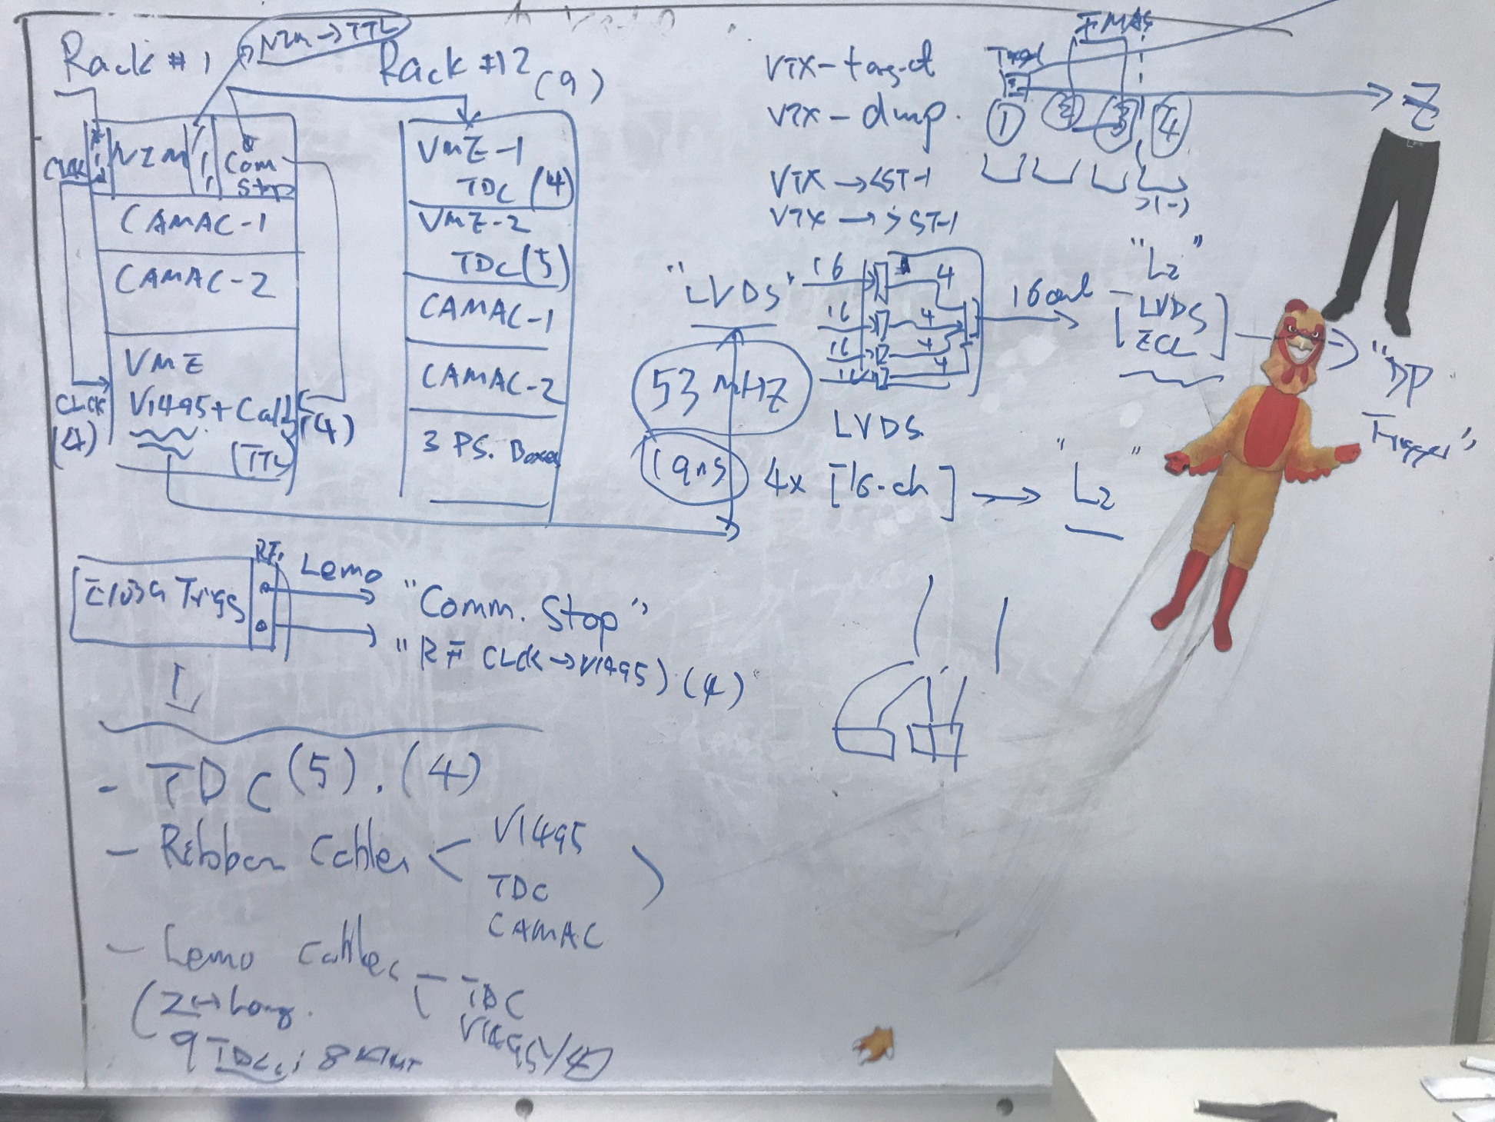
End of Day 1 – Reconfigured Rack1 and Rack2
Rack 1:
NIM crate
CAMAC-1
CAMAC-2
VME
V1495(4)
Pulser(6)
Rack 2:
VME-1
TDC(5, for ST1)
VME02
TDC(4, for ST2)
CAMAC-1
CAMAC-2
DP power boxes (3)
25’ ribbon cables labeled
2 x (4x5) = 40 for ST-1
2 x (4 x3) = 24 for St-2, partially cabled
80-20 frame for ST-1 power boxes
Built

Slide 4
V1495 Cable Mapping
A: Special ports, reserved for ST4-Y
B: 1= St1-1; 2=St1-2
C: Outputs
D: 1=St1-3; 2 = St1-4
E: 1=St1-5;
2 = St2 -1;
F: 1 = St2-2; 2 = St2-3
V1495 in VME crate order:
TL – TR – BL – BR

Slide 5
To Do’s for this week
Install 3 more TDCs
Finish 12 St2-ribbon cables – labeling
Connect all Ribbon cables
CAMAC – TDC
CAMAC – V1495
Finish 80-20 Al frame for ST-1 power box
Connect Lemo cables
Common STOP for TDCs
Comm STOP and Clock for V14956
A standalone DAQ for DP trigger commissioning? (Andrew)
TTL pulser from upstairs for calibration
Implement DP trigger
Simulation
DP signal
Target – Dump separeation
FPGA lookup table

Slide 6
Day-2. 10/15/2015
Completed labeling all St1 and St2 ribbon cables, 52 of them
ST-2 V1496 cables (12) already installed
Installed St-1 TDC readout cables (20) at the CAMAC, the mapping on the TDC end TBD, need inputs from Kun, Andrew et al
Completed 80-20 Al frame for St-1 power boxes, installed
Nice work by Cristina, Zongwei, Mindy, Kun et al!

Slide 7
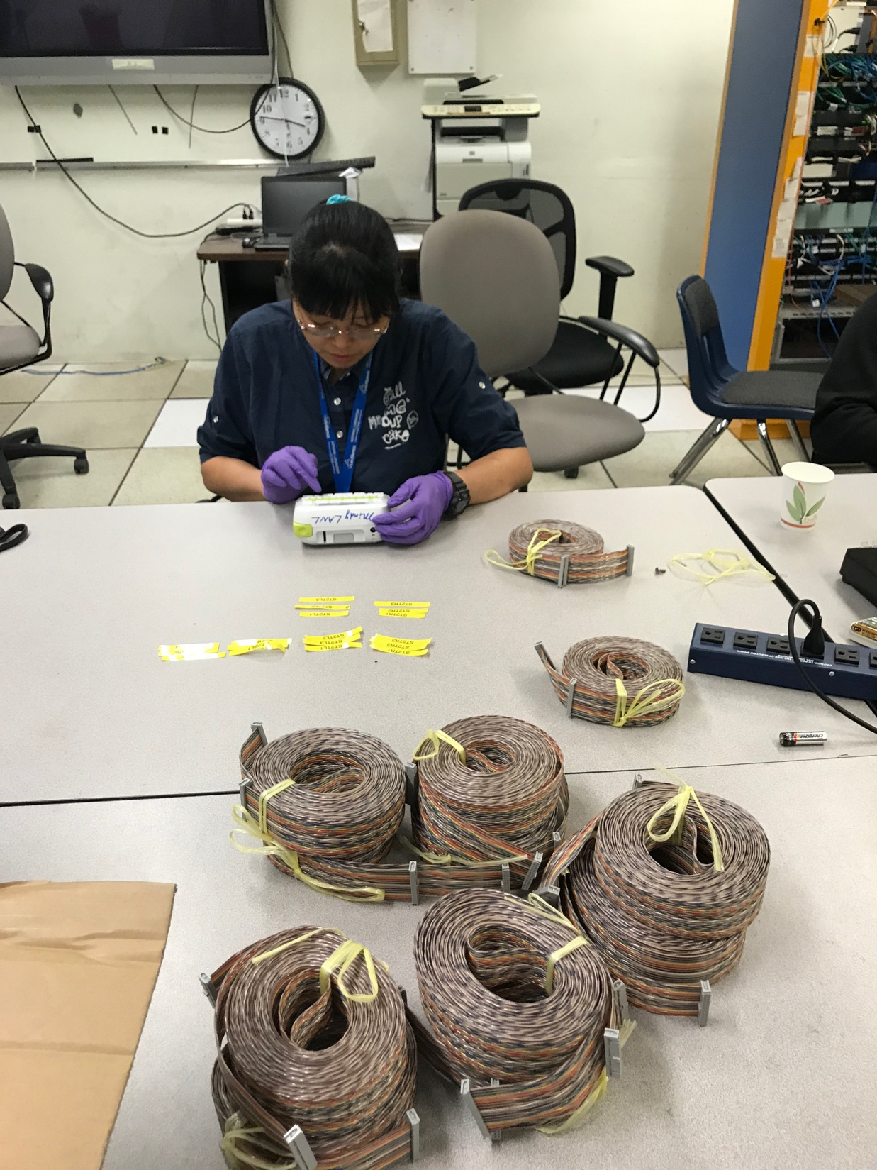
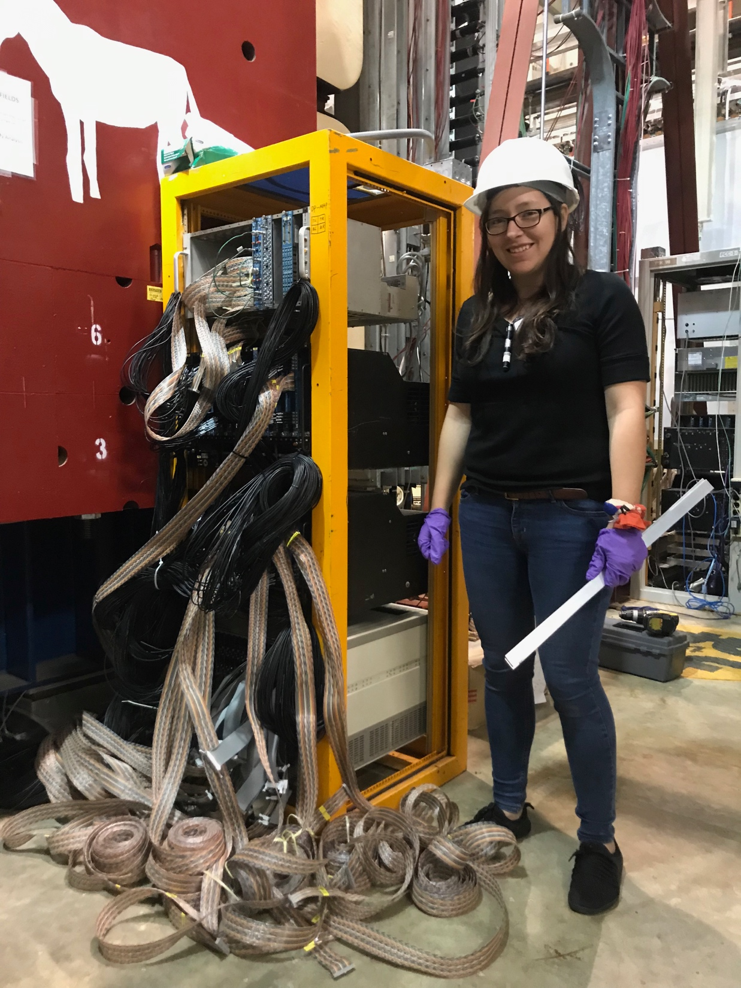
ST-1 readout
Cables – black ones
Making labels for ST-2
TDC cables
All TST-1 DC ribbon cables
connected

Slide 8
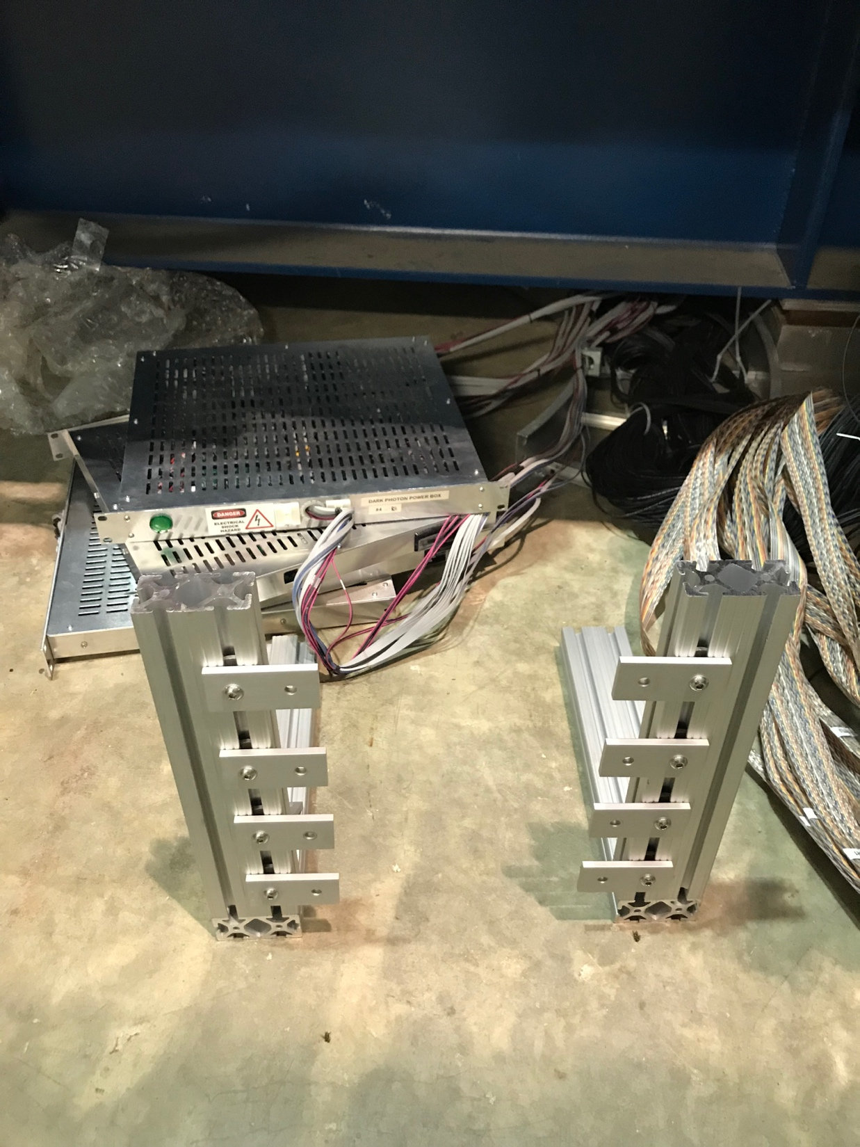
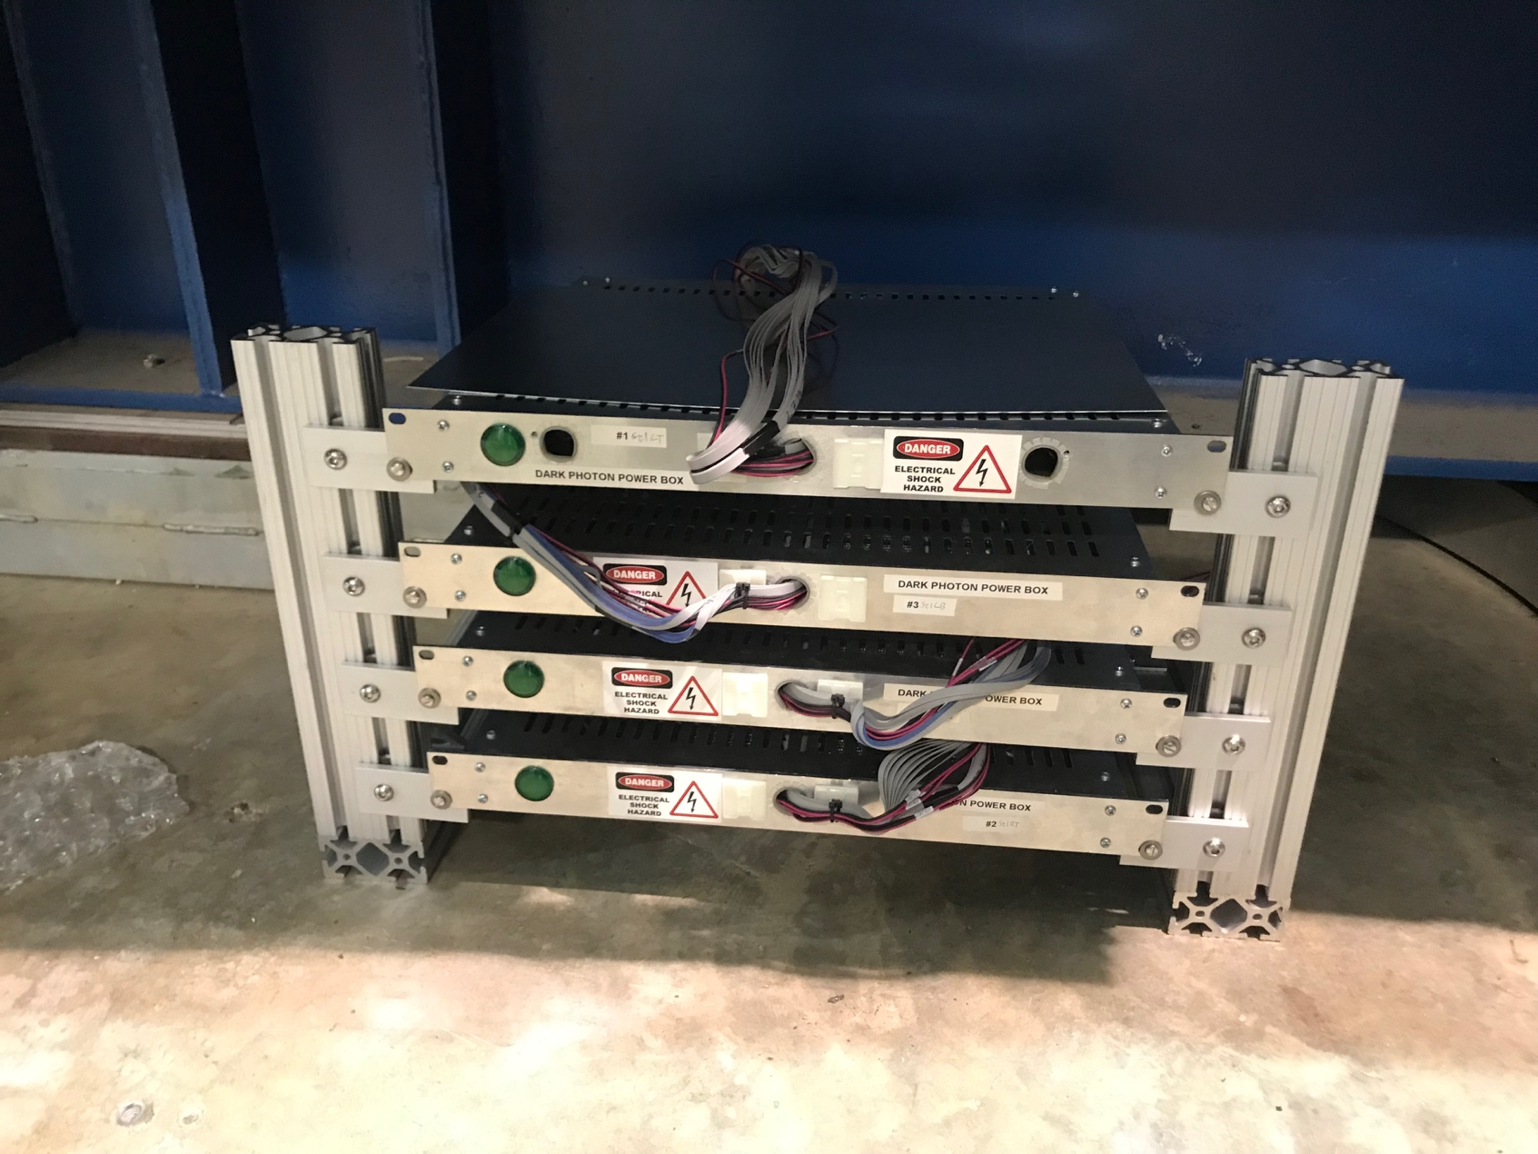
ST-1 power boxes are installed
ST-1 power boxes installed
80-20 support frame
80-20 Al supporting frame

Slide 9
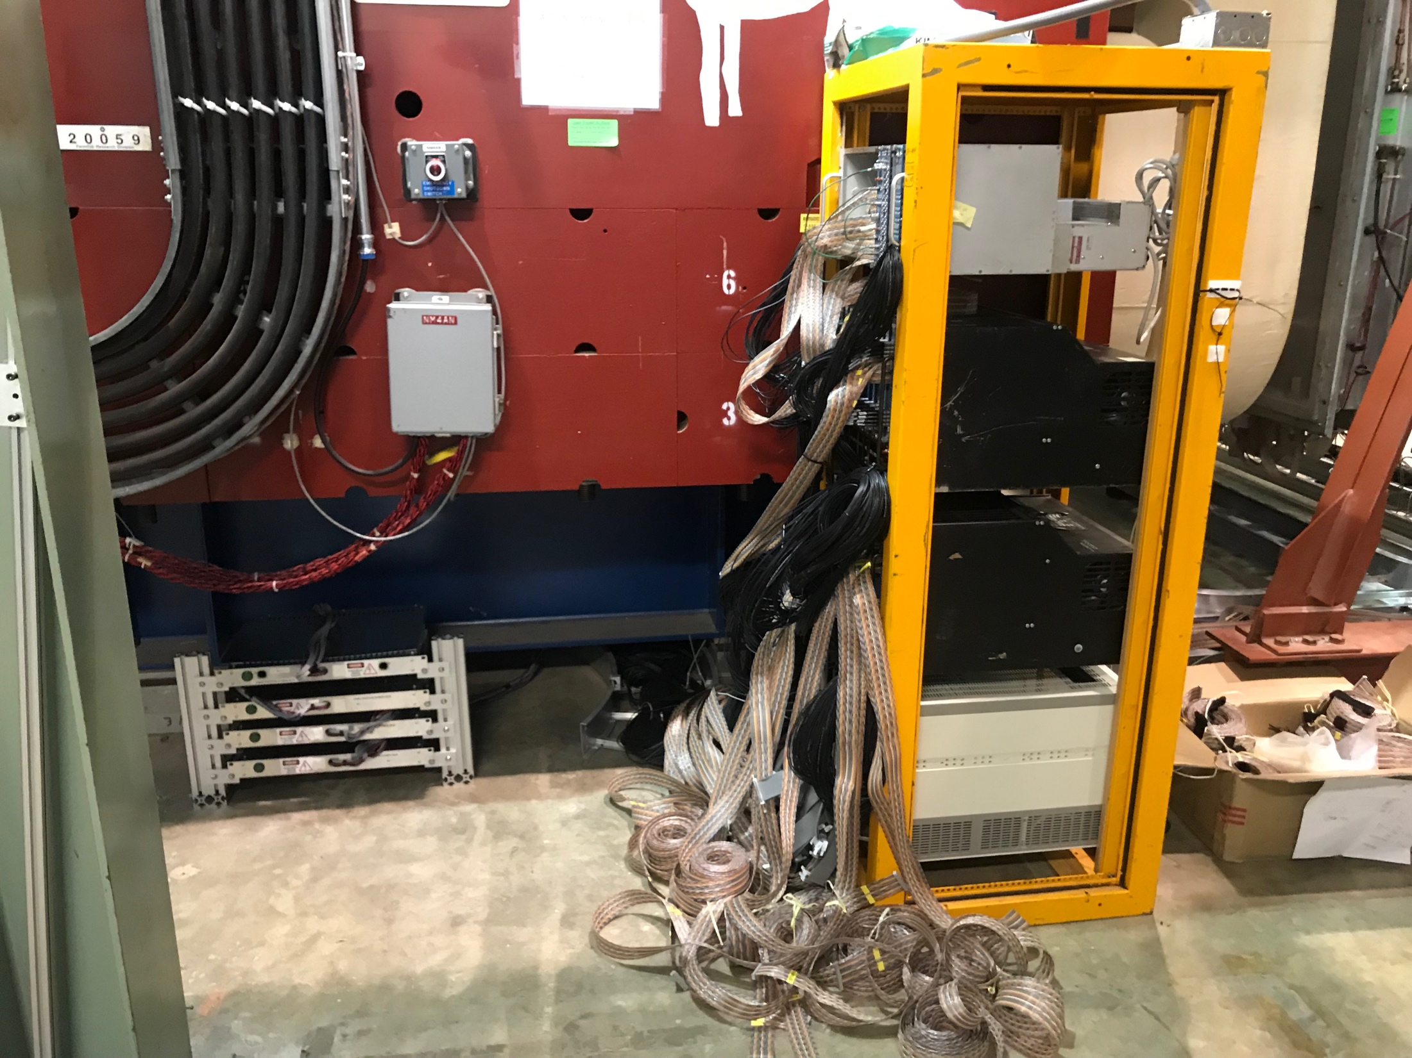
ST-1 rack
ST-1 power

Slide 10
To DO’s for tomorrow
Install 3 TDC boards for ST-2
Connect ST-1 ribbon cables to TDC boards, mapping TBD
Connect St-1 ribbon cables to V1495
Connect ST-2 ribbon cables to TDC boards, mapping TBD
Connect Lemo cables
RF clock
Common Stop
Fan-Out, and more Lemo cables

Slide 11
DY & J/Psi simulations for Target – single muons
Projected Z-vtx from ST-1 in Y-direction
Study target-dump separation for
Single muons
Dimuons
J/Psi (M = 3.1 GeV) and DY (M>4 GeV)
Record all J/Psi events if possible at trigger level

Slide 12
E906 single muon and dimuon Data – from Forhad

Slide 13
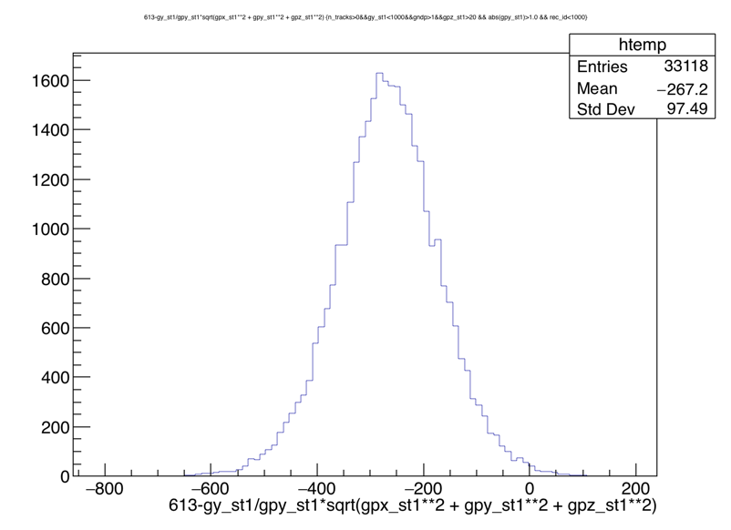
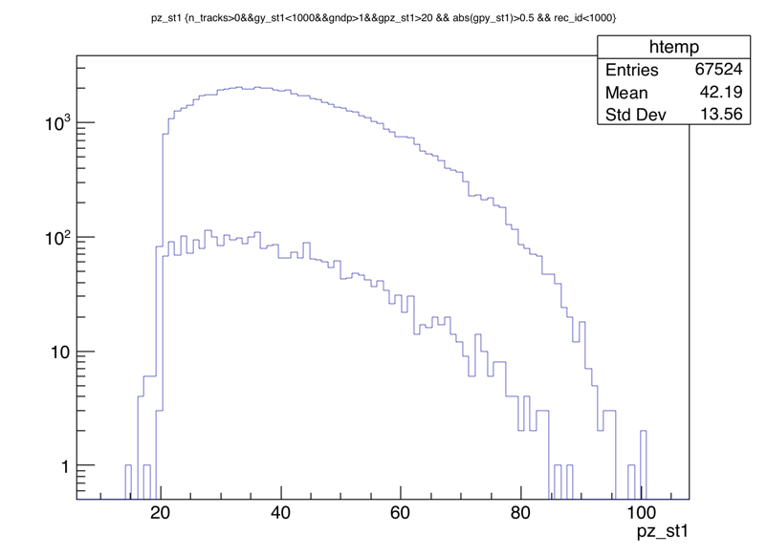
DY and J/Psi simulation – Target DY events
Thank Zulkaida’s
large MC DY samples!
Projected collision vertex distribution
@ST1, ~ projection from DP detectors; dimuon_mass>2, 4GeV, pY_St1>1.0GeV
Single muon Proj. z_vtx,
Target = -300cm
pY > 1.0
<Z> = --270
<Z_Sigma> = 97 cm
gMass > 2
Single muon Pz @St1
gMass > 4

Slide 14
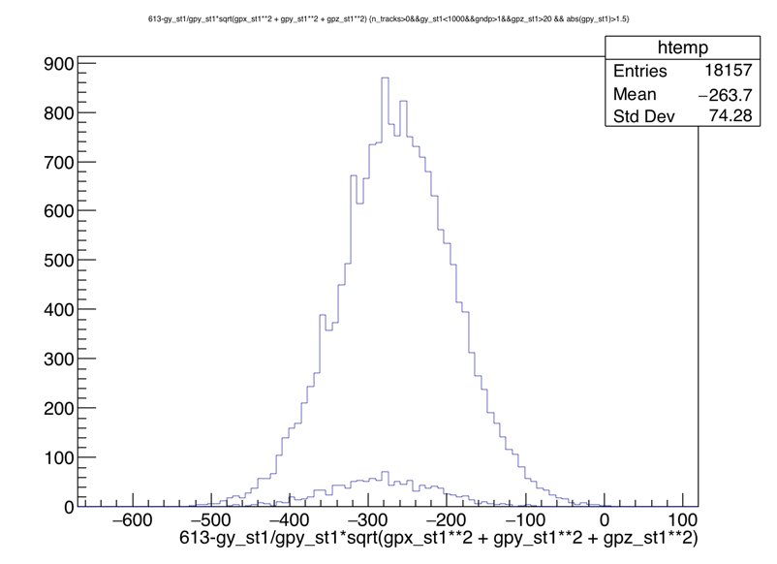
Z-VTX for pY >1.5 GeV
Single muon Proj. z_vtx,
Target = -300cm
pY_St1 > 1.5
<Z> = -260cm
<Z_Sigma> = 75 cm
Dimu_gmass > 2
Dimu_gmass > 4

Slide 15
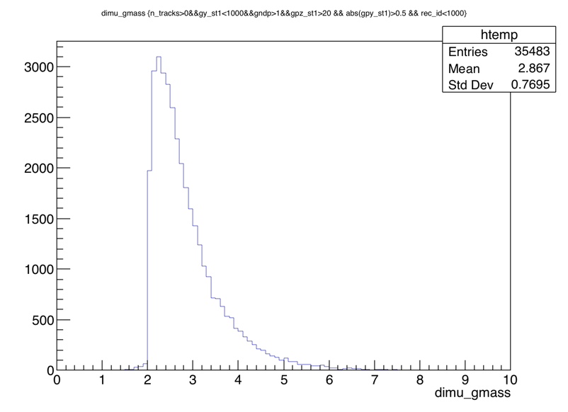
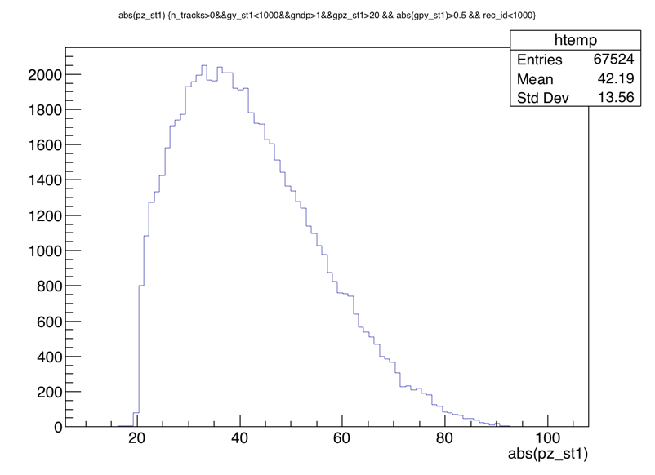
Generated Dimuon Events – with reconstructed single muons

Slide 16
To-do for simulations
More DY and J/Psi events produced at:
Target Z = -300cm
Beam dump Z = +25cm
Reco’d track acceptance and efficiency
Z_VTX of single muons and also for dimuons
Z_VTX cut optimization to separate Target –Dump tracks at trigger level

Slide 17
Day-3: finish cabling TDC, V1495 etc.
TDC cables - labeled and connected
V1495 cables – labeled and connected
Pulser – TTL :
NIM : installed 2 fan-out module for Comm. Stop and CLK
Lemo cables – installed 9 Comm. Stop cables for all TDCs
Ethernet cables – PS boxes,
Power extension cable for ST-1 PS, four ~6’ cables
Start commissioning
Install rack power – timeline?
Operation safety review –
Turn on and start commissioning --

Slide 18
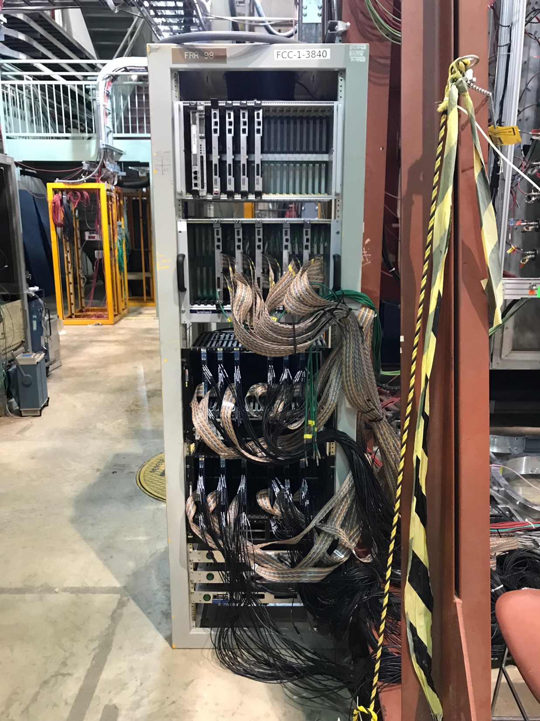
CAMAC Cable Mapping
ST-2 TDC
Top-Left Top-Right
Bot-Left Bot-Right
ST-1 TDC
Top pins: To TDC modules
Watch out for chan-1 pin locations, they are in opposite ends!
Bottom pins: To V1495 modules
All St-1 TDCs cabled!
St-2 TDC cabling in progress

Slide 19
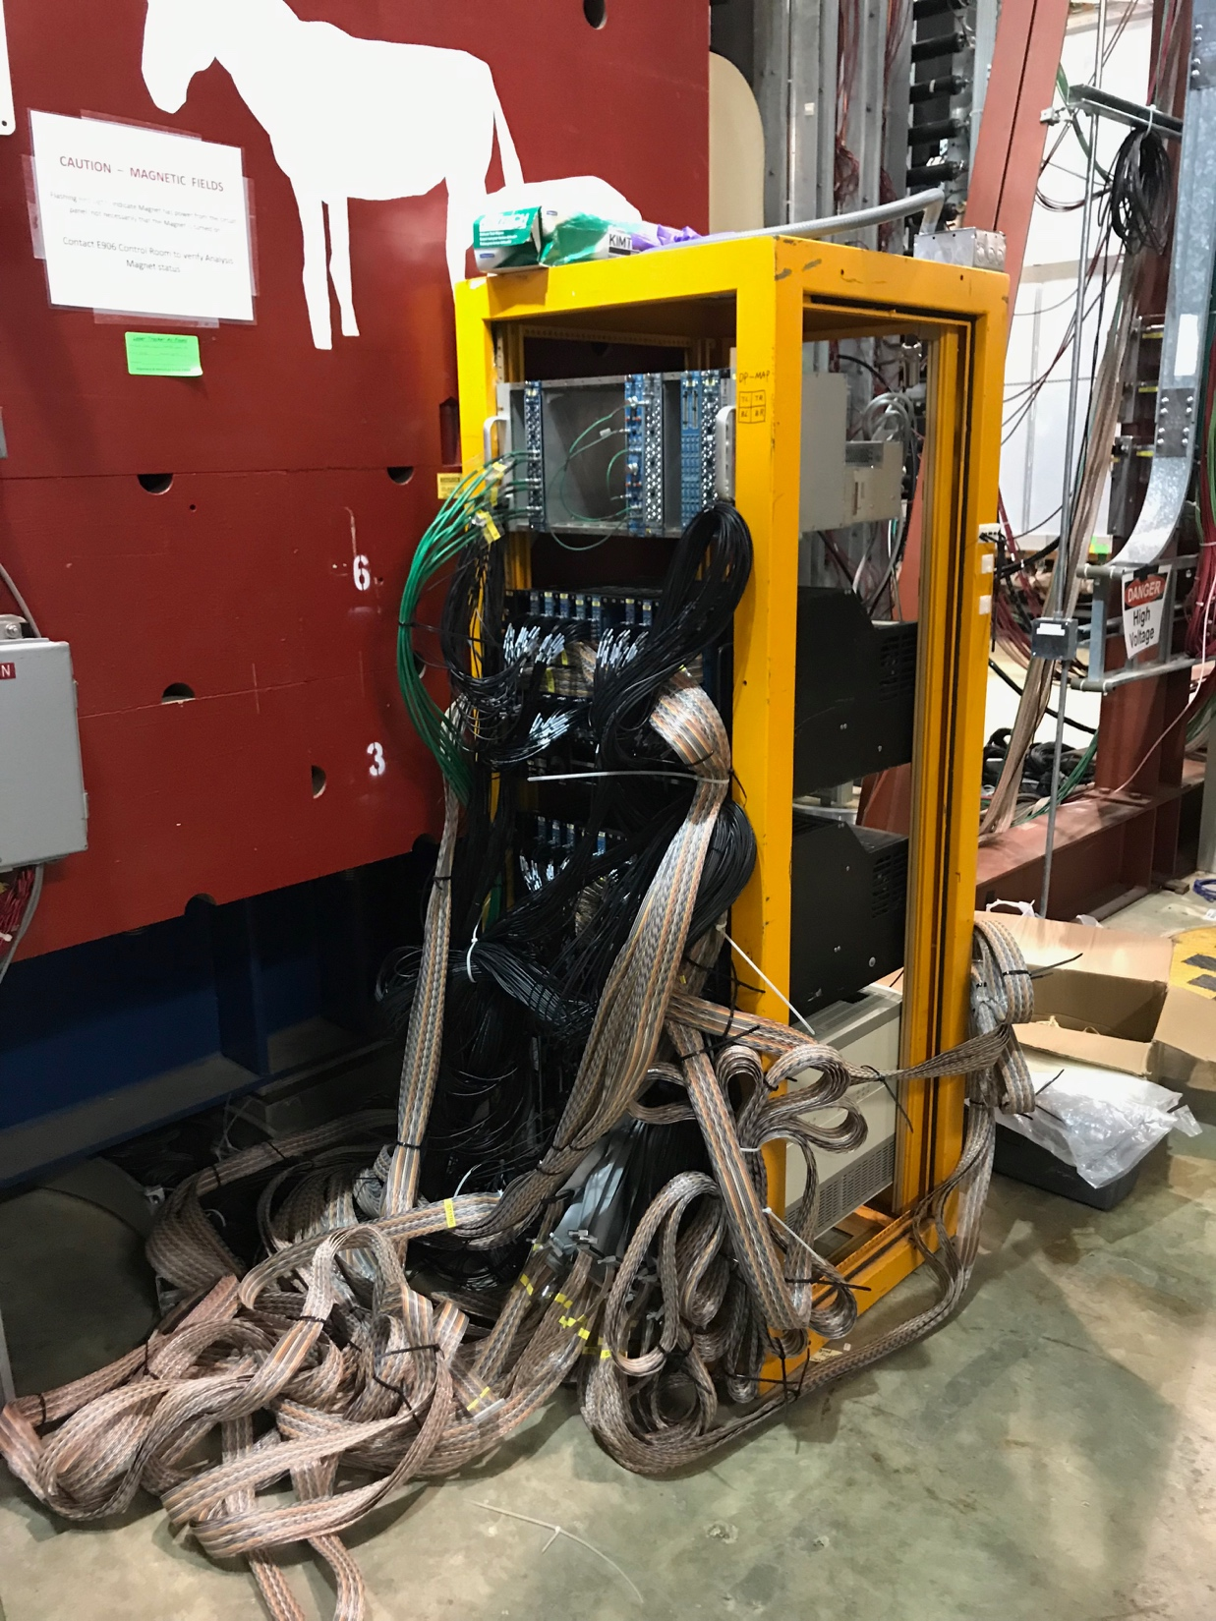
ST-1 Rack Setup
Comm. Stop for TDC
TDC Common Stop – all cabled
ST1 V1495 cables
ST1 TDC cables
All ST-2 V1495 cabled
St-1 V1495 cabling in progress

Slide 20
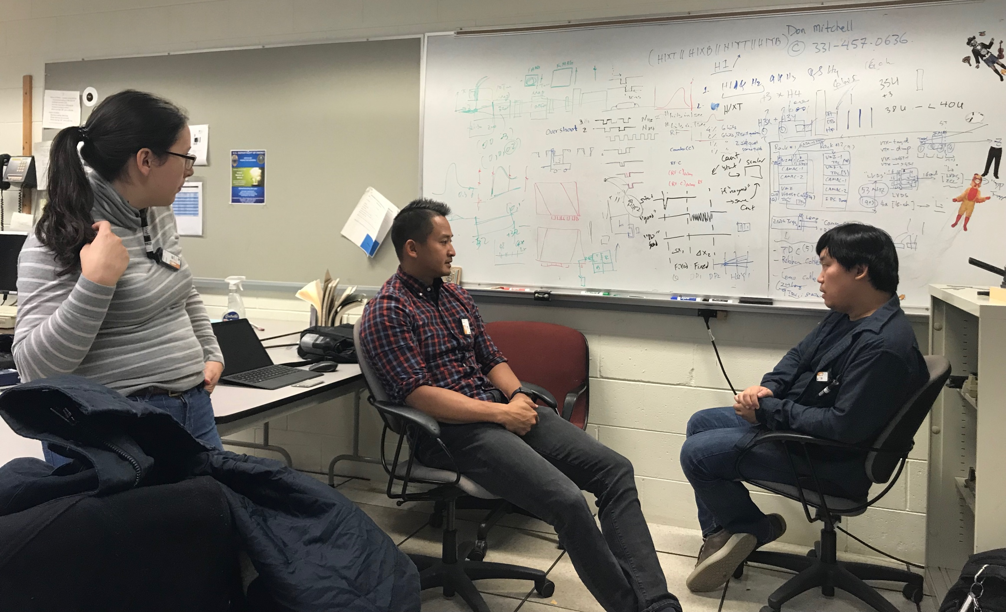
DP Trigger Discussion – Optimization
Simulation new output table:
Quad, DP1, DP2, H4-Y1

Slide 21
To Do’s for tomorrow
Finish cabling ST-1 V1495
Finish cabling St-2 TDC
Connect 4 Comm. Stop to V1495
Connect master CLK and Comm Stop from Control room
Connect calibration TTL – 6
Discuss near future plan -
DP talk at next Friday’s collaboration meeting – Cristina will give the talk
Connect power to the racks – next week, Rick
ORC review – next week or later, Kun
Turn on detectors, start commissioning, Cristina, Kun, Ming et al, get help from Sho
DAQ integration for DP TDC
DP trigger
Target-Beam separation with DP trigger

Slide 22
Summary of Progress from this week, 10/17/2019 – We have completed all installation work for DP detectors
All CAMAC discriminators are connected, ST-1 & St-1
All TDC, V1495 are cabled
Master RF Clock are connected to all 4 V1495
Master Comm. Stop connected to all 8 TDCs
Cabled tray is put near Rack #1
ST-1 power boxed mounted on 80-20 frame under the KMag

Slide 23
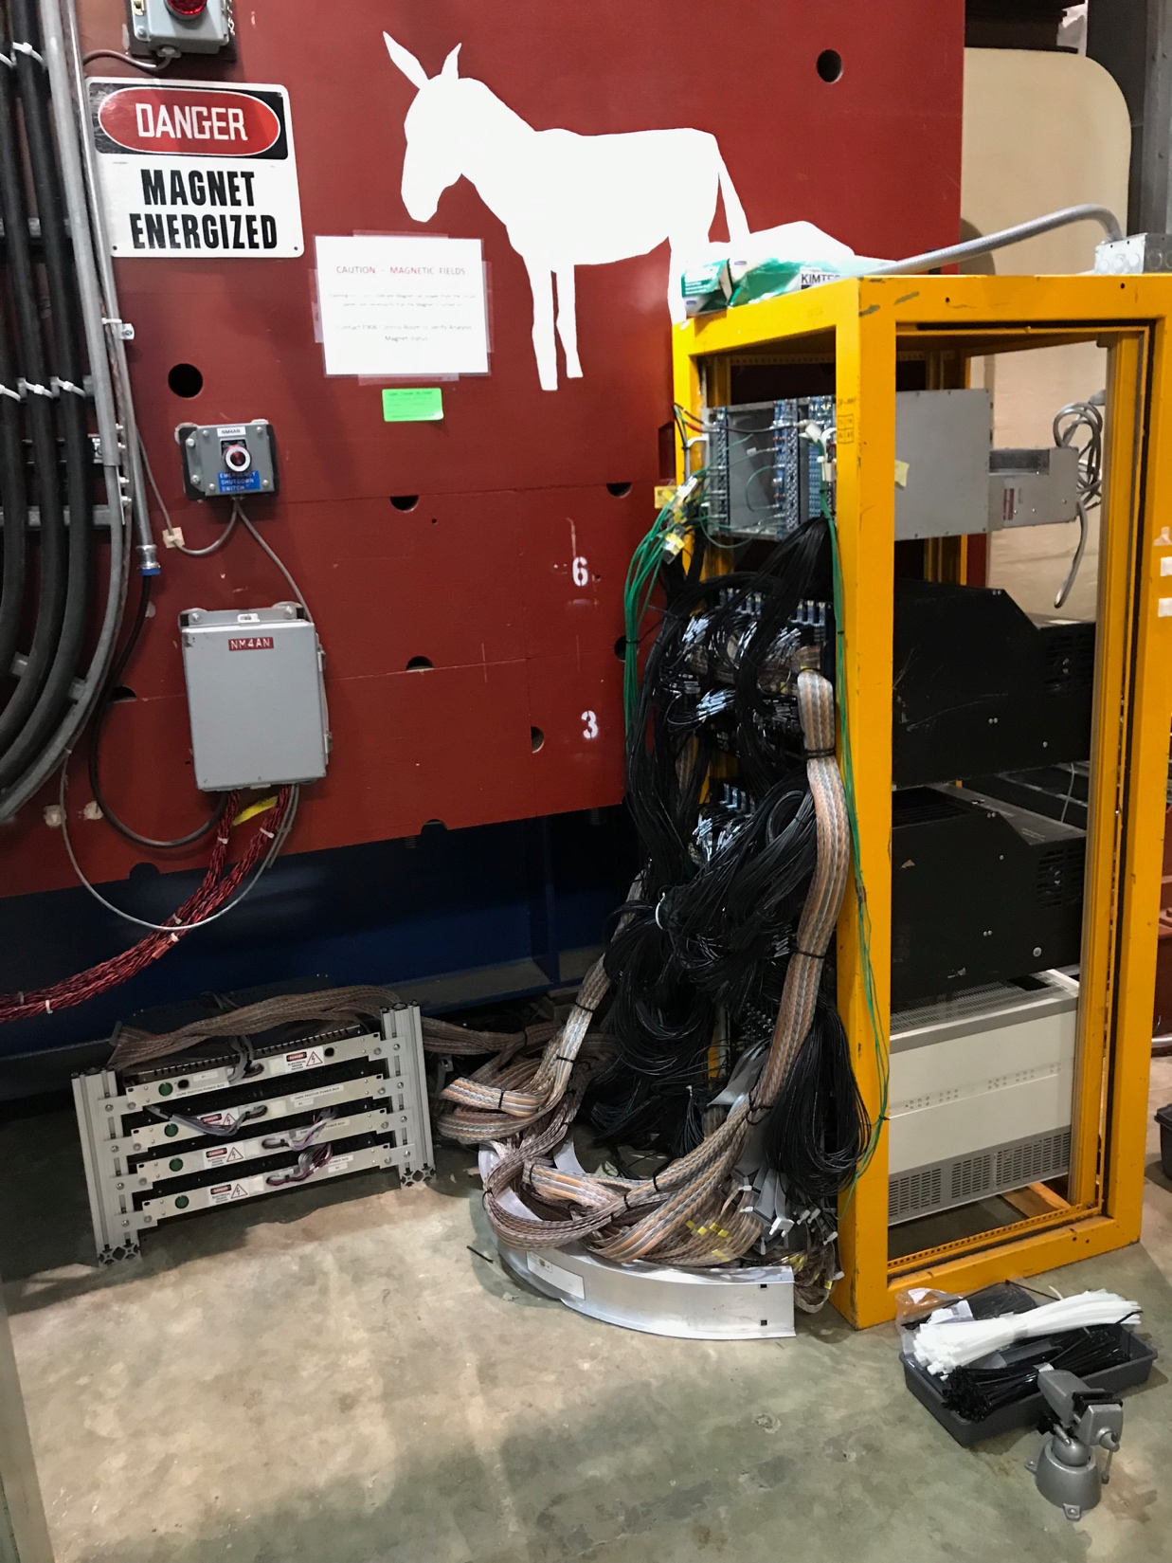
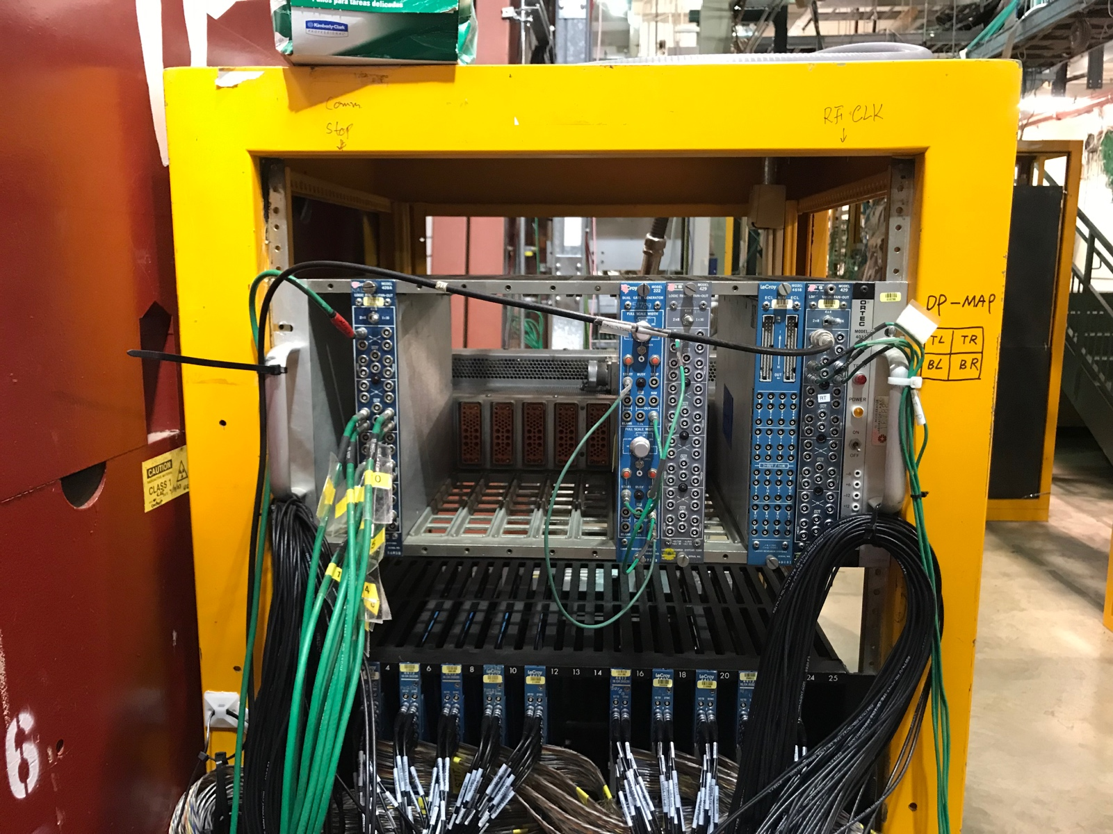
Master RF clock and Common Stop for
TDCs and V1495
Rack #1
ST-1 Power Boxes

Slide 24
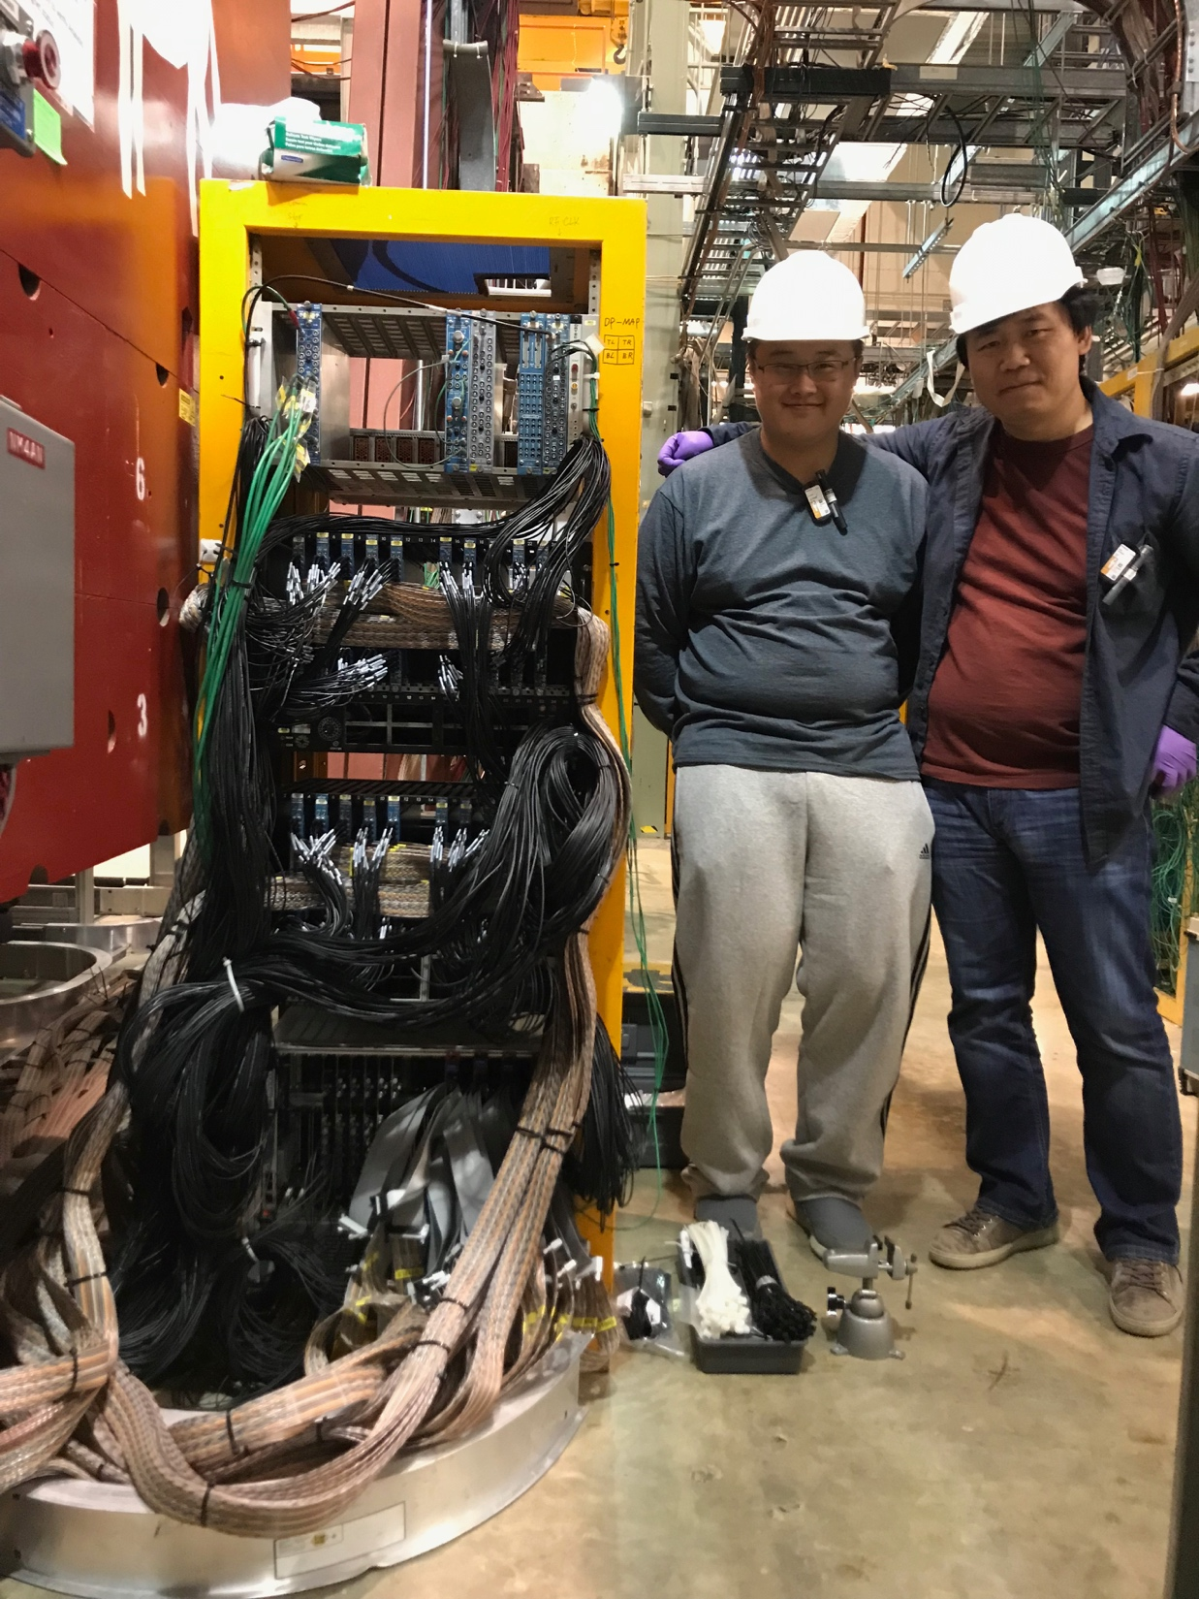
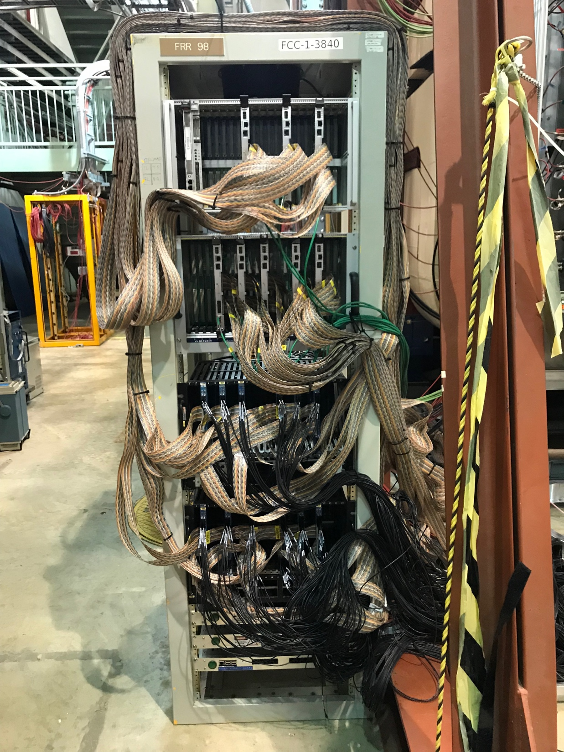
Rack #2
Rack #1

Slide 25
To-Do’s for coming weeks
Connect power to rack #1, #2; ~next week (Rick)
ORC review (Kun et al), in a week or two?
Start detector commissioning (Cristina, Ming, Kun et al) once we pass the ORC
~ Mid November
DAQ & Slow control integration (Andrew/Zongwei , Misha et al )
~Mid November
Cosmic runs with the rest of E1039 detectors
~Early December

Slide 26
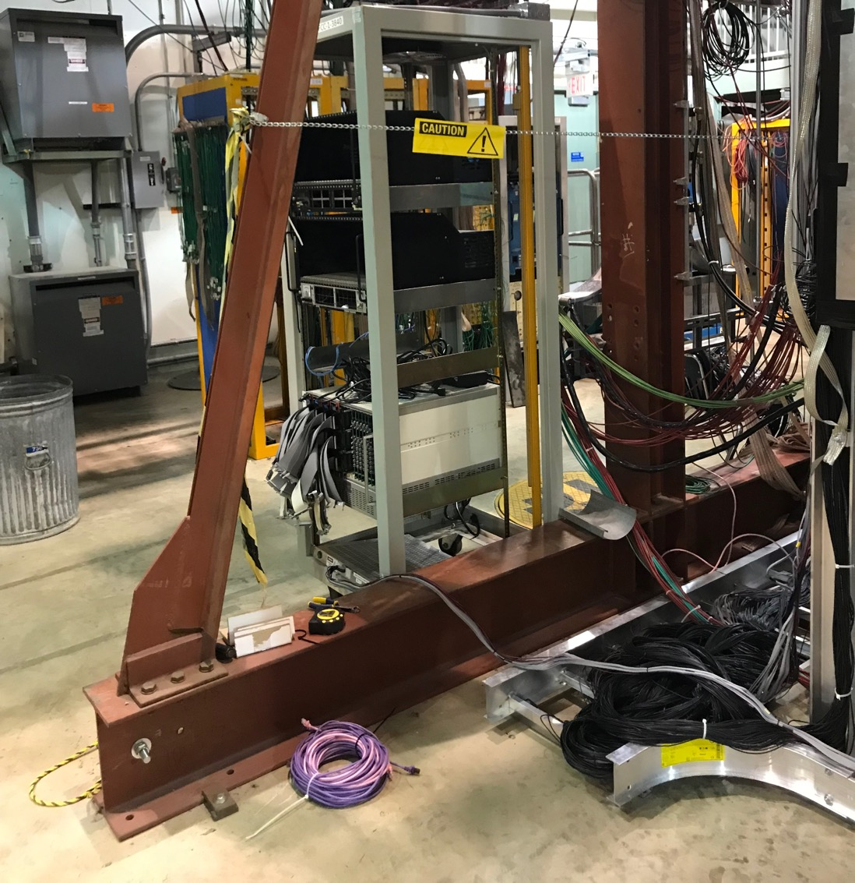
Work Plan Update – 10/21/2019
1. Move the St-2 power boxes to the location shown in photo
- Build a similar 80-20 frame
- Just order a few 80-20 (1”x 3” x 30” ?)
2.Replaing and re-cabling Rack#1 probably is not a big job, 1~2-day work
since all cables already labeled
mapping is fixed
If possible, get a taller rack
Cristina + Astrid + local helpers?
3. We could submit electrical contract work well in advance, so they can work on them once we replaced the rack #1 (even before the installation of all modules/cables)
ST-2 Power Boxes (3) here?

