Slide 1
Dark Photon Detector Status and Plan
Ming Liu, LANL
E1039 Collaboration Meeting
07/15-16, 2019, Fermilab

Slide 2
Dart Photon Detectors – Introduction

Slide 3
Displaced Vertex Trigger

Slide 4
Basic Design - Hardware
ST-1 Quadrant
ST-2 Quadrant

Slide 5
Basic Detector Design Parameters

Slide 6
Trigger Logic – Can also help DY & J/Psi from Upstream Target

Slide 7
Readout Status – 11/2018 (from Sho)

Slide 8
DP Detector Status
All broken channels fixed in Nov, 2018, by Sho, Hubert, Kun et al.
https://seaquest-docdb.fnal.gov/cgi-bin/private/ShowDocument?docid=4615
This summer work in progress, July – September, 2019
Reconfigure the readout/power cables route
Relocate racks for readout and PS, to break the ground loop
TDC crates, DAQ integration

Slide 9
DP Trigger New Layout (5/28/2019)
beam
- Run all cables under
the KMag, with cable tray
Possible extended SMA-Lemo, ~5’ (NOT needed! 7/2019); cable tray
DP-1
KMAG
RACK-4 (exists)
VME/TDC (6)
VME/TDC (6)
RACK-1
Signal cables (40’), under kMag
DC-2
Existing cable
tray
Rack-3/DP Trigger
(L2 rack)
-VME:
4xV1495
L1 trigger
DC-2
RACK-3 (exists)
DP/V1495
RACK-2
DP-2
New Rack-2, SMA-Lemo unchanged, cable tray, new power to Rack-2
(4 Qs)
Rack-1/ST-1: 4x 80 ch
-CAMAC (10 x LeCroy 4413)
-CAMAC (10 x LeCroy 4413)
-NIM/BlueLogic trigger
Calibration
SiPM PS
Rack-2/ST-2: 4x 50ch
-CAMAC (8 x LeCroy 4413)
-CAMAC (8 x LeCroy 4413)
-NIM
-SiPM PS
L2 rack/V1495 (Rack-3)
DP trig(OR)
DY trig(AND FPGA trig’s)

Slide 10
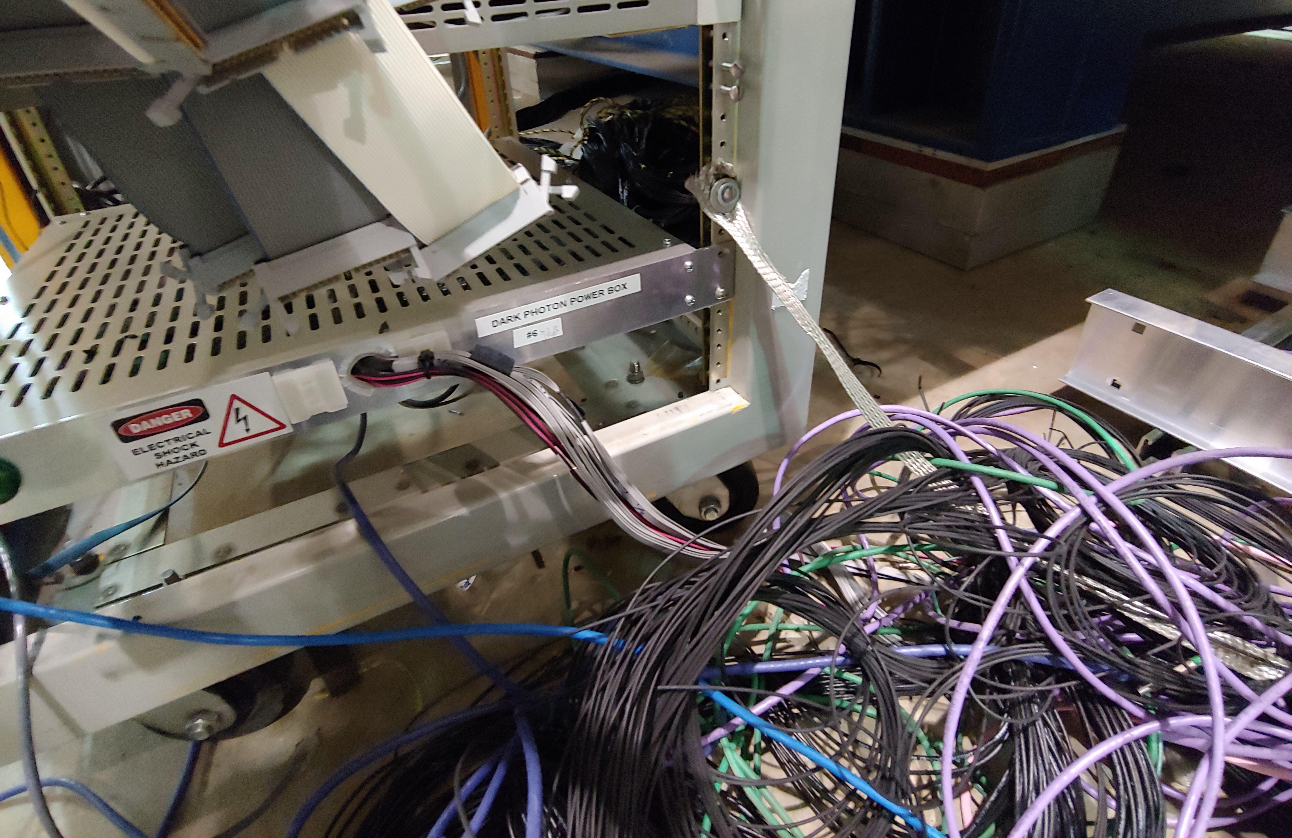
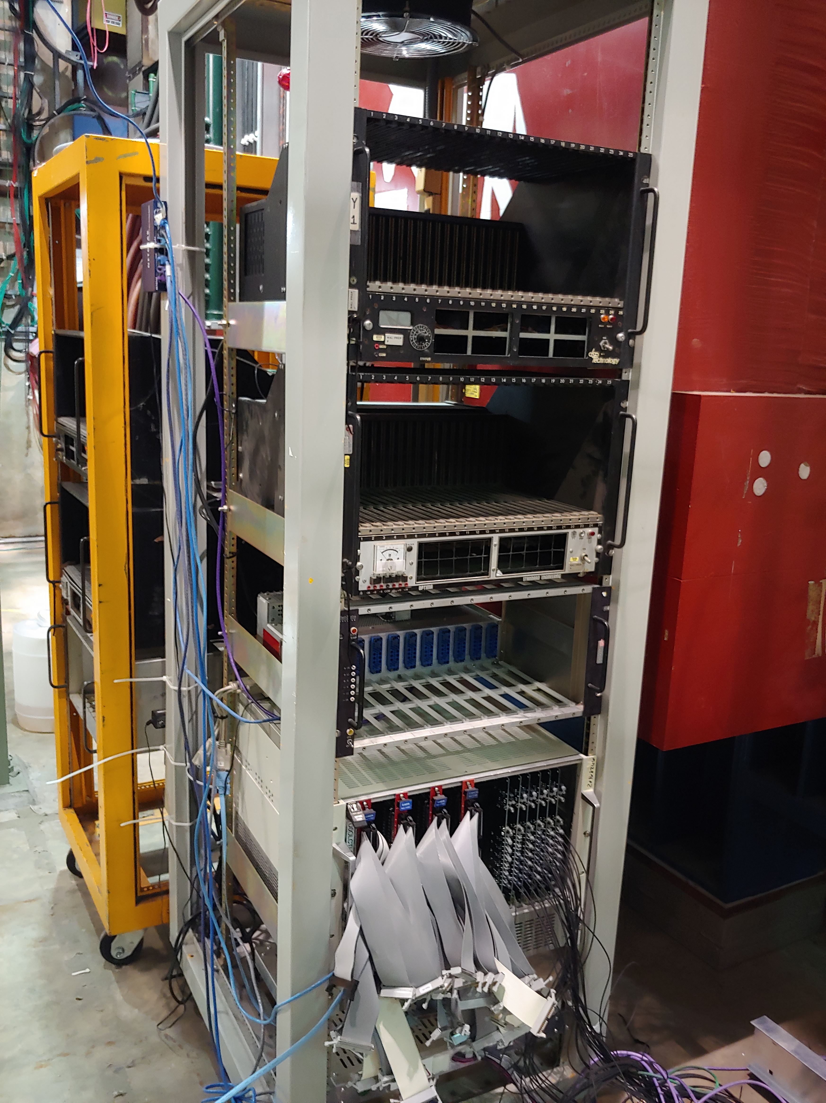
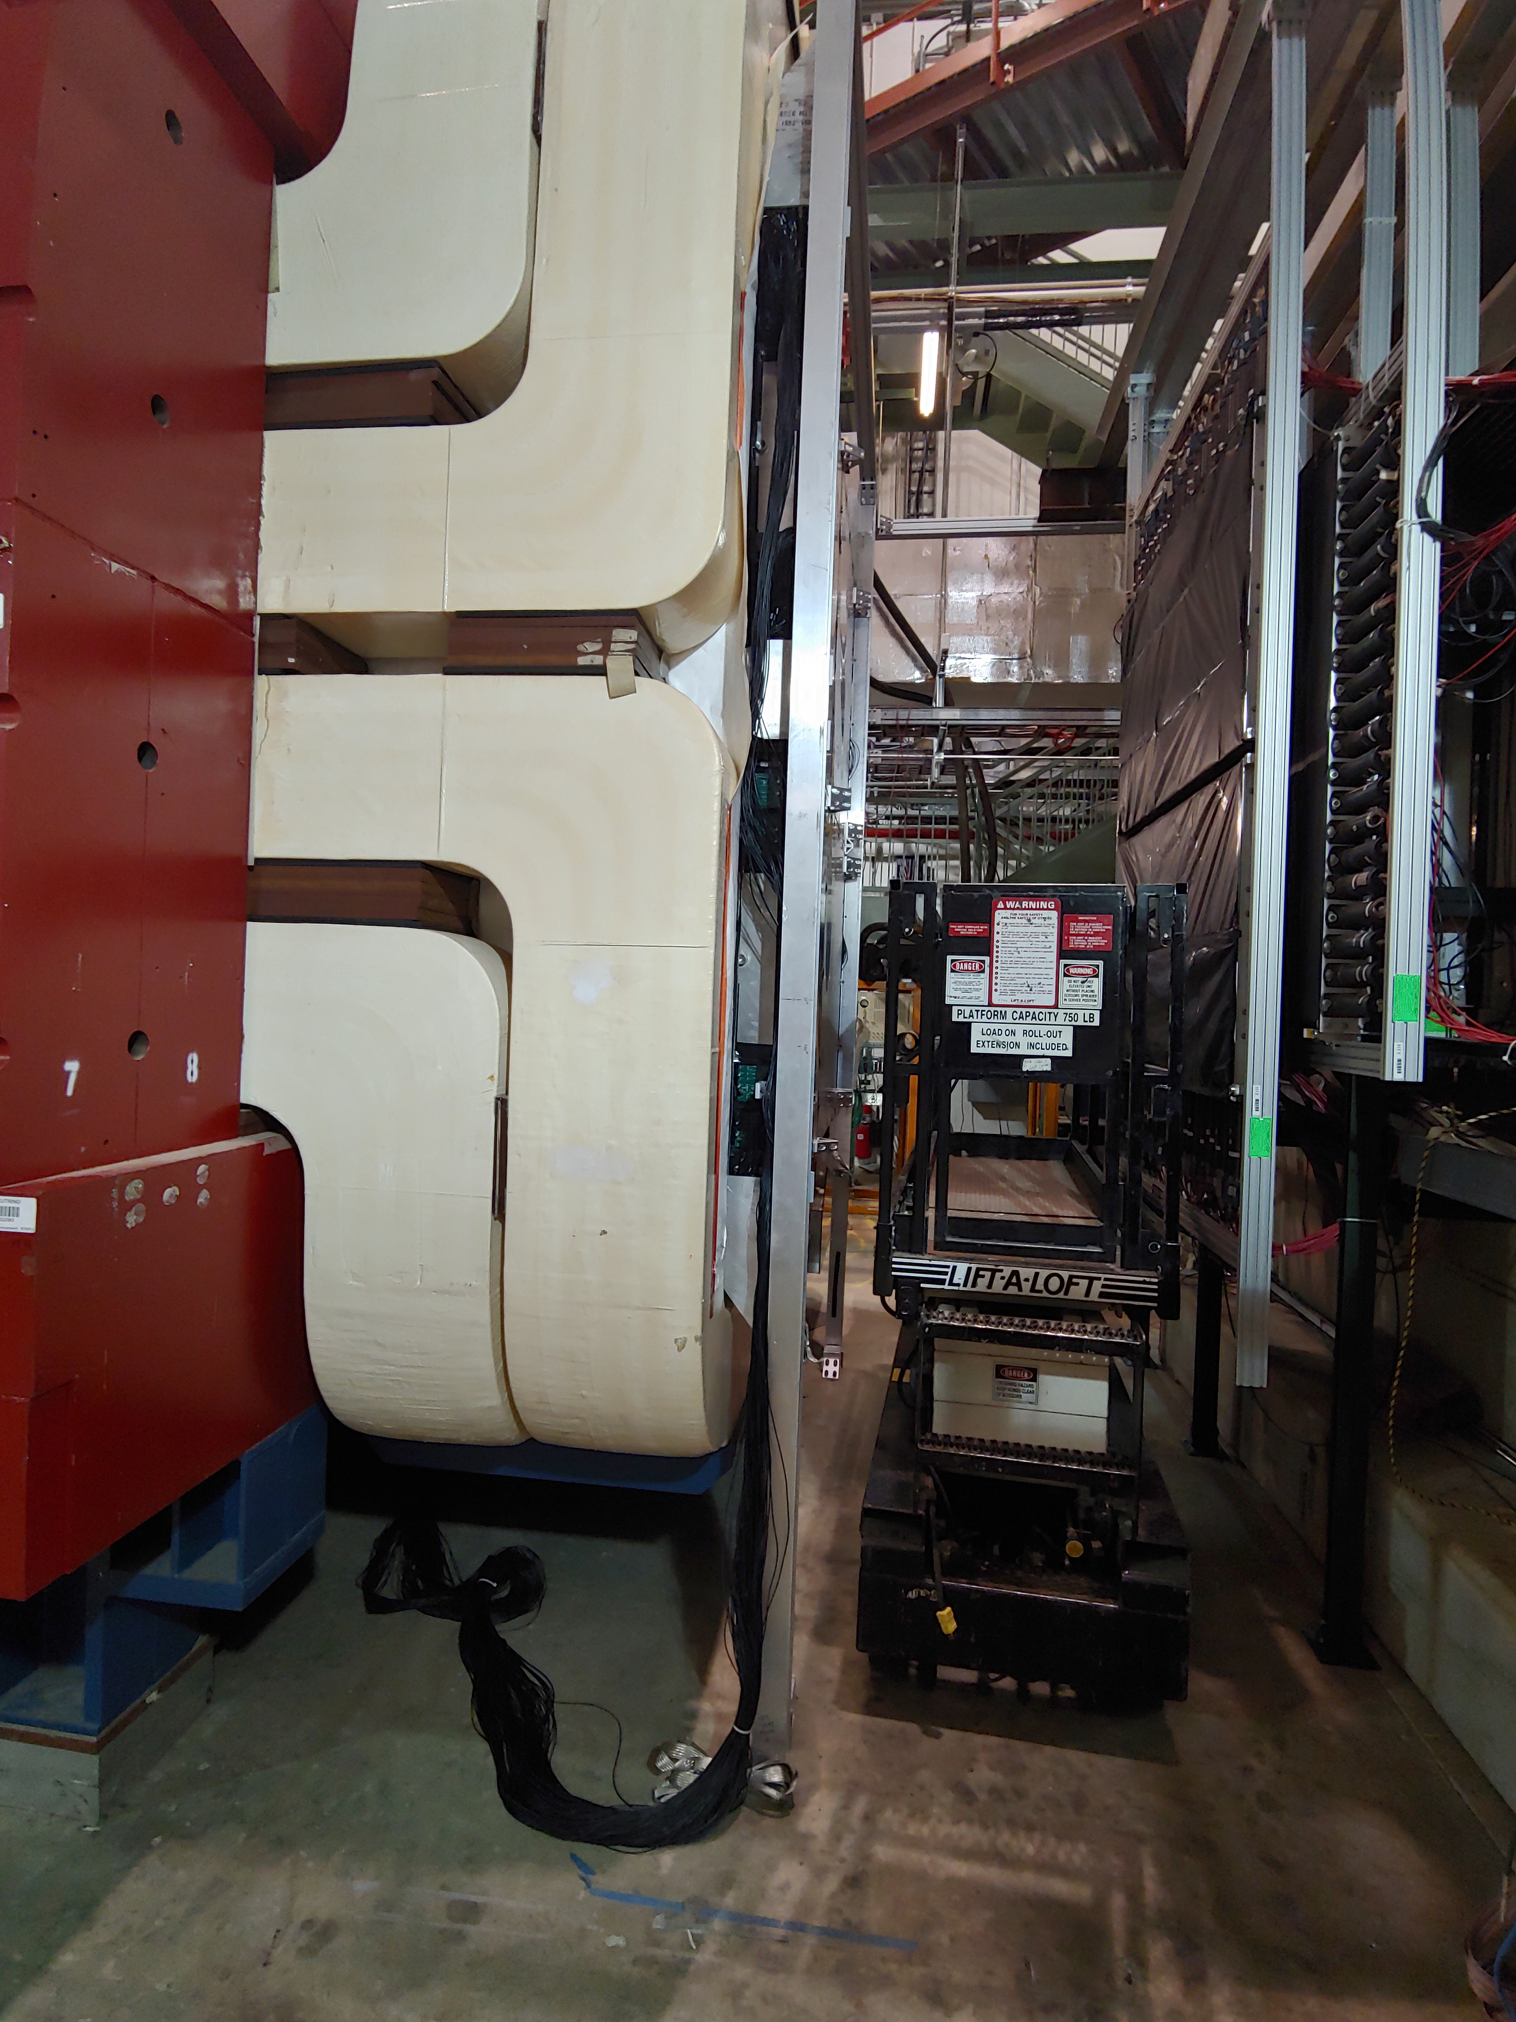
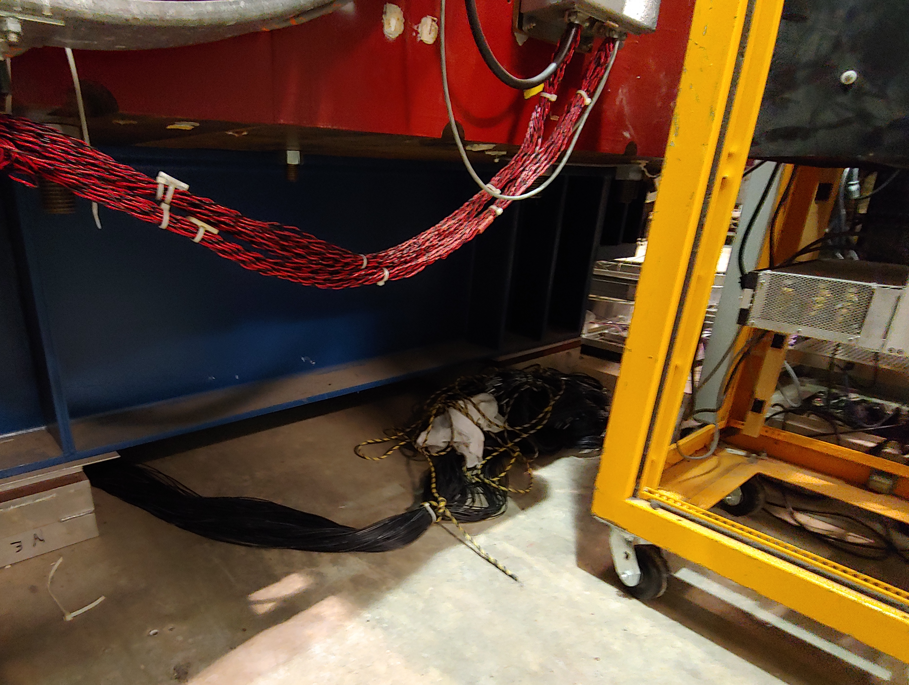
Work in Progress – Summer 2019
All cables are pull off and ready for reconnection in the new locations,
Thanks Marshall, Kun, Mindy et al

Slide 11
Test Plan: Aug. – Sept. 2019

Slide 12
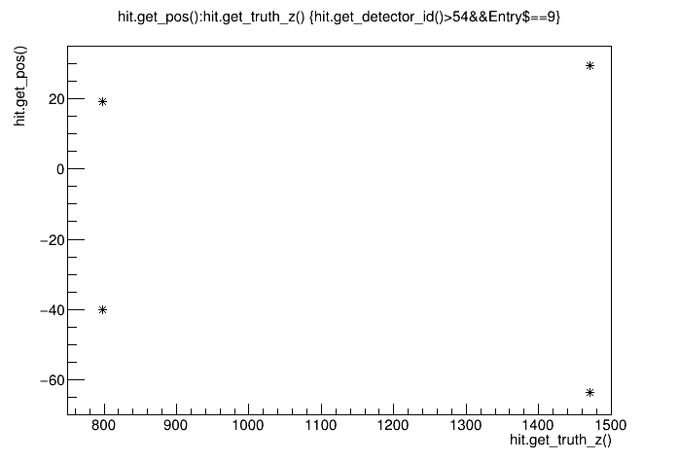
Target/Dump Simulation Study - Work in Progress
Thanks Haiwang Yu’s help for setting up the simulation framework for DP,
Also Kenichi, Kun and Mindy et al.
MC samples from target:
DY
J/Psi
Single muons
Target-Dump separation @Trigger level
Y
DP-1
hits
Z
DP-2
hits
Dimuon simulations: Evt: #9
10K Dimuons @Z = -300cm: /seaquest/users/mxliu/DP_Trig_Sim/e1039-analysis/SimChainDev

Slide 13
Simulation To-Do’s
Generate MC samples at
target (Z = -300cm)
beam dump (Z = 0~50cm)
Physics signal samples
J/Psi
Drell-Yan, M= 4-8GeV
Single muons (pi/K/Charm)
Trigger lookup tables
Beam-Dump separation
FPGA
To be ready for Day-1 Physics
J/Psi A_N
Dark Photon search
Single Muons A_N
Drell-Yan A_N

Slide 14
Summary
Dark Photon Detector re-configuration in progress
Re-cabling
Install TDCs,
Trigger & DAQ integration
Test run w/ calib system
Cosmic run, including other DCs, in Aug/Sept. 2019
Dark photon trigger optimization for target
Signal simulations: J/Psi, DY, single muons
Dark photon and alikes
Update FPGA lookup table
To be ready for beam in mid October, 2019
People involved -
Sho, Kun, Mindy, Marshall, Huizi, Zongze, Hubert, Ming
Haiwang, Kenichi,
Noah, Minjung,
Dylan, Cristina, Nhan et al (HEP groups)
Welcome to join us!

Slide 15
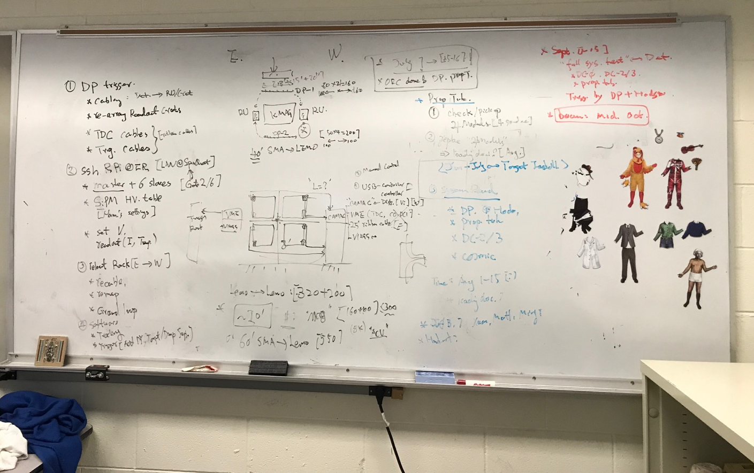
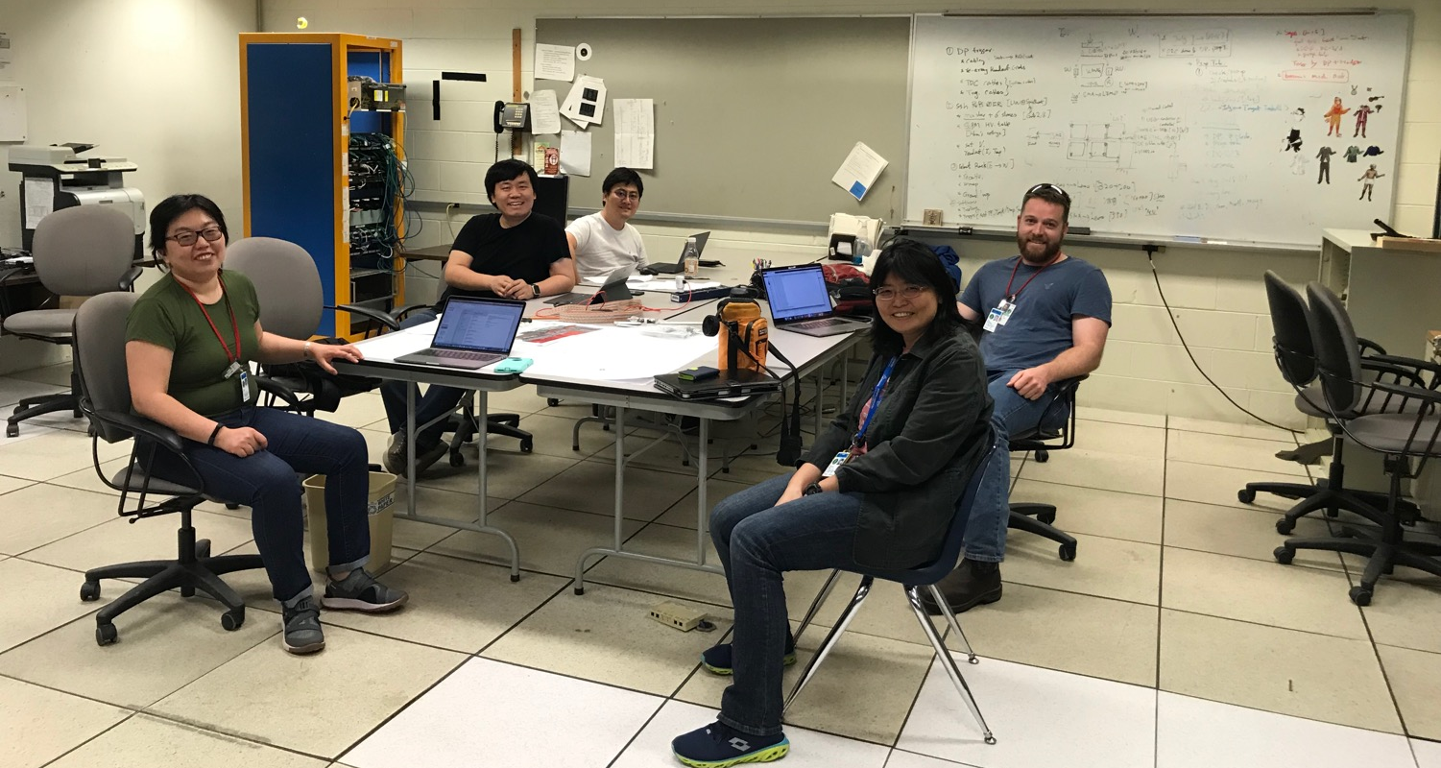
05/26/2019 Planning Discussion @FNAL

