Slide 1
E1039 Simulations
02/05/2021, Ming
MB events @target, ~50M
  Decay muons
  Standalone Pythia simulations
J/psi events, ~10M
  @target, Z =-300 cm
  @dump, Z = 0.0cm. (better +25cm)
  @after dump, Z = +500 cm
  Pythia p+p -> J/Psi + x
  Full G4 simulation
  Full offline tracking
SpinQuest Dimuon Tracking Top View

Slide 2
Standalone Pythia Simualations
@target, Z = -300 cm
Sim: p+p -> MB, pT> 0.5GeV
Ran 50+M events …

Slide 3
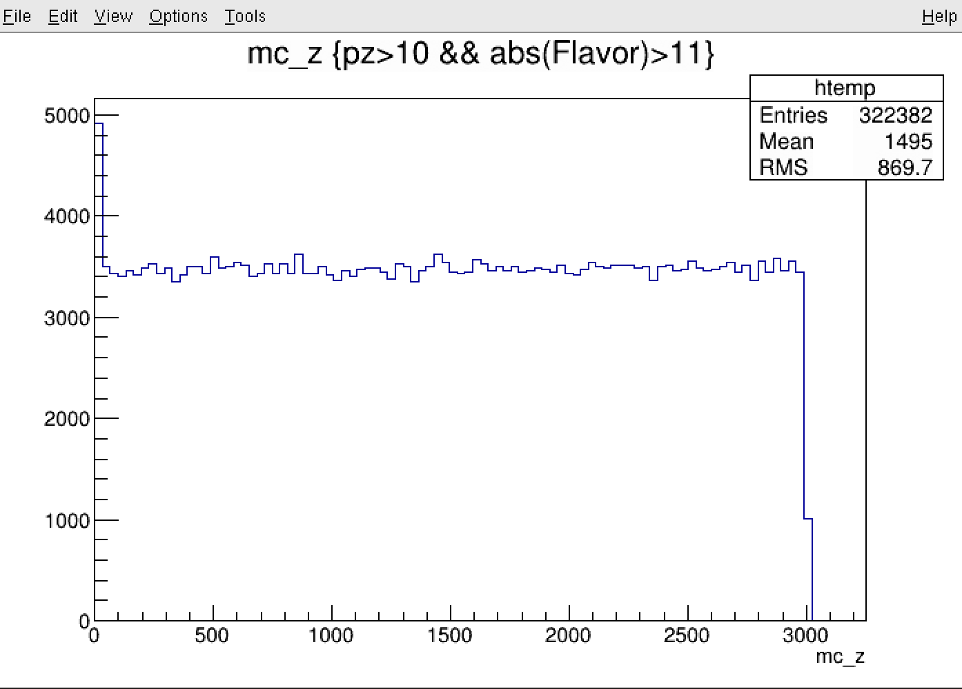
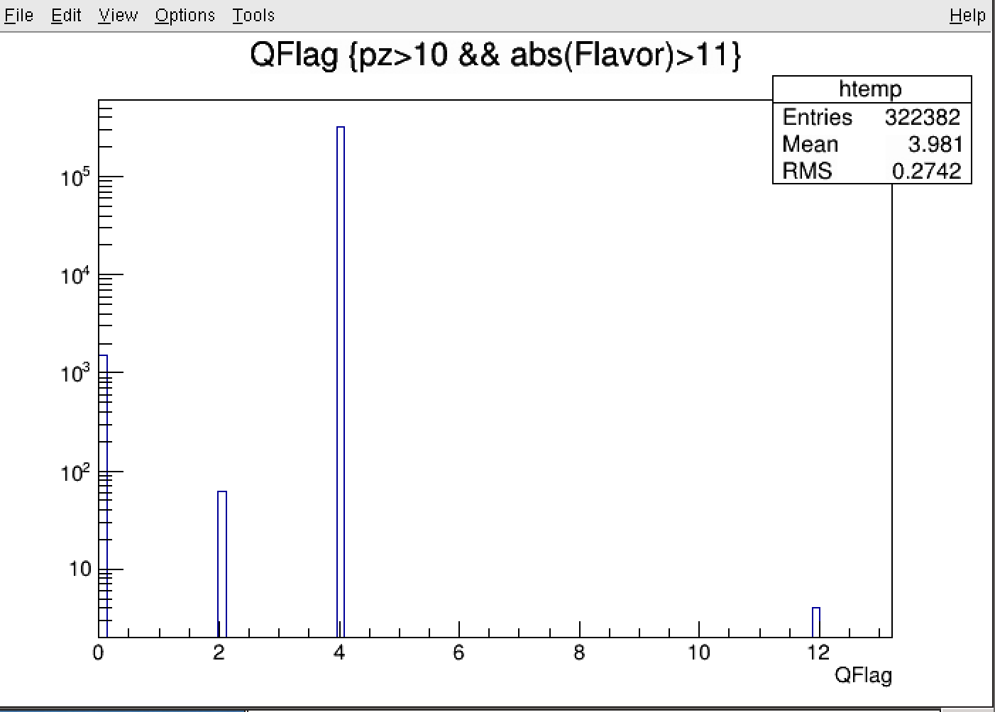
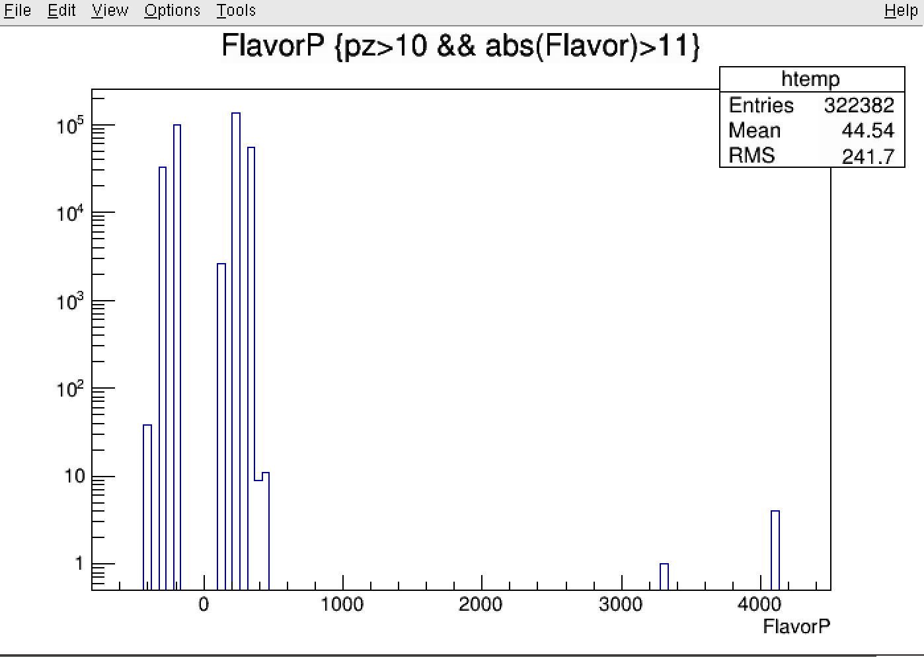
Muons from Weak Decays
Most muons are from the charged pi/K weak decays
QFlag:
0 (QCD/QED)
1 (b->mu)
2 (c->mu)
4 (pi/K -> mu)
11 (b->pi/k->X);
12 (c->pi/k->X);
13 (b->c->pi/k->X)
Decay z-vtz
parents

Slide 4
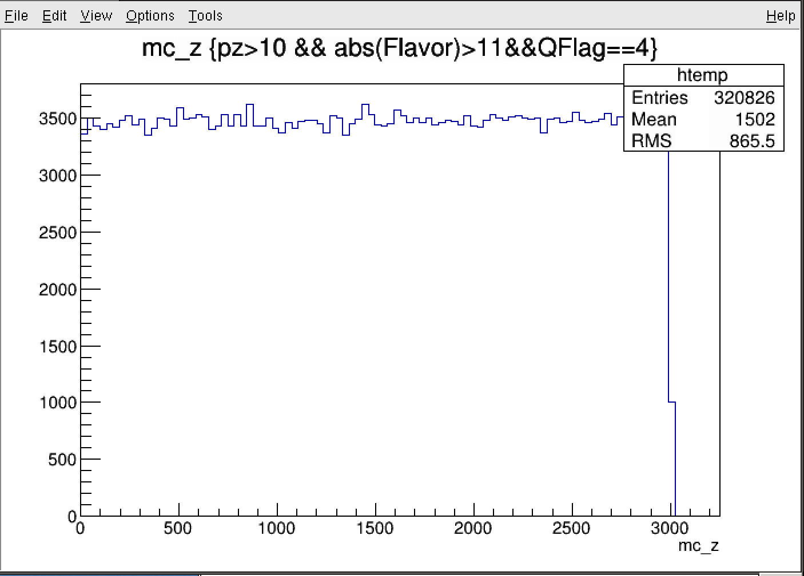
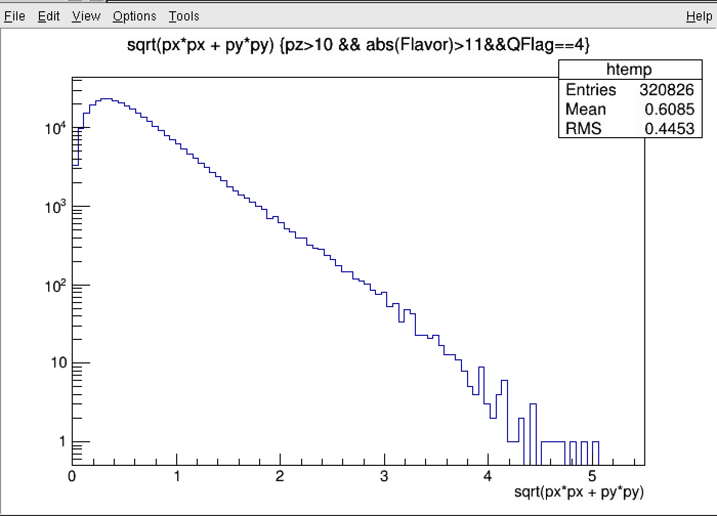
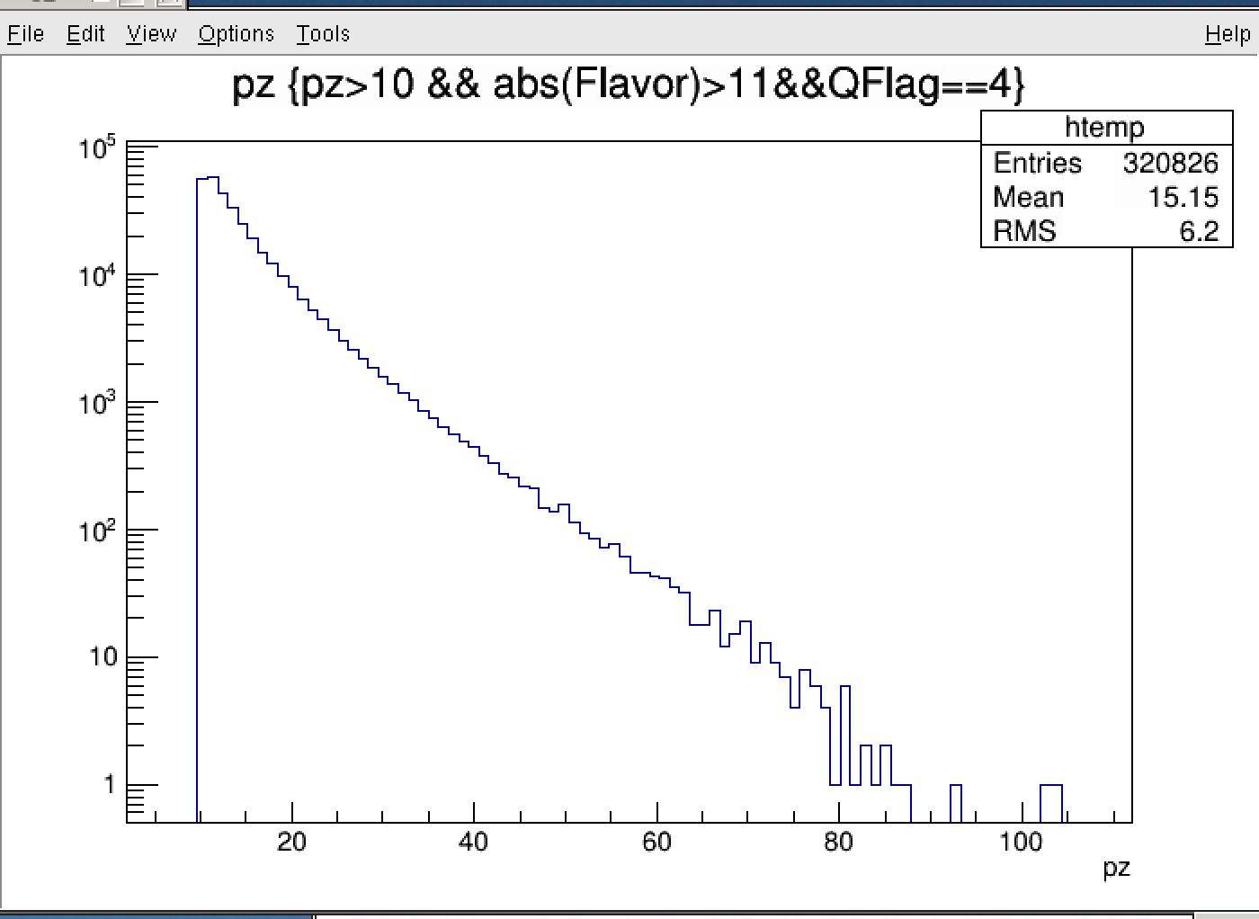
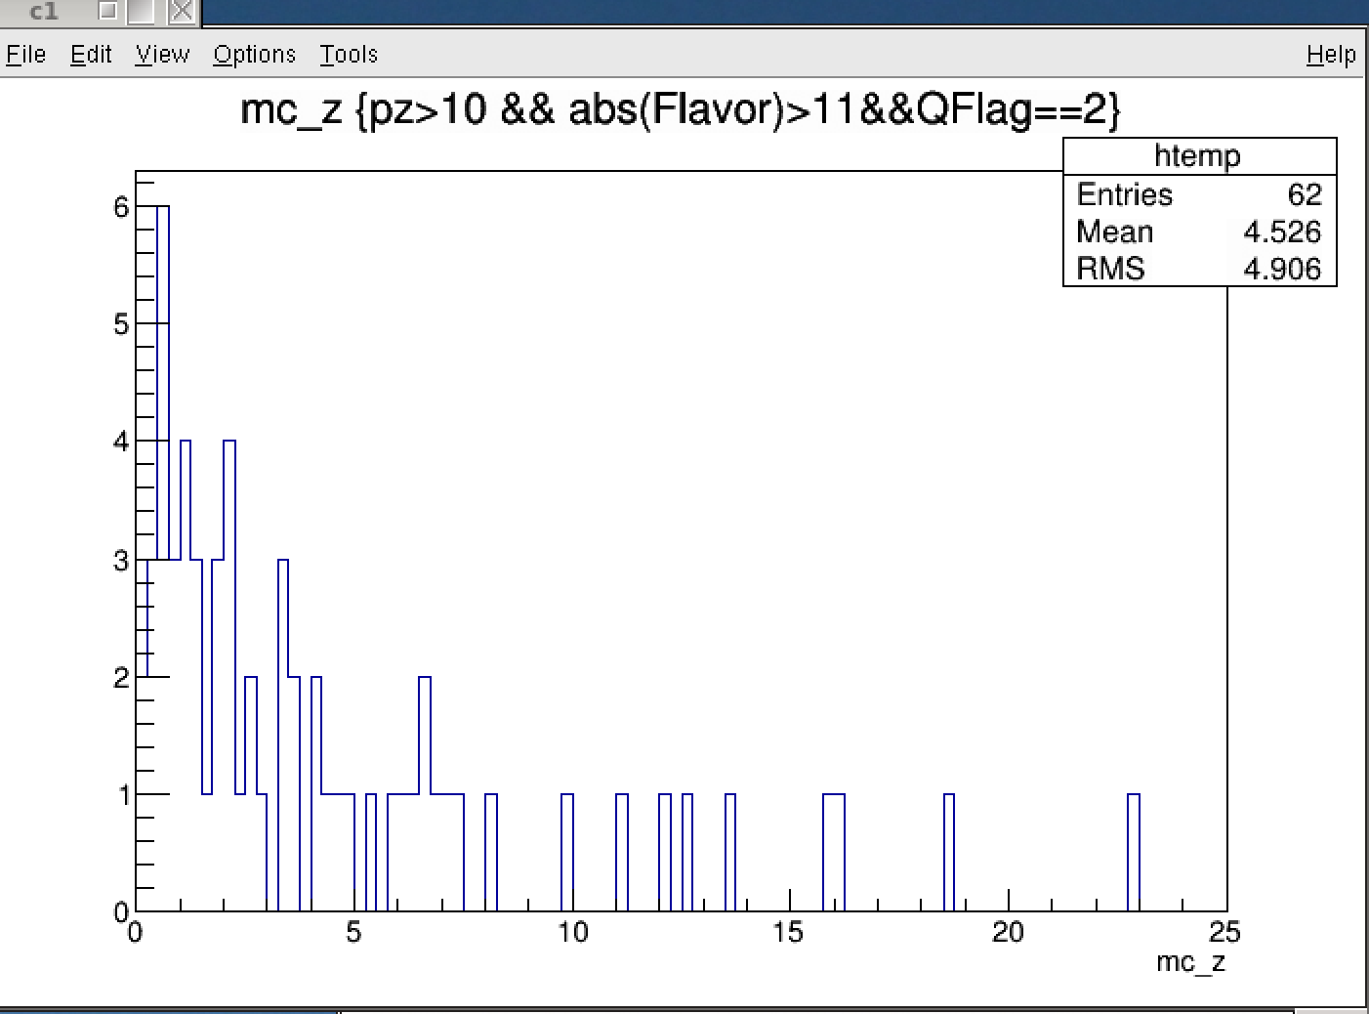
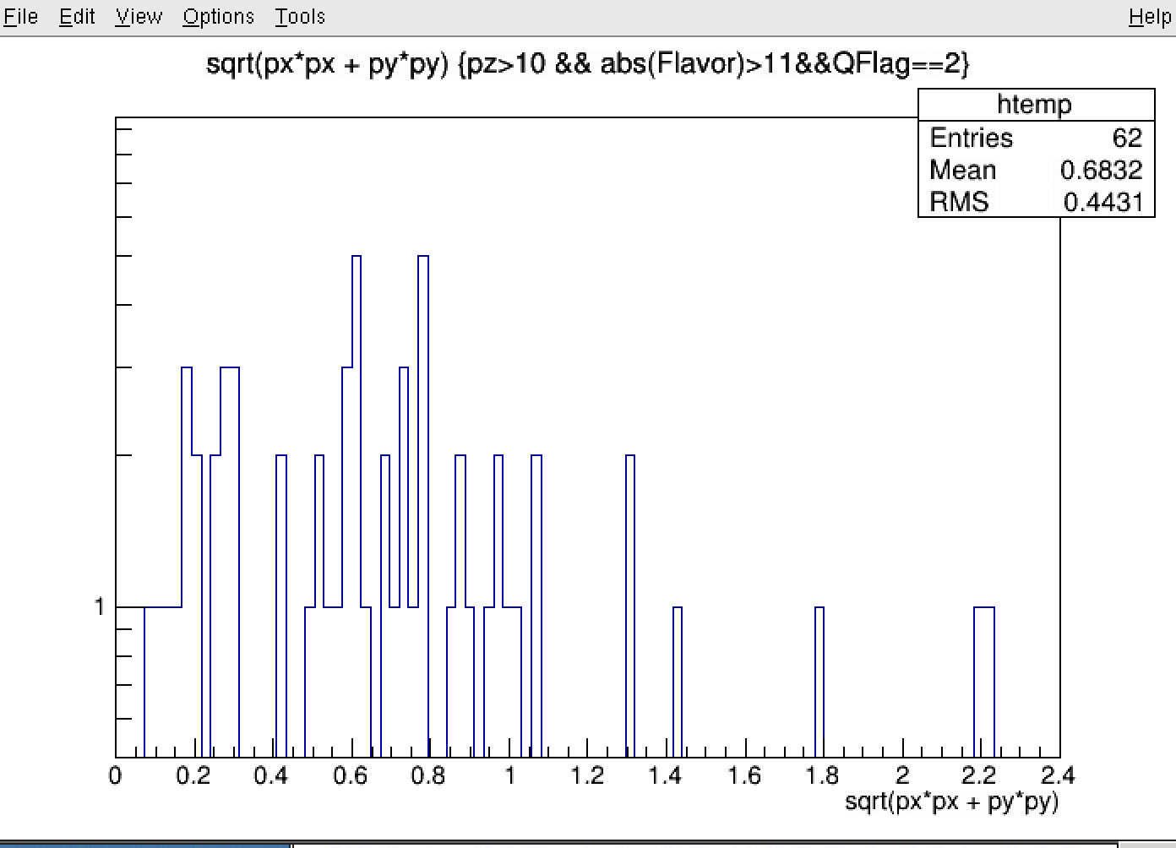
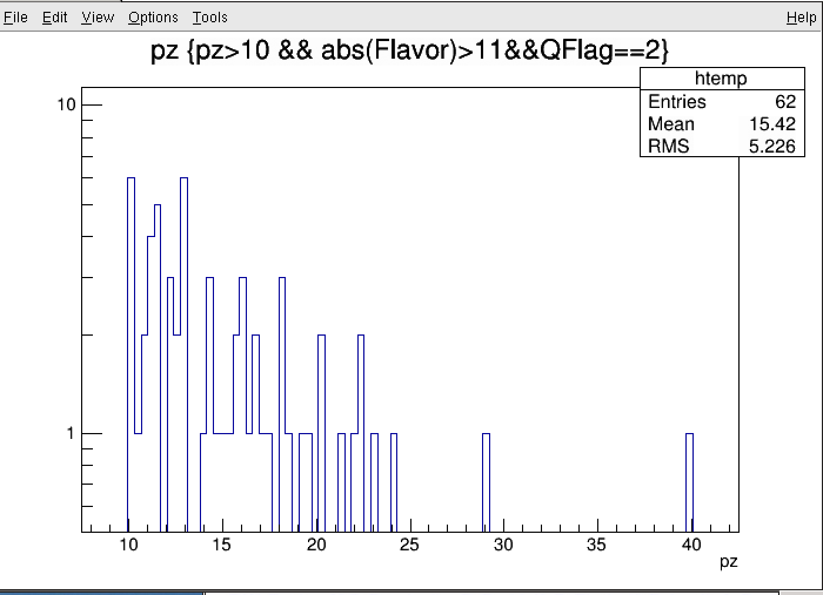
QFlag = 2, 4: mc_z(mm), pT, pz (GeV)

Slide 5
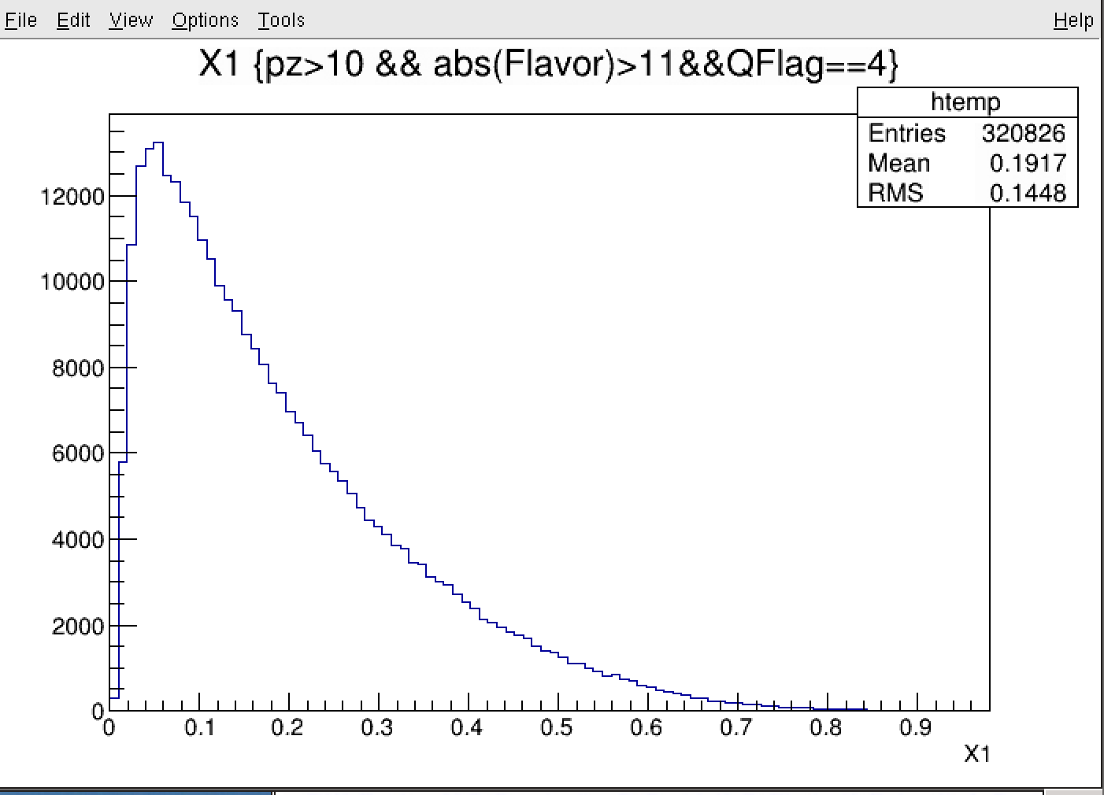
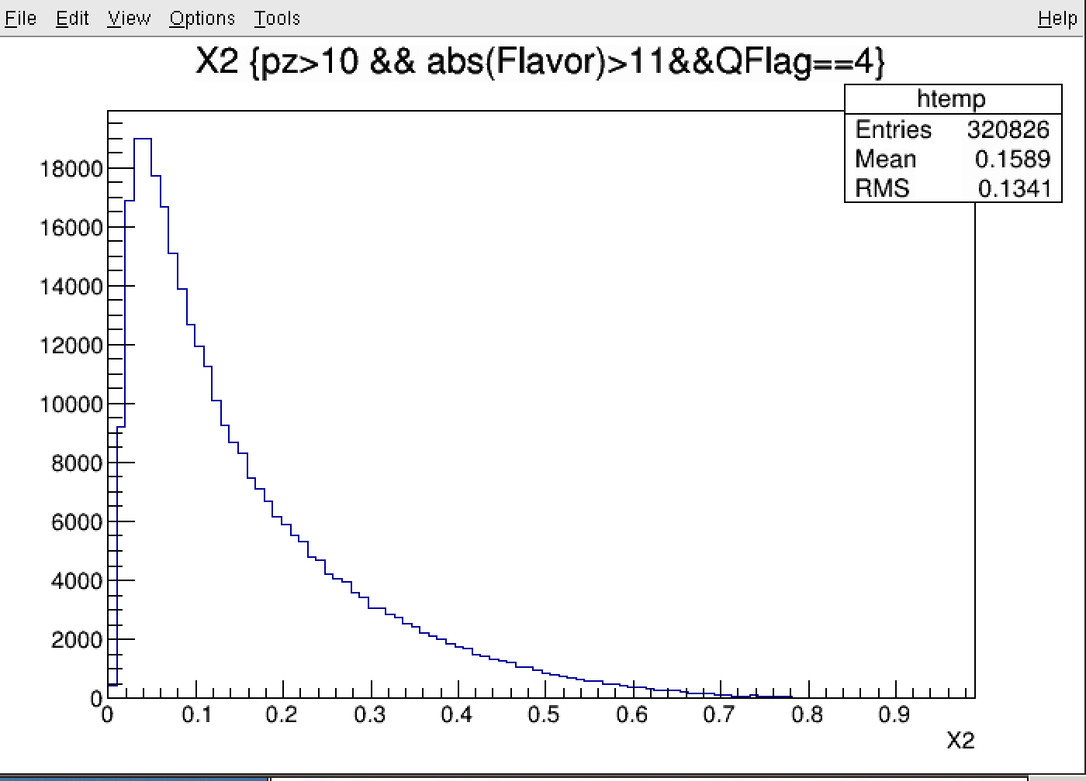
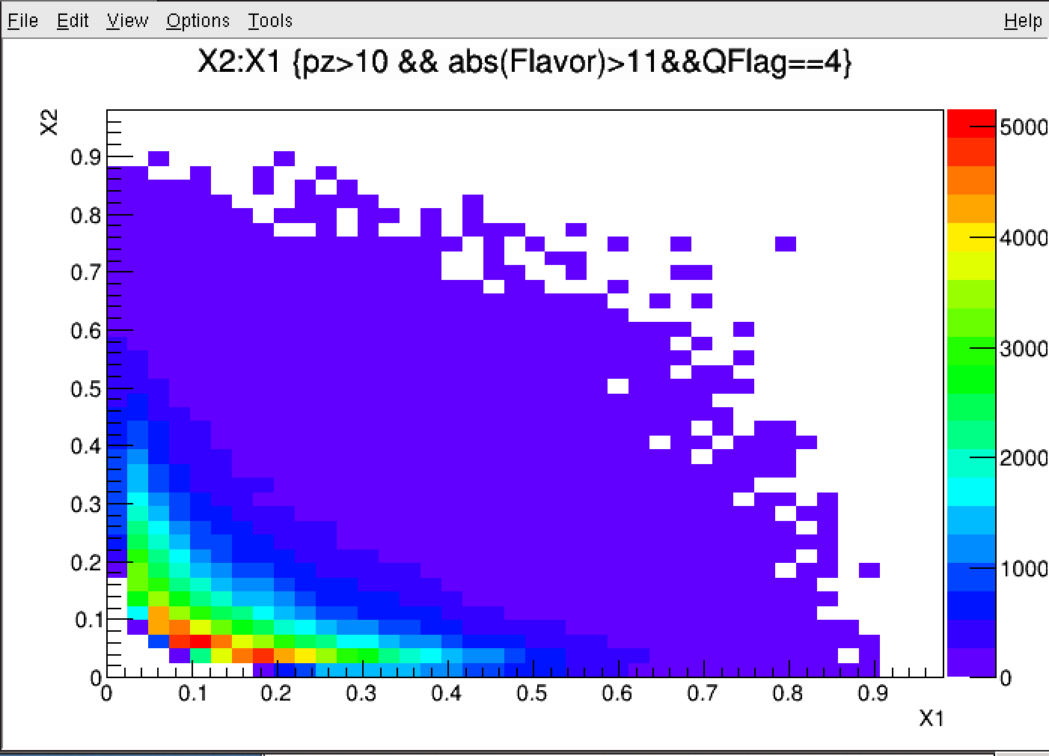
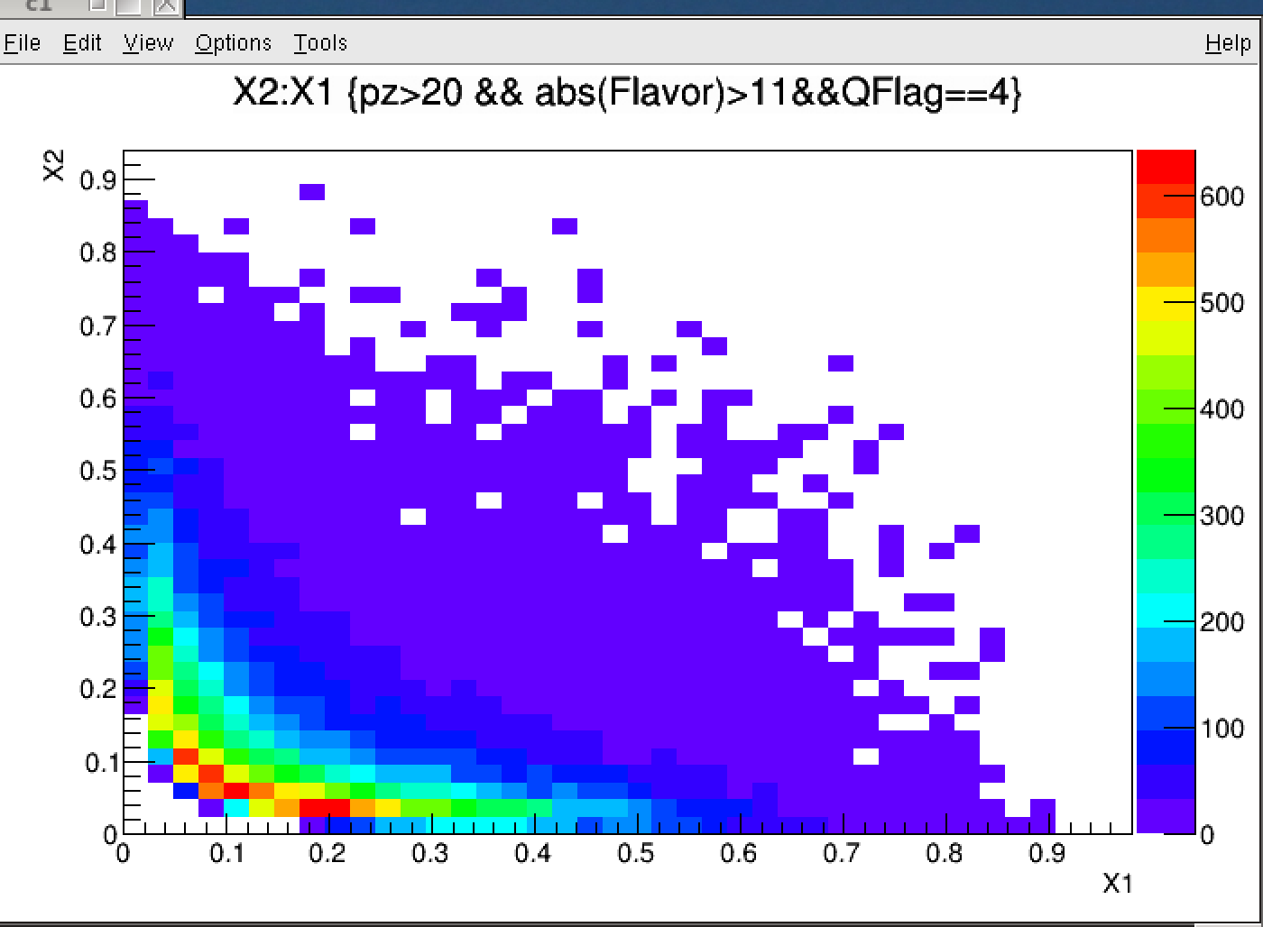
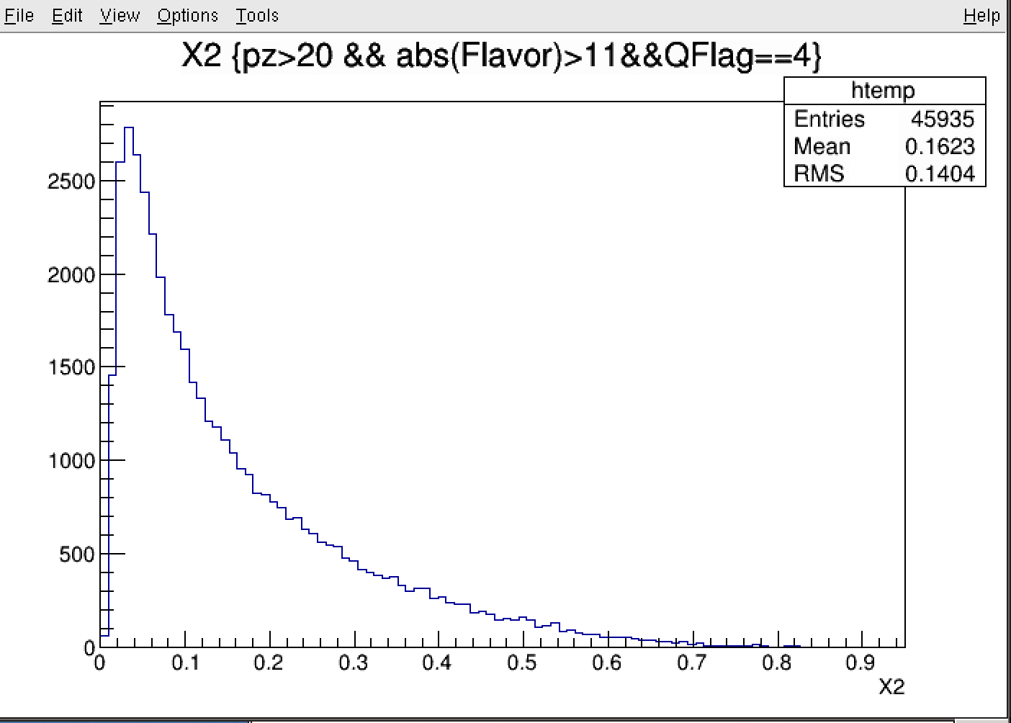
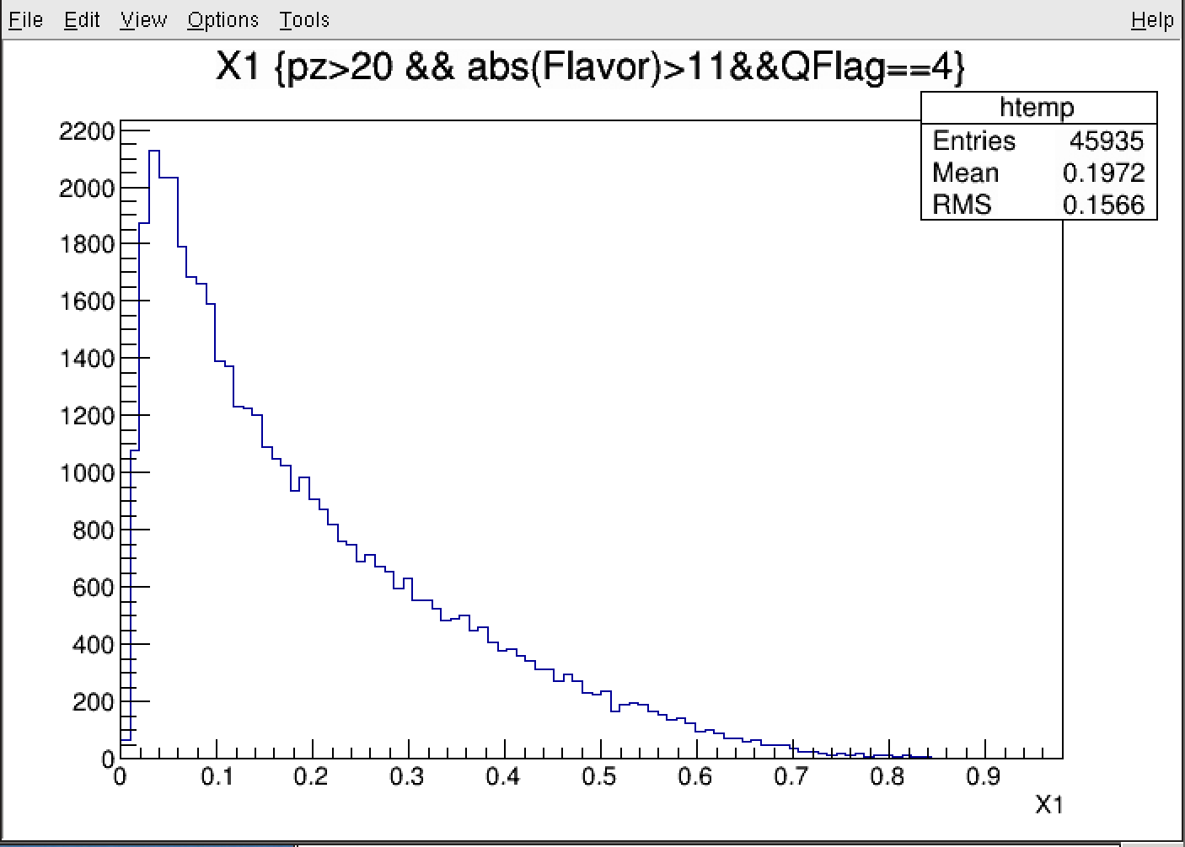
X1, X2: Qflag = 4, muons from pi/K decays
Pz> 10
Pz> 20

Slide 6
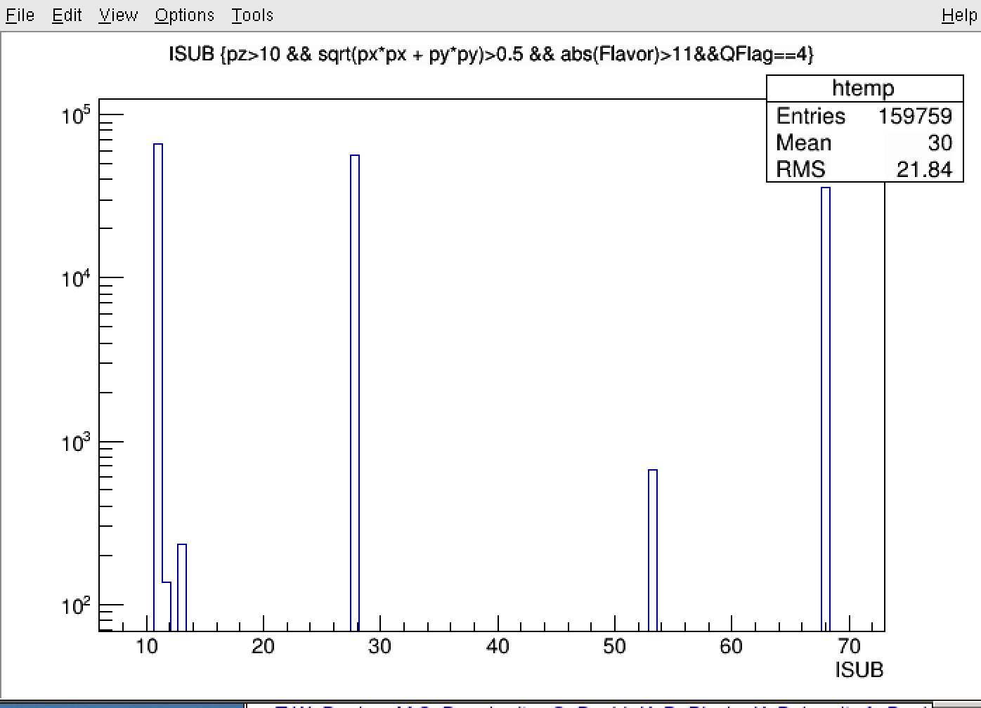
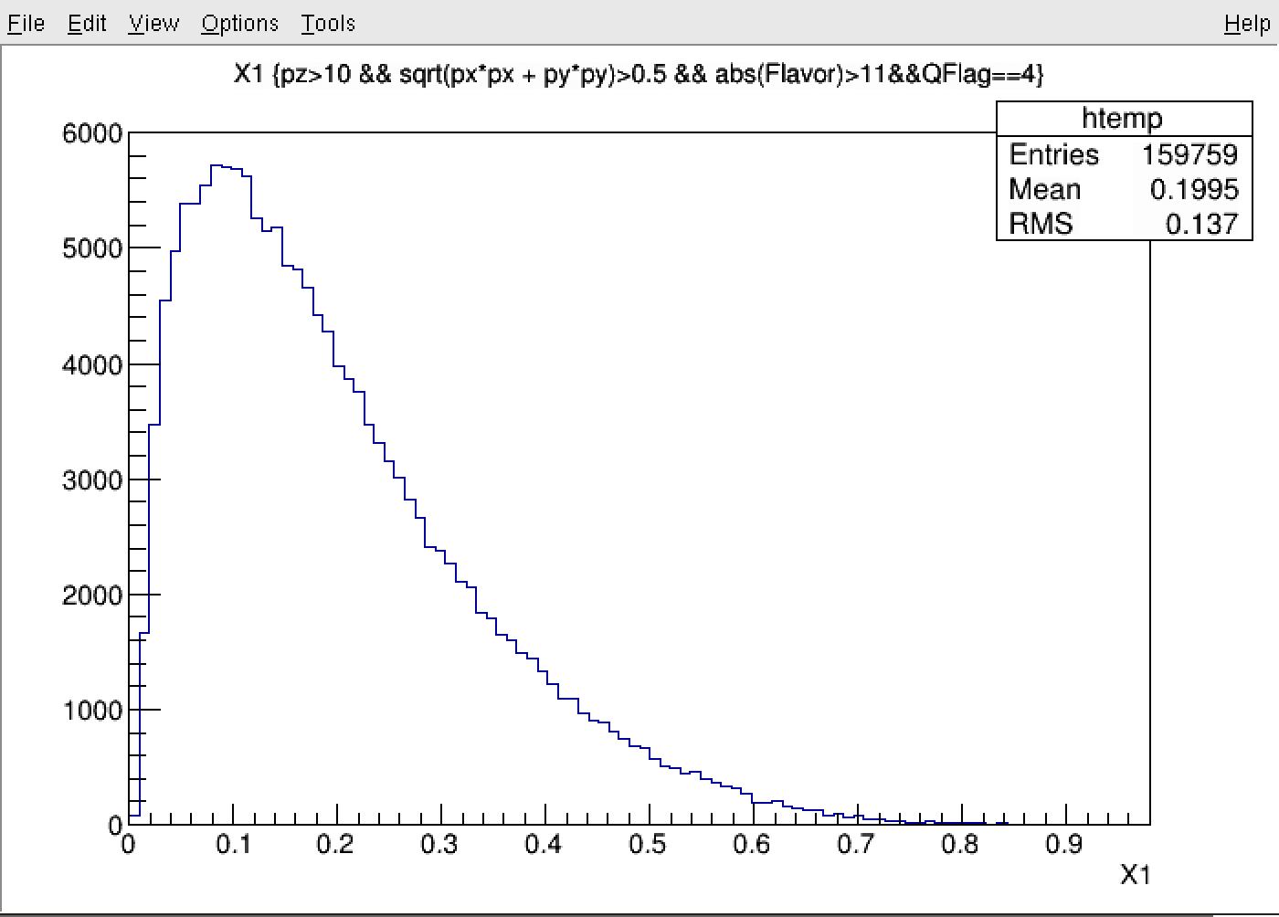
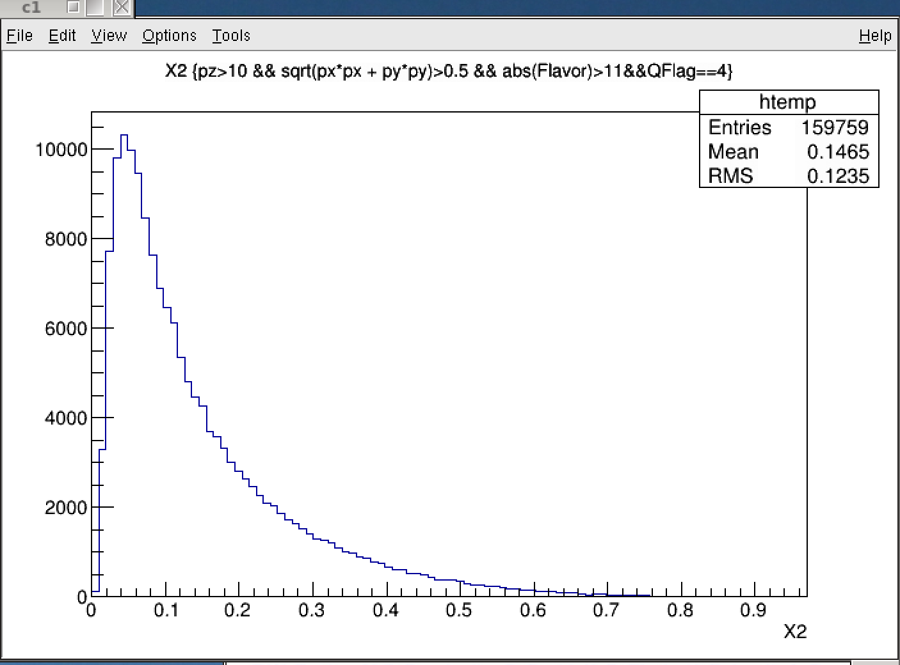
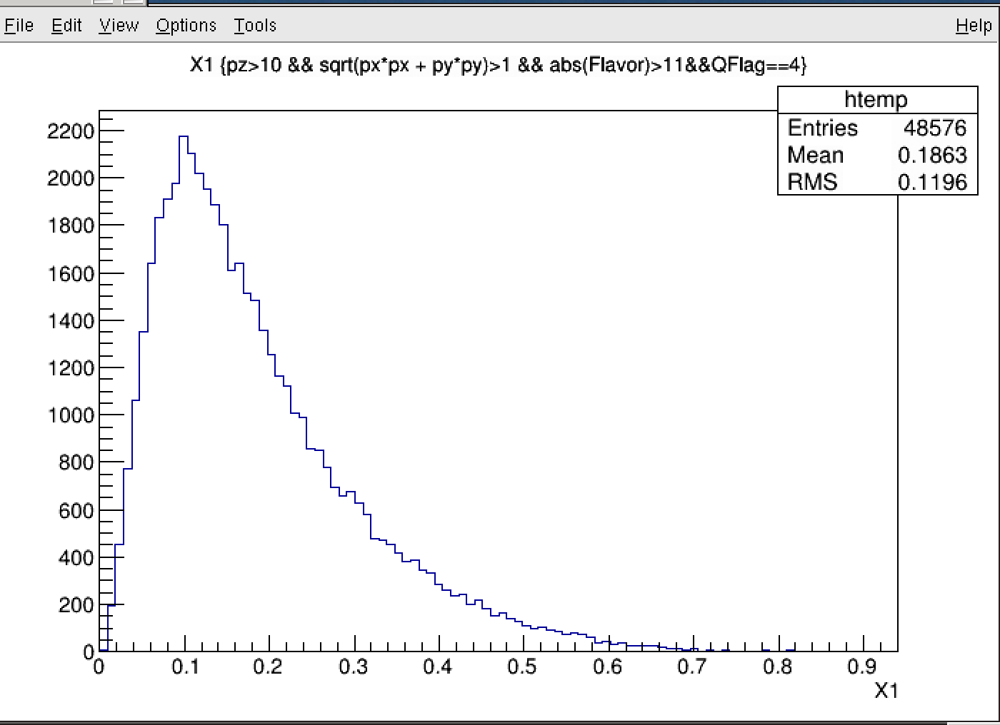
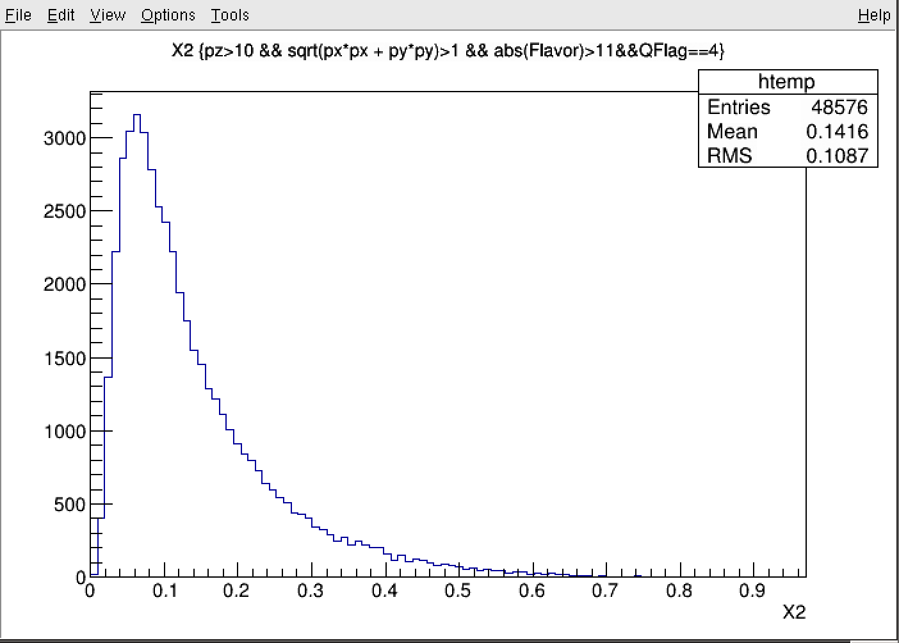
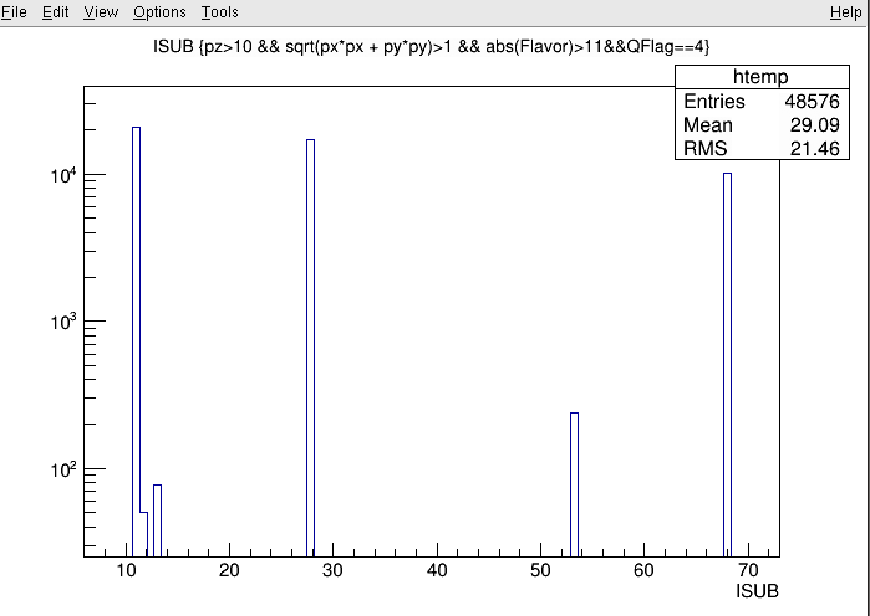
X1, X2: Qflag = 4, muons from pi/K decays
11
28
68
pT>0.5
pT>0.5
pT>1.0
11: f_i + f_j -> f_i + f_j
28: f + g -> f + g
68: g + g -> g + g
pT>1.0

Slide 7
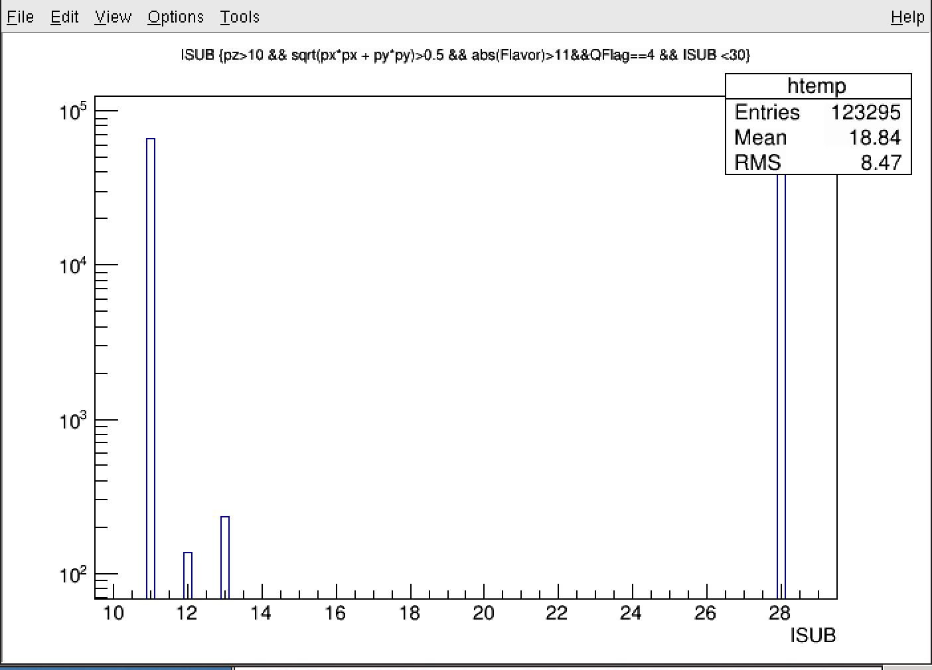
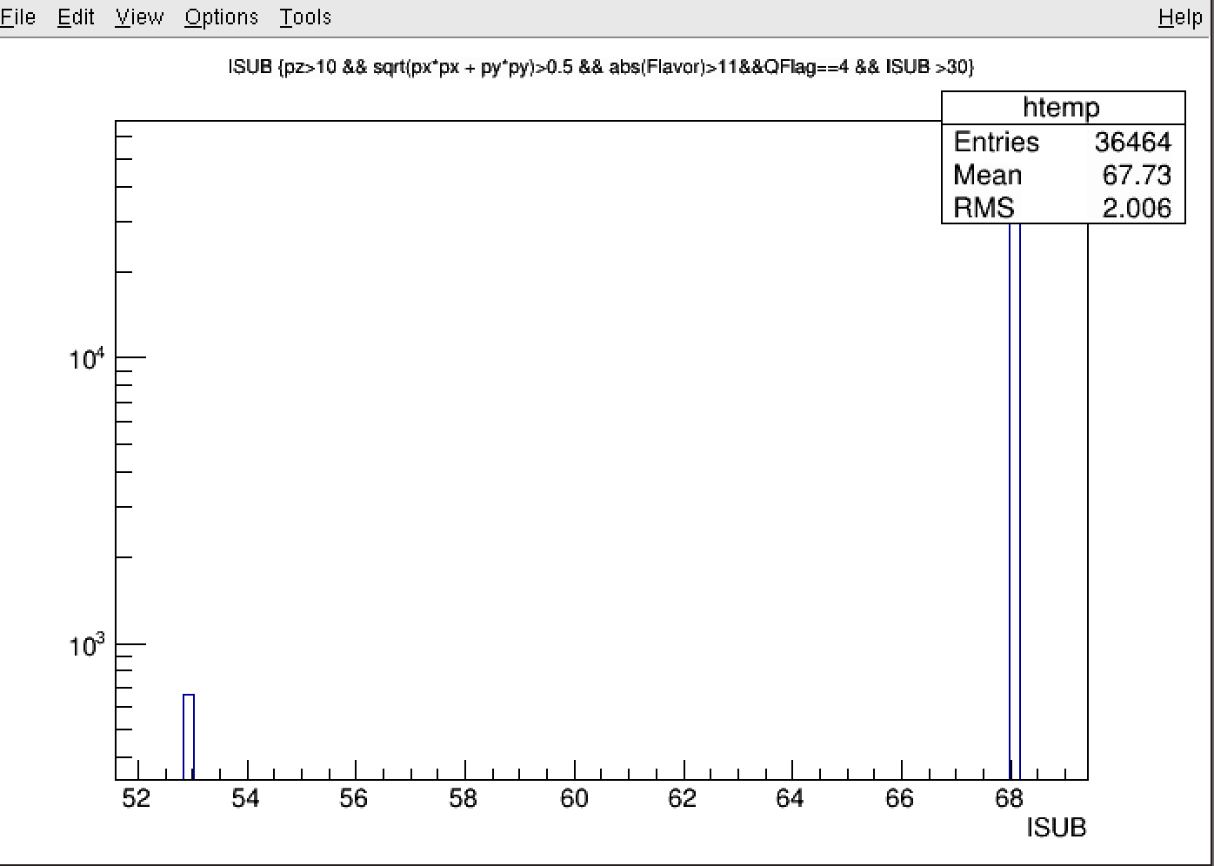
ISUB
11
28
68
12
13
53: g+g -> f + fbar

Slide 8
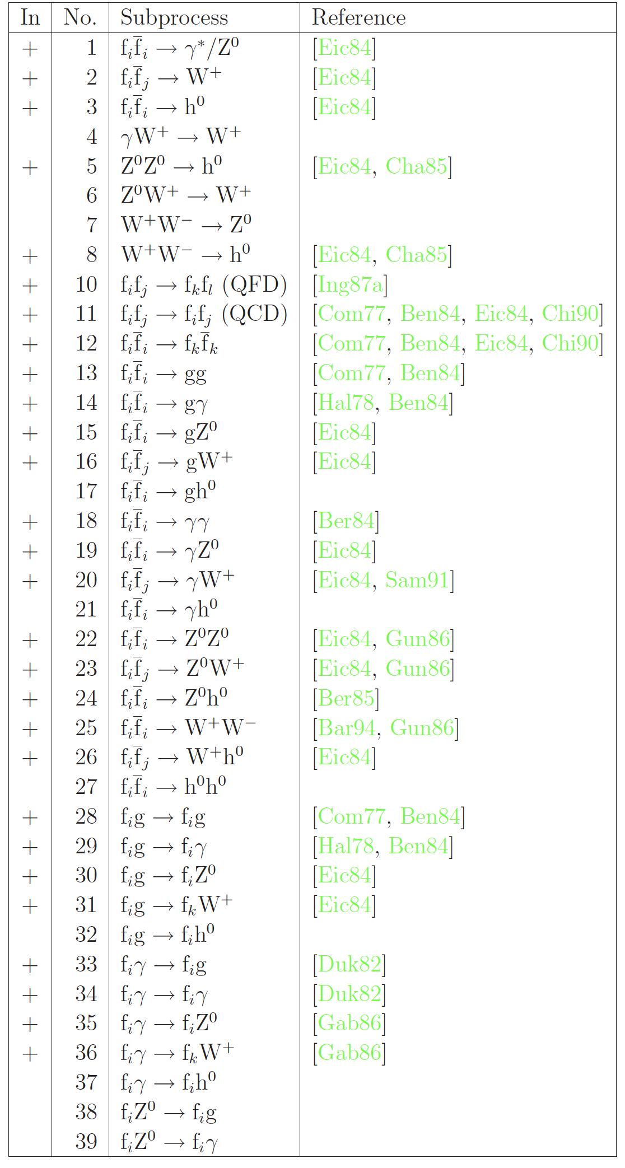
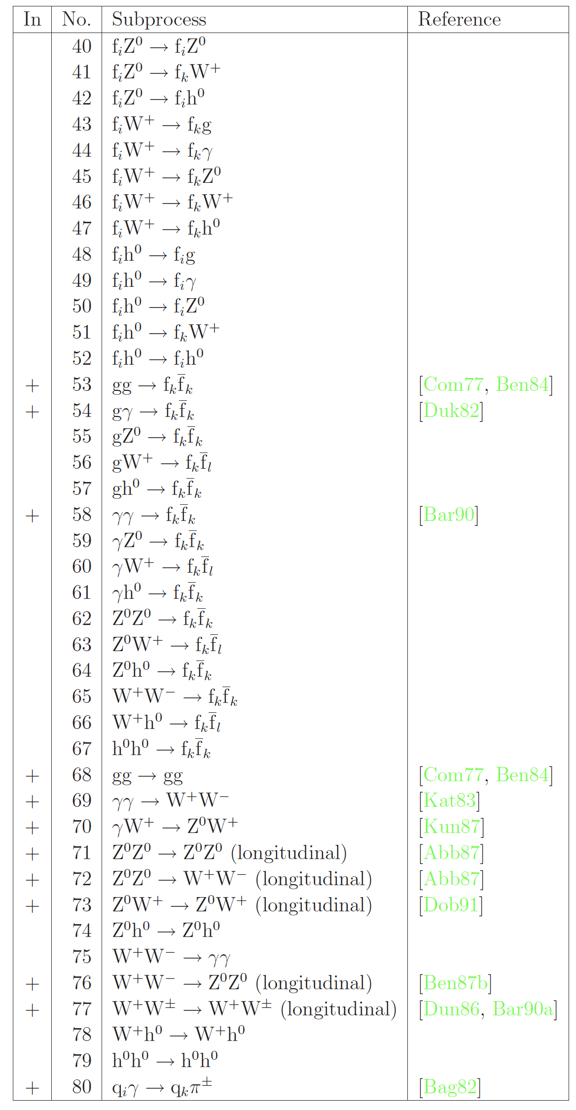
PYTHIA: ISUB
11: f_i + f_j -> f_i + f_j
28: f + g -> f + g
68: g + g -> g + g
1: DY

Slide 9
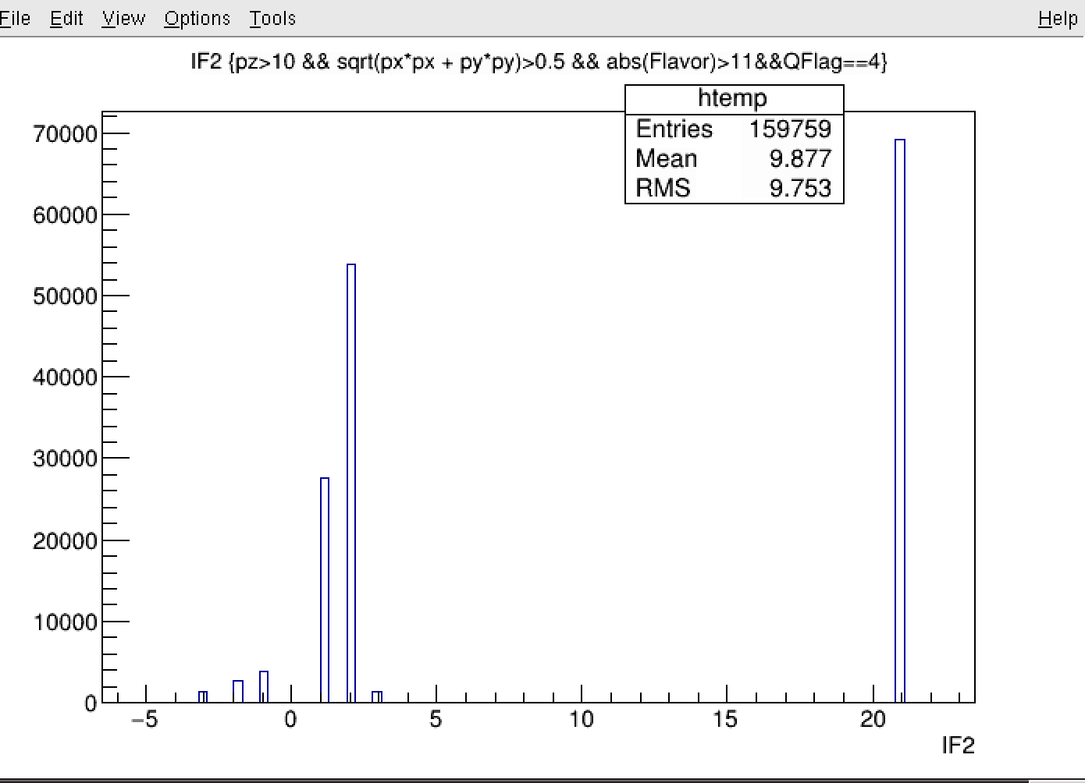
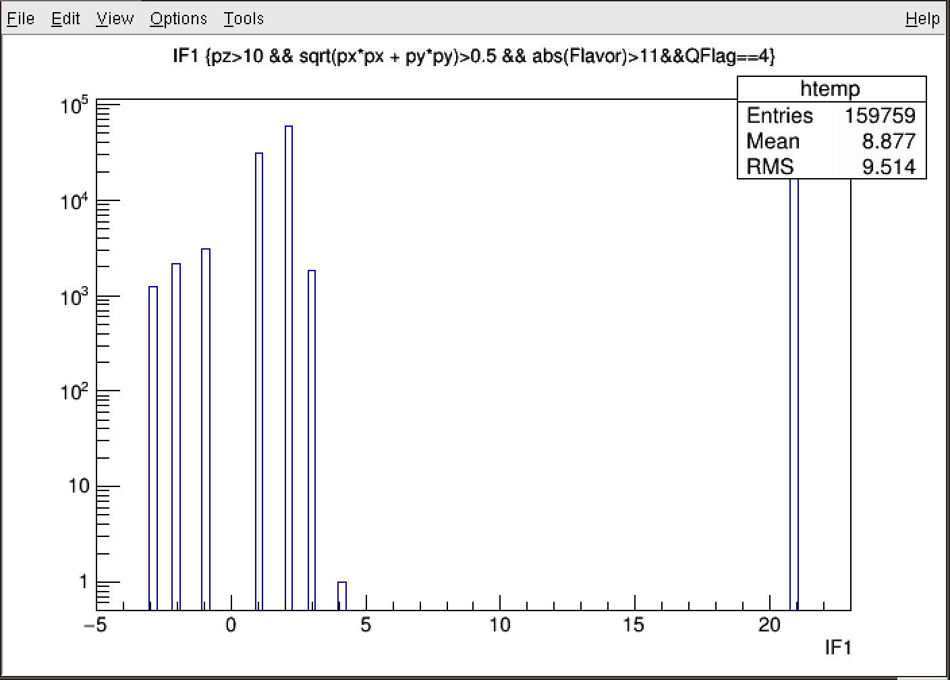
IF1, IF2
X2: dominated by valence quarks (d,u,g)
~30% of u-quark
→ expect large “Sivers Asymmetry” from “pi+”
d
u
IF:
1 = d
2 = u
3 = s
4 = c
5 = b
21 = g
u
g
d
Sea-quarks

Slide 10
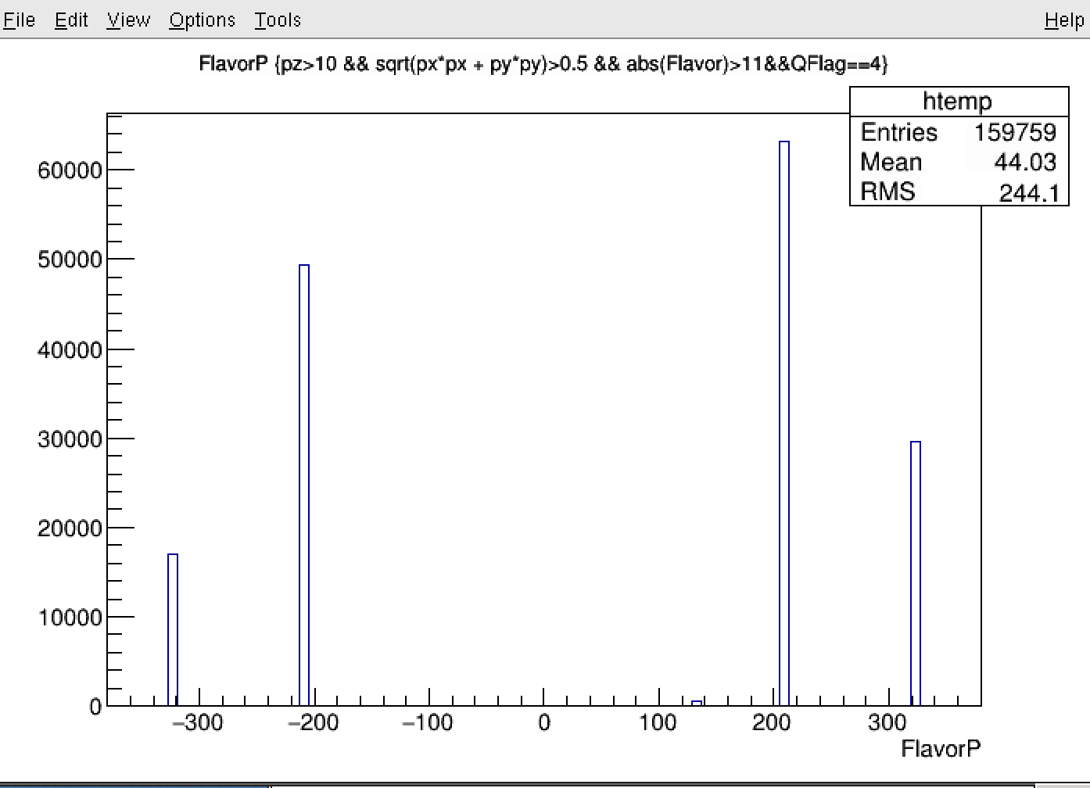
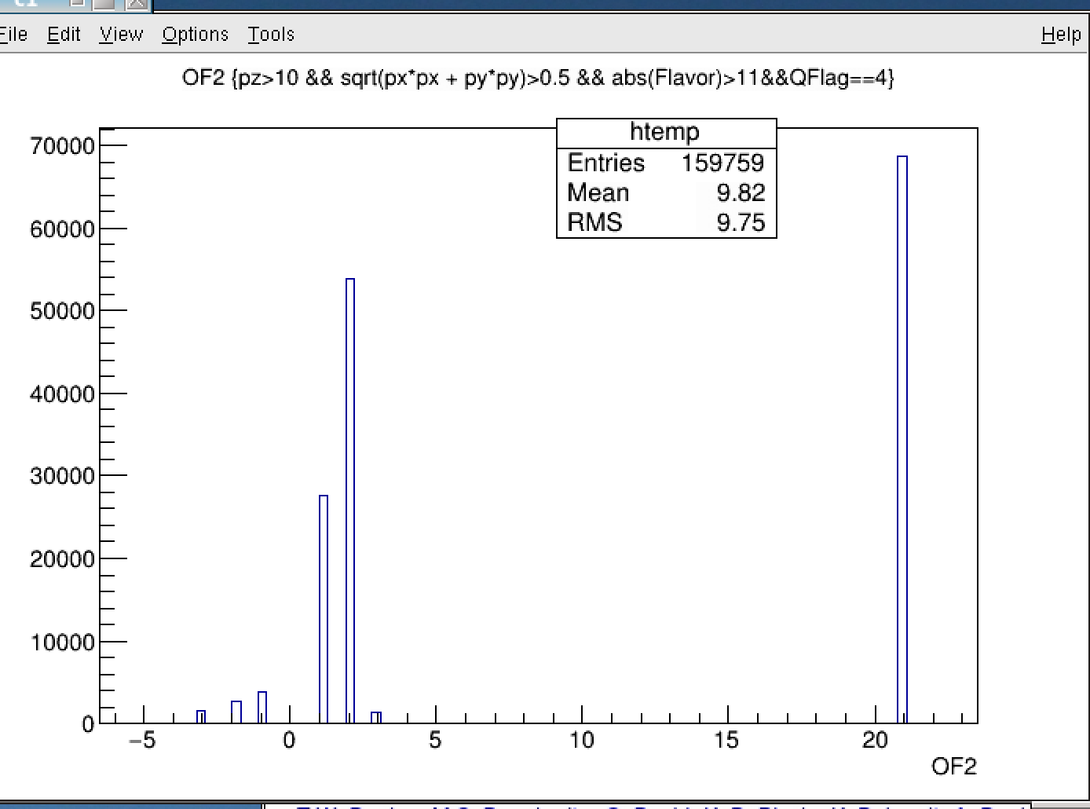
OF2 and FlavorP
<X2> ~ 0.15
Polarized target: <x2> = 0.15
Pi-
Pi+
u
K+
K-
d

Slide 11
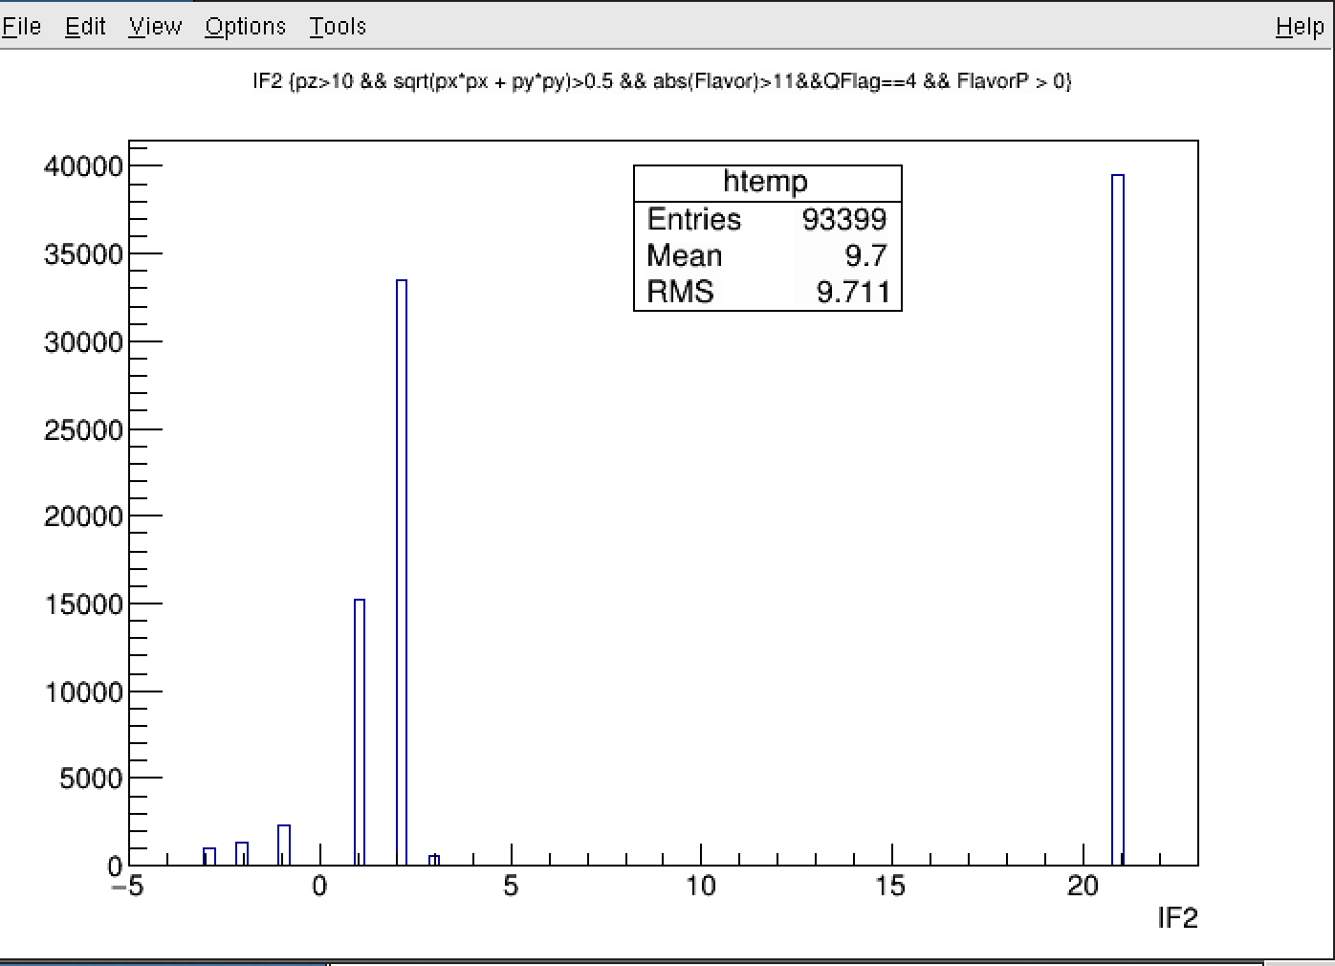
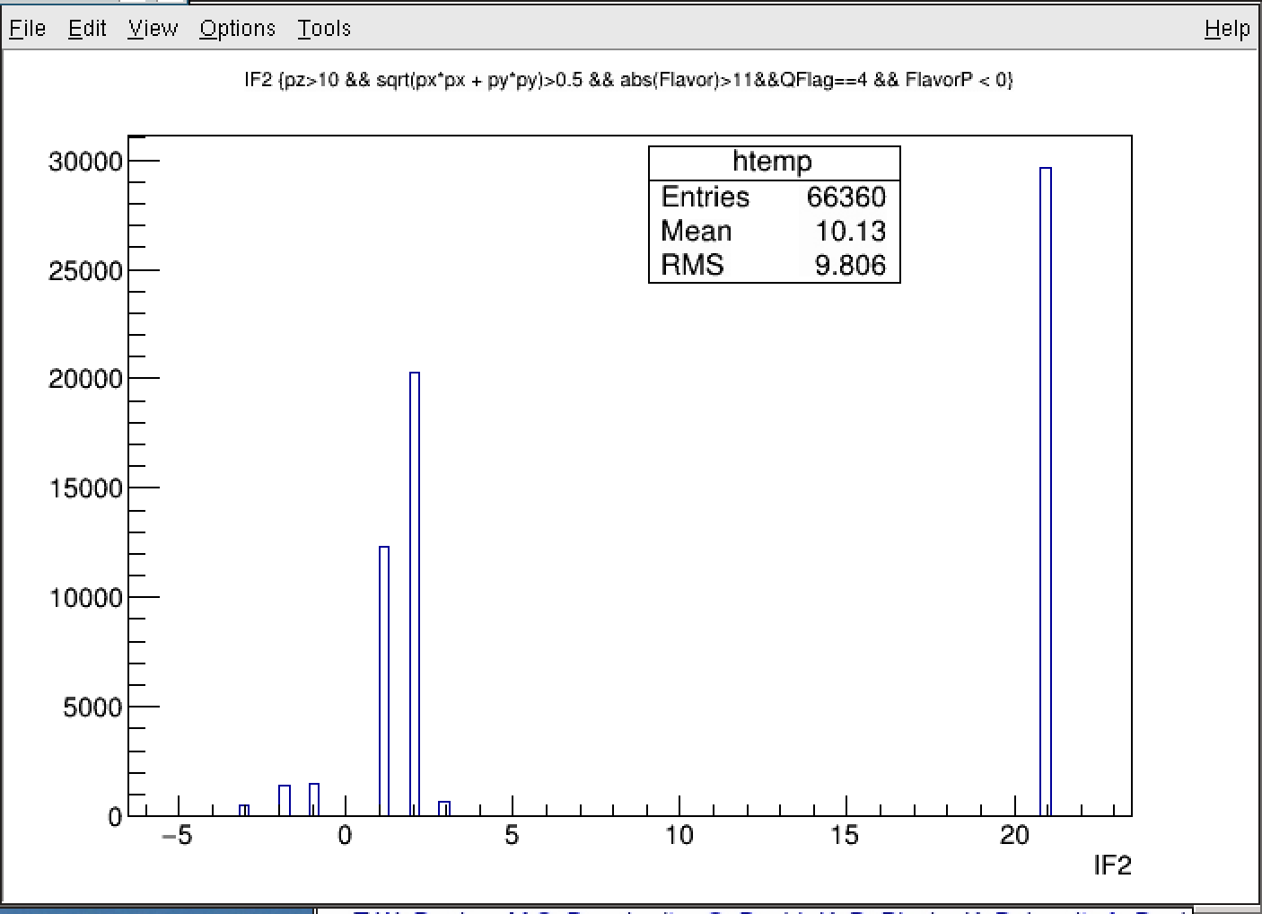
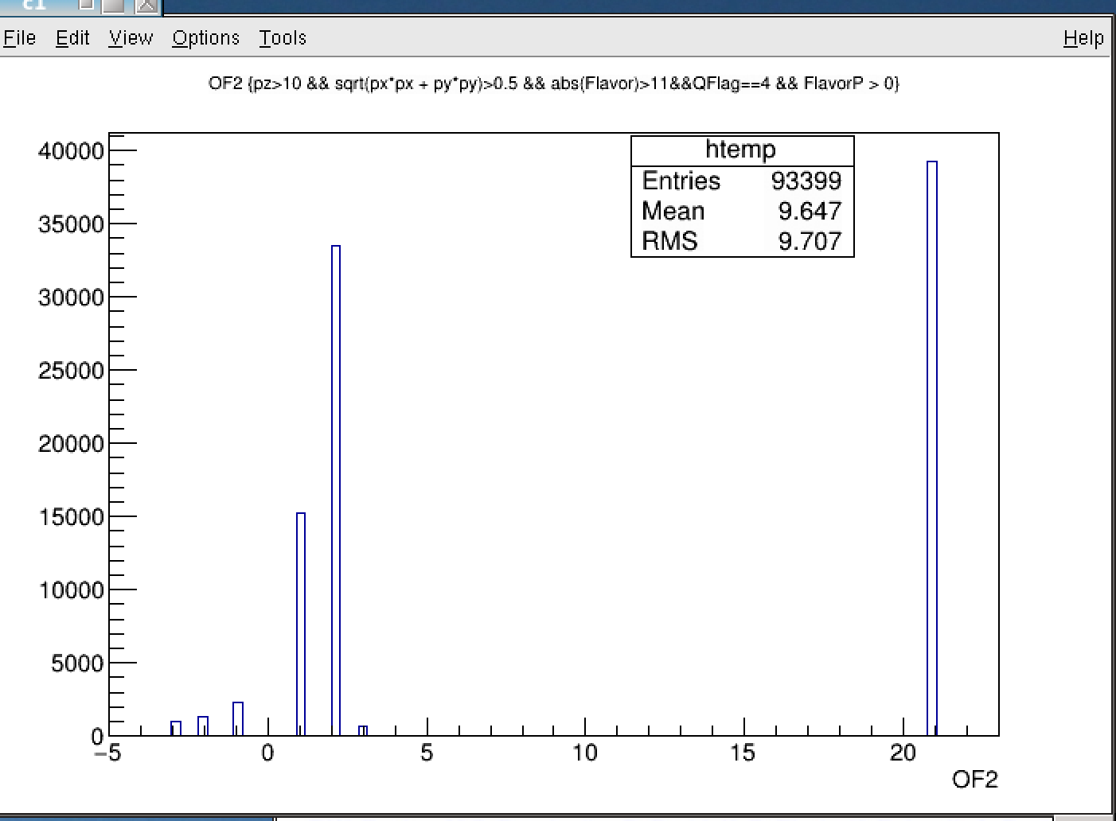
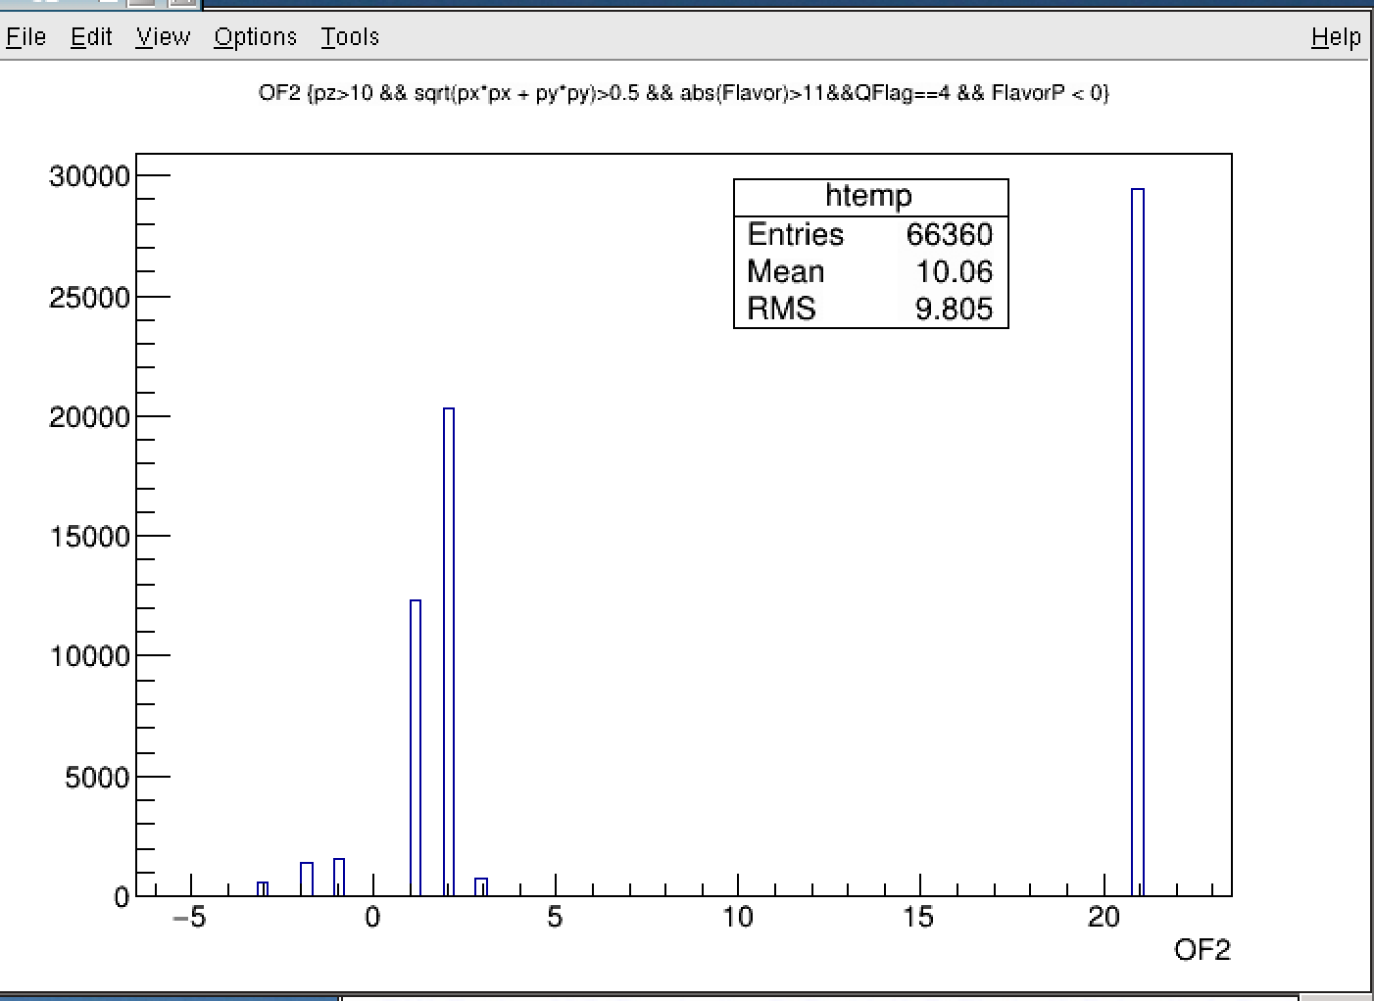
Favored and un-Favored Productions
IF2
IF2
Fav.: mu+
Un-Fav.: mu-
Dominated by
u-quark over d-quark
OF2
OF2
Fav.: mu+
Un-Fav.: mu-

Slide 12
J/Psi Events: Reco’d IP_VTX
J/Psi events generated at Z = -300cm/target; 0.0cm/dump; +500cm/after-dump
G4 sim, full offline reconstruction
Reconstructed IP-VTX , w/o “J/Psi” dimuon selection
Z = -300cm
Z = 0.0cm
Z = +500cm

Slide 13
J/Psi Full Simulations @Target, Z = -300cm
- J/Psi mass
reco’d z-vtx
Backgrounds

Slide 14
J/Psi Full Simulations @Dump, Z = 0.0 cm

Slide 15
J/Psi Full Simulations @Behind Dump, Z =+500cm

