Slide 1
Exploring Transverse Spin Physics at SeaQuest
Ming Liu
LANL
6/15/2018
SeaQuest/E1039 Collaboration Meeting

Slide 2
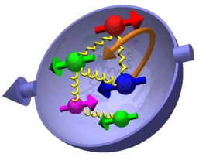
Outline
Overview of latest TMD physics
  Recent highlights and global fits
    RHIC/W, charged hadrons, J/Psi, Charm
    COMPASS DY, JLab
SeaQuest opportunities
  Sea quark Sivers,
    ubar & dbar
  Gluon Sivers at valence region
  Transversity distributions
  Experimental observables
    J/Psi
    Open charm
Day-1 physics
  Positive signal confirmation
  Target and dump separation
  Trigger optimization

Slide 3
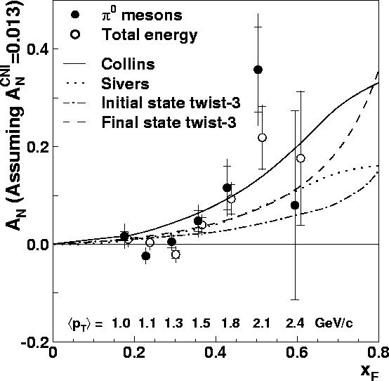
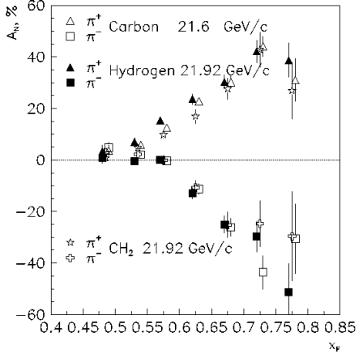
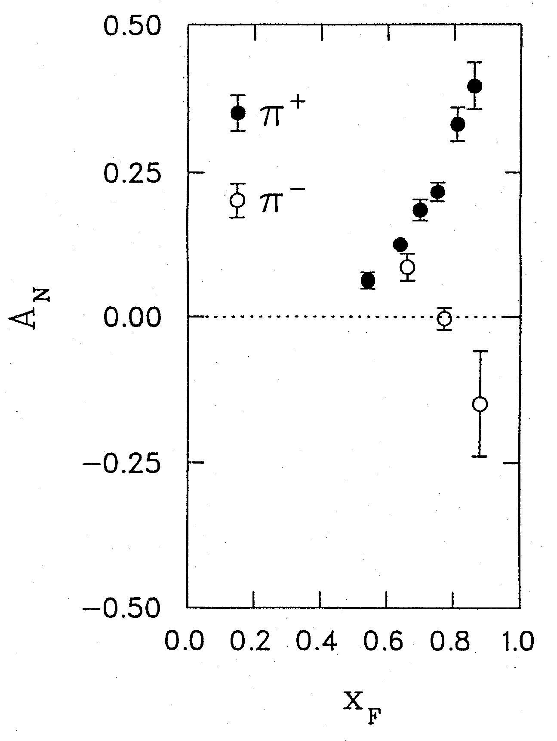
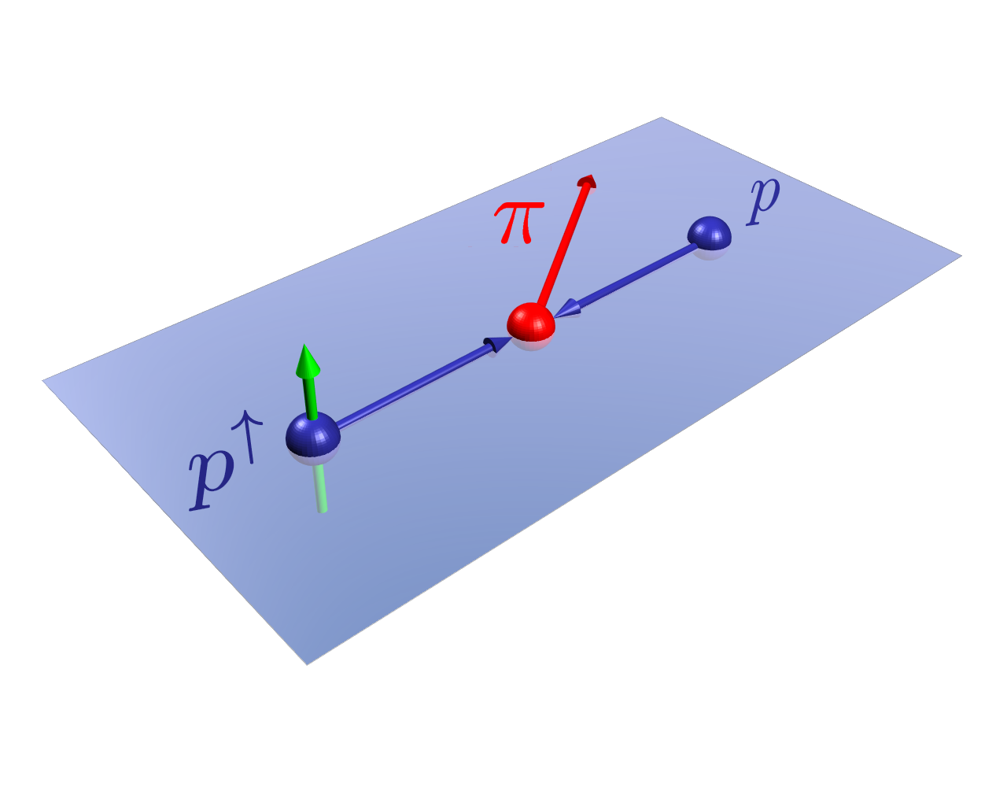
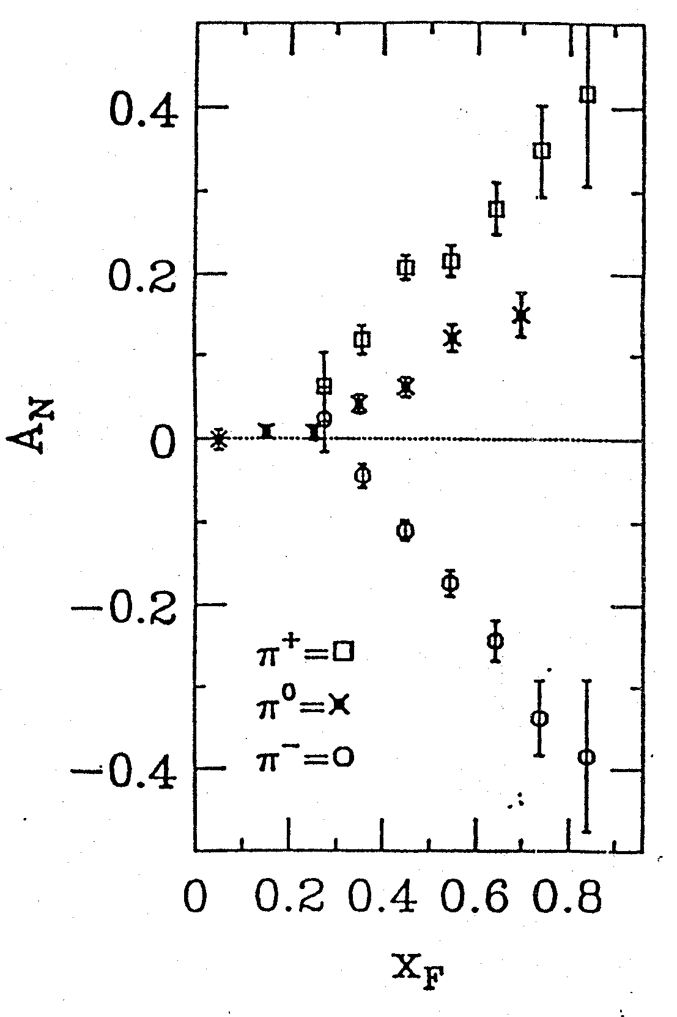
Four Decades of Transverse Spin Measurements
- Do we understand the physics?
RHIC 200 GeV CMS
Large Transverse Single Spin Asymmetry (TSSA) in forward hadron production persists up to top RHIC energy.
FNAL 200 GeV beam
AGS 22 GeV beam
ZGS 12 GeV beam
PRL (2004)
PLB261, 201 (1991)
PLB264, 462 (1991)
PRD65, 092008 (2002)
PRL36, 929 (1976)
Sivers, Collins, Twist-3 ….
Non-Perturbative cross section
Perturbative cross section

Slide 4
Nucleon Structure and TMD
TMD: f(x, k_{T}),
Sivers functions, quark transversity etc.

Slide 5
Probe the Underlying Physics via Hard Scatterings
TMD vs Collinear Twist-3 Factorizations
(i) Sivers mechanism:
correlation proton spin & parton k_{T}
(ii) Collins mechanism: Transversity × spin-dep fragmentation
S_{P}
Phys Rev D41 (1990) 83; 43 (1991) 261
S_{P}
Nucl Phys B396 (1993) 161
S_{q}
p
k_{T,q}
p
p
p
S_{q}
k_{T,π}
Collinear Twist-3 (RHIC, Fermilab):
quark-gluon/gluon-gluon correlation

Slide 6
Hadron TSSA in p+p in Twist-3 Framework
Qiu & Sterman PRD 59 (1998)
1st term: twsit-3 correlation functions, “Sivers”
2nd term: twist-2 transversity * twist-3 from unpol beam (expected small)
3rd term: twist-2 transversity * twist-3 FF, “Collins”
6

Slide 7
Sivers Functions from Global Fits – Quarks
Sea Quark Sivers poorly constrained, but seem small
1612.06413, M. Anselmino et al

Slide 8
Drell-Yan Sivers Asymmetries
Kang et al, 1401.5078
COMPASS
SeaQuest: p+p
COMPASS
n+p desired!

Slide 9
E1039 DY A_{N} Sensitivity
It is critical to control of systematic
errors for high precision measurements
SeaQuest: p+p

Slide 10
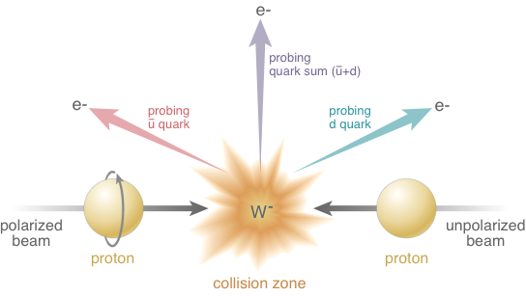
Electroweak Probe for Sea Quarks at High Energy at RHIC
A_{N}(W⁺) ~
Sensitive to flavor identified
(sea)quarks’ Sivers functions
A_{N}(W⁻) ~

Slide 11
RHIC W^{+/-} TSSA: Sea Quark Sivers
QCD Evolution included, Kang et al, 2014
QCD evolution:
reduces the amplitude
Anselmino et al 2016
RHIC data:
Statistically limited, ~0(10%)
E1039:
- lower Q²
- Better statistics, ~O(1%)

Slide 12
Non-Vanishing Sea Quark Sivers Distribution ?
Sea quark generates left-right bias ?
Left-right bias generated through fragmentation process ?
But the asymmetry from sea-quark
could not be very large

Slide 13
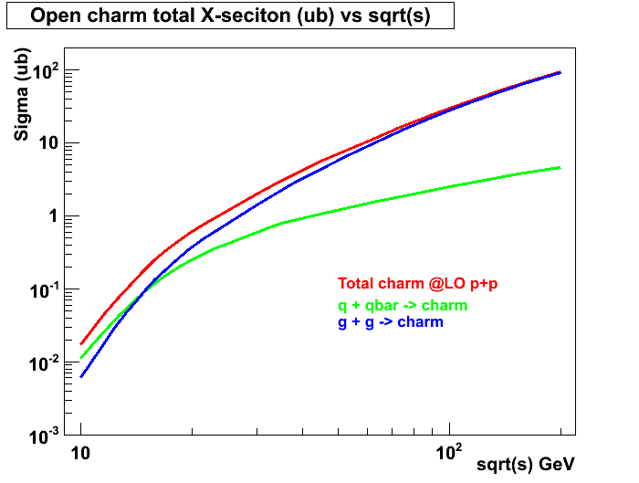
Open Charm Production in p+p at LO
- access gluon distribution
@SeaQuest:
relative contributions sensitive to XF
~50% from g+g
~50% from q+qbar
Similar for J/Psi
RHIC 200 GeV
RHIC 62GeV
E906
JAPRC

Slide 14
Gluon Sivers in the Valence Region
- a lot of gluons at high x!
1611.00125 Z. Lu & B.Q. Ma
Gluon Sivers poorly known
Unpolarized PDF:
Glons dominate at x < 0.2
SeaQuest coverage
by charm

Slide 15
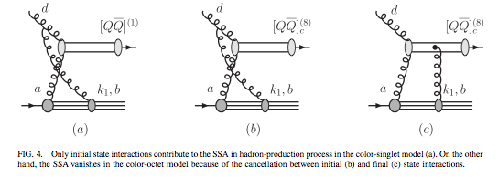
J/ψ A_{N}
J/ψ A_{N} is sensitive to the production mechanisms
  Assuming a non-zero gluon Sivers function, in pp scattering, J/ψ A_{N} vanishes if the pair are produced in a color-octet model but survives in the color-singlet model
  F. Yuan, PRD 78, 014024(2008)
One color-singlet diagram
— no cancellation, asymmetry generated by the initial state interaction, A_{N}≠0
Two color-octet diagrams
— cancellation between initial and final state interactions, no asymmetry A_{N}=0

Slide 16
Heavy Flavor: J/ψ A_{N}
Some nuclear final state effects?
PHENIX: 1805.01491

Slide 17
High Precision A_{N} Measurements @SeaQuest
Cross section contributions:
- gluon+gluon
u + ubar
d + dbar, could be significant
Sivers functions:
  Gluon
  ubar
  dbar
Polarized targets:
- NH3
- ND3

Slide 18
SeaQuest Dimuons:
Improve acceptance for low mass dimuons
Open up dimuon acceptance at trigger level:
Possible with the dark photon triggers
Improved DAQ
Better background determination
PHENIX dimuons

Slide 19
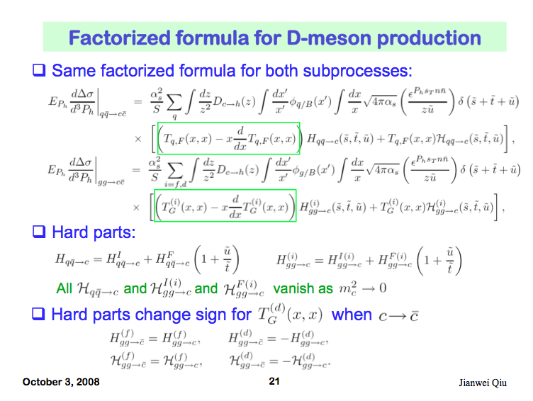
Open Charm TSSA in Twist-3 Approach
Qiu, 2010

Slide 20
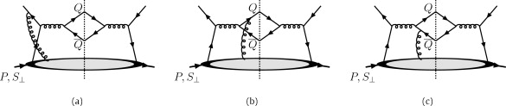
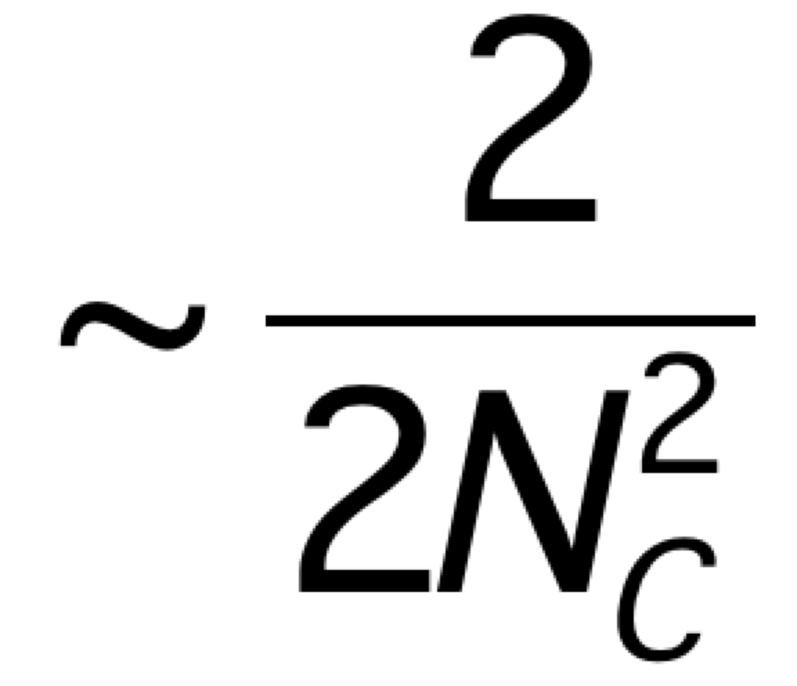
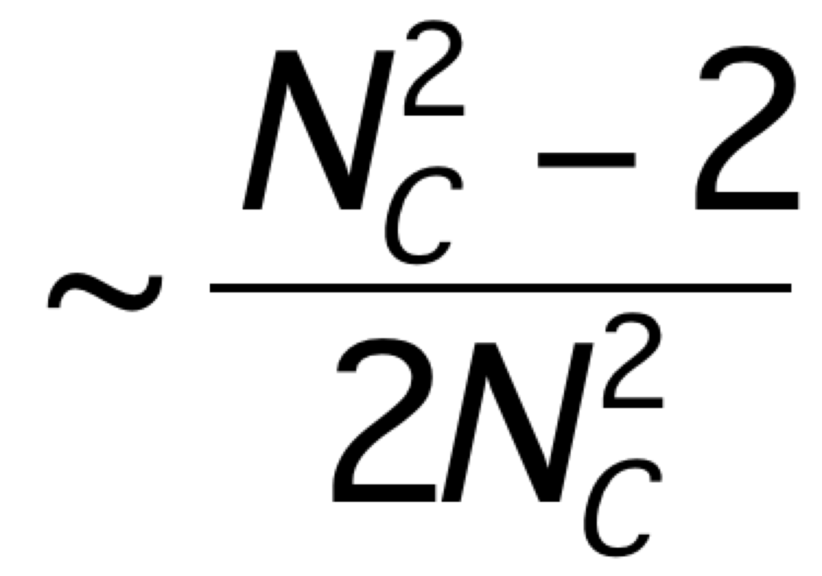
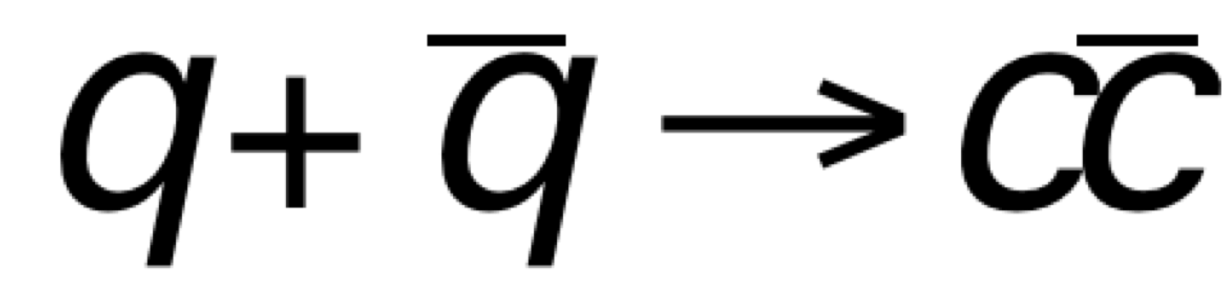
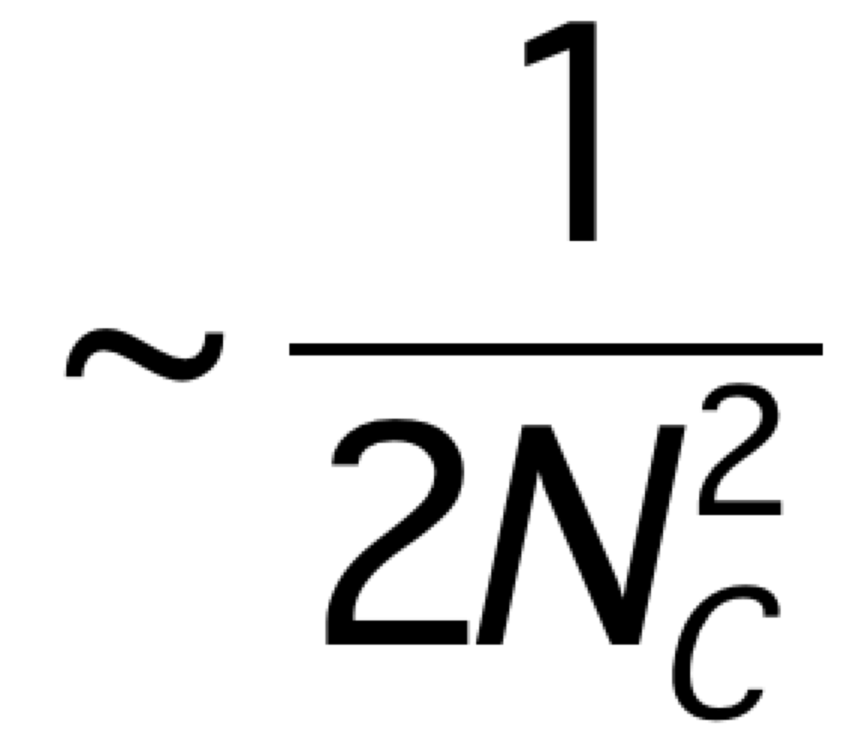
Heavy Quark TSSA @Fermilab
Twist-3 quark-gluon correlation functions
Different color factors for charm and anti-charm A_{N}
F. Yuan and J. Zhou PLB 668 (2008) 216-220
Initial state
Charm
anti-Charm

Slide 21
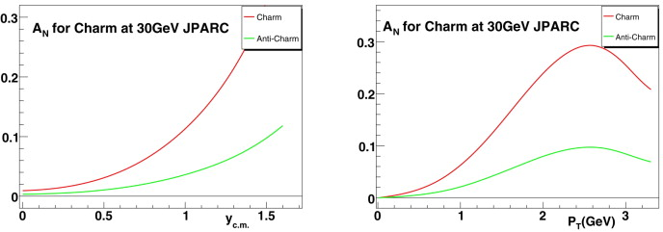
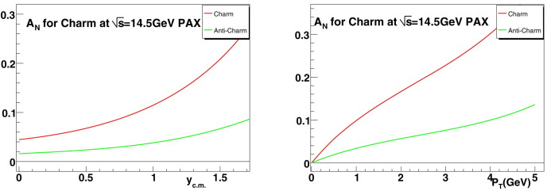
Open Charm TSSA at Low Energy
JPARC p+p
GSI: p+pbar

Slide 22
First Precision Open HF A_{N} from PHENIX

Slide 23
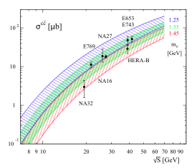
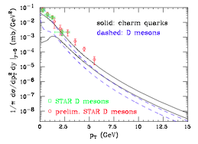
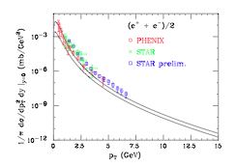
More on Open Charm Production
Fixed targets vs NLO
Collider mode @RHIC
PRL 95, 122001 (2005) M. Cacciari, P. Nason, R. Vogt
EPJ C 52, 987 (2007) J. Riedl, A. Schafer, M. Stratmann
SeaQuest

Slide 24
Open Charm via high pT Single muons?
Open charm cross section
  Test NLO pQCD framework
Open charm TSSA
  test pQCD twist-3 framework
High pT single muon trigger
Target and dump separation

Slide 25
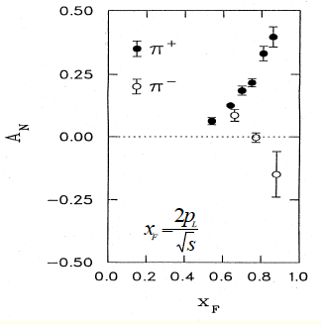
Day-1 Physics:
Can we confirm positive TSSA from day-1?
Large TSSA observed in charged hadron production
Help to understand the polarized target and detector performance
Control the systematics
Requires trigger optimization for
  Target vs dump events

Slide 26
Experimental Layout for Single Muon Positive Signal Confirmation
Polarized
target
ST-1
ST-2
ST-3
ST-4
ç
ç
ç
ç
Z=-350cm
Z=0
Tag: single muons from pi/K decays
- from target and beam dump
2. Trigger: single muons
- high statistic single muons to provide positive A_{N} signals
- Low pZ events preferred (more “valence origin” hadrons), trigger optimization required;
- High pZ events are more sensitive to gluon and sea-quark Sivers

Slide 27
Target and Beam Dump Event Separation target at upstream: Z=-3.5m
Trigger optimization possible!

Slide 28
Confirm positive signals from muons from charged hadrons h^{+/-} decays
Target @ Z= -350cm, long decay length
Decay muons from charged pi^{+/-} and K^{+/-}
  K+/- decay could be very important
Confirm positive signal from mu⁺ and mu⁻
Asy (phi) = S(phi)/Ref(phi)
Need to rum full MC to simulate
  Single mu^{+/-} from pi/K decays
  Kinematics and single muon trigger optimization

Slide 29
The Measured Raw Asymmetry:
P_{T}=0.8 target polarization
~0.1
for pure NH₃ dilution factor:
In reality, need count all unpolarized material in beam’s path, f=0.12~0.14.
In JLab Hall B, deep-inelastic scattering data, f=0.14 (eg1-dvcs).
Need to control systematic uncertainty on measured asymmetry to δ(A)_{meas} ≈ 0.1% for DY
(1% for h^{+/-} )
Challenging !!!

Slide 30


The Normal Approach in “collider-mode”: RHIC, JLab etc.
Spin UP(1) and DOWN(2):
A = <pol>*physics asymmetry, ~O(1%)
Relative luminosity,
for E1039, this is the luminosity of beam on target, which is very hard to measure to <<(0.1%)!
Need precision measurements of relative luminosity, better than ~O(0.1%)

Slide 31
How to Measure Drell-Yan(Single Muon) TSSA Raw Asymmetry at 10^-3 Level with a polarized proton target?
The challenges of precision TSSA measurements
  Detector acceptance * efficiency varies >>1% level over a few hours of operation under a given “target polarization” configuration
  Very difficult to measure the relative beam on target(NH3) luminosity at ~10^-3 level
    Large beam x-y profile
    small target size
    Beam position/direction jitter (dX ~ 1-2mm),
      see https://p25ext.lanl.gov/elog/Hardware/12
    non-uniform DC responses to large beam intensity fluctuations (~O(10%))
    NH3 packing factor variation >~1% from target to target
    Target polarization known to ~O(3-4%) level through NMR
    Other variations, including target changes etc, ~O(1%)
  Frequent spin flip is hard/impossible
    can’t do what we are doing at RHIC and Jlab
    Takes time to reach a stable polarization
  We must be able to measure raw TSSA at 10^-3 level for a given target polarization configuration
A new approach needed

Slide 32
False Detector Asymmetry Study
Run-2 data dimuons (Roadset 57)
Event selection:
  4< mass < 7
  Target events: -250 < z0 < -50cm
  Beam dump events: -50 < z0 < 200 cm
  Track quality cuts
Detector (relative) acceptance for DY events
  Raw “spin” asymmetries
  MC study need to correct target/beam dump acceptance difference
    Trigger road bias
    Detector acceptance corrections
  Further reduce raw asymmetry via target spin-flip and Fmag/kMag field directions
    Keep the same “target dipole field”, only change RF frequency to flip the direction of target polarization
    Change the FMag and kMag field directions
    Impact of Relative beam on target beam luminosity

Slide 33
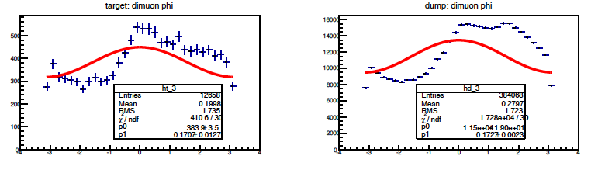
Run-2: Close Look of DY Phi Distributions
We need to get the false asymmetry << 0.1% ~ expected raw spin asymmetry
A = 0.171 +/- 0.013 --→ 100x too large!
Huge false asymmetry: >> X10 sigma

Slide 34
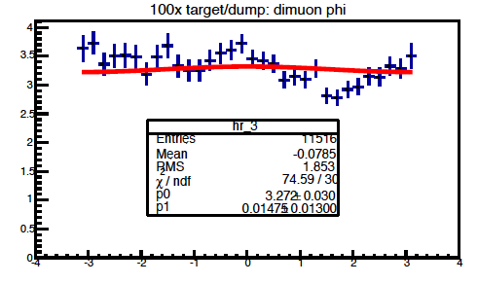
A New Approach
Using the same DY( or h^{+/-}) events from beam dump to normalize the detector acceptance effects
  Beam dump events, 100x statistics, similar muon acceptance
    the stat_err from reference << signal stat_err
  the beam dump asymmetry = 0
    Known physics
  normalize the beam intensity
    Can achieve O(1%) on relative luminosity of beam on target, with dedicated telescopes
  Identical timing and spatial variation of detector acceptance and efficiency for signal and background
    Can achieve O(0.1%) on raw asymmetry
False asymmetry after normalization:
~ 1 sigma, good!
Need to run ~100x more MC or data to prove we can reach 0.001 level!

Slide 35
J/Psi MC at Production: Phi

Slide 36
Drell-Yan MC: Target and Dump Distributions

Slide 37
Future Work for Improvements
Detailed MC simulation with the new polarized target position
  Prove the systematic error can be controlled to O(0.1%)
  Target/Dump DY acceptance correction study
  100x more MC events to reach O(0.1%) level precision
Real data analysis to understand and correct the large false asymmetry
  Beam axis, directions
  Detector response to instant beam fluctuations
  Systematic reduction of the false asymmetry
New beam position/direction monitoring instruments?
  Summer shutdown work 2018?
Beam on target luminosity telescope
  Summer shutdown work 2018?

Slide 38
Summary: New Physics Topics for E1039
Gluons Sivers functions in “valence region”
  Xg = 0.1~0.3
  Gluon Sivers functinos can be best determined in E1039
  Large A_{N} observed from valance quark in this x-range, it would be very interesting to explore the gluon sector in this kinematic region.
  Could be probed by charm, J/Psi and high pZ hadrons(q-g scattering)
Open charm and anti-Charm A_{N}
  Single muon A_{N} for mu⁺ and mu⁻ from charm decay
  Reveals the underlying physics of color interaction
  Test pQCD Twist-3 framework
J/Psi and Psi’
  Study the J/Psi production mechanisms with A_{N}.
  Early theoretical work shows J/Psi A_{N} is sensitive to production processes
Light hadron A_{N} using decay muons: day-1 physics
  This is the one we plan to use to calibrate the Drell-Yan A_{N} measurements

Slide 39
Backup slides

Slide 40
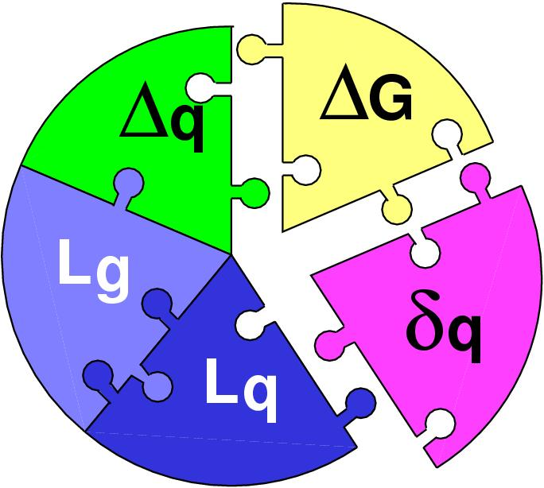
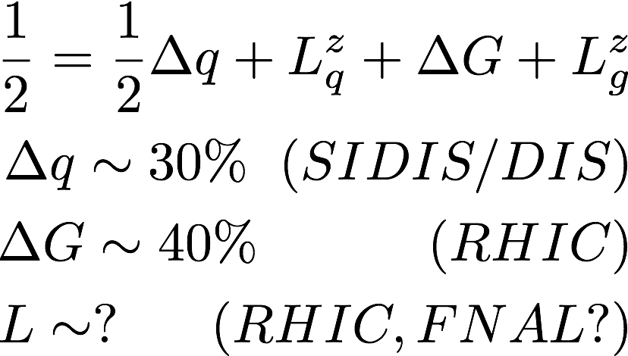
Three Decades of the Proton Spin Puzzle
Early expectation: large gluon polarization
 | Quark Spin | Gluon Spin
SLAC -> 2000 | E80 – E155
CERN ongoing | EMC, SMC, COMPASS
DESY ->2007 | HERMES
JLab ongoing | Hall A,B,C
RHIC ongoing | (BRAHMS), (PHENIX), STAR
Axial anomaly
Cheng & Li, PRL (1989)
EMC, 1980s
 | SIDIS/DIS
 | Polarized p+p

Slide 41
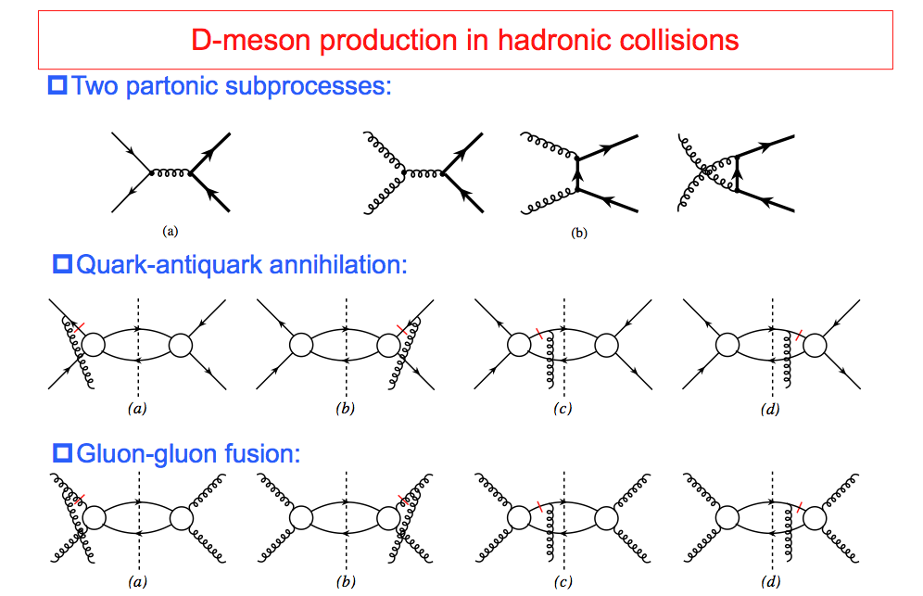
TSSA in Heavy Quark Production in p+p
Kang, Qiu, Vogelsang, Yuan, PRD 2008

Slide 42
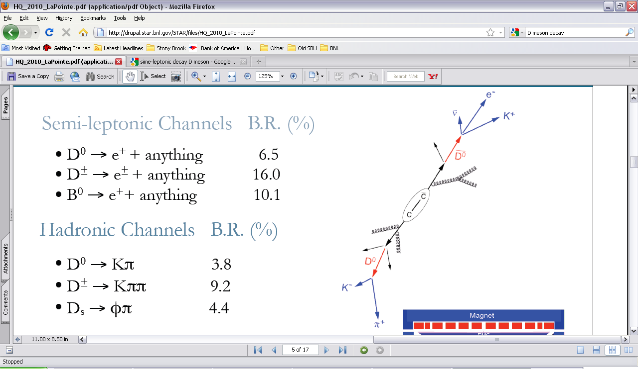
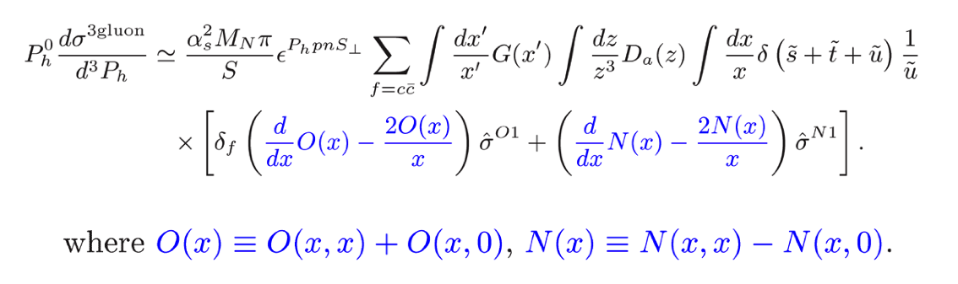
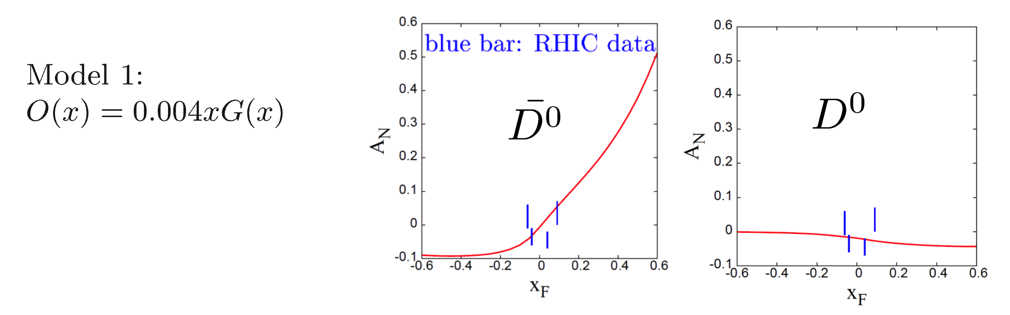
Open Charm TSSA at High Energy at RHIC
Twist-3 tri-gluon correlation Functions
Koike et. al. (2011)
Kang, Qiu, Vogelsang, Yuan (2008)

Slide 43
Drell-Yan Asymmetry (II)
05/27/2015
Use beam-dump events as reference, R(phi)
Use target events as signal, S(phi)
Asymmetry(phi) = S(phi)/Ref(Phi)
This is a follow up of previous discussions about DY spin asymmetry measurements
https://p25ext.lanl.gov/elog/Drell-Yan/29
https://www.phenix.bnl.gov/WWW/publish/mxliu/E906/LDRD-Pol-DY-Work-2015-Ming.pdf (pptx)

Slide 44
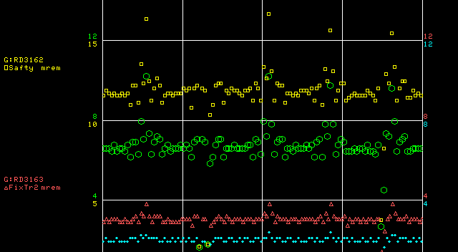
Bean Profile Study
Chuck suggested to scan W-target and monitor radiation rates outside of the building (Yellow)
Can do at ~2 sigma level (~5%), but hard to reach 0.1% for beam halo study…

Slide 45
Telescope
4 units of 2”x2” telescope rates:
  3+4: 349k counts/spill
  1+2+3+4: 339K counts/spill
  Background rate < 1 Hz
Location
  ~5m from the instrumentation package (~1%)
  ~45 degree
Polarized target:
  Small tunnels at ~90 degree on both L/R sides to provide service lines (Cryo and Microwave)
  Scattering rate at ~90? Must by very low

Slide 46
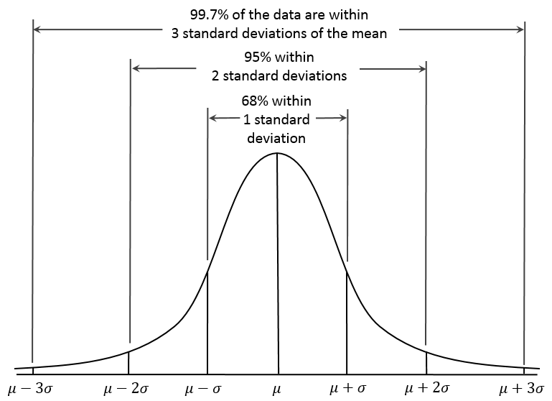
Beam on Target: 4-sigma coverage relative luminosity measurement better than 2x10⁻⁴
Expected Raw Asymmetry:
~ 1%/10~20 = 5 x 10⁻⁴
Asymetry = (N⁺/R - N⁻)/(N⁺/R + N⁻)
R = spin-dependent
relative luminosity
dR <~ 2x10⁻⁴

Slide 47
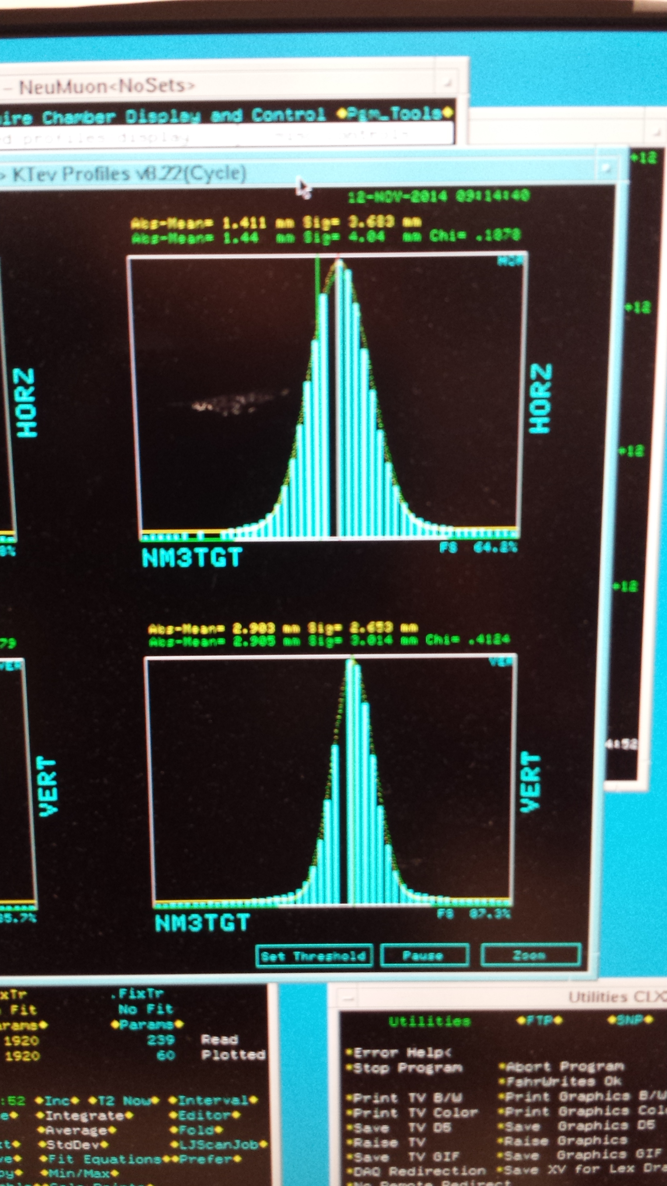

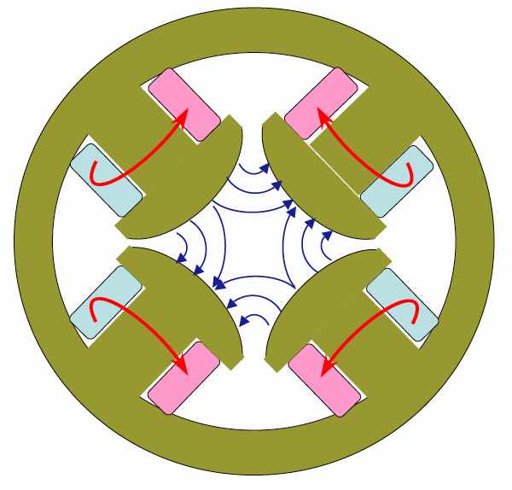
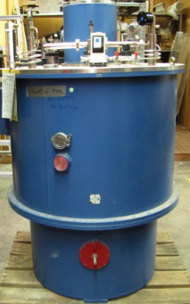
New Beam Collimator, Focusing Q3 and Target
Target cross section: 18 x 28 mm²
E906 beam profile:
SigX = 4.0mm
SigY = 3.0mm
Beam cross section:
Need be well contained within
4 sigma, required by dR< 2x10⁻⁴
sigX = 18/2/4 = 2.2 mm
sigY = 28/2/4 = 3.5 mm
Beam jitter: dX=dY ~ 1mm
1 sig = 0.68269
2 sig = 0.95450
3 sig = 0.99730
4 sig = 0.99994
Beam collimator
120GeV
beam
Final focusing Q3

Slide 48
Beam position and angular direction measurements 4/1/2015
Two sets of “position-sensitive diamond detector” ~2cm apart, better than 1mm spatial resolution
Quadrant Pattern
  (X,Y) and sigma
MC PYTHIA Sim
  MB to check rates
  Optimal detector locations

Slide 49
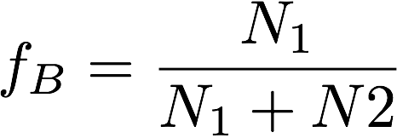
Reality: Not So Perfect Detector and Beam Controls
Not so perfect detectors (dt ~ minutes) without fast spin flip (dT << minutes)
  Polarized target spin-flip period ~ several hours
Acceptance varies within the time of a fixed “target spin config.”
  Time dependence
  Dead and hot space points
  Impossible to get to << O(0.1%)
If target is not a pure proton, for e.g. NH₃, another background fraction “f_{B}”, including all other supporting materials,
Background fraction:
Varies target to target
Target and time-dependent
DY events produced in “Target”
Target variation
(space,time) variation

Slide 50
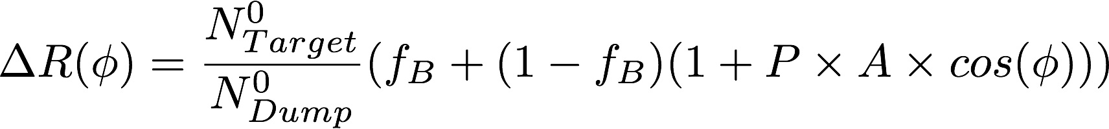
How it works?
If we use the same DY dimuon events
(mass, pT,xF etc) from Target and Dump:
the time-dependent detector acceptance variations are mostly canceled out
The small difference can be corrected with MC and data by using the muons measured in the same phase space
Much reduced requirements on relative lumi, background fraction, target polarization measurements
  sufficient at O(1%) level.

Slide 51
Run-2 DY Dimuon (Roadset 57): all targets
vtxZ
4 < m <7
phi
pT
target
dump

Slide 52
New Beam Collimator, Focusing Q3 and Target
Target cross section: 18 x 28 mm²
E906 beam profile:
SigX = 5.0mm
SigY = 3.5mm
Beam cross section:
Need be well contained within
4 sigma, required by dR< 2x10⁻⁴
sigX = 18/2/4 = 2.2 mm
sigY = 28/2/4 = 3.5 mm
Beam jitter: dX=dY ~ 2mm
28mm
18mm
1 sig = 0.68269
2 sig = 0.95450
3 sig = 0.99730
4 sig = 0.99994
Beam collimator
120GeV
beam
Final focusing Q3

Slide 53
Run-3 Beam X Position Stability vs Spill_ID
Run = 13360, M3TGHM/HS; VM/VS
(mm)
Spill-ID

