Slide 1
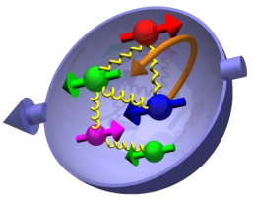
Transverse Spin Physics at SpinQuest
Ming Liu
LANL
3/07/2019
E1039 Collaboration Meeting

Slide 2
Outline
Recent highlights
  RHIC,COMPASS et al
E1039 opportunities
  Sea quark Sivers at high-x
    ubar & dbar
  Gluon Sivers at high-x
  Other topics
    Transversity distributions …
Trigger optimization
  J/Psi
  Open charm

Slide 3
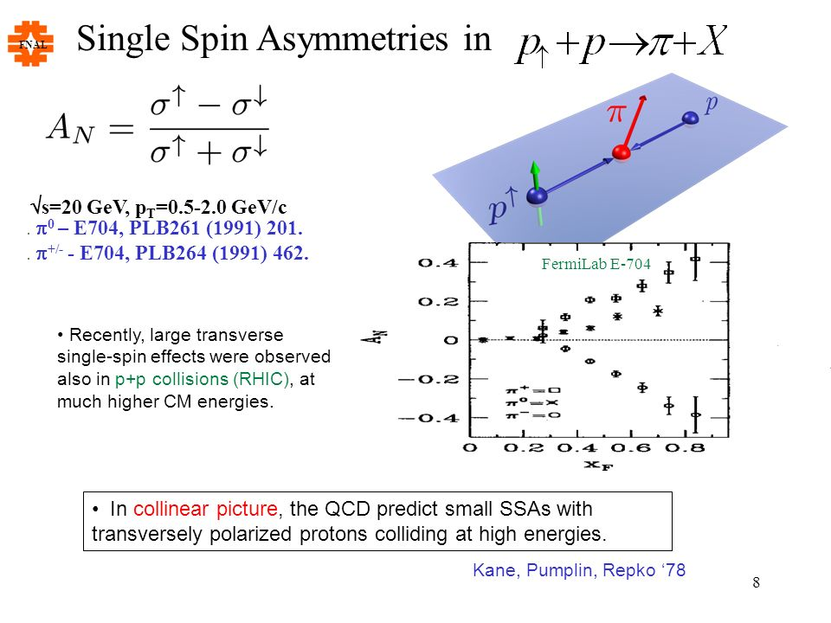
Large TSSA Challenge: TMD Physics
Large Transverse Single Spin Asymmetry (TSSA) in forward hadron production persists up to top RHIC energy.
Kane, Pumplin, Repko (1978)
A_{N} ~ O(10%)
Fermilab
E704 (1991)

Slide 4
Probe the Underlying Physics via Hard Scatterings
TMD vs Collinear Twist-3 Factorizations
(i) Sivers mechanism:
correlation proton spin & parton k_{T}
(ii) Collins mechanism: Transversity × spin-dep fragmentation
S_{P}
Phys Rev D41 (1990) 83; 43 (1991) 261
S_{P}
Nucl Phys B396 (1993) 161
S_{q}
p
k_{T,q}
p
p
p
Low pT DY TSSA
S_{q}
k_{T,π}
Collinear Twist-3 (RHIC, Fermilab):
quark-gluon/gluon-gluon correlation
for hadron production @E1039

Slide 5
Nucleon Structure and TMD
TMD: f(x, k_{T})
Sivers functions, quark transversity etc.

Slide 6
E1039 Dimuon Acceptance
Polarized target
coverage:
Sea quarks at
x = 0.1~ 0.5

Slide 7
Sivers: Global Fits w/ TMD Evolution
Large TSSA from
valence quarks
Sivers fits:
small ubar, large dbar
Kang et al, 1401.5078
E1039

Slide 8
Sivers Functions from Global Fits – Quarks
Sea Quark Sivers poorly constrained, but small
1612.06413, M. Anselmino et al
- Test pion cloud model
E1039 coverage

Slide 9
E1039 DY A_{N} Sensitivity
Control of systematic errors for high
precision measurements
ND₃
NH₃
Kang et al 2014
E1039: NH₃

Slide 10
E1039 Polarized Targets and TSSA
~ 0.1
~ 0.01
A_{meas} ~ 0.001

Slide 11
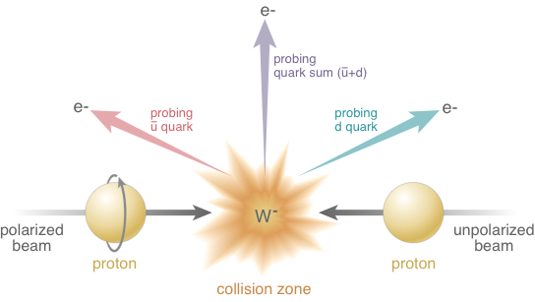
Sea Quarks Probed at RHIC 500GeV p+p
A_{N}(W⁺) ~
Sensitive to flavor identified
(sea)quarks’ Sivers functions
A_{N}(W⁻) ~
<x>_RHIC ~ 0.15

Slide 12
RHIC W^{+/-} TSSA: Sea Quark Sivers
QCD Evolution included, Kang et al, 2014
QCD evolution:
reduces the amplitude
Anselmino et al 2016
RHIC data:
Statistically limited, ~0(10%)
E1039:
- lower Q²
- Better statistics, ~O(1%)

Slide 13
Sea Quark Sivers Effects: RHIC W^{+/-} A_{N}
Favors non-zero d-bar Sivers:
~ pion cloud picture
Slightly prefer to have good
d-bar data (ND₃) from E1039 first

Slide 14
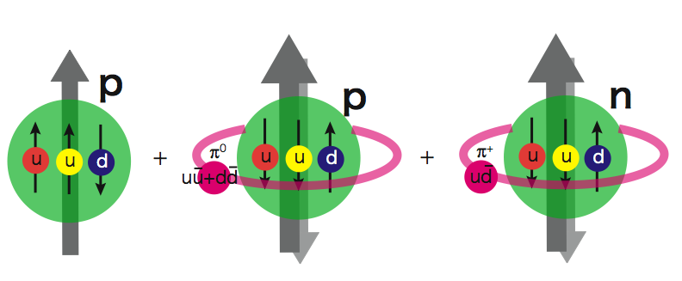
SeaQuest/E1039 Projected Drell-Yan A_{N}
Sea quark Sivers:
Pion cloud model:
Prefer to use ND₃ for “d-bar” Sivers

Slide 15
Non-Vanishing Sea Quark Sivers Distribution ?
Sea quark generates left-right bias ?
Left-right bias generated through fragmentation process ?
But the asymmetry from sea-quark
could not be very large

Slide 16
Study Gluon Sivers at high-x
- a lot of gluons but poorly known!
E1039 coverage

Slide 17
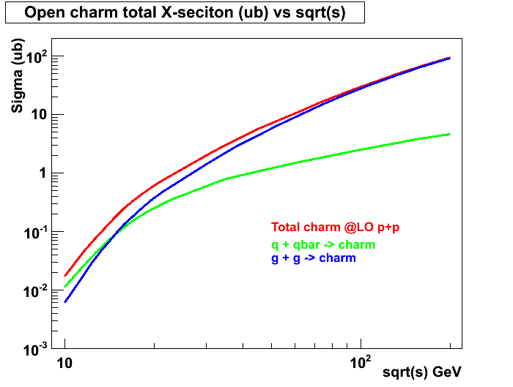
Open Charm Production in p+p at LO
- access gluon distribution
@SeaQuest:
relative contributions sensitive to XF
~50% from g+g
~50% from q+qbar
Similar for J/Psi
RHIC 200 GeV
RHIC 62GeV
E906
JAPRC

Slide 18
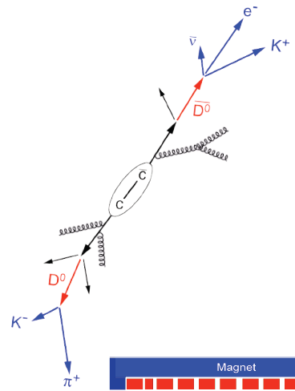
Gluon Sivers from a Model Fit
1611.00125 Z. Lu & B.Q. Ma
Possible large gluon Sivers
E1039 coverage:
x =0.1 ~ 0.4
E1039
D -> mu + X
E1039

Slide 19
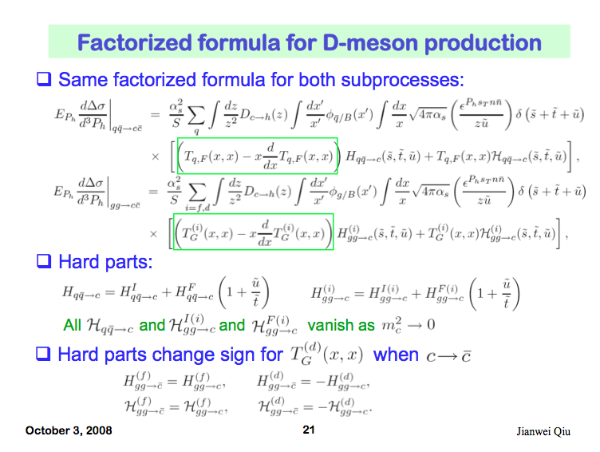
Open Charm TSSA in Twist-3 Approach
Qiu, 2010
Twist-3
-Quark-gluon
-Tri-gluon

Slide 20
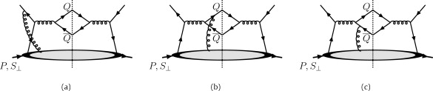
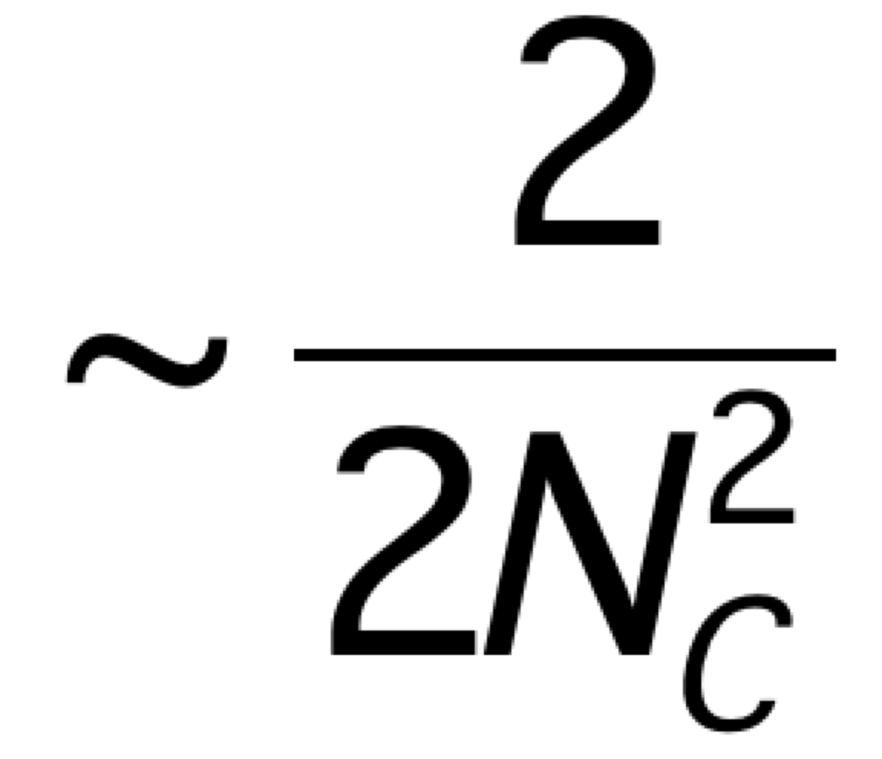
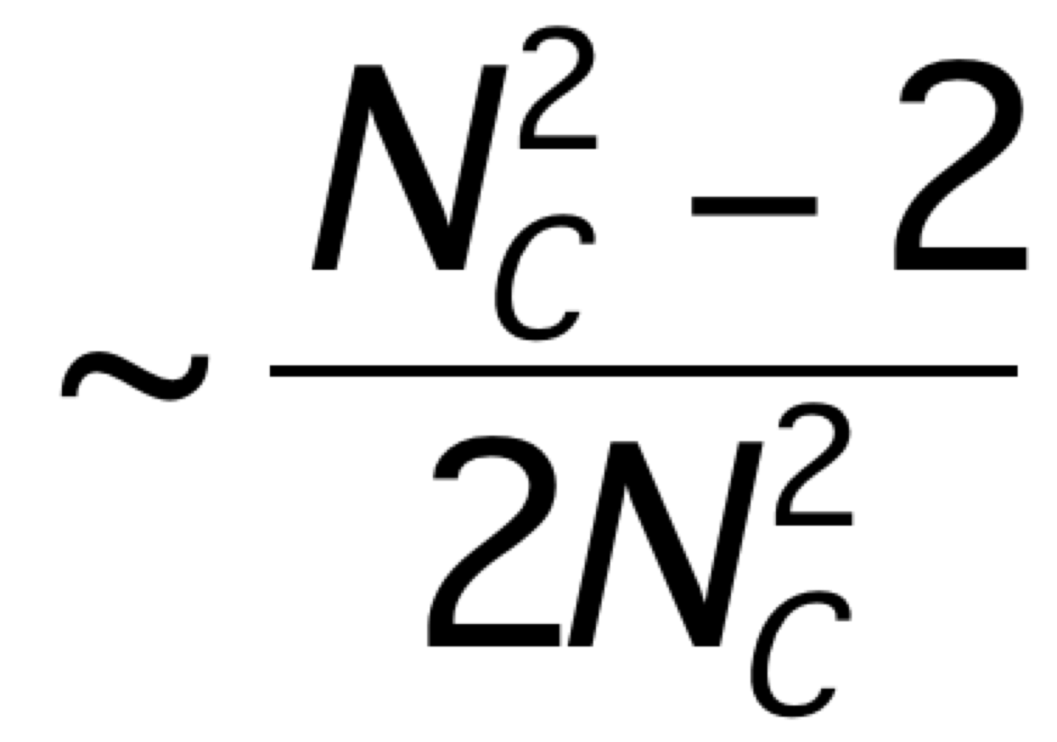
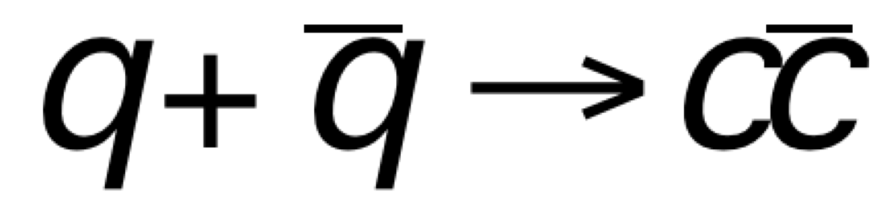
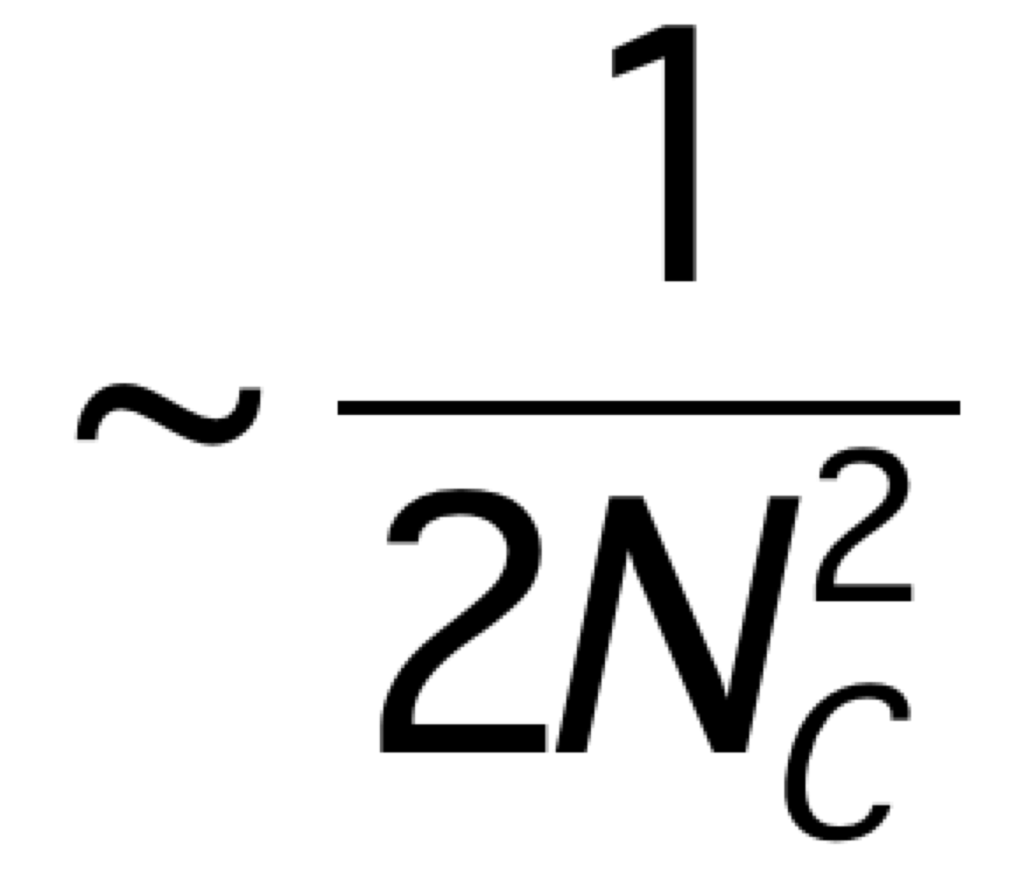
Heavy Quark TSSA @Fermilab
Twist-3 quark-gluon correlation functions
Different color factors for charm and anti-charm A_{N}
F. Yuan and J. Zhou PLB 668 (2008) 216-220
Initial state
Charm
anti-Charm

Slide 21
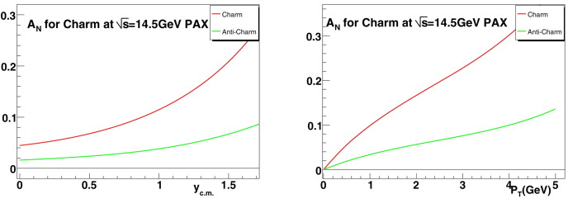
Open Charm TSSA at Low Energy
GSI: p+pbar. (similar energy of E1039)

Slide 22
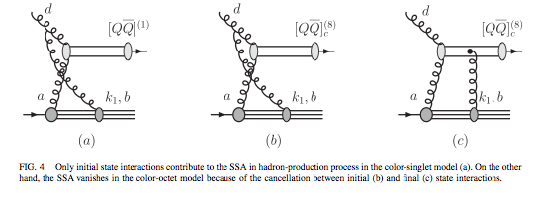
J/ψ A_{N}
J/ψ A_{N} is sensitive to the production mechanisms
  Assuming a non-zero gluon Sivers function, in pp scattering, J/ψ A_{N} vanishes if the pair are produced in a color-octet model but survives in the color-singlet model
  F. Yuan, PRD 78, 014024(2008)
One color-singlet diagram
— no cancellation, asymmetry generated by the initial state interaction, A_{N}≠0
Two color-octet diagrams
— cancellation between initial and final state interactions, no asymmetry A_{N}=0

Slide 23
Single & Dimuon Triggers:
Target-Dump Separation with DP trigger detectors? (dZ~30cm)
Polarized
target
ST-1
ST-2
ST-3
ST-4
ç
ç
ç
ç
Z=-350cm
Z=0
Tag: single muons from pi/K decays
- from target and beam dump
2. Trigger: single muons
- high statistic single muons to provide positive A_{N} signals
- Low pZ events preferred (more “valence origin” hadrons), trigger optimization required;
- High pZ events are more sensitive to gluon and sea-quark Sivers

Slide 24
Summary
Sea quark Sivers
  D-bar (ND3)
  Ubar (NH3)
Gluon Sivers
  Open charm
  J/Psi
Triggers optimization
  Target and dump separation
Expected TSSA small -- > a lot of statistics required, important to trigger on signals from the target

Slide 25
Backup slides

Slide 26
Target and Beam Dump Event Separation target at upstream: Z=-3.5m
Trigger optimization possible!

Slide 27
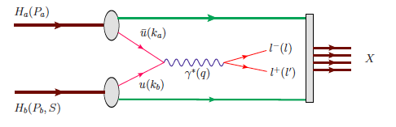
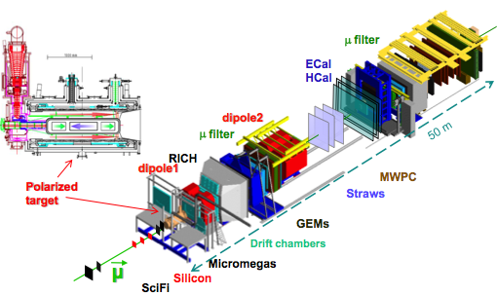

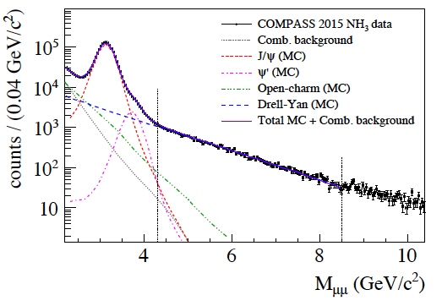
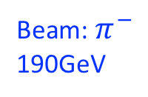
Drell-Yan A_{N} from COMPASS Polarized Target
Beam: $π^{−}$
190GeV
M. Quaresma’s talk
Polarized
Proton target
- J/ψ (NH₃) ~1.5M
- HM DY (NH₃) ~35K

Slide 28
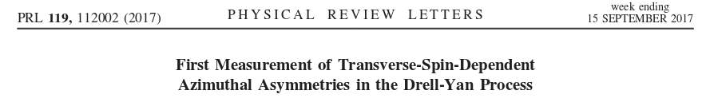
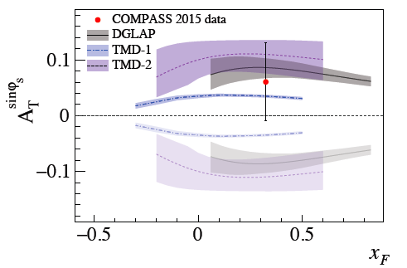
COMPASS Drell-Yan Run 2015 Results
Sign change
NO Sign change
Expectation from 2018 polarized Drell-Yan run:
Verification of the sign change by reducing of the error by a factor of ~1.5.

Slide 29
Drell-Yan Sivers Asymmetries
Kang et al, 1401.5078
COMPASS
SeaQuest: p+p
COMPASS
n+p desired!

Slide 30
Open Charm via high pT Single muons?
Open charm cross section
  Test NLO pQCD framework
Open charm TSSA
  test pQCD twist-3 framework
High pT single muon trigger
Target and dump separation

Slide 31
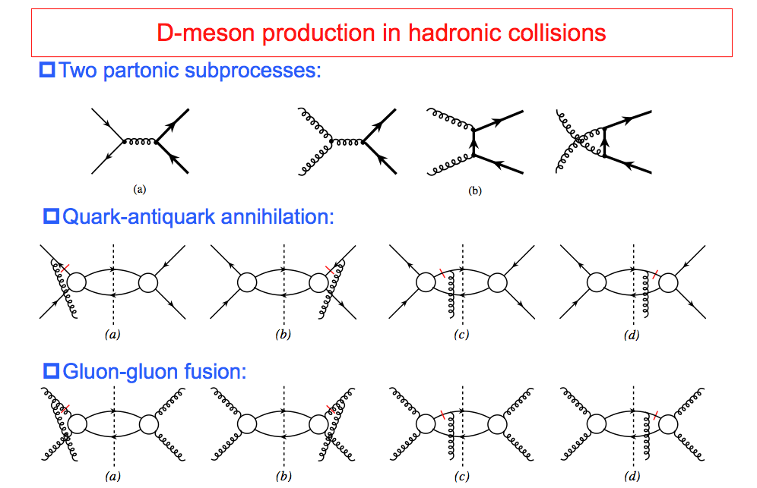
TSSA in Heavy Quark Production in p+p
Kang, Qiu, Vogelsang, Yuan, PRD 2008

Slide 32
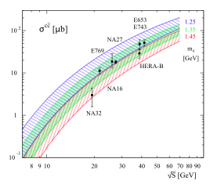
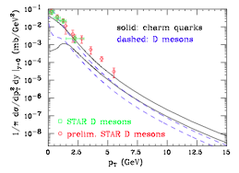
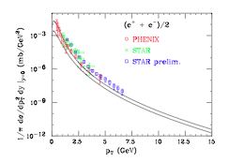
More on Open Charm Production
Fixed targets vs NLO
Collider mode @RHIC
PRL 95, 122001 (2005) M. Cacciari, P. Nason, R. Vogt
EPJ C 52, 987 (2007) J. Riedl, A. Schafer, M. Stratmann
SeaQuest

Slide 33
SeaQuest Dimuons:
Improve acceptance for low mass dimuons
Open up dimuon acceptance at trigger level:
Possible with the dark photon triggers
Improved DAQ
Better background determination
PHENIX dimuons

Slide 34
First Precision Open HF A_{N} from PHENIX

