Slide 1
Station 4 μID Testing July 2010
C. Aidala, L. Guo, M. Liu, A. Puckett

Slide 2
Outline
Status of St. 4 muID testing, June 2010
Conditioning of tubes
July 2010 testing
  Procedure
  Results

Slide 3
Good, V_{max}>2050V
16 15 14 13 12 11 10 9
8 7 6 5 4 3 2 1
06/18/2010
Dead
Module 41
Module 34
Noisy/Background/high V_{mi}n//low V_{max}
NIM Channel map
Module 14 Module 23 Module 20 Module 104 Module 35 Module 100
Module 2 Module 36 Module 38 Module 40 Module 103 Module 17
Module 15 Module ? Module 9 Module 7 Module 37 Module 21
Module 33 Module 30 Module 105 Module 45 Module 51 Module 1
Module 11 Module 26 Module 29 Module 28 Module 31 Module 32
Module 10 Module 50 Module 24 Module 42 Module 27 Module 22
Module 46 Module 16 Module ??? Module 44 Module 101 Module 4
Module 47 Module 52 Module 102 Module 48 Module 18 Module 6

Slide 4
Last Time—June 2010
Gas mixture Ar/CO₂ 90/10
HV scans, 1500<HV<2100
Measure count rates vs. HV per module/channel using VME scalers
Three categories for test results:
  Green = “good” channels, reasonable rates, plateau region of HV
  Black = “dead” channels, no counts or very low counts at all HV
  Orange = “marginal” channels, either too hot (very large count rates, noisy) or too cold (reasonable count rate only at very large HV)

Slide 5
This Time—July 2010
Gas mixture = 80/20 Ar/CO₂
Conditioning of tubes with continuous negative applied HV, “clean” ions from anode wires while flushing with gas
Same testing procedure as last time, HV scan 1600-2200 V, VME scaler DAQ
Four categories for test results:
  Green and black same as before
  Red = “HOT” channels
  Blue = “COLD” channels

Slide 6
Good, V_{max}>2050V
16 15 14 13 12 11 10 9
8 7 6 5 4 3 2 1
07/30/2010
Dead
Module 41
Module 34
“HOT”
NIM Channel map
“COLD”
Module 14 Module 23 Module 20 Module 104 Module 35 Module 100
Module 2 Module 36 Module 38 Module 40 Module 103 Module 17
Module 15 Module ? Module 9 Module 7 Module 37 Module 21
Module 33 Module 30 Module 105 Module 45 Module 51 Module 1
Module 11 Module 26 Module 29 Module 28 Module 31 Module 32
Module 10 Module 50 Module 24 Module 42 Module 27 Module 22
Module 46 Module 16 Module ??? Module 44 Module 101 Module 4
Module 47 Module 52 Module 102 Module 48 Module 18 Module 6

Slide 7
Observations
Significant improvement in many modules/channels observed after ~5 weeks conditioning
A few selected channels have regressed, but on balance, test results significantly more promising
Source of problems not always obvious
Expect more improvement with production drift gas, HV and LV system and electronics
Eventual availability of production DAQ for all modules will enable more rigorous and informative testing

Slide 8
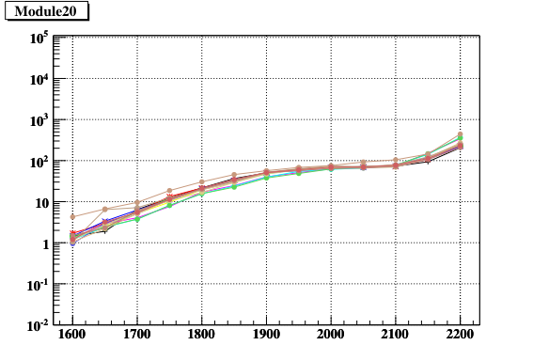
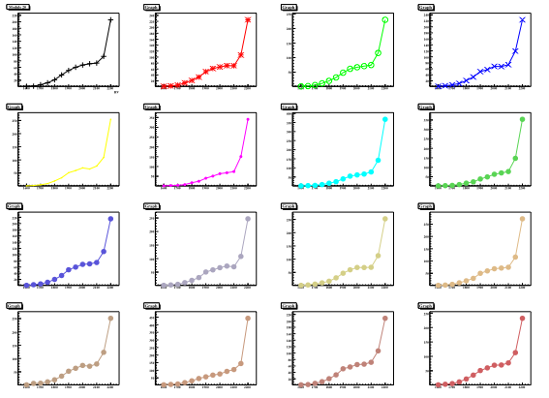
Example Test Results—Module 20 “Golden Module”
All channels exhibit same characteristic curve of count rate vs. HV
Universal curve exhibits “plateau” in the range 1900<HV<2100

Slide 9
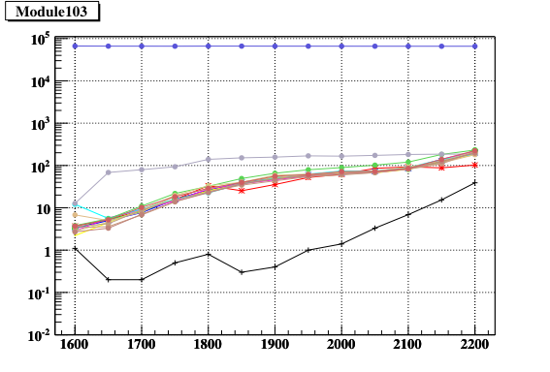
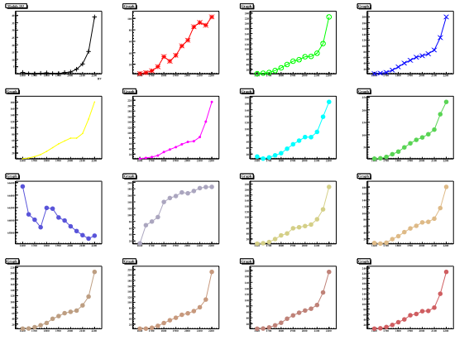
Example Test Results—Module 103
One channel “HOT” + one channel “COLD”
Module 103, channel 9: very high count rates at all HV, almost 1000X “normal”
Channel 1: low count rates at all HV, approaching good plateau region at high HV

Slide 10
Conclusions
Conditioning of prop. tubes with good gas, negative HV has led to a marked improvement in performance
Currently, we have:
  26 “perfect” modules; defined as “all green”
    Of these, 3 are “wrong shape”
  14 modules with only 1 problem channel
    2 wrong-shape
Expect further improvement with continued conditioning, production drift gas, and production electronics, LV/HV supply.
Still have room for improvement, but trend is positive, and we are close to having enough good modules for the final assembly, depending on our criteria for evaluation

