Slide 1
Preparation for E1039 Summer Shutdown Work Plan – Draft 3/11/15 meeting w/ Fermilab Management for Labor and Support
E906 work
St-1 chamber work
Other small projects
IR work for E1039
Install L/R telescopes?
Beam on target luminoity
X-Y Position monitor?
Target support/platform
Power, water cooling etc
Other work?
Shielding
MARS calculation?
DAQ and slow control signal integration at Counting House
E906 approach:
HV monitoring etc.
Server pull the information from Keithley every ~3min and send them to MySQL
E1039 NMR/Target information
Windows/LabView send the information to MySQL
Shielding for electronics?
Install Ethernet cable in the target area

Slide 2
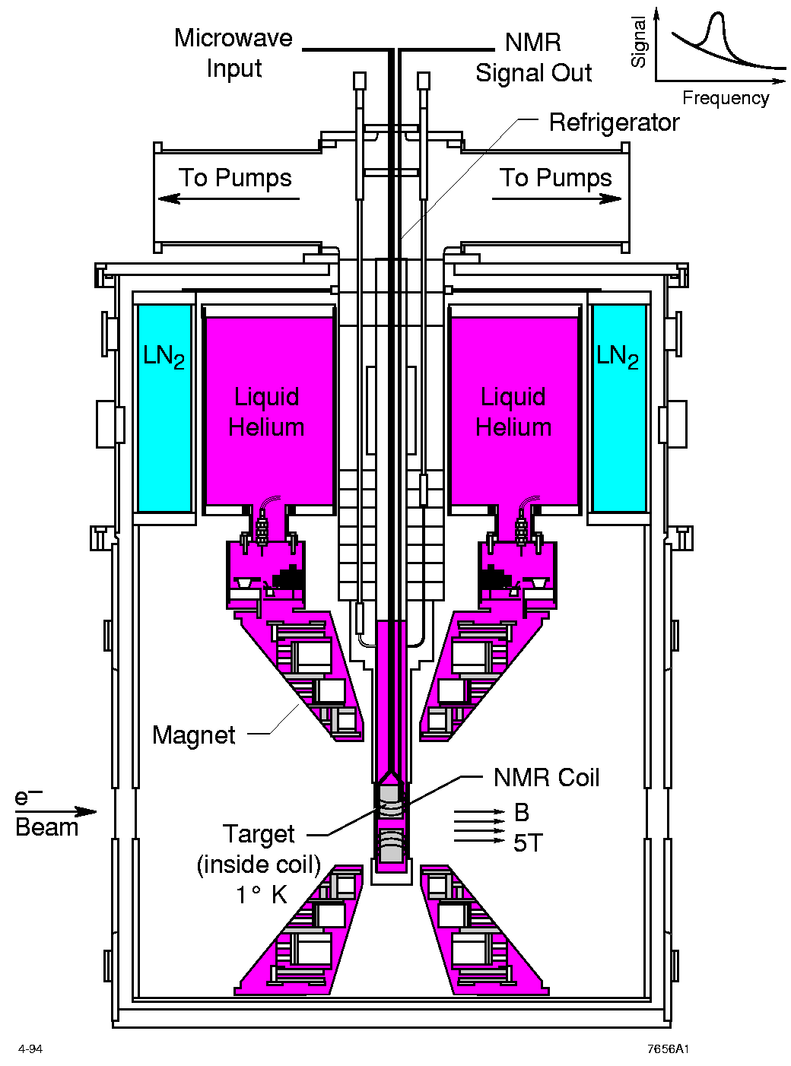
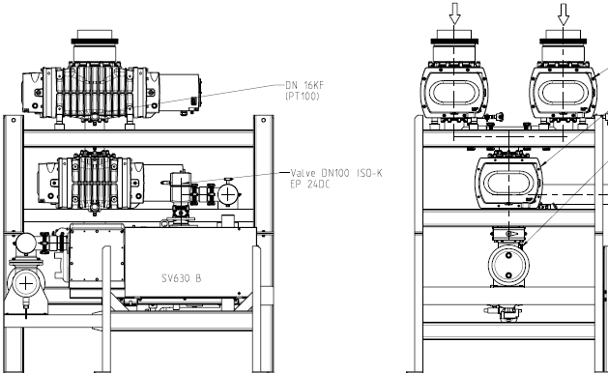
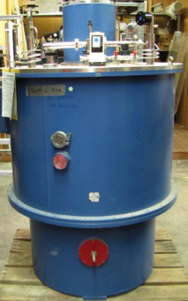
Conceptual Design of the New Polarized Target Area - new services and modifications needed to operate the polarized target: - pumps, cryo, electrical, microwave, NMR
Z = -3.5m
Modifications
needed
620cm
457 cm
178 cm

Slide 3
Schedule and Timeline
New target area and radiation shielding design and safety review
Cryogenics System design and installation
Beam line modifications
Beam on target monitoring telescopes
End of E906
9/2016
E906 Operation
~ 6 months
Target area shielding design and safety review
Remove E906
shielding blocks
Some work
during
2015 shutdown
7/4-9/26
- Target stand design
and preparation
- Safety interlock system
- Target and service
line installations
- System test
Service line layout & preparation
Cryogenics
Electrical and water
Pumps, vacuum
Microwave system
NMR and DAQ
- Shielding block
Installation
- Safety reviews
Beam line work:
- collimator and Q3
Kmag/FMag new switch and controls
New beam monitoring telescopes
E1039
commissioning
data taking

Slide 4
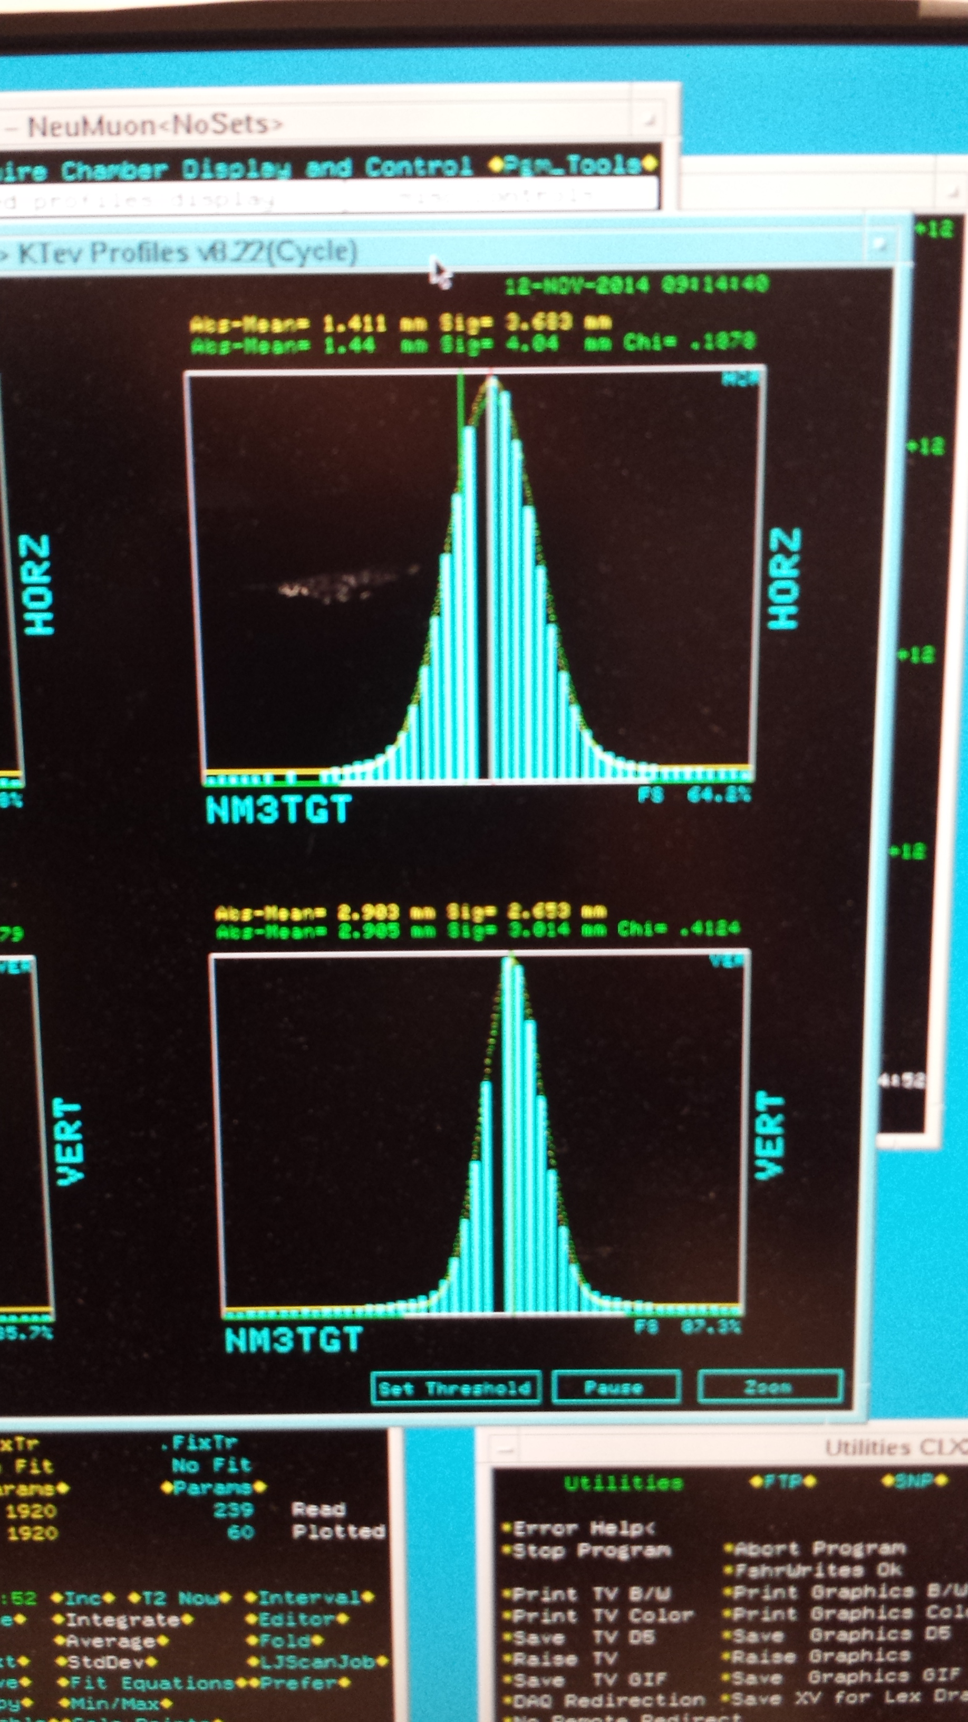

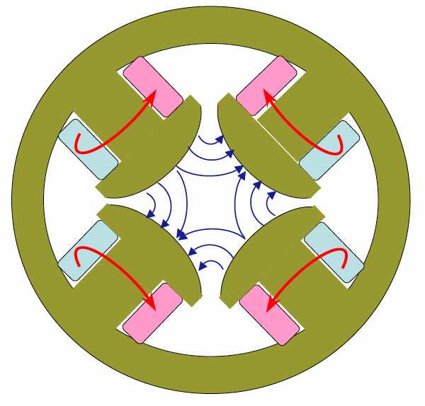
New Beam Collimator, Focusing Q3 and Target
Target cross section: 18 x 28 mm²
E906 beam profile:
SigX = 5.0mm
SigY = 3.5mm
Beam cross section:
Need be well contained within
4 sigma, required by dR< 2x10⁻⁴
sigX = 18/2/4 = 2.2 mm
sigY = 28/2/4 = 3.5 mm
Beam jitter: dX=dY ~ 2mm
28mm
18mm
1 sig = 0.68269
2 sig = 0.95450
3 sig = 0.99730
4 sig = 0.99994
Beam collimator
120GeV
beam
Final focusing Q3

Slide 5
Run-3 Beam X Position Stability vs Spill_ID Run = 13360, M3TGHM/HS; VM/VS
(mm)
Spill-ID

Slide 6
To Do List
Target and Beam Control
DAQ and Spectrometers
Some changes @IR
New space for operation, target change etc
New target stand (a platform )
Radiation shielding around the target area
Target operation and maintenance related
Service lines, Power, Cryogenic systems
NMR system, radiation shielding for electronics, network access
Space for target changes etc.
Beam control
A new final focusing quadrapoles
Beam collimator, target magnet quench protection
Beam spot position/direction/size monitors
Beam position/direction stability
Luminosity monitors, Cerenkov, new telescopes
Fermilab Engineering and Safety Review
Spectrometers
New switches to Reverse fields of FMag and KMag for spin asymmetry systematic control
Triggers
A new trigger road map to optimize signal from target
DAQ
Improve DAQ bandwidth
Slow control integration into DAQ
Physics asymmetry systematic controls
Precision luminosity

