Slide 1
Station 4 Prop Tubes Status and Plan
Ming Liu
Los Alamos National Lab

Slide 2
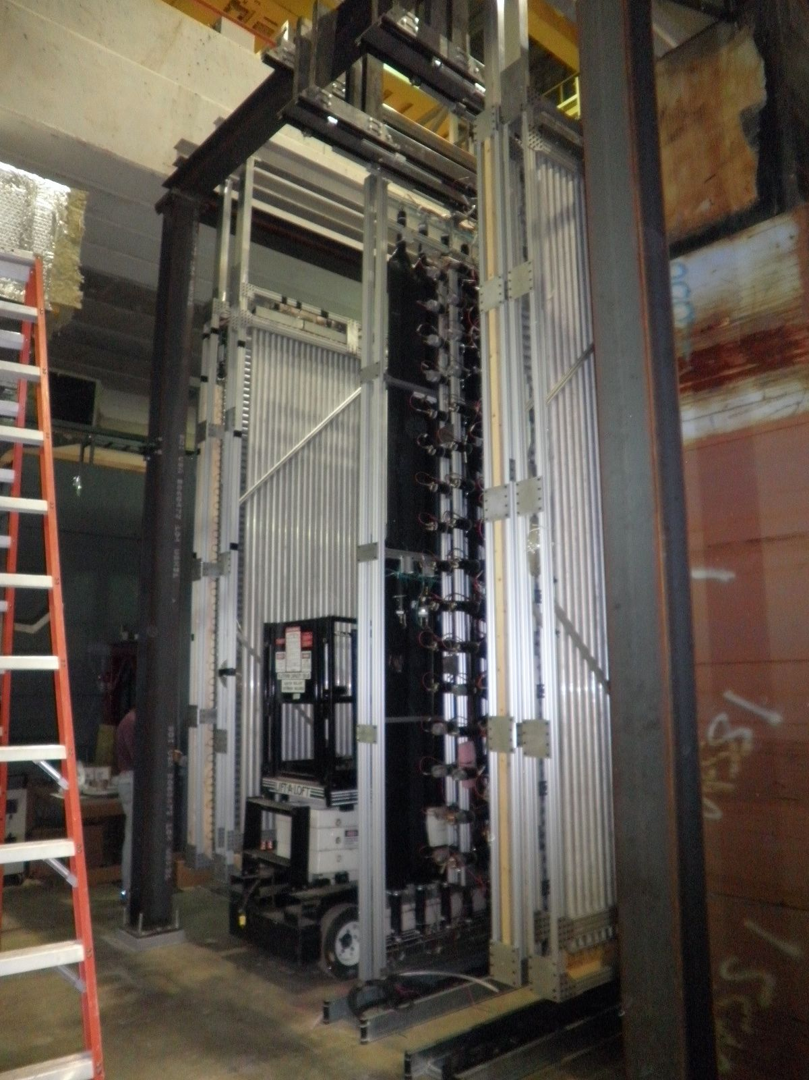
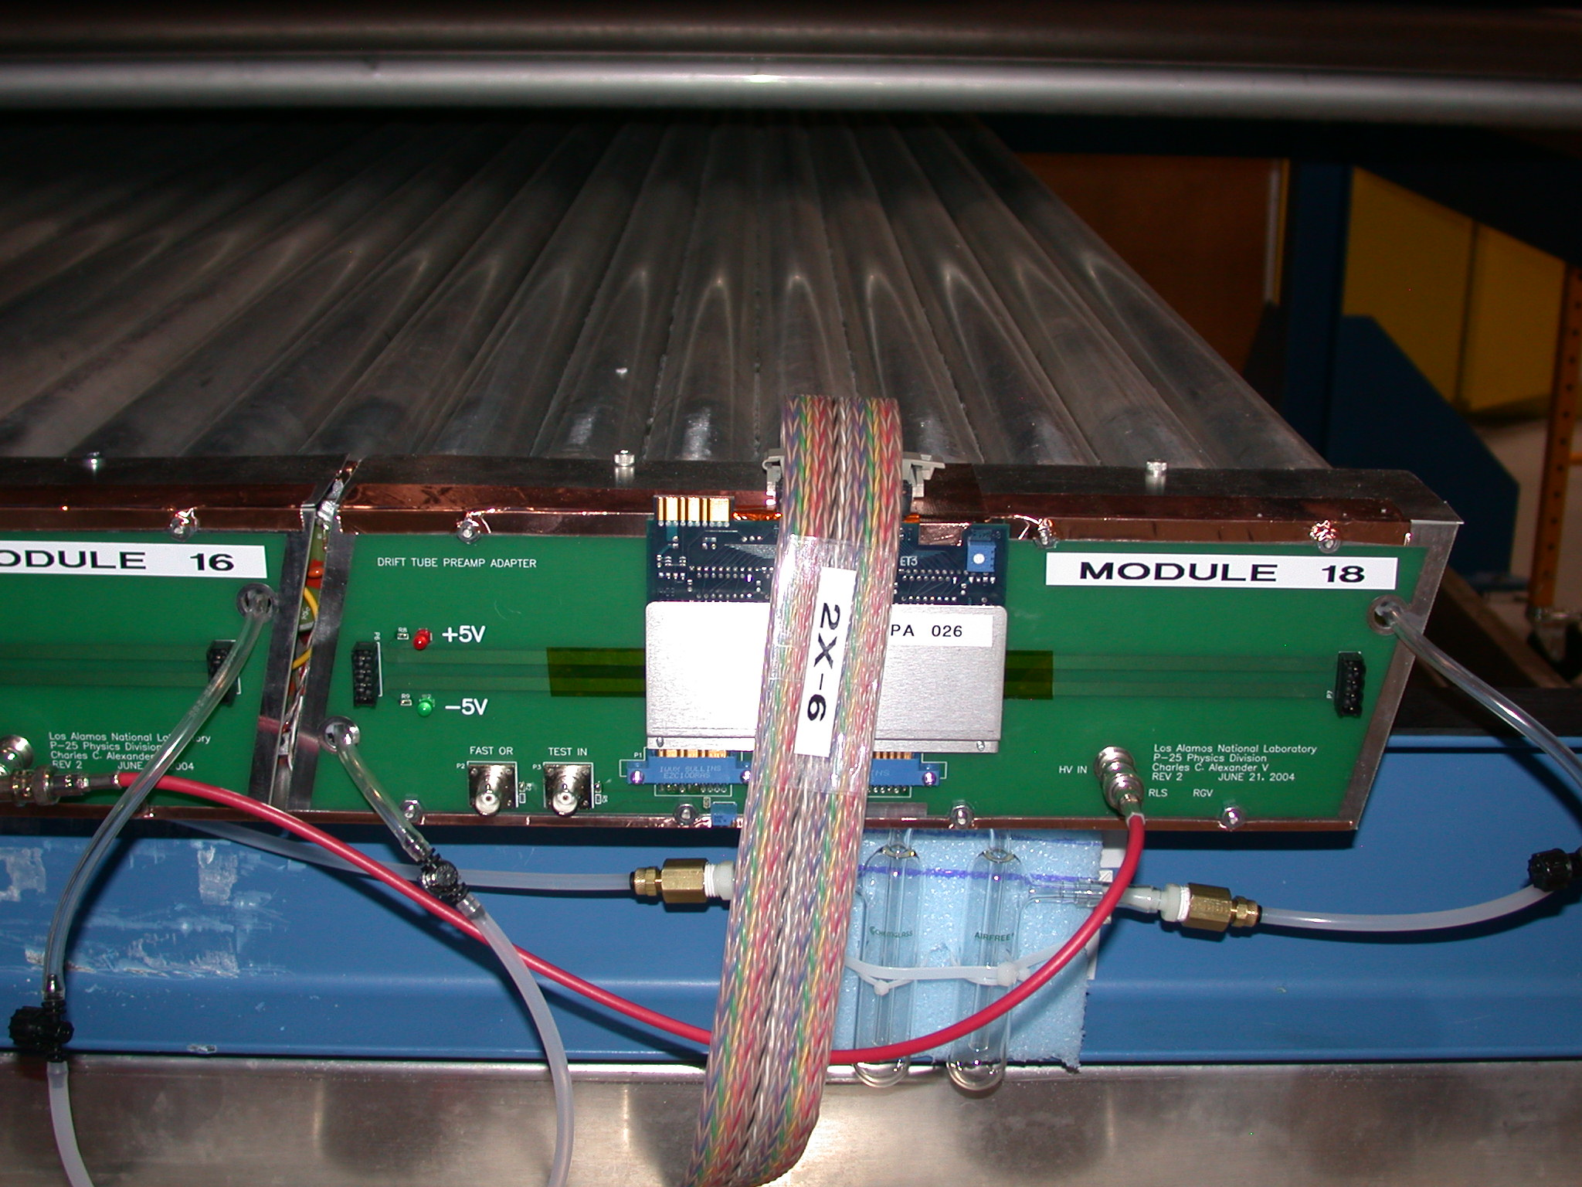
Station-4 Muon Prop Tubes
Installed in March, 2011
Tested with cosmic rays
μ

Slide 3
P1Vxx
P2Vxx
16 15 14 13 12 11 10 9
8 7 6 5 4 3 2 1
16 15 14 13 12 11 10 9
8 7 6 5 4 3 2 1
16 15 14 13 12 11 10 9
8 7 6 5 4 3 2 1
V1
P1Hxx
V1
P2Hxx
NIM channel map
Front View
V2
V2
16 15 14 13 12 11 10 9
8 7 6 5 4 3 2 1
16 15 14 13 12 11 10 9
8 7 6 5 4 3 2 1
X
IP, Top View
……
……
Z
Document committed
in E906 Doc Server
16 15 14 13 12 11 10 9
8 7 6 5 4 3 2 1
16 15 14 13 12 11 10 9
8 7 6 5 4 3 2 1
V9
V9
READOUT
ELECTRONICS
Plane-1
Plane-2

Slide 4
P1Vxx
P1Hxx
P2Vxx
P2Hxx
P1H1
Wrong
Shpd mod.
16 15 14 13 12 11 10 9
8 7 6 5 4 3 2 1
16 15 14 13 12 11 10 9
8 7 6 5 4 3 2 1
9 10 11 12 13 14 15 16
1 2 3 4 5 6 7 8
1
H1
H1
NIM channel map
Front View
16, 15, … 3, 2, 1
FEM Card
16 15 14 13 12 11 10 9
8 7 6 5 4 3 2 1
2
H2
16 15 14 13 12 11 10 9
8 7 6 5 4 3 2 1
Y
H2
X
(P2H2)
……
Z
……
IP, Side View
16 15 14 13 12 11 10 9
8 7 6 5 4 3 2 1
16 15 14 13 12 11 10 9
8 7 6 5 4 3 2 1
9
H9
Ground Floor

Slide 5
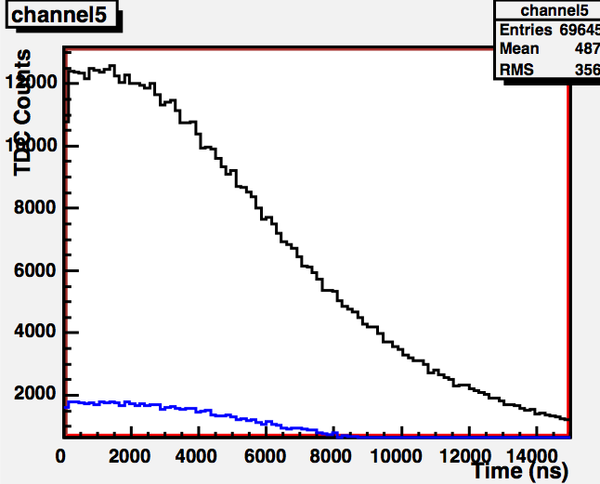
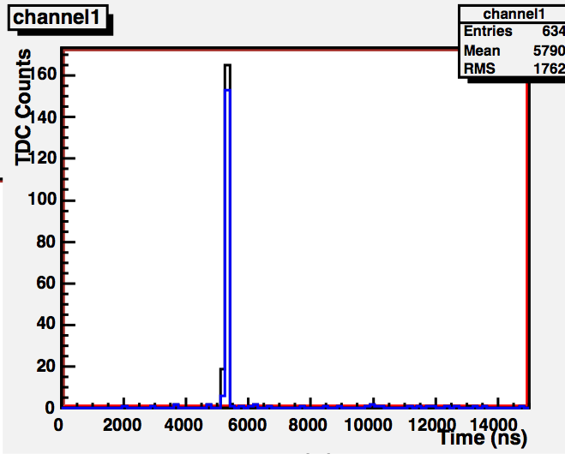
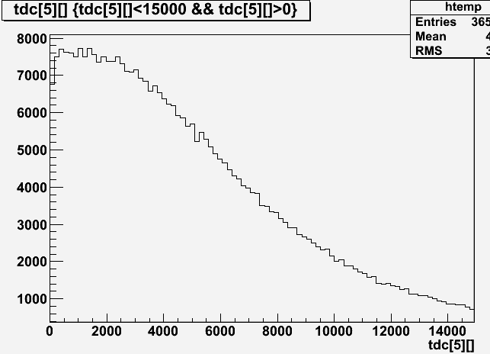
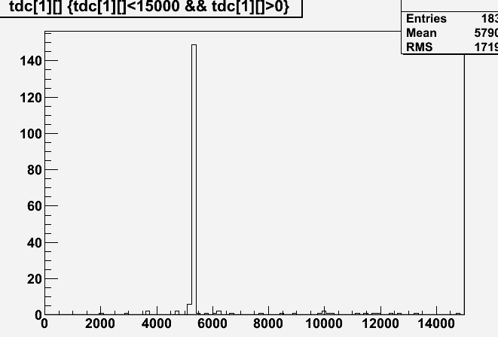
Progress on the decoder/offline analysis (Kun Liu, a new LANL local student)
Reproduce Kaz’s plots based on old TDC format
Working on a handy decoder with new TDC format for the test runs and detector commissioning
Kaz’s
Kun’s

Slide 6
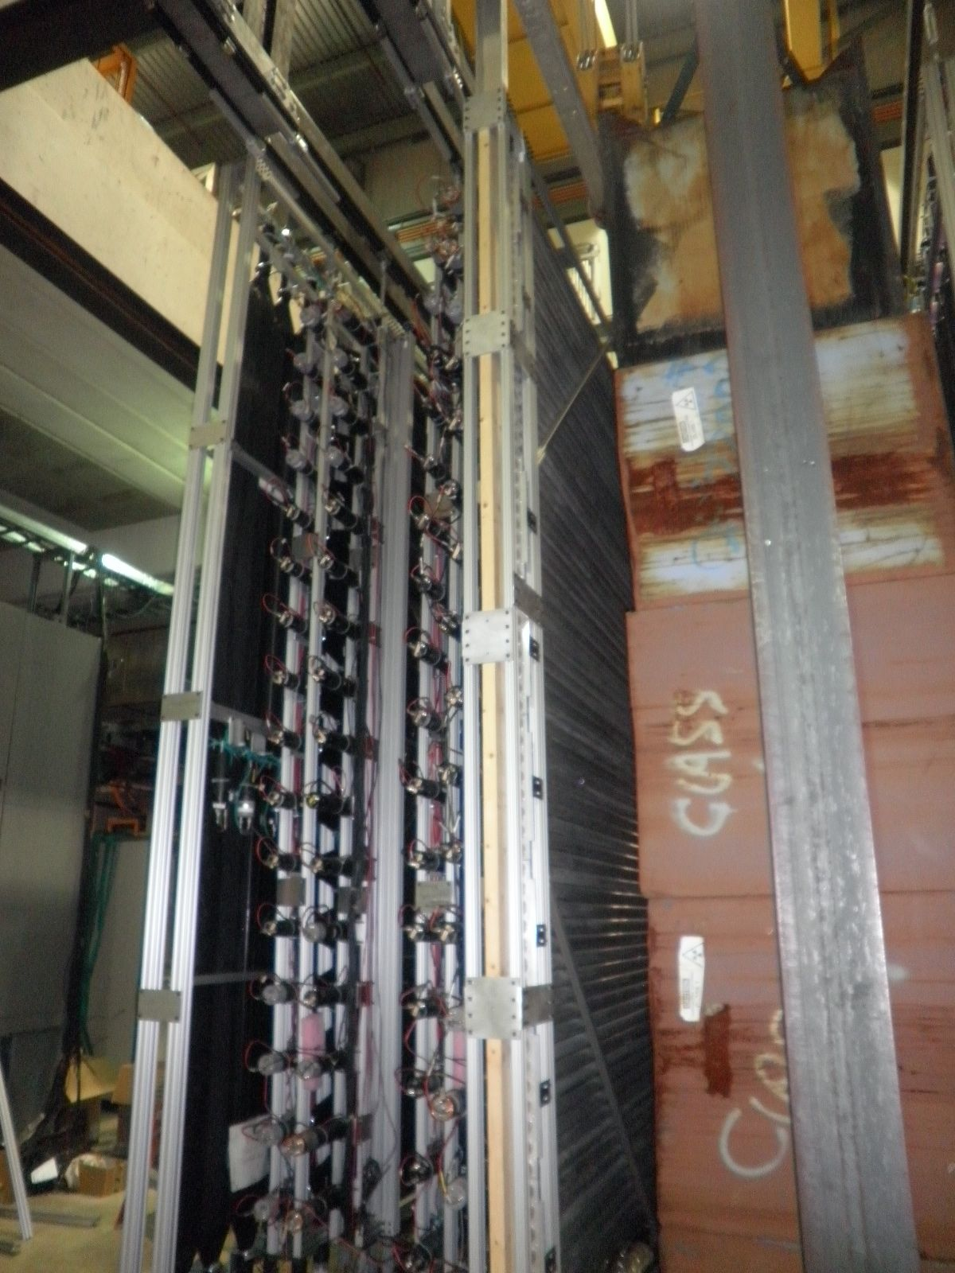
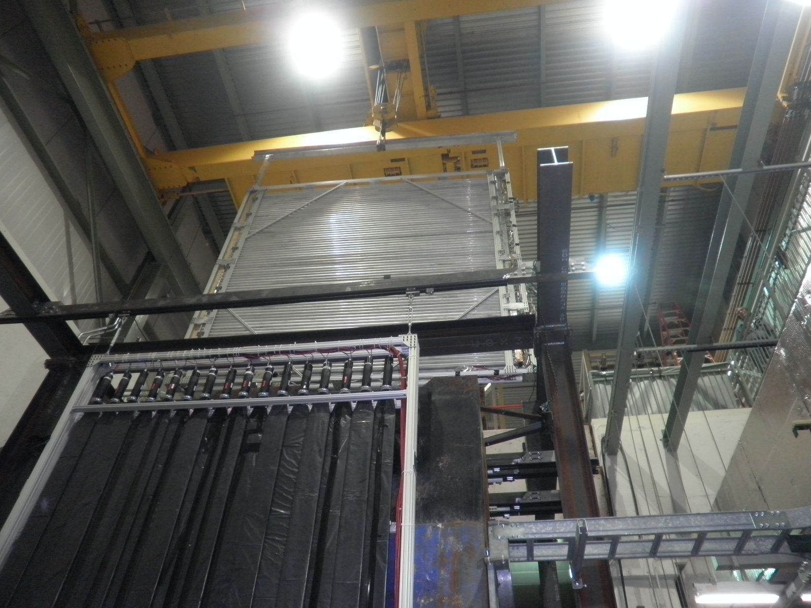
Y1-plane installation 2/28/2011

Slide 7
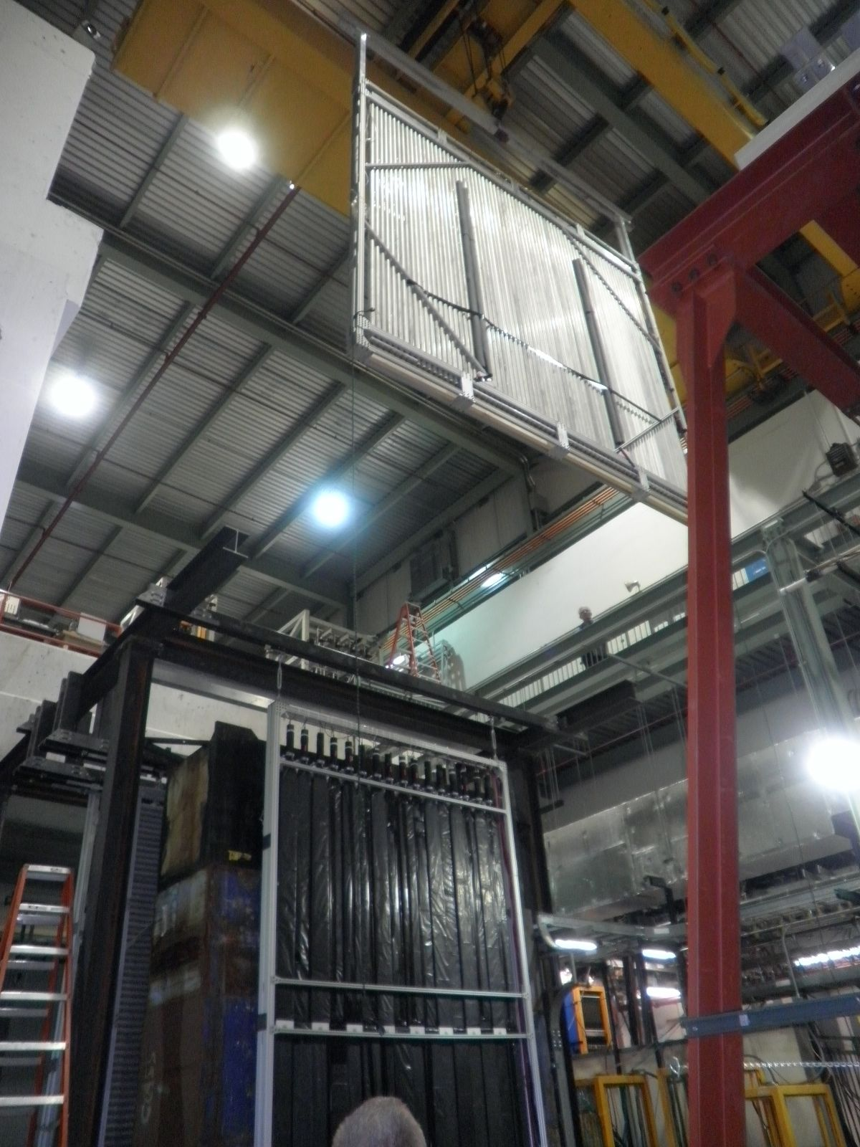
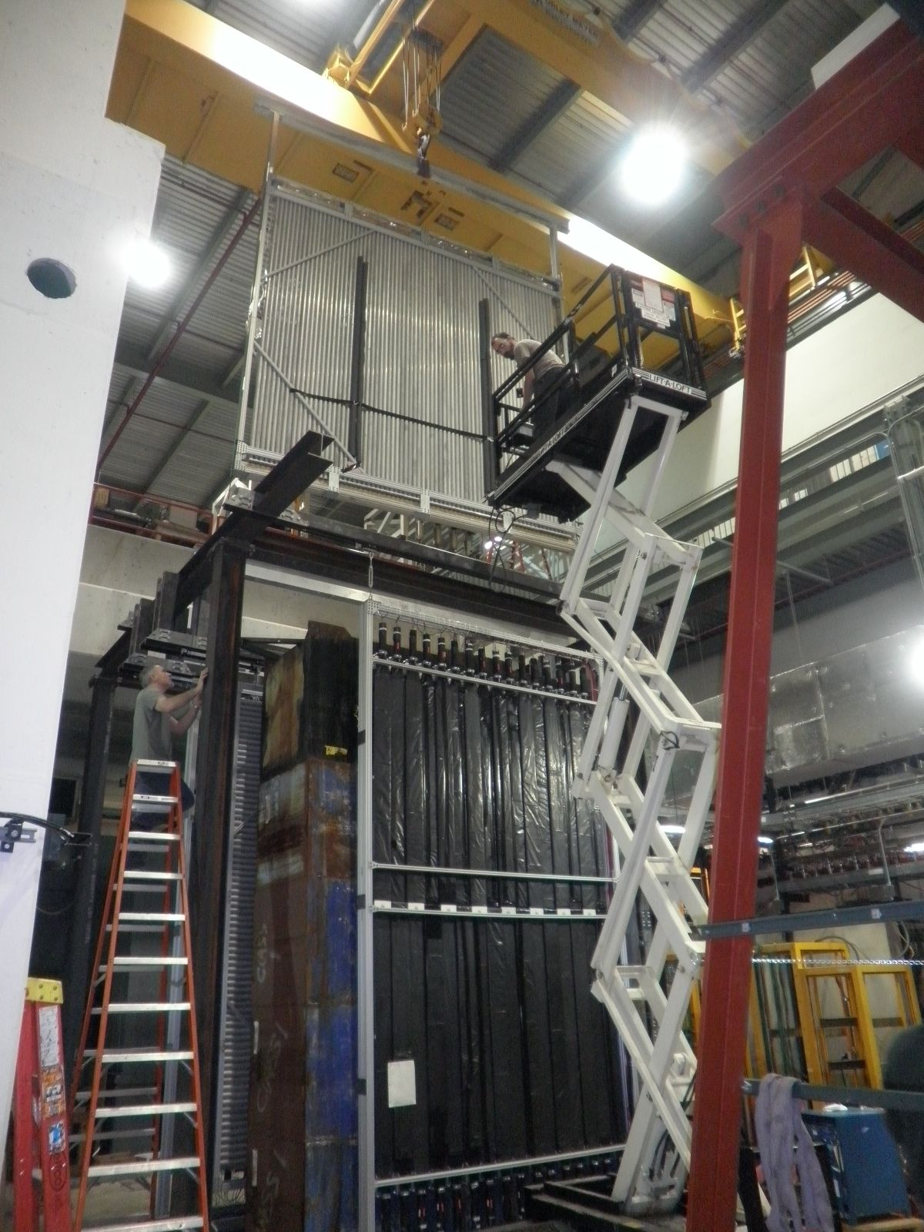
X1 plane installation 3/1/2011

Slide 8
Current Status and Plan
Detectors are in place
LV, HV connected
Signal connected, but no TDC cards yet
Gas lines installed and connected
Issues and to-do list
(new) flamebloc spray caused a shortage in HV for all modules
Found a solution this week, can be cleaned up with water,
work in progress (next a few slides)
Need to take all planes out from the experimental area
Clean up with water,
Apply corona dope (HV coating)
apply “white paint” to wood lumbers
Electronics noise and ringing
Need to work on the electrical ground
Major source of problem identified this week!
need to rework the output ECL cable layout (next a few slides)

Slide 9
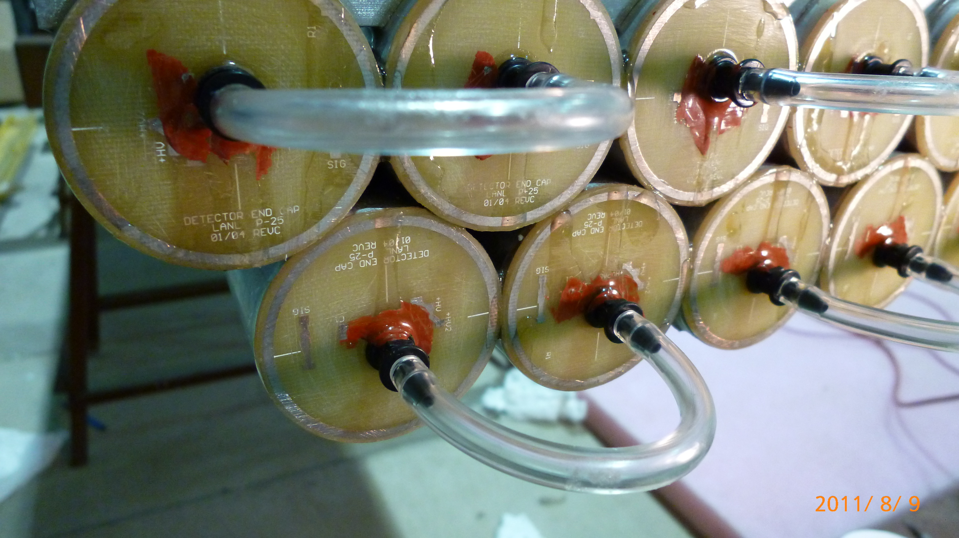
Flamebolc and HV shortage problem

Slide 10
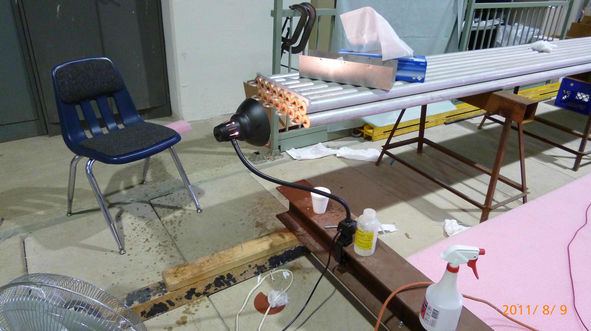
Flamebloc GS 200

Slide 11
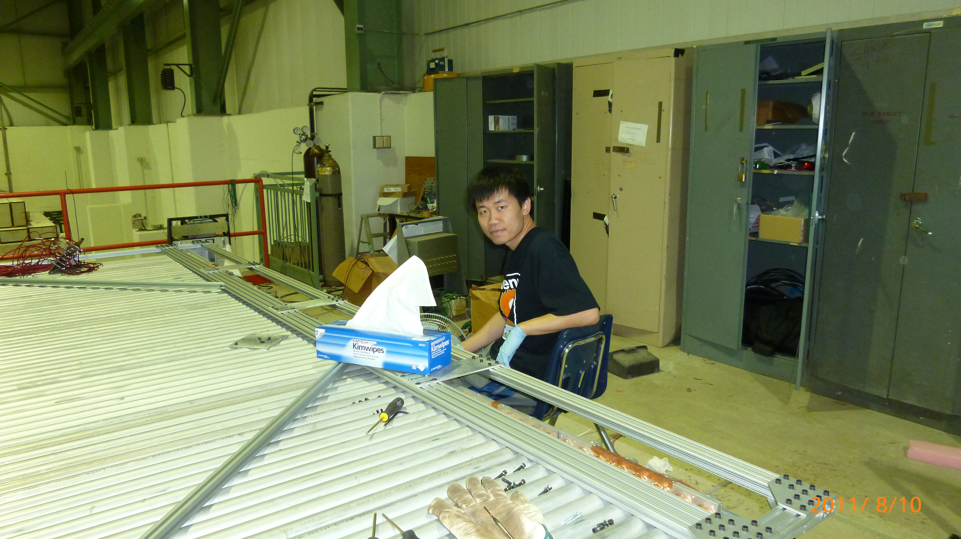
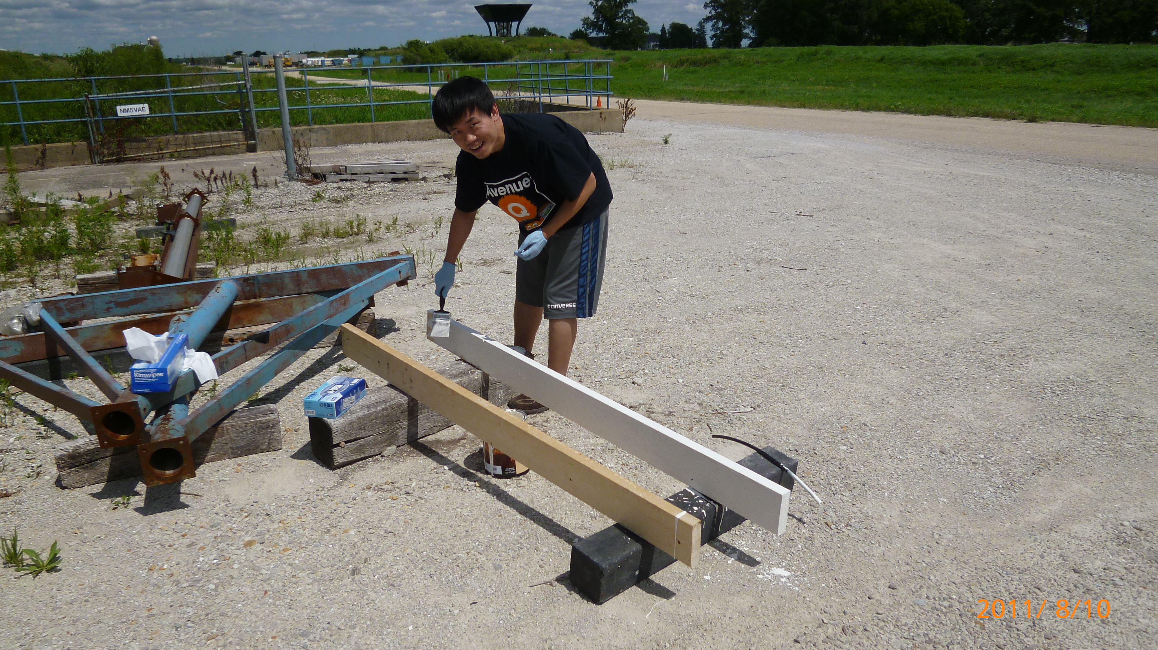
More on Flamebloc Clean up Work Problem Fixed!
Flamebloc cleaned with water
HV come back to normal operation
- Apply Corona Dope to the exposed
HV posts at end of tubes
- Apply flam-retardant “white paint”
Thanks Mike Geelhoed!

Slide 12
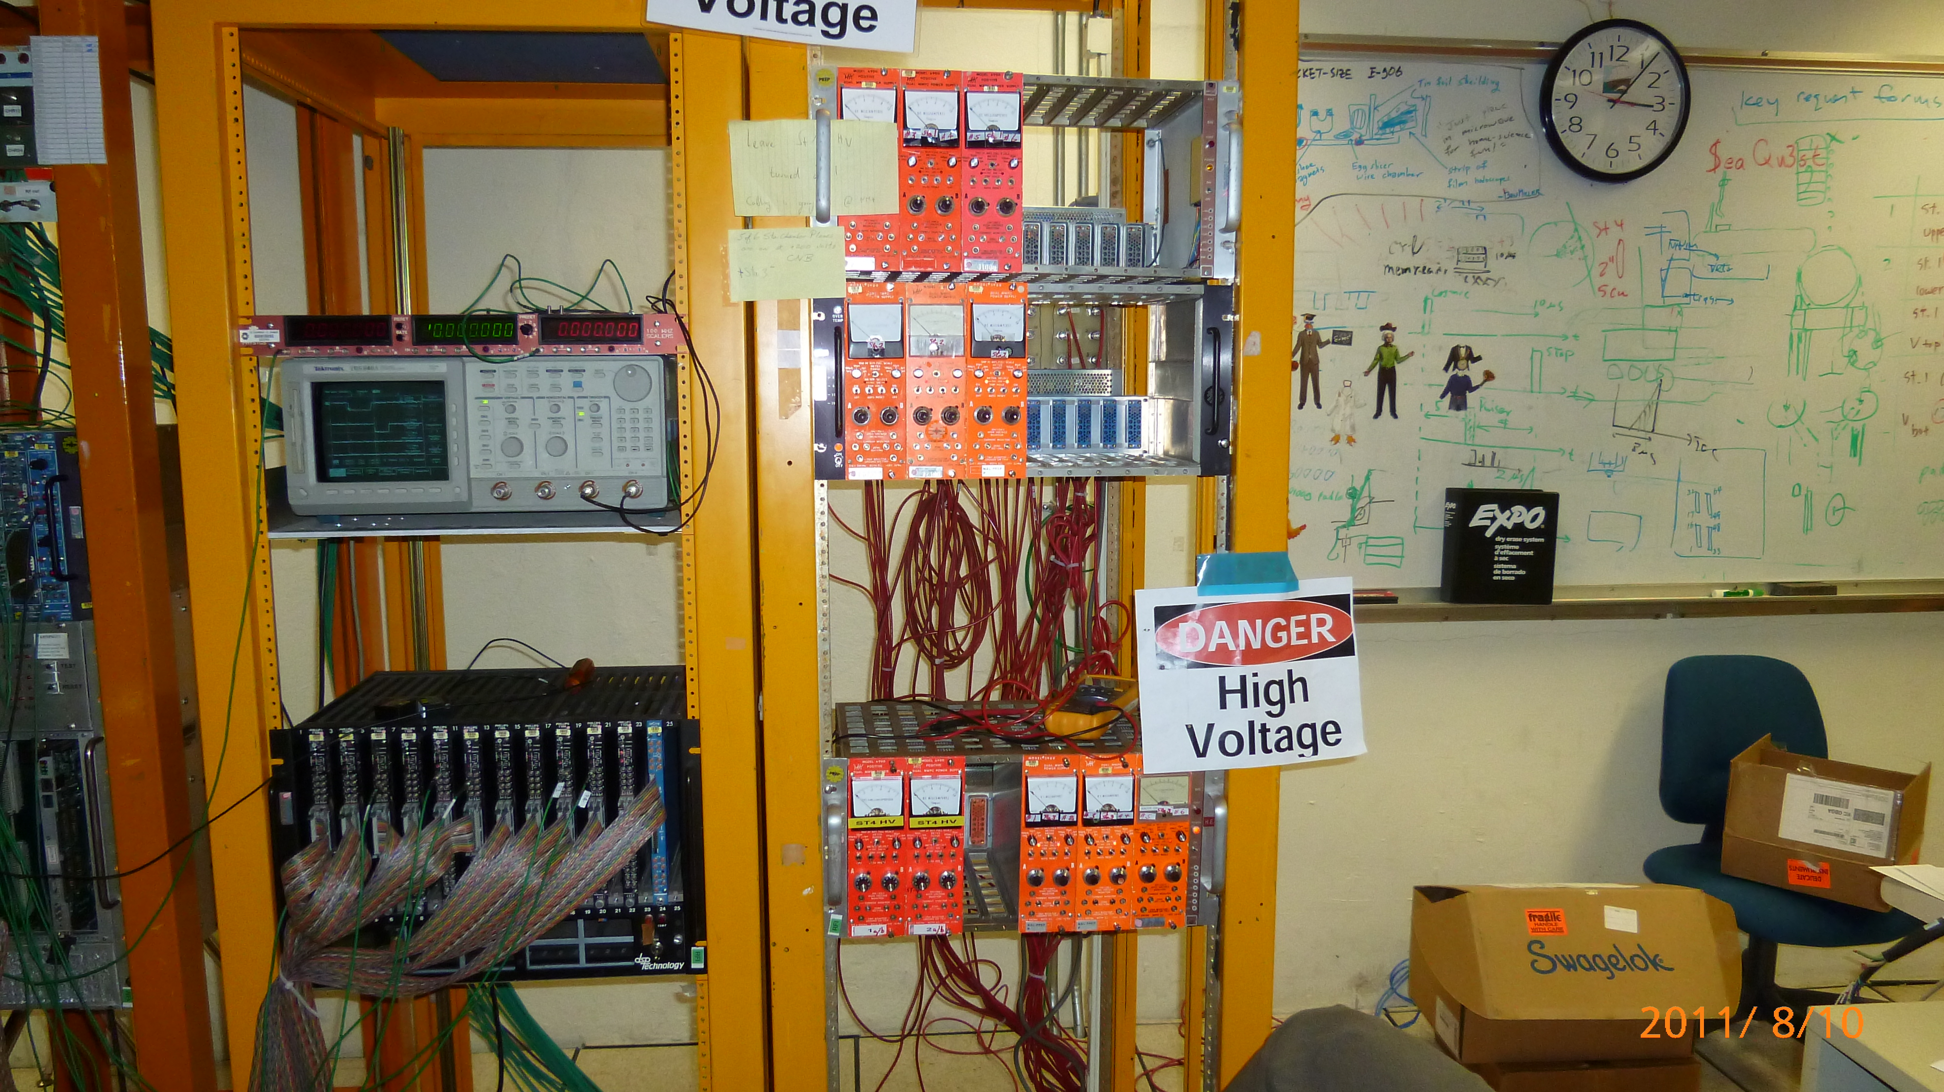
HV system
One HV channel per plane (for now):
HV = +1800~2100V,
I ~ 10s nA per module @2KV
4 channels total

Slide 13
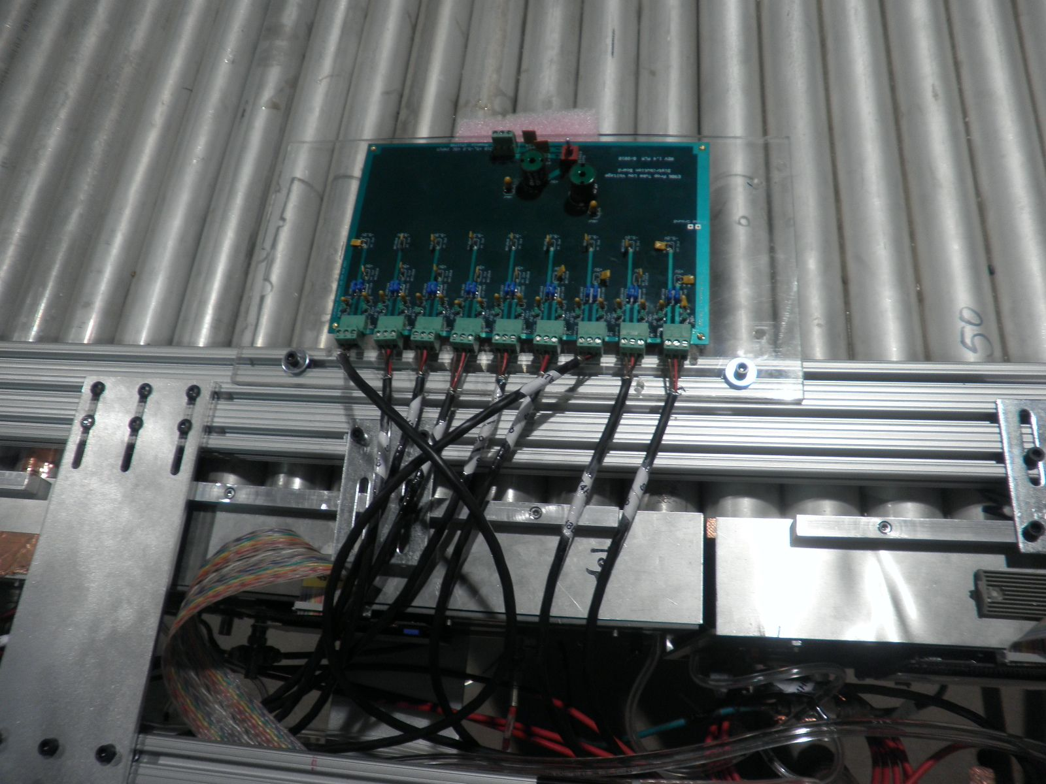
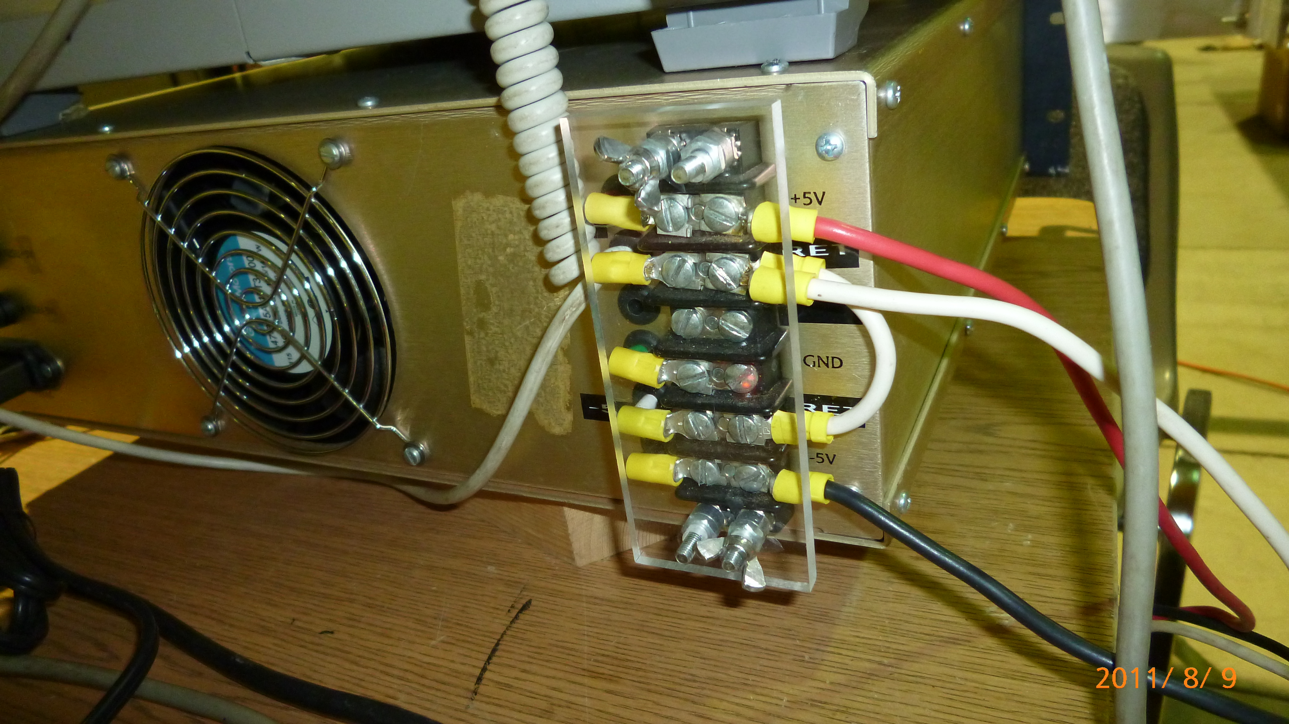
LV system
UCLA LV PS:
5V & 18A each
Fixed and certified by D0 group!
4 PS total
Per plane (9 modules)
+5V, 0.5x9=4.0A
-5V, 0.75x9=6.8A
Ground configuration
A common Floating ground for +/- 5V
Chase ground available

Slide 14
Prop Tube Circuit Diagram and Electrical Groundings
+HV (2000V)
R=10M
F.G. @PS
+5V @PS
C = 10? pf
Frame ground
- AL tubes+ frames
- Poor earth ground via I-beam
R=6.5 K ?
-5V@PS
F.G. @detector
dV= 10M x 1 uA = 10V
F.G.@detector

Slide 15
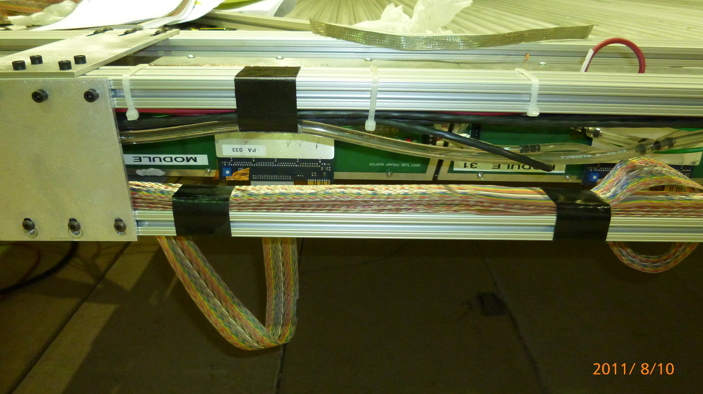
Stacked ECL Output Cables Source of Cross Talks and Cross Module Ringing

Slide 16
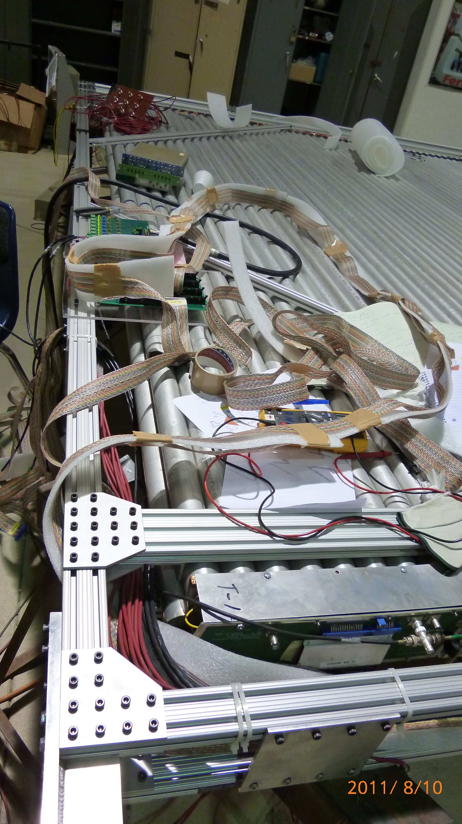
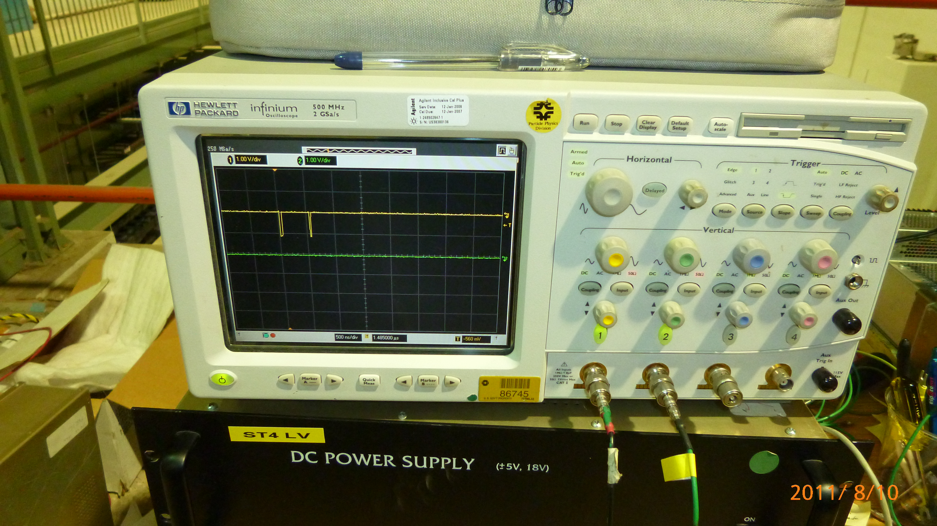
A Solution
Increased space/gap between cables ¼” foam
Or metal jacked-shield cable?
Works for Modules 8 and 7
Clean cosmic hits seen! (was ringing badly)

Slide 17
System Integration Plan
Individual module works fine in stand alone mode
LV on
HV on
Readout cables connected and checked with scope
PreAmps develop ringing when multiple module LV cables are connected, clearly a electrical grounding issue
HV cables seems having no effect
Mainly from cross talks via output ECL cables
Increased gap proved eliminate the cross module ringing problem!
Plan
Address the grounding/cross talk issues before the detector is moved back to the experimental area, i.e. @ loading dock
New ECL cable layout
Test with external pulser
Test with cosmic rays
Need ~4 weeks @ one plane/week
Complete installation and electrical test by the end of September.

