Slide 1
St-4 Muon Prop Tubes
Summer Work
June: Lei and Ming
July : Andrew, Christine, Lei and Ming
Checked all modules with Ar/CO2 (80/20)
Installation plan
Background rate

Slide 2
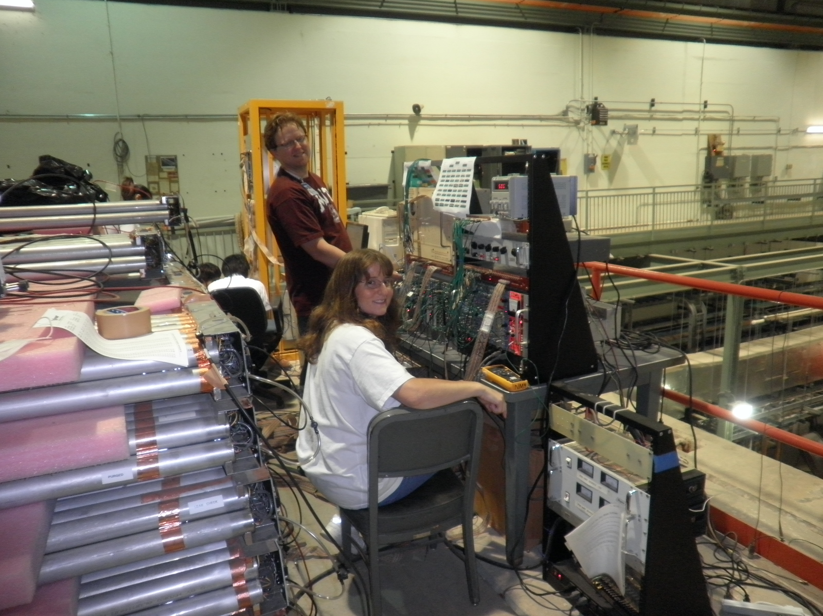
July 2010 @NM4

Slide 3
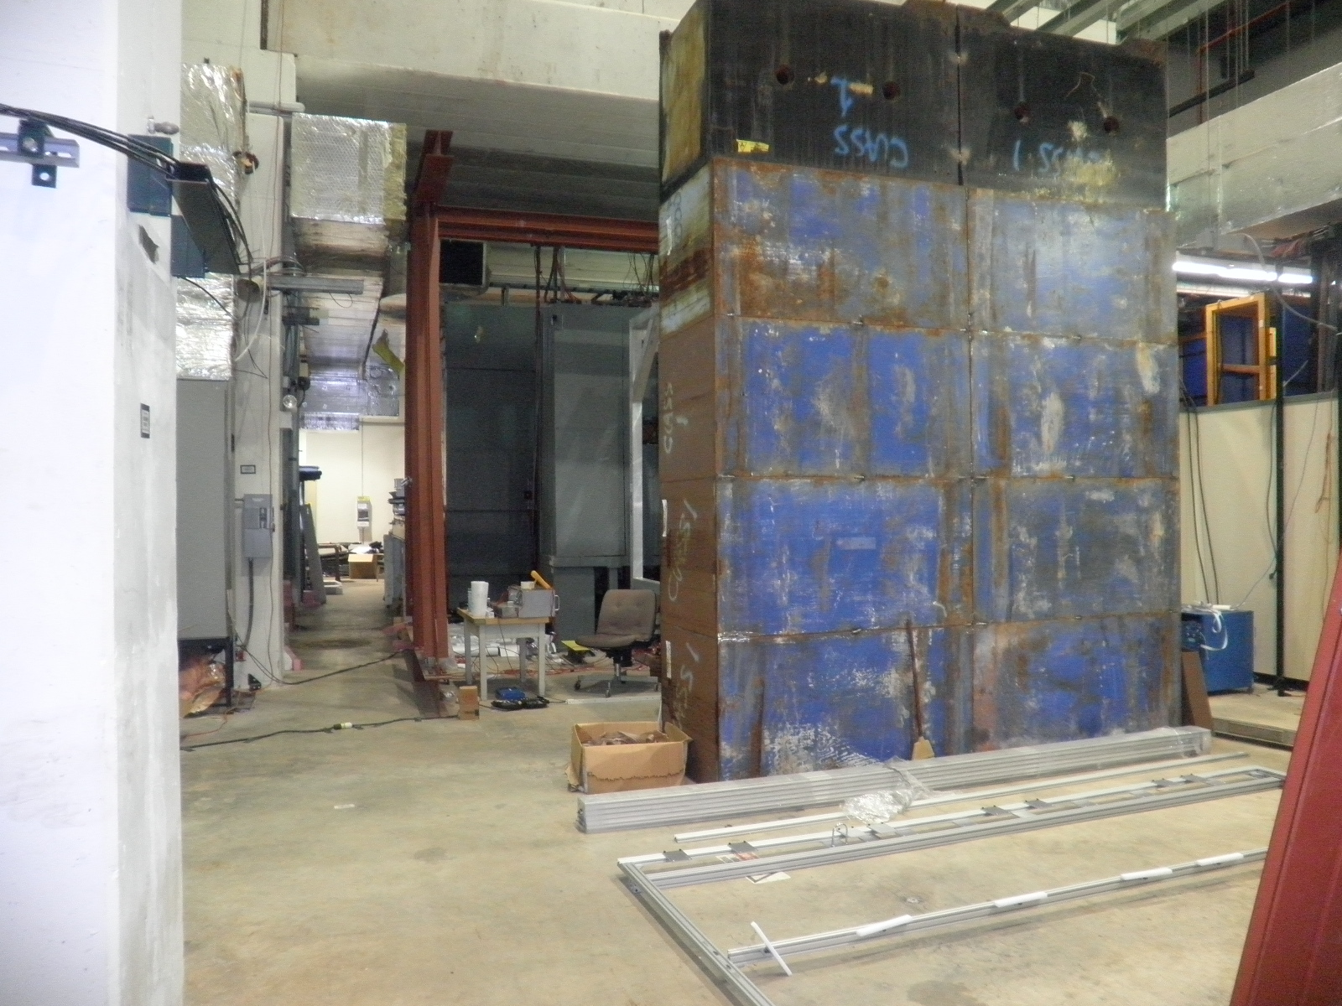
Ion absorbers

Slide 4
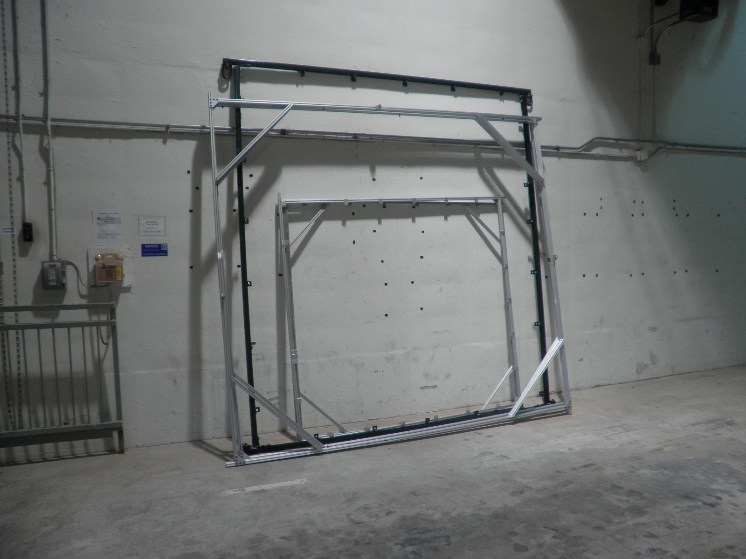
80-20 based ST-4 Prop Tube Frame will look like this one…

Slide 5
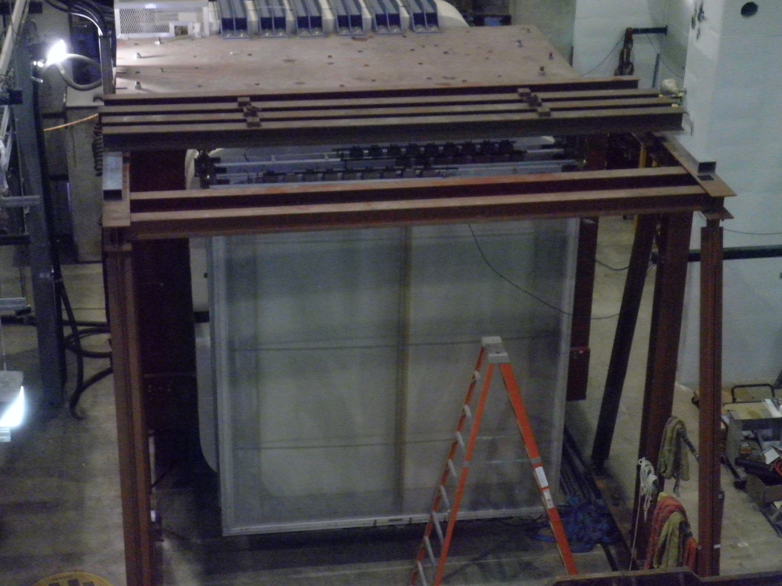
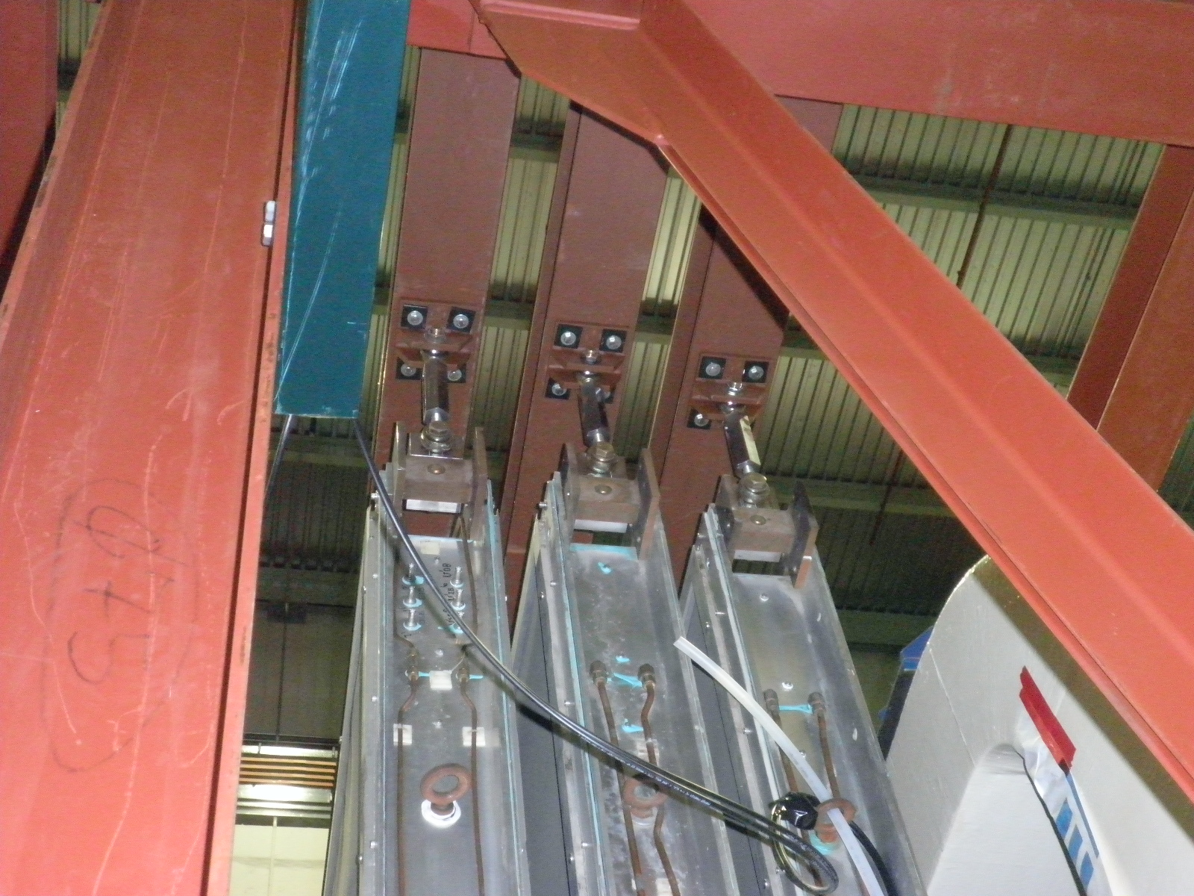
Prop Tube Lifting Points (similar to ST-2 chambers)

Slide 6
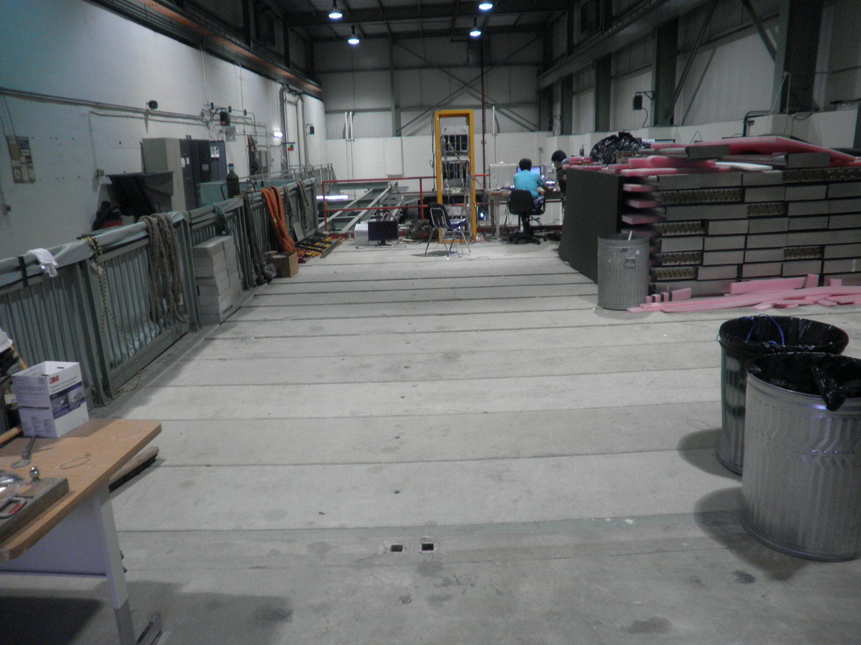
Assembling area

Slide 7
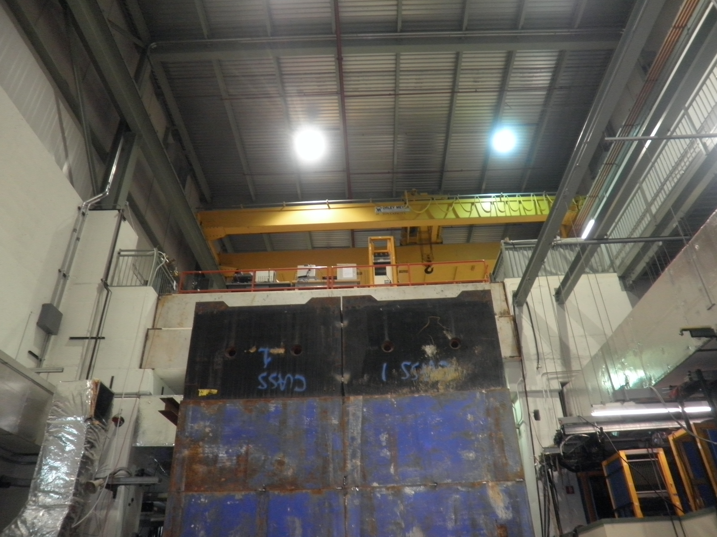
Installation – drop in w/ crane

Slide 8
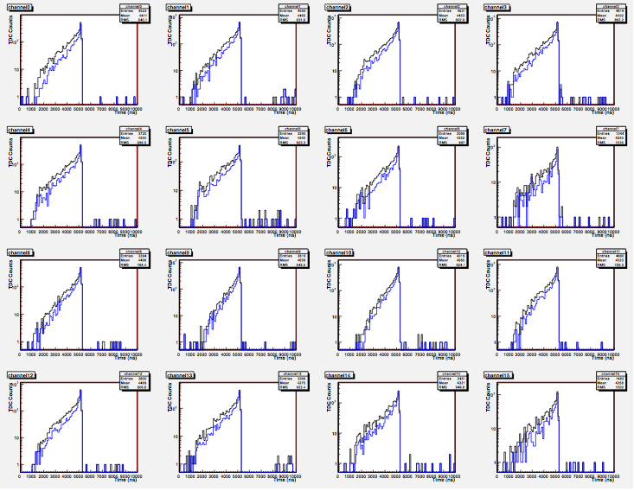
TDC spectra: Mod. #35 Ar/Co2 =80/20 HV=1900V ΔT_{max} ~ 2 uS
Thanks Kaz!
signal
TDC
Drift Time
Time
Trig.
Comm. Stop
BLK = all
BLUE = 1st sample only, rings removed

Slide 9
Background (I)
From Don G.
1.5 MHz

Slide 10
Max. Drift Time and Background Rate
Background rates set the maximum Drift time
Can we reduce the BG?

Slide 11
Background rate (II) muon energy spectrum
37% low energy muons, P < 1.5 GeV, can be removed by thick (1 m) ion blocks, E_loss ~ 1.5GeV
From Don G.

Slide 12
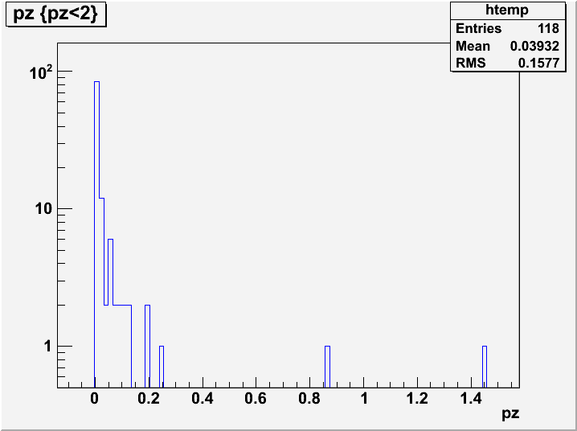
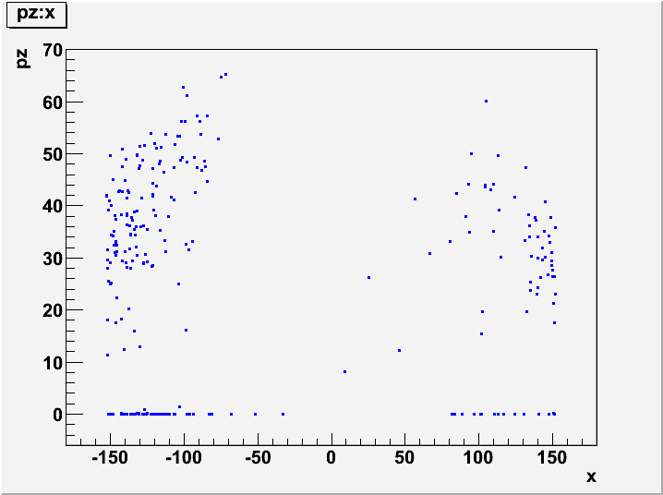
More on background
Pz vs X distribution
If pz < 1GeV removed
Rate = 1.5 *0.63
= 0.95MHz
Like to have more MC samples

Slide 13
Some Issues
More absorbers?
Current ion blocks don’t cover the whole detectors
More ion or concrete blocks?
Schedule of the I-beam support frame
Schedule of TDC electronics andDAQ
Check background rate with test beam, when?
Which Gas?

Slide 14
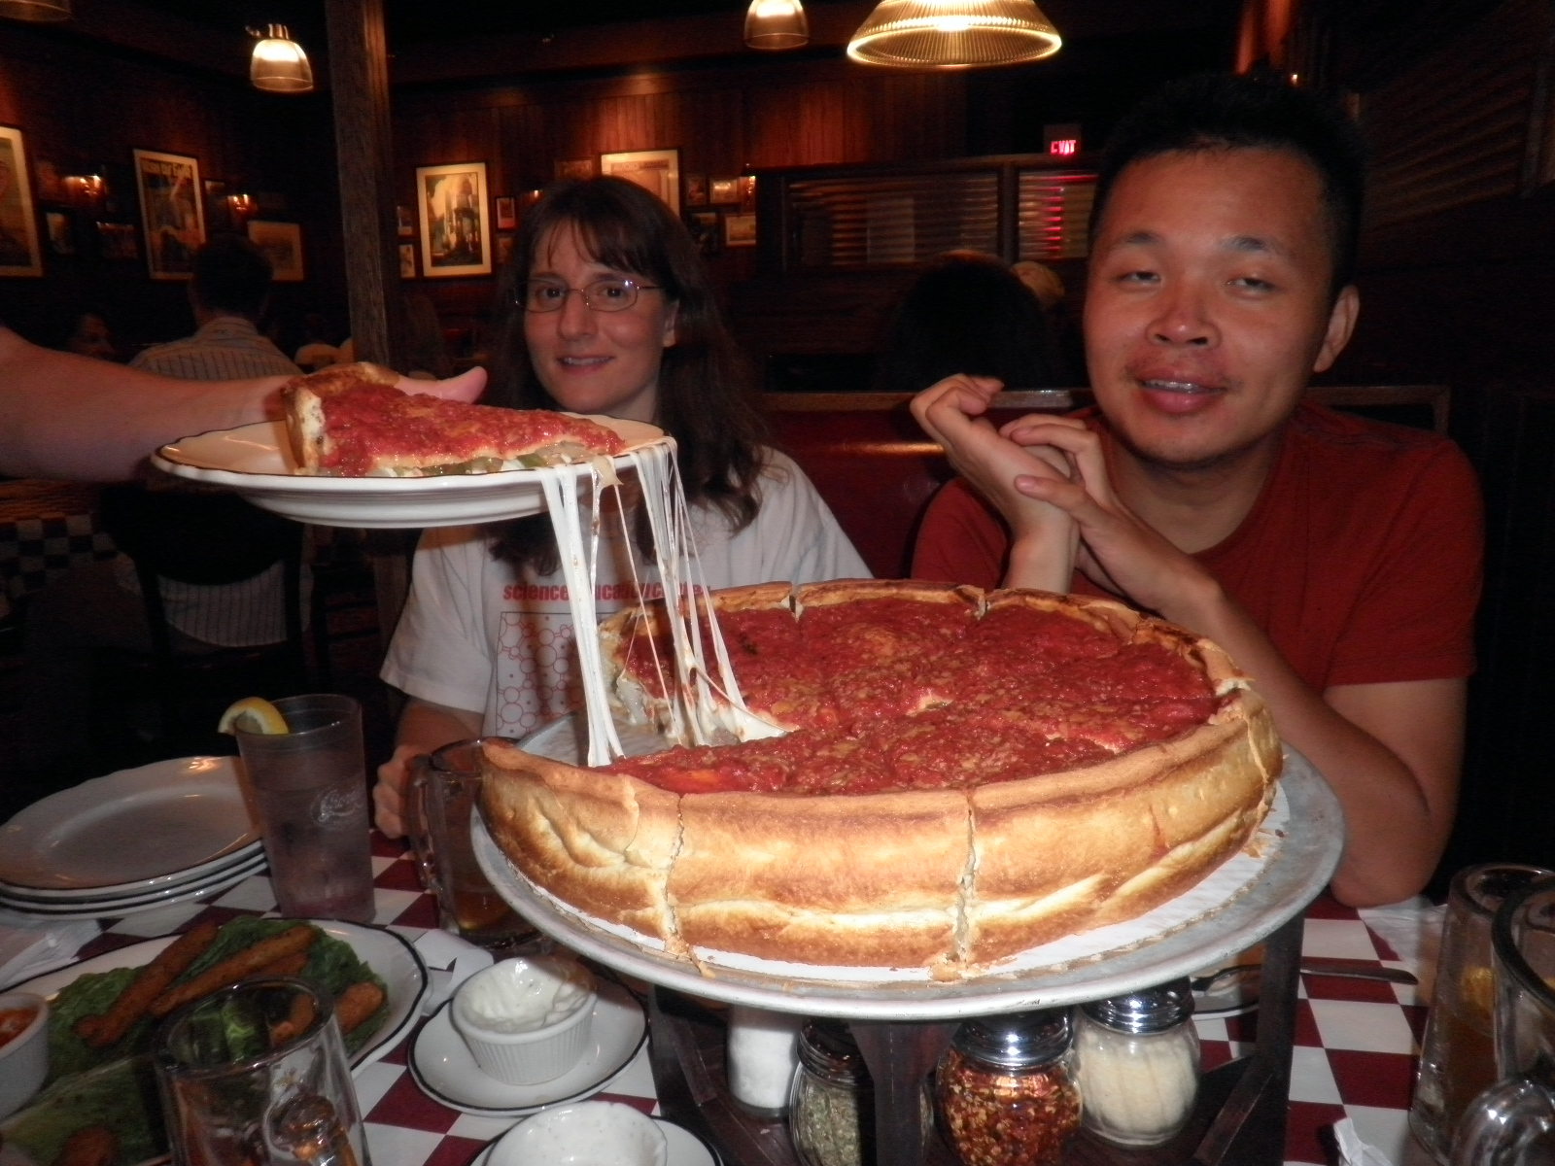
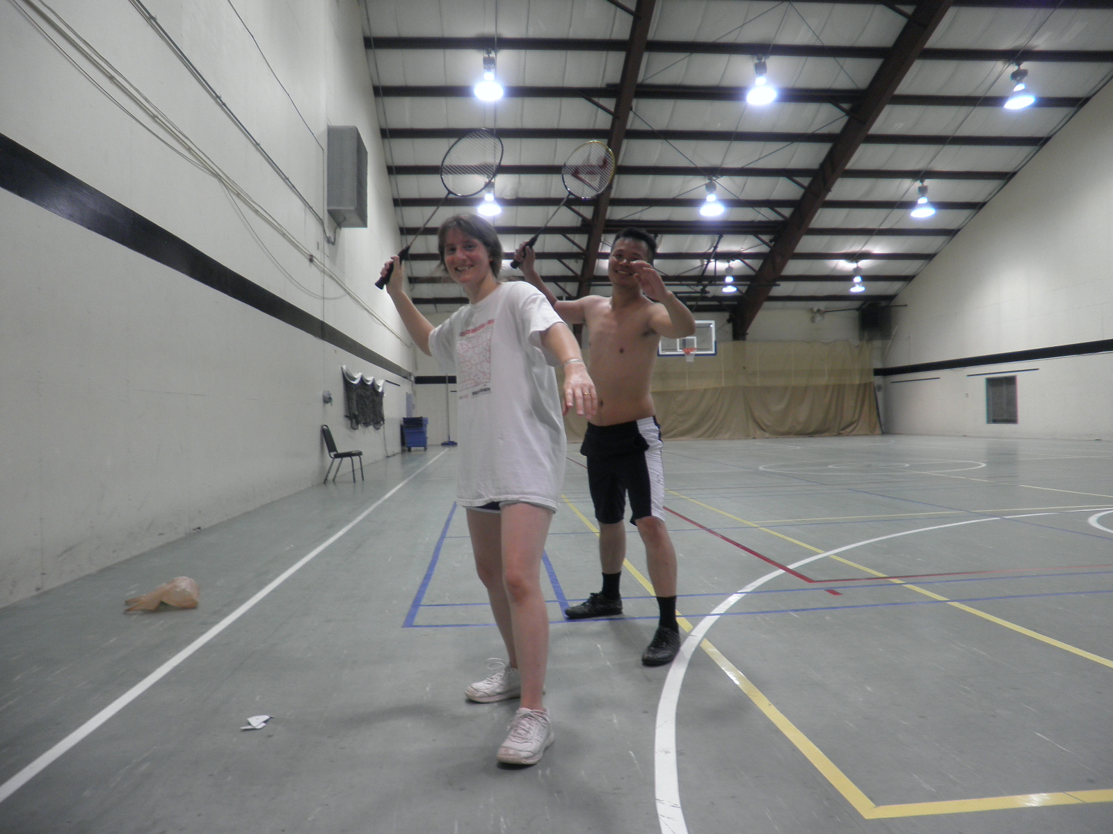

Slide 15
First TDC Readout

Slide 16
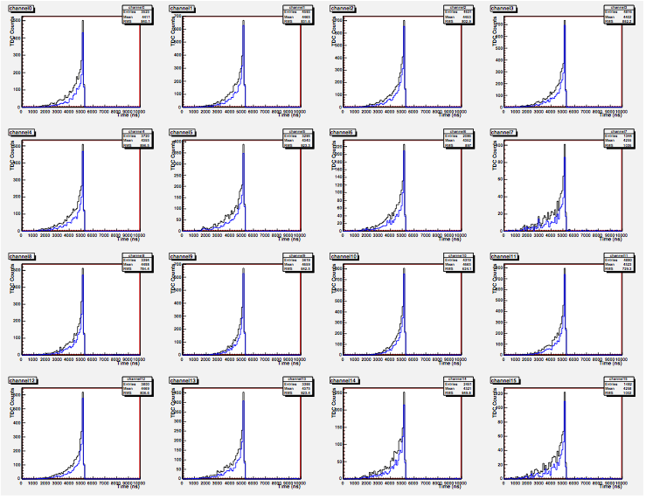
First TDC readout

