Slide 1
Status of St-4 Muon Prop Tubes 05/27/2010 E906 Collaboration Meeting
Ming X. Liu
LANL
Gas test
Module test
Installation and commissioning plan

Slide 2
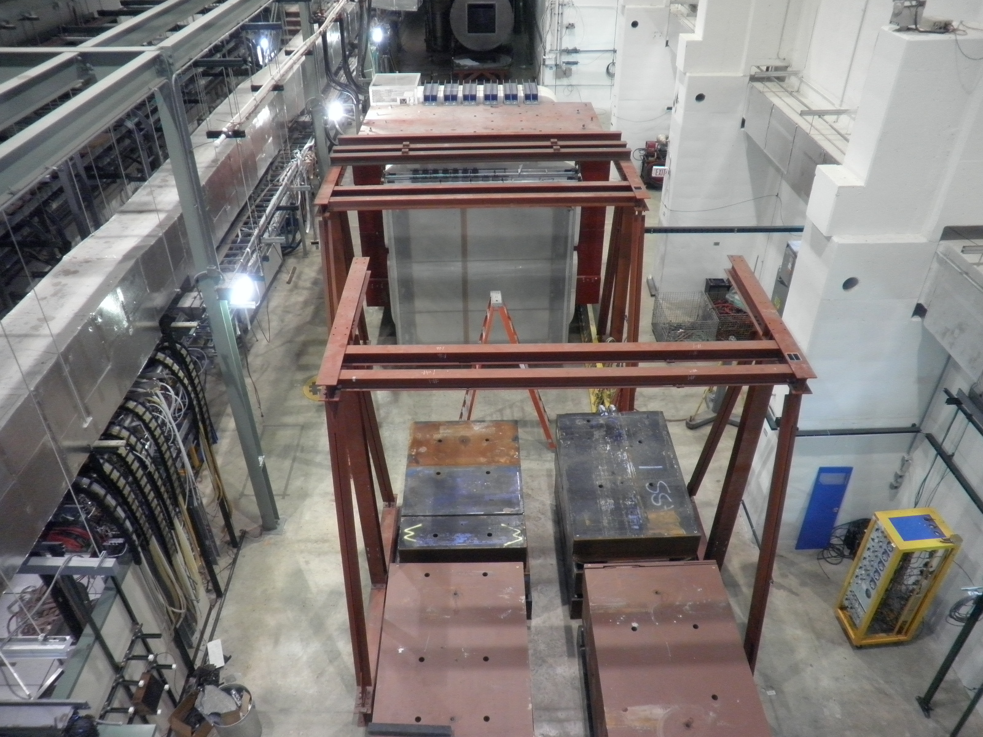
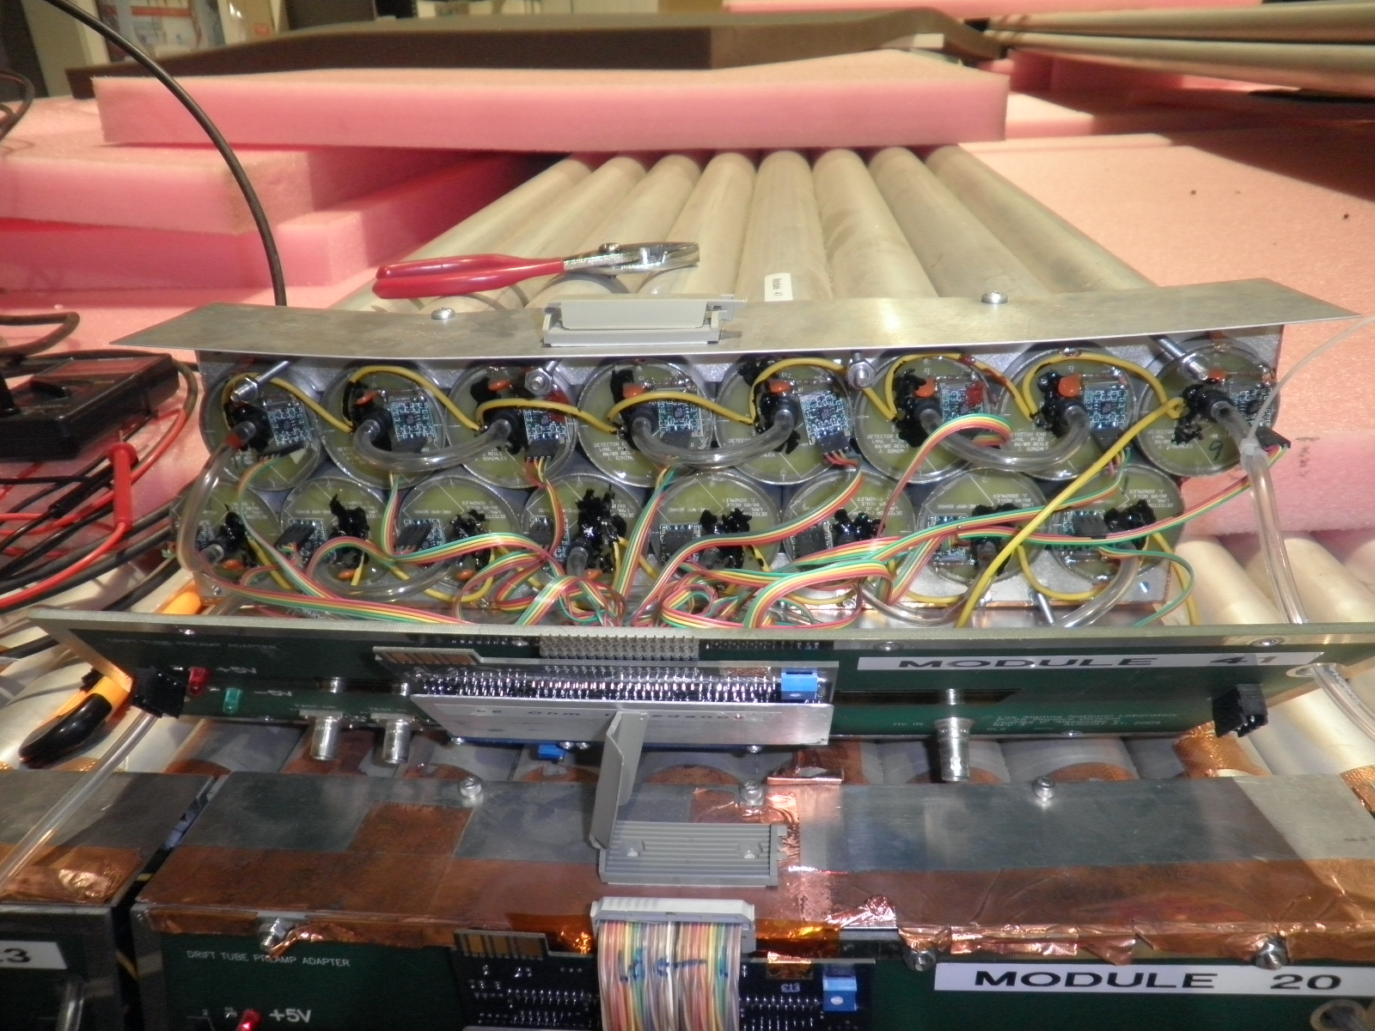
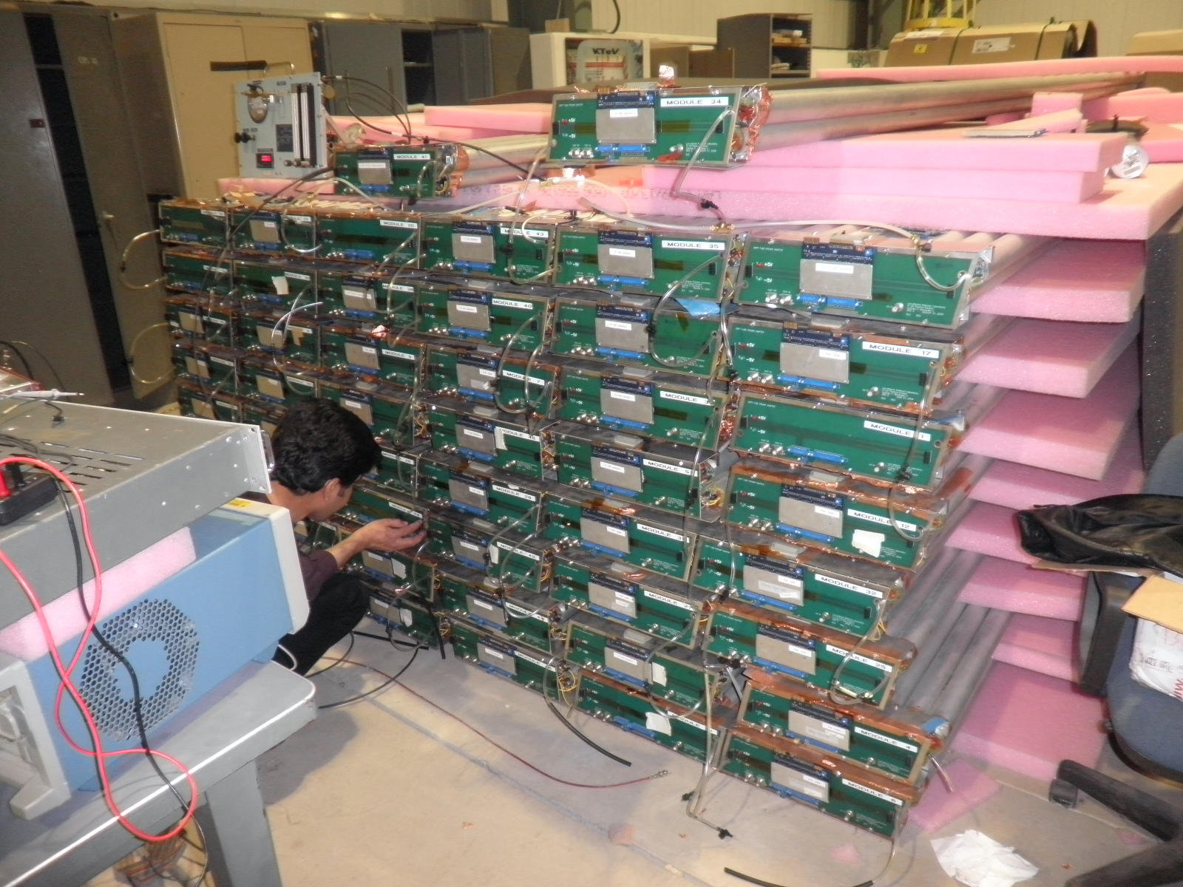
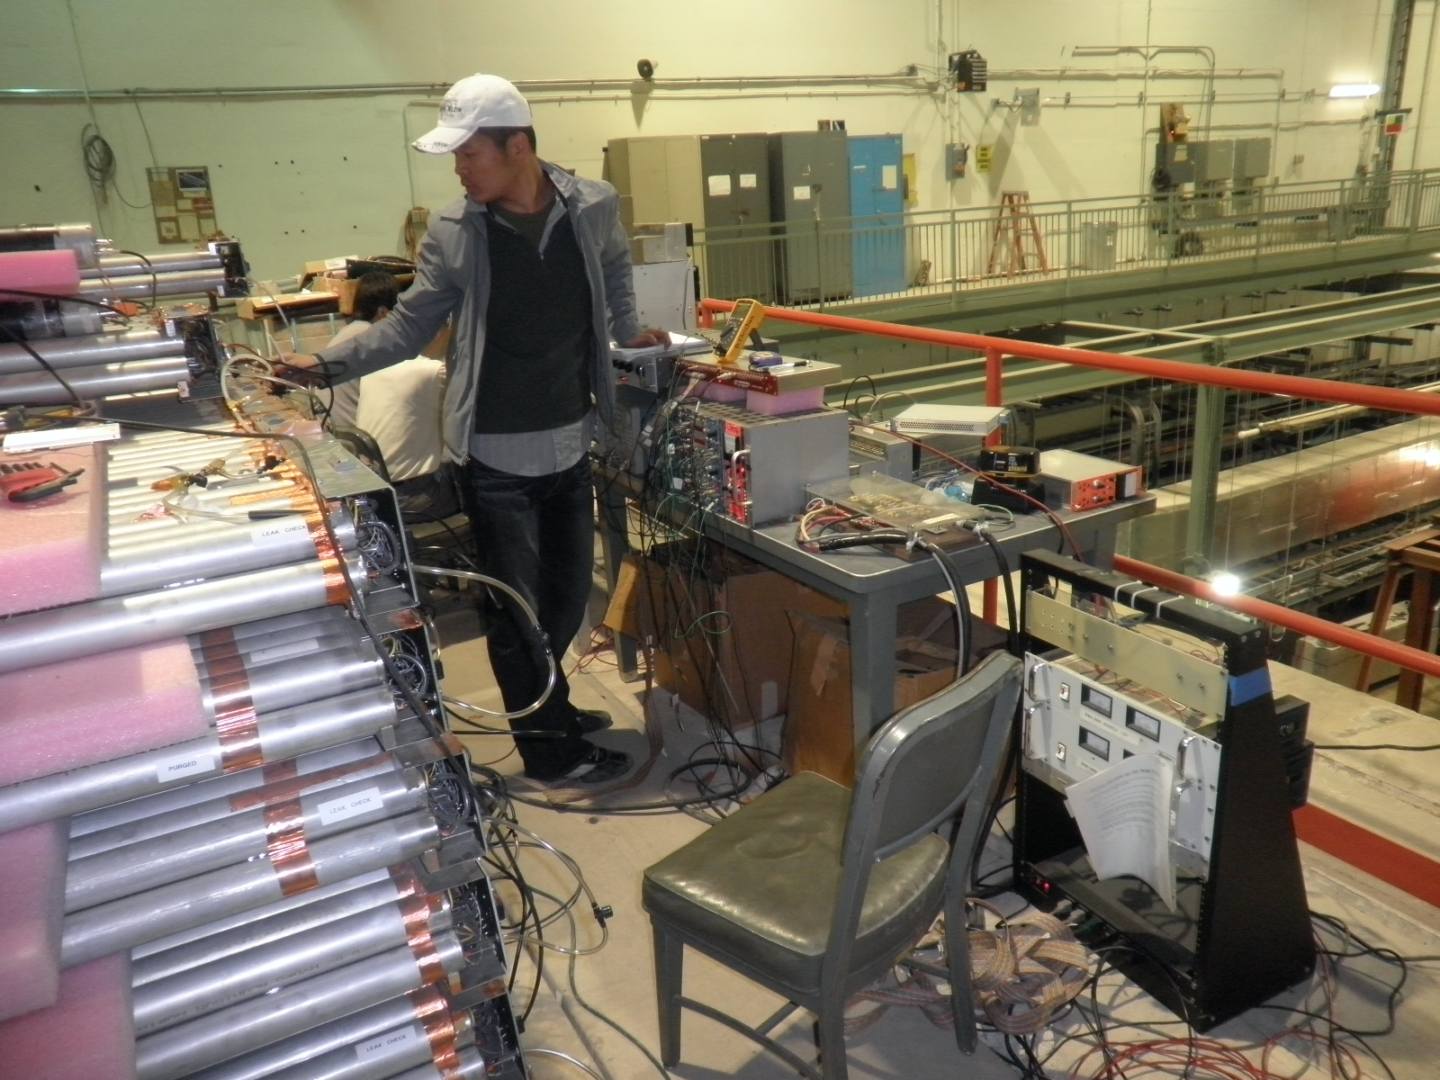
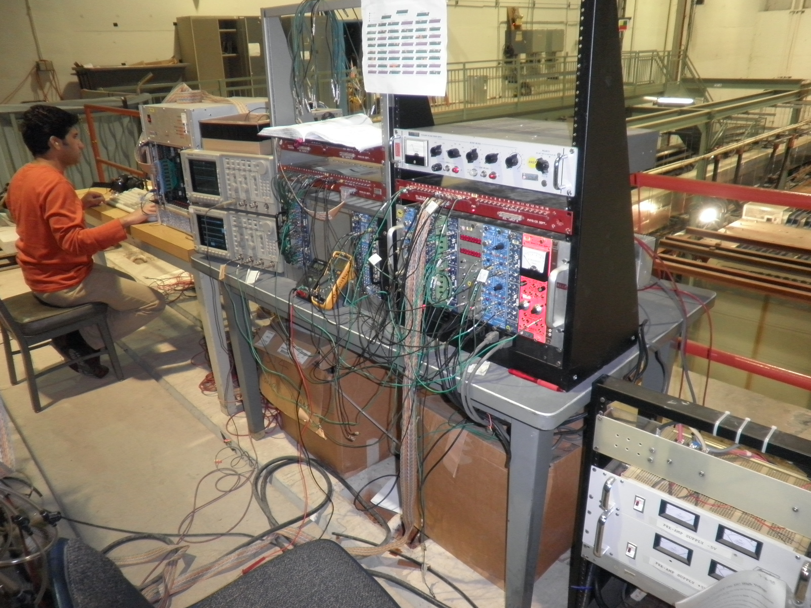
Progress at Fermilab
3/10
3/10
03/4-7: fixed gas tubing, HV, signal lines …
Imran, Andrew, Ming…
04/19-24: test gas & fix broken modules
Lei, Chuck, Ming et al.
05/9-16: HV scan, first time 8-ch readout
Imran, Yen-Chu, Kaz, Chuck, Ming et al.
3/10
4/10
5/10

Slide 3
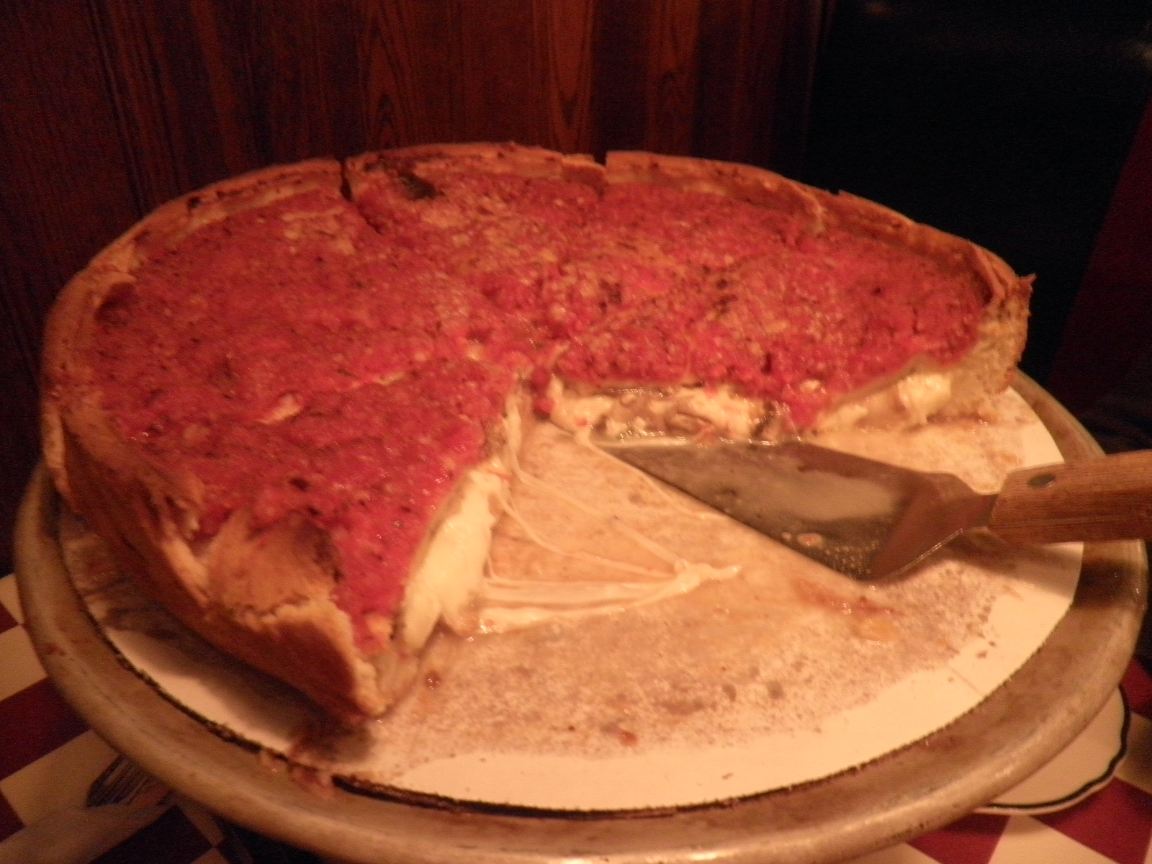
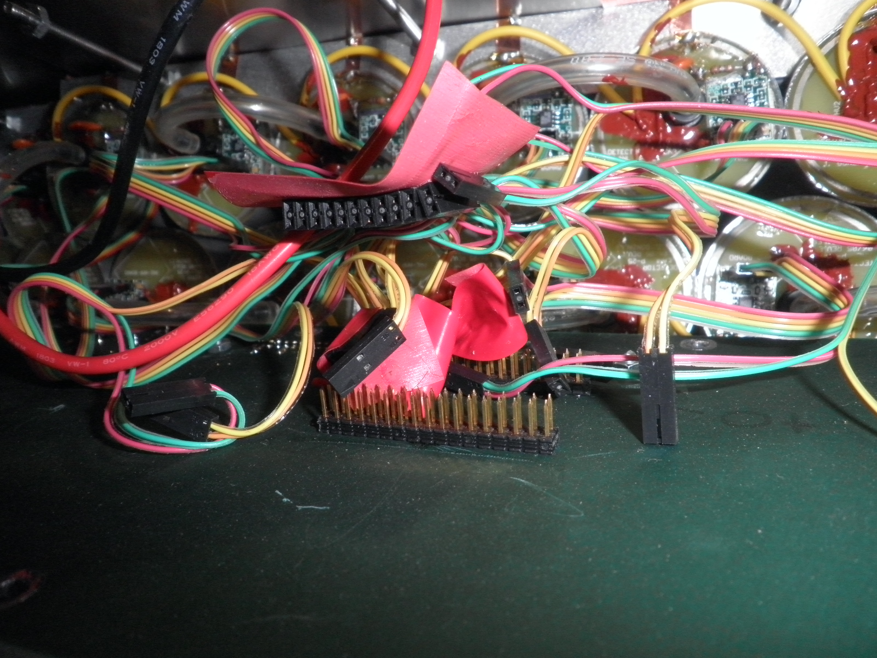
Chicago’s Famous Pizza … and Spaghetti

Slide 4
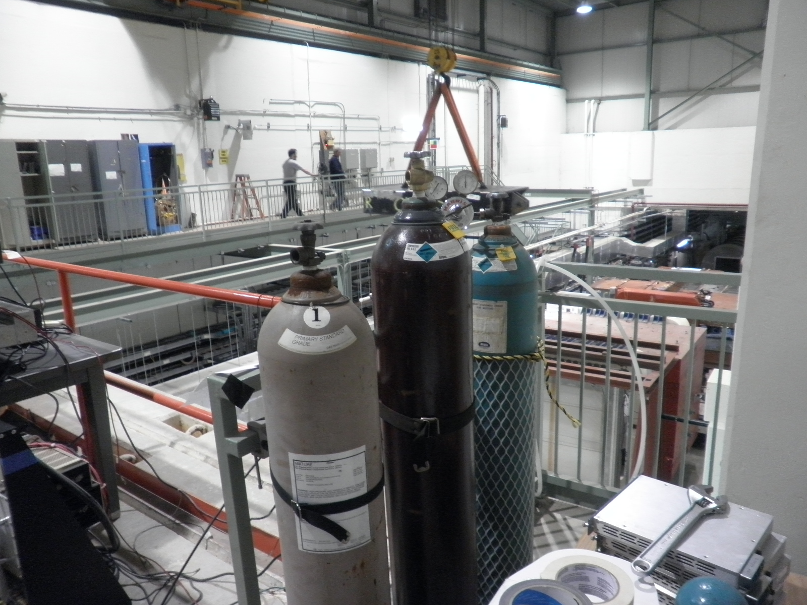
Gas Test - Summary
Maximum drift time study:
MIPP: 0.35uS
Ar/CO2 (80/20): 2.5uS
Ar/CO2(95/5):1.5uS
D0 Muon Gas: 0.8uS
HV plateau scan
MIPP: 1850-2100V
Ar/CO2(80/20): 1900-2100
D0 muon gas:1900-2100
Ar/CO2 80/20
MIPP Gas
D0 Gas

Slide 5
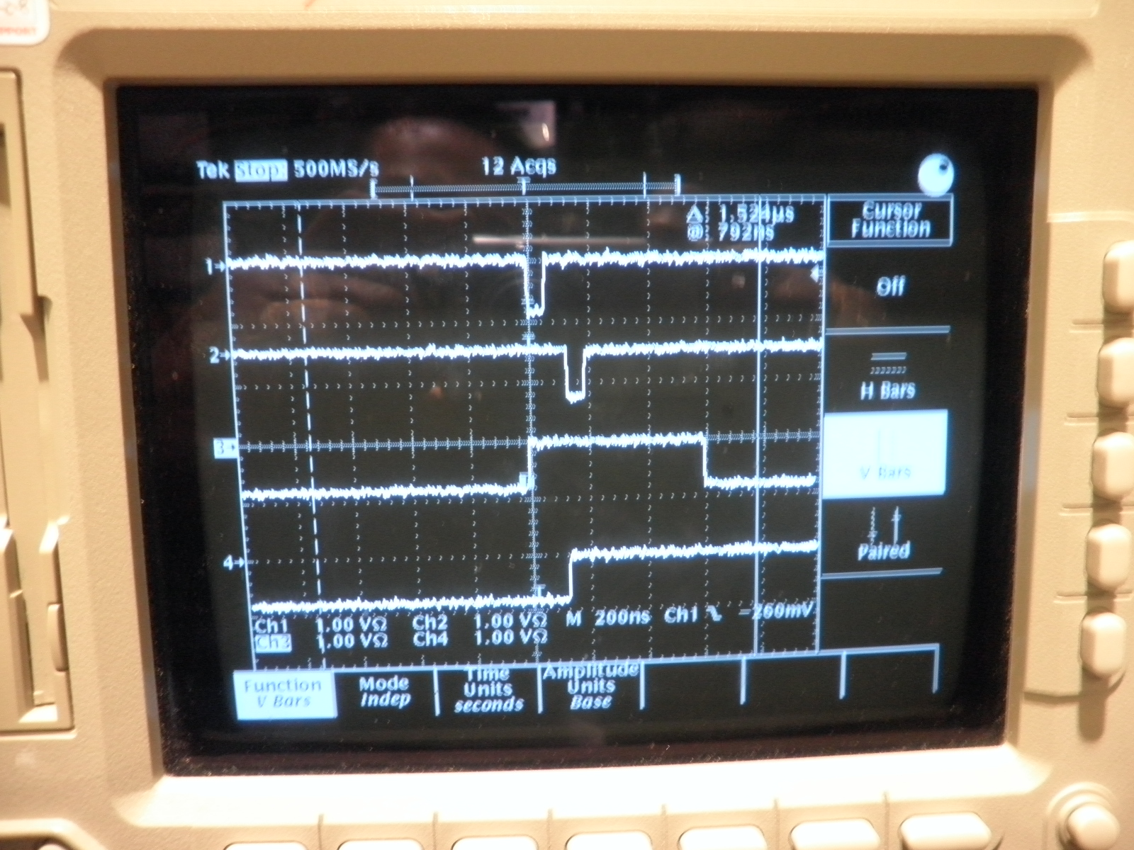
MIPP Gas: It is Fast! ΔT_{drift} ~ 0.35 uS @2000V
Module

Slide 6
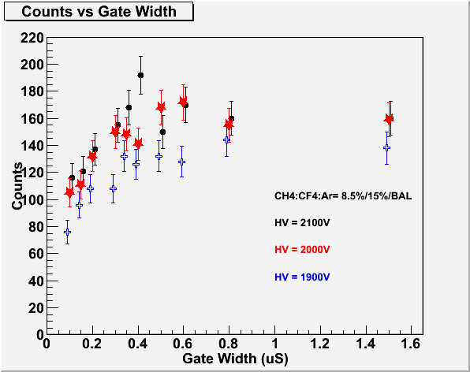
Maximum Drift Time Measurements Module #34, chan-9..
ΔT=0.35 uS
Trig.
Signal
Coin. Gate
Time

Slide 7
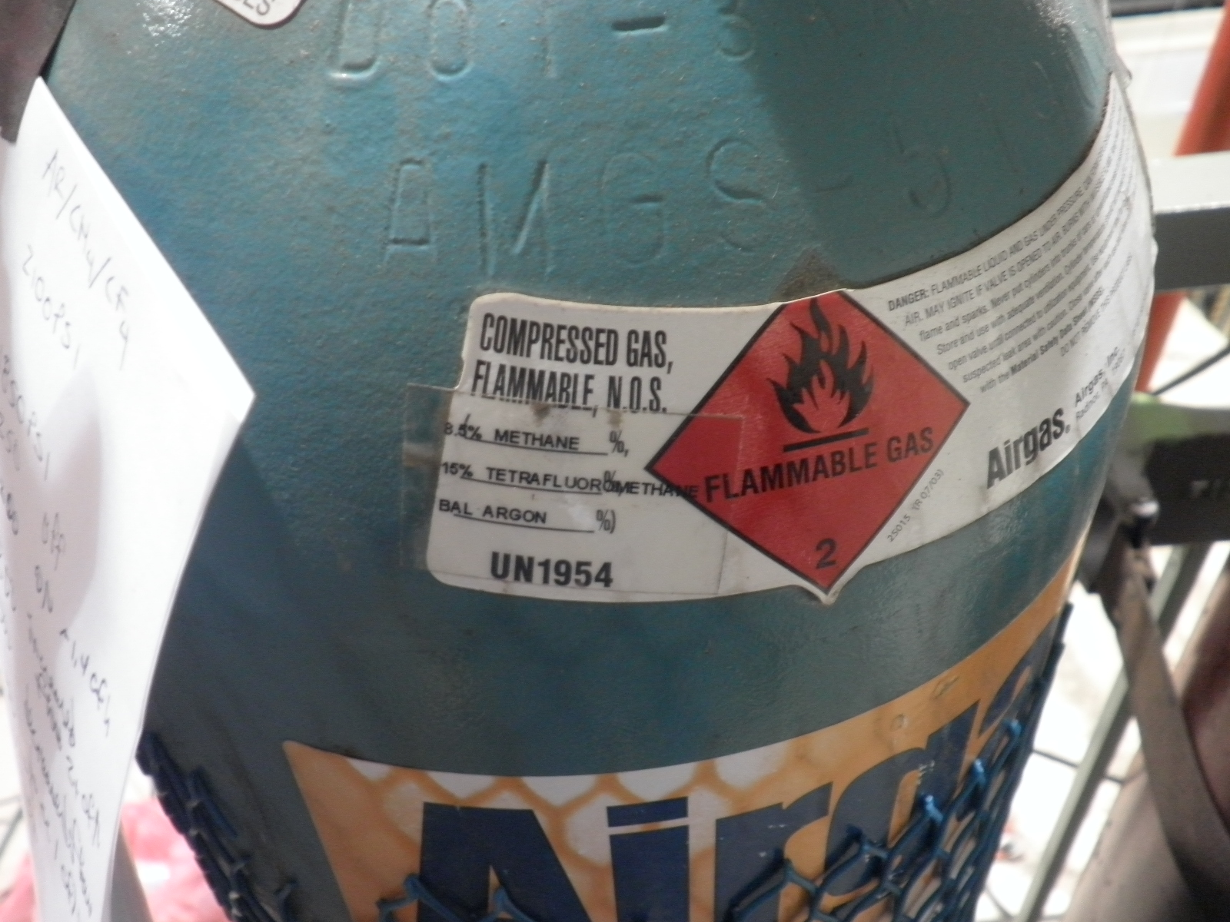
MIPP Gas

Slide 8
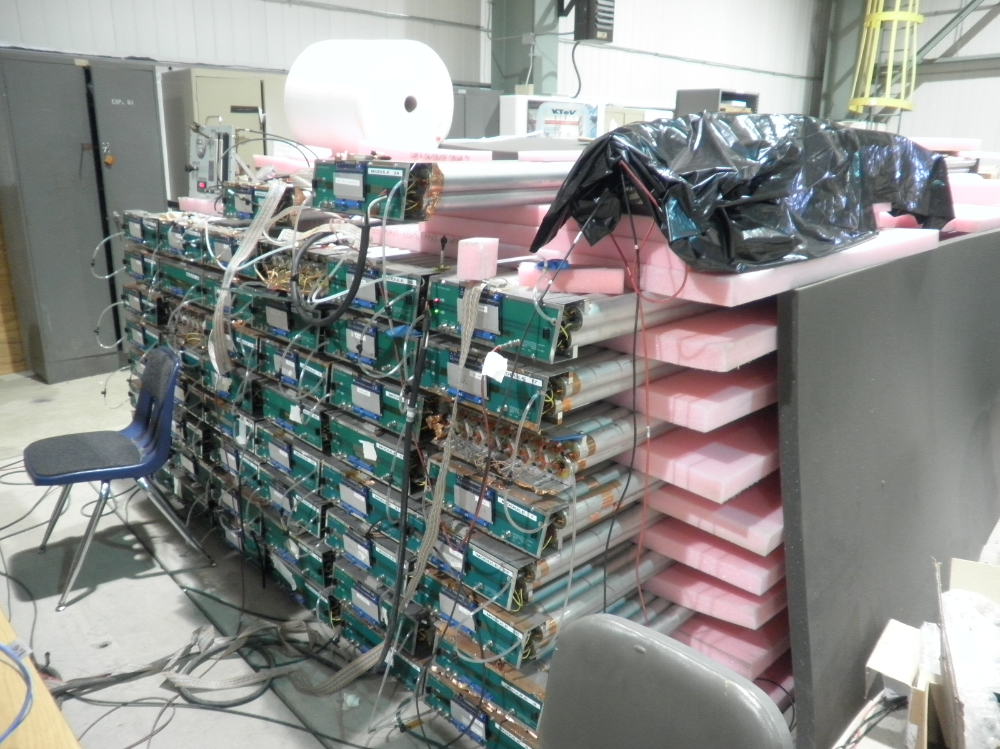
Qualitative HV scan and Signal Rates with Cosmic Rays (Ar/CO2)
Cosmic trigger

Slide 9
Good, V_{max}>2050V
16 15 14 13 12 11 10 9
8 7 6 5 4 3 2 1
Dead
Module 41
Module 34
Noisy/Background/high V_{mi}n//low V_{max}
NIM Channel map
Unusable module
Module 14 Module 23 Module 20 Module 43 Module 35 Module 100
Bad Threshold Resistor
Module 2 Module 36 Module 38 Module 40 Module 103 Module 17
Module 15 Module ? Module 9 Module 7 Module 37 Module ?
Module 33 Module 30 Module 105 Module 45 Module 51 Module 1
Module 11 Module 26 Module 29 Module 28 Module 31 Module 32
Module 10 Module 50 Module 24 Module 42 Module 27 Module 25
Module 46 Module 16 Module 104 Module 44 Module 101 Module 4
Module 47 Module 52 Module 102 Module 48 Module 18 Module 6
No PreAm, Flowing gas now 4/23/10

Slide 10
Quantitative HV Plateau Scan with 8-ch Readout for all Tubes (May 2010)
Tested all individual tubes w/ DAQ, 8-channel scalar readout (Thanks Yen-Chu, Kaz and Josh!)
Imran, Lei, Chuck, David C., David N., Ming …
Ar/CO2 for most of the modules
One stack with MIPP fast gas (Mod. #34)
CH4/CF4/Ar = 8.5% / 15% / bal.
One module with D0 muon gas (Mod. #17)
CO2/CF4/Ar = 8% / 8% / bal.

Slide 11
HV Scan with 8-ch Readout ECL to ECL scalar

Slide 12
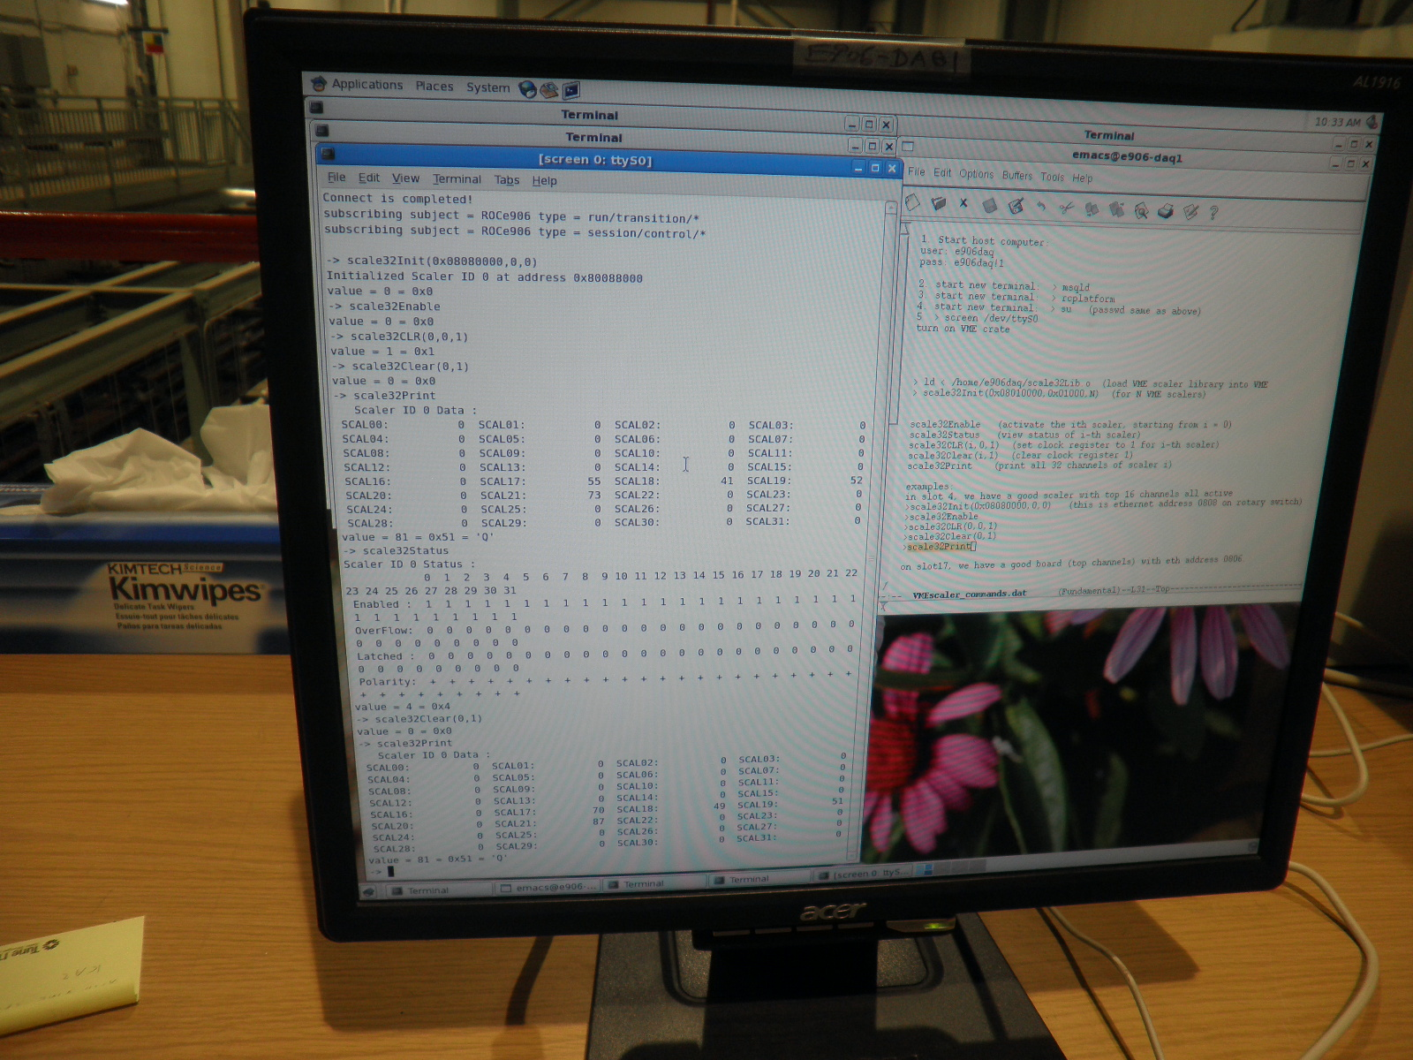
DAQ 8-ch Scalar Readout Screen Dump

Slide 13
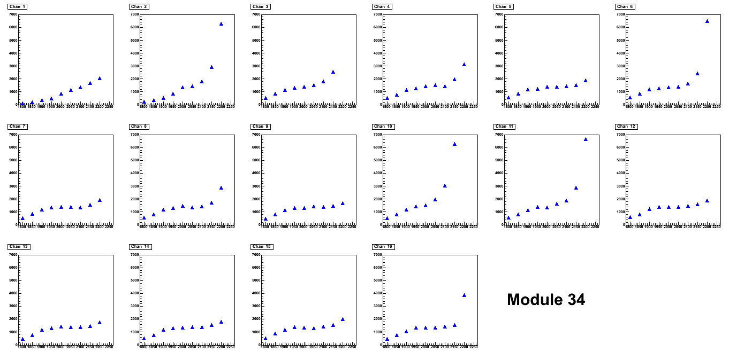
HV scan: MIPP Gas for Module #34
1850-2150

Slide 14
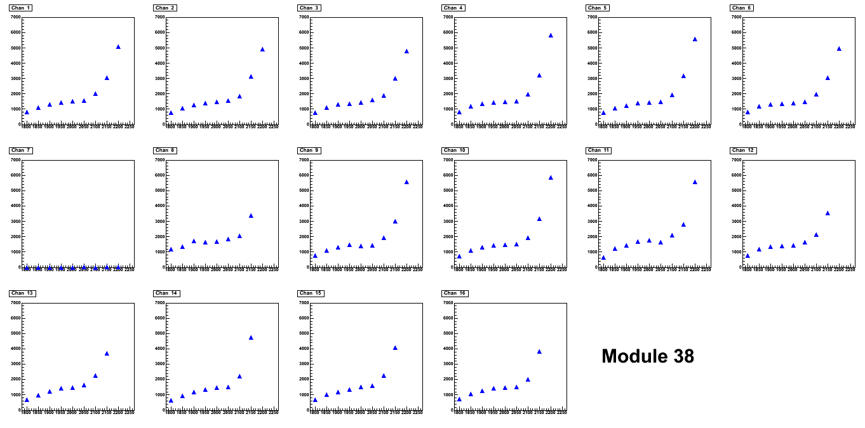
HV scan for Mod. #38 Ar/CO2 (80/20)
1850-2100
Broken tube

Slide 15
Good Modules from Quantitative HV scan
 |  | 41 |  | 34
14 | 23 | 20 | 43 | 35 | 100
2 | 36 | 38 | 40 | 103 | 17
15 | ?? | 9 | 7 | 37 | ??
33 | 30 | 105 | 45 | 51 | 1
11 | 26 | 29 | 28 | 31 | 32
10 | 50 | 24 | 42 | 27 | 25
46 | 16 | 104 | 44 | 101 | 4
47 | 52 | 102 | 48 | 18 | 6
Good modules (mostly)
Draw high current above 2000 V due to a couple of bad channels.
Still need to be tested. (different shape modules).
Draw very high current.
Some unstable channels.

Slide 16
Number of Good Modules
Need 2x8+2x9 = 34 modules
Green ones: 24+7 =31 ➔ we need 3 more good ones!
Possibly good ones:
4 Modules:
# 6, 32, 42, 101 were tested good in April 2010. High current problem probably due to poor gas and/or humidity, as we stopped flowing Ar/CO2 gas for a while for these modules.
2 modules:
# 18 and #43, need to replace preamp board (#43) and preamp card(#18).
Module #100
flaky FEM board and poor grounding?
7 wrong shaped ones
Can we use 4 of them, but read them out from the opposite side?
Would like to run them all with MIPP gas and check their performances
We will have enough good modules if we can recover these possibly good modules – very likely.

Slide 17
Picture Frames and Installation Plan
Initial design done, under Engineering evaluation at LANL
Thanks Tom, David N., Walt/John/Matt (LANL)
Got a Quote from 80-20 for the materials based on initial design
Thanks Tom!
Once Paul and Chuck obtain the green light from Fermilab, I would like to place the order for materials ASAP (some time in June)
Assembly and installation in late June - July

Slide 18
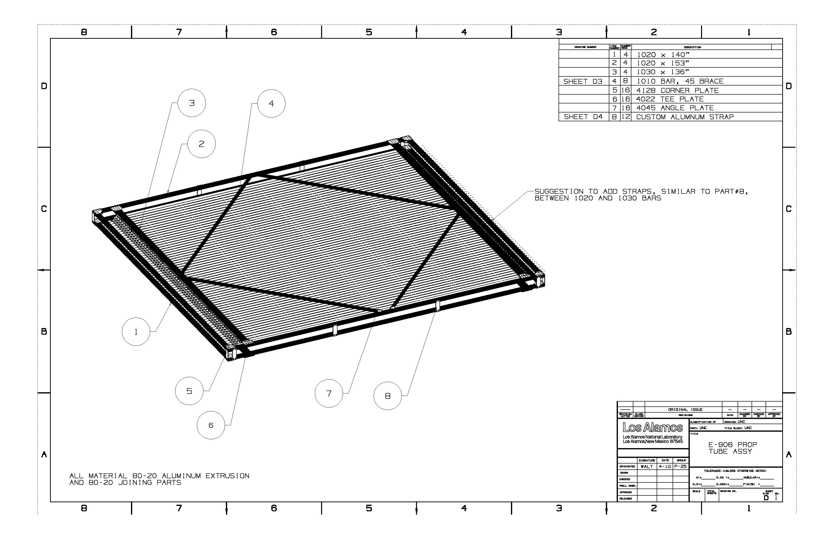
The Design of the Picture Frames (2nd version)

Slide 19
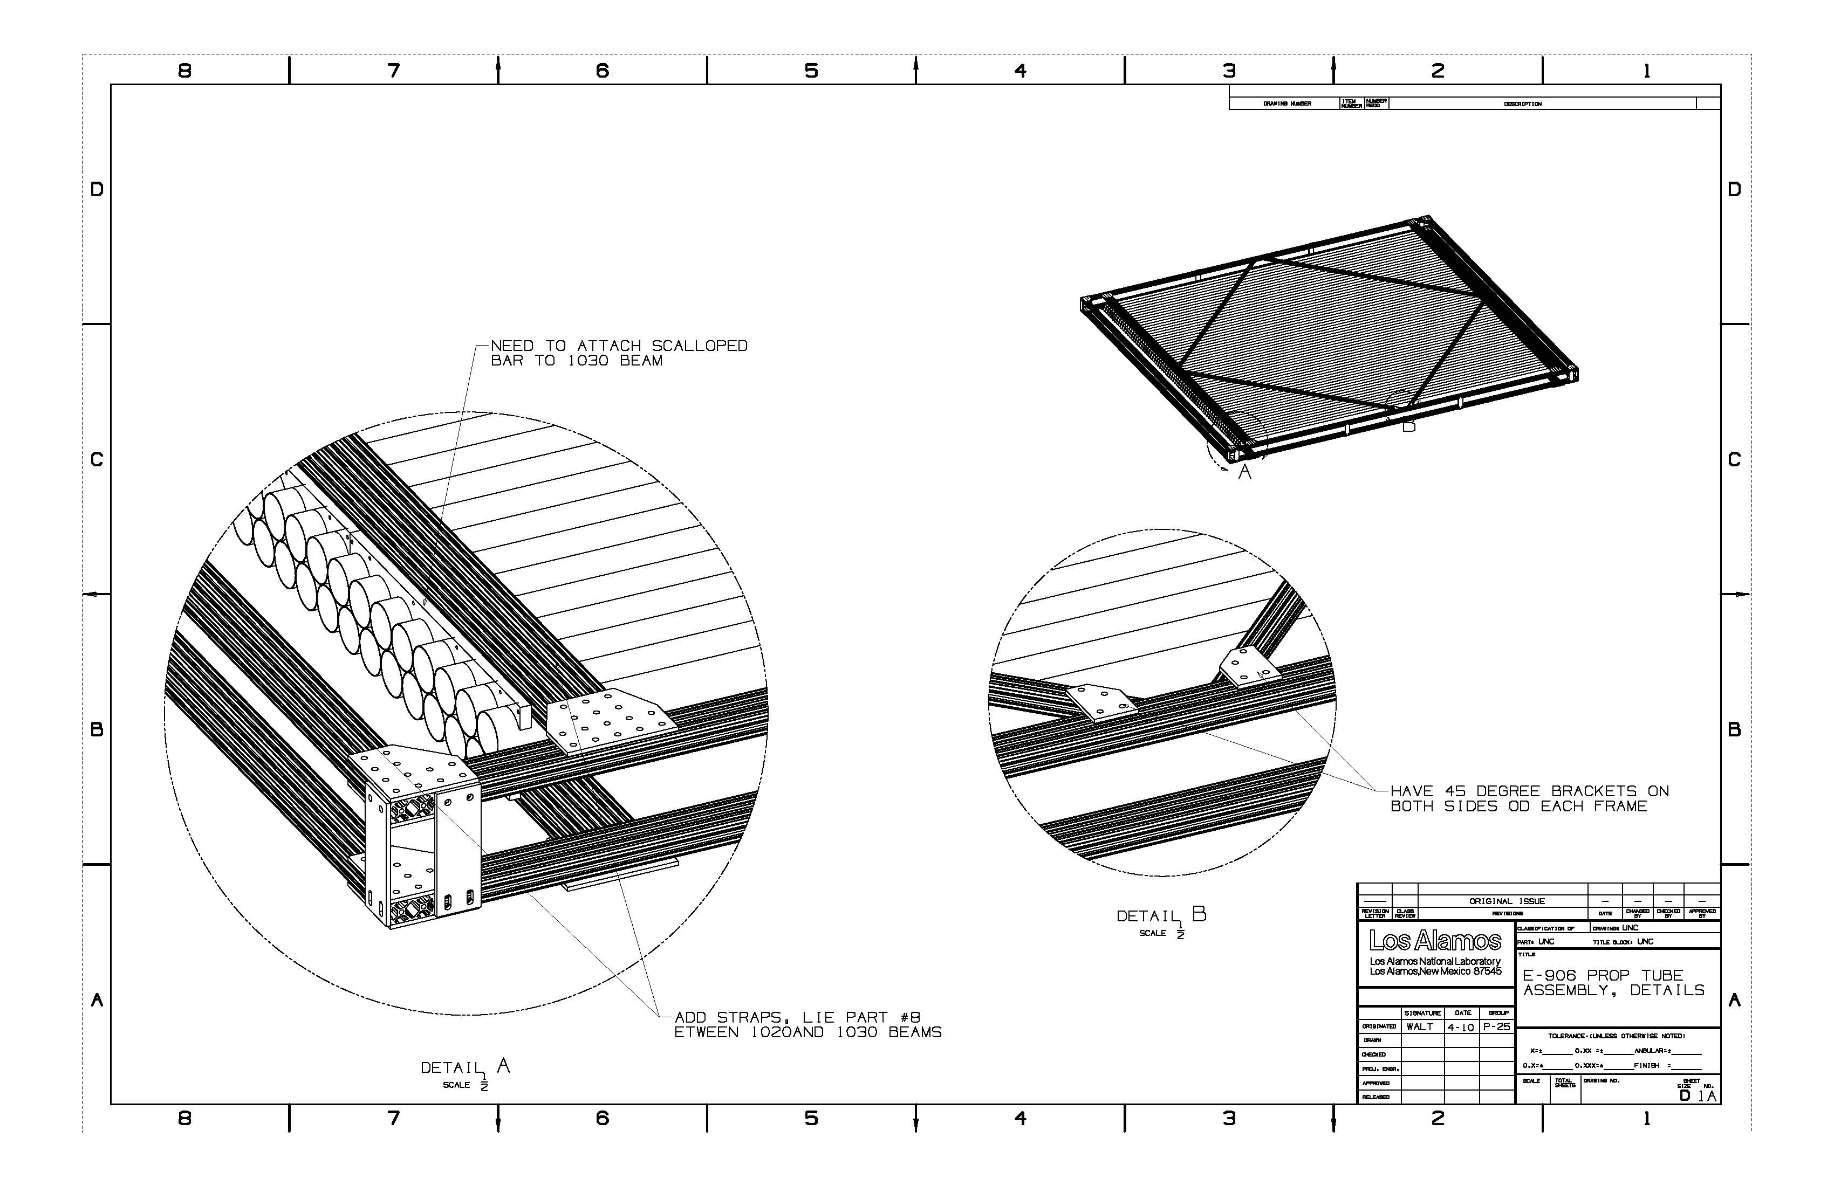
More Details about Picture Frame

Slide 20
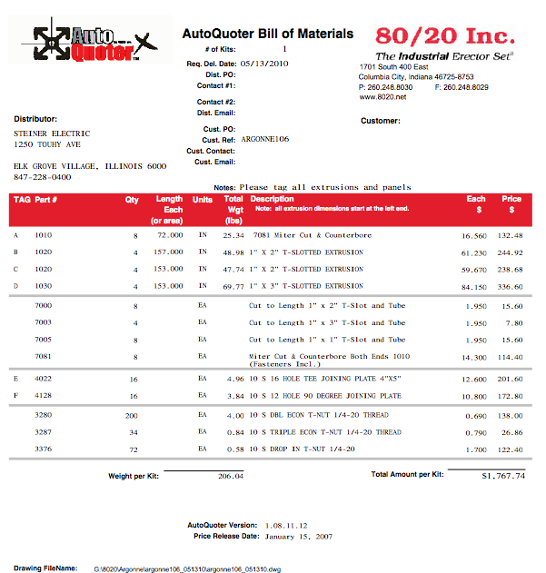
Quote from 80-20
4x1.8K =$7.2K
LANL Engineers’ efforts $xx

Slide 21
Future Plan
Recover “bad” modules:
Test 7 wrong shaped modules with Ar/CO2 at next visit, try to use 4 of them if possible.
Test 4 modules that were tested good but failed at last checkup - likely due to bad gas.
Would like to run “good fast gas” for all modules, scan for HV plateau for all tubes, identify 34+ good modules for the final assembly
MIPP or D0 muon gas (or something similar)
Assembly and installation:
Get Fermilab structural engineers’ approval ASAP, order the materials from 80-20 in June.
Assembly and installation in late June/July
Electrical ground and noise
Need to run the full DAQ and some sort of online/offline analysis code
Need ECL to ECL TDC, 34x16=544 channels
Would like to get the detector in for the test beam and check the background rates this summer

