Slide 1
Summer DAQ & Trigger Work
@LANL/Fermilab
DAQ upgrade
  @LANL, standalone DAQ to develop and test new TDC FPGA code
    New TDC data format with global trigger counter
    EOS (5+55) triggered VME readout of TDCs and integration
Trigger upgrade
  @LANL, standalone DAQ to develop LVL-1 and LVL-2 readout with V1495 boards
  Integration of Trigger and DAQ
  Finalize SiPM readout via sPHENIX HCAL readout/or CDF ASDQ cards
  Build mechanical support frames: safety review

Slide 2
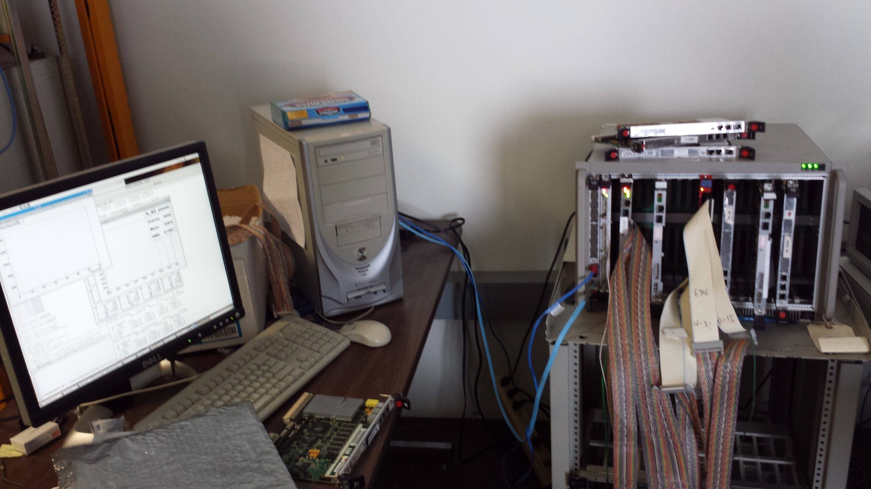
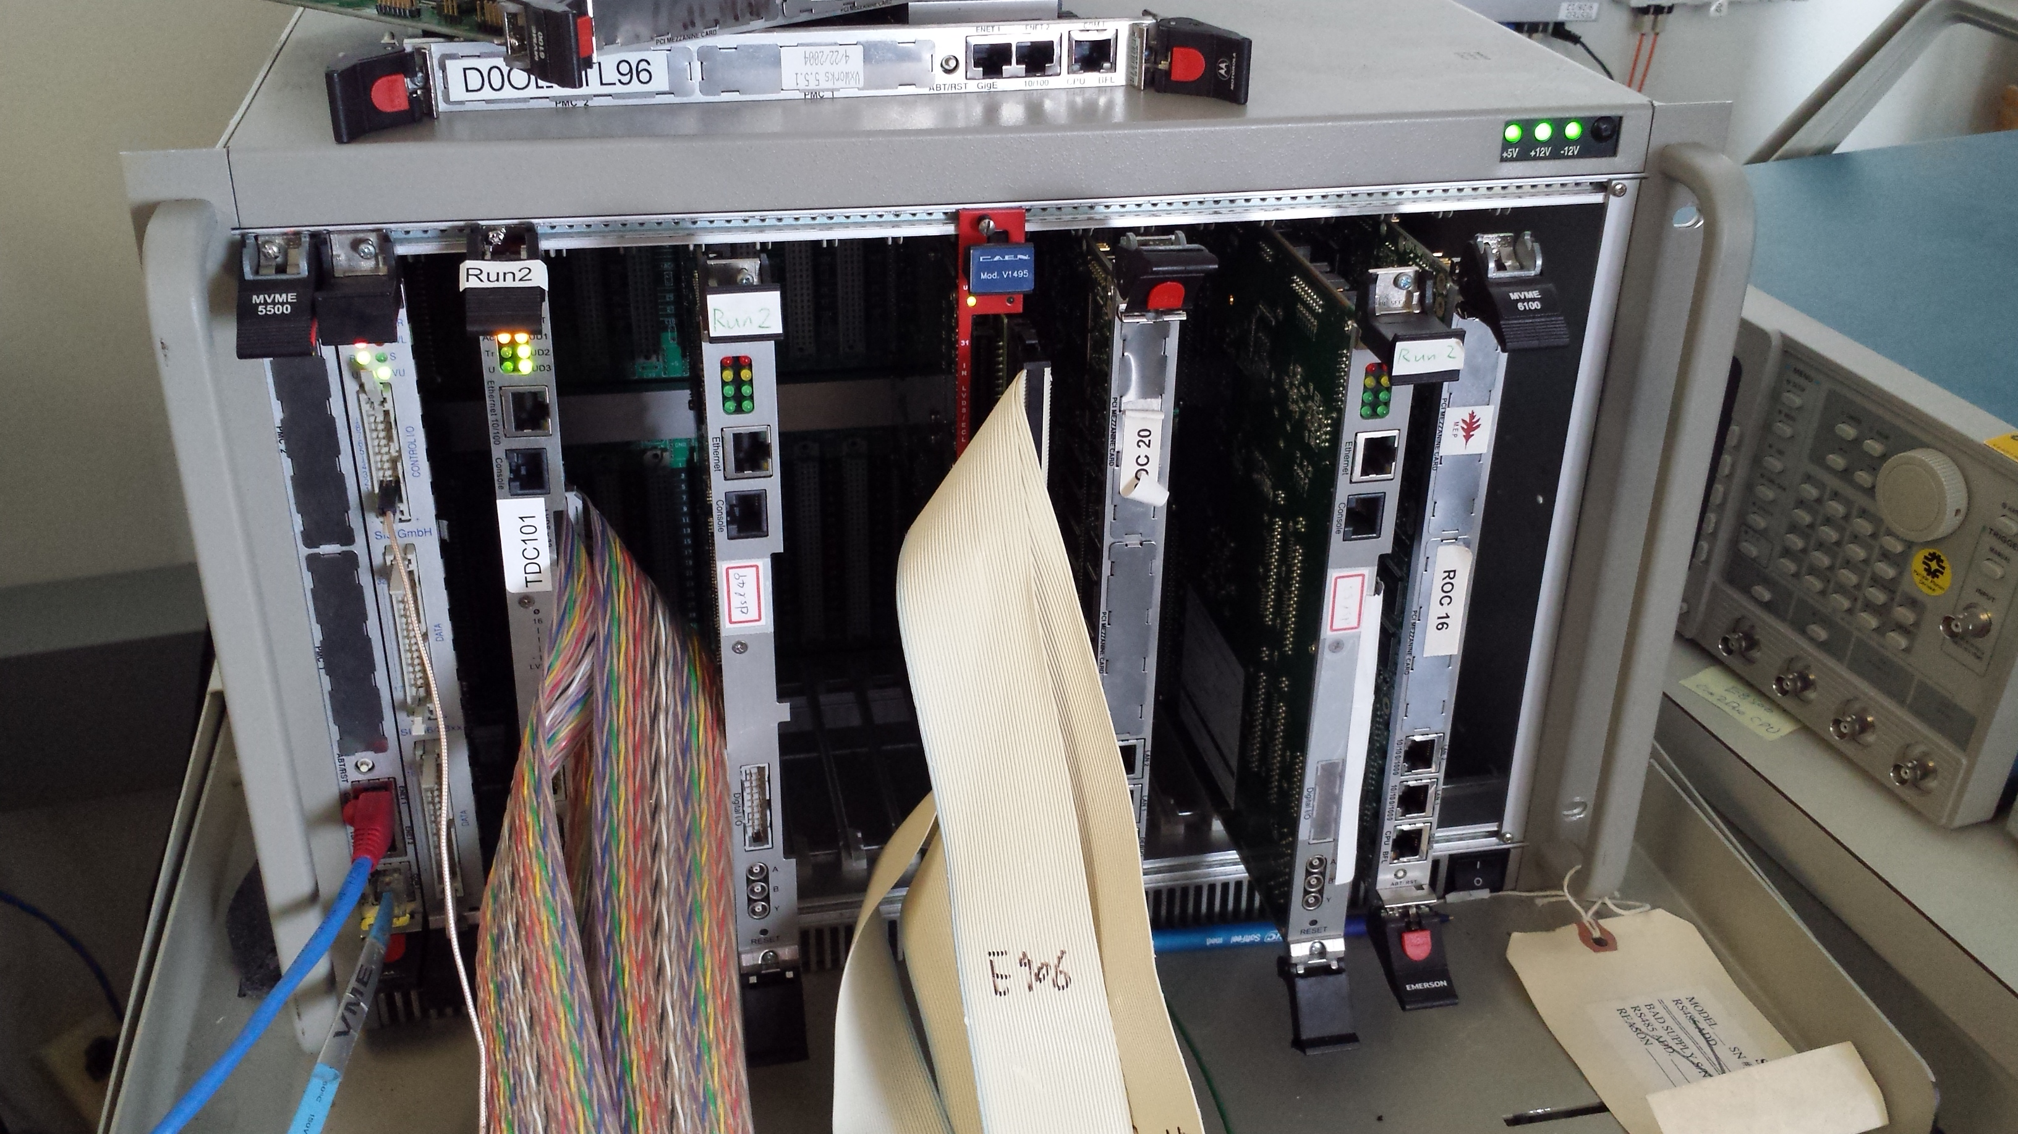
E906 DAQ
(TDC-II Test Stand)
PC/Linux: Jlab CODA, Ethernet Readout
CPU MVME5500: old VxWork (Jlab)
Trigger Supervisor: SIS
TDC-II, new data format
V1495 mock TDC data generator
V1495 L1 Trigger “development brd”
Windows PC: Altara FPGA programing
TDC Test Bench
-CNTRL
-SIS, as TS
-TDC-II (x)
-TDC-II (x)
-(4)V1495, trigger inputs
-(1)V1495 as scintillator
Trigger pattern emulator

Slide 3
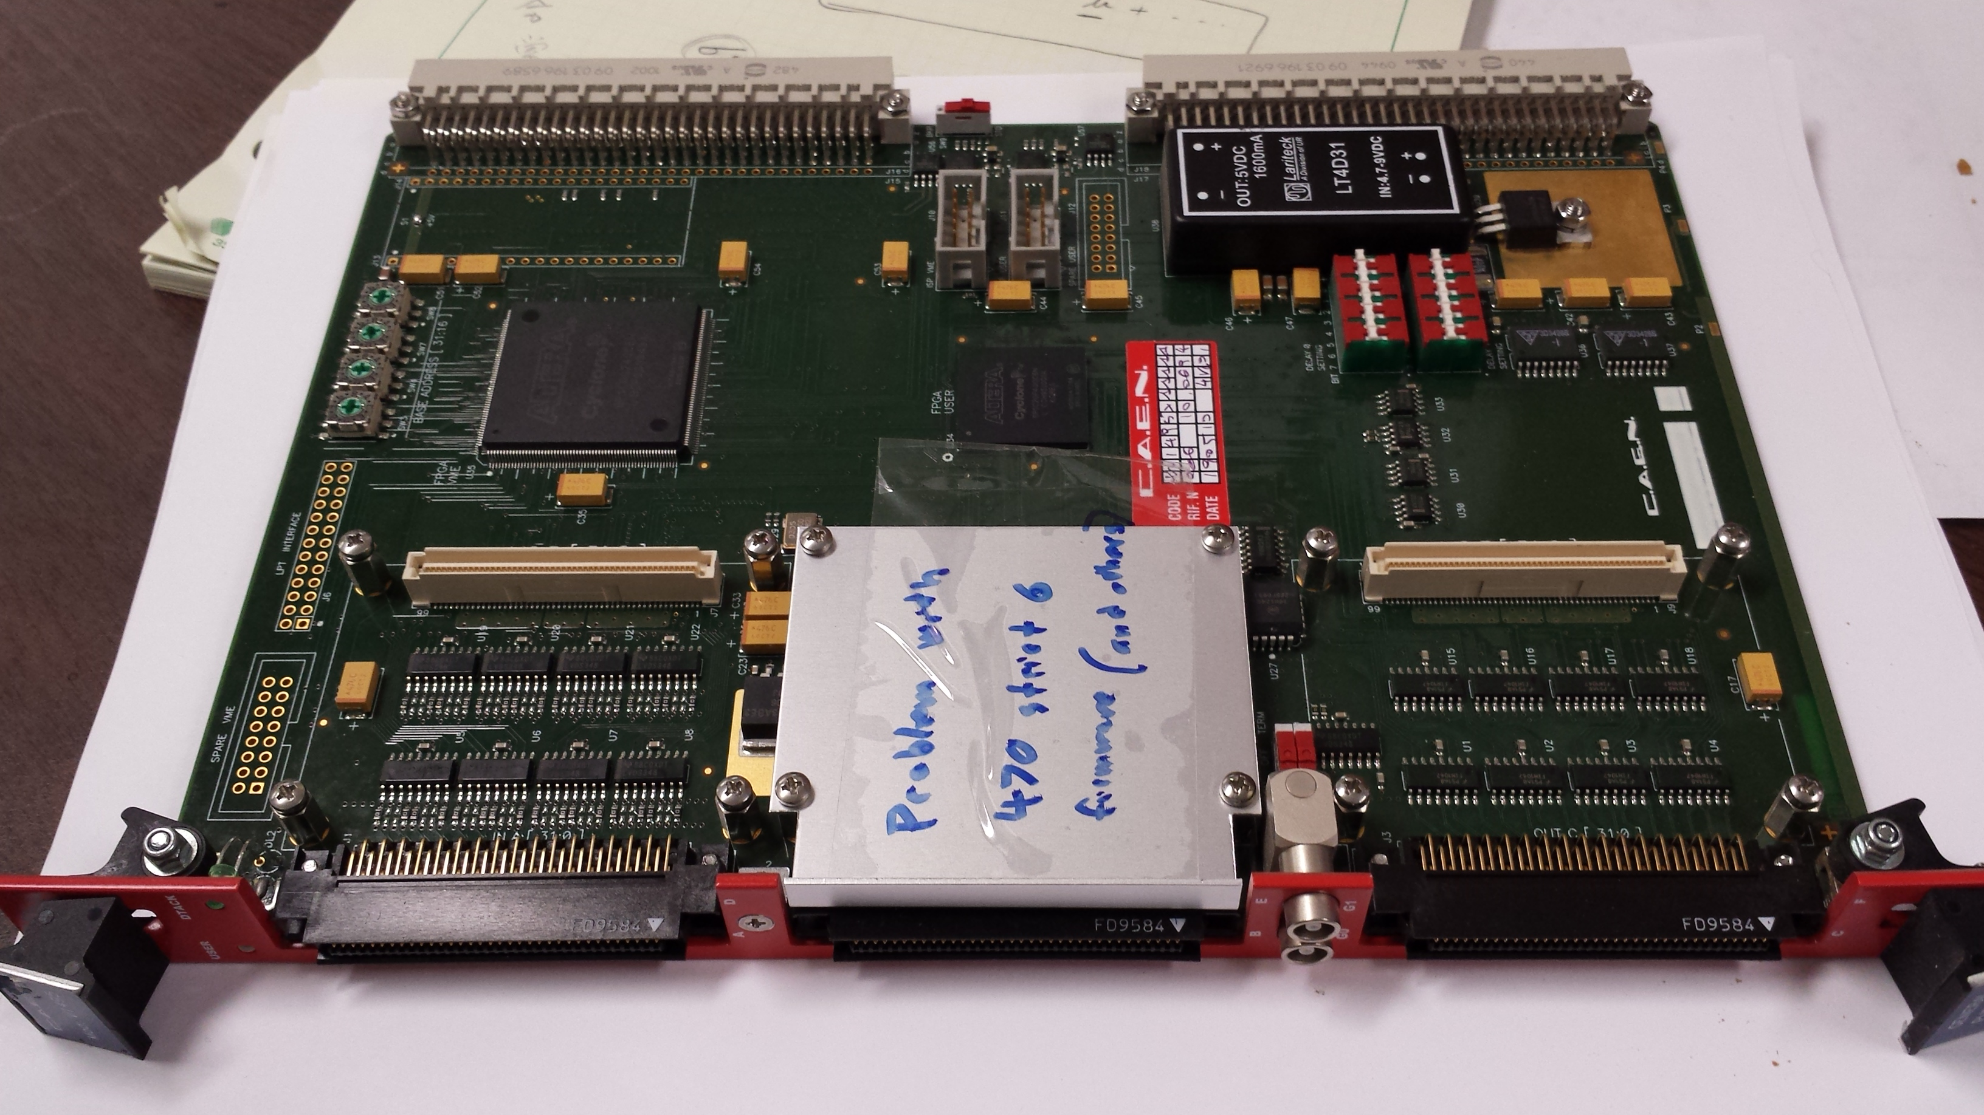
V1495 Board
2 Altara FPGA Chips: Cyclone-V

Slide 4
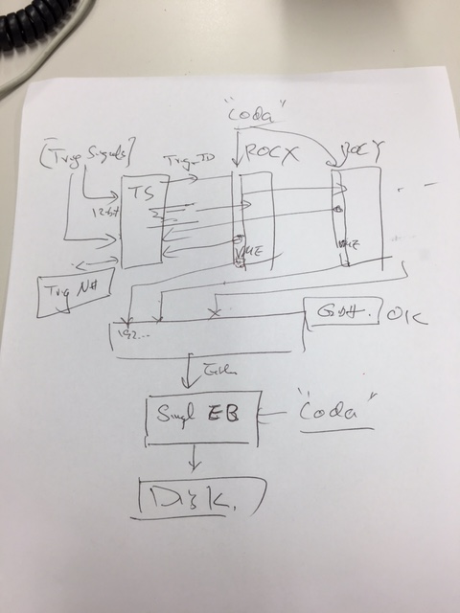
E906 DAQ for upgrade
TDC FPGA upgrade
  hold data within a spill, only send them out on EOS signal
  55 sec for readout TDC into disk
  New TDC data format with the global Trigger_ID information
  A global Trigger_ID generated by TS
  Using known pattern (from V1495 on the test bench) to validate the new TDC code on a standalone DAQ, as we did before @WH14, single ROC
DAQ integration
  Event assembly based on the global trigger_ID/Evt_ID in one spill
  TS accepts ROC responses
  Multi ROC readout

Slide 5
Low Mass Dark Photon Displayed Vertex Trigger
Y-Plane Trigger:
- No mass cut
- Displaced z-vertex
Coincident with St-4 Hodos(?)
Quadrant triggers? 4 x V1495
Y-channels per quadrant:
1x V1495
80(St1) + 50(St2) + 8x2 (St4-Y1,2) = 146
96+64 = 160 inputs possible
  72+72+16 = 160 ( input possible)
  (2NIM=RFCLK+ComSTOP )
  32 outputs
Coincident Z-vtx
window matched@L2
St1
St2

Slide 6
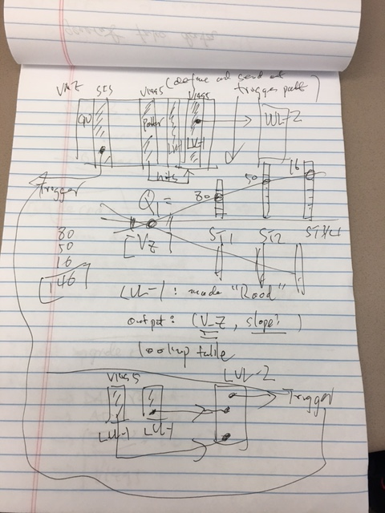
Trigger R&D on Standalon DAQ
Road finder in each quadrant at LVL-1 V1495
  80+50+16
  Output VTX_Z and road information (N_ST1, N_ST2, N_ST3, Z_VTX) to LVL-2
AT LVL-2, make trigger decisions
  (Z_VTX, and roads information) via lookup table
  Send out trigger pattern to TS
A stand alone trigger DAQ
  Two (four) LVL-1 V1495
  One LVL-2 V1495
  One TS (SIS 3031)
  one V1495 to generate trigger hit pattern, and send them to LVL-1 to validate the performance
  (or a few TDCs for DAQ integration work)

Slide 7
Trigger Detector Layout Schematics beam view
http://kuraraypsf.jp/psf/ws.html
WLSF Y-11(200):
Att_L>3.5m
Y
SiPMs (80/50)
Readout preAMs
cards
80[ST01]
or 50 (ST2)
80[ST01]
or 50 (ST2)
Trigger LVL-1
& TDC
Fermilab extruded
scintillators
(8’ = 2.44m
above floor)
X
80[ST01]
or 50 (ST2)
80[ST01]
or 50 (ST2)
(X= -120cm)
Y = -50cm
Being tested for
SiPM Radhard

Slide 8
Use 8-ch ASDQ from CDF?
LVL-1
V1498
LVL-2
ASDQ
10mm x 10mm extruded
Scintillators with
WLSF SiPM readout @FNAL
8 SiPMs
Input:
DC coupled
Outputs:
LVDS
AQDQ: free from CDF
Or
sPHENIX Hcal preamps?
- modified to have rising time < 10nS
Modified sPHENIX

Slide 9
Dark Photon Q-Trigger
DAQ/Data stream
LVDS cable 2x16ch bundle available
Q1 (LVL1)
DAQ Trigger
LVL2
(vtxZ matching+road infor.)
Q2 (LVL1)
TS
(12 inputs total)
(1-free bit available)
Q3 (LVL1)
DP Trigger
1-bit
Q4 (LVL1)
MC simulation
Dummy pattern
A test stand needed!
To check FPGA
Logic
Timing
4 x 16-bit from 4 Q1-4/V1495
(2 x 32LVDS cables)
Q1: 80(ST1’) + 50 (ST2’) + 2x8(ST4-Y1/2) = 146, FANOUT ST4
Up to 72(ST1) + 72 (ST2) + 2x8(ST4Y1/2) = 160

Slide 10
E906 Trigger & DAQ Integration
(Pulse Gen.
V1495 @TB)
DAQ
VME/CPU
Ethernet
Hodos
Hits/
Start
TDC (xx)
Threshold Discriminator
……
L1-Trigger
V1495 (4)
(24x4)
L0 Trigger: not “actively” used
- 4 V1495 boards available
L1 Trigger: in operation
- 4 V1495 boards
(2) for Y-plane, not used
(2) for X-Plane, in use
- 700nS latency
L2 Trigger: pass through
1 V1495
Could do simple look-up
Trigger pattern
TS: Trigger Supervisor
L2-Trigger
V1495 (1)
L2: limited I/O
1(O), 5(I), 32x
only 2 (I) used
Trigger Supervisor
Comm.
Stop/Trigger

Slide 11
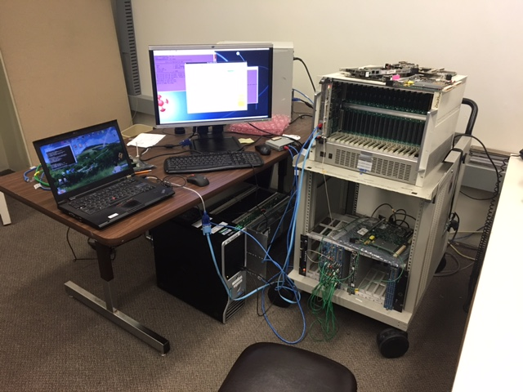
LANL Standalone DAQ Setup
Integrate:
TDCs
  FPGA update TDC
  data format
  - VME readout
V1495 (mock data generator)
  Read in MC data
2x+ V1495 (LVL-1)
  Trigger road finder
1x V1495 (LVL-2)
  Trigger decision
Trigger Supervisor (SIS boards)
  Coordinate TDC+Trigger readout
Partial EMCal installation ?
  Use HBD readout?

Slide 12
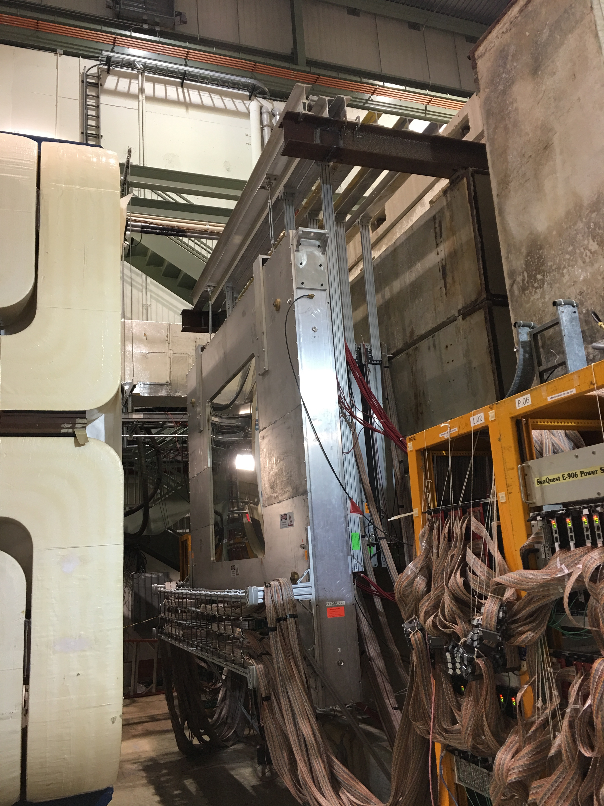
Make a small stick to hold 3 SiPMS
Mark their serial #,
Put in IR:
1) for 2 days; Thur noon – Sat noon
them measure (I,V) curves
2) For 1 week; do (I,V), put SiPMs
back to the same locations
3)For 2 weeksl do (I,V)
#1: (X=150, -50)cm
#2: (X=150, -100)cm
#3: (X=150, -150)cm

Slide 13
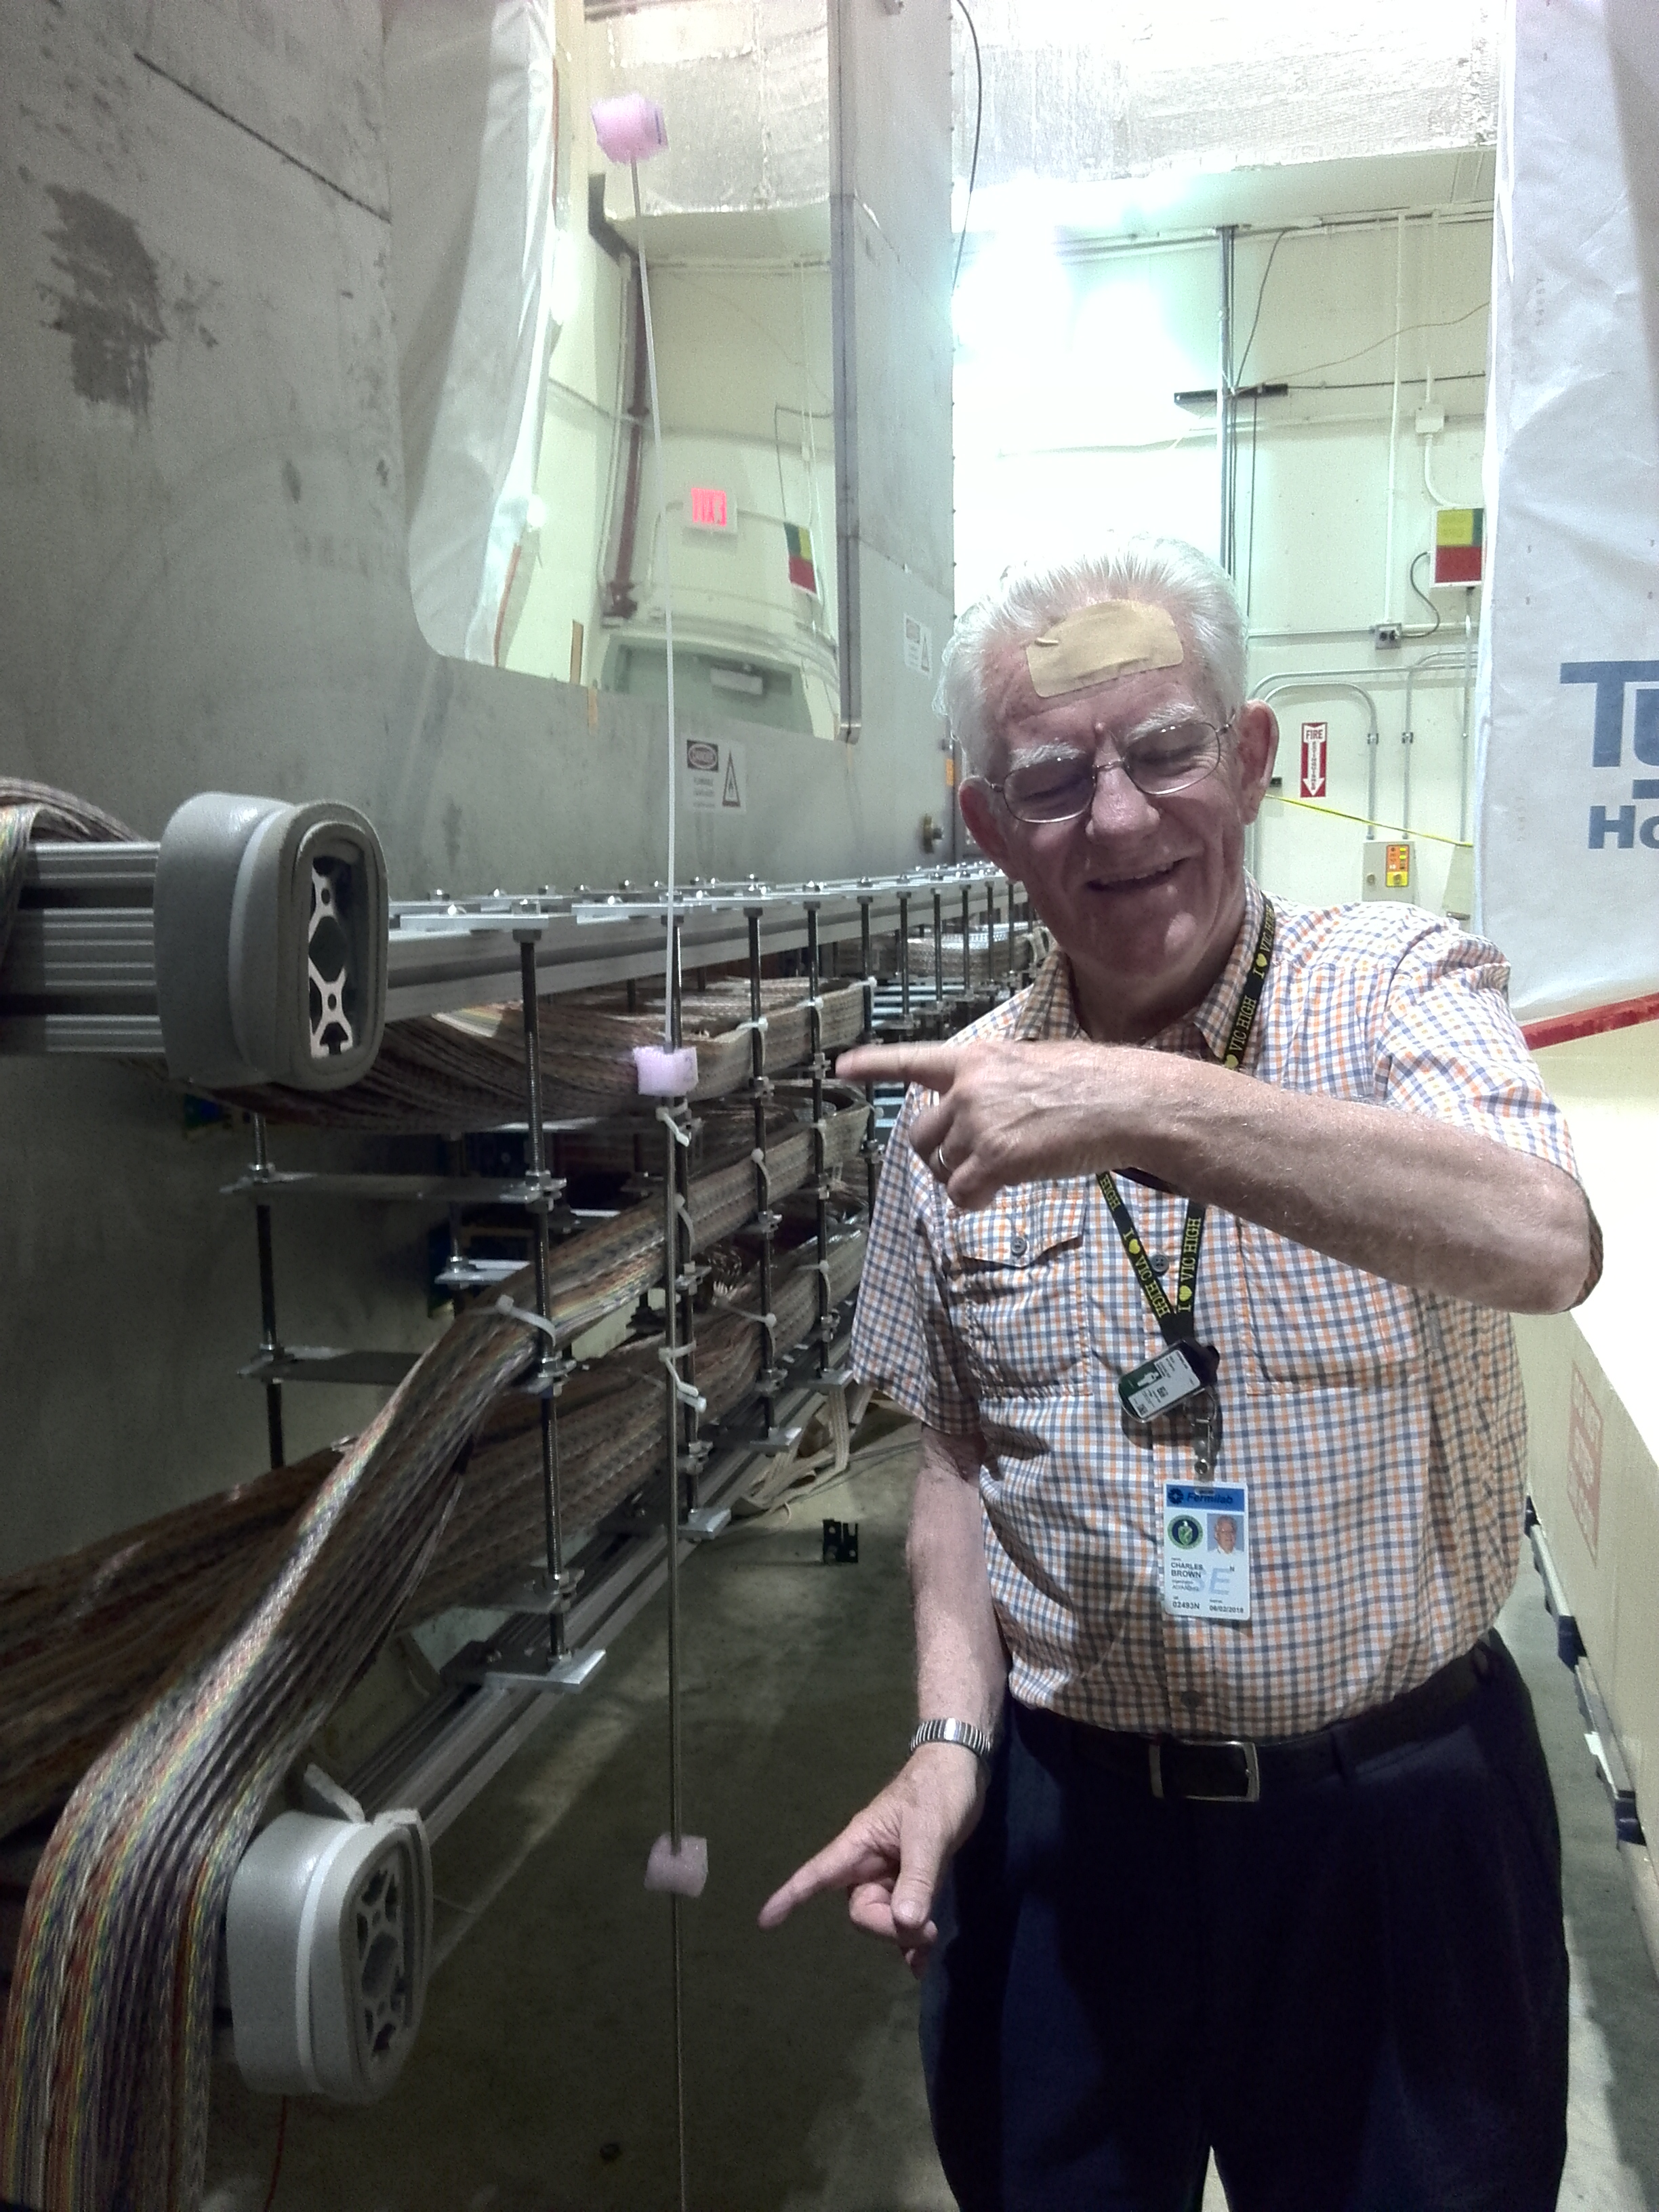
Locations:
#1: X = - 120cm, Y = - 60cm
#2: X = - 120cm, Y = - 100cm
#3: X = - 120cm, Y = - 160cm
#1:
3025CS: 10009
#2:
3025CS: 10010
#3:
3025CS: 10013

Slide 14
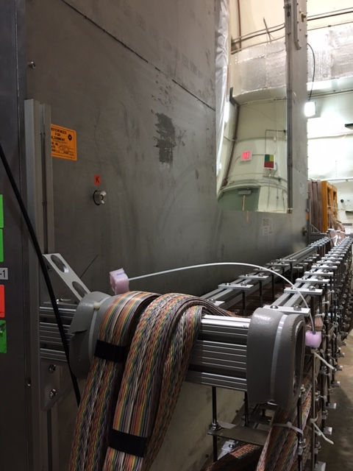
After 2 days … 6/18/2016

Slide 15
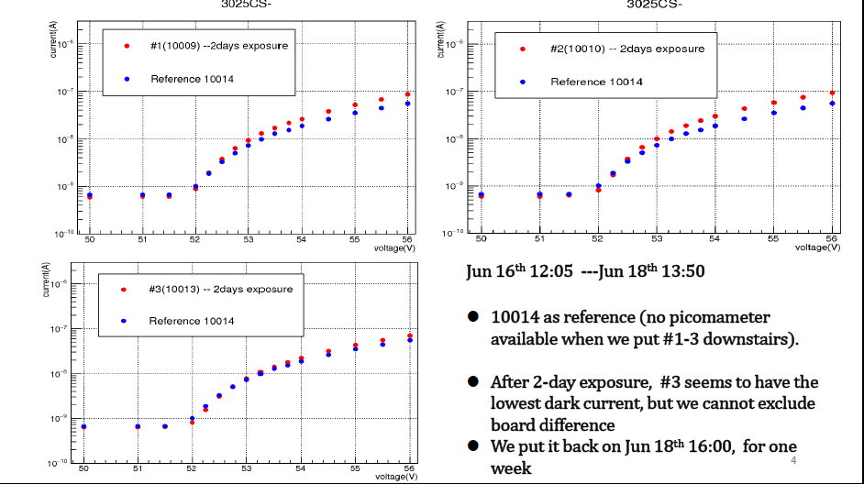
After 2 days … 6/18/2016, I-V curves

Slide 16
Reference SiPM Dark current: 13360-3025CS-10014:
S/N: 10009/10010/10013 are exposed to radiation behind ST-1
First put in the Hall: 6/15/2016 noon
Light leak in dark box
Good dark box

Slide 17
Dark Matter Workshop at Fermilab
March – April , 2017
SeaQues
MiniBooNE
DUNE/LBNF
LHC/CMS
“Center for Dark Matter Research at Fermilab”

Slide 18
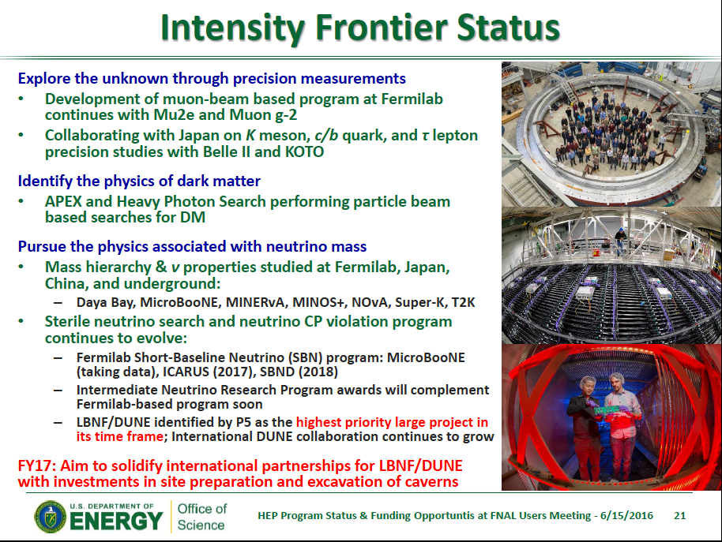
→Fermilab SeaQuest Dark Matter Search

Slide 19
Future application of the polarized target
JParc – fixed target Drell-Yan proposal (50GeV)
  Currently only 30GeV, limitation of applicability of pQCD
  Hadron Hall (Phase-I) completed (?)
RHIC fixed target polarized DY
  Luminosity limited, beam dump
  AGS? Only 24GeV
JLab12, LHC ?

Slide 20





