Slide 1
Possible EMCal Upgrade at SeaQuest 05/30/2018

Slide 2
CIPANP – Update on Physics
Gori et al, arXiv:1804.00661
A possible way to access larger
coupling, by using shorter “FMag”,
drill a longer hole inside the FMAG –
background could increase
17 MeV dark photon candidate
NA64, arXiv:1803.07748
17MeV

Slide 3
17MeV
17MeV

Slide 4
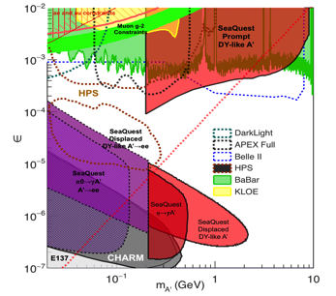
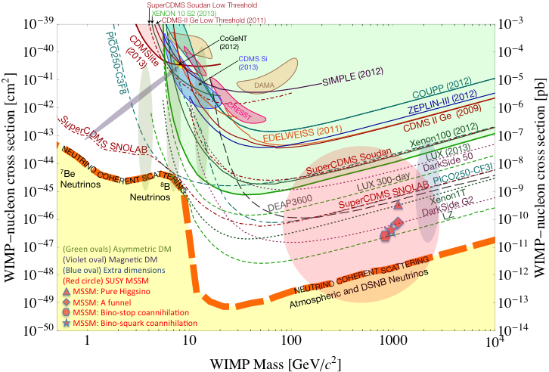
Dark Photon/Higgs Search at BeamDump Experiments @Fermilab
E1067/SeaQuest search for low mass dark particles:
- mass =1 MeV – 10GeV
- WIMP search – mass > 10GeV,
- Needs low mass coverage, mass < 10GeV

Slide 5
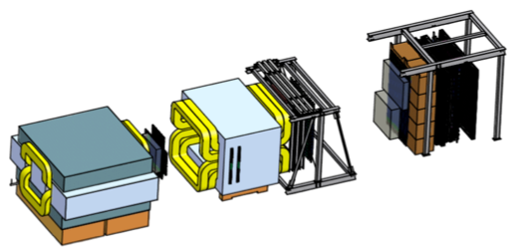
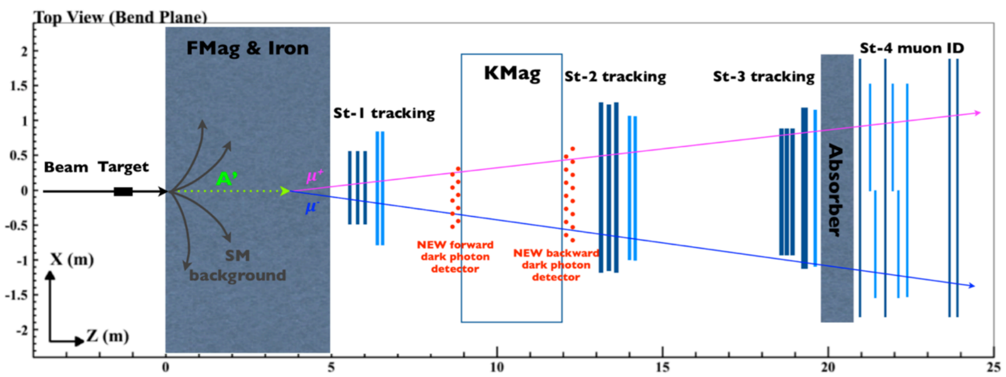
SeaQuest at the Intensity Frontier at Fermilab
High intensity proton beam: “beam dump mode” @SeaQuest/E1067
35,000 fb⁻¹ (in a 2-year parasitic run, 1.4x10¹⁸ POT @5% beam)
LHC-II: 300 fb⁻¹ (~2025), achieved 25fb⁻¹ in Run-I
B-factory@KEK: 50K fb⁻¹ (~2023)
Absorber wall and proportional
tube based Muon ID
Spectrometer magnet
Δpt = 0.4 GeV
Focusing magnet
and solid iron dump
Δpt = 2.9 GeV
Beam
120 GeV proton from Main Injector
19ns RF, 4s spill, 0.5×10¹³ protons per spill
25 m
LDRD/ER: 2016-2018
Trigger upgrade, parasitic runs
Target system
Liquid H and D
Solid C, Fe, W
- Beam dump mode: p+Fe collisions! Target ~ 10%λ_{I}
- Parasitic run with other fixed target experiments, E906/E1039

Slide 6
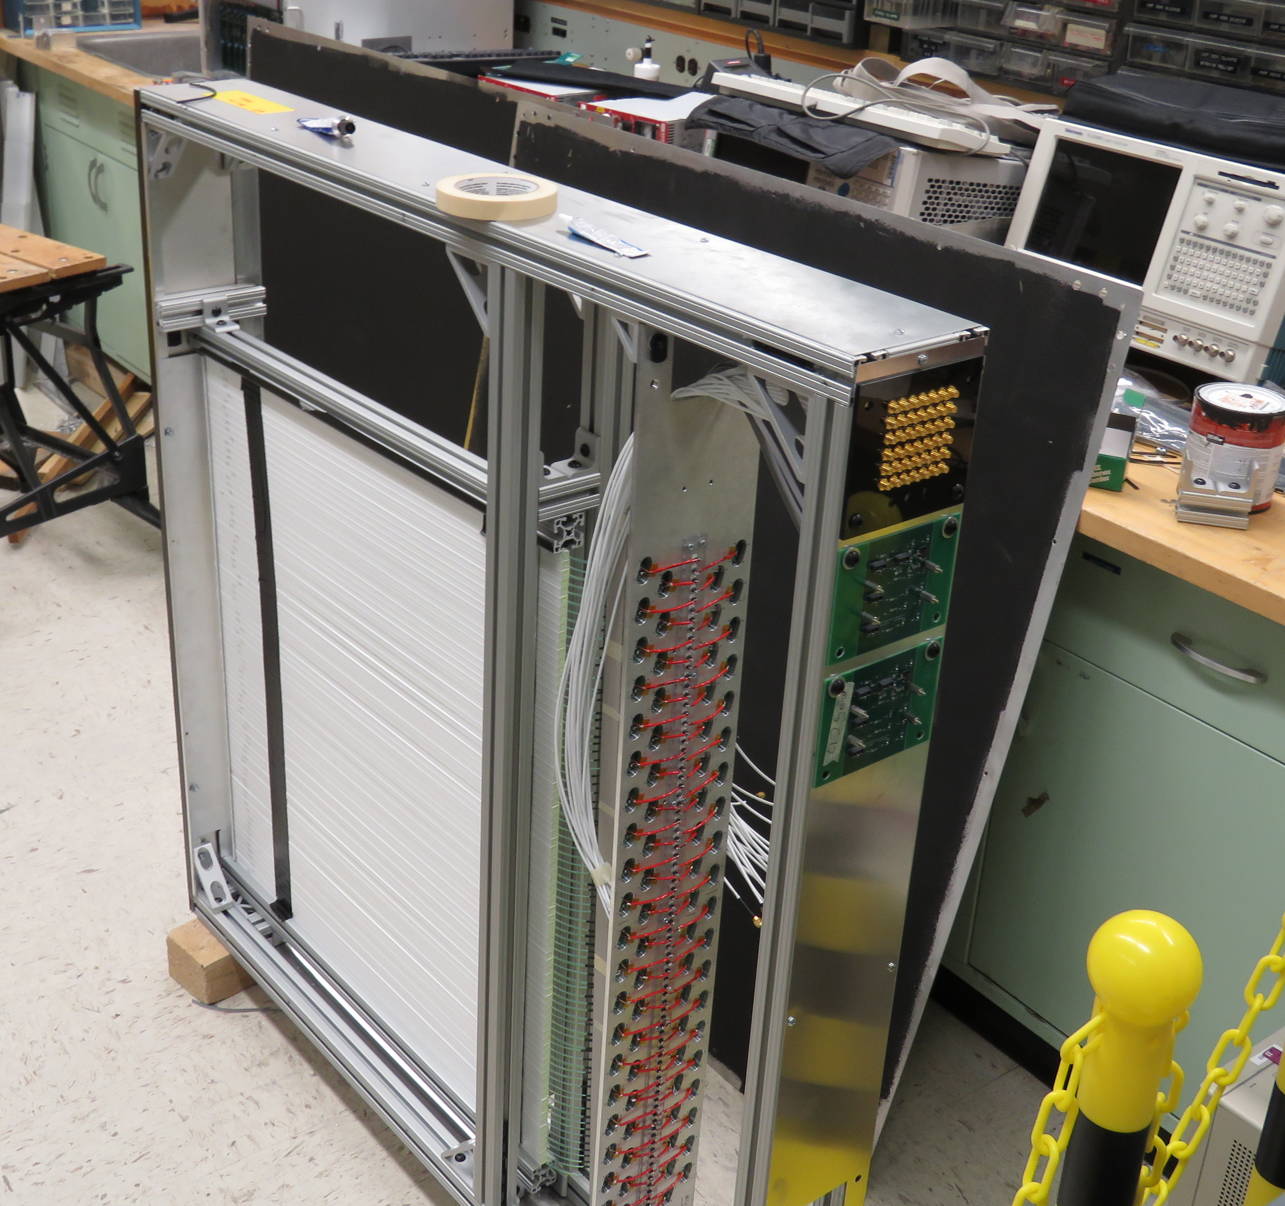
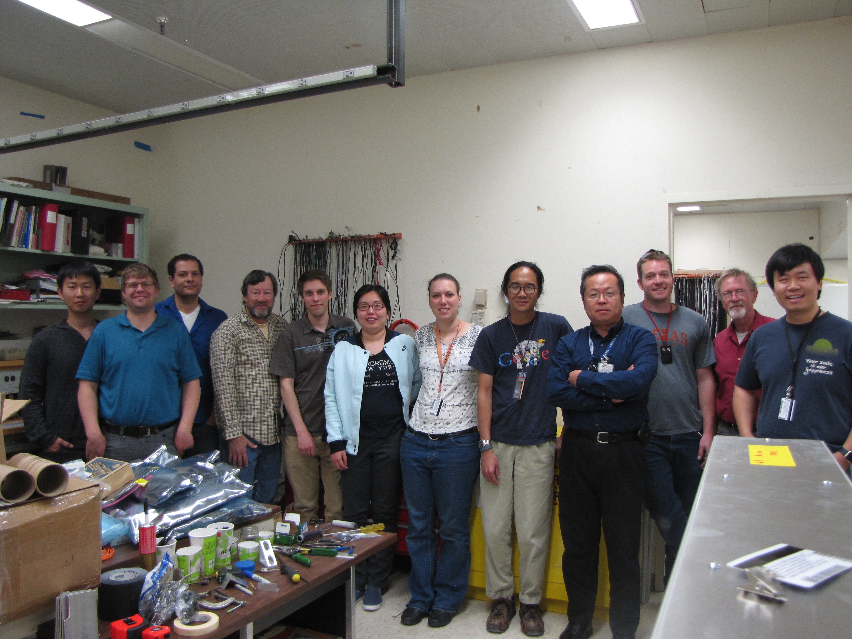
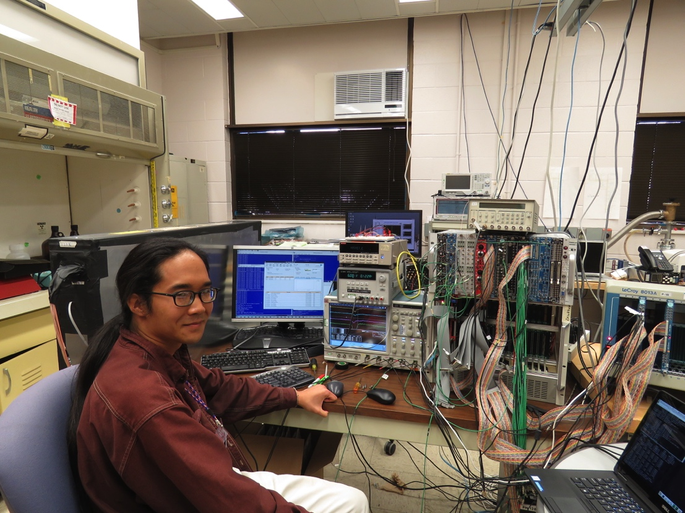
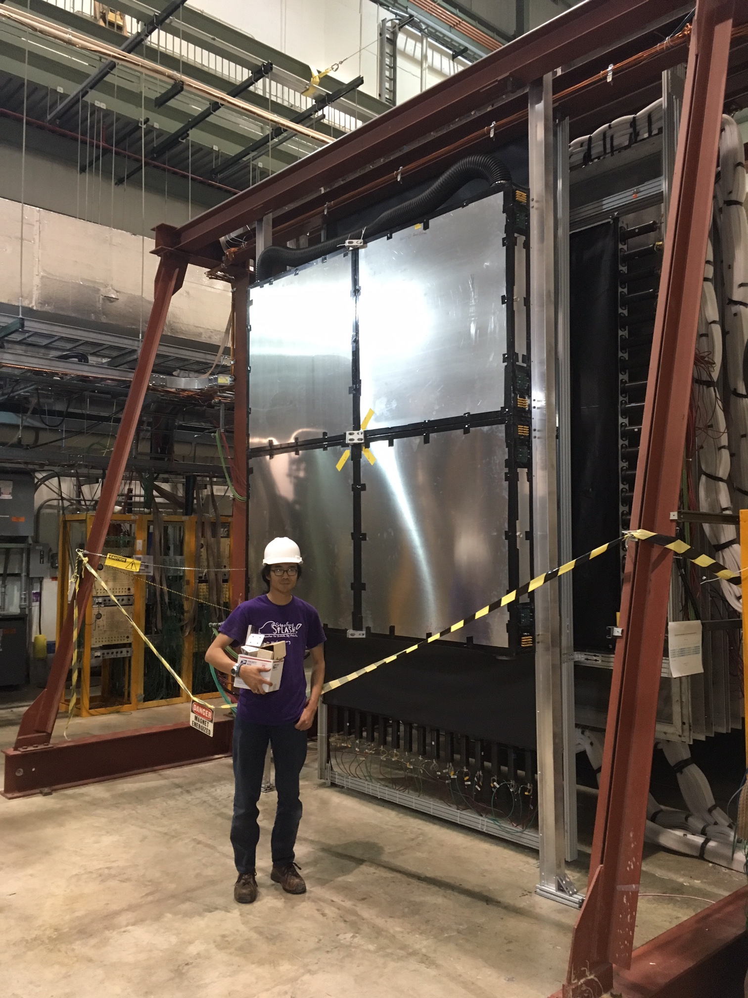
Dark photon trigger detectors completed at LANL, 4/2017
Trigger detector installed
and
took data in 2017!

Slide 7
Seek new HEP Support: $350K/year
LDRD/ER: 2016-2018
Established physics case
Upgraded DAQ bandwidth
10+ x
Built, commissioned dark photon trigger in 2017
Parasitic data w/E906
Add EMcal for di-electron
New low mass region: 1 – 200 MeV
Physics analysis
Parasitic run w/ E1039
2019-2021
HEP support needed: 2019-2022
0.5 Staff
1 PD
$350K/year, for 4 years
Support data taking w/ E1039
Dark photon trigger & EMCal operation, calibration and maintenance
2018-2020
Data analysis and publication
2019-2021
Physics beyond 2020+
Expand the physics with a dedicated dark matter search program at Fermilab
5% beam time -> 20+% at SeaQuest
Upgrade tracking around dump
Optimize the spectrometers

Slide 8
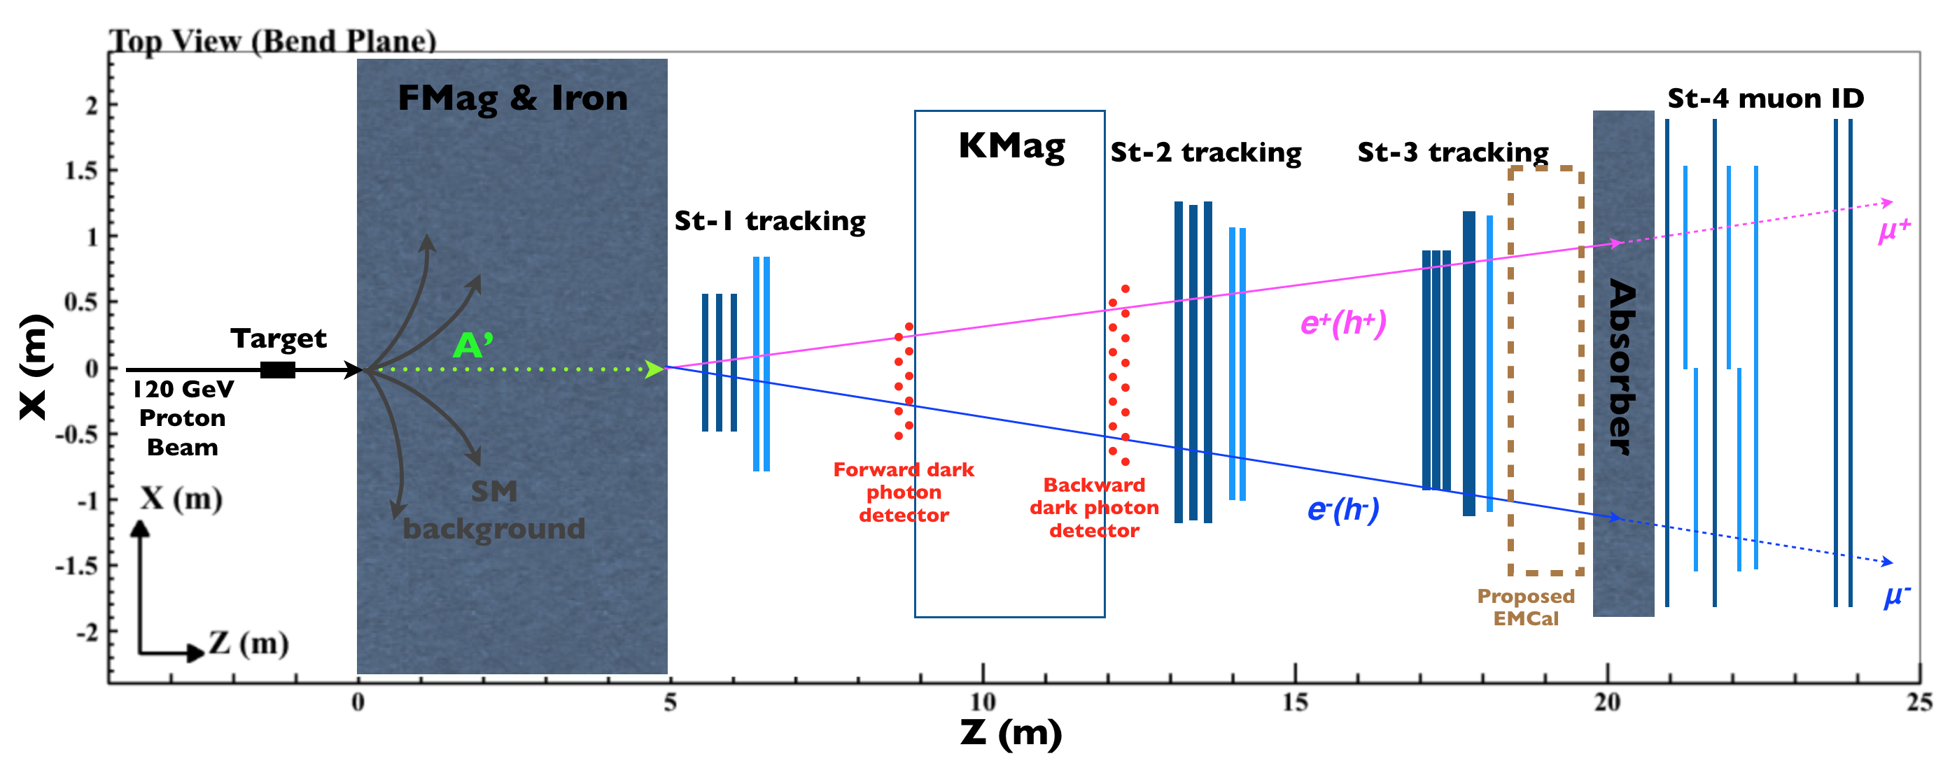
Installation plan

Slide 9
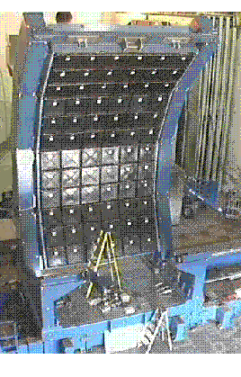
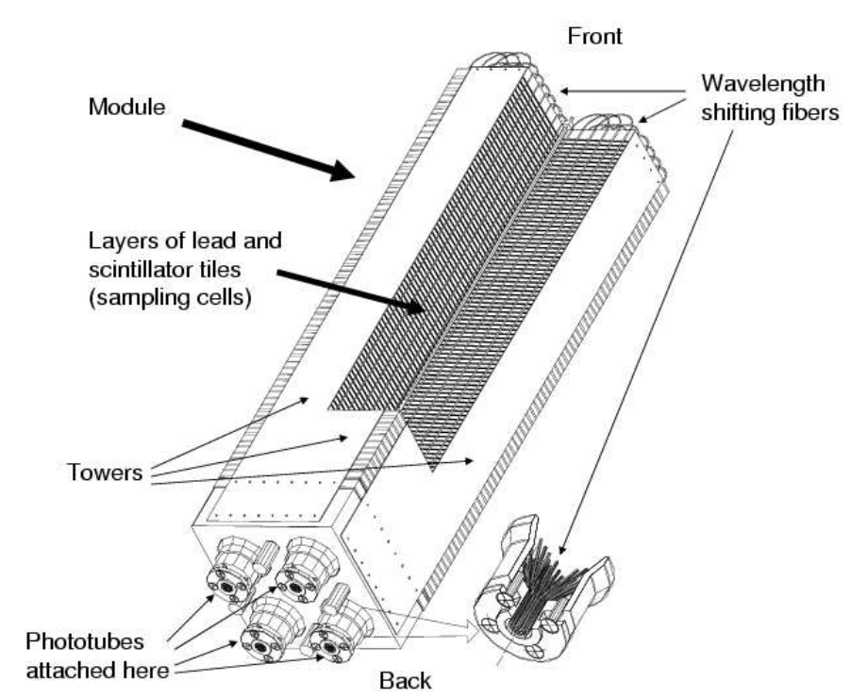
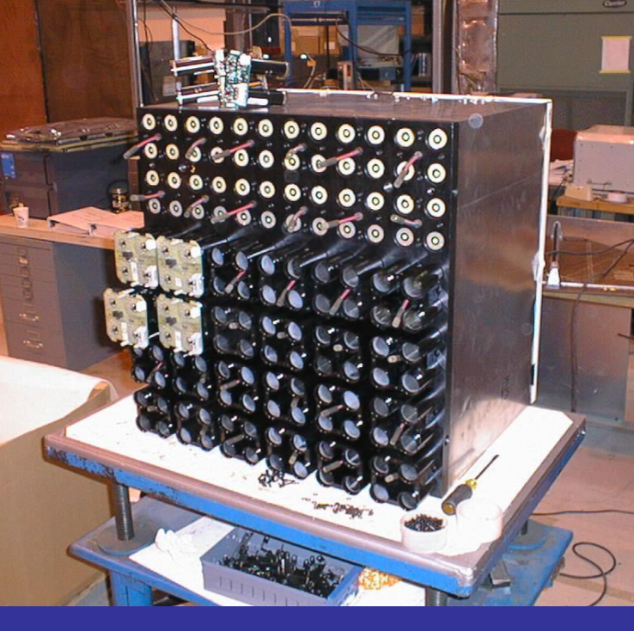
Details of PHENIX EMCal
Weight = (5.5x5.5x33)x11g/cm^3x4(per module)x36(per super-module)x18(per sector)
= 28,500 kg/sector, if 100% Pb; reality < 20,000kg.
2m
Shashlik-type Pb scintilator
1 tower is 5.52*5.52*33 cm³
4 towers make a module
Total # of readout channels if
Gang 4-”PMTa” with one SIPM:
One sector = 36 x 3 x 6 = 648 (2592)
6*6 modules make a super module
3*6 supermodules make a sector
1 sector is about 2*4 m², weights about 20t
4m

Slide 10
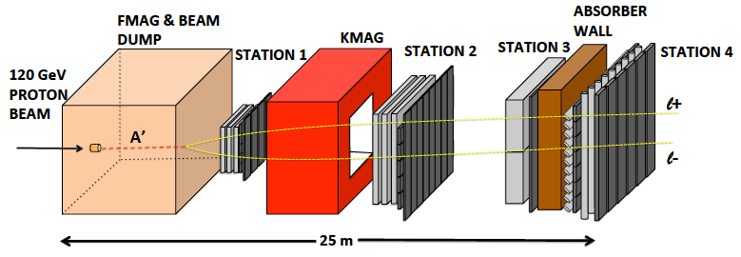
E-1067 Future Upgrade: Phase-II 2020 ~ 2025+
EMCal
Add tracking detectors close to “target” to improve mass resolution
Add EMCal, PID
e^{+/-}, h^{+/-} , π^{+/-}

Slide 11
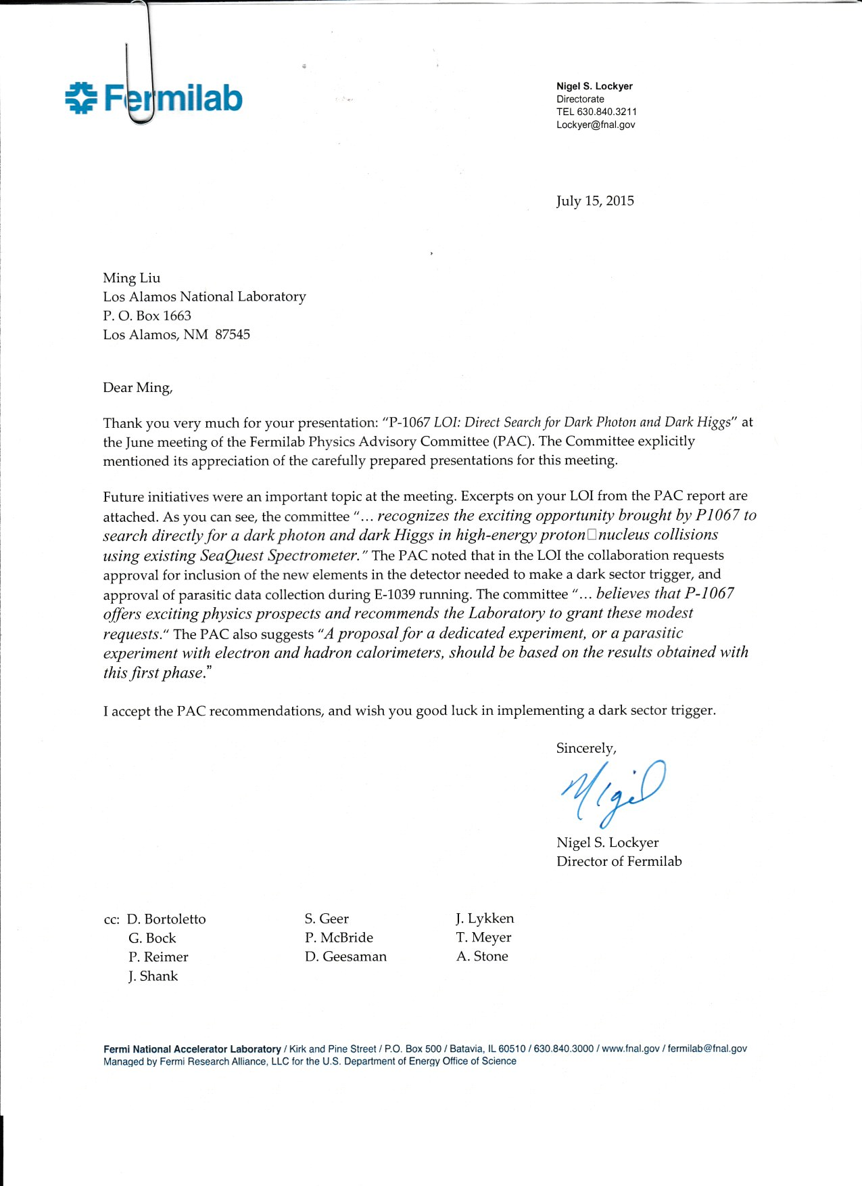
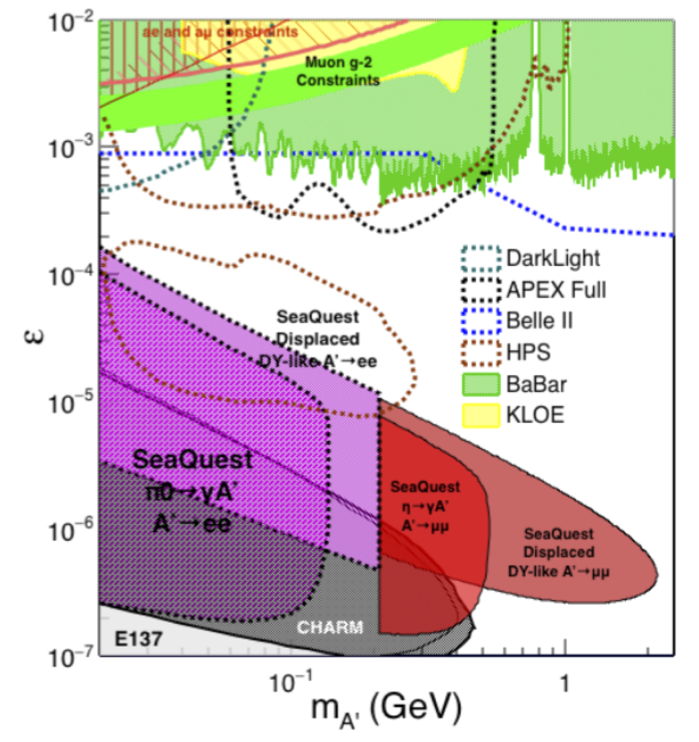
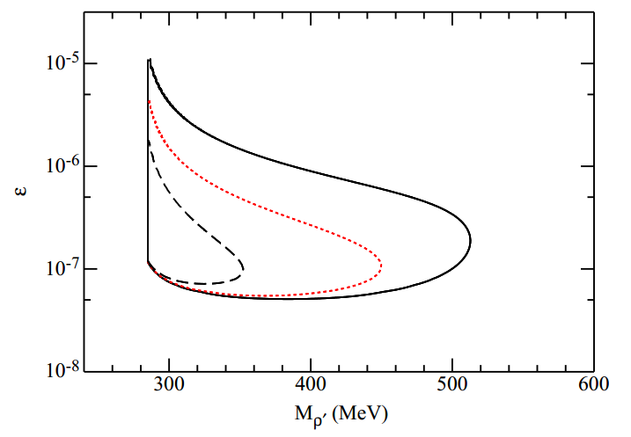
Physics goal and past work
LOI of dark matter search in dimuon channel was presented to PAC in June 2015. Obtained very positive feedbacks.
A phase-II of EMCal and possibly HCal was also mentioned. PAC suggested we submit the new proposal based on the results obtained from this first phase
The detector proposed in the first phase was successfully installed and accumulated one week worth of data before E906 shuts down
We will continue to take the dimuon data parasitically with E1039

Slide 12
Ongoing and potential collaboration/support
Ongoing support from LANL LDRD: $300k for FY-18
Submitted joint proposal with KEK/RIKEN/TokyoTech: $270k for FY-18 if supported
Collaboration with PHENIX/sPHENIX EMCal group on detector/readout support

Slide 13
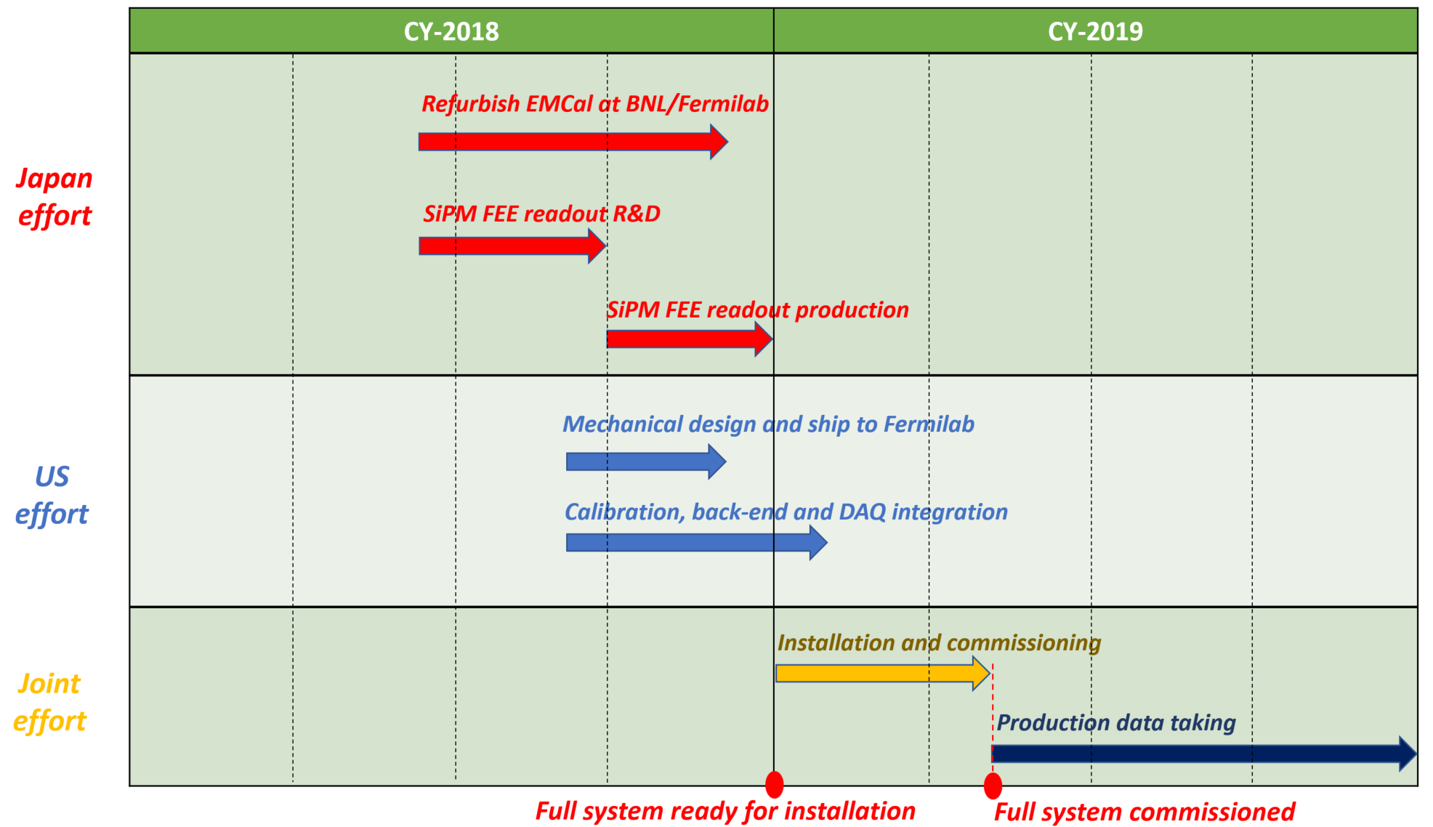
Proposed work and timeline – needs update
Ultimate goal:
Have the full detector ready for installation before the end of this calendar year
Install the detector either during the accelerator maintenance downtime, or the summer shutdown in 2019
Take data with E1039 for at least a year
Immediate goal:
Ship the detector to Fermilab either in Feb. or some later time
Find some onsite space with crane support and basic utilities for the refurbishment work
Prepare a new LOI for the upcoming PAC meeting

