Slide 1
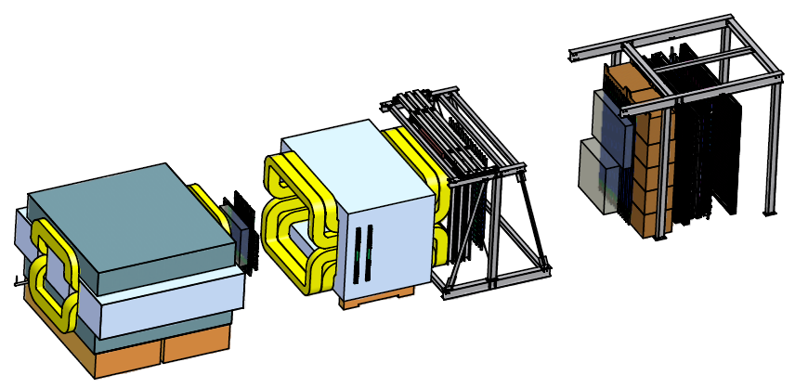
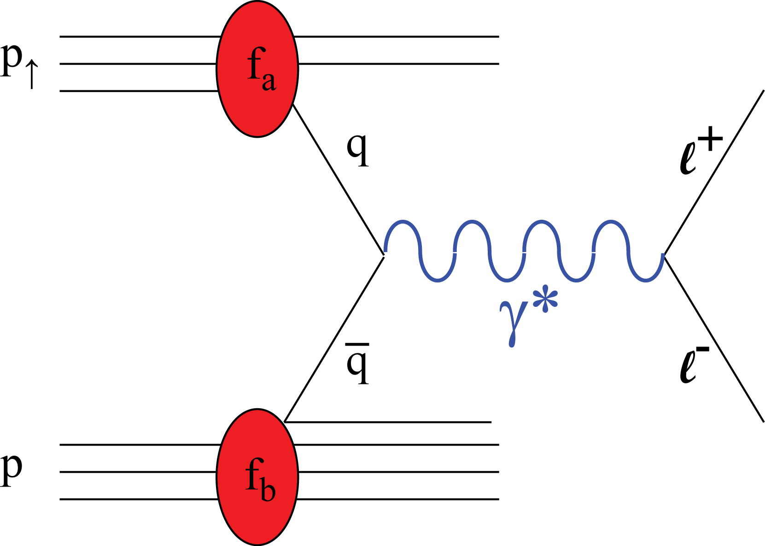
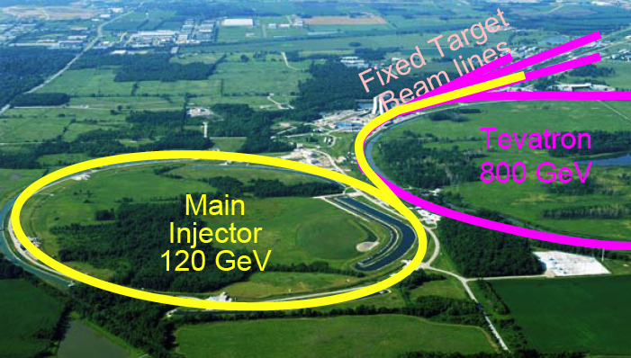
Take advantage of the current E906 Drell-Yan Exp. @Fermilab, develop a new polarized hadron physics Program
Opportunity of a Polarized Target Drell-Yan Exp@Fermilab
A New Polarized Target
4.9m
Drell-Yan Transverse Single Spin Asymmetry:
  Polarized proton (NH₃) target, design & construction at LANL.
  (polarized) 120 GeV proton beam from the Fermilab’s Main Injector
A new capability single and double spin physics program with polarized beam (E-1027)
  A_{LL}, A_{TT}, A_{LT} etc
  Sean quark polarization, TMDs

Slide 2
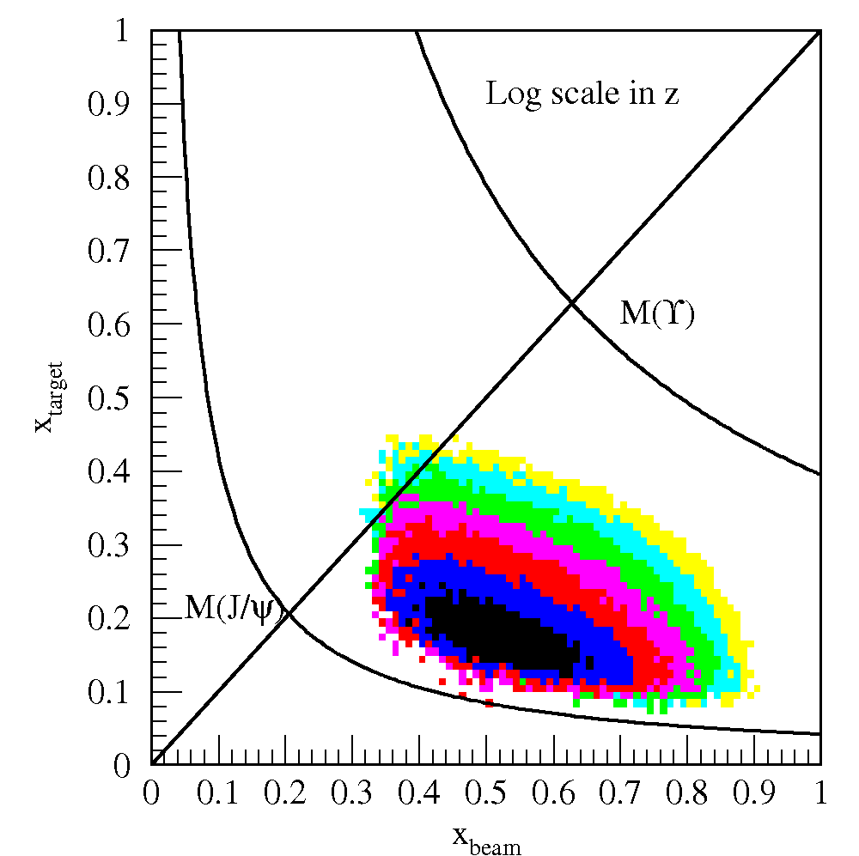
Polarized Target Drell-Yan Transverse Single
Spin Asymmetry @Fermilab
Sea-Quark Sivers Effects
The first precise measurements of seaquark Sivers distributions
@ large x = 0.1~0.4, significant Sivers Asymmetry observed in pol. SIDIS
Sea-quark’s Sivers Funcs poorly known
Pol. Target
E906 Coverage
Current E906
Coverage

Slide 3
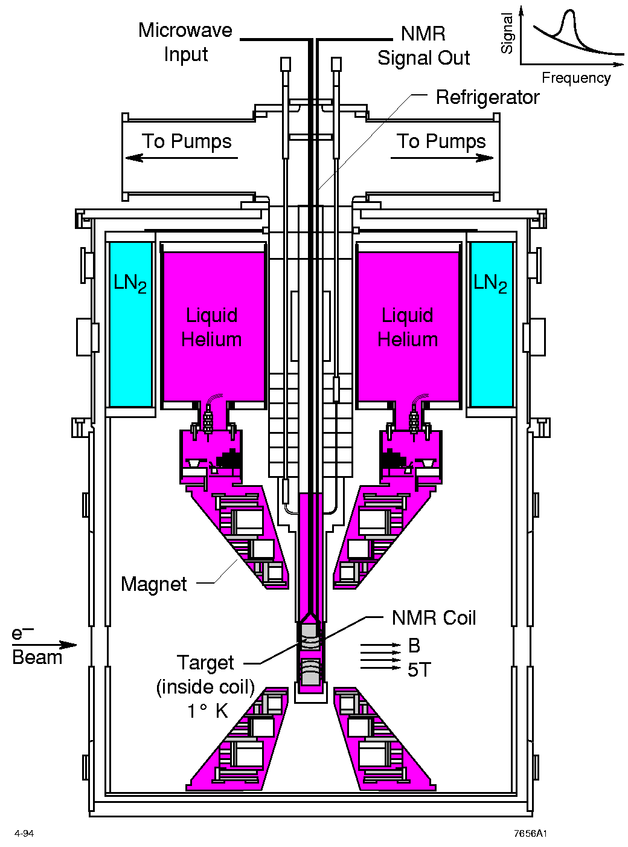
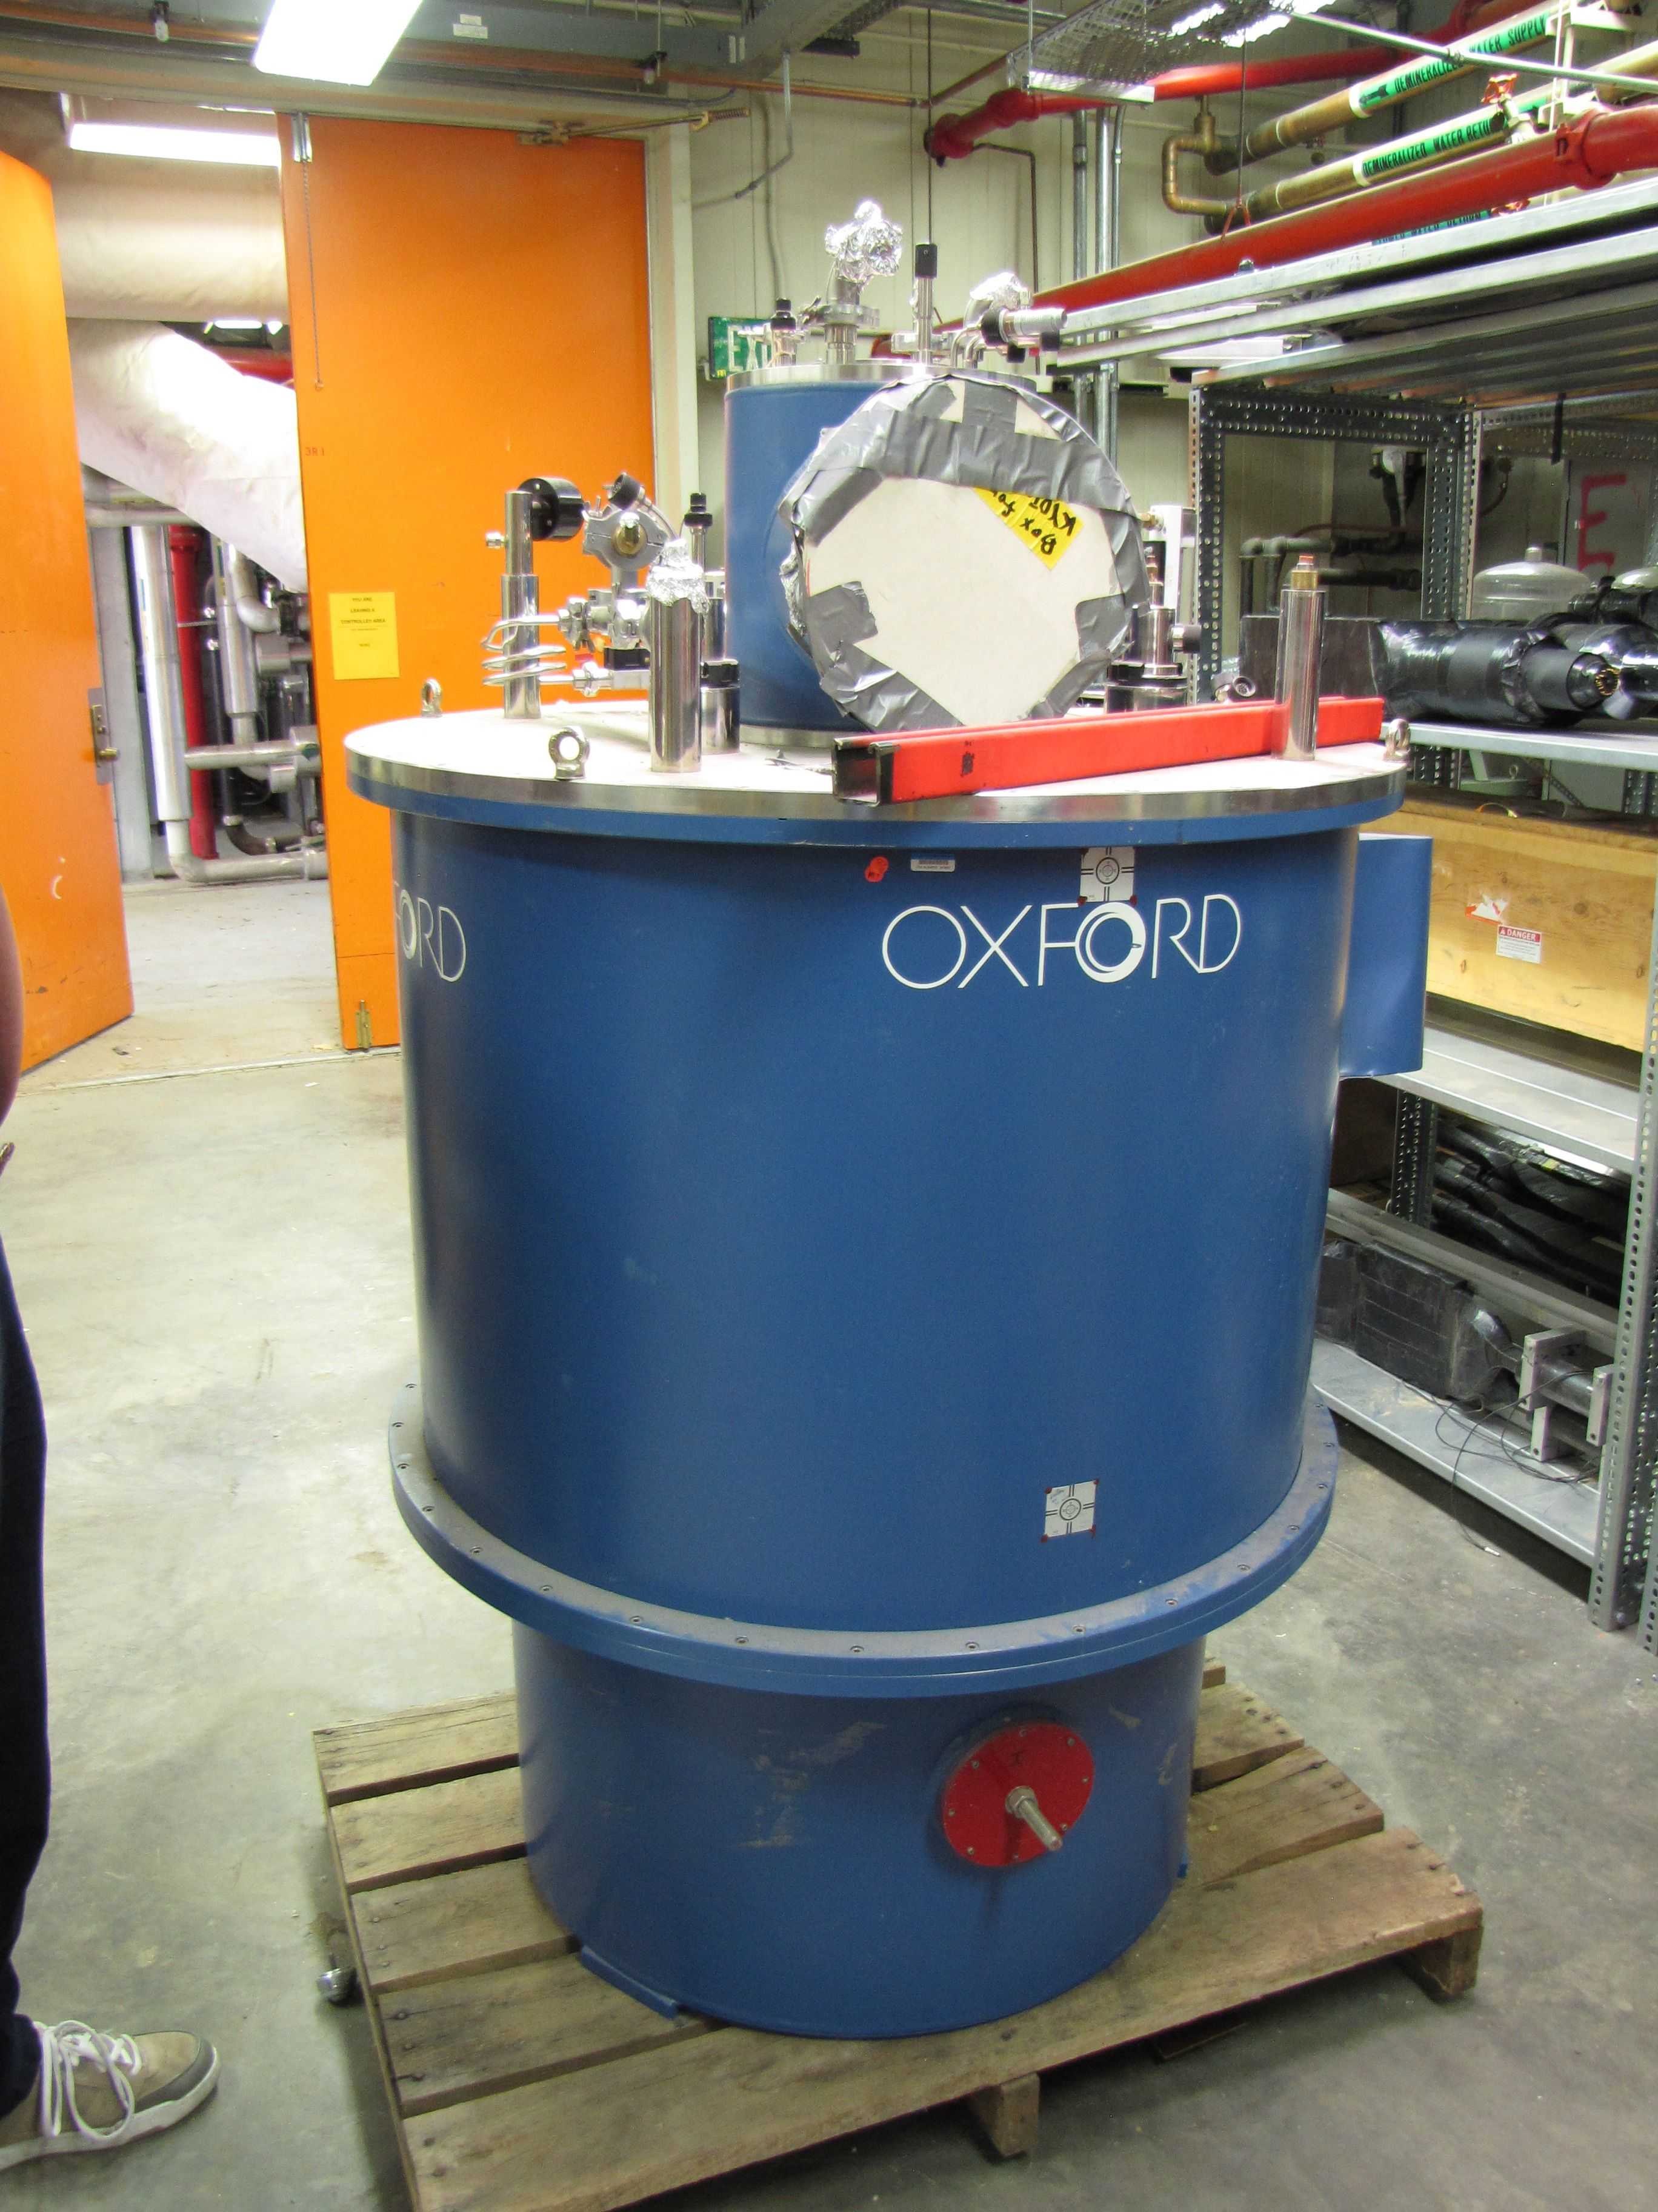
LANL High Density Polarized Proton (Neutron) Target
Superconducting dipole magnet
  Temperature ~ 1 K
  Magnetic Field: 5 Tesla
  10cm long NH₃ target
Proved capable of handling high luminosity
  up to ~ 10³⁵ (Hall C)
~ 10³⁴ (Hall B)

Slide 4
LANL Polarized Proton Target
Drell-Yan Proposal
LANL approved LDRD project: FY13-FY16
  A (½+3)-year project to have preliminary polarized DY spin asymmetry measurements at E906/Fermilab by the end of FY16; also including a significant theoretical effort on data interpretation within pQCD and L-QCD framework.
  FY13:
    A LOI of fixed target polarized Drell-Yan to Fermilab, followed by a full proposal
    Polarized target development
  FY13-FY14:
    Fermilab’s approval of the full proposal
    Re-build the LANL polarized proton target, in collaboration with UVA, Jlab and Oxford
    Be ready for installation and beams in FY15
  FY15-FY16:
    first physics run with the polarized target at E906
    Preliminary results by the end of FY16.

Slide 5
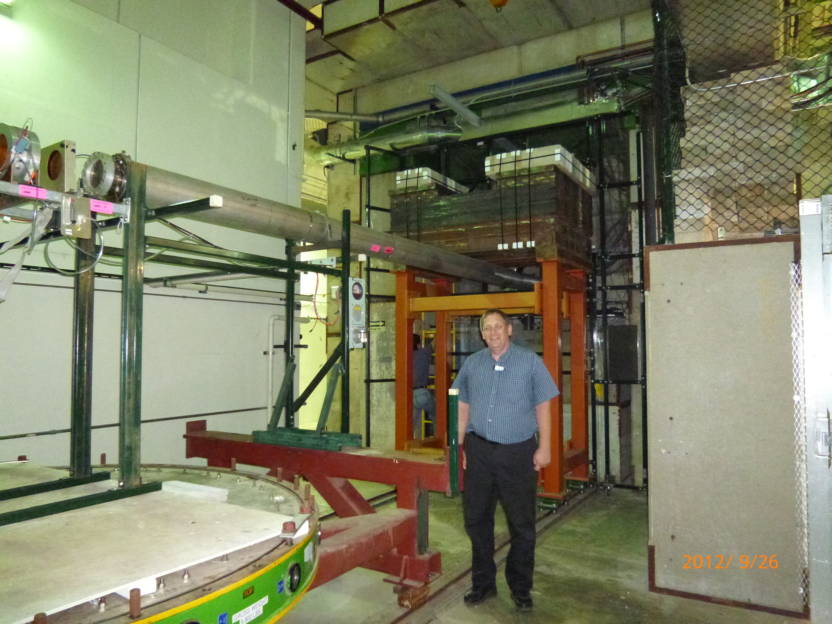
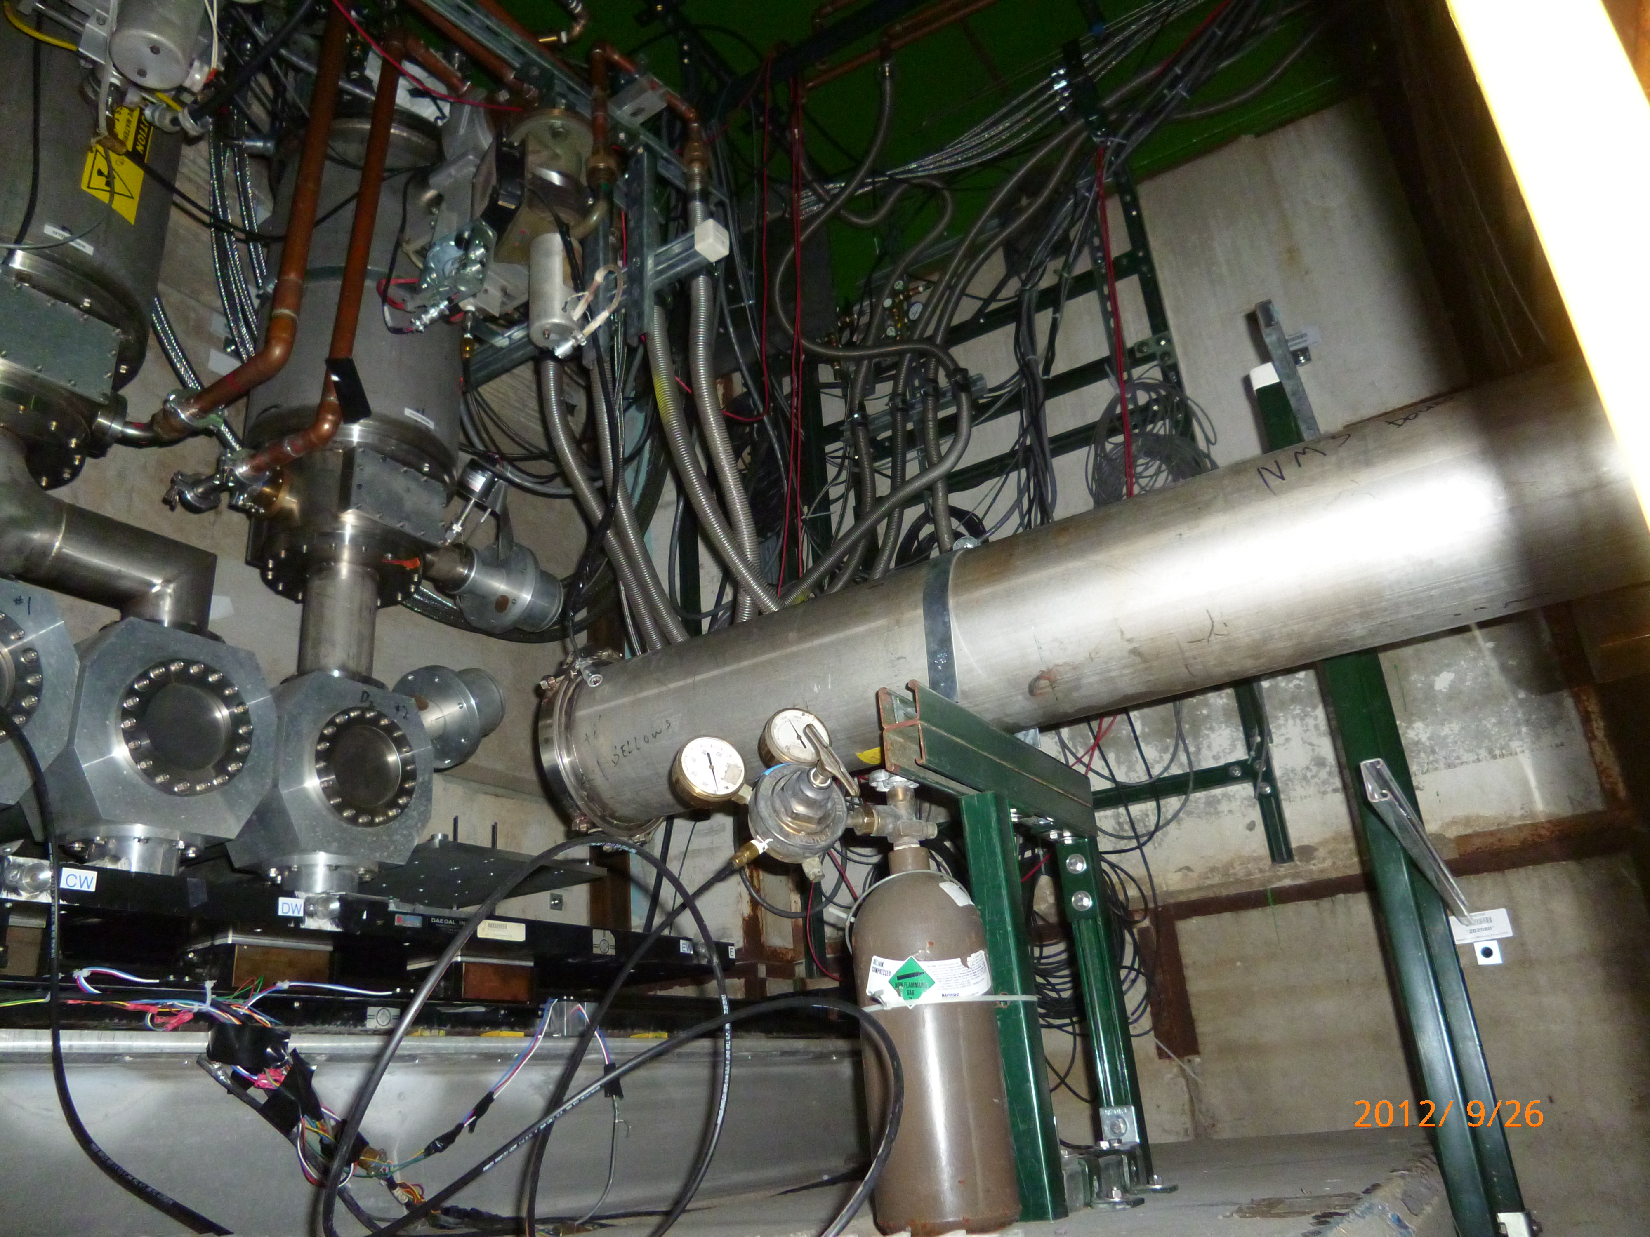
Available E906 Target Area
Target is shielded
110”
105”
Beam pipe
24”

