Slide 1
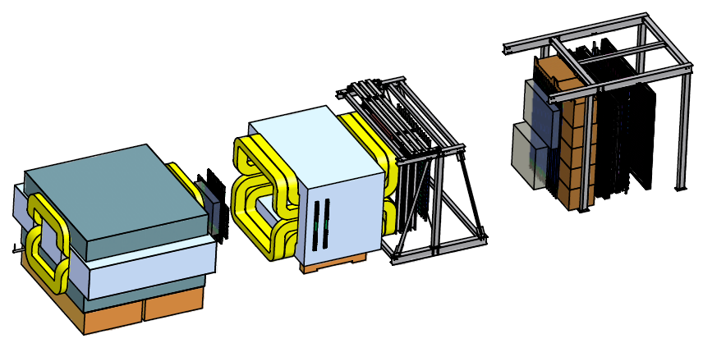
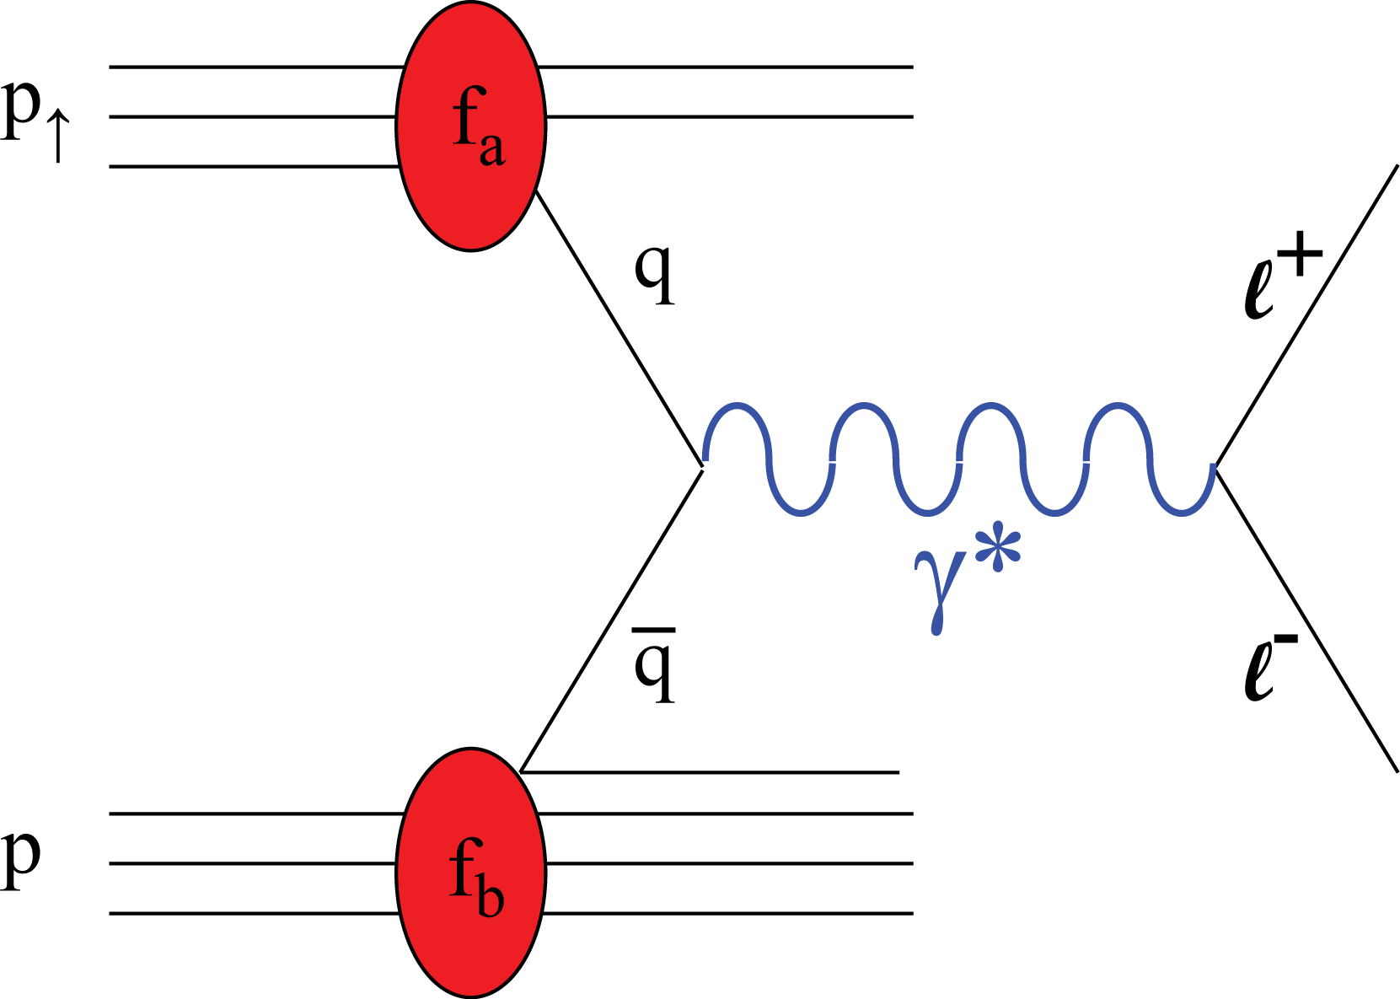
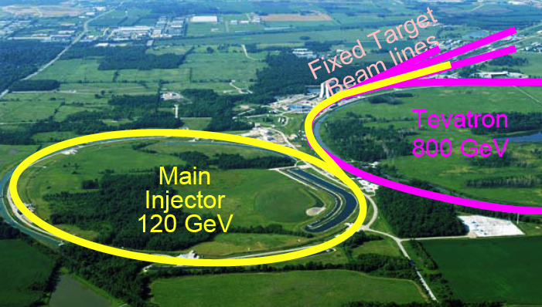
Take advantage of the current E906 Drell-Yan Exp. @Fermilab, develop a new polarized hadron physics Program
Opportunity for a Polarized Target Drell-Yan Exp@Fermilab
A New Polarized Target
4.9m
Drell-Yan Transverse Single Spin Asymmetry:
Polarized proton (NH₃) target, design & construction at LANL.
(polarized) 120 GeV proton beam from the Fermilab’s Main Injector, E-1027

Slide 2
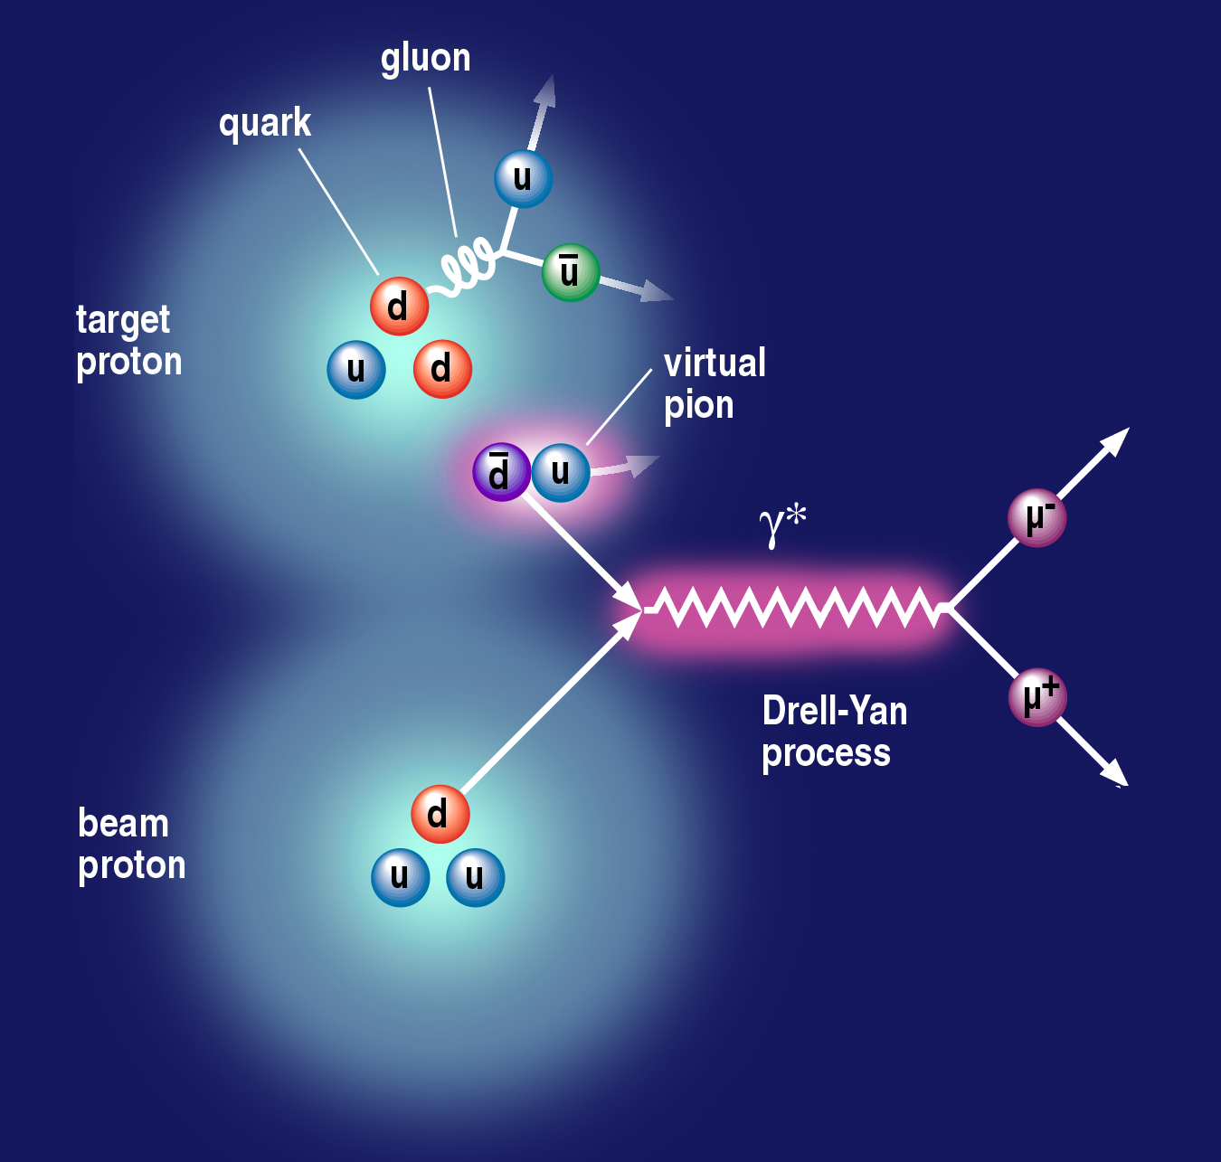
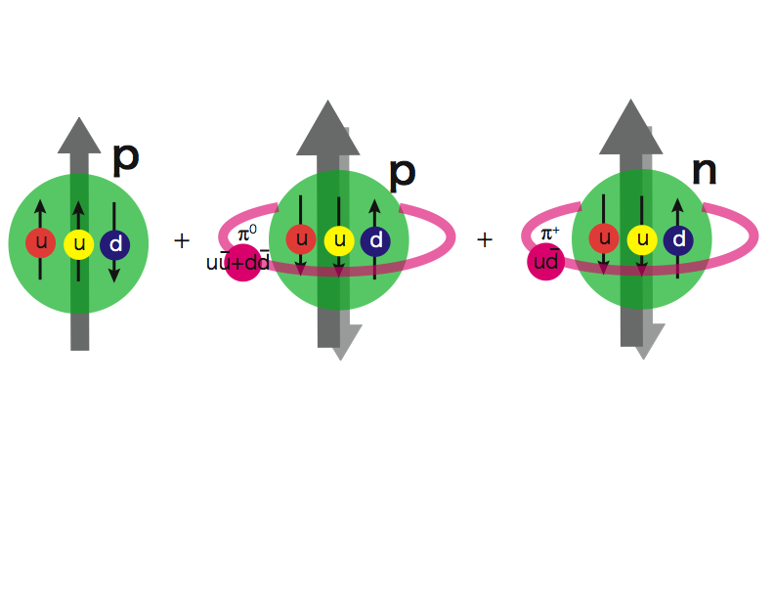
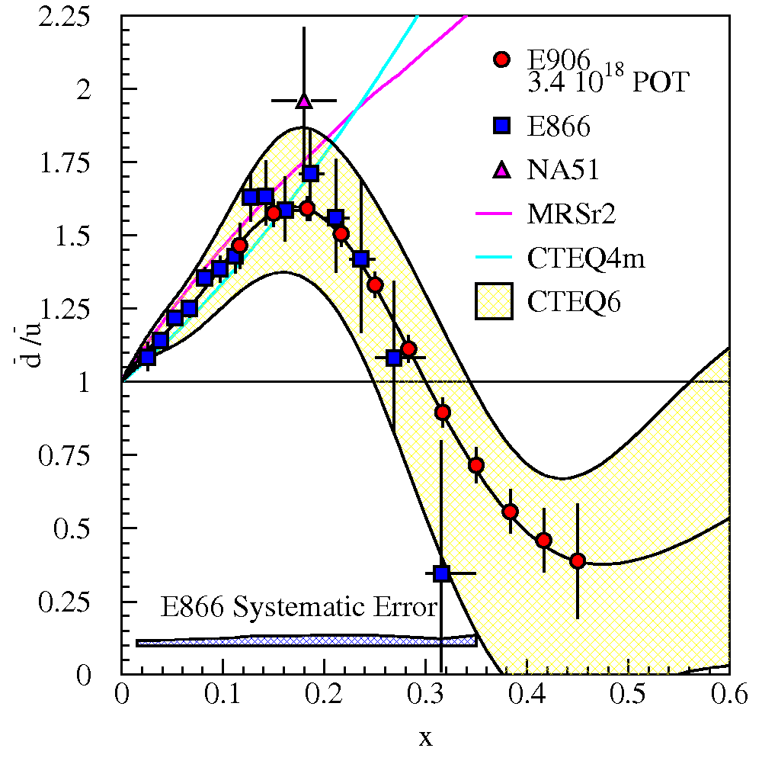
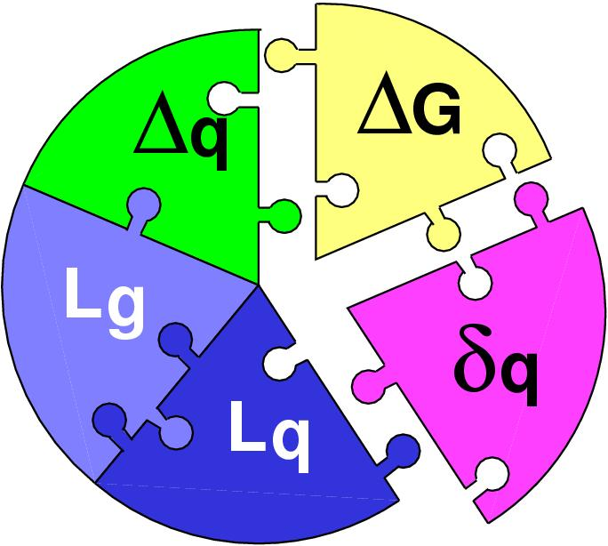
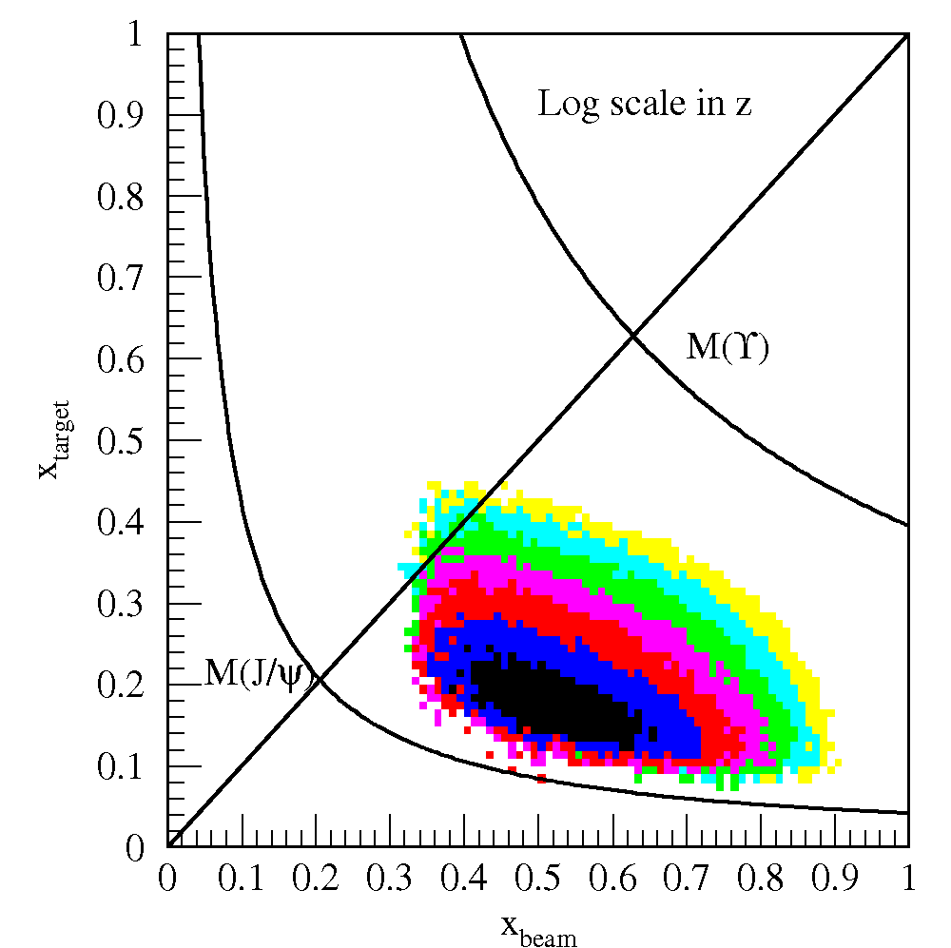
The Physics
(Sea-quark flavor asymmetry)
Sea-quark orbital angular motion and Sivers function at x = 0.0 ~ 0.3
Proton spin puzzle
E906 dbar/ubar projection
E906 Spect.
Monte Carlo
E906 Spect.
Monte Carlo
E906 Spect.
Monte Carlo

Slide 3
Drell-Yan Transverse Single Spin Asymmetry @Fermilab
SeaQuark Sivers Effects
The first precise measurements of seaquark Sivers distributions
@ large x = 0.1~0.4 where significant Sivers Asymmetry observed in pol. SIDIS
Sea-quark’s Sivers Funcs poorly known
Pol. Target
E906 Coverage
Current E906
Coverage

Slide 4
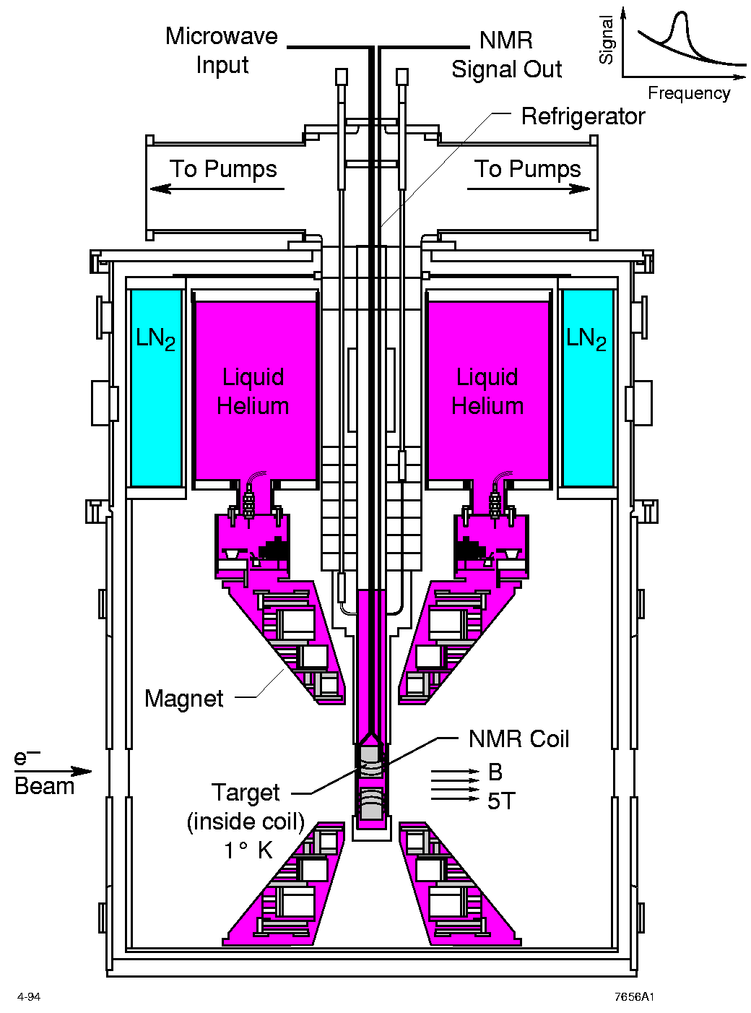
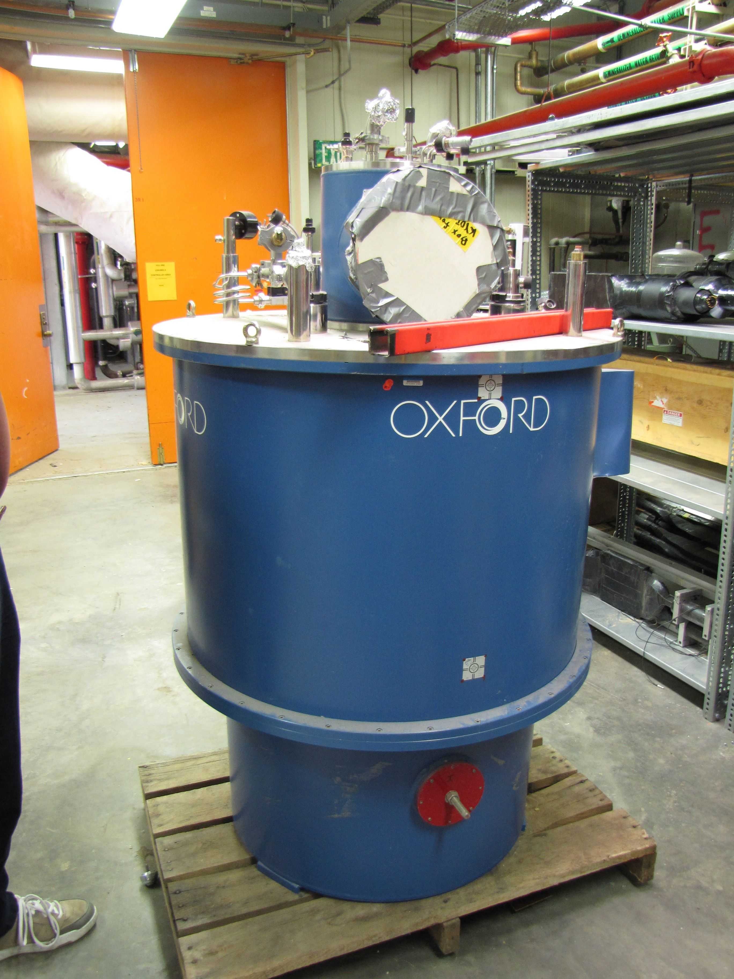
LANL High Density Polarized Proton (Neutron) Target
Superconducting dipole magnet
  Temperature ~ 1 K
  Magnetic Field: 5 Tesla
  10cm long NH₃ target
Proved capable of handling high luminosity
  up to ~ 10³⁵ (Hall C)
~ 10³⁴ (Hall B)

Slide 5
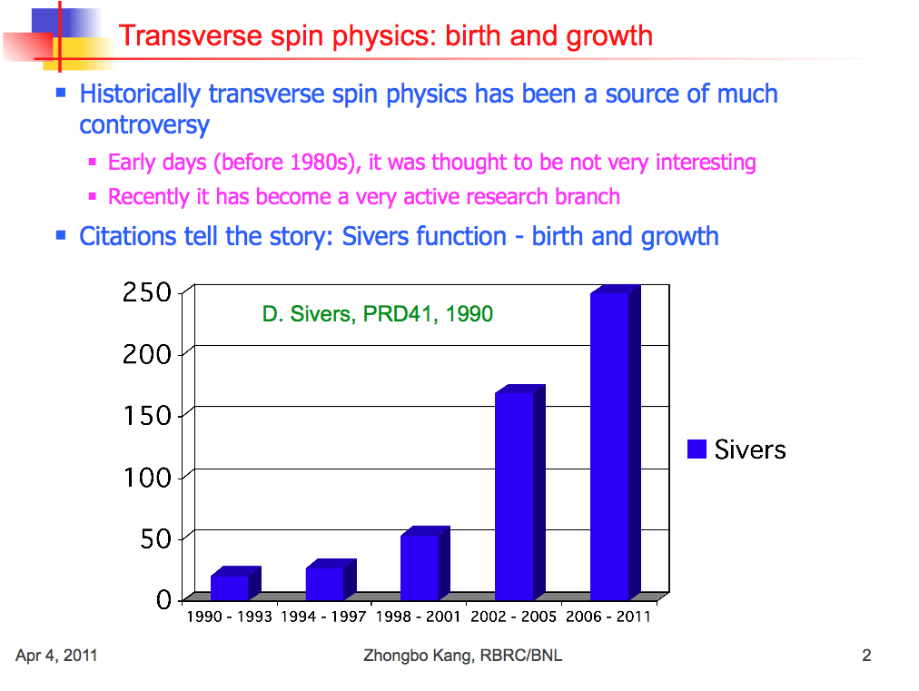
=> Probe Sivers Functions via Polarized DY!
Kang 2011

Slide 6
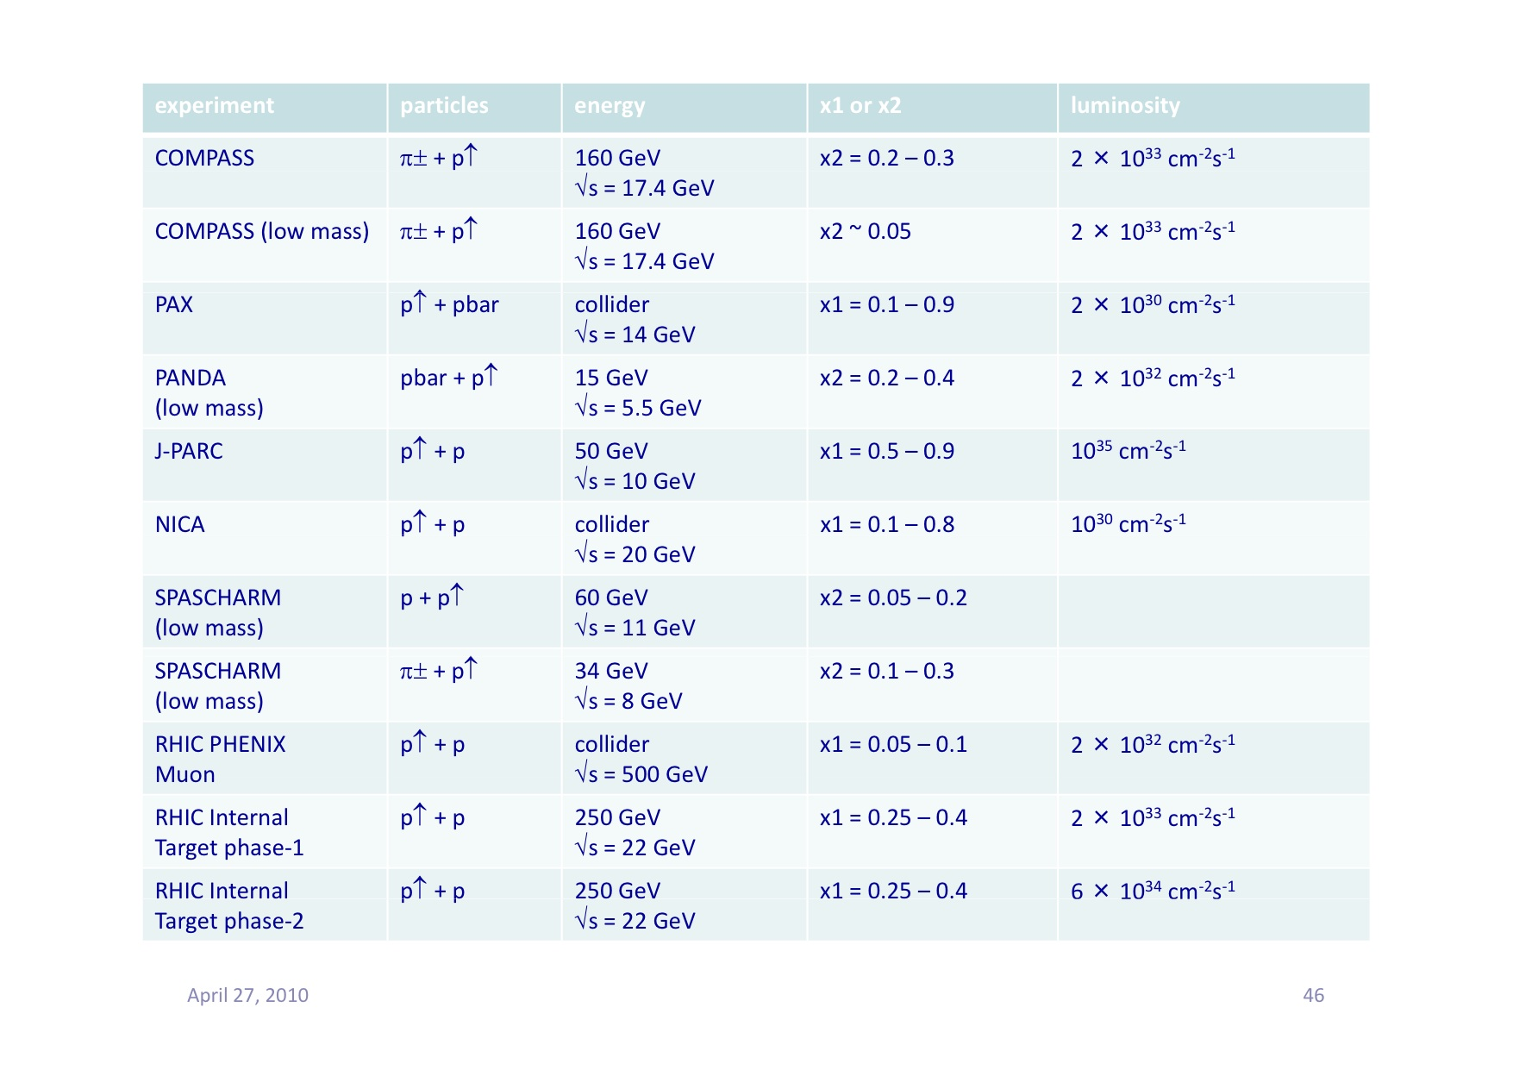
Proposed Future Polarized DY Exp’s
Y. Goto 4/2010 CERN DY
Polarized DY Dimuon Exp. at Fermilab Main Injector: 120GeV
RHIC fixed target possibility: 250 GeV

Slide 7
Polarized Target for Drell-Yan@Fermilab
LANL LDRD project: FY13-FY15 (~$1.5M/year)
  A 3-year project to have preliminary polarized DY spin asymmetry measurements at E906/Fermilab; also a significant theoretical effort on pQCD and L-QCD at LANL
  FY13-FY14:
    Re-build a polarized target, and be ready for beams at E906 in FY14
  FY15:
    first physics run with polarized target at Fermilab for DY
    Preliminary results by the end of FY15.

Slide 8
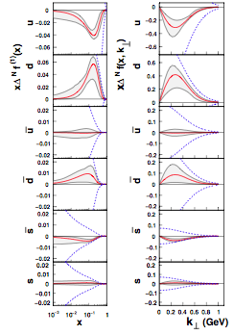
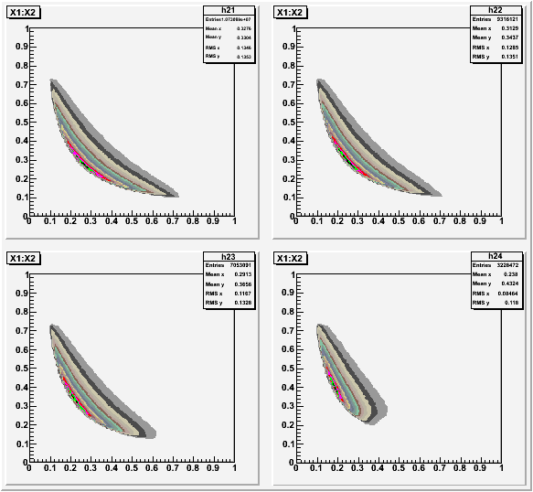
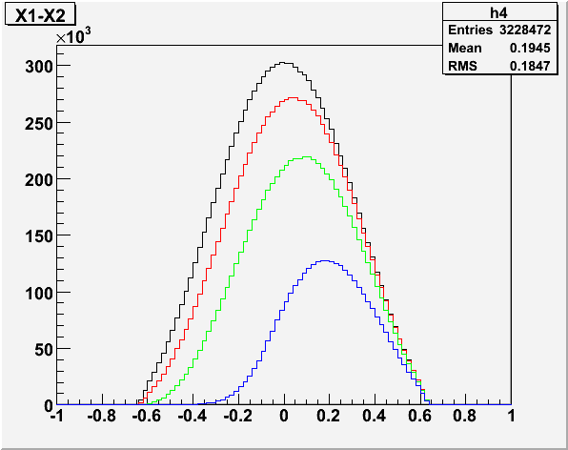
Kinematics Coverage: 120 GeV @Main Injector
Anselmino et al PRD 79 -54010(2009)
x_{Beam}
4<M<8
P_{muon}>0
P_{muon}>5
P_{muon}>10
P_{muon}>20
x_{Target}
Sivers functions
x_{F} = x₁ – x₂

Slide 9
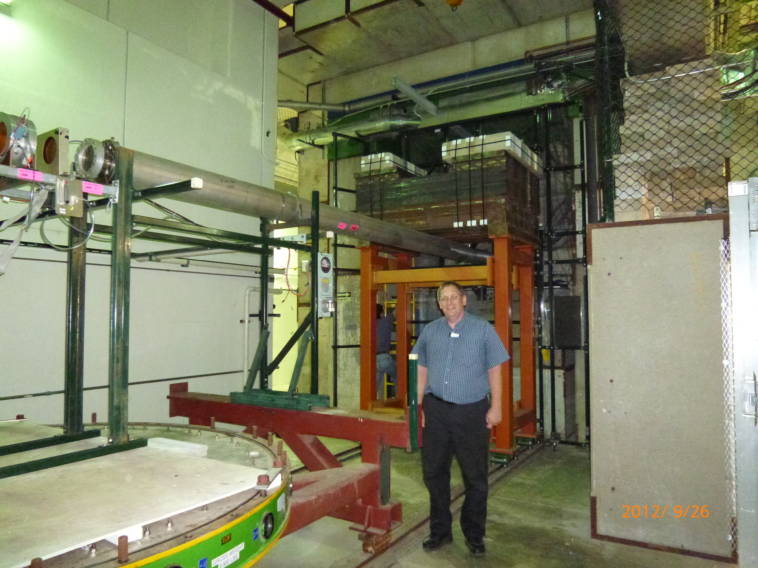
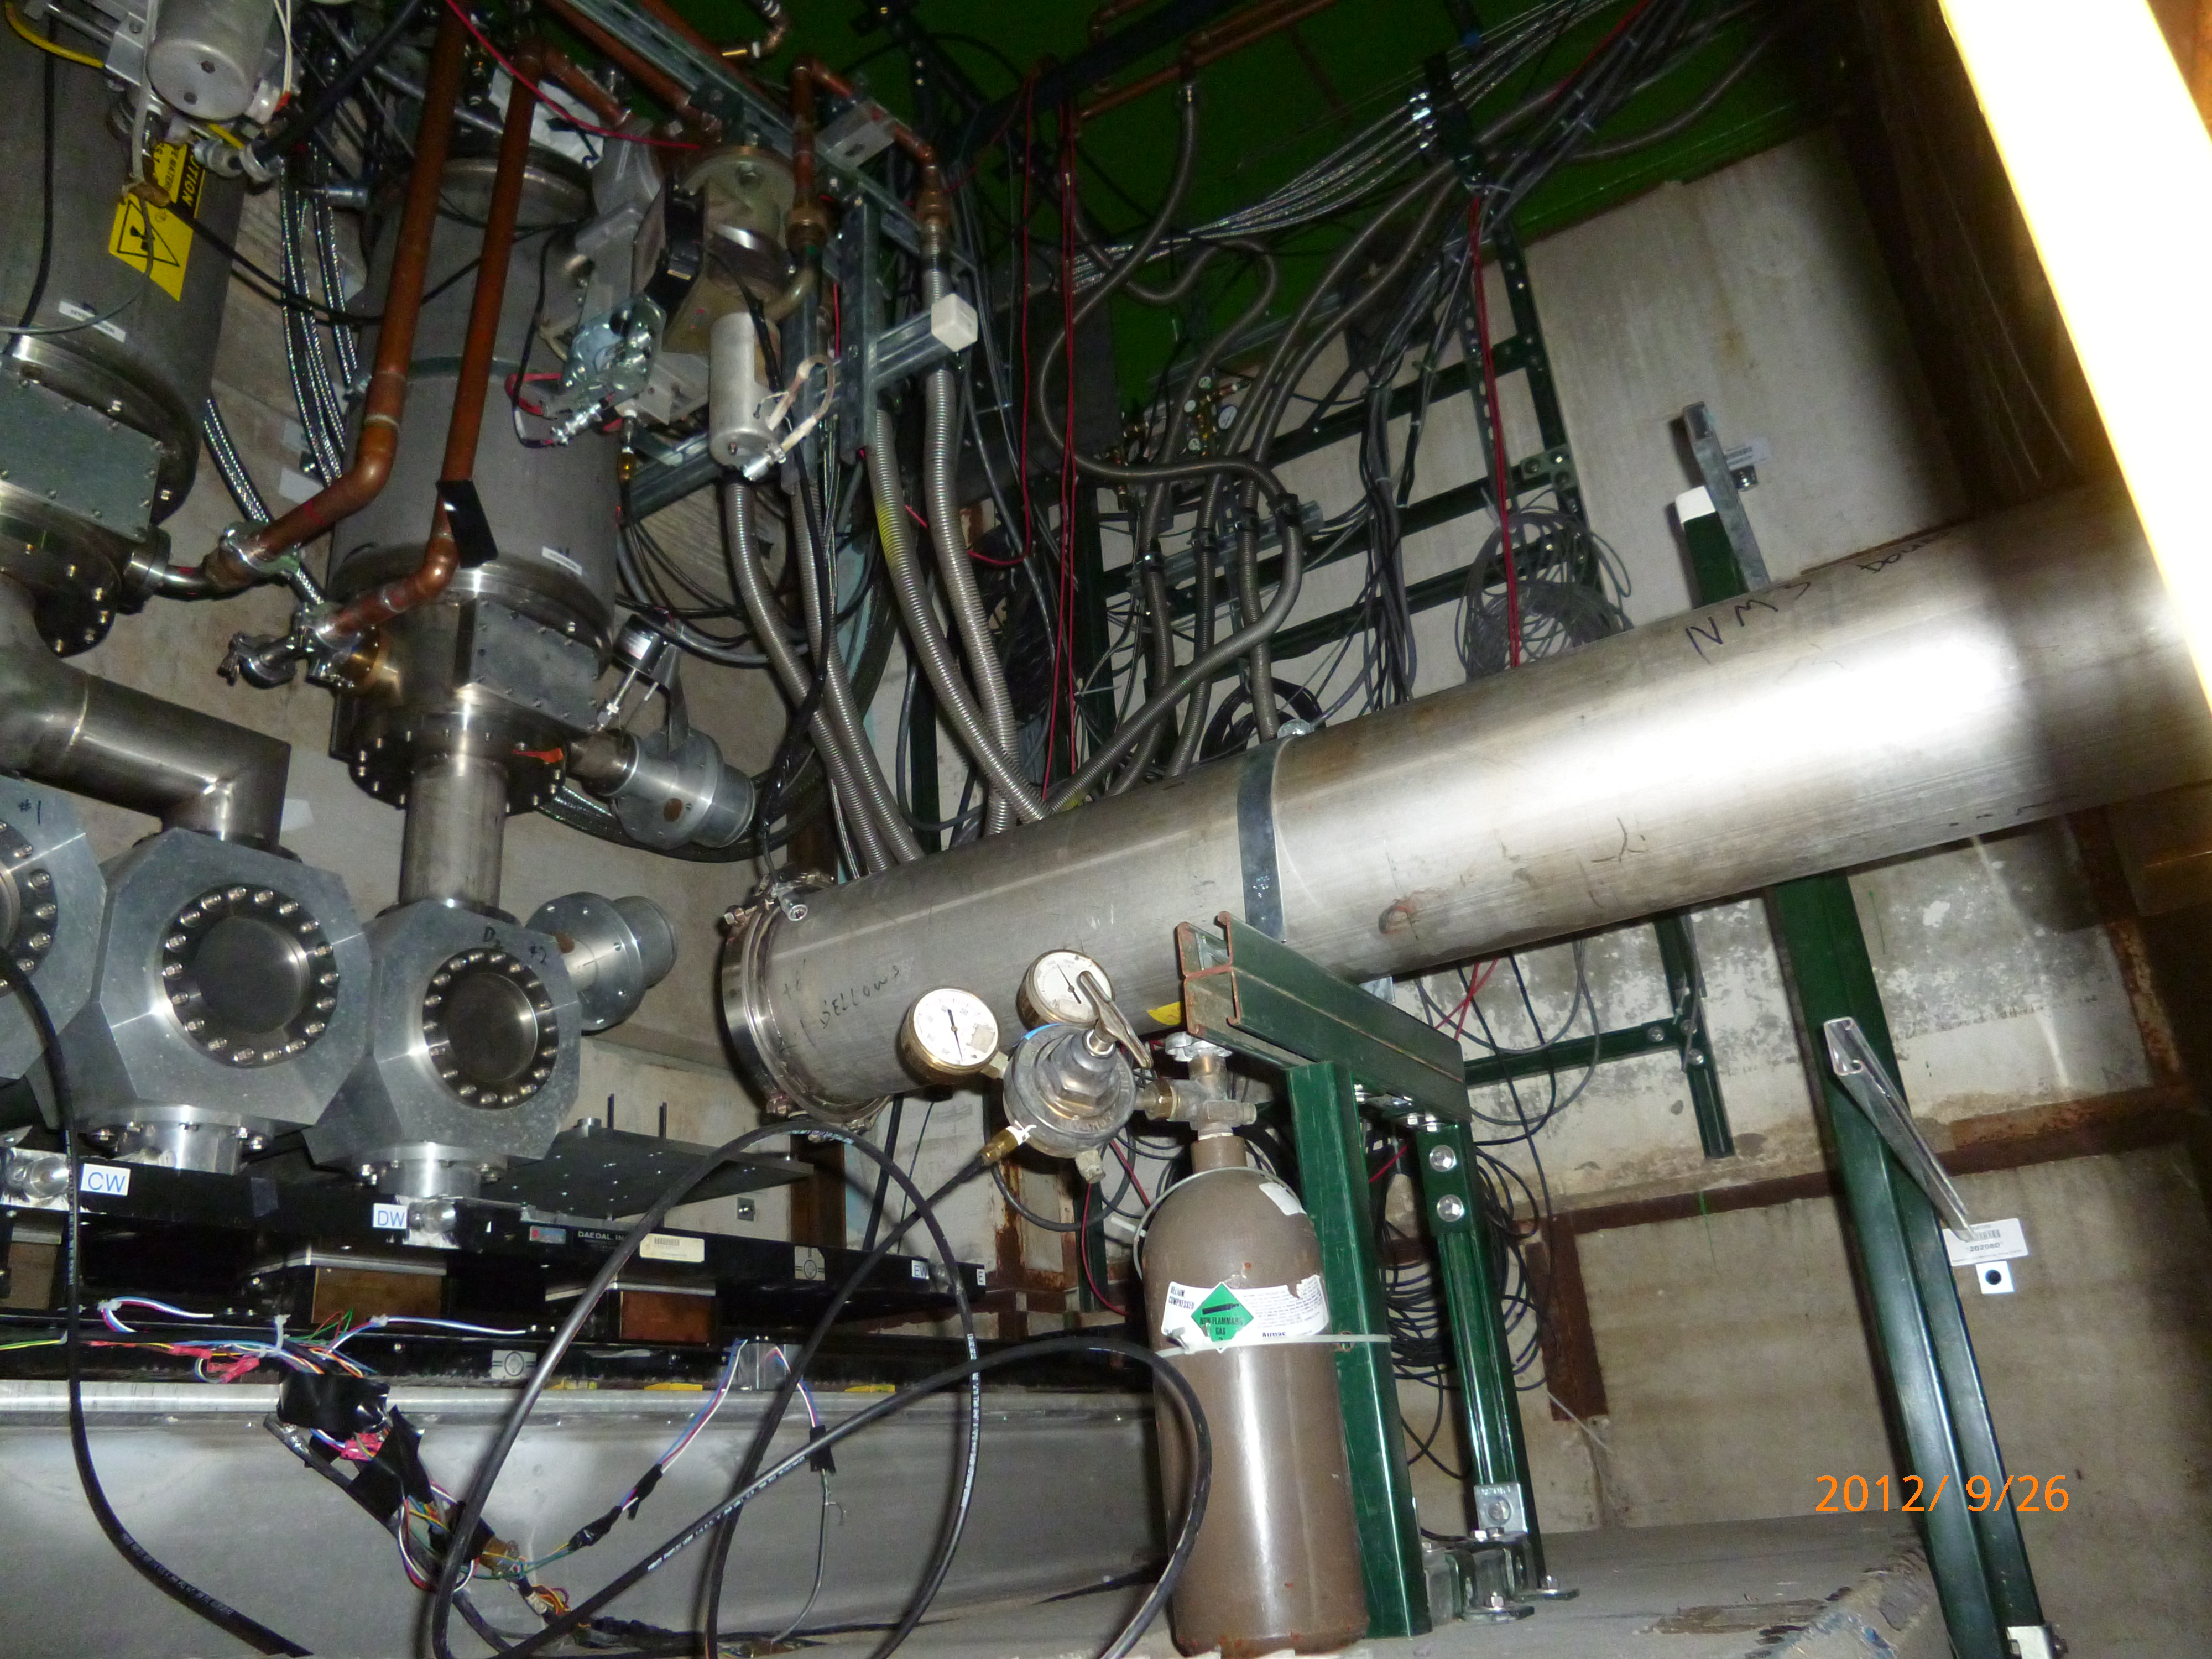
E906 Target Area
Target is shielded
110”
105”
Beam pipe
24”

Slide 10
