Slide 1
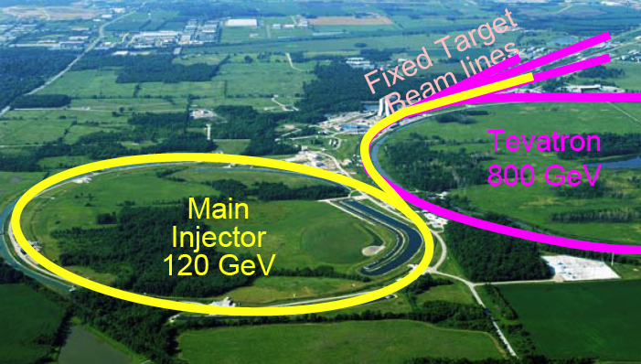
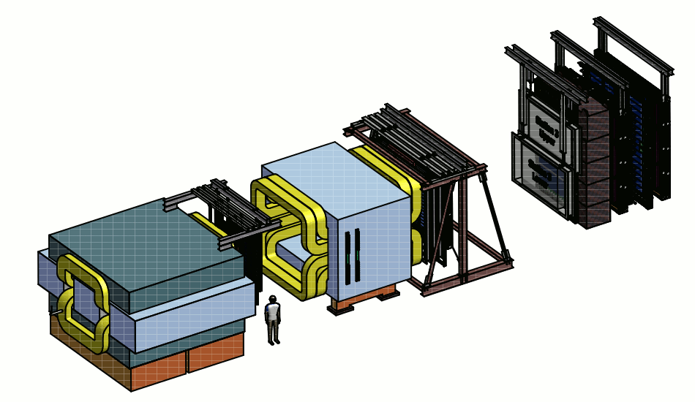
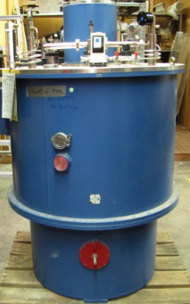
Transition from E906 to E1039
Ming Liu
P-25
E906
Pol Target
120 GeV proton beam

Slide 2
E906 vs E1039
Fixed target dimuon experiments for Drell-Yan and J/Psi productions in p+p and p+A
  Common Forward Muon Spectrometers
  Very different target systems
E906 Targets: “simple”
  10~20% of nuclear interaction length, >5cm in diameter
  LH₂ and LD₂, ~50cm long, operate at 20K
  C, Fe and W
E1039 polarized target:
  NH3 operate at 1K, 5T B-field
Target

Slide 3
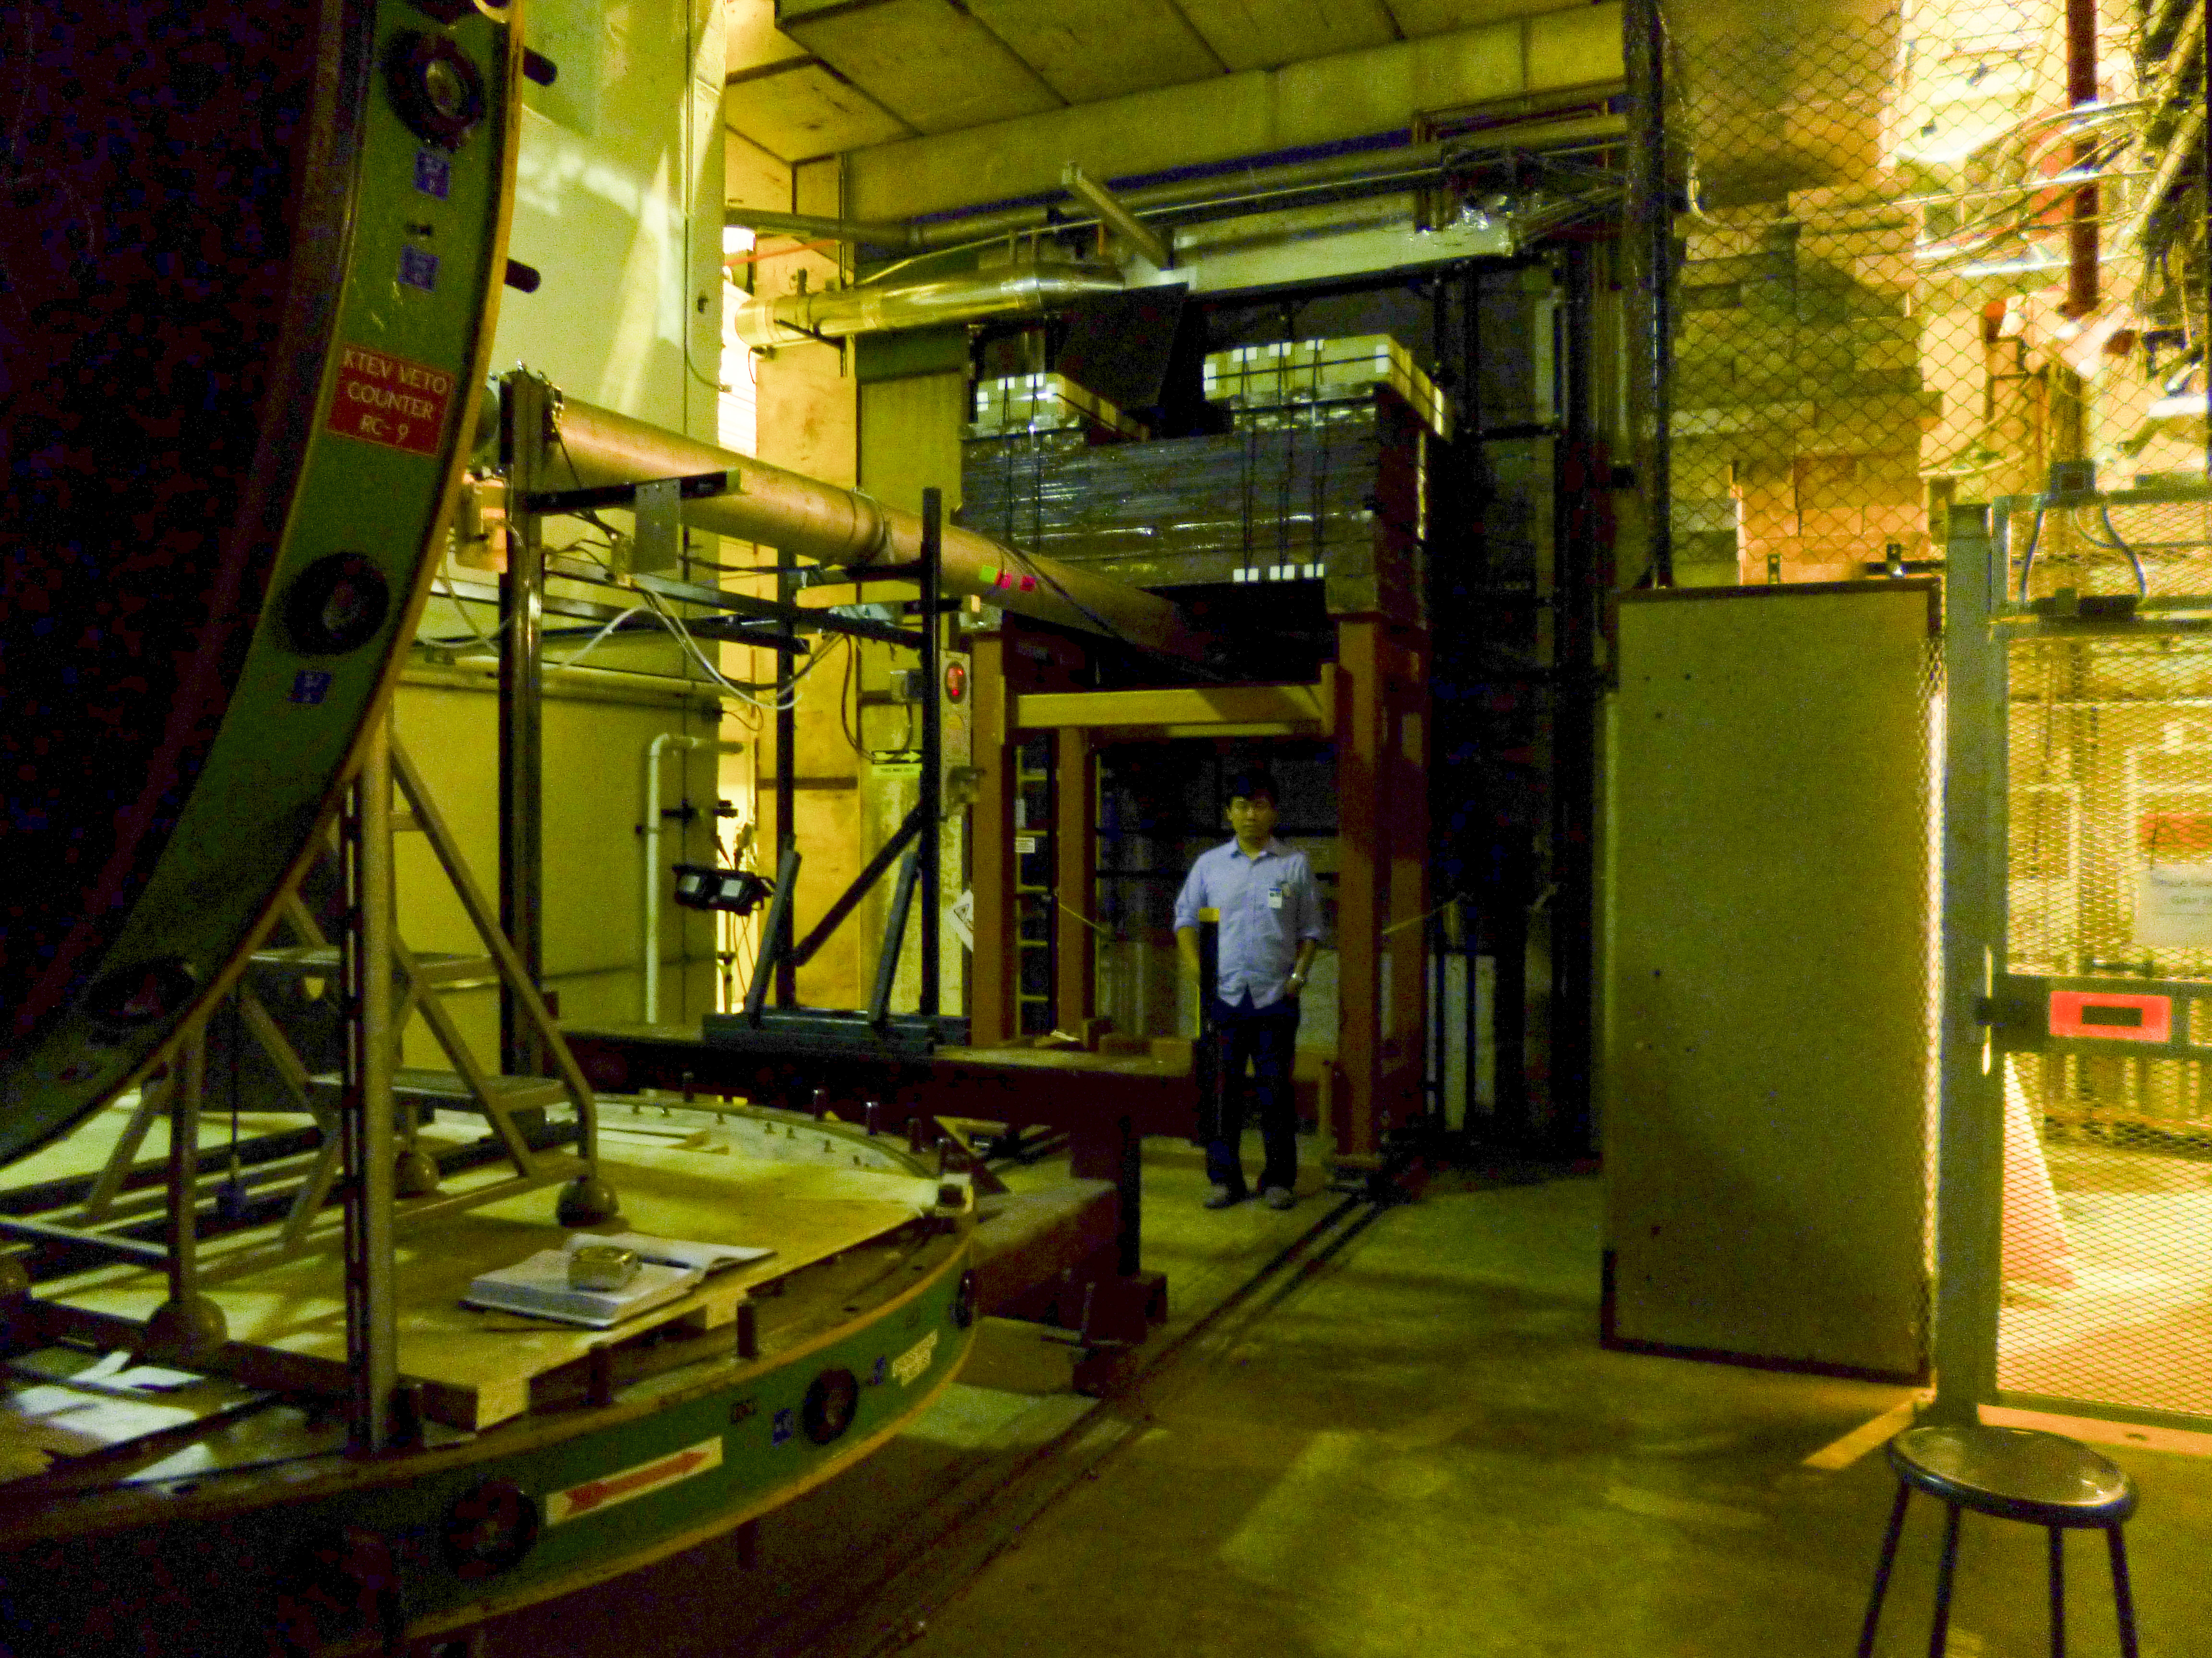
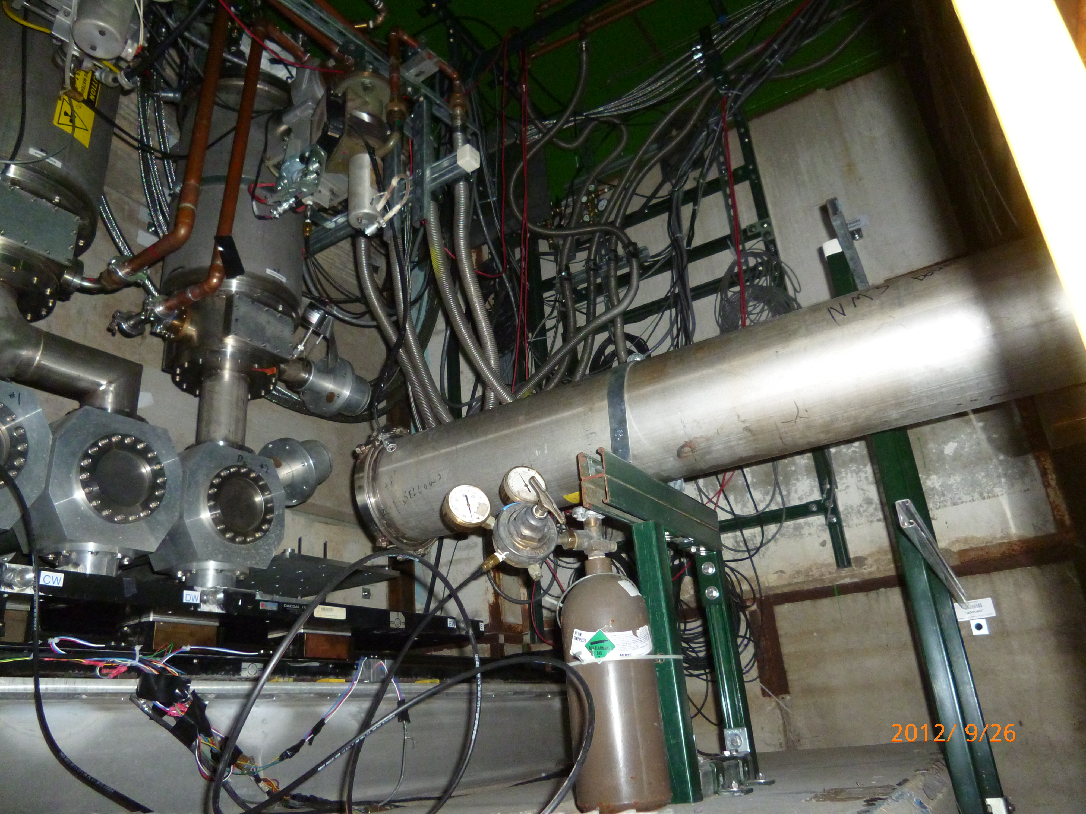
From E906 to E1039: To Do List
Target
Beam line
DAQ
Mechanical
Cryogenics
Electrical
Cooling
Shielding
Safety Review
KMAG
B-Field
FMAG
x
z
p beam 120 GeV
E906 Target Cave
E906 Targets: LH2, LD2, C, Fe, W

Slide 4
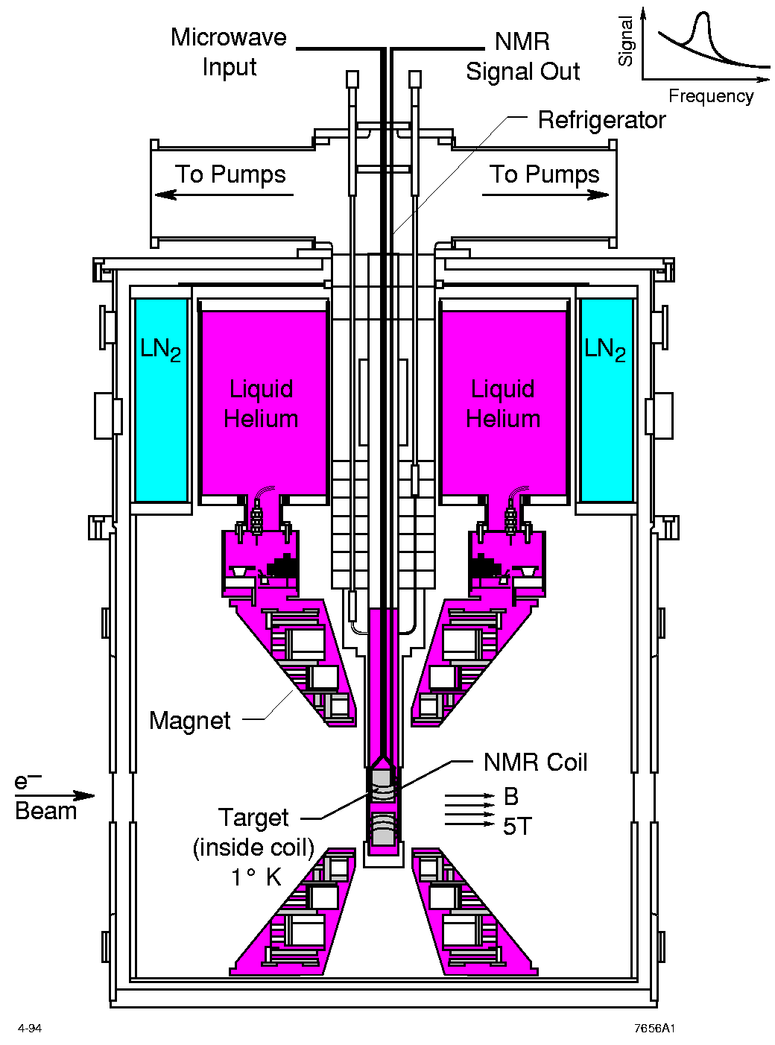
LANL High Density Polarized Proton (NH₃) Target
Superconducting dipole magnet
  Temperature ~ 1 K
  Magnetic Field: 5 Tesla
  8cm long NH₃ target
Proved capable of handling high luminosity
  up to ~ 10³⁵ (Hall C)
~ 10³⁴ (Hall B)

Slide 5
Modifications to E906 Setup
Target and Beam Control
DAQ and Spectrometers
Some changes @IR
  New space for operation, target change etc
  New target stand (a platform )
  Radiation shielding around the target area
Target operation and maintenance
  Service lines, Power, Cryogenic systems
  NMR system, radiation shielding for electronics, network access
  Space for target changes etc.
Beam control
  A new final focusing quadrupoles (Q3 near target)
  Beam collimator, target magnet quench protection
  Beam spot position/direction/size monitors
  Beam position/direction stability
  Luminosity monitors, Cerenkov, new telescopes
Fermilab Engineering and Safety Review
Spectrometers
  New switches to Reverse fields of FMag and KMag for spin asymmetry systematic control
Triggers
  A new trigger road map to optimize signal from target
DAQ
  Improve DAQ bandwidth
  Slow control integration into DAQ
Physics asymmetry systematic controls
  Precision luminosity

Slide 6
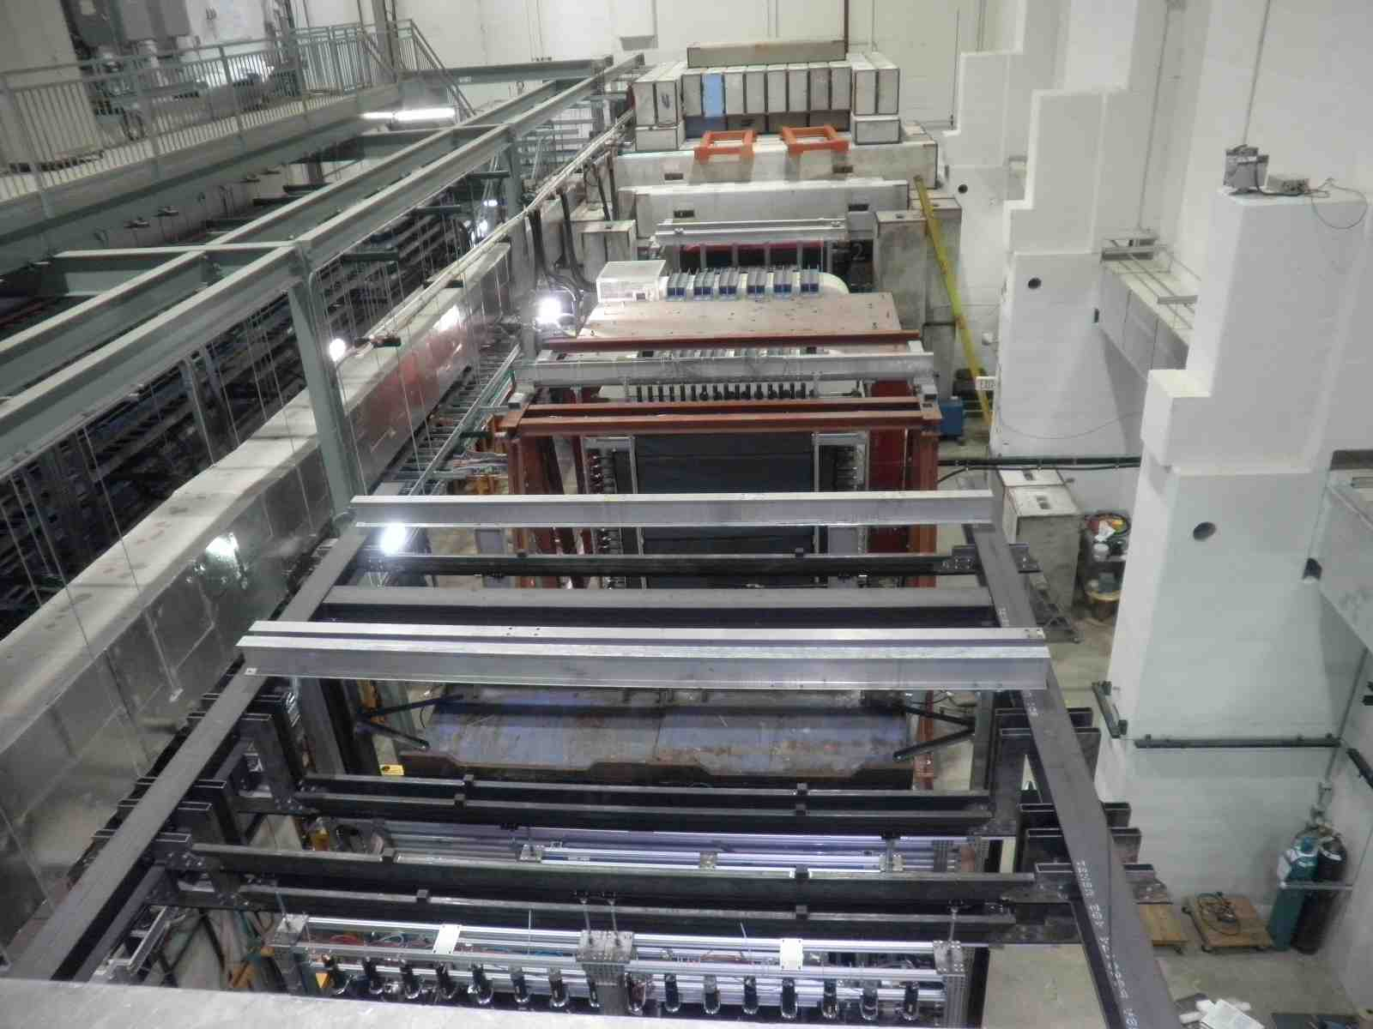
The Experimental Hall: No Change
Target Area
Tracking Station-1
Tracking Station-2
Tracking Station-3
Tracking Station-4

Slide 7
Target Area
Targets must be rad. shielded
E906 target cave too small for Pol. Target
Issues with target and beam dump separation
Stability of beam on target
110”
105”
Beam pipe
24”
Current E906 Target Cave

Slide 8
Target and Beam Dump Event Separation move the target upstream: Z=-3.5m
25% loss

Slide 9
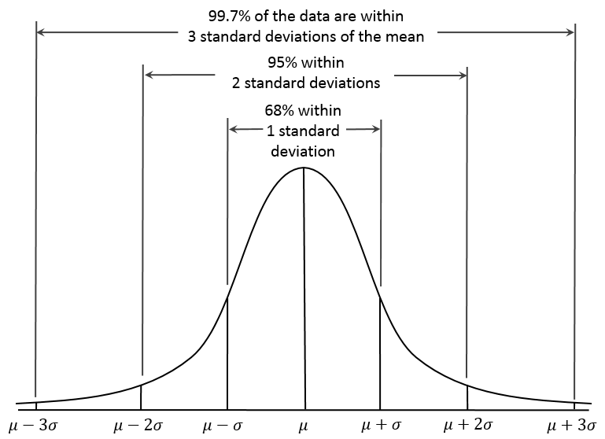
Beam on Target: 4-sigma coverage relative luminosity measurement better than 2x10⁻⁴
Expected Raw Asymmetry:
~ 1%/10~20 = 5 x 10⁻⁴
Asymetry = (N⁺/R - N⁻)/(N⁺/R + N⁻)
R = spin-dependent
relative luminosity
dR <~ 2x10⁻⁴

Slide 10
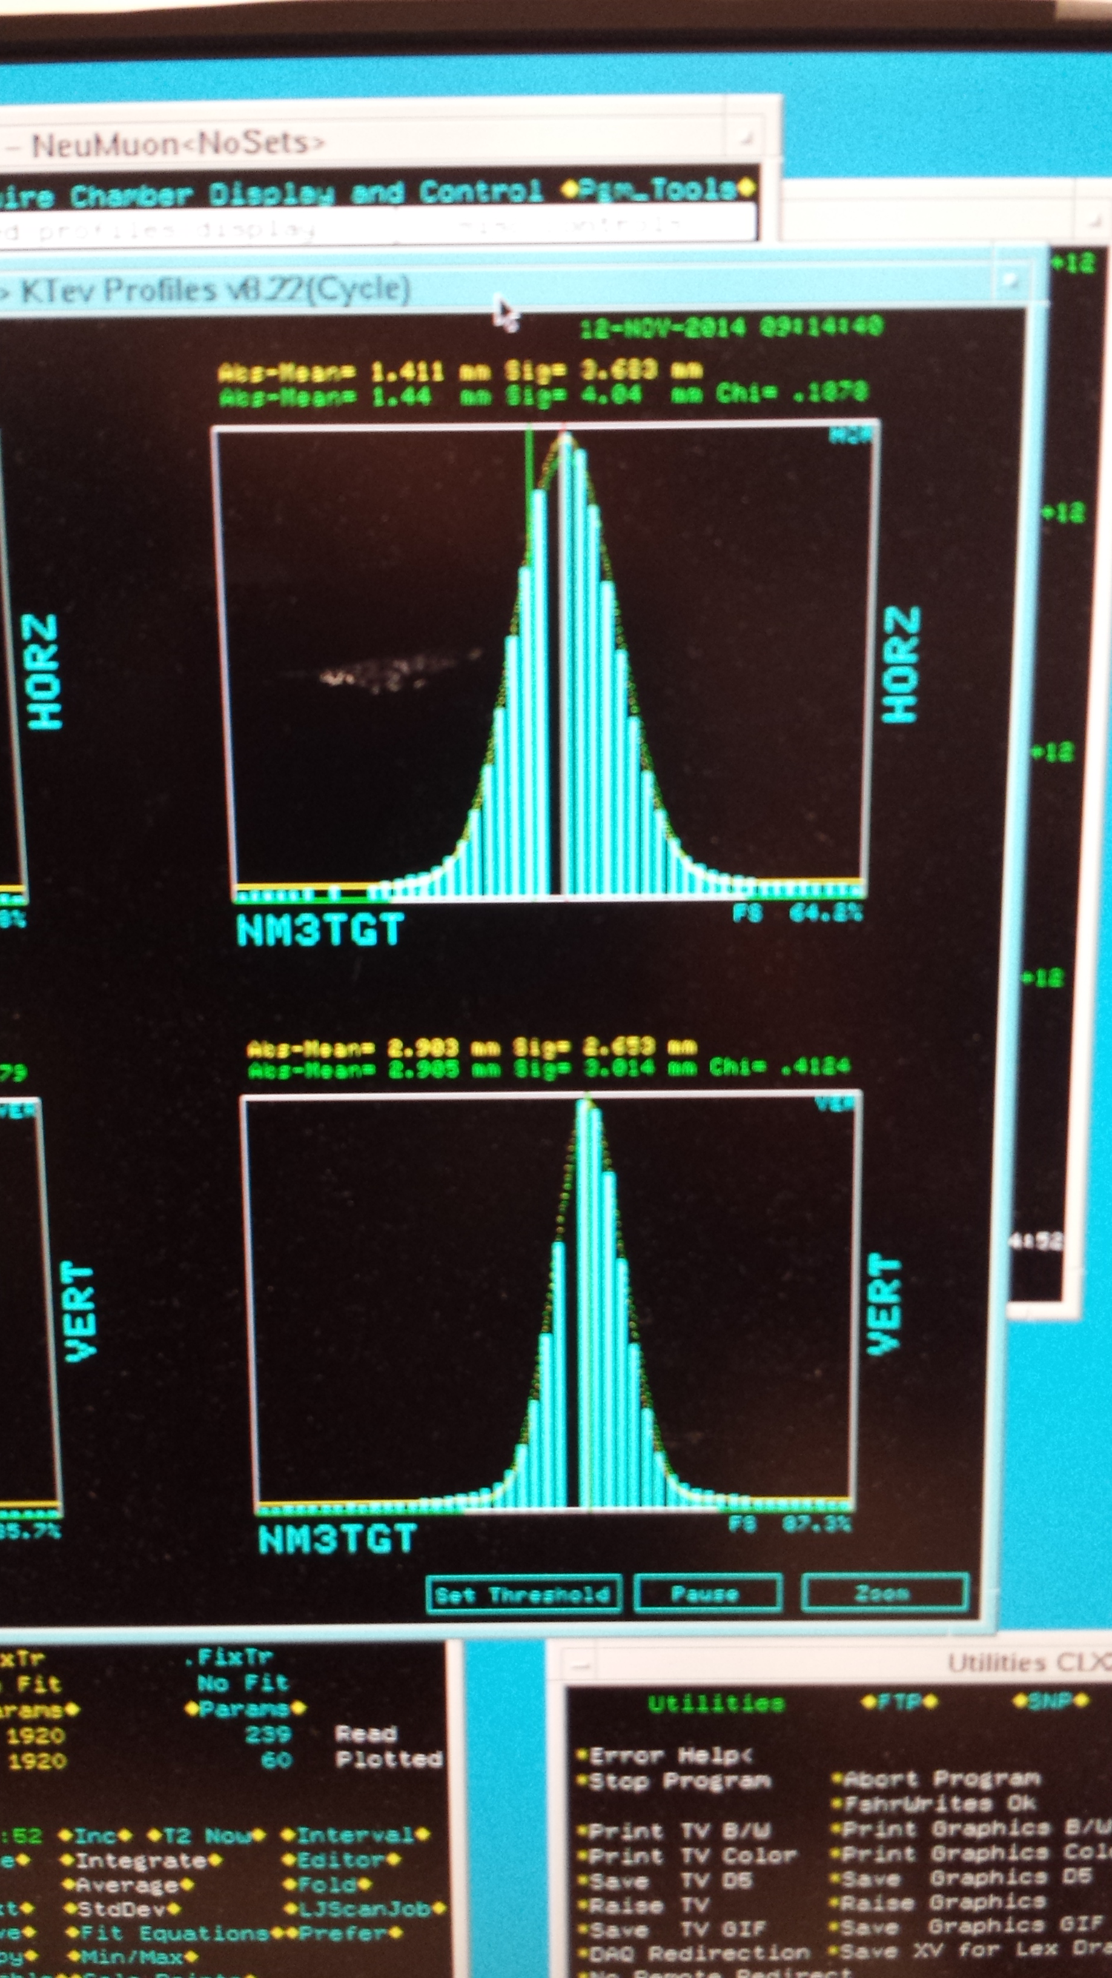

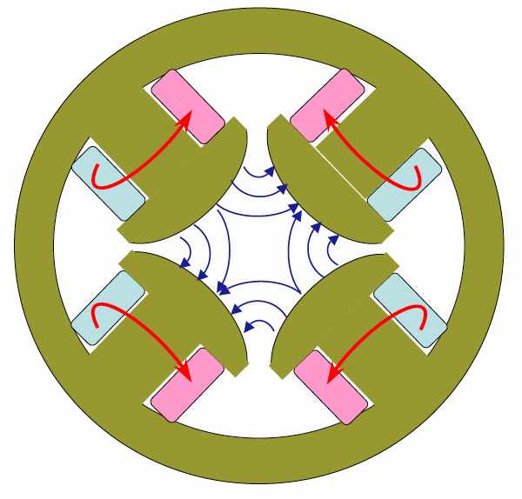
New Beam Collimator, Focusing Q3 and Target
Target cross section: 18 x 28 mm²
E906 beam profile:
SigX = 4.0mm
SigY = 3.0mm
Beam cross section:
Need be well contained within
4 sigma, required by dR< 2x10⁻⁴
sigX = 18/2/4 = 2.2 mm
sigY = 28/2/4 = 3.5 mm
Beam jitter: dX=dY ~ 1mm
1 sig = 0.68269
2 sig = 0.95450
3 sig = 0.99730
4 sig = 0.99994
Beam collimator
120GeV
beam
Final focusing Q3

Slide 11
Polarized Target Operation
Target stick movement: 3.6m to ceiling (tight)
Mechanical issues:
Need platform to work around for target insert changes, helium refill, Nitrogen refill
Stand of target magnet
Crane or Gantry to lift target, max 2000 lb
New position -350 cm upstream of FMAG
Pump connections for evaporation cooling
Pump connection for separator
Pump connection for main vacuum
Placement of liquefier system
1.72 m
Beam entry (8’ above ground)

Slide 12
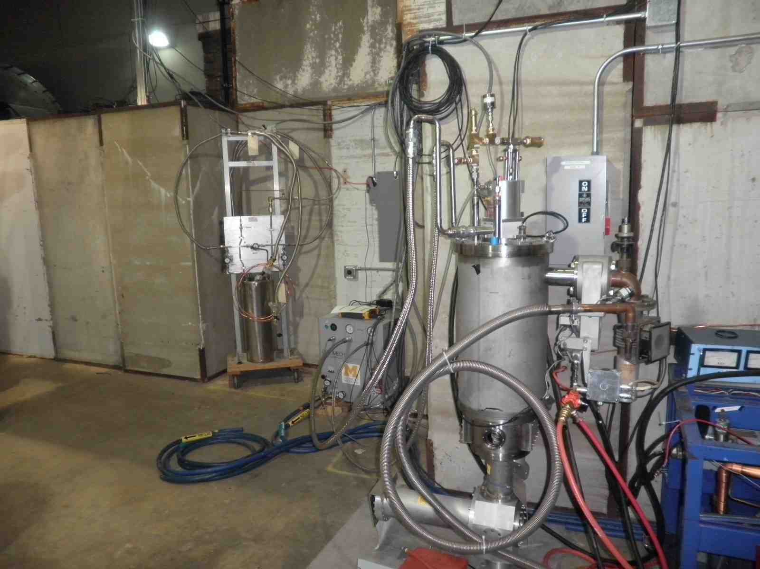
Current E906 Target Cryogenic Service
Next to the E906 Target Cave
outside of the
906 Target Cave
- “Much smaller scale” E906 LH2 and LD2 cryogenic system
- Cryogenic system located outside of the target cave
- 20 K
- 25 W cooling power

Slide 13
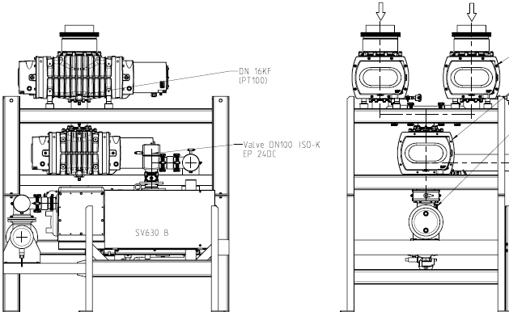
Root Pump, Microwave and Mechanical Support
Chiller for microwave
Where to locate pump?
  Cave or outside?
Connect exhaust of magnet to pump
15’ = 457 cm
172cm
70”=178 cm

Slide 14
Conceptual Design of the New
Polarized Target Area
- new services and modifications needed to operate the polarized target:
- pumps, cryo, electrical, microwave, NMR
Z = -3.5m
Modifications
needed
620cm
457 cm
178 cm

Slide 15
Shielding and Beam Line Work
- work in progress
Radiation Shielding
Cave/ceiling shielding for new target position
Electronics around target
  microwave tube
  microwave power supply
  NMR electronics
  control electronics
  Magnet power supply, controls
Calculations for target activation
Target area radiation monitoring
Beam line and spectrometer
Beam size requires additional Quads
Collimator upstream of target
Beam position interlock, loss monitors
Spin-sorted luminosity monitor of beam on target

Slide 16
More on Service Needs
Electrical, Water Cooling and Cryogenics
Pump: 460V
Fmag and kMAG magnets need field direction switches
Network close to target
regular 220 and 110 outlets
2.3 lt/min cooling H₂O
⁴He and N₂ lines
Pump lines
Fermilab Tech support

Slide 17
Safety and Monitoring
Radiation monitor and safety interlock
Oxygen deficiency monitor
Quench lines to outside building
Activation analysis for target
Fermilab Engineering and Safety Reviews of cryogenic, electrical, vacuum, water cooling etc.

Slide 18
Schedule and Timeline
New target area and radiation shielding design and safety review
Cryogenics System design and installation
Beam line modifications
Beam on target monitoring telescopes
End of E906
9/2016
E906 Operation
~ 6 months
Target area shielding design and safety review
Remove E906
shielding blocks
- Target stand design
and preparation
- Safety interlock system
- Target and service
line installations
- System test
Service line layout & preparation
Cryogenics
Electrical and water
Pumps, vacuum
Microwave system
NMR and DAQ
- Shielding block
Installation
- Safety reviews
Beam line work:
- collimator and Q3
Kmag/FMag new switch and controls
New beam monitoring telescopes
E1039
commissioning
data taking

Slide 19
Summary
Target and Beam Control
DAQ and Spectrometers
Some changes @IR
  New space for operation, target change etc
  New target stand (a platform )
  Radiation shielding around the target area
Target operation and maintenance
  Service lines, Power, Cryogenic systems
  NMR system, radiation shielding for electronics, network access
  Space for target changes etc.
Beam control
  A new final focusing quadrupoles
  Beam collimator, target magnet quench protection
  Beam spot position/direction/size monitors
  Beam position/direction stability
  Luminosity monitors, Cerenkov, new telescopes
Fermilab Engineering and Safety Review
Spectrometers
  New switches to Reverse fields of FMag and KMag for spin asymmetry systematic control
Triggers
  A new trigger road map to optimize signal from target
DAQ
  Improve DAQ bandwidth
  Slow control integration into DAQ
Physics asymmetry systematic controls
  Precision luminosity

