Slide 1
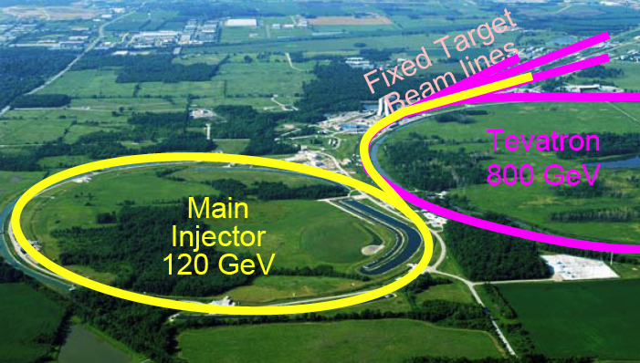
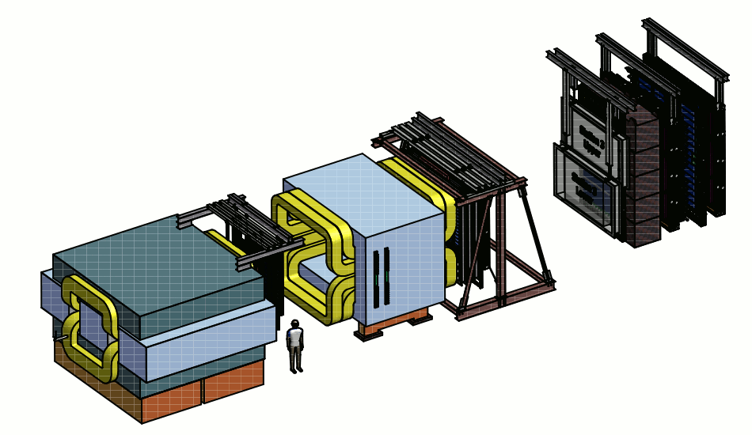
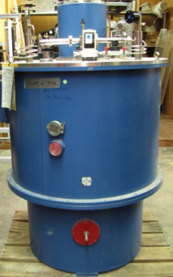
Transition from E906 to E1039
Ming Liu
P-25
E906
Pol Target
120 GeV proton beam

Slide 2
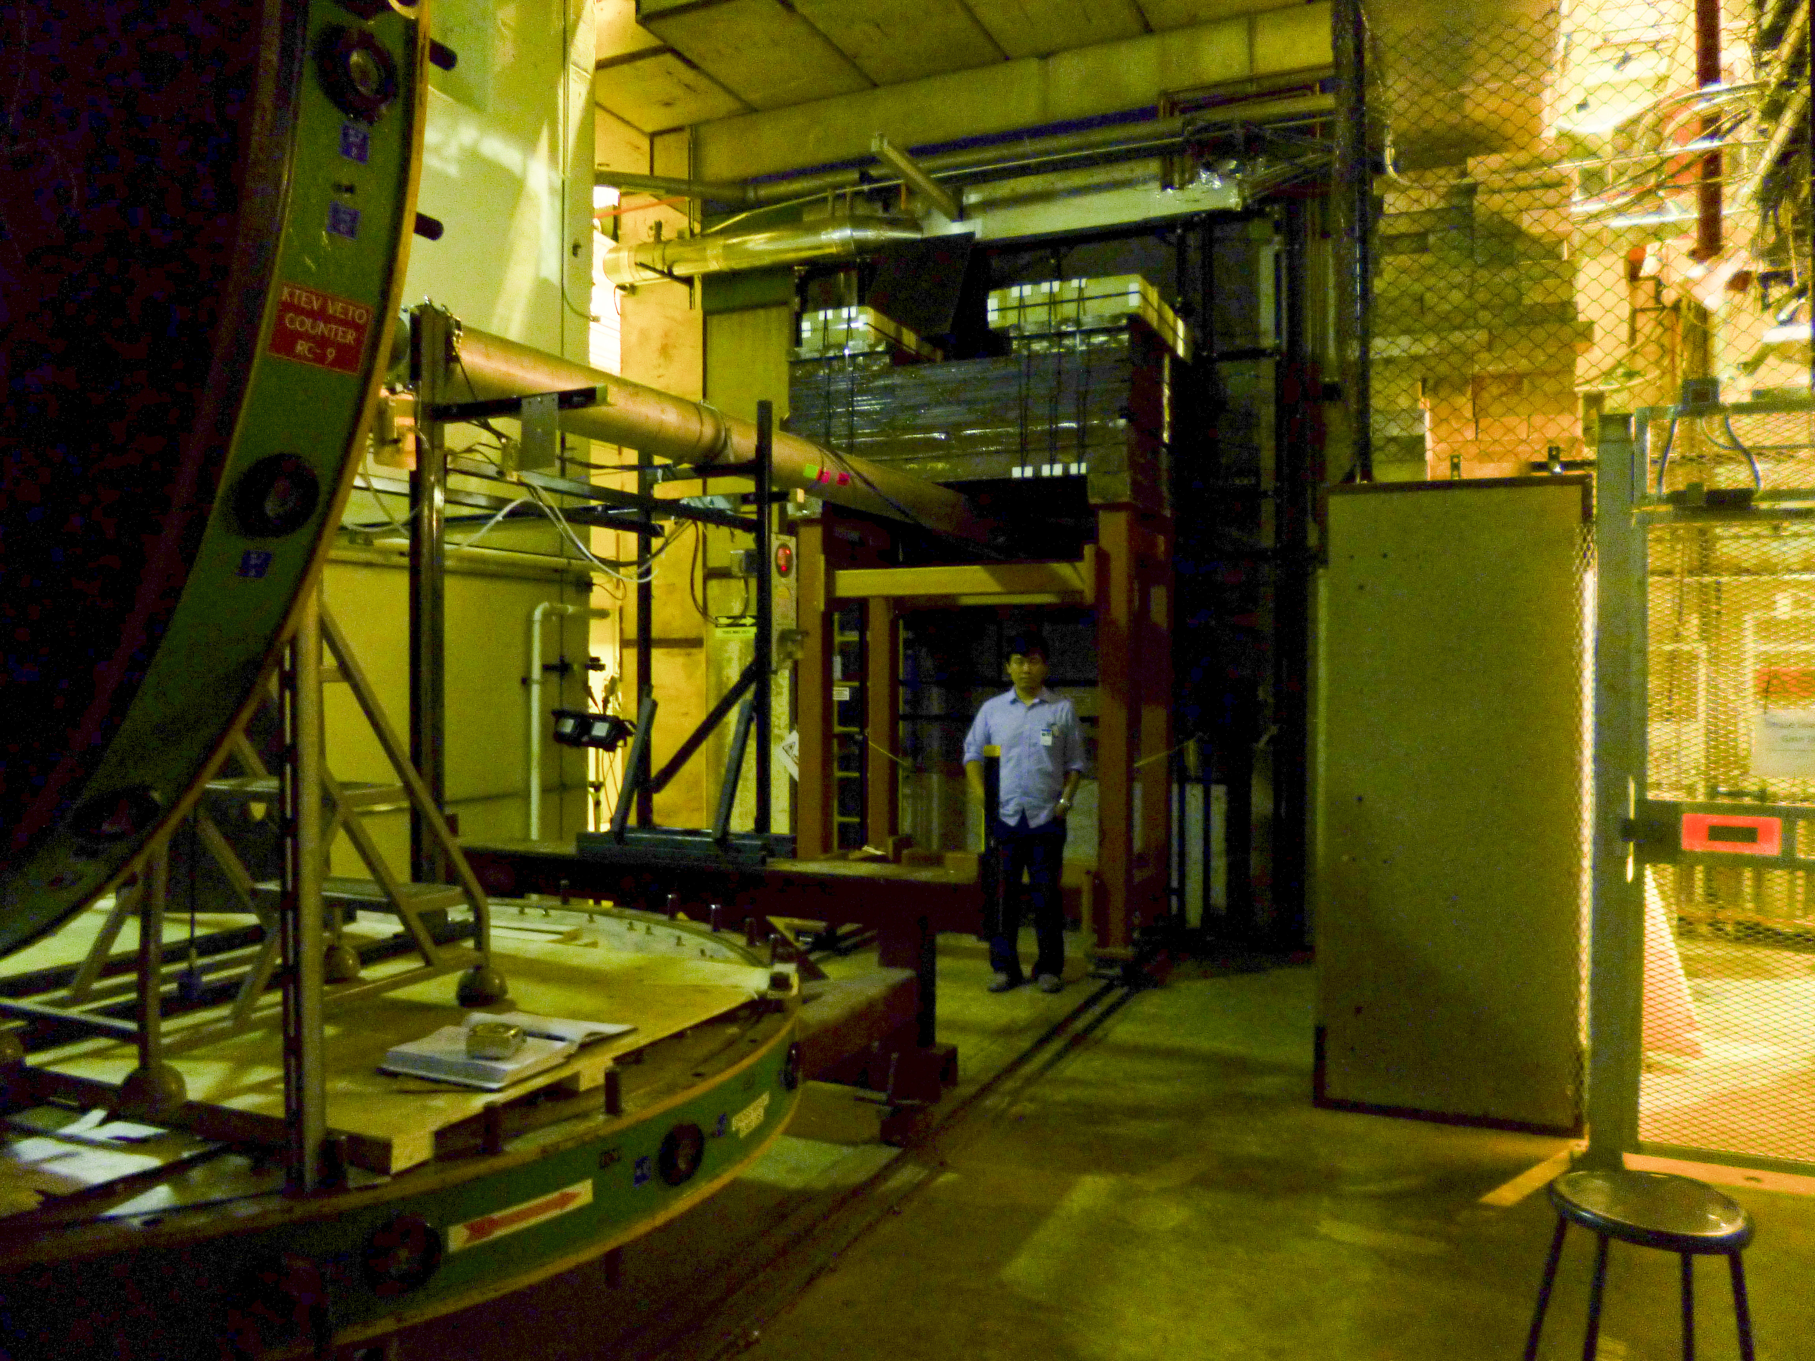
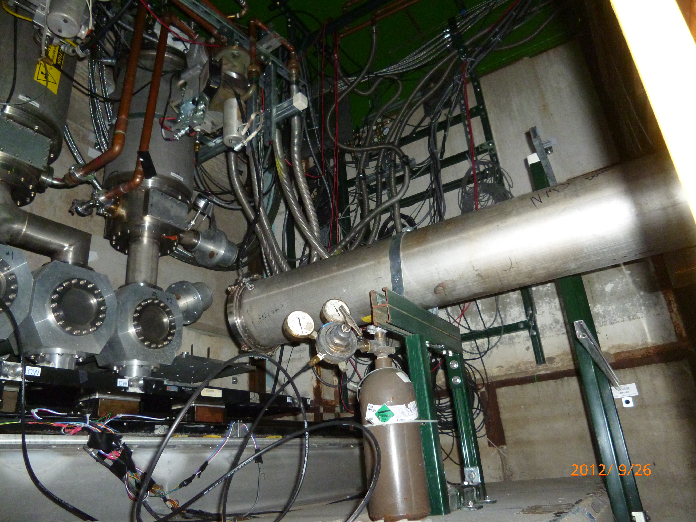
E1039 vs E906: To Do List
Beam line
Target
Mechanical
Cryogenics
Electrical
Cooling
Safety
Shielding
KMAG
B-Field
FMAG
x
z
p beam 120 GeV
E906 Targets: LH2, LD2, C, Fe, W

Slide 3
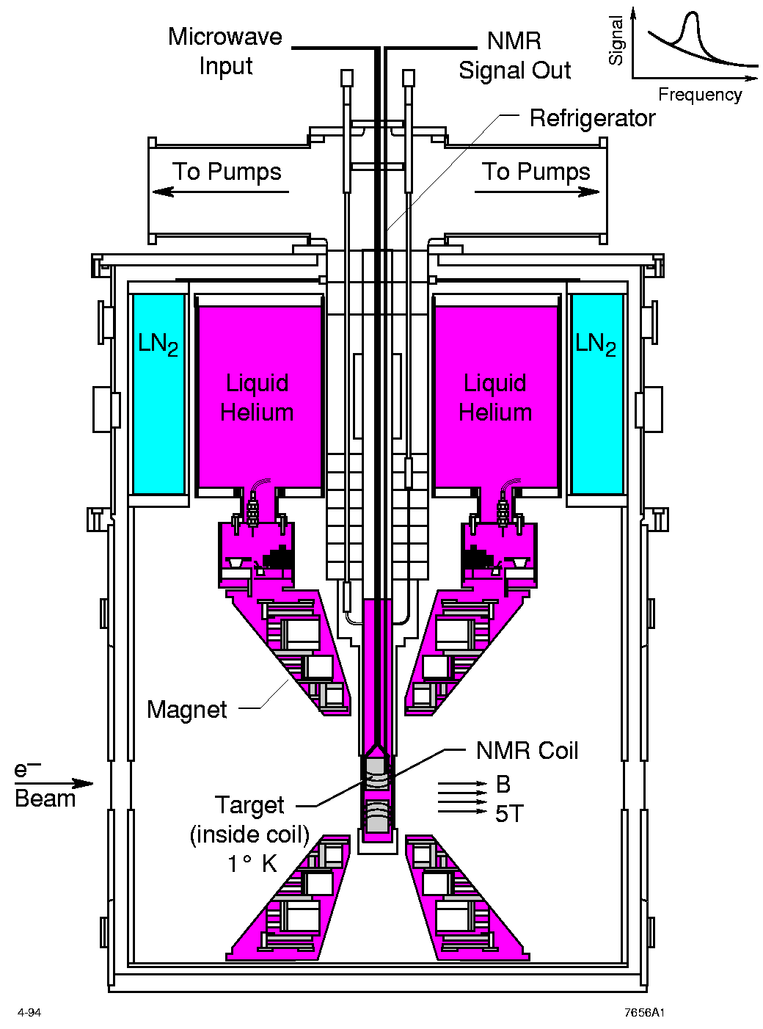
LANL High Density Polarized Proton (NH₃) Target
Superconducting dipole magnet
  Temperature ~ 1 K
  Magnetic Field: 5 Tesla
  8cm long NH₃ target
Proved capable of handling high luminosity
  up to ~ 10³⁵ (Hall C)
~ 10³⁴ (Hall B)

Slide 4
Required Modifications to E906 Setup
Target and Beam Control
DAQ and Spectrometers
Some changes @IR
  New space for operation, target change etc
  New target stand (a platform )
  Radiation shielding around the target area
  SM0 focusing magnet(?, Cost and Schedule)
  B-field shielding for the target(SM0?)
Target operation and maintenance
  Service lines, Power, Cryogenic systems
  NMR system, radiation shielding for electronics, network access
  Space for target changes etc.
  Target magnet quench protection
Beam control
  A new final focusing quadrupoles (Q3 near target)
  Beam collimator, target magnet quench protection
  Beam spot position/direction/size monitors
  Beam position/direction stability
  Luminosity monitors, Cerenkov, new telescopes
Fermilab Engineering and Safety Review
Spectrometers
  No change for chambers
  New switches to Reverse fields of FMag and KMag for spin asymmetry systematic control
Triggers
  A new trigger road map to optimize signal from target
  Rate capability not an issue, expect lower beam intensity in E1039 than that in E906
DAQ
  Current E906 OK for Drell-Yan channel, J/Psi can use more DAQ bandwidth
  Higher rate capability could help “relative luminosity” and other J/Psi and Psi physics measurements
  Slow control target related information into DAQ data stream
Physics asymmetry systematic controls
  Precision relative luminosity
  Beam position and direction
  Additional beam monitoring telescopes

Slide 5
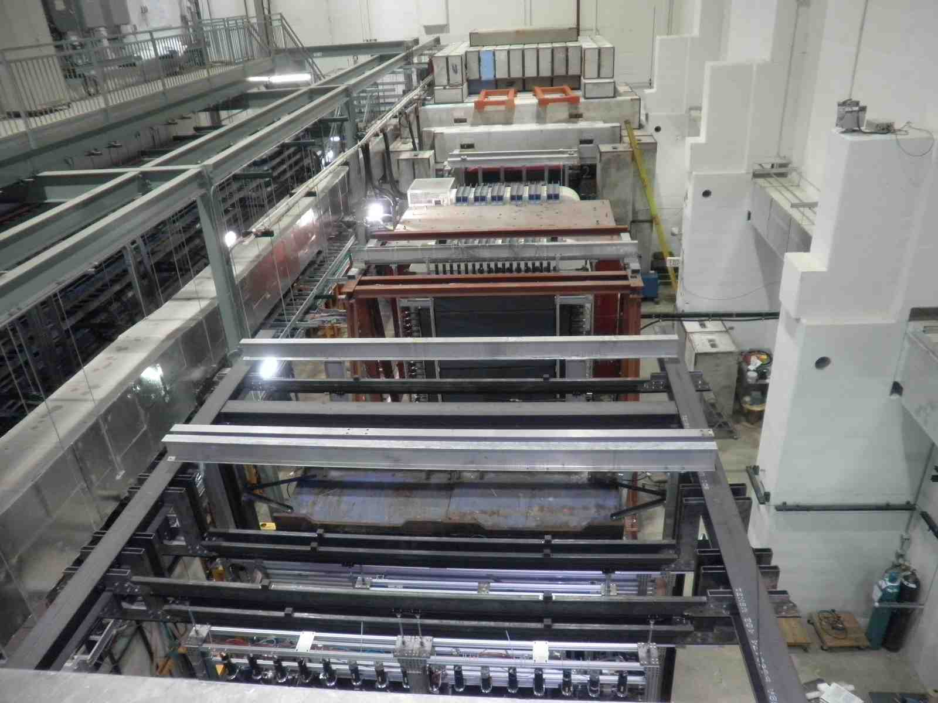
The Experimental Hall: No Change

Slide 6
E906 Target Area
Targets are rad. shielded
Too Small for Pol. Target
Issues with target and beam dump separation
110”
105”
Beam pipe
24”

Slide 7
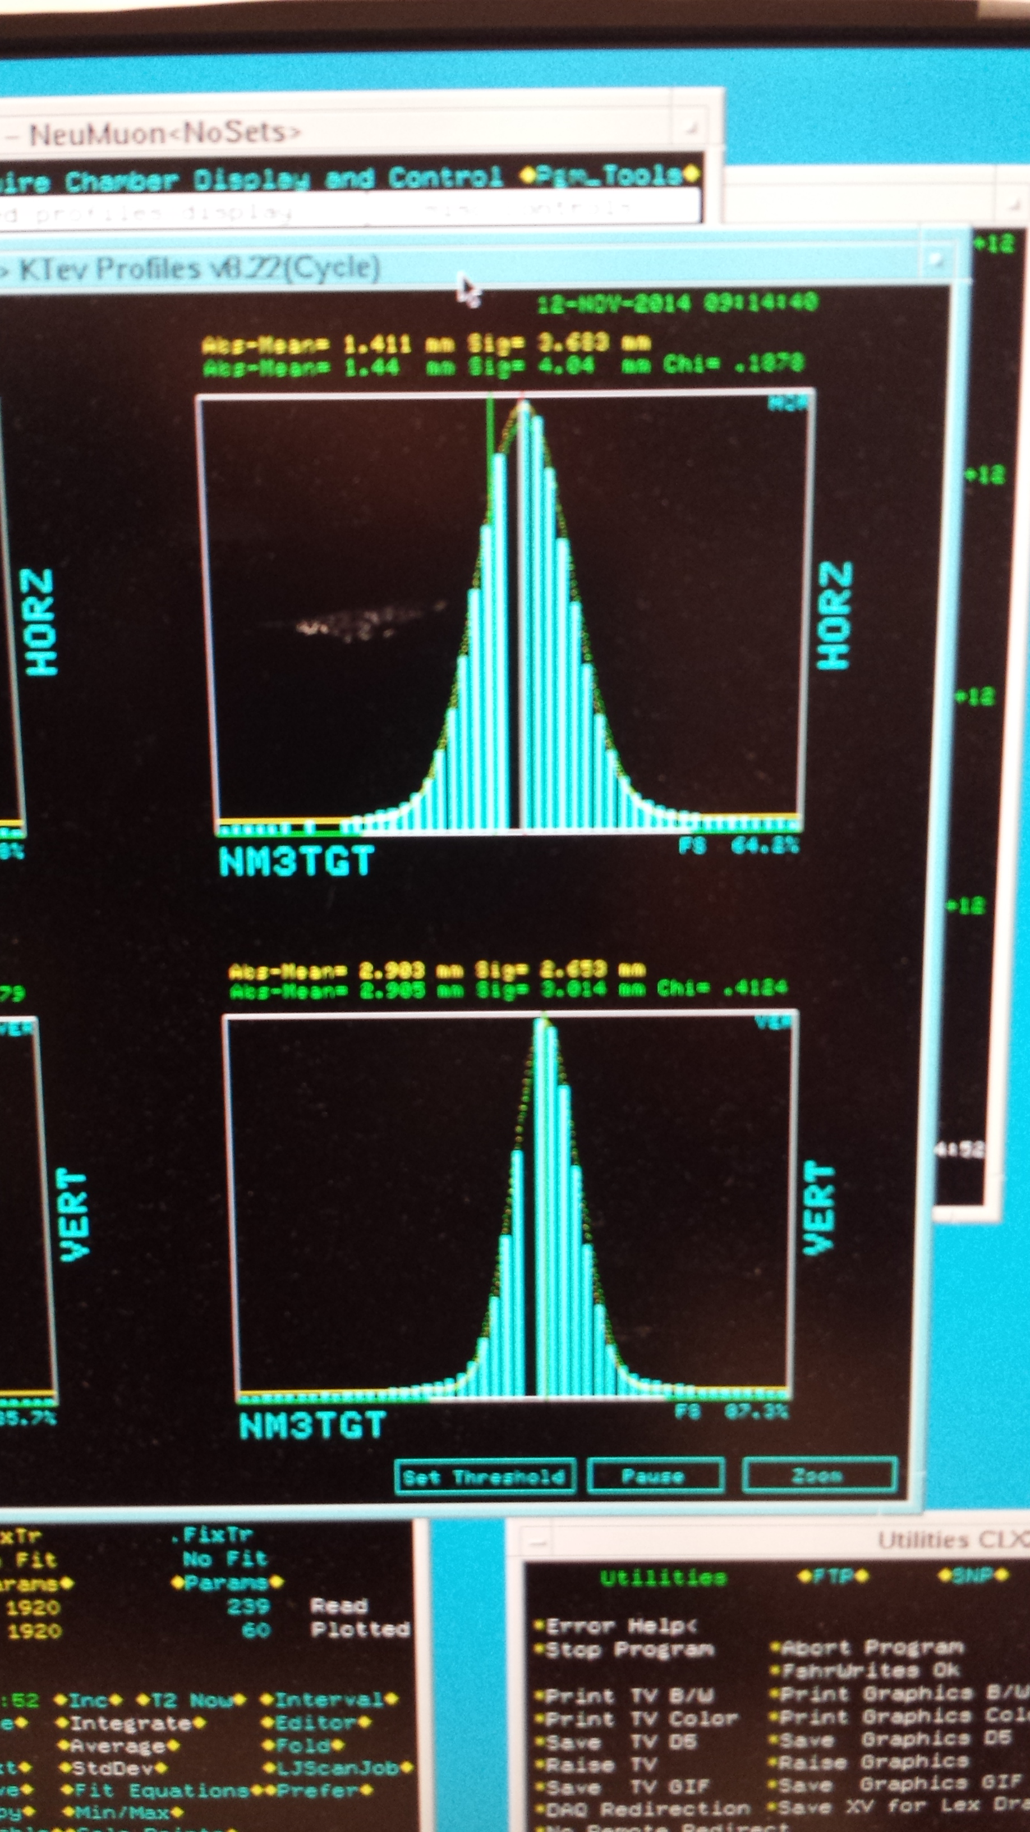

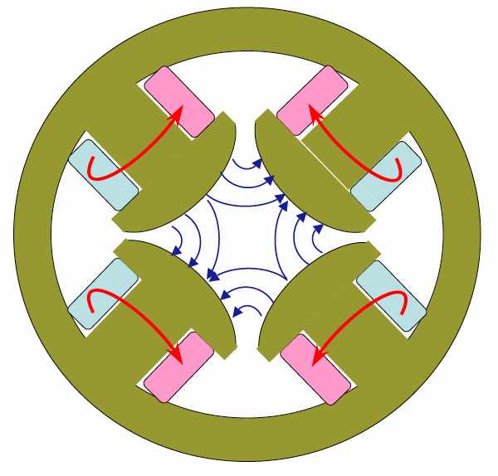
New Beam Collimator, Focusing Q3 and Target
Target Cross Section: 18 x 28 mm²
E906 beam:
SigX = 4.0mm
SigY = 3.0mm
Beam cross section:
well contained within
4 sigma, dR< 1x10⁻⁴
sigX = 18/2/4 = 2.2 mm
sigY = 28/2/4 = 3.5 mm
Beam jitter: dX=dY ~ 1mm
1 sig = 0.68269
2 sig = 0.95450
3 sig = 0.99730
4 sig = 0.99994
Beam collimator
120GeV
beam
Final focusing Q3

Slide 8
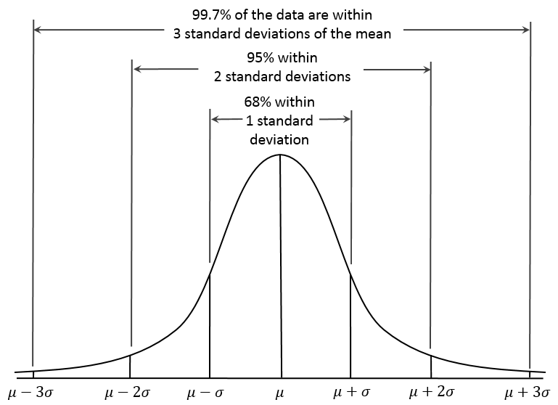
Beam on Target: 4 sigma
Relative Luminosity better than 1x10⁻⁴
Expected Raw Asymmetry:
~1%/10~20 ~ 5 x 10⁻⁴
A = (N⁺/R - N⁻)/(N⁺/R + N⁻)
R = relative luminosity
dR <~ 1x10⁻⁴

Slide 9
Target and Beam Dump Event Separation move the target upstream: Z=-3.5m
7.9% loss

Slide 10
Polarized Target Operation
Target stick movement: 3.6m to ceiling (tight)
Mechanical issues:
Need platform to work around for target insert changes, helium refill, Nitrogen refill
Stand of target magnet
Crane or Gantry to lift target, max 2000 lb
New position -350 cm upstream of FMAG
Pump connections for evaporation cooling
Pump connection for separator
Pump connection for main vacuum
Placement of liquefier system
1.72 m
Beam entry (8’ above ground)

Slide 11
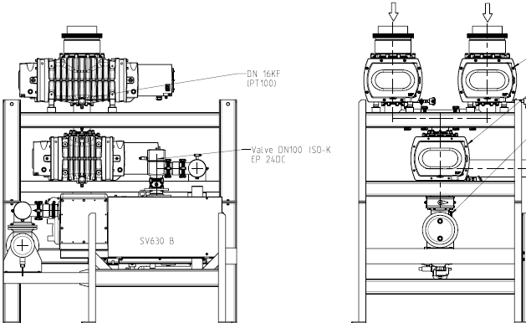
Root Pump, Microwave and Mechanical Support
Chiller for microwave
Where to locate pump?
  Cave or outside?
Connect exhaust of magnet to pump
15’ = 457 cm
172cm
70”=178 cm

Slide 12
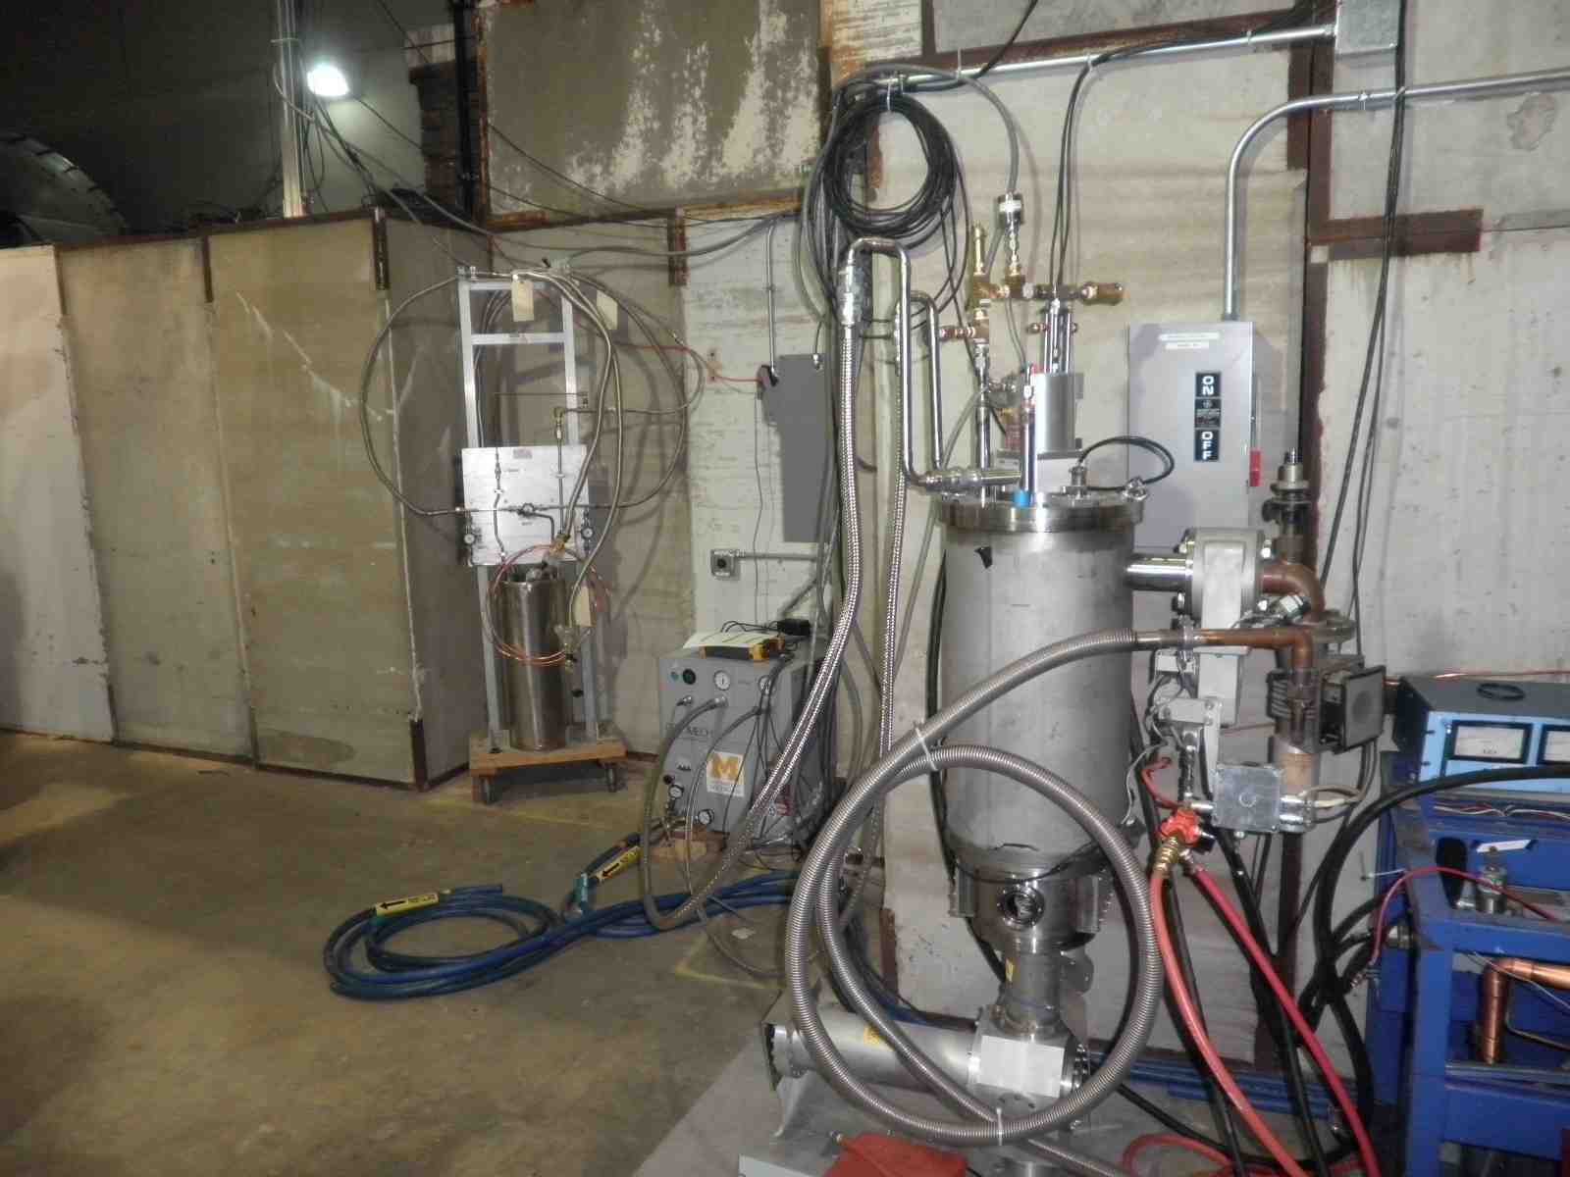
Outside of E906 Target Area
Current E906 Cryogenic Services

Slide 13
New Polarized Target Area new services and modifications needed to operate the polarized target:
- pumps, cryo, electrical, microwave, NMR
Z = -3.5m
Modifications
needed
620cm
457 cm
178 cm

Slide 14
Shielding and Beam Line Work
Radiation Shielding
Cave/ceiling shielding for new target position
electronics around target
  microwave tube
  microwave power supply
  NMR electronics
  control electronics
  Magnet power supply, controls
Calculations for target activation
Target area radiation monitoring
Beam line and spectrometer
Beam size requires additional Quads
Collimator upstream of target
Beam position interlock, loss monitors
Third magnet between target and FMAG?

Slide 15
More on Service Needs
Electrical and Water Cooling
Pump: 460V
3rd magnet: 2000A,200V
all magnets need field direction switches
Network close to target
Oxygen deficiency monitors
regular 220 and 110 outlets.
2.3 lt/min cooling H2O
Need to calculate flow

Slide 16
Cryogenics: Liquid ⁴He and N₂
⁴He closed loop system
Placement of ⁴He liquifier
Access for ⁴He and LN₂ dewars
Transfer lines for ⁴He and liquid Nitrogen
Exhaust to liquefier connection, balloon?

Slide 17
Safety and Monitoring
Oxygen deficiency monitor
Quench lines to outside building
Target vacuum windows
Activation analysis for target
Fermilab Engineering and Safety Reviews of cryo, electrical, vacuum, water cooling etc.

Slide 18
E906 vs E1039
Fixed target dimuon experiments for Drell-Yan and J/Psi productions in p+p and p+A
  Common Forward Muon Spectrometers
  Very different target systems
E906 Targets: “simple”
  10~20% of nuclear interaction length
  LH2 and LD2, ~50cm long, operate at 20K
  C, Fe and W
E1039 polarized target:
  NH3 operate at 1K, 5T B-field

Slide 19
Summary: Tasks
Target and Beam Control
DAQ and Spectrometers
Some changes @IR
  New space for operation, target change etc
  New target stand (a platform )
  Radiation shielding around the target area
  SM0 focusing magnet(?, Cost and Schedule)
  B-field shielding for the target(SM0?)
Target operation and maintenance
  Service lines, Power, Cryogenic systems
  NMR system, radiation shielding for electronics, network access
  Space for target changes etc.
  Target magnet quench protection
Beam control
  A new final focusing quadrupoles (Q3 near target)
  Beam collimator, target magnet quench protection
  Beam spot position/direction/size monitors
  Beam position/direction stability
  Luminosity monitors, Cerenkov, new telescopes
Fermilab Engineering and Safety Review
Spectrometers
  No change for chambers
  New switches to Reverse fields of FMag and KMag for spin asymmetry systematic control
Triggers
  A new trigger road map to optimize target signal from beam dump
  Better rate capability, probably not an issue, expect lower beam intensity in E1039 than that in E906
DAQ
  Current E906 OK for Drell-Yan channel, J/Psi can use more DAQ bandwidth
  Higher rate capability could help “relative luminosity” and other J/Psi and Psi physics measurements
  Slow control target related information into DAQ data stream
Physics asymmetry systematic controls
  Precision relative luminosity
  Beam position and direction
  Additional beam monitoring telescopes

Slide 20
Schedule and Timeline
New target area and radiation shielding design and safety review
A new target stand and safety review
Electrical and cooling water layout design and installation
Cryogenics System layout design and installation
  LN₂ and L⁴He
New beam monitoring telescopes
Beam line modifications
  Collimator design and installation
  Final focusing Q3 installation
End of E906
9/2016
E906 Operation
Target area shielding design and safety review
Remove E906
shielding blocks
- Target stand design
and preparation
- Safety review
- Target and service
line installations
- System test
Service line layout & preparation
Cryogenics
Electrical and water
Pumps, vacum
Microwave
NMR and DAQ
- Shielding block
Installation
- Safety reviws
Beam line work:
- collimator and Q3
Kmag/FMag new switch and controls
New beam monitoring telescopes
E1039
data taking

Slide 23
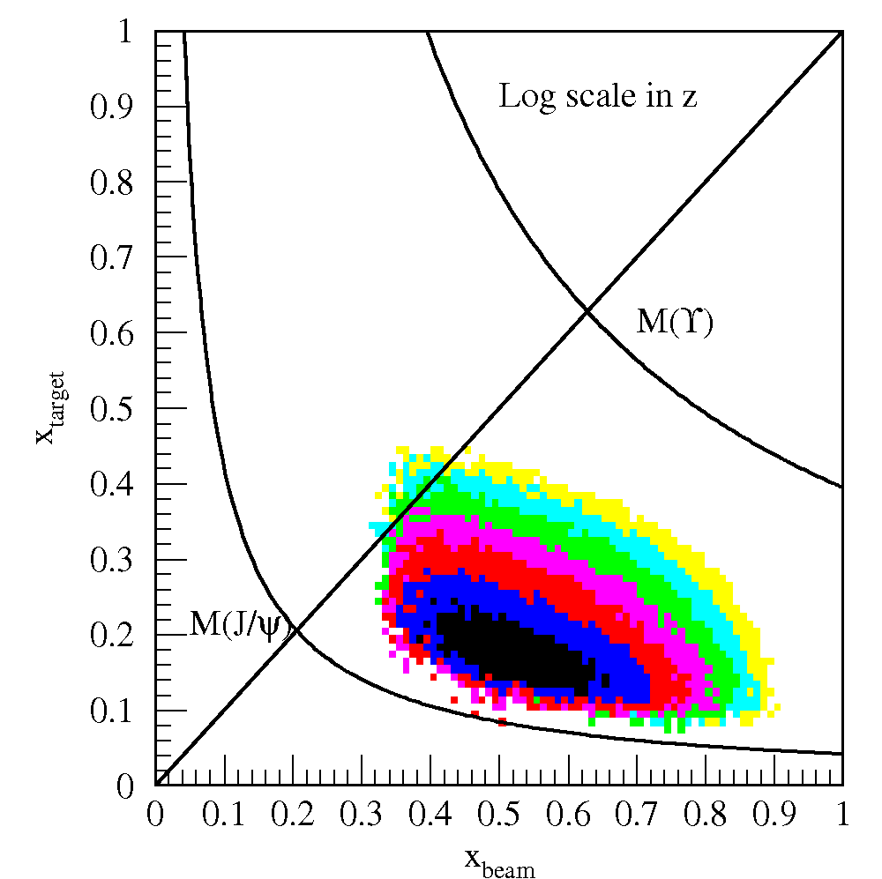
Polarized Target Drell-Yan Transverse Single
Spin Asymmetry @Fermilab
Sea-Quark Sivers Effects
The first precise measurements of seaquark Sivers distributions
@ large x = 0.1~0.4, significant Sivers Asymmetry observed in pol. SIDIS
Sea-quark’s Sivers Funcs poorly known
Pol. Target
E906 Coverage
Current E906
Coverage

Slide 24
E906->E1039
Z = 3.5m
Z = 7.0m

Slide 25
A New Focusing Magnet?
Refocus dimuons from target to improve acceptance
Option-1: BNL 48D48 magnet:
  a large aperture magnet, up to 3.5 T*m
  18.5” x 48” x 48”; 48” = 1.22m
  CAD/BNL reluctant to give it away, they may need it. Need to write a memo to BNL ALD if we want to get it to Fermilab.
  Possible window for 2016 – 2019, as there is no currently planned usage of this magnet
BNL 18D36 magnet:
  Smaller gap: 6” (15.2cm), up to 2.0 T*m
  6” x 18” x 36”, 36” = 91.4cm

Slide 26
Geometry
See more details in
Kun/David’s simulation talk
Dave/Kun

Slide 27
Drell-Yan Signal Acceptance

Slide 28
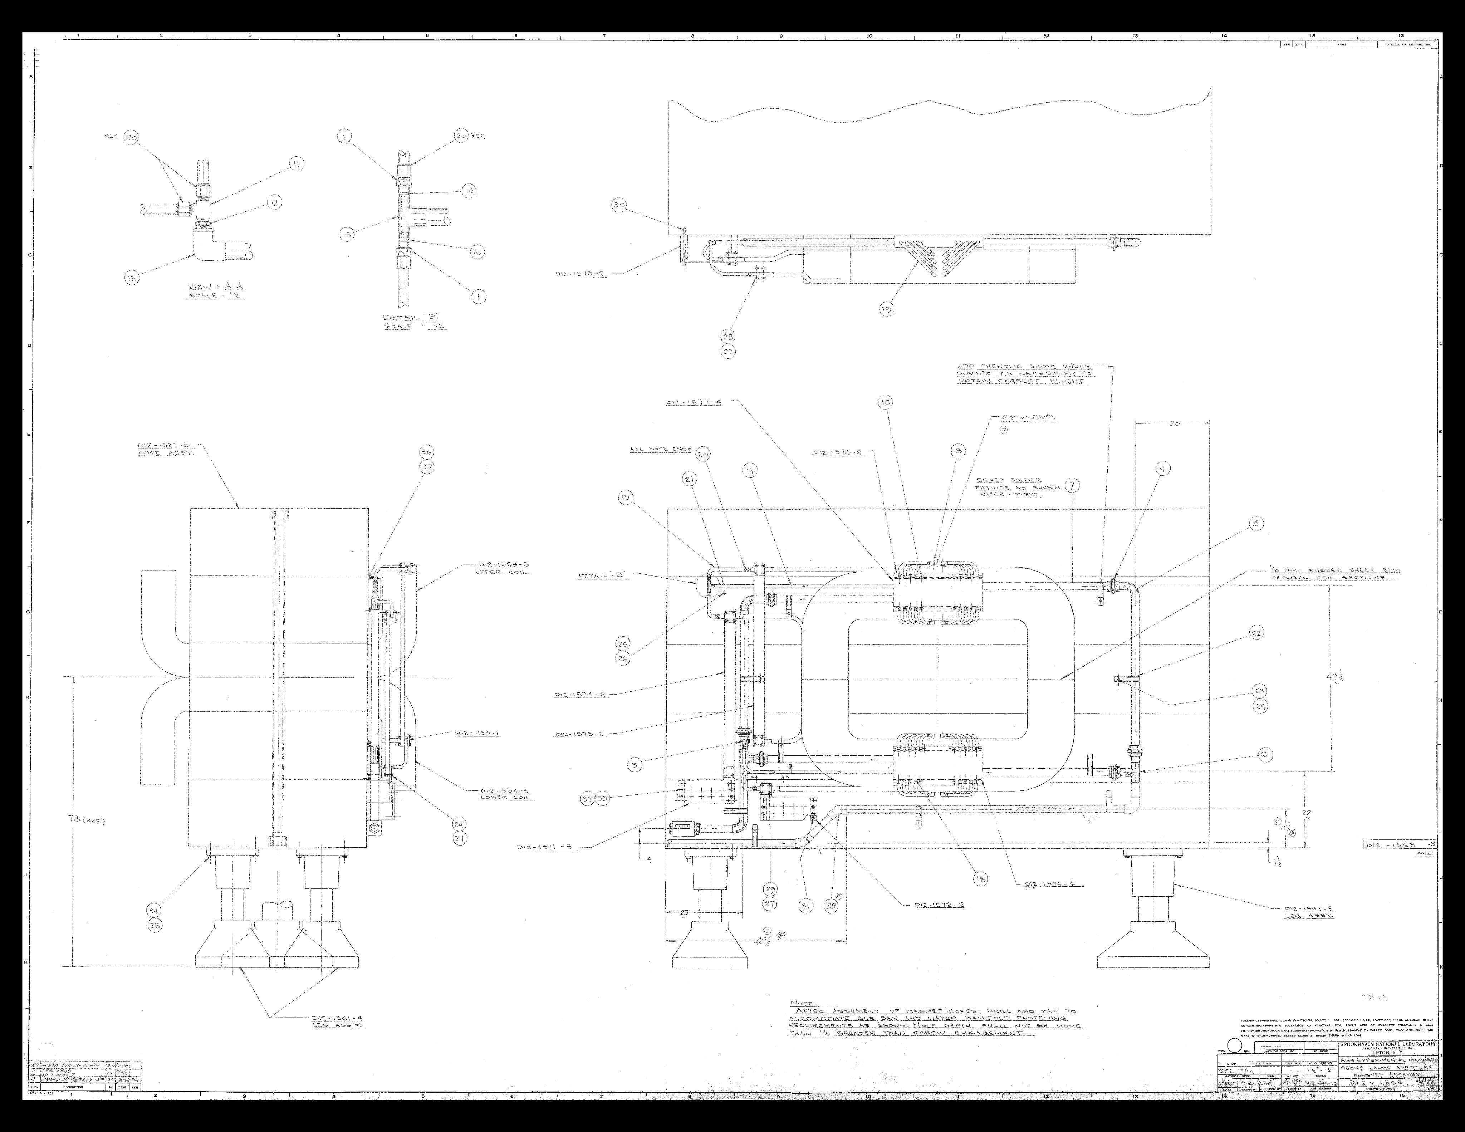
48D48 Magnet
One at BNL, NOT in use yet, an official request to BNL needed
Y_Gap = 18” =45.7cm
X_Gap = 48” =122cm
Field = up to 3.5 T*m

Slide 29
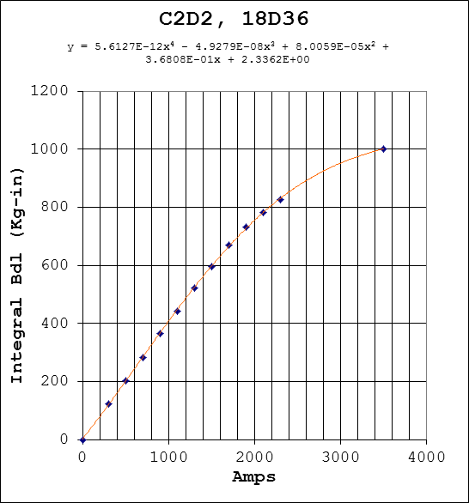
BNL Smaller 36D36 Magnet
Several of them at BNL
  Y_Gap = 6” = 15.2 cm
  X_Gap = 18” =45.7cm
  Field up to 1000kGx2.54cm = 2.5 T*m
  OK for signal muon tracks
  Impact on background understudy

