Slide 1
Overview of SeaQuest/E1039 Polarized Fixed Target Drell-Yan Experiment at Fermilab
Ming Xiong Liu (柳明雄)
Los Alamos National Laboratory
(For the E1039 Collaboration)
The 10th Workshop on Hadron Physics in China and Opportunities Worldwide
Shandong University, Weihai, China

Slide 2
Outline
SeaQuest experiments at Fermilab
  E906 unpolarized targets
  E1039 polarized NH₃/ND₃ targets
Novel physics of sea quarks at x = 0.1 ~ 0.4
  Flavor asymmetry
  Sivers & OAM
Future opportunities
  E1067 dark photon search, 2016 - 2021+
  E1027 polarized beam, 2021+
  TMD physics in p+p/n complementary to EIC, 2019-2021+
EicC: sea quarks

Slide 3
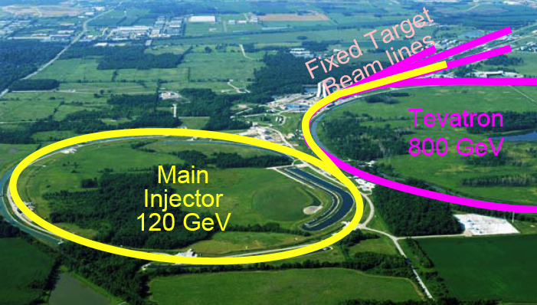
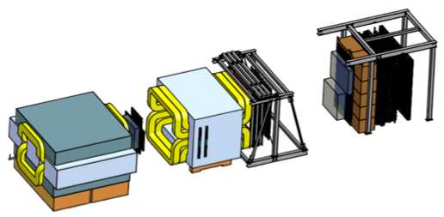
Fermilab High Intensity Frontier

Slide 4
SeaQuest Dimuon Spectrometer
120 GeV protons from the Main Injector
4s beam spill very 60 sec
19ns RF, ~10s K protons per RF bucket
5x10¹² Proton On Target (POT) per spill
Total integrated POT for E1039 (2-year):
1.4x10¹⁸ POT
Year 2015
Beam
120 GeV proton from Main Injector
19ns RF, 4s spill, 0.5×10¹³ protons per spill
SeaQuest Dimuon Tracking Top View
E906 unpolarized targets: 2012-2017
¹H, ²D, ¹²C, ⁵⁶Fe, ¹⁸⁴W
E1039 polarized targets: 2018 – 2021+
Polarized protons (NH₃)
Polarized neutrons (ND₃)
E1027 polarized beam

Slide 5
SeaQuest Experimental Hall
Beam
Target area
F-Mag
K-Mag
Muon-ID

Slide 6
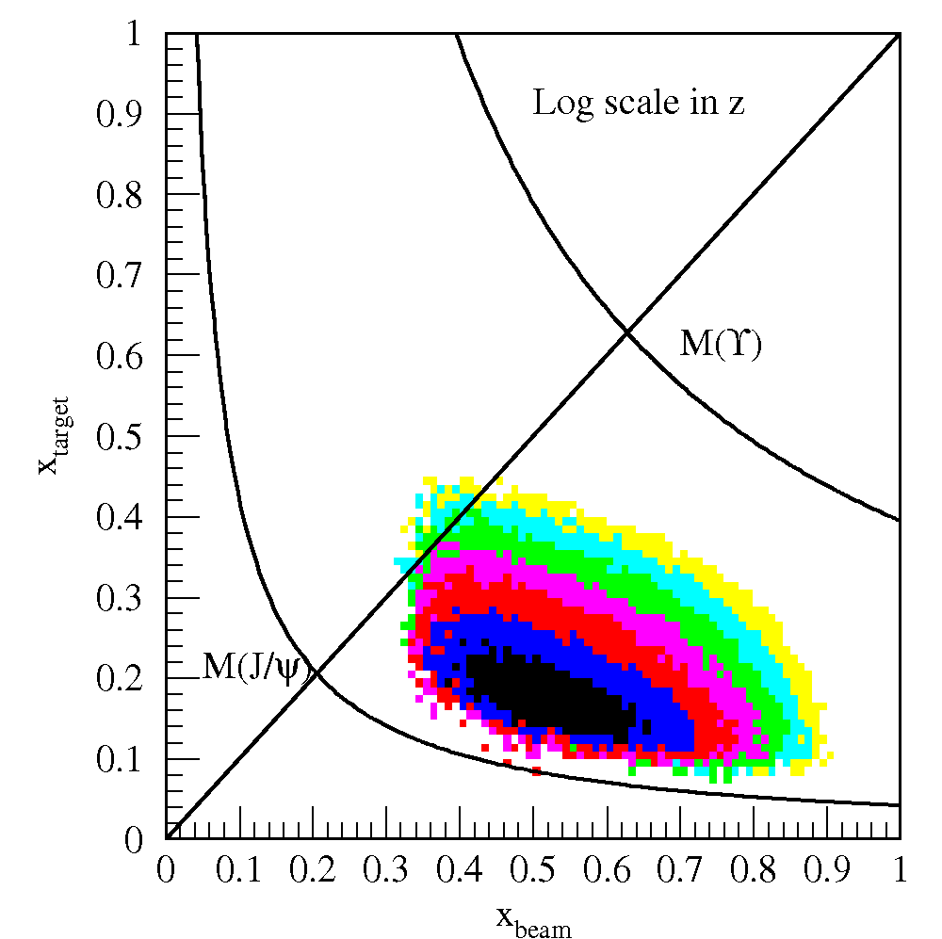
Drell-Yan @SeaQuest – a Sea Quark Laboratory
SeaQuest
acceptance
Kinematically favors sea-quarks
from target – a sea quark lab!

Slide 7
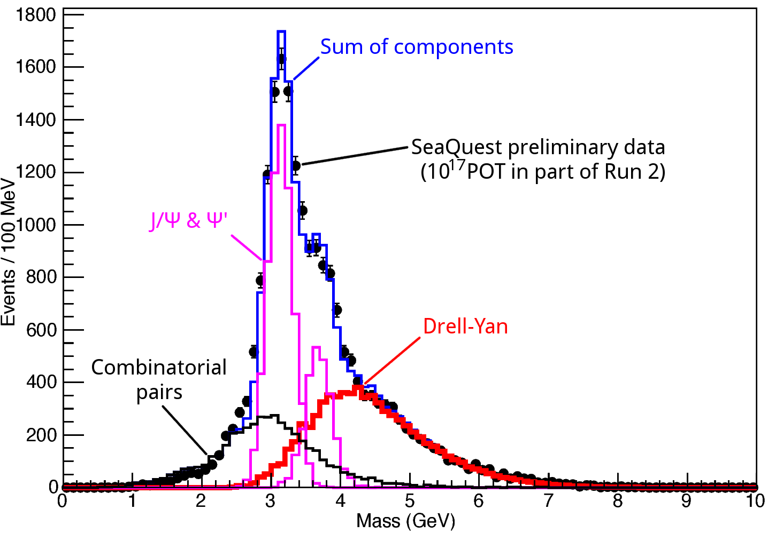
Dimuon Mass from SeaQuest/E906

Slide 8
E906 Unpolarized Physics Program
Thin targets: ~10% interaction length
  Liquid H/D
  Solid C, Fe, W
Physics
  Sea quark flavor asymmetry, dbar/ubar
  Quark energy loss in p+A collisions, dE/dx
  and more …
Experimental runs – 6 years
  2012 – commissioning
  2017 – completed

Slide 9
Flavor Asymmetry of Sea Quarks at Intermediate x
Proton vs “Neutron” targets:
This could lead to a very interesting physics …

Slide 10
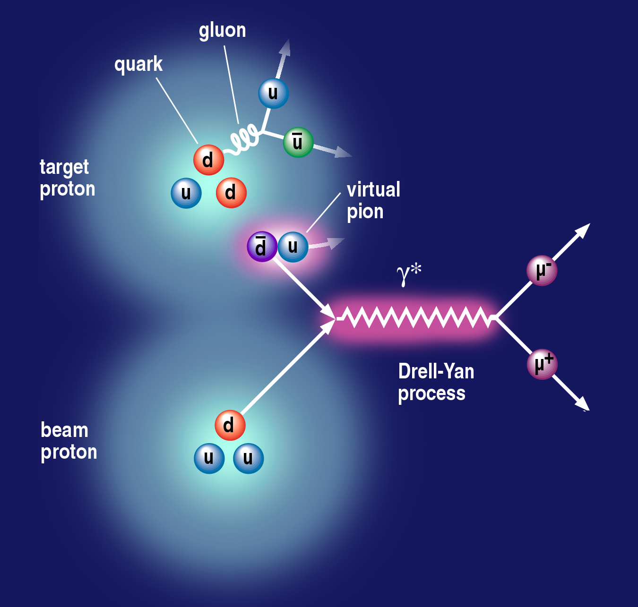
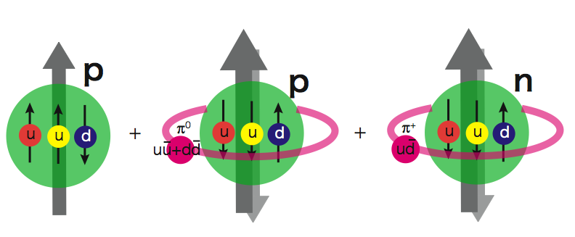
Sea Quark Flavor Asymmetry and OAM
Pion cloud and
Drell-Yan process
Pion cloud model
Sea-quark flavor asymmetry
Sea-quark orbital angular motion
Expect large Sivers function at x = 0.0 ~ 0.4
|p> = a|p₀> + b|p₀ + pi⁰> + c|n+pi⁺> + …
proton
neutron
L_{Z} = 1
E906 Spect.
Monte Carlo
E906 Spect.
Monte Carlo
E906 Spect.
Monte Carlo

Slide 11
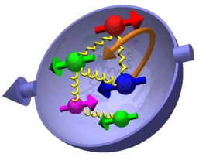
Nucleon 3-D Structure and Sivers Function
(x, k_{T})

Slide 12
Sivers Functions from Global Fits
Sea Quark Sivers poorly constrained, SIDIS not sensitive to sea quarks at large x
1612.06413, M. Anselmino et al
Sea quarks

Slide 13
RHIC pp500GeV: W^{+/-} A_{N}
Anselmino et al 2016
A_{N}(W⁺) ~
A_{N}(W⁻) ~
RHIC data:
A mix of valence and sea quark Sivers
Quark flavor identified
High Q²
Statistically limited, ~0(10%)
Possible large dbar Sivers contributions
E1039:
- low Q²
- Good statistics, ~O(1%)

Slide 14
Polarized NH₃ Target Developed for DY Sivers

Slide 15
Dynamic Nuclear Polarization: Pol. ~90%
With DNP,
Pol. ~ 90%
W/o DNP, at thermal
equilibrium:
- T = 1K
- B = 5T
Proton target polarization:
P_{i} = 0.5%
V_{p}=213MHz

Slide 16
Projected SeaQuest Target and Beam Performance

Slide 17
Projected Drell-Yan Transverse Single Spin Asymmetry

Slide 18
Drell-Yan Sivers Asymmetries w/ QCD Evolution
Kang et al, 1401.5078
COMPASS
Valence quark
Sivers
SeaQuest: p+NH₃
COMPASS
Sea quark
Sivers

Slide 19
E1039 Status & Plan
DOE approval, March 2018
E906 decommissioned 6/2018
E1039 target shielding in progress
Beam collimator in fabrication, to be installed later
Polarized target to be installed by fall of 2018
Fermilab Stage-2 approval, May 2018
2018 summer detector work in progress
E1039 commissioning starts in late 2018
Run for 2+ years, 2019-2021+
Spectrometer
NH₃
Target
120GeV
beam

Slide 20
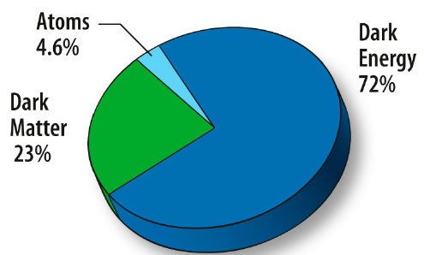
Physics Beyond E1039 Polarized DY A_{N}
Dark sector physics search – E1067
  Parasitic run with E1039: 2018 – 2021
  Proposed dedicated run after E1039: 2021 – 2030
Physics with polarized beams – E1027
  Polarize the Main Injector 120GeV beam
  Valence quark Sivers
  Test QCD dynamics in DY vs DIS

Slide 21
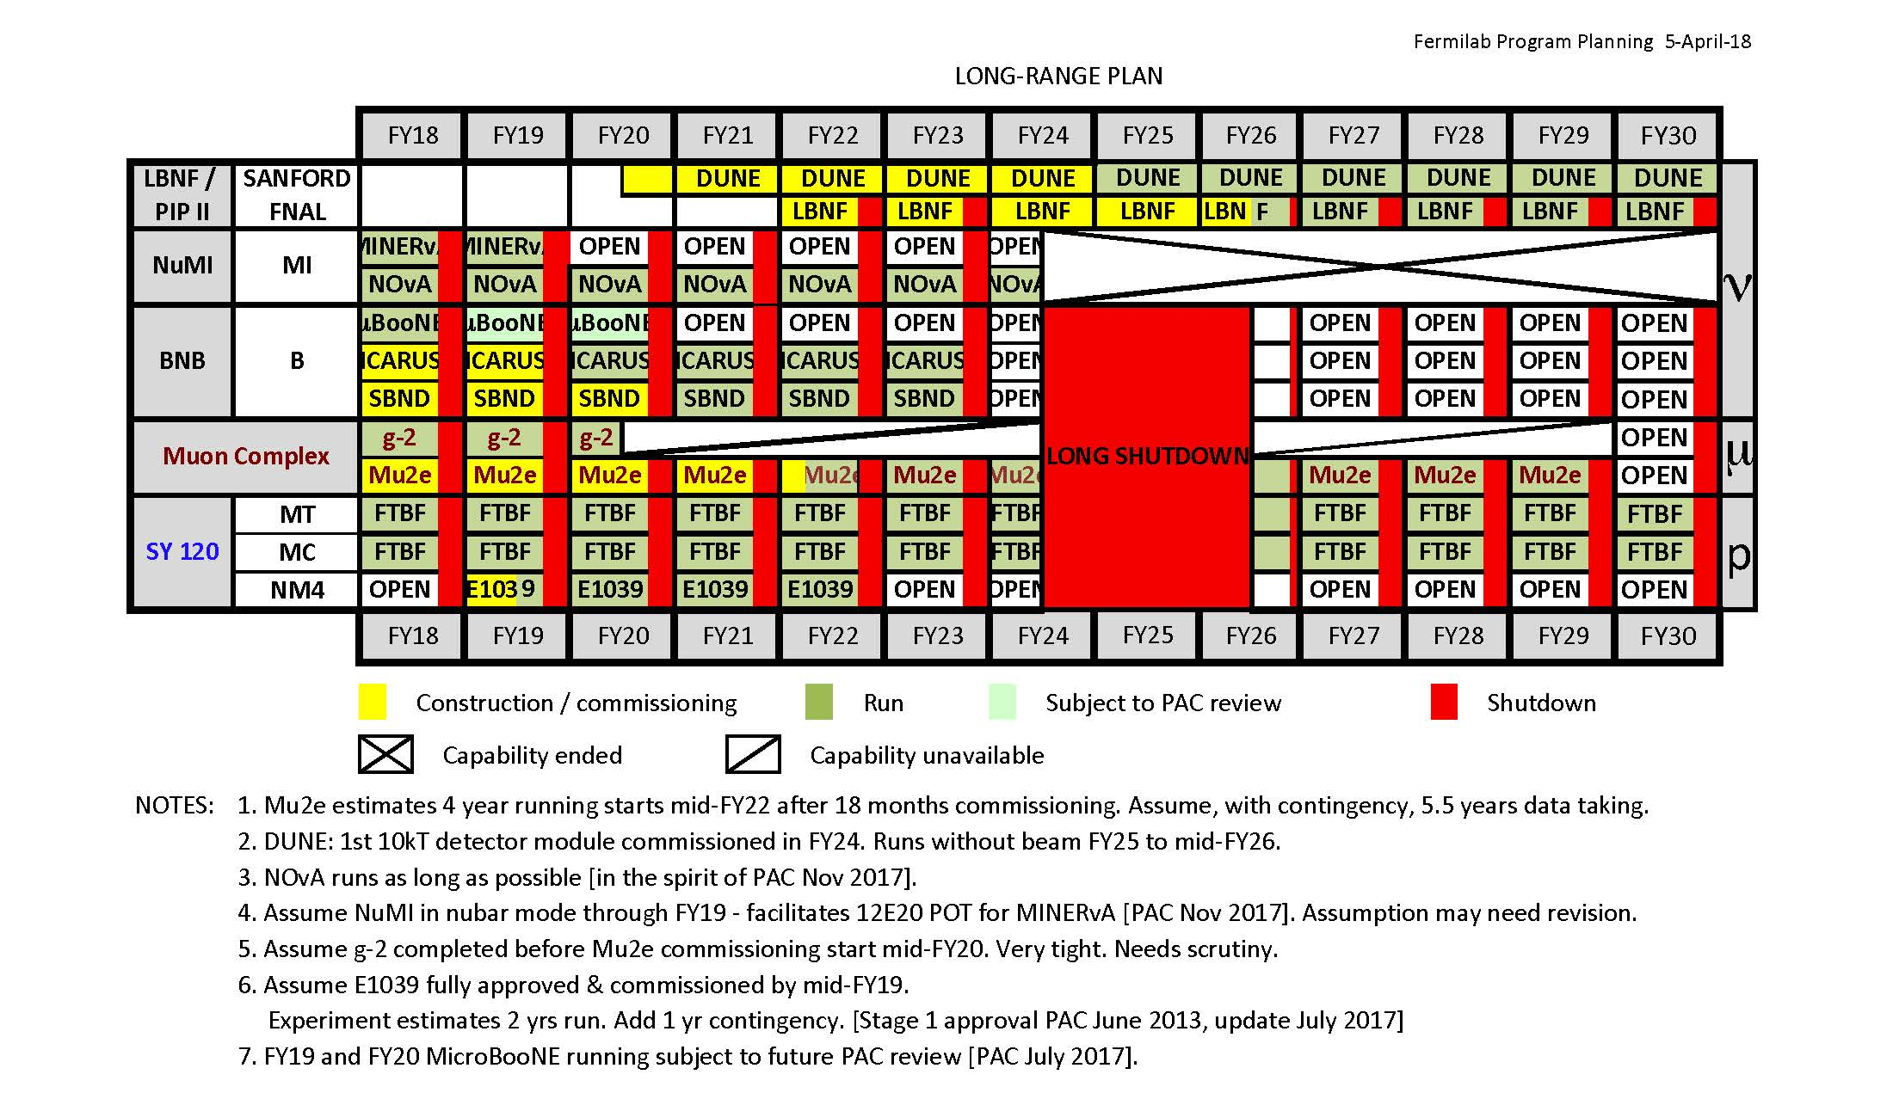
Fermilab Long Range Plan
SeaQuest
Opportunity for new programs at SeaQuest after E1039

Slide 22
Dark Photons and Dark Higgs Search at SeaQuest
Photon portal: “vector”
Higgs portal: “scalar”
θ = μ v/m_{h}²
Advantage of hadronic collisions

Slide 23
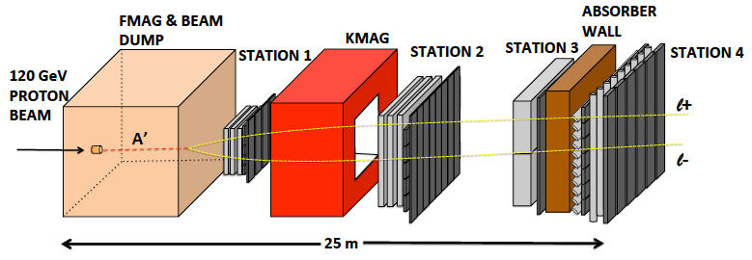
Dark Sector Physics Search at SeaQuest
2018 ~ 2021+, proposed long term program after E1039
Add tracking detectors close to “target” to improve mass resolution
Add EMCal, PID
e^{+/-}, h^{+/-} , π^{+/-}

Slide 24
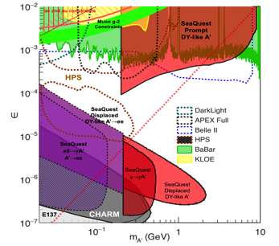
Projected Dark Sector Physics Search Sensitivity
Dark photon search
Dark Higgs search
1x
5x
25x

Slide 25
Spin physics Program with Polarized Main Injector – E1027
Access both valence and sea quarks
Fermilab PAC stage-1 approved
Complementary to EIC Spin Physics
Test QCD processes in DY vs DIS
over a broad range of kinematics

Slide 26
Summary and Outlook
Experiments | Run Time | Collision Types | Physics
E906 | 2012-2017 | p + targets (H, D, C, Fe, W) | - dbar/ubar asymmetry - quark dE/dx
E1039 | 2018 – 2021+ | p + pol. targets (NH₃, ND₃) | Sea-quark Sivers, TMDs
E1067 | 2017 – 2021+ | p + any targets (beam dump) | dark photon, dark Higgs
E1027 | 202x | Pol. p-beam + any targets | quark Sivers TMD, spin

Slide 27
SeaQuest/E1039 Collaboration
A small collaboration, great opportunities for new comers to contribute
and lead major detector and physics efforts

Slide 28

Welcome to join us the fun at Fermilab now!
Contacts: E1039 co-SP
Dr. Kun Liu <liuk@lanl.gov>
Dr. Dustin Keller <dmk9m@Virginia.EDU> and also during the workshop,
Ming Liu (ming@bnl.gov)
I WANT YOU

Slide 29
backup

Slide 30
TMDs probed via DY at SeaQuest
E906, E1039, E1027
E1039
E1027
→COMPASS, RHIC, EIC/SeaQuest for sea quarks

Slide 31
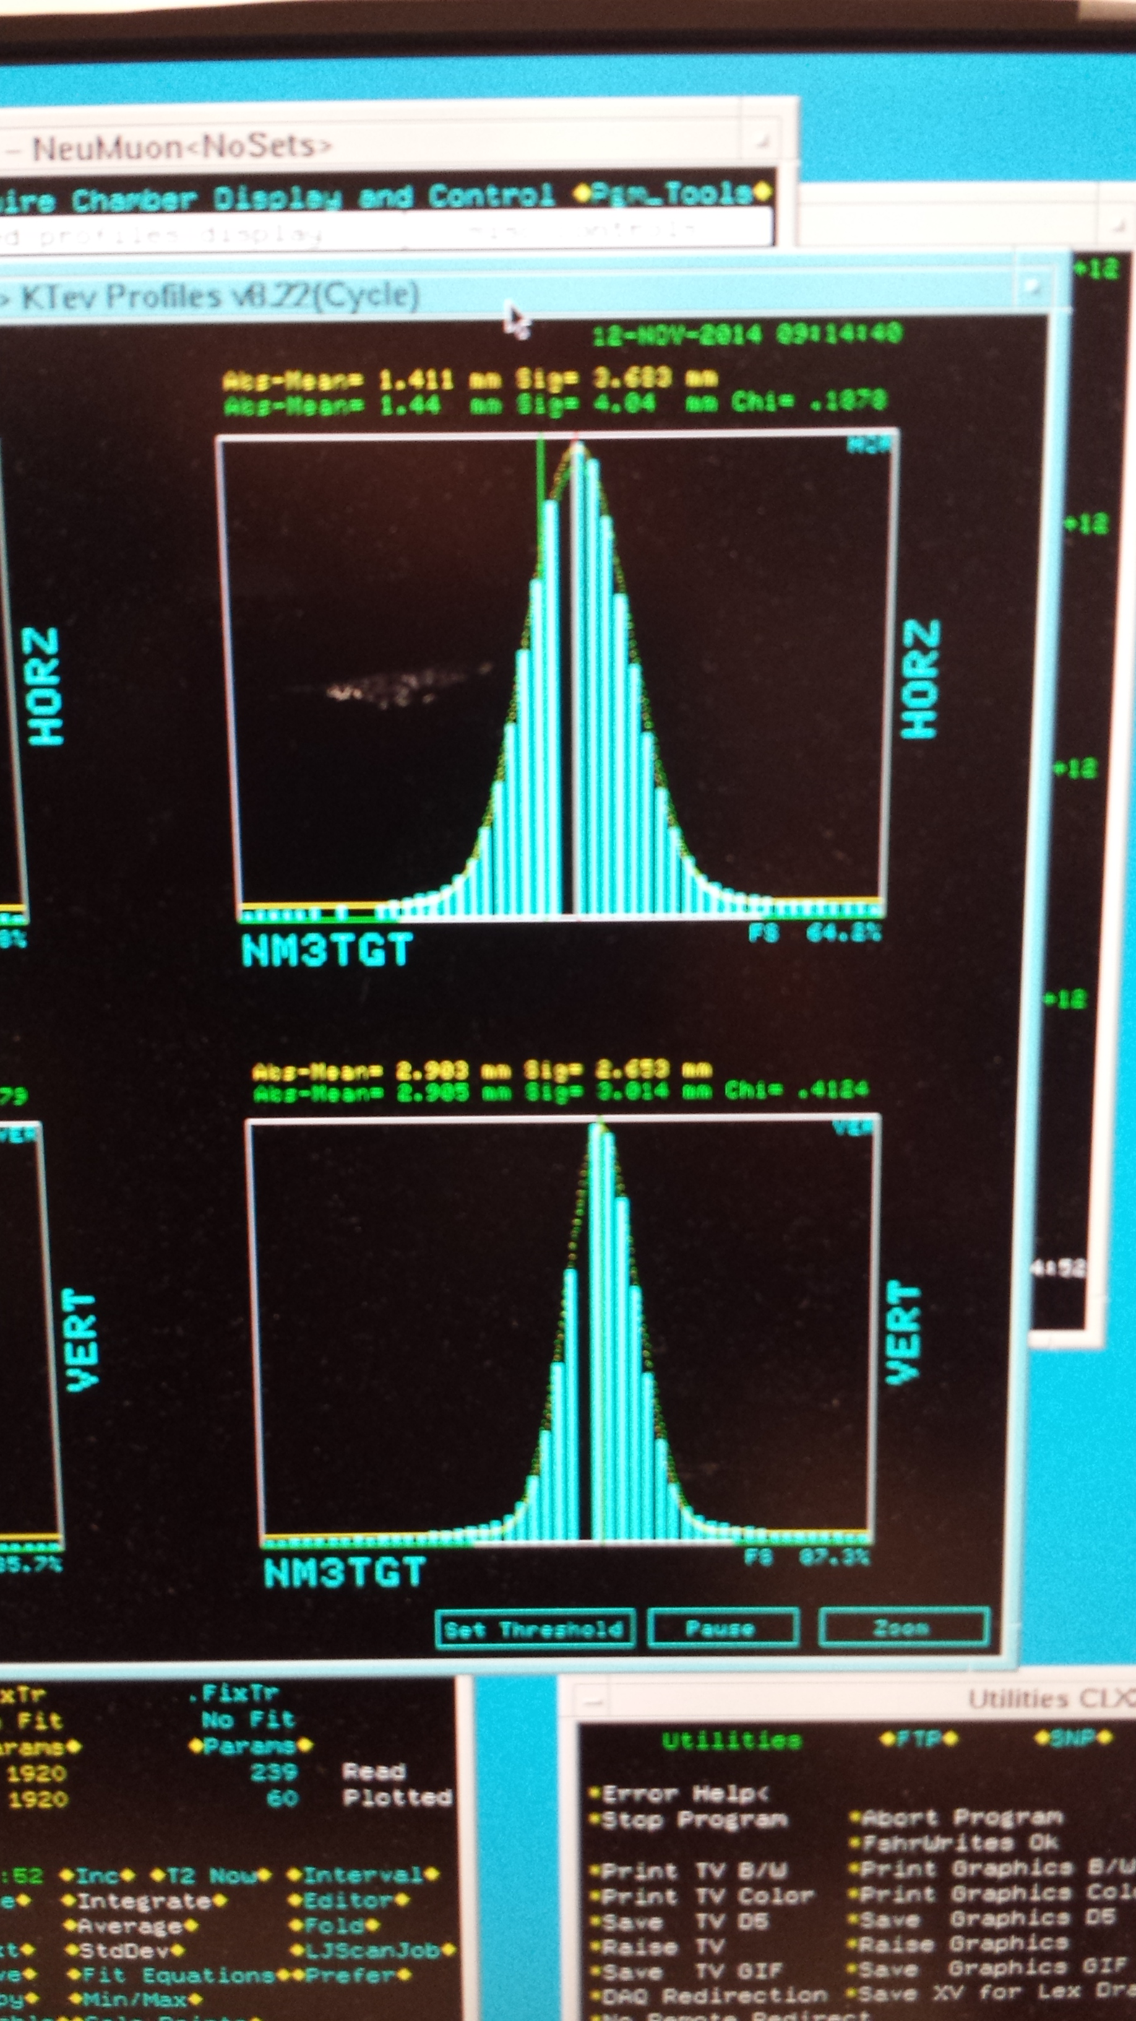

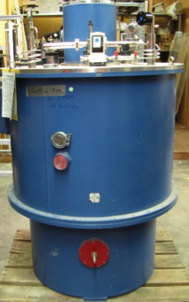
New Beam Collimator and Target
Target cross section: 18 x 28 mm²
E906 beam profile:
SigX = 4.0mm
SigY = 3.0mm
Beam cross section:
Need be well contained within
4 sigma, required by dR< 2x10⁻⁴
sigX = 18/2/4 = 2.2 mm
sigY = 28/2/4 = 3.5 mm
Beam jitter: dX=dY ~ 1mm
1 sig = 0.68269
2 sig = 0.95450
3 sig = 0.99730
4 sig = 0.99994
Beam collimator
120GeV
beam

Slide 32
Target and Beam Dump Event Separation target at upstream: Z=-3.5m
Trigger optimization possible!

Slide 33
Dark Sector Physics Search Program at SeaQuest
2018 2019 2020 2021
2022 2023 2024 2025
2026 2027 … 2030+
E1039 installation
& commissioning
Planned
Parasitic Dark Sector
Physics with E1039
Proposed
PHENIX EMCal refurbishment at Fermilab,
HEP dark sector physics program development
EMCal installation
& commissioning
Long shutdown,
detector upgrade
High luminosity dark sector physics
program at Fermilab Intensity Frontier
DP search w/ EMCal upgrade
Parasitic Nuclear Physics program possible
Parasitic Nuclear Physics program possible

Slide 34
Dark Photon Search at SeaQuest with all Future Projections

Slide 35
Dark Higgs
Y. Zhang et al, arXiv:1502.06983
θ = μ v/m_{h}²
arXiv:1312.4992
e⁺e⁻
Phase-I:
High-mass: μ⁺μ⁻ and hadrons
Advantage of using hadron beams
with muon probes over electrons
Phase-II:
Low-mass: e⁺e⁻, <200MeV possible
High-mass: hadrons, (5x)
Electron ID
upgrade!
μ⁺μ⁻

Slide 36
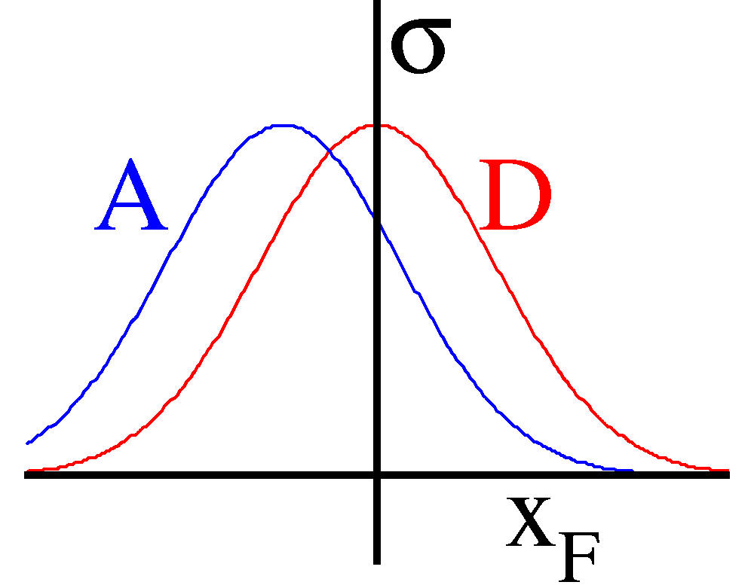
Determine and Calibrate dE/dx with DY in p+A
(Drell-Yan Process)
Known initial state nuclear parton density;
Minimal final-state interactions of the detected particles.
E906: No shadowing correction at moderate X_{t}
q, g
DY
euterium
Energy loss reduces x_{b} and x_{F} in nuclei versus proton (x_{F} = x_{b}-x_{t})
Possible sea-quark shadowing effects

