Slide 1
Overview of SeaQuest/E1039 Polarized Fixed Target Drell-Yan Experiment at Fermilab
Ming Xiong Liu (柳明雄)
Los Alamos National Laboratory
The 10th Workshop on Hadron Physics in China and Opportunities Worldwide
Shandong University, Weihai, China

Slide 2
Outline
SeaQuest experiments at Fermilab
  E906 unpolarized targets
  E1039 polarized NH3 target
Novel physics of sea quarks at intermediate x = 0.1 ~0.4
  Flavor asymmetry
  Sivers & OAM
Future opportunities
  E1067 dark photon search, 2016 - 2021+
  E1027 polarized beam, 2021+
  TMD physics in p+p/n complementary to EIC, 2019-2021+

Slide 3
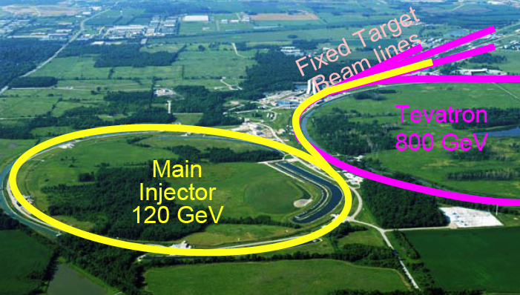
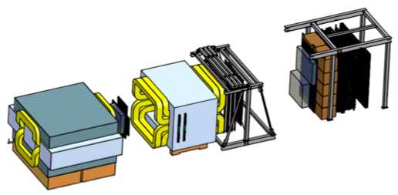
Fermilab High Intensity Frontier

Slide 4
SeaQuest Spectrometer
120 GeV protons from the Main Injector:
4 sec beam spill very 60 sec
19nS RF, ~10K protons per RF bucket
5x10¹² Proton On Target (POT) per spill
Total integrated POT for E1039:
1.4x10¹⁸ POT
Year 2015
Beam
120 GeV proton from Main Injector
19ns RF, 4s spill, 0.5×10¹³ protons per spill
E906 targets:
H, D, C, Fe, W
E1039 targets:
Polarized protons (NH₃)
Polarized neutrons (ND₃)

Slide 5
Top View of SeaQuest Spectrometer
Target area
K-Mag
Muon-ID

Slide 6
SeaQuest/E1039 Collaboration

Slide 7
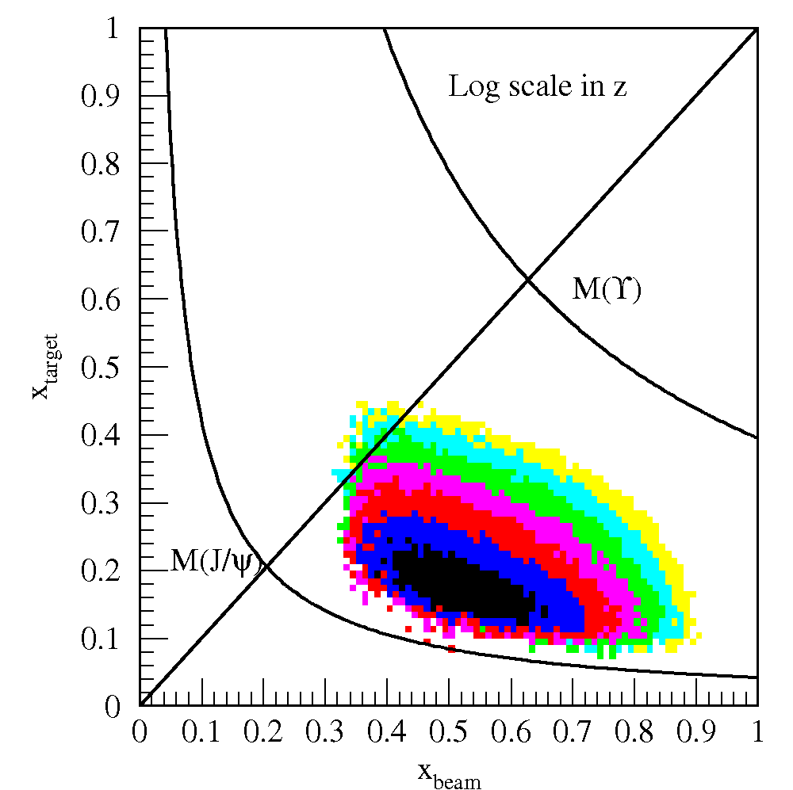
Drell-Yan @SeaQuest – a Sea Quark Laboratory
SeaQuest
acceptance
Kinematically favors sea-quarks
from target – a Sea Quark Lab!

Slide 8
E906 Unpolarized Physics Program
Targets: ~10% interaction length
  Liquid H/D
  Solid C, Fe, W
Physics
  Sea quark flavor asymmetry
  Quark energy loss in p+A collisions
Experimental runs:
  2012 – commissioning
  2017 – completed

Slide 9
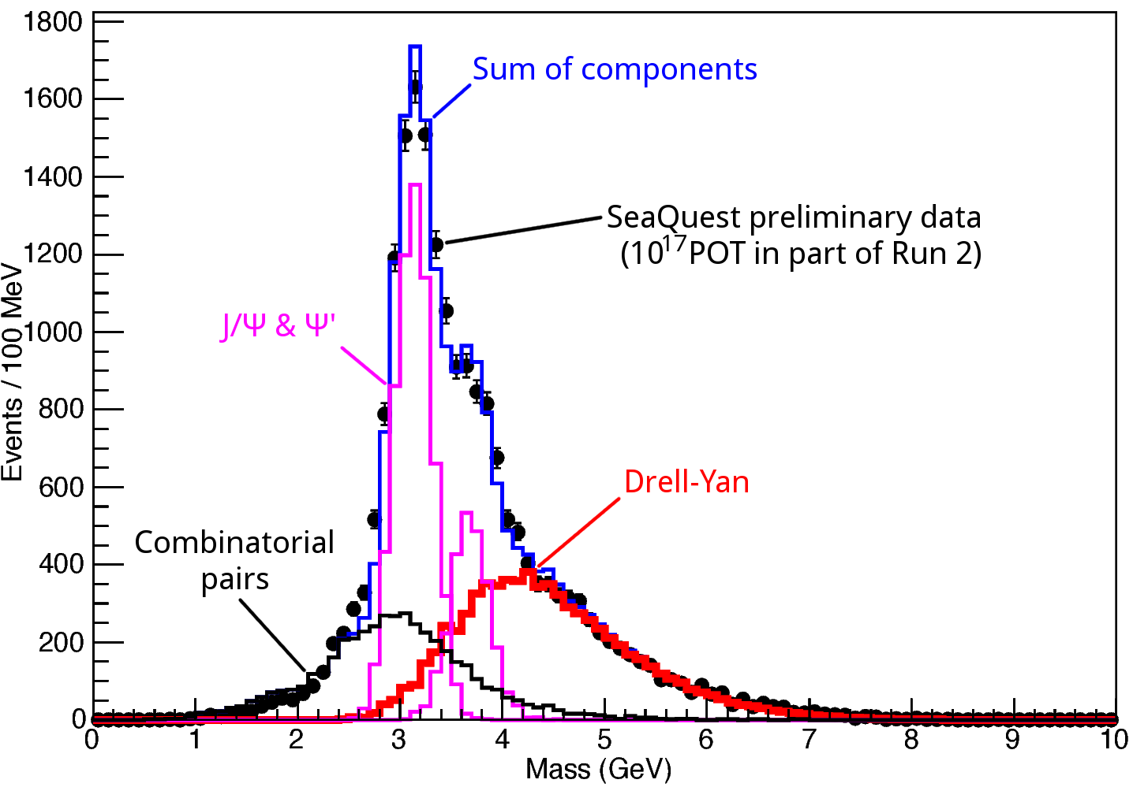
Dimuon Mass

Slide 10
Flavor Asymmetry of Sea Quarks at Intermediate x
Proton vs “Neutron” targets:

Slide 11
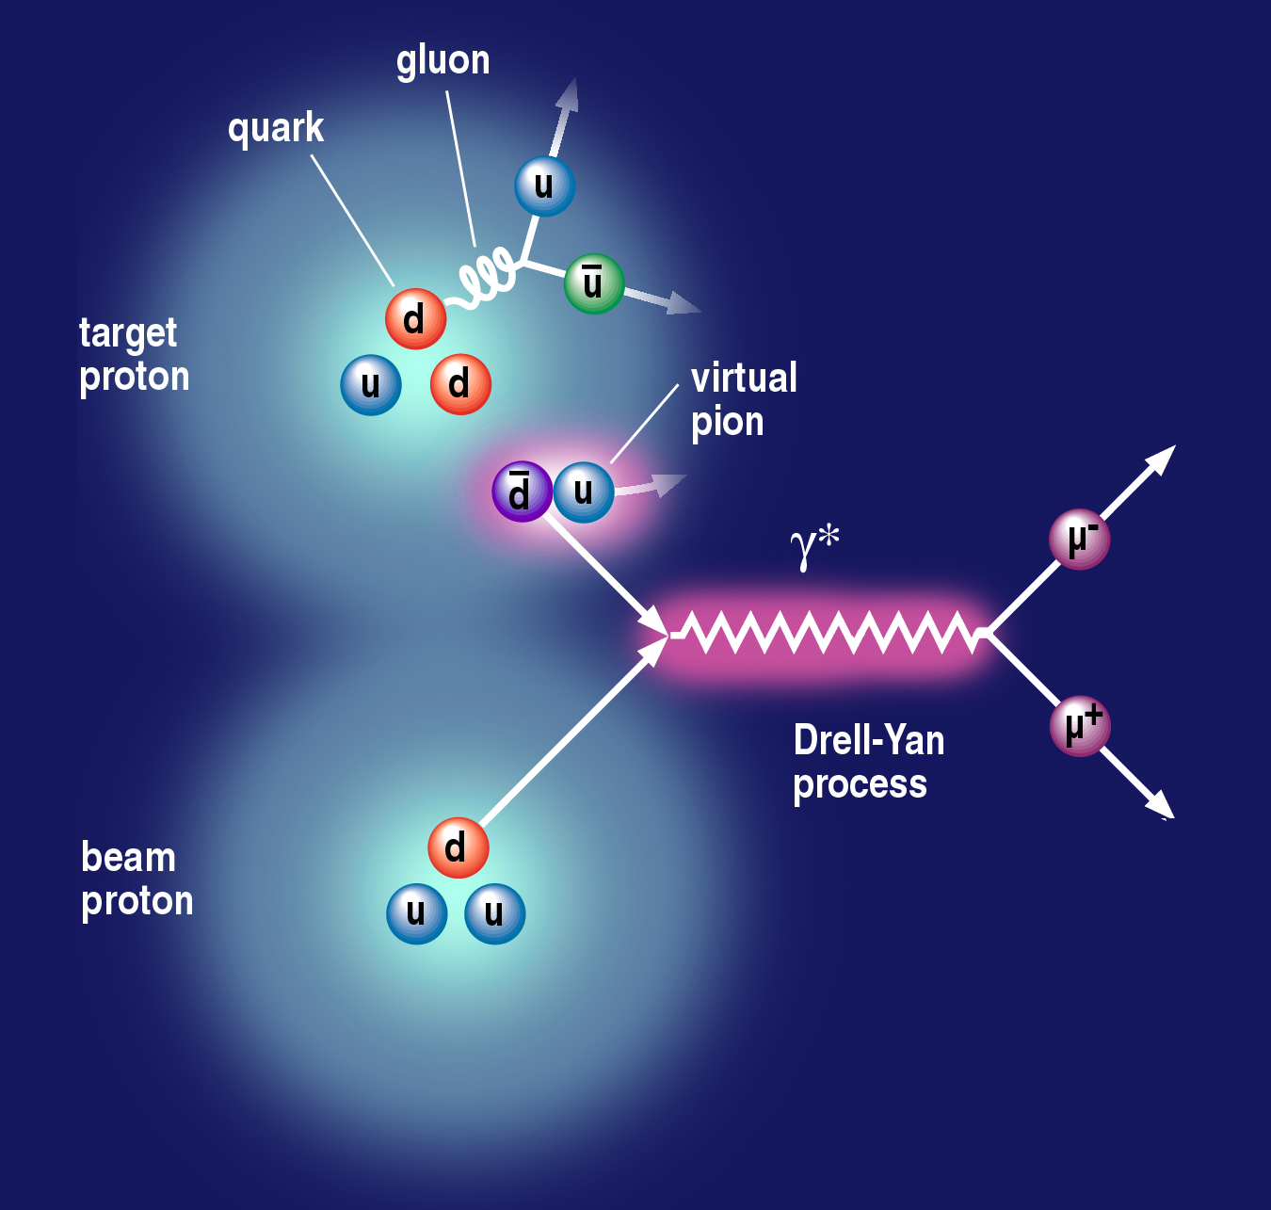
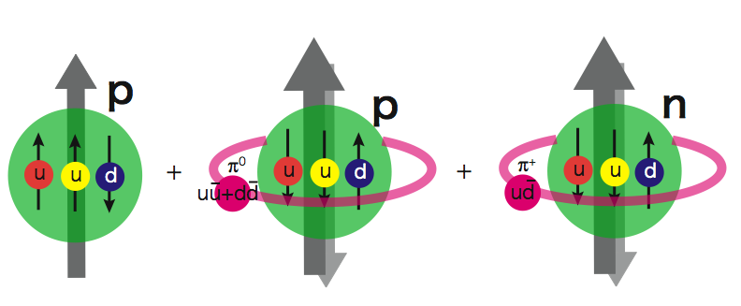
Flavor Asymmetry and Sea Quarks OAM
Pion cloud model
And Drell-Yan
Pion cloud model
Sea-quark flavor asymmetry
Sea-quark orbital angular motion
Expect large Sivers function at x = 0.0 ~ 0.3
|p> = |p₀> + a|p₀ + pi⁰> + b|n+pi⁺> + …
proton
neutron
E906 Spect.
Monte Carlo
E906 Spect.
Monte Carlo
E906 Spect.
Monte Carlo

Slide 12
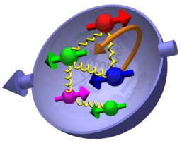
Nucleon 3-D Structure and Sivers Function

Slide 13
Sivers Functions from Global Fits – Quarks
Sea Quark Sivers poorly constrained, but seem small
1612.06413, M. Anselmino et al

Slide 14
TMDs can be probed via DY

Slide 15
Projected Drell-Yan Sivers Asymmetries
Kang et al, 1401.5078
COMPASS
Valence quark
Sivers
SeaQuest: p+p
COMPASS
Sea quark
Sivers

Slide 16
Polarized Target System: 8cm long NH₃ target

Slide 17
Dynamic Nuclear Polarization
With DNP,
Pol. ~ 90%
W/o DNP, at thermal
equilibrium:
- T = 1K
- B = 5T
Proton target polarization:
P_{i} = 0.5%
V_{p}=213MHz

Slide 18
Projected Target and Beam Performance
Target NH₃ with DNP

Slide 19
Projected Drell-Yan Transverse Single Spin Asymmetry

Slide 20
E1039 Status & Plan
E906 decommissioned 6/2018
E1039 shielding in progress
Beam collimator in fabrication, to be installed later
Polarized target to be installed by fall of 2018
- 2018 Summer detector work
E1039 Commissioning starts in the fall of 2018
Run for 2+ years

Slide 21
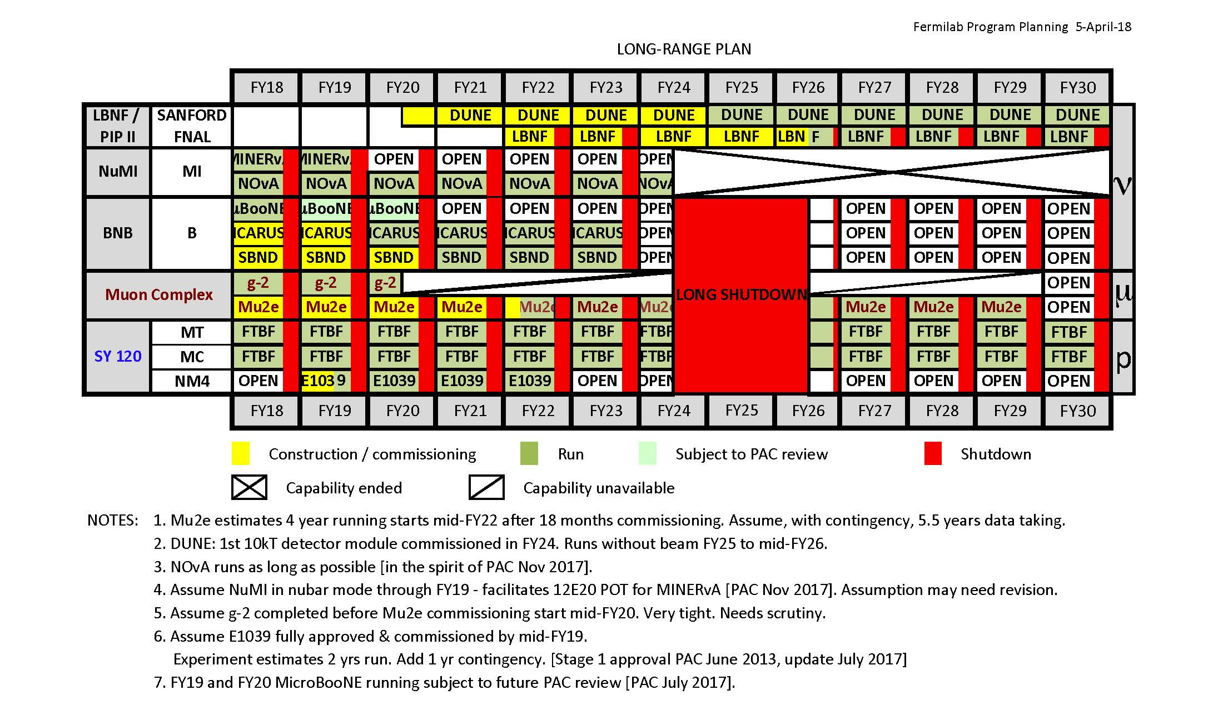
Fermilab Long Range Plan

Slide 22
Physics Beyond E1039
Dark sector physics search – E1067
  Parasitic run with E1039: 2018 – 2021
  Proposed dedicated run after E1039: 2021 – 2030
Physics with polarized beams – E1027
  Polarize the Main Injector 120GeV beam:

Slide 23
Dark Photons and Dark Higgs Search at SeaQuest
Photon portal: “vector”
Higgs portal: “scalar”
θ = μ v/m_{h}²

Slide 24
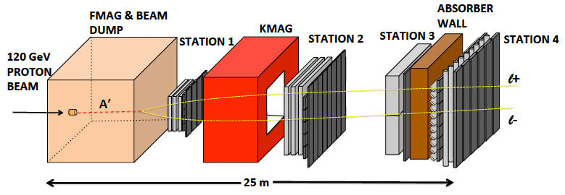
Dark Sector Physics Search at SeaQuest
2018 ~ 2021+
Add tracking detectors close to “target” to improve mass resolution
Add EMCal, PID
e^{+/-}, h^{+/-} , π^{+/-}

Slide 25
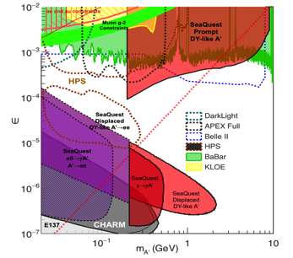
Projected Dark Sector Physics Search Sensitivity
1x
5x
25x

Slide 26
Spin physics Program with Polarized Main Injector – E1027
Complementary to EIC Spin Physics
Access both valence and sea quarks
Stage-1 approved

Slide 27
Summary and Outlook
Experiments | Operation | Collision Types | Physics
E906 | 2012-2017 | p + targets (H, D, C, Fe, W) | - dbar/ubar flavor asymmetry - quark dE/dx
E1039 | 2018 – 2021+ | p + pol. targets (NH₃, ND₃) | Sea-quark Sivers
E1067 | 2017 – 2021+ | p + any targets (beam dump) | Dark photon, dark Higgs search
E1027 | 202x | Polarized p-beam + any targets | Quark Sivers TMD spin

Slide 28

Welcome to join us the fun at Fermilab now!
Contacts:
Dr. Kun Liu <liuk@lanl.gov>
Dr. Dustin Keller <dmk9m@Virginia.EDU> and also during the workshop,
Dr. Ming Liu (ming@bnl.gov)

Slide 29
backup

Slide 30
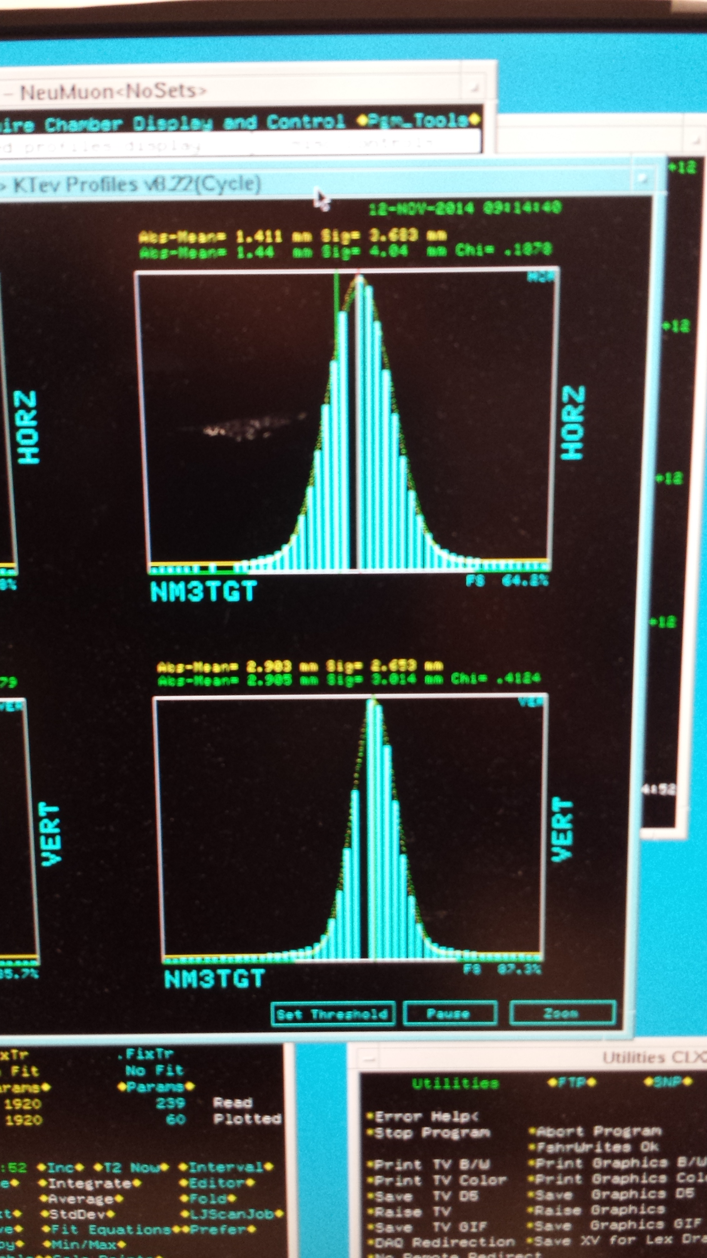

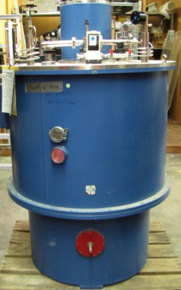
New Beam Collimator and Target
Target cross section: 18 x 28 mm²
E906 beam profile:
SigX = 4.0mm
SigY = 3.0mm
Beam cross section:
Need be well contained within
4 sigma, required by dR< 2x10⁻⁴
sigX = 18/2/4 = 2.2 mm
sigY = 28/2/4 = 3.5 mm
Beam jitter: dX=dY ~ 1mm
1 sig = 0.68269
2 sig = 0.95450
3 sig = 0.99730
4 sig = 0.99994
Beam collimator
120GeV
beam

Slide 31
Target and Beam Dump Event Separation target at upstream: Z=-3.5m
Trigger optimization possible!

Slide 32
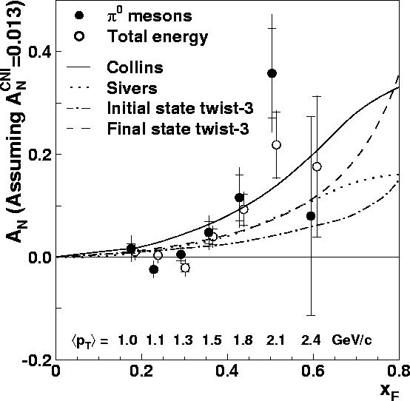
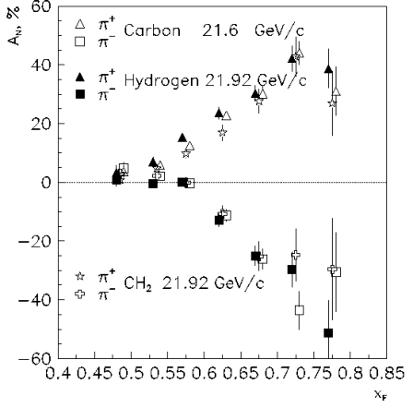
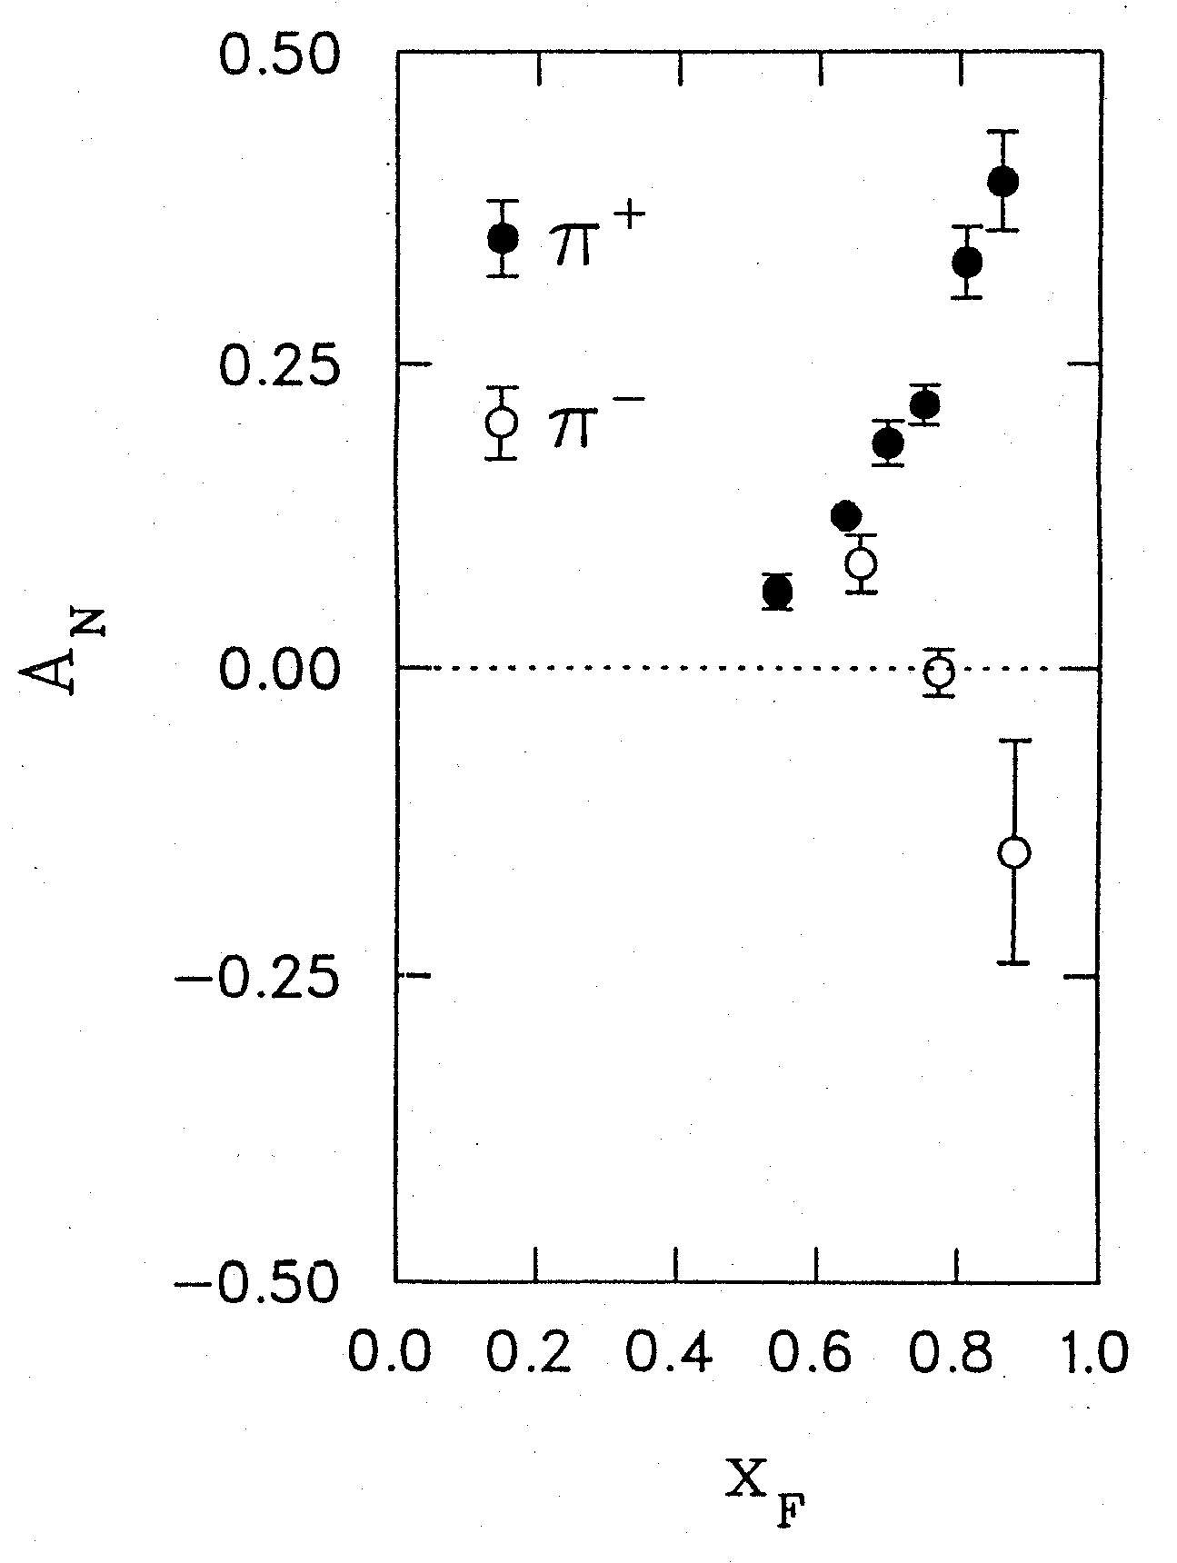
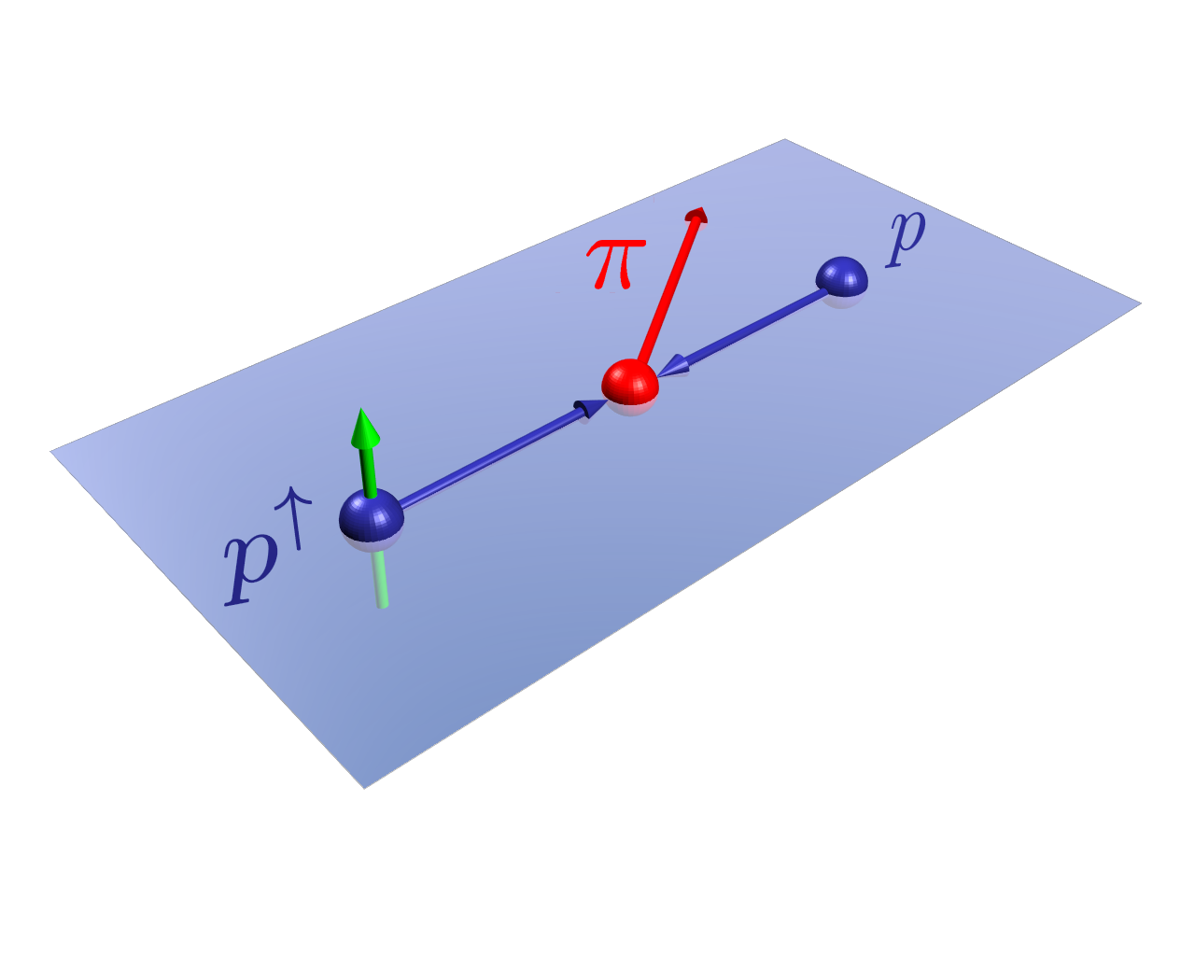
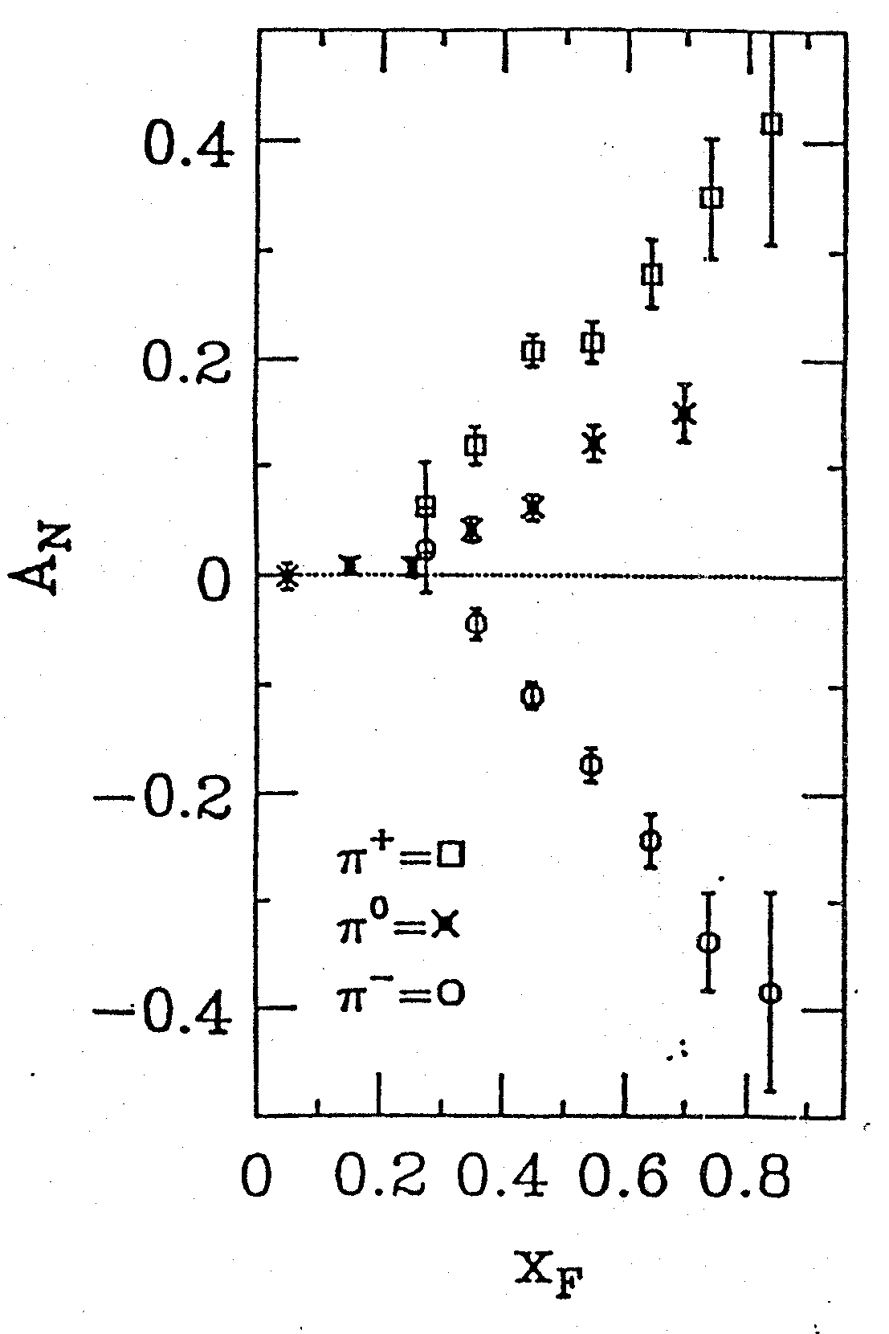
Four Decades of Transverse Spin Measurements
- Do we understand the physics?
RHIC 200 GeV CMS
Large Transverse Single Spin Asymmetry (TSSA) in forward hadron production persists up to top RHIC energy.
FNAL 200 GeV beam
AGS 22 GeV beam
ZGS 12 GeV beam
PRL (2004)
PLB261, 201 (1991)
PLB264, 462 (1991)
PRD65, 092008 (2002)
PRL36, 929 (1976)
Sivers, Collins, Twist-3 ….
Non-Perturbative cross section
Perturbative cross section

Slide 33
Probe the Underlying Physics via Hard Scatterings
TMD vs Collinear Twist-3 Factorizations
(i) Sivers mechanism:
correlation proton spin & parton k_{T}
(ii) Collins mechanism: Transversity × spin-dep fragmentation
S_{P}
Phys Rev D41 (1990) 83; 43 (1991) 261
S_{P}
Nucl Phys B396 (1993) 161
S_{q}
p
k_{T,q}
p
p
p
S_{q}
k_{T,π}
Collinear Twist-3 (RHIC, Fermilab):
quark-gluon/gluon-gluon correlation

Slide 34
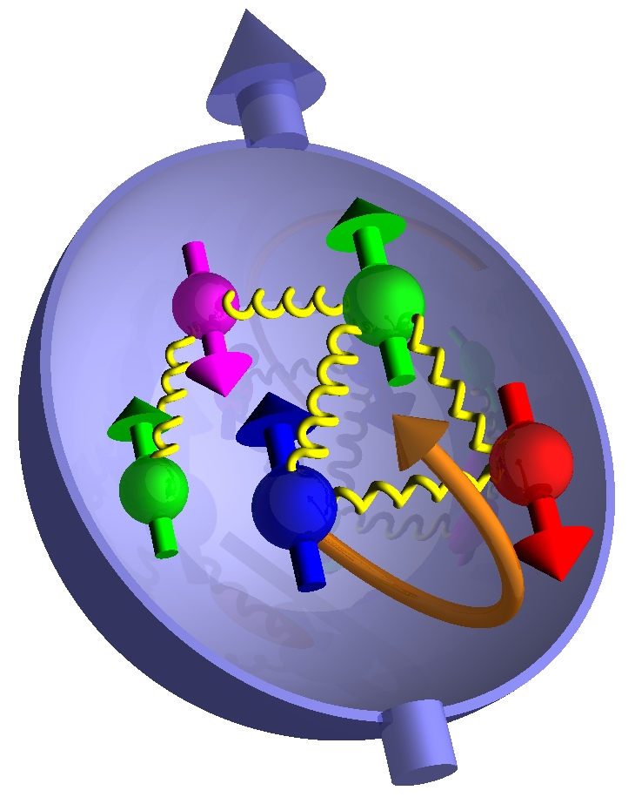
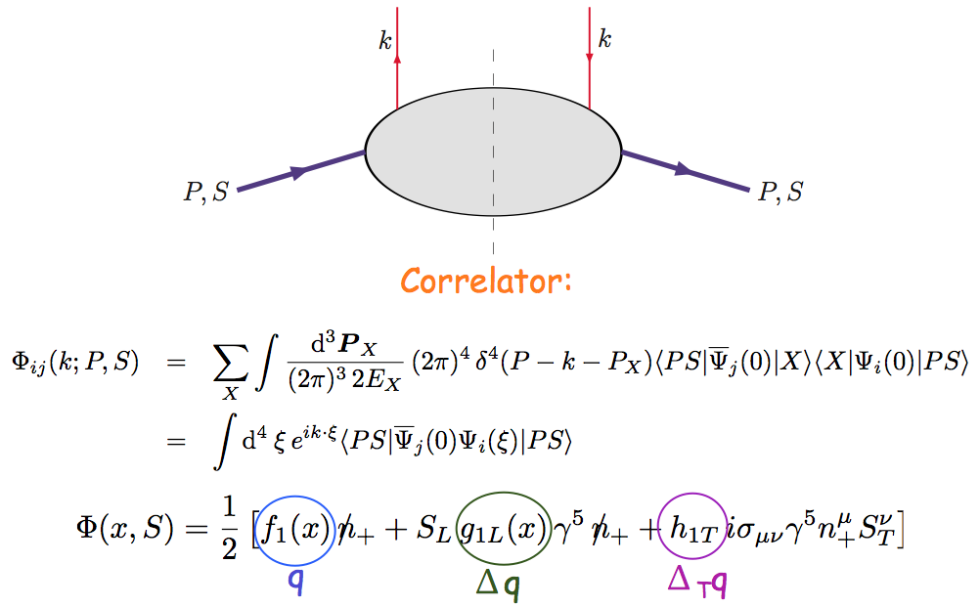
Nucleon Structure @Leading Twist Collinear Approximation (I)
Partonic interpretation of hard scatterings
Universal functions

Slide 35
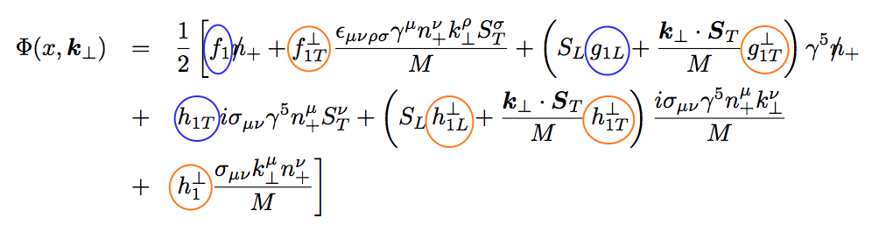
Including k_{T} … 5 more (II)
No K┴ dependence
K┴ - dependent
T-even
K┴ - dependent
T-odd

Slide 36
Dark Sector Physics Search Program at SeaQuest
2018 2019 2020 2021
2022 2023 2024 2025
2026 2027 … 2030+
E1039 installation
& commissioning
Planned
Parasitic Dark Sector
Physics with E1039
Proposed
PHENIX EMCal refurbishment at Fermilab,
HEP dark sector physics program development
EMCal installation
& commissioning
Long shutdown,
detector upgrade
High luminosity dark sector physics
program at Fermilab Intensity Frontier
DP search w/ EMCal upgrade
Parasitic Nuclear Physics program possible
Parasitic Nuclear Physics program possible

Slide 37
Dark Photon Search at SeaQuest with all Future Projections

Slide 38
Dark Higgs
Y. Zhang et al, arXiv:1502.06983
θ = μ v/m_{h}²
arXiv:1312.4992
e⁺e⁻
Phase-I:
High-mass: μ⁺μ⁻ and hadrons
Advantage of using hadron beams
with muon probes over electrons
Phase-II:
Low-mass: e⁺e⁻, <200MeV possible
High-mass: hadrons, (5x)
Electron ID
upgrade!
μ⁺μ⁻

Slide 39
Projected Dark Higgs Sensitivity
POT:1.4x10¹⁸ (Phase-I)
Y. Zhang (2015)
Dimuons with downstream displaced decay vertices
Limited sensitivity to “prompt” large mixing case due to small cross-section
Dark Higgs or dark photons?
  Dimuon kinematic and angular distributions
Phase-II
  Dedicated high luminosity runs optimized for low mass acceptance, mass<3GeV
1x
5x
25x

Slide 40
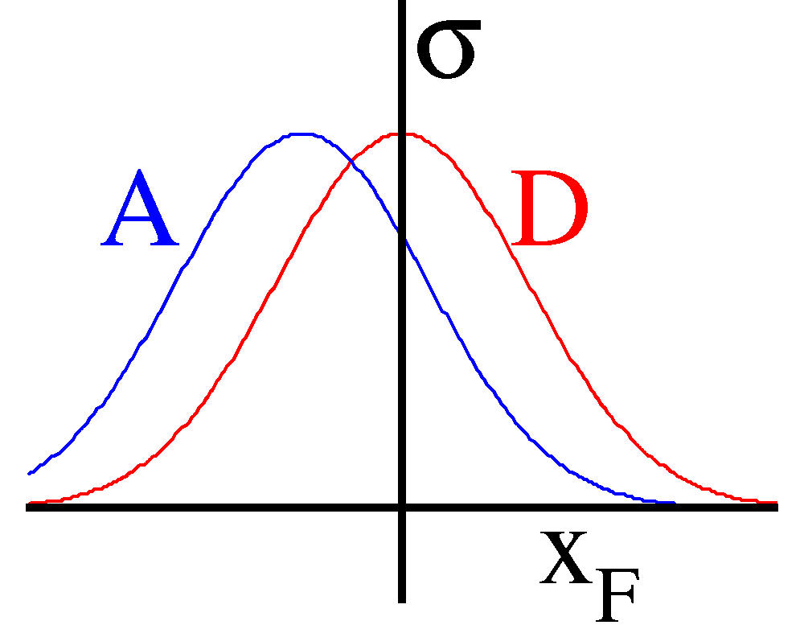
Determine and Calibrate dE/dx with DY in p+A
(Drell-Yan Process)
Known initial state nuclear parton density;
Minimal final-state interactions of the detected particles.
E906: No shadowing correction at moderate X_{t}
q, g
DY
euterium
Energy loss reduces x_{b} and x_{F} in nuclei versus proton (x_{F} = x_{b}-x_{t})
Possible sea-quark shadowing effects

