Slide 1
Overview of SeaQuest/E1039 Polarized Fixed Target Drell-Yan Experiment at Fermilab
Ming Xiong Liu (柳明雄)
Los Alamos National Laboratory
7/27/2018
The 10th Workshop on Hadron Physics in China and Opportunities Worldwide
Shandong University, Weihai, China

Slide 2
Outline
SeaQuest experiments at Fermilab
  E906 unpolarized targets
  E1039 polarized NH3 target
Novel physics of sea quarks at “intermediate x”
  Flavor asymmetry
  Sivers & OAM
Future opportunities
  E1067 dark photon search, 2016 - 2021+
  E1027 polarized beam, 2021+
  TMD physics in p+p/n complementary to EIC, 2019-2021+

Slide 3
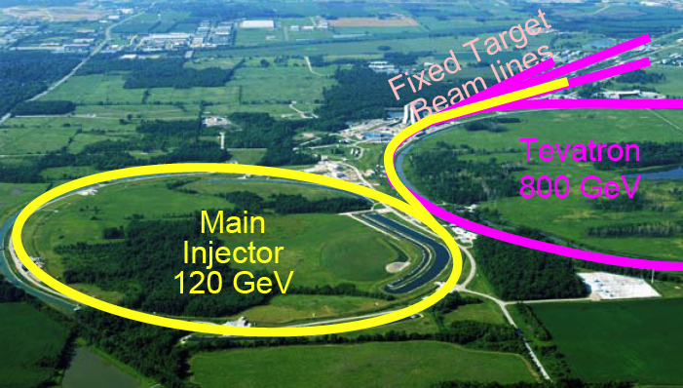
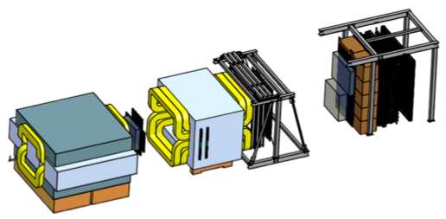
Fermilab High Intensity Frontier

Slide 4
SeaQuest Spectrometer
120 GeV protons from the Main Injector:
4 sec beam spill very 60 sec
19nS RF, ~10K protons per RF bucket
5x10¹² Proton On Target (POT) per spill
Total integrated POT for E1039:
1.4x10¹⁸ POT
Year 2015
Beam
120 GeV proton from Main Injector
19ns RF, 4s spill, 0.5×10¹³ protons per spill
E906 targets:
H, D, C, Fe, W
E1039 targets:
Polarized protons (NH₃)
Polarized neutrons (ND₃)

Slide 5
SeaQuest/E1039 Collaboration

Slide 6
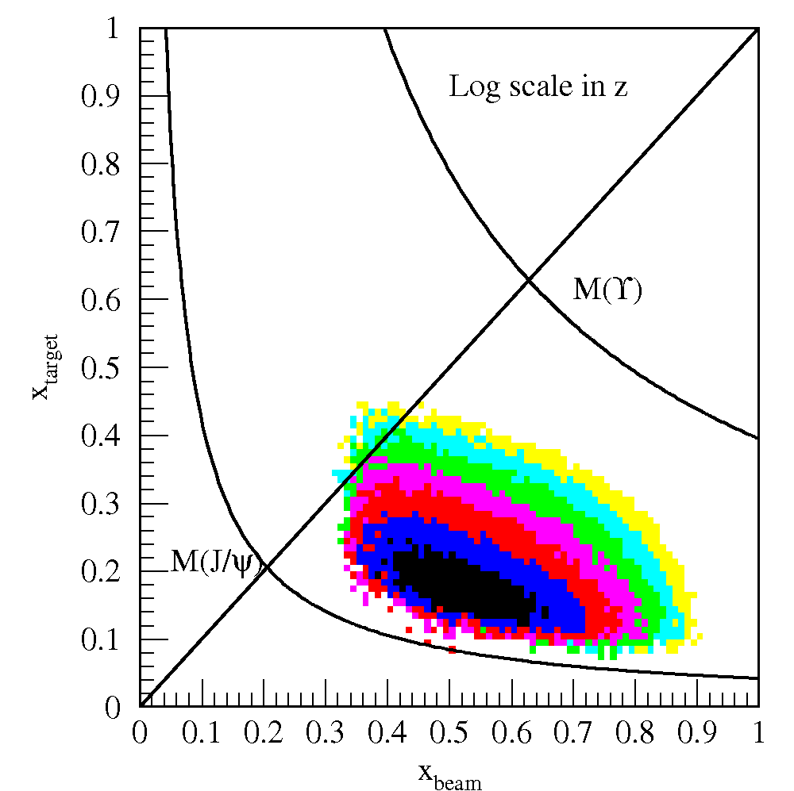
Drell-Yan @SeaQuest – a Sea Quark Laboratory
SeaQuest
acceptance
Kinematically favors sea-quarks
from target – a Sea Quark Lab!

Slide 7
E906 Unpolarized Physics Program
Targets: ~10% interaction length
  Liquid H/D
  Solid C, Fe, W
Physics
  Sea quark flavor asymmetry
  Quark energy loss in p+A collisions
Experimental runs:
  2012 – commissioning
  2017 – completed
Run history

Slide 8
Flavor Asymmetry of Sea Quarks at Intermediate x
Proton vs “Neutron” targets:

Slide 9
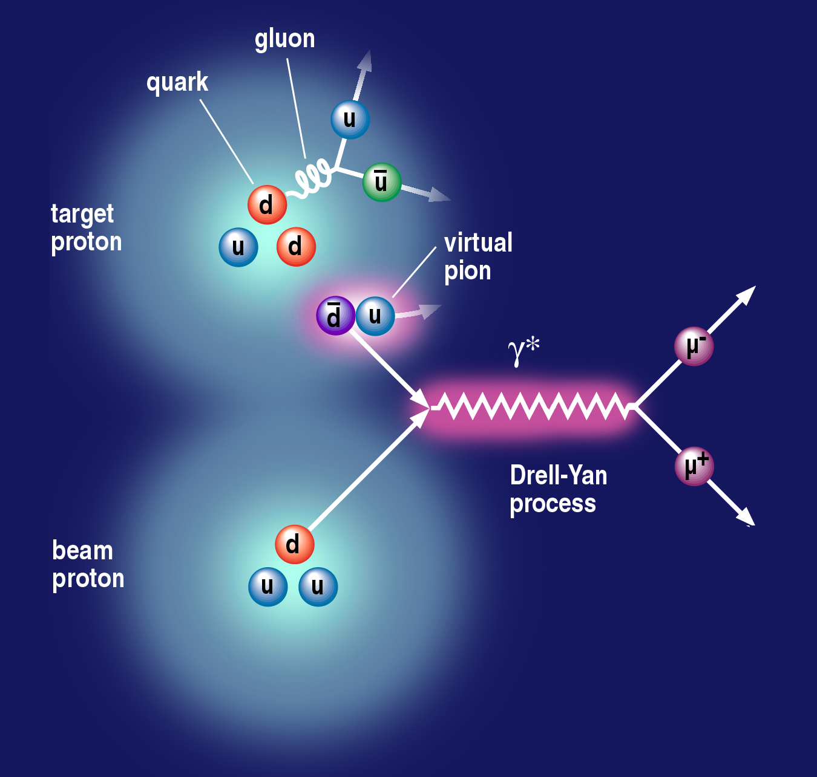
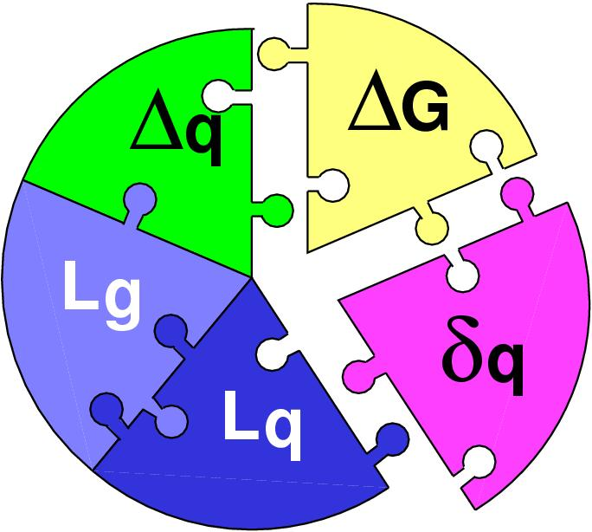
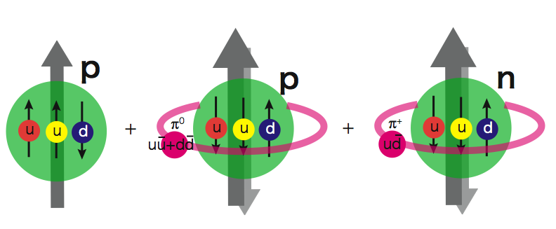
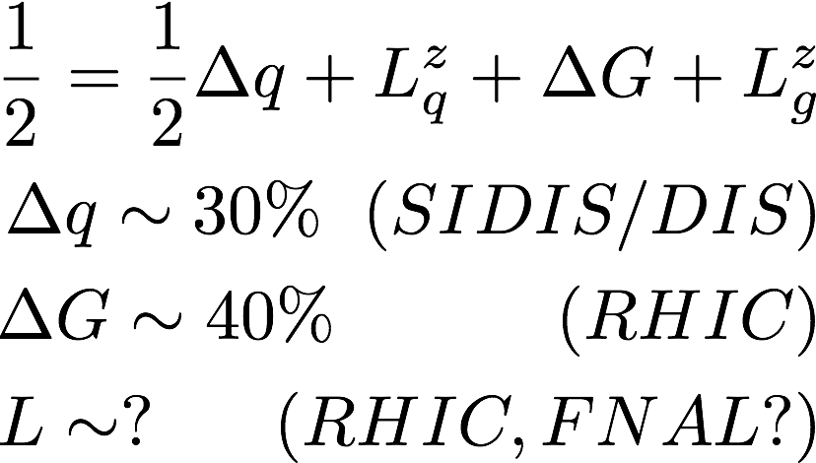
Flavor Asymmetry and Sea Quarks OAM?
Sea-quark flavor asymmetry
Sea-quark orbital angular motion and Sivers function at x = 0.0 ~ 0.3
Proton spin puzzle?
|p> = |p₀> + a|p₀ + pi⁰> + b|n+pi⁺> + …
E906 Spect.
Monte Carlo
E906 Spect.
Monte Carlo
E906 Spect.
Monte Carlo

Slide 10
TMD and Sivers Function

Slide 11
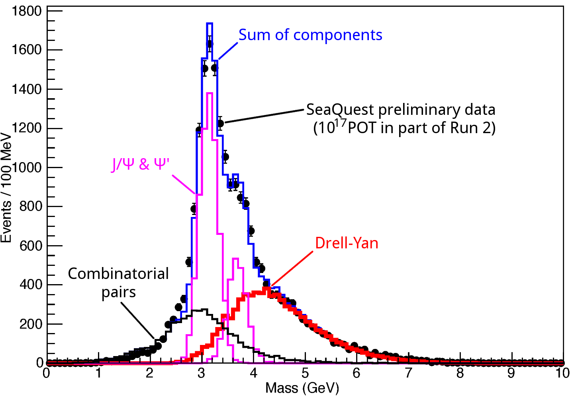
Dimuon Mass

Slide 12
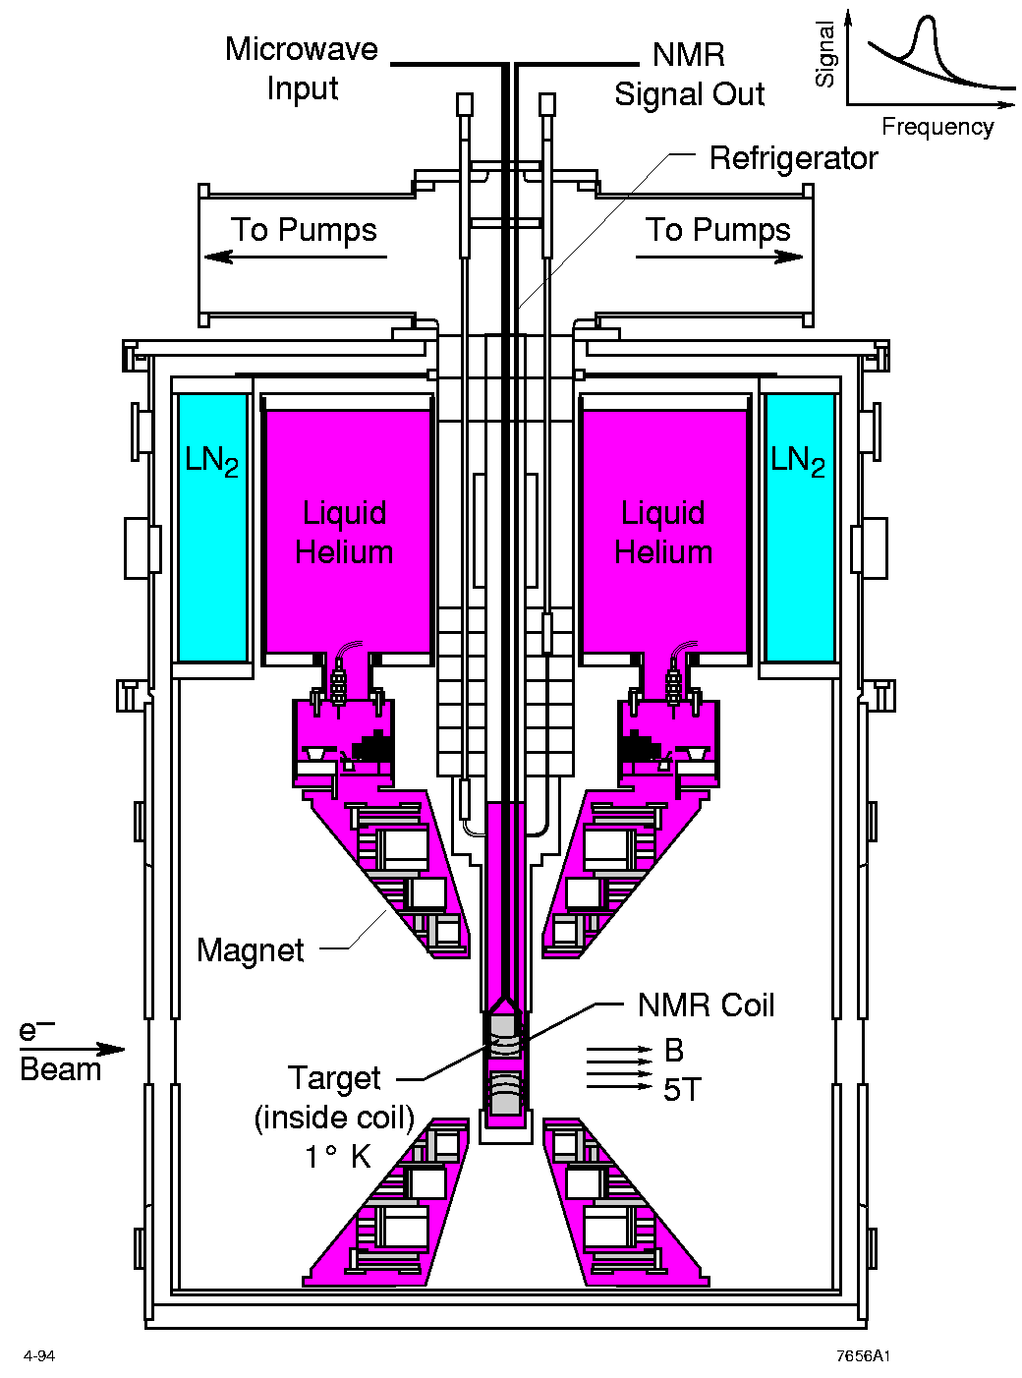
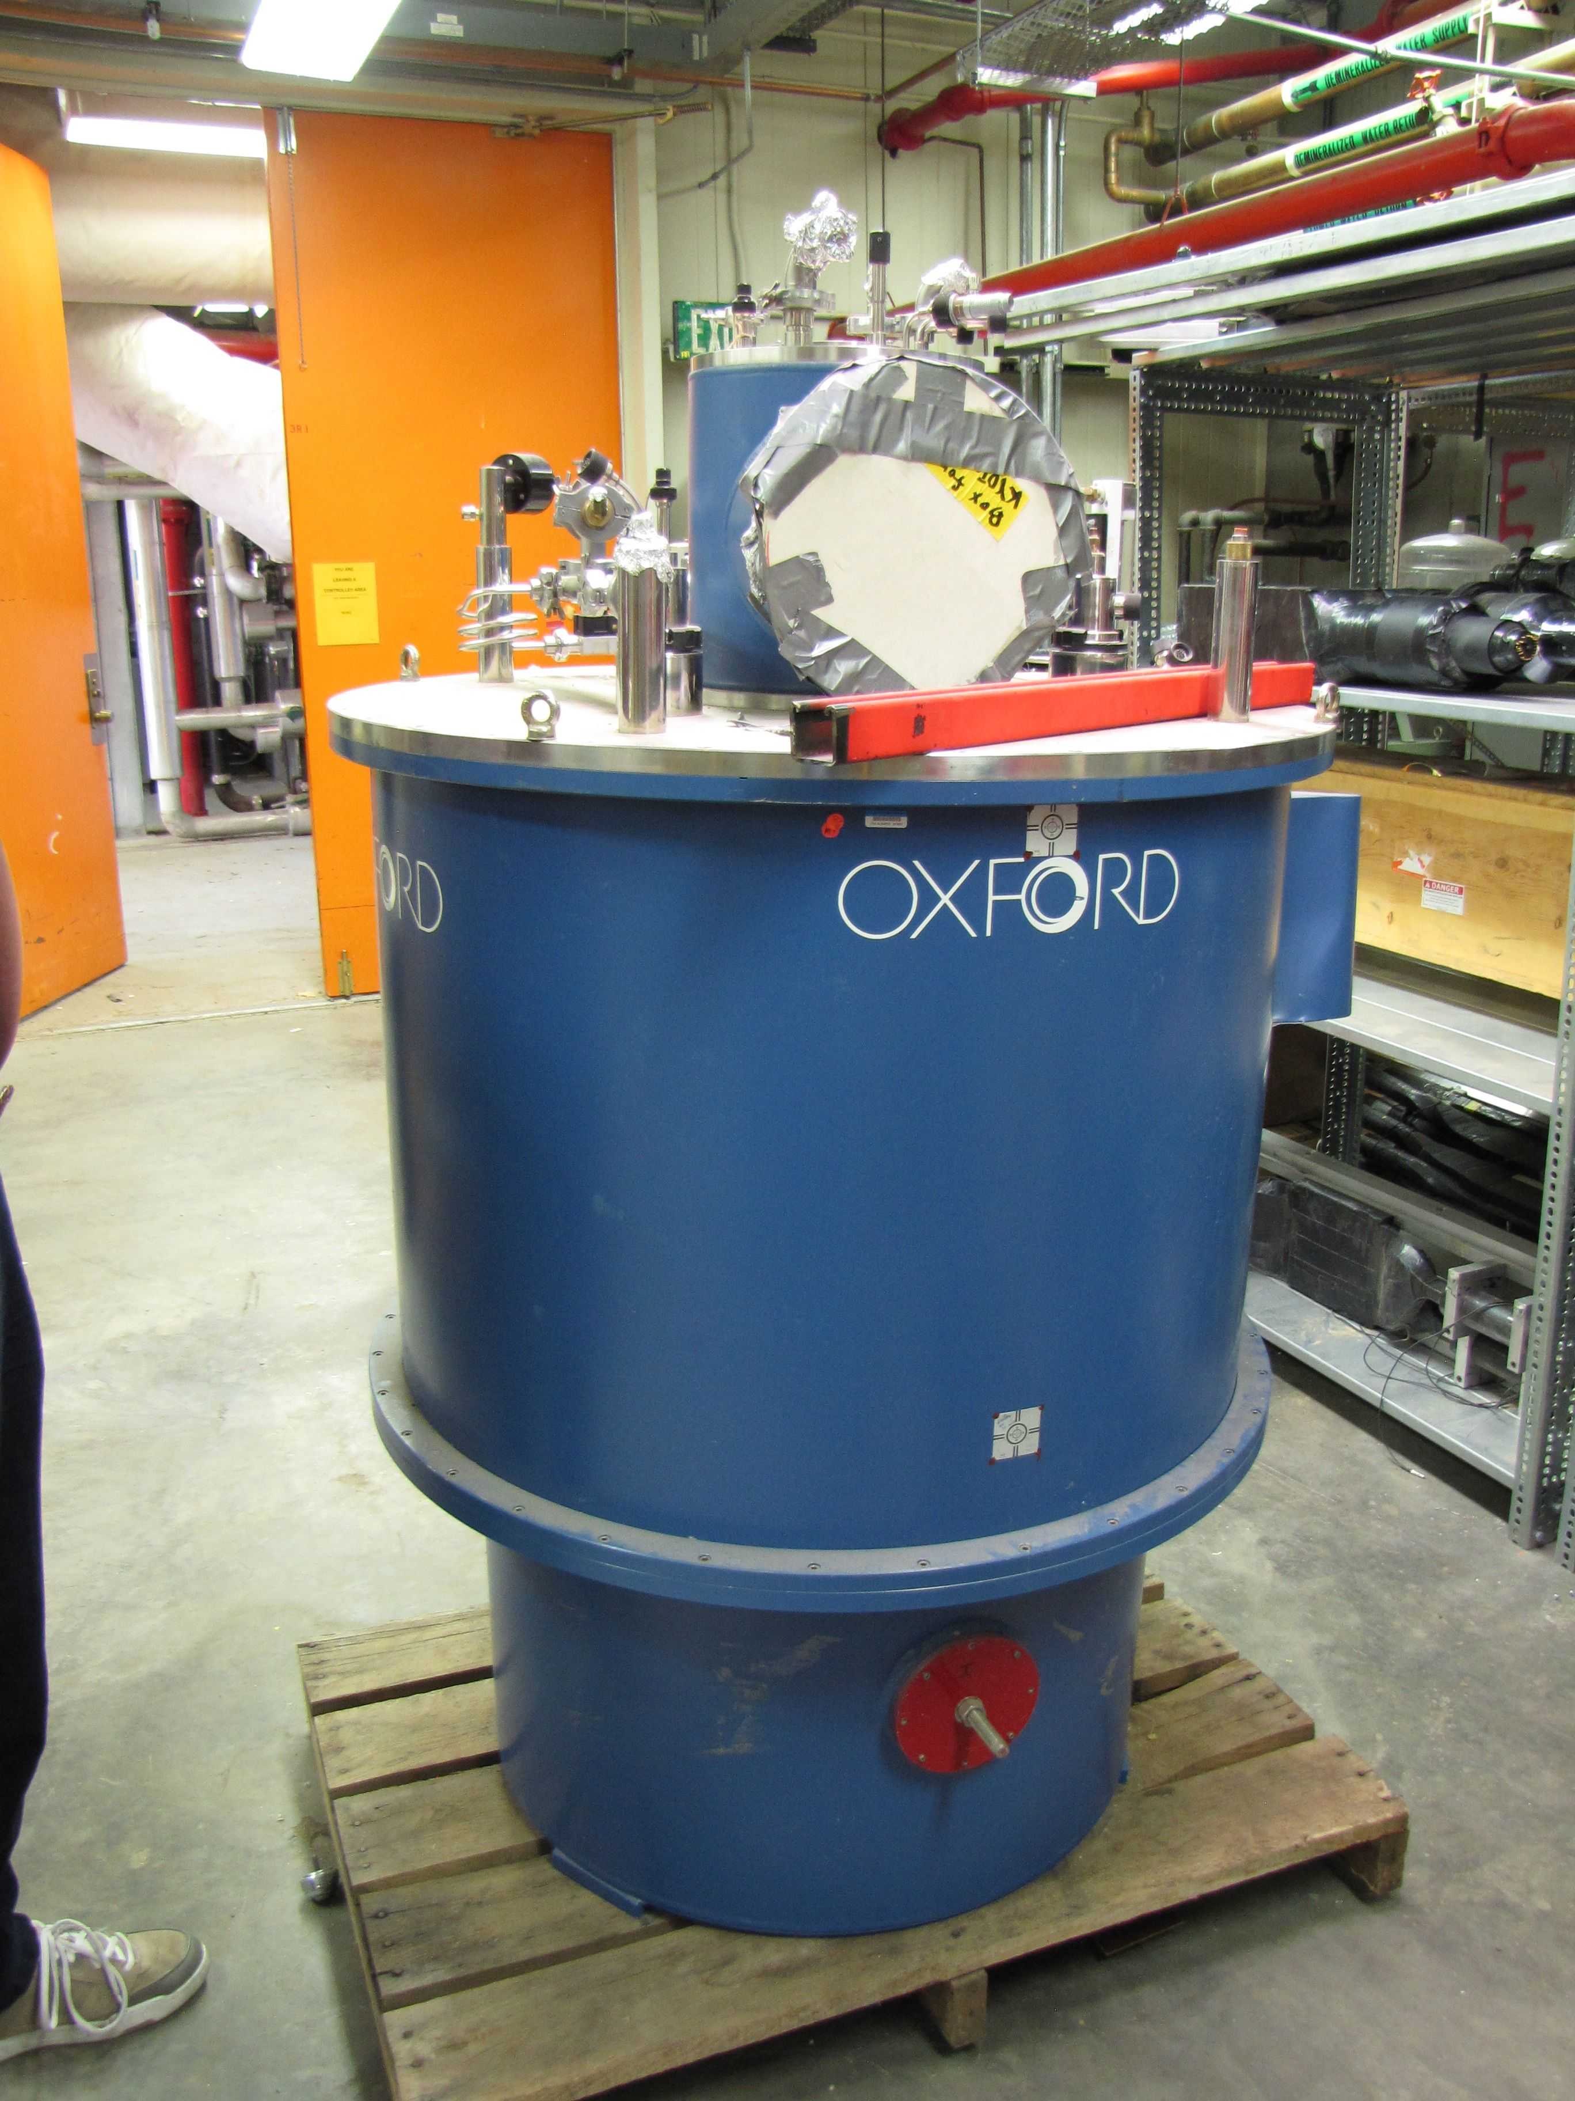
High Density Polarized Proton (Neutron) Target
Superconducting dipole magnet
  Temperature ~ 1 K
  Magnetic Field: 5 Tesla
  8cm long NH₃ (ND₃) target
Proved capable of handling high luminosity
  up to ~ 10³⁵ (Hall C)
~ 10³⁴ (Hall B)

Slide 13
Polarization
Target NH3

Slide 14
Projected Sensitivity

Slide 15
E1039 Status
E906 decommissioned 6/2018
E1039 shielding in progress
Beam collimator in fabrication, to be installed later
Polarized target to be installed by the end of 2018

Slide 16
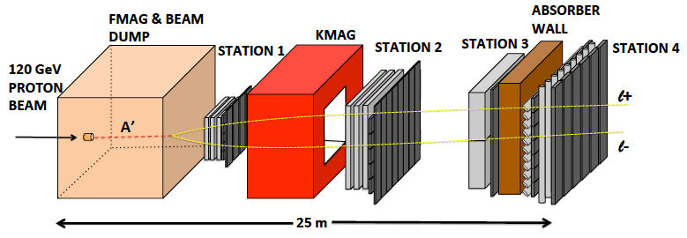
SeaQuest: A Sea Quarks Factory
Unique access to sea quarks at Intermediate-x via Drell-Yan Process
E1039 Coverage
Pol. Target

Slide 18
SeaQuest – Introduction
Spectromter
Run history

Slide 19
SeaQuest Timeline
E1039 Polarized Target Program: 2018 - 2021

Slide 20
Top View of SeaQuest/E1039 Spectrometer (Photo)

Slide 21
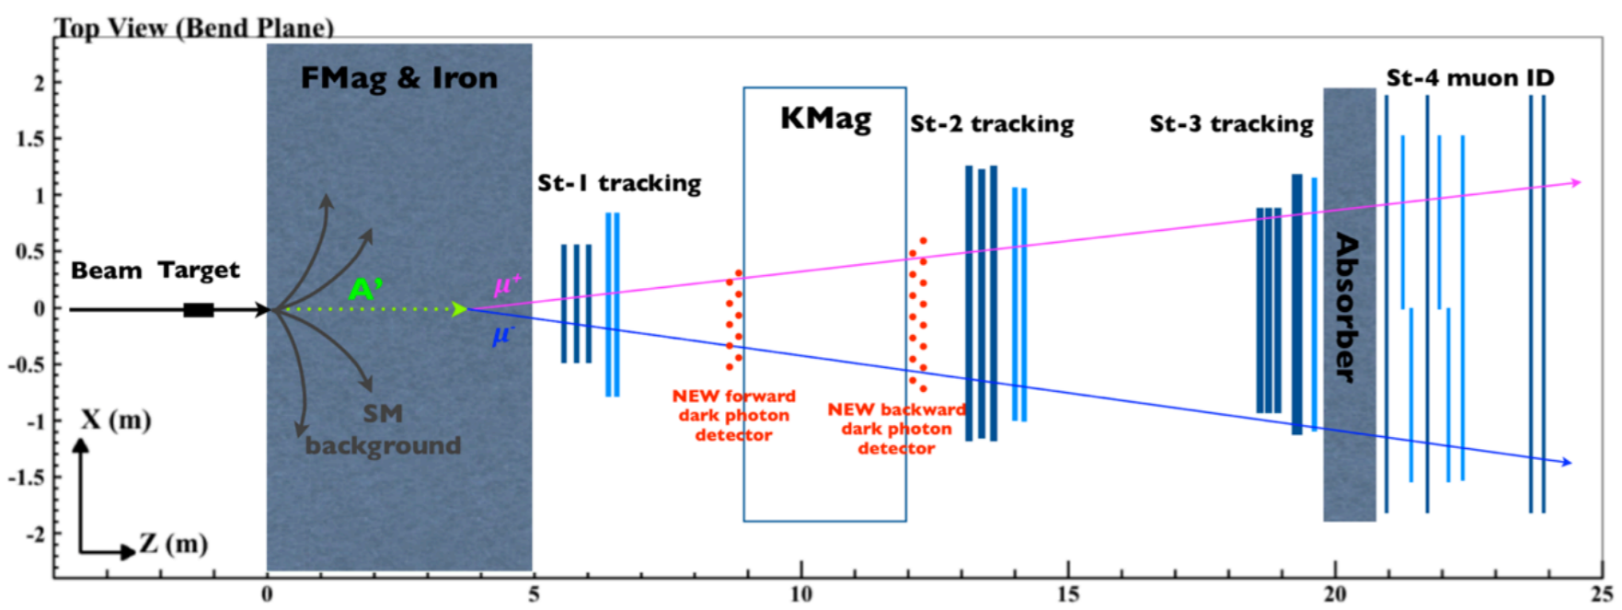
Proposal for a Dedicated Dark Sector Physics Program at SeaQuest
PAC endorsement is essential
attract new members;
start EMCal work at Fermilab in 2018
2019-2021: Parasitic Dark Sector physics program with E1039
  Attract and build up HEP groups in SeaQuest
    Carry out DP physics program with dimuons: dark photon, dark Higgs etc.
    EMCal refurbishment and preparation for integration at Fermilab, 2018-2021
  New HEP members develop SeaQuest detector expertise for the future experiment operation and data analysis
    Also help E1039 operation and maintenance of spectrometer and DAQ
  Transition into HEP DP program after E1039
    Develop new proposals, seek HEP DOE/NSF and other external fund
    Parasitic data taking with E1039 for DP search, further explore new opportunities
    Develop online/offline analysis, study DAQ and triggers capability for future DP experiment
    Background study, test small prototype in SeaQuest, w/ minimal impact on E1039
  E1039 2-year data taking: summer 2019 – summer 2021
2022-2024: first dedicated dark sector physics run @NM4
  Install EMCal for electron and hadrons ID, explore new phase space below dimuon mass (200MeV)
  Further develop dark sector physics program
  Possible NP parasitic physics program under discussion
  POT = a few 10¹⁸
2024-2025: major detector upgrade during the long shutdown
  Upgrade tracking chambers
  Add di-photon capability with preshower detectors
  Add tracking station-0 near target, more shielding
  Possible PID with TOF etc
  And more
2026-2030+: high luminosity dark sector physics program
  Full physics program with upgrade detectors, POT =10¹⁹~10²⁰
  Carry out an extensive (SHiP-like) HEP experimental program at NM4
  Possible NP parasitic physics program under discussion (~US EIC physics era)
SeaQuest in 2017 with displaced dark photon trigger
PAC endorsement is essential to develop this program
SeaQuest in 2021+ with EMCal upgrade

Slide 22
Dark Sector Physics Search Program at Fermilab SeaQuest
2018 2019 2020 2021
2022 2023 2024 2025
2026 2027 … 2030+
E1039 installation
& commissioning
Planned
Parasitic Dark Sector
Physics with E1039
Proposed
PHENIX EMCal refurbishment at Fermilab,
HEP dark sector physics program development
EMCal installation
& commissioning
Long shutdown,
detector upgrade
High luminosity dark sector physics
program at Fermilab Intensity Frontier
DP search w/ EMCal upgrade
Parasitic Nuclear Physics program possible
Parasitic Nuclear Physics program possible

Slide 23
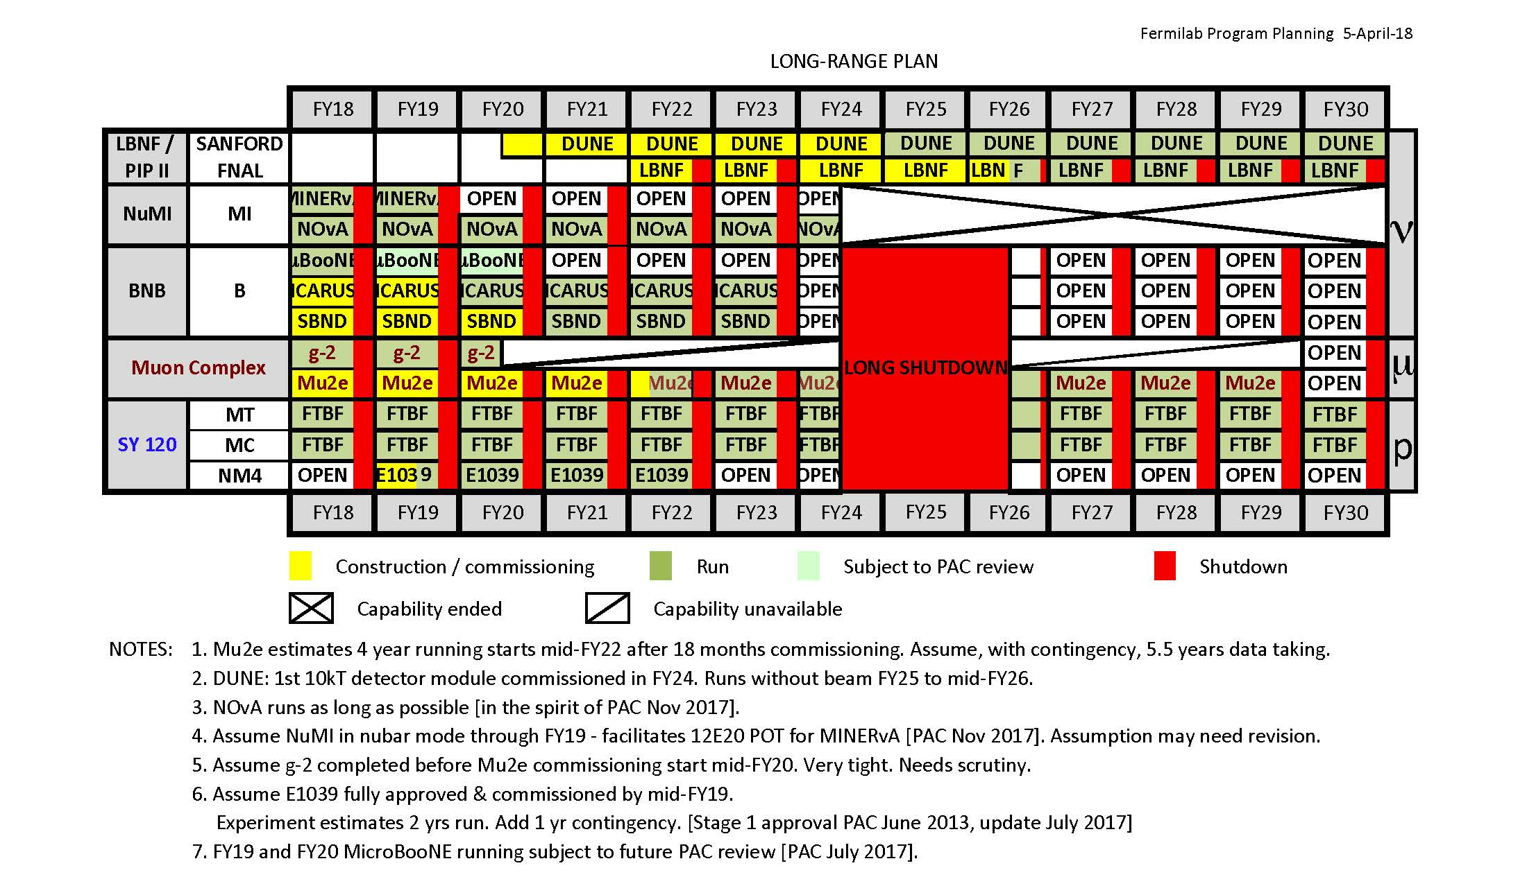
Fermilab Long Range Plan

Slide 24
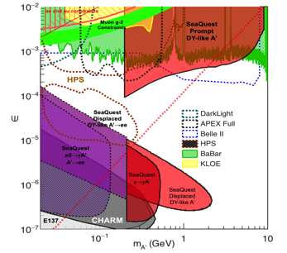
Money Plots (I) to include all other experimental searches up to year ~2025+
Phase space covered by SeaQuest:
2019 ~2021 – dimuon channel (POT = 10^18)
2022-2024 – add di-electron (POT = 10^18)
2026 – 2030+ --- all channels (POT > 10^19)
SeaQuest dark photon coverage:
Dimuons (current capability)
Di-electrons (w/ EMCal upgrade)
Detailed SeaQuest coverage in various production channels with
di-electrons and di-photons
17MeV
arXiv:1804.00661

Slide 25
Money Plots (II) - with all Future Projections

Slide 26
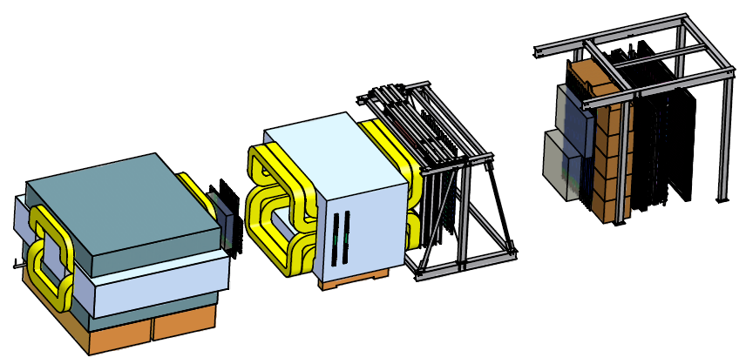
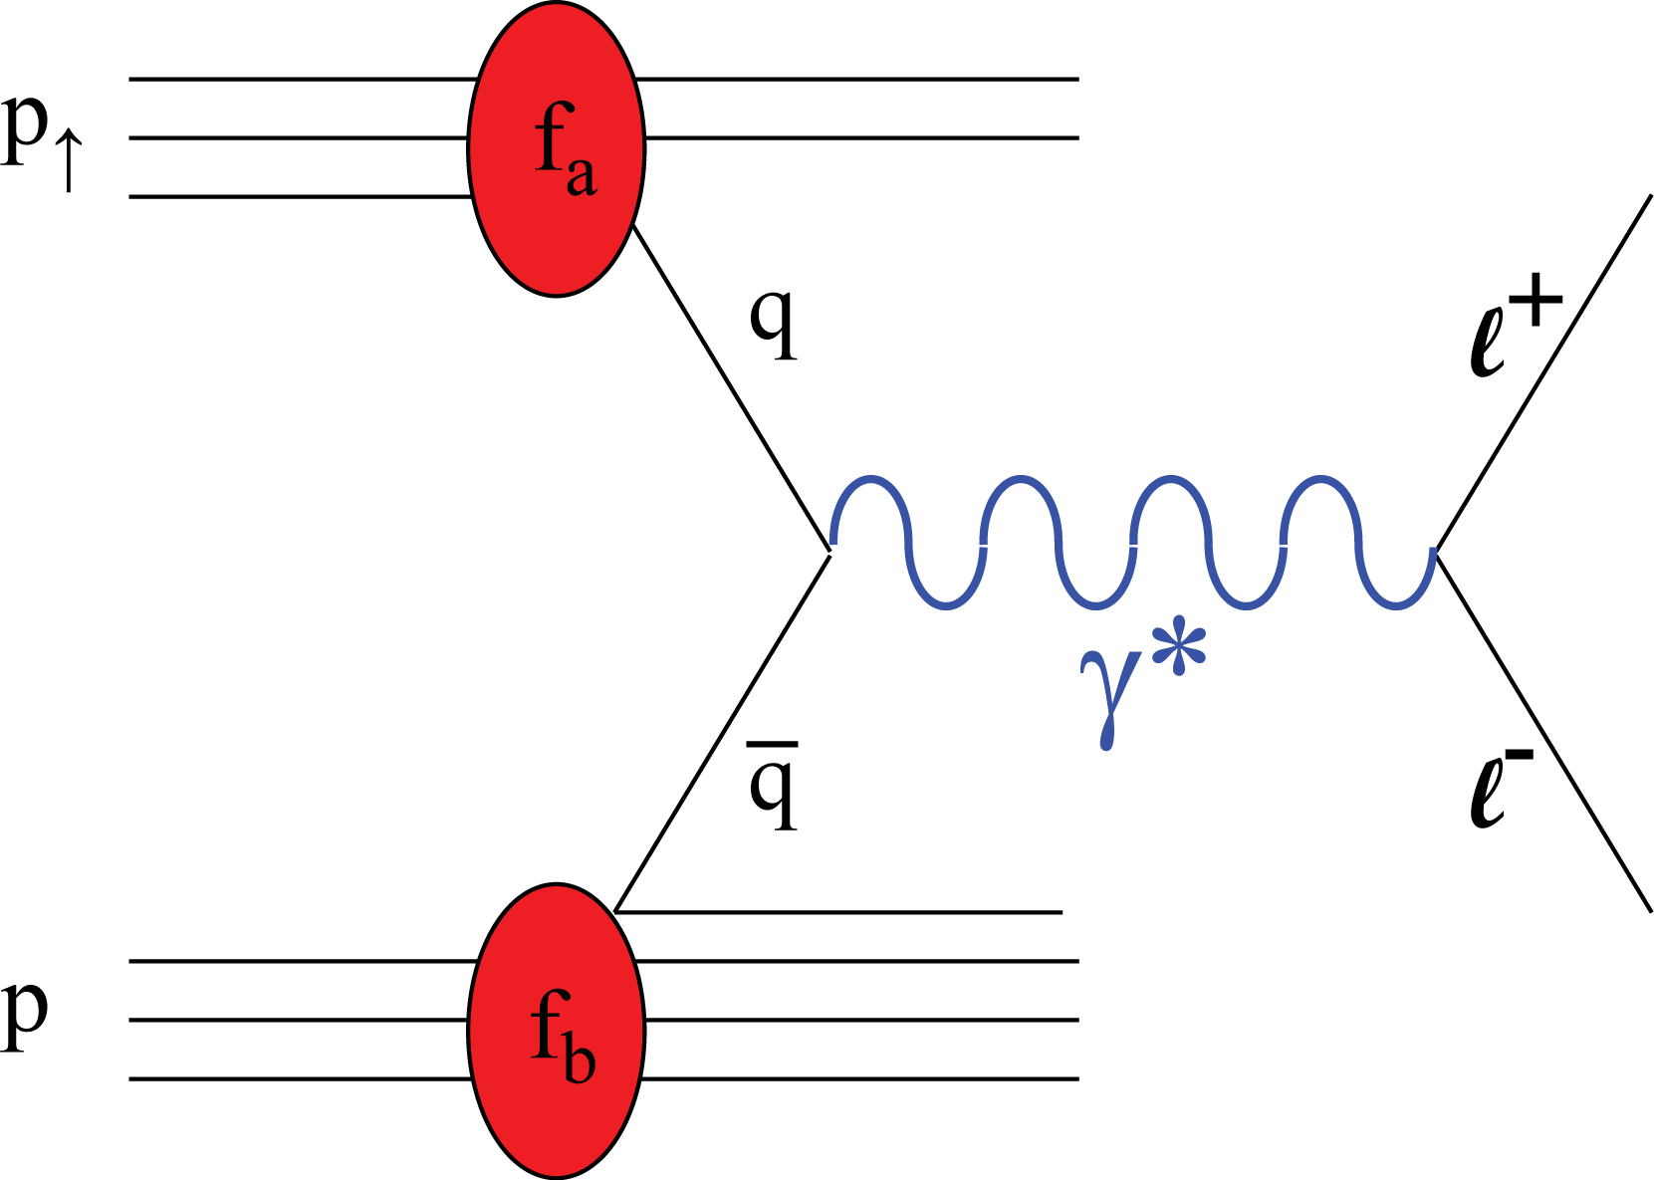
Summary:
A New Polarized Fixed Target Drell-Yan Experiment @Fermilab
A New Polarized Target
4.9m
Drell-Yan Transverse Single Spin Asymmetry (2018-2021)
Parasitic Dark Photon search, E-1067 (2018 – 2021+)
Polarized 120 GeV proton beam from the Fermilab’s Main Injector, E-1027 (2021+)

Slide 27

SeaQuest at the Intensity Frontier at Fermilab
High intensity proton beam: “beam dump mode” @SeaQuest/E1067
35,000 fb⁻¹ (in a 2-year parasitic run, 1.4x10¹⁸ POT @5% beam)
LHC-II: 300 fb⁻¹ (~2025), achieved 25fb⁻¹ in Run-I
B-factory@KEK: 50K fb⁻¹ (~2023)
Absorber wall and proportional
tube based Muon ID
Spectrometer magnet
Δpt = 0.4 GeV
Focusing magnet
and solid iron dump
Δpt = 2.9 GeV
Beam
120 GeV proton from Main Injector
19ns RF, 4s spill, 0.5×10¹³ protons per spill
25 m
Target system
Polarized NH3
120 GeV high intensity protons from the Main Injector:
4 sec beam very 60 sec,
19nS RF, ~10K protons per RF bucket
5x10¹² Proton On Target (POT) per spill
Total integrated POT: 1x10¹⁸ POT
4 sec beam@SeaQuest

Slide 28
SeaQuest/E1039 Drell-Yan Exp.
A New Polarized Fixed Target Drell-Yan Experiment @Fermilab
A New Polarized Target
4.9m
4 sec beam@SeaQuest
60 sec cycle
Plot from dark photon talk to show all current detector
120 GeV high intensity protons from the Main Injector:
4 sec beam very 60 sec,
19nS RF, ~10K protons per RF bucket
5x10¹² Proton On Target (POT) per spill
Total integrated POT: 1x10¹⁸ POT

Slide 30
Complimentality between DIS and Drell-Yan
DIS
Drell-Yan
Polarized DIS
Polarized DY NOT yet!
McGaughey, Moss, Peng,
Ann.Rev.Nucl. Part. Sci. 49 (1999) 217
Both DIS and Drell-Yan process are tools to probe the quark and antiquark structure in hadrons (factorization, universality)
30

Slide 31
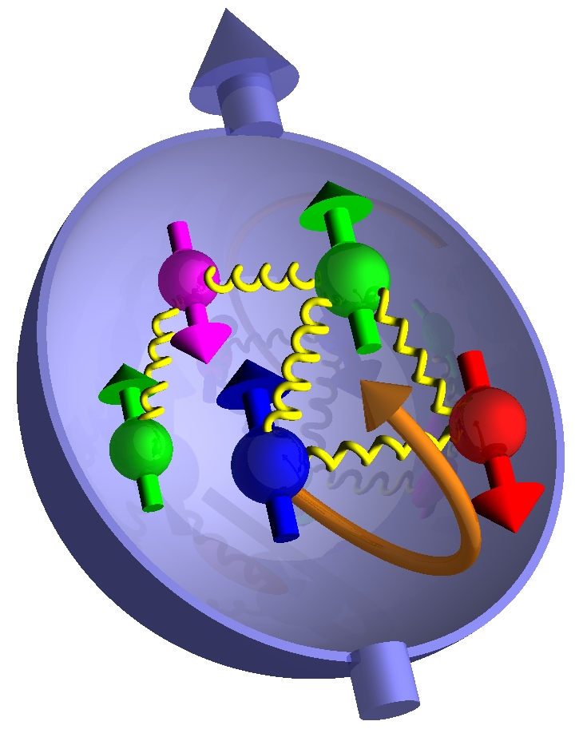
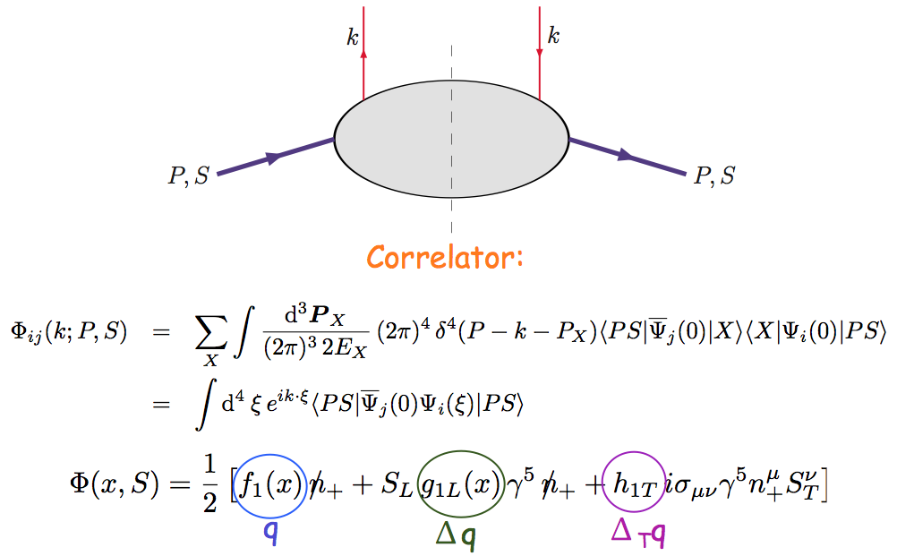
Nucleon Structure @Leading Twist Collinear Approximation (I)
Partonic interpretation of hard scatterings
Universal functions

Slide 32
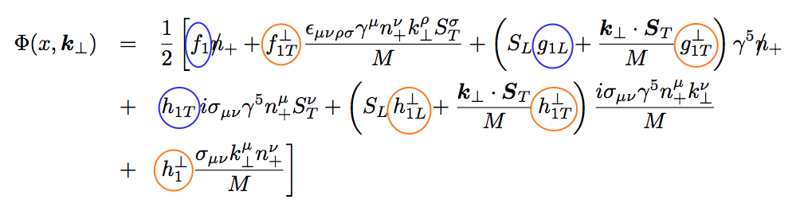
Including k_{T} … 5 more (II)
No K┴ dependence
K┴ - dependent
T-even
K┴ - dependent
T-odd

Slide 33
Transversity and TMDs can be probed via DY

Slide 34
Drell-Yan Transverse Single Spin Asymmetry @Fermilab
SeaQuark Sivers Effects
The first precise measurements of seaquark Sivers distributions
@ large x = 0.1~0.4 where significant Sivers Asymmetry observed in pol. SIDIS
Sea-quark’s Sivers Funcs poorly known
Pol. Target
E906 Coverage
Current E906
Coverage

Slide 35
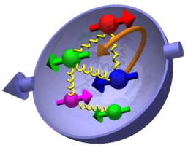
Outline
Overview of latest TMD physics
  Recent highlights and global fits
    RHIC/W, charged hadrons, J/Psi, Charm
    COMPASS DY, JLab
SeaQuest opportunities
  Sea quark Sivers,
    ubar & dbar
  Gluon Sivers at valence region
  Transversity distributions
  Experimental observables
    J/Psi
    Open charm
Day-1 physics
  Positive signal confirmation
  Target and dump separation
  Trigger optimization

Slide 36
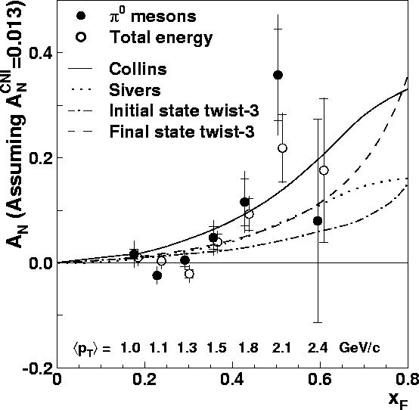
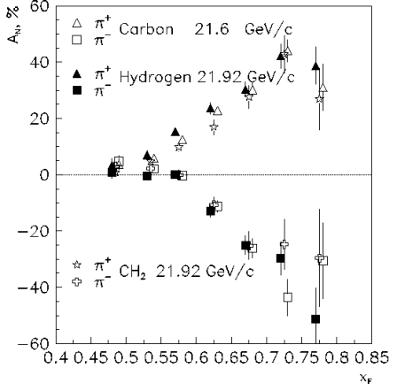
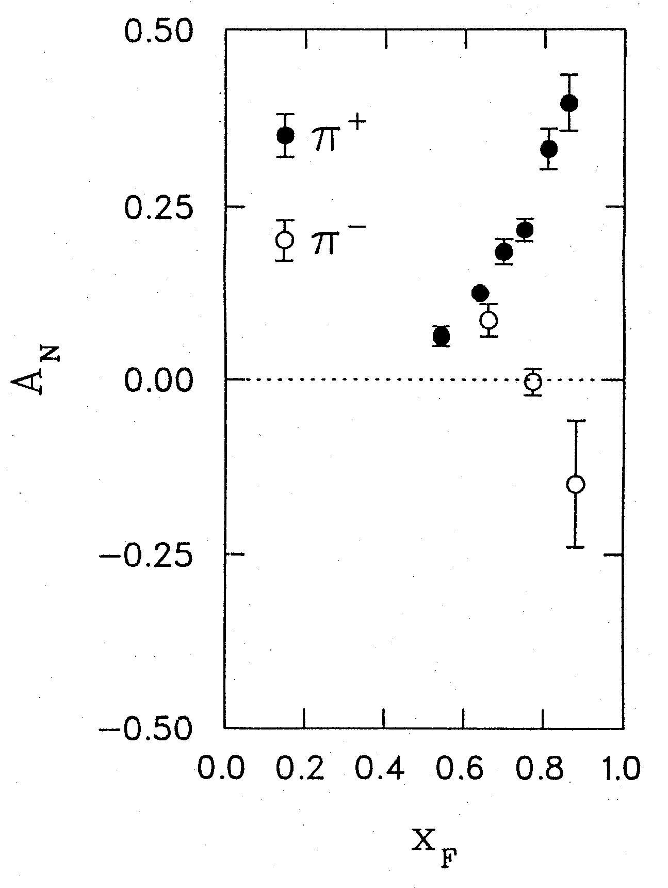
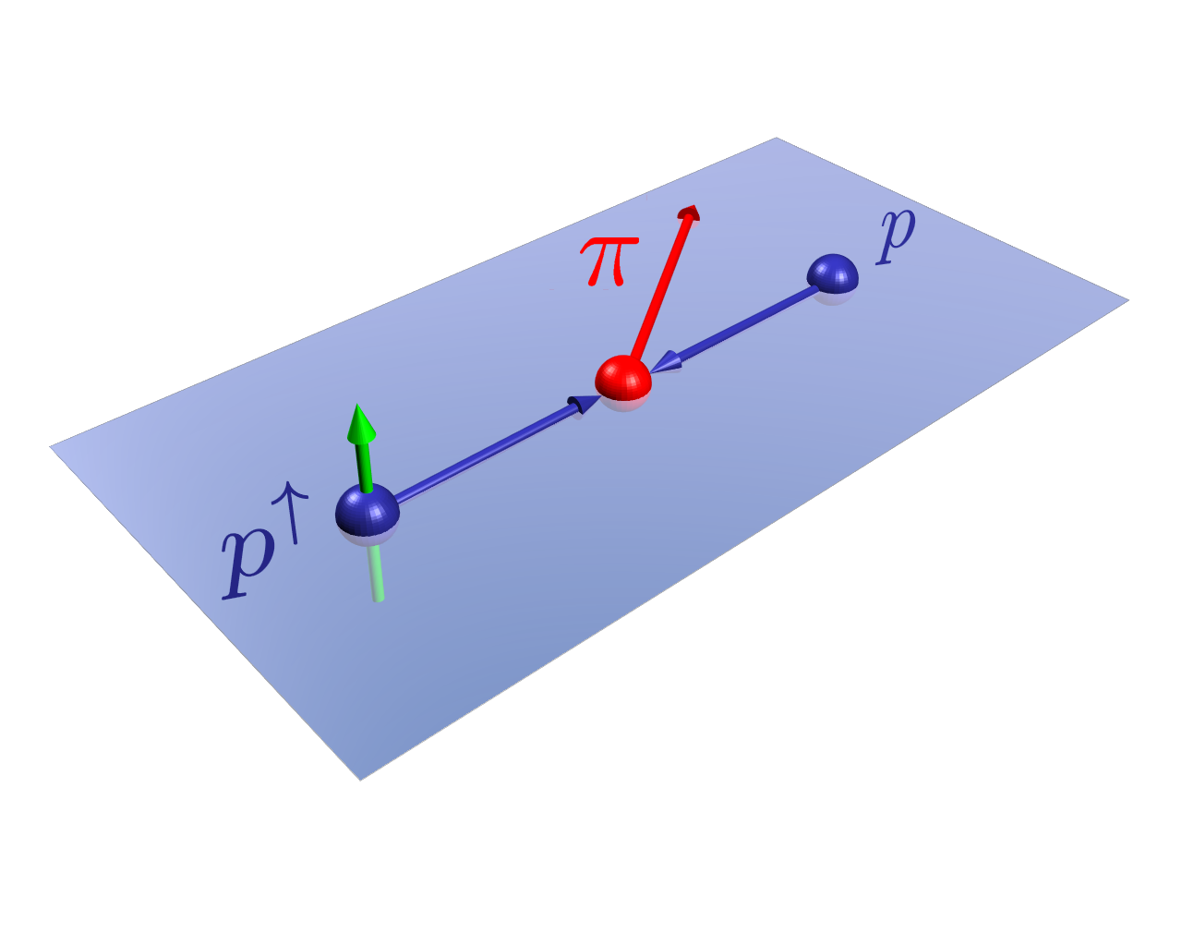
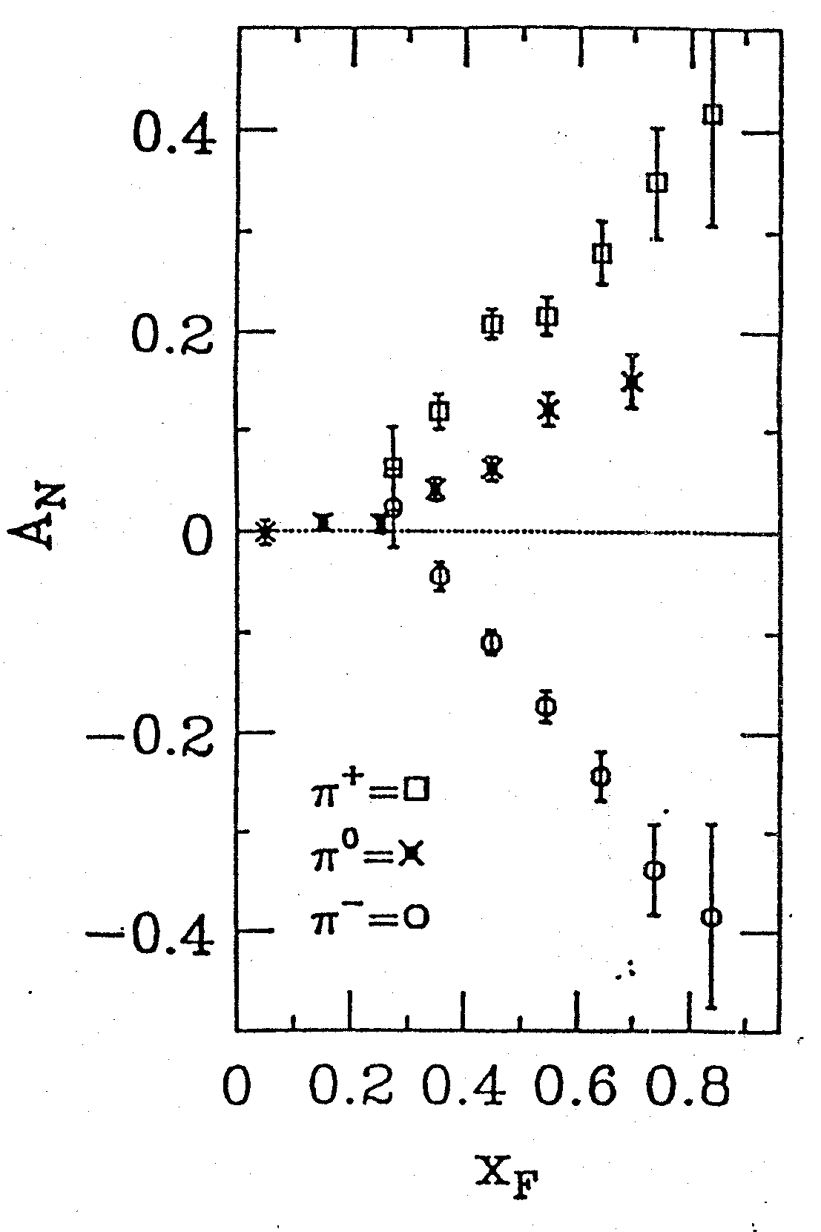
Four Decades of Transverse Spin Measurements
- Do we understand the physics?
RHIC 200 GeV CMS
Large Transverse Single Spin Asymmetry (TSSA) in forward hadron production persists up to top RHIC energy.
FNAL 200 GeV beam
AGS 22 GeV beam
ZGS 12 GeV beam
PRL (2004)
PLB261, 201 (1991)
PLB264, 462 (1991)
PRD65, 092008 (2002)
PRL36, 929 (1976)
Sivers, Collins, Twist-3 ….
Non-Perturbative cross section
Perturbative cross section

Slide 37
Nucleon 3-D Structure and TMD
TMD: f(x, k_{T}),
Sivers functions, quark transversity etc.

Slide 38
Probe the Underlying Physics via Hard Scatterings
TMD vs Collinear Twist-3 Factorizations
(i) Sivers mechanism:
correlation proton spin & parton k_{T}
(ii) Collins mechanism: Transversity × spin-dep fragmentation
S_{P}
Phys Rev D41 (1990) 83; 43 (1991) 261
S_{P}
Nucl Phys B396 (1993) 161
S_{q}
p
k_{T,q}
p
p
p
S_{q}
k_{T,π}
Collinear Twist-3 (RHIC, Fermilab):
quark-gluon/gluon-gluon correlation

Slide 39
Hadron TSSA in p+p in Twist-3 Framework
Qiu & Sterman PRD 59 (1998)
1st term: twsit-3 correlation functions, “Sivers”
2nd term: twist-2 transversity * twist-3 from unpol beam (expected small)
3rd term: twist-2 transversity * twist-3 FF, “Collins”
39

Slide 40
Sivers Functions from Global Fits – Quarks
Sea Quark Sivers poorly constrained, but seem small
1612.06413, M. Anselmino et al

Slide 41
Drell-Yan Sivers Asymmetries
Kang et al, 1401.5078
COMPASS
SeaQuest: p+p
COMPASS
n+p desired!

Slide 42
Polarized Target
DNP: P ~90%
THERMAL EQUILIBIRUM: P ~ 0.5%
P

Slide 43
E1039 DY A_{N} Sensitivity
It is critical to control of systematic
errors for high precision measurements
SeaQuest: p+p

Slide 44
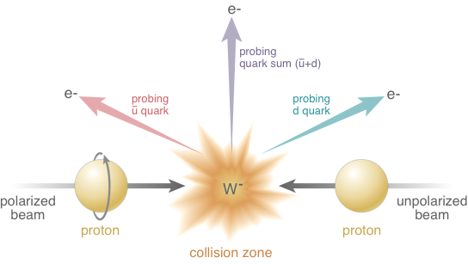
Electroweak Probe for Sea Quarks at High Energy at RHIC
A_{N}(W⁺) ~
Sensitive to flavor identified
(sea)quarks’ Sivers functions
A_{N}(W⁻) ~

Slide 45
RHIC W^{+/-} TSSA: Sea Quark Sivers
QCD Evolution included, Kang et al, 2014
QCD evolution:
reduces the amplitude
Anselmino et al 2016
RHIC data:
Statistically limited, ~0(10%)
E1039:
- lower Q²
- Better statistics, ~O(1%)

Slide 46
Non-Vanishing Sea Quark Sivers Distribution ?
Sea quark generates left-right bias ?
Left-right bias generated through fragmentation process ?
But the asymmetry from sea-quark
could not be very large

Slide 47
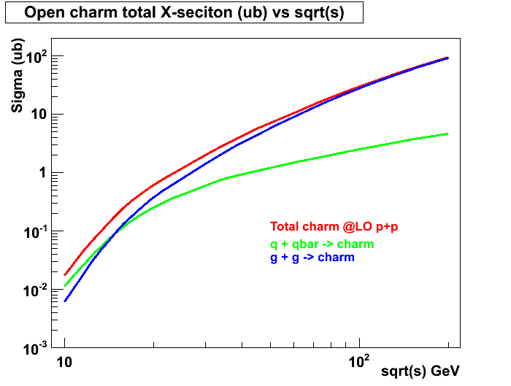
Open Charm Production in p+p at LO
- access gluon distribution
@SeaQuest:
relative contributions sensitive to XF
~50% from g+g
~50% from q+qbar
Similar for J/Psi
RHIC 200 GeV
RHIC 62GeV
E906
JAPRC

Slide 48
Gluon Sivers in the Valence Region
- a lot of gluons at high x!
1611.00125 Z. Lu & B.Q. Ma
Gluon Sivers poorly known
Unpolarized PDF:
Glons dominate at x < 0.2
SeaQuest coverage
by charm

Slide 49
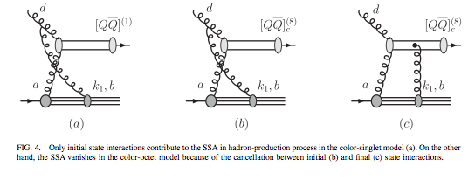
J/ψ A_{N}
J/ψ A_{N} is sensitive to the production mechanisms
  Assuming a non-zero gluon Sivers function, in pp scattering, J/ψ A_{N} vanishes if the pair are produced in a color-octet model but survives in the color-singlet model
  F. Yuan, PRD 78, 014024(2008)
One color-singlet diagram
— no cancellation, asymmetry generated by the initial state interaction, A_{N}≠0
Two color-octet diagrams
— cancellation between initial and final state interactions, no asymmetry A_{N}=0

Slide 50
Heavy Flavor: J/ψ A_{N}
Some nuclear final state effects?
PHENIX: 1805.01491

Slide 51
High Precision A_{N} Measurements @SeaQuest
Cross section contributions:
- gluon+gluon
u + ubar
d + dbar, could be significant
Sivers functions:
  Gluon
  ubar
  dbar
Polarized targets:
- NH3
- ND3

Slide 52
SeaQuest Dimuons:
Improve acceptance for low mass dimuons
Open up dimuon acceptance at trigger level:
Possible with the dark photon triggers
Improved DAQ
Better background determination
PHENIX dimuons

Slide 53
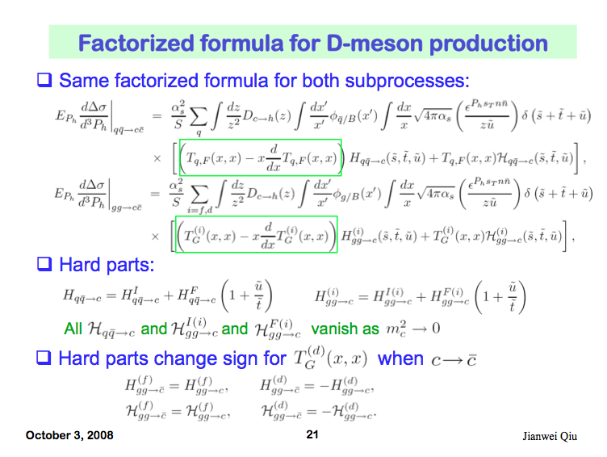
Open Charm TSSA in Twist-3 Approach
Qiu, 2010

Slide 54
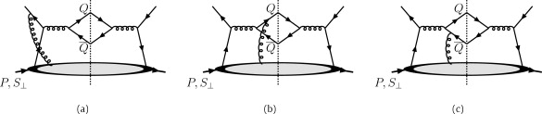
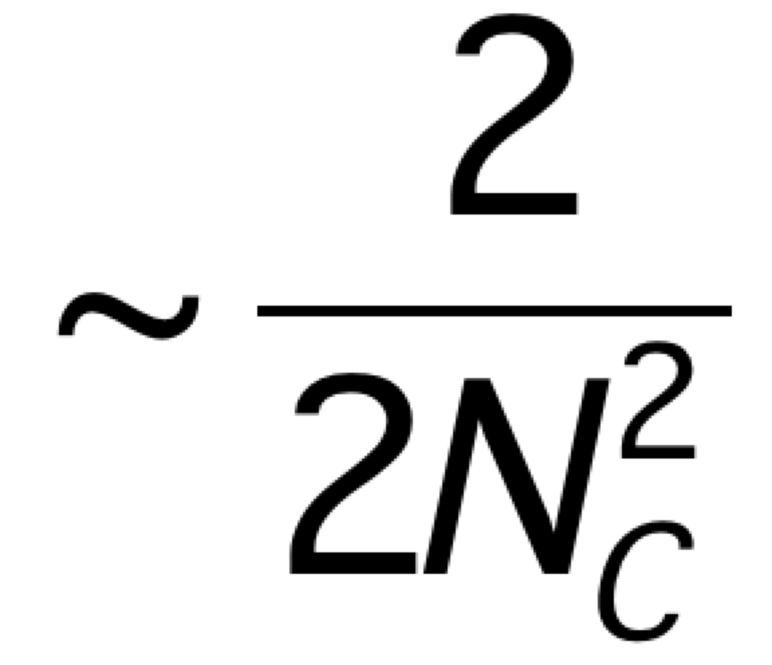
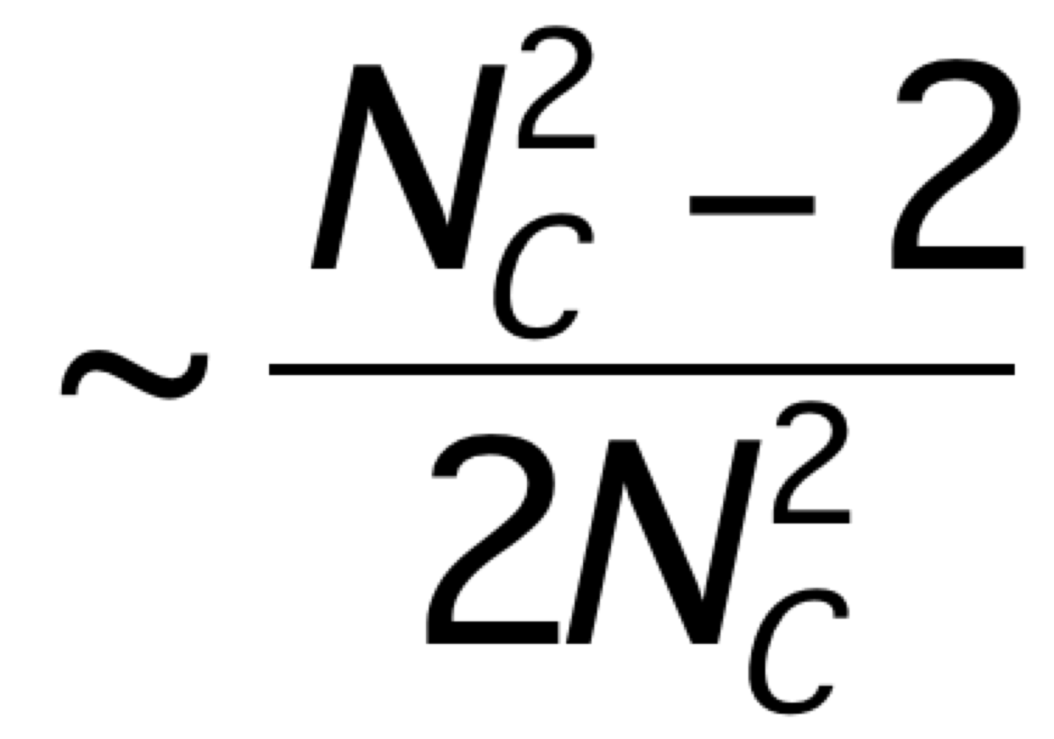
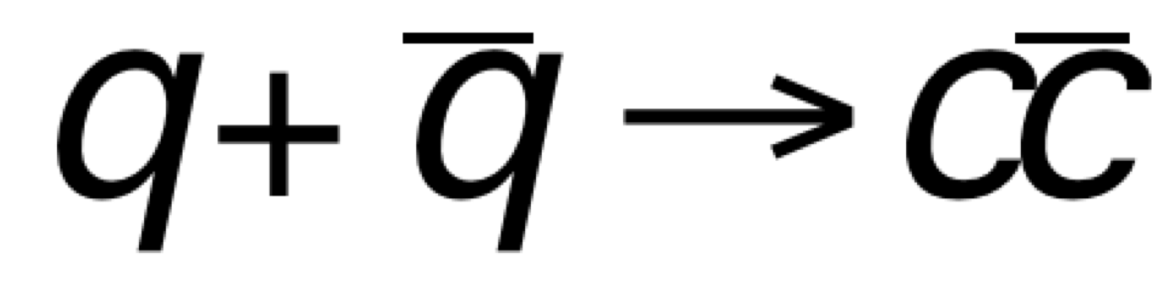
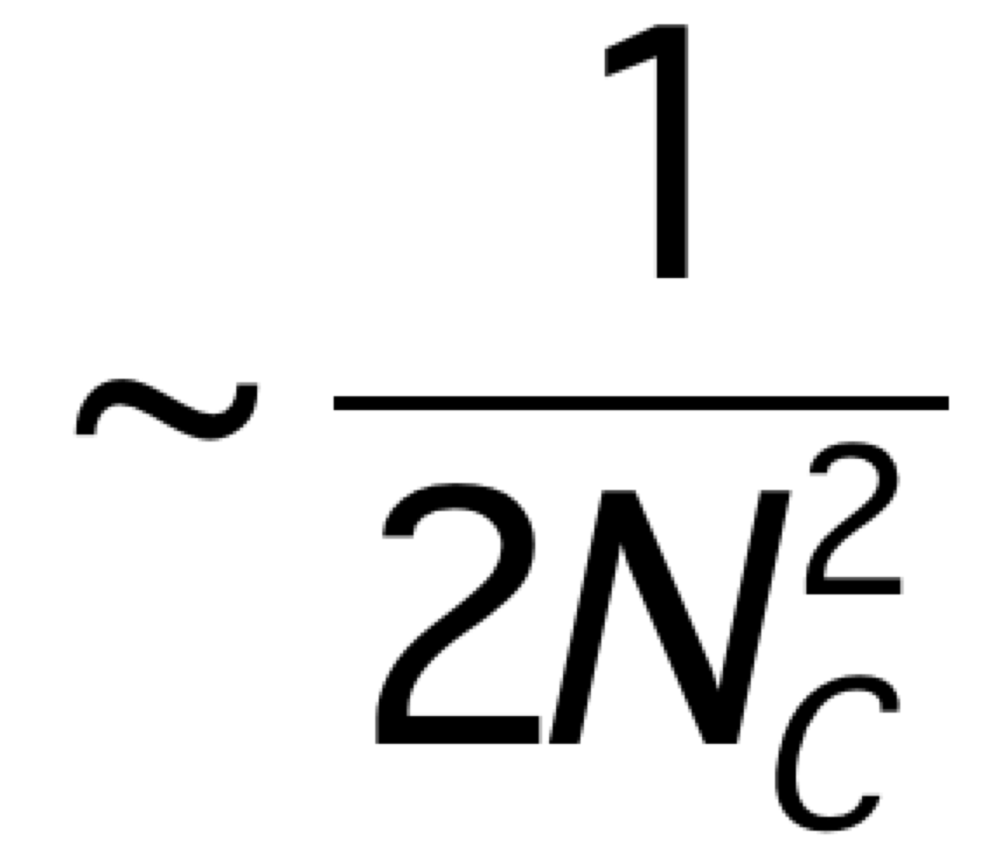
Heavy Quark TSSA @Fermilab
Twist-3 quark-gluon correlation functions
Different color factors for charm and anti-charm A_{N}
F. Yuan and J. Zhou PLB 668 (2008) 216-220
Initial state
Charm
anti-Charm

Slide 55
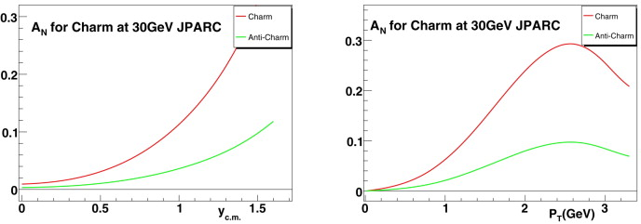
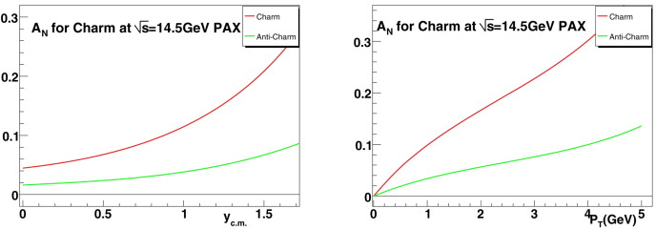
Open Charm TSSA at Low Energy
JPARC p+p
GSI: p+pbar

Slide 56
First Precision Open HF A_{N} from PHENIX

Slide 57
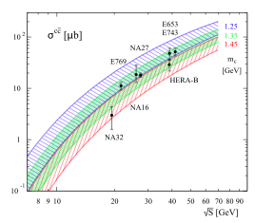
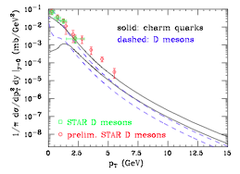
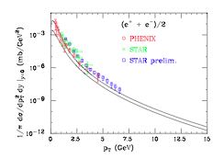
More on Open Charm Production
Fixed targets vs NLO
Collider mode @RHIC
PRL 95, 122001 (2005) M. Cacciari, P. Nason, R. Vogt
EPJ C 52, 987 (2007) J. Riedl, A. Schafer, M. Stratmann
SeaQuest

Slide 58
Open Charm via high pT Single muons?
Open charm cross section
  Test NLO pQCD framework
Open charm TSSA
  test pQCD twist-3 framework
High pT single muon trigger
Target and dump separation

Slide 59
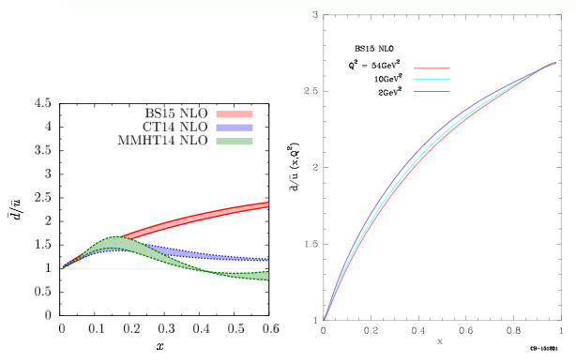

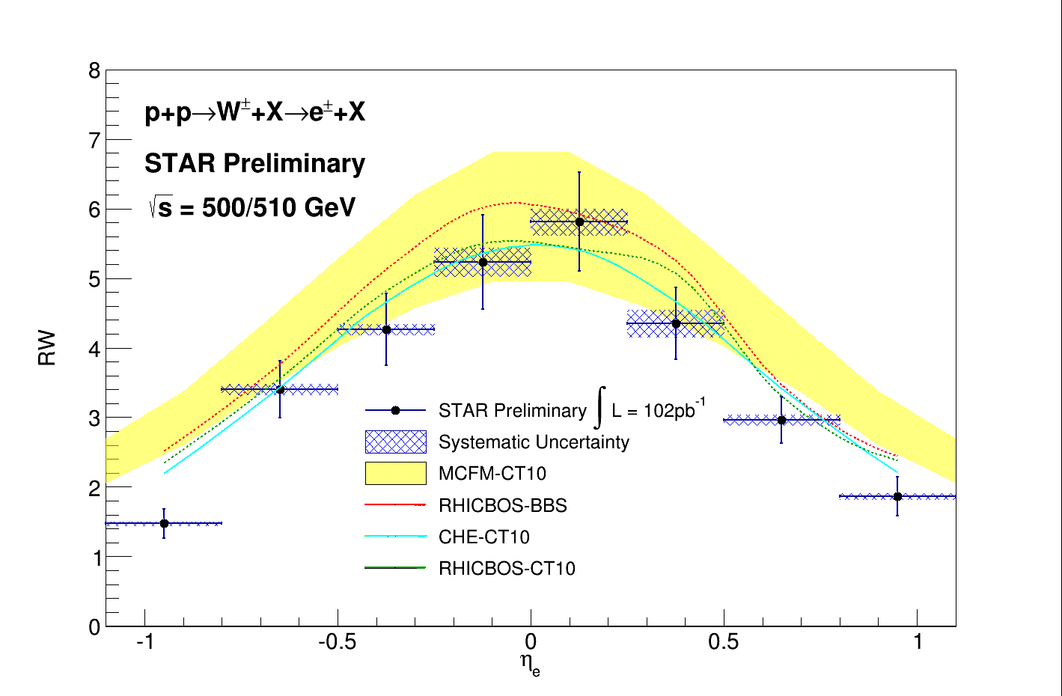
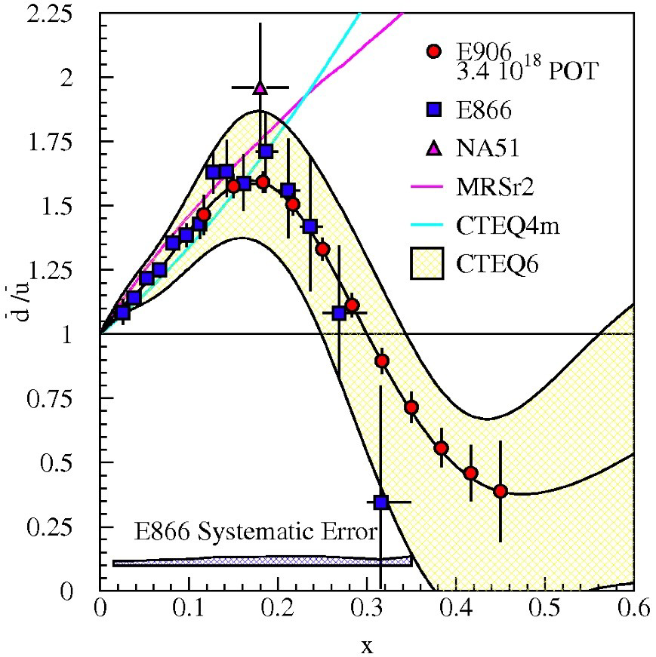

Unpolarized Sea Quark Distributions
C. Bourrely and J. Soffer (2013)
0.1 < x < 0.3
projected

Slide 60
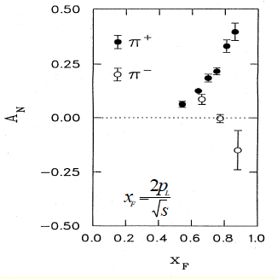
Day-1 Physics:
Can we confirm positive TSSA from day-1?
Large TSSA observed in charged hadron production
Help to understand the polarized target and detector performance
Control the systematics
Requires trigger optimization for
  Target vs dump events

Slide 61
Experimental Layout for Single Muon Positive Signal Confirmation
Polarized
target
ST-1
ST-2
ST-3
ST-4
ç
ç
ç
ç
Z=-350cm
Z=0
Tag: single muons from pi/K decays
- from target and beam dump
2. Trigger: single muons
- high statistic single muons to provide positive A_{N} signals
- Low pZ events preferred (more “valence origin” hadrons), trigger optimization required;
- High pZ events are more sensitive to gluon and sea-quark Sivers

Slide 62
Target and Beam Dump Event Separation target at upstream: Z=-3.5m
Trigger optimization possible!

Slide 63
Confirm positive signals from muons from charged hadrons h^{+/-} decays
Target @ Z= -350cm, long decay length
Decay muons from charged pi^{+/-} and K^{+/-}
  K+/- decay could be very important
Confirm positive signal from mu⁺ and mu⁻
Asy (phi) = S(phi)/Ref(phi)
Need to rum full MC to simulate
  Single mu^{+/-} from pi/K decays
  Kinematics and single muon trigger optimization

Slide 64
The Measured Raw Asymmetry:
P_{T}=0.8 target polarization
~0.1
for pure NH₃ dilution factor:
In reality, need count all unpolarized material in beam’s path, f=0.12~0.14.
In JLab Hall B, deep-inelastic scattering data, f=0.14 (eg1-dvcs).
Need to control systematic uncertainty on measured asymmetry to δ(A)_{meas} ≈ 0.1% for DY
(1% for h^{+/-} )
Challenging !!!

Slide 65


The Normal Approach in “collider-mode”: RHIC, JLab etc.
Spin UP(1) and DOWN(2):
A = <pol>*physics asymmetry, ~O(1%)
Relative luminosity,
for E1039, this is the luminosity of beam on target, which is very hard to measure to <<(0.1%)!
Need precision measurements of relative luminosity, better than ~O(0.1%)

Slide 66
How to Measure Drell-Yan(Single Muon) TSSA Raw Asymmetry at 10^-3 Level with a polarized proton target?
The challenges of precision TSSA measurements
  Detector acceptance * efficiency varies >>1% level over a few hours of operation under a given “target polarization” configuration
  Very difficult to measure the relative beam on target(NH3) luminosity at ~10^-3 level
    Large beam x-y profile
    small target size
    Beam position/direction jitter (dX ~ 1-2mm),
      see https://p25ext.lanl.gov/elog/Hardware/12
    non-uniform DC responses to large beam intensity fluctuations (~O(10%))
    NH3 packing factor variation >~1% from target to target
    Target polarization known to ~O(3-4%) level through NMR
    Other variations, including target changes etc, ~O(1%)
  Frequent spin flip is hard/impossible
    can’t do what we are doing at RHIC and Jlab
    Takes time to reach a stable polarization
  We must be able to measure raw TSSA at 10^-3 level for a given target polarization configuration
A new approach needed

Slide 67
False Detector Asymmetry Study
Run-2 data dimuons (Roadset 57)
Event selection:
  4< mass < 7
  Target events: -250 < z0 < -50cm
  Beam dump events: -50 < z0 < 200 cm
  Track quality cuts
Detector (relative) acceptance for DY events
  Raw “spin” asymmetries
  MC study need to correct target/beam dump acceptance difference
    Trigger road bias
    Detector acceptance corrections
  Further reduce raw asymmetry via target spin-flip and Fmag/kMag field directions
    Keep the same “target dipole field”, only change RF frequency to flip the direction of target polarization
    Change the FMag and kMag field directions
    Impact of Relative beam on target beam luminosity

Slide 68
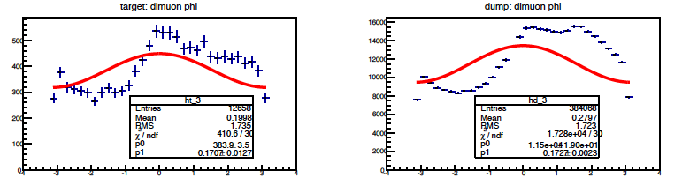
Run-2: Close Look of DY Phi Distributions
We need to get the false asymmetry << 0.1% ~ expected raw spin asymmetry
A = 0.171 +/- 0.013 --→ 100x too large!
Huge false asymmetry: >> X10 sigma

Slide 69
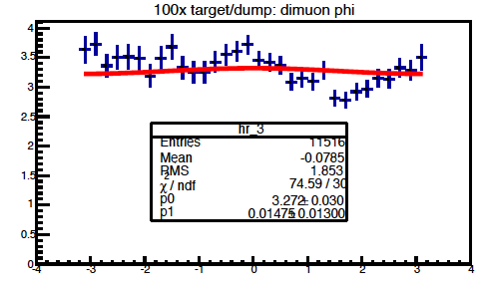
A New Approach
Using the same DY( or h^{+/-}) events from beam dump to normalize the detector acceptance effects
  Beam dump events, 100x statistics, similar muon acceptance
    the stat_err from reference << signal stat_err
  the beam dump asymmetry = 0
    Known physics
  normalize the beam intensity
    Can achieve O(1%) on relative luminosity of beam on target, with dedicated telescopes
  Identical timing and spatial variation of detector acceptance and efficiency for signal and background
    Can achieve O(0.1%) on raw asymmetry
False asymmetry after normalization:
~ 1 sigma, good!
Need to run ~100x more MC or data to prove we can reach 0.001 level!

Slide 70
J/Psi MC at Production: Phi

Slide 71
Drell-Yan MC: Target and Dump Distributions

Slide 72
Future Work for Improvements
Detailed MC simulation with the new polarized target position
  Prove the systematic error can be controlled to O(0.1%)
  Target/Dump DY acceptance correction study
  100x more MC events to reach O(0.1%) level precision
Real data analysis to understand and correct the large false asymmetry
  Beam axis, directions
  Detector response to instant beam fluctuations
  Systematic reduction of the false asymmetry
New beam position/direction monitoring instruments?
  Summer shutdown work 2018?
Beam on target luminosity telescope
  Summer shutdown work 2018?

Slide 73
Summary: New Physics Topics for E1039
Gluons Sivers functions in “valence region”
  Xg = 0.1~0.3
  Gluon Sivers functinos can be best determined in E1039
  Large A_{N} observed from valance quark in this x-range, it would be very interesting to explore the gluon sector in this kinematic region.
  Could be probed by charm, J/Psi and high pZ hadrons(q-g scattering)
Open charm and anti-Charm A_{N}
  Single muon A_{N} for mu⁺ and mu⁻ from charm decay
  Reveals the underlying physics of color interaction
  Test pQCD Twist-3 framework
J/Psi and Psi’
  Study the J/Psi production mechanisms with A_{N}.
  Early theoretical work shows J/Psi A_{N} is sensitive to production processes
Light hadron A_{N} using decay muons: day-1 physics
  This is the one we plan to use to calibrate the Drell-Yan A_{N} measurements

Slide 74
Backup slides

Slide 75
Three Decades of the Proton Spin Puzzle
Early expectation: large gluon polarization
 | Quark Spin | Gluon Spin
SLAC -> 2000 | E80 – E155
CERN ongoing | EMC, SMC, COMPASS
DESY ->2007 | HERMES
JLab ongoing | Hall A,B,C
RHIC ongoing | (BRAHMS), (PHENIX), STAR
Axial anomaly
Cheng & Li, PRL (1989)
EMC, 1980s
 | SIDIS/DIS
 | Polarized p+p

Slide 76
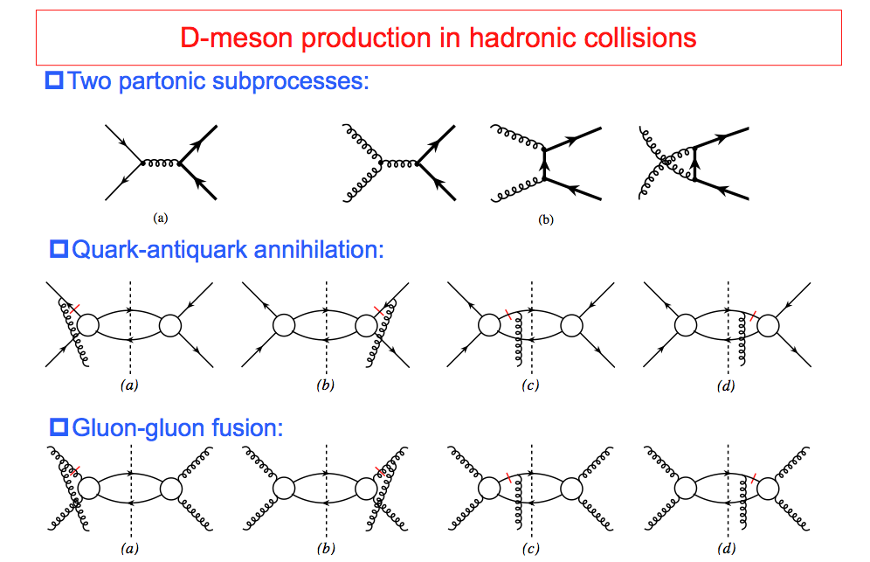
TSSA in Heavy Quark Production in p+p
Kang, Qiu, Vogelsang, Yuan, PRD 2008

Slide 77
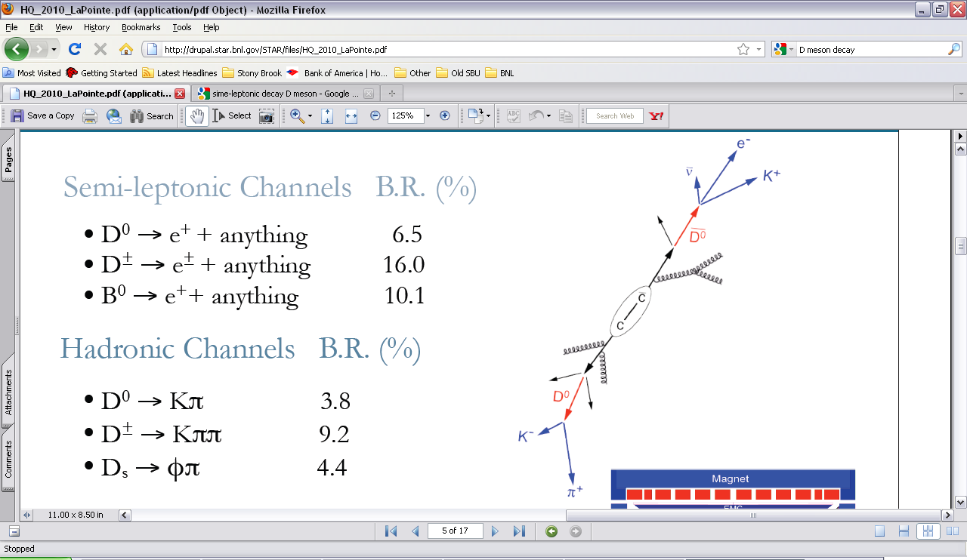
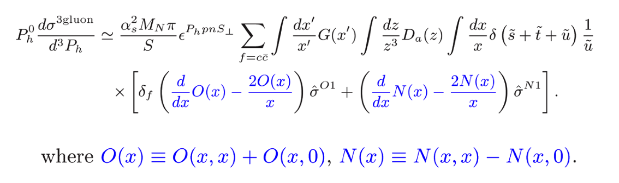
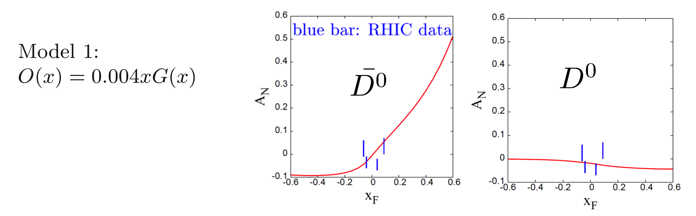
Open Charm TSSA at High Energy at RHIC
Twist-3 tri-gluon correlation Functions
Koike et. al. (2011)
Kang, Qiu, Vogelsang, Yuan (2008)

Slide 78
Drell-Yan Asymmetry (II)
05/27/2015
Use beam-dump events as reference, R(phi)
Use target events as signal, S(phi)
Asymmetry(phi) = S(phi)/Ref(Phi)
This is a follow up of previous discussions about DY spin asymmetry measurements
https://p25ext.lanl.gov/elog/Drell-Yan/29
https://www.phenix.bnl.gov/WWW/publish/mxliu/E906/LDRD-Pol-DY-Work-2015-Ming.pdf (pptx)

Slide 79
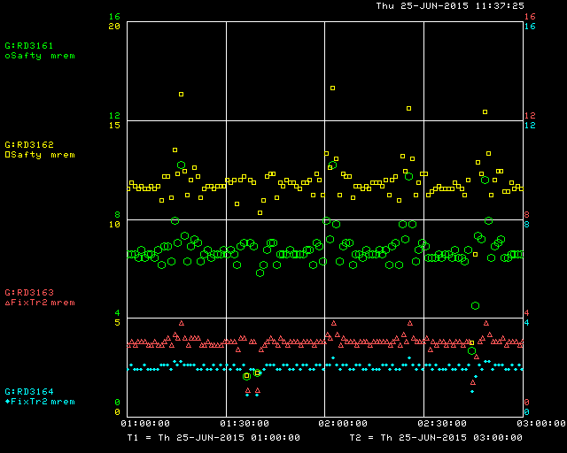
Bean Profile Study
Chuck suggested to scan W-target and monitor radiation rates outside of the building (Yellow)
Can do at ~2 sigma level (~5%), but hard to reach 0.1% for beam halo study…

Slide 80
Telescope
4 units of 2”x2” telescope rates:
  3+4: 349k counts/spill
  1+2+3+4: 339K counts/spill
  Background rate < 1 Hz
Location
  ~5m from the instrumentation package (~1%)
  ~45 degree
Polarized target:
  Small tunnels at ~90 degree on both L/R sides to provide service lines (Cryo and Microwave)
  Scattering rate at ~90? Must by very low

Slide 81

Beam on Target: 4-sigma coverage relative luminosity measurement better than 2x10⁻⁴
Expected Raw Asymmetry:
~ 1%/10~20 = 5 x 10⁻⁴
Asymetry = (N⁺/R - N⁻)/(N⁺/R + N⁻)
R = spin-dependent
relative luminosity
dR <~ 2x10⁻⁴

Slide 82




New Beam Collimator, Focusing Q3 and Target
Target cross section: 18 x 28 mm²
E906 beam profile:
SigX = 4.0mm
SigY = 3.0mm
Beam cross section:
Need be well contained within
4 sigma, required by dR< 2x10⁻⁴
sigX = 18/2/4 = 2.2 mm
sigY = 28/2/4 = 3.5 mm
Beam jitter: dX=dY ~ 1mm
1 sig = 0.68269
2 sig = 0.95450
3 sig = 0.99730
4 sig = 0.99994
Beam collimator
120GeV
beam
Final focusing Q3

Slide 83
Beam position and angular direction measurements 4/1/2015
Two sets of “position-sensitive diamond detector” ~2cm apart, better than 1mm spatial resolution
Quadrant Pattern
  (X,Y) and sigma
MC PYTHIA Sim
  MB to check rates
  Optimal detector locations

Slide 84

Reality: Not So Perfect Detector and Beam Controls
Not so perfect detectors (dt ~ minutes) without fast spin flip (dT << minutes)
  Polarized target spin-flip period ~ several hours
Acceptance varies within the time of a fixed “target spin config.”
  Time dependence
  Dead and hot space points
  Impossible to get to << O(0.1%)
If target is not a pure proton, for e.g. NH₃, another background fraction “f_{B}”, including all other supporting materials,
Background fraction:
Varies target to target
Target and time-dependent
DY events produced in “Target”
Target variation
(space,time) variation

Slide 85

How it works?
If we use the same DY dimuon events
(mass, pT,xF etc) from Target and Dump:
the time-dependent detector acceptance variations are mostly canceled out
The small difference can be corrected with MC and data by using the muons measured in the same phase space
Much reduced requirements on relative lumi, background fraction, target polarization measurements
  sufficient at O(1%) level.

Slide 86
Run-2 DY Dimuon (Roadset 57): all targets
vtxZ
4 < m <7
phi
pT
target
dump

Slide 87
New Beam Collimator, Focusing Q3 and Target
Target cross section: 18 x 28 mm²
E906 beam profile:
SigX = 5.0mm
SigY = 3.5mm
Beam cross section:
Need be well contained within
4 sigma, required by dR< 2x10⁻⁴
sigX = 18/2/4 = 2.2 mm
sigY = 28/2/4 = 3.5 mm
Beam jitter: dX=dY ~ 2mm
28mm
18mm
1 sig = 0.68269
2 sig = 0.95450
3 sig = 0.99730
4 sig = 0.99994
Beam collimator
120GeV
beam
Final focusing Q3

Slide 88
Run-3 Beam X Position Stability vs Spill_ID
Run = 13360, M3TGHM/HS; VM/VS
(mm)
Spill-ID

Slide 93
DNP = Dynamic Nuclear Polarization

Slide 100

Determine and Calibrate dE/dx with DY in p+A
(Drell-Yan Process)
Known initial state nuclear parton density;
Minimal final-state interactions of the detected particles.
E906: No shadowing correction at moderate X_{t}
q, g
DY
euterium
Energy loss reduces x_{b} and x_{F} in nuclei versus proton (x_{F} = x_{b}-x_{t})
Possible sea-quark shadowing effects

