Slide 1
Today’s Presentations
Overview and Plan, 40+10’ – Ming Liu (PI)
Theoretical progress, 20+10’ – Zhongbo Kang(T-2, co-PI)
Experimental highlights, 20+10’ – Kun Liu (P-25, co-PI)
Open Q&As

Slide 2
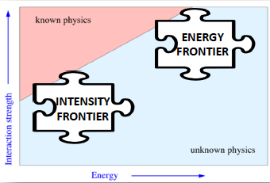
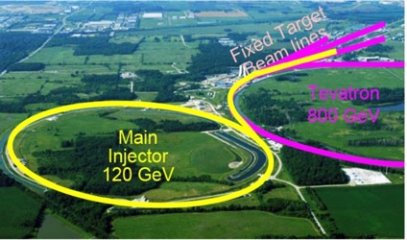
Direct Search for Low-Mass Dark Photons at Fermilab Intensity Frontier
Ming Liu (PI), Zhongbo Kang(co-PI, T-2), Kun Liu (co-PI), Hubert van Hecke, Sanghoon Lim, Pat McGaughey, Richard Van De Water, Xinkun Chu, Vincenzo Cirigliano(T-2)
LDRD/ER 20160081
A joint experimental and theoretical project

Slide 3
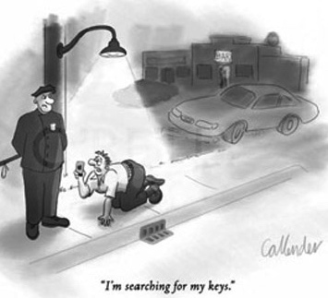
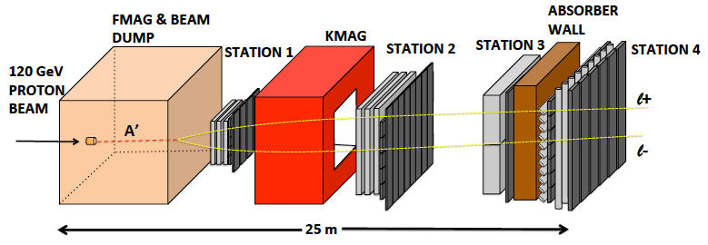
Goal of the LDRD/ER Project
Direct search of dark photon production in the beam-dump mode using SeaQuest/E-1067 dimuon spectrometer at Fermilab Main Injector High Intensity Frontier
Experimental measurements
Theoretical study of sensitivity

Slide 4
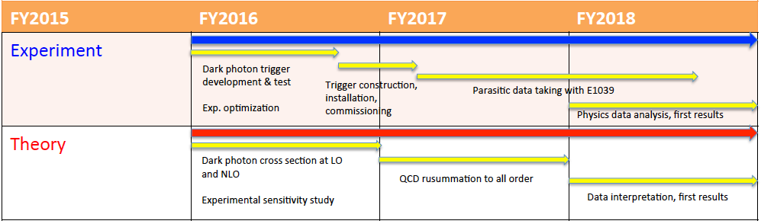
LDRD Tasks & Schedules
FY16: Accomplished all milestones and more!
QCD resummation to all orders
Today, good work in progress

Slide 5
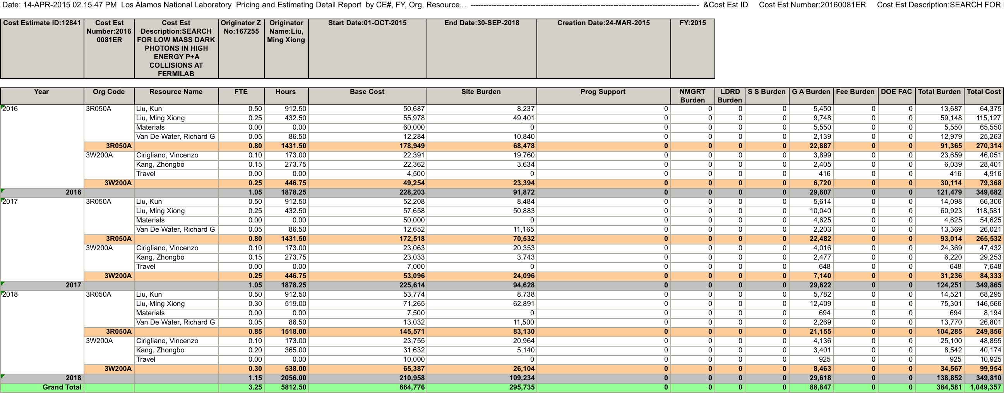
Proposed LDRD/ER Budget: 350K/year
More people get involved later at various R&D and construction stages:
Hubert, Sanghoon(PD), David(PD), Xinkun (Student) et al.

Slide 6

People Involved
Experimental efforts (P-25)
  Ming Liu, Kun Liu(PD, Staff), Pat McGaughey, Hubert van Hecke, Sanghoon Lim(PD), Richard Van de Water, Grass Wang(PD), Xinkun Chu (Student)
Theoretical effort (T-2)
  Zhongbo Kang
  Vincenzo Cirigliano
External collaborators
  Fermilab/SeaQuest
  BNL/sPHENIX
  SLAC/N. Toro, P. Schuster
  Caltech/Y. Zhang
  Univ. Cincinnati/S. Gori
  And more…

Slide 7
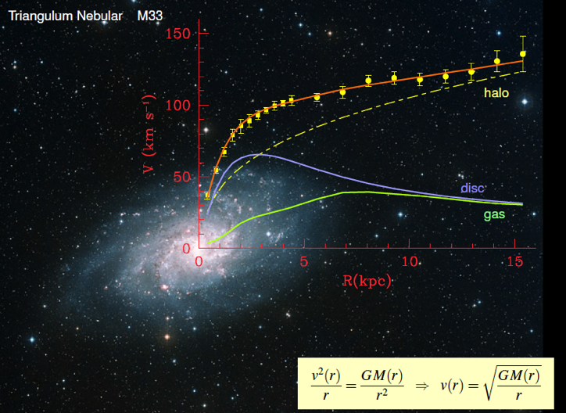
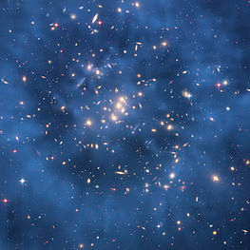
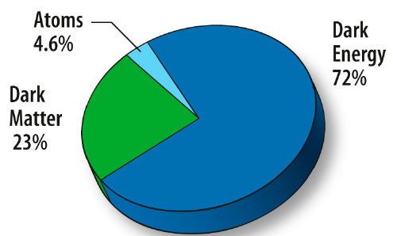
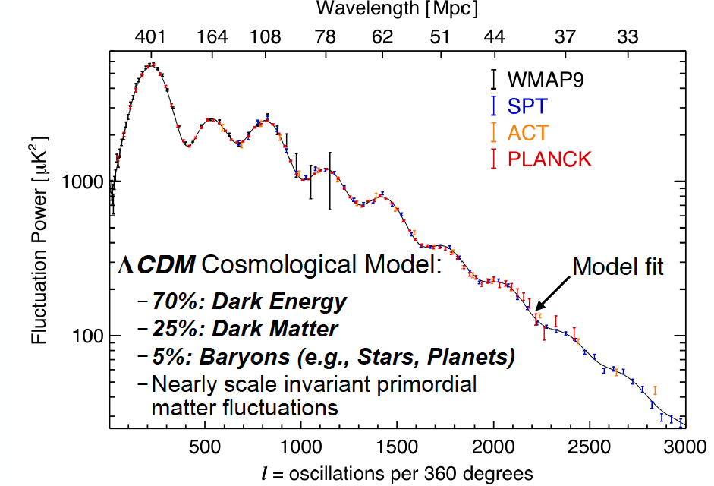
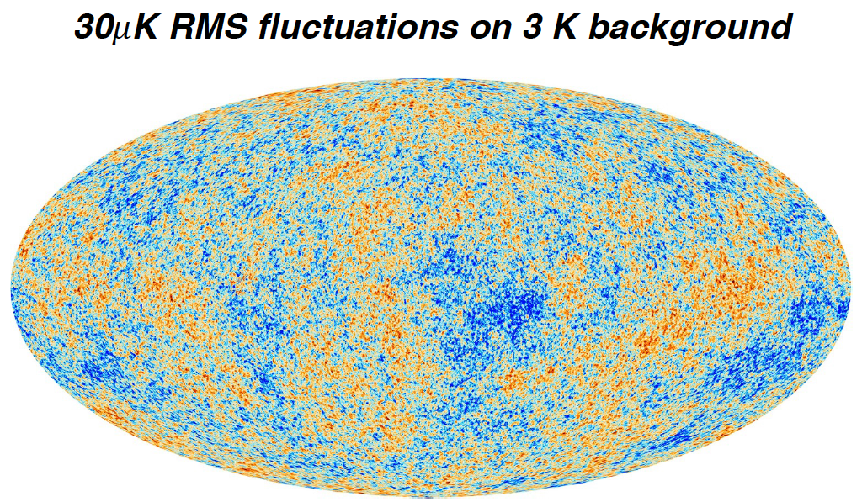
Dark Matter?
Galaxies’ rotation curve
Gravitational lensing (Hubble 2007)
F. Zwicky, ApJ 86 (1937) 217, V. Rubin et al, ApJ 238 (1980) 471
Planck: 2013
Benson’s talk @CIPANP 2015
Notes:
It is widely accepted today that visible matter only account for 5% of matter and energy, with 25% dark matter .. With many compelling experimental obseravtions , how ever the nature of dark matter and dark energy remtain as the biggest scientific challenges for hunam being … sa they only interactio with SM particels very weakly .. Only shown in gravitaiton sectors ..

Slide 8
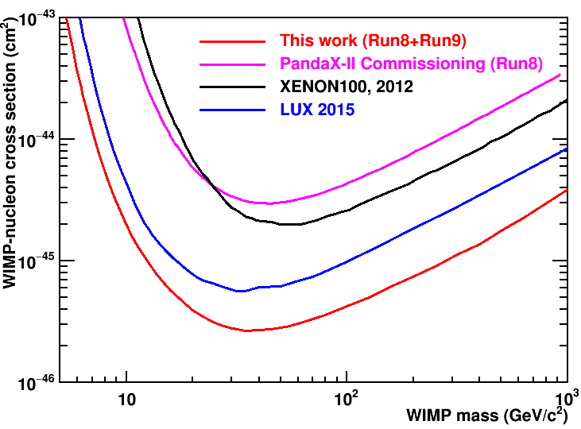

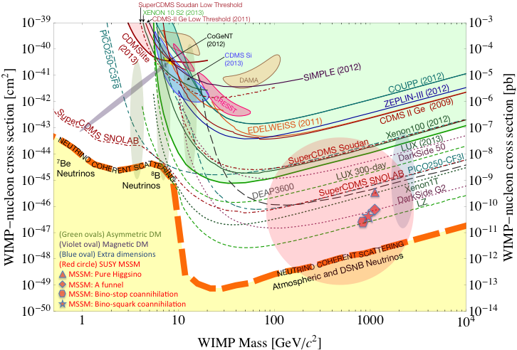
Why Light Dark Matter?
WIMPs (Weekly Interacting Massive Particles) being excluded?
Recent anomalies observed by satellite and terrestrial experiments suggest a new “dark sector”
  “Portals” to the SM
    “vector portal”: dark photon
    “scalar portal”: dark Higgs
    “neutrino portal” and more …
“Sub-GeV” low mass weakly-interacting dark particles become very interesting!
Mass: O(MeV ~ GeV)
High-intensity colliders (B-factories) and fixed target experiments (Fermilab, JLab, LHC etc.) offer an ideal environment to probe these new ideas.
Ji @IDM2016
Notes:
What are the DM? WIMP is considered one of the primary candidates of DM …

Slide 9
Portals to a Dark Sector?
SM symmetries limit the allowed couplings
  scalar, vector, tensor interactions etc.
SM
g, W±,Z⁰,γ, H
Dark Sector
particles &
interactions
A’
E-1067/SeaQuest: Dark photon (vector), Dark Higgs (scalar) Portals

Slide 10
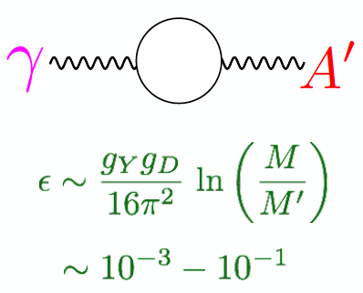
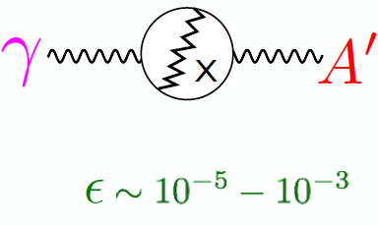
Expected Coupling Strength from GUT
After EWSB, there is a coupling ε between the dark photon and the photon (also the Z, less important at low energies).
Theoretical prejudice for a mass scale
m_{A}’ ~ √ε m_{EW} ~ (MeV – GeV)
e.g. Arkani-Hamed & Weiner;
Cheung, Ruderman, Wang, Yavin;
Morrissey, Poland, Zurek;
Essig, Schuster, Toro;
Weakly interacting → small cross section →high intensity beam to create them

Slide 11

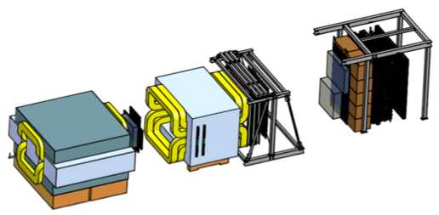
Intensity Frontier at Fermilab: 120 GeV Beam
World’s highest intensity high energy proton beam:
“beam dump mode” @E-1067
50,000 fb⁻¹ (in 1 year of parasitic run)
LHC-II: 300 fb⁻¹ (~2025), achieved 25fb⁻¹ in Run-I
B-factory@KEK: 50,000 fb⁻¹ (~2023)
Absorber wall and proportional
tube based Muon ID
Spectrometer magnet
Δpt = 0.4 GeV
Focusing magnet
and solid iron dump
Δpt = 2.9 GeV
Beam
120 GeV proton from Main Injector
19ns RF, 4s spill, 0.5×10¹³ protons per spill
25 m
Target system
Liquid H and D
Solid C, Fe, W
- Capture most beam in beam dump mode: p+Fe collisions!
- Parasitic run mode possible with other experiments, E906/E1039

Slide 12
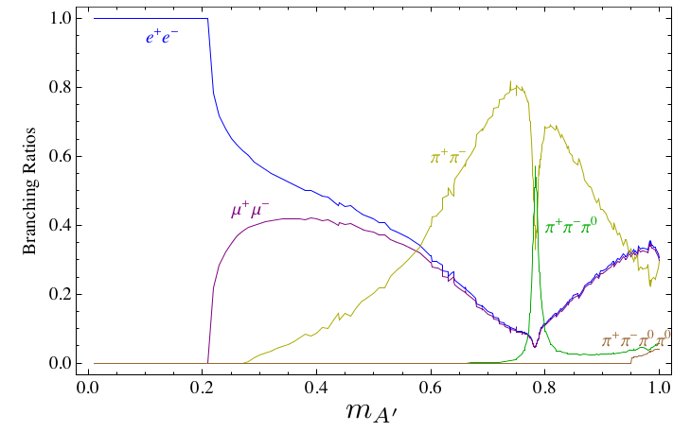
Dark Photon Production and Decay in p+Fe (Beam-dump) at Fermilab
Photon portal: “vector”
A visible decay mode: dimuons
Fermilab(on-going)
SHiP/CERN(in preparation)
J-Lab12(on-going)
KEK B-factory(on-going)
and many more …
(GeV)

Slide 13
Our Approach and Expected Signals
Dark photon displaced vertex trigger upgrade
Unique signals
  Displaced dimuon decay vertex for long-lived particles
  Invariant mass peak in dimuon mass spectrum
Beam time
  Run parasitically with E906/E1039 (2017-2019)
  Possible dedicated runs later with upgraded (e^{+/-}, h^{+/-})
-- 2.5%
-- 6.0%
Dimuon mass resolution
Top View, B-field
X
Z (meter)

Slide 14
Integrated Theory Effort
Kang’s talk
Signal: detailed calculation for dark photon cross section
To provide expected dimuon signal from dark photon decay as function of decay length L and model parameters (ε, m_{A’}), theory team will
  Compute Dark photon production cross section at both LO and NLO
  Derive the branching ratio of dark photon to dimuon
  Theory team: expertise in perturbative QCD and effective field theory for resummation
Dimuon signal
Drell-Yan background
Background: detailed calculation for Drell-Yan cross section
Main background is DY dimon production: reliable computation of the cross section is essential to calculate our experimental sensitivity to (ε, m_{A’}), and understand implication of dark photon search
  We have a NLO DY code that works well in the required energy range
  Calculations will be performed in the necessary energy and kinematic regions

Slide 15
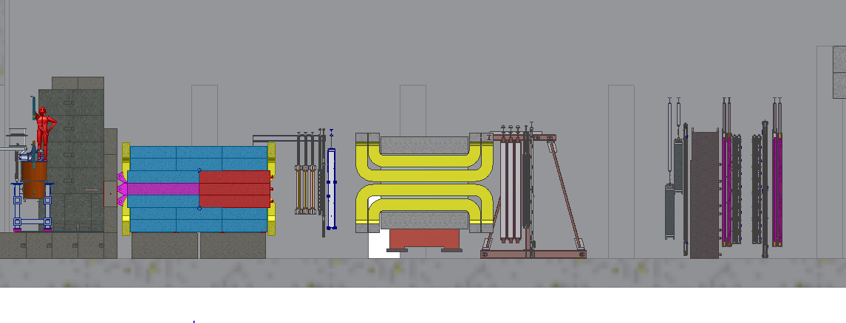
Side View of the Proposed Experimental Setup
F Mag
K Mag
LDRD:
St-1 trigger plane, 160 x 160 cm
Made of 4 1cm x 1cm x 80cm
scintillator planes
St-2 trigger plane, 200 cm x 200 cm
Made of 4 2cm x 2cm x 100cm
scintillator planes

Slide 16
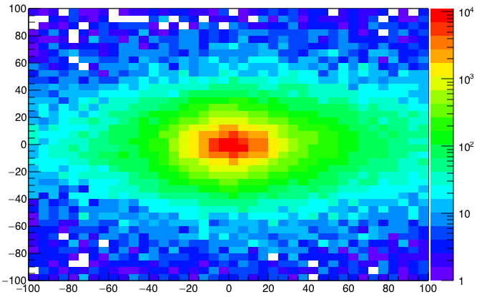
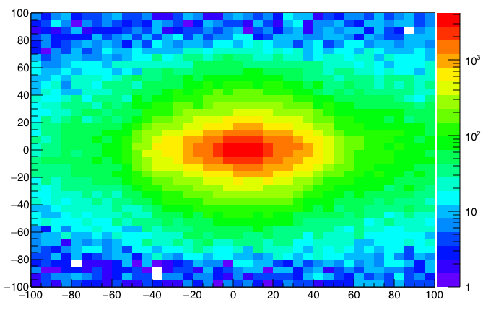
A New High-Granularity Displayed Dimuon Vertex Trigger
High rejection power, low rate, << 1 kHz(current E906 DAQ limit)
Y-Plane (non-bending) Trigger:
A quadrant panel: 80cm x 80cm (100cmx100cm @ST-2)
  ST1: 1cm x 1cm x 80 cm scintillating strips, SiPM readout
  ST2: 2cm x 2 cm x 100 cm strips
- Straight line projection, σ_{Z} ~30cm
Displaced z-vertex, mostly low mass < 3GeV
Y-channels per quadrant:
1x V1495
80(St1) + 50(St2) + 8x2 (St4-Y1,2) = 146
96+64 = 160 inputs possible
  (2NIM=RFCLK+ComSTOP)
ST1: beam view
Y
80x80cm
Dimuon Z-vertex (cm)
Q4
Q1
X
ST1
ST2
Q1: track
ST1
Q3
Q2
Z
Coincident Z-vtx
window matched@L2
ST2
Q3: track
Trigger fired: Q1 & Q3 & VTX
Z1=9m
Z1=12m

Slide 17
Displaced Dark Photon Trigger Logic
DAQ/Data stream
Trigger fired: Q1 & Q3 & VTX
Q1 (LVL1)
DAQ Trigger
LVL2
(vtxZ matching)
Q2 (LVL1)
VTX
TS
(12 inputs total)
(1-free bit available)
Q3 (LVL1)
DP Trigger
1-bit
Q4 (LVL1)
4 x 16-bit from 4 V1495 boards
(2 x 32LVDS cables)
V1495
Per quadrant Q(1-4): 80(ST1) + 50 (ST2) + 2x8(ST4-Y1/2) = 146, FANOUT ST4 Hodo

Slide 18
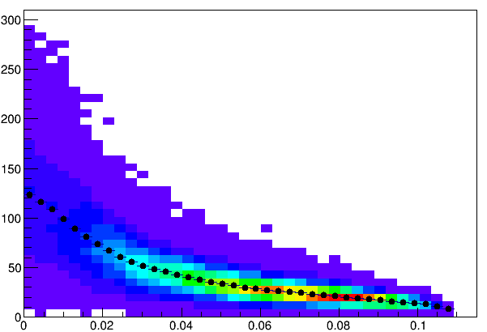
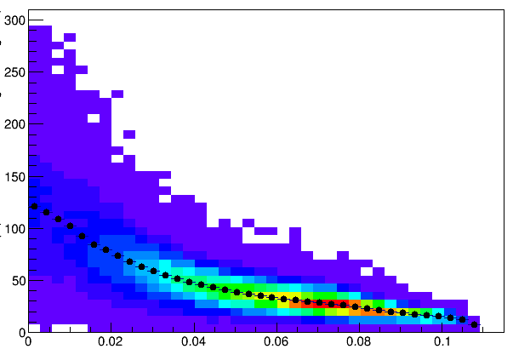
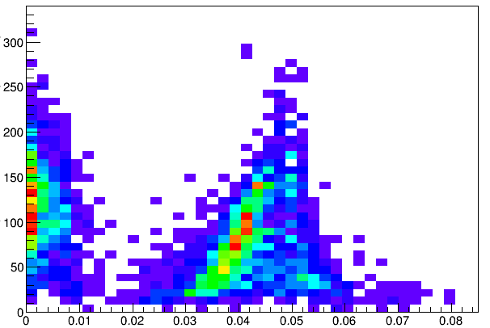
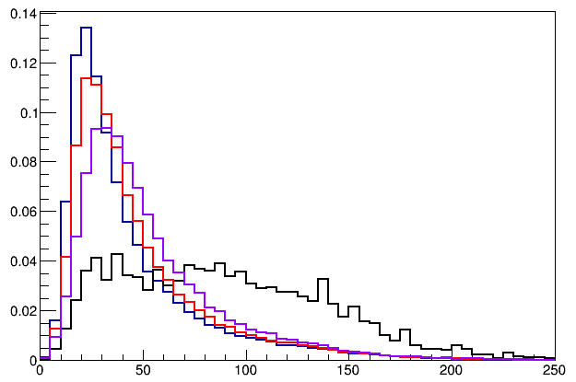
Scintillator Size Optimization
Single Muon Z-Vertex Resolution
Kun’s talk
-DPSim package
σ_{Z} (cm)
σ_{Z} (cm)
Forward: 1cm
Backward: 1cm
Forward: 1cm
Backward: 2cm
Sigma_Z ~ 30cm
σ_{Z} (cm)
Forward: 1cm
Backward: 1cm
Forward: 1cm
Backward: 2cm
Forward: 2cm
Backward: 2cm
E906
Current
E906
σ_{Z} (cm)
Open. Angl.

Slide 19
Low Mass Prompt Dimuon Trigger Rate Study
Current E906 setup
Proposed 2-layer trigger upgrade (10x improvement)
Additional Y-trigger after ST-3 absorber, and also using existing E906 X-Plane trigger
(additional ~2x improvement)
Current E906 DAQ 1kHz, can be improved to ~10+kHz with small cost
15+kHz possible for next run (reprogramming trigger firmware etc.)
Parasitic mode: use up to ~10% DAQ bandwidth
data
MC
Kun’s talk
- DPSim & DAQ
Expected (Prompt) Low mass dimuon trigger performance

Slide 20
Trigger Detector R&D

Slide 21
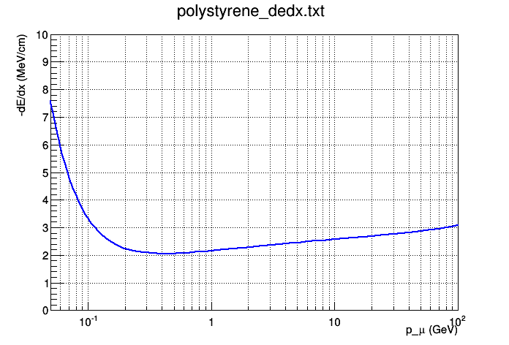
Scintillator Thickness and Light Yield
For thickness = 1.0cm, P > 5GeV
  dE/dx = 2.5MeV/cm
  Light yield = 2.5MeV / 100eV ~ 25K photons
  SiPM Eff = 30%
  Scintillator/WLSF light collection Eff estimated ~O(1%)
  Total “PE” = 25K x 30% x 1% = 75 >>1
Required light output
  MIP detecting eff > 95%
Using polystyrene as example (same as FNAL scintillator)
Muon dE/dx = 2.41 MeV/cm @ 4 GeV, and 2.69 MeV/cm @ 20 GeV

Slide 22
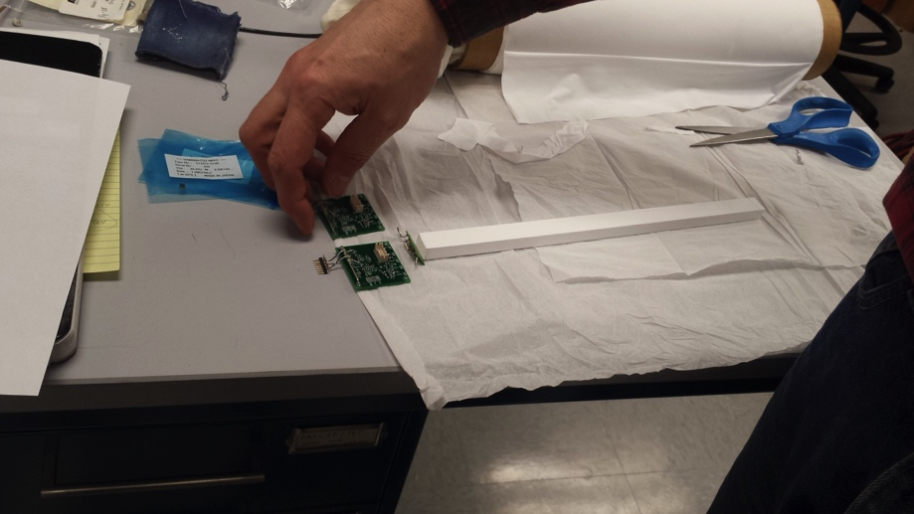
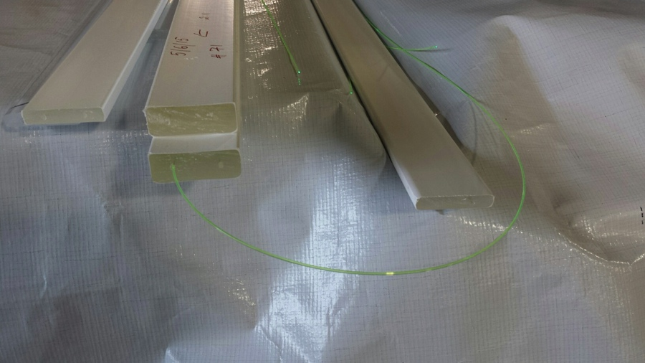
Selection of Trigger Scintillator
High quality scintillator bars
  1x1x50cm
  Directly coupled SiPM readout
  Expensive, ~$100/ch.
  Original plan
Fermilab extruded scintillator + WLSF for light detection
  1x1cm
  2x2cm
  SiPM readout
  Low cost, ~$10/ch
  Final choice!

Slide 23
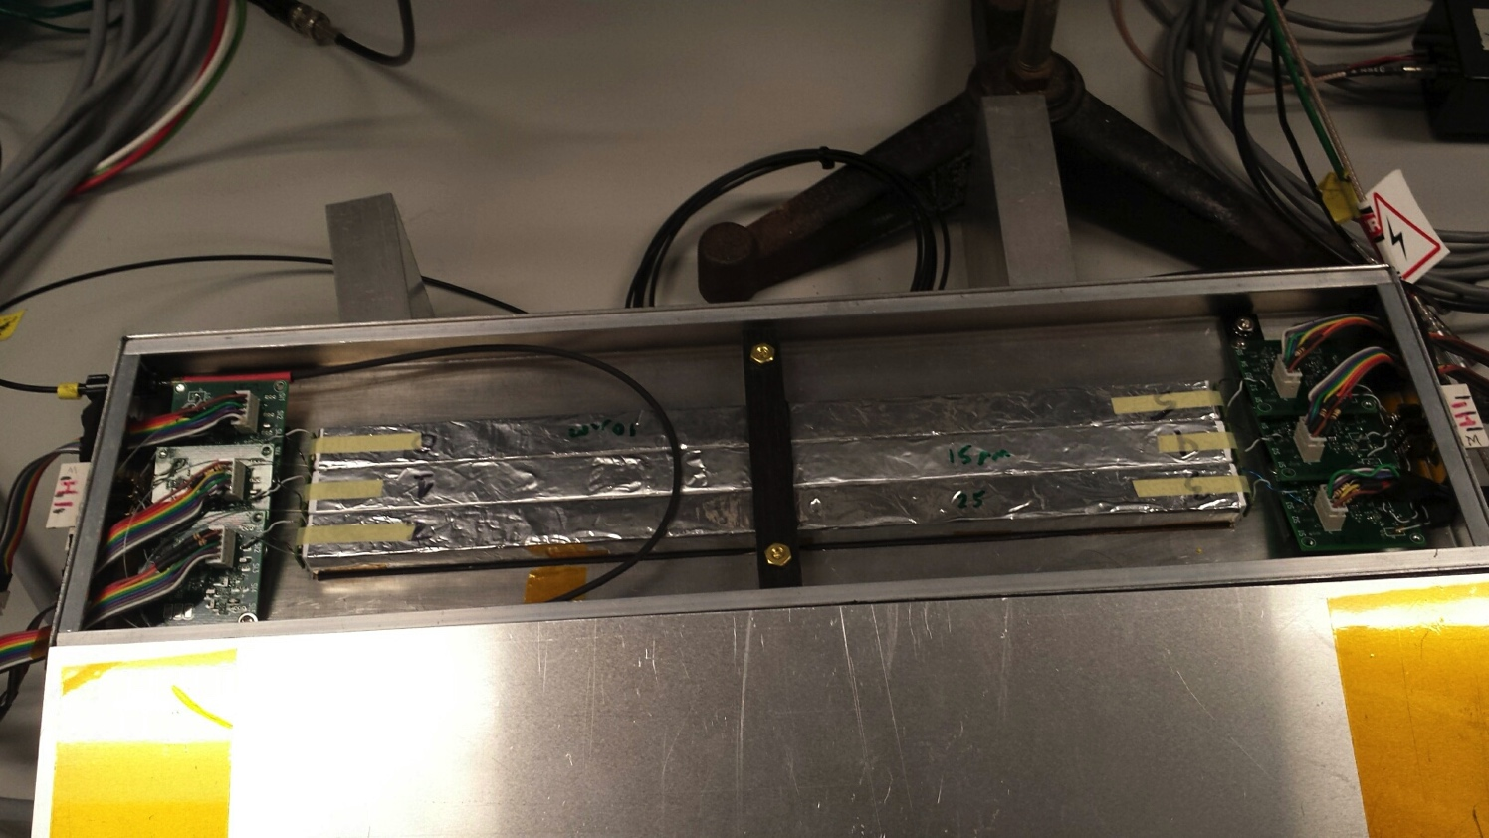
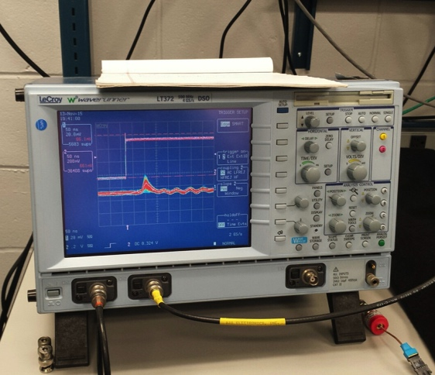
Trigger Detector R&D (I)
Scintillator directly coupled to SiPMs
  Preamps developed by sPHENIX group at BNL
  Clear MIP signal observed
  But with long tail … 30nS

Slide 24
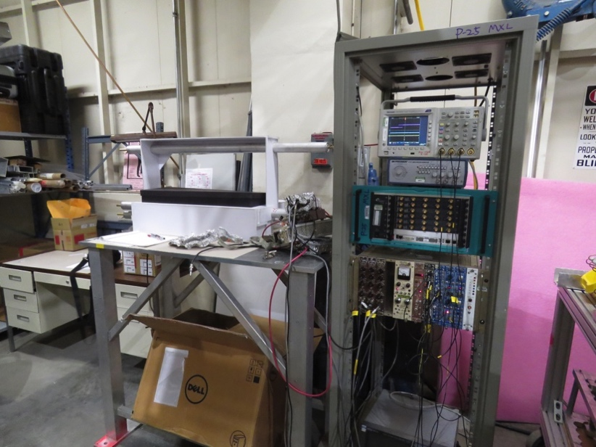
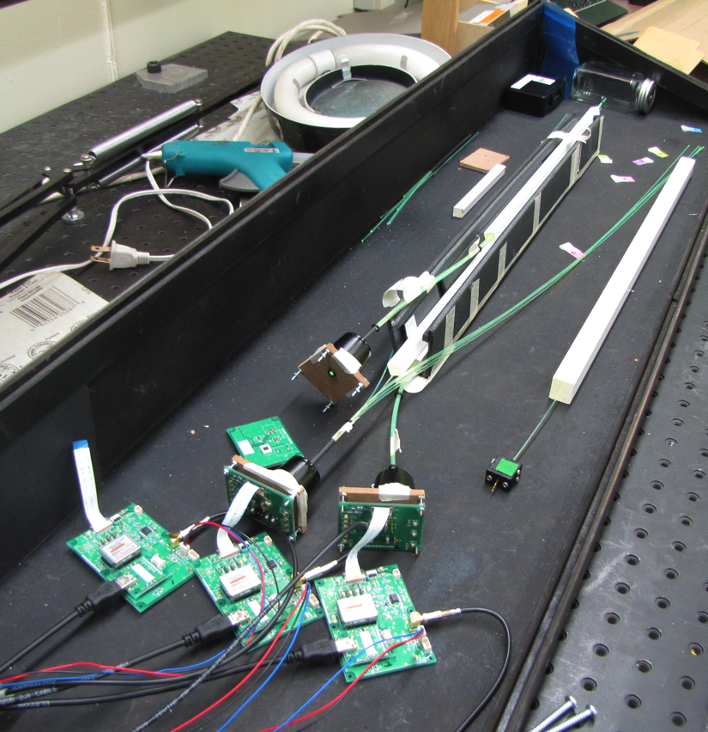
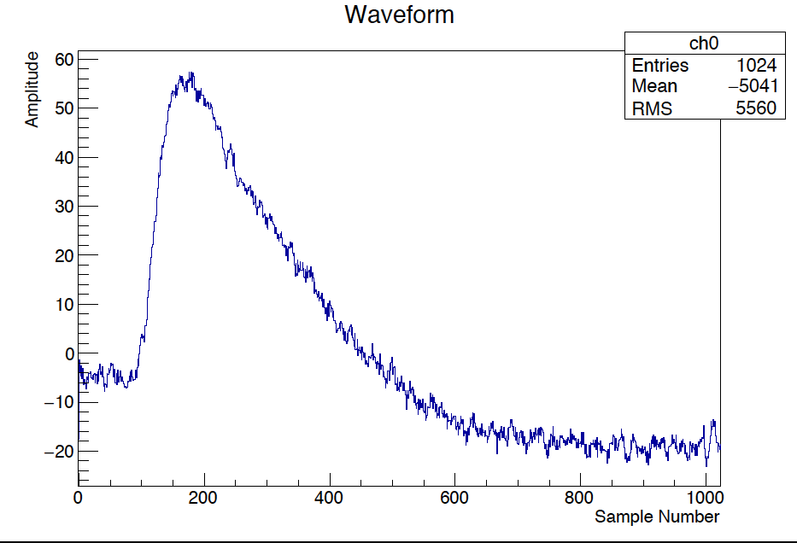
Trigger Detector Prototype R&D (II)
- Fermilab extruded scintillator + WLSF
SiPM readout
Excellent S/B!
Default option now!
2 x 2 x 50 cm + 1mmD WLSF
+ SiPM readout

Slide 25
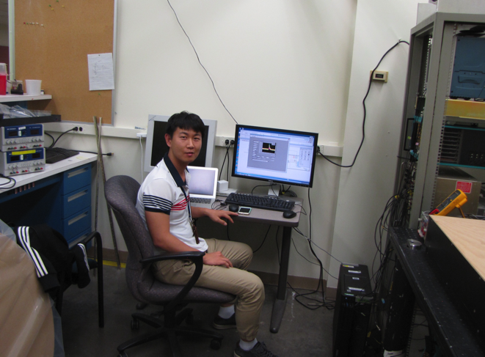
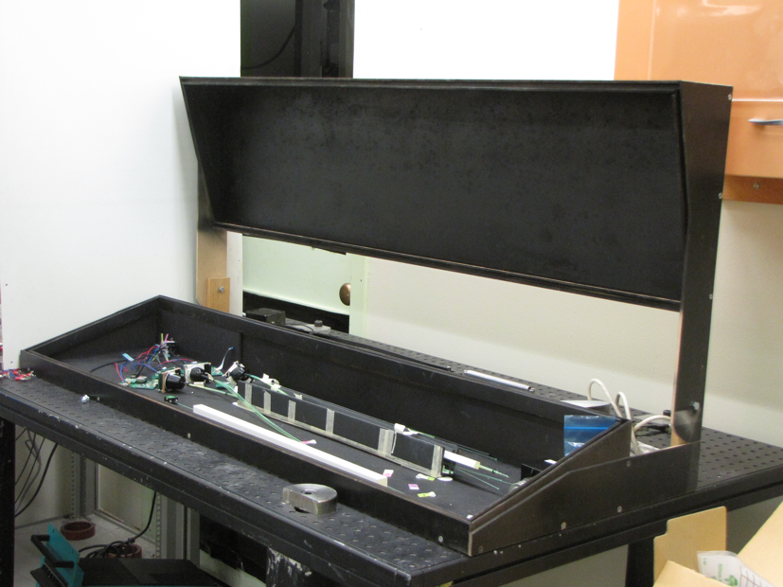
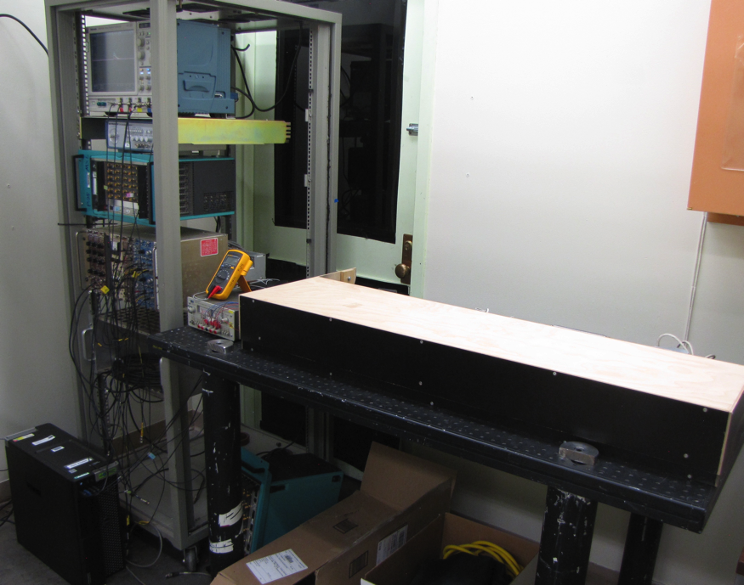
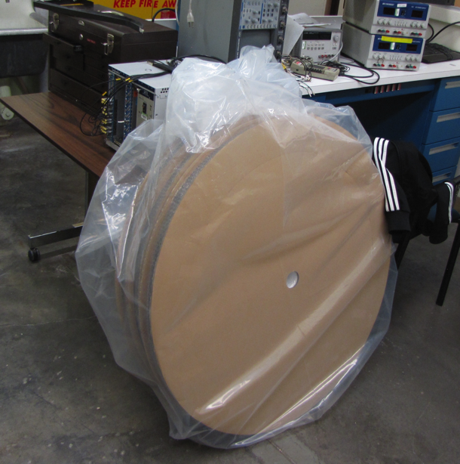
Trigger R&D Lab - C114 a good training ground for postdocs on detector hardware skills

Slide 26
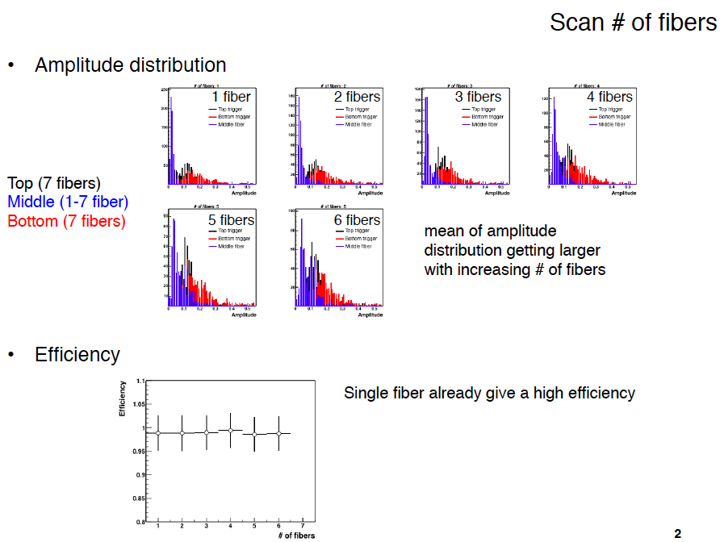
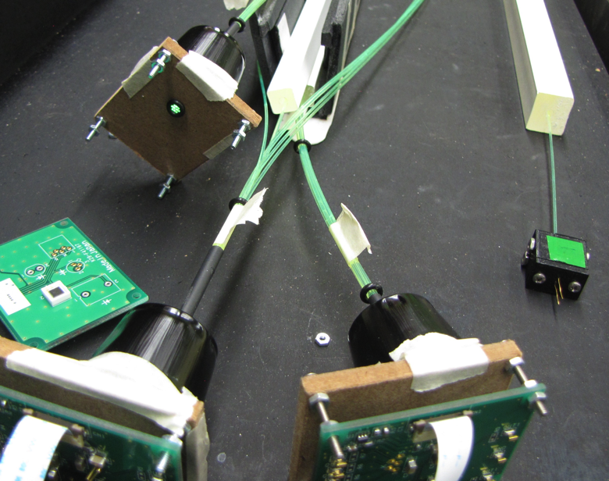
Light Collection Efficiency vs # of WLSF
Hole:
- d~ 2.8mm
- up to 7 1mm fibers
Cosmic ray

Slide 27
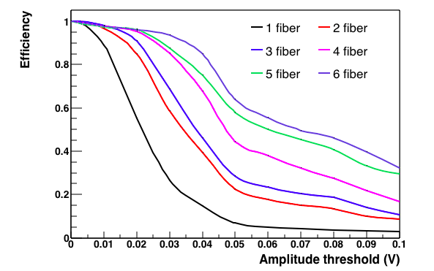
Scintillator-based Trigger Efficiency
Threshold: 5~10mV
Eff > 98% (w/ 2+ WLSF)

Slide 28
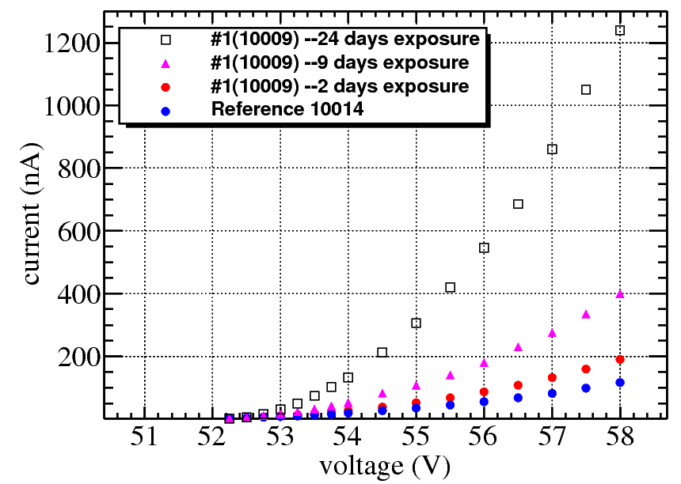
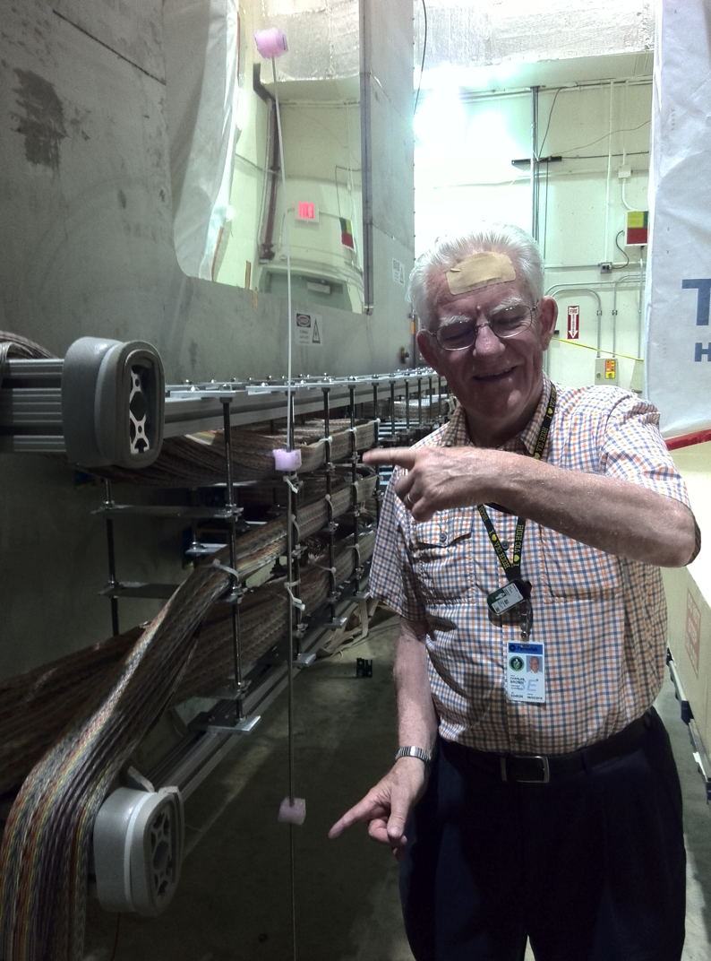
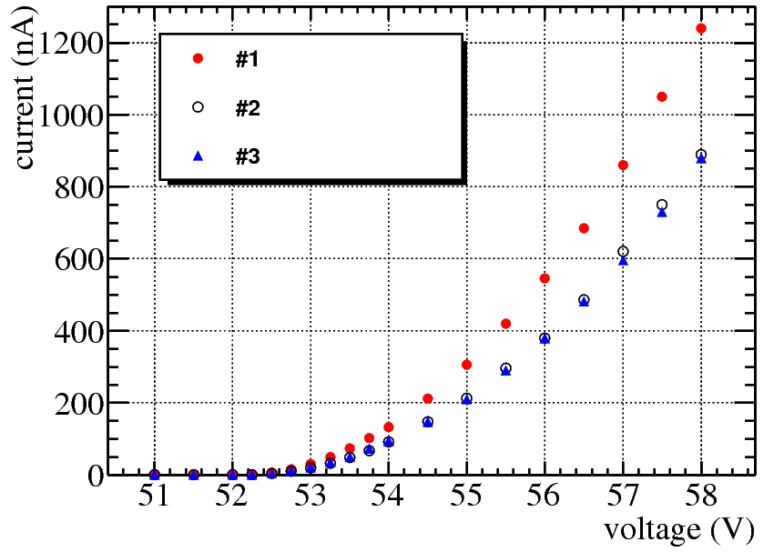
SiPM Irradiation Study at LANSCE and Fermilab
#1
2,9,24 days
#2
24 days
Y-position
dependence
#3

Slide 29
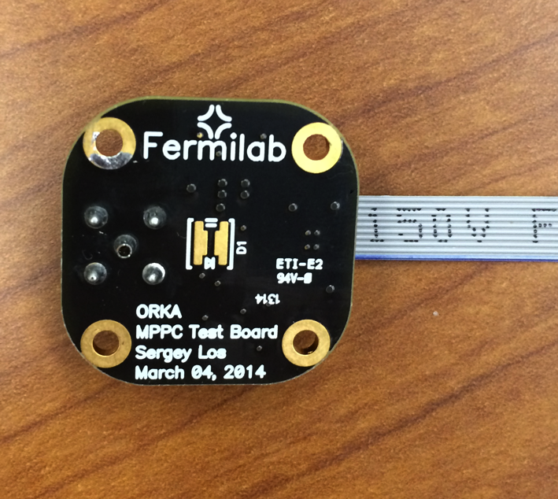
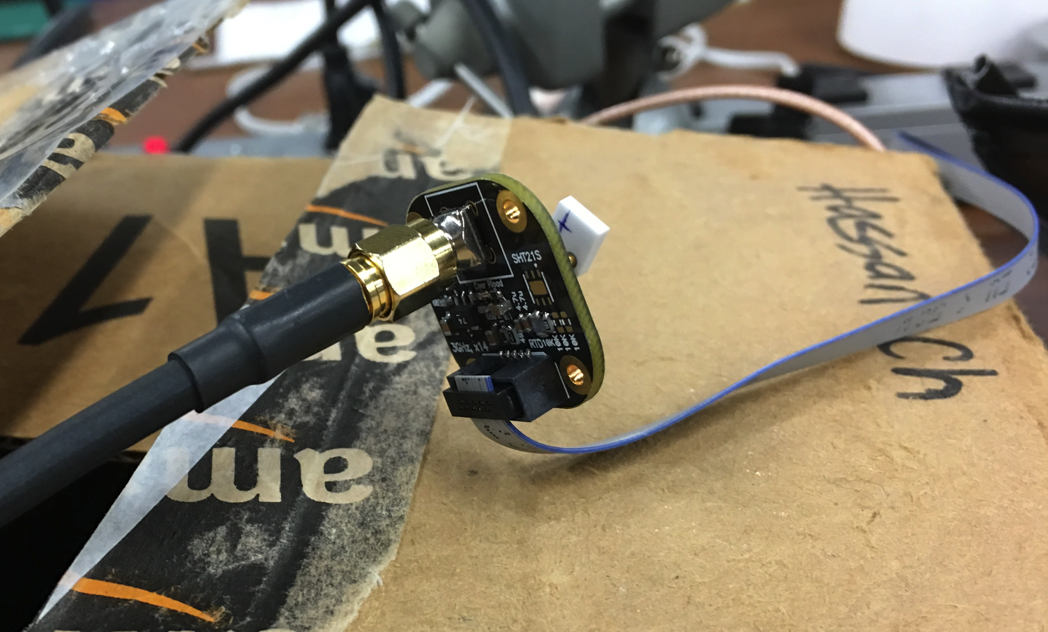
SiPM Readout R&D with Fermilab preamps

Slide 30
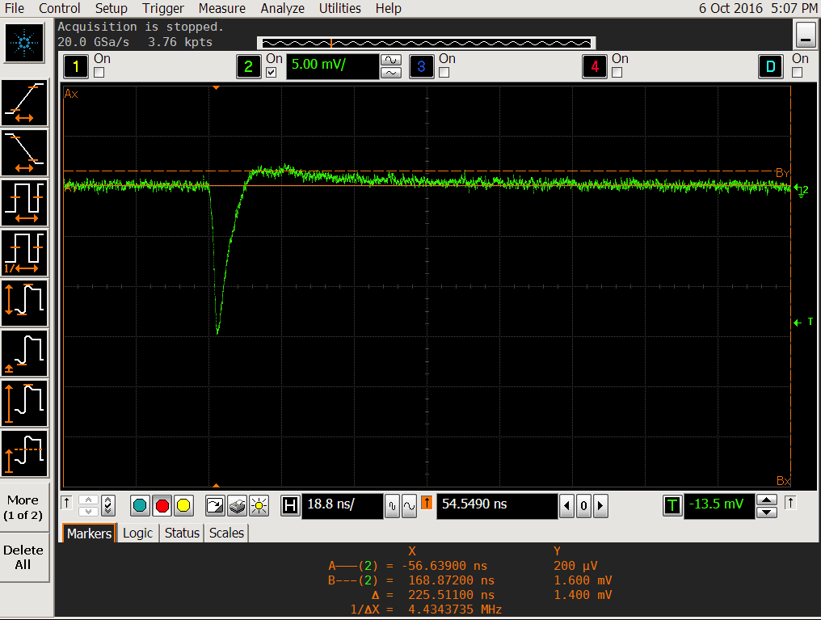
Scope Capture of MIP signal
RF bucket: 19nS
Rising T: < 2nS
Trailing Time: <5nS
Fast: clear signal within one RF bucket
Excellent S/B > 20

Slide 31
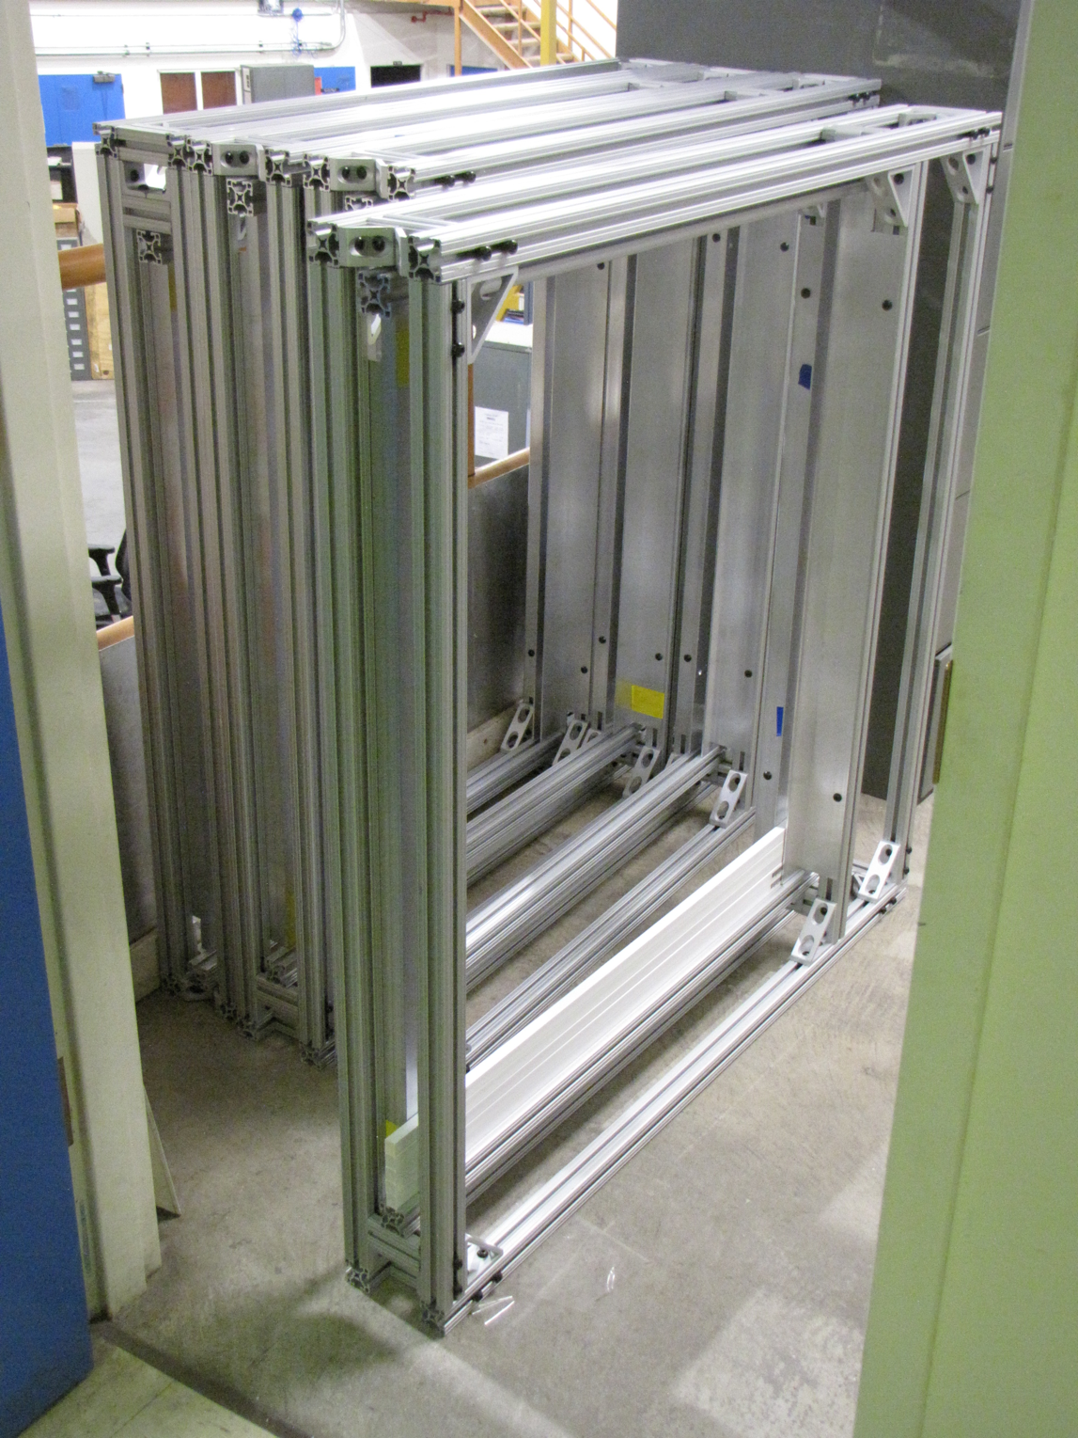
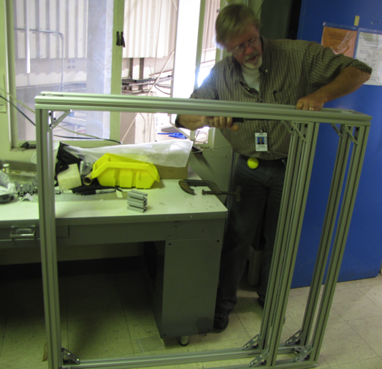
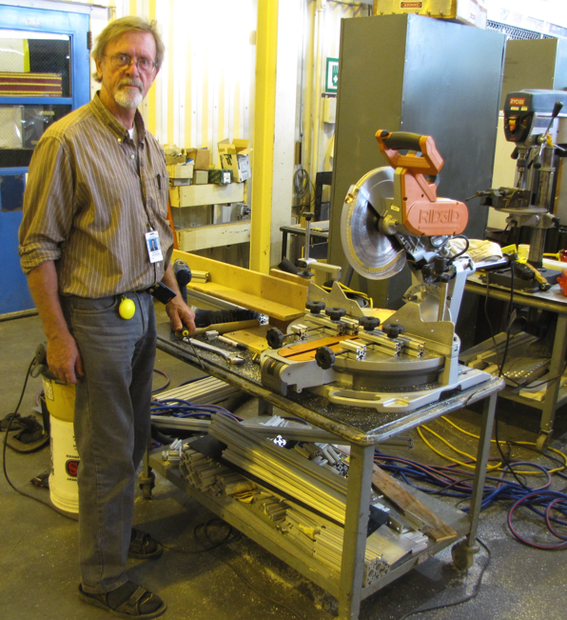
4 Mechanical Box Frames Assembled
Work in progress:
4 more box frames
System integration
Fermilab safety review

Slide 32
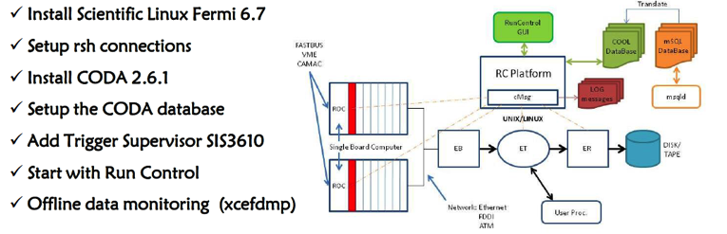
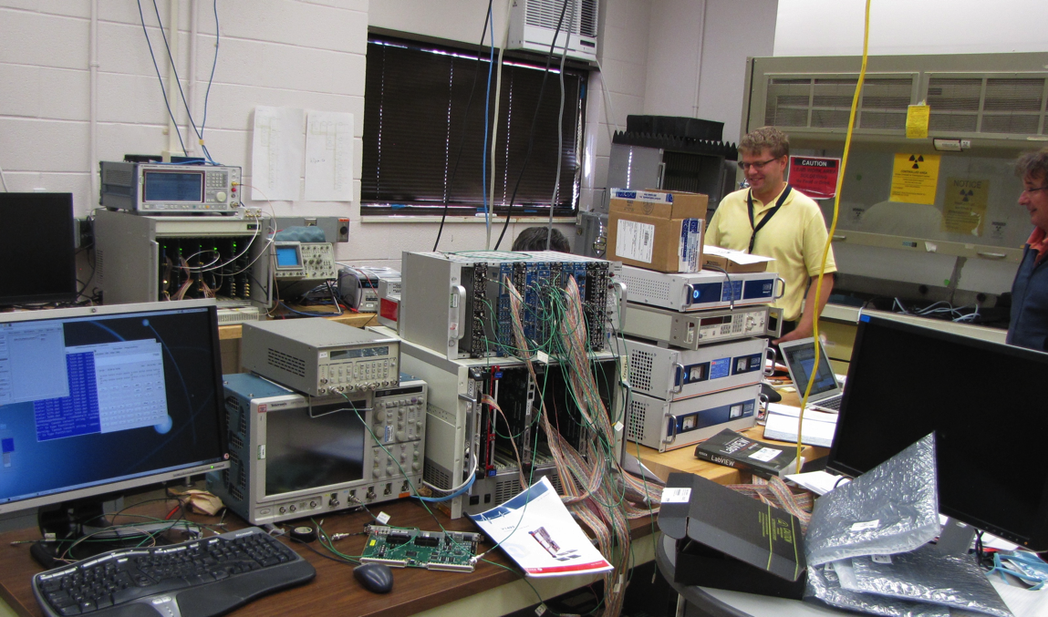
LANL Standalone DAQ/Trigger Upgrade
Test new DAQ readout scheme
Trigger algorithm development
Trigger firmware and system integration
Online monitoring
DAQ new readout R&D:
Proof of principle achieved!
Expected improvement ~15x
Kun’s talk

Slide 33
Detector Upgrade Status: Summary
Trigger detector
Readout & DAQ integration
WLSF: Y-11 (200)
  1 mm D, 1,000m
  1.5 mm D, 1,000m
Extruded scintillator
  Produced at Fermilab
SiPMs
  3x3mm, 600
  S13360-3050CS
  Gain ~ 1.7 x 10^6
Mechanical support
  80/20 Al frame
  Assembly 50%
  System integration
  Safety review
VME and Control
  1 VME crate + Linux CPU
  1 Linux computer
New V1495 boards
  4 V1495
  12 daughter cards
  Splitting Y-cables (12x2)
E906 spares
  V1495, 4(LVL-0)+2
  Daughter cards, #?
DAQ upgrade
  Expected x15+ improvement
Preamp+LVDS digital board
  Fermilab stamp-peramp

Slide 34
Dark Photon Physics Simulation and Sensitivity Study
A new MC simulation package developed
Updated theoretical model calculations
  Production channels
  Decay channels
  Collaboration with other leading theorists

Slide 35


Dark Photon Detection in Dimuon Decay Channel
Drell-Yan like
π⁰, η, … decay
Bremsstrahlung
(DM)
MiniBooNE
Beam-dump
(DM)
p
l⁺
p
l⁻

Slide 36

Preliminary Results: Dark Photon Sensitivity
(parasitic run w/ E906/1039)
Signals considered:
Drell-Yan like
Eta decays
Bremsstralung
Covers a wide range of unexplored parameter phase space
Displaced dimuons
- Minimal SM background
Prompt dimuons
- Excellent coverage over BELLE-II
projection
- Possible dedicated runs later to fully
restore mass < 3GeV (Phase-II)
Phase-II with upgrades
Access below 200MeV with di-electrons
( add EMCal)
Work in progress!

Slide 37


FY16: Scientific Impact to the Community
SLAC Dark Sectors Workshop: 4/28-30, 2016
- Community Report arXiv:1608.08632
1st report of Fermilab dark photon
program to the community
- Kun, Ming, Richard
BNL Dark Interactions: 10/4-7, 2016
Our Fermilab dark photon/Higgs program
highlighted at opening plenary talk
- Two talks, by Arun, Ming

Slide 38
Publications and Presentations
SLAC Dark Sectors Physics Workshop, April, 2016
  Kun, Richard and Ming
  Community report whitepaper (arXiv:1608:08632)
BNL Dark Interaction Workshop, October, 2016
  Arun (SeaQuest student), Ming
Invited seminar at Caltech, November, 2015
  Ming
Invited seminar at MIT, ~early 2017
  Ming
Invited review paper for Modern Physics Letters A (MPLA, World Scientific)
  Ming, in progress
In preparation of a paper on updated sensitivity with latest calculations/simulations
  LDRD team + external collaborators (Toro et al.)

Slide 39
Summary of FY16 Progress
Met all FY16 milestones, and more!
  New MC simulation package and DAQ Upgrade
  Trigger detector R&D and optimization
  Trigger readout R&D
  Mechanical support frames R&D
  Major hardware purchases
  Completed LO calculation and more
  New ideas developed for the future
Recognized by the community as an important experiment
In good progress to meet FY-17 goals
  Experimental
  Theoretical

Slide 40
LDRD Tasks & Schedules
FY16: Accomplished all milestones and more!
QCD resummation to all orders
Today, good work in progress

Slide 41
Plan for FY17-FY18 and Beyond
FY-17
FY-18 and beyond
Complete DAQ upgrade for next run
  Early November
Trigger detector installation and commissioning
  By early 2017
Parasitic data taking with E906
  Till summer 2017
Parasitic data taking with E1039 (polarized DY)
  Two years, FY18-19
Physics data analysis
  FY17, 18 and 19 data sets
Publications of preliminary results!
Major discovery potential!

Slide 42

More New Ideas!

Slide 43
Dark Higgs
Y. Zhang et al, arXiv:1502.06983
θ = μ v/m_{h}²
arXiv:1312.4992
e⁺e⁻
Phase-I:
High-mass: μ⁺μ⁻ and hadrons
Advantage of using hadron beams
with muon probes over electrons
Phase-II:
Low-mass: e⁺e⁻, <200MeV possible
High-mass: hadrons, (5x)
Electron ID
upgrade!
μ⁺μ⁻

Slide 44
Projected Dark Higgs Sensitivity
POT:1.4x10¹⁸ (Phase-I)
Y. Zhang (2015)
Dimuons with downstream displaced decay vertices
Limited sensitivity to “prompt” large mixing case due to small cross-section
Dark Higgs or dark photons?
  Dimuon kinematic and angular distributions
Phase-II
  Dedicated high luminosity runs optimized for low mass acceptance, mass<3GeV
1x
5x
25x

Slide 45

E-1067 Future Upgrade: New Idea
2018 ~ 2025+
Add tracking detectors close to “target” to improve mass resolution
Add EMCal, PID
e^{+/-}, h^{+/-} , π^{+/-}

Slide 46

Displaced Low Mass Dark Photons with EMCal upgrades
Projection: POT 1.4 x 10¹⁸
Detector upgrades
  EMCal: e^{+/-}
  HCal: π^{+/-}
  Recycle from other experiments, PHENIX/RHIC etc.
DAQ upgrade
  100+ kHz
Timeline of runs
  2018+
Detector configuration
  Access low mass region with optimized Fmag settting

Slide 47


EMCal from PHENIX/RHIC
2 EMCal sectors are available from PHENIX experiment at RHIC, ~end of 2016
  One sector:
    2m x 4m, 18 (3x6)super modules
    Super module = 36 modules; Module = 4 towers
    36 x 4 x 18 = 2592 channels
    Could gang 2x2 (or 3x3) into one ADC/TDC readout
Available in summer 2017 for
installation at Fermilab
- dE/E = 8.1%/sqrt(E) + 2.1%
- dT < 200 ps
- Excellent e/pi separation

Slide 48


Impacts on the 2014 US P-5 Report
E1067/SeaQuest: Great Discovery Opportunities at the Fermilab Intensity Frontier!
Notes:
P5 reprot highted the 5 sciecne driver …
We respond to the call of P5 report and identified a new opportunity to explore key physics at Femirlab intensity frontier

Slide 49


Outlook
Phase-I (LDRD) on track!
  Completed all FY16 milestones
  On track to meet FY17 milestones
  Great discovery potential!
  Early parasitic data taking 2017-2019+
  POT 1.4 x10¹⁸
Phase-II (new ideas!)
  Possible detector upgrade later, add electrons and hadrons
  A new dedicated dark matter program at Intensity Frontier!
Dark Higgs
search
Preparation Phase-I (parasitic runs)
Phase-II
2015
2016
2017
2018
2019
2020+

Slide 50
Backup

Slide 51

LOI submitted to Fermilab PAC
May 20, 2015
A joint experimental and theoretical collaboration
(most E906/E1039 + new members, ~60)
---------------------------------------
Phase-I: (parasitic runs)
Addition of a new displaced dimuon trigger to tag long-lived downstream decayed dark photons (dark Higgs).
Parasitic data taking with E1039 in 2017-2019;
  A short dedicated run (up to ~1 month) if needed.
POT 1.44x10¹⁸
Phase-II: (upgrade)
Dedicated runs later with EMCal/HCal upgrades, e^{+/-} and h^{+/-} capabilities.
Cover the full parameter phase space allowed by beam energy and luminosity
POT: >> 1.4x10¹⁸
Phase-II request will be presented to PAC at a later time.
Notes:
Responding to P5 reprot, we submitted LOI last month .. And the membership is growing …

Slide 52

A heart-full endorsement
from Fermilab Director and PAC
July 15, 2015!
New experiment! E-1067
LANL LDRD support:
- FY16-17-18
- $1M to implement
the trigger/DAQ upgrade and theory development
Goals:
Trigger installed, 2017
Physics run, 2017-18
Preliminary results 2018!

Slide 53

Dark Photon Decay Modes
“Minimal” Decay:
Dark photon is the lightest in the dark sector;
  SM final state particles only
Long proper decay length: L₀ ~ O(1m)
D. Curtin, et al, arXiv: 1312.4992
Electron ID
required!
“General” Decay:
Decay into other dark particles,
dominant channel if allowed
  Dark -> Dark
  Dark -> SM particles
(GeV)

Slide 54
E906 Run 2 Data: Dimuon Invariant Mass and Reconstructed Z-Vertex
J/Psi
Psi’
Drell-Yan
Rndm
E906 Trigger and event selection optimized
for high-mass dimuons, mass > 2.5GeV ;
Low-mass dimuons are rejected by trigger.
Dimuon event z-vtx distributions
after target/dump separation;
No events observed beyond Z-vtx > 2m

Slide 55


Production Scintillator Bars
Produced:
ST-1: 350(320), 1x1x80 cm
ST-2: 240(200), 2x2x100 cm

Slide 56

Production SIPMs etc.
SiPMS, 600
Cables
Power supply

Slide 57
DAQ Upgrade
Current E906 mode
  Log event on every trigger
  Store each event on disk at each trigger
New DAQ mode
  Store event on buffer during the spill ~4 Sec
  Send data to disk when no beam, ~56 Sec
  Low dead time
  High bandwidth

Slide 58

DAQ and Trigger Upgrade R&D Tasks
Improve the DAQ bandwidth
  Xinkun, Kun, Grass, Dave C. et al
Trigger upgrade
  Build scintillator based displaced dimuon trigger detectors
    Mechanical assembly and support structure
    Readout integration
  Develop trigger firmware for displaced vertex
    V1495
  Can use more help
A Standalone DAQ – a sandbox
  DAQ improvement
  Trigger algorithm development (Byron Roe, Daniel Morton, Kun et al)
  Trigger firmware and DAQ integration (LANL)
  Can use more help

Slide 59


A Standalone DAQ for Trigger Development
PC/Linux: Jlab CODA, Ethernet Readout
CPU MVME5500: old VxWork (Jlab)
“TS” SIS3200
TDC-II
V1495 pulse generator
V1495 L1 Trigger “development brd”
Windows PC: Altara FPGA programing
-CNTRL
-SIS3200, as TS
-TDC-II (x)
-TDC-II (x)
-V1495, trigger inputs
at least 4
-V1495 as trigger
pattern emulator

Slide 60

DAQ and Trigger Test Stand at Fermilab

Slide 61

V1495 Trigger Logic Unit R&D

Slide 62

More on Scintillator+WLSF Efficiency Study

Slide 63

SiPM I-V and Gain

Slide 64

SiPM Radiation Damage Study at Fermilab
After 24 days exposure (~10% of total)
~100nA at 54V
~400nA at 56V
~1,000nA at 58V
~ observed no change in gain (<10%)

Slide 65

Two Possible Configurations and Their Impact
Two configurations:
Option I: use EMCal to
replace the absorber
Option II: insert EMCal between H3 and absorber (will need to slightly adjust station-3 position)
Test MC samples (for each scenario):
500k single 𝛑/μ/e tracks with 5 GeV < P < 115 GeV
1M high mass (M > 4 GeV) target DY pairs
2E10 inclusive pp collisions (see, MC simulation talk by David K.)
Potential impacts on our primary physics goal:
Muon identification power
Acceptance? (MC shows no impact)
Occupancy in station-4 and thus our raw trigger rate
Data volume and DAQ deadtime?

