Slide 1
PAC Charge
LOI: Direct Search for Dark Photon & Dark Higgs Particles with the SeaQuest Spectrometer in Beam (P-1067)
We ask the PAC to comment on whether the science goals are compelling, the scope and appropriateness of the support requested, and the compatibility of this new initiative with the previously proposed SeaQuest running with a polarized target.
20’+10’ for PAC presentations 6/22
  Science goals, Ming ~15’
  Scope and compatibility, Paul ~5’

Slide 2
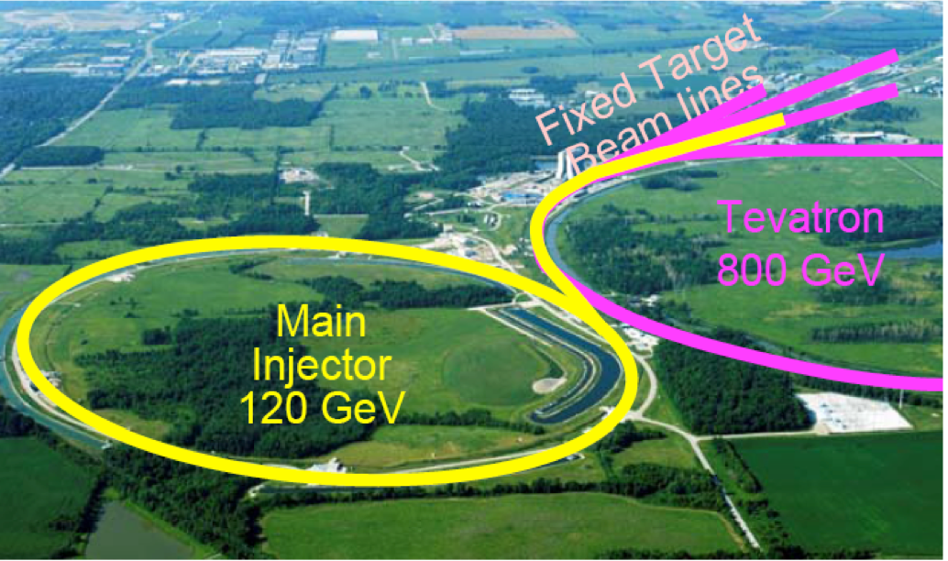
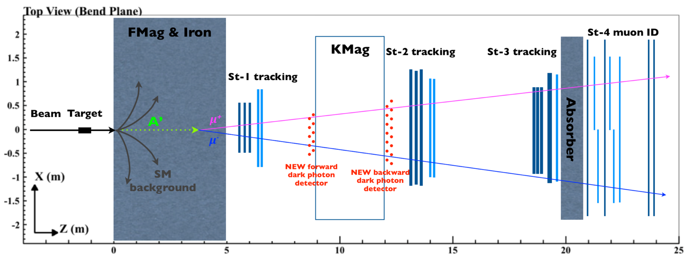
A Direct Search for Dark Photon and Dark Higgs Particles with the SeaQuest Spectrometer in Beam Dump Mode at Fermilab
(P-1067)
Ming X. Liu
Los Alamos National Laboratory

Slide 3
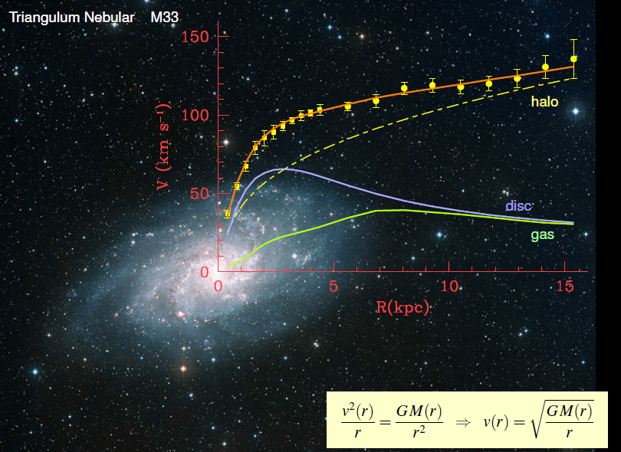
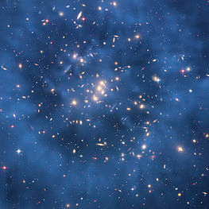
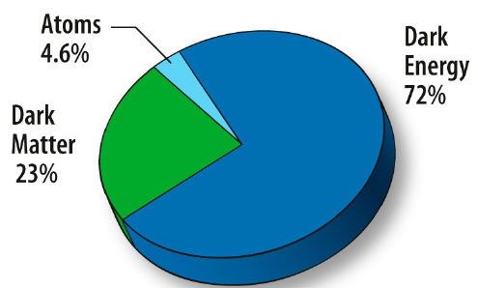
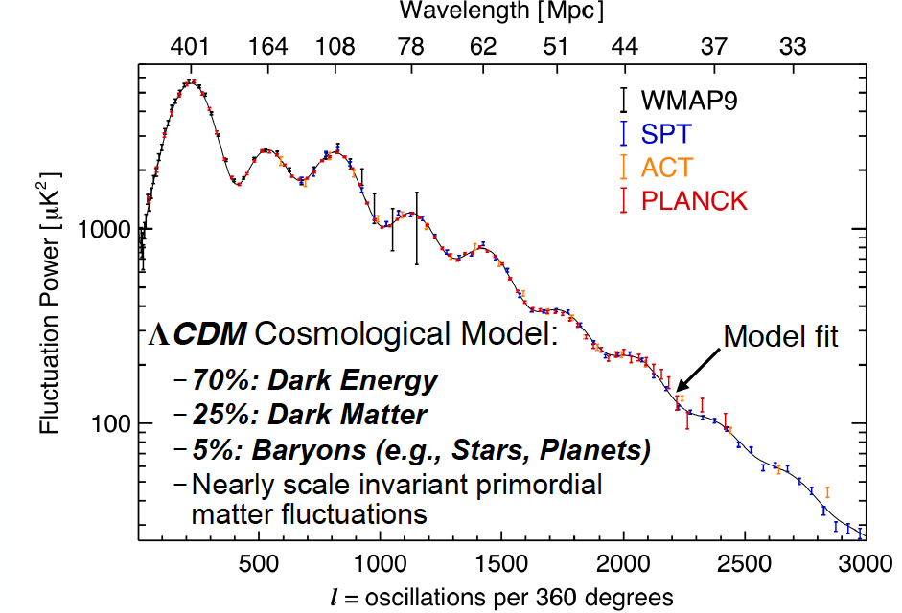
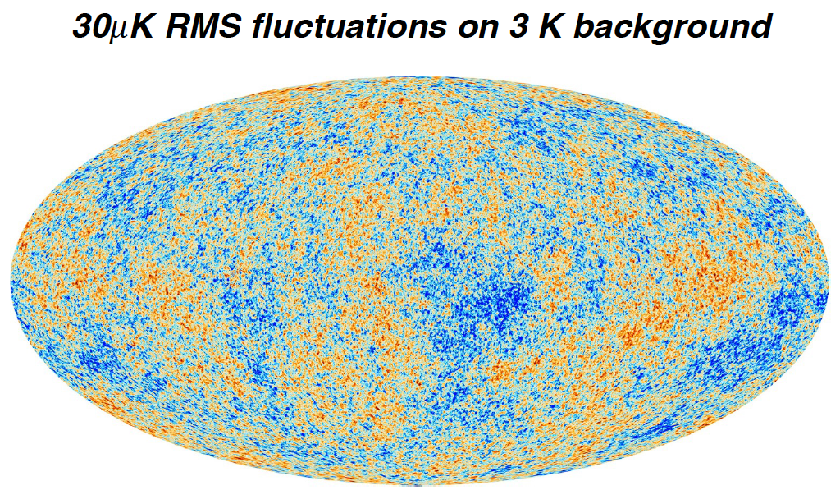
Dark Matter?
Galaxies’ rotation curve
Gravitational lensing (Hubble 2007)
F. Zwicky, ApJ 86 (1937) 217, V. Rubin et al, ApJ 238 (1980) 471
Plank: 2013
Benson’s talk @CIPANP 2015

Slide 4
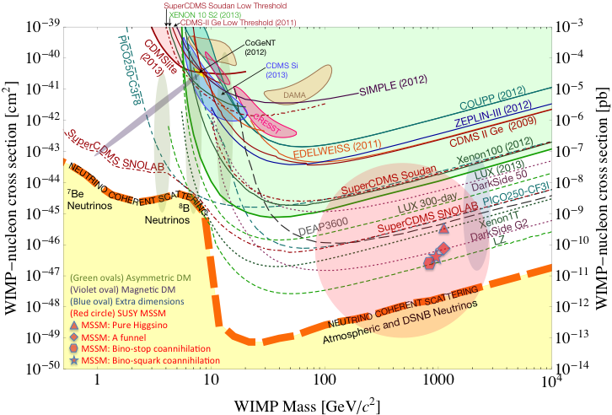
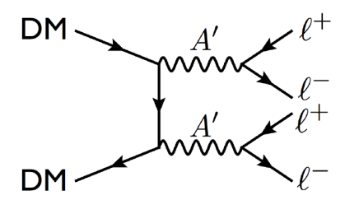
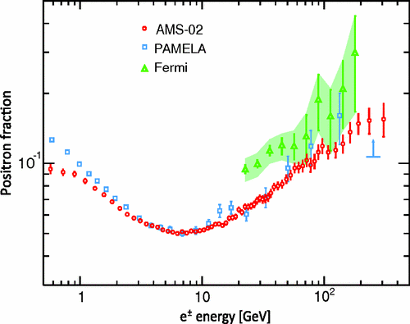
Dark Particles?
WIMP being excluded?
Recent anomalies observed by satellite and terrestrial experiments have motivated dark matter models introducing a new sector with a ‘dark’ force.
Low mass weakly-interacting “dark particles”
become very interesting!
Mass: O(MeV ~ GeV)
In particular, high-intensity colliders (B-factories) and fixed target experiments (Fermilab, JLab, LHC) offer an ideal environment to probe these new ideas.
Montgomery’s talk at CIPANP2015
“a vision of nuclear and particle physics”
Imaginable space for these experiments is rapidly disappearing
the “natural” theory space is also disappearing.
I like to think that Dark Matter is on solid ground, maybe not!!!
PLR 110, 141102 (2013)

Slide 5

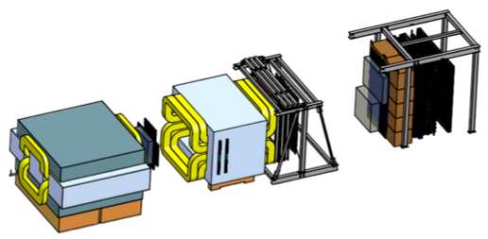
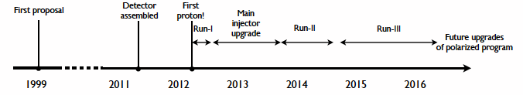
Intensity Frontier at Fermilab: 120 GeV Beam
World’s highest intensity high energy proton beam:
“beam dump mode” @SeaQuest/E906
35,000 fb⁻¹ (in 2 years of parasitic runs)
LHC-II: 300 fb⁻¹ (~2025), achieved 25fb⁻¹ in Run-I
B-factory@KEK: 50,000 fb⁻¹ (~2023)
Absorber wall and proportional
tube based Muon ID
Spectrometer magnet
Δpt = 0.4 GeV
Focusing magnet
and solid iron dump
Δpt = 2.9 GeV
Beam
120 GeV proton from Main Injector
19ns RF, 5s spill, 1×10¹³ protons per spill
25 m
Target system
Liquid H and D
Solid C, Fe, W
E866
done
E906 Started
This LOI

Slide 6
Direct Productions of Dark Photons and Dark Higgs in p+Fe at Fermilab
Weakly interacting dark photons and dark Higgs
Photon portal: “vector”
Higgs portal: “scaler”
θ = μ v/m_{h}²

Slide 7
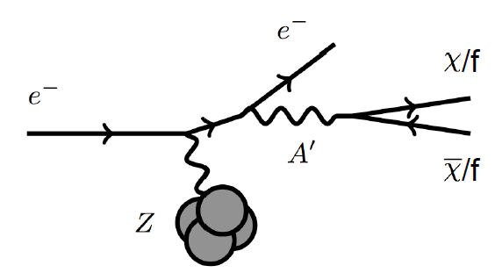
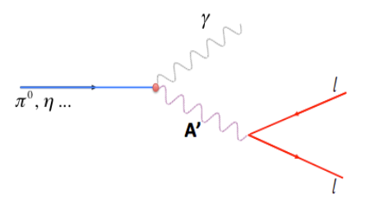
Dark Photon Search in Dimuon Channel at SeaQuest in Beam Dump Mode (p+Fe)
p
Bremsstrahlung
π⁰, η, … decay
Drell-Yan like
l⁺
p
l⁻

Slide 8
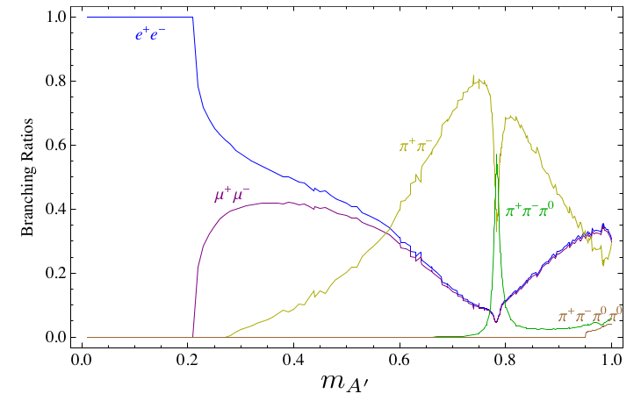
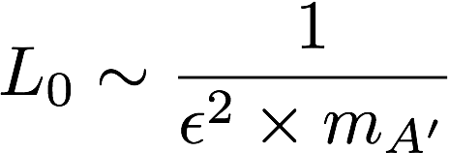
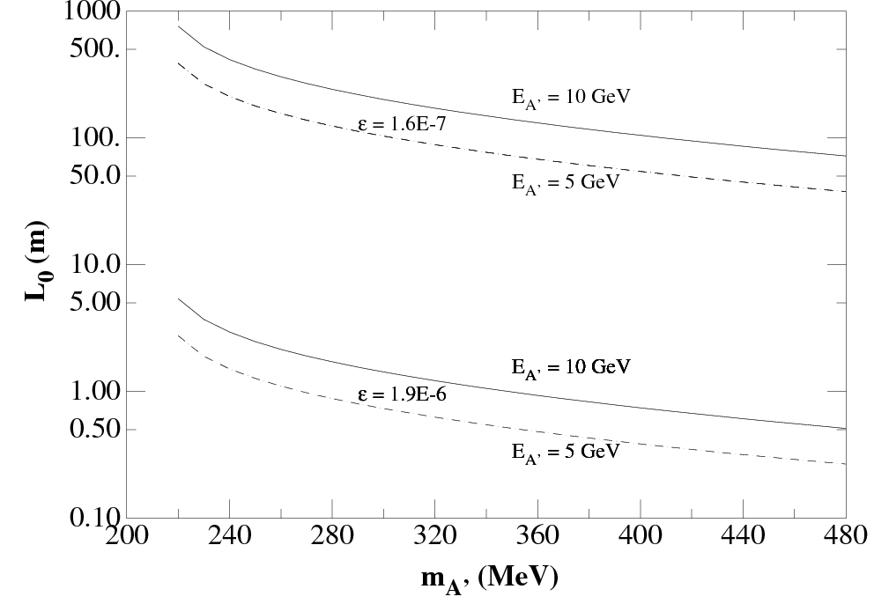
Dark Photon Decay Modes
“Minimal” Decay:
Dark photon is the lightest in the dark sector;
SM final state particles only
Same mixing parameter
  Long decay length
“General” Decay:
Decay into other dark particles,
dominant channel if allowed
  Dark -> Dark
  Dark -> SM particles

Slide 9
Proposed Experimental Measurements
Unique signals
  Invariant mass peak in dimuon mass spectrum
  Displaced dimuon decay vertex for long-lived particle
Beam time
  Run parasitically with E906/E1039 (2017-2019)
  Possible dedicated runs later
Dark photon trigger upgrade
  low mass dimuons (0.2 - 3)GeV
  Displaced dimuon vertex trigger

Slide 10
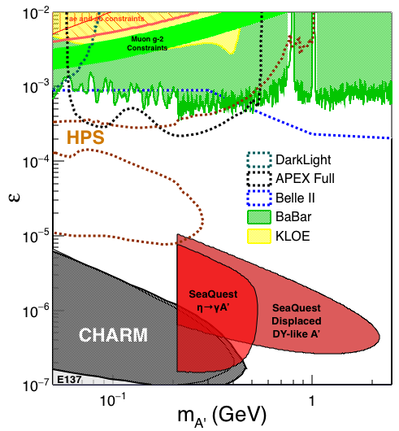
Sensitivity (I): Long-lived Dark Photons
3m < Z-vtx < 6 m
Requires reconstructed
dimuon decay:
3 < Z < 6m
2E12 ppp
200 days
4 events contours
~ 1.4 x 10¹⁸ POT
Plot credit: A. Tadepalli
Plot credit: K. Liu

Slide 11
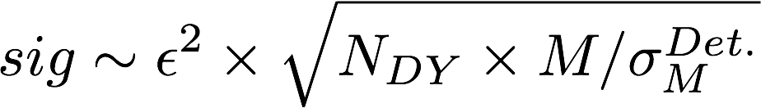


Sensitivity (II): “Prompt” Dark Photons vs Drell-Yan
Z-vtx < 3m
With projected POT: 1.4 x10¹⁸
Good mass
resolution
good mass
resolution
= 1.5 GeV/c²
Place holder

Slide 12
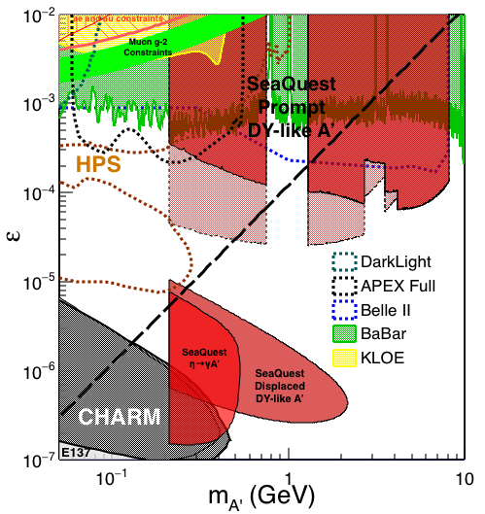

Dark Photon Sensitivity: Summary
POT:1.4x10¹⁸ (parasitic w/ E1039)
Signals considered:
Drell-Yan like
Bremsstralung
Eta decays
Covers a wide range of parameter phase space
Prompt dimuons
  - Low mass < 3GeV is limited by DAQ and Acceptance, requires dedicated run to fully restore the accessible phase space
Displaced dimuons
Plot credit: K. Liu

Slide 13
Dark Higgs Search at SeaQuest
Y. Zhang et al, arXiv:1502.06983
θ = μ v/m_{h}²
D. Curtin et al arXiv:1312.4992
High-mass: μ⁺μ⁻ and hadrons
Low-mass: e⁺e⁻, <200MeV
Advantage of using hadron beams
with muon probes over electrons

Slide 14
SeaQuest Dark Higgs Sensitivity
POT:1.4x10¹⁸, 5x, 25x
Y. Zhang (2015)
Tagged by displaced decay vertex dimuons
Limited sensitivity to large mixing case due to small cross-section compared to SM background
Dark Higgs vs dark photons
  Dimuon kinematic and anglular distributions
Y. Zhang et al

Slide 15
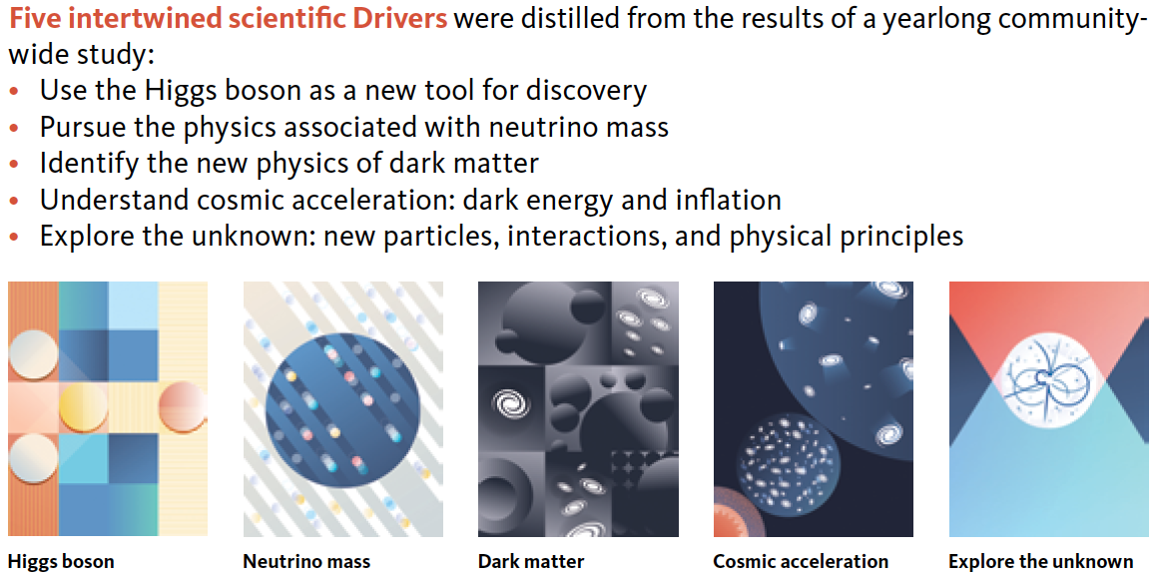
2014 US P-5 Report
Great Opportunities at the Fermilab Intensity Frontier!!!

Slide 16
Summary and Outlook
Great discovery potential!
Early parasitic data taking 2017-2019+
Possible upgrade later, add electrons and hadrons
A new dedicated dark matter program at Intensity Frontier!

Slide 17
Backup 1

Slide 18
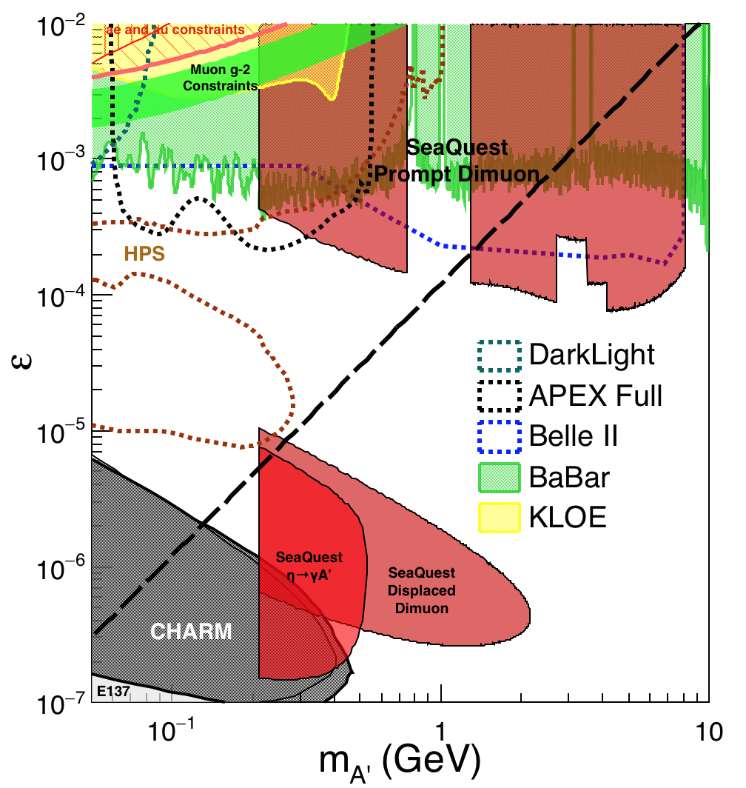
Scope and Compatibility
Preparation work: 2016 – 2017
  Displaced vertex dimuon trigger upgrade (external $$)
    Add a new trigger bit
    No change to existing triggers
  Possible upgrade of DAQ bandwidth under consideration (external $$)
  Commissioning with cosmic rays
Parasitic runs w/ E1039: 2017 – 2019
  Displaced vertex dimuon trigger upgrade
  Use up to ~10% DAQ bandwidth
  Achieve 1.44 x10¹⁸ POT
Possible dedicated runs later with upgrades: 2019+
  High luminosity goals:
    POT >> 1.4x10¹⁸
  DAQ
    10 – 100 kHz capability
  EMCAL/HCAL/PID
    Electrons
    charged hadrons
  Fully cover the accessible phase space
    Low mass “prompt photon” region, M < 3 GeV
  Possible parasitic runs with E1027
Place holder

Slide 19
Dark Photon/Higgs Displayed Dimuon Vertex Trigger
Y-Plane Trigger:
- No mass cut
- Displaced z-vertex
Coincident with St-4 Hodos(muons)
Quadrant triggers: 4 x V1495
Y-channels per quadrant:
- 1x V1495
40(St1) + 40(St2) + 8x2 (St4-Y1,2) = 96
96+64 = 160 possible
  72+72+16 = 160 (possible)
  (2NIM=RFCLK+ComSTOP )
St1
St2
Coincident Z-vtx
window matched@L2

Slide 20
E1039: Polarized Fixed Target Experiment
Replace current E906 targets with a polarized NH₃ target located about 3.5m upstream of the beam-dump
  E906 targets are located 1.3m upstream of the beam-dump
No change to E906 spectrometer setup
  Same dimuon acceptance

Slide 21
Schedule of SeaQuest Experiments
E906: ~ 2017
  Unpolarized fixed target Drell-Yan
  dbar/ubar, and p+A
E1039: 2017 ~ 2019
  Polarized fixed target Drell-Yan
  Parasitic run beam-dump mode
E1027: ??
  Polarized Main Injector Drell-Yan
Dedicated search: 2019+
Dark photon and dark Higgs search:
Parasitic run: 2017 -2019
Future runs under consideration:
detector upgrades
DAQ upgrade
Dark photon(Higgs)
Search; parasitic run.

Slide 22
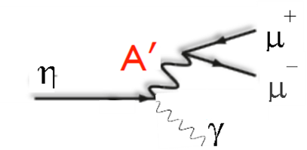
Access Low Mass Region with e⁺e⁻ with future detector upgrades
S. Gardner, R. Holt et al
p
l⁺
p
l⁻

Slide 23
Non Abelian Dark Sector with future detector upgrades
non-Abelian dark sector process
S. Gardner and R. Holt
[Note: Batell, Pospelov, and Ritz, PRD 80 (2009) 095024 for a review re fixed target expts.]
Here we consider a non-Abelian (gluon) portal
[Baumgart et al., JHEP 0904, 014 (2009); Gardner and He, PRD 87 (2013) 116012]
The “shining through walls” design – unique to Seaquest – makes this possible ,
to yield, e.g., via a “minimal” decay….

Slide 24
Backup slides

Slide 25
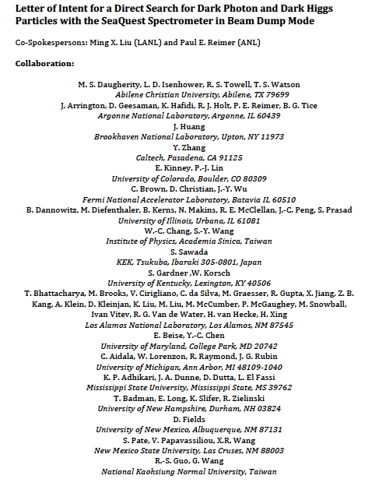
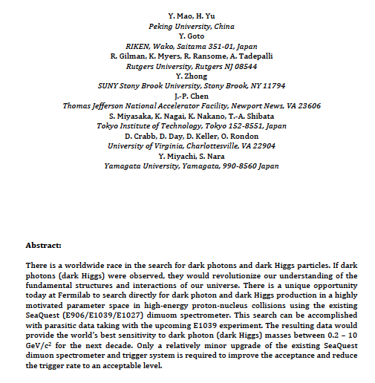
LOI submitted to Fermilab PAC
on May 20, 2015
A joint experimental and theoretical collaboration
---------------------------------------

Slide 26
Integrated theory efforts
Signal: detailed calculation for dark photon (dark Higgs) cross section
To provide expected dimuon signal from dark photon decay as function of decay length L and model parameters (ε, m_{A’}), theory team will
  Compute Dark photon production cross section at both LO and NLO
  Derive the branching ratio of dark photon to dimuon
  Theory team: expertise in perturbative QCD and effective field theory for resummation
Dimuon signal
Drell-Yan background
Background: detailed calculation for Drell-Yan cross section
Main background is DY dimon production: reliable computation of the cross section is essential to calculate our experimental sensitivity to (ε, m_{A’}), and understand implication of dark photon search
  We have a NLO DY code that works well in the required energy range
  Calculations will be performed in the necessary energy and kinematic regions

Slide 27
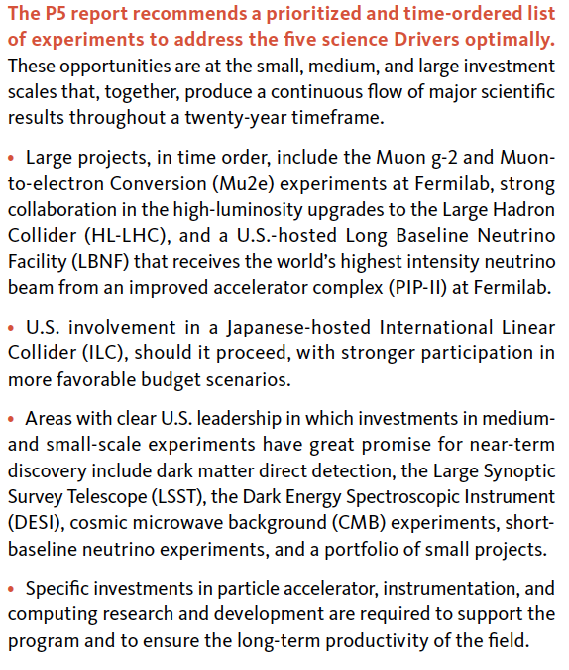
P-5 Recommndations

Slide 28
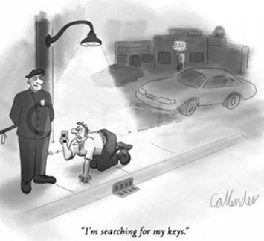
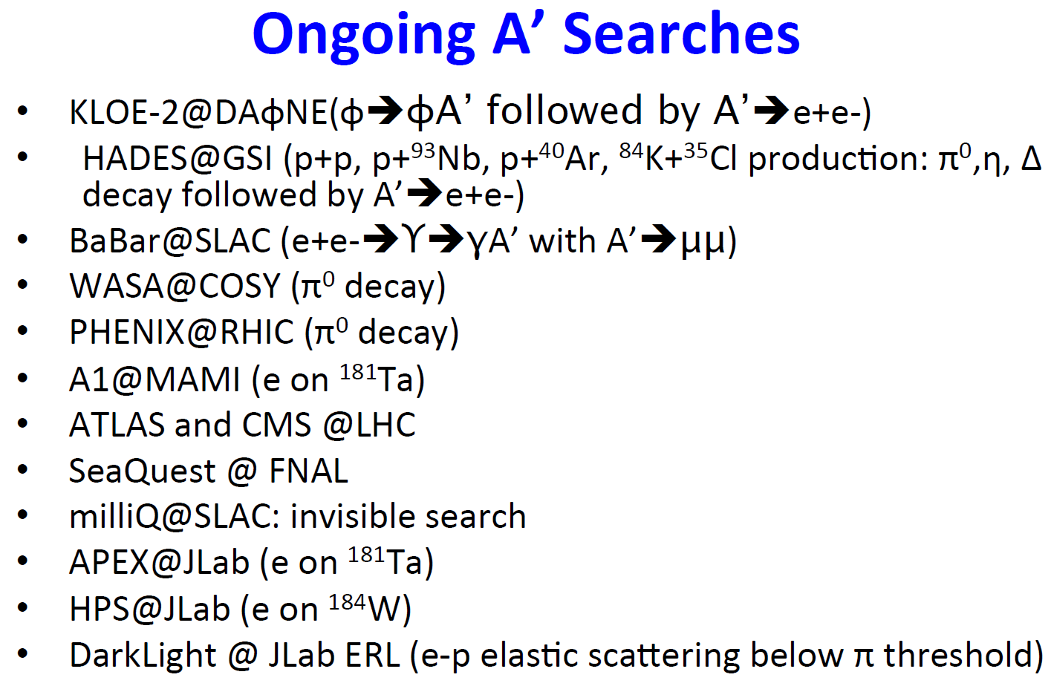
  How important are dark photons in current models of new physics ?
2014 US High-Energy Physics Report (P5)
  Top 5 science drivers:
  “Identify the New Physics of Dark Matter”
  Dark photons
  “one of the key search area for physics beyond the SM”
  One of the two most important portals to “dark sector”:
  Vector coupling, kinetic mixing
  (scaler coupling, dark Higgs)
On-going and/or proposed experimental programs in all major accelerator facilities in the world!
  World wide competitions!
Courtesy: R. Milner(MIT) at the Fundamental Interactions Town Meeting, Chicago, Sept. 28-29, 2014

Slide 29
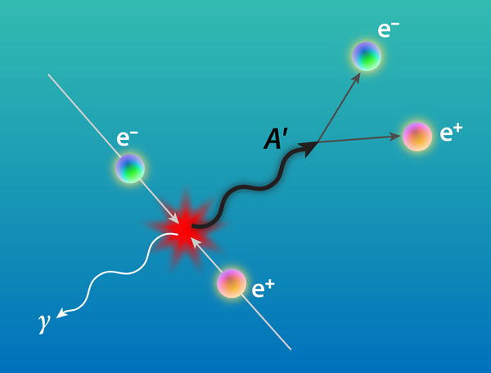



Current Accelerator Based Direct Search for Dark Photons
B-fatories, RHIC, LHC, Jlab, BES-III etc
B. Holdom, Phys. Lett. B 166 (1986) 196
J. D. Bjorken et al, arXiv:0906.0580
l
A’
“Kinetic Mixing”
l

Slide 30
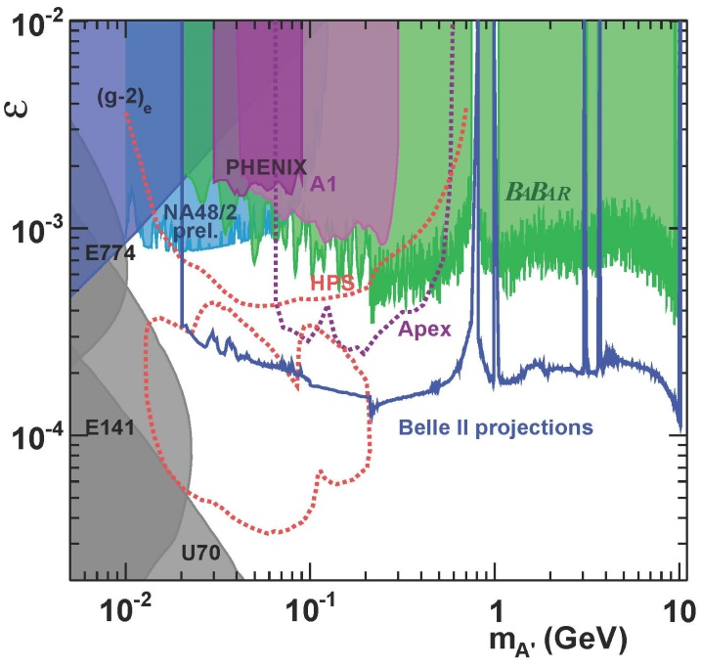
Current Limits on Dark Photon Search
R. Essig et al arXiv:1309.5084

Slide 31
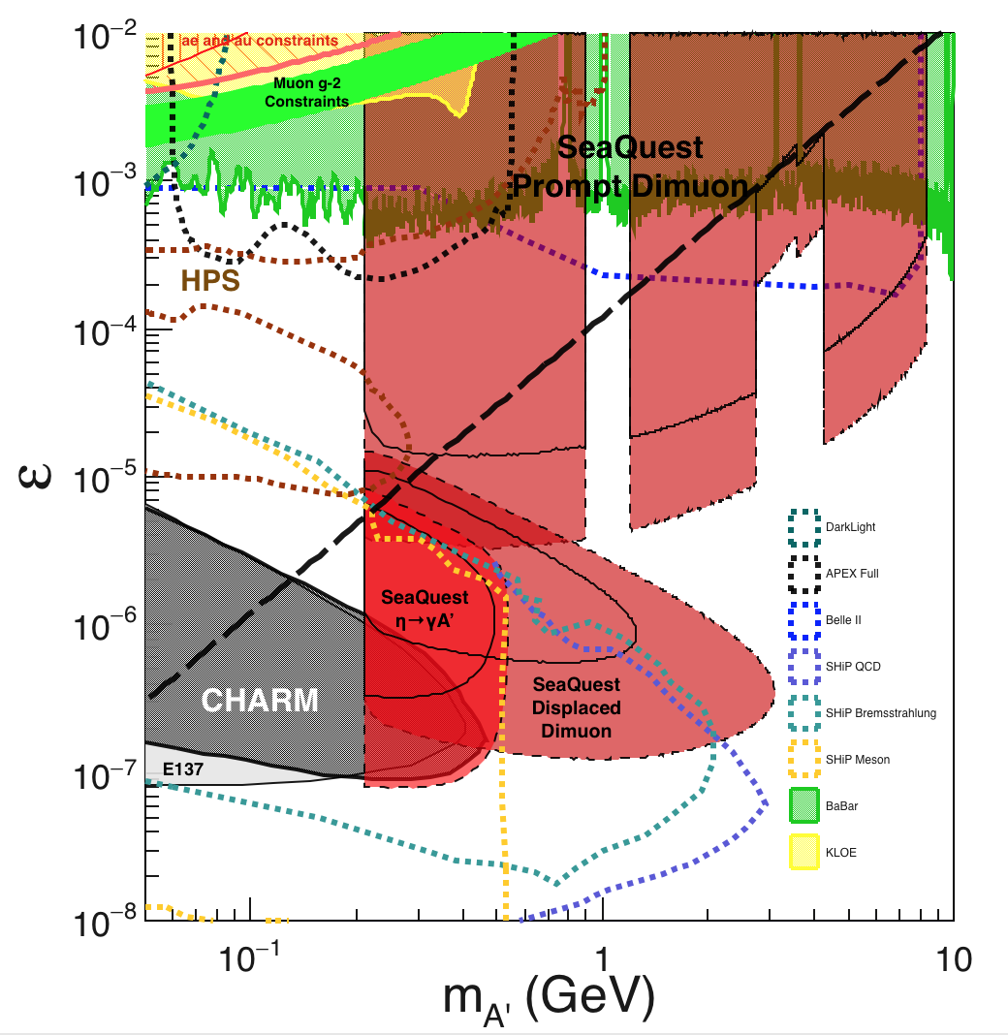
Comparison with SHiP Proposal
120 GeV@FNAL: 2017 -2019
1.4x10¹⁸ POT, future runs possible
400 GeV@SPS: 2025 -2030
4x10²⁰ POT

Slide 32
  How does the newly-proposed SHiP related to this proposal in terms of overlap in parameter space, timing, and scale?
E906: a running experiment
  Minor upgrade of the trigger and DAQ system, ~$100K
  First parasitic runs w/ E1039, 2017-2019
  Dedicated runs later, with upgraded detectors (e^{+/-}, h^{+/-})
  Lower beam energy (120GeV)
    Pros:
    Access phase space of low mixing parameter as SM background is low
SHiP: a proposal using SPS @CERN
  Needs ~10 years to build the experiment, @$100M, (Search for Hidden Particles)
  A new fixed target experiment for “dark sector”
  Data taking, 2025 – 2030
  Higher beam energy (400GeV)
    Pros:
    Access to a large phase in the displaced decay mode
    Cons:
    Not sensitive to phase space of low mixing parameters, due to much larger SM background than what E906 sees

Slide 33
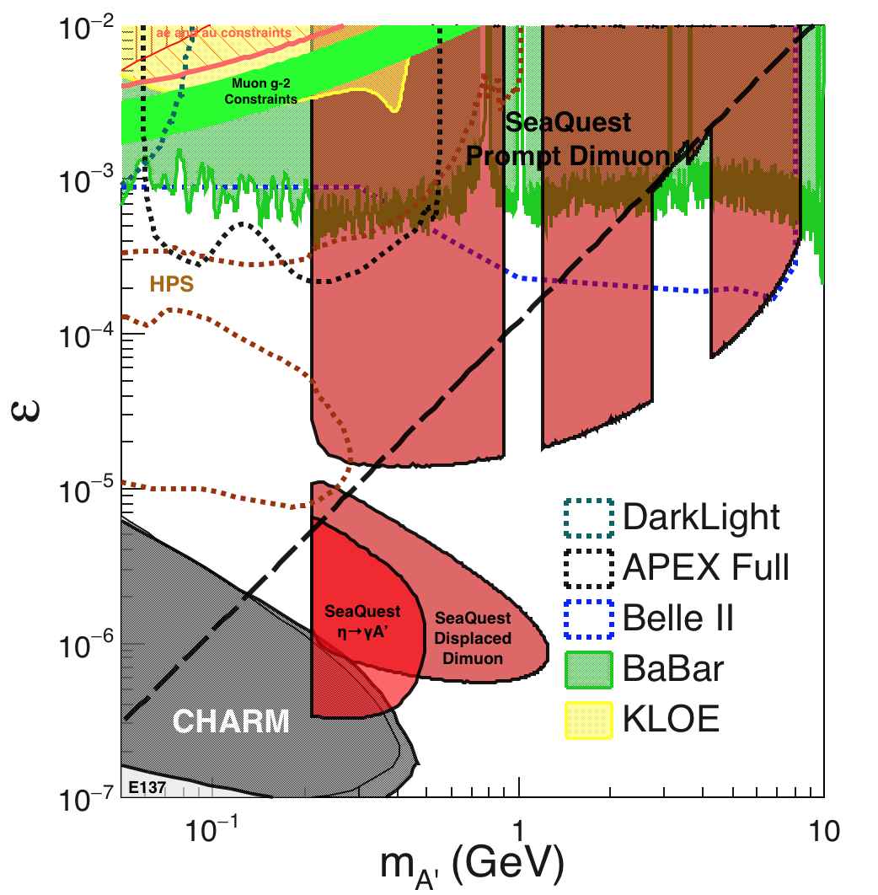
SeaQuest Dark Photon Sensitivity
POT:1.4x10¹⁸ (parasitic w/ E1039)
From signals:
Drell-Yan like
Eta decays
Bremsstralung
Covers a wide range
of phase space
- Prompt dimuons
- Displaced dimuons
Plot credit: K. Liu

Slide 34
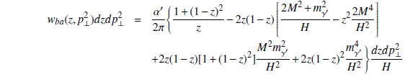

Probe-1: Proton Bremsstrahlung
Generalized Fermi-Williams-Weizsacker approximation
J. Blumlein, J.Brunner, PLB 731 (2014) 320
R. Holt
p’
l⁺
p
γ + p -> Α’ + p’
l⁻
z = (E_{p} – E_{p}’)/E_{p}; s = 2ME_{p}; s’ = 2M(E_{p} – E_{A’})

Slide 35
Proton Bremsstralung Flux
R. Holt
ε = 1

Slide 36
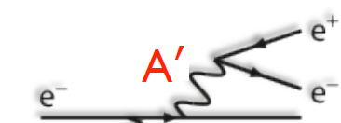


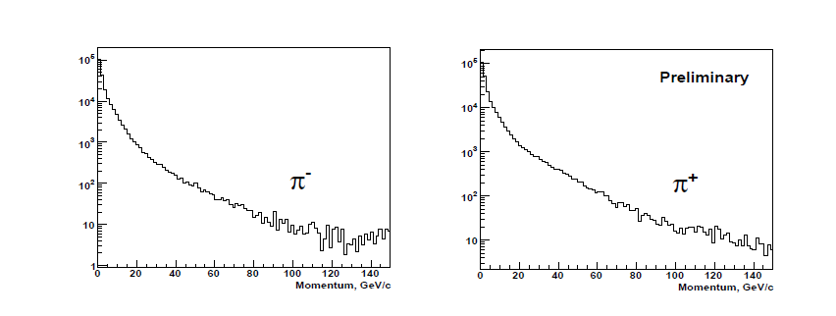
Probe-2: η Meson Production at 120 GeV
R. Holt
= 2.2 b for all charged particle production
Assume that π’s represent 90% of charged particles,
and η production is ~1/10 of this value.
μ⁺
η
Resonance production
μ⁻
γ
S. Mahajan, R. Raja, arXiv:1311.2258; FNAL E907, MIPP

Slide 37
Probe-3: Drell-Yan Like sensitive to both prompt and long-lived decay

Slide 38

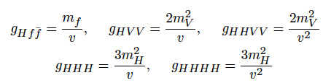
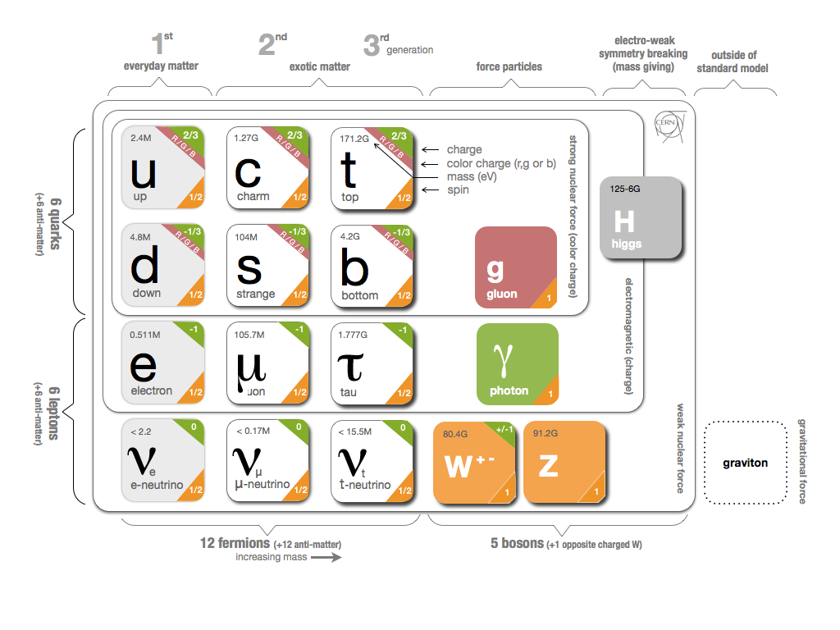
Higgs!
PPG
The only scalar in the SM
Couples strongly with mass
High potential portal to dark sector

Slide 39
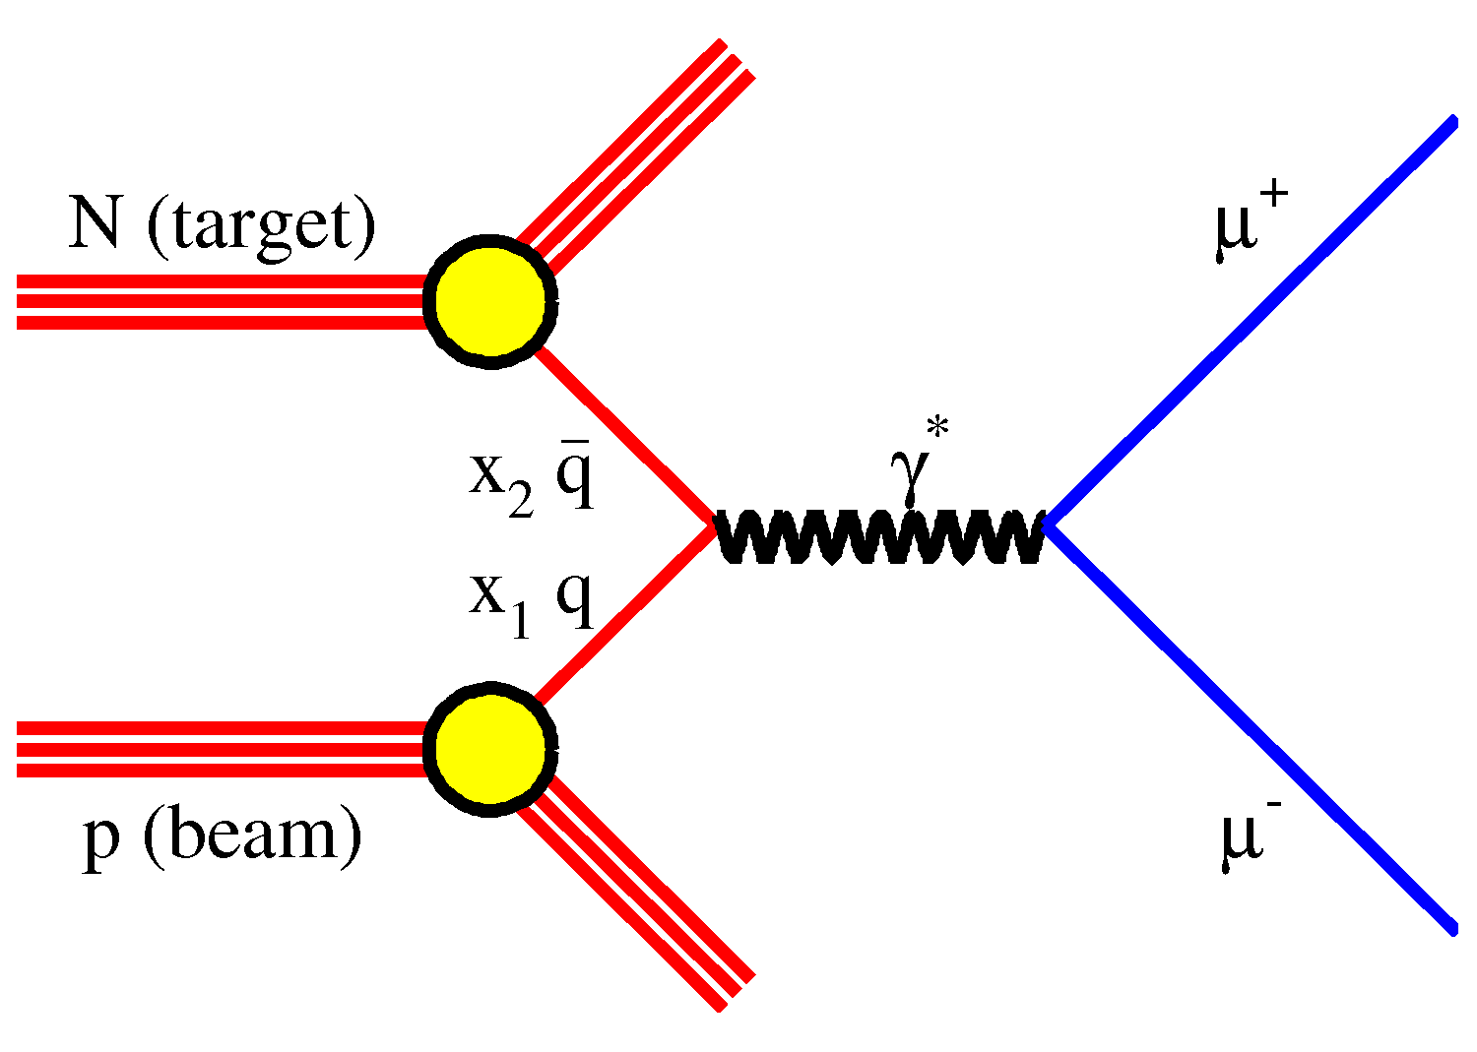
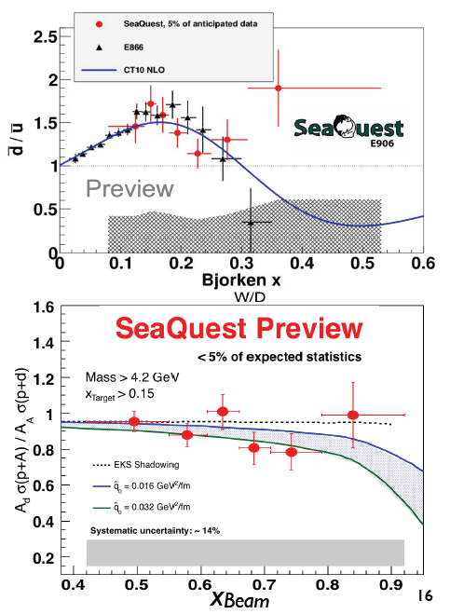

E906 Drell-Yan Measurements in p+A Collisions
Thin targets (10-20% λ_{I} ): H, D, C, Fe, W
J/Psi
Psi’
Drell-Yan
Rndm

Slide 40
E906 Run 2 Data: Dimuon Invariant Mass and Reconstructed Z-Vertex
J/Psi
Psi’
Drell-Yan
Rndm
E906 Trigger and event selection optimized
for high-mass dimuons, mass > 2.5GeV ;
Low-mass dimuons are rejected by trigger.
Dimuon event z-vtx distributions
after target/dump separation;
No events observed beyond Z-vtx > 2m

Slide 41
Low Mass Dimuon Trigger Rates Study
Current E906 setup
Proposed 2-layer trigger upgrade (10x improvement)
Additional Y-trigger after ST-3 absorber, and also use E906 X-Plane trigger
(additional ~2x improvement)
Current E906 DAQ 1kHz, can be improved to 10kHz with small cost
200kHz possible (reprograming trigger firmware)

Slide 42
Work in Progress Sensitivity Study
2-year parasitic run
With 10kHz DAQ bandwidth,
the accepted low mass dimuons, M<3GeV, are statistically limited by DAQ throughput and detector acceptance (assuming only uses 10% DAQ).
100kHz DAQ bandwidth is needed to
fully cover the phase space (assuming 10% usage of DAQ bandwidth) and dedicated dark photon run.
In the first two-year parasitic runs with E1039, our focus is on 1)the displaced dimuons for low mass; 2)prompt high mass dimuons M> 3GeV.
We can still cover more phase space than what BELLE-II can achieve in ~2023.
Full coverage of low mass (M<3GeV) can be achieved later through dedicated runs with much improved DAQ bandwidth after E1039.

Slide 43
Toward Improving E906 DAQ Bandwidth
Working with E906 DAQ group to improve DAQ bandwidth from 1kHz to 10kHz(or more)
  TDC board FPGA reprogramming
    Taiwan group
    Fermilab engineer
  Two options considered:
    Directly readout each TDC with Ethernet instead of reading serially through VME backplane
      ~10kHz possible
    Store all raw data in onboard RAM chips (already built in on Taiwan TDC boards, but not used yet!) during the 4-sec spill and read them out during the remaining 56-sec.
      ~200kHz possible

Slide 44
E906 Trigger & DAQ System
Pulse Gen.
V1495 @TB
DAQ
VME/CPU
Ethernet
Hodos
Hits/
Start
TDC (xx)
Threshold Discriminator
……
L1-Trigger
V1495 (4)
(96)
L0 Trigger: not “actively” used
- 4 V1495 boards available
L1 Trigger: in operation
- 4 V1495 boards
(2) for Y-plane, not used
(2) for X-Plane, in use
- 700nS latency
L2 Trigger: pass through
1 V1495
Could do simple look-up
TS: Trigger Supervisor
L2-Trigger
V1495 (1)
L2: limited I/O
1(O), 5(I), 32x
only 2 (I) used
Trigger Supervisor
Comm.
Stop/Trigger

Slide 45
Dark Photon Q-Trigger
DAQ/Data stream
LVDS cable 2x16ch bundle available
Q1 (LVL1)
DAQ Trigger
LVL2
(vtxZ matching)
Q2 (LVL1)
TS
(12 inputs total)
(1-free bit available)
Q3 (LVL1)
DP Trigger
1-bit
Q4 (LVL1)
MC simulation
Dummy pattern
A test stand at LANL
To check FPGA
Logic
Timing
4 x 16-bit from 4 Q1-4/V1495
(2 x 32LVDS cables)
Q1: 40(ST1’) + 40 (ST2’) + 2x8(ST4-Y1/2) = 96, FANOUT ST4
Upto 72(ST1) + 72 (ST2) + 2x8(ST4Y1/2) = 160

Slide 46
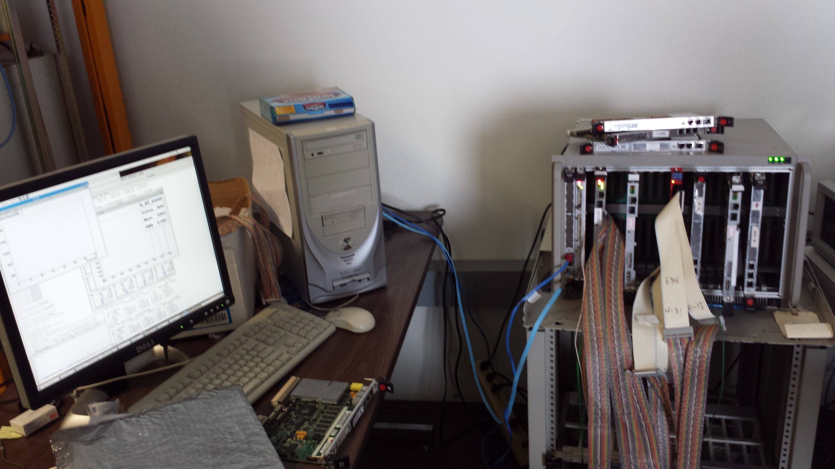
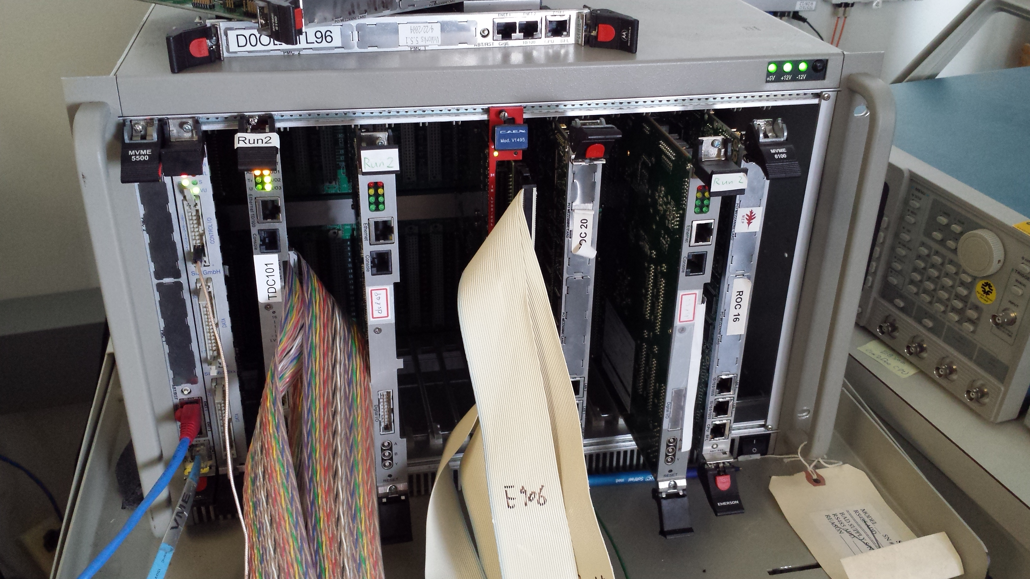
E906 DAQ Test Stand
PC/Linux: Jlab CODA, Ethernet Readout
CPU MVME5500: old VxWork (Jlab)
“TS” ?
TDC-II
V1495 pulse generator
V1495 L1 Trigger “development brd”
Windows PC: Altara FPGA programing

Slide 47
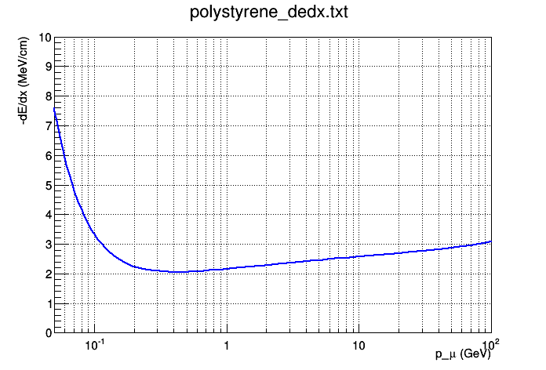
Plastic Scintillator dE/dx and
Particle Identification
Using polystyrene as example (same as FNAL scintillator factory)
Muon dE/dx = 2.41 MeV/cm @ 4 GeV, and 2.69 MeV/cm @ 20 GeV
  11.5% difference
For 4 GeV Kaon vs 20 GeV muon it’s an even bigger difference, 26.5%

Slide 48
Minimal Thickness for Light Yields
For thickness = 1.0cm, P > 5GeV
  dE/dx = 2.5MeV/cm
  Light yield = 2.5MeV / 100eV ~ 25K photons
  SiPM Eff = 20%
  Scintillating strip light collection Eff = 10%
  Total “light yield” = 25K x 20% x 10% = 500 >>1
Required light output
  Photon detecting eff > 99%

Slide 49
Dark matter search strategies
SM
χ
Direct production:
LHC, Fermilab …
Indirect search:
PAMELA, Fermi, HESS, ATIC, AMS-02, WMAP
SM
χ
Direct search:
CDMS, DAMA, XENON, CREST, LUX
COUPP, PICO, MiniCLEAN, …

Slide 50
MiniBooNE Dark Matter Search
Needs slides/plots
Other Fermilab “dark matter search” programs

Slide 51
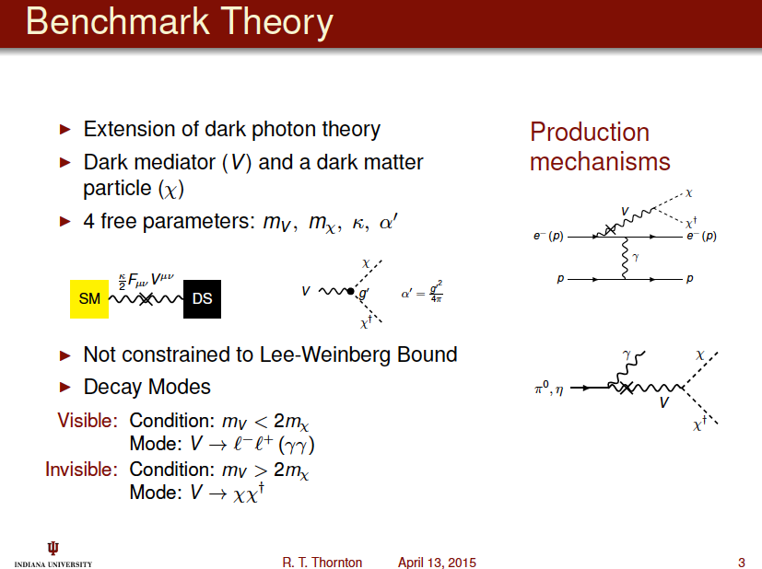

Slide 52
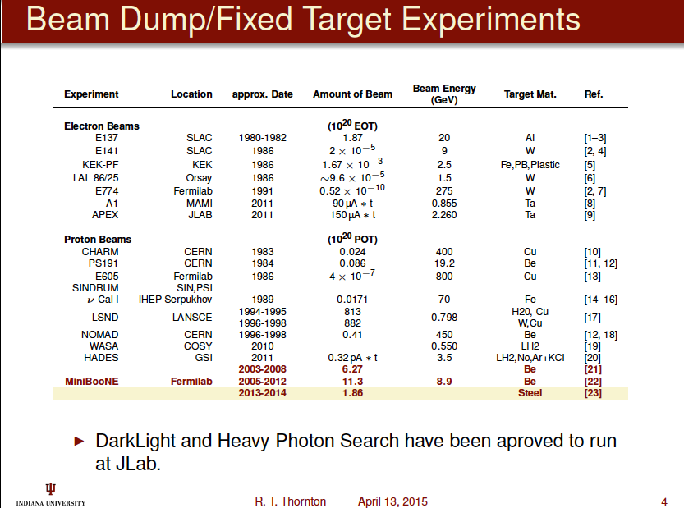

Slide 53
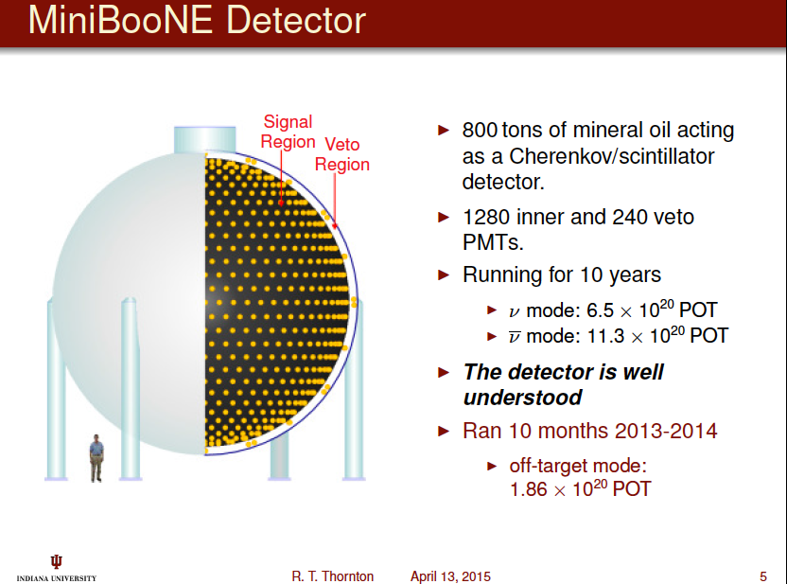

Slide 54
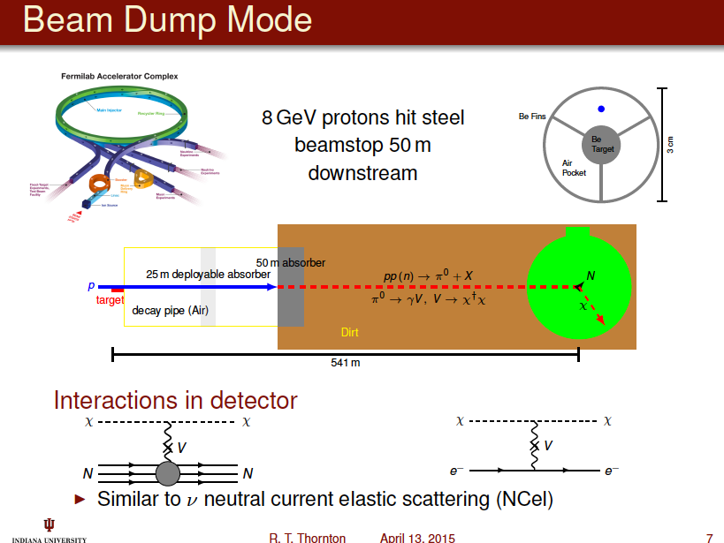

Slide 55
