Slide 1
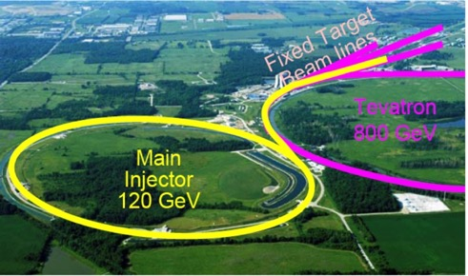
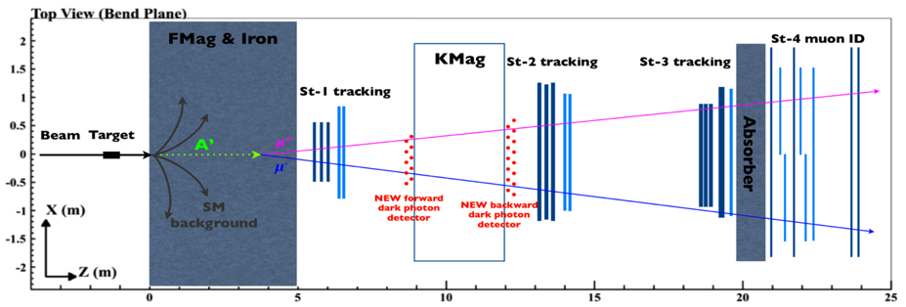
Direct Search for Dark Photons and Dark Higgs in Beam-dump Mode at E-1067/SeaQuest at Fermilab
Ming X. Liu
Los Alamos National Laboratory

Slide 2

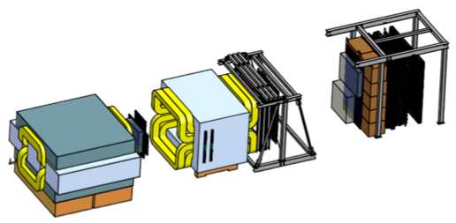

Intensity Frontier at Fermilab: 120 GeV Beam
World’s highest intensity high energy proton beam:
“beam dump mode” @E-1067
50,000 fb⁻¹ (in 1 year of parasitic run)
LHC-II: 300 fb⁻¹ (~2025), achieved 25fb⁻¹ in Run-I
B-factory@KEK: 50,000 fb⁻¹ (~2023)
Absorber wall and proportional
tube based Muon ID
Spectrometer magnet
Δpt = 0.4 GeV
Focusing magnet
and solid iron dump
Δpt = 2.9 GeV
Beam
120 GeV proton from Main Injector
19ns RF, 4s spill, 0.5×10¹³ protons per spill
25 m
Target system
Liquid H and D
Solid C, Fe, W
- Capture most beam in beam dump mode: p+Fe collisions!
- Parasitic run mode possible with other experiments, E906/E1039

Slide 3
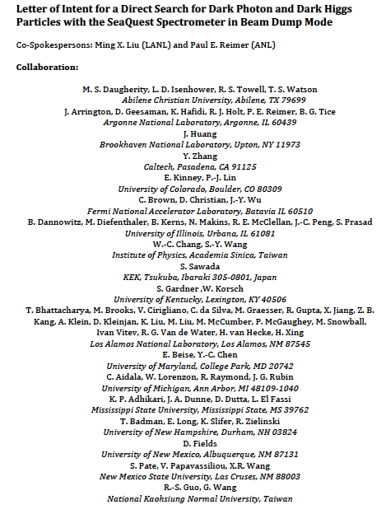
LOI submitted to Fermilab PAC
May 20, 2015
A joint experimental and theoretical collaboration
(most E906/E1039 + new members, ~60)
---------------------------------------
Phase-I: (parasitic runs)
Addition of a new displaced dimuon trigger to tag long-lived downstream decayed dark photons (dark Higgs).
Parasitic data taking with E1039 in 2017-2019;
  A short dedicated run (up to ~1 month) if needed.
POT 1.44x10¹⁸
Phase-II: (upgrade)
Dedicated runs later with EMCal/HCal upgrades, e^{+/-} and h^{+/-} capabilities.
Cover the full parameter phase space allowed by beam energy and luminosity
POT: >> 1.4x10¹⁸
Phase-II request will be presented to PAC at a later time.
Notes:
Responding to P5 reprot, we submitted LOI last month .. And the membership is growing …

Slide 4
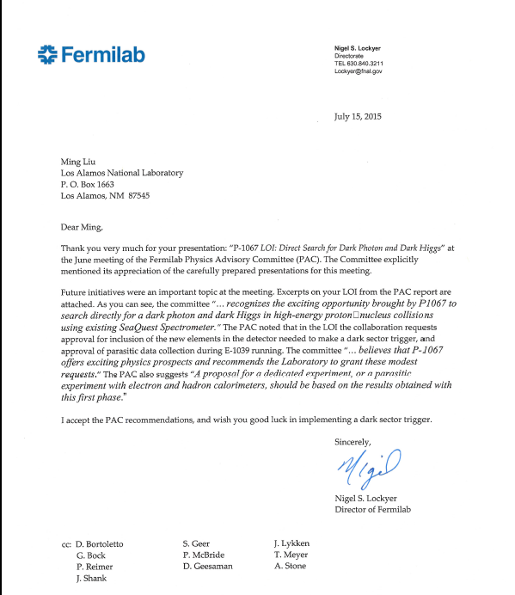
A heart-full endorsement
from Fermilab Director and PAC
July 15, 2015!
New experiment! E-1067
LANL LDRD support:
- FY16-17-18
- $1M to implement
the trigger/DAQ upgrade and theory development
Goals:
Trigger installed, 2017
Physics run, 2017-18
Preliminary results 2018!

Slide 5
Outline
Physics of dark sectors
  Mass: MeV ~ GeV
Detector upgrade
  Displaced dimuon trigger
  DAQ improvement
New opportunity
  EMCal from PHENIX, available this fall
  Electron/hadron ID
Schedules

Slide 6
Dark Photons and Dark Higgs Productions in p+Fe/BeamDump at Fermilab
Photon portal: “vector”
Higgs portal: “scalar”
θ = μ v/m_{h}²

Slide 7
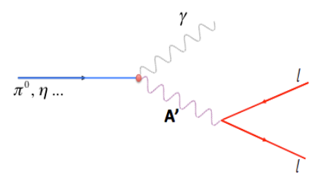
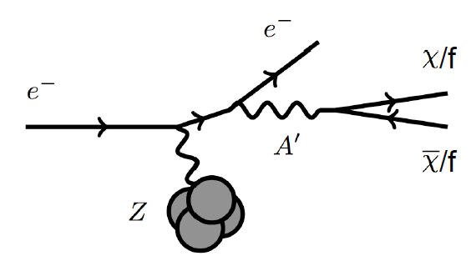
Dark Photon Detection in Dilepton Decay Channel
Drell-Yan like
π⁰, η, … decay
Bremsstrahlung
(DM)
MiniBooNE
Beam-dump
(DM)
p
l⁺
p
l⁻
~ Fixed target w/
electron beams

Slide 8
Detector Upgrades and Expected Signals
Dark photon trigger upgrade
  Add a fine-granularity scintillating strip based trigger/tracking to tag dimuons from the same decay Z-vertex
  A new trigger for events with displaced down-stream dimuons
Unique signals
  Displaced dimuon decay vertex for long-lived particles
  Invariant mass peak in dimuon mass spectrum
  Mostly from beam dump (target ~10% λ_{I}.)
Beam time
  Run parasitically with E906/E1039 (2017-2019)
  Possible dedicated runs later with upgrade (e^{+/-}, h^{+/-})
-- 2.5%
-- 6.0%
Dimuon mass resolution
Z (meter)

Slide 9
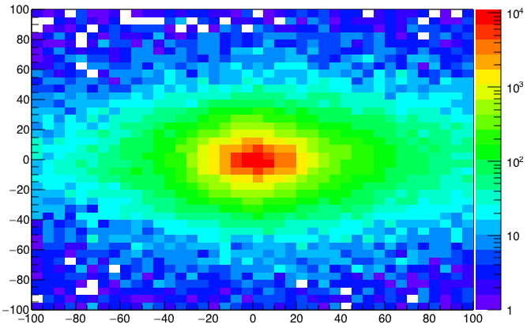
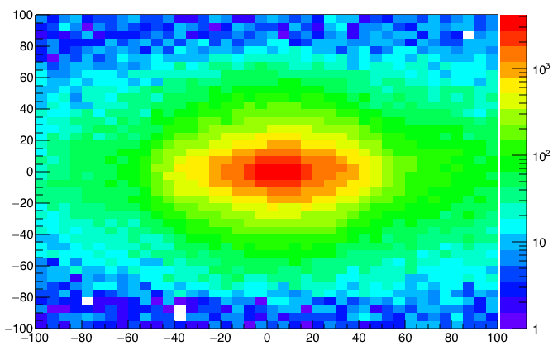
A New High-Granularity Displayed Dimuon Vertex Trigger
High rejection power, low rate, << 1 kHz(current E906 DAQ limit)
Y-Plane (non-bending) Trigger:
A quadrant panel: 80cm x 80cm (100cmx100cm @ST-2)
  ST1: 1cm x 1cm x 80 cm scintillating strips, SiPM readout
  ST2: 2cm x 2 cm x 100 cm strips
- Straight line projection, σ_{Z} ~30cm
Displaced z-vertex, mostly low mass < 3GeV
Y-channels per quadrant:
1x V1495
80(St1) + 50(St2) + 8x2 (St4-Y1,2) = 146
96+64 = 160 inputs possible
  (2NIM=RFCLK+ComSTOP)
Y
Dimuon Z-vertex (cm)
ST1
X
St1
St2
Z
Coincident Z-vtx
window matched@L2
Z1=9m
Z1=12m
ST2

Slide 10
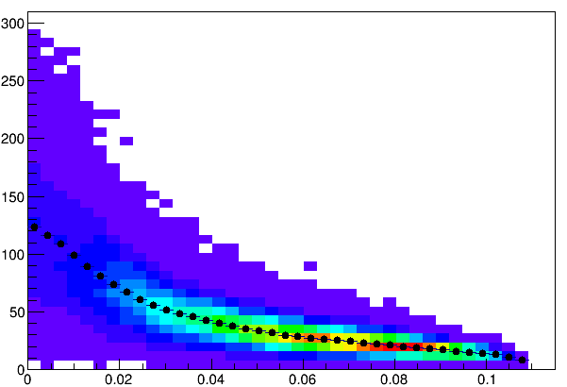
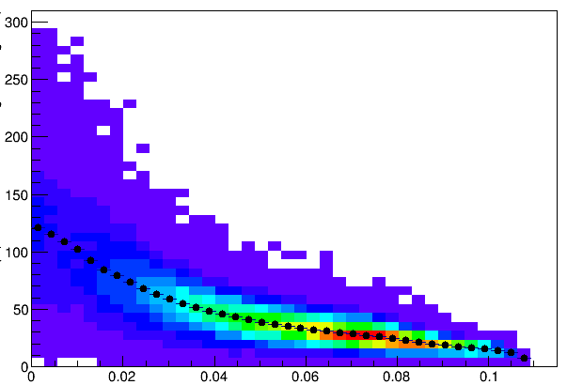
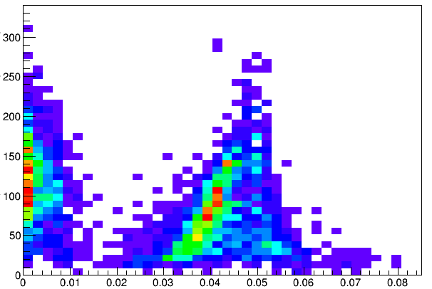
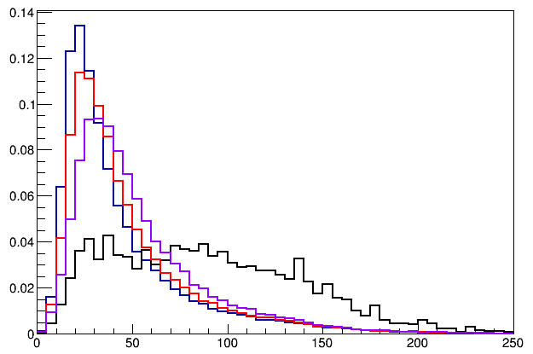
Trigger Detector Optimization
Single Muon Z-Vertex Resolutions
Forward: 1cm
Backward: 1cm
Forward: 1cm
Backward: 2cm
Sigma_Z ~ 30cm
Forward: 1cm
Backward: 1cm
Forward: 1cm
Backward: 2cm
Forward: 2cm
Backward: 2cm
E906
Current
E906

Slide 11
Low Mass Prompt Dimuon Trigger Rate Study
Current E906 setup
Proposed 2-layer trigger upgrade (10x improvement)
Additional Y-trigger after ST-3 absorber, and also using existing E906 X-Plane trigger
(additional ~2x improvement)
Current E906 DAQ 1kHz, can be improved to ~10+kHz with small cost
20+kHz possible for next run (reprograming trigger firmware etc.)
Parasitic mode: use up to ~10% DAQ bandwidth
Expected (Prompt) Low mass dimuon trigger performance

Slide 12
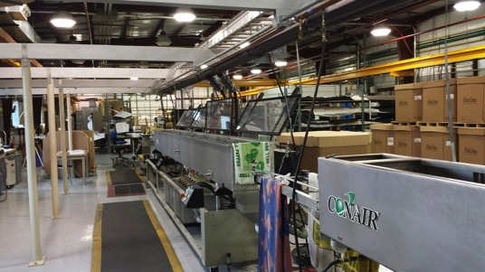
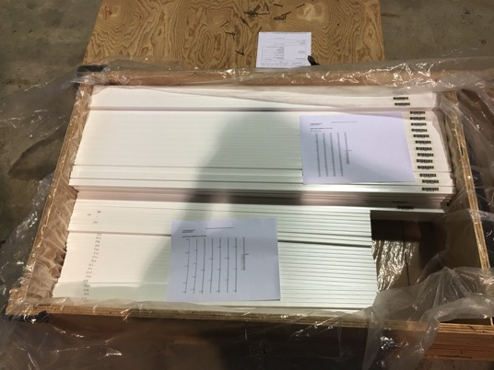
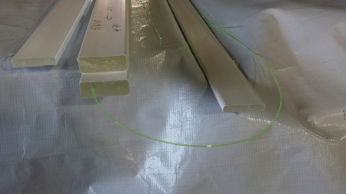
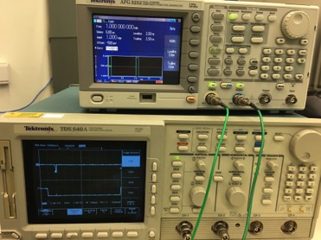
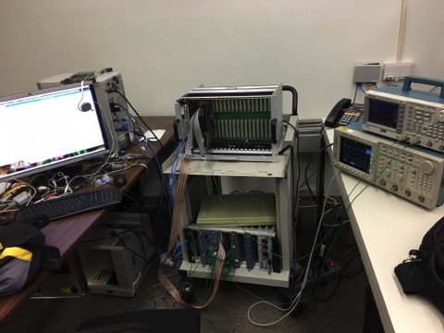
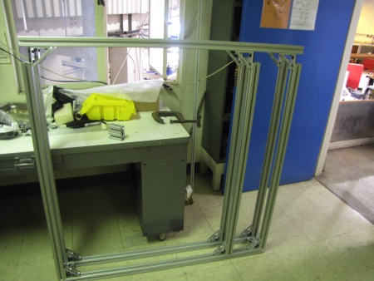
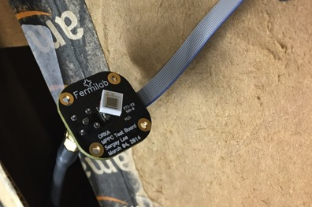
Trigger/DAQ Upgrade
In good progress, to be installed by 2016
- Extruded scintillators + WLSF
SiPM readout, frames
Improve DAQ rate, x20+ expected

Slide 13
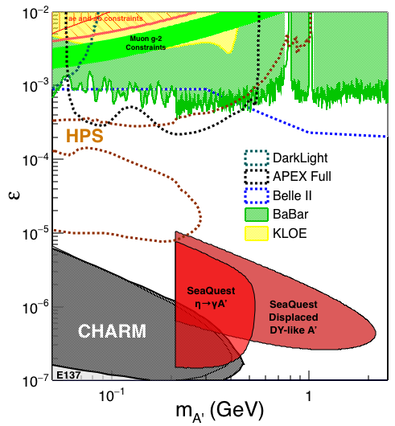

Search Mode (1): Long-lived Dark Photons
Reconstructed dimuons with downstream Z-vertex:
3m < Z-vertex < 6m
Very low trigger rate, << 1kHz
Almost SM background free
Dimuon mass peak
- 5x10¹² ppp ( current E906)
200 days
1.4 x 10¹⁸ POT (recorded)
4 events contours (2-sigma)
2-sigma (95%) exclusion plots
Excellent coverage of uncharted region!

Slide 14



Search Mode (2): “Prompt” Dark Photons vs Drell-Yan
Bump hunt at Z-vertx < 3m
Expected Drell-Yan like signal and backgrounds:
Excluded phi
resonance region
Dark photon
signal
Drell-Yan Background
Work in progress:
- optimization …,
- understand BG ...

Slide 15
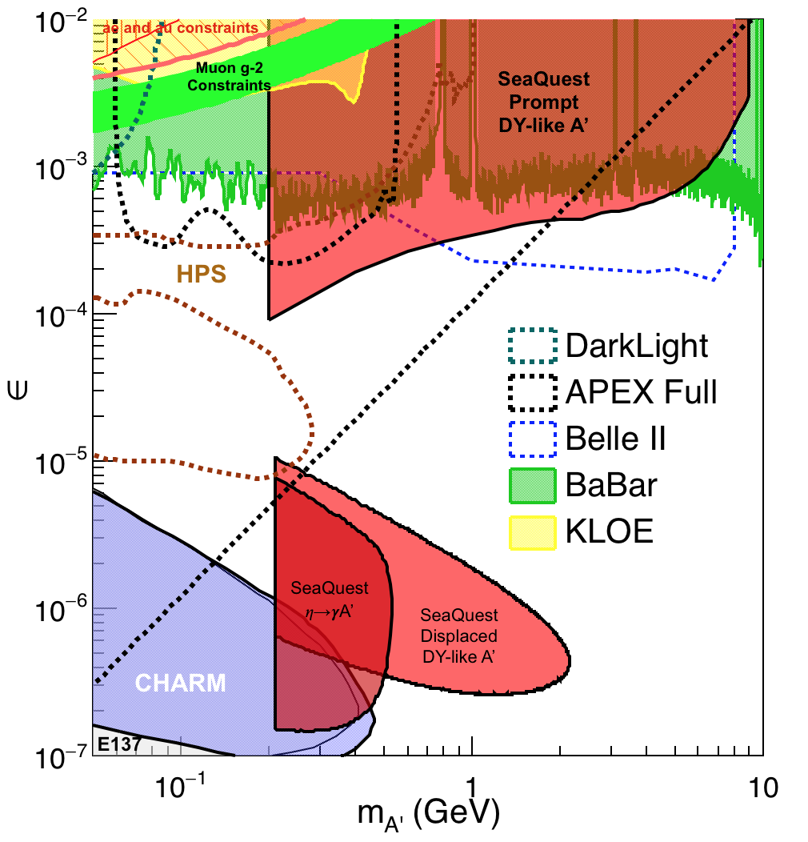
Phase-I Expectation: Dark Photons
(parasitic run w/ E906/1039)
Signals considered:
Drell-Yan like
Eta decays
Bremsstralung
Covers a wide range of unexplored parameter phase space
Displaced dimuons
- Minimal SM background
Prompt dimuons
- Excellent coverage over BELLE-II
projection
- Possible dedicated runs later to fully
restore mass < 3GeV (Phase-II)
Phase-II with upgrades
Access below 200MeV with di-electrons
( add EMCal)
Work in progress!

Slide 16
Dark Higgs
Y. Zhang et al, arXiv:1502.06983
θ = μ v/m_{h}²
arXiv:1312.4992
e⁺e⁻
Phase-I:
High-mass: μ⁺μ⁻ and hadrons
Advantage of using hadron beams
with muon probes over electrons
Phase-II:
Low-mass: e⁺e⁻, <200MeV possible
High-mass: hadrons, (5x)
Electron ID
upgrade!
μ⁺μ⁻

Slide 17
Projected Dark Higgs Sensitivity
POT:1.4x10¹⁸ (Phase-I)
Y. Zhang (2015)
Dimuons with downstream displaced decay vertices
Limited sensitivity to “prompt” large mixing case due to small cross-section
Dark Higgs or dark photons?
  Dimuon kinematic and angular distributions
Phase-II
  Dedicated high luminosity runs optimized for low mass acceptance, mass<3GeV
1x
5x
25x

Slide 18
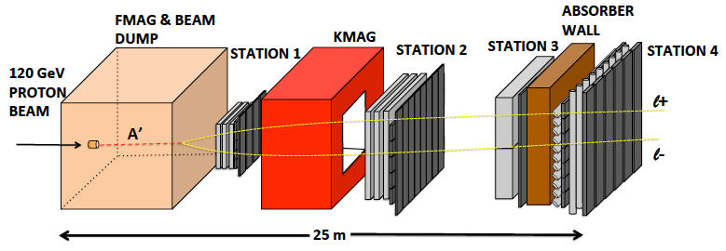

E-1067 Future Upgrade: Phase-II
2020 ~ 2025+
Add tracking detectors close to “target” to improve mass resolution
Add EMCal, PID
e^{+/-}, h^{+/-} , π^{+/-}

Slide 19
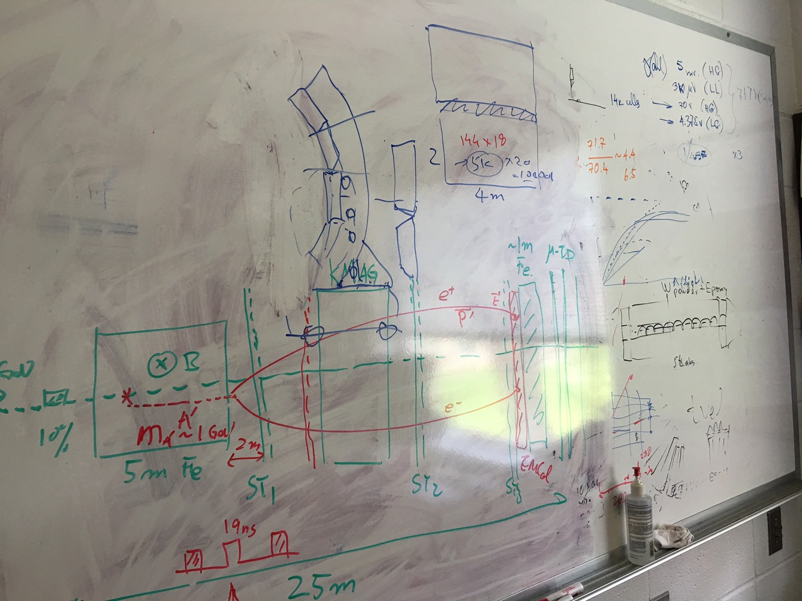
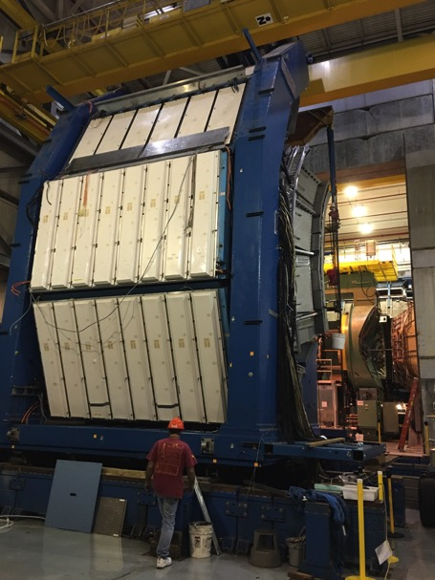
EMCal from PHENIX/RHIC
2 EMCal sectors are available from PHENIX experiment at RHIC, ~end of 2016
  One sector:
    2m x 4m, 18 (3x6)super modules
    Super module = 36 modules; Module = 4 towers
    36 x 4 x 18 = 2592 channels
    Could gang 2x2 (or 3x3) into one ADC/TDC readout
- dE/E = 8.1%/sqrt(E) + 2.1%
- dT < 200 ps
- Excellent e/pi separation

Slide 20
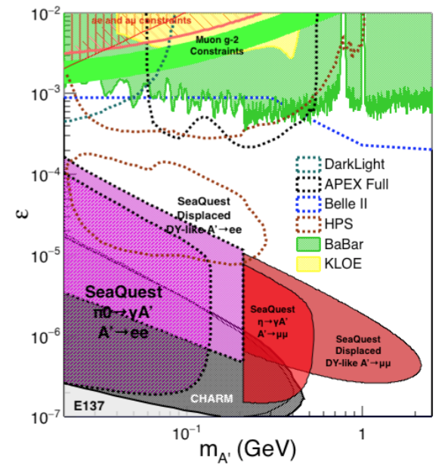
Phase-II: Displaced Low Mass Dark Photons with EMCal upgrades
Projection: POT 1.4 x 10¹⁸
Detector upgrades
  EMCal: e^{+/-}
  HCal: π^{+/-}
  Recycle from other experiments, PHENIX/RHIC etc.
DAQ upgrade
  100+ kHz
Timeline of dedicated runs
  2020+
Detector configuration
  Access low mass region with optimized Fmag settting

Slide 21

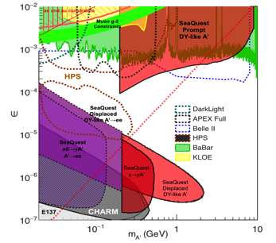
Summary and Outlook
Phase-I
  Great discovery potential!
  A new vertex trigger & DAQ++
  Early parasitic data taking 2017-2019+
  POT 1.4 x10¹⁸ or more
Phase-II
  Possible detector upgrade later, add electron and hadron capability
  A new dedicated dark matter program at Intensity Frontier!
Dark Higgs
search
Preparation Phase-I (parasitic runs)
Phase-II
2015
2016
2017
2018
2019
2020+

Slide 23
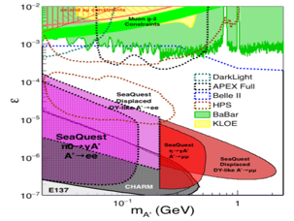
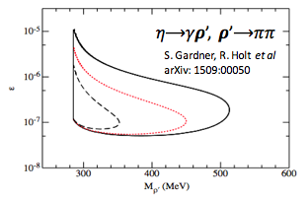
EMCal Upgrade: More Opportunities
2 sectors (4×4 m² coverage) PHENIX EMCal will be available after this summer almost for free (not including shipping and instrumentation)
With EMCal installed, we will be able to access:
  dark photon from 𝛑⁰ decay
  dark 𝝆 decays to 𝛑𝛑
  enhanced dark higgs sensitivity
Two different scenarios of including EMCal have been studied via MC, and it poses little impact to our primary physics goal
Potential bonus of better background rejection on trigger level (studies underway).

Slide 24
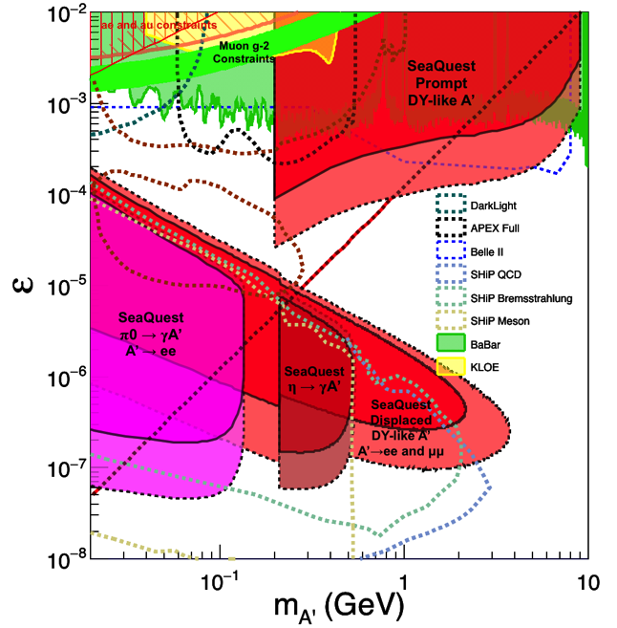
Comparison with SHiP Proposal
120 GeV@FNAL: 2017 -2019
1.4x10¹⁸ POT or more, future dedicated runs
400 GeV@SPS: 2025 -2030
4x10²⁰ POT

Slide 25
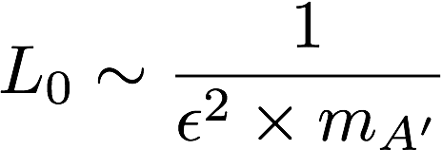
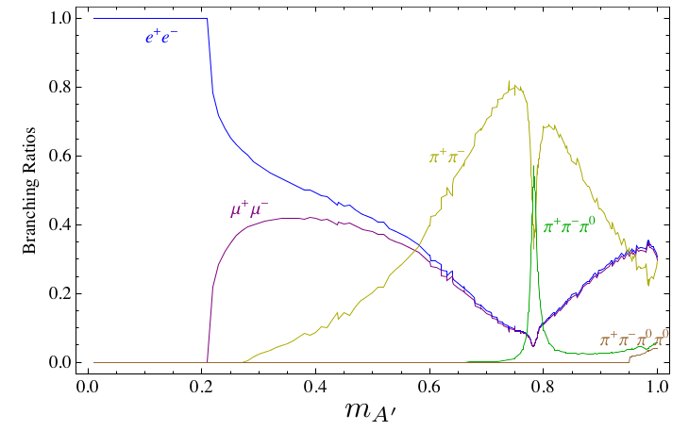
Dark Photon Decay Modes
“Minimal” Decay:
Dark photon is the lightest in the dark sector;
  SM final state particles only
Proper decay length: L₀ ~ O(1m)
D. Curtin, et al, arXiv: 1312.4992
Electron ID
required!
“General” Decay:
Decay into other dark particles,
dominant channel if allowed
  Dark -> Dark
  Dark -> SM particles
(GeV)

Slide 26
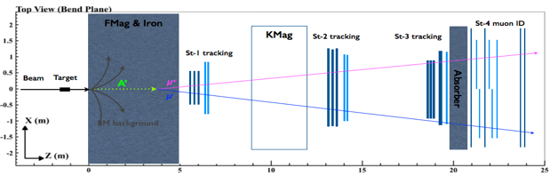
Two Possible Configurations and Their Impacts
Two configurations:
Option I: use EMCal to
replace the absorber
Option II: insert EMCal between H3 and absorber (will need to slightly adjust station-3 position)
Test MC samples (for each scenario):
500k single 𝛑/μ/e tracks with 5 GeV < P < 115 GeV
1M high mass (M > 4 GeV) target DY pairs
2E10 inclusive pp collisions (see, MC simulation talk by David K.)
Potential impacts on our primary physics goal:
Muon identification power
Acceptance? (MC shows no impact)
Occupancy in station-4 and thus our raw trigger rate
Data volume and DAQ deadtime?

Slide 27
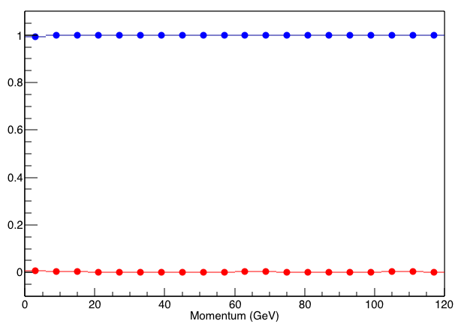
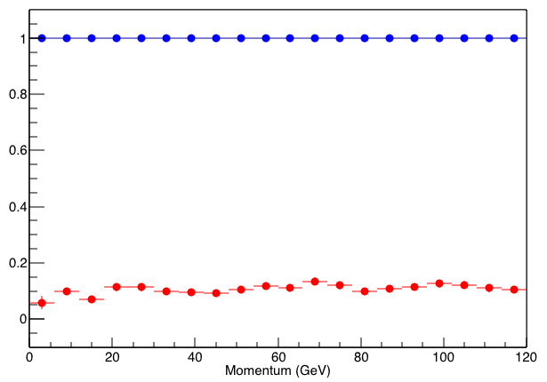
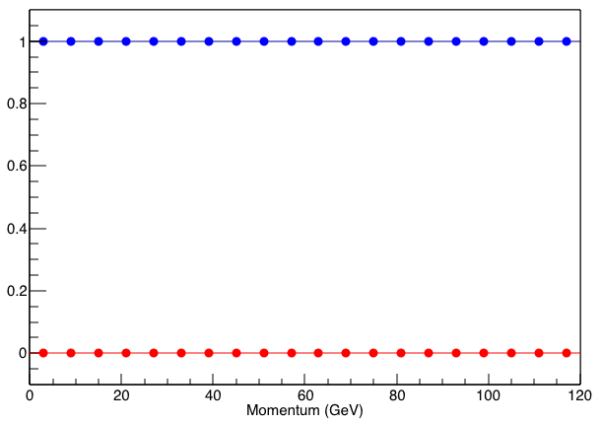
μ/𝛑 separation: case 1 vs. case 2 vs. original
Orignal
Case 1
Case 2
μ survival chance
𝛑 survival chance
For μ survival chance (or μ-ID efficiency), all 3 cases are very close to 100%
For 𝛑 survival change (or 𝛑 contamination):
  original design is around 0.5%
  case 1 is around 10%
  case 2 is around 0.1%
μ identification favors case 2

Slide 28
Displaced Dark Photon Trigger
DAQ/Data stream
LVDS cable 2x16ch bundle available
Q1 (LVL1)
DAQ Trigger
LVL2
(vtxZ matching)
Q2 (LVL1)
TS
(12 inputs total)
(1-free bit available)
Q3 (LVL1)
DP Trigger
1-bit
Q4 (LVL1)
4 x 16-bit from 4 V1495 boards
(2 x 32LVDS cables)
V1495
Q1: 80(ST1’) + 50 (ST2’) + 2x8(ST4-Y1/2) = 146, FANOUT ST4 Hodo (or EMCal Cluster)

