Slide 1
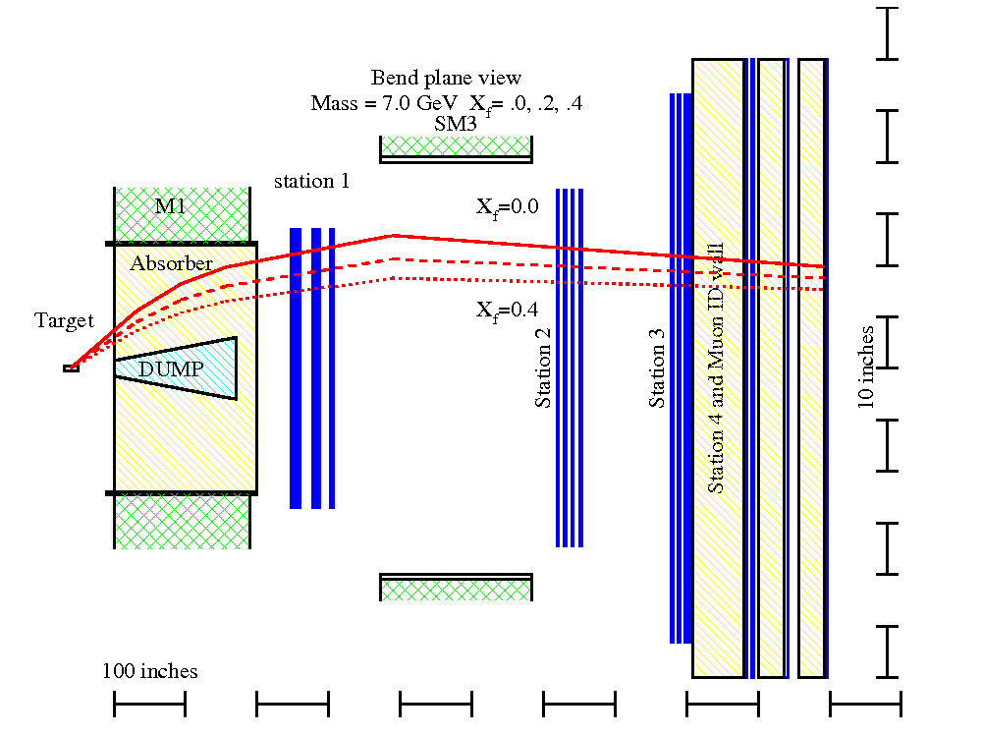
E906 Update
03/27/2012
Beam, target and detector commissioning
μ
E906 Bend Plane View
120 GeV
protons
Drift
Chambers
Muon ID

Slide 2
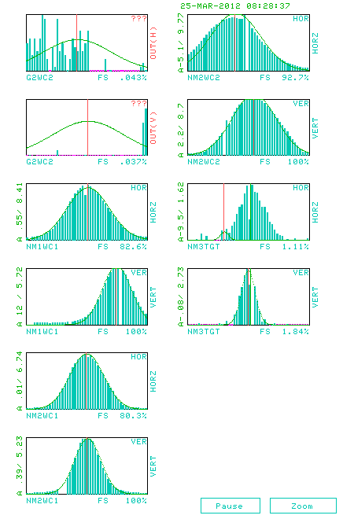
Beam Profile
Sigma_x = 6.5mm
Sigma_y = 3.5mm
15 bunches per spill
5x 10^10 ppp
4sec/minute
19ns RF buckets
y
x

Slide 3
Target and Detector Commissioning
Triggers
  NIM vs FPGA triggers
Detectors
  Timing
  HV scan for some old DCs
Targets & Beam
  H, D
  C, Fe, W (10%)
Last day: 4/29/2012 (35 days from now!)

Slide 4
Detector & Trigger Timing
RF dT = 19ns

Slide 5
Hit Distributions
ST-1 Hodoscpes

Slide 6
ST4 Prop Tubes: P1H2

Slide 7
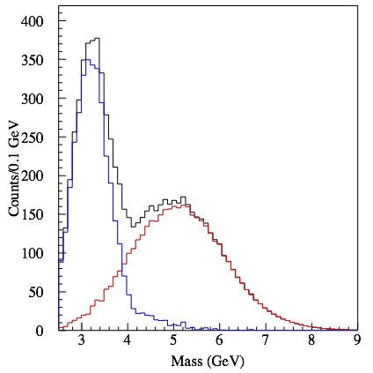
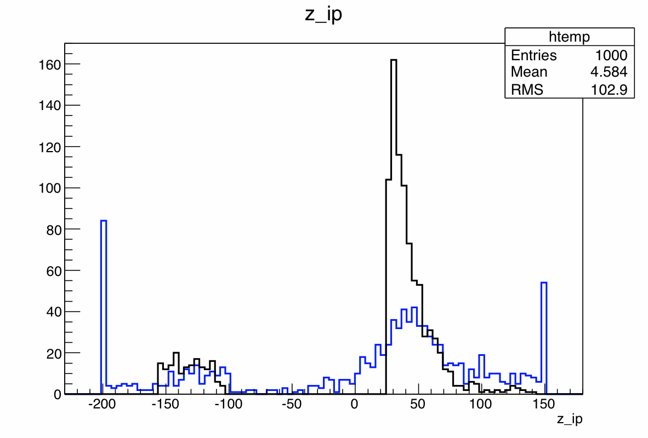
Expected Detector Performance
Reasonable J/Psi and Drell-Yan seperation
Much improved tracking to separate tracks from target and beam dump
μ
E906 Bend Plane View
120 GeV
protons
Drift
Chambers
Muon ID

