Slide 1
Summer E906 Work Plan http://projects-docdb.fnal.gov:8080/cgi-bin/DisplayMeeting?conferenceid=32
June: 1 week + 1 Summer ACU Student?
  Work to do
    Test 7 wrong shaped modules, identify best 4 for final assembly
    Replace frontend board and preAmp card for two modules
    Develop installation plan – cable layout etc
    Design LV distribution cards
  Picture frame
    Order supporting frame materials from 80-20, and get them in ~2 weeks.
  Manpower
    Lei, Ming, Pat, Andrew, Melynda?+ local ACU students
  Schedule: middle of June
July: 2 weeks + 1 Summer ACU student?
  Work to do
    Test all modules with good gas, determine the optimal operating HV for all modules
    Assemble the modules, install detector
    Make and layout LV, HV and readout cables
  Manpower
    Lei, Andrew, Ming, Pat, Melynda + local ACU students?
  Schedule: early-mid July?
August/Sept: ~2 weeks
  Test readout, study noise, electric ground, timing etc.
  Need full readout cards ( when? )
  Manpower
    Andrew, Ming, Melynda …
  Schedule: late Aug. / early Sept. ? dep. on the availability of DAQ and final gas
Ready for Experiment in Oct. /Nov. ? ~ 1week
  Other subsystems, Station-1 chambers particularly, won’t be ready until Oct.

Slide 2
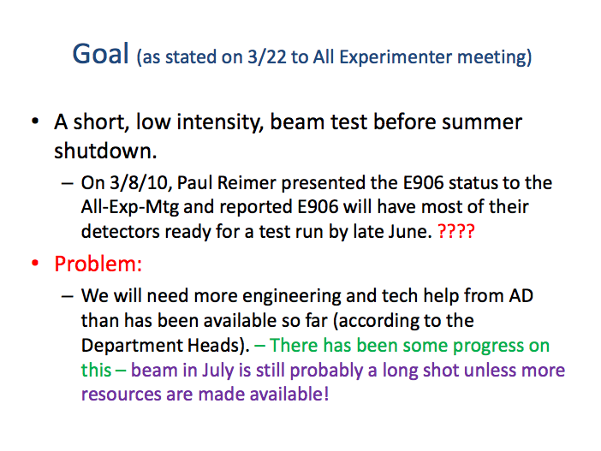
E906 current status - beams
5/27/10 Collaboration meeting, Chuck Brown

Slide 3
Status – We have lots of work to do
Don Geessaman 5/28/10
Component | Projected Ready | Comments/Issues
Beam Line | Early to Mid July ????
Target | When needed -Aug
Magnets | Mid June
Sta 1 DC | October
Hodo 1 and 2 | 1 July | Support Structure, Cabling, Electronics
Sta 2 DC | Ready | Cabling, Electronics
Absorber wall | Mid June | Needed before Support Structure for 3 and 4
Sta 3 DC – Lower, New | Ready, Early July | Support Structure, Cabling, Electronics
Sta 3 and 4 Scin | Early July | Support Structure, Electronics
Prop Tubes | Early July | Support Structure, Cabling, Electronics
Gas System |  | Pre mix in July as fall back
Preamps | ?????????
TDC’s | ??????????
Latches | August
Trigger | 1 July | Calibration triggers
Scalers |  | Not a major effort, but need organizing
DAQ | ?????

Slide 4
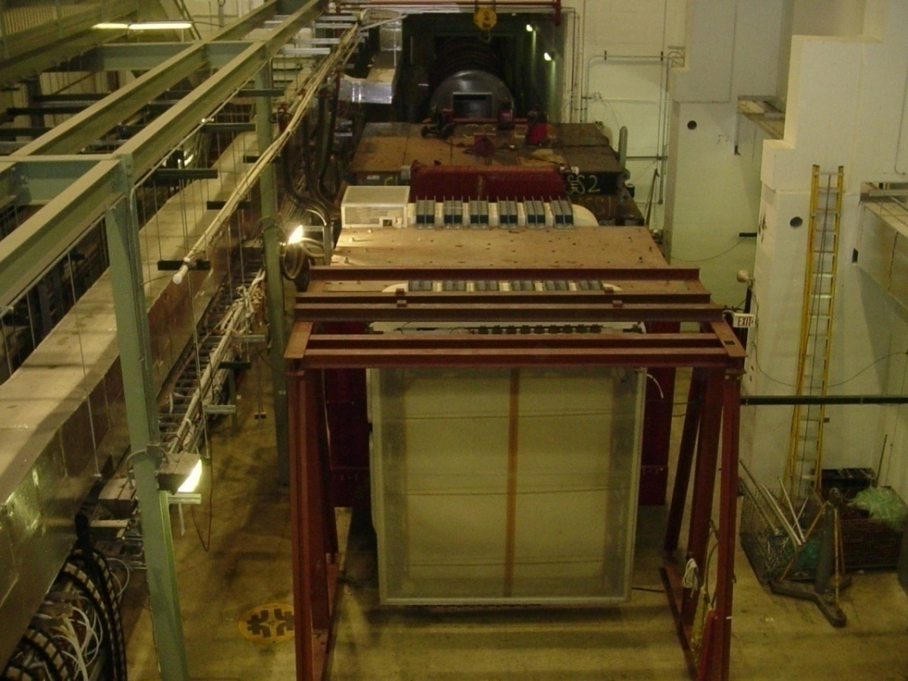
Magnet Installation
Focusing magnet (FMAG) installed
kTeV magnet (KMAG) installed
Hadron absorber
Beam dump (watch muons from J/ψ)

Slide 5
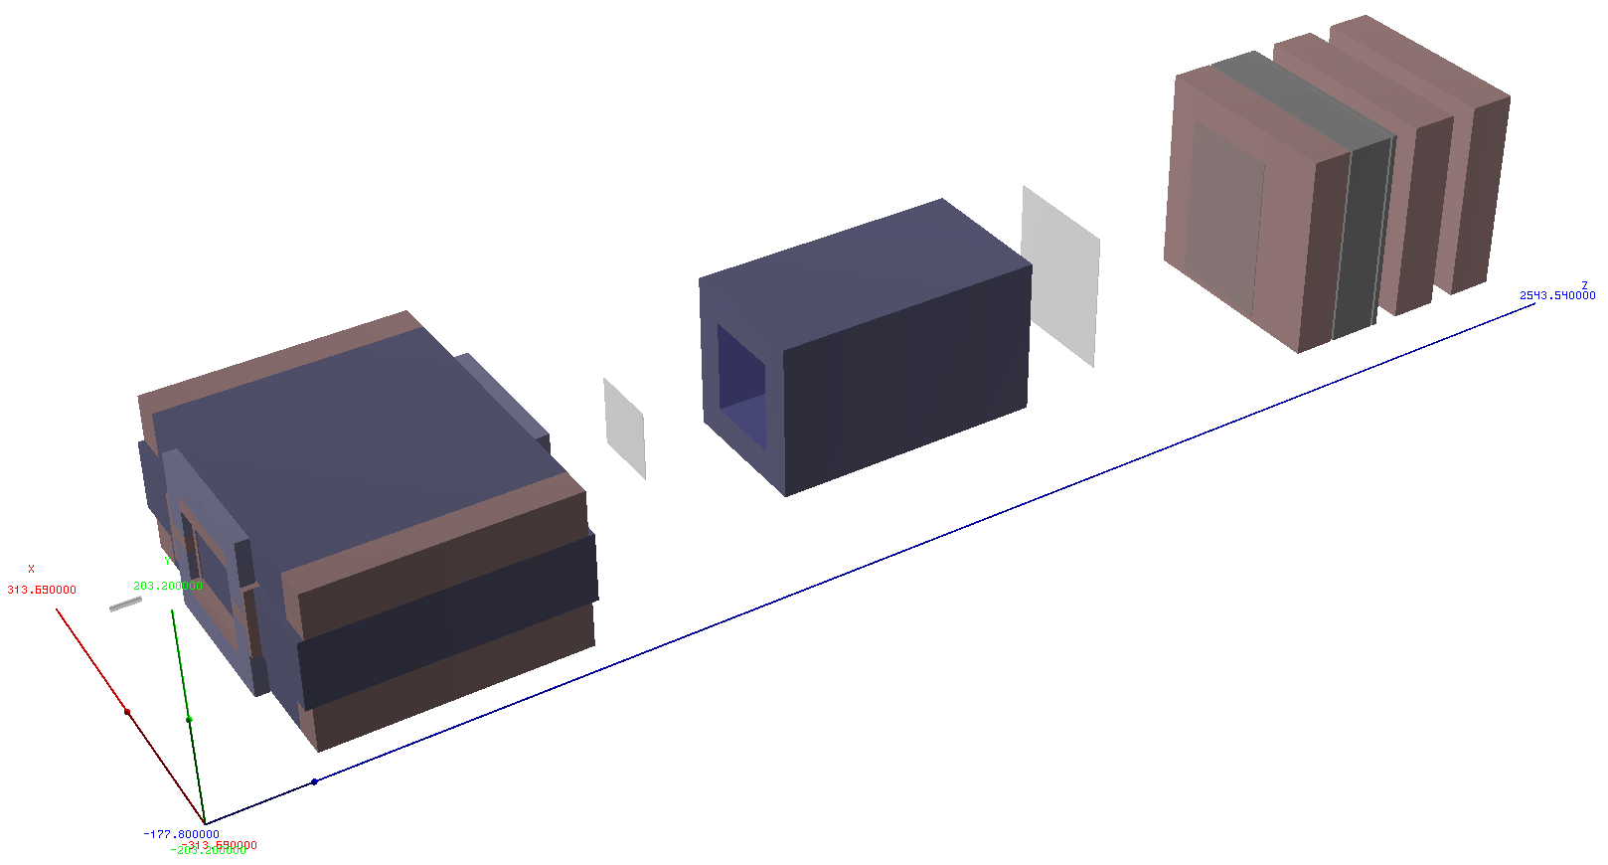
Drell-Yan Spectrometer for E-906
Station 2 and 3:
Hodoscope array
Drift Chamber tracking
Solid Iron Focusing Magnet, Hadron absorber and beam dump
Station 1:
Hodoscope array
MWPC tracking
Hadron Absorber
Mom. Meas.
(KTeV Magnet)
Station 4:
Hodoscope array
Prop tube tracking
4.9m
25m
Liquid H₂, d₂, and solid targets

Slide 6
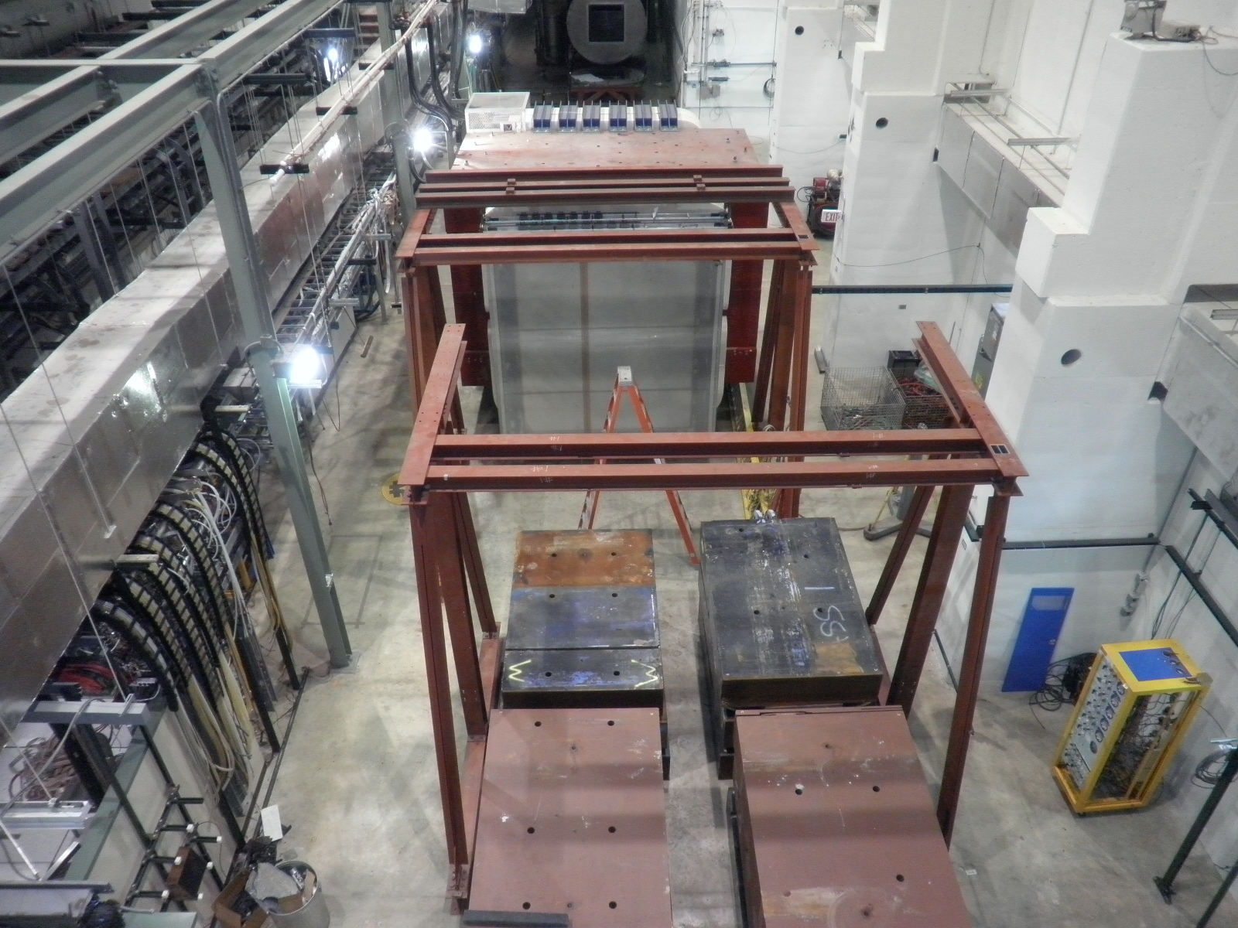
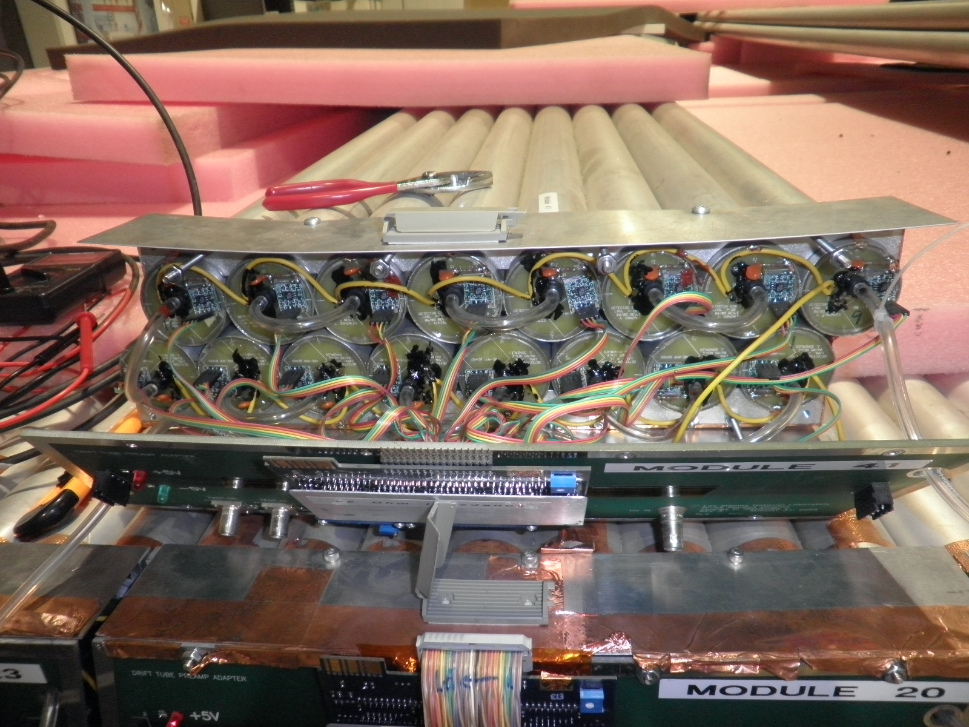
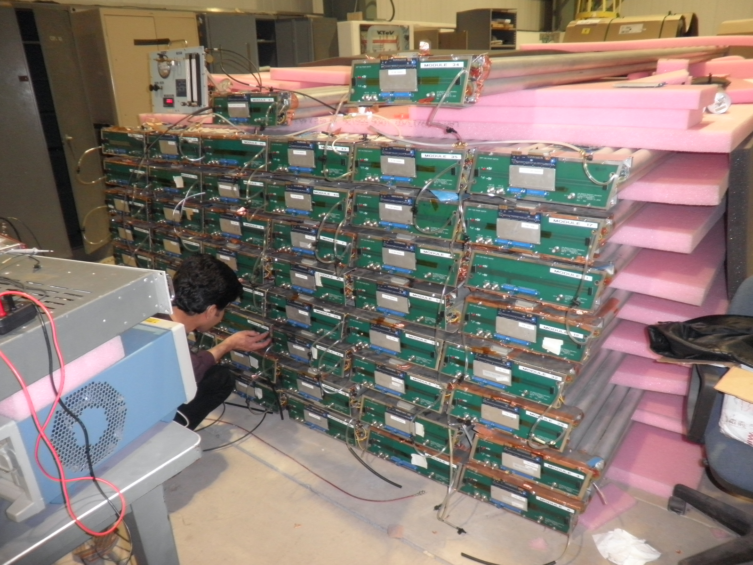
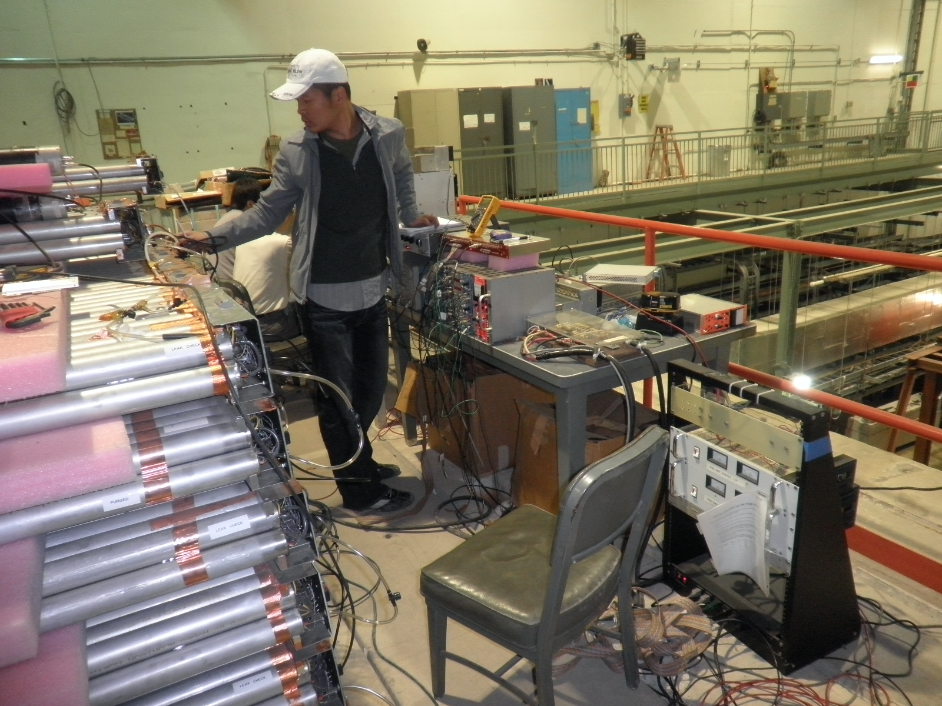
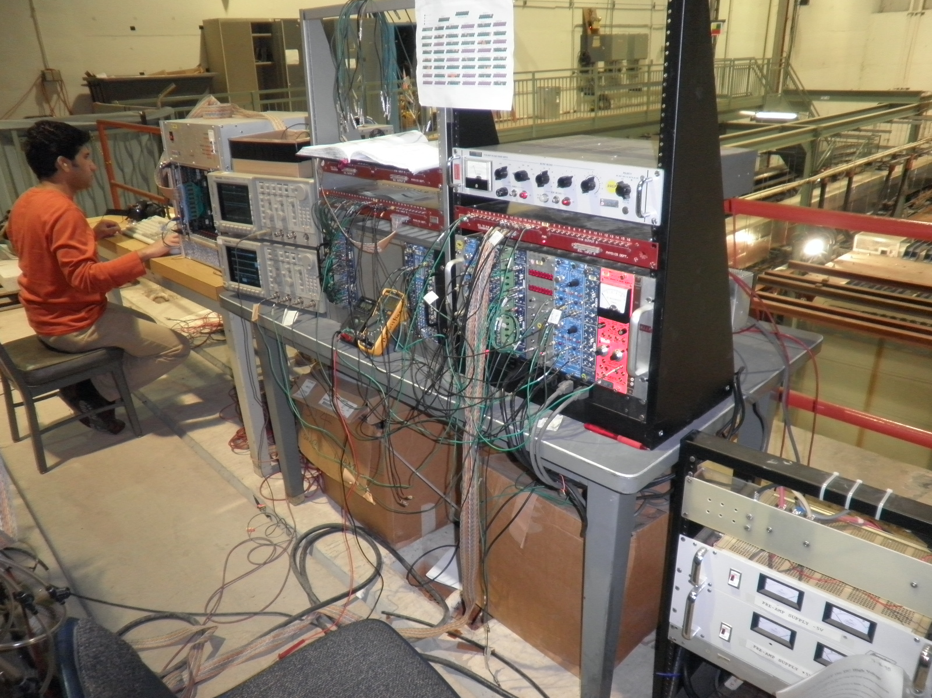
Progress at Fermilab
3/10
3/10
03/4-7: fixed gas tubing, HV, signal lines …
  Imran, AndrewG, Ming…
04/19-24: test gas & fix broken modules
  Lei, Chuck, Ming et al.
05/9-16: HV scan, first time 8-ch readout
  Imran, Yen-Chu, Kaz, Chuck, Ming et al.
3/10
4/10
5/10

Slide 7
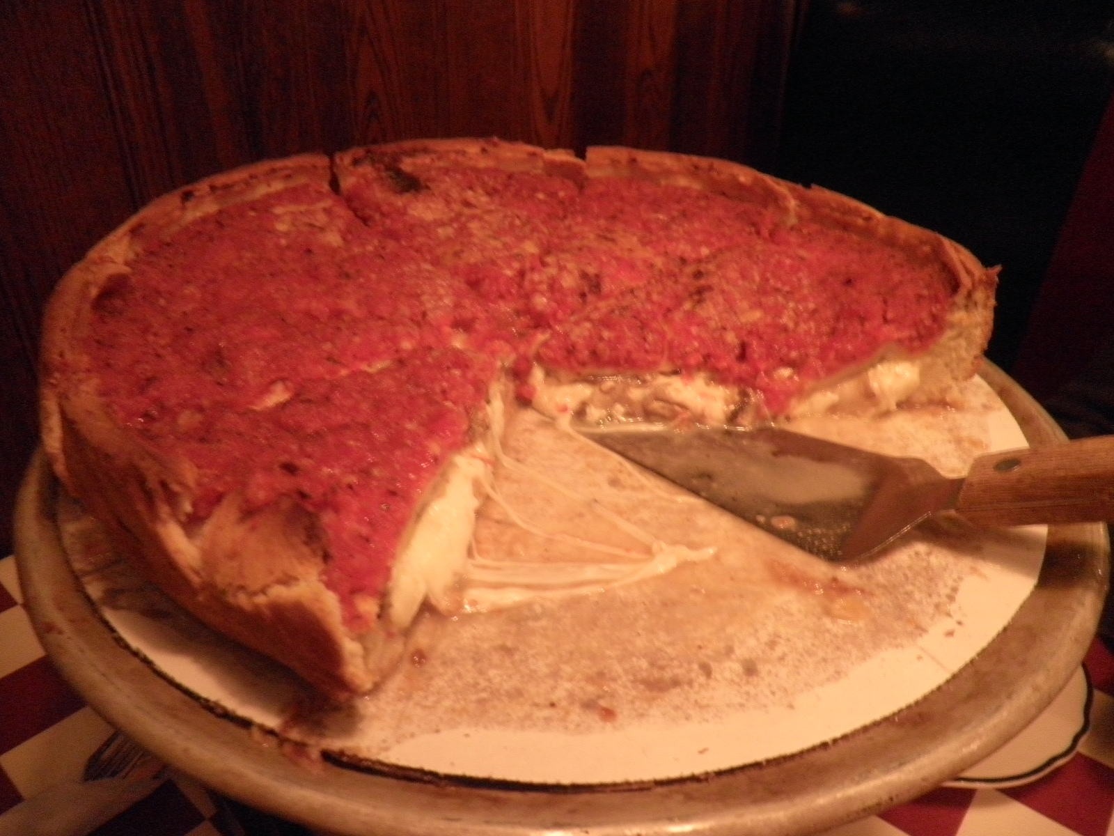
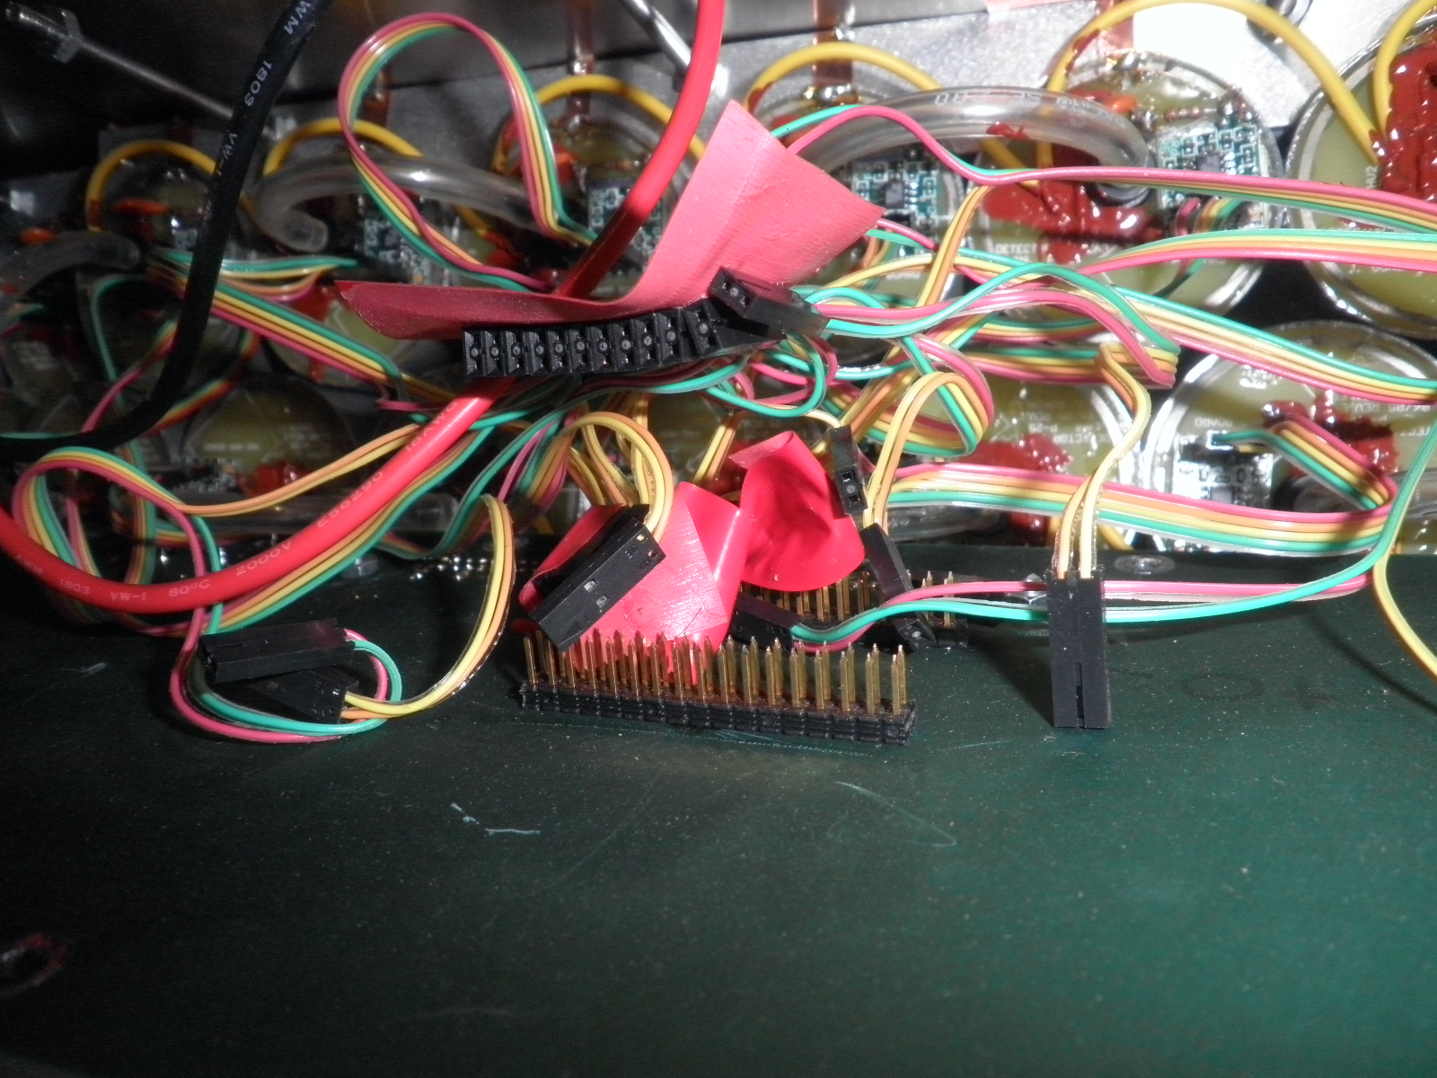
Chicago’s Famous Pizza
… and Spaghetti

Slide 8
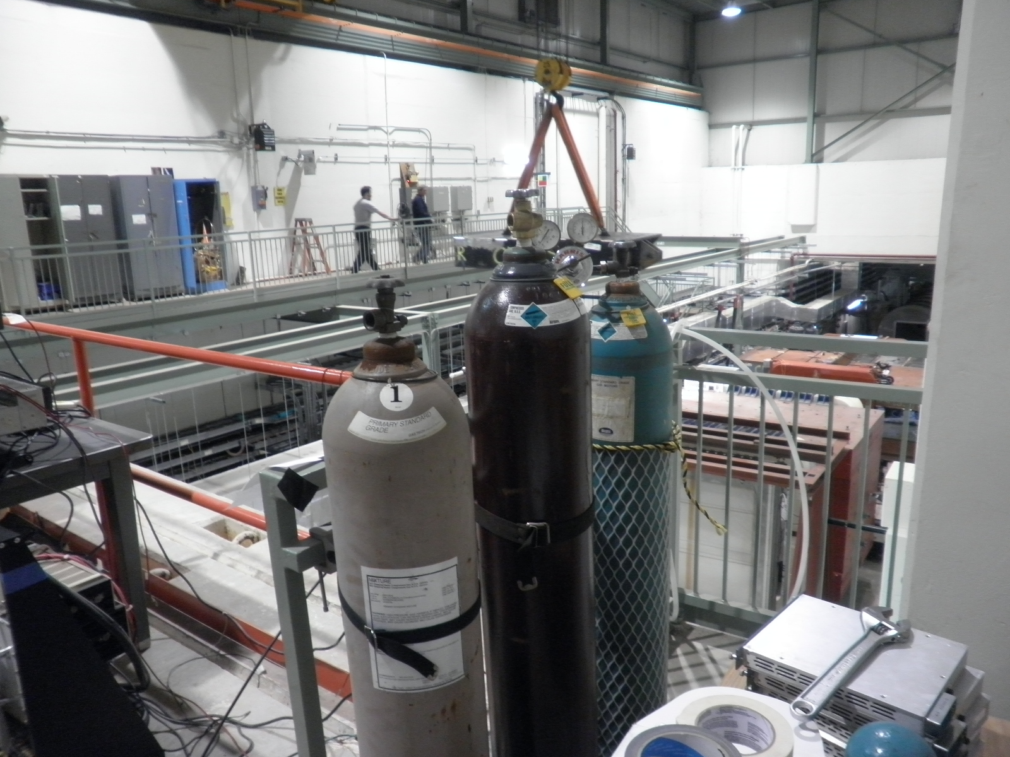
Gas Test - Summary
Maximum drift time study:
  MIPP: 0.35uS
  Ar/CO2 (80/20): 2.5uS
  Ar/CO2(95/5):1.5uS
  D0 Muon Gas: 0.8uS
HV plateau scan
  MIPP: 1850-2100V
  Ar/CO2(80/20): 1900-2100
  D0 muon gas:1900-2100
Ar/CO2 80/20
MIPP Gas
D0 Gas

Slide 9
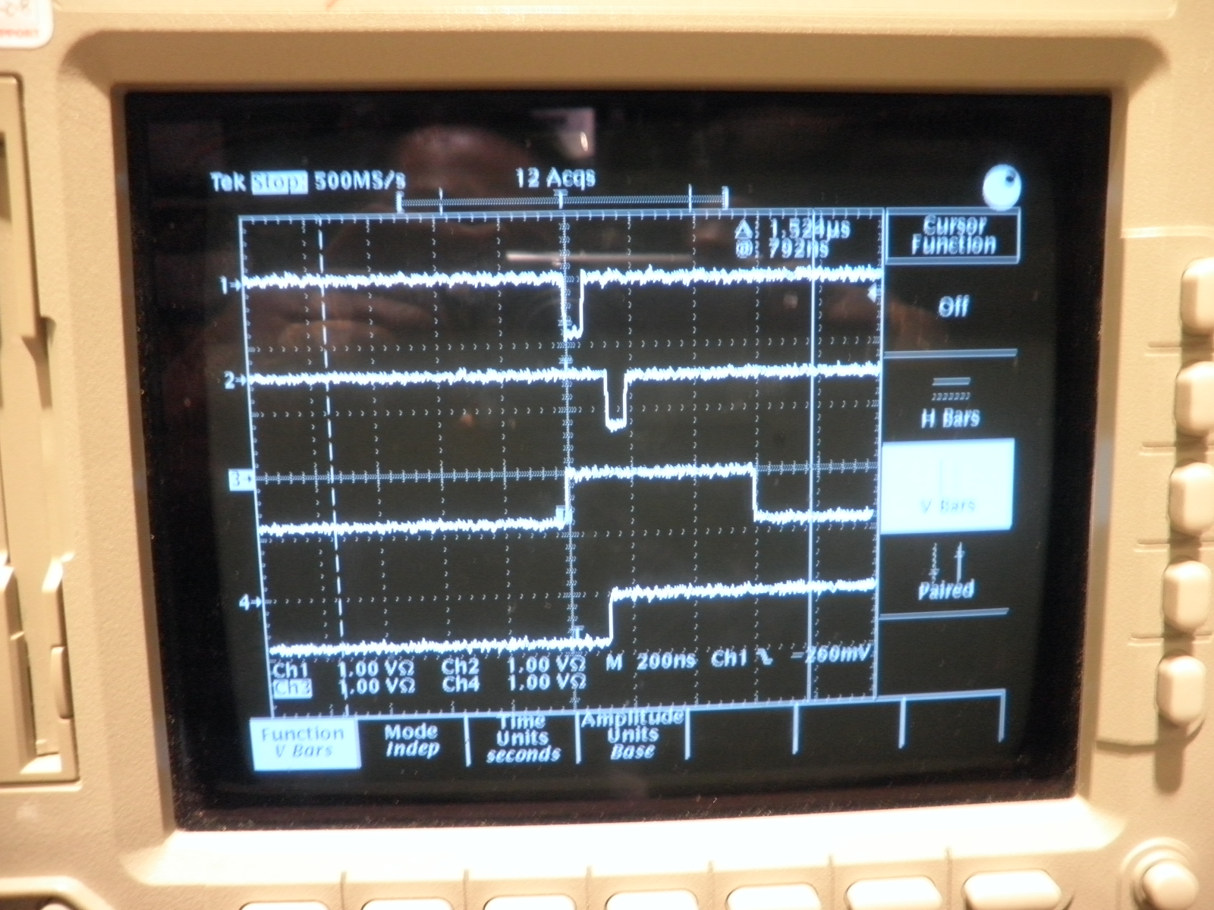
MIPP Gas: It is Fast!
ΔT_{drift} ~ 0.35 uS @2000V
Module

Slide 10
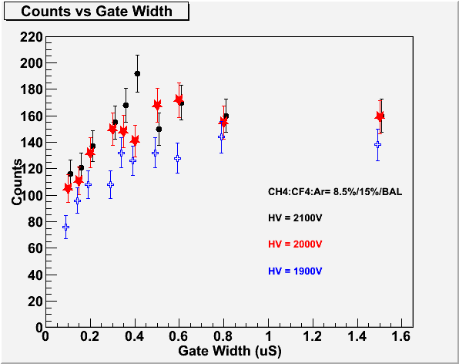
Maximum Drift Time Measurements
Module #34, chan-9..
ΔT=0.35 uS
Trig.
Signal
Coin. Gate
Time

Slide 11
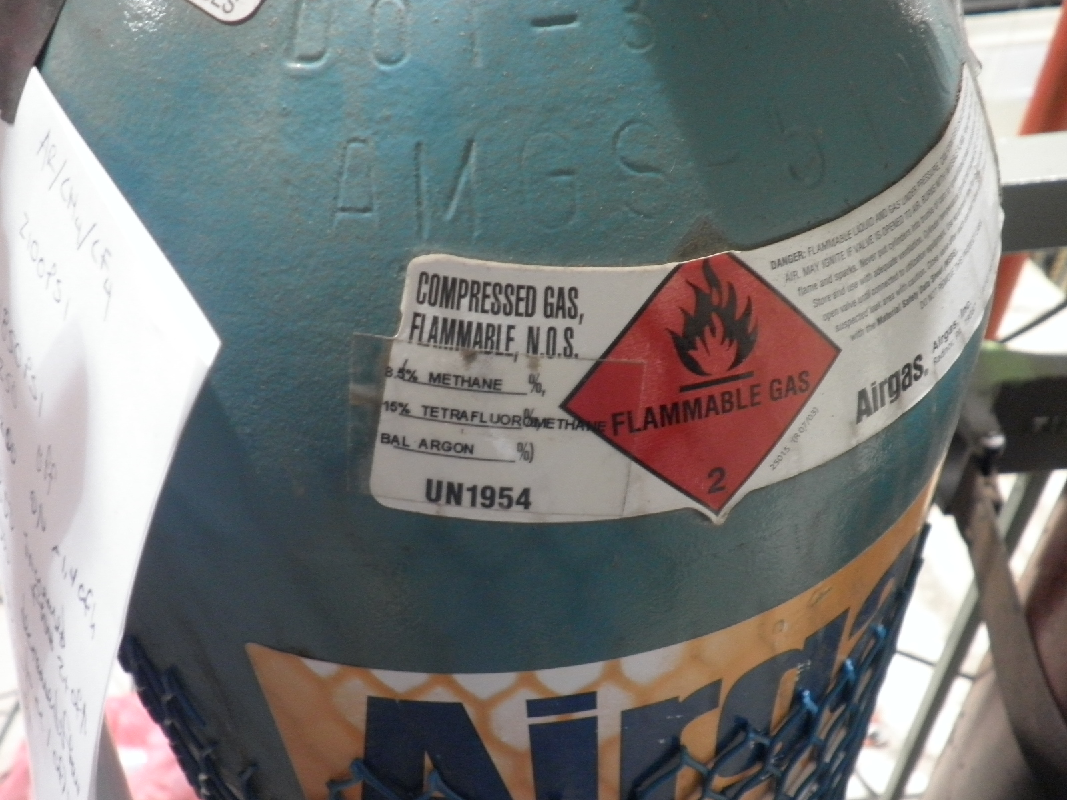
MIPP Gas

Slide 12
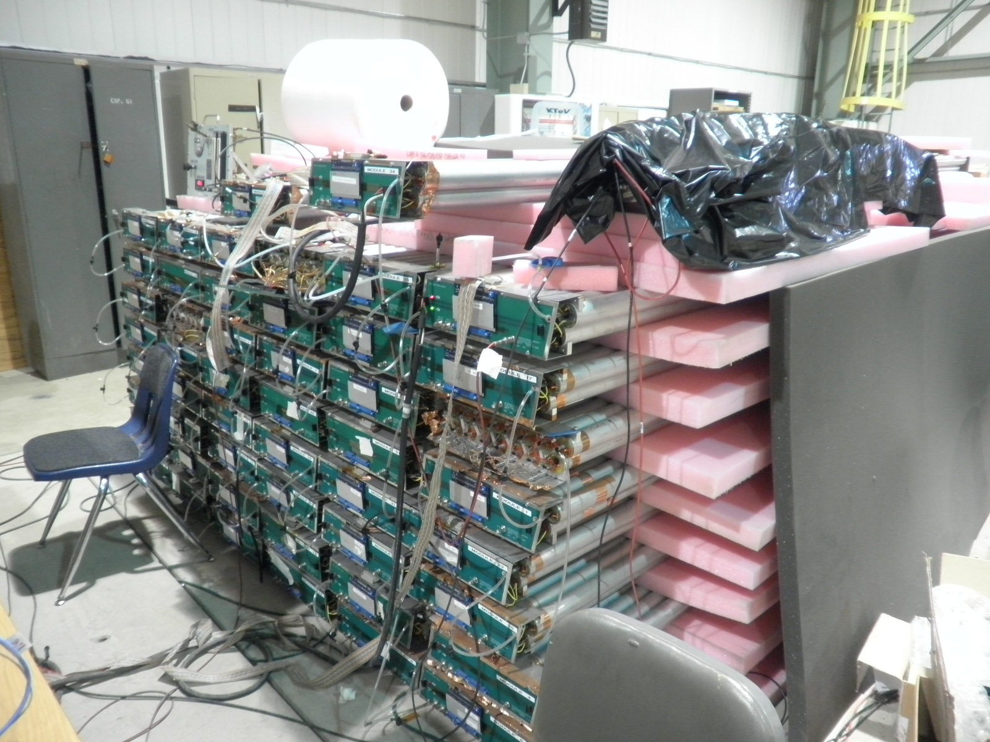
Qualitative HV scan and Signal Rates with Cosmic Rays (Ar/CO2)
Cosmic trigger

Slide 13
Good, V_{max}>2050V
16 15 14 13 12 11 10 9
8 7 6 5 4 3 2 1
Dead
Module 41
Module 34
Noisy/Background/high V_{mi}n//low V_{max}
NIM Channel map
Unusable module
Module 14 Module 23 Module 20 Module 43 Module 35 Module 100
Bad Threshold Resistor
Module 2 Module 36 Module 38 Module 40 Module 103 Module 17
Module 15 Module ? Module 9 Module 7 Module 37 Module ?
Module 33 Module 30 Module 105 Module 45 Module 51 Module 1
Module 11 Module 26 Module 29 Module 28 Module 31 Module 32
Module 10 Module 50 Module 24 Module 42 Module 27 Module 25
Module 46 Module 16 Module 104 Module 44 Module 101 Module 4
Module 47 Module 52 Module 102 Module 48 Module 18 Module 6
No PreAm, Flowing gas now 4/23/10

Slide 14
Quantitative HV Plateau Scan with 8-ch Readout for all Tubes (May 2010)
Tested all individual tubes w/ DAQ, 8-channel scalar readout (Thanks Yen-Chu, Kaz and Josh!)
  Imran, Lei, Chuck, David C., David N., Ming …
  Ar/CO2 for most of the modules
  One stack with MIPP fast gas (Mod. #34)
    CH4/CF4/Ar = 8.5% / 15% / bal.
  One module with D0 muon gas (Mod. #17)
    CO2/CF4/Ar = 8% / 8% / bal.

Slide 15
HV Scan with 8-ch Readout
ECL to ECL scalar

Slide 16
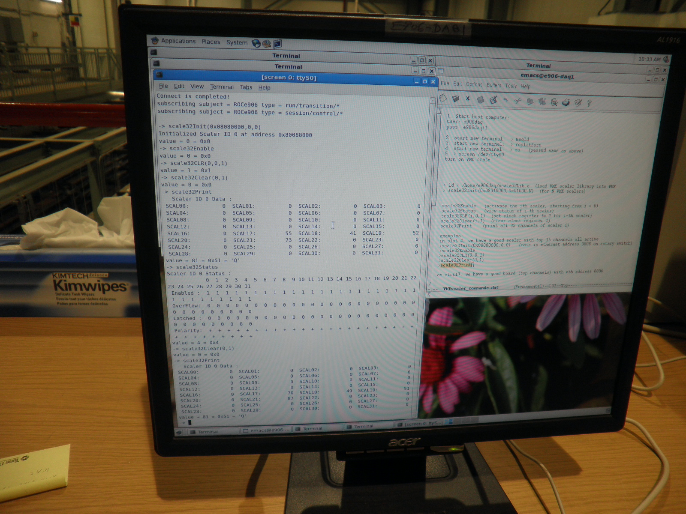
DAQ 8-ch Scalar Readout Screen Dump

Slide 17
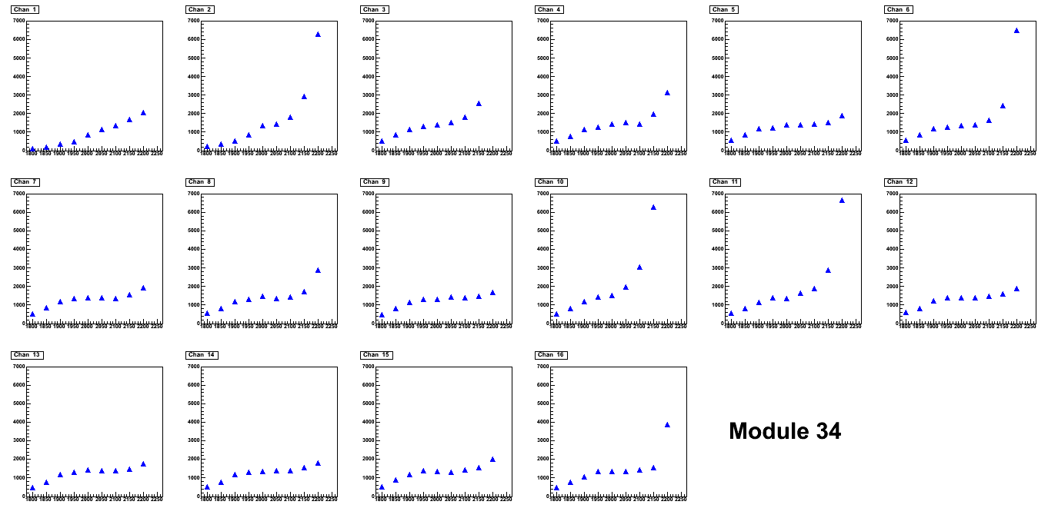
HV scan: MIPP Gas for Module #34
1850-2150

Slide 18
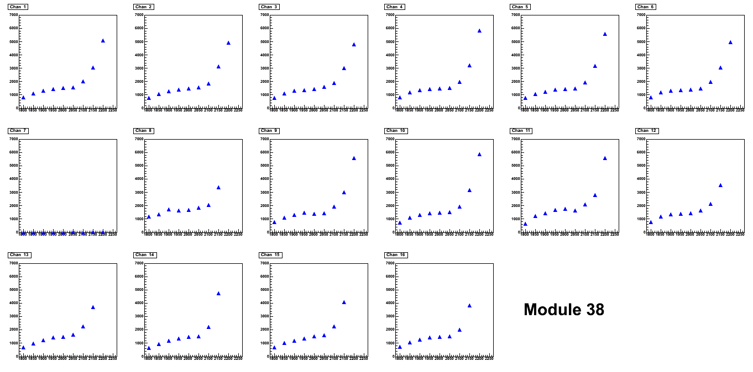
HV scan for Mod. #38 Ar/CO2 (80/20)
1850-2100
Broken tube

Slide 19
Good Modules from Quantitative HV scan
 |  | 41 |  | 34
14 | 23 | 20 | 43 | 35 | 100
2 | 36 | 38 | 40 | 103 | 17
15 | ?? | 9 | 7 | 37 | ??
33 | 30 | 105 | 45 | 51 | 1
11 | 26 | 29 | 28 | 31 | 32
10 | 50 | 24 | 42 | 27 | 25
46 | 16 | 104 | 44 | 101 | 4
47 | 52 | 102 | 48 | 18 | 6
Good modules (mostly)
Draw high current above 2000 V due to a couple of bad channels.
Still need to be tested. (different shape modules).
Draw very high current.
Some unstable channels.

Slide 20
Number of Good Modules
Need 2x8+2x9 = 34 modules
Green ones: 24+7 =31 ➔ we need 3 more good ones!
Possibly good ones:
  4 Modules:
    # 6, 32, 42, 101 were tested good in April 2010. High current problem probably due to poor gas and/or humidity, as we stopped flowing Ar/CO2 gas for a while for these modules.
  2 modules:
    # 18 and #43, need to replace preamp board (#43) and preamp card(#18).
  Module #100
    flaky FEM board and poor grounding?
  7 wrong shaped ones
    Can we use 4 of them, but read them out from the opposite side?
Would like to run them all with MIPP gas and check their performances
We will have enough good modules if we can recover these possibly good modules – very likely.

Slide 21
ST4 Muon detector to do list
LV
  Patch panel with 2A fuse for each channel (or a group of 2~3)
  Daisy chain short cables
  Plan cable layout and determine the cable length
HV
  2~3 modules per HV channel
  4 HV channels for 8 module plane (H)
  3 HV channels for 9 module plane (V)
  HV cables
Gas distribution
  Manifold and Tubing
Full detector ECL readout cables
  Plan cable layout and length
  34+ cables
Module assembly
Full readout with the new TDC cards (when??)
Detector installation and commissioning

Slide 22
Gas
Module to module tubings
Gas manifold to modules
  One manifold -> 4 fan-out
  Flow monitor?
  Two inputs per plane?

Slide 23
LV
Power supply
  Per channel
    +5V/0.5A?
    -5V/0.5A?
  Total 36 modules
  Remove control and monitor of LV for each channel? How?
LV cables
  From patch panel to modules
    20’ longest
    36 channels
    New cables or recycle the old ones from other experiments?
LV distribution panel
  Poly-fuse per channel, a new design?
LV monitor
  Slow control?

Slide 24
HV
Total HV channels
  H-plane (8 modules)
    4 channels x2 = 8
  V-plane (9 modules)
    3 channels x 2 = 6
HV Power Supply
  2 channel/module
  Total 7 modules, probably can get them from Fermilab
  Remove control and monitor of HV? How?
HV cables
  Short ones, T-connectors, OK
  Long ones from PS to chamber, have recycled ones from KTeV, are they long enough?

Slide 25
Readout and commissioning
All 4 planes
  16 x 34 = 544 channels
  New 32-channel TDC -> need 17 cards
  ECL-to-ECL cables, use old ones from KTEV
  How far can we drive ECL signal?
    Detector to readout crate ~30ft?
Noise reduction and cross-talk
DAQ and TDC are not available until Oct.?
Oct – Nov. ?

Slide 26
Supporting structure
June:
  Order materials from 80-20
  Arrive at Fermilab end of June/early July
  Installation plan
    How to move in and out
    How to access the service end
    Cable route…
Fermilab structural engineering approval
  June?
Assembly
  Early-middle of July if want to check background with test beam
  DAQ won’t be ready ???
  Use “scalor” boards to read up to 16 channels with test beam if possible
  Otherwise, in Sept/Oct

Slide 27
Picture Frames and Installation Plan
Initial design done, under Engineering evaluation at LANL
  Thanks Tom, David N., Walt/John/Matt (LANL)
Got a Quote from 80-20 for the materials based on initial design, expect ~2-week turn around
  Thanks Tom!
I would like to place the order for materials ASAP (some time in June)
Once Paul and Chuck obtain the green light from Fermilab, we will do the installation
Assembly and installation in July or later?
  DAQ won’t be available till Oct. (?)

Slide 28
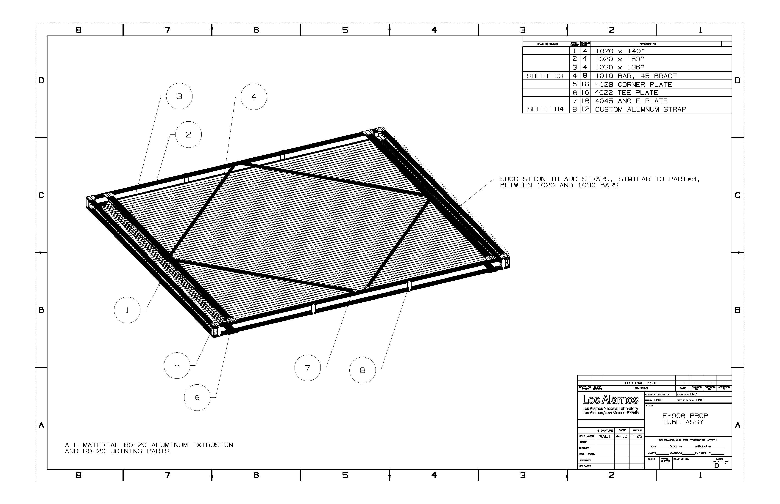
The Design of the Picture Frames
(2nd version)

Slide 29
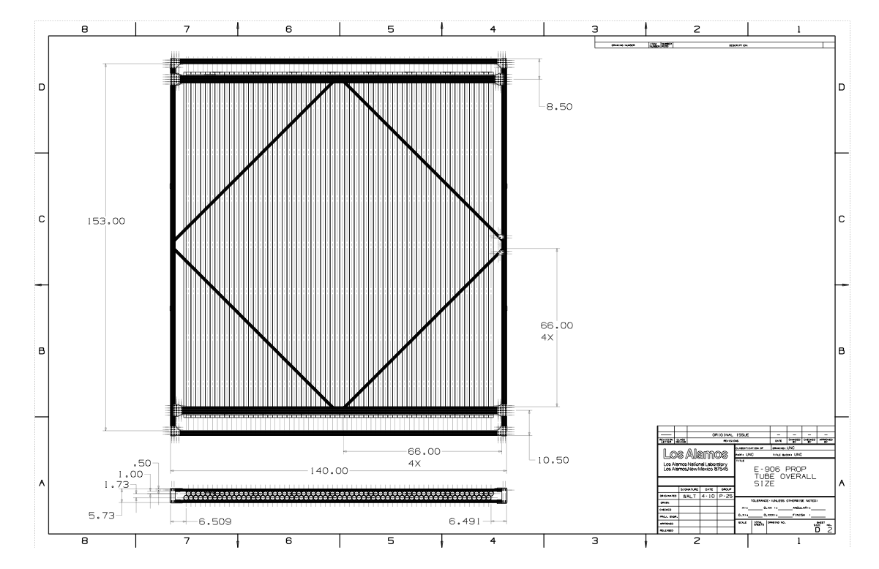
Frames – 8 module plane
For 9-mod.
H=+17”=157”

Slide 30
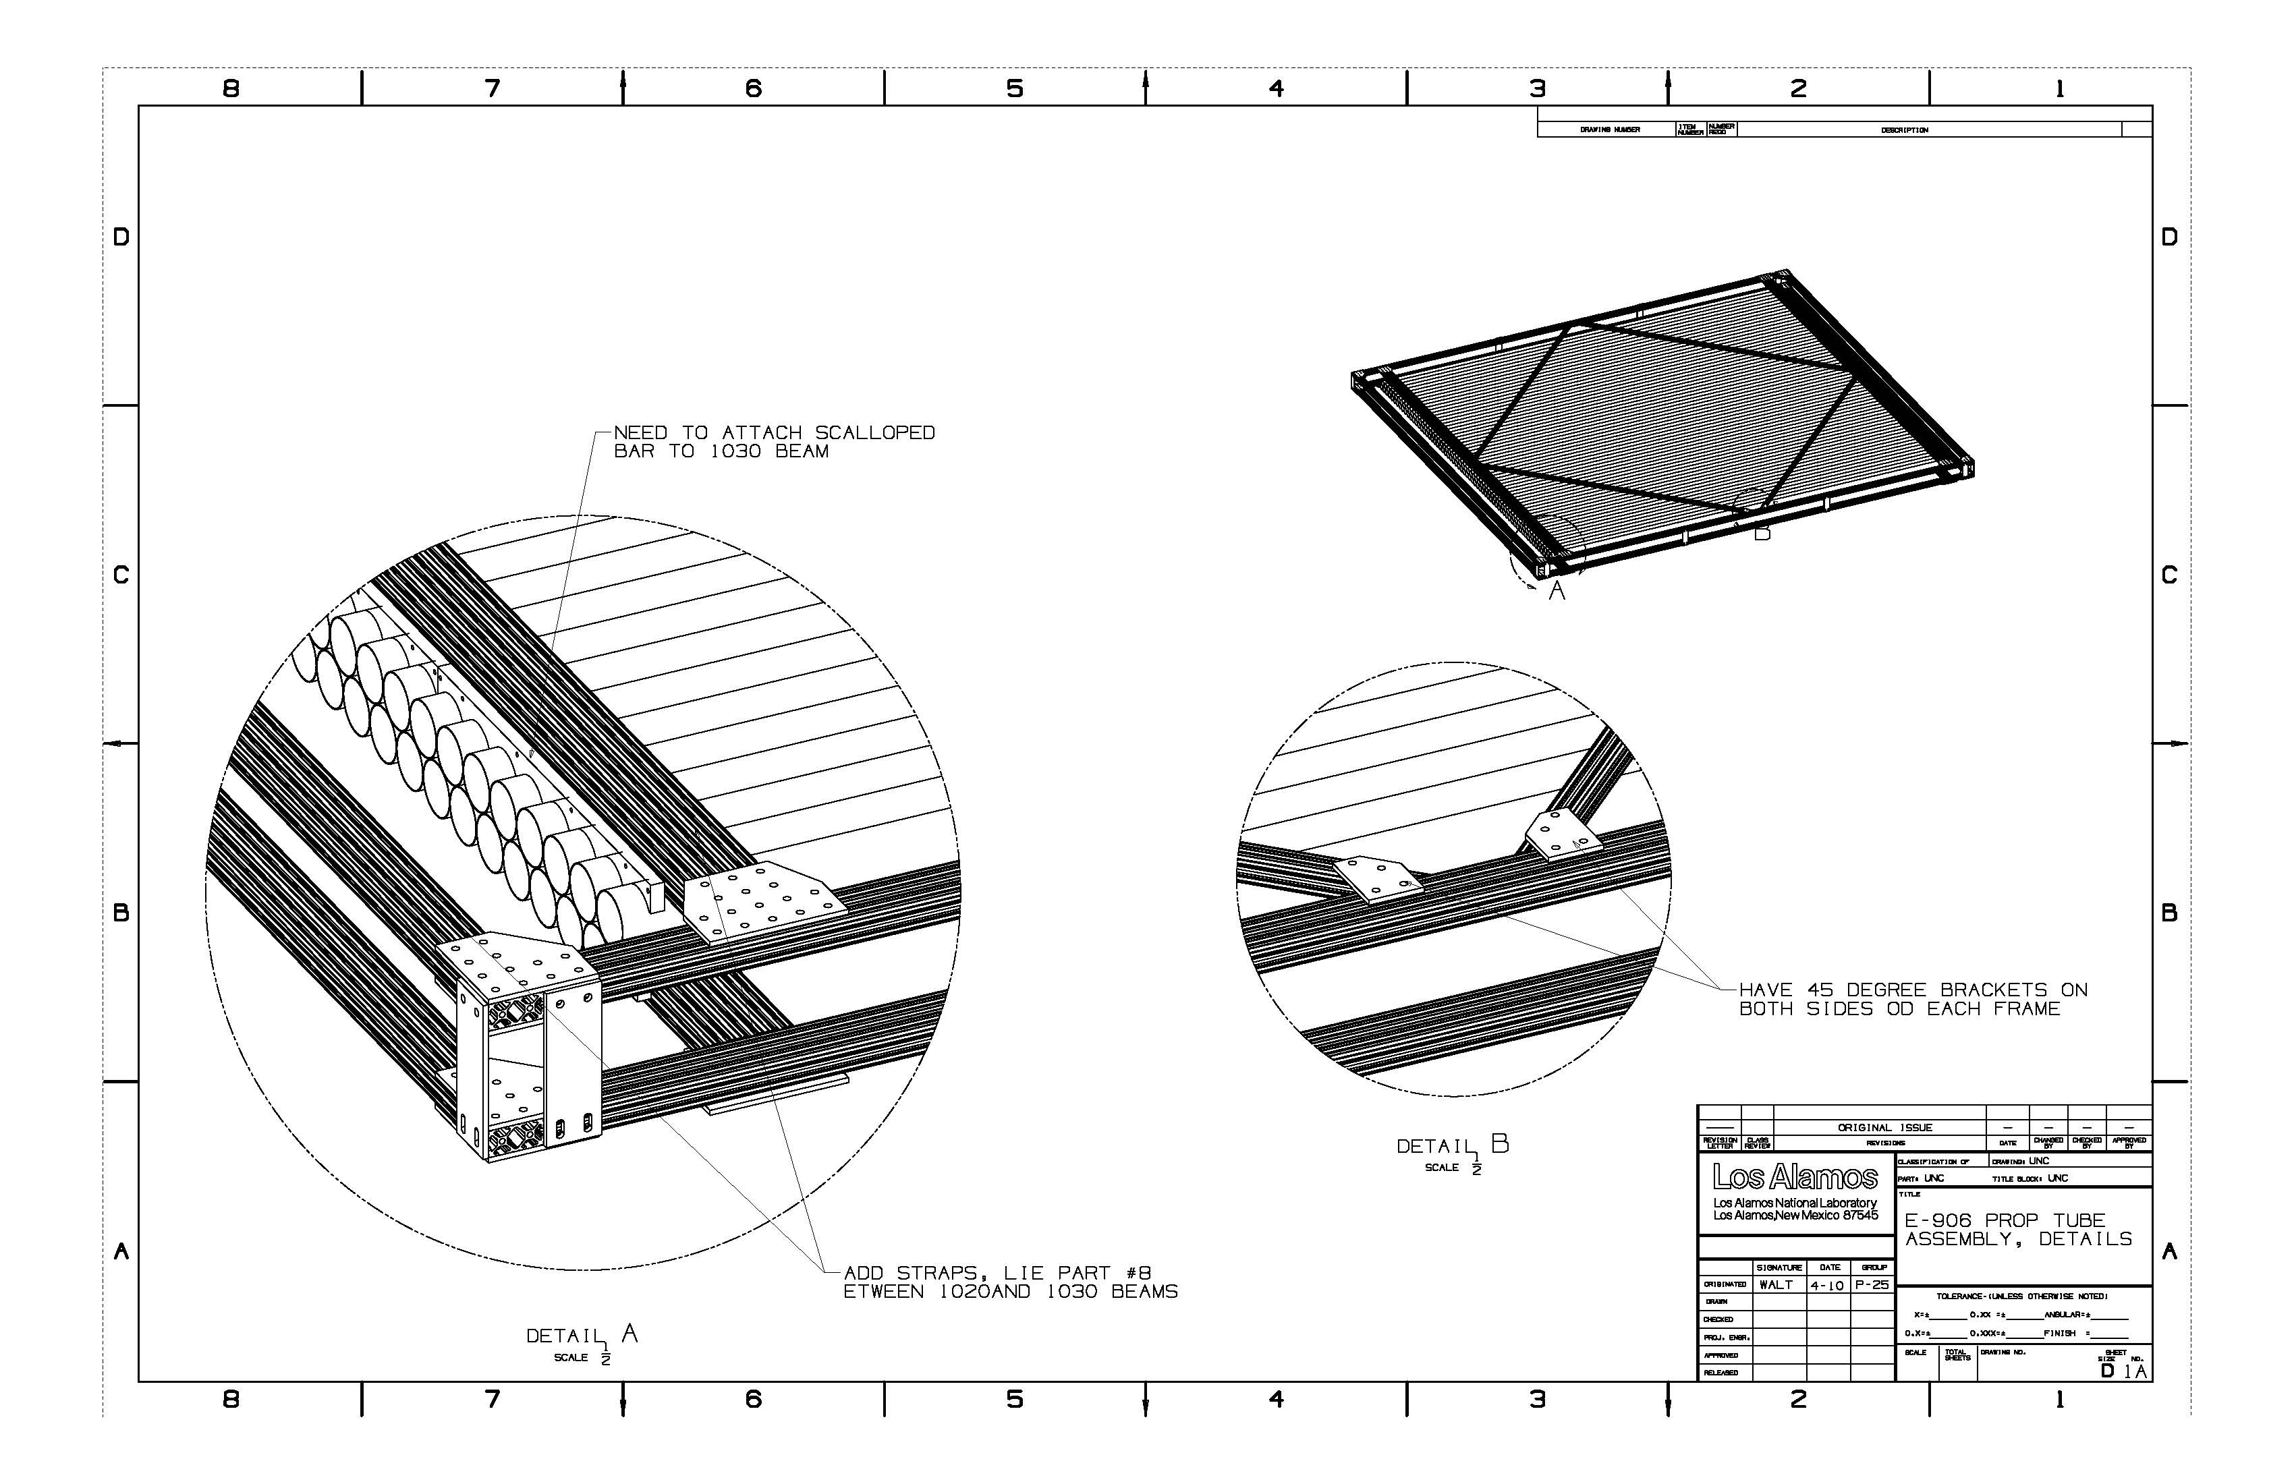
More Details about Picture Frame

Slide 31
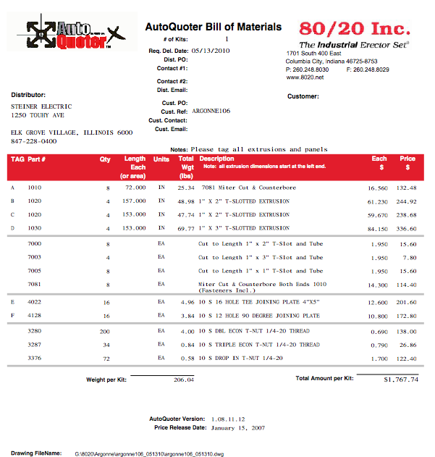
Quote from 80-20
4x1.8K =$7.2K
LANL Engineers’ efforts $xx

Slide 32
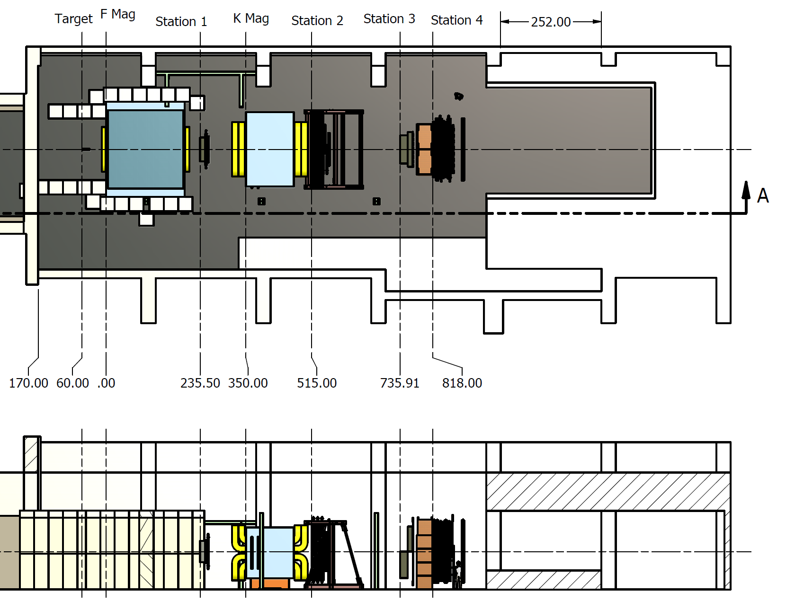
Hall Layout and work areas
Steel from KTeV
Scint. Tests
Radioactive Materials
Work Area
Work Area

Slide 33
Hall Layout Equipment Positions
FMag, KMag and St. 2 Structural Support are in place
St. 2 support was designed to accommodate 4” for an alignment block. Do we want this?
Steel Absorber Wall and FMag sarcophagus soon

Slide 34
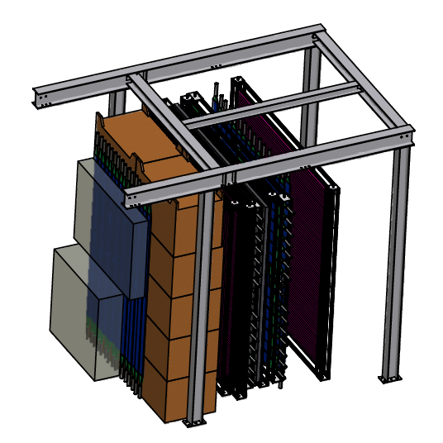
St. 3 and 4 Support Structure
Chambers and Hodoscopes roll out on unistrut rollers to the west
Clearance problem

Slide 35
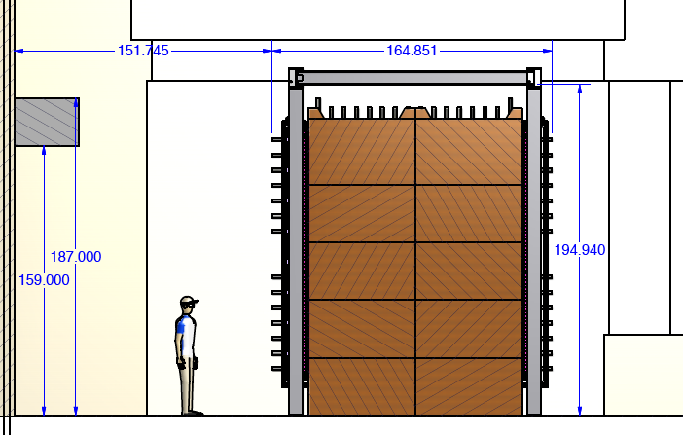
Chambers roll out into this space on unistrut roller

Slide 36
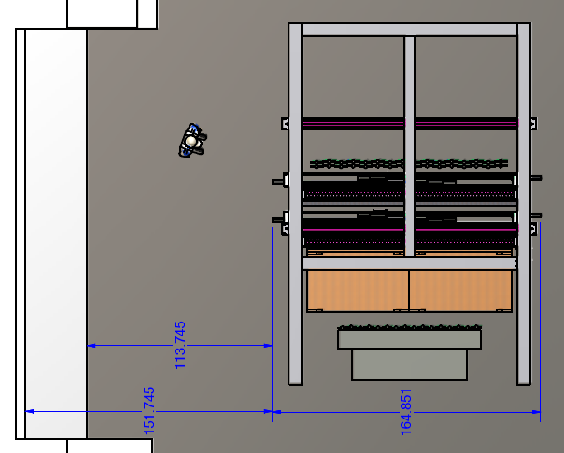
Chambers roll out into this space on unistrut roller

Slide 37
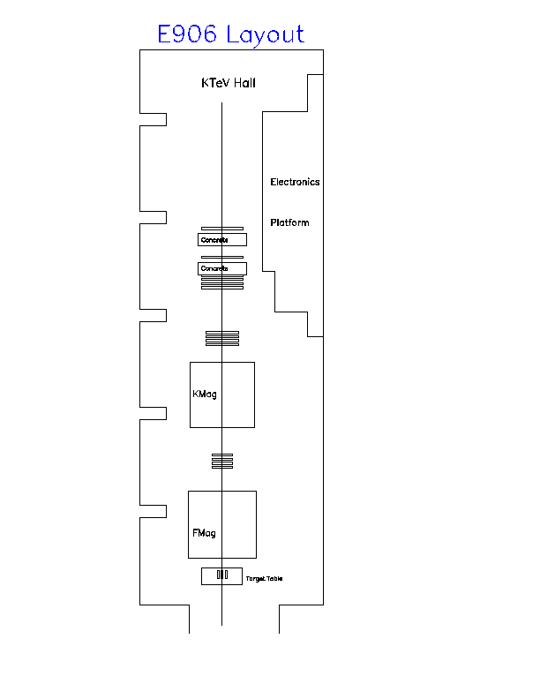
Cabling and Crate Location
: TDCs
Counting Room
: discriminators
: Trigger Logic
PT4 + HD4(TDC4E)
: Tracking Chambers (twist pair cables) to TDC
DC3 + HD3(TDC3E)
DC3
TDC3W
: Hodos (coax cables) to discriminators
Trigger Logic (V1495s + TS)
: Disc. to trigger logic (twist pair)
DC2
TDC2W
DC2 + HD2(TDC2E)
: disc. To TDC (for Hodos, twist pair)
St. 1 Discriminators
: TDC stop to ROCs (see next page)
MWPC
TDC1W
MWPC+HD1(TDC1E)
Stair
~24ft
See http://projects-docdb.fnal.gov:8080/cgi-bin/ShowDocument?docid=941

Slide 38
Cabling and Crate Location
: TDC
Counting Room
: discriminator
: Trigger Logic
PT4 + HD4
: TDC stop
DC3 + HD3
Updated based on discussion of last collaboration meeting.
Should St. 3 and 4 roll out without uncabling? This implies some sort of flexible cable tray.
Some cables may be recovered from KTeV and elsewhere, but E-906 does not have a specific cable budget. These are considered part of the spectrometer elements.
Everyone will need to help with cabling if requested.
DC3
Trigger Logic (V1495s + TS)
DC2
DC2 + HD2
St. 1 Discriminators
MWPC
Mwpc+HD1
~24ft
See http://projects-docdb.fnal.gov:8080/cgi-bin/ShowDocument?docid=941

Slide 39
Future Plan from Ming’s 5/27/10 Collaboration Meeting talk
Recover “bad” modules:
  Test 7 wrong shaped modules with Ar/CO2 at next visit, try to use 4 of them if possible.
  Test 4 modules that were tested good but failed at last checkup - likely due to bad gas.
Would like to run “good fast gas” for all modules, scan for HV plateau for all tubes, identify 34+ good modules for the final assembly
  MIPP or D0 muon gas (or something similar)
Assembly and installation:
  Get Fermilab structural engineers’ approval ASAP, order the materials from 80-20 in June.
  Assembly and installation in late June/July
Electrical ground and noise
  Need to run the full DAQ and some sort of online/offline analysis code
  Need ECL to ECL TDC, 34x16=544 channels
Would like to get the detector in for the test beam and check the background rates this summer

