Slide 1
St4 Muon detectors: status 06/11/2011
All patch panels and cables installed and connected
The system is ready for commissioning!
LV, HV, Signal, Gas
HV:
4 cables connected to HVPS,
1A and 1B for first two planes
2A and 2B for the two backplanes
LV:
PS: 3 working KTeV/UCLA
+/-5V, 18A each channel
made 4 LV cables, no feedback sensors connected yet
Voltages at patch panels:
+4.7V and -4.7V for single LVPS
+4.6V and – 4.4V for doubled ones (two front planes)
ECL cables
36 of 35’ long ECL cables made, tested and connected, ACU students
Gas lines
4 lines connected, now flowing Ar/Co2 @0.5CFH per plane
Ming: 6/7-11
Christine: 6/10-16

Slide 2
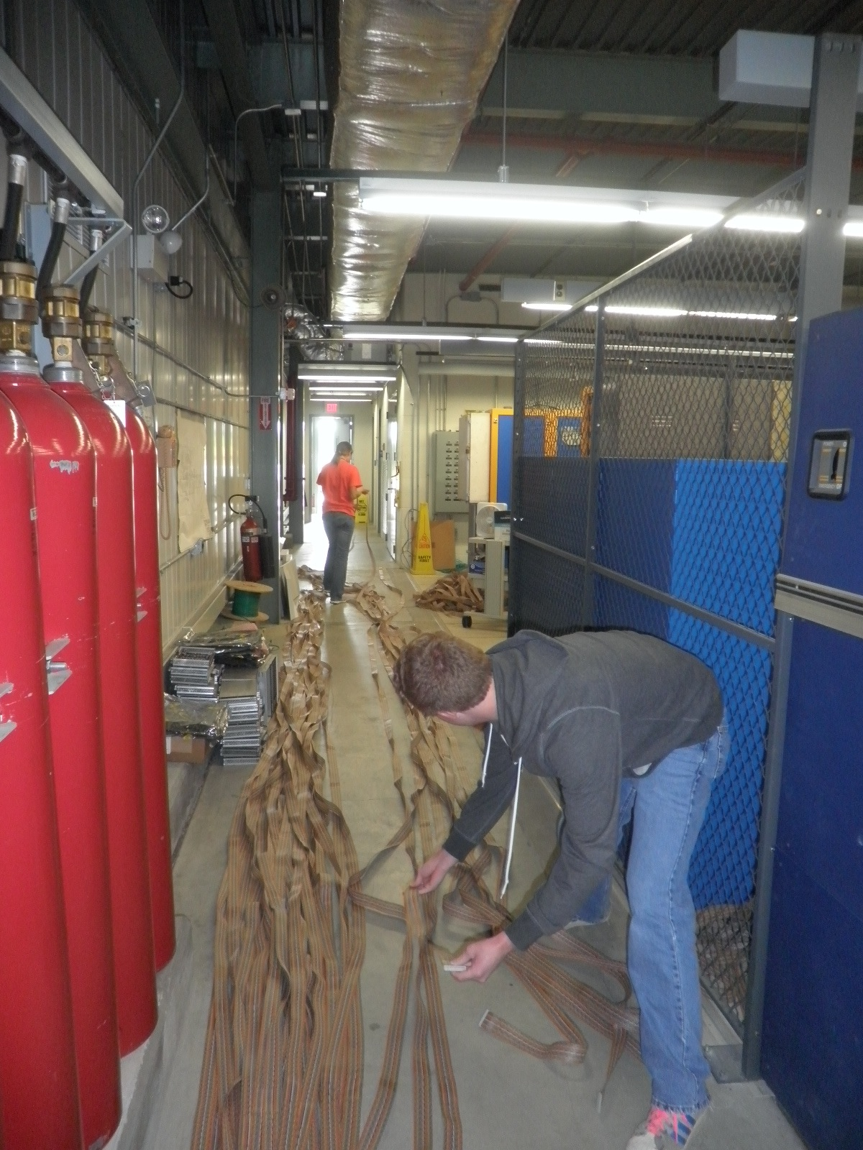
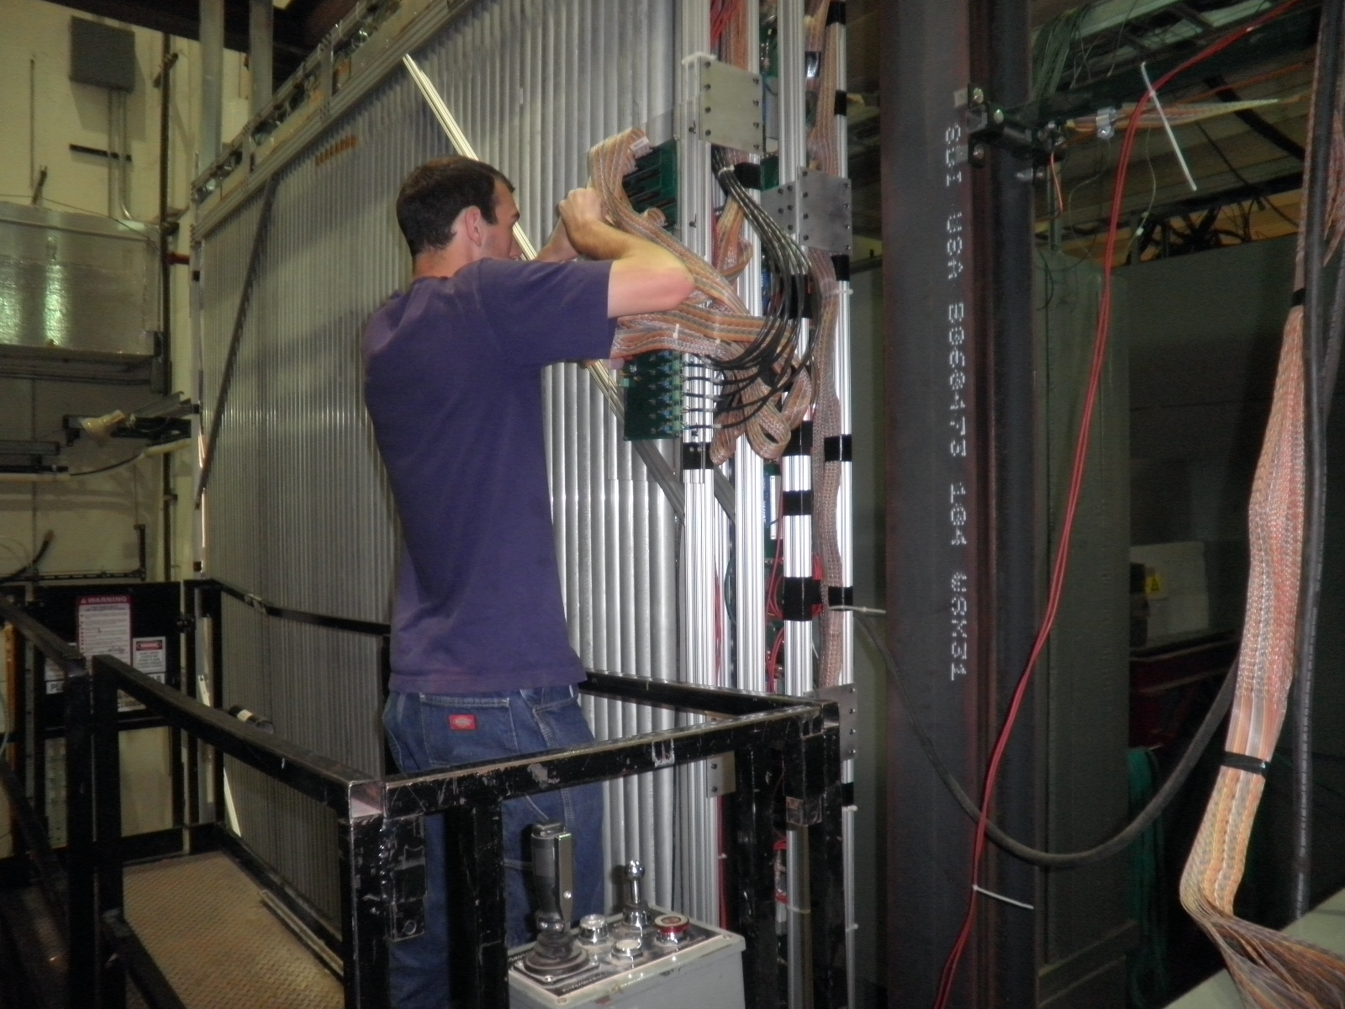
Signal ECL cables 36 x 35’ long
Thanks ACU !

Slide 3
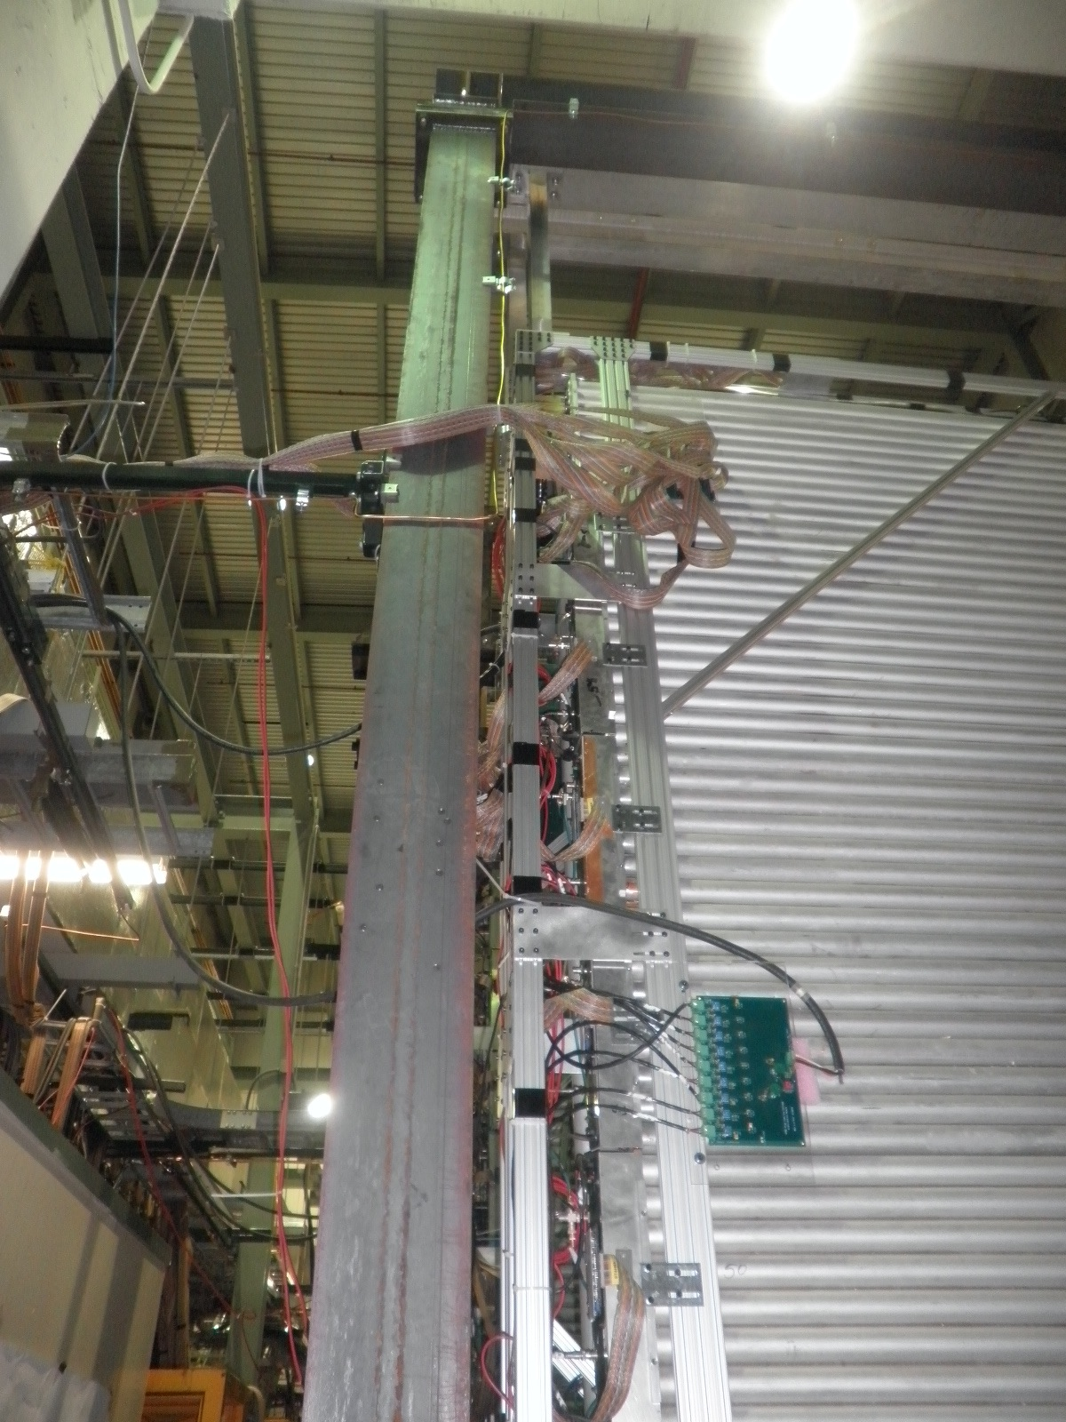
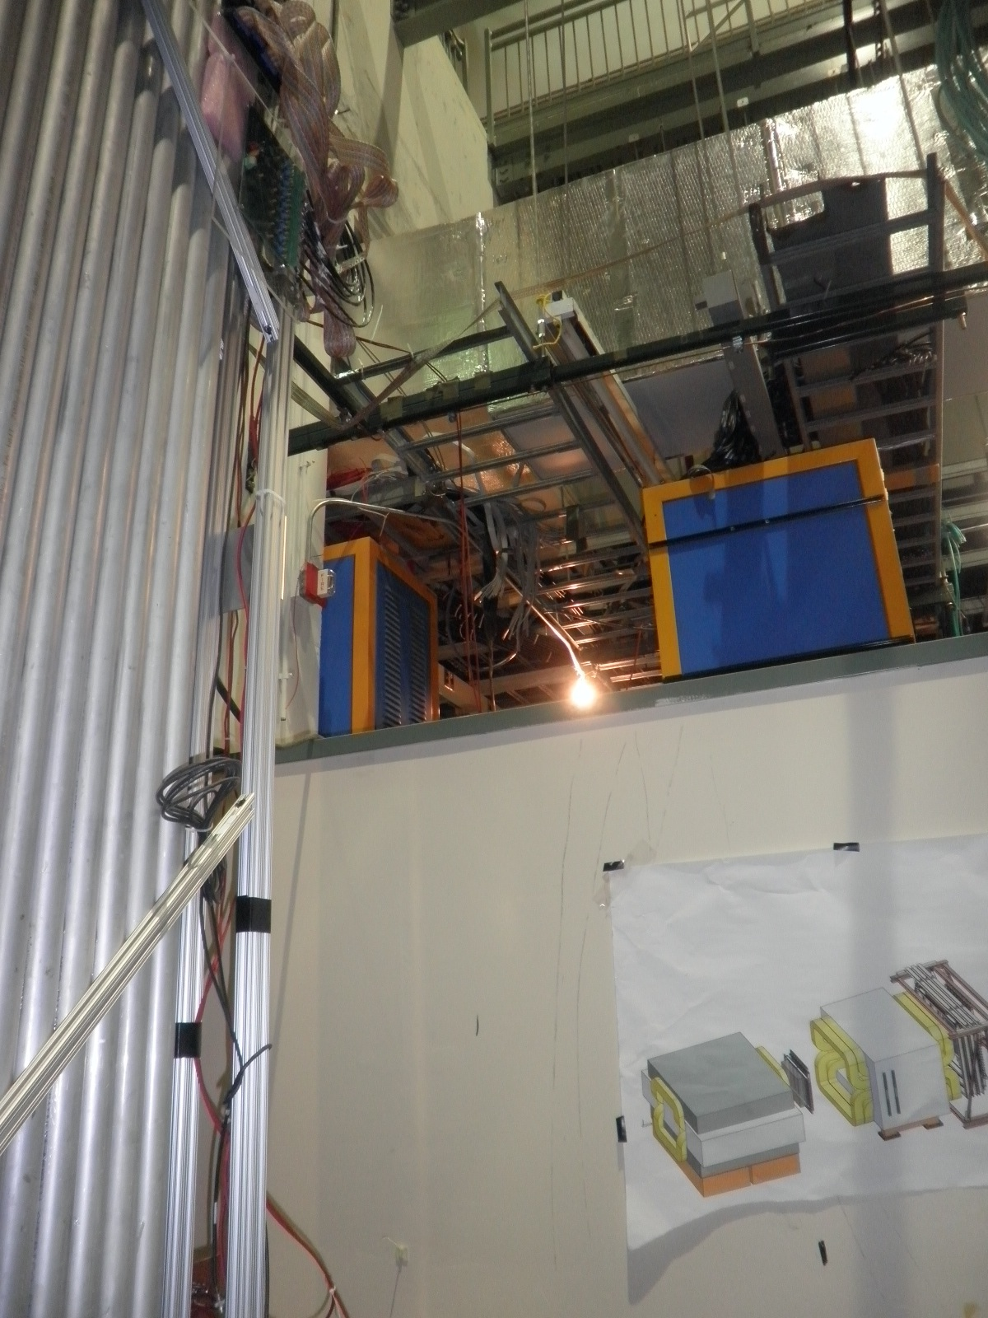
St4 prop tubes

Slide 4
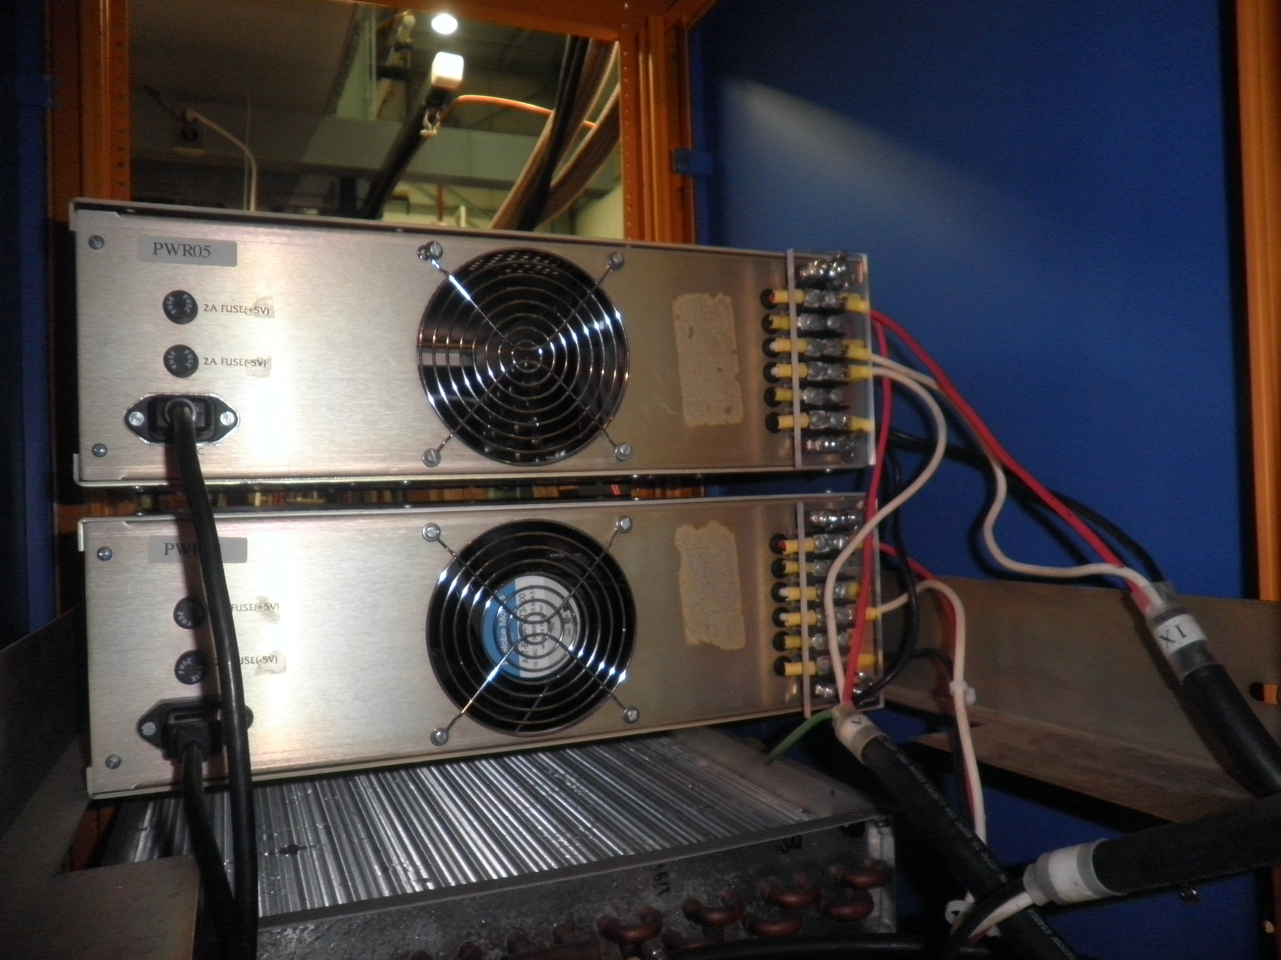
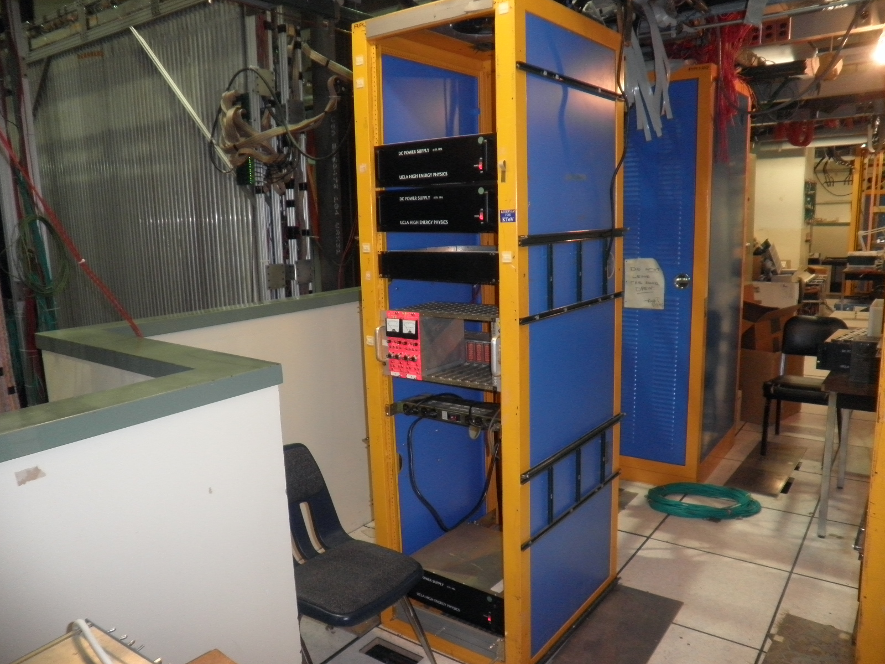
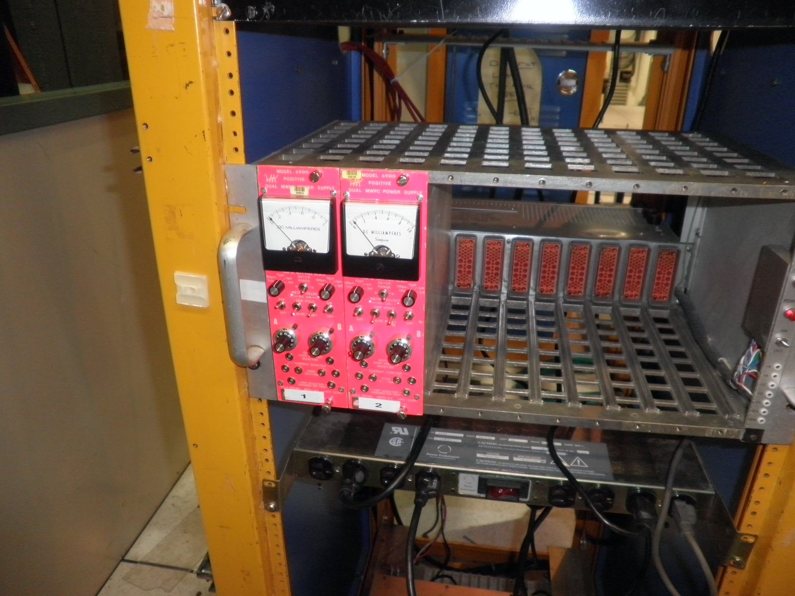
LV and HV PS

Slide 5
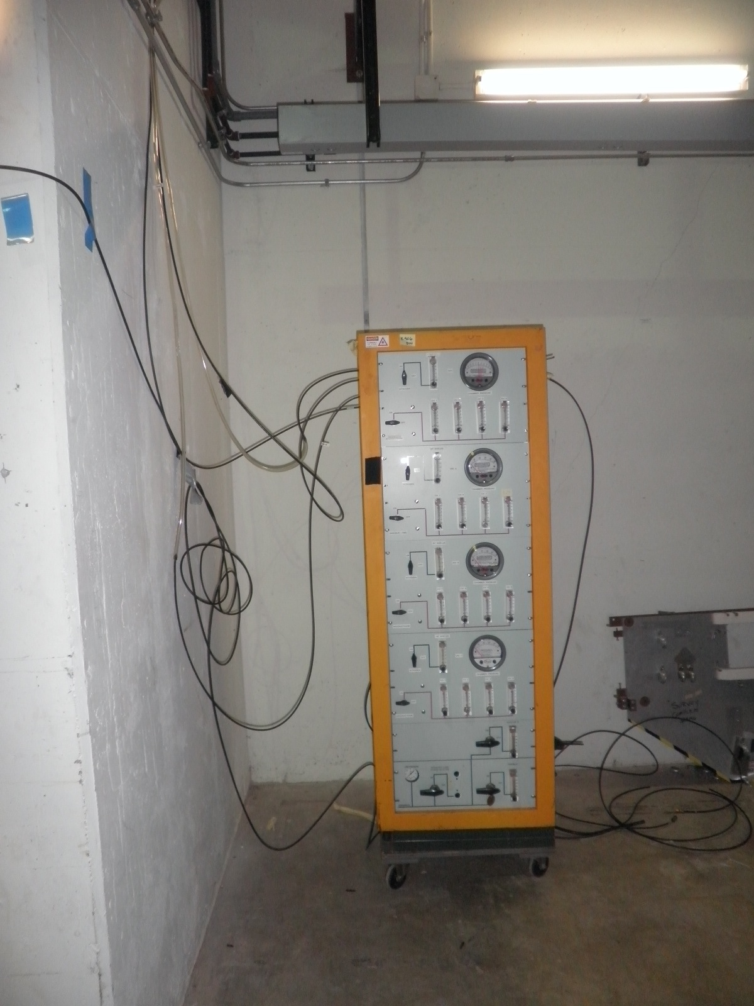
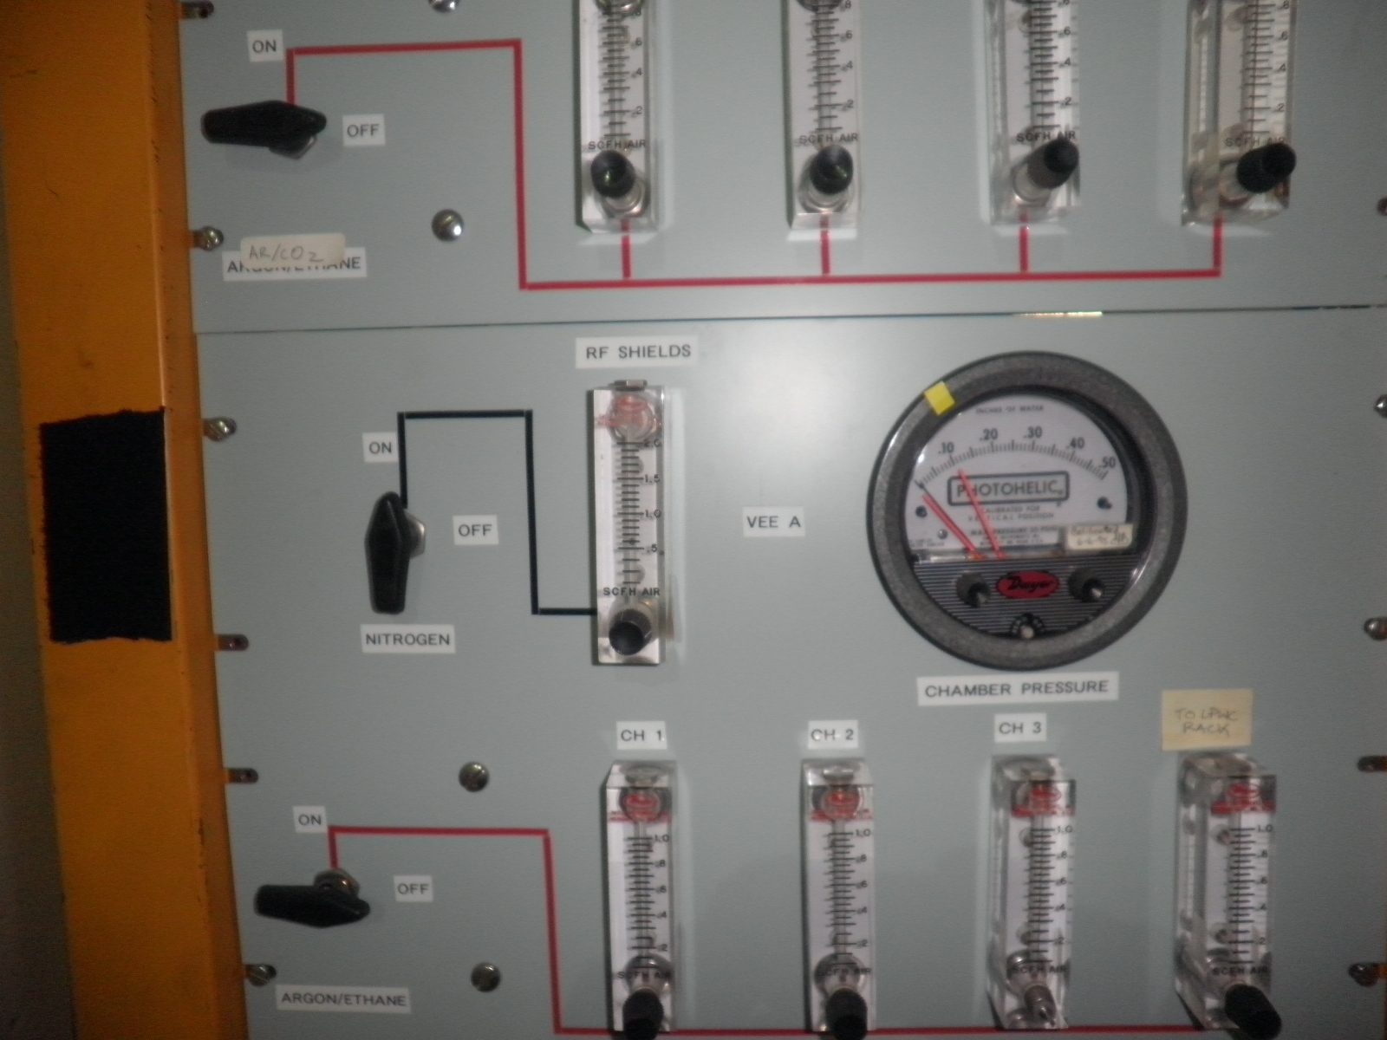
Gas System 3-input and 1-output per plane

Slide 6
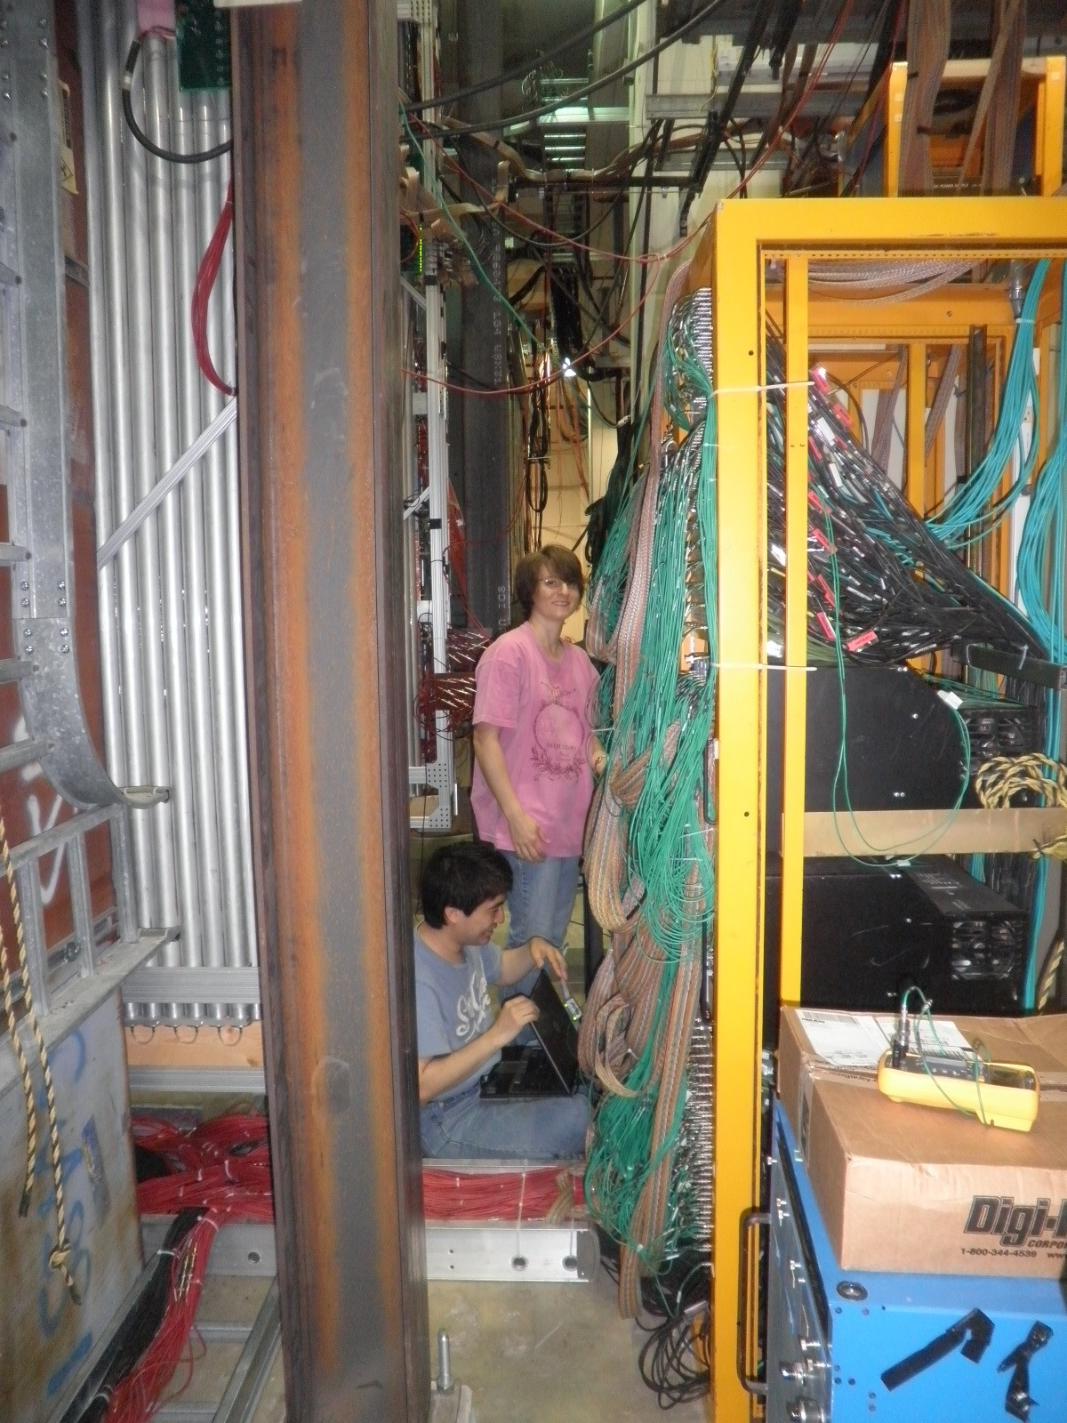
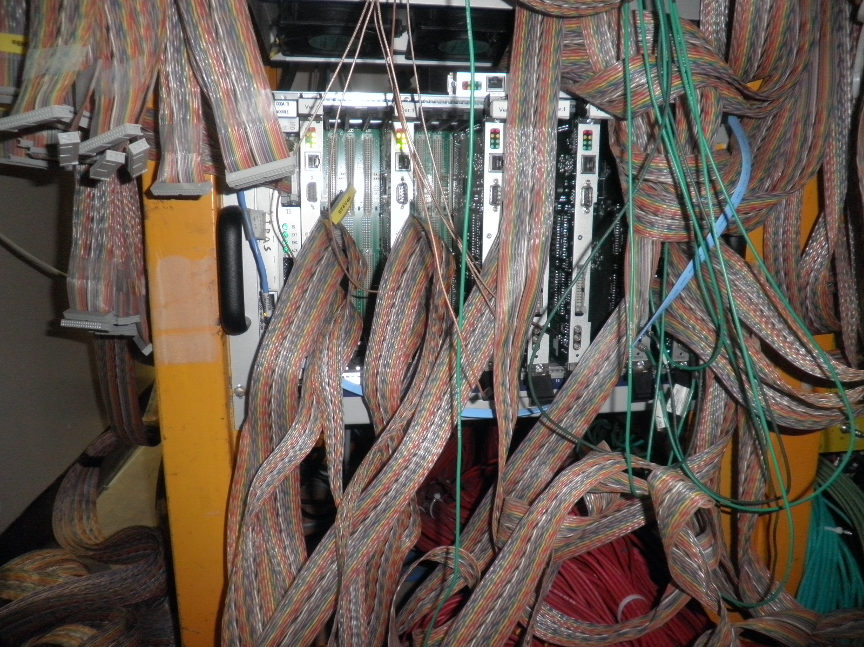
Multi-module TDC Readout Test

Slide 7
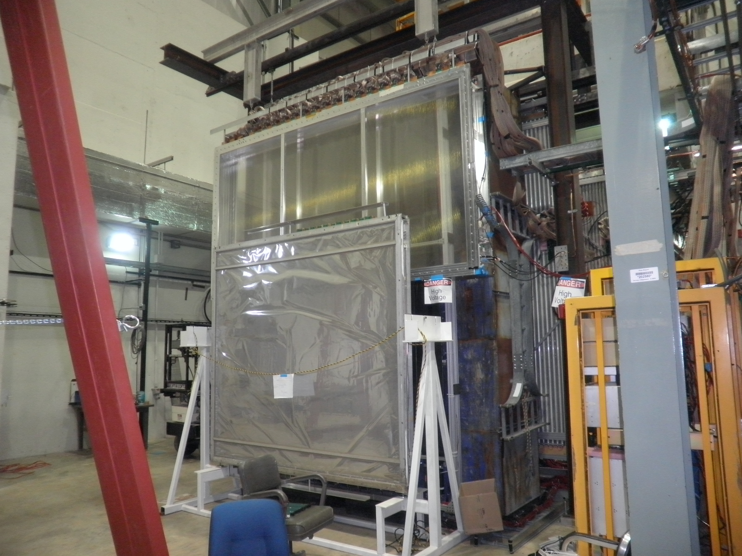
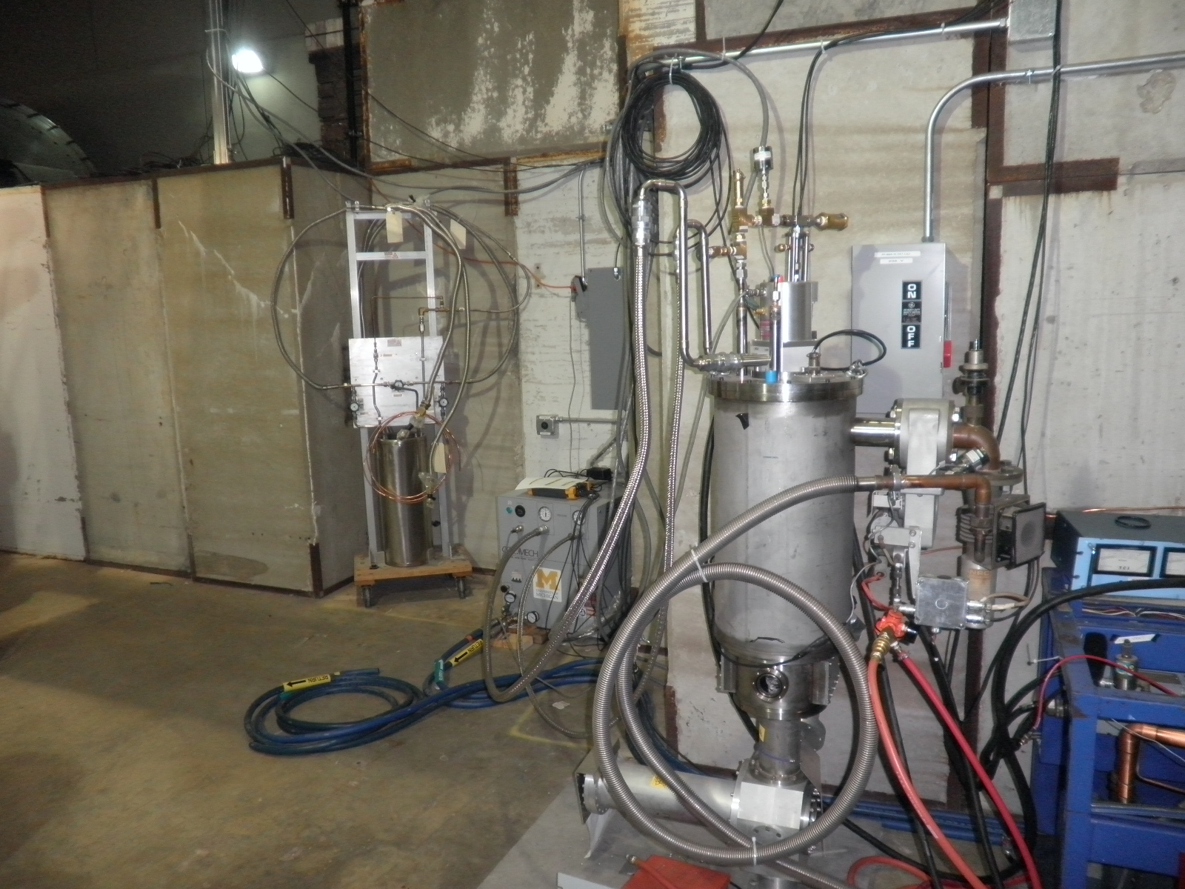
Other subsystems

Slide 8
Issues and Commissioning Plan
System grounding and electronics noise
Start to work on it
External pulser and calibrations
Some bad T-connectors? Bad pulser signal propagation
Some modules show no pulser signals
But Can see cosmic signal with HV on
Run 9 calibration cables per plane?
Multi-module TDC readout
5 TDC cards available, good for two planes (18 ECL cables)
Unstable TDC and controllor, need FPGA code update
Were able to read out 2 cards and confirmed the prop tube/TDC timing was right
Cosmic data with the Hodoscope trigger

Slide 9
E906 beam schedule
Originally: beams ~ after mid of June
Beam line vacuum leak discovered two weeks ago
Various options are being explored
Probably insert a new smaller beam pine
Beam possible/likely after July 4th break,

