Slide 1
E905 Prop tube status 03/06/2011
First two X and Y planes
Y-plane installed Monday 2/28
X-plane installed Tuesday 3/1
3rd plane (X) installed Wed. 3/2/2011
4th plane (Y) installed Friday 3/4/2011

Slide 2
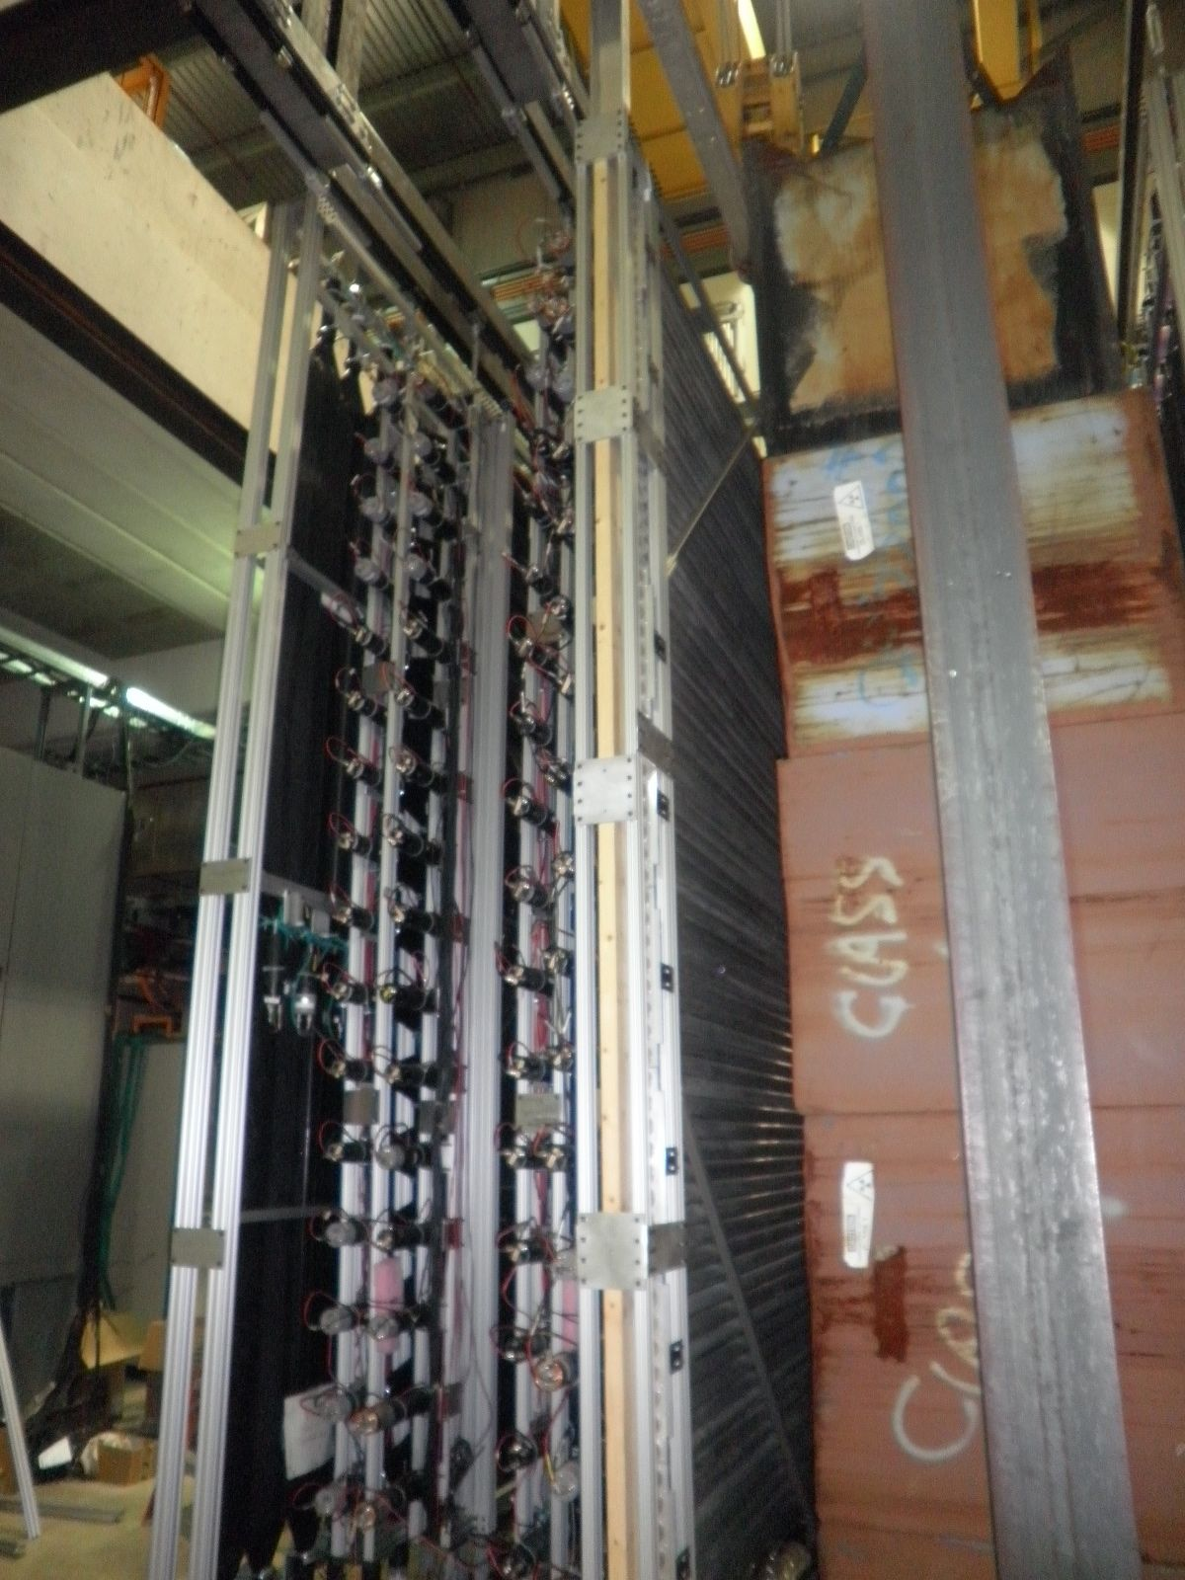
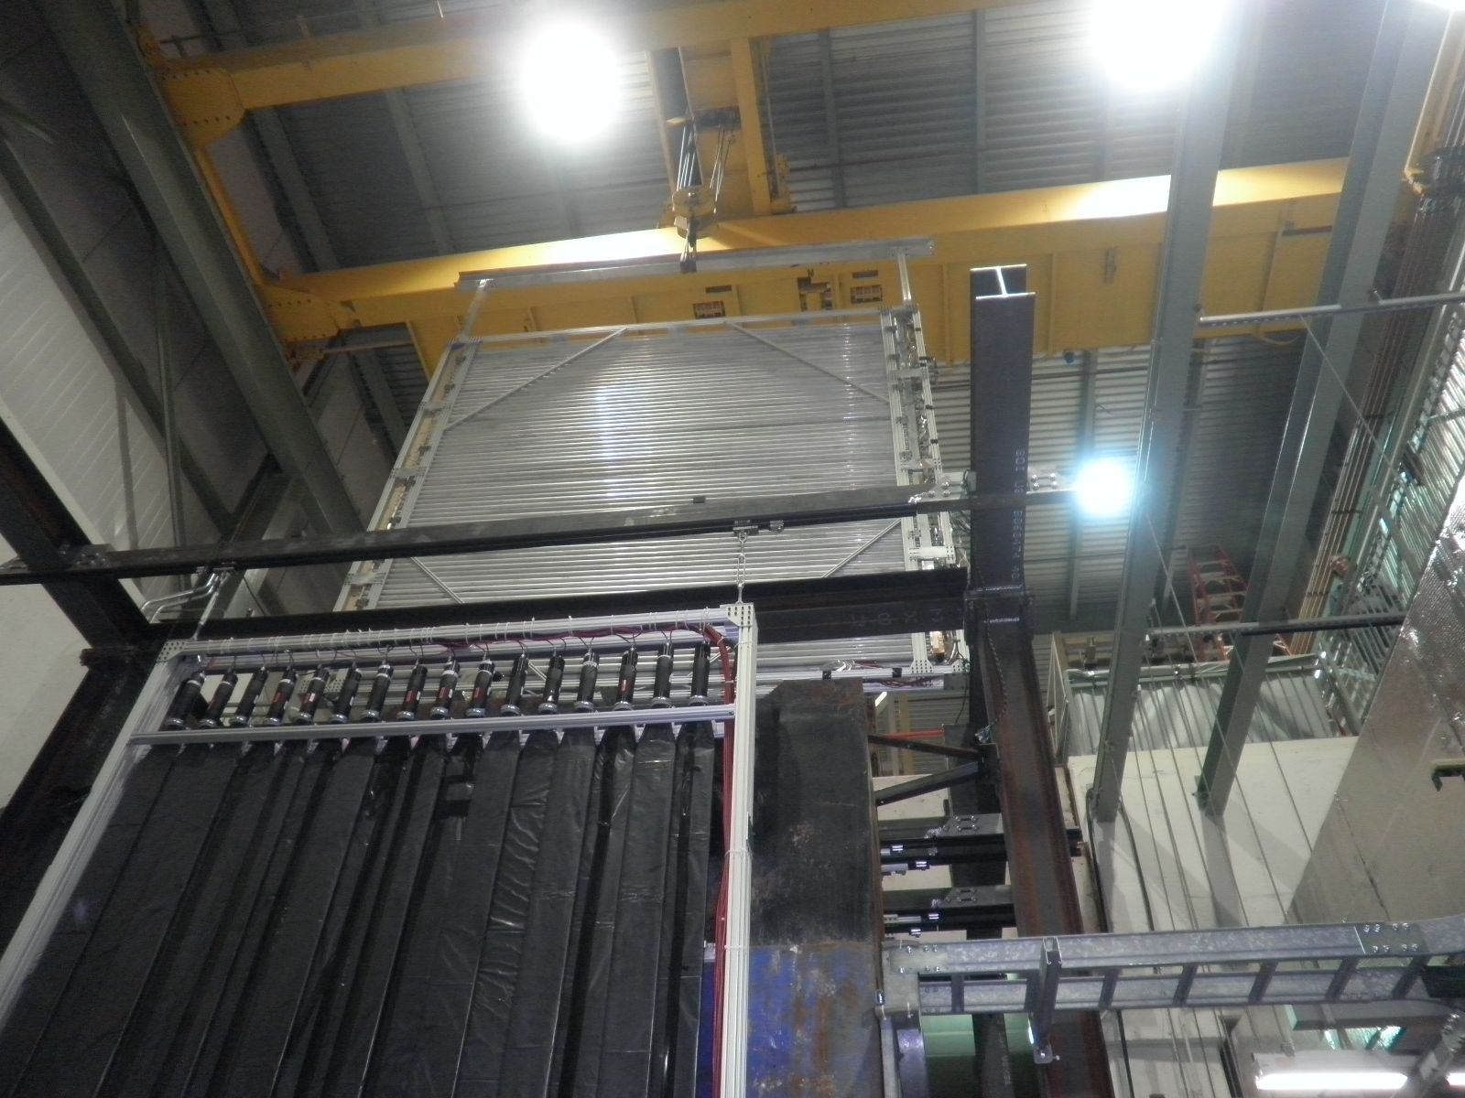
Y1-plane installation 2/28/2011

Slide 3
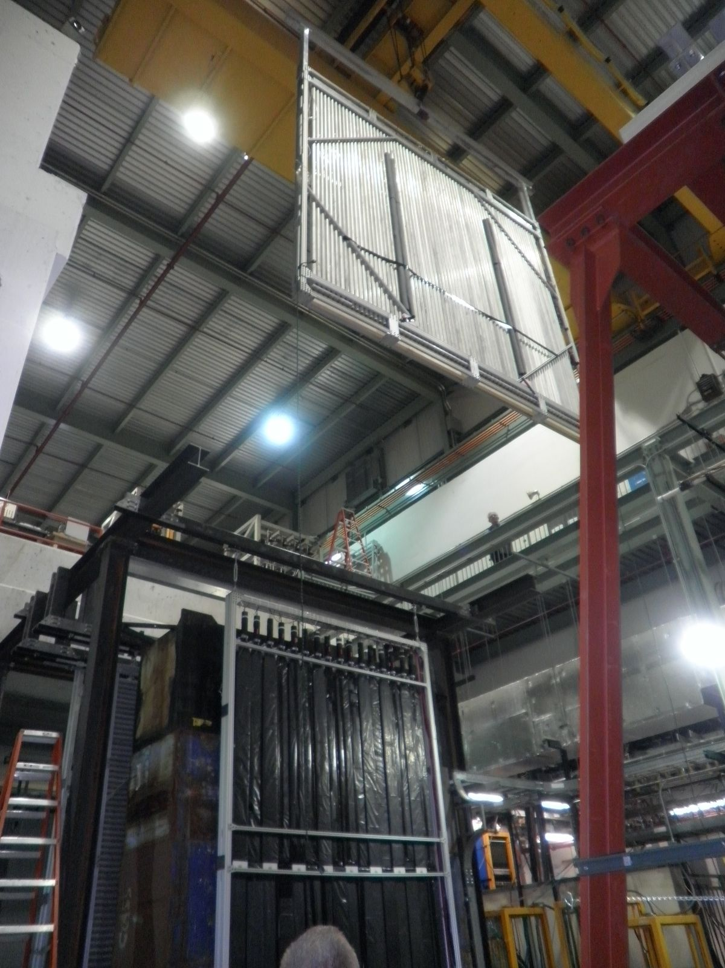
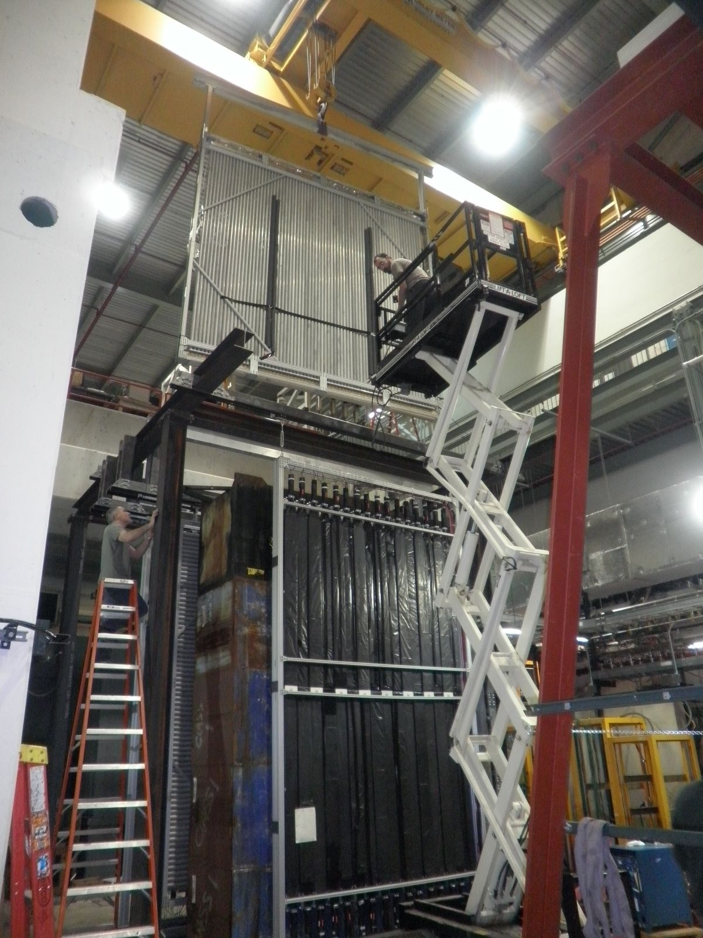
X1 plane installation 3/1/2011

Slide 4
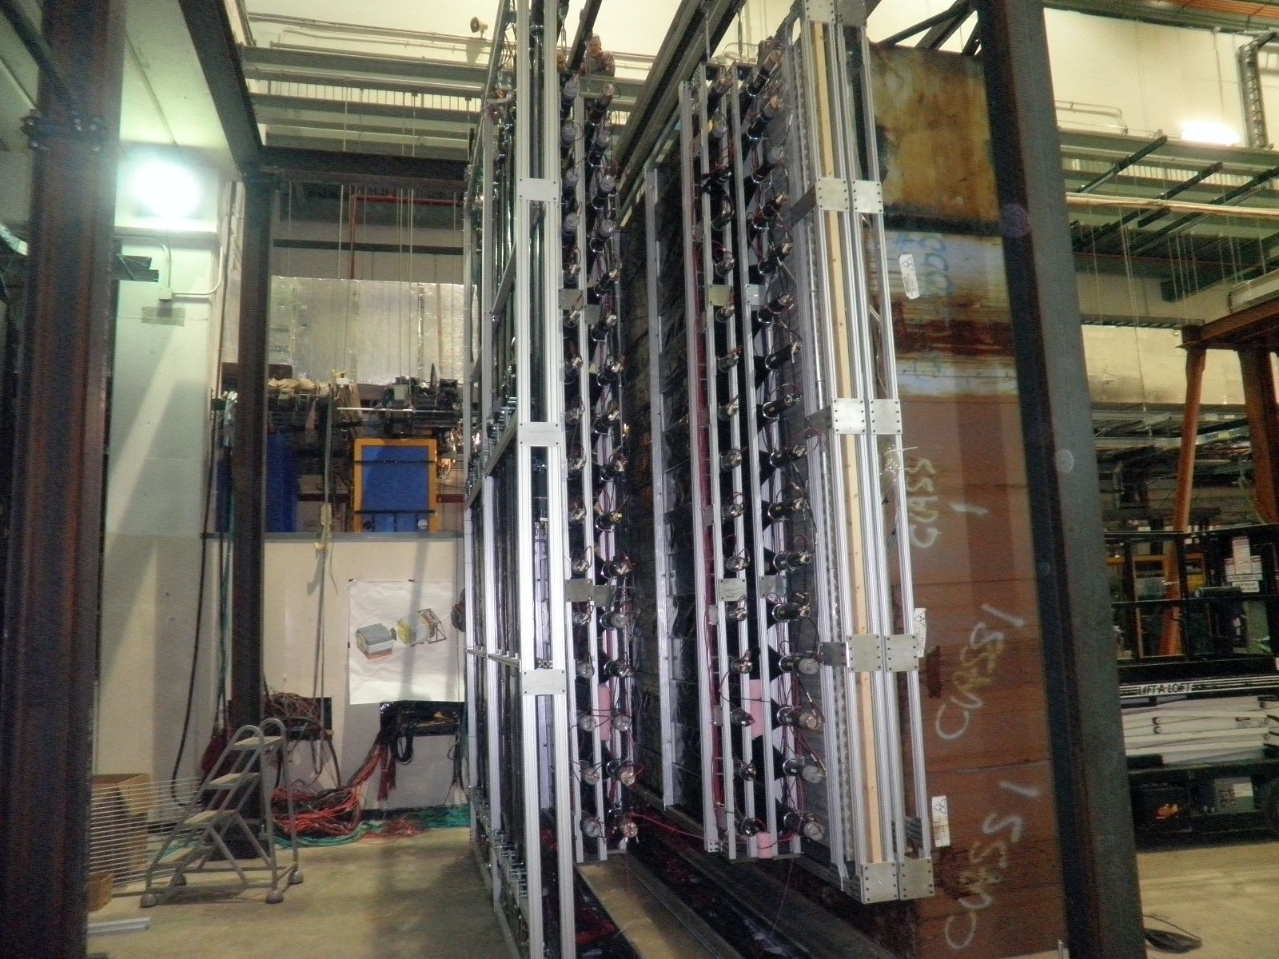
1st X and Y planes installed
St-4 Y and X planes

Slide 5
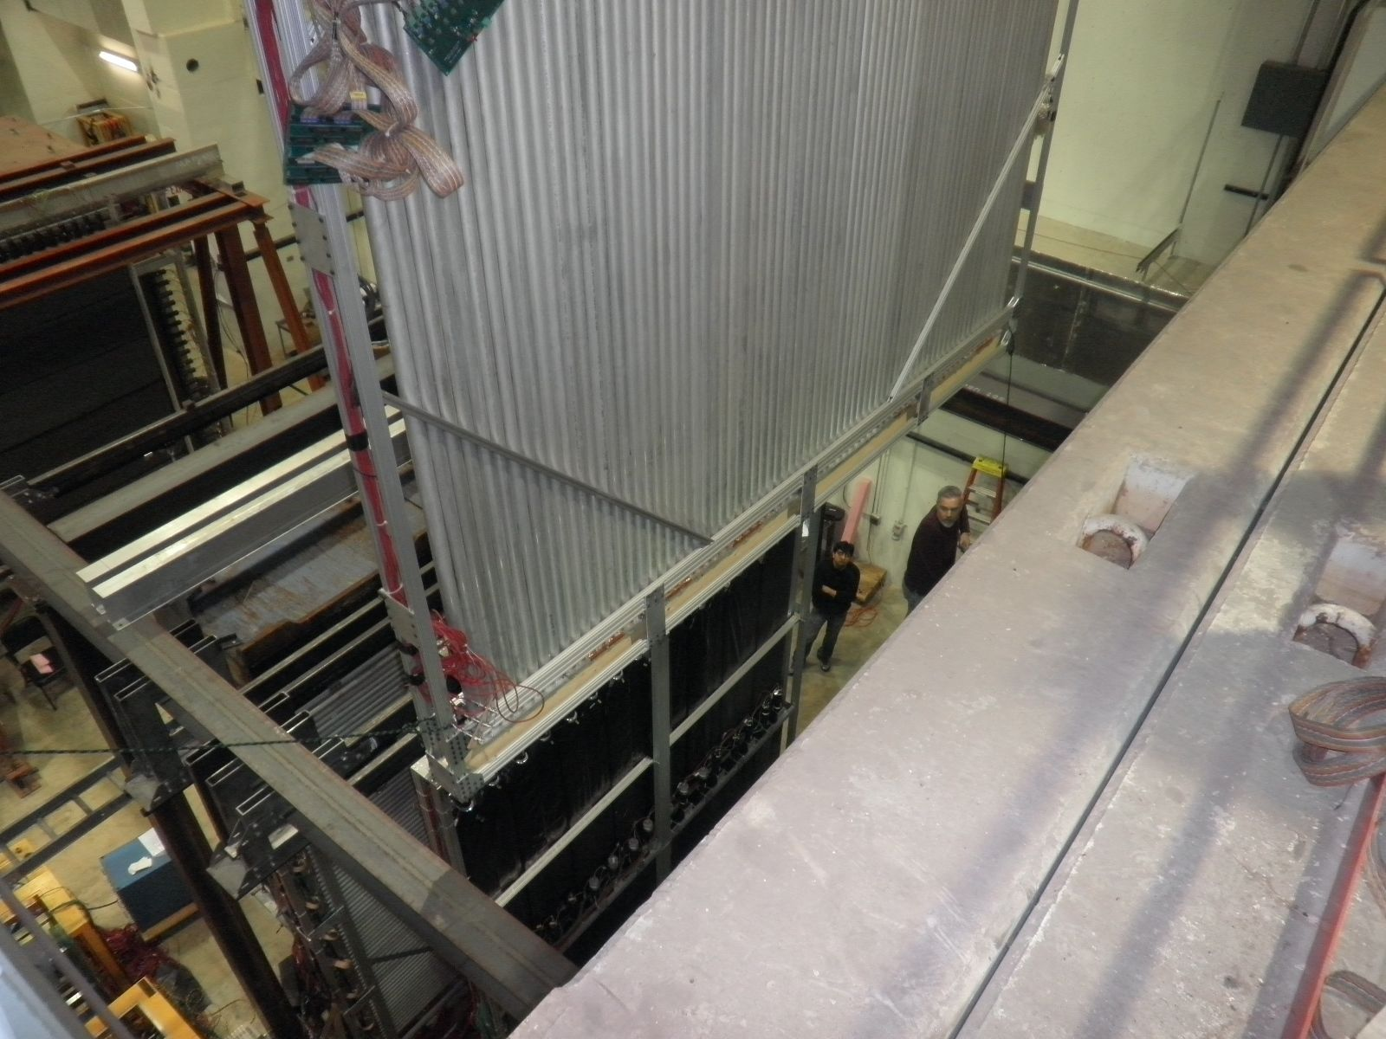
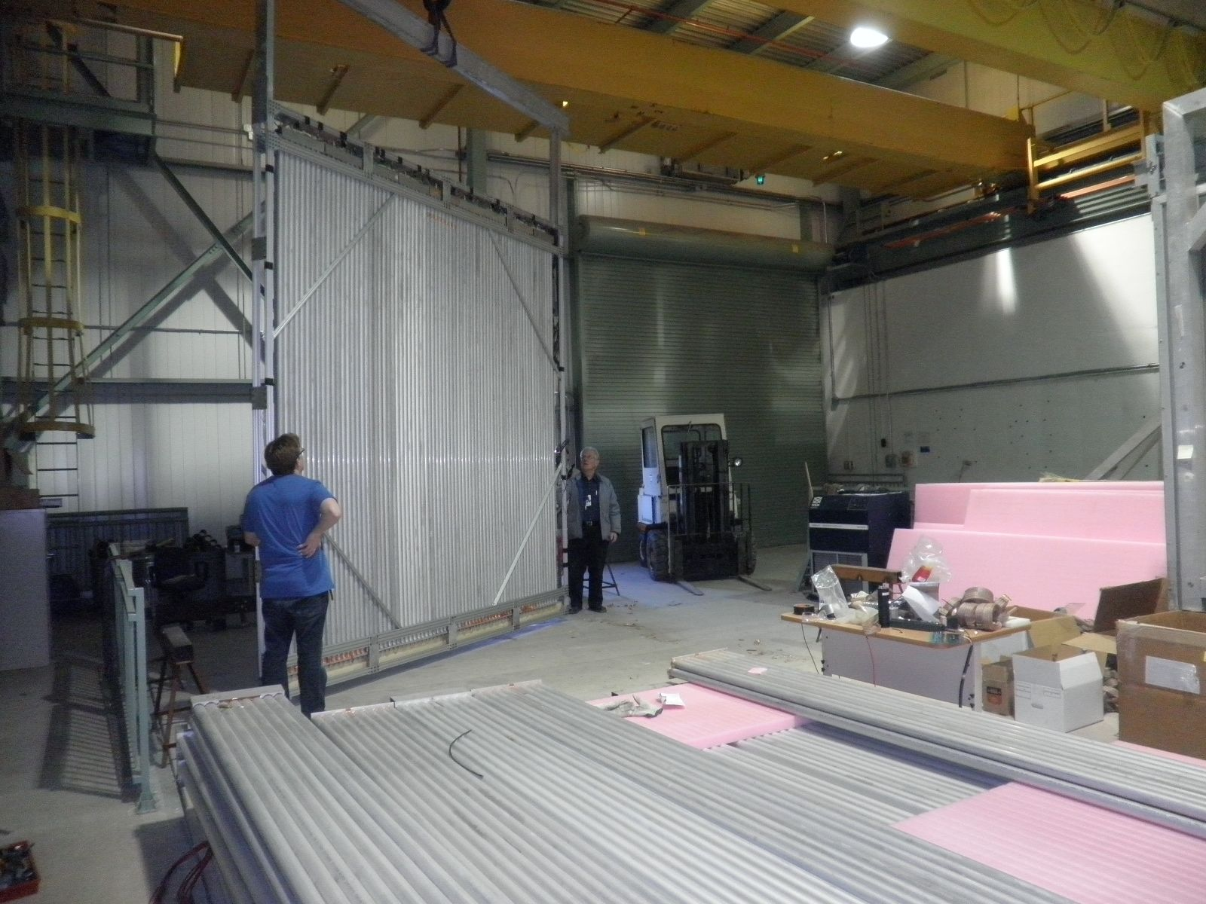
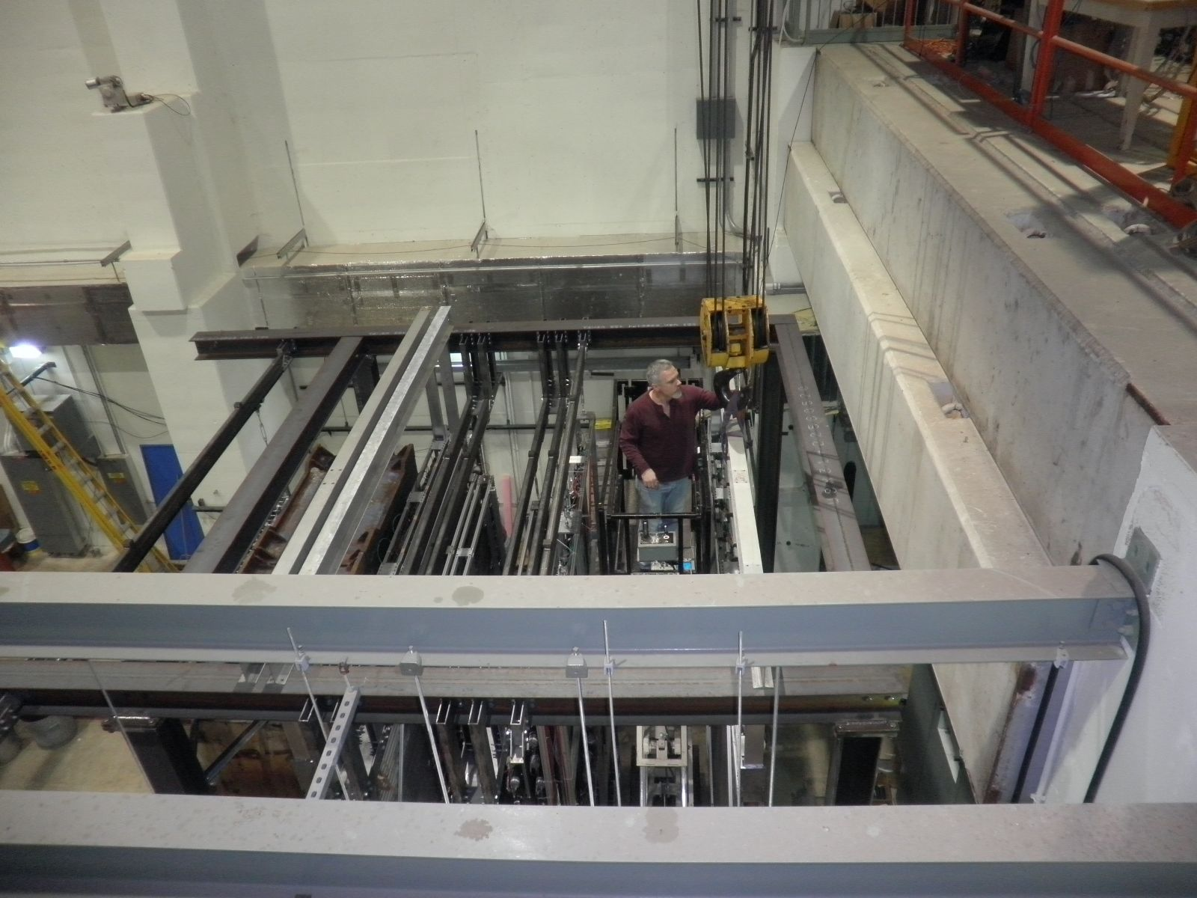
Installing the X2 plane

Slide 6
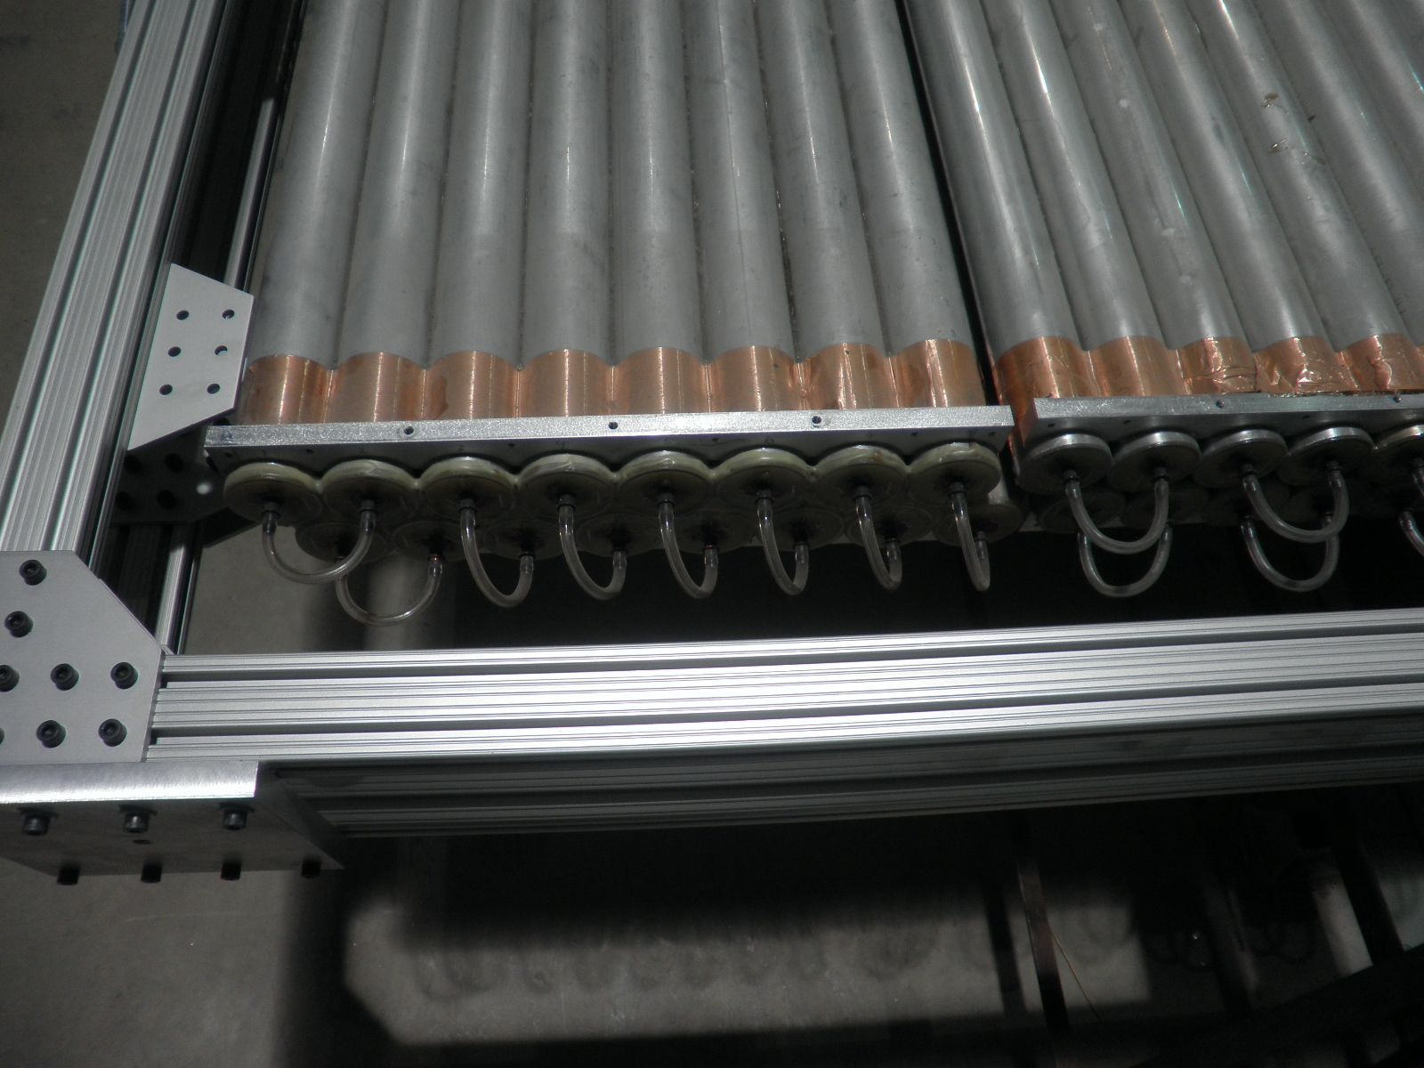
The last plane
One module with wrong shape
One module with wrong gas tubing

Slide 7
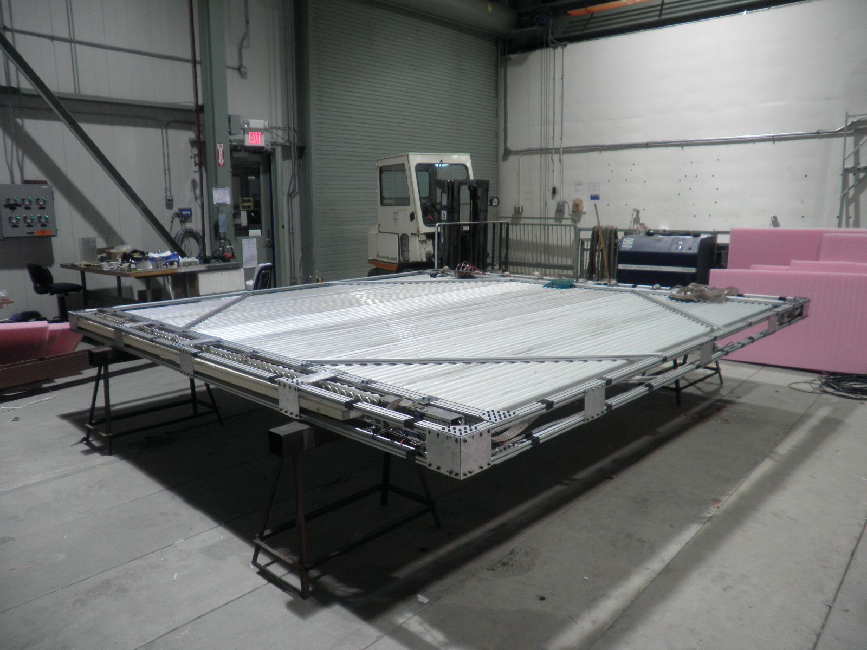
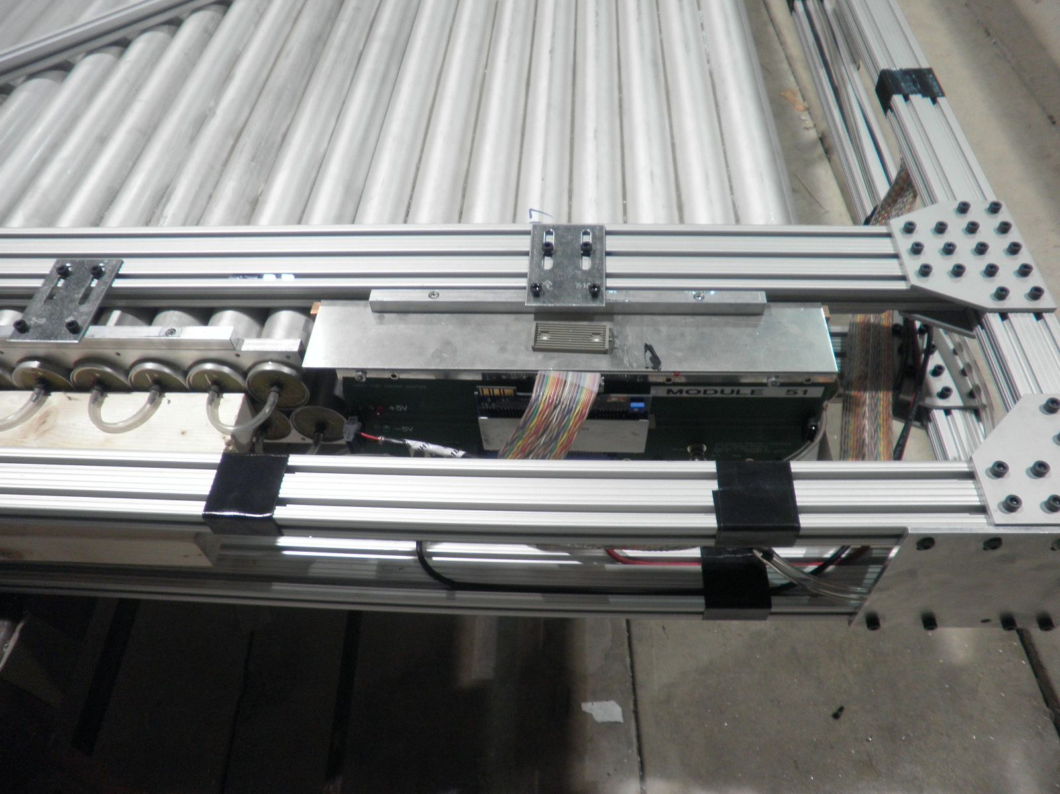
The only wrong shaped module
Installed on the top of the last Y-plane

Slide 8
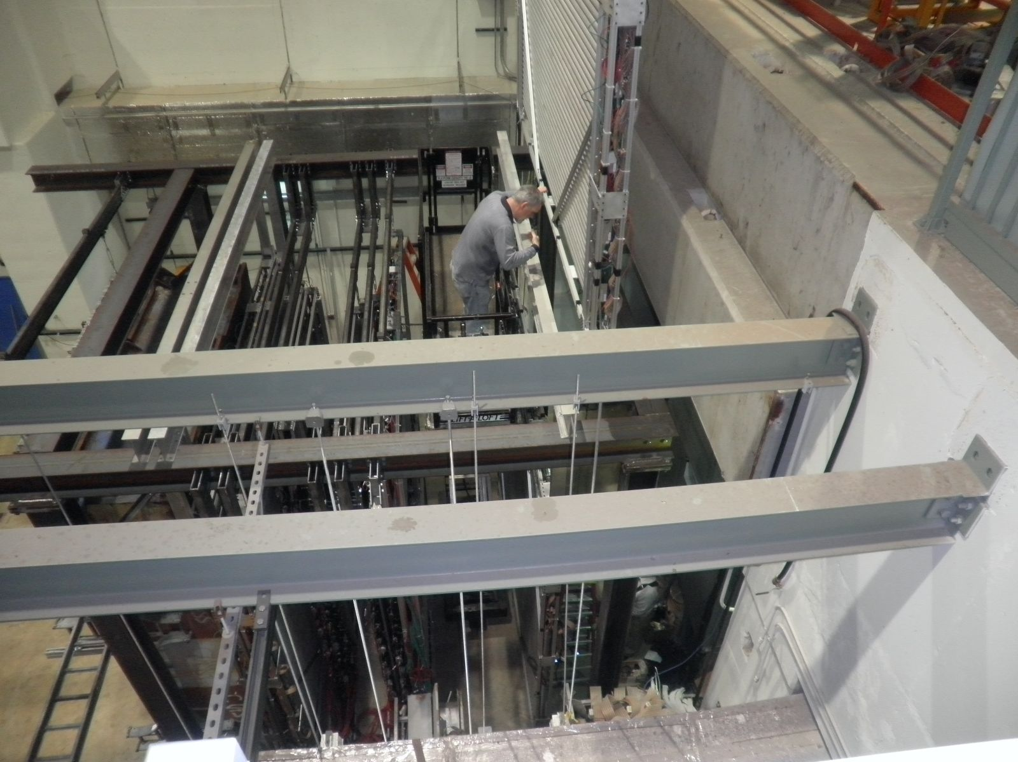
Installing the last plane

Slide 9
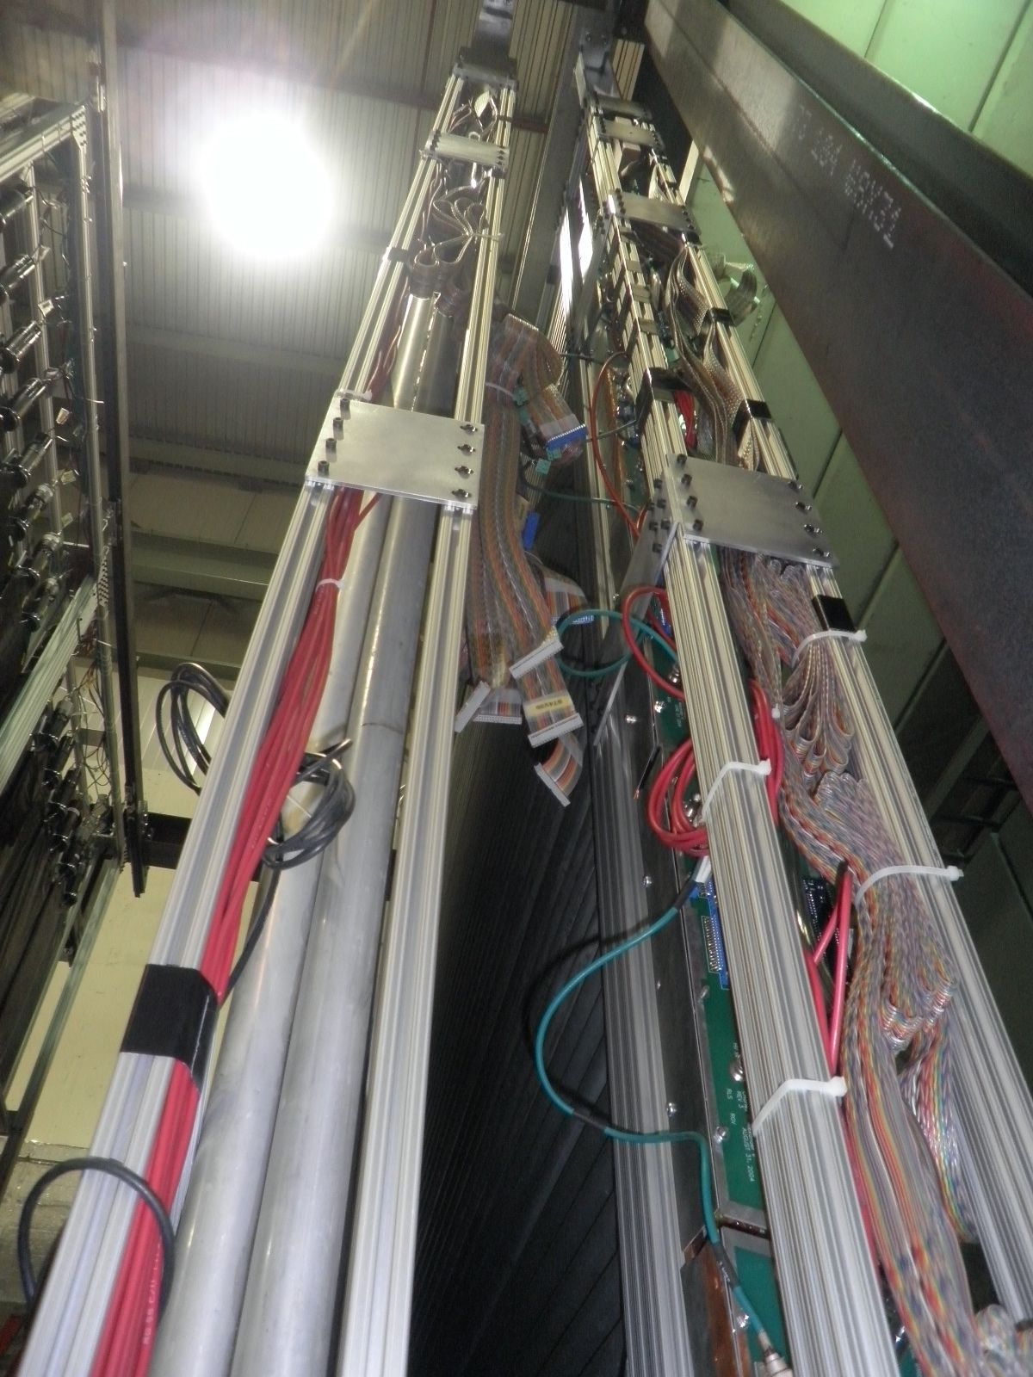
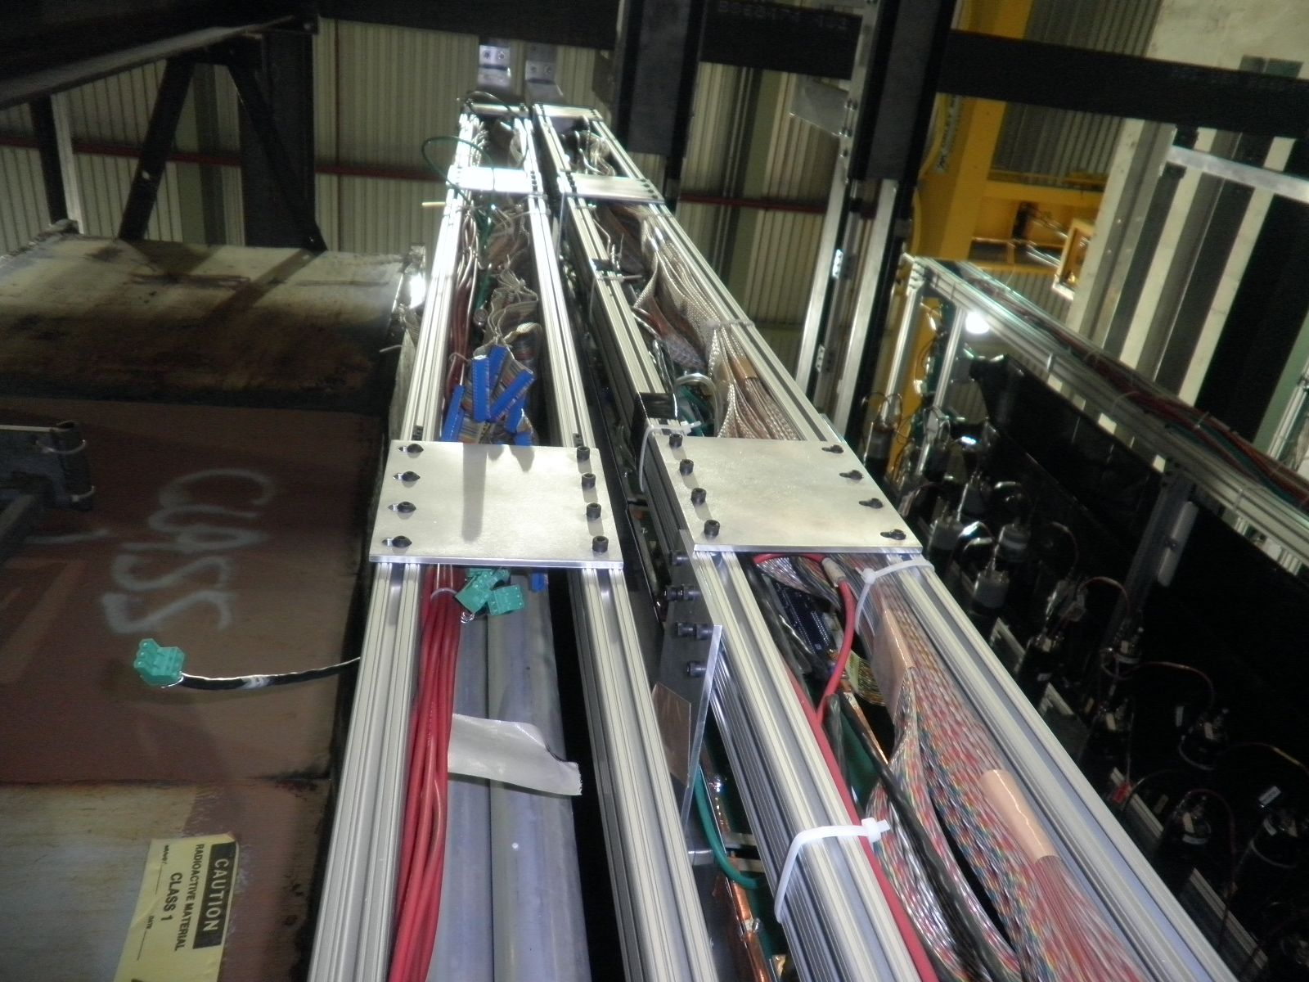
X and Y planes
X2 and Y2
X1 and Y1

Slide 10
16 15 14 13 12 11 10 9
8 7 6 5 4 3 2 1
16 15 14 13 12 11 10 9
8 7 6 5 4 3 2 1
16 15 14 13 12 11 10 9
8 7 6 5 4 3 2 1
NIM channel map
X1
Y1
X2
Y2
16 15 14 13 12 11 10 9
8 7 6 5 4 3 2 1
16 15 14 13 12 11 10 9
8 7 6 5 4 3 2 1
IP, Top View
……
……
Z
X
16 15 14 13 12 11 10 9
8 7 6 5 4 3 2 1
16 15 14 13 12 11 10 9
8 7 6 5 4 3 2 1
READOUT
ELECTRONICS

Slide 11
Wrong
Shpd mod.
16 15 14 13 12 11 10 9
8 7 6 5 4 3 2 1
16 15 14 13 12 11 10 9
8 7 6 5 4 3 2 1
9 10 11 12 13 14 15 16
1 2 3 4 5 6 7 8
NIM channel map
X1
Y1
X2
Y2
16 15 14 13 12 11 10 9
8 7 6 5 4 3 2 1
16 15 14 13 12 11 10 9
8 7 6 5 4 3 2 1
Y
IP, Side View
……
Z
……
16 15 14 13 12 11 10 9
8 7 6 5 4 3 2 1
16 15 14 13 12 11 10 9
8 7 6 5 4 3 2 1
Ground Floor

Slide 12
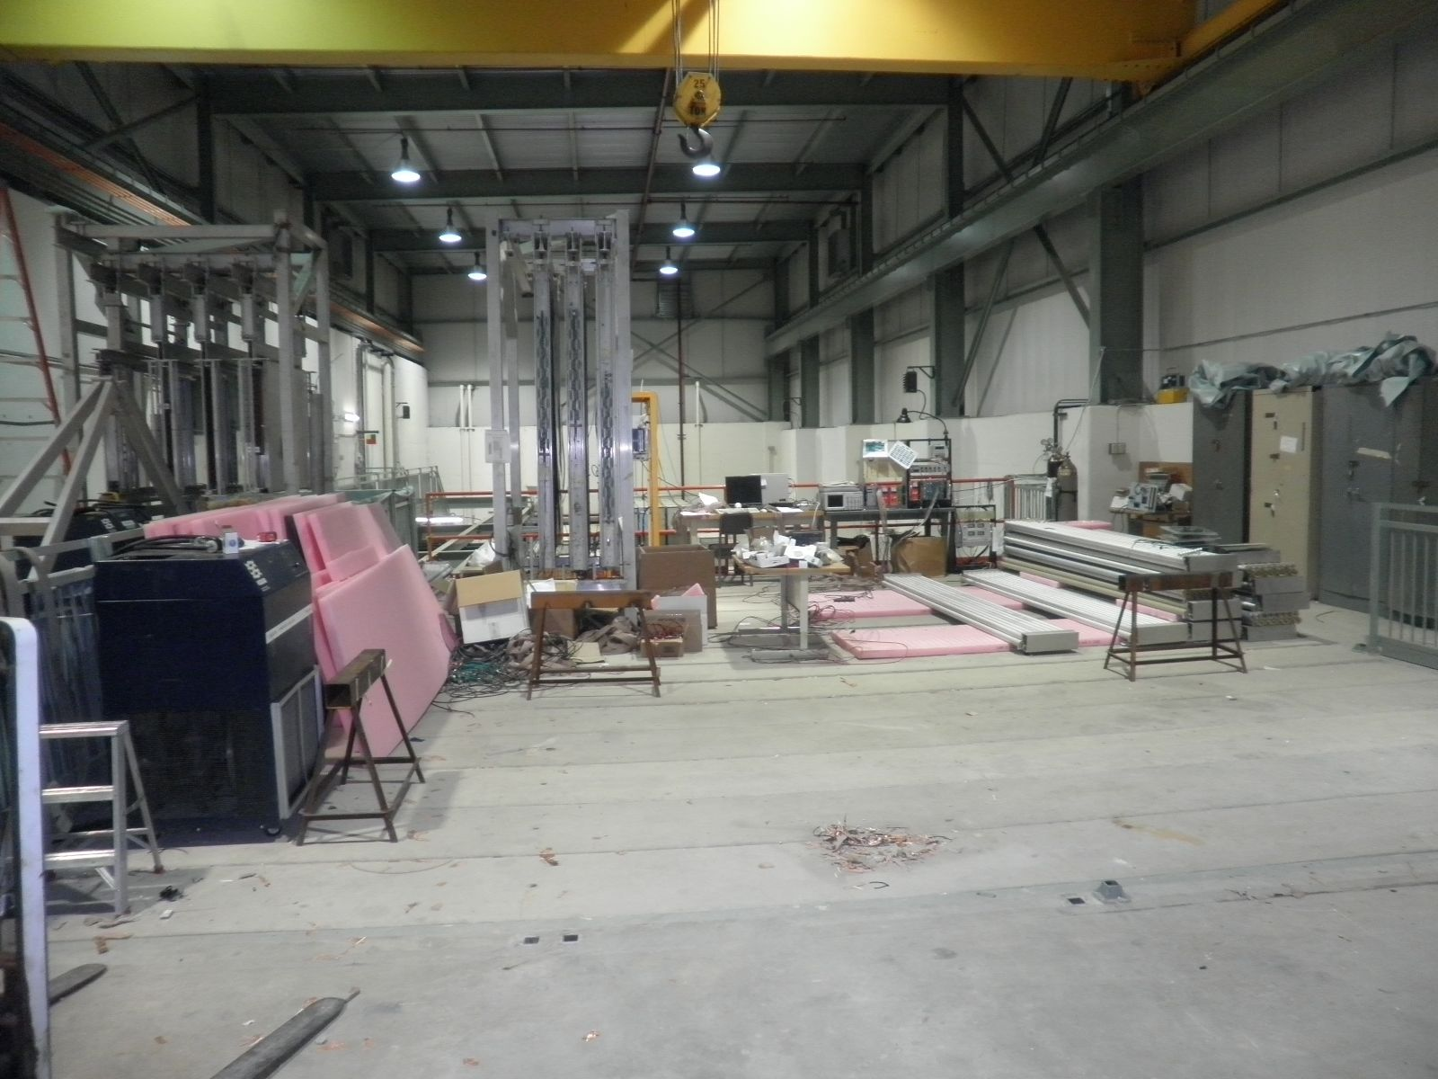
The old test area

Slide 13
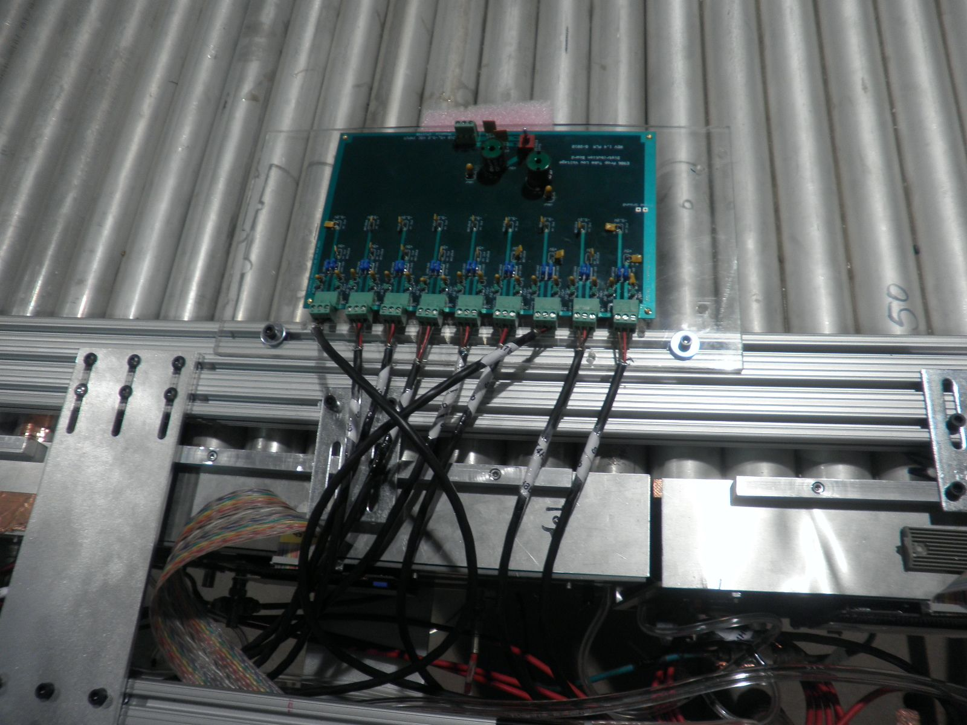
LV system
Delta LV PS:
5V & 20A each
Need connectors
Per plane
+5V, 0.5x9=4.0A
-5V, 0.75x9=6.8A
Two Delta
+5V and -5V
Ground configuration

Slide 14
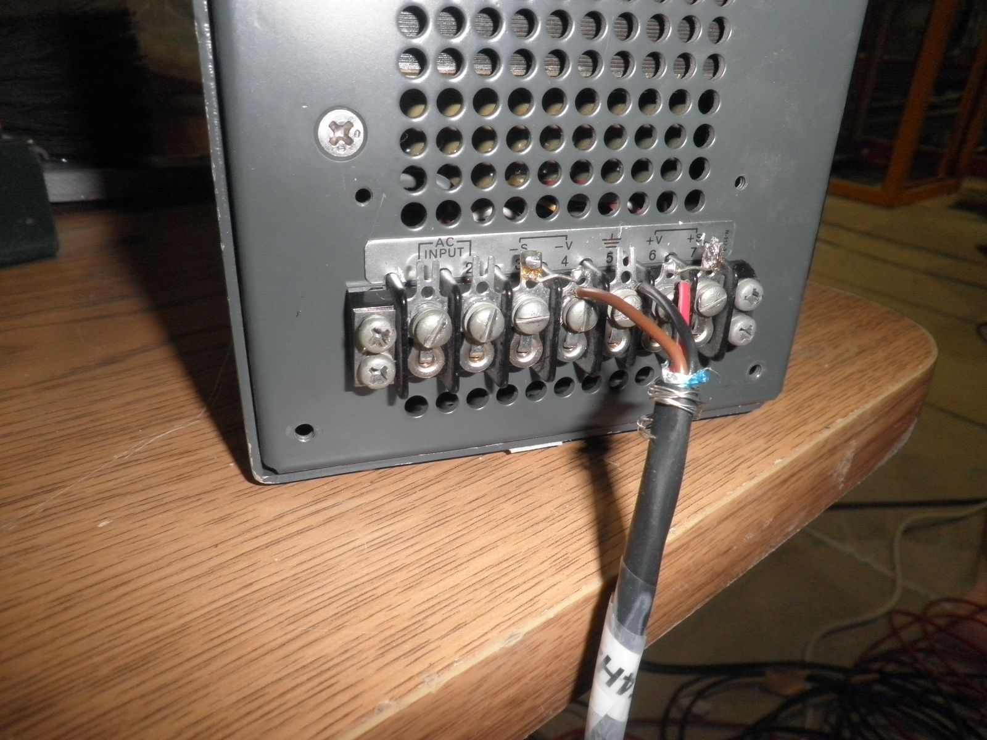
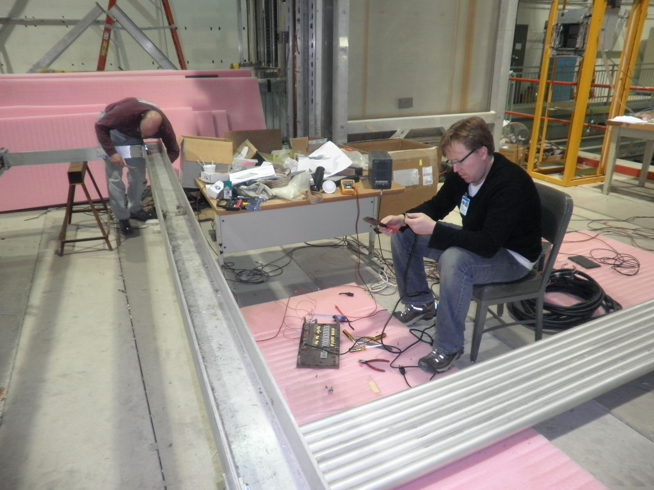
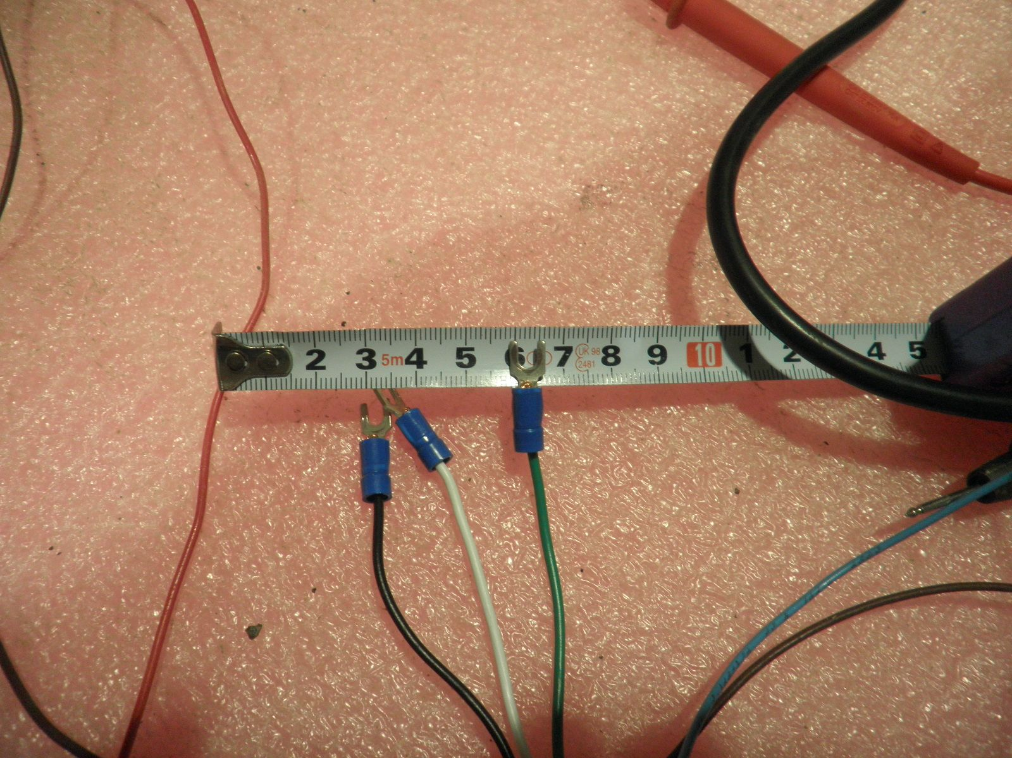
LV system (cont.)

Slide 15
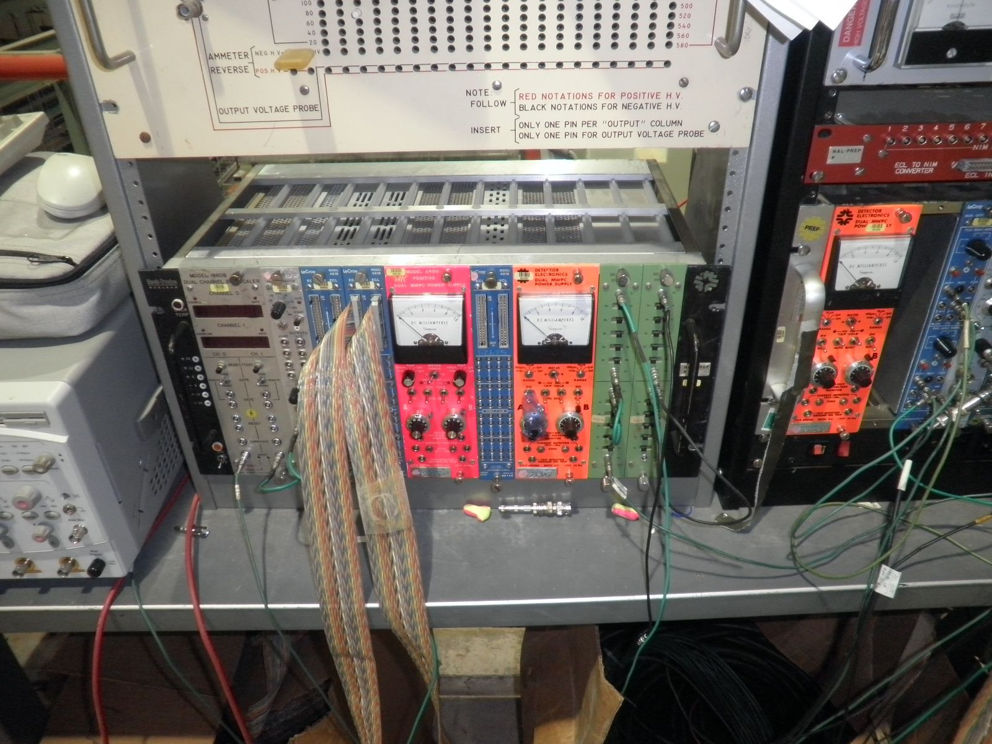
HV modules
36 channels
18 modules

Slide 16
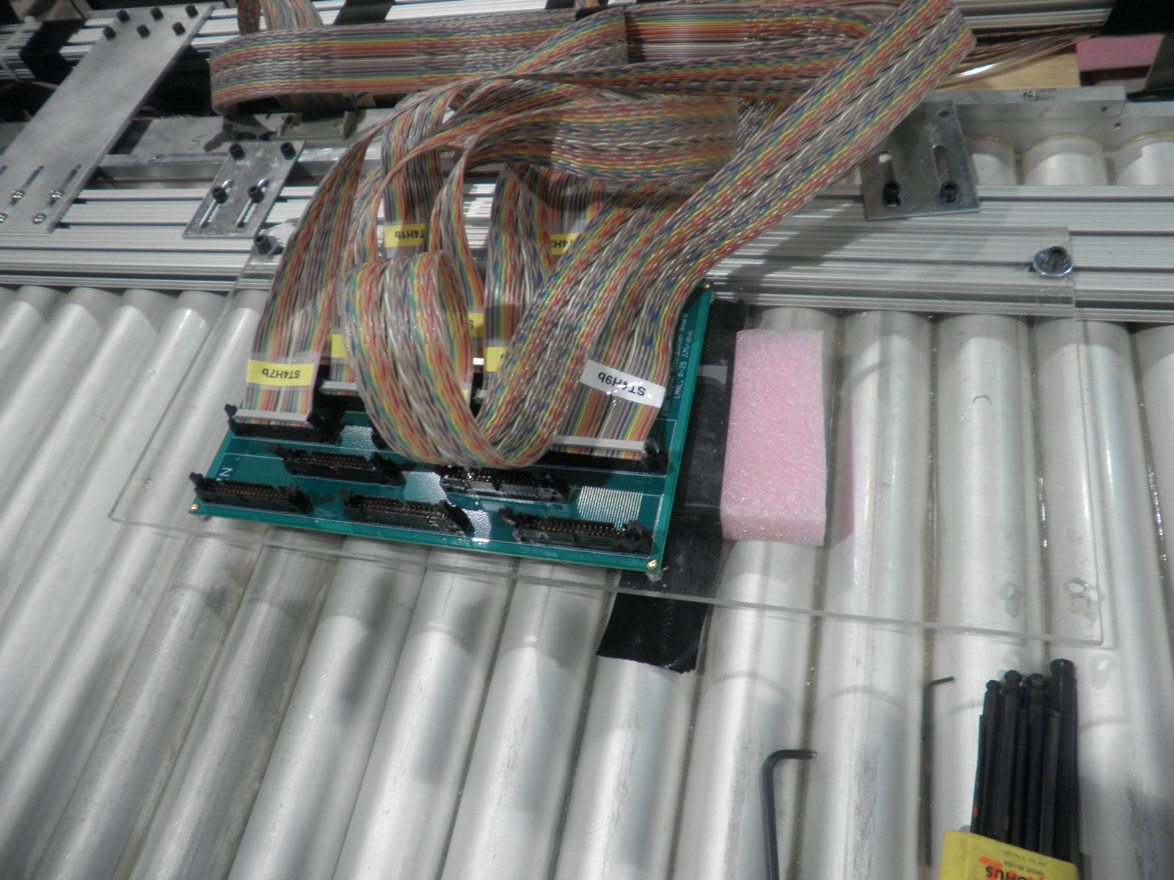
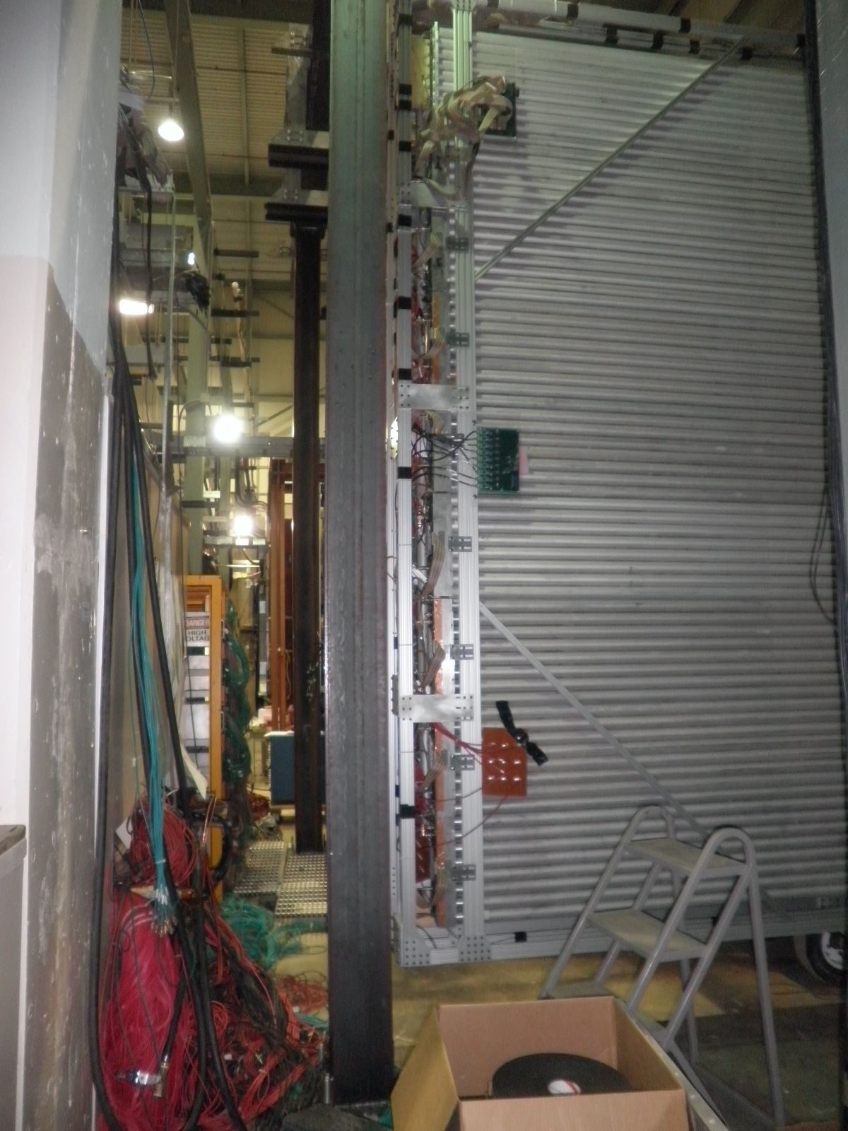
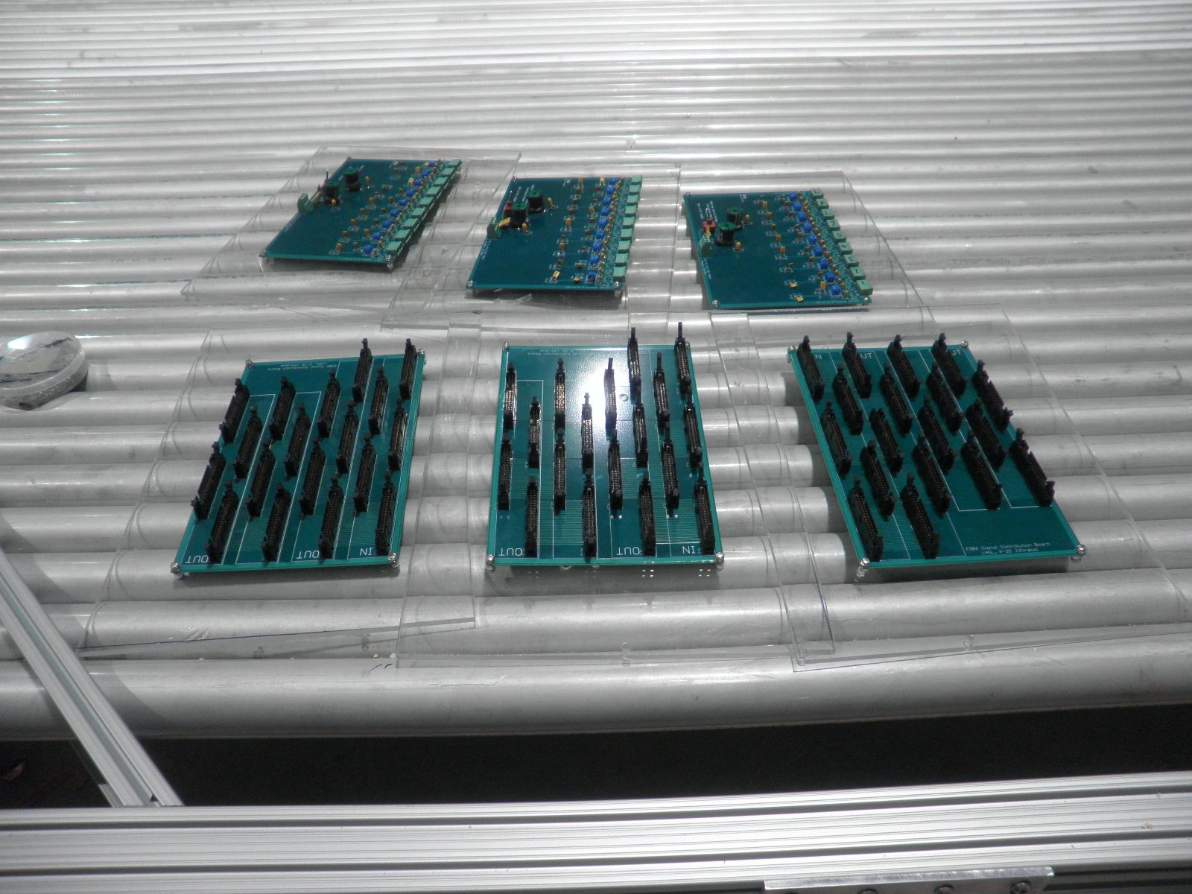
Patch panels
LVs, HV
ECL signals

Slide 17
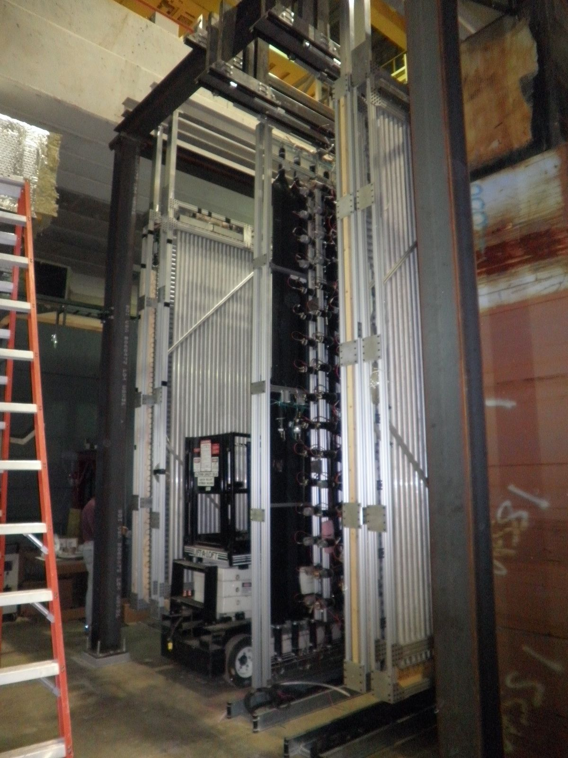
Station-4
Prop tubes
X1, Y1, X2, Y2
Hodoscopes
X, Y

Slide 18
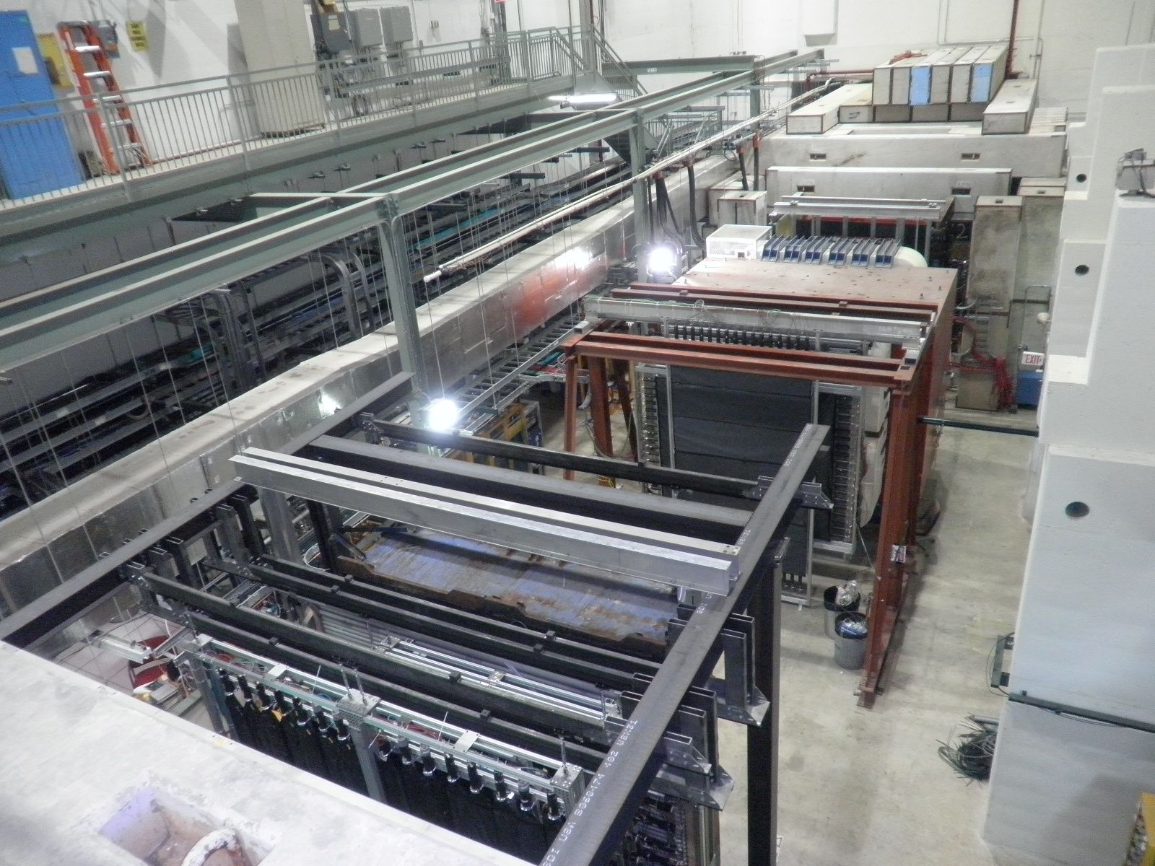
E906 as of 3/4/2011

Slide 19
To do list
LV system
PS: Delta 5V supplies from Fermilab, have 5 of them, not fully tested yet
need a minimal of 4 for (X1Y1) and (X2Y2), but can use more if available
Need some small connectors for master LV cables, cable to PS
Long/gauge-8 (?) LV master cables are recycled from previous LANL Exp.
HV system
Have 2 modules right now, a total of 4 HV channels, good for one channel per plane
Like to have 16 more
Independent HV channel for each module
Long HV cables recycled from precious Fermilab Exp.
ECL cables to TDC boards
Need to make 36 ECL cables, length TBD
Cables from previous Fermilab Exp.
Gas:
to be worked on by DaveN.
D0 muon gas?
Ar/Co2 for cosmic ray?

Slide 20
Many Thanks to …
E906 collaboration and particularly people
@ Fermilab:
Chuck, Paul, Tom, Kevin, Dave Christian, Dave Northack, Kaz, Grass, Ting, Donald and more…
@ LANL:
Walt, John, Mat, Andrew Green, Jackie and Jose and more
E906 members from LANL

