Slide 1
Quark Energy Loss in p+A Collisions
Benchmark Energy Loss Models with Drell-Yan
Kun Liu
(presented by Ming Liu)
Los Alamos National Lab
For Fermilab E906/SeaQuest Collaboration

Slide 2
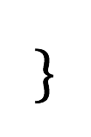
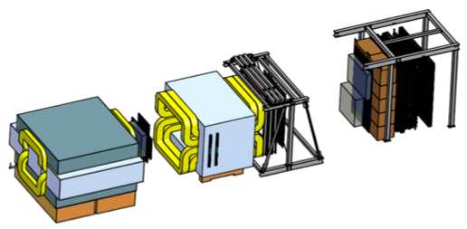
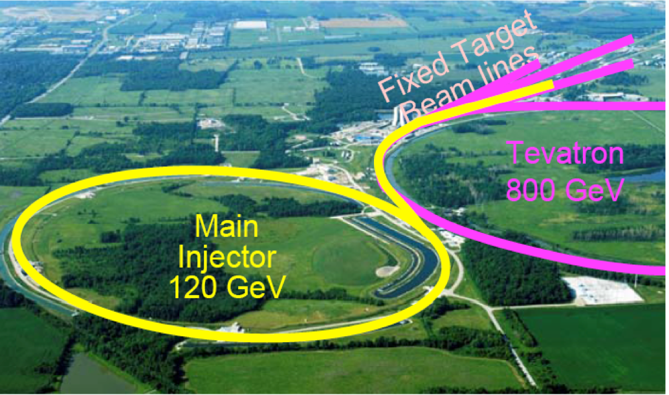
E906/SeaQuest Dimuon Experiment at Fermilab
Aimed at measuring dimuon production in Drell-Yan process and J/ψ decay
Absorber wall and proportional
tube based Muon ID
Spectrometer magnet
Δpt = 0.4 GeV
Focusing magnet
and solid iron dump
Δpt = 2.9 GeV
Beam
120 GeV proton from Main Injector
19ns RF, 5s spill, 1×10¹³ protons per spill
25 m
Target system
Liquid H and D
Solid C, Fe, W
Tracking detectors
Drift chambers and
hodoscope scintillators

Slide 3
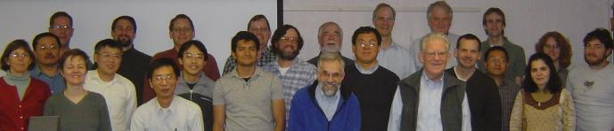
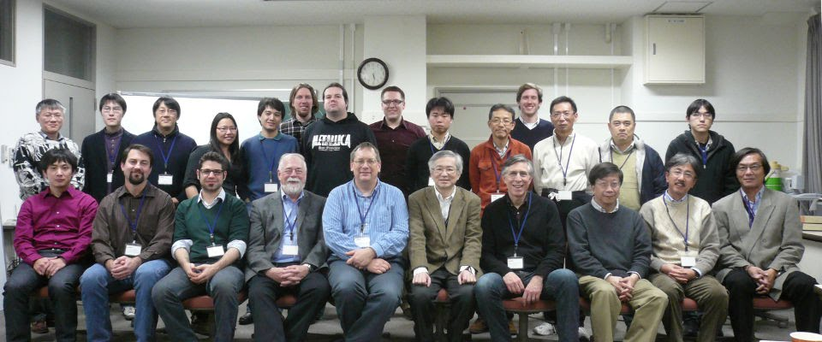
E906/SeaQuest Collaboration
p+A
q, g
2009 @ Los Alamos
2013 @Tokyo Tech

Slide 4
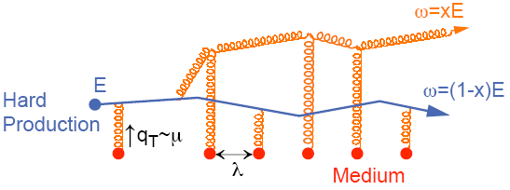
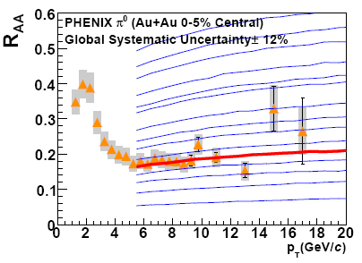
Do We Understand Jet Quenching at RHIC and LHC ?
Energy loss of partons from hard scattering through re-scattering in the hot & dense medium
  nuclear modification factor R_{AA} << 1 at high p_{T}
  Access medium properties through statistical analysis
example: transport coefficient
Very much model dependent
Single Hadron Tomography
jet
g
A. Adare et al., PRC 77(2008)064907
g
T
T
g
PQM
One of the key questions
in Heavy Ion today
→

Slide 5

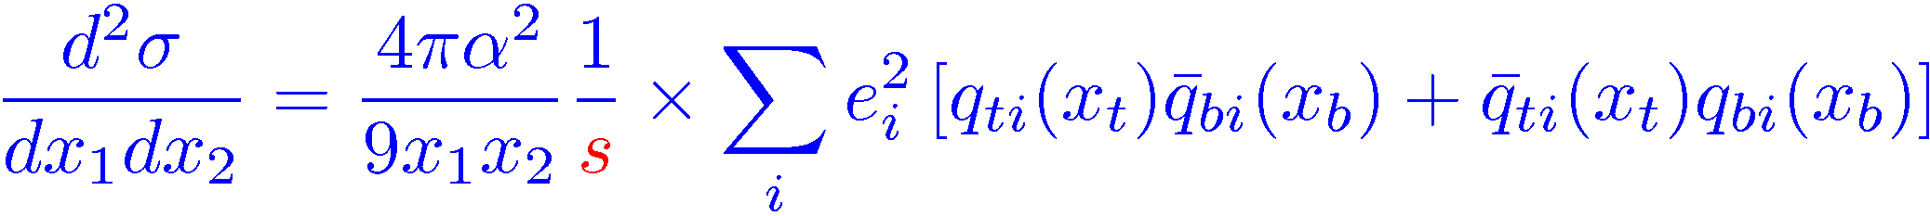

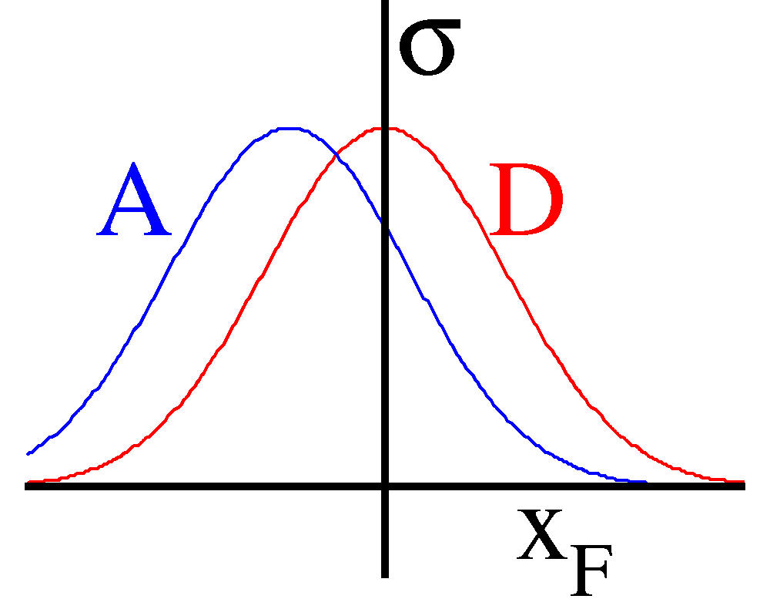
Initial-State Energy Loss and Drell-Yan in p+A
Benchmark Quark Energy Loss Models
Minimal final-state interactions
Known nuclear matter
q, g
Radiative dE/dx
p
Collisional dE/dx
X_{F} =x₁ –x₂

Slide 6
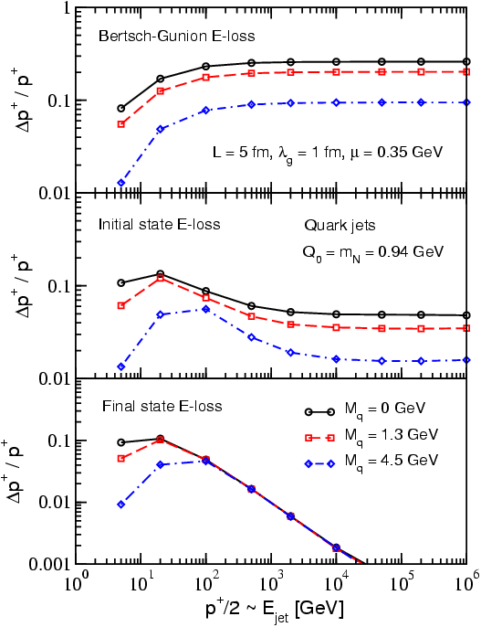
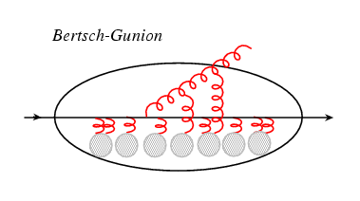
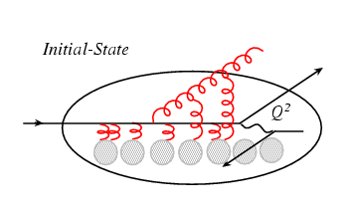
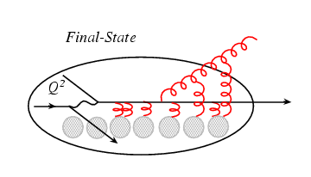
The Expectations
Think of the parton (quark) energy in the
nuclear rest frame:
I. Vitev PRC 75, 064906 (2007)
Ideal QGP
Drell-Yan: p+A
DIS: e+A
Initial-state E-loss is large and much larger than final-state energy loss for cold nuclei
RHIC
E906
In Drell-Yan we don’t have final-state interactions

Slide 7
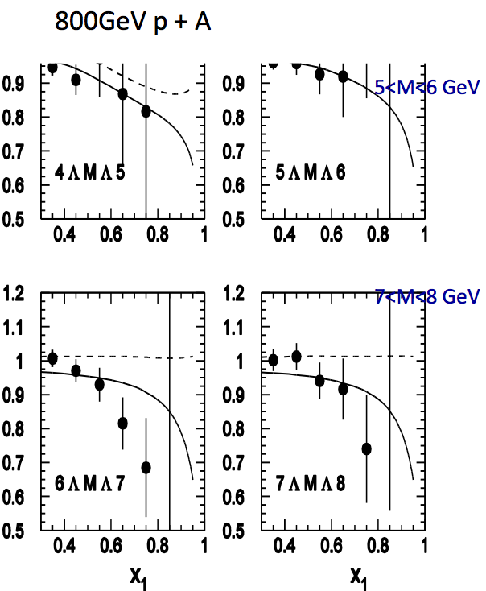
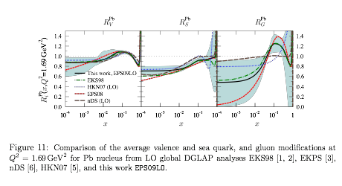
Early Data from E866 @Fermilab
(Drell-Yan, 800 GeV p+A)
q, g
Energy loss vs shadowing
  Correction must be made for shadowing effects, x₂ < 0.05
    Garvey & Peng PRL 90 (2003)
  NO partonic energy loss if all effects from shadowing
    Vasiliev et al., PRL 83,(1999)
  Significant parton energy loss, ~1.2GeV/fm if all from energy loss
    Johnson et al.
    Phys. Rev. C 65, 025203 (2002)
arXiv:0802.0139
Both yield 20~30% effects in R_{pA}

Slide 8
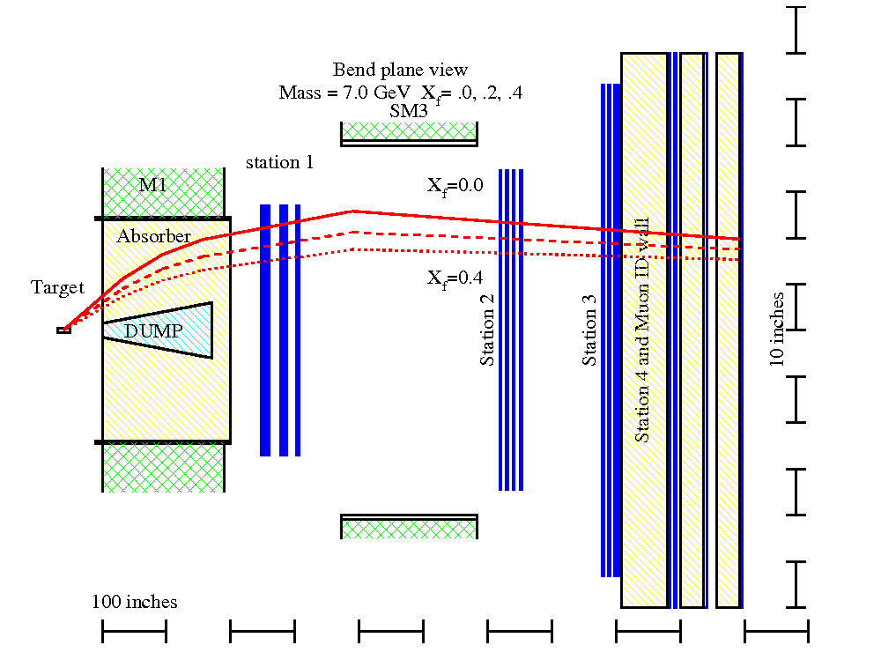
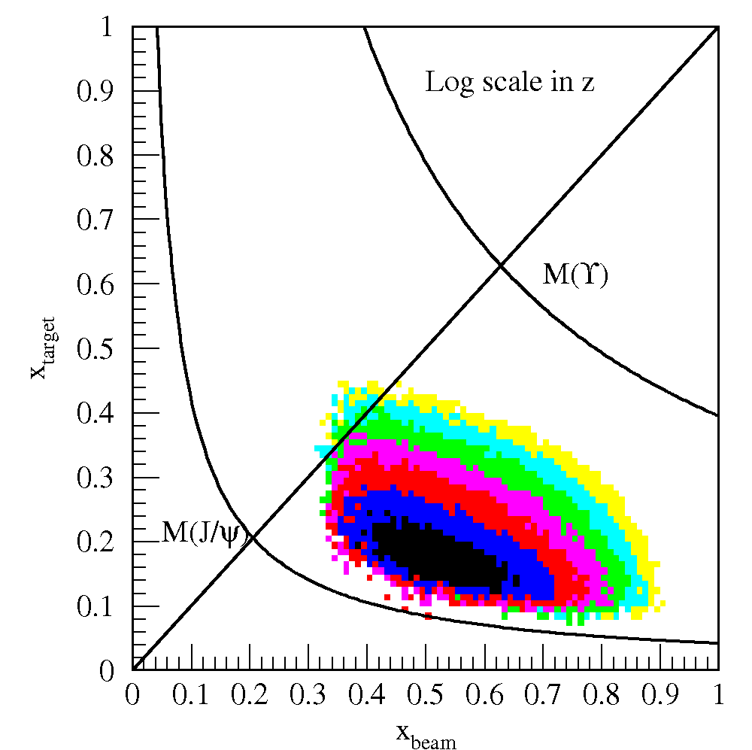
E906 Drell-Yan Dimuon Acceptance
120GeV proton beam from Main Injector
Fixed p, d, and other A-targets (C, Fe, W …)
sea quark x = 0.1 ~ 0.3
minimal shadowing

Slide 9
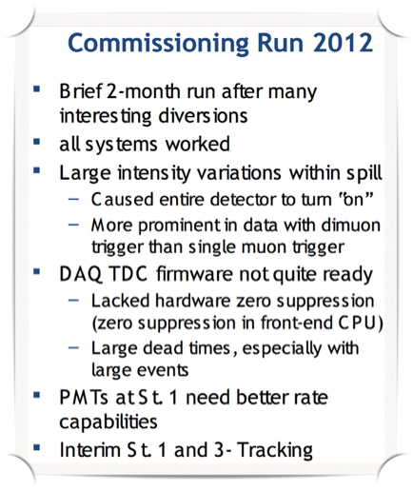
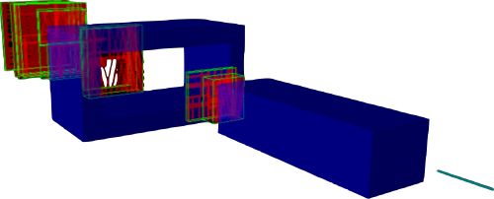
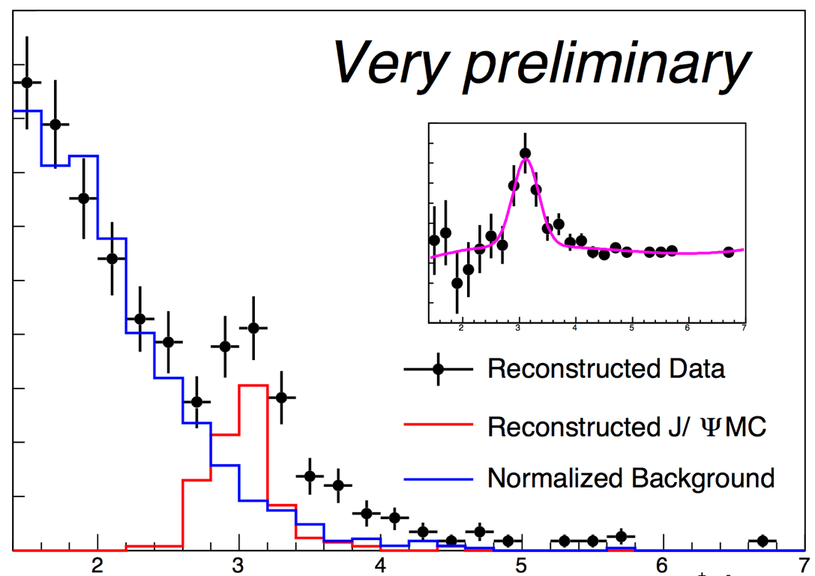
E906/SeaQuest Run-I
Online Event Display
J/Psi
Most problems fixed/improved;
A new year-long run will start next week!
M(µ⁺µ⁻) (GeV)

Slide 10
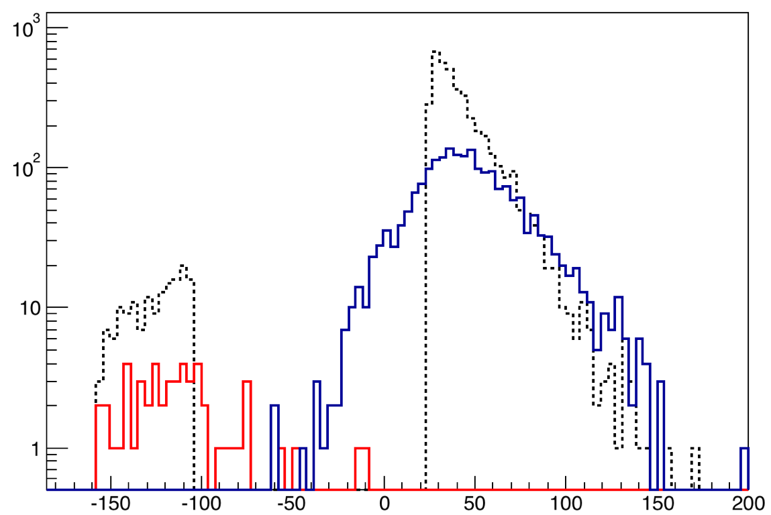
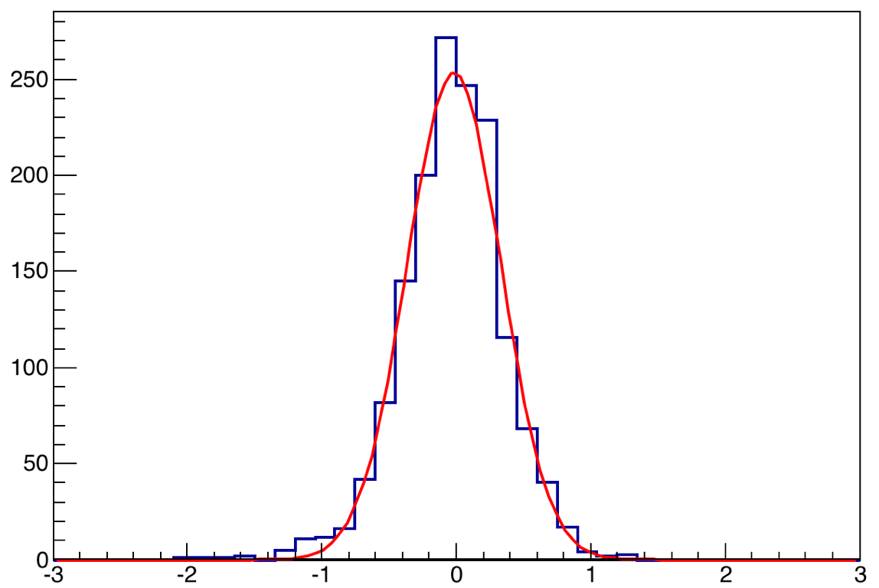
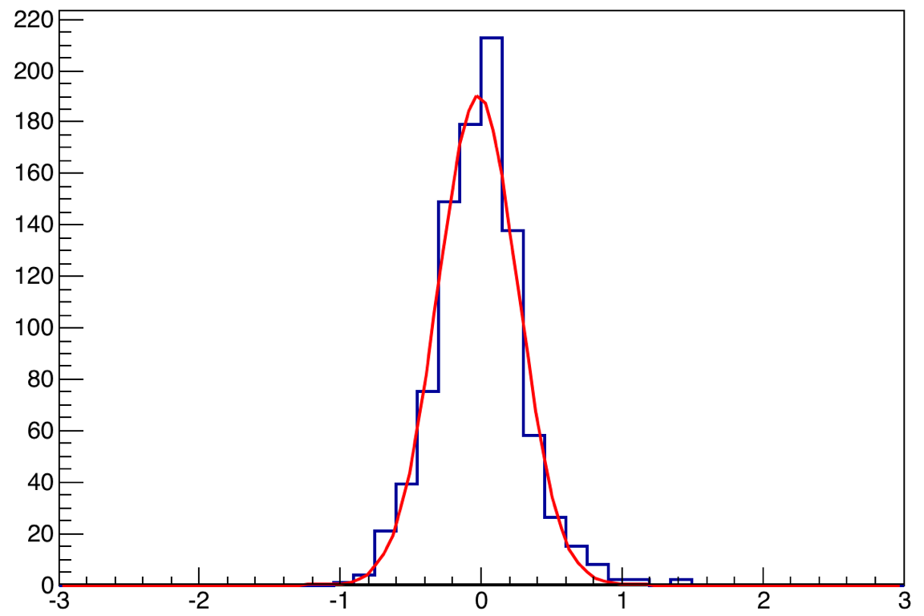
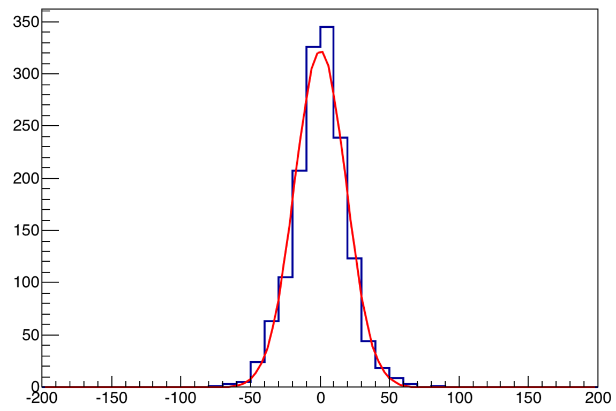
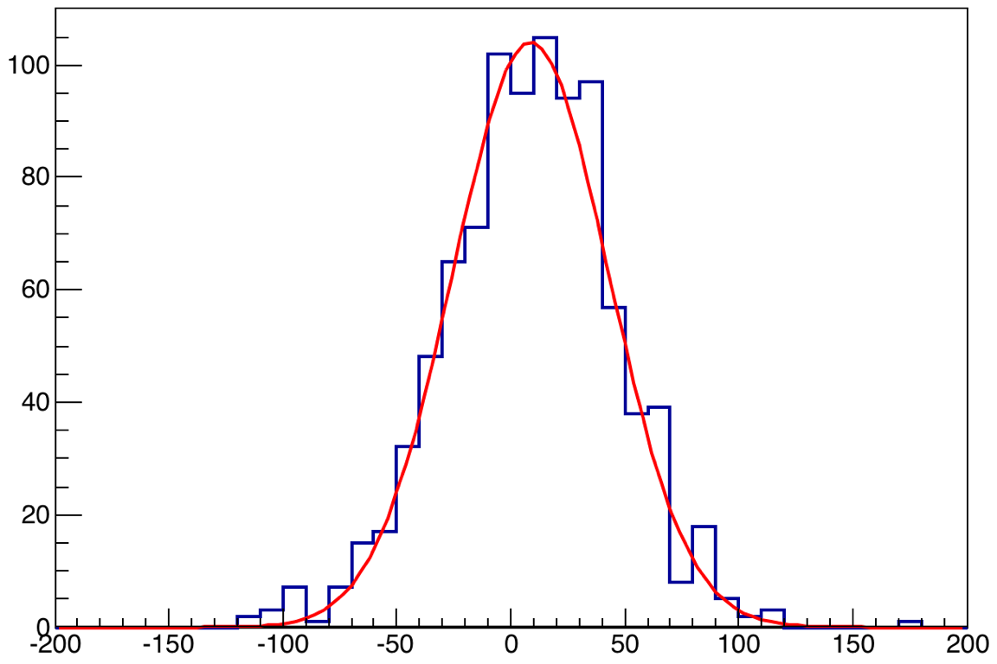
Mass/Vertex Resolution and Target/Dump Separation (MC)
MC generated
Dump reconstructed
Target reconstructed
M(µ+µ-) = 3.097 GeV
M(µ+µ-) > 4 GeV
ΔZ
σ ~ 34 cm
ΔZ
σ ~ 18 cm
Target-A
ΔM
ΔM
σ ~ 350 MeV
σ ~ 280 MeV
- Good target/dump separation for high mass DY events
- Work in progress

Slide 11
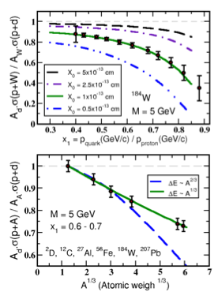

Summary and Outlook:
First unambiguous determination at E906
Run-II start next week!
The fractional energy loss effect greatly amplified since it scales with 1/s
Kinematic range well above shadowing region
E906 will achieve sensitivity of ~ 20%
Clearly distinguish between the leading models of L-dependence of E-loss
  -dE ∝ A^{1/3} (or ∝ L)
  -dE ∝ A^{2/3} (or ∝ L²)
DNP 2014
11

Slide 12
backup

Slide 13
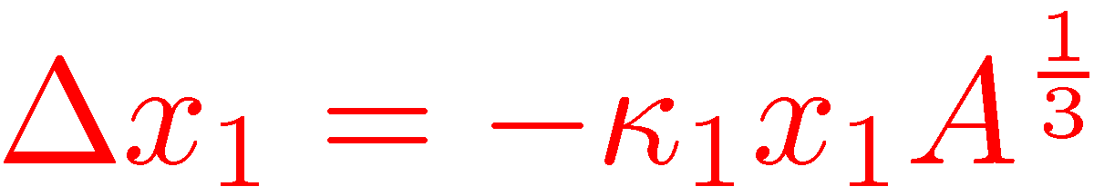
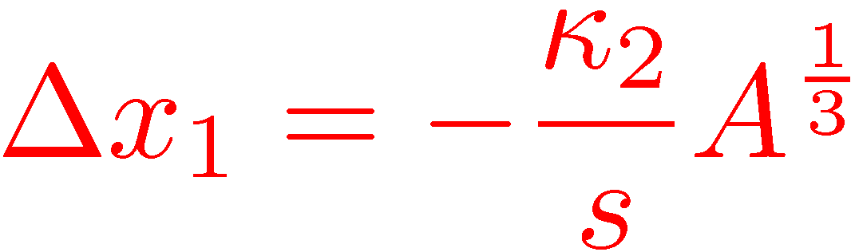
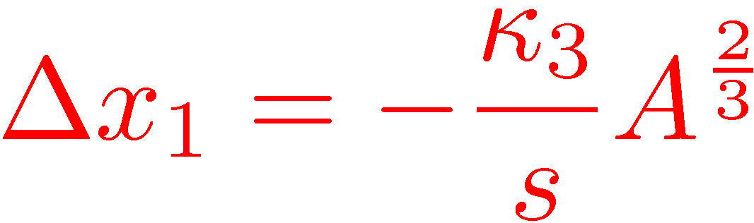
First direct measurement of dE/dx from p+A @E906
High energy parton energy loss
  parton initial energy E= 10~100 GeV
  Relevant to RHIC and LHC parton energy
  Provides direct test of various parton energy loss models
Models:
  Galvin and Milana
  Brodsky and Hoyer
  Baier et al.

Slide 14
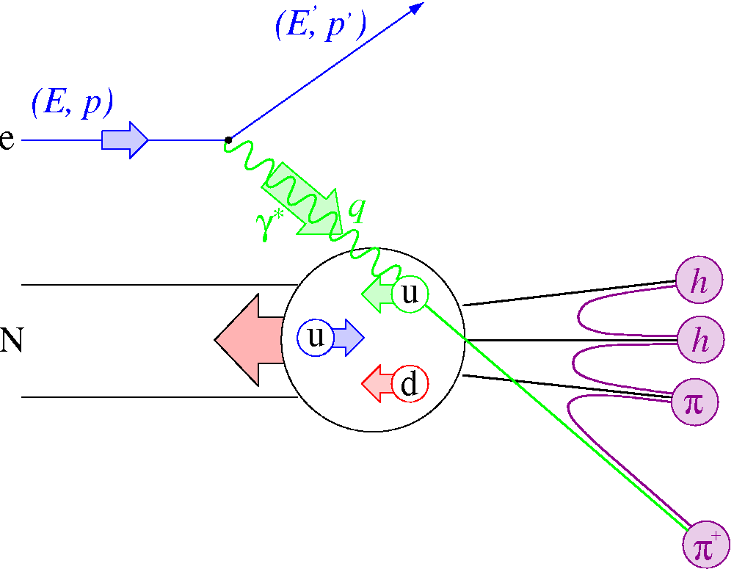
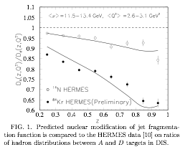
Parton Energy Loss in SIDIS
Out going quarks
  HERMES A-dep Fragmentation Functions
  Must understand nuclear–dependent fragmentation
  Wang & Wang
    Assume all from quark energy loss
    dE/dx = 0.5 GeV/fm
    @E =10 GeV for Au.
Wang & Wang PRL 89 (2002) 162301

