Slide 1
Quark Energy Loss in p+A Collisions Benchmark Energy Loss Models with Drell-Yan
Kun Liu
(presented by Ming Liu)
Los Alamos National Lab
For Fermilab E906/SeaQuest Collaboration

Slide 2
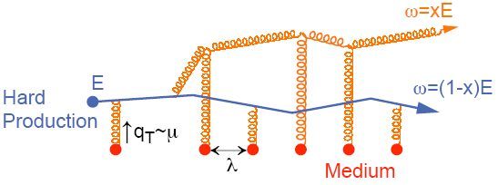
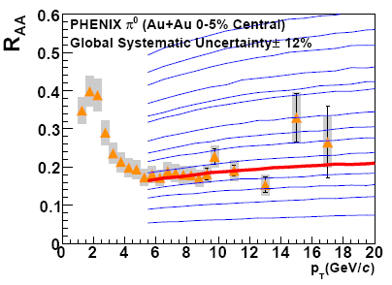
Do We Understand Jet Quenching at RHIC and LHC ?
Energy loss of partons from hard scattering through re-scattering in the hot & dense medium
nuclear modification factor R_{AA} << 1 at high p_{T}
Access medium properties through statistical analysis
example: transport coefficient
Very much model dependent
Single Hadron Tomography
jet
g
A. Adare et al., PRC 77(2008)064907
g
T
T
g
PQM
One of the key
questions in HI today
→

Slide 3
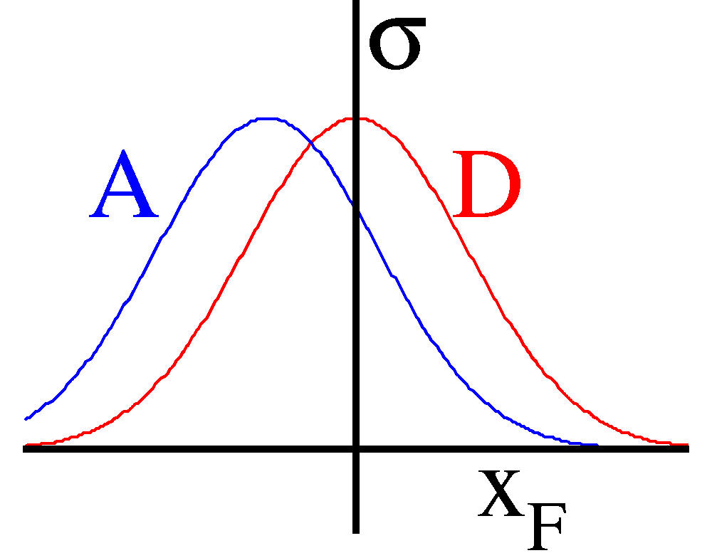
Drell-Yan and Initial-State Energy Loss in p+A Benchmark Energy Loss Calculations
(Drell-Yan Process)
Minimal final-state interactions
q, g
Radiative dE/dx
p
Collisional dE/dx
X_{F} =x₁ –x₂

Slide 4
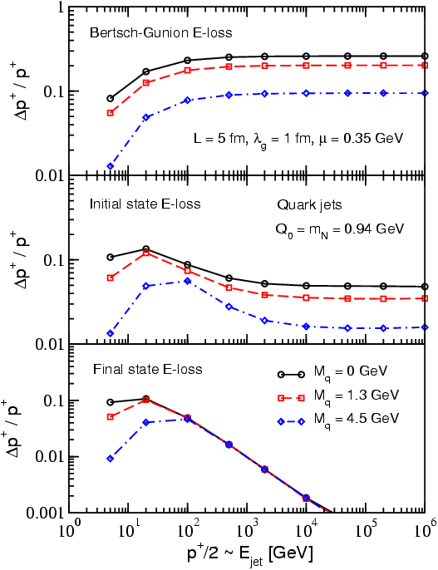
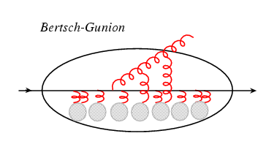
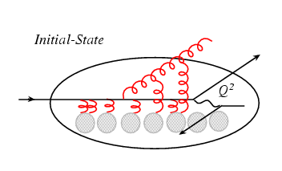
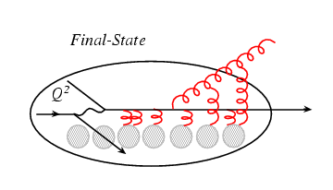
Model Calculations of in Parton Energy Loss
Think of the parton (quark) energy in the
nuclear rest frame:
I. Vitev PRC 75, 064906 (2007)
Ideal QGP
Drell-Yan: p+A
DIS: e+A
Initial-state E-loss is large and much larger than final-state energy loss for cold nuclei
RHIC
E906
In Drell-Yan we don’t have final-state interactions

Slide 5
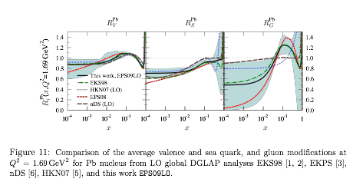
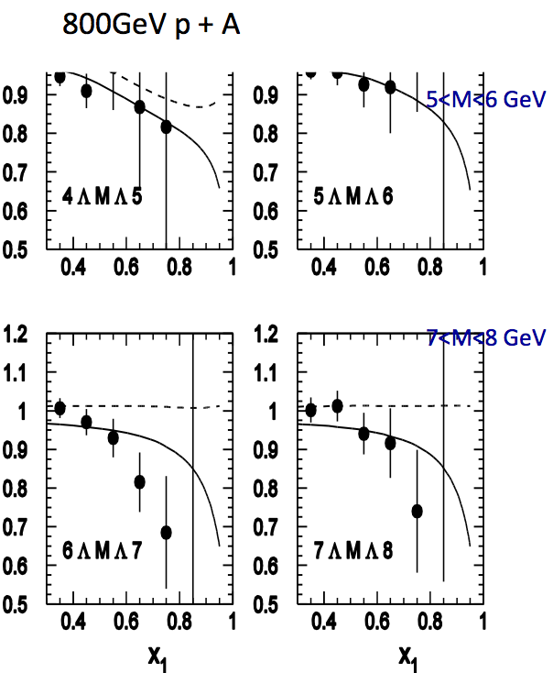
Early Data from E866 @Fermilab (Drell-Yan, 800GeV p+A)
q, g
Energy loss vs shadowing
Correction must be made for shadowing effects, x₂ < 0.05
Garvey & Peng PRL 90 (2003)
NO partonic energy loss if all effects from shadowing
Vasiliev et al., PRL 83,(1999)
Significant parton energy loss, ~1.2GeV/fm if all from energy loss
Johnson et al.
Phys. Rev. C 65, 025203 (2002)
arXiv:0802.0139
Both have 20~30% effects in R_{pA}

Slide 6
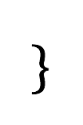
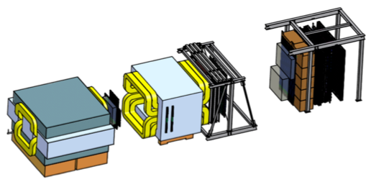
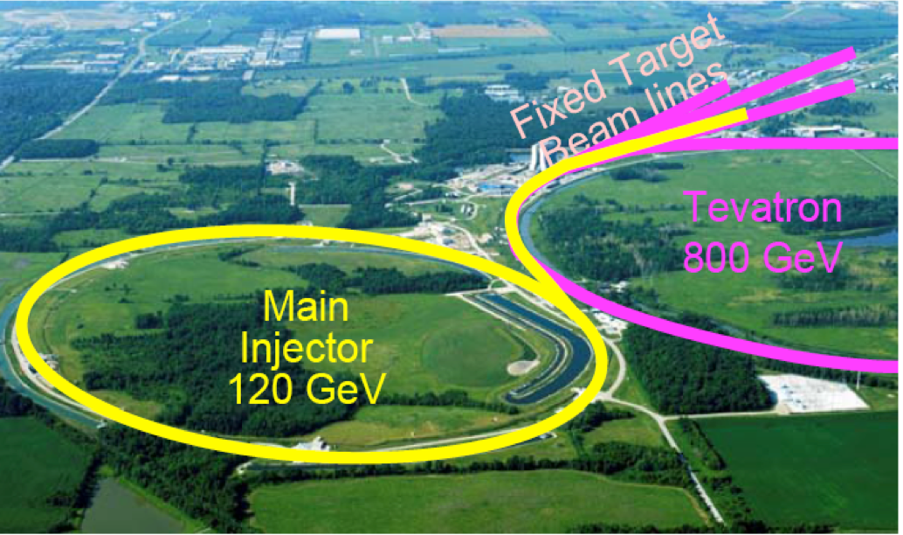
E906/SeaQuest Experiment at Fermilab
Aimed at measuring dimuon production in Drell-Yan process and J/ψ decay
Absorber wall and proportional
tube based Muon ID
Spectrometer magnet
Δpt = 0.4 GeV
Focusing magnet
and solid iron dump
Δpt = 2.9 GeV
Beam
120 GeV proton from Main Injector
19ns RF, 5s spill, 1×10¹³ protons per spill
25 m
Target system
Liquid H and D
Solid C, Fe, W
Tracking detectors
Drift chambers and
hodoscope scintillators

Slide 7
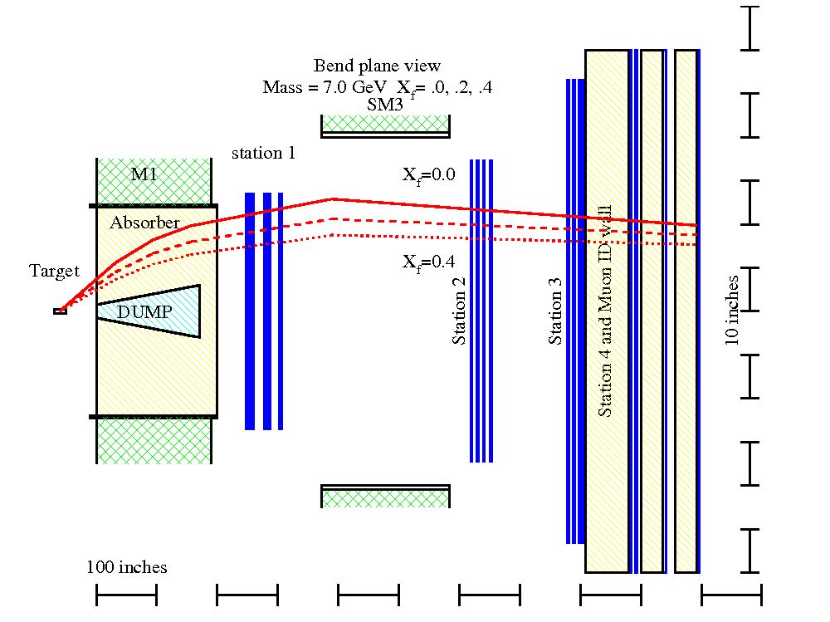
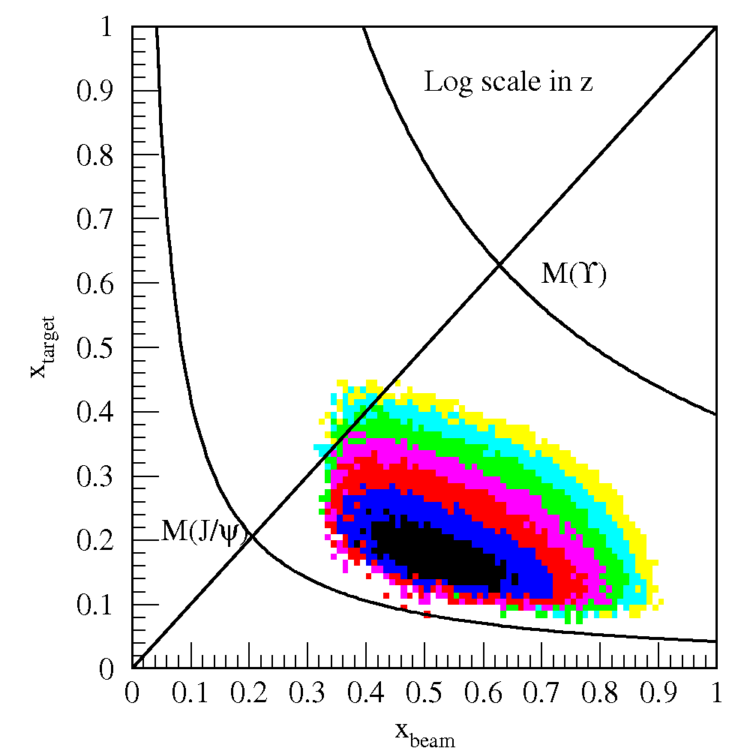
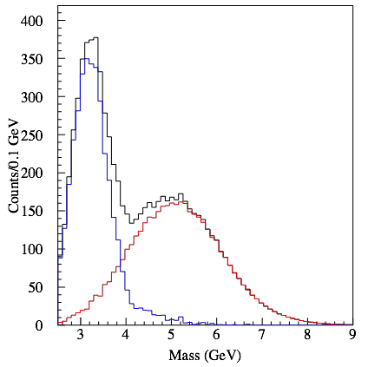
E906 Dimuon Acceptance
120GeV proton beam from Main Injector
Fixed p, d, and other A-targets (C, Fe, W …)
First Engineering run 2012
Run-II starts next week 10/2013
J/Psi
MC:
dimuons
DY

Slide 8
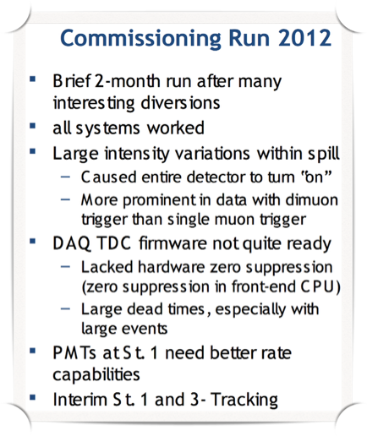
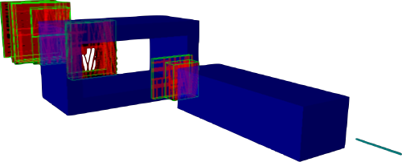
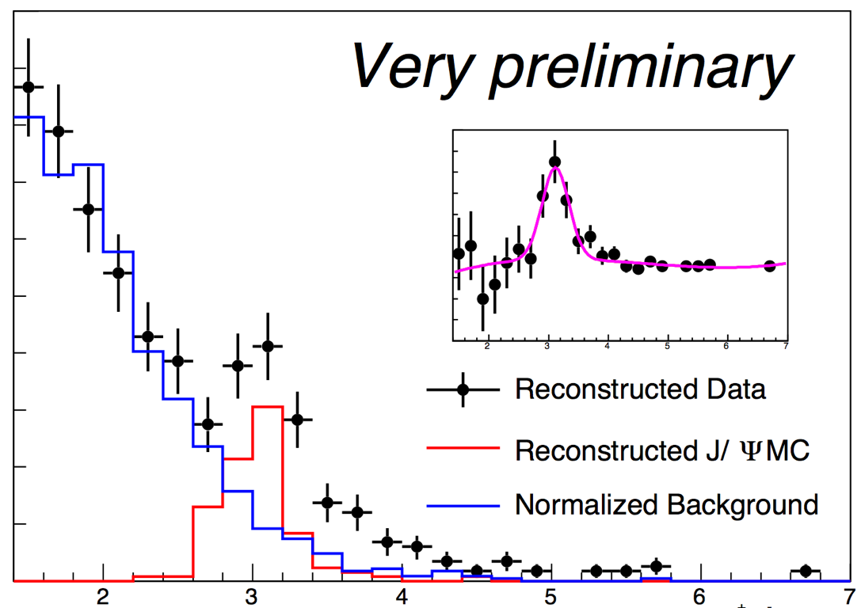
E906/SeaQuest Run-I (Engineering Run)
Online Event Display
J/Psi
Most problems fixed/improved;
A new year-long run will start next week!
M(µ⁺µ⁻) (GeV)

Slide 9
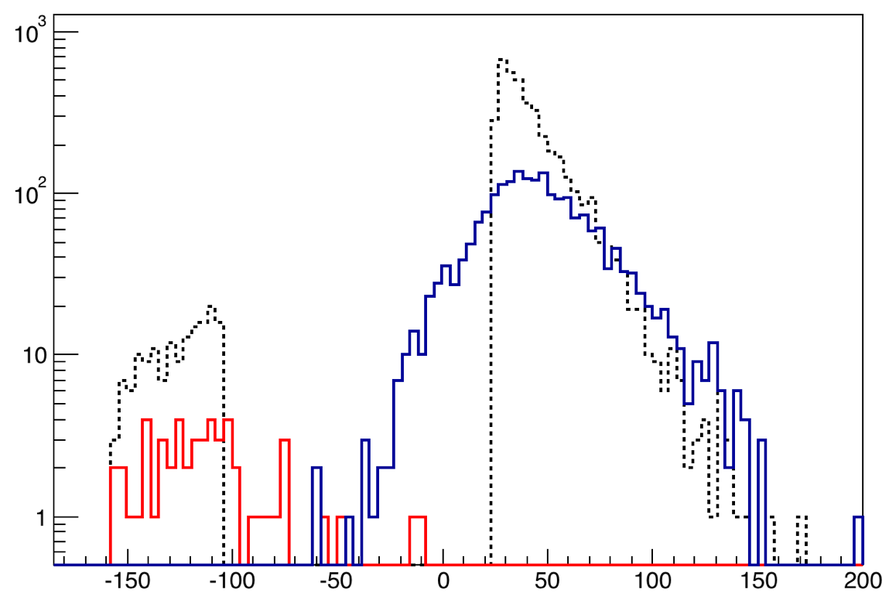
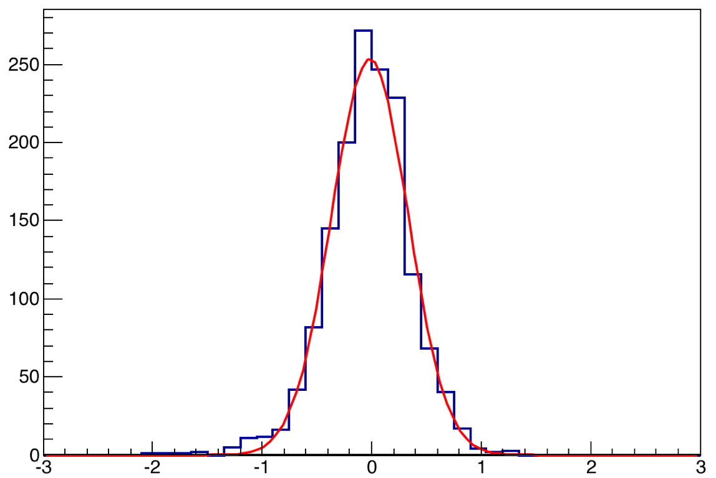
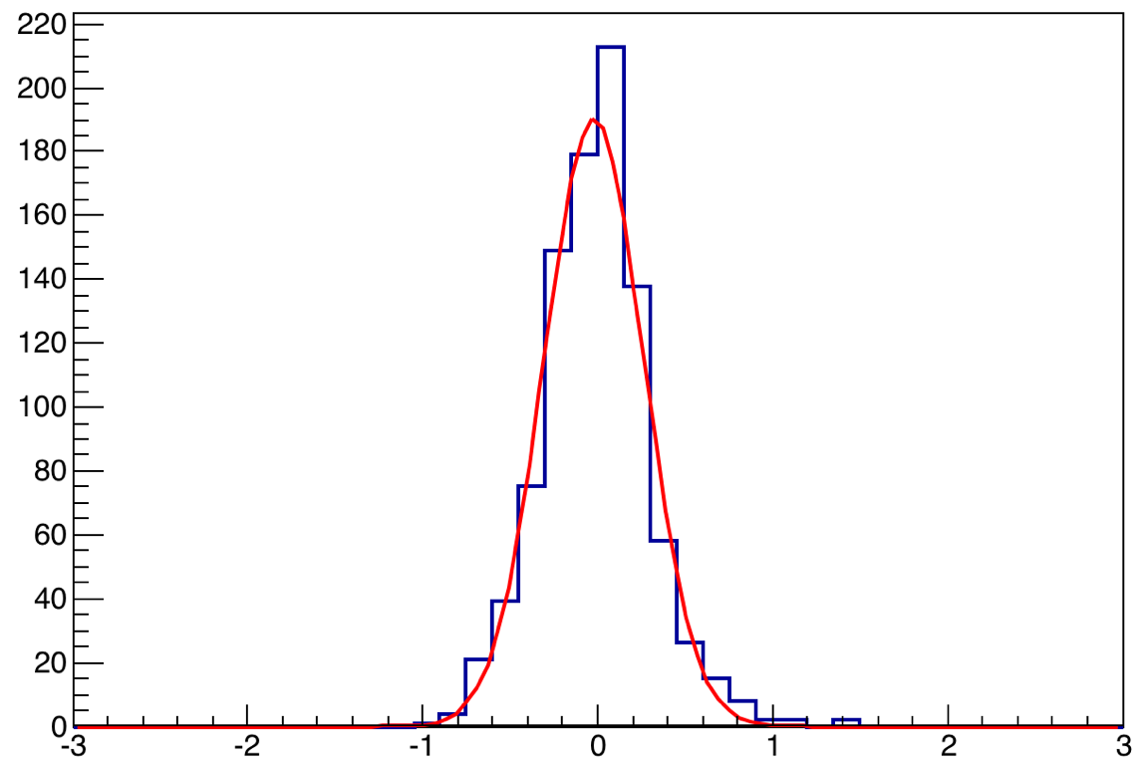
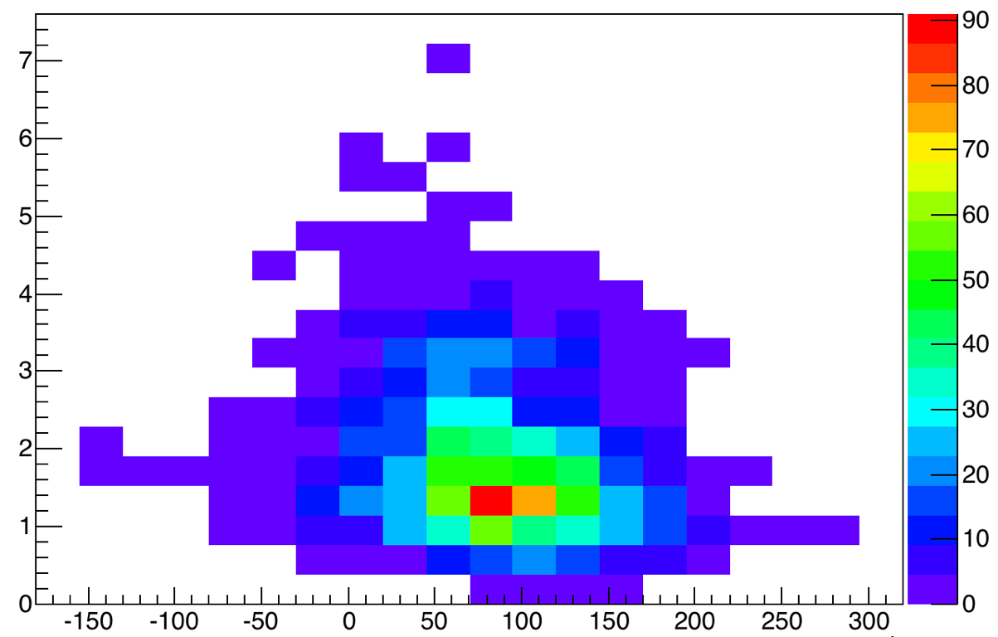
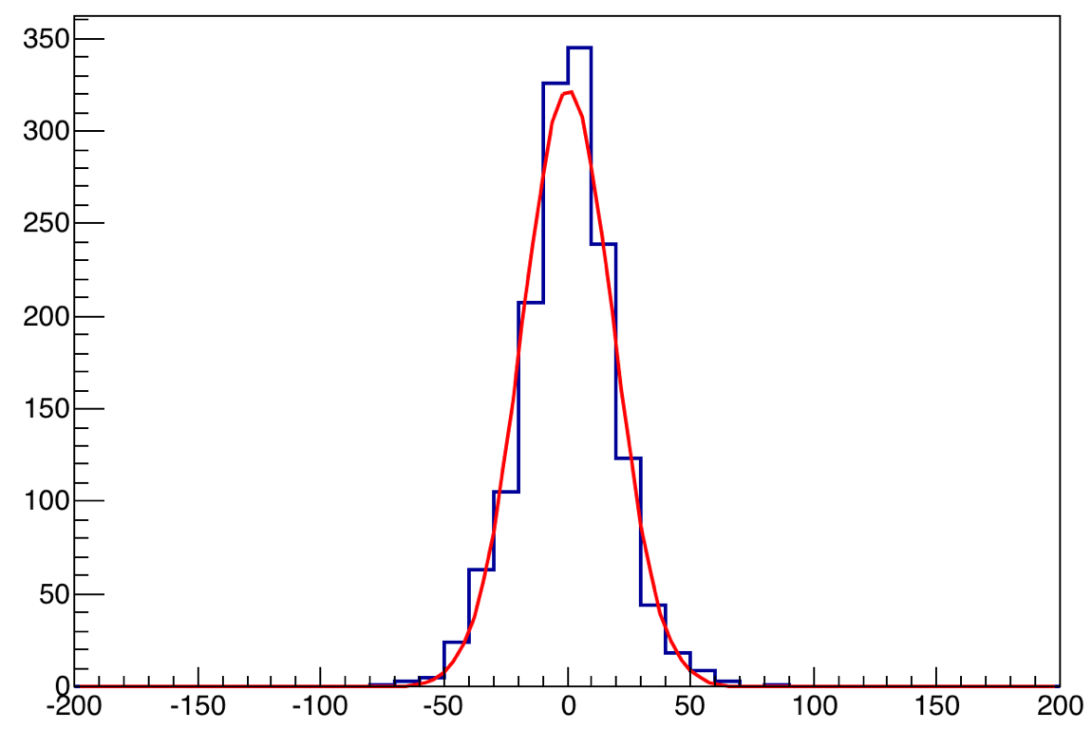
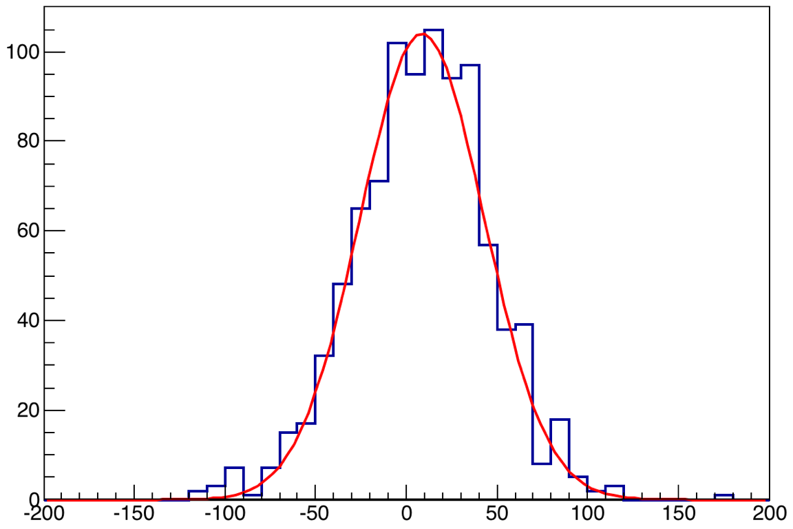
Mass/Vertex Resolution and Target/Dump Separation (MC)
MC generated
Dump reconstructed
Target reconstructed
M(µ+µ-) = 3.097 GeV
M(µ+µ-) > 4 GeV
ΔZ
σ ~ 34 cm
ΔZ
σ ~ 18 cm
ΔM
ΔM
M(µ⁺µ⁻)
σ ~ 350 MeV
σ ~ 280 MeV
Good target/dump separation for high mass DY
Work in progress
Z(µ⁺µ⁻) (cm)

Slide 10
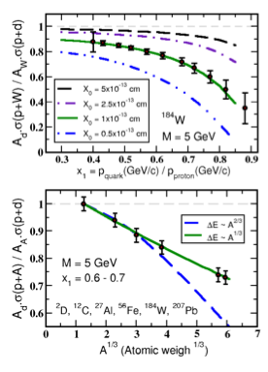
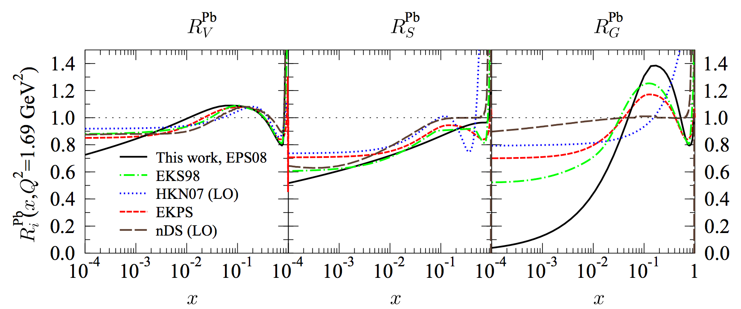
Summary and Outlook: First unambiguous determination at E906
Run-II start next week!
The fractional energy loss effect greatly amplified since it scales with 1/s
Kinematic range well above shadowing region
E906 will achieve sensitivity of ~ 20%
Clearly distinguish between the leading models of L-dependence of E-loss (5σ effect)
-dE ∝ A^{1/3} (or ∝ L)
-dE ∝ A^{2/3} (or ∝ L²)
arXiv: 0802.0139
E906
E866
10

Slide 11
backup

Slide 12
First direct measurement of dE/dx from p+A @E906
High energy parton energy loss
parton initial energy E= 10~100 GeV
Relevant to RHIC and LHC parton energy
Provides direct test of various parton energy loss models
Models:
Galvin and Milana
Brodsky and Hoyer
Baier et al.

Slide 13
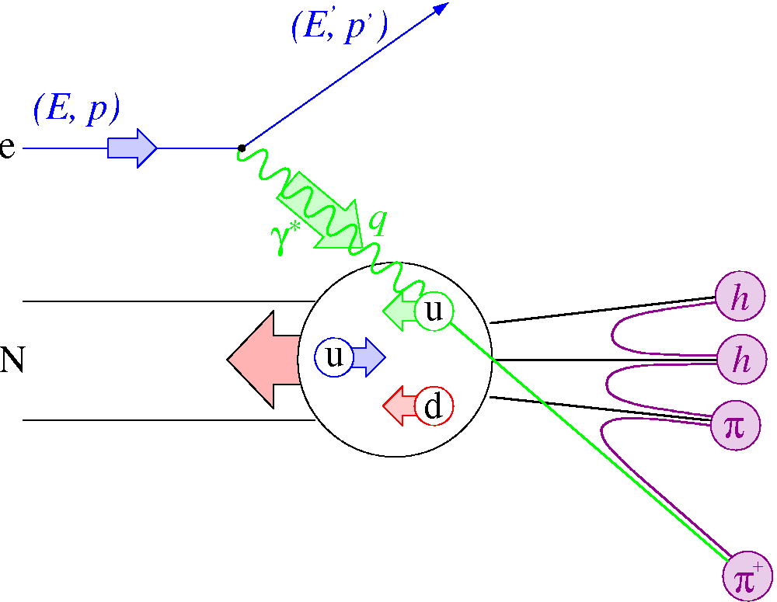
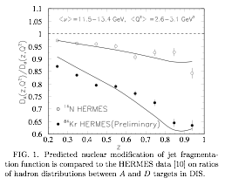
Parton Energy Loss in SIDIS
Out going quarks
HERMES A-dep Fragmentation Functions
Must understand nuclear–dependent fragmentation
Wang & Wang
Assume all from quark energy loss
dE/dx = 0.5 GeV/fm
@E =10 GeV for Au.
Wang & Wang PRL 89 (2002) 162301

