Slide 1
Quark Energy Loss in p+A Collisions Benchmark Energy Loss Model Calculations with Drell-Yan
Kun Liu, Ming Liu
Los Alamos National Lab
(Fermilab E906/SeaQuest Collaboration)

Slide 2
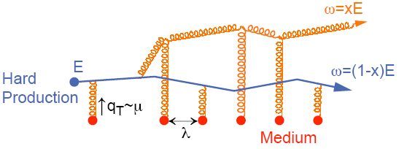
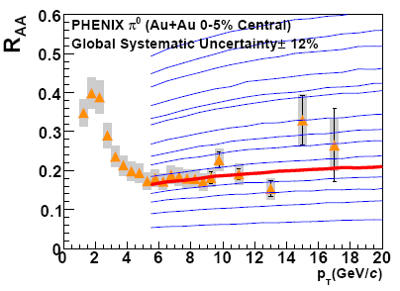
Do We Understand Jet Quenching at RHIC and LHC ?
Energy loss of partons from hard scattering through re-scattering in the hot & dense medium
nuclear modification factor R_{AA} << 1 at high p_{T}
Access medium properties through statistical analysis
example: transport coefficient
Very much model dependent
Single Hadron Tomography
jet
g
A. Adare et al., PRC 77(2008)064907
g
T
T
g
PQM
→

Slide 3
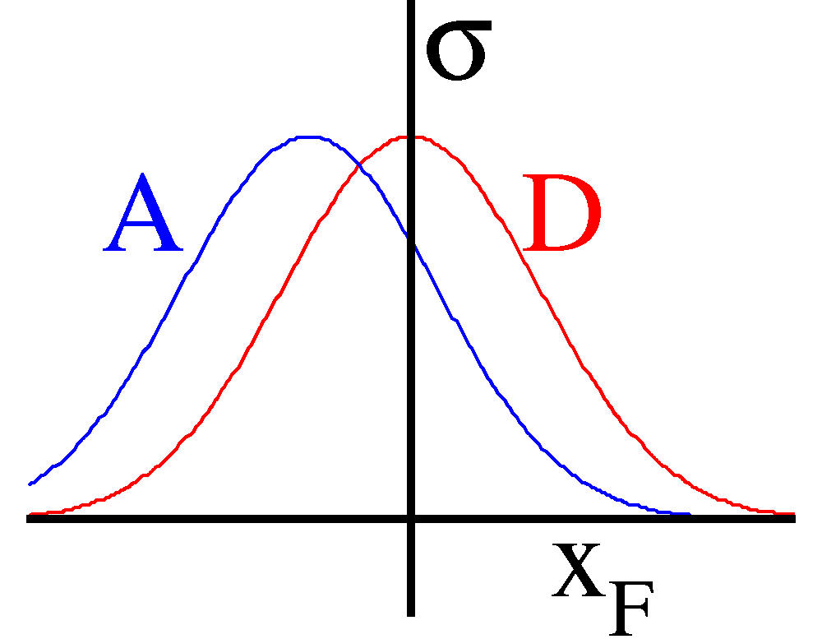
The Idea of Initial-State Energy Loss in p+A Benchmark Energy Loss Calculations
(Drell-Yan Process)
Minimal final-state interactions of the detected particles.
q, g
Radiative dE/dx
Collisional dE/dx

Slide 4
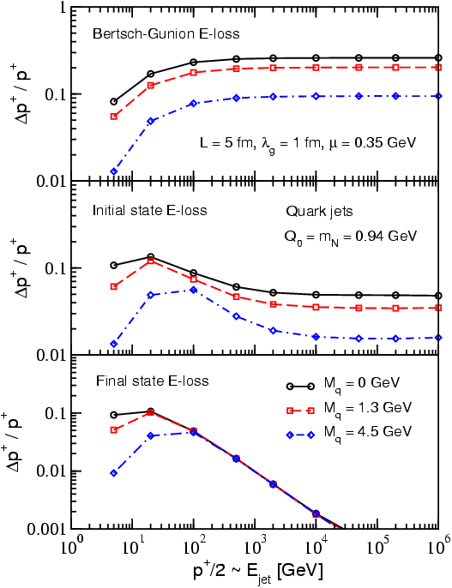
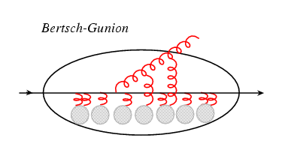
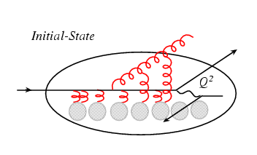
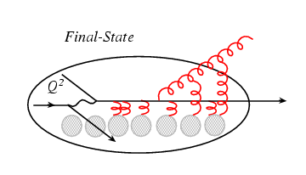
Model Calculations of in Parton Energy Loss
Think of the parton (quark) energy in the
nuclear rest frame:
I. Vitev PRC 75, 064906 (2007)
Ideal QGP
Drell-Yan: p+A
DIS: e+A
Initial-state E-loss is large and much larger than final-state energy loss for cold nuclei
RHIC
E906
In Drell-Yan we don’t have final-state interactions

Slide 5
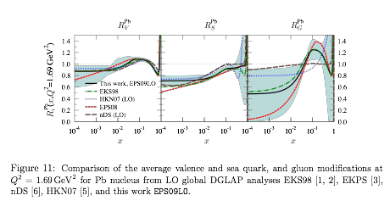
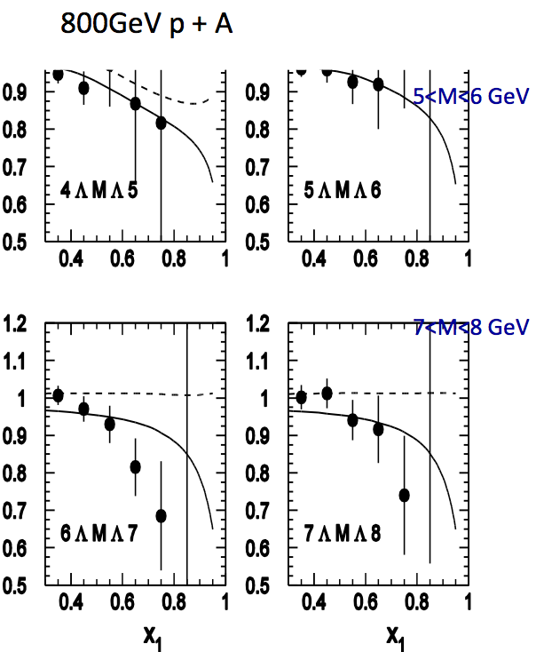
Early Data from E866 @Fermilab (Drell-Yan, 800GeV p+A)
q, g
Energy loss vs shadowing
Correction must be made for shadowing effects, x₂ < 0.05
Garvey & Peng PRL 90 (2003)
NO partonic energy loss if all effects from shadowing
Vasiliev et al., PRL 83,(1999)
Significant parton energy loss, 1.2GeV/fm if all from energy loss
Johnson et al.
Phys. Rev. C 65, 025203 (2002).
arXiv:0802.0139

Slide 6
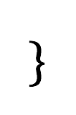
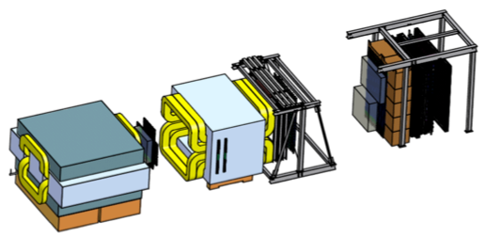
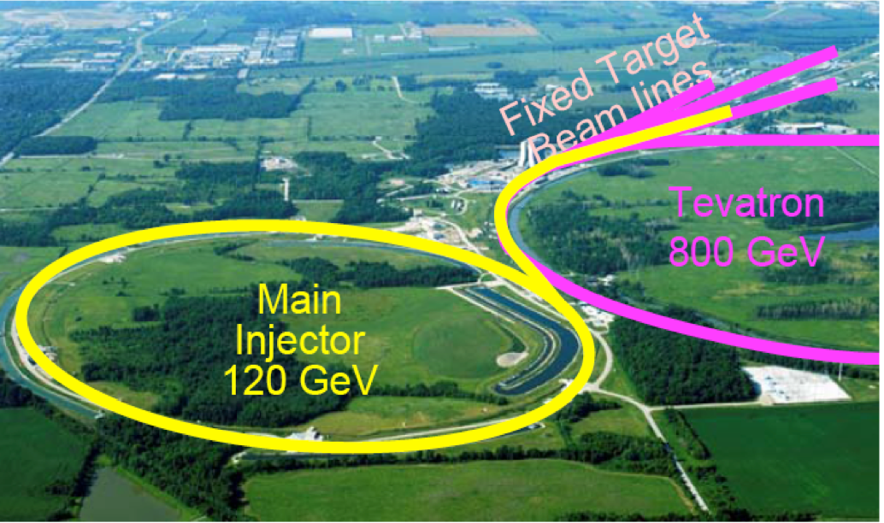
E906/SeaQuest Experiment at Fermilab
Aimed at measuring dimuon production in Drell-Yan process and J/ψ decay
Absorber wall and proportional
tube based Muon ID
Spectrometer magnet
Δpt = 0.4 GeV
Focusing magnet
and solid iron dump
Δpt = 2.9 GeV
Beam
120 GeV proton from Main Injector
19ns RF, 5s spill, 1×10¹³ protons per spill
25 m
Target system
Liquid H and D
Solid C, Fe, W
Tracking detectors
Drift chambers and
hodoscope scintillators
6

Slide 7
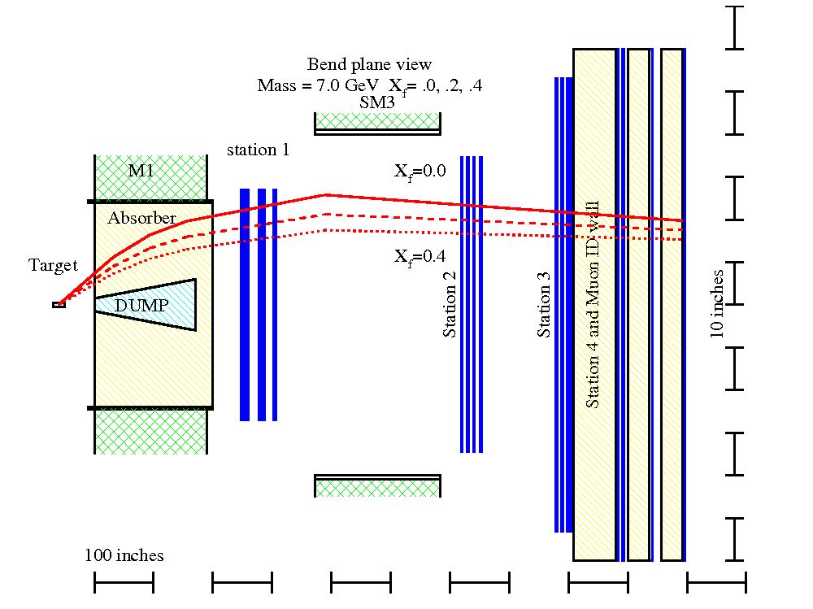
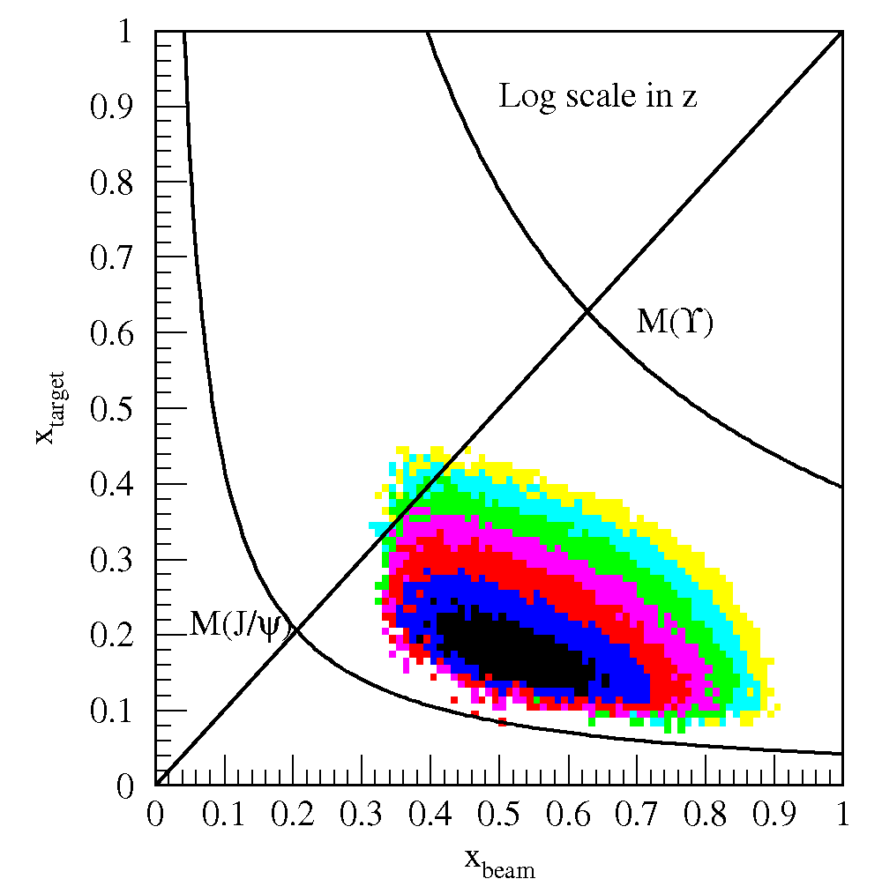
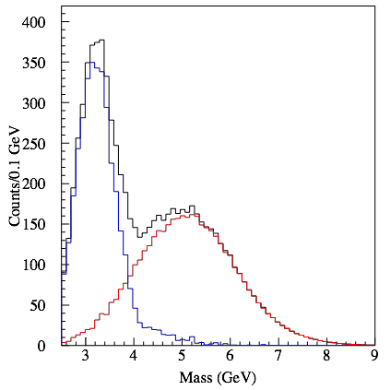
E906/SeaQuest Dimuon Drell-Yan @Fermilab
120GeV proton beam from Main Injector
p, d, and other A-targets
First Engineering run 2012
Run-II stats next week 10/2013
dimuons

Slide 8
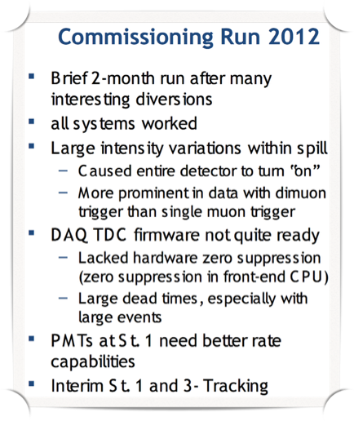
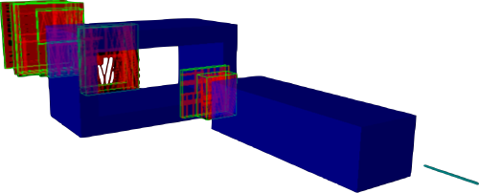
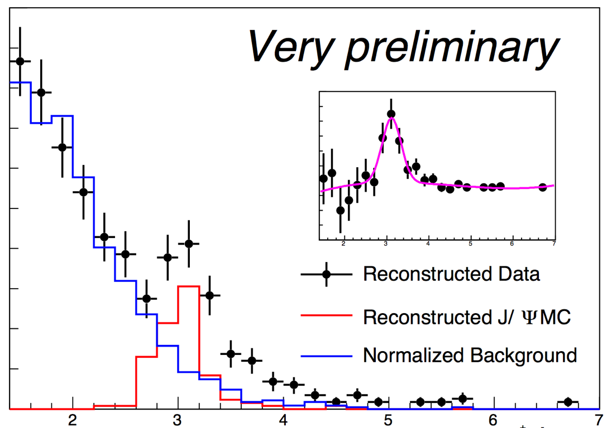
E906/SeaQuest Run-I (Engineering Run)
A new two-year run will start in next week!
M(µ⁺µ⁻) (GeV)
8

Slide 9
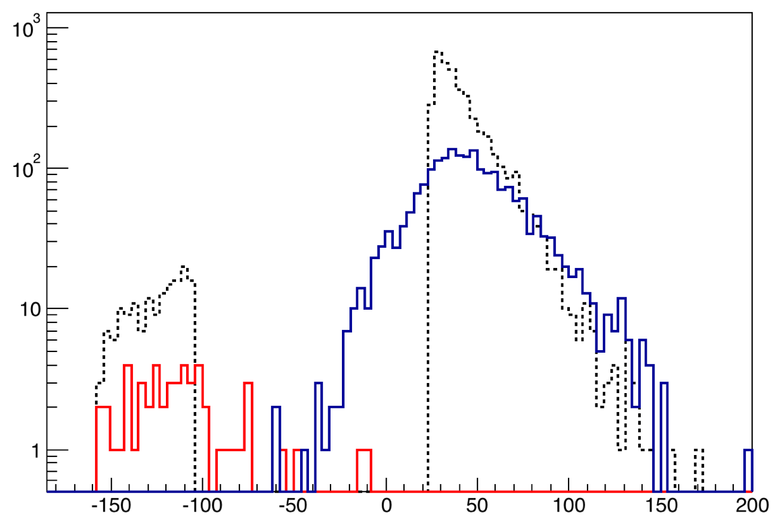
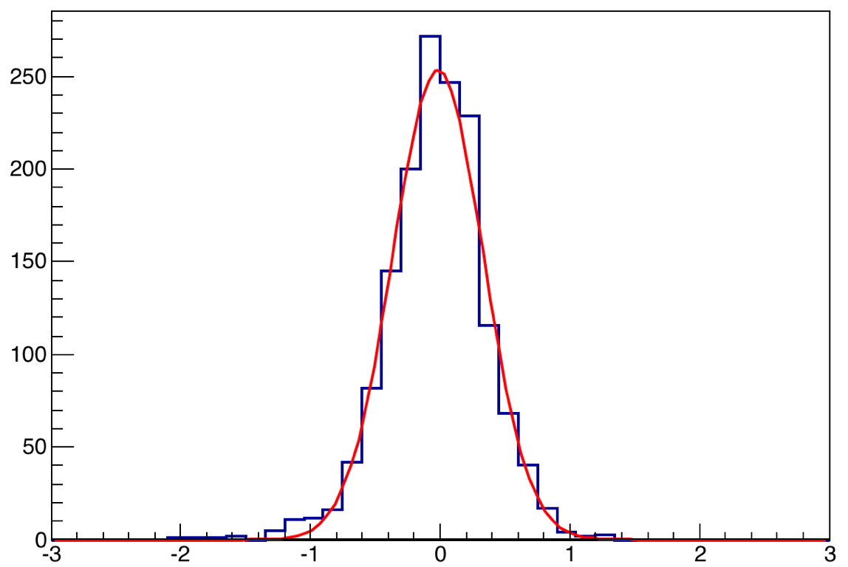
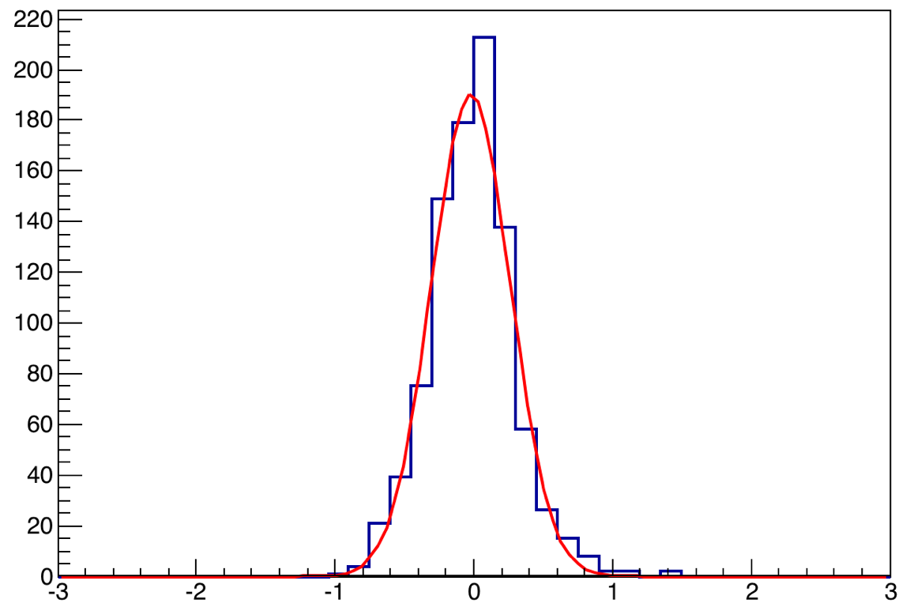
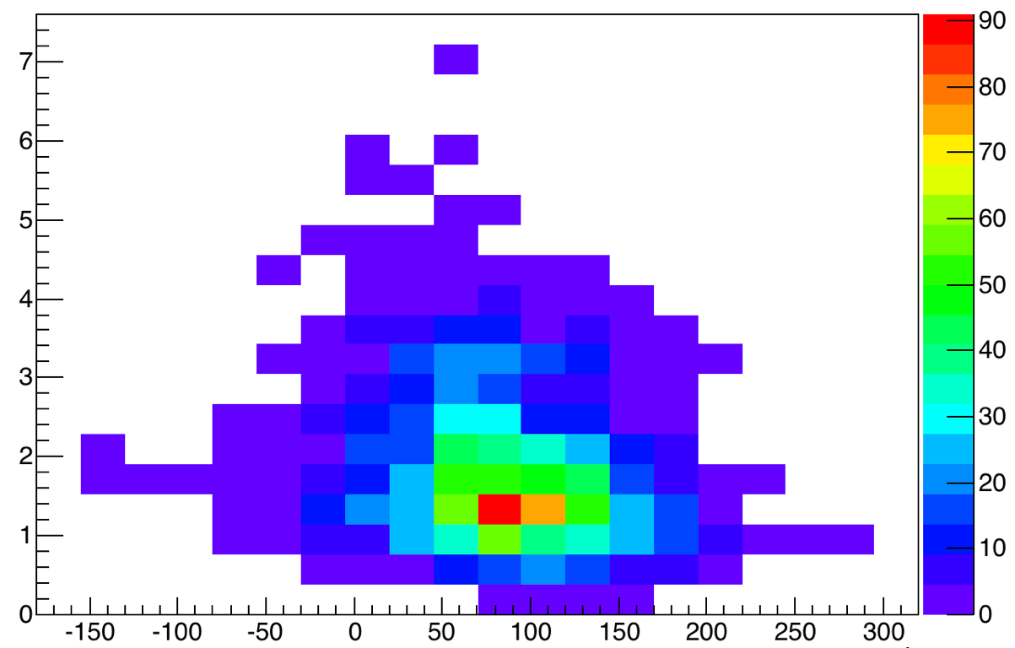
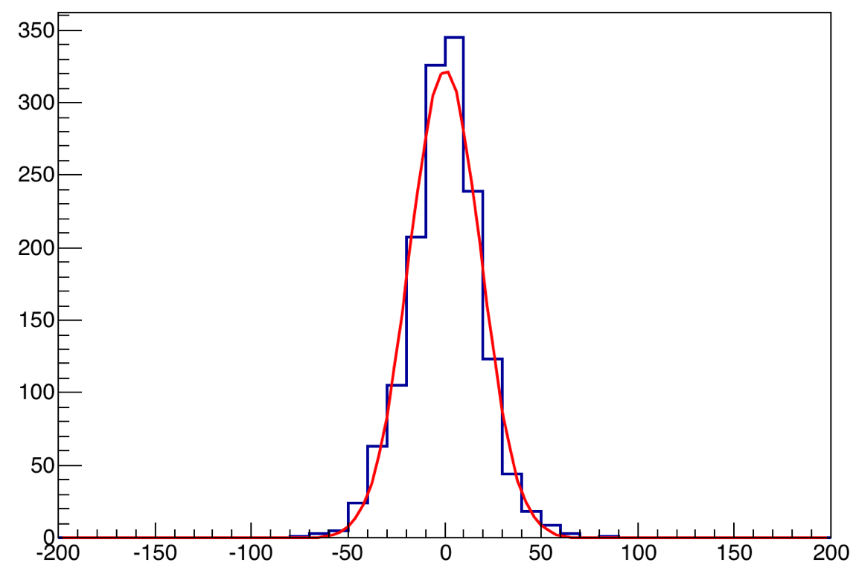
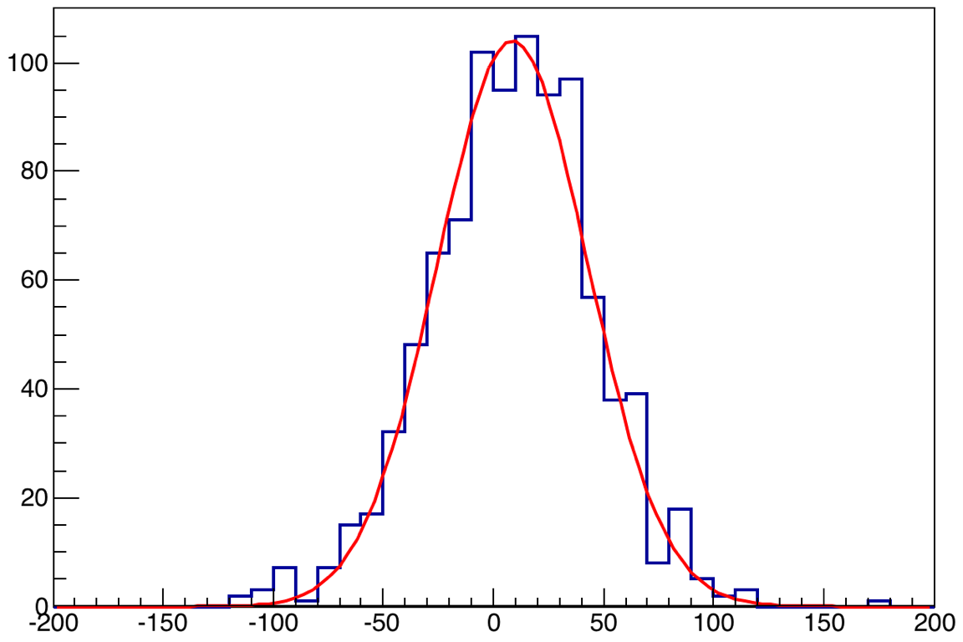
Mass/Vertex resolution and target/dump separation
MC generated
Dump reconstructed
Target reconstructed
M(µ+µ-) = 3.097 GeV
M(µ+µ-) > 4 GeV
ΔZ
σ ~ 34 cm
ΔZ
σ ~ 18 cm
M(µ⁺µ⁻)
ΔM
σ ~ 280 MeV
ΔM
σ ~ 350 MeV
Z(µ⁺µ⁻) (cm)
9

Slide 10
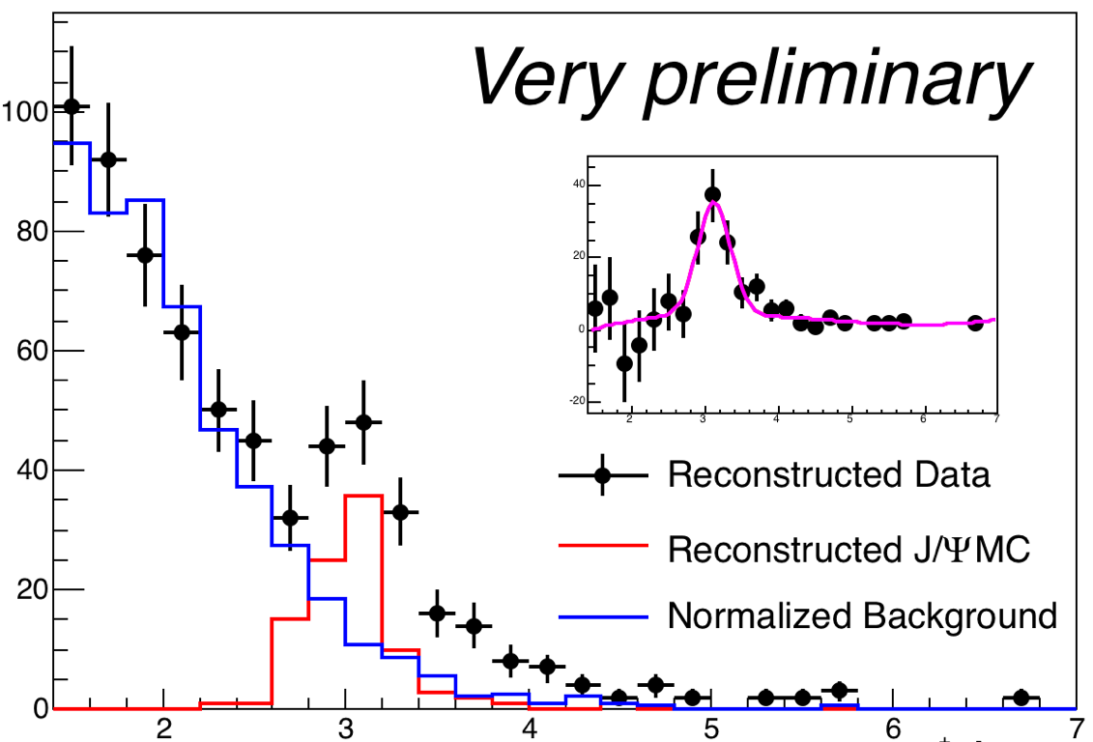
Latest Work in Progress
Random mixing background (from Run 2166) is normalized so that the number of events below 2.4 GeV are the same
Acceptance/Trigger efficiency/Reconstruction efficiency is decided by GMC.
N(J/Psi) = Leff × σJ/Psi × Br(J/Psi⟶ µ⁺µ⁻) × Acc(J/Psi) × Trig(J/Psi) × Recon(J/Psi)
N(DY) = Leff × σDY × Br(𝛾*⟶ µ⁺µ⁻) × Acc(DY) × Trig(DY) × Recon(DY)
M(µ+µ⁻) (GeV)
N(J/Psi) = 87.8 ± 37.6
M = (3.12 ± 0.05) GeV
σ = (226 ± 73) MeV
σ(DY)∕σ(J/Psi)
= (9.2 ± 4.3)×10⁻³
N(M > 4 GeV) = 28.4 ± 5.3
At √s = 15.06 GeV:
σDY(M > 4 GeV) = 0.14 nb (PYTHIA)
σJ/Psi ≈ 30 nb (PLB 638, 202-208, 2006)
σDY∕σJ/Psi≈4.6×10⁻³
* Total number of protons delivered: 3.4 × 10¹⁵ (sum of NM3:ION)
10

Slide 11
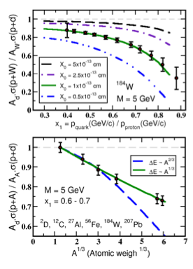
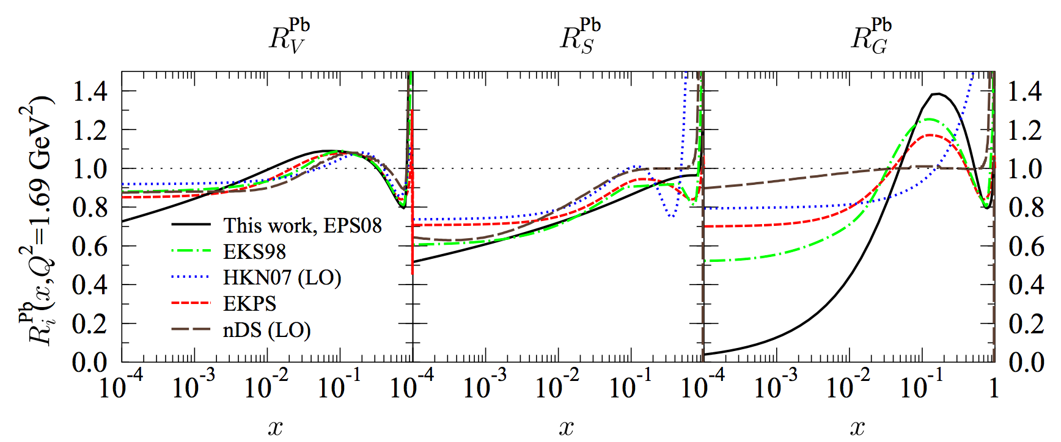
Summary and Outlook: First unambiguous determination at E906
Run-II start next week!
The fractional energy loss effect greatly amplified since it scales with 1/s
Kinematic range well above shadowing region
E906 will achieve sensitivity of ~ 20%
Clearly distinguish between the leading models of L-dependence of E-loss (5σ effect)
-dE ∝ A^{1/3} (or ∝ L)
-dE ∝ A^{2/3} (or ∝ L²)
arXiv: 0802.0139
E906
E866
11

Slide 12
backup

Slide 13
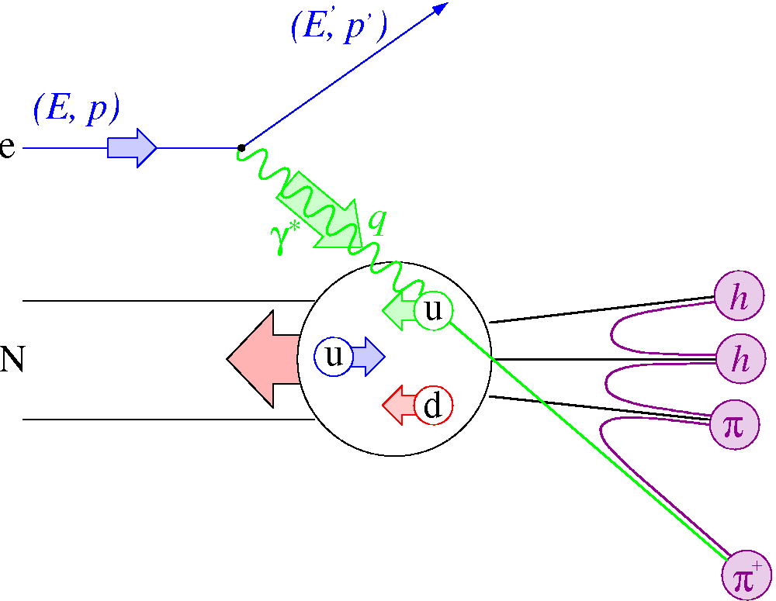
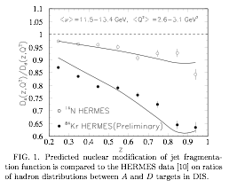
Parton Energy Loss SIDIS @HERMES
Out going quarks
HERMES A-dep Fragmentation Functions
Must understand nuclear–dependent fragmentation
Wang & Wang
Assume all from quark energy loss
dE/dL=0.5GeV/fm
@E =10 GeV for Au.
Wang & Wang PRL 89 (2002) 162301

Slide 14
First direct measurement of dE/dx from p+A @E906
High energy parton energy loss
parton initial energy E= 10~100 GeV
Relevant to RHIC and LHC parton energy
Provides direct test of various parton energy loss models
Models:
Galvin and Milana
Brodsky and Hoyer
Baier et al.

Slide 15
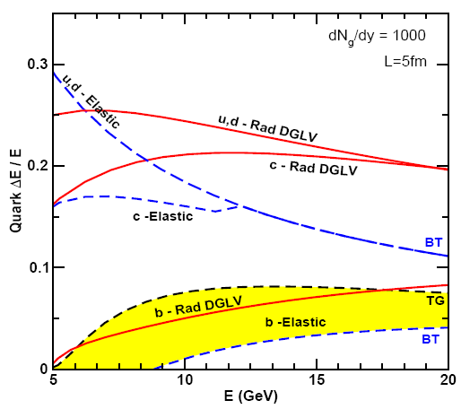
Mechanisms of Energy-loss:
Radiation
due to scattering
Elastic collision,
energy re-distribution
Many models on relative importance
Probe via high-pt heavy-quarks
smaller energy loss after elastic collision
gluon radiation also reduced
interference during radiation
dead-cone effect
S.Wicks, W. Horowitz, M. Djordjevic M. Gyulassy (WHDG) nucl-th/0512076
-There is no agreed to value of parton dE/dX(GeV/fm) in either cold nor QGP matter
-We need a better understanding of high parton energy loss in nuclear medium

