Slide 1
Study of Quark Energy Loss Effect in p+A Collisions at Fermilab E906 Experiment Benchmark Energy Loss Models with Drell-Yan
Ming Liu
Los Alamos National Lab
(For Fermilab E906/SeaQuest Collaboration)

Slide 2
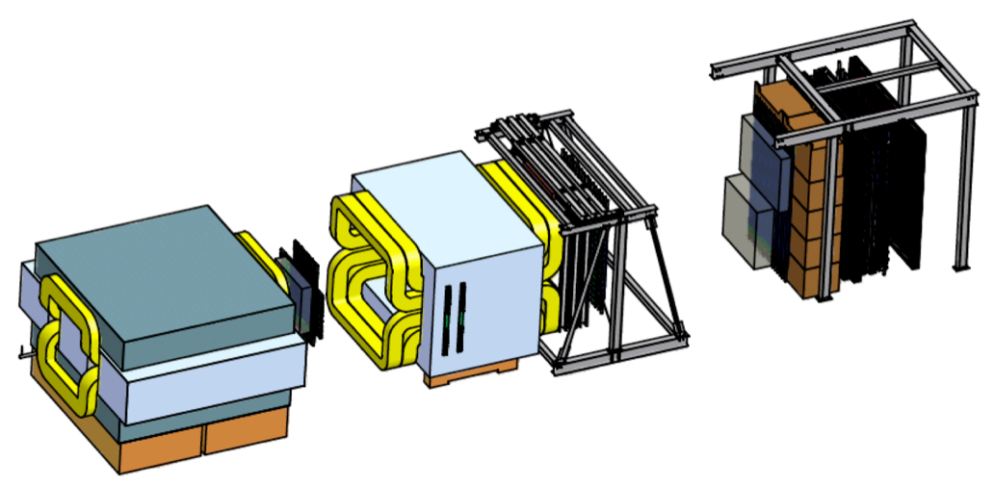
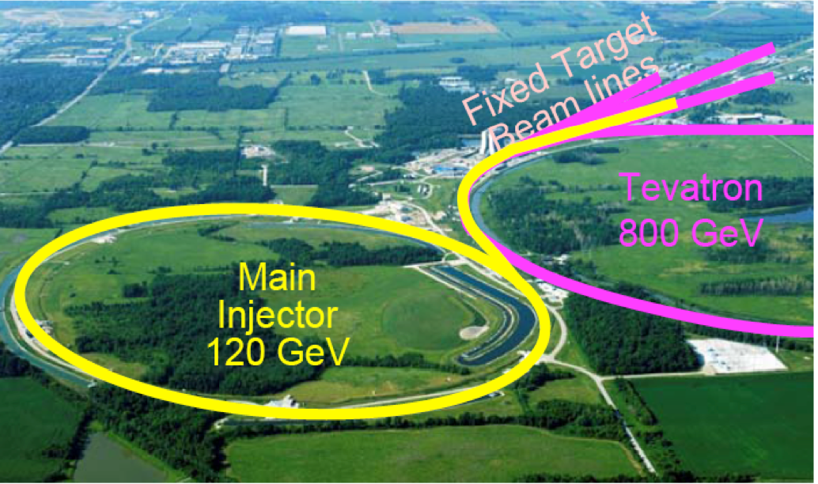
E906/SeaQuest Experiment at Fermilab
Aimed at measuring dimuon production in Drell-Yan process and charmonium decay
Absorber wall and proportional
tube based Muon ID
Spectrometer magnet
Δpt = 0.4 GeV
Focusing magnet
and solid iron dump
Δpt = 2.9 GeV
Beam
120 GeV proton from Main Injector
19ns RF, 5s spill, 1×10¹³ protons per spill
25 m
Target system
Liquid H and D
Solid C, Fe, W
Tracking detectors
Drift chambers and
hodoscope scintillators

Slide 3
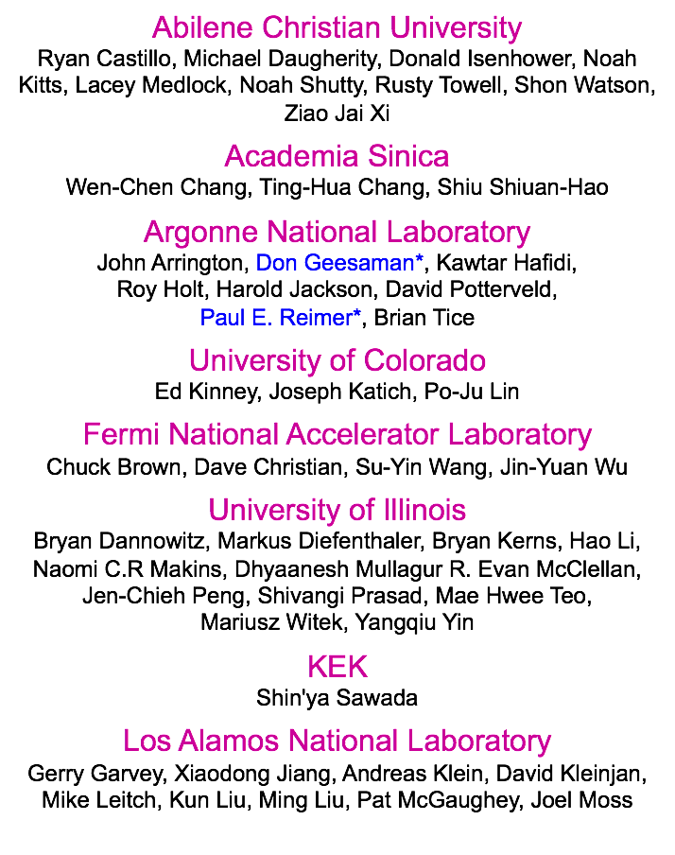
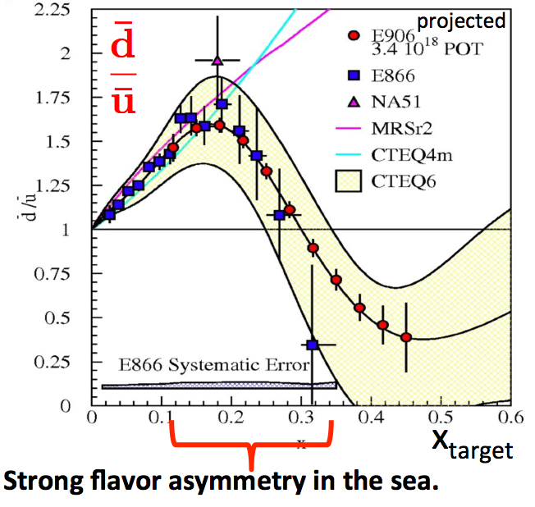
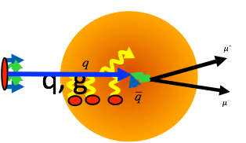
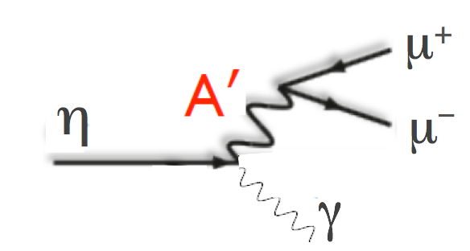
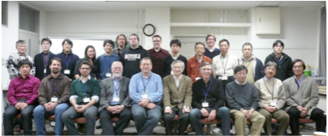
E906/SeaQuest Collaboration
McClellan @PDF Sun. 8:25AM
2009 @ Los Alamos
Sta. MD/PHE/PPHI @4PM
2013 @ Tokyo Tech

Slide 4
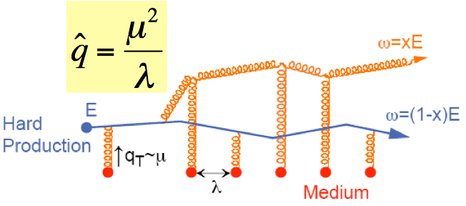
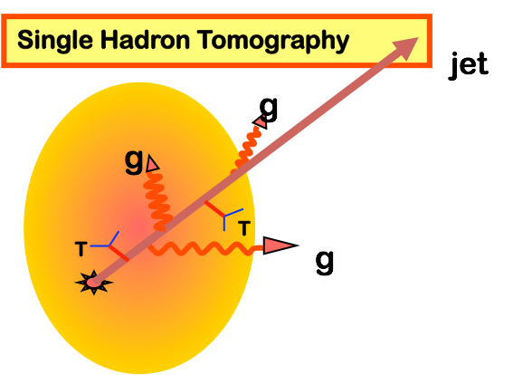
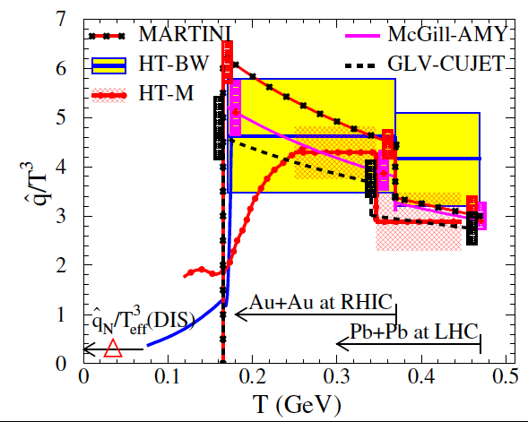
Do We Understand Jet Quenching at RHIC/LHC?
Energy loss of partons from hard scattering through re-scattering in the hot & dense medium
nuclear modification factor RAA << 1 at high pT
Access medium properties through statistical analysis:
example: transport coefficient
model dependent
One of the key questions in heavy ion today
Recent JET collaboration progress (PRC 90, 014909 (2014)) for 10GeV quark:
qhat = 1.2 ± 0.3 GeV²/fm (RHIC); 1.9 ± 0.7 GeV²/fm (LHC)

Slide 5
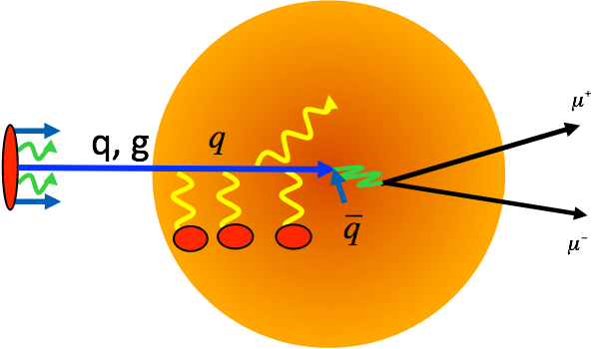
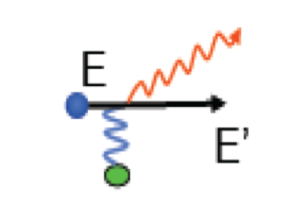
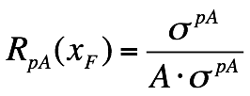
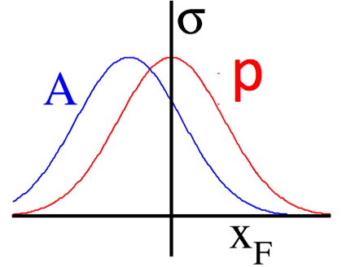
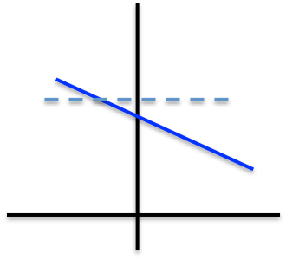
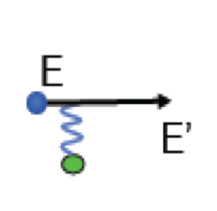
Initial-state Energy Loss and Drell-Yan in p+A
Benchmark quark energy loss models
Minimal final-state interactions
Know nuclear matter
Radiative dE/dx
Collisional dE/dx
xF

Slide 6
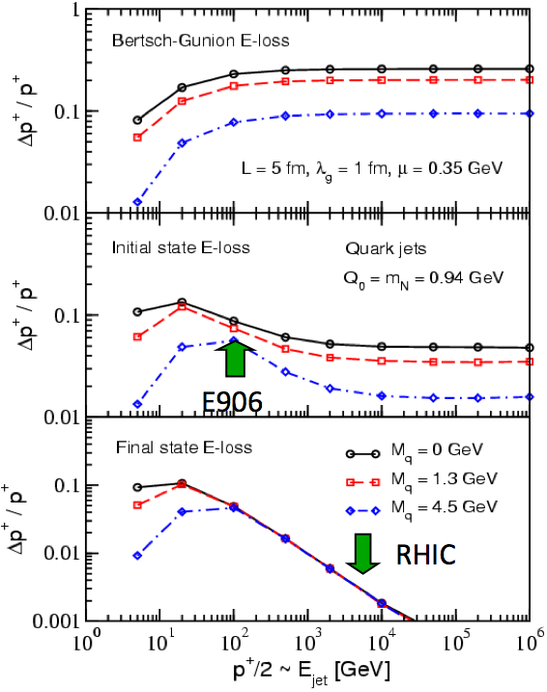
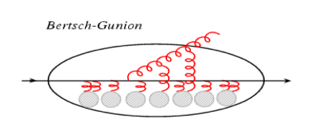
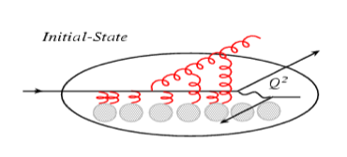
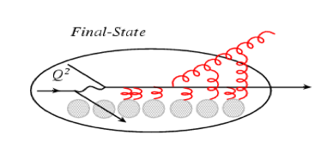
The Expectations
Think of the parton (quark) energy loss in the nuclear rest frame
I. Vitev PRC 75, 064906 (2007)
Ideal QGP
Drell-Yan: p+A
DIS:e+A
Initial-state E-loss is large and much larger than final-state energy loss for cold nuclei
In Drell-Yan we don’t have final-state interactions

Slide 7
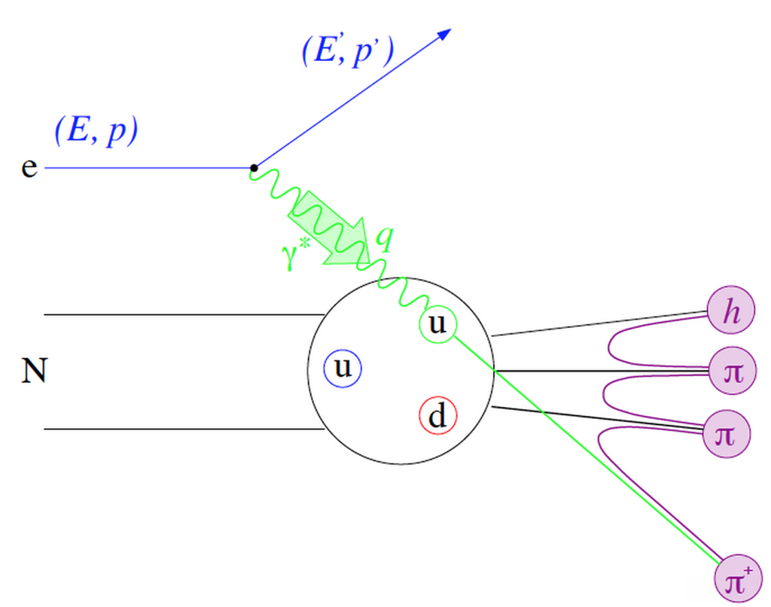
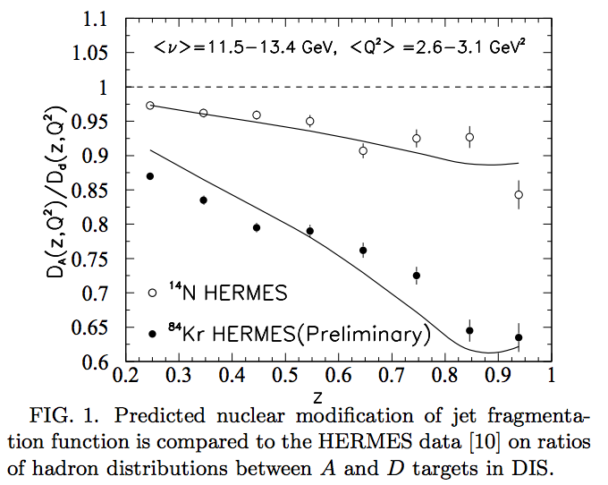
Parton Energy Loss in SIDIS
Out going quarks
HERMES A-dependent fragmentation functions
Must understand nuclear-dependent fragmentation
Wang & Wang
Assume all from quark energy loss:
Wang & Wang PRL 89 162301 (2002)
dE/dx = 0.5 GeV/fm @ E = 10 GeV for Au.

Slide 8
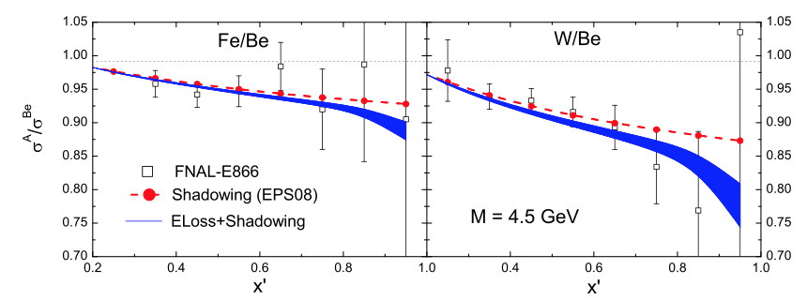
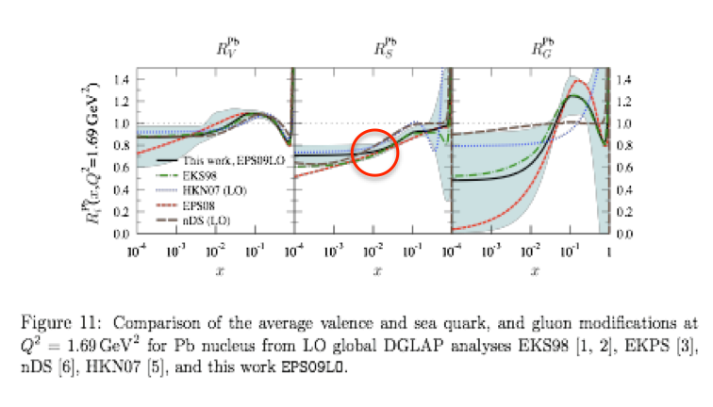
Early Data from E866 @ Fermilab
Energy loss vs. shadowing
Correction must be made for shadowing effects
Garvey & Peng PRL 90 (2003)
NO partonic energy loss if all effects from shadowing
Vasiliev et al., PRL 83 (1999)
Significant parton energy loss, ~1.2 GeV/fm if all from energy loss
Johnson et al., PRC 65 025203 (2002)
Nucl. Phys. A 879 (2012)
arXiv: 0802.0139
Both yield 20~30% effects in RpA

Slide 9
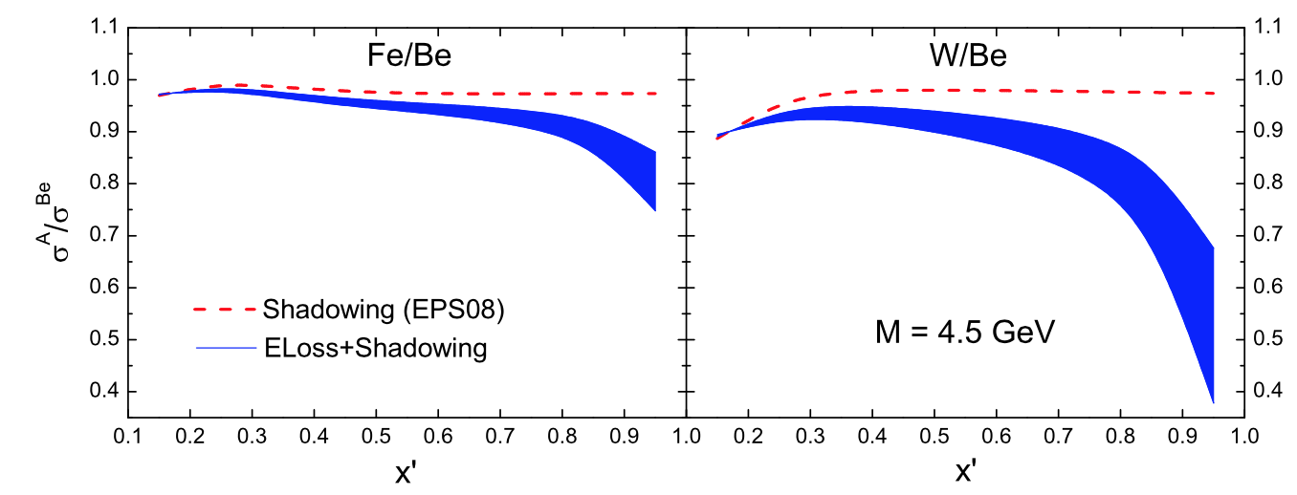
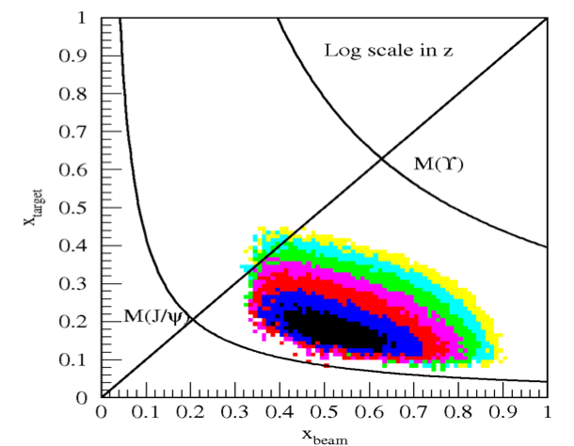
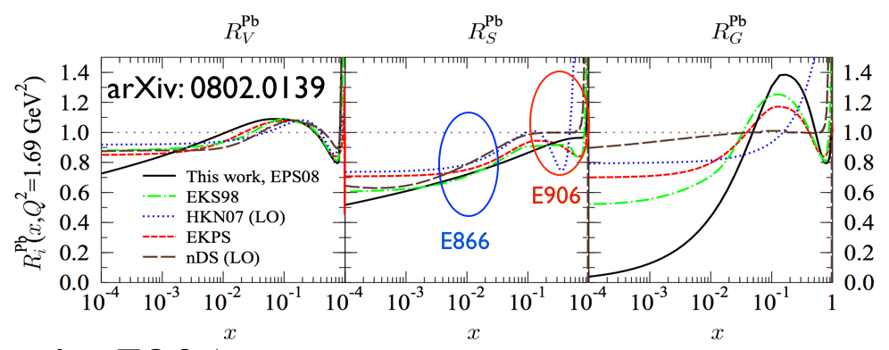
E906 Drell-Yan Dimuon Acceptance
Nucl. Phys. A879 (2012)
Parton initial energy: 30 - 120 GeV (relevant to RHIC and LHC parton energy)
Direct test on various models:
Gavin and Milana:
Brodsky and Hoyer:
Baier et al:
Sea quark x = 0.1 ~ 0.3
Minimal shadowing
1/s enhanced dE/dx effect
First unambiguous determination of dE/dx in CNM

Slide 10
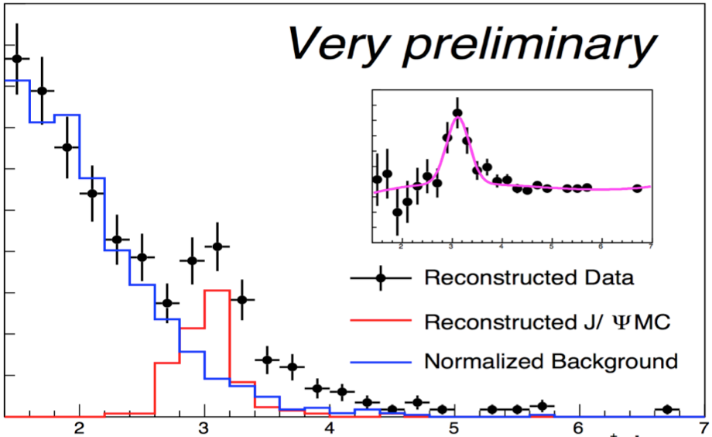
Timeline and milestones of SeaQuest
Analyzable data
First proposal
Detector
assembled
First
proton!
Main
injector
upgrade
Run-I
Run-II
Run-III
Future upgrades
of polarized program
New Drift Chamber
1999
2011
2012
2013
2014
2015
2016
Due to various delays, only a very short 2-month commissioning Run-I was taken in early 2012
In the longer Run-II, we solved almost all the problems discovered in Run-I
After a short 2-month accelerator maintenance, we started a 2-yr Run-III
New station-1 drift chamber will be installed soon to extend the x2 coverage
Polarized projects (target and/or beam) will take over in summer 2016
SeaQuest Run-I
Mass (GeV)
Dr. Markus Diefenthaler, Polarized Drell-Yan measurement at Fermilab: The future of the SeaQuest experiment, WG7, Apr. 30

Slide 11
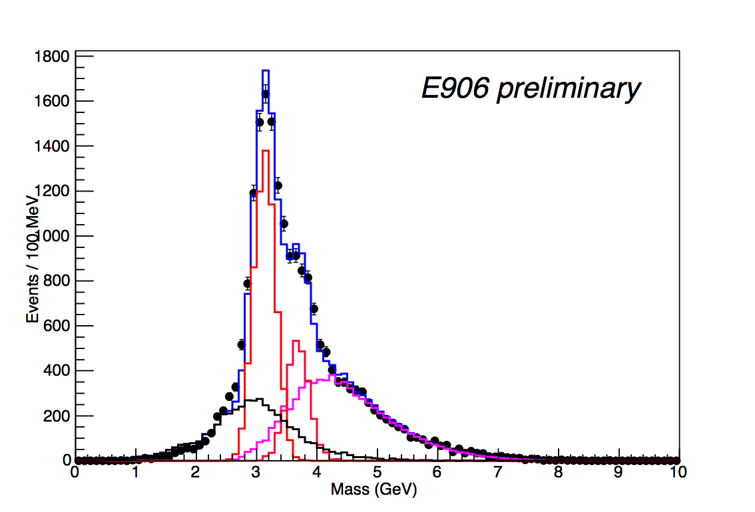
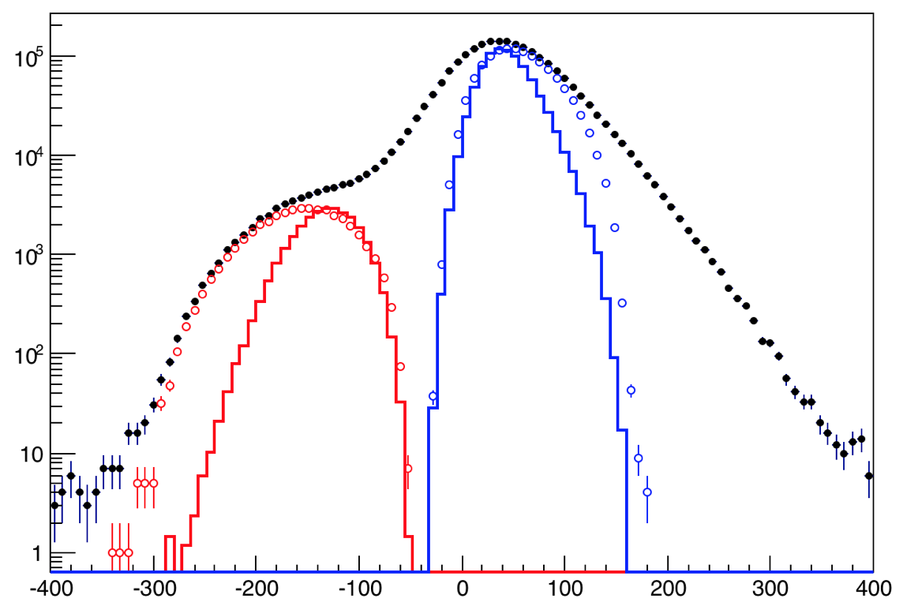
Data from Run 2014 (Run-II)
Monte Carlo describe data well
Resolution better than expected
σM(J/ψ) ~ 180 MeV, σM(DY) ~ 220 MeV
J/ψ ψ’ separation
Cleaner DY sample
Good target/beam dump separation
Beam quality worse than expected (instantaneous rate much higher than average)
live time of spectrometer greatly reduced by the ‘super’ RF buckets
Reconstruction efficiency lower than expected because of the high detector occupancy
~ 5% of expected statistics
- J/ψ Monte Carlo
- ψ’ Monte Carlo
- Drell-Yan Monte Carlo
- Random Background
- Combined MC and bg
All “good” dimuons in data
Data with dump cut
Data with target cut
Entire beam interacts upstream of SeaQuest spectrometer
Pointing resolution very poor along beam axis
Dominated by random coincidences
Dump MC
Target MC
Zvtx (cm)

Slide 12
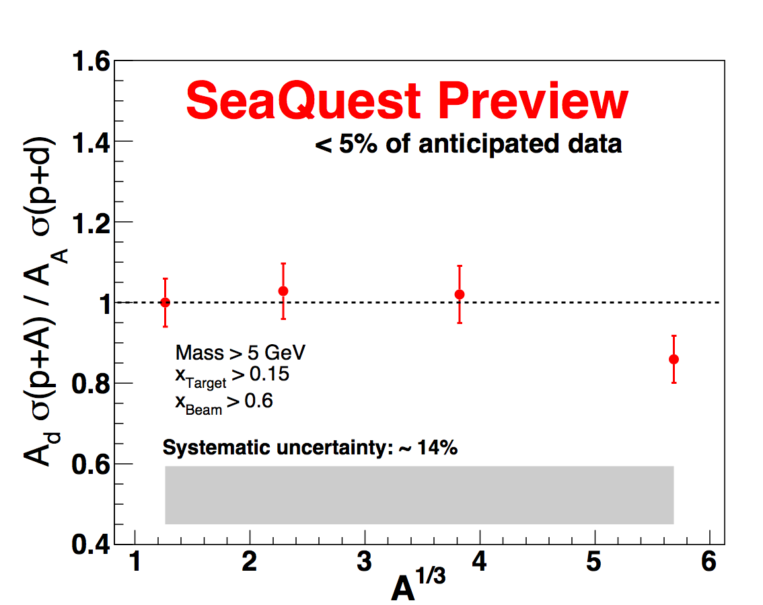
First Quark Energy Loss Study at E906
Too early to make any conclusion on p+Fe as limited by the statistics
A consistently negative slope beyond the shadowing strength is observed in p+W data.
With 20x more statistics, we will be able to clearly distinguish between:
-dE ∝ A^{1/3} (or ∝ L)
-dE ∝ A^{2/3} (or ∝ L²)
D
C
Fe
W

Slide 13
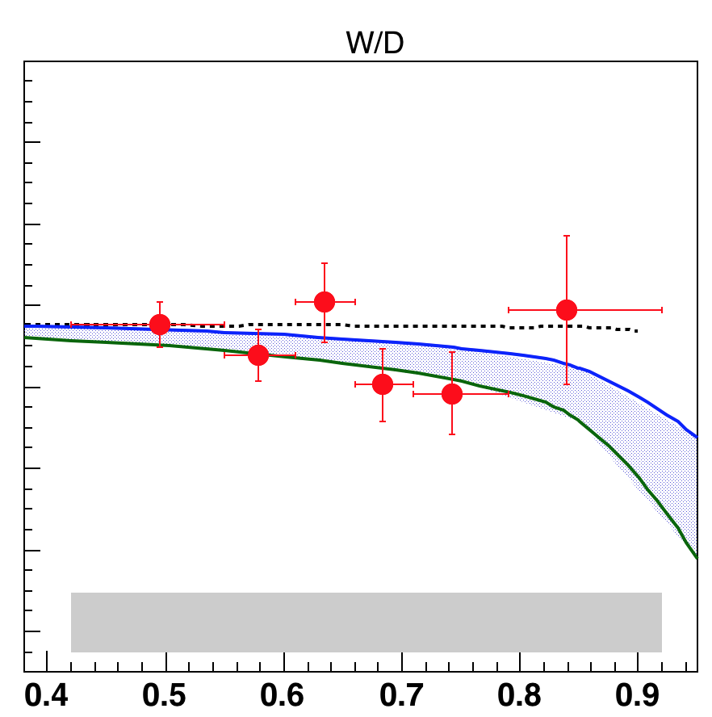
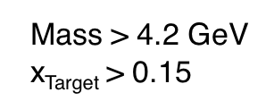
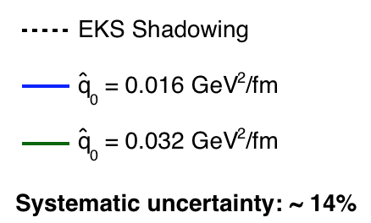
Summary
Run-II: 5% of total statistics:
observed a negative slope 2σ beyond the extent of shadowing
Ongoing Run-III: ~20x of Run-II statistics
Other ongoing physics analysis:
EMC effect in Drell-Yan
Transverse momentum broadening
Difference between J/ψ and ψ’ suppression in pA
Search for double J/ψ production
Search for dark photons
...
xBeam

