Slide 1
E906 Update
Beam tuning
  Unstable beams, very large intensity fluctuations
  Average intensity is OK
Cerenkov Beam luminosity monitor
  Works at 1st order, baseline shift
  Need fine tune to get ~1% RF bucket to bucket
Detector HV scan and Timing

Slide 2
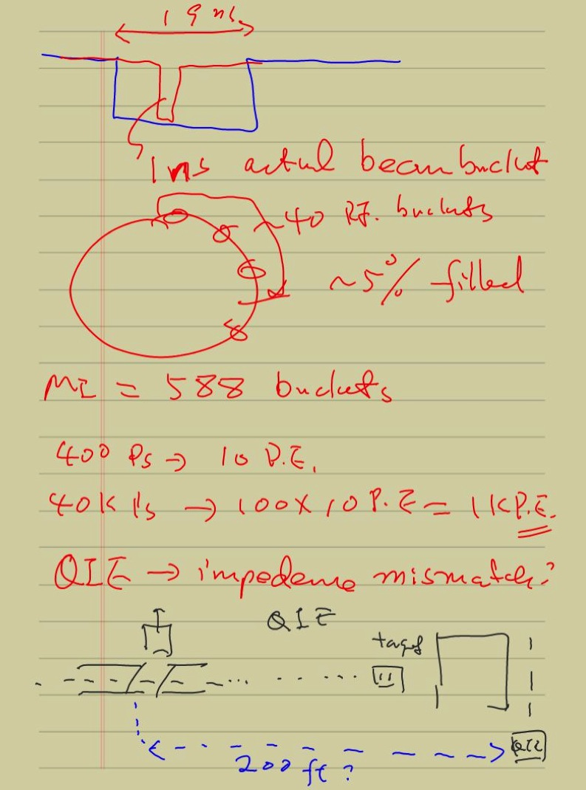

Slide 3
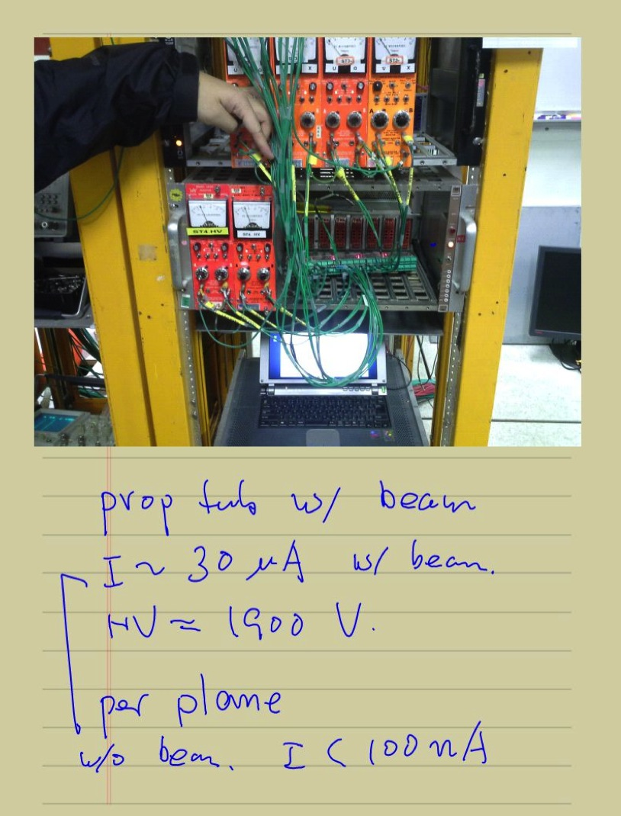

Slide 4
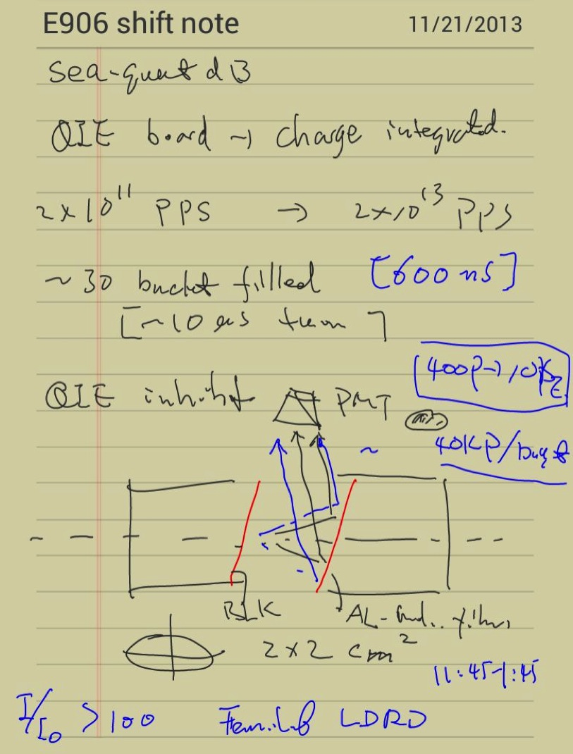
New Beam
Luminosity Monitor

Slide 5
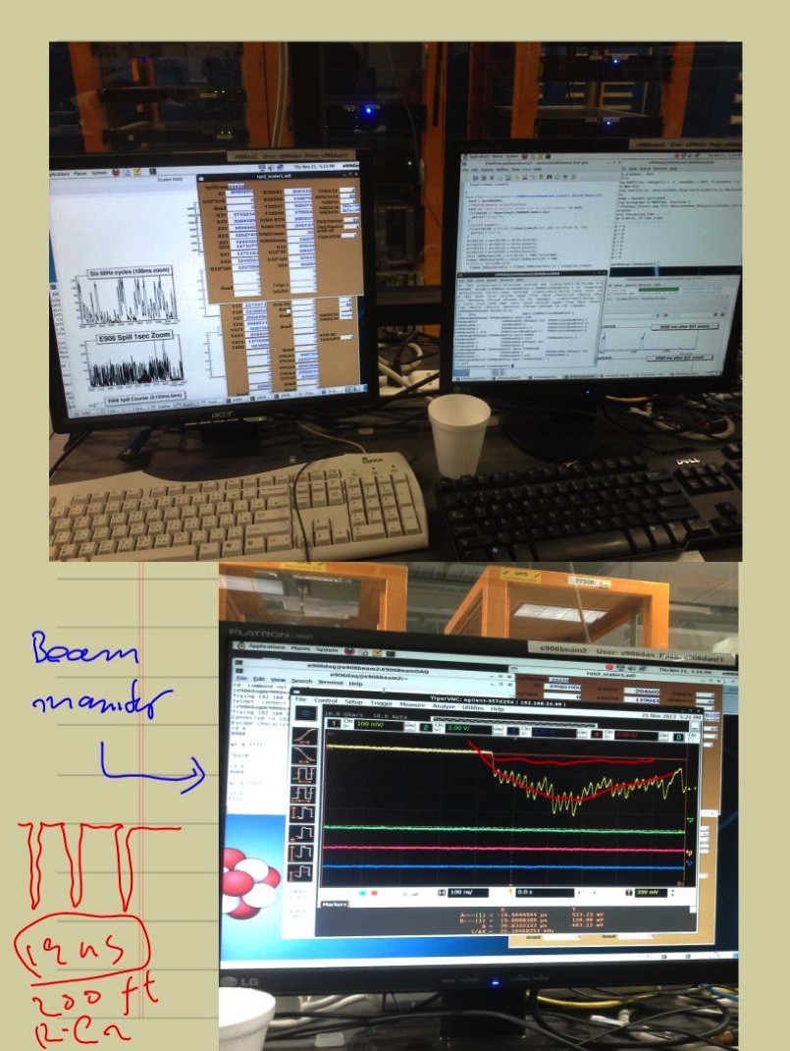
Beam Monitor
Cerenkov output

Slide 6
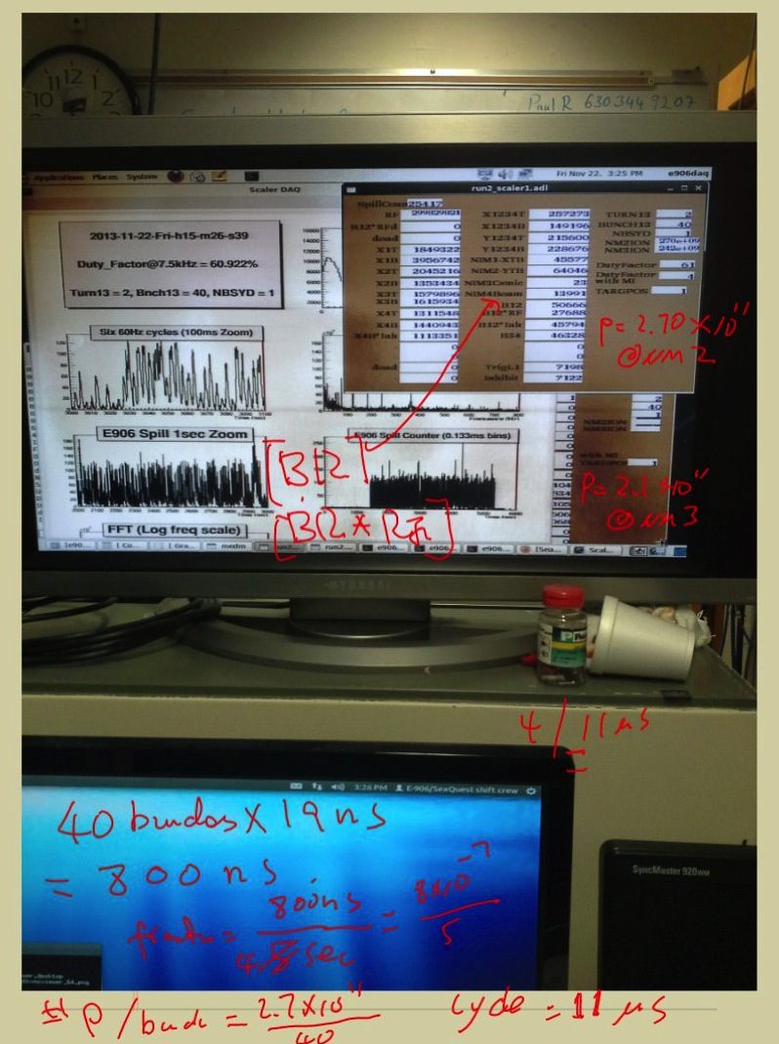

Slide 7
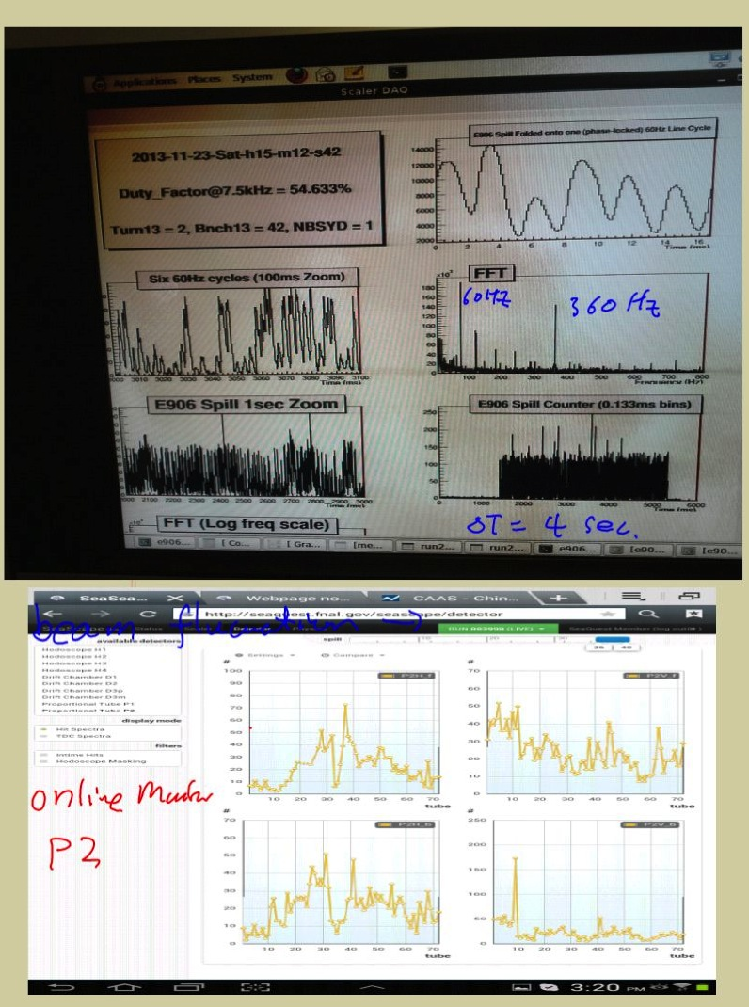

Slide 8
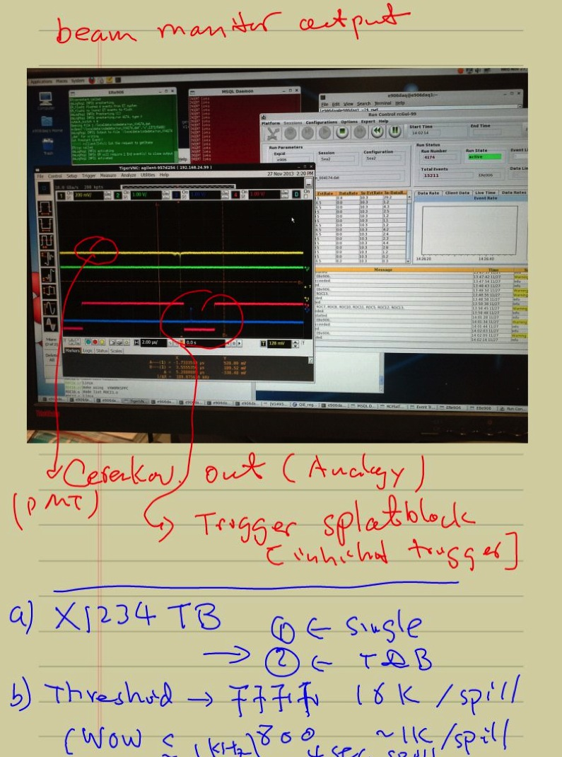

Slide 9
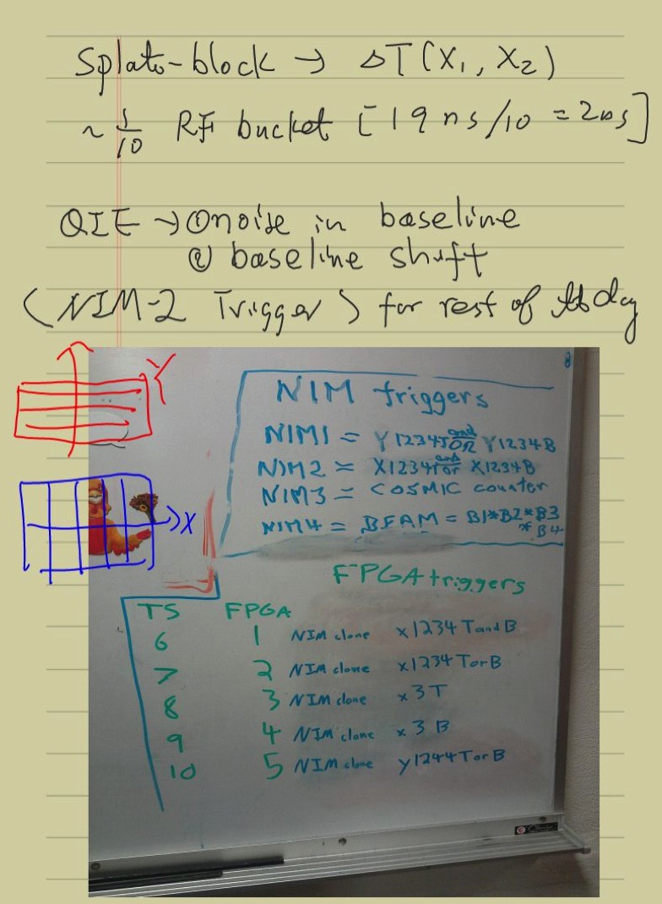

Slide 10
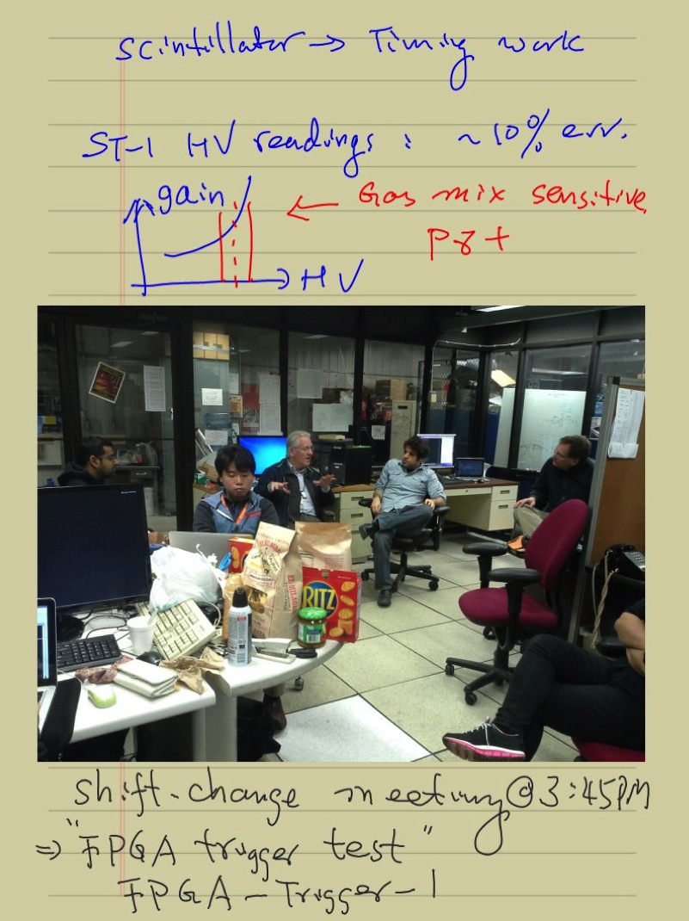

Slide 12
E906 DY Target/Beam Dump Study
E906 default spectrometers setup
Target = 10cm thick, Liquid H2
Target_Z = -80, [-130], -180 cm
Target_Z = -300, -400, -500 cm
  Additional ideal dipole maget at
    Z =[-100, -50]cm
    B_y = 5 Tesla
Study mass, pT, xB, xT acceptance

Slide 13
Accepted Events, w/o Cross Section Weight
Z = -80 cm

Slide 14
Z = -130 cm

Slide 15
Z = -180cm

Slide 16
Z= -180 cm
Cross section weighted
distributions

Slide 17
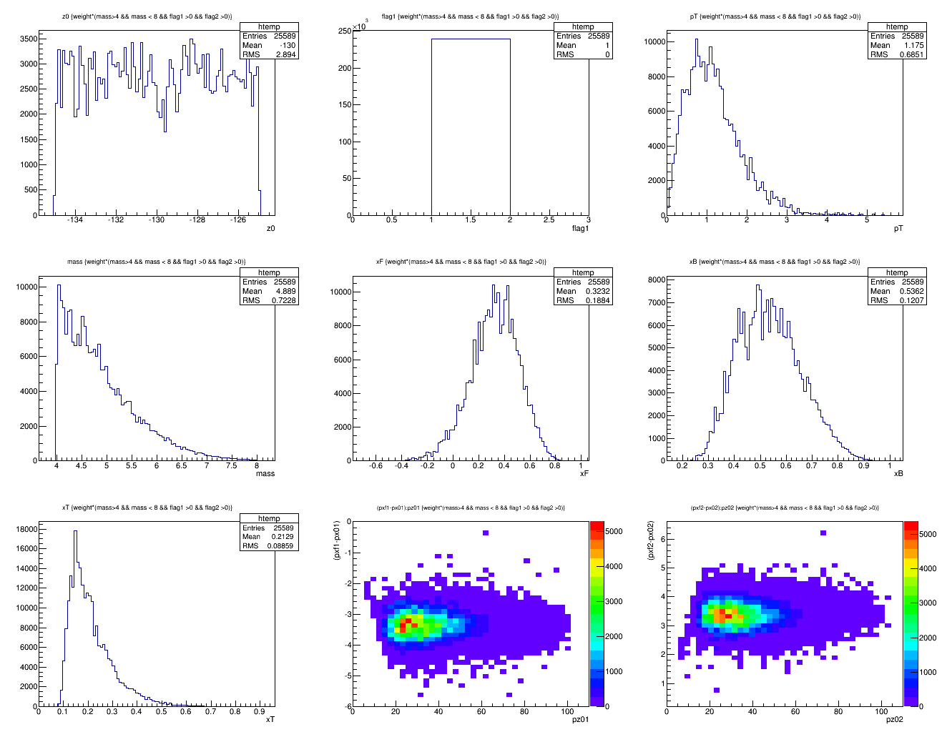
Z = -130cm, Default
Z = -130 cm
<x>=0.21
X_target

Slide 18
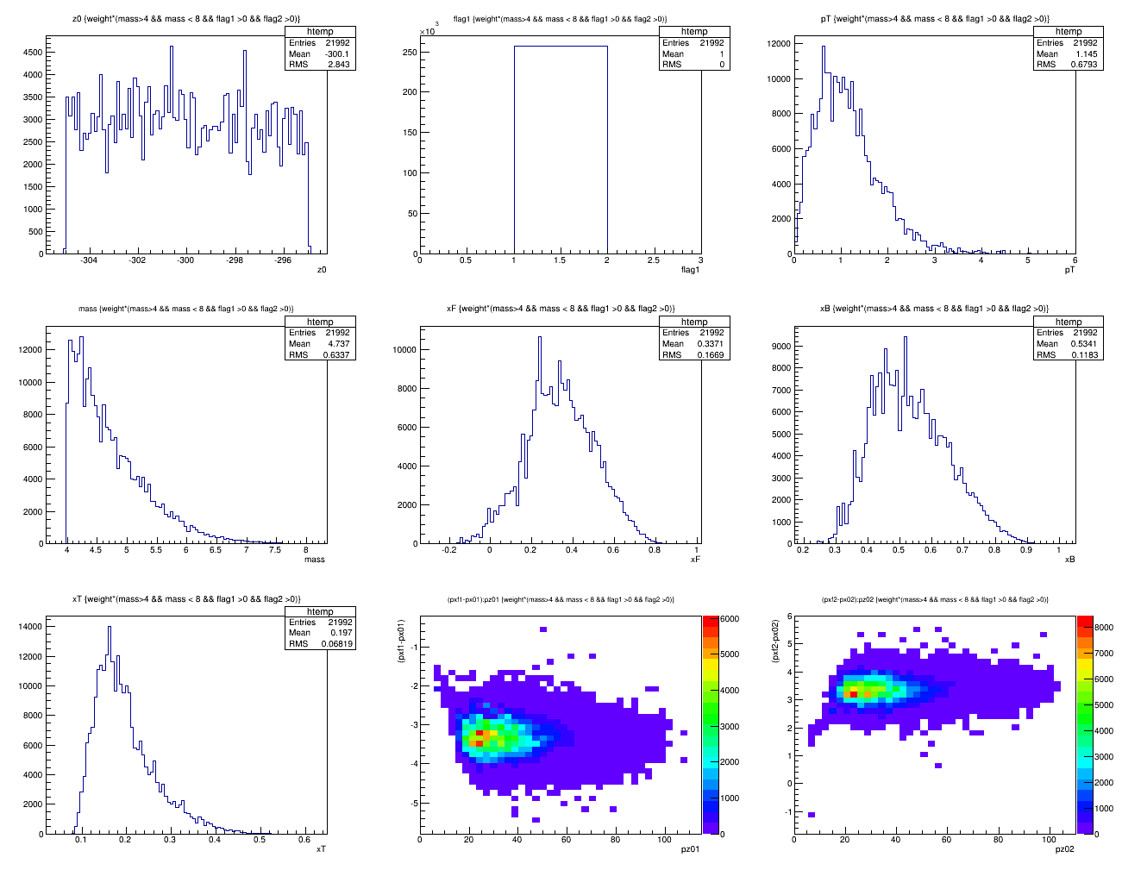
Z = -300cm, default
<x>=0.18

Slide 19
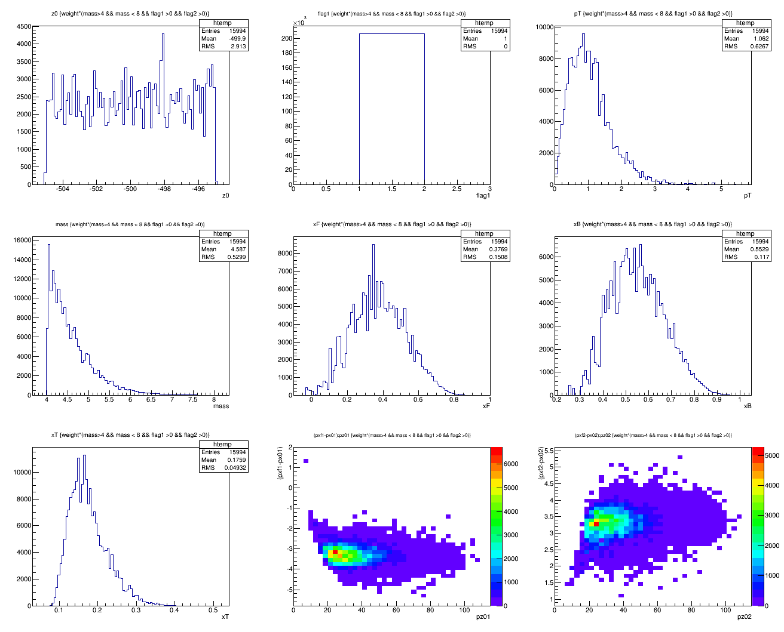
Z = -500cm, default
<x>=0.18

Slide 20
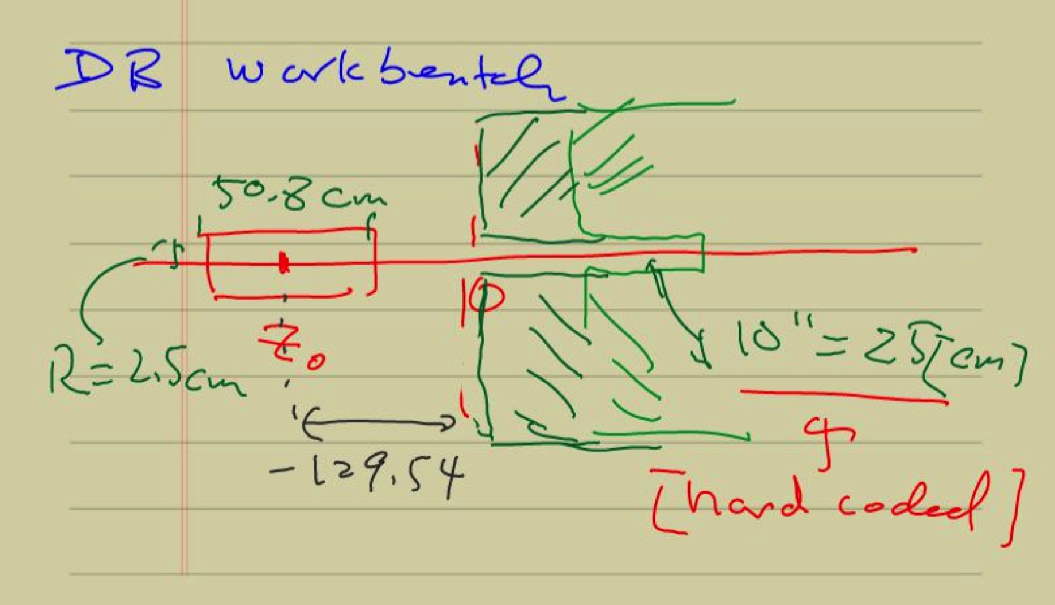

Slide 21
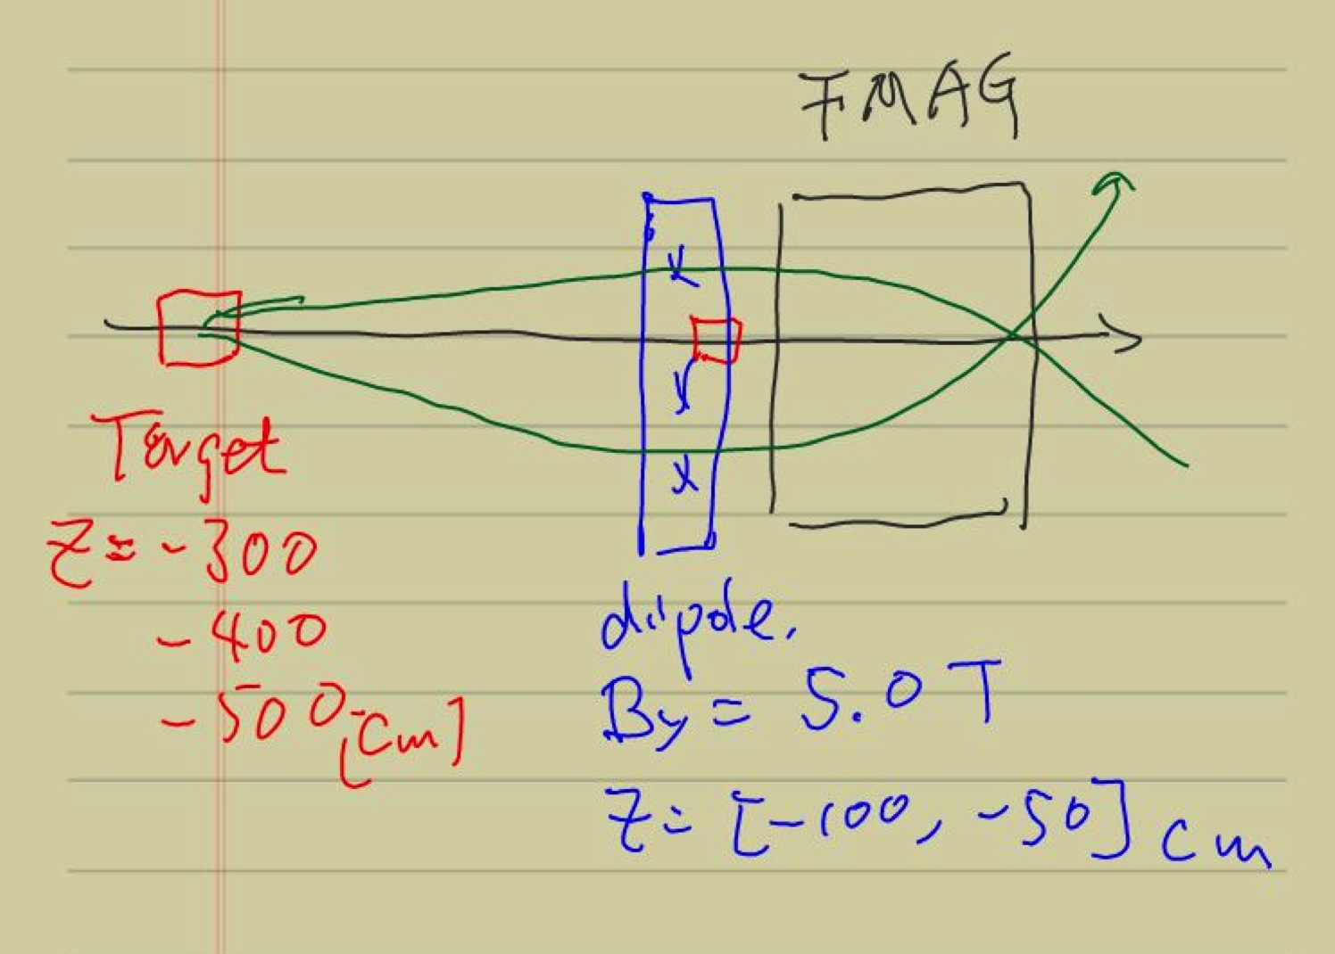
Add an ideal dipole, B_y = 5 Teslas
@Z=[-100,-50]

Slide 22
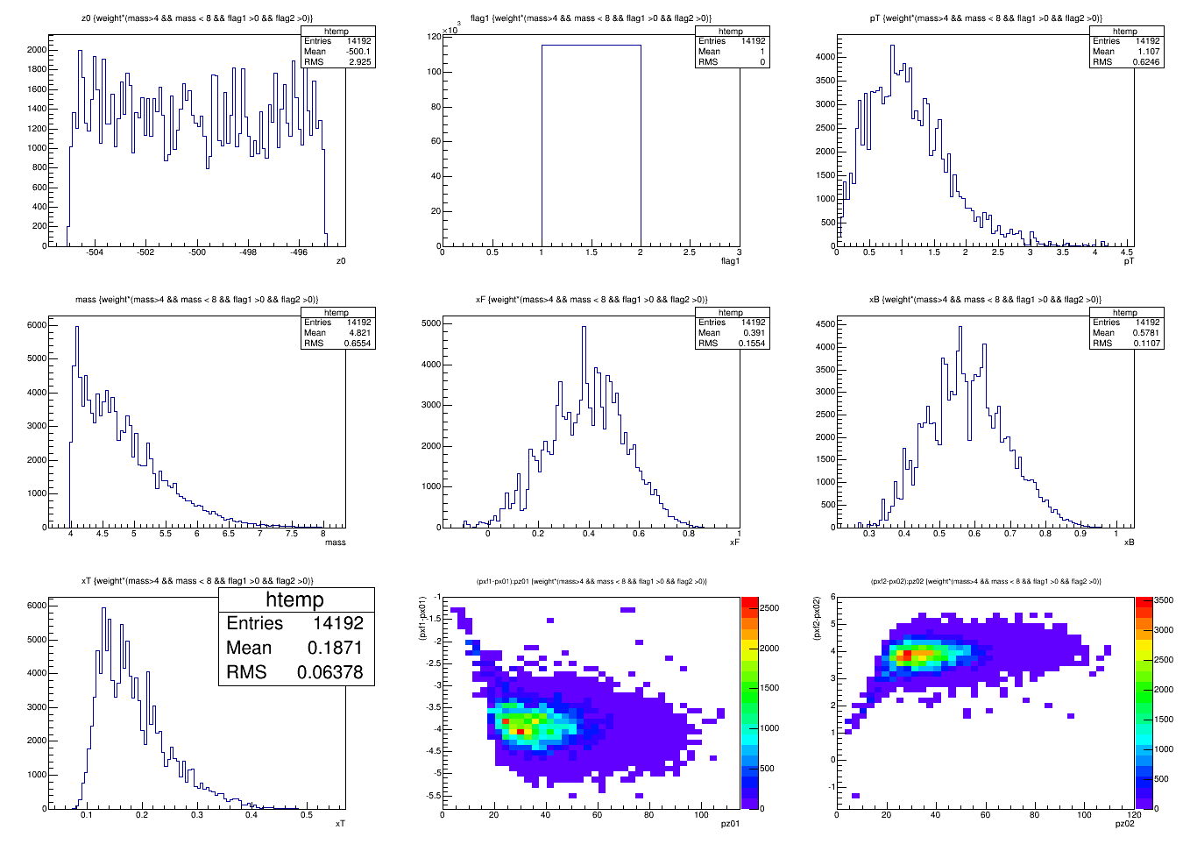
Z = -500cm, Dipole = 5T@[-100,-50]cm

Slide 23
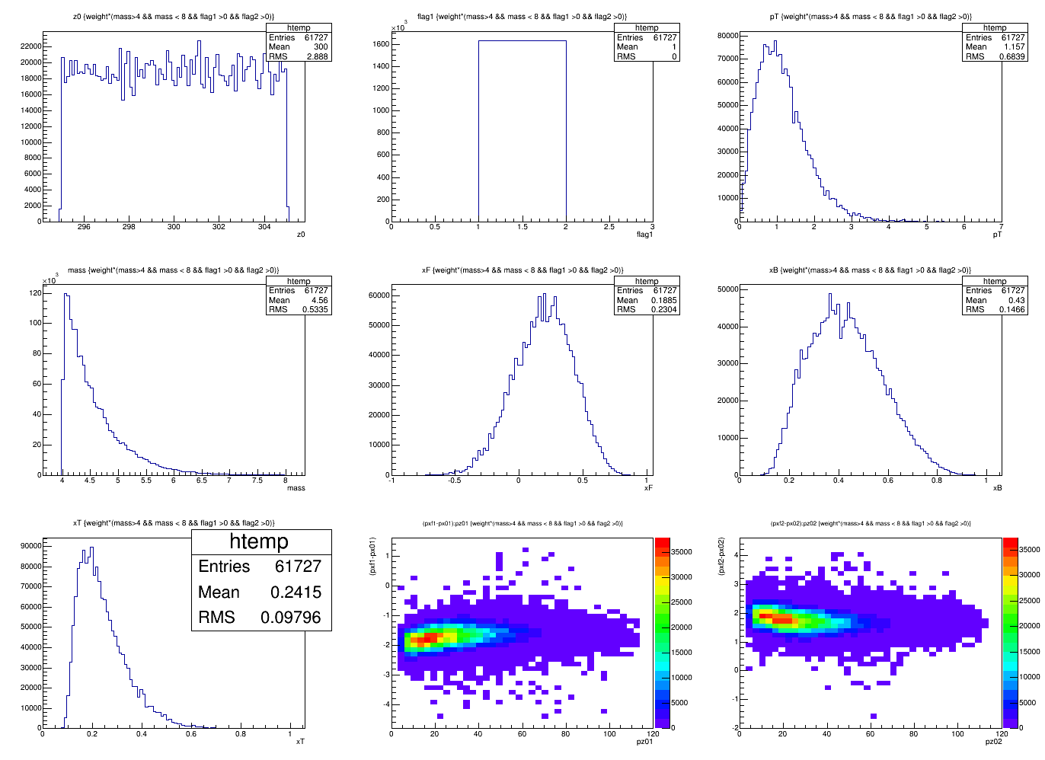
Z = -300cm, Dipole = 5T@[-100,-50]cm

Slide 24
To do list
Add offline full track reconstruction
Atrget and Beam dump separation
More realistic field map
Optimize the layout of target and dipole magnet
Dipole size and position
Target B-shielding

