Slide 1
E906 Acceptance Study with a SM0 Dipole Magnet
Ming Liu

Slide 2
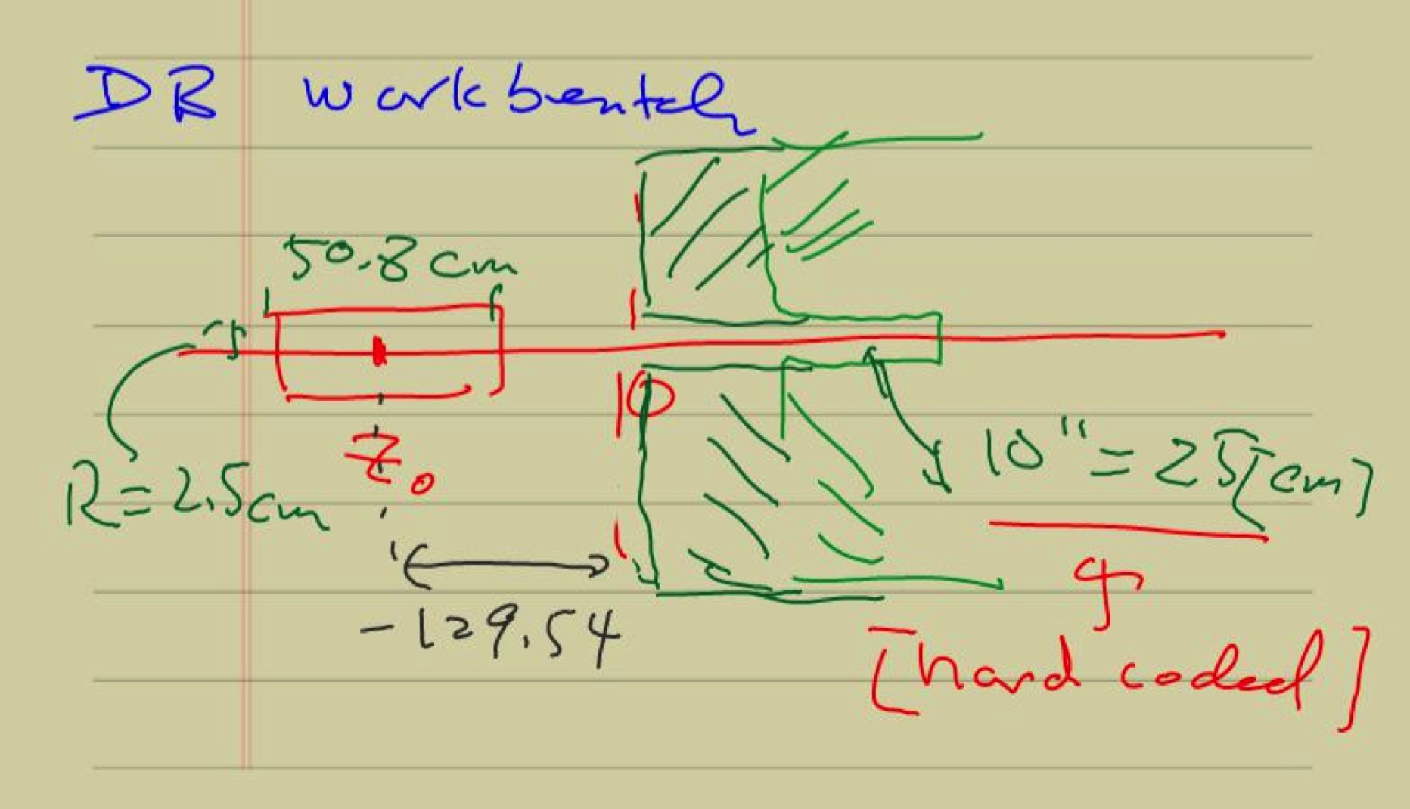

Slide 3
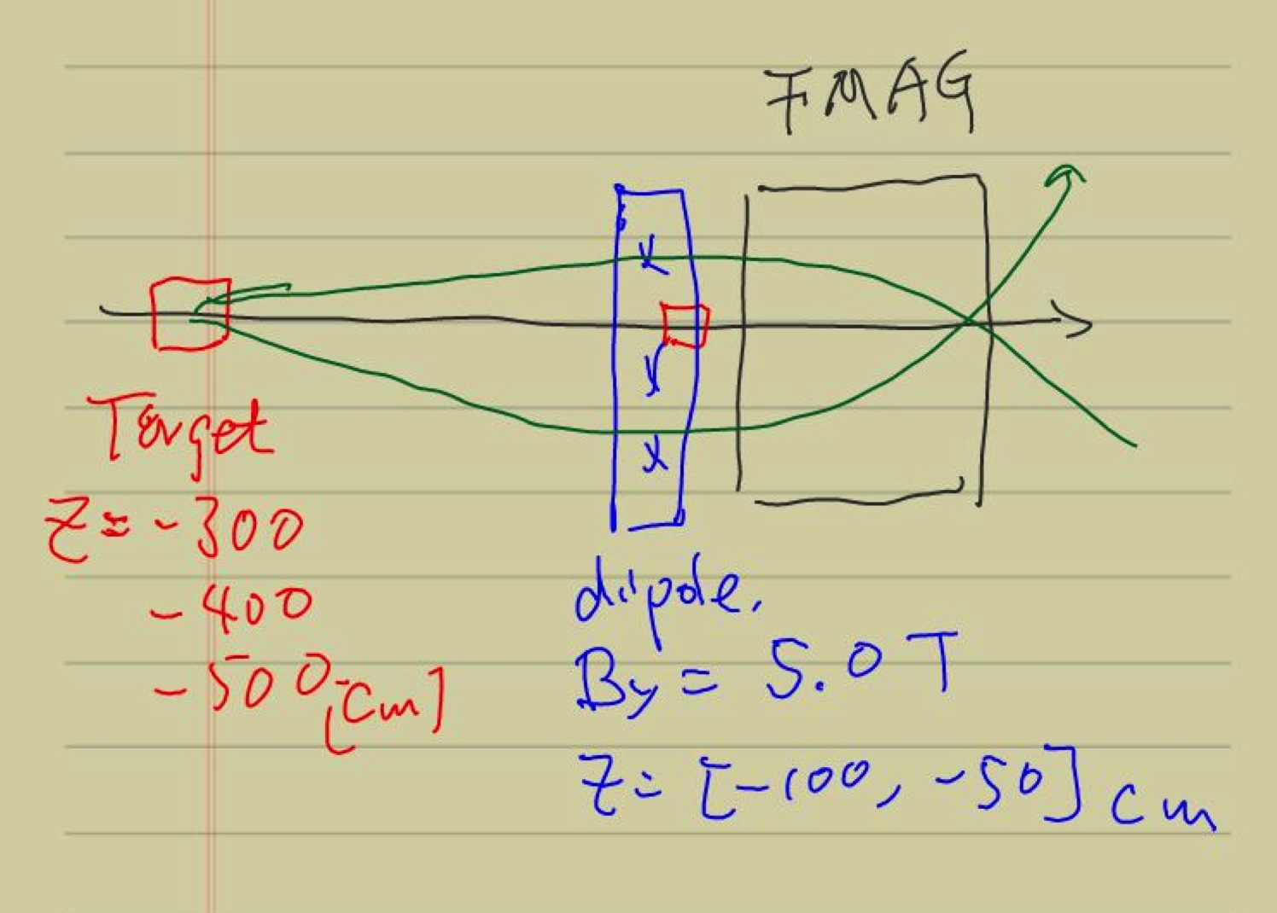
Add an ideal dipole, B_y = 5 Teslas
@Z=[-100,-50]

Slide 4
Default E906 with Various Target Z Positions w/o SM0

Slide 5
E906 DY Target/Beam Dump Study
E906 default spectrometers setup
Target = 10cm thick, Liquid H2
Target_Z = -80, [-130], -180 cm
Target_Z = -300, -400, -500 cm
  Additional ideal dipole maget at
    Z =[-100, -50]cm
    B_y = 5 Tesla
Study mass, pT, xB, xT acceptance

Slide 6
Accepted Events, w/o Cross Section Weight
Z = -80 cm

Slide 7
Z = -130 cm

Slide 8
Z = -180cm

Slide 9
Z= -180 cm
Cross section weighted
distributions

Slide 10
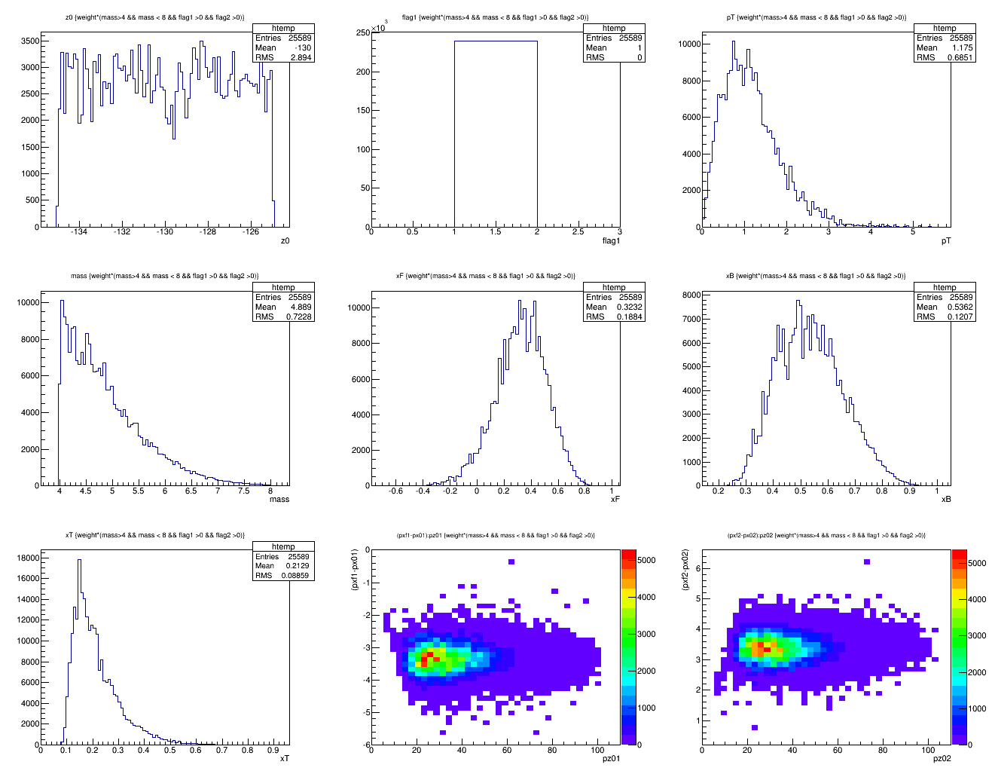
Z = -130cm, Default
Z = -130 cm
<x>=0.21
X_target

Slide 11
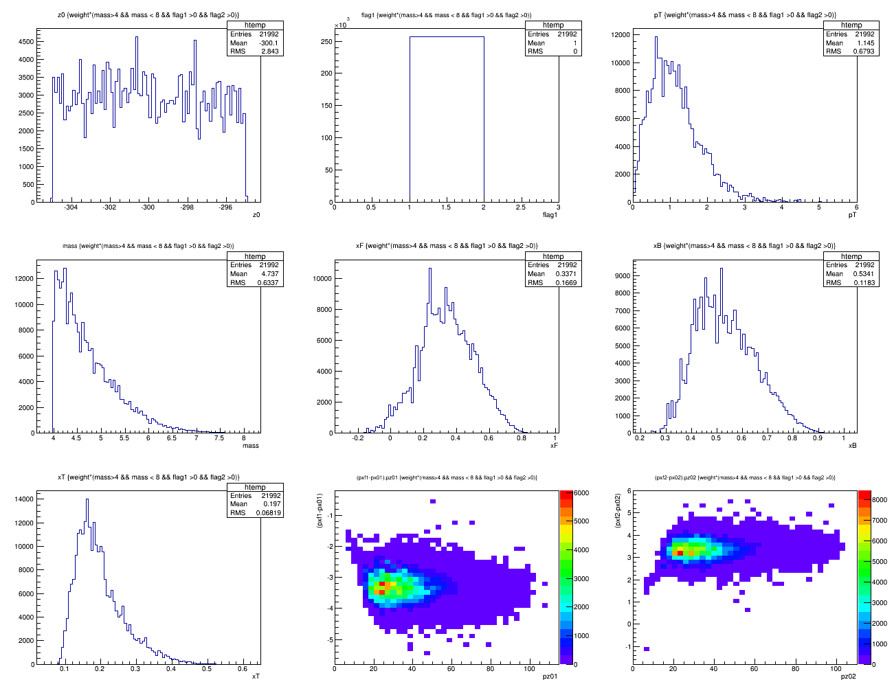
Z = -300cm, default
<x>=0.18

Slide 12
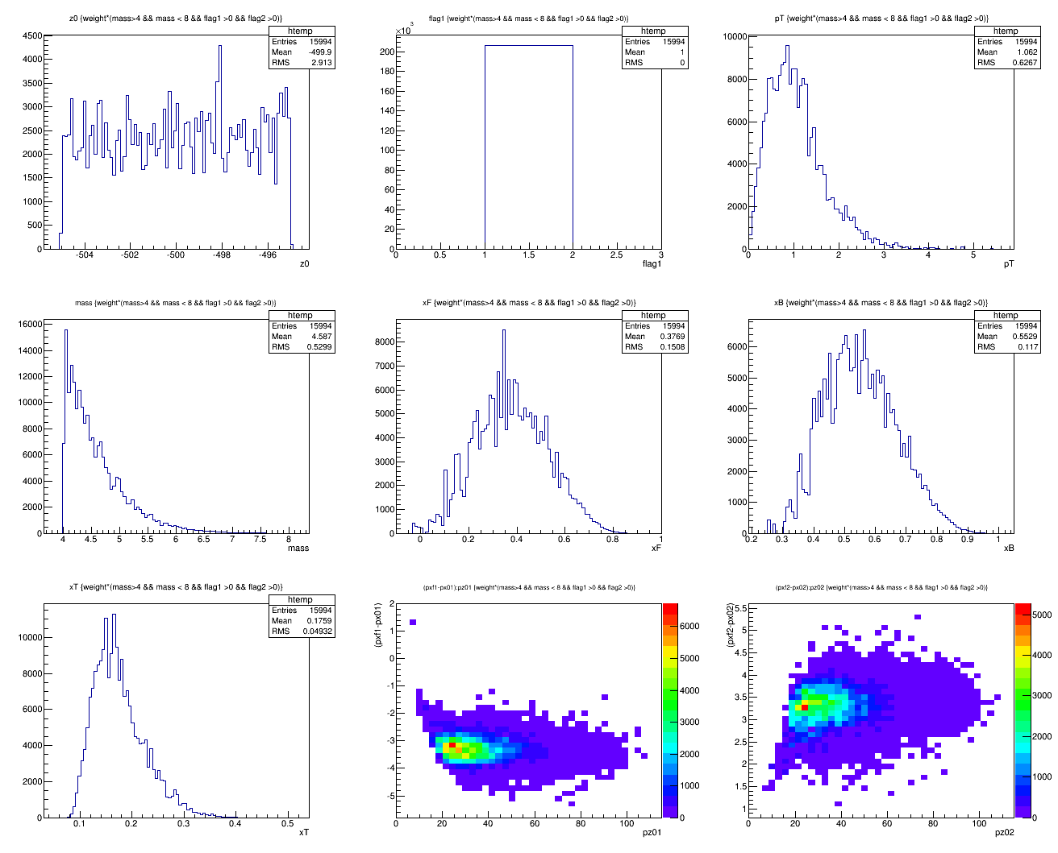
Z = -500cm, default
<x>=0.18

Slide 13
Early Study
SM0 configuration
  B_y = 5.0 Testla
  B_x = B_z = 0
  Field range: Z = []

Slide 14
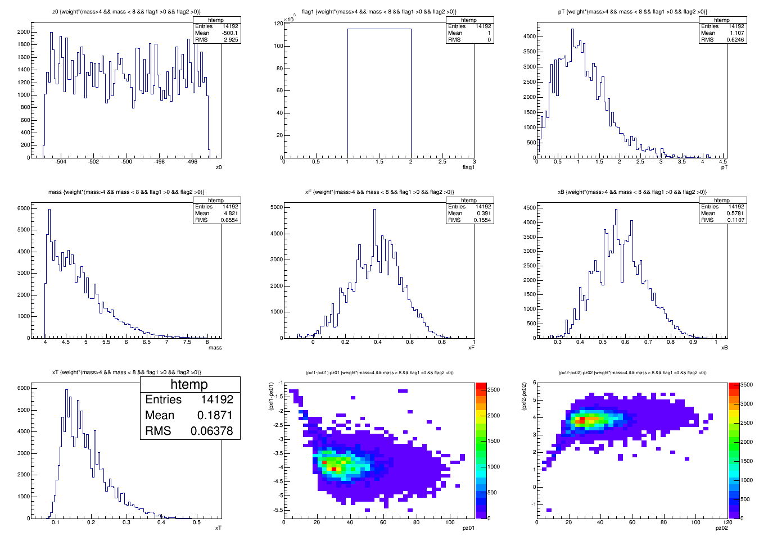
Z = -500cm, Dipole = 5T@[-100,-50]cm

Slide 15
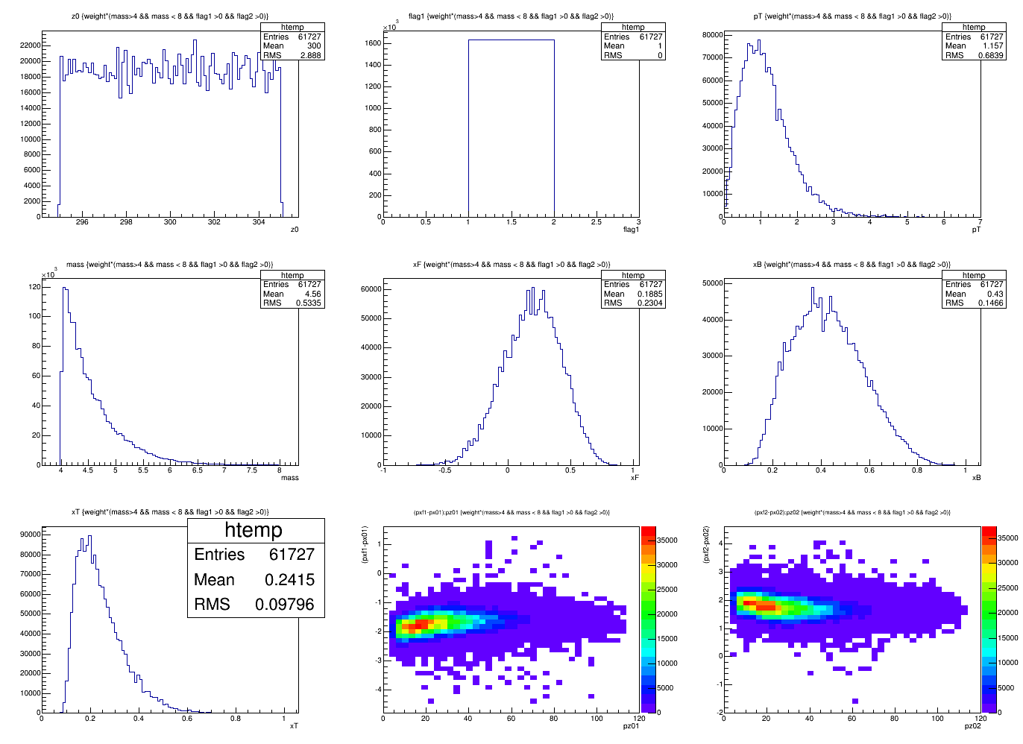
Z = -300cm, Dipole = 5T@[-100,-50]cm

Slide 16
New SM0 Configuration (1)
B_y = 2.0 Tesla
B_x = B_z = 0
Z = [-200, -100]cm
Target = 10cm LH2
Target_Z = -500, -400, -300

Slide 17
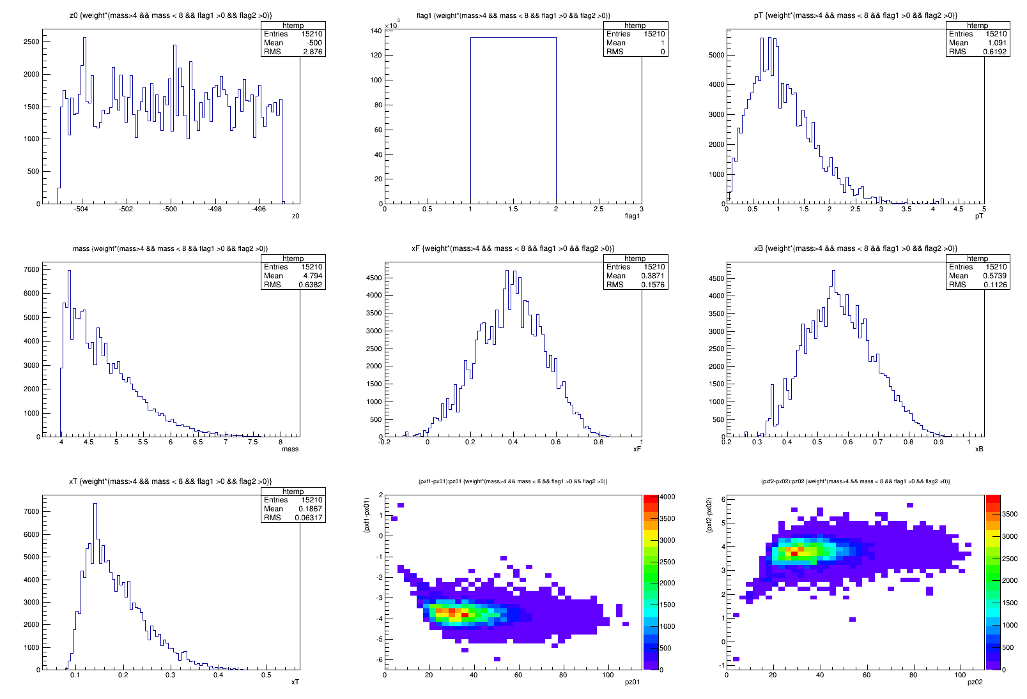
Target_Z = -500cm

Slide 18
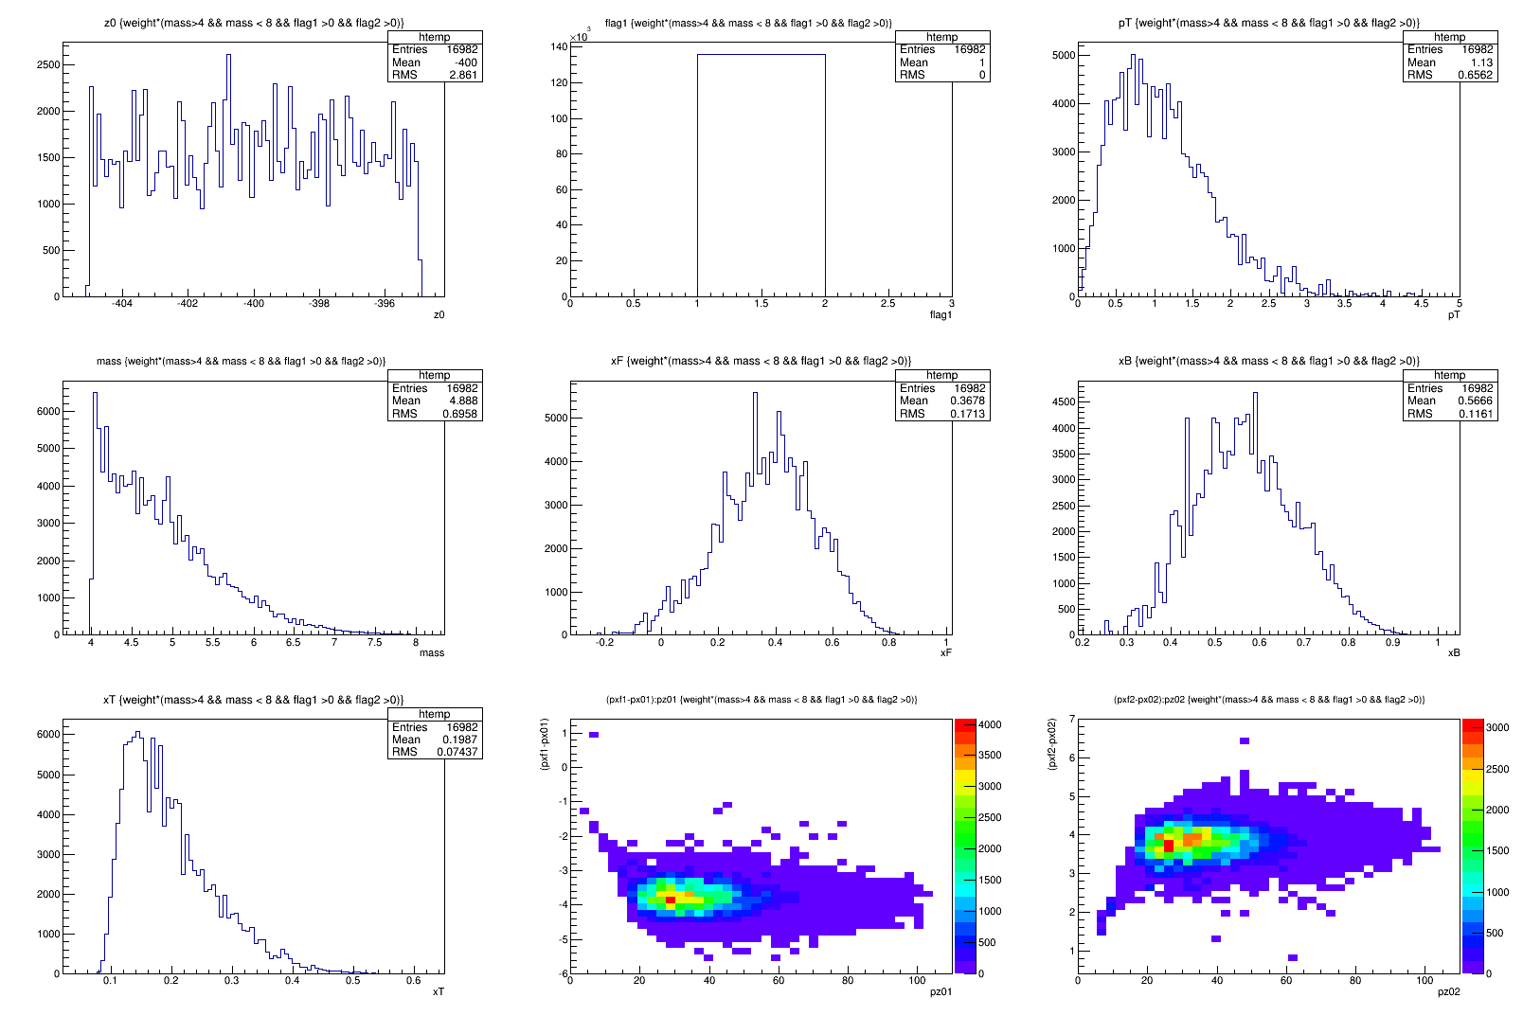
Target_Z = -400cm

Slide 19
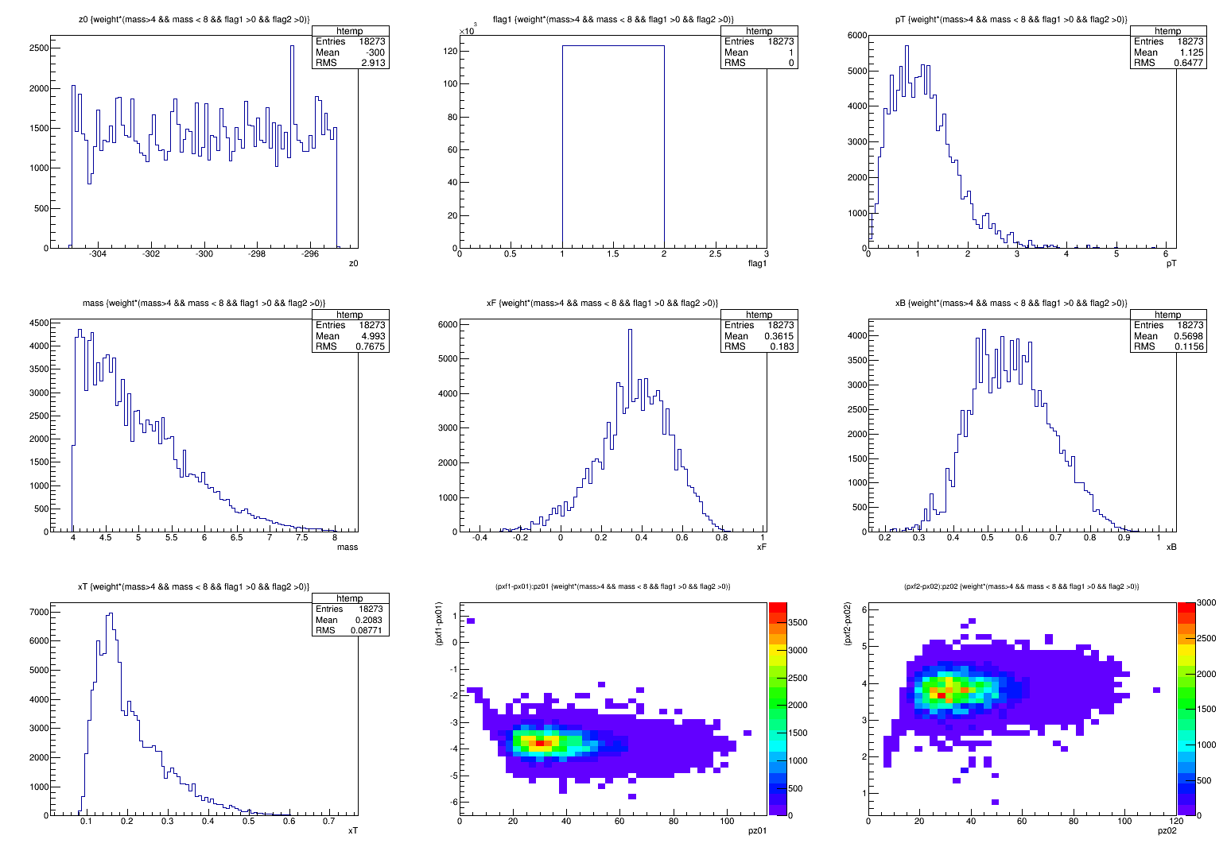
Target_Z = -300cm

Slide 20
New SM0 Configuration (2)
B_y = -2.0 Tesla
B_x = B_z = 0
Z = [-200, -100]cm
Target = 10cm LH2
Target_Z = -500, -400, -300

Slide 21
To do list
Add offline full track reconstruction
Atrget and Beam dump separation
More realistic field map
Optimize the layout of target and dipole magnet
Dipole size and position
Target B-shielding

