Slide 1
E906 Acceptance Study with a SM0 Dipole Magnet
Ming Liu

Slide 2
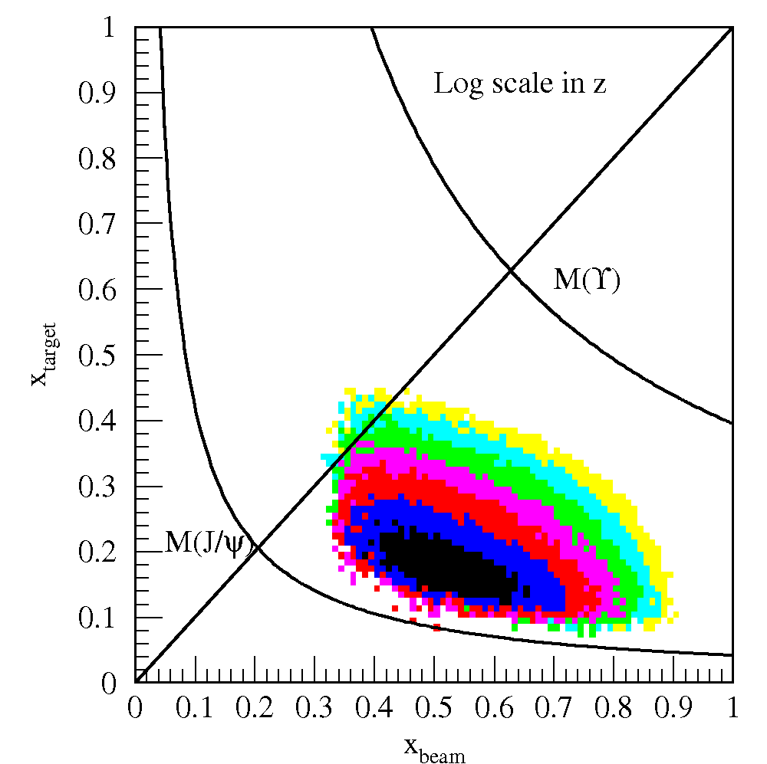
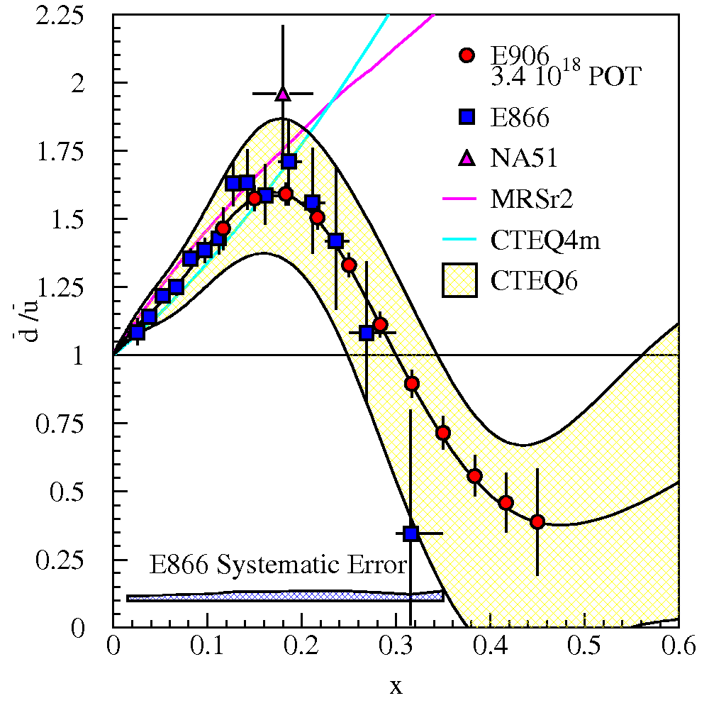
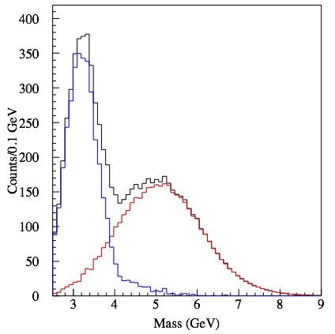
E906 Acceptance
E906 Spect.
Monte Carlo
Interesting kinematic range:
X2 = [0, 0.3] for pol. DY A_N
Default E906 = [0.1, 0.4]

Slide 3
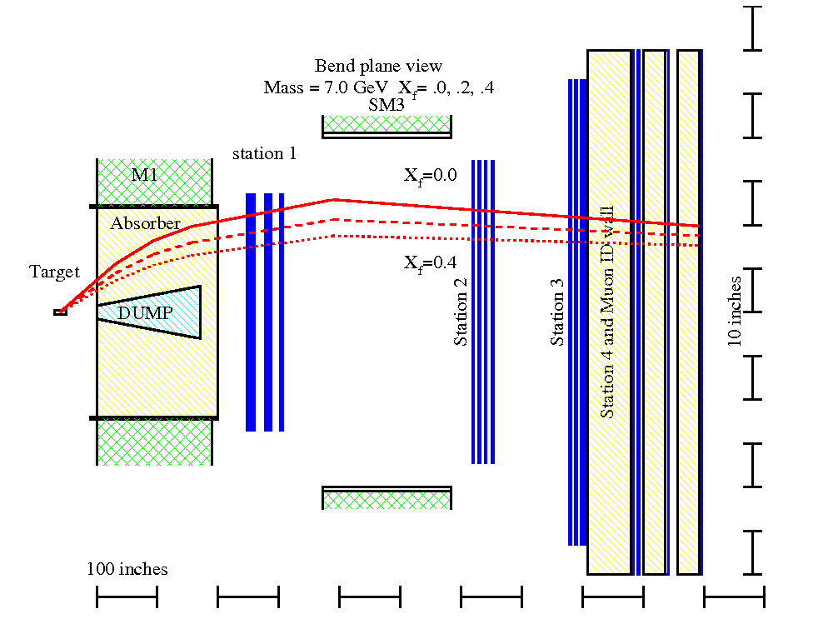
Expected Detector Performance
Reasonable J/Psi and Drell-Yan separation
  Drell-Yan: M>4GeV
Improved tracking to separate tracks from target and beam dump
Rec’d primary vtx
from Kun Liu
μ
E906 Bend Plane View
120 GeV
protons
Drift
Chambers
Muon ID

Slide 4
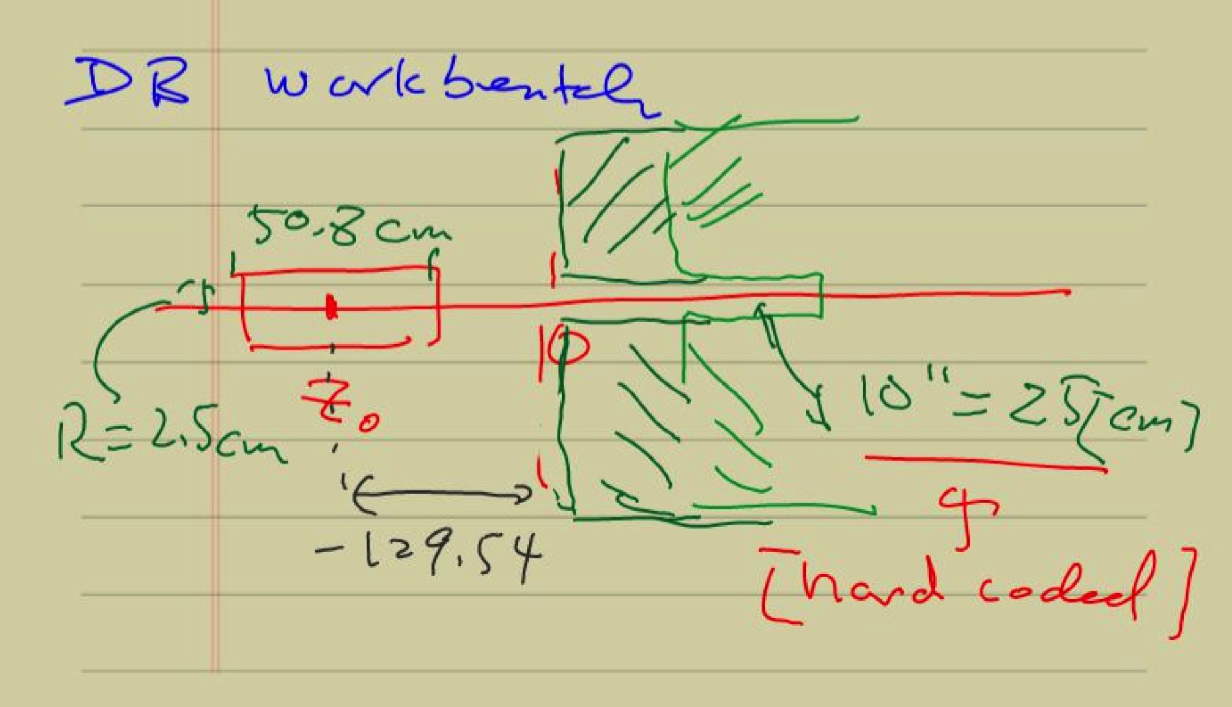

Slide 5
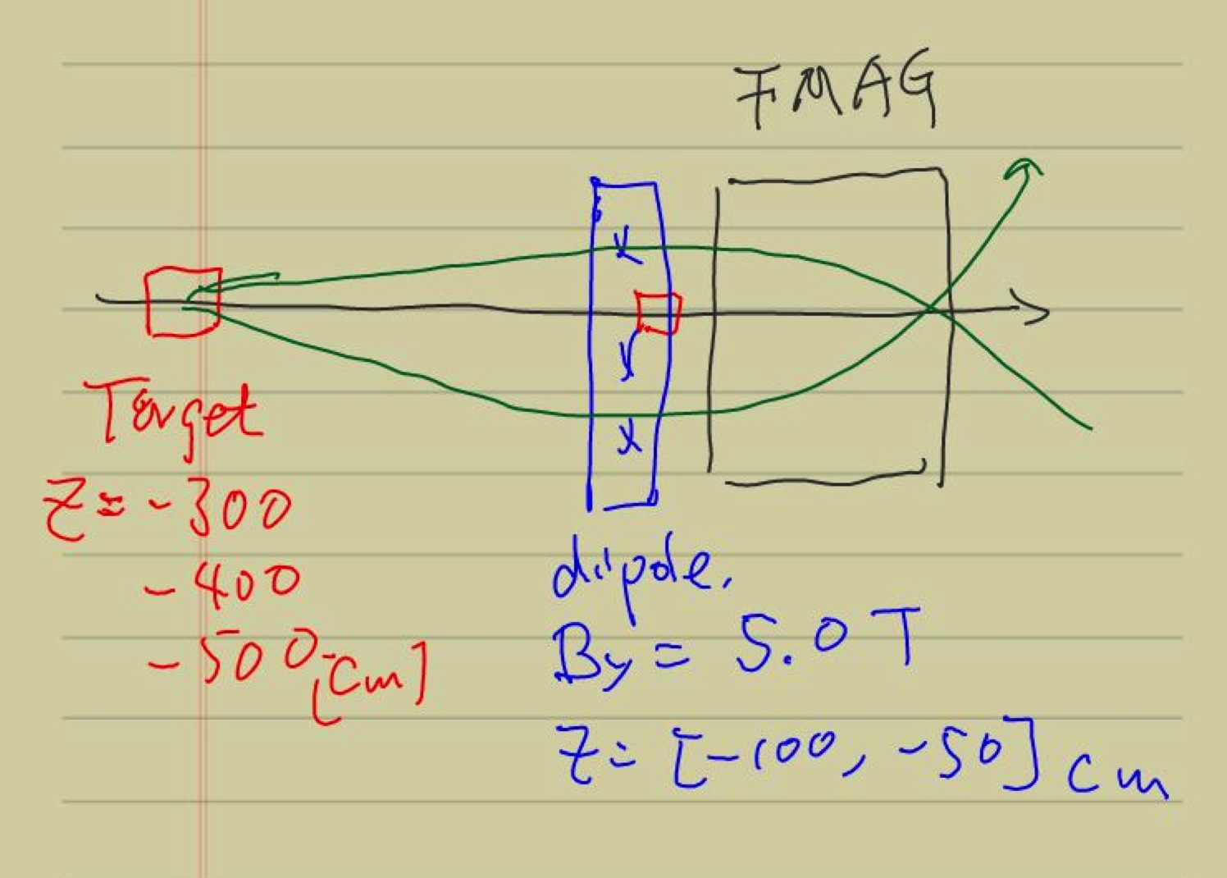
Add an ideal dipole
B_y = 5 Teslas @Z=[-100,-50]cm
B_y = +/-2 Tesla @Z=[-200,-100]cm

Slide 6
Default E906 with Various Target Z Positions, w/o SM0

Slide 7
E906 DY Target/Beam Dump Study
E906 default spectrometers setup
Target = 10cm thick, Liquid H2
Target_Z = -80, [-130], -180 cm
Target_Z = -300, -400, -500 cm
  Additional ideal dipole maget at
    Z =[-100, -50]cm
    B_y = 5 Tesla
Study mass, pT, xB, xT acceptance

Slide 8
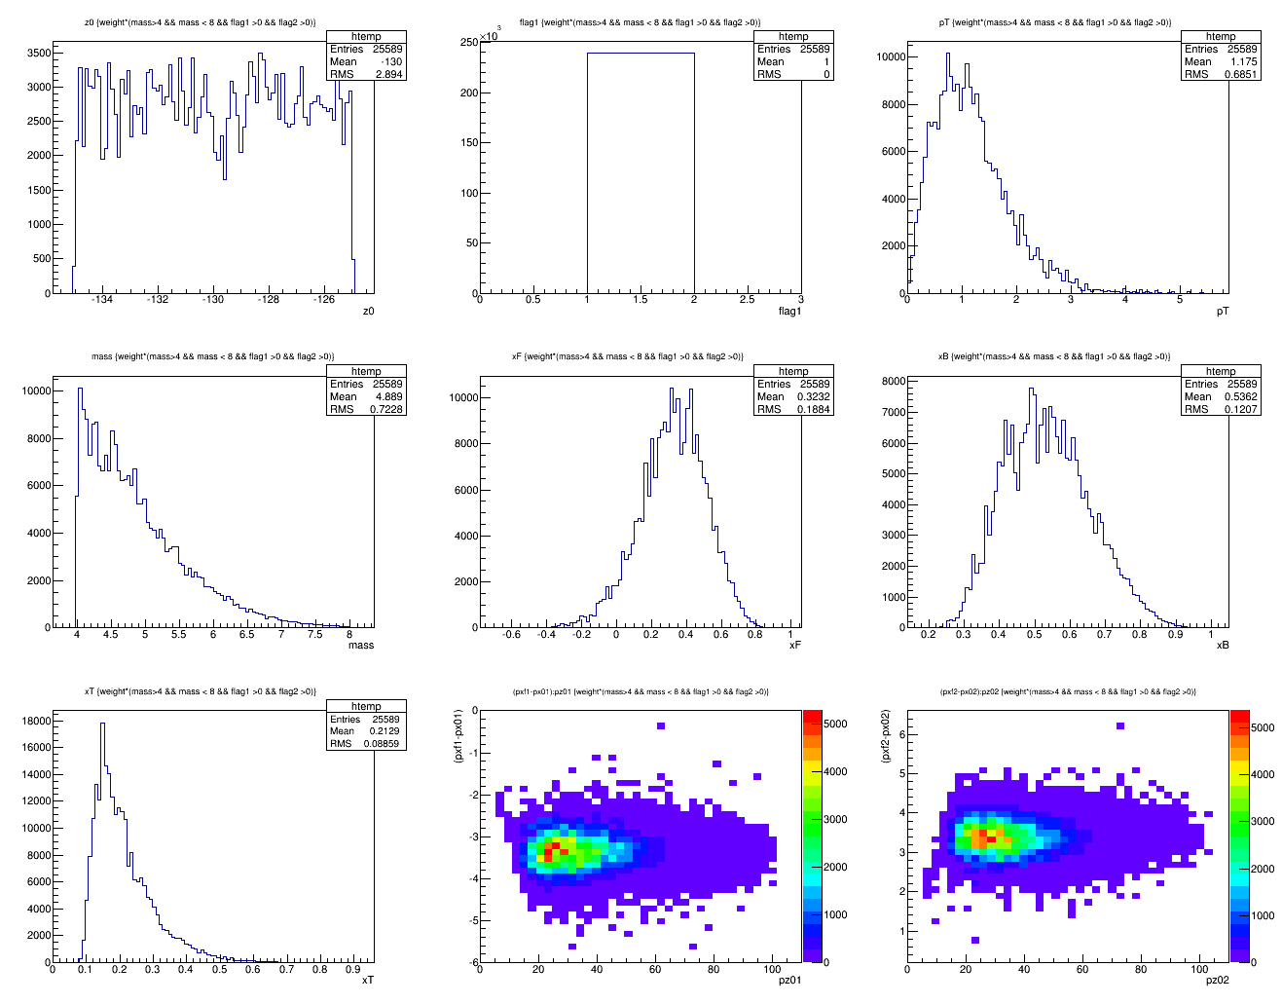
Z = -130cm, Default, w/ Cross-section weighted
Z = -130 cm
<x>=0.212
X_target
N = 25.6K

Slide 9
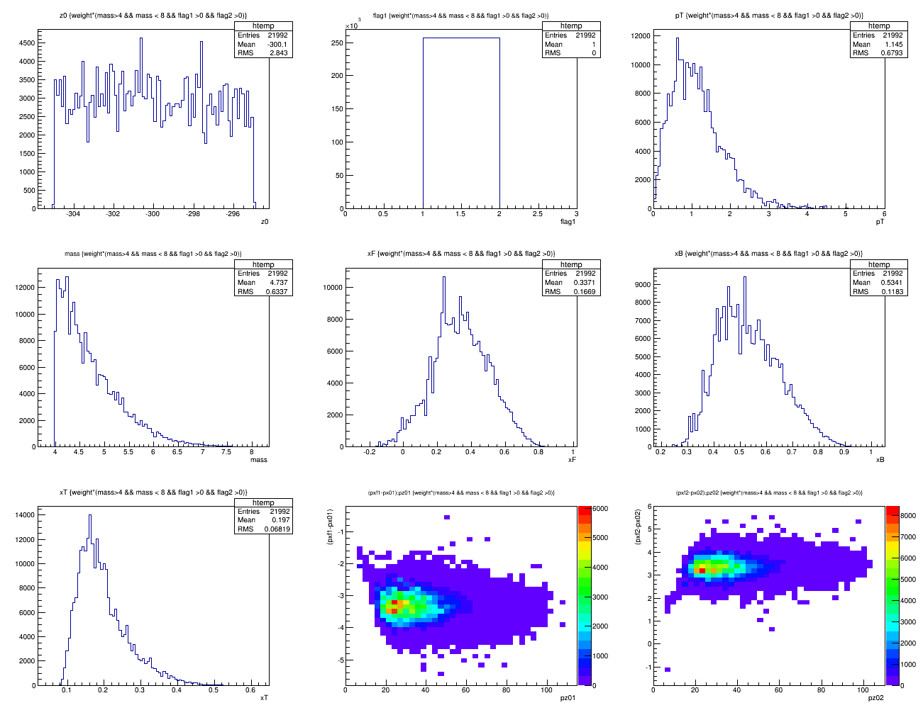
Z = -300cm, default
<x>=0.197
N =22.0K

Slide 10
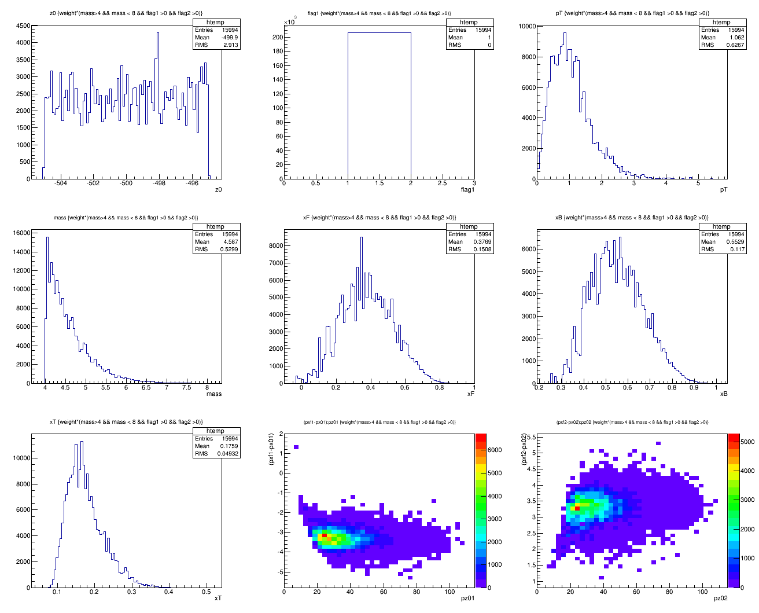
Z = -500cm, default, no SM0
<x>=0.176
N = 16.0K

Slide 11
Initial Study of SM0
SM0 configuration
  B_y = 5.0 Testla
  B_x = B_z = 0
  Field range: Z = [-100, -50]cm

Slide 12
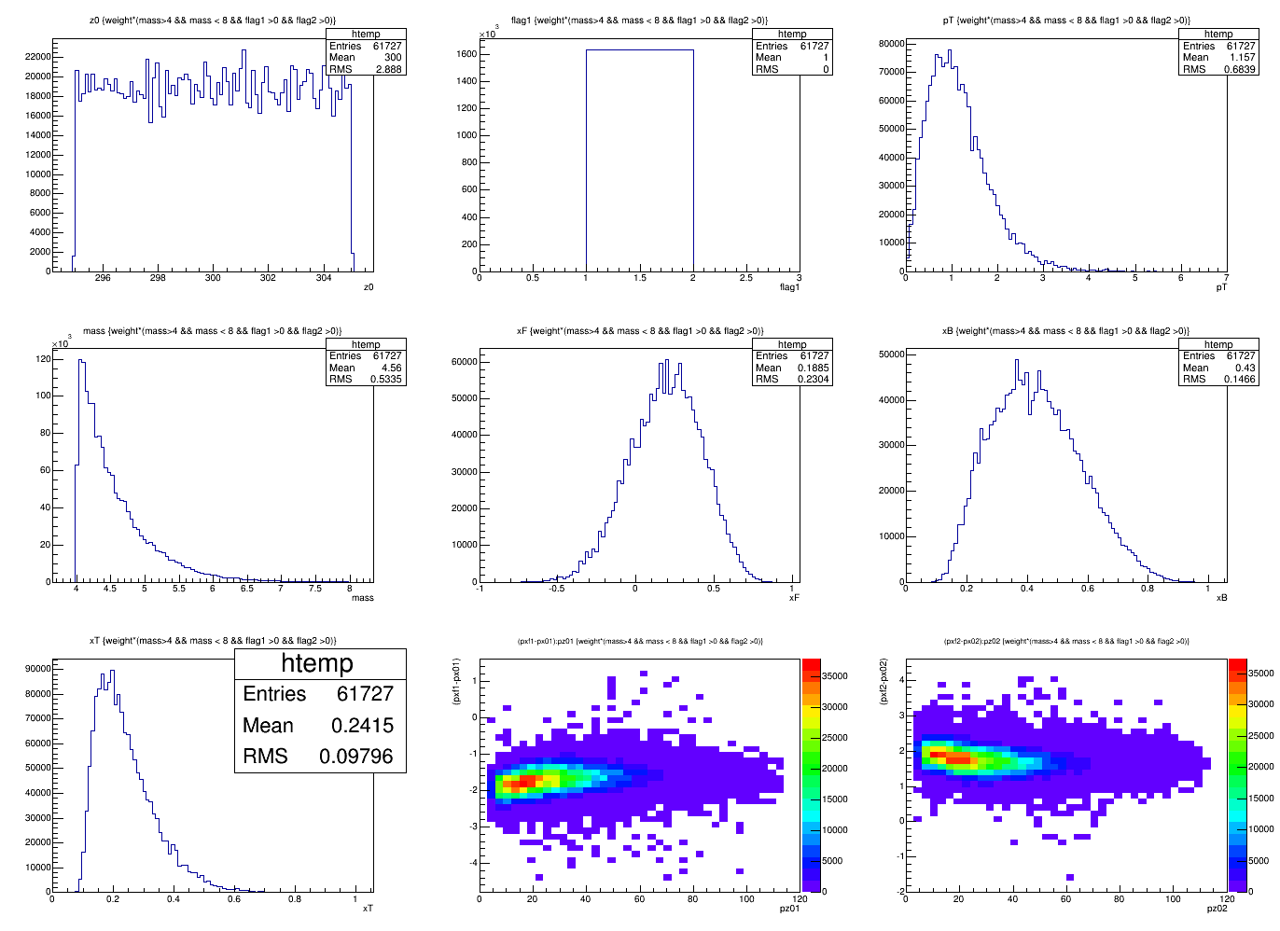
Z = -300cm, Dipole = 5T@[-100,-50]cm

Slide 13
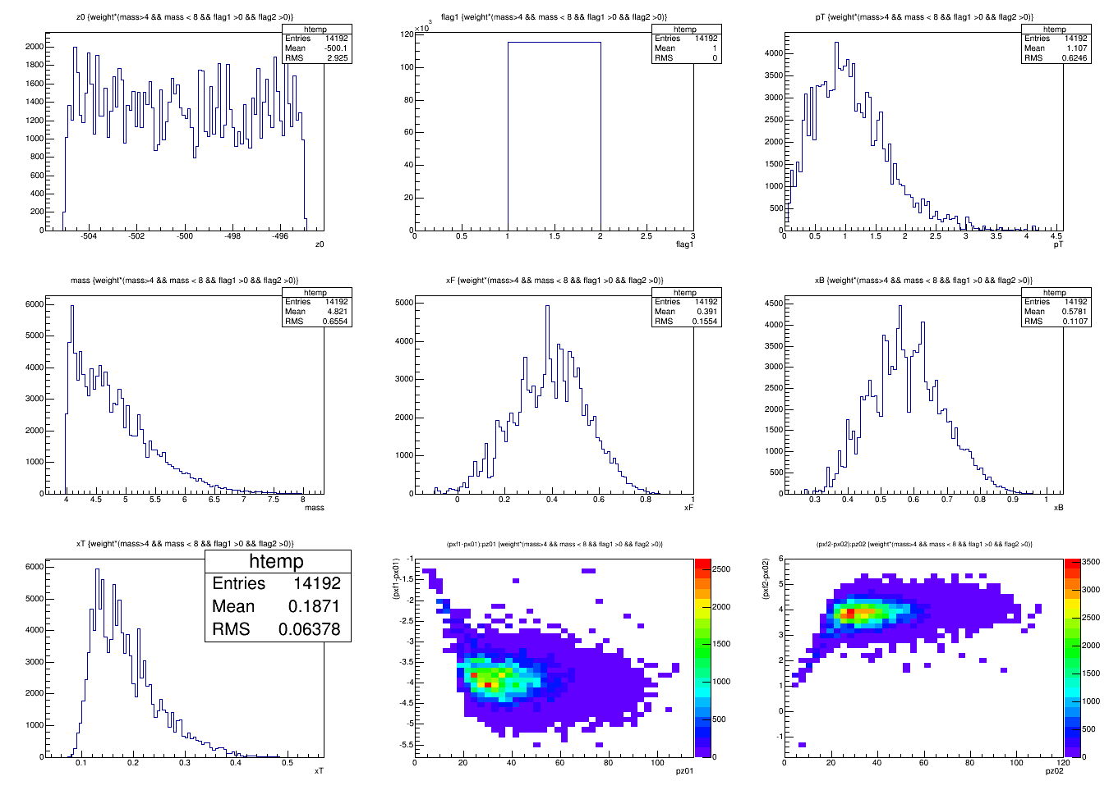
Z = -500cm, Dipole = 5T@[-100,-50]cm
<X2> = 0.187
N = 14.2K

Slide 14
New SM0 Configuration (1)
B_y = 2.0 Tesla
B_x = B_z = 0
Z = [-200, -100]cm
Target = 10cm LH2
Target_Z = -500, -400, -300
B_y = -2.0 Tesla
Z = [-200, -100]cm
Target_Z = -500, -400., -300
GMCbuildmaster_dev2

Slide 15
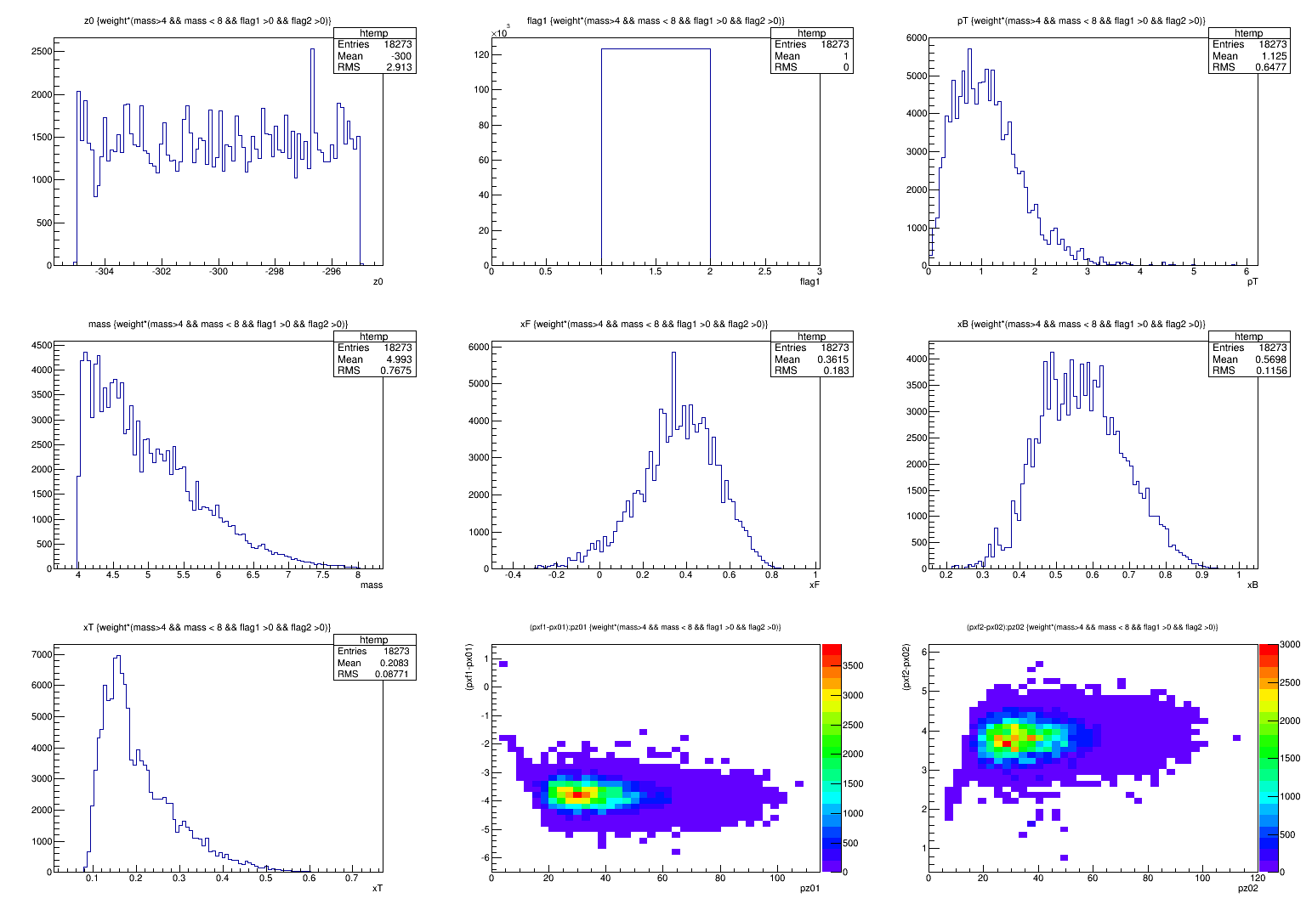
Target_Z = -300cm, By = 2.0Tesla
<X2>=0.208
N=18.3K

Slide 16
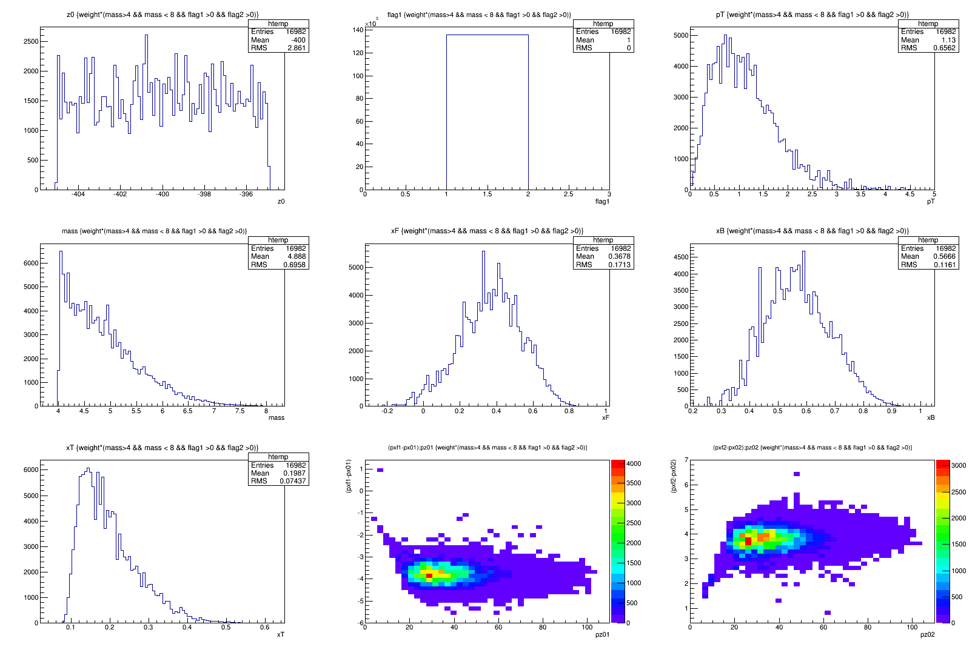
Target_Z = -400cm
<X2>=0.199
N=17.0K

Slide 17
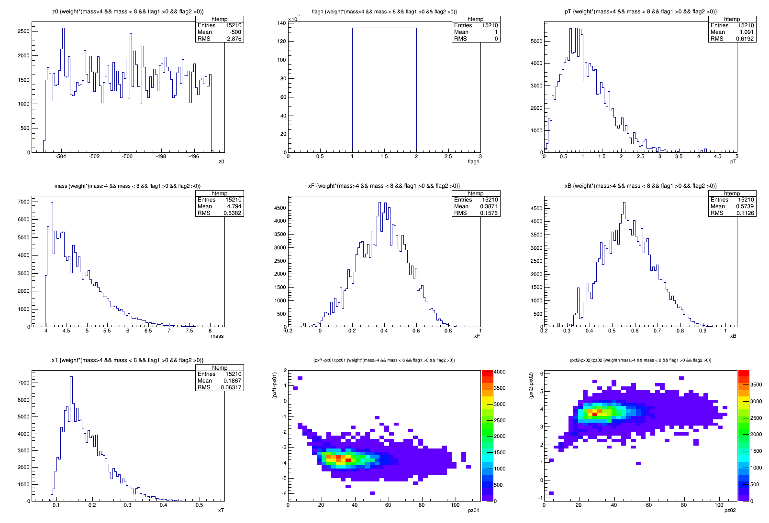
Target_Z = -500cm
<X2>=0.187
N=15.2K

Slide 18
New SM0 Configuration (2)
B_y = -2.0 Tesla
B_x = B_z = 0
Z = [-200, -100]cm
Target = 10cm LH2
Target_Z = -500, -400, -300
B_y = -2.0 Tesla
Z = [-200, -100]cm
Target_Z = -500, -400., -300
GMCbuildmaster_dev3

Slide 19
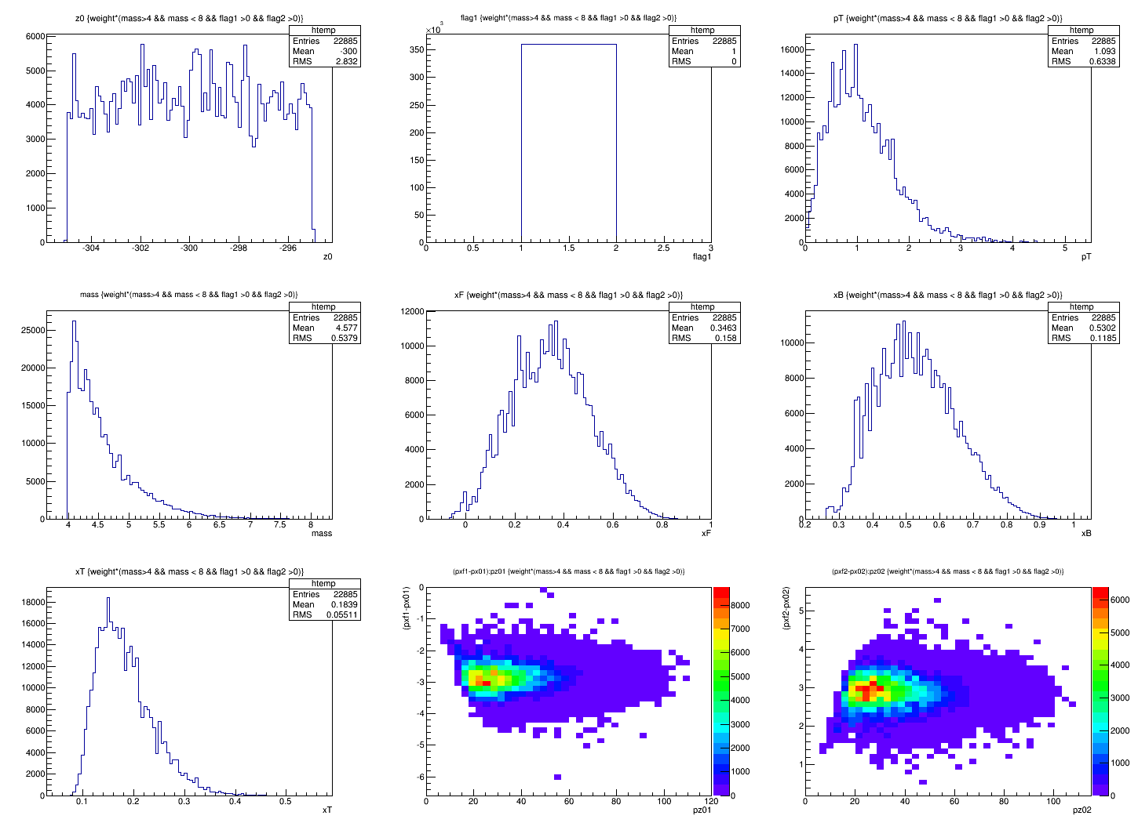
Target Z = -300 cm; By = -2.0T
<X2>=0.184
N=22.9K

Slide 20
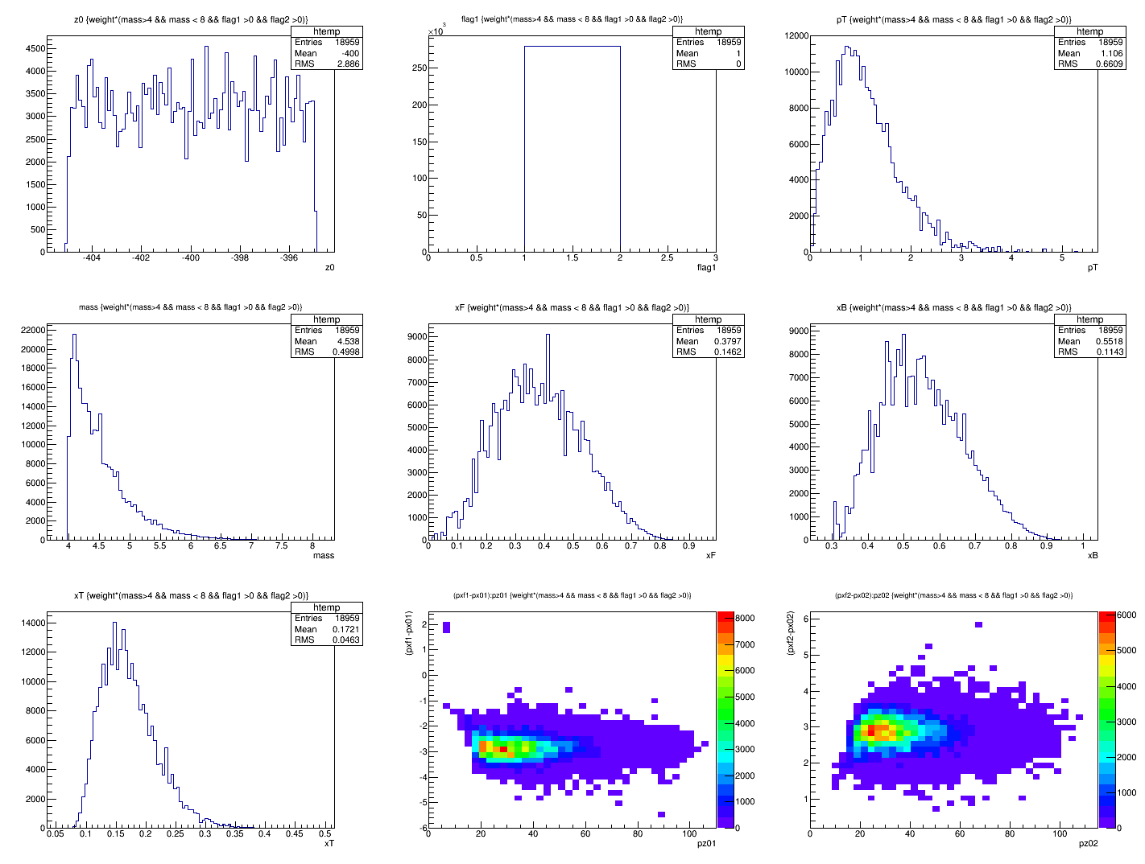
Target Z = -400 cm; By = -2.0T
<X2>=0.172
N=19.0K

Slide 21
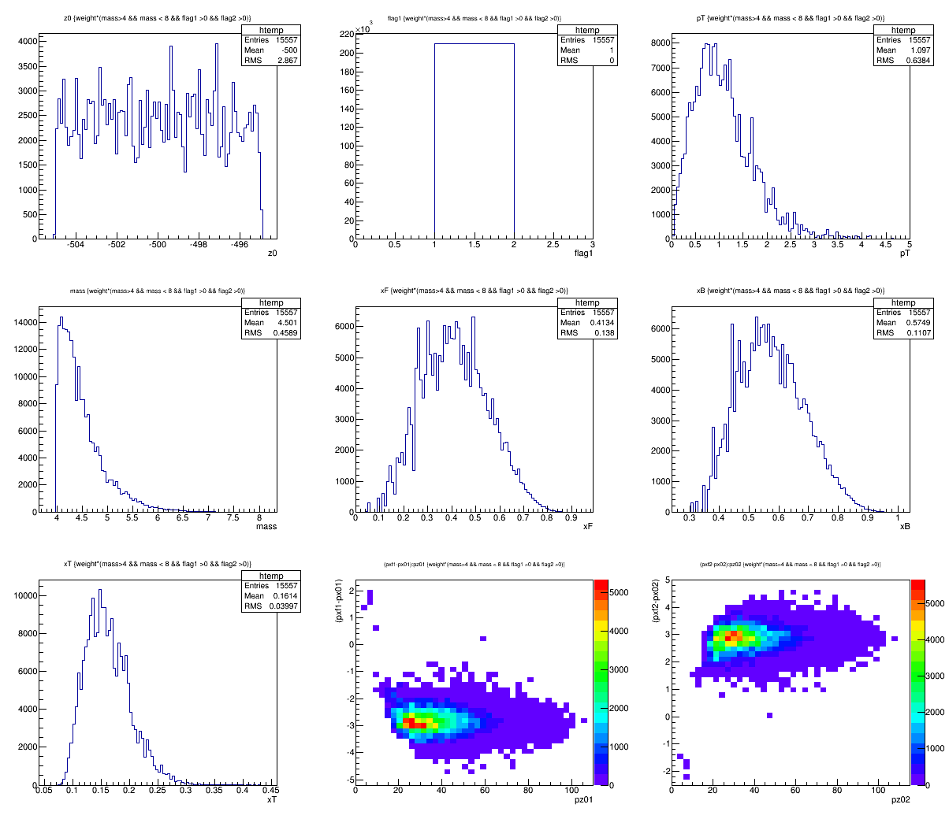
Target Z = -500 cm; By = -2.0T
<X2>=0.161
N=15.6K

Slide 22
Quick Summary
W/o SM0 target_Z = -500 cm
  <X2> = 0.176
  N = 16.0K
With SM0, target_Z = -500 cm; B_y = +2.0 Tesla
  <X2> = 0.187
  N = 14.2K
With SM0, target_Z = -500 cm; B_y = -2.0 Tesla
  <X2> = 0.161
  N = 15.6K
@Z = -130 cm
<X2> = 0.212
N = 25.6K

Slide 23
To do list
Add offline full track reconstruction
  Remove “hot areas” near beam line
  Near beam line hits rejection
  Tracking efficiency
Target and Beam dump separation
  Efficiency vs purity
More realistic field map
  (3)2D field map
Optimize the layout of target and dipole magnet
  Optimal X2 range from target
SM0 Dipole size and position
  Mechanical design
Target B-shielding, impact of “5Tesla” target fields

Slide 25
Default Setup Accepted Events w/o Cross Section Weight
Z = -80 cm

Slide 26
Z = -130 cm

Slide 27
Z = -180cm

Slide 28
Z= -180 cm
NOT cross section
weighted
distributions

