Slide 1
Optimization of Target and Beam-Dump Separation?
Kun Liu, Pat McGaughey, Ming Liu
LANL

Slide 2
Motivations
Target/Dump Separation
  Optimization of Target/Dump Separation
Physics desires for Sivers functions
  Keep the small-x sea-quarks as much as possible
  Significant TSSA A_N in DIS experiments
    X = 0.05 ~ 0.3
  E906 sea quark acceptance
    X = 0.1 ~ 0.4
    Would like to reach the small x2 region around 0.1~0.2
Sivers function plots
from global fits

Slide 3
Target/Dump Separation
Run2 data
  “online z-sigma” ~ 100cm
  Separation at trigger level needed for “small target”

Slide 4
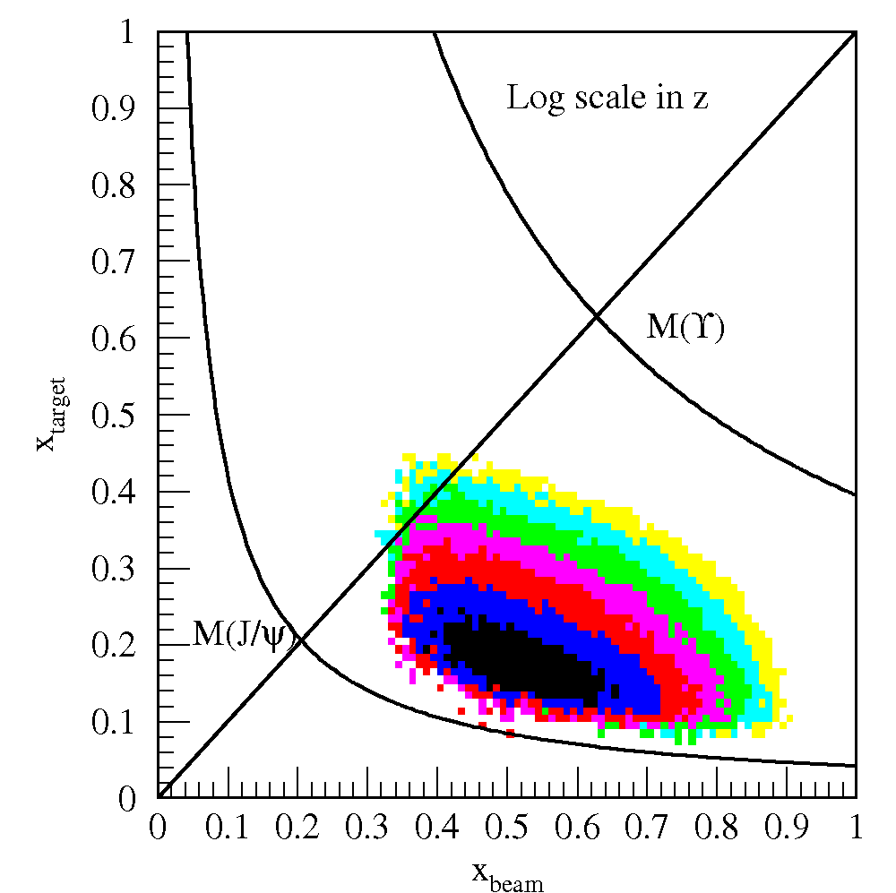
Detector Acceptance for Physics
Reasonable J/Psi and Drell-Yan separation
  Drell-Yan: M>4GeV
Good access to “interesting” x_target region
E906 Spect.
Monte Carlo

Slide 5
Target Position and Detector Acceptance
Move the target upstream further sway from beam dump
Add SM0 dipole to keep the acceptance

Slide 6
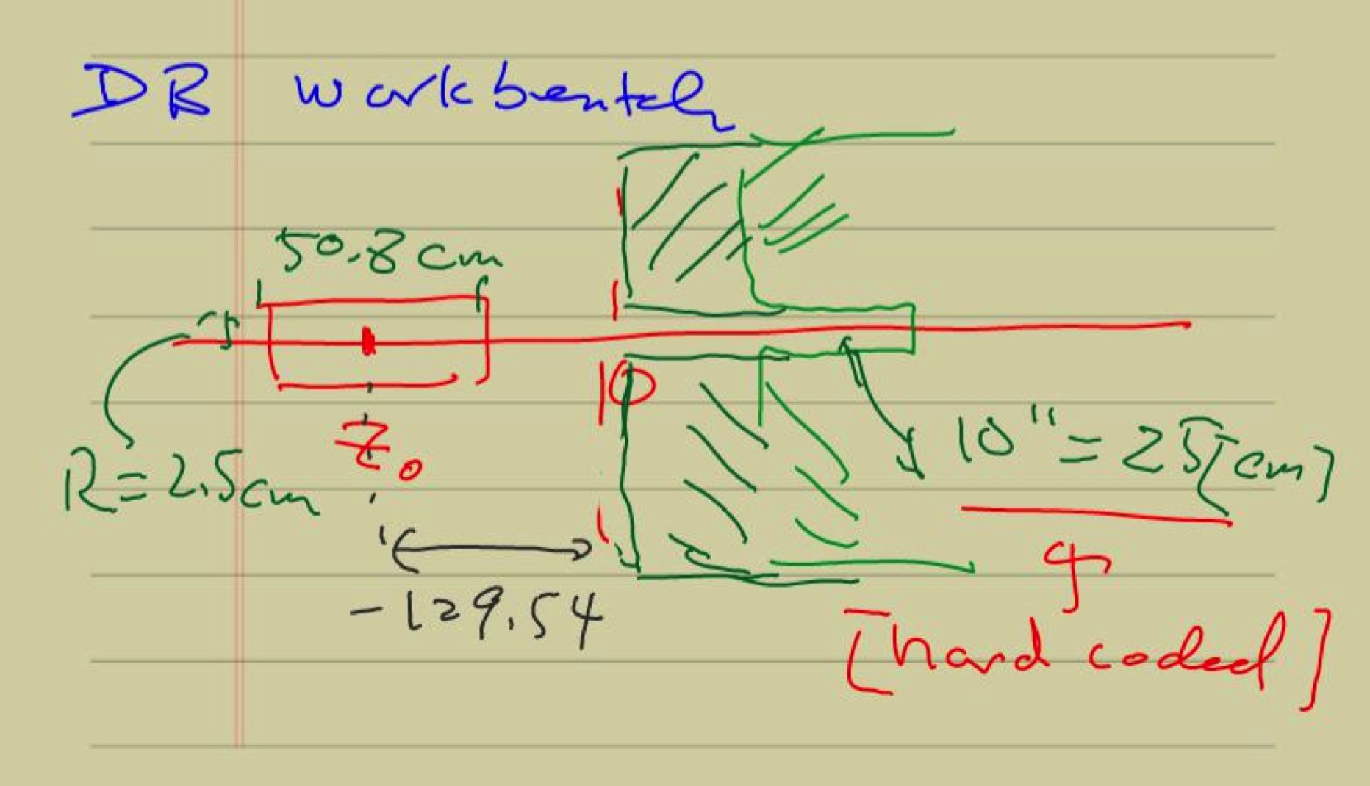

Slide 7
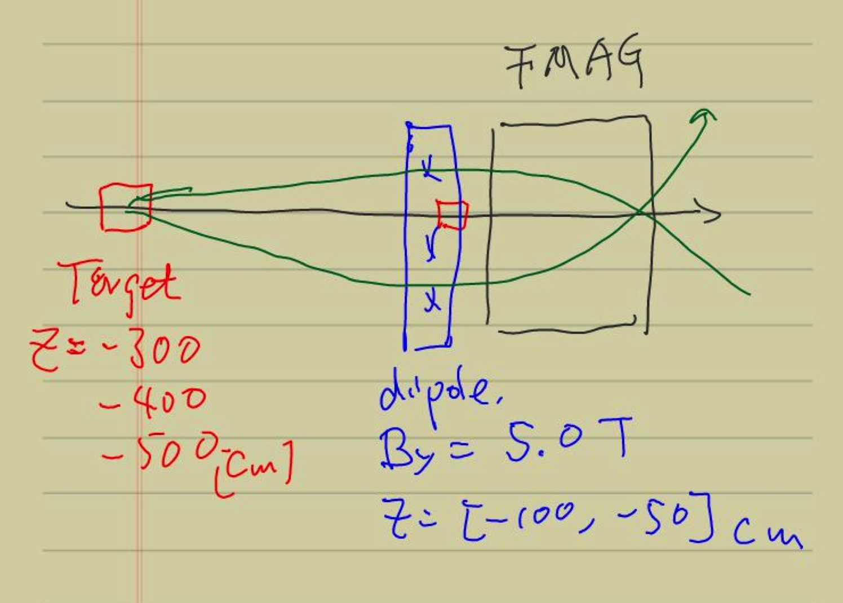
Add an ideal dipole
B_y = 5 Teslas @Z=[-100,-50]cm
B_y = +/-2 Tesla @Z=[-200,-100]cm

Slide 8
Target sea-quark x-Range and Statistics
Case-1:
  target @ Z = -300/-400/-500 cm
  SM0: NO
Case-2
  target @ Z = -300/-400/-500 cm
  SM0: By= 5 testla, @Z=[-100, -50]cm
Case-3
  target @ Z = -300/-400/-500 cm
  SM0: By= -2 Tesla, @Z=[-300, -200]cm

Slide 9
Case-I : E906 DY Target/Beam Dump Study
E906 default spectrometers setup
Target = 10cm thick, Liquid H2
Target_Z = [-130]cm
Target_Z = -300, -400, -500 cm
  Additional ideal dipole maget at
    Z =[-100, -50]cm
    B_y = 5 Tesla
Study mass, pT, xB, xT acceptance

Slide 10
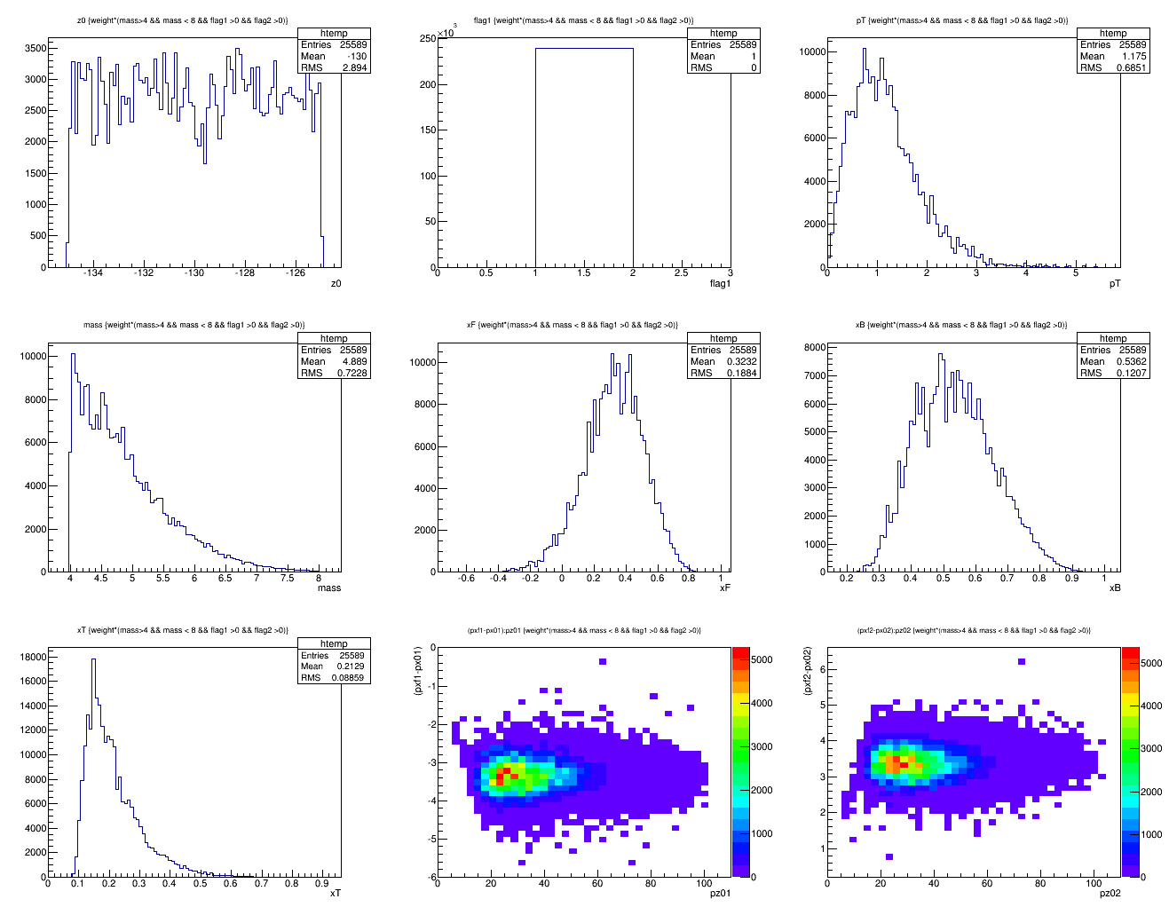
Z = -130cm, Default, w/ Cross-section weighted
Z = -130 cm
4<M<8
<x>=0.212
X_target
N = 25.6K

Slide 11
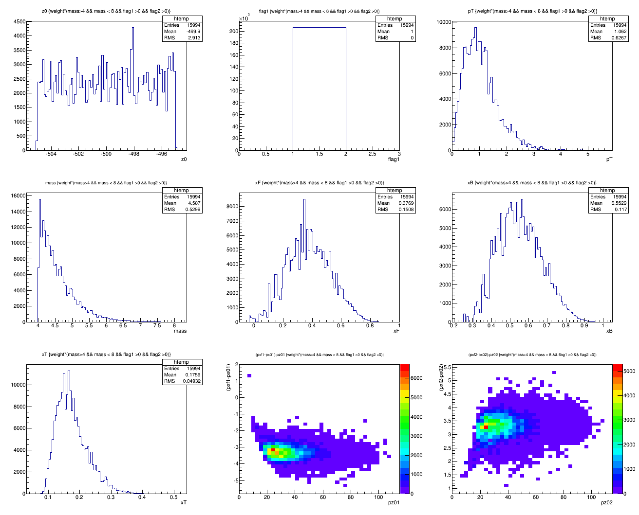
Z = -500cm, default, no SM0
<x>=0.176
N = 16.0K

Slide 12
Case-II: New SM0 Configuration
B_y = -2.0 Tesla
B_x = B_z = 0
Z = [-200, -100]cm
Target = 10cm LH2
Target_Z = -500, -400, -300
B_y = -2.0 Tesla
Z = [-200, -100]cm
Target_Z = -500, -400., -300
GMCbuildmaster_dev3

Slide 13
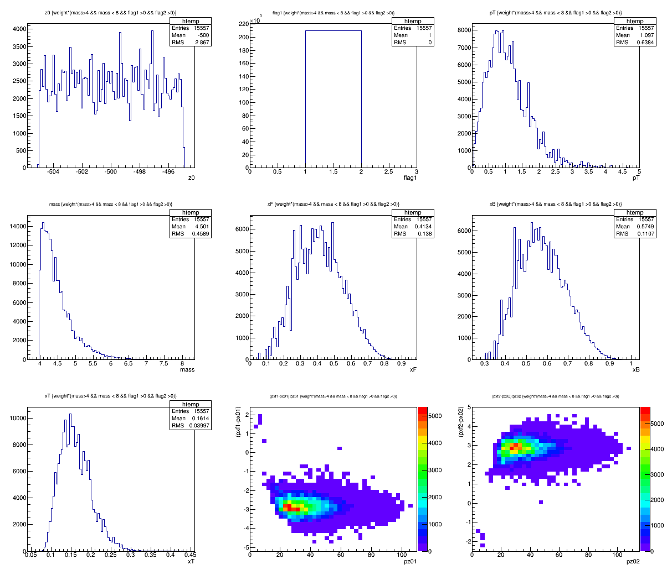
Target Z = -500 cm; By = -2.0T
<X2>=0.161
N=15.6K

Slide 14
Case-III: New SM0 Configuration
B_y = -2.0 Tesla
B_x = B_z = 0
Z = [-500, -400]cm
Target = 10cm LH2
Target_Z = -600, -700, -800cm

Slide 15
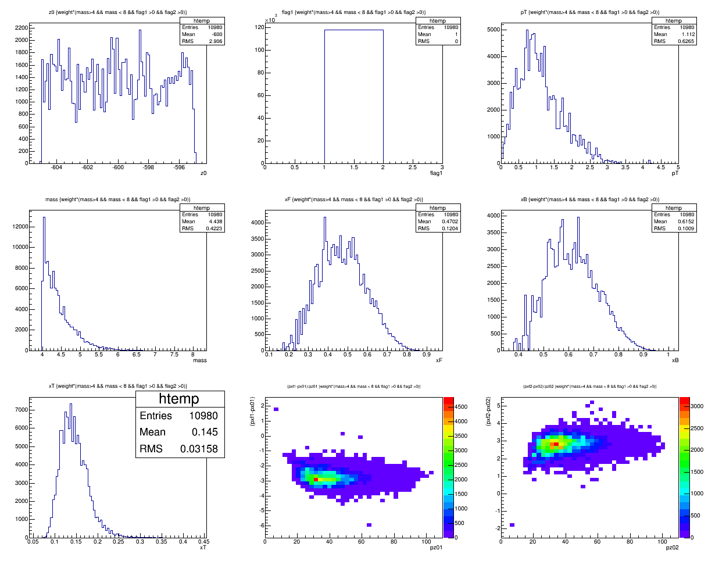
Z= -600cm; By=-2.0Tesla
X2=0.145
N=10,980

Slide 16
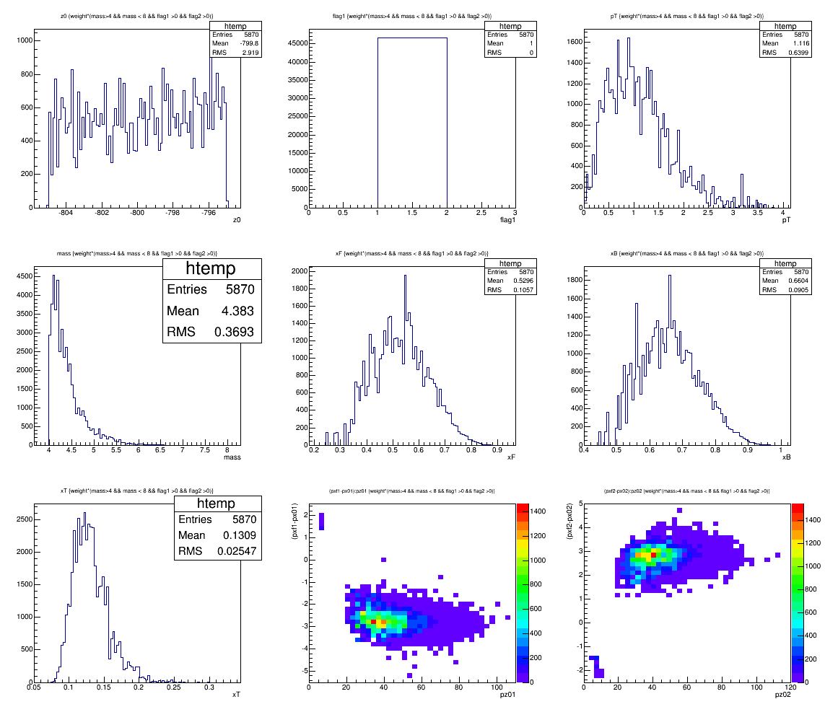
Z= -800cm; By=-2.0Tesla
X2=0.13
N=5870

Slide 17
Target/Dump Separation at Trigger

Slide 18
Backup slides

Slide 19
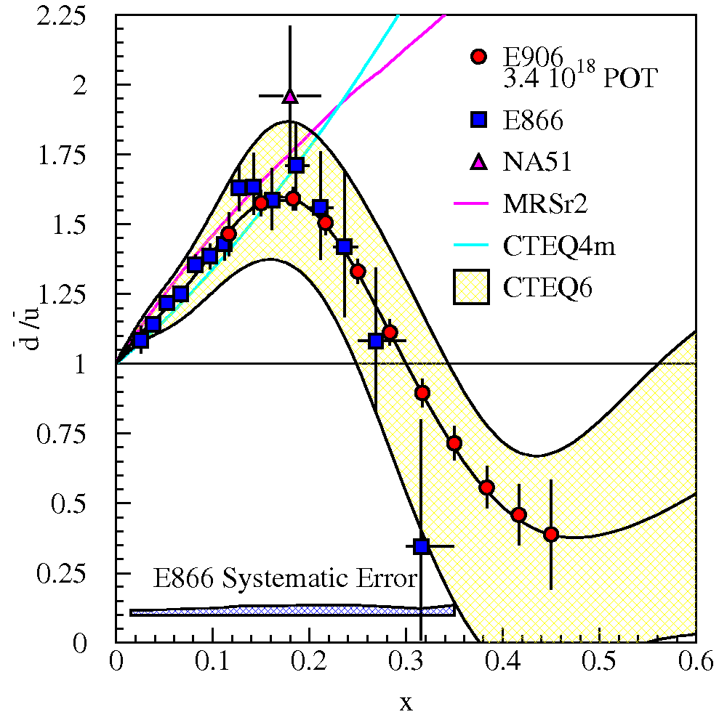
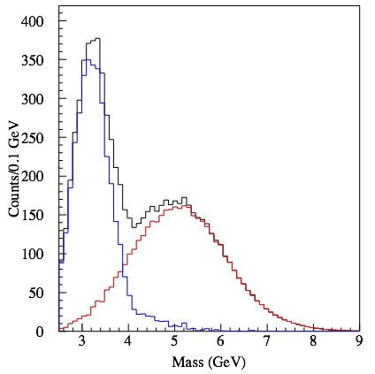
E906 Acceptance
E906 Spect.
Monte Carlo
Interesting kinematic range:
X2 = [0, 0.3] for pol. DY A_N
Default E906 = [0.1, 0.4]

Slide 20
Initial Study with simple SM0
Target at -500, -400, -300cm from
SM0 options
  By= +/-2 Testla
  L = 100 cm

Slide 21
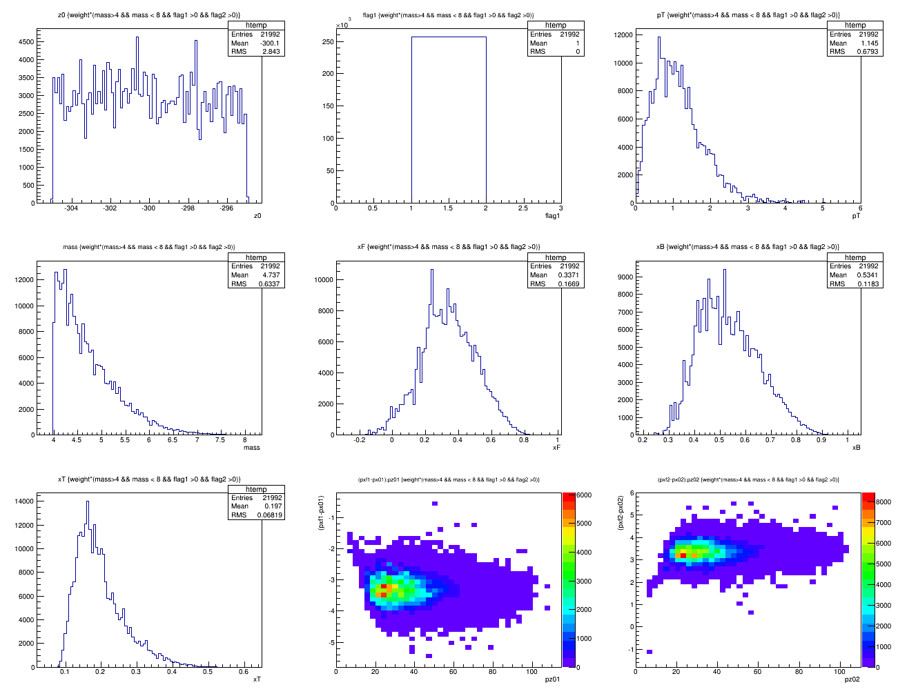
Z = -300cm, default
<x>=0.197
N =22.0K

Slide 22
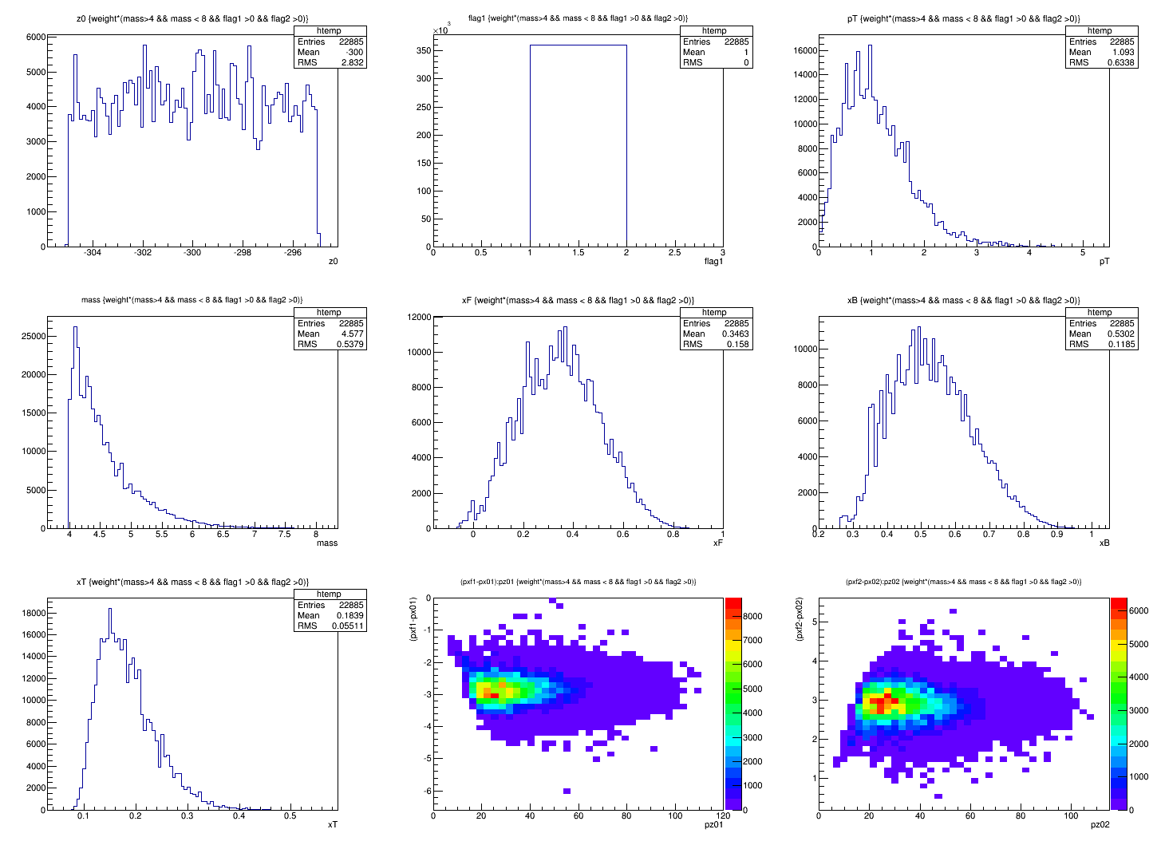
Target Z = -300 cm; By = -2.0T
<X2>=0.184
N=22.9K

Slide 23
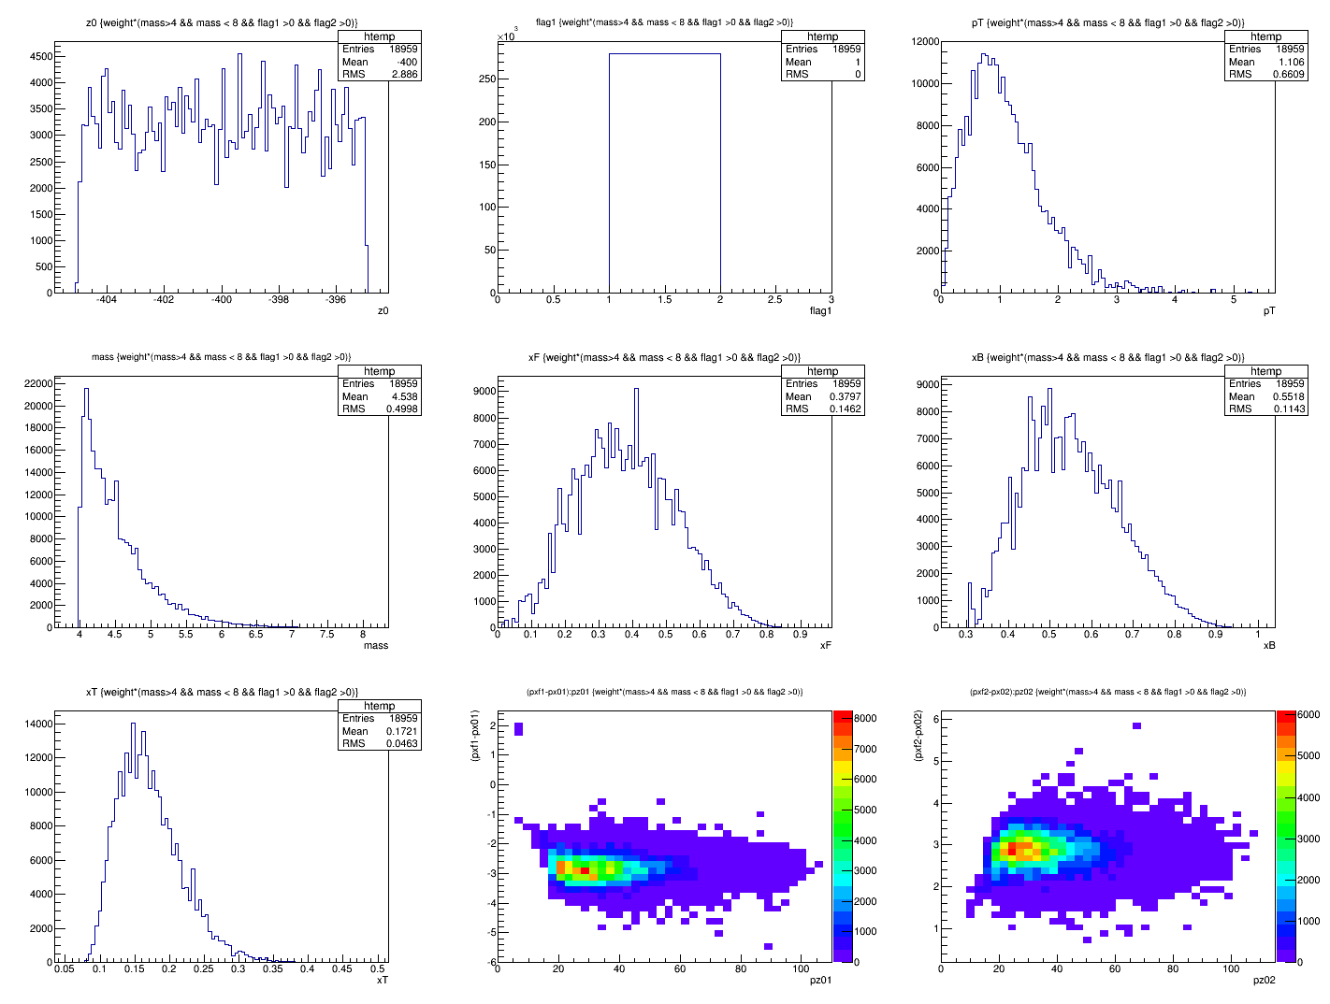
Target Z = -400 cm; By = -2.0T
<X2>=0.172
N=19.0K

Slide 24
MC Events

Slide 25
Default Setup Accepted Events w/o Cross Section Weight
Z = -80 cm

Slide 26
Z = -130 cm

Slide 27
Z = -180cm

Slide 28
Z= -180 cm
NOT cross section
weighted
distributions

