Slide 1
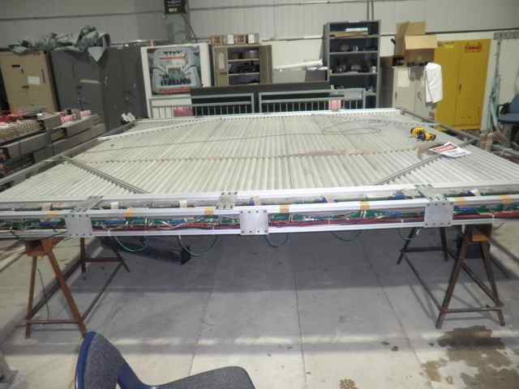
St4 Prop Tubes Detectors
Jan. 20, 2011 first 9-module V-plane(1X) completed

Slide 2
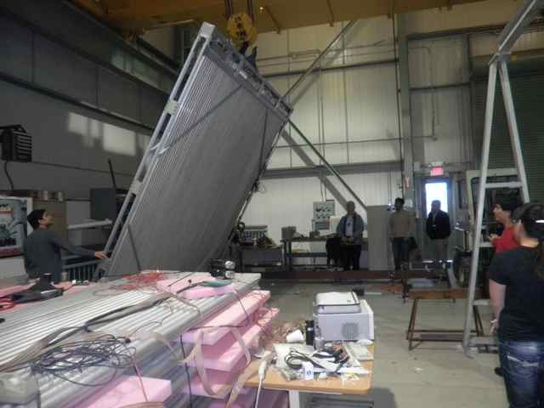
The first completed plane

Slide 3
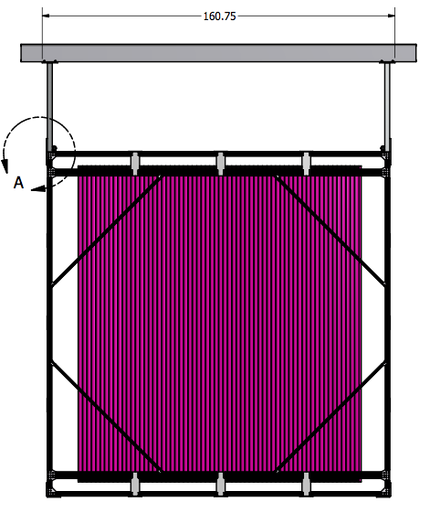
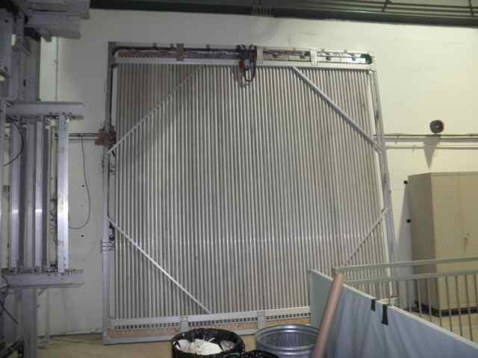
Completed St4 Prop Tubes: V1

Slide 4
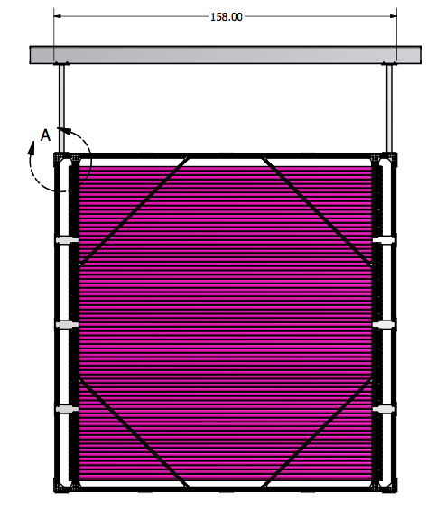
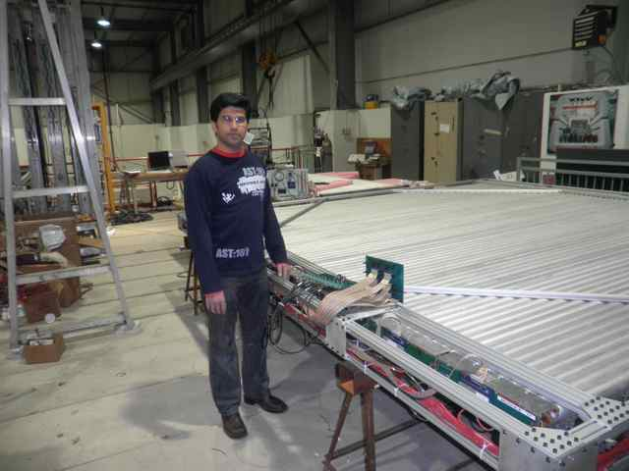
Completed 2nd Plane: H1 (1Y) 01/26/2011

Slide 5
Station 4 Muon Identifier Design
2 X and 2 Y layers, coverage = 12’ x 12’
Aluminum drift tubes for good position resolution → track matching to Station 3 drift chambers
Each plane constructed of 2 staggered rows of 2” diameter tubes for excellent efficiency and reasonable channel count
Nanometrics amplifier / discriminator electronics with ECL output.
Well tested design with 1000’s of operational tubes.
Works with a variety of gas mixtures @ ~ +2300V
μ
End view of a 16 tube module

Slide 6
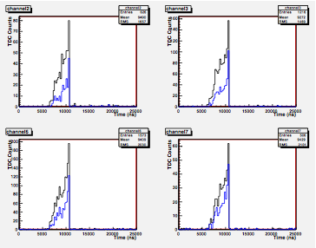
Cosmic TDC Spectra Thanks Kaz and Grass!
ΔT~3uS

Slide 7
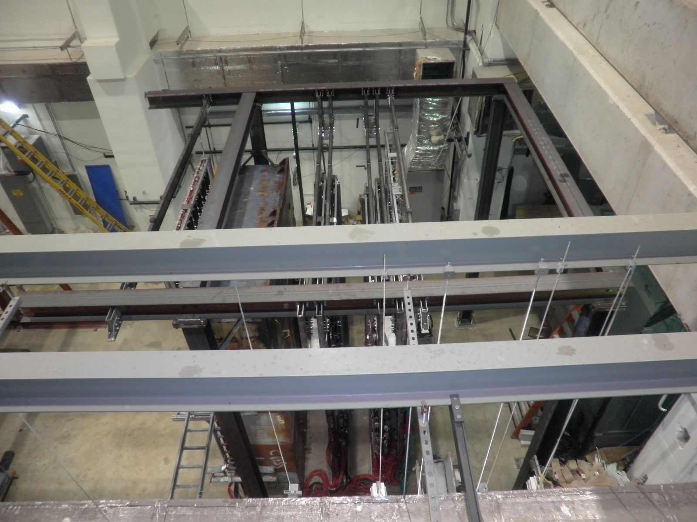
I-beam support structure

Slide 8
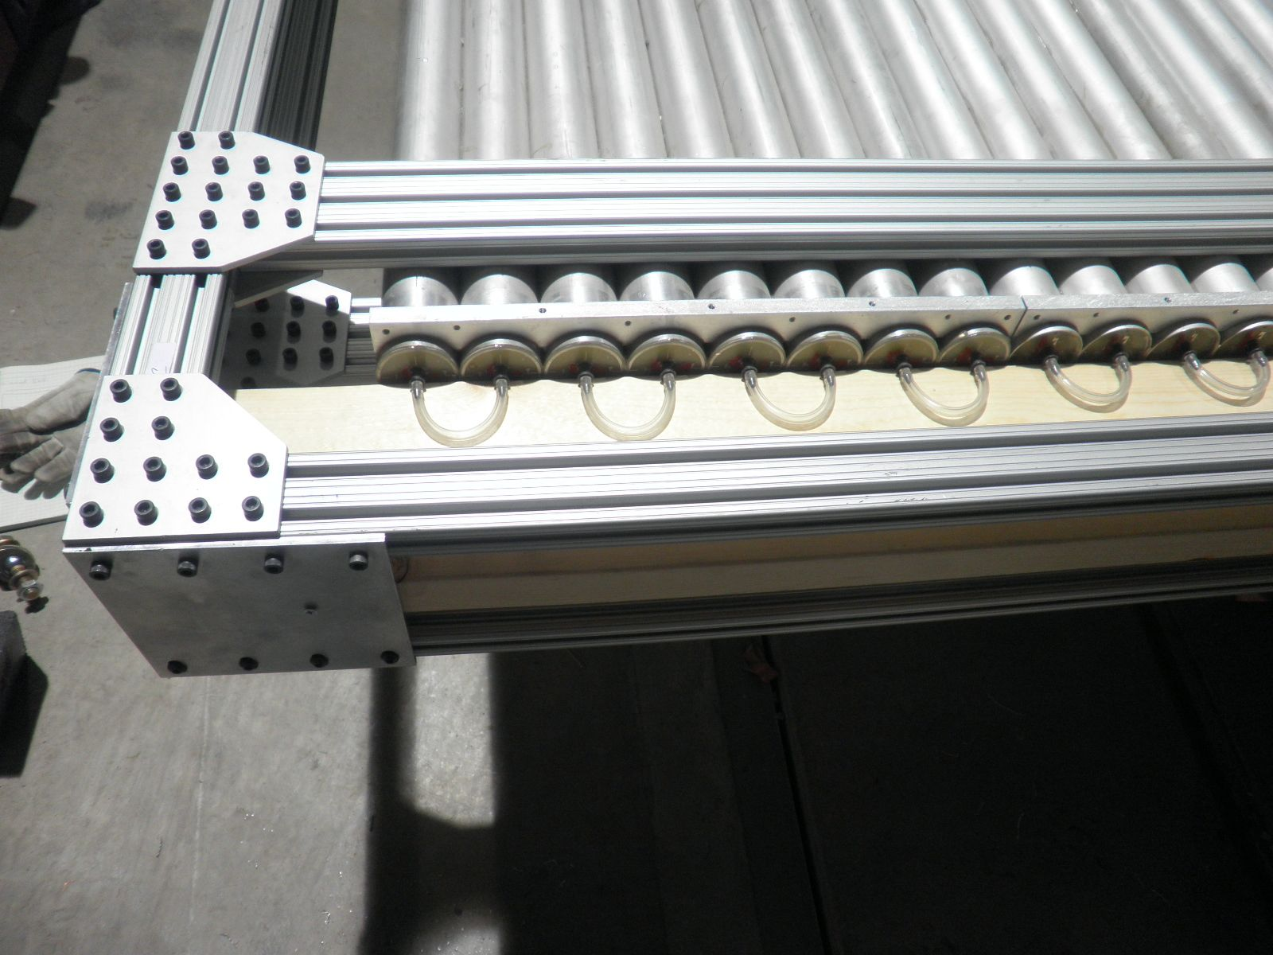
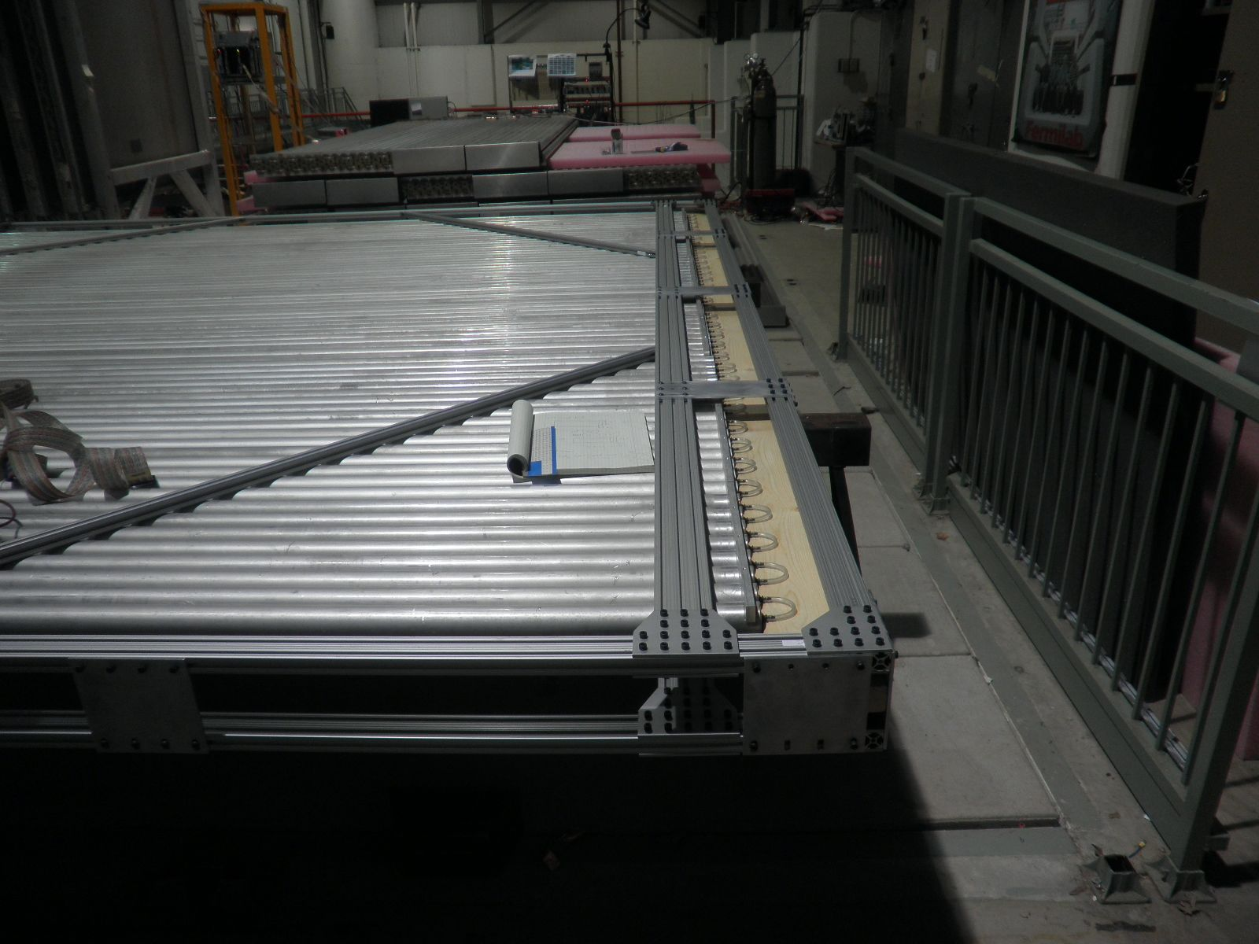
Module support at Bottom
Lumber block support
HomeDepot!

Slide 9
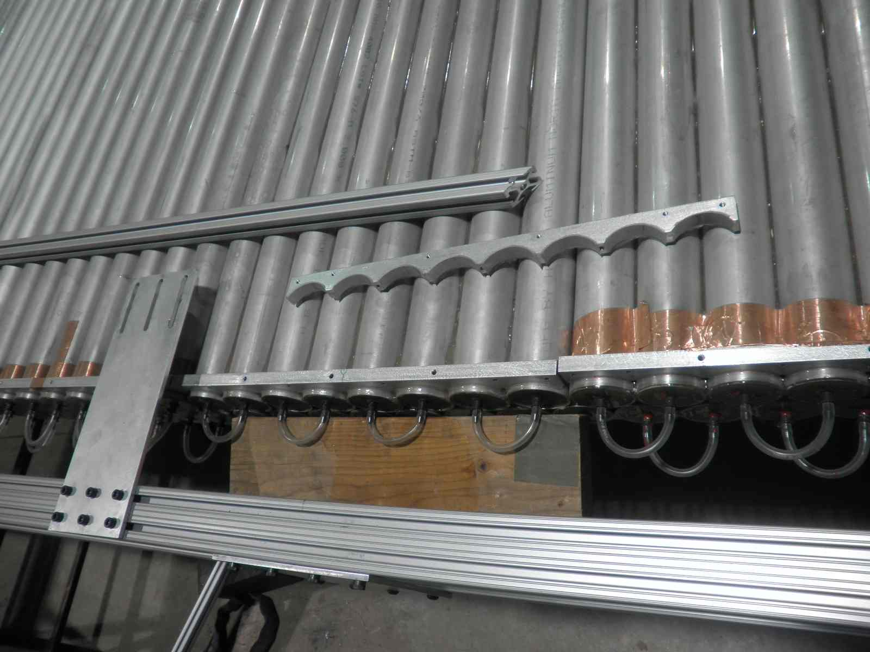
Problem with Glued Al frames

Slide 10
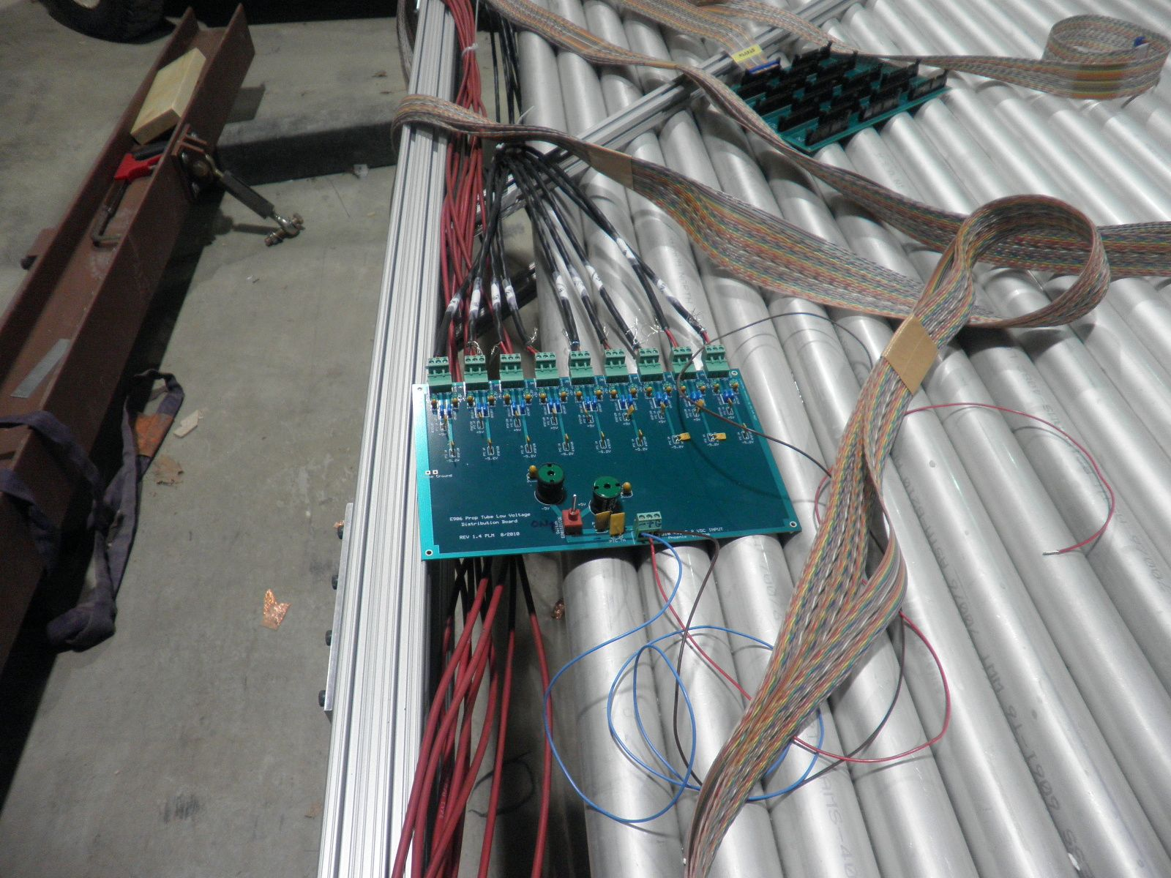
LV distribution Card

Slide 11
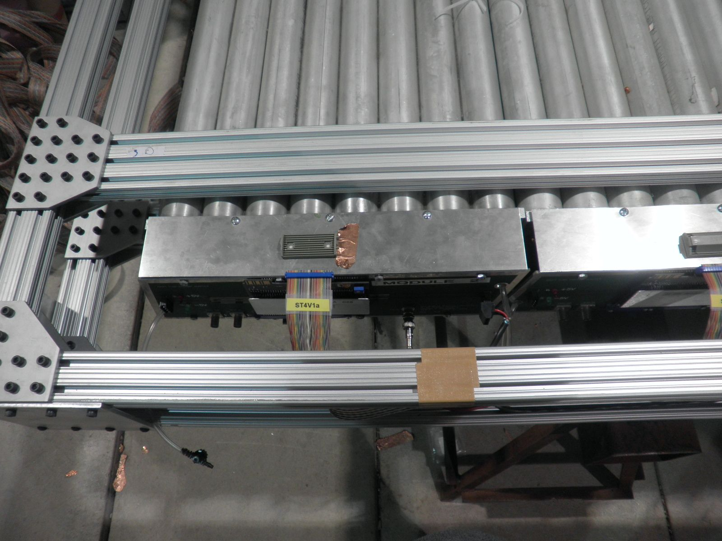
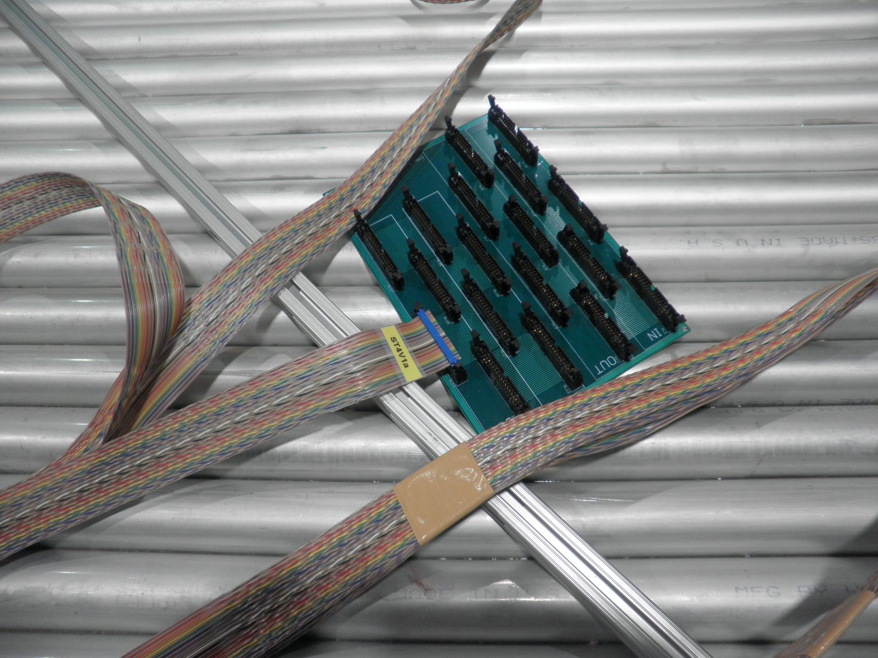
ECL signal patch panel

Slide 12
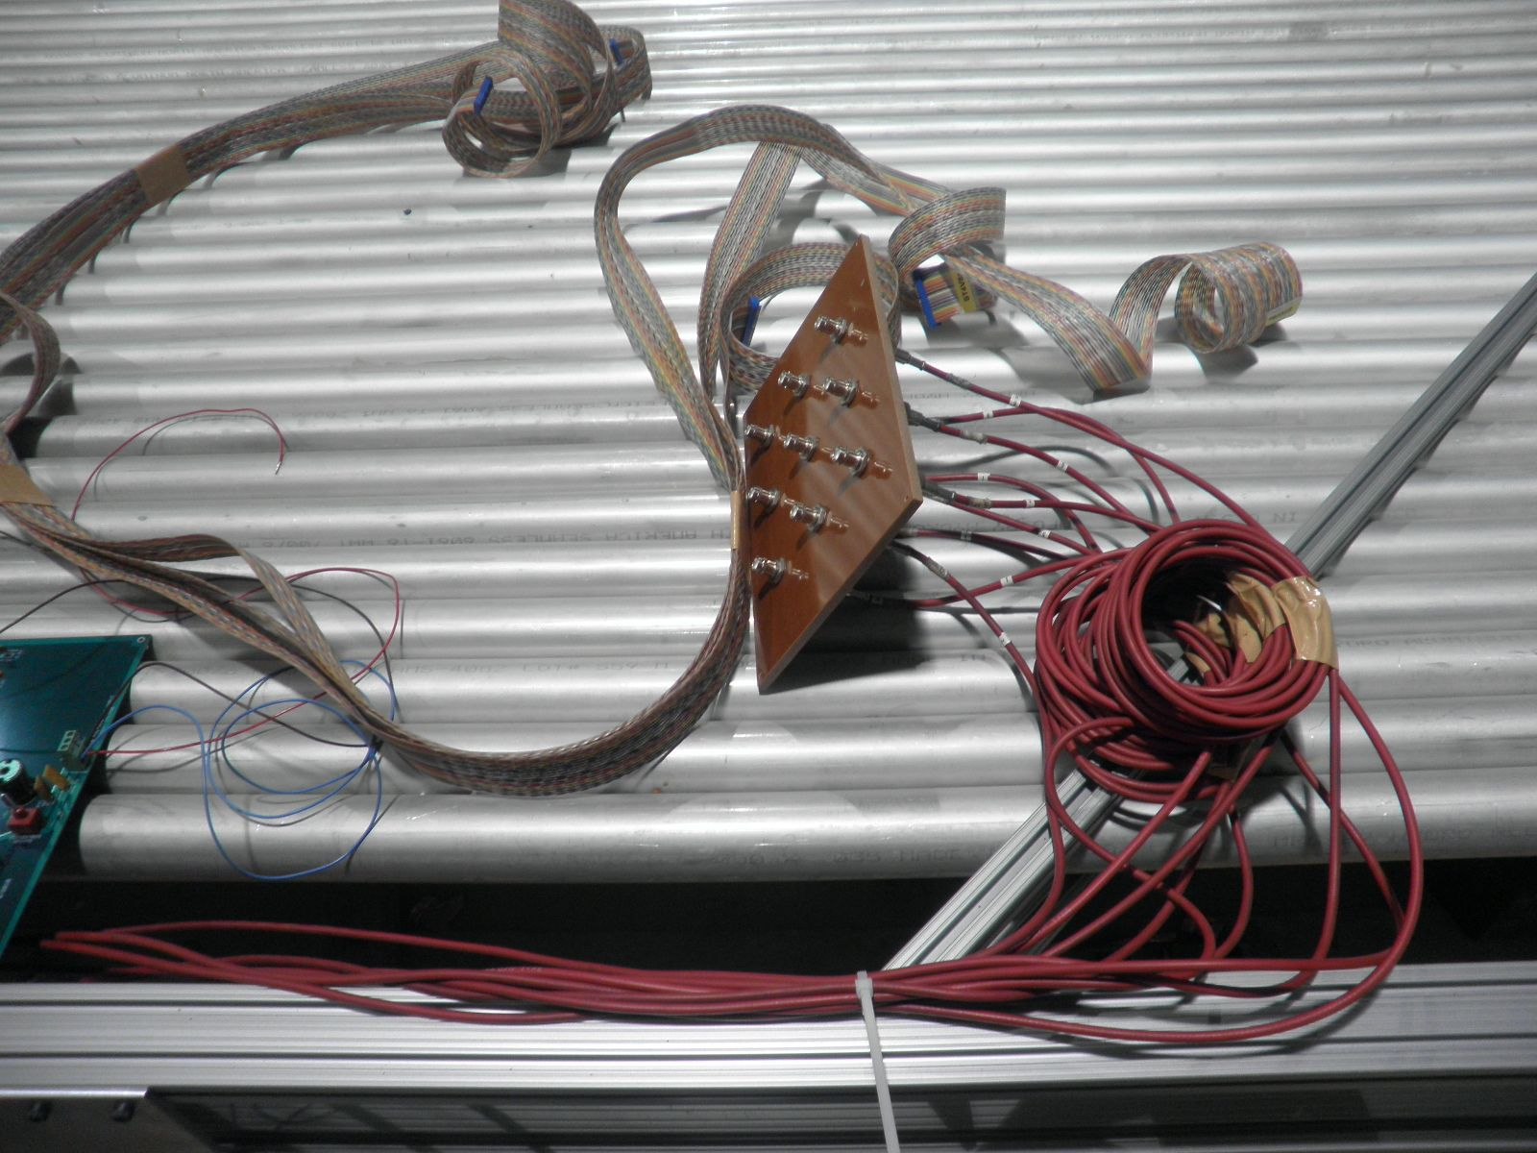
HV distribution

Slide 13
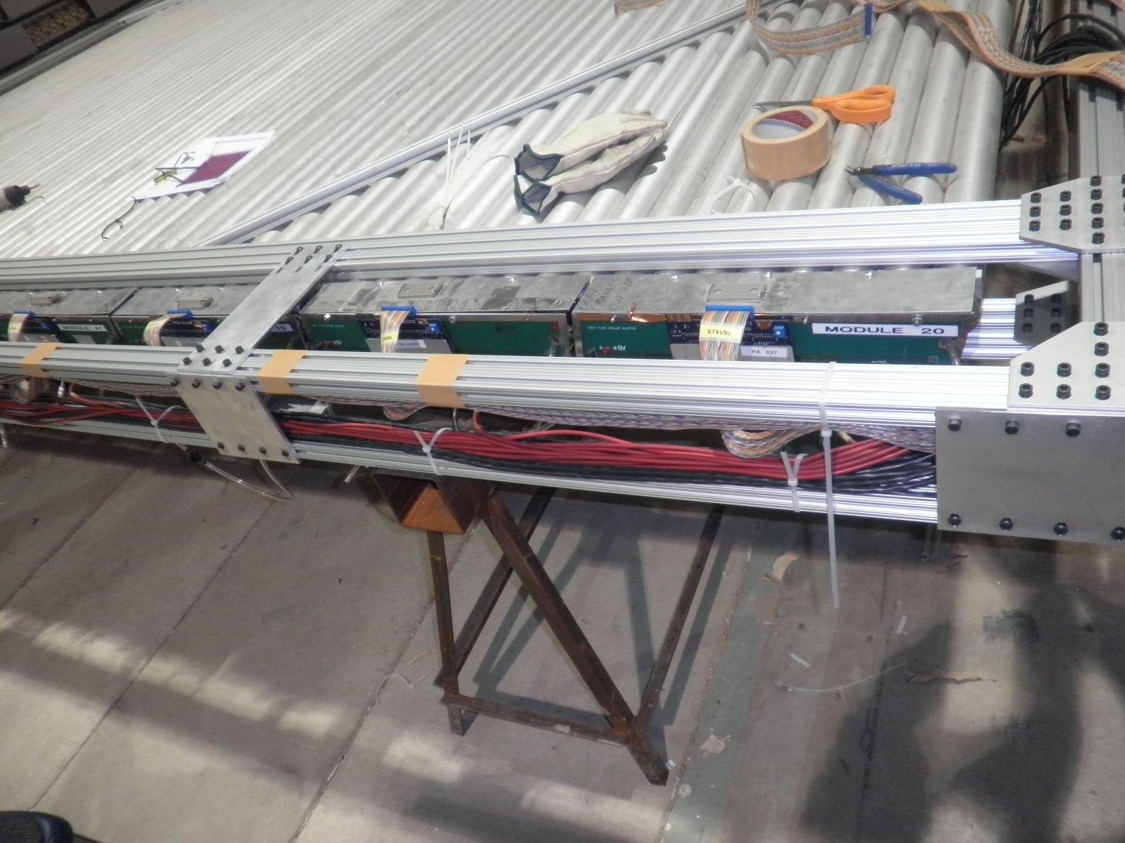
cables

Slide 14
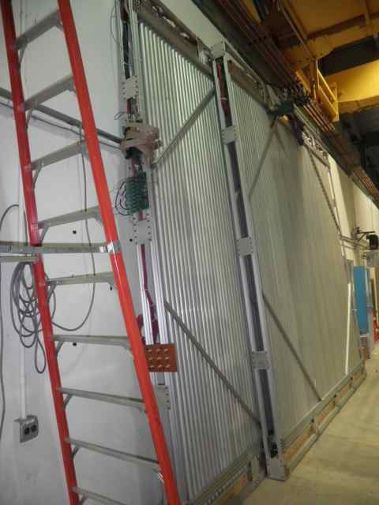
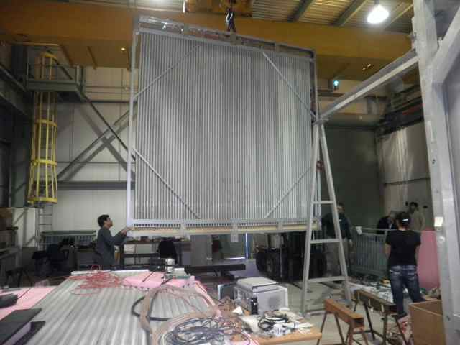
Two completed planes (1X,1Y)

Slide 15
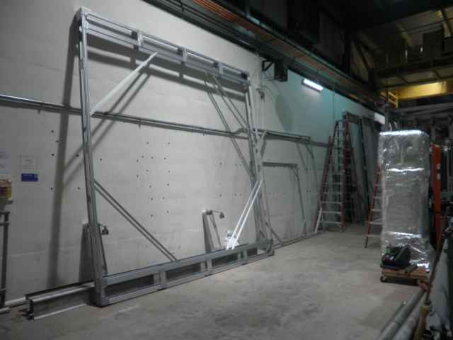
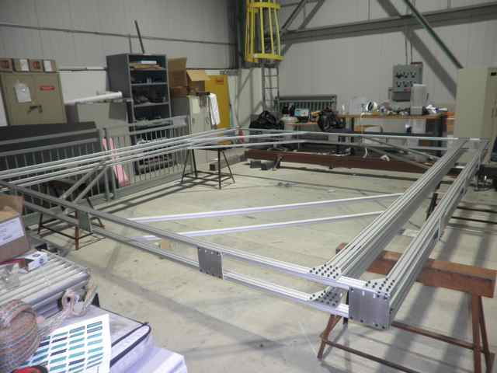
Two completed frames (2X, 2Y)

Slide 16
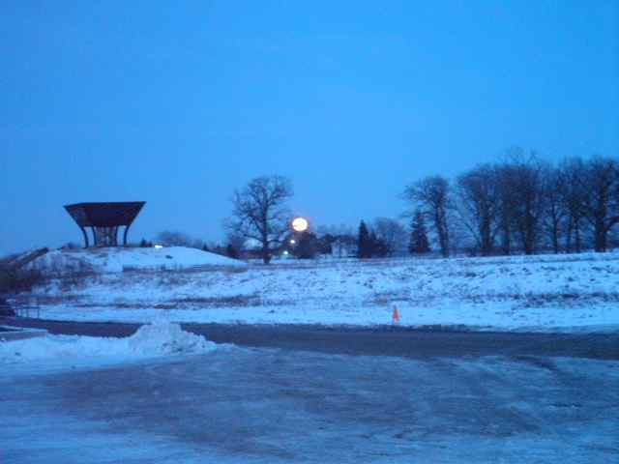
A beautiful night @E906

Slide 17
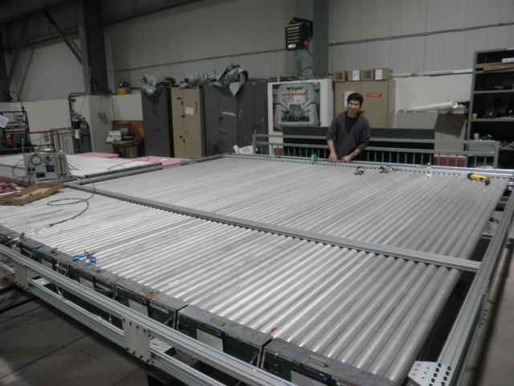
Working hard and happily

Slide 18
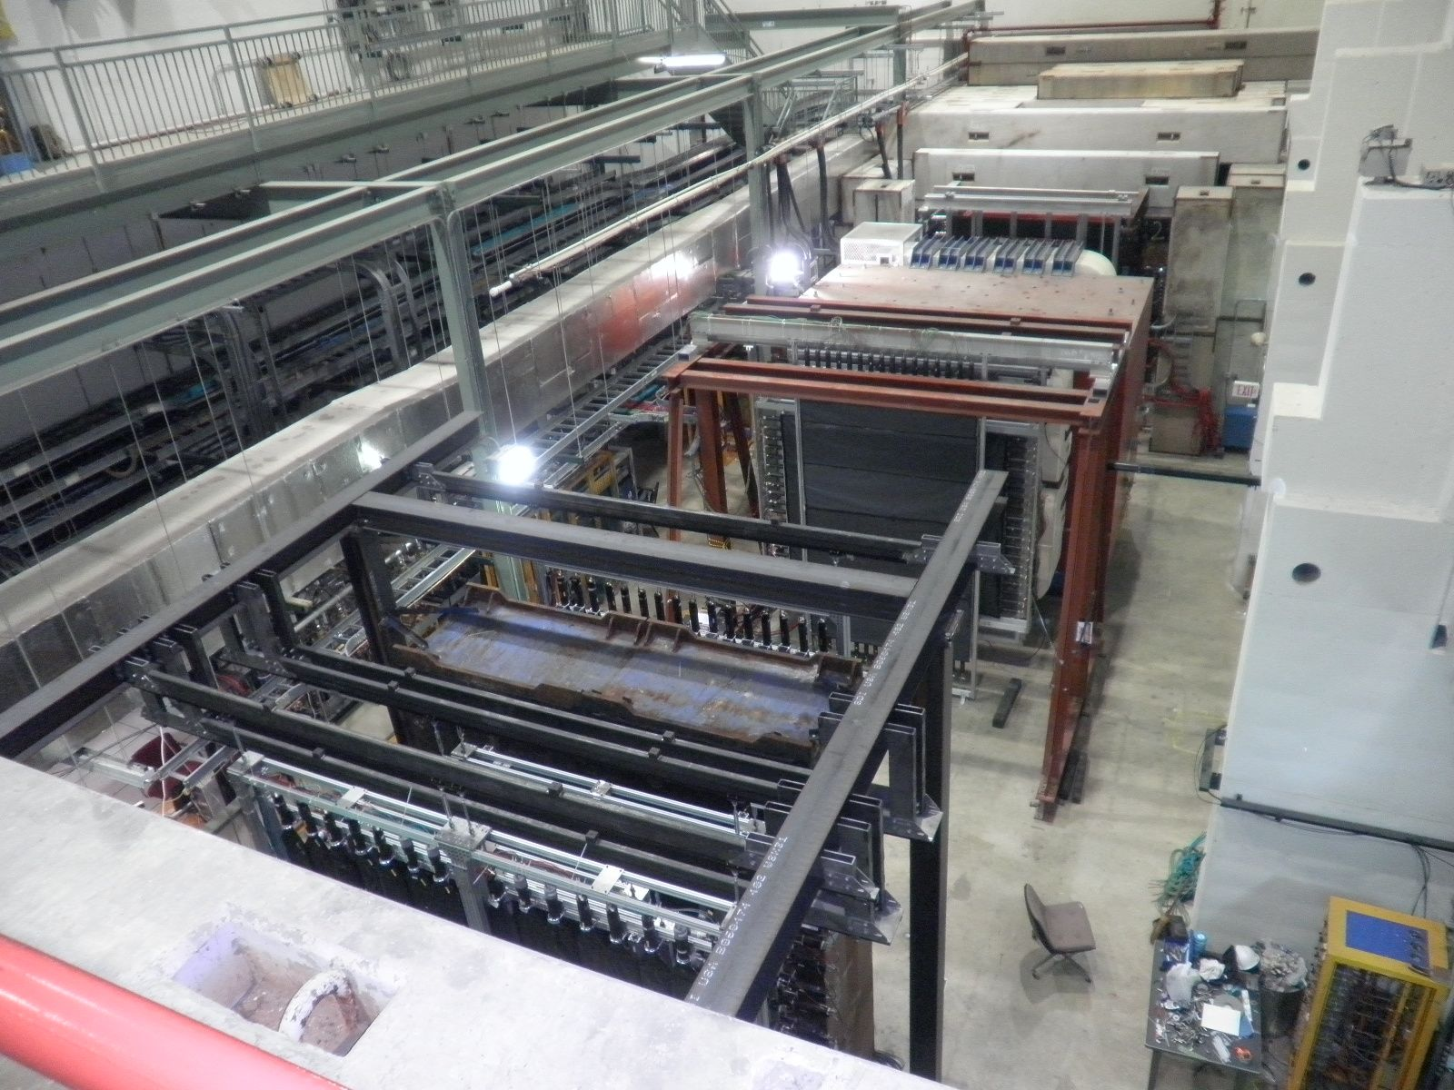
E906 Hall on 1/20/2011

Slide 19
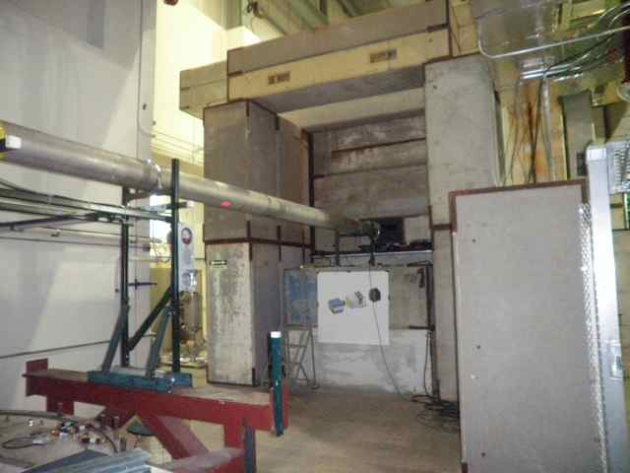
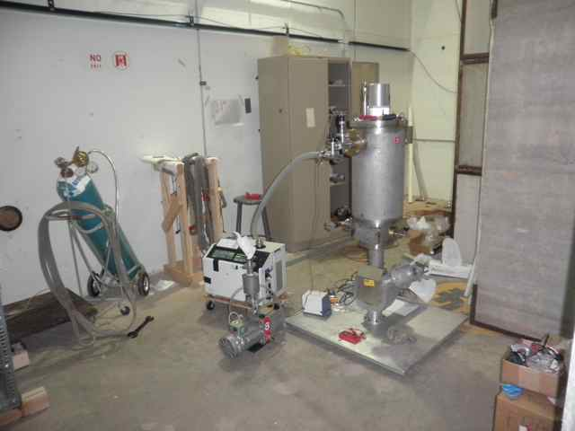
Target

Slide 20
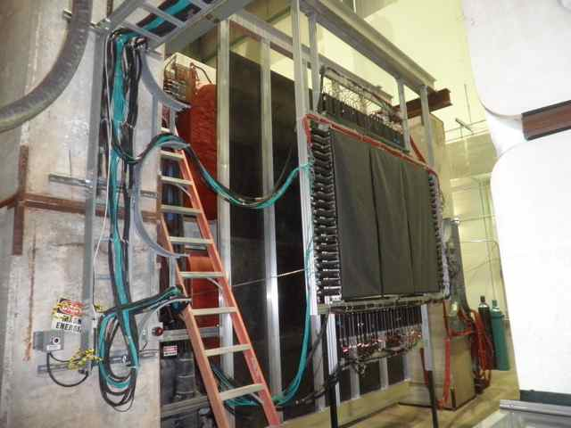
St-1

Slide 21
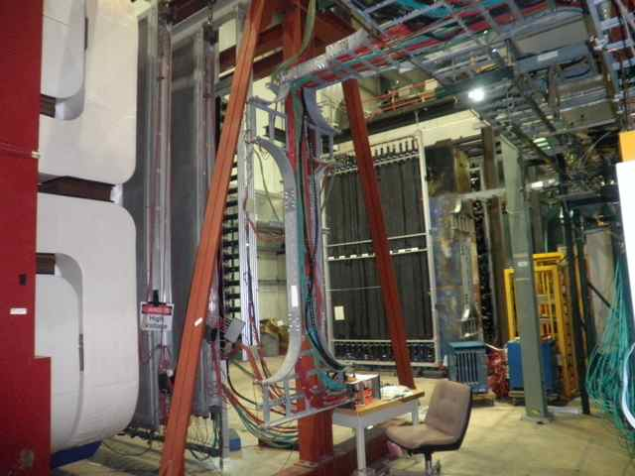
St-2,3

Slide 22
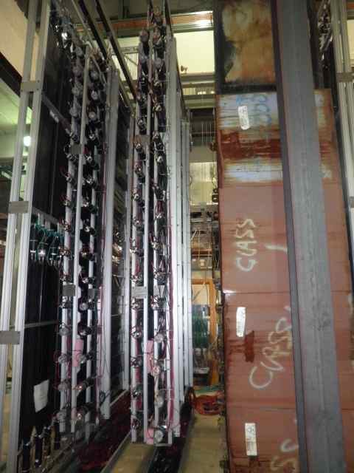
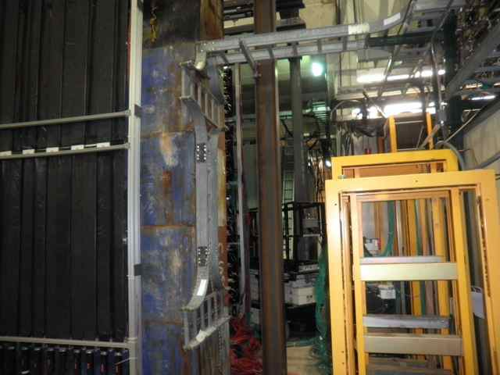
St-4

Slide 23
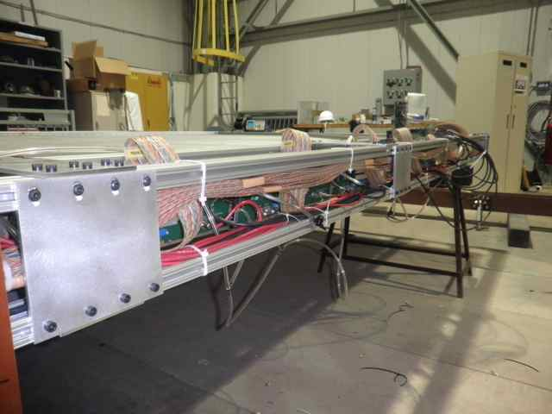
Summary and To do list
Detectors
Completed 1X and 1Y detectors
Assembled the remaining 2X and 2Y frames
Statistics
3500+ Screws/T-Nuts
15+hr a day
Installation
1X and 1Y ready to go
2X and 2Y later in Feb.?
Final Gas test
MIPP?
Ready for beam
Timing, efficiency etc.

