Slide 1
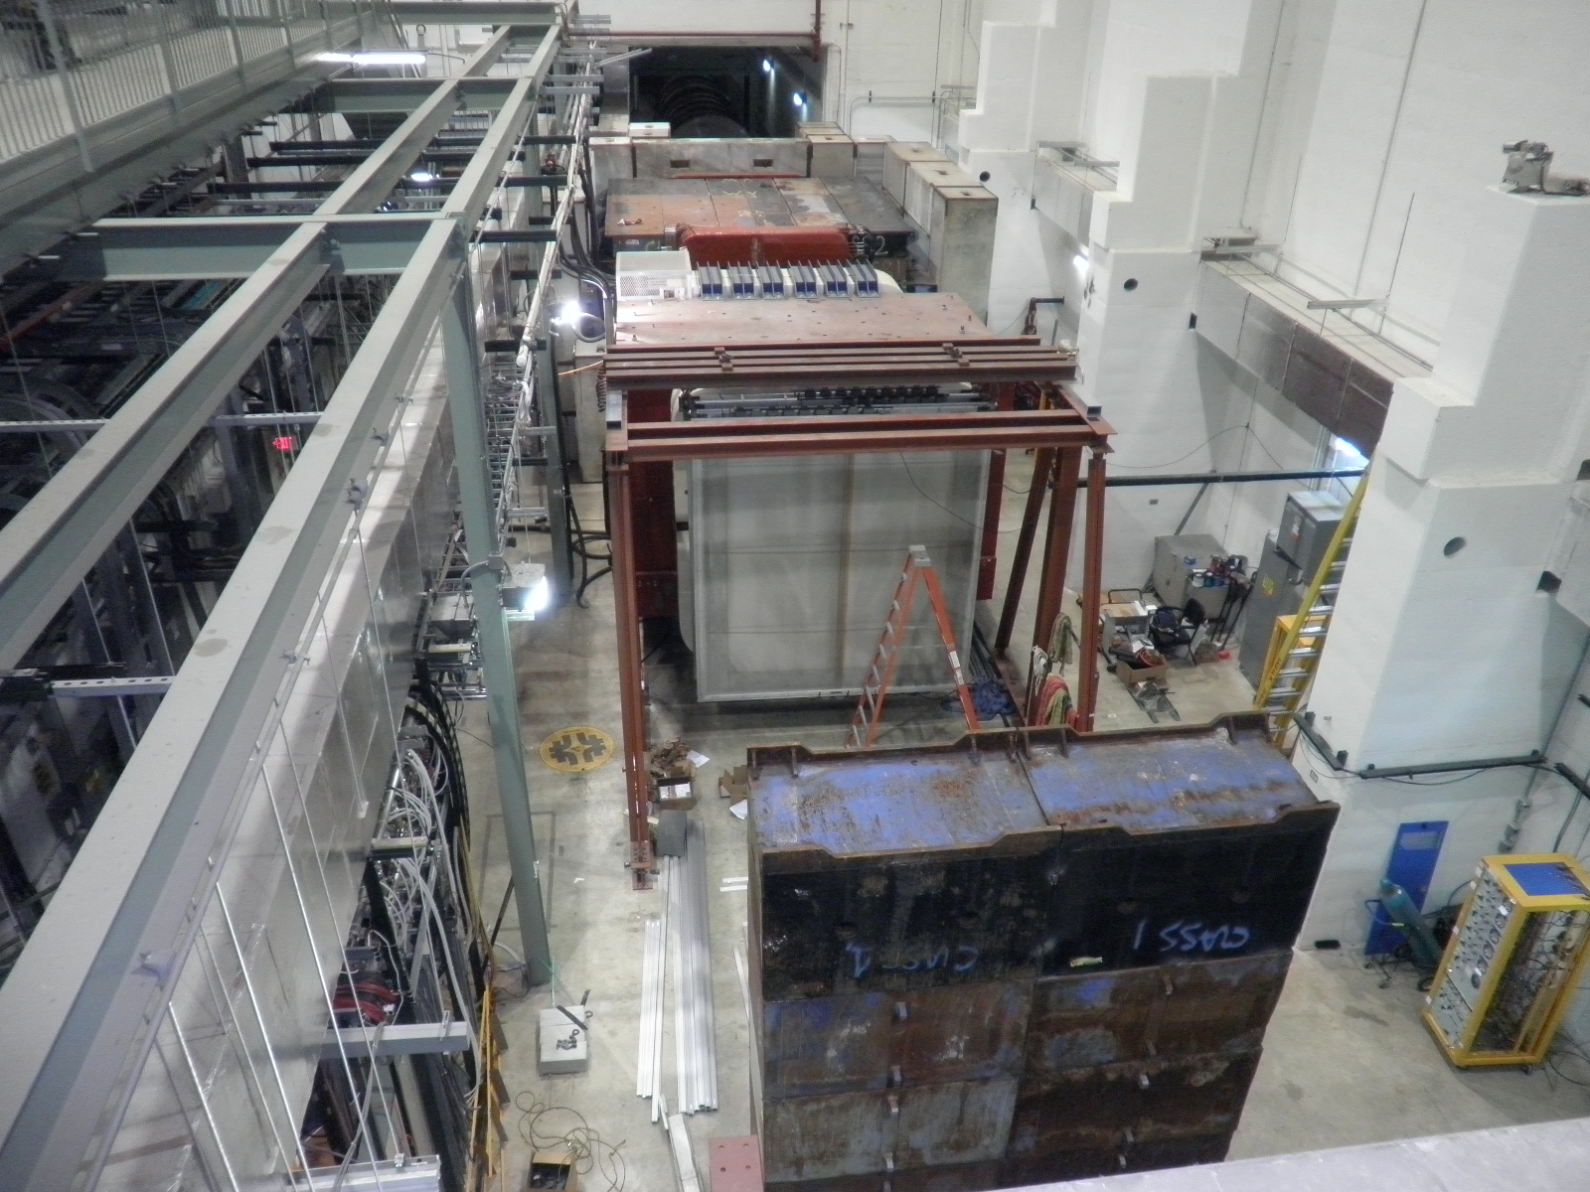
Experimental hall as of 07/30/2010

Slide 2
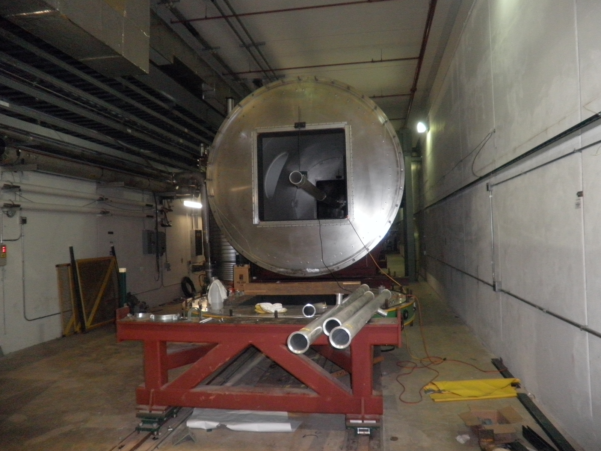
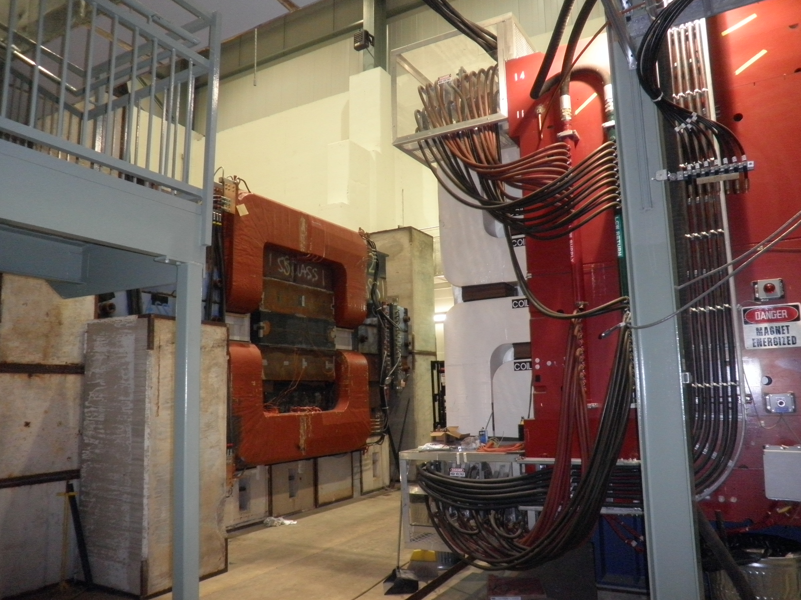
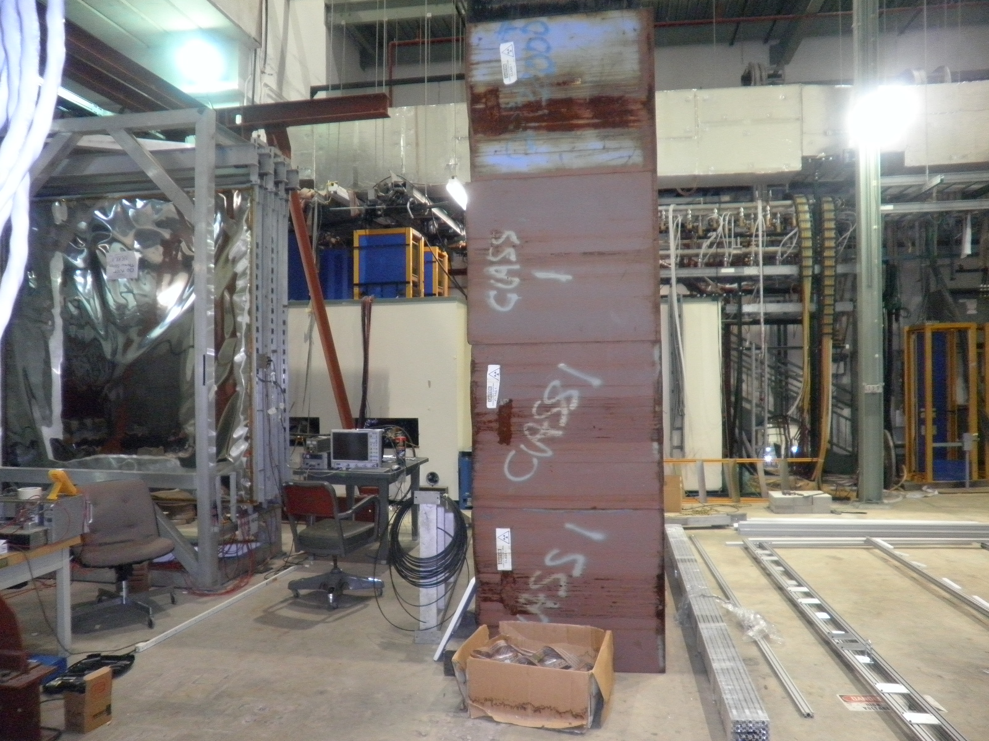
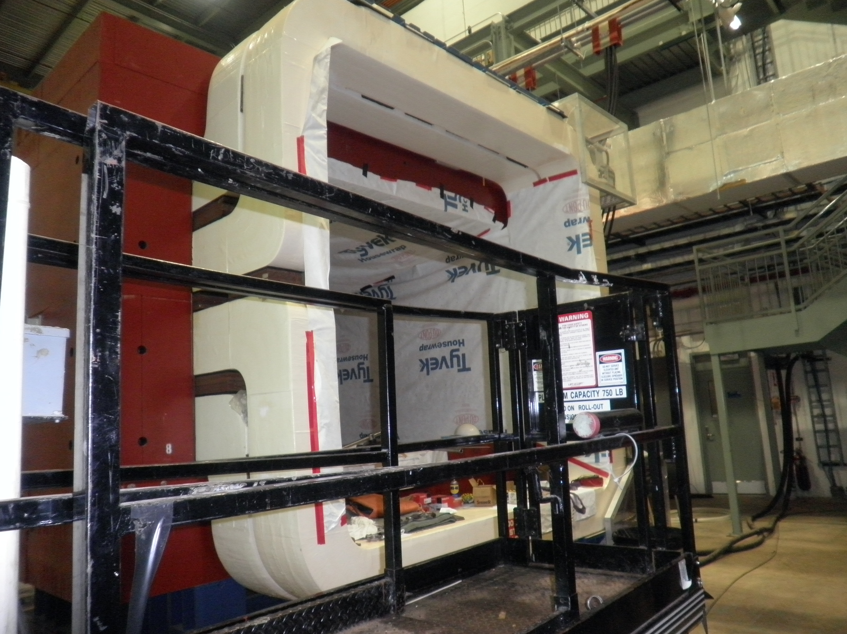
E906 Status

Slide 3
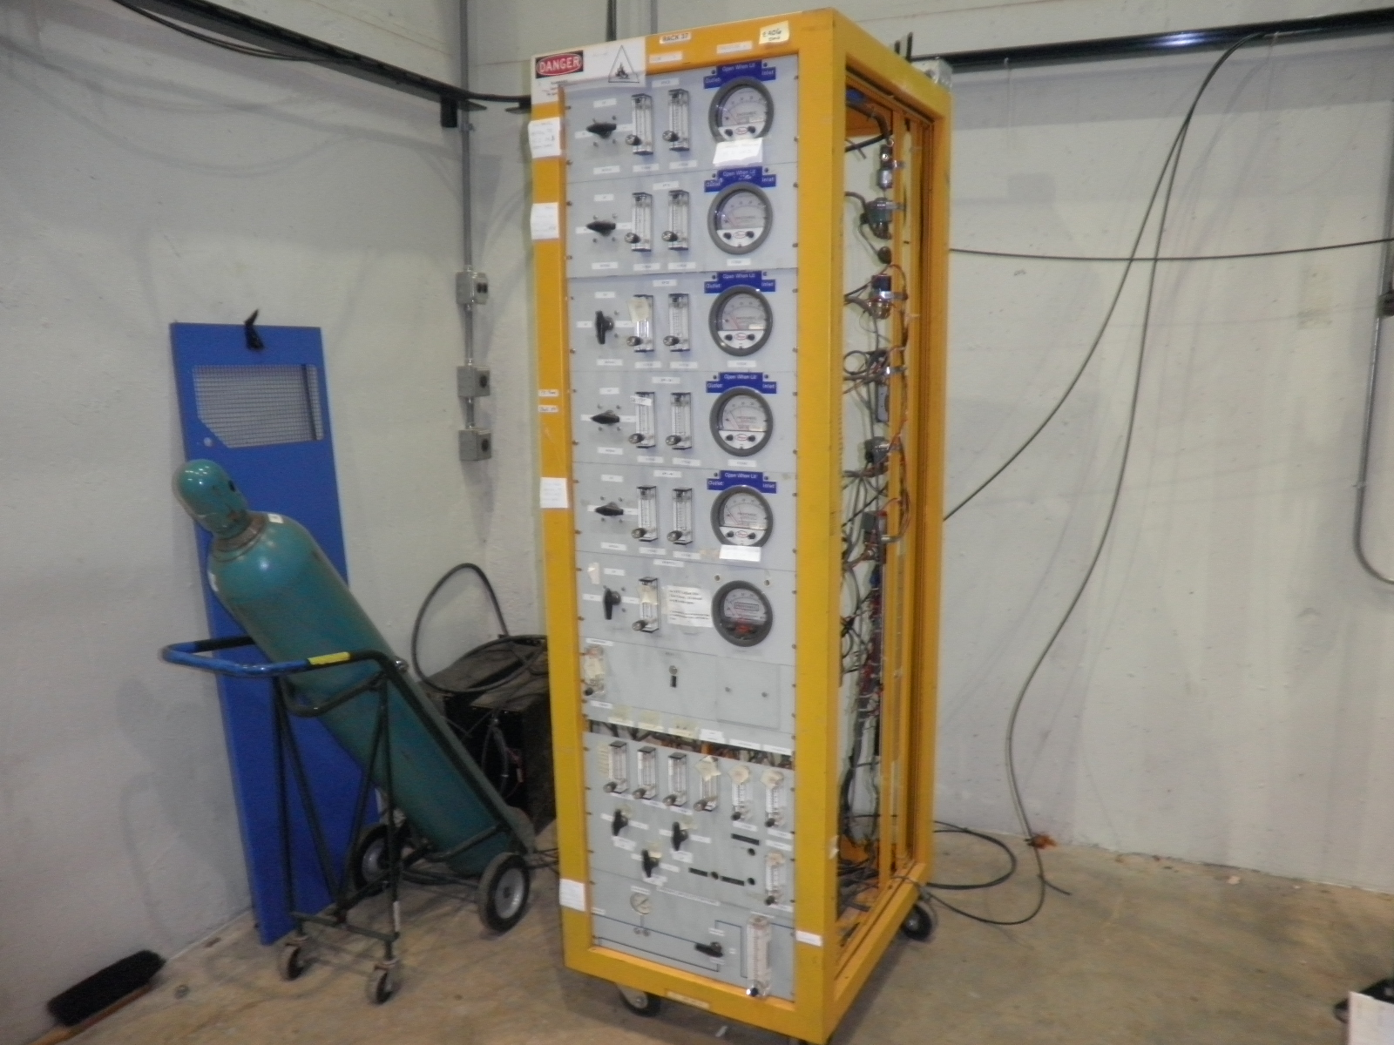
Gas rack

Slide 4
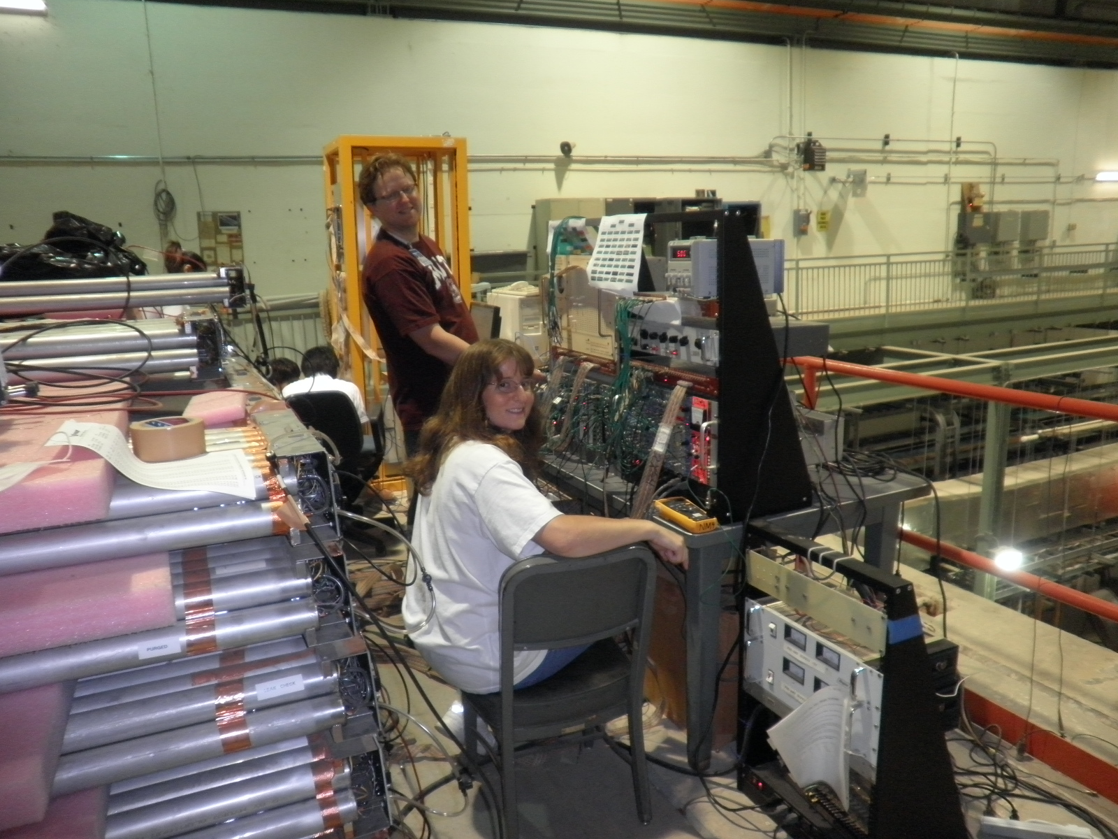

Slide 5
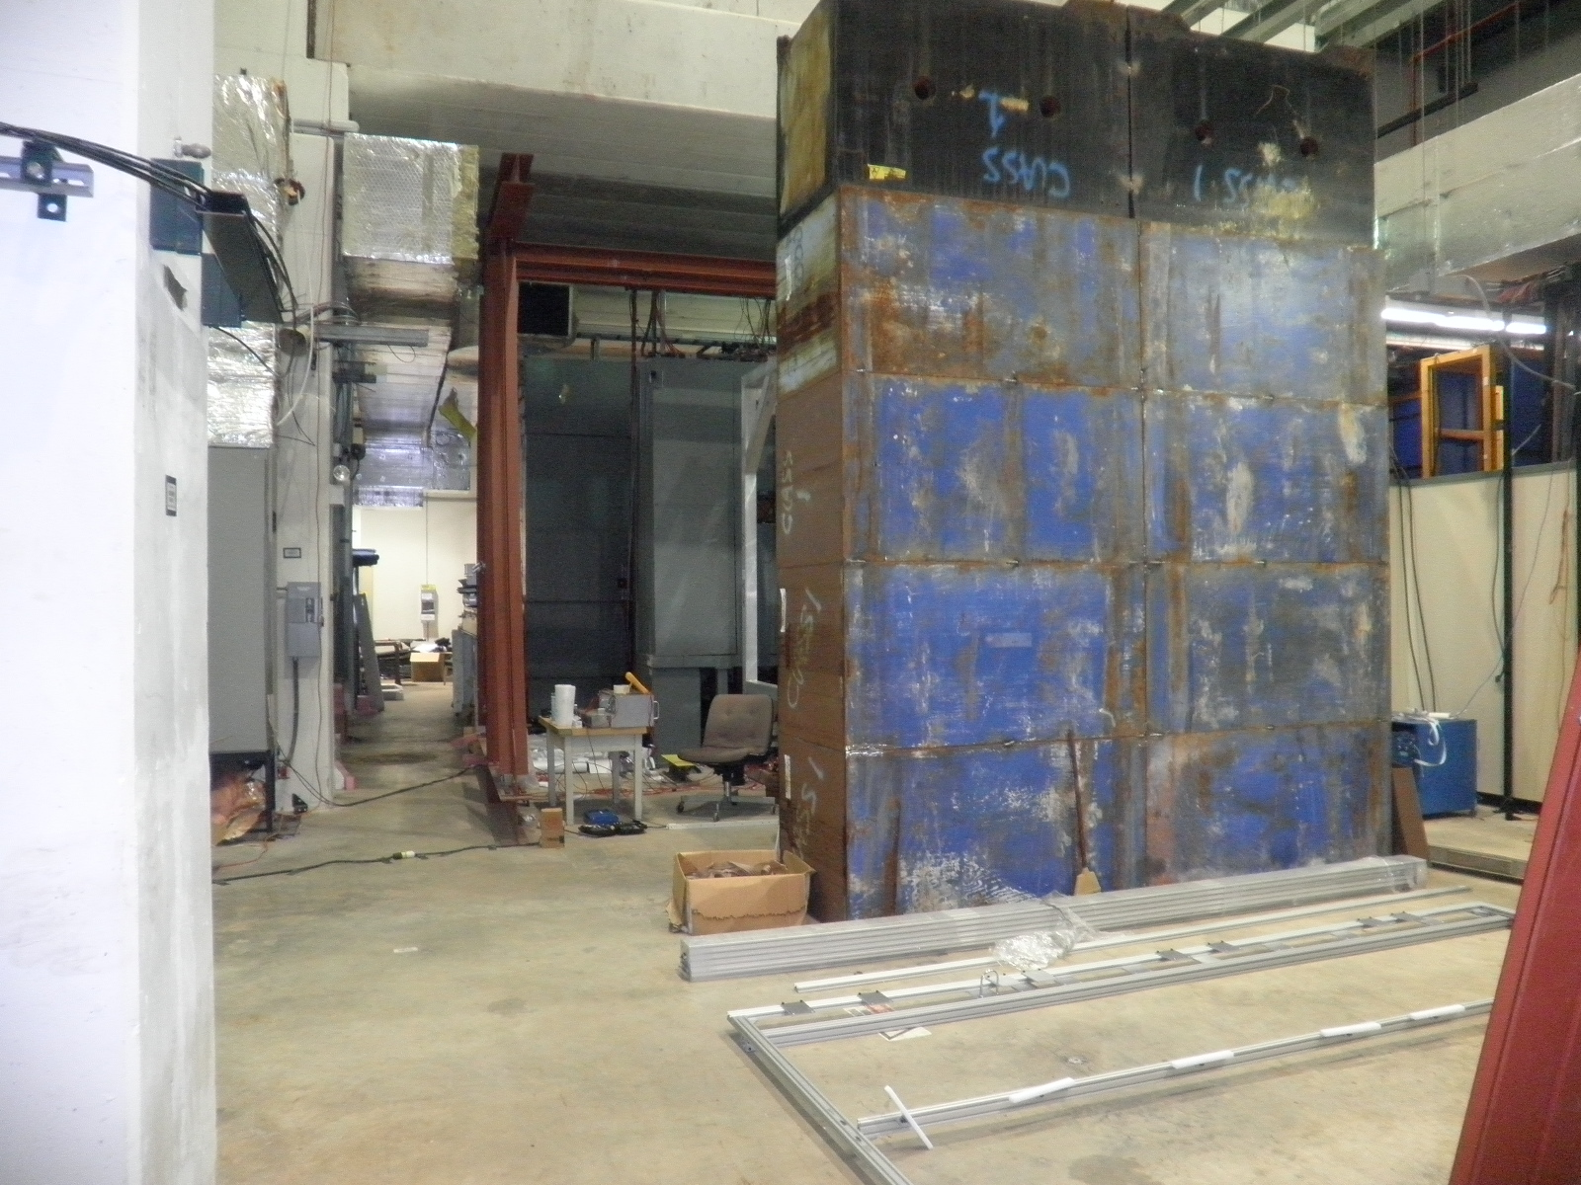
Ion absorbers

Slide 6
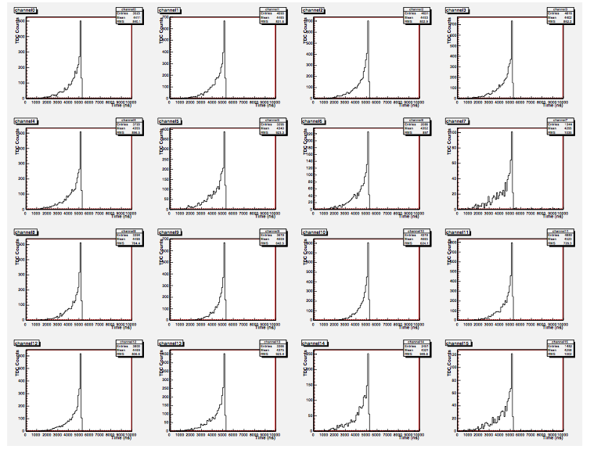
TDC spectra: Mod. #35 Ar/Co2 =80/20 HV=1900V ΔT_{max} = 2.5 uS
signal
TDC
Drift Time
Time
Trig.
Comm. Stop

Slide 7
ST4 Pre-Installation work
Need more absorbers to cover the ends of ST4 tuebs + electronics
Current ion blocks: 126” x 39”(99cm)
St4 tubes: 144” long (156” frame)
Need to add 9” absorbers on both sides
This will affect the design of the support structure
Support structure: will be available end of Sept/early Oct ?
Wide enough to allow drop-in of the whole chamber/plane from the top
Patch panel be attached to the 80-20 frame
Allow enough clearance along z-direction, ½’ per plane?
Attached the 80-20 frame to an I-beam before the installation
Directly drop in the whole plane with the I-beam
Cables layout
LV
HV
Schedule: depends on the beam schedule, assuming mid of Oct. test beam
Start assembly in middle of Sept? (Andrew + Ming/others)
Complete the installation in middle of Oct.
Plan – B
Slide-in requires asymmetric support structure and more complicated design

Slide 8
Plan-B: installation
Wall to ion block = 171”
With shortened A-frame on the loading side to the edge of the ion block, we could have 170” clearance
Frame lifting points:
at least +15” in on both sides
Patch panel
SHV 9 channels
LV: 3 channels (+5V, 2A fuse; -5V, 3A fuse)
Signal: 9/8 connectors

Slide 9
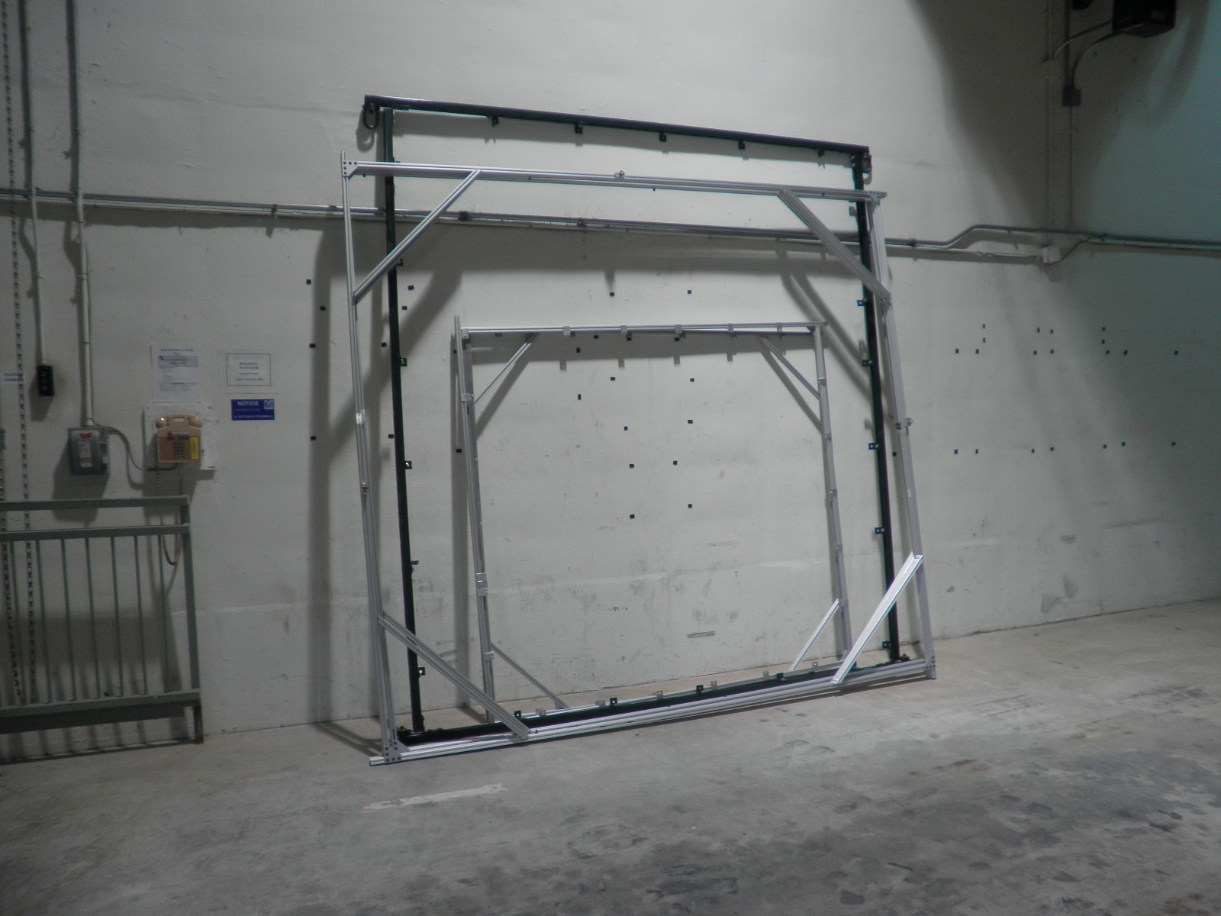
ST-4 Scint. Frame

Slide 10
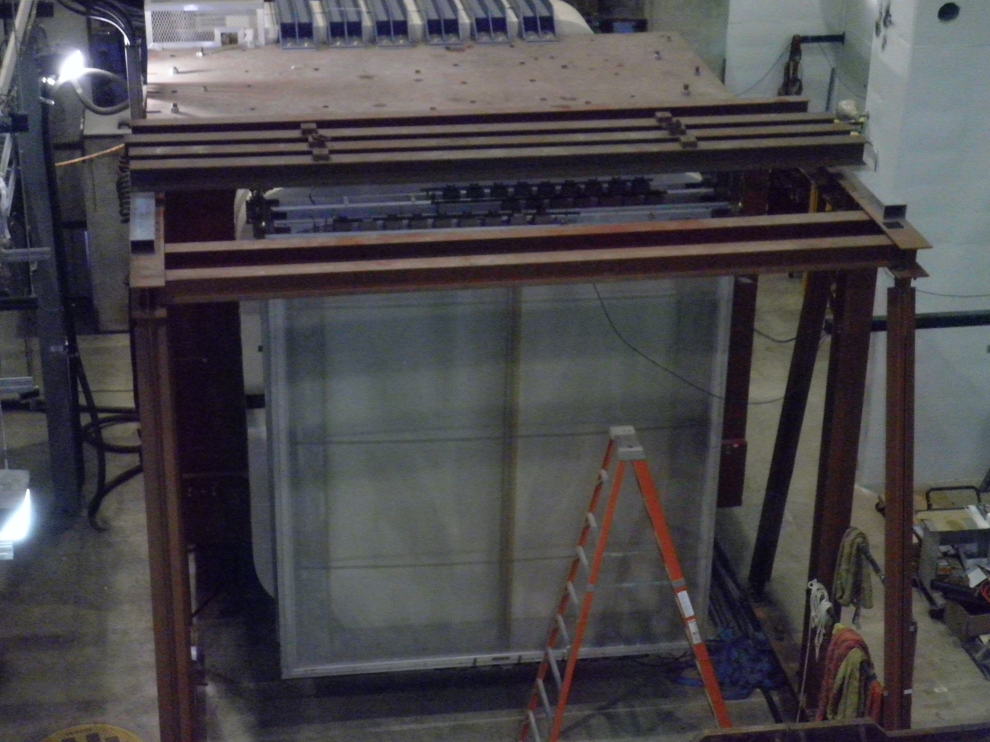
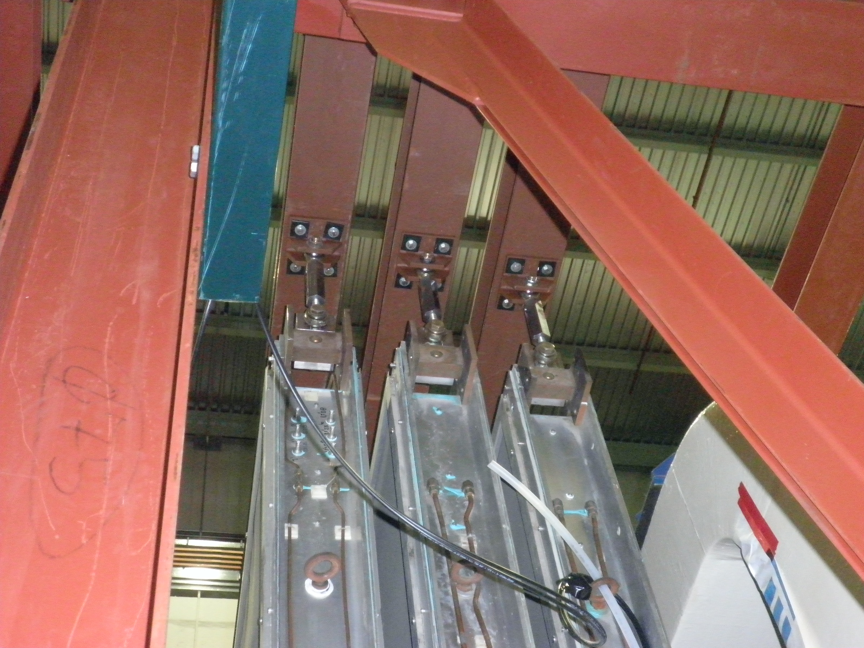
Prop Tube Lifting Points (similar to ST-2 chambers)

Slide 11
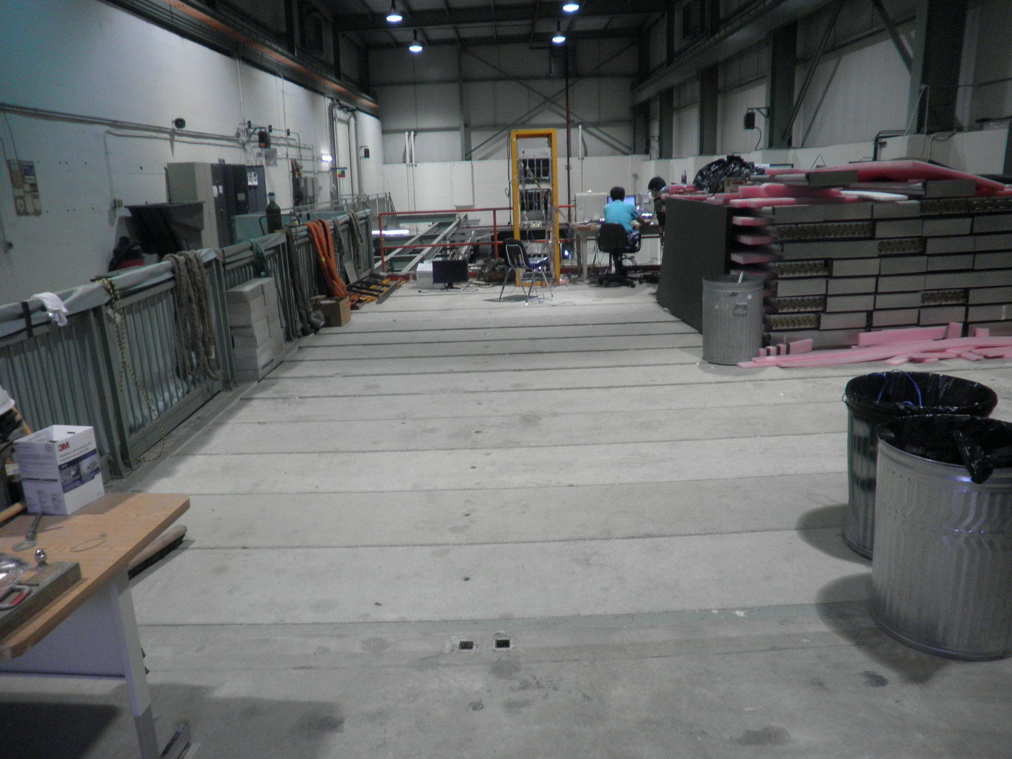
Assembling area

Slide 12
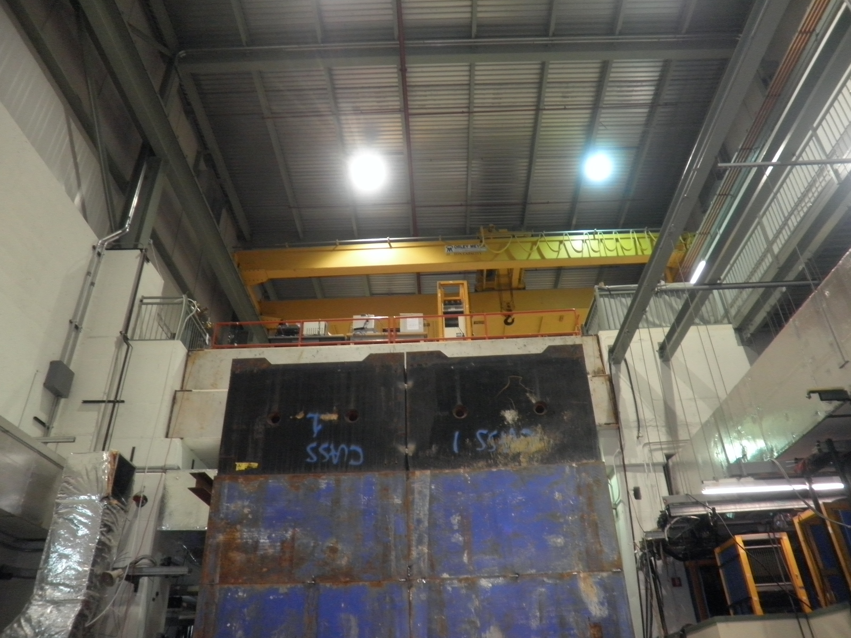
Installation – drop in w/ crane

Slide 13
One Power rack for ST-4
HV PS:
17 modules = 4 NIM crates
LV PS:
+5V and -5V
Distribution to 4 planes with fuses

Slide 14
Patch panel on the detector
9 SHV feed-throughs
3 gas feed-throughs
3 working gas inputs: ¼” line
1 pressure feed back: 3/8” line
1 exhaust: ½”
1 N2/dry air input: 3/8” line
Hole sizes?
9 ECL signal connectors
9-chan LV Distribution cards
+5V with 1A fuse
-5V with 2A fuse
Ground line
Cables from module to patch panel
Feed through connectors
LV
HV
ECL

Slide 15
HV PS
+2500V (1800~2200V)
34 channels total
17 dual channel PS
4 crates (<6 per crate)
Cables
Module to patch panel
PS to patch panel

Slide 16
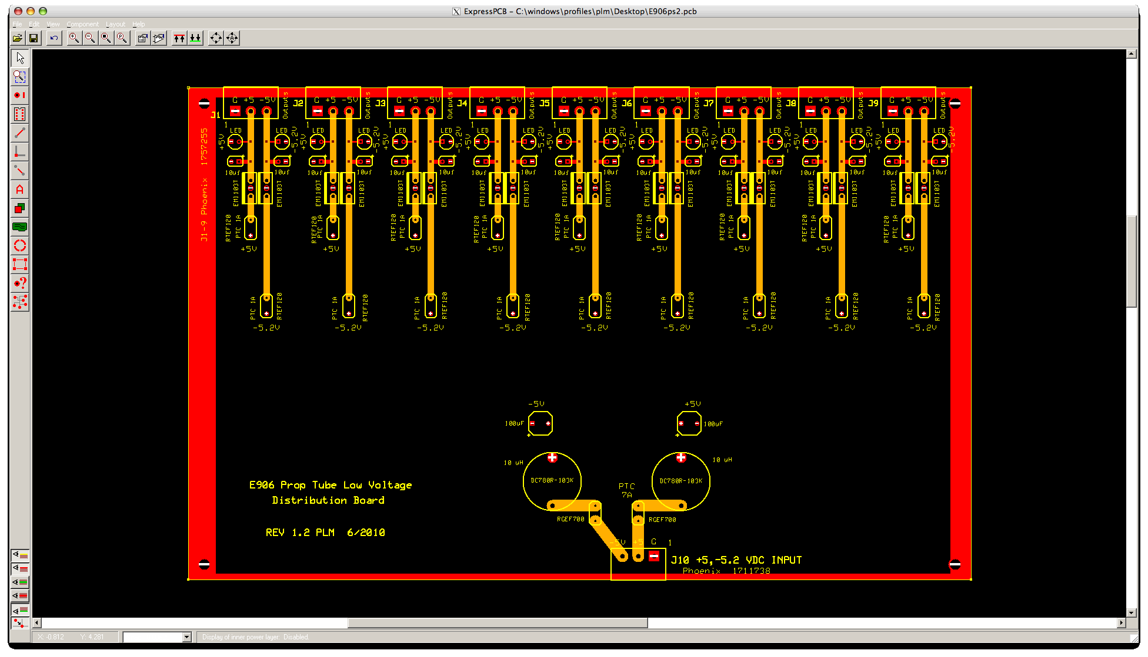
LV distribution card

Slide 17
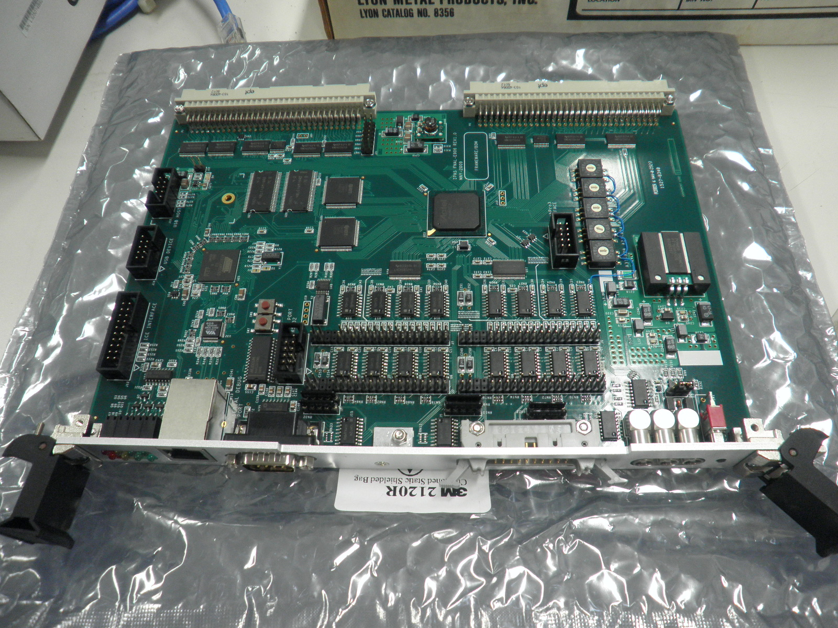
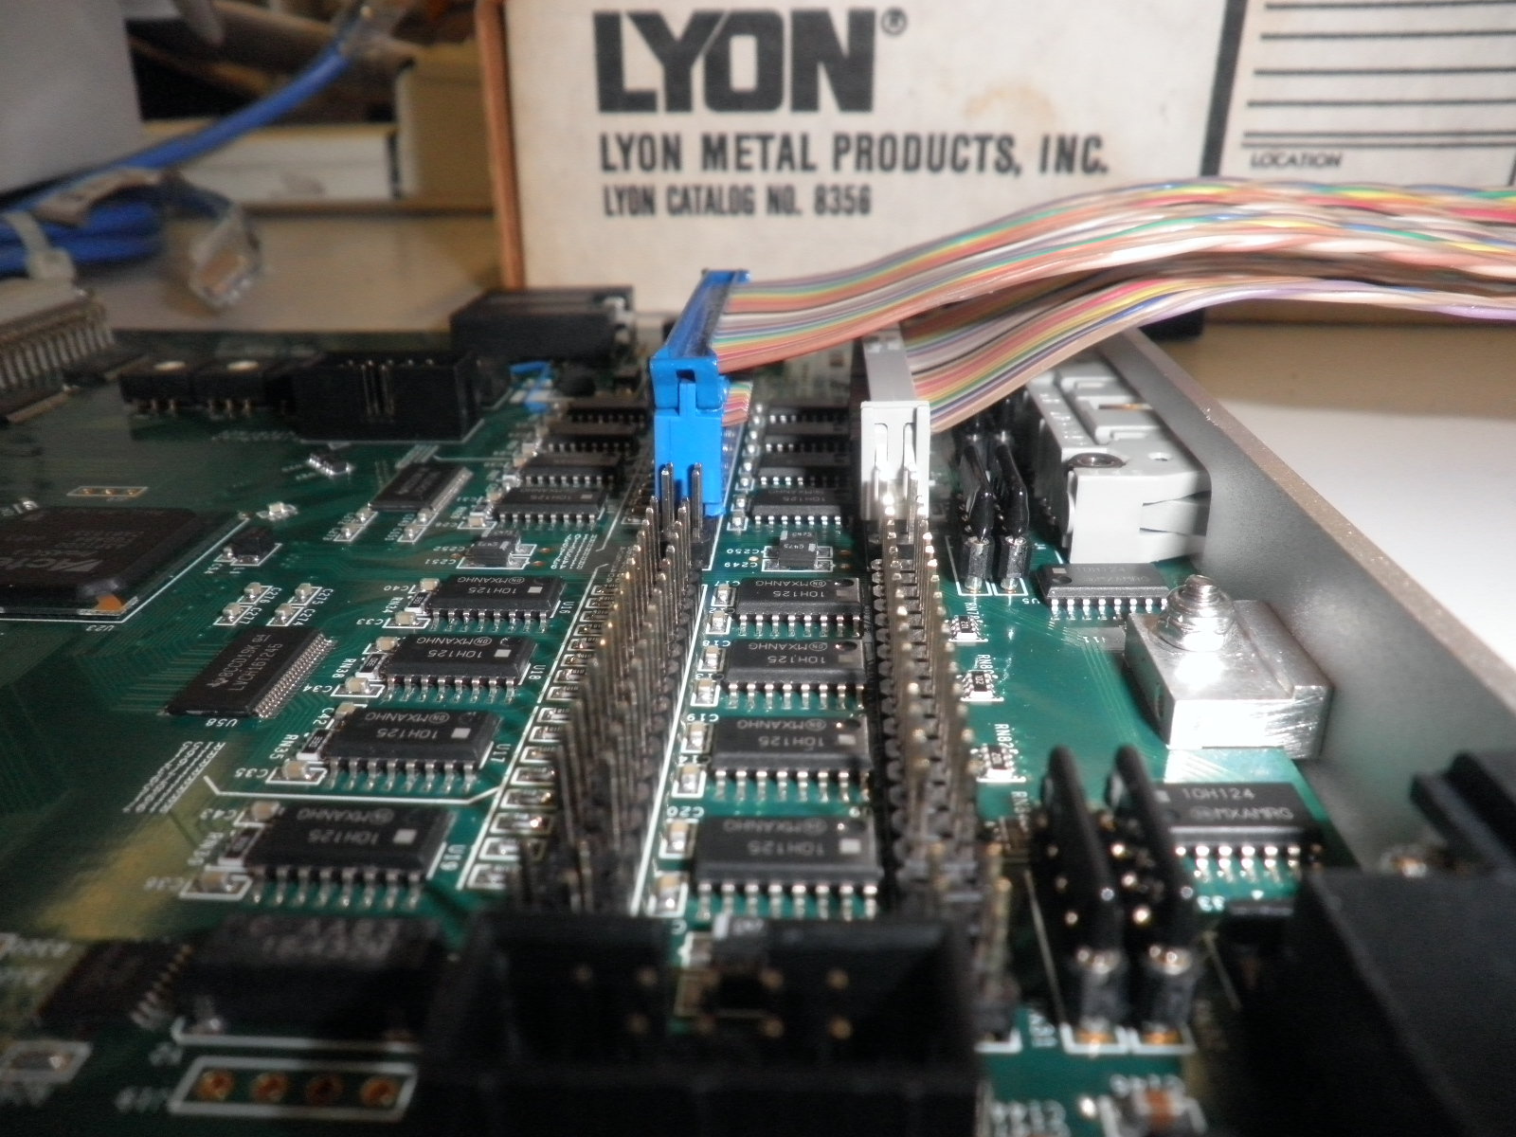
64-channel TDC & ECL connectors:
Need low profile connectors
Amphenol PART# CAT 812
#842-812-3422-134

Slide 18
30’ ECL cable test (40’ longest)
Timing
< 5nS smearing (NIM leading edge time)
dT0 = 2.5nS +/-0.5, (NIM signal output from a pocket pulser)
dT1 = 4.0 ns +/- 0.5 (10’ cable), NIM output
dT2 = 4.5 ns +/- 0.5 (30’ cable), NIM output
X-talk
Adjacent channel <= 3mV/@1V = 0.3%
Next adjacent < 1mV, undetectable
ECL to TDC
Need low profile connectors, double layers, 64 channels per TDC
Connectors:
Amphenol PART # CAT:812
842-812-3422-134

Slide 19
LV PS
+5V: 0.3A => 9x0.3 = 3.0A
-5V: 0.8 A => 9x0.8 = 7.5A
Total 4 planes:
+5V: 4x3= 12 A
-5V: 4x7.5 = 30 A
Cables
Module to patch panel
PS to patch panel

Slide 20
schedule
A/T-frame availability
End of Sep or early Oct ?
ST4 assembly work
1 week / per plane
4 weeks total
Gas rack & location
Sept or later?
Test beams delivered to Exp Hall?
mid Oct or later?

Slide 21
E906 to do list
Chamber installation
Identify 34 good modules for the final assembly
Obtain engineering approval from Fermilab for the mechanical supporting structure
Develop LV, HV and signal cable layout plan
Make LV, HV and signal cables
Design and make LV, HV and signal patch panels
Detector installation
Continue flowing gas and conditioning tubes with + and – HV.
Commissioning
Check ECL signal quality at rack input
Optimize electronics thresholds for each board with the final gas
Determine optimal operating HV level
Test prop tubes with cosmic rays (or source?), study drift time, efficiency etc.
Readout with the final TDC boards, fix timing relative to trigger etc
channel mapping, be part of the offline tracking
Slow control and monitoring
LV, HV, Temperature, Pressure, drift time, gain …
Get ready for beams in Oct. 2010
Timing in the detector

Slide 22
E906 Summer Work Plan http://projects-docdb.fnal.gov:8080/cgi-bin/DisplayMeeting?conferenceid=32
June: 1 week + 1 Summer ACU Student
Work to do
Test 7 wrong shaped modules, identify best 4 for final assembly
Replace frontend board and preAmp card for two modules
Develop installation plan – cable layout etc
Design LV distribution cards
Picture frame
Order supporting frame materials from 80-20, and get them in ~2 weeks.
Manpower
Lei, Ming, Pat + local ACU students
Schedule: middle of June
July: 1 week + 1 Summer ACU student?
Work to do
Test and conditioning all modules with good gas, determine the optimal operating HV for all modules
Make and layout LV, HV and readout cables
Complete the tech note and obtain Fermilab Engineering approval for the supporting structure
Develop detector installation plan
Manpower
Lei, Andrew, Ming, Pat, Melynda + local ACU students?
Schedule: early-mid July?
Aug. + Sept: 2~3 weeks
Assemble the modules, install detector
Test readout, optimize signal to noise ratio, study electric ground, timing etc.
Need full readout cards ( when? )
Manpower
Andrew, Ming, Melynda, Christine …
Schedule: mid/late Sept. ? dep. on the availability of DAQ and final gas
Ready for Experiment in Oct. /Nov. ? ~ 3week
Other subsystems, Station-1 chambers particularly, won’t be ready until Oct.

Slide 23
Future Projection
Hardware support: 2011 – 2013
1/2 FTE
Detector calibration and monitoring
Physics analyses: 2011-2014
Fermilab FY 2012 long shutdown?
1PD + 1/4ST
Quark energy loss: p+A/p+p
Parton distributions: p+d/p+p
Simulations and data analysis
Final publication

Slide 24
