Slide 1
St4 prop tube progress
Last visit to Fermilab: 10/18-22
Imran and Ming
Work done
Assembled 80-20 frames for one plane
Established frame assembling procedure
Identified missing pieces, T-nuts, L-straps …
Tried to directly read out modules with TDC…

Slide 2
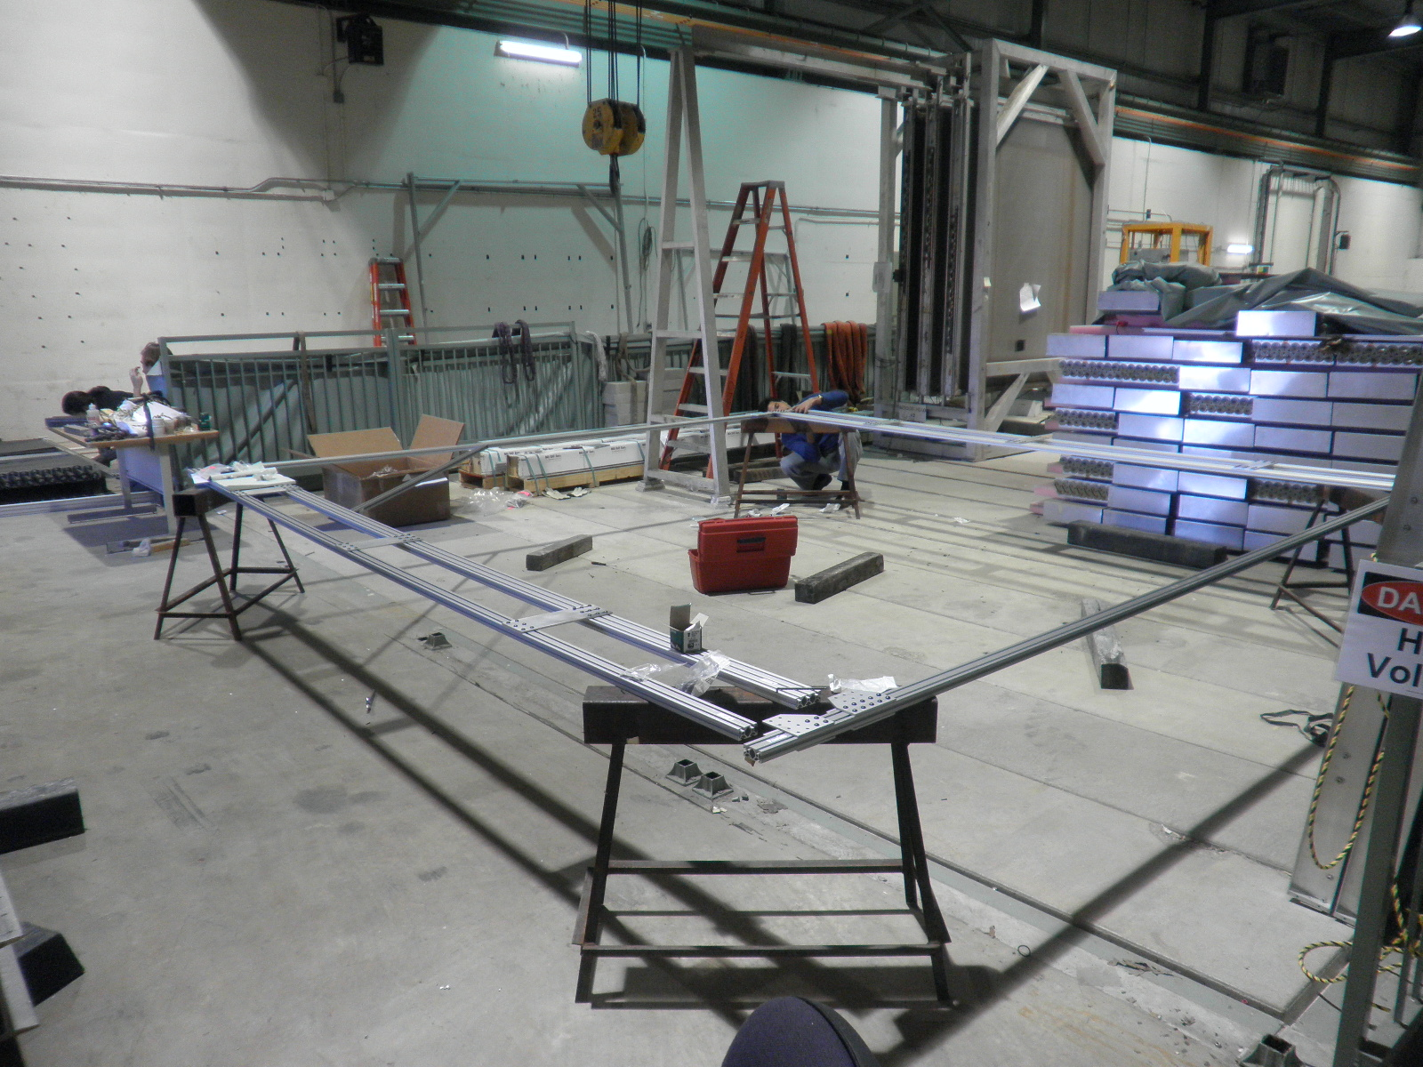
Putting them together …

Slide 3
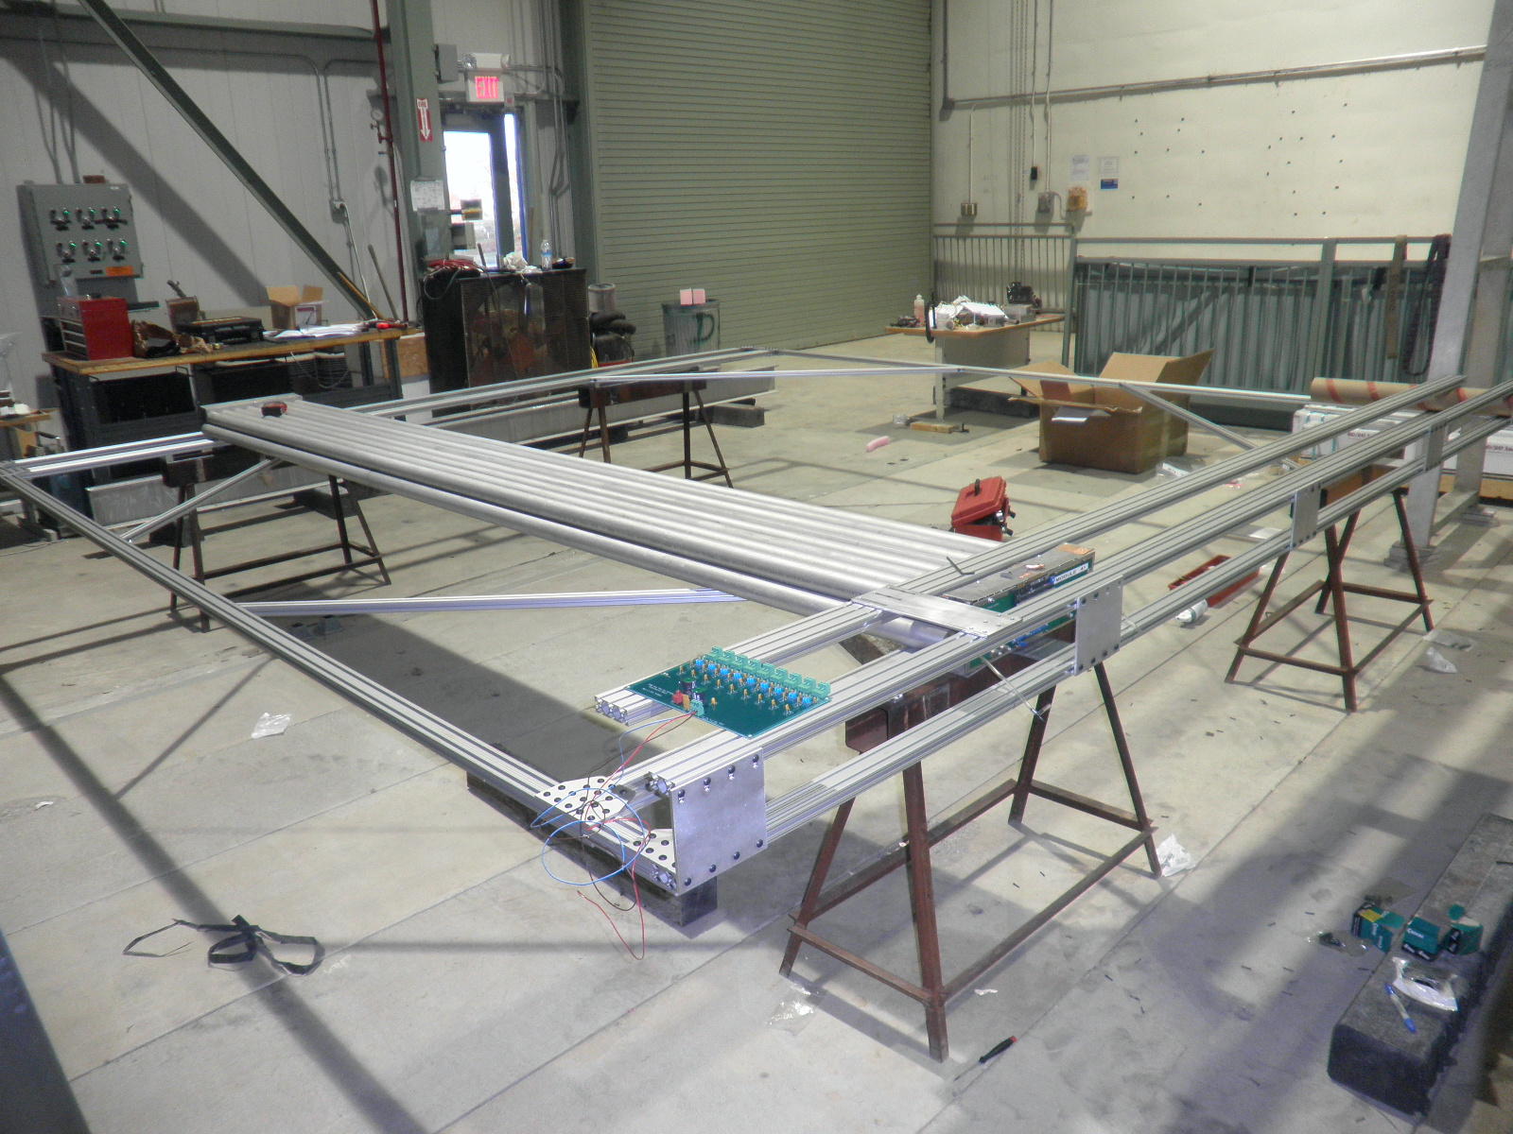
Frame with one module (8 or 9 modules total for one plane)

Slide 4
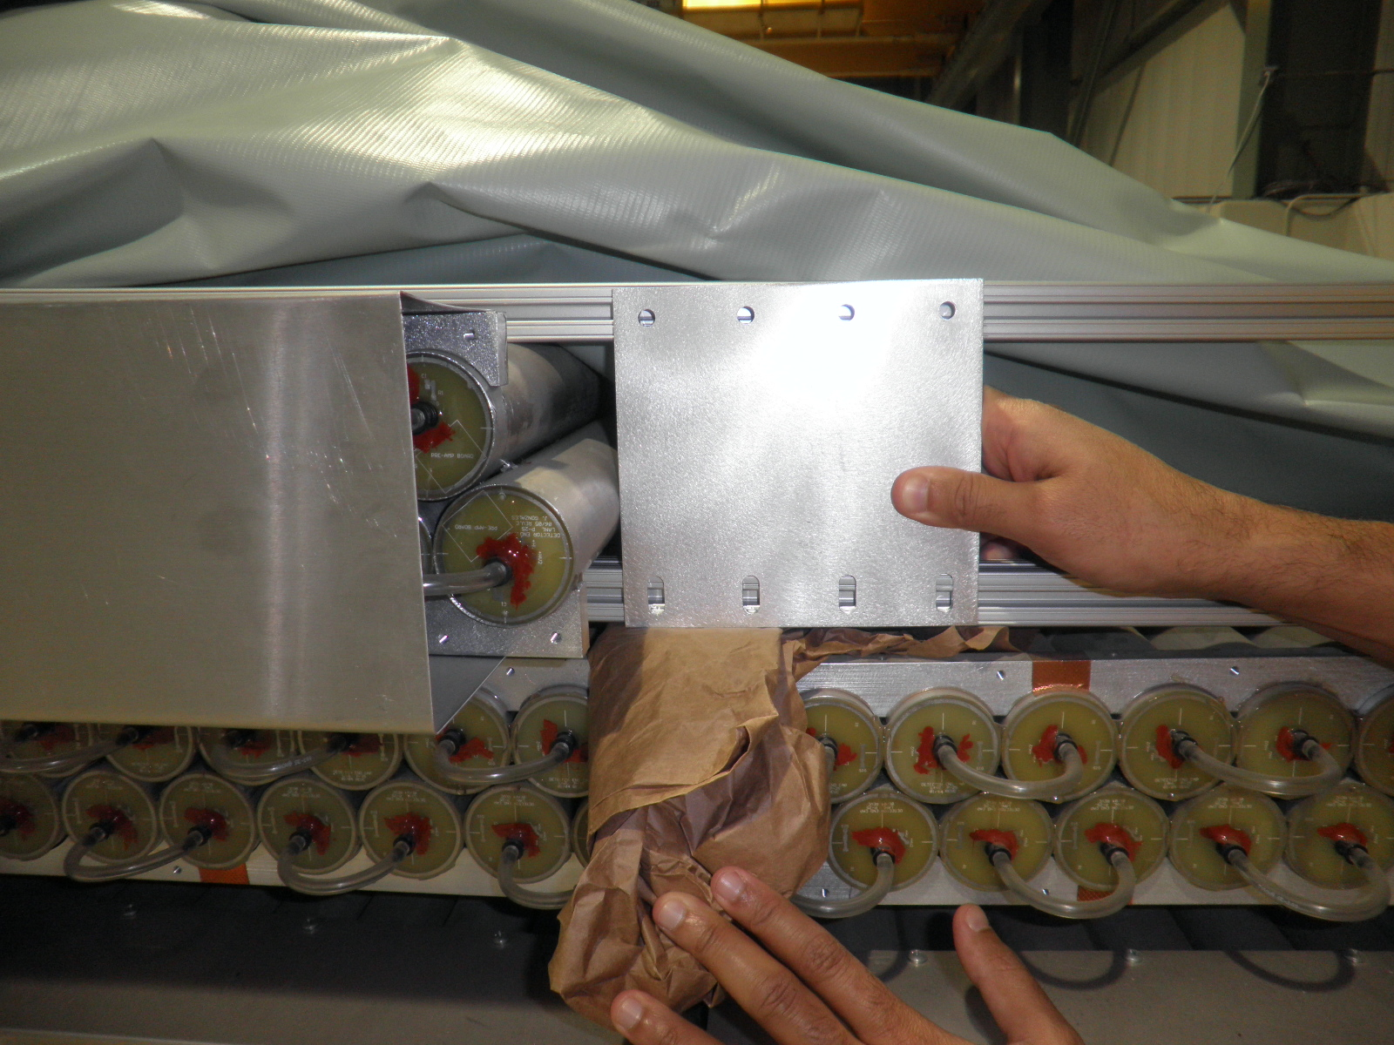
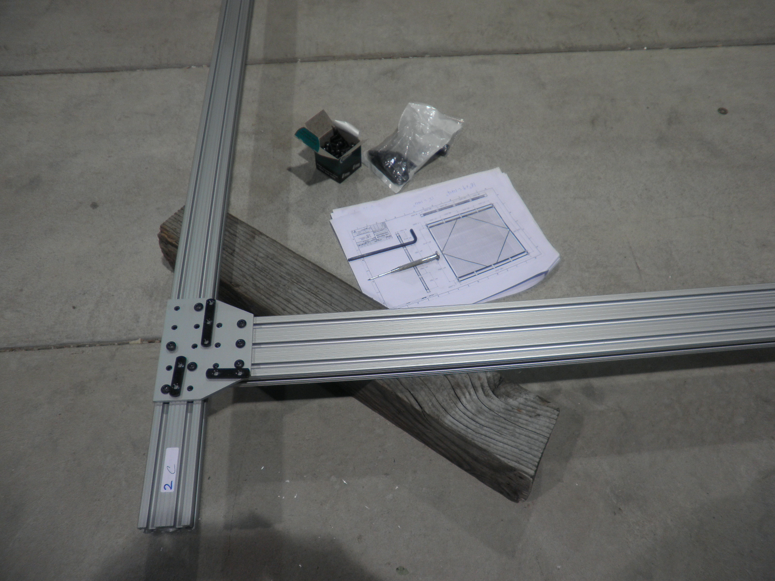
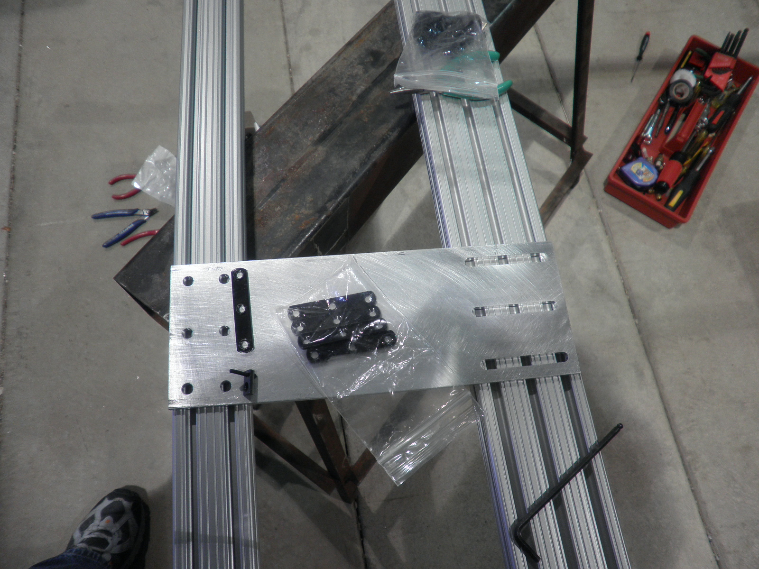
Needed: custom T-nuts for Al plates/straps

Slide 5
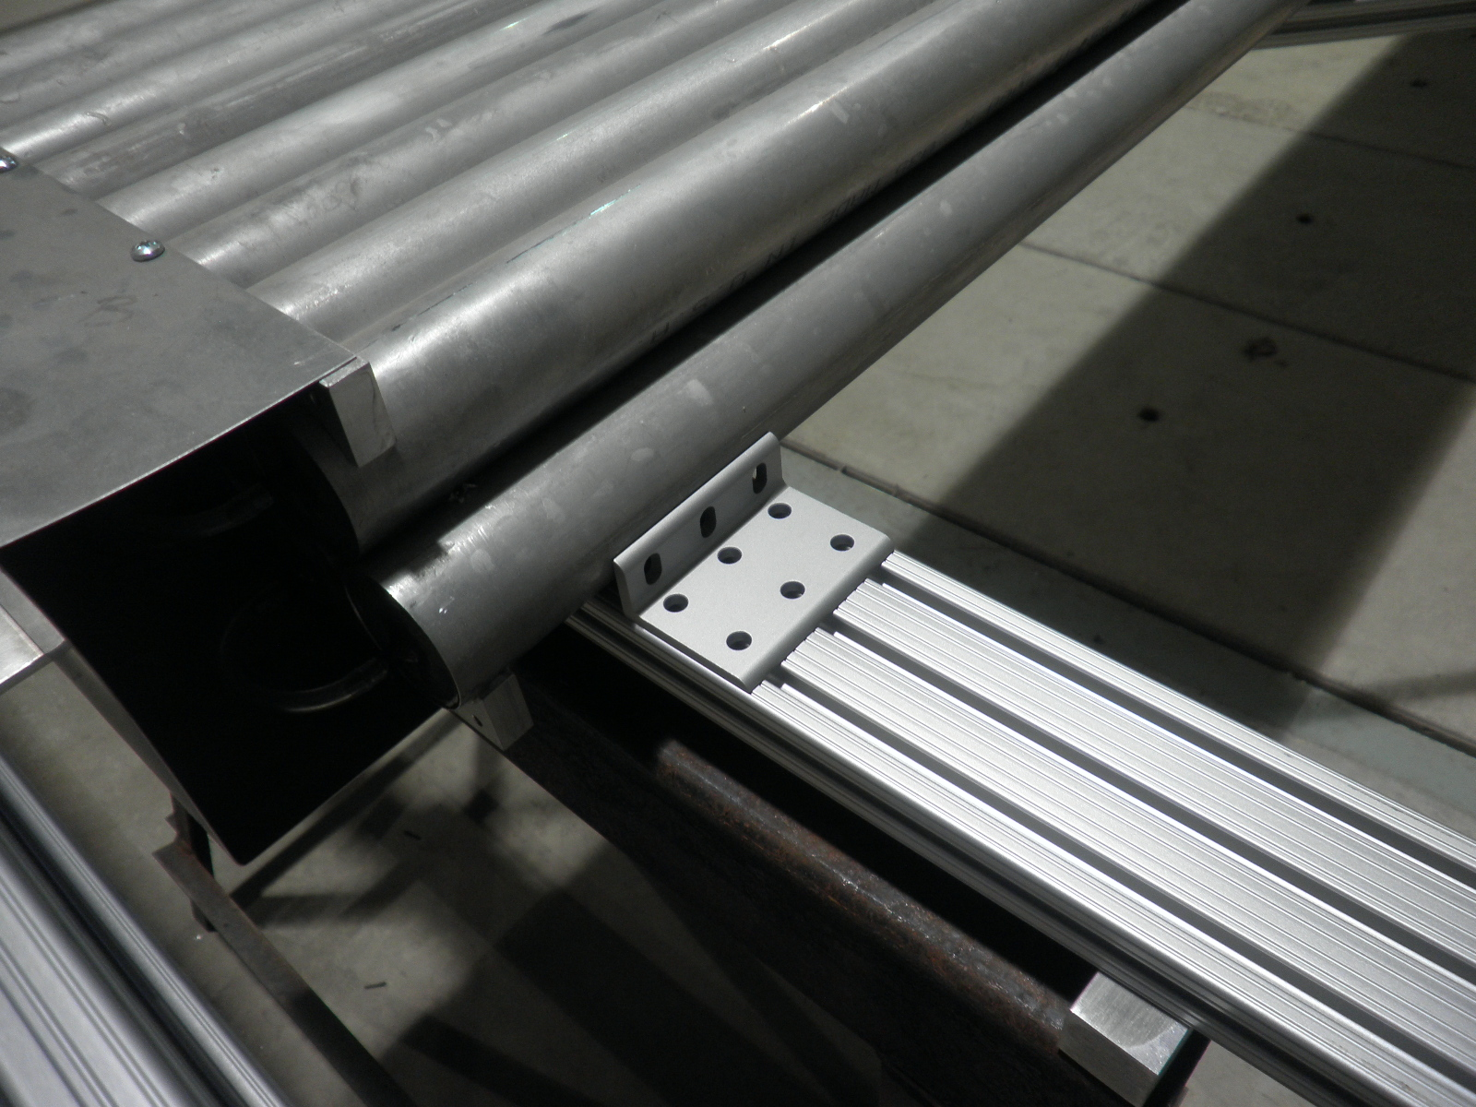
Needed: L-shape module stoppers

Slide 6
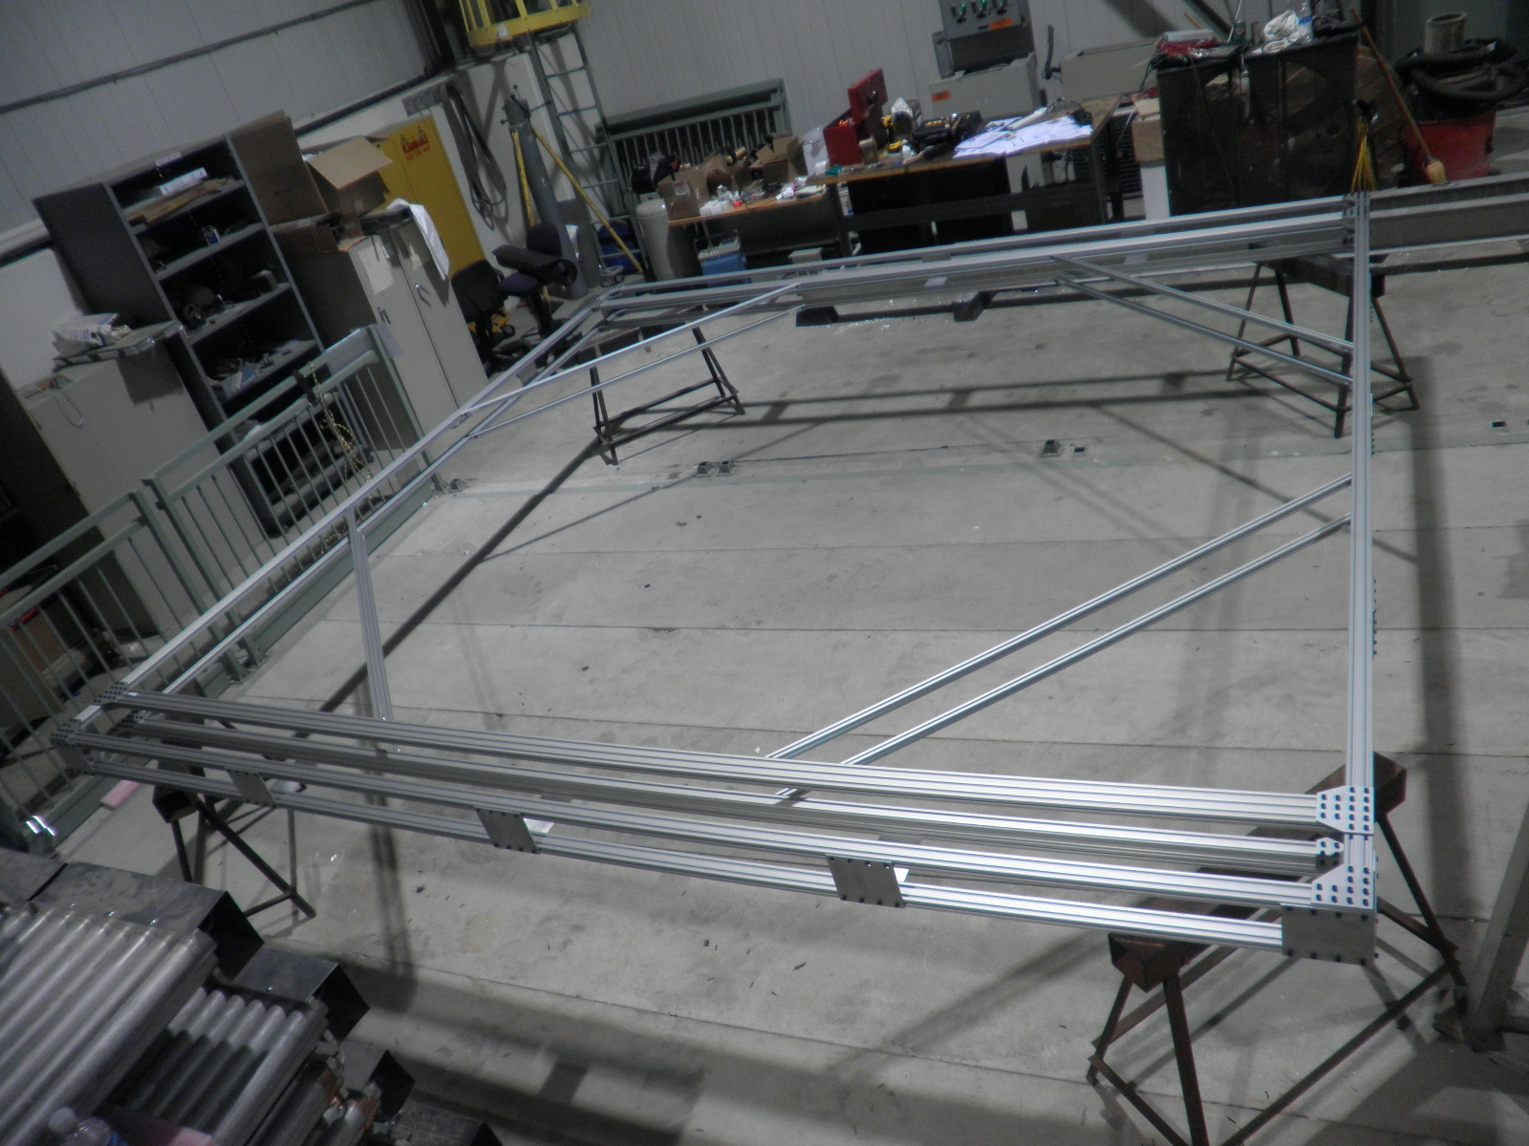
One completed 80/20 frames

Slide 7
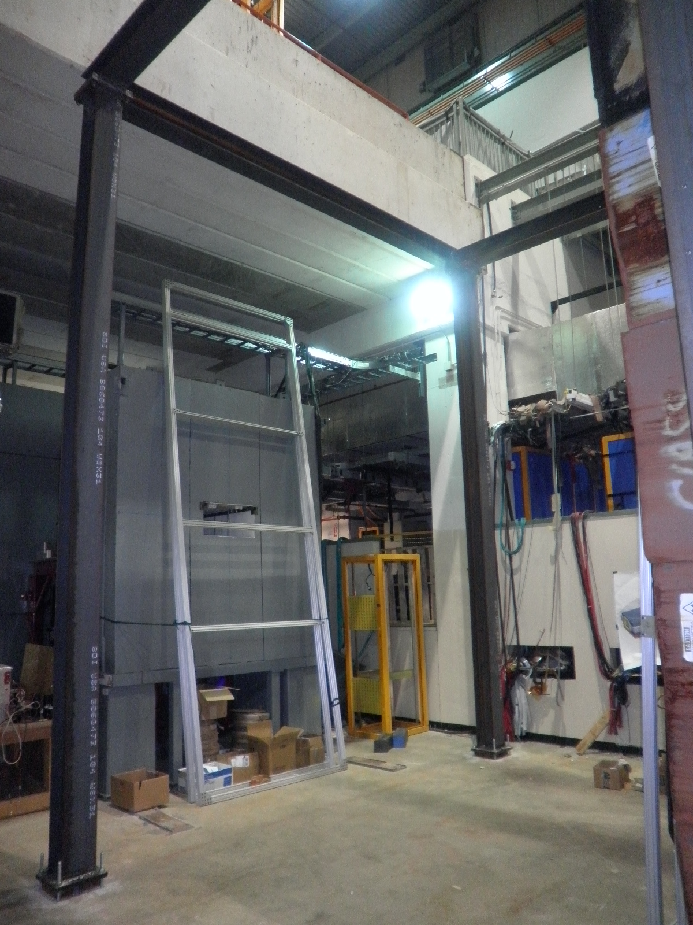
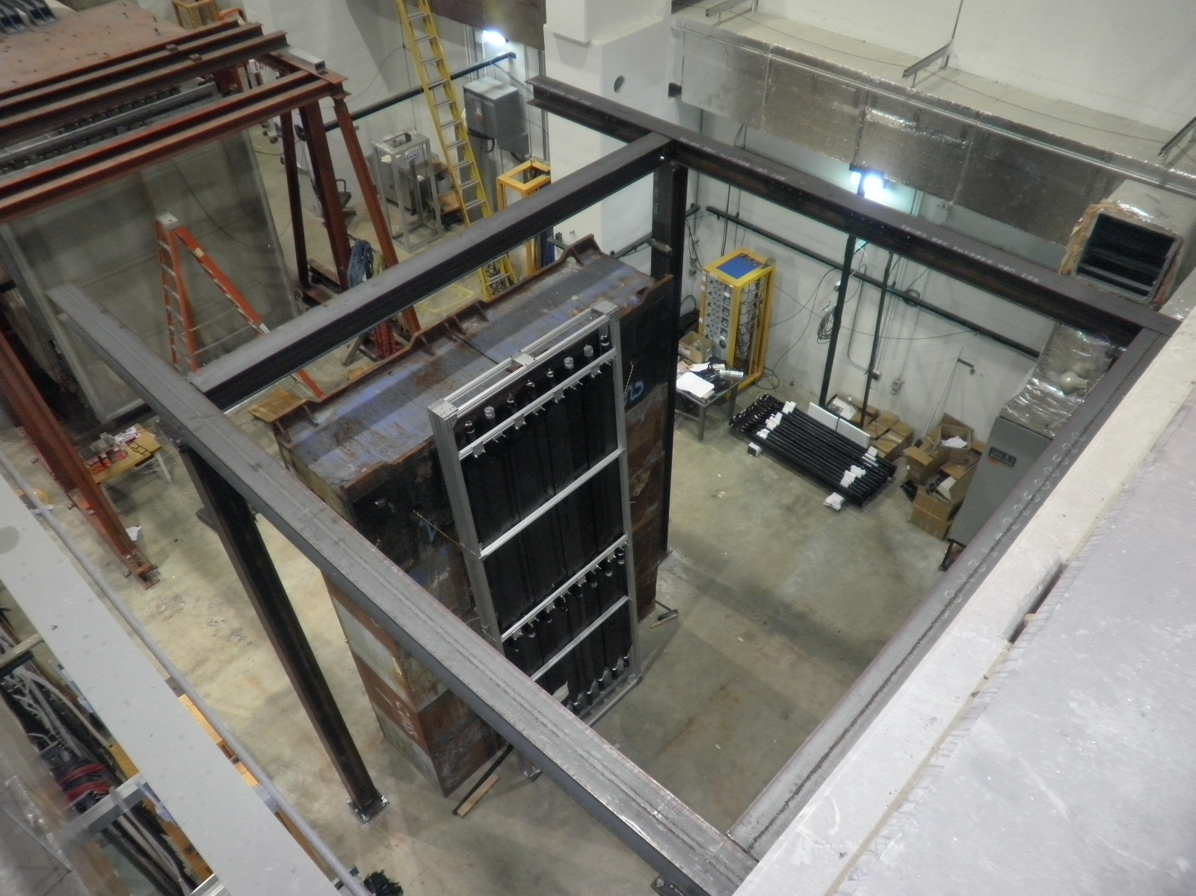
Supporting I-beam structure

Slide 8
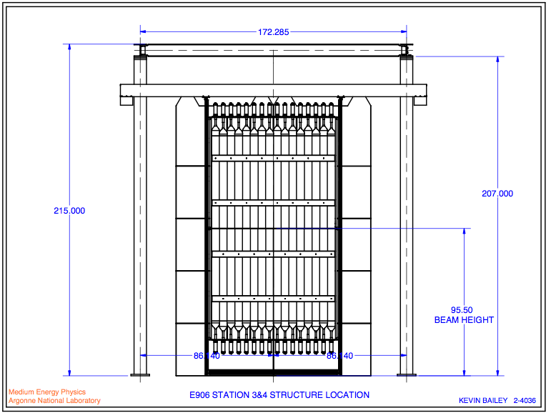
Supporting frame

Slide 9
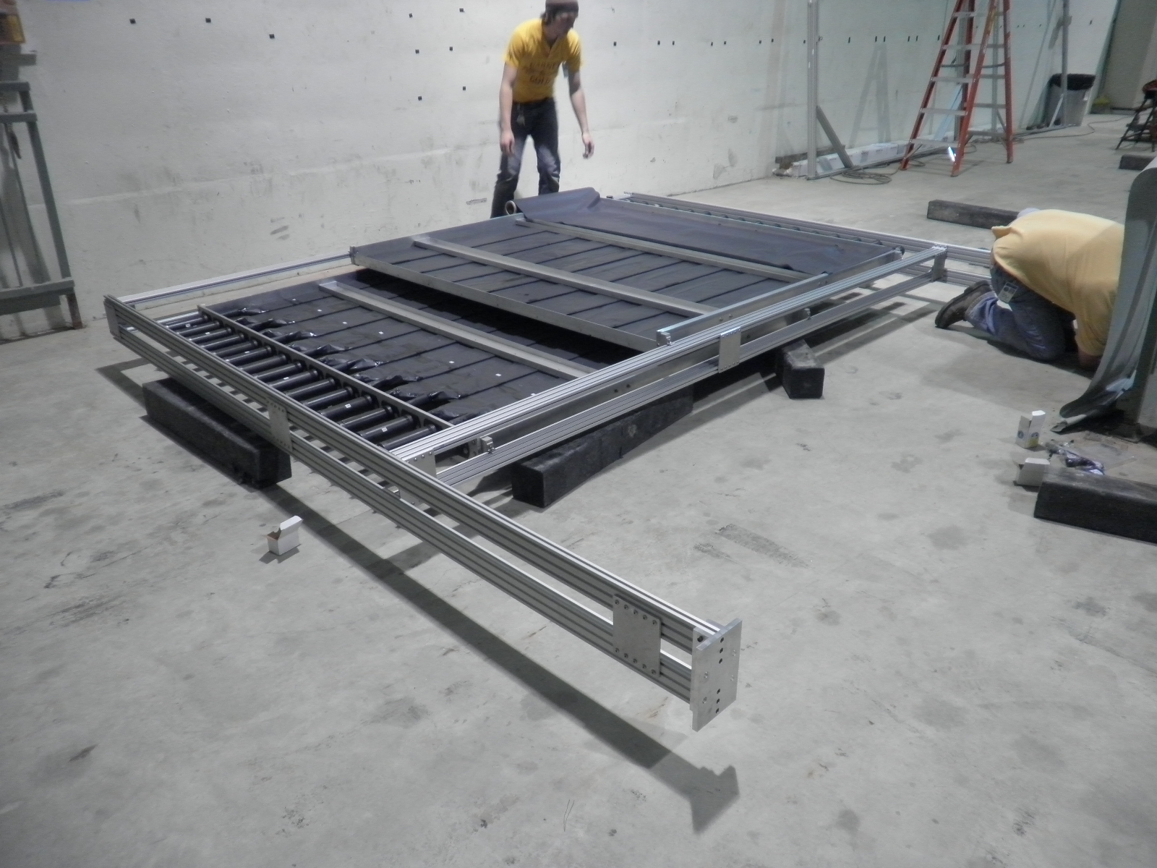
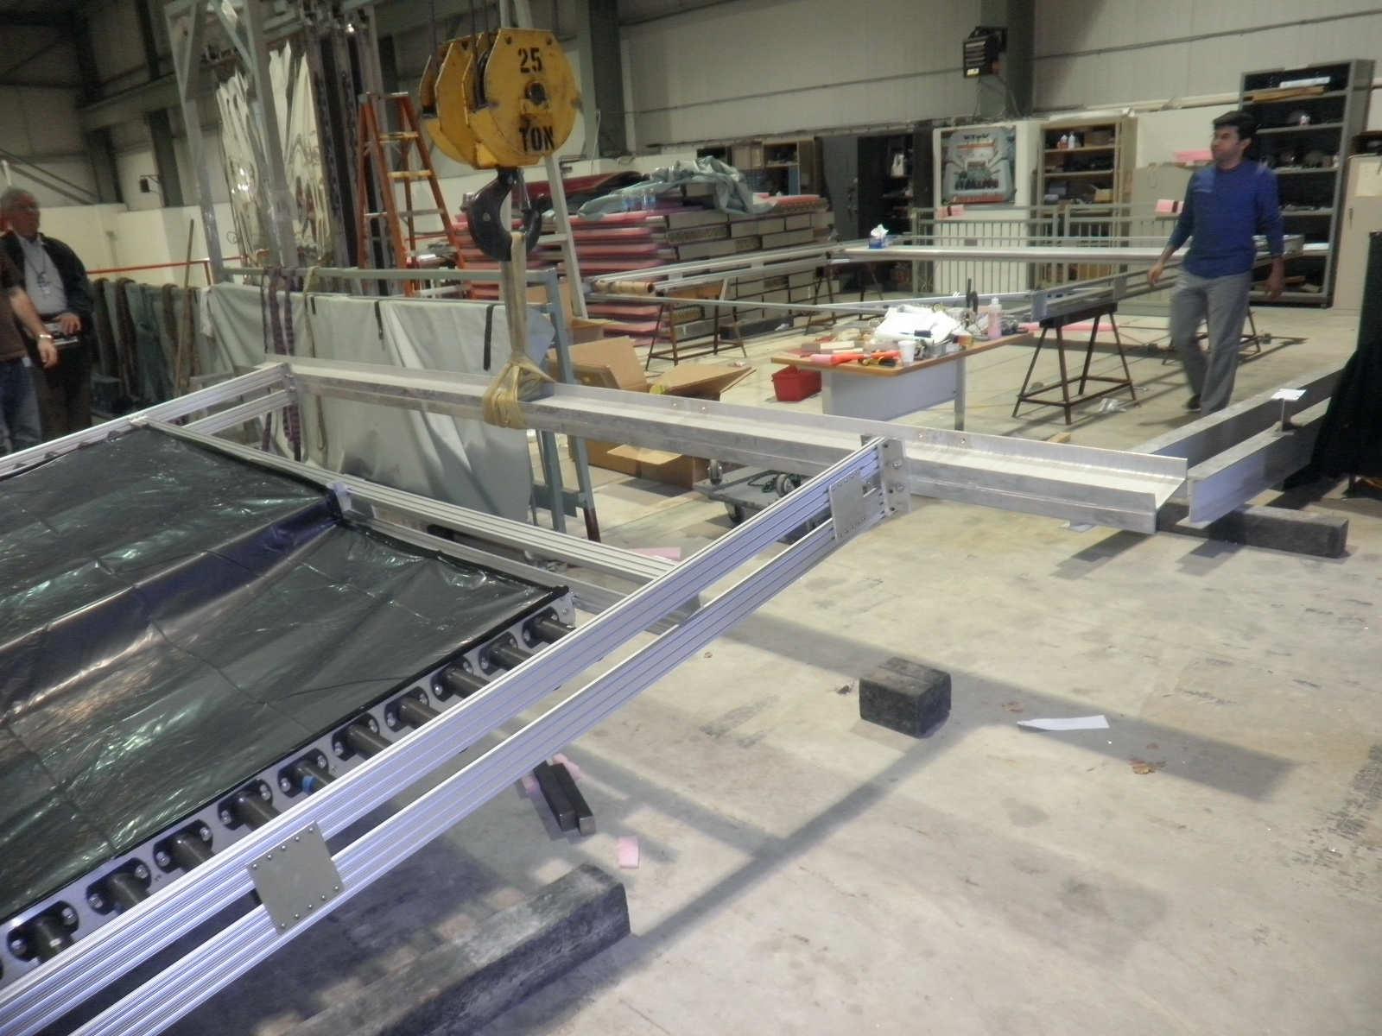
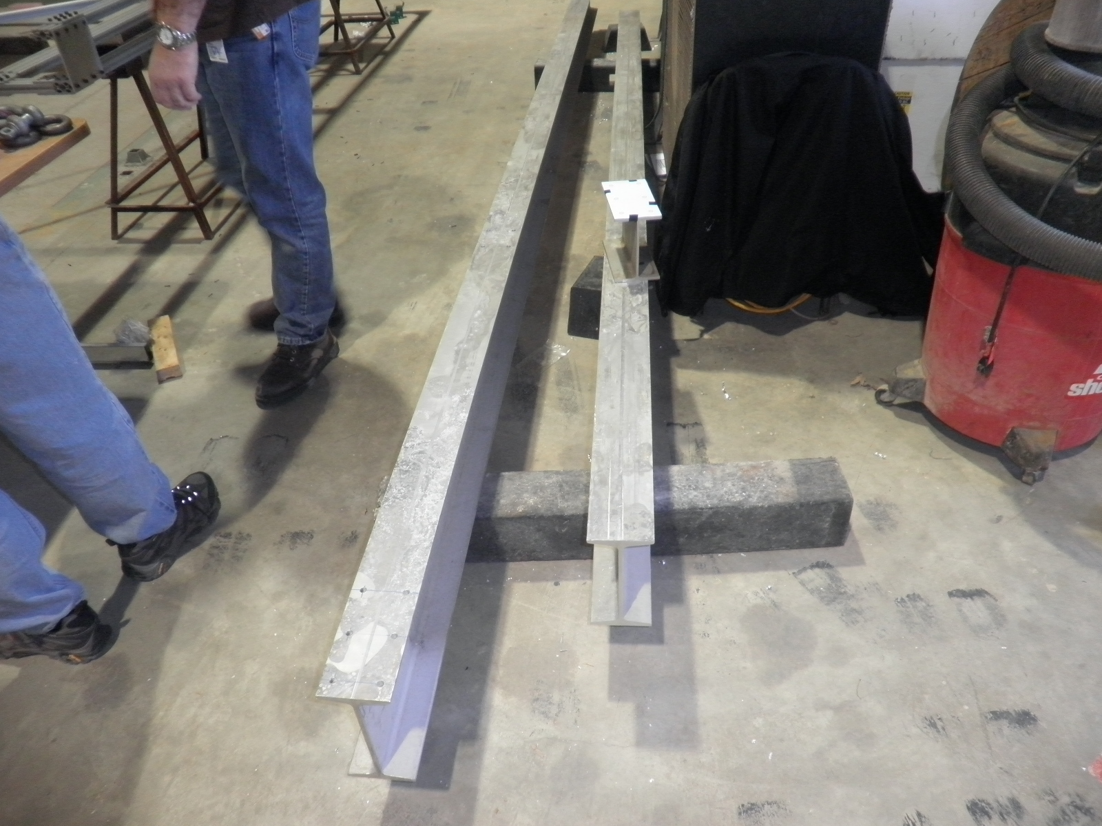
Attach frame to the cross I-beam

Slide 10
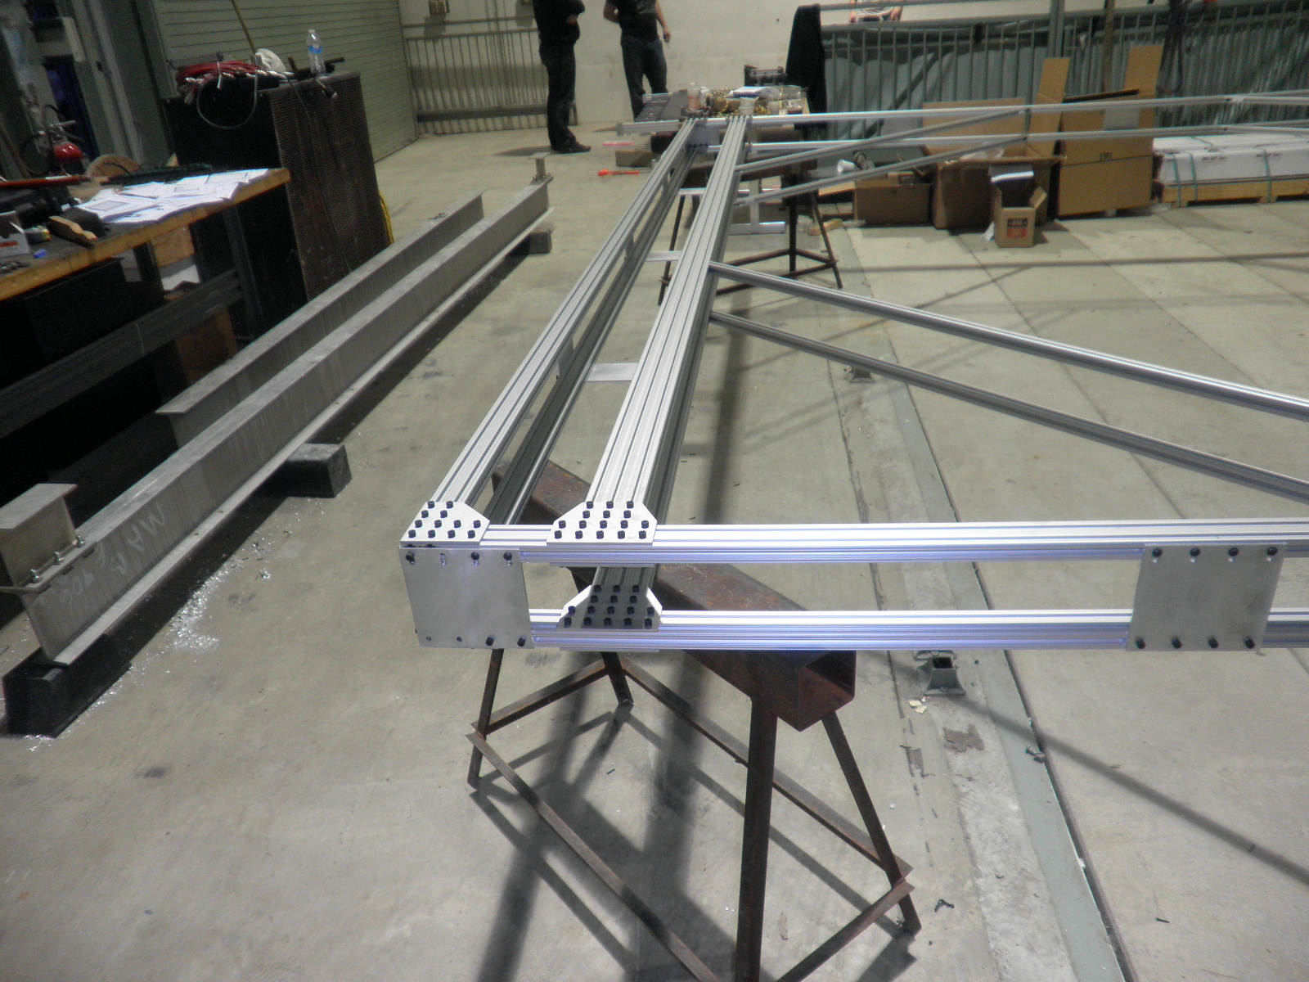
Prop tube frame and the cross I-beam

Slide 11
Parts list – need to make/buy them …
Custom T-nuts for side AL plates
Strap #1: hole spacing = 1. 66?
Strap #2: hole spacing = 1.5”
Long Al plate/bar to attach the 80/20 frame to cross I-beam.
L-shape ½” thick Al plate?, similar to strap #2
Cables from module front-end to patch panel connectors:
LV cables: 9 per plane, total 9(8)x4=34
HV cables: 9 per plane, total 9(8)x4 = 34
Signal cables: 9 per plane, total 9(8)x4 = 34
Gas tubs: 2(3) lines per plane, total 10 tubes

Slide 12
Schedule and progress
Work in progress @LANL
Assembling patch panels : a few weeks
HV feed through panels
LV panels
ECL signal panels
Will order custom T-nuts, L-shapes stoppers ~< 2 weeks
Need to order short LV cable “green connectors”: ~<2 weeks
Order short HV cables (module to patch panel) : ~< 2 weeks
Fermilab
Make LV and ECL cables:
short ones (module to patch panels)
long ones (PS /rack to patch panels)
LV wires from KTEV?
ECL cables from KTEV?
Make long Al plate/bar to attach 80/20 frame to I-beam?
Travel and work plan
12/8 is the earliest for me..
Need to check others who can help
Chuck and Paul offered to help to speed up things at Fermilab…

