Slide 1
May E906 Work and Status
TDC readout
One full TDC board, 4 ECL cables/modules
KTEV UCLA LV PS – Thanks Dave N.!
+/- 5V, 18A each
Spade /10-12AWG from ACE
HV: +2000~2200 V
Last plane (H): bottom modules 5,6,7,8
4 ECL cables/one TDC card
TDC with global pulser
cosmic trigger from ST4-Hodoscopes, 2H+1V
HV off
TDC with cosmic trigger
Global pulser ON
HV on

Slide 2
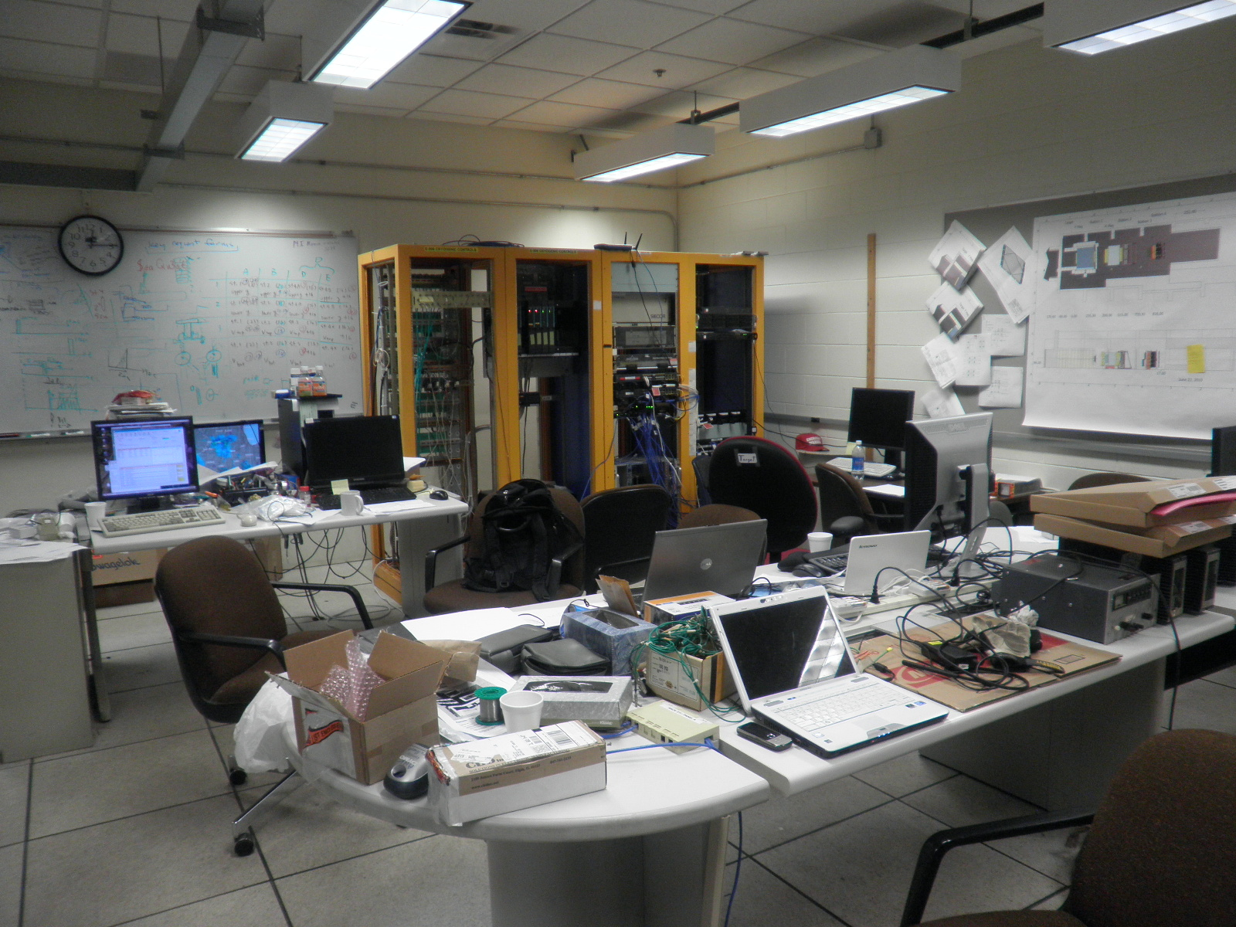
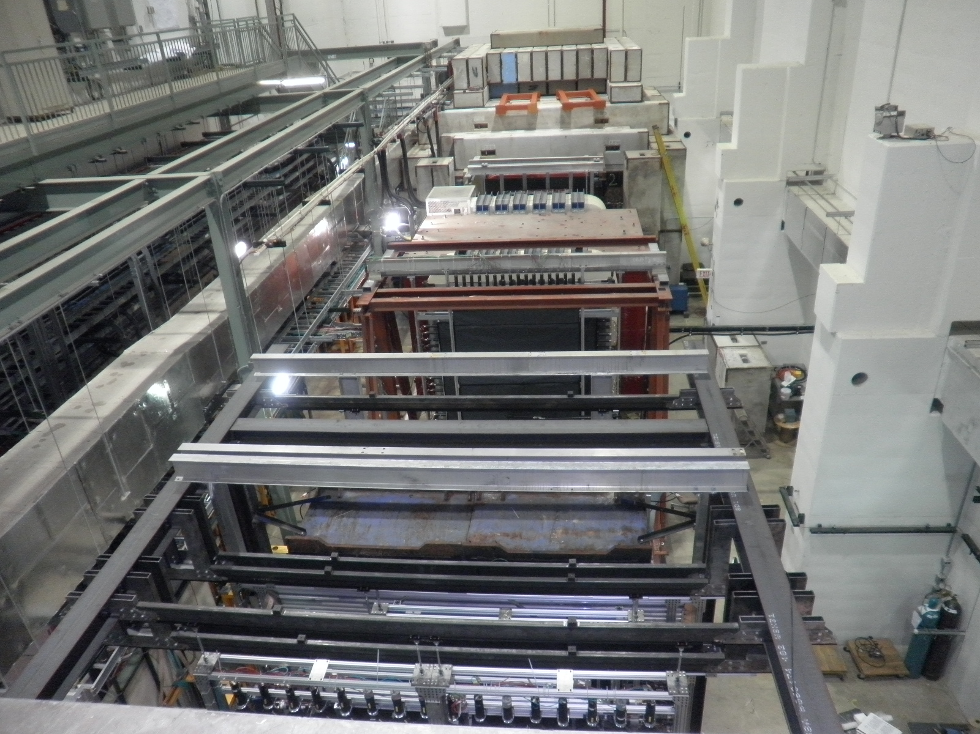
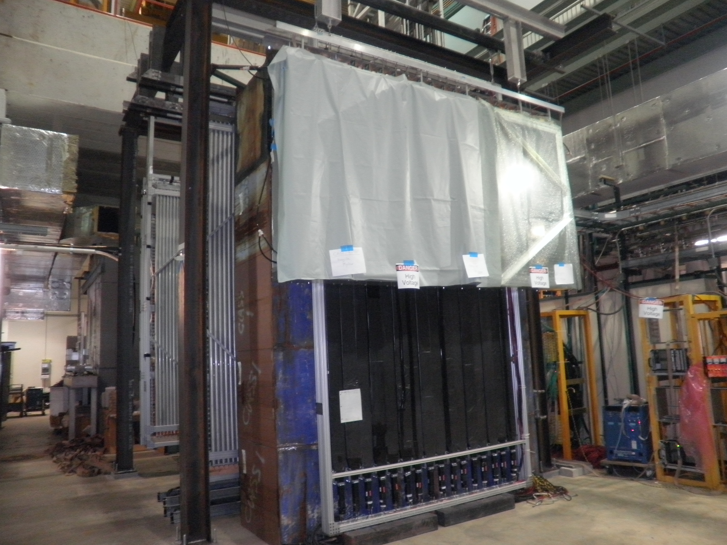
May 15, 2011

Slide 3
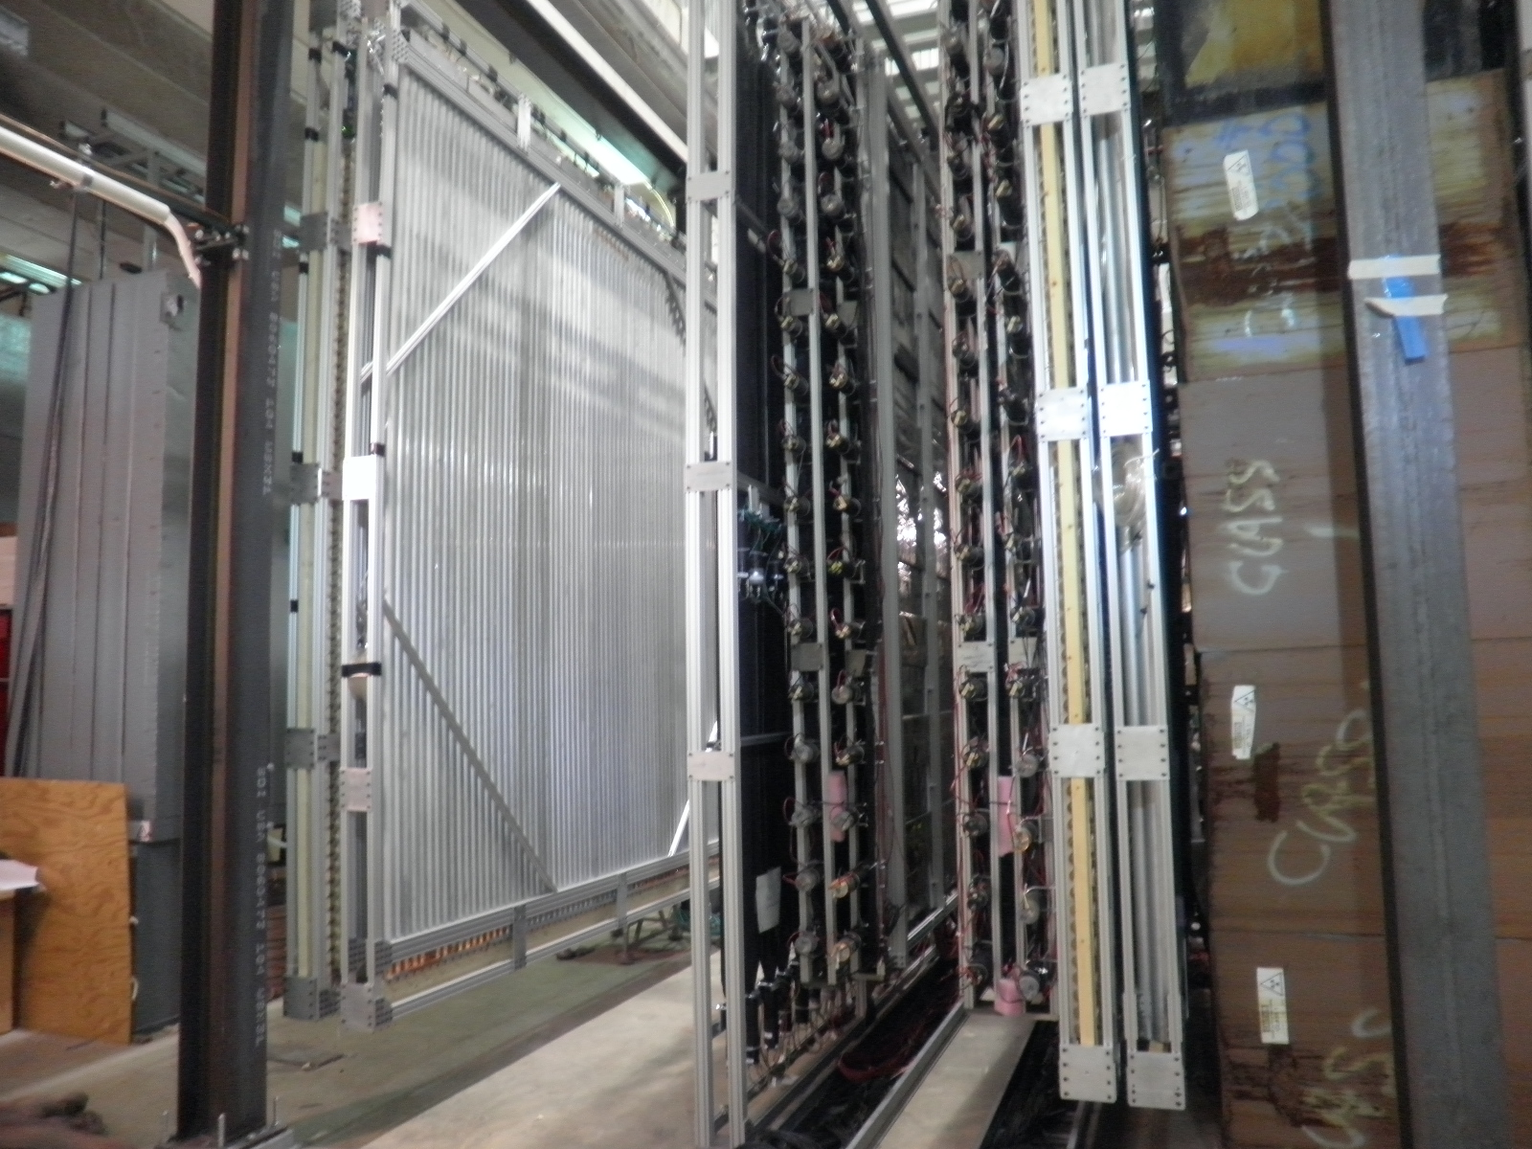
Cosmic trigger

Slide 4
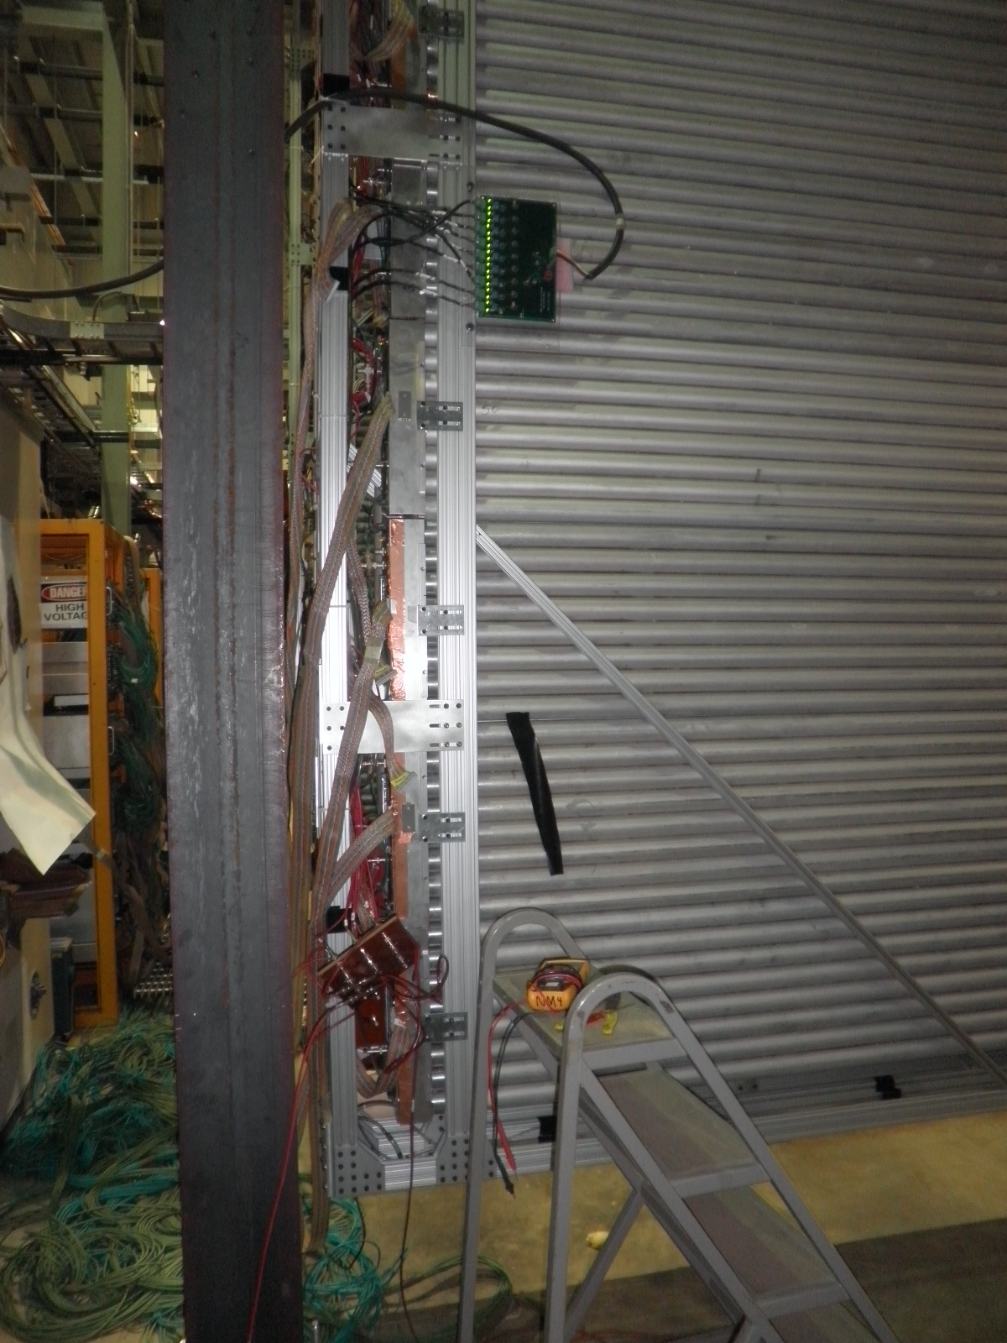
First full TDC readout with ST4-hodoscope cosmic trigger
One TDC card (new one, w/ 2nS step)
4x16 channels (4 cables)
Global external pulser delay = 2 uS
External pulser connected to modul 8
Read out up to 8 samples per channel
2nS step, 0xee1 = 3809 x 2nS = 7.618 uS
Cable-1 (mod 8; 1(top)-9(bottom))
Some hits, but none close to “8uS”
Cable-2(mod 7)
Most hits close to “8uS”
Cable-3(mod 6)
No hits, bad FEM? Broken pulser input?
Cable-4(mod 5)
Every channel has hit, and close to “8 uS”

Slide 5
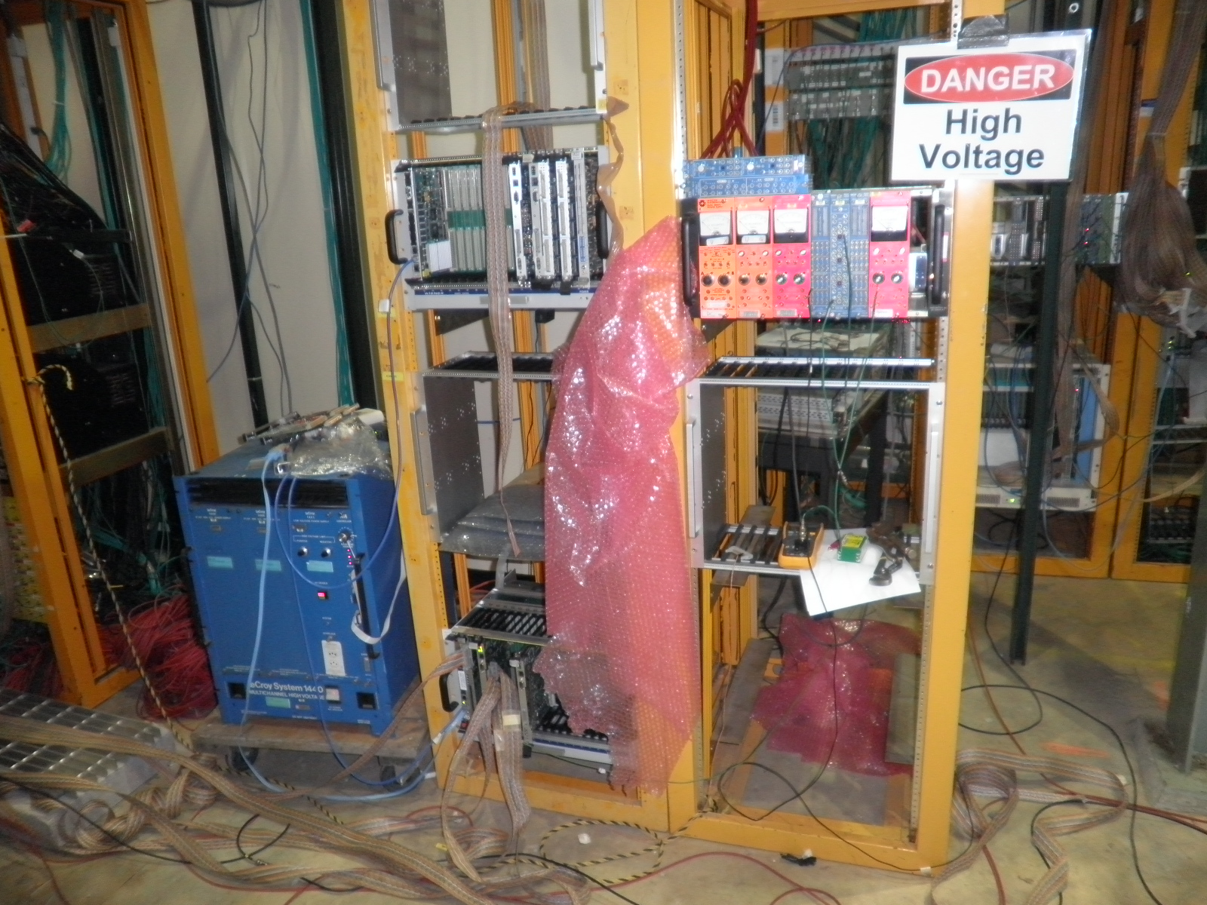
State of the art DAQ and Control

Slide 6
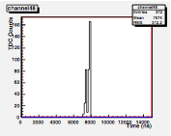
Trigger and readout setup
Cosmic trig.
Delayed pulser
ΔT ~ 2uS
Some after pulses (noise)
data
Com. stop
TDCs (<=8 samples)
0
10 uS
start
stop
8 uS!
8 uS
TDC

Slide 7
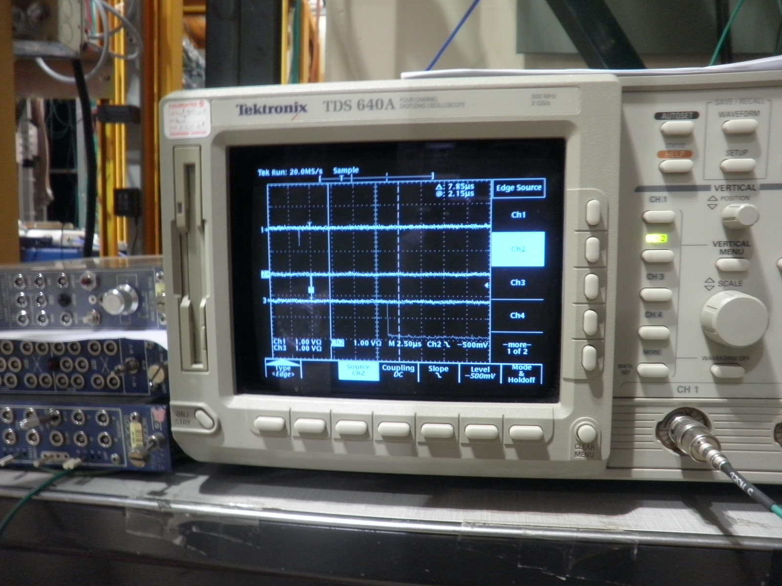
Cosmic signal and trigger/com. stop

Slide 8
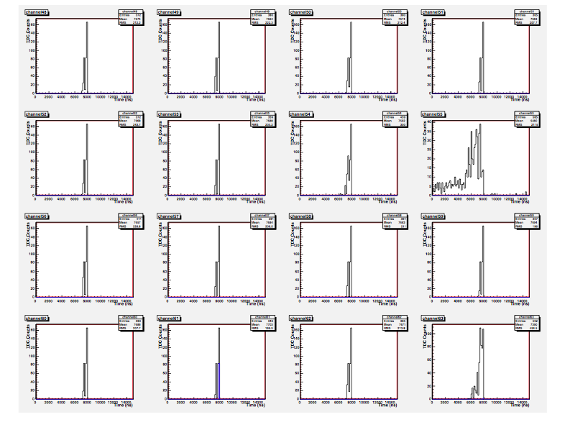
Cable-4 (mod. 5) TDC from external pulser (cosmic trigger), HV=off
8 uS!
Noisy channel!

Slide 9
Second readout test
Global pulser Delay 5uS
Some DAQ problems
DAQ auto self rebooting …
Pulser causing the problem? Some grounding issues?
DAQ runs fine without pulser
Data volume too large? Further test needed

Slide 10
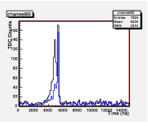
Cosmic data!
Com. Stop delayed 5 uS
HV=2200 V
Black: all samples
Blue: the first sample only
5.0 uS

Slide 11
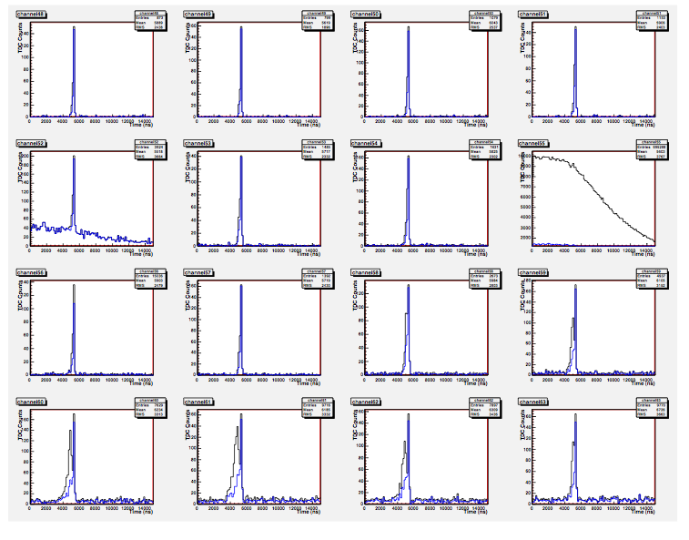
Module 4: TDCs (16 chan.)

Slide 12
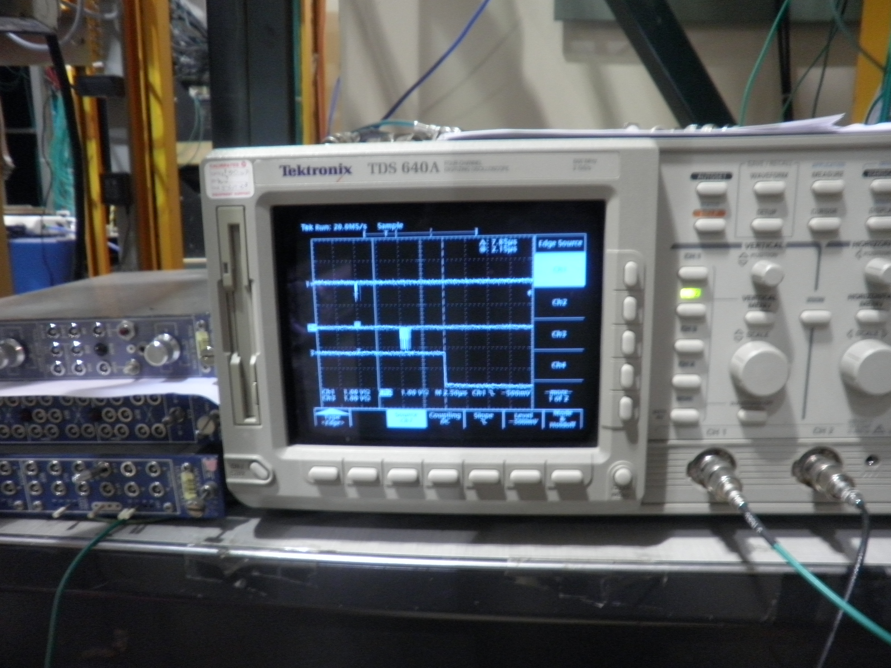
Trigger, data, Com-Stop a lucky shot!

Slide 13
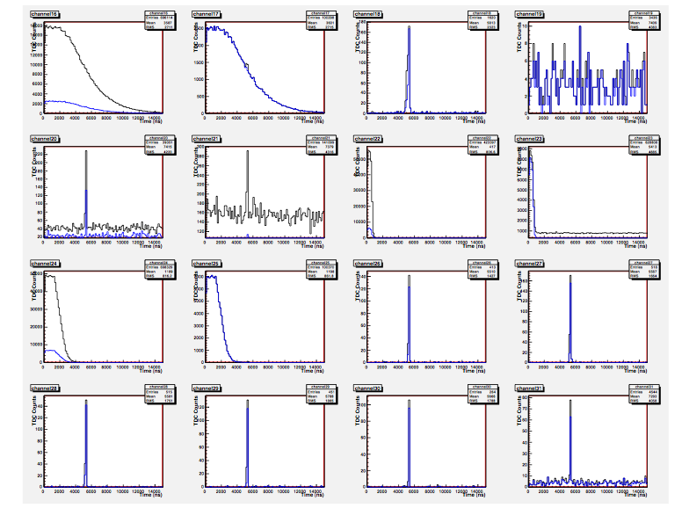
The challenge: what are they?!

Slide 14
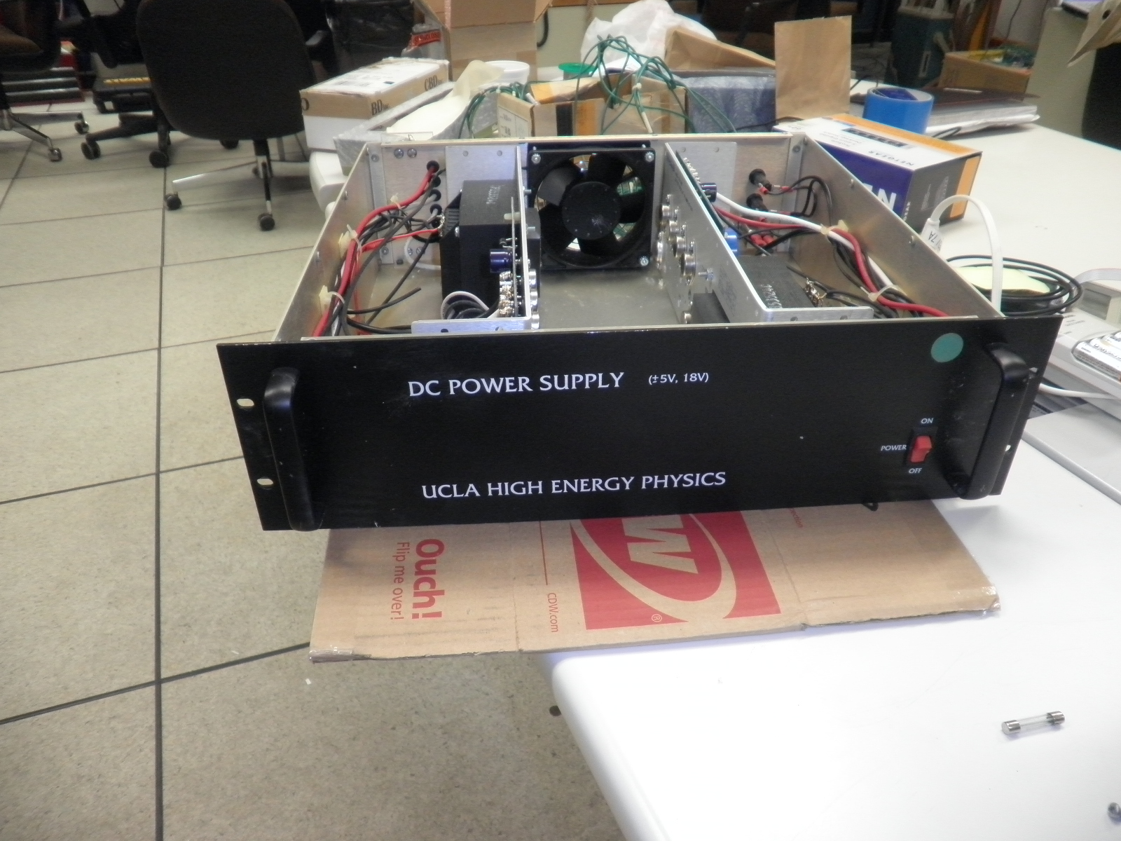
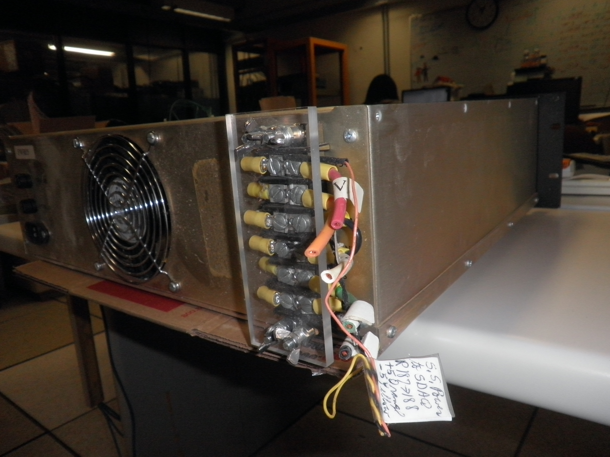
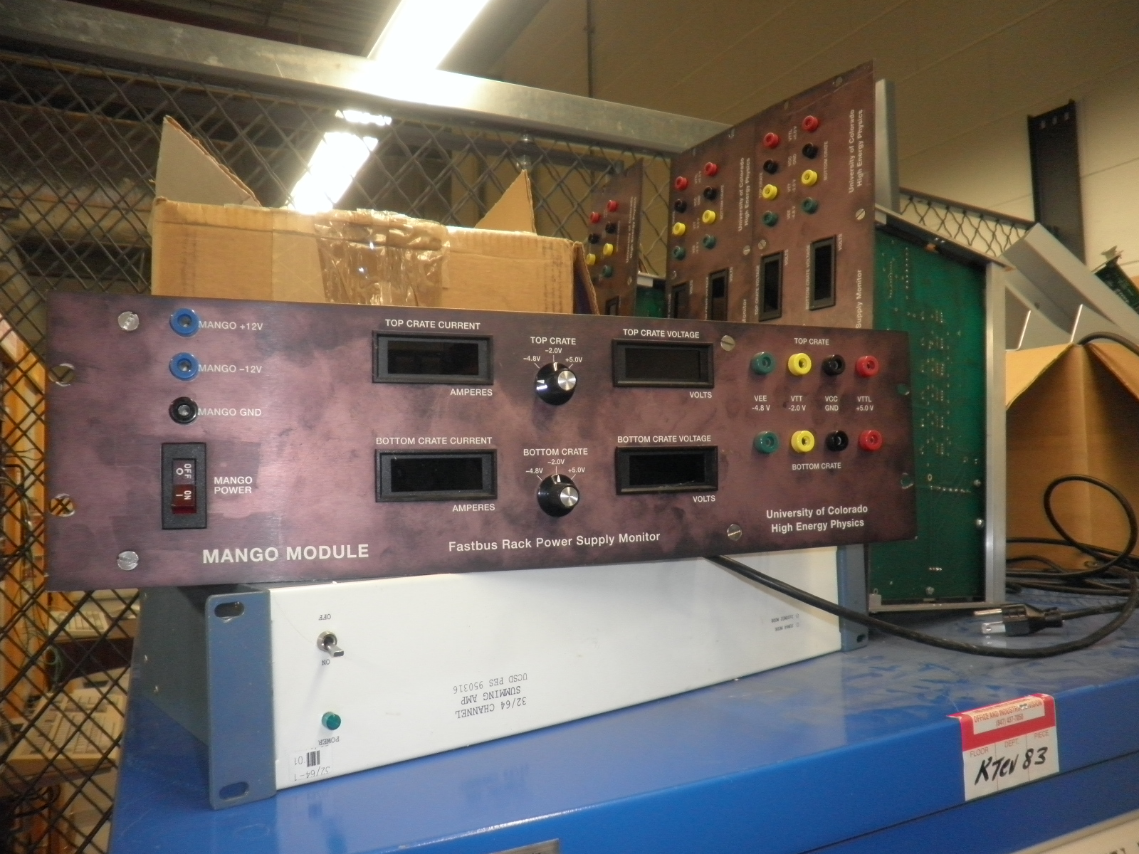
Gifts from God

Slide 15
LV cables

Slide 16
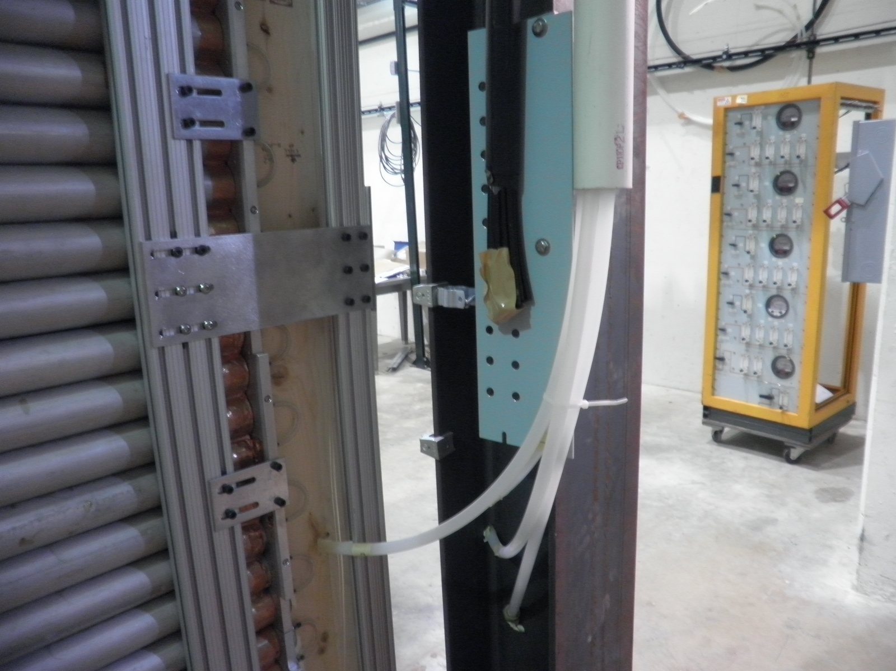
Gas lines

Slide 17
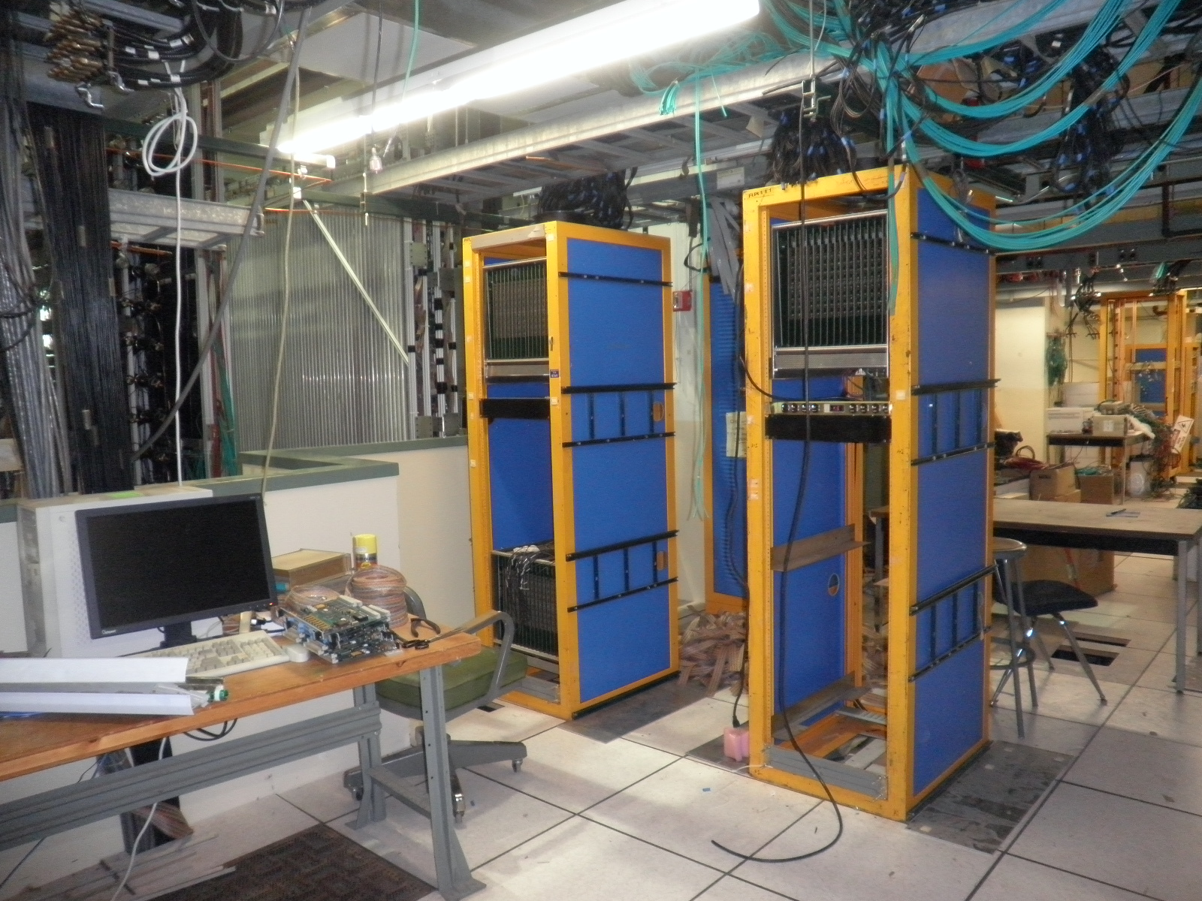
LV and HV racks

Slide 18
To do list
LV
Replace the cooling fans
location
LV cables from PS to chambers
HV
How many channels do we need?
4? (2 modules)
4x9=36? (18 modules)
Location
Cables from PS to chambers
Signal
Rack location
Cables 4x9 = 36
Calibration pulser driver
NIM able to drive all 9 modules per plane, -1V, XX mA?
Gate generator : voltage sagging ~ [-0.5, -0.8]
Gas panels (4)

Slide 19
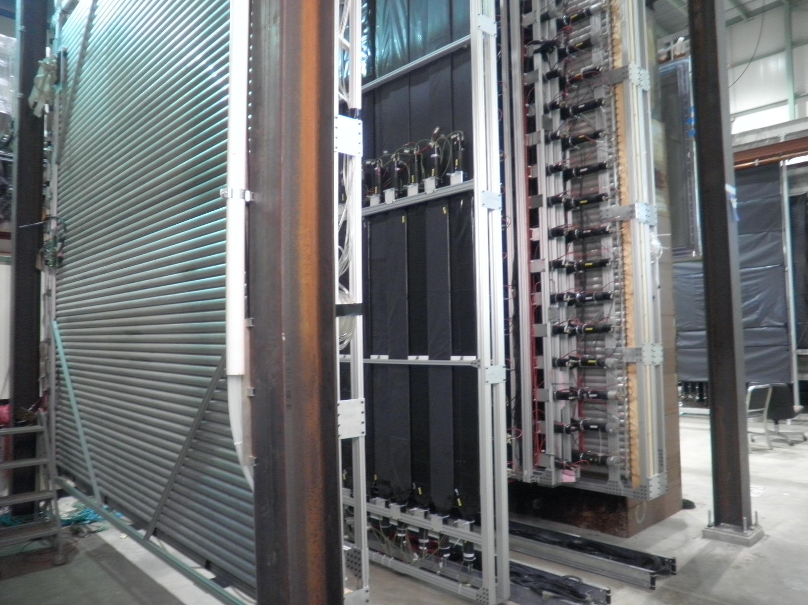
Trigger

Slide 20
