Slide 1
QIE Study
Kaz, Kun, Ming

Slide 2
Signals from QIE
One spill data collected 11/30/2013
Dumped “amplitude, RF# and turn#”
About 2.4 seconds worth of data
Work in progress

Slide 3
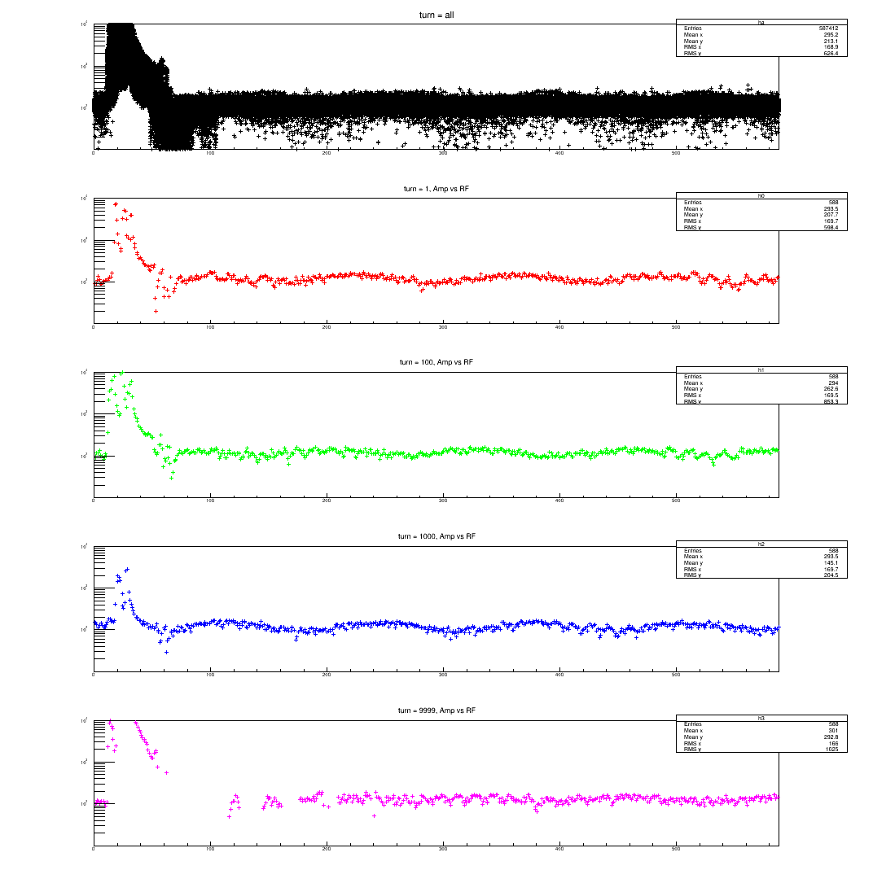
Amp vs RF#: Turn =1, 100, 1000, 10000
Note:
Within a single turn,
the RF to RF relative amplitude
remain more or less the same.
The amplitude of each single
Bucket moves up and down together

Slide 4
Amp vs Turns: RF = 5, 20, 30, 40
Dominant fast oscillations:
Frq ~ 360 Hz
3000 cycles/12 periods * 11 uS
Note: in a given spill,
the amplitude pattern for each
RF bucket is “predictable”
from the first a few cycles

Slide 5
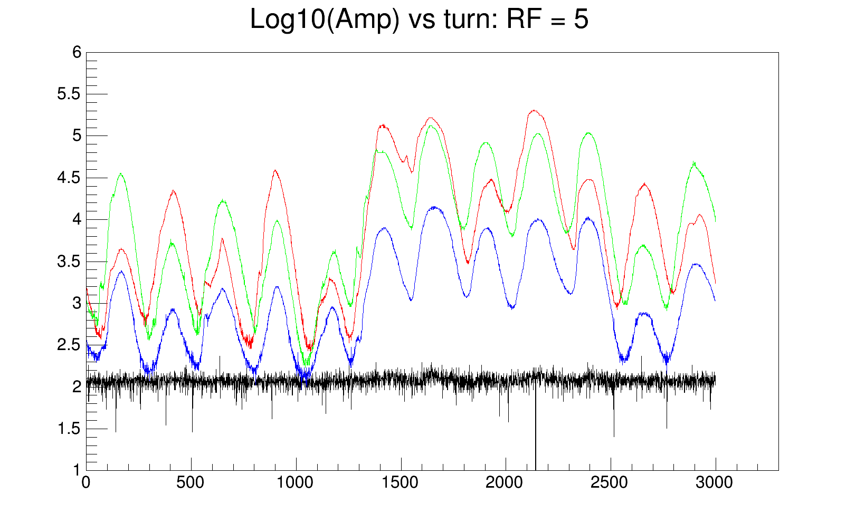
Amp vs Turn: RF = 20/30/40

Slide 6
Amps vs Turns: RFs=20/30/40
RF = 5(Ped), 20 (RED), 30(GREEN), 40(BLUE)

Slide 7
Amp vs Turn (3000): RFs=[0, 79]

