Slide 1
Possible Topics for First Year Physics
Ming Liu
Los Alamos National Lab
- Drell-Yan and J/Psi productions @120 NN
Quark energy loss via DY in p+A
CNM J/Psi production in p+A
Quark-Gluon Plasma (QGP)
Cold Nuclear Matter Effects (CNM)

Slide 2
Outline
Physics Motivations
  Drell-Yan suppression in p+A
Year-1 E906 statistics
  Drell-Yan production
J/Psi suppression in p+A
  J/Psi CNM absorption and breakup
DY cos(2phi) type modulation (B-M type)
  Expect samll asymmetries

Slide 3
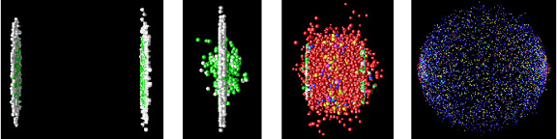
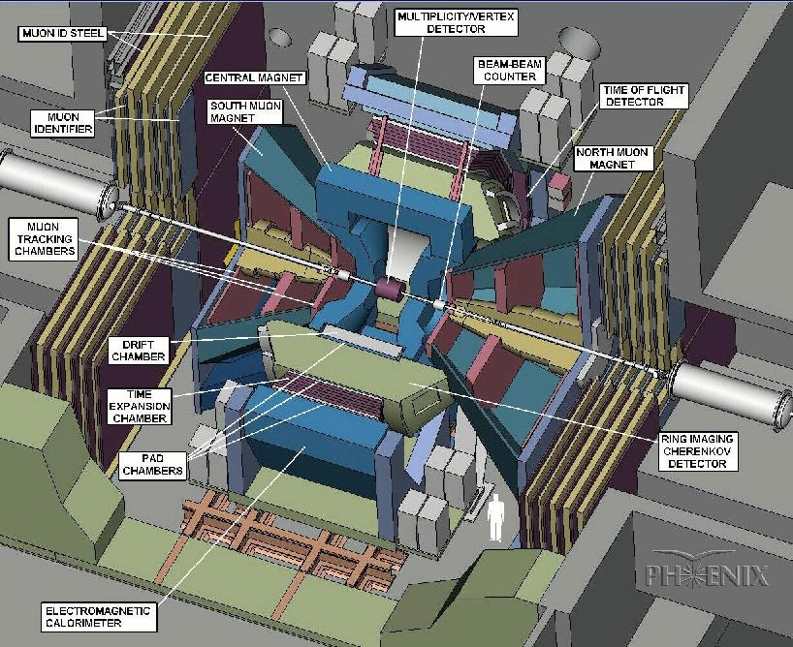
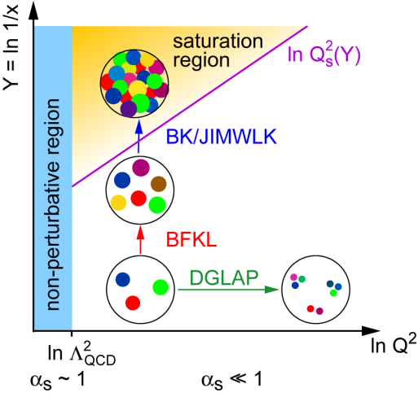
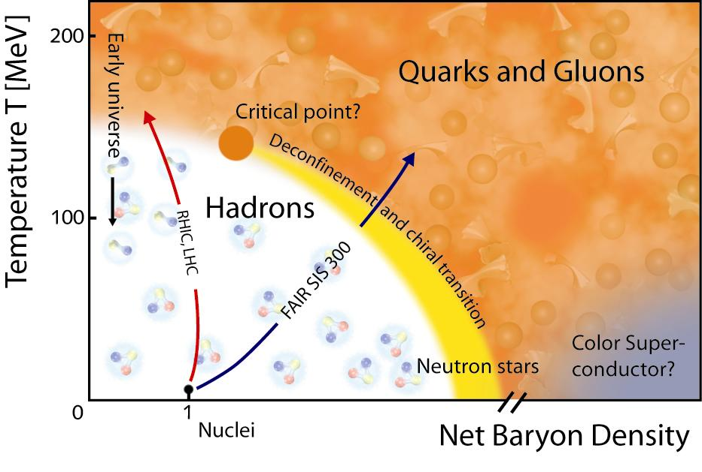
Physics of Heavy Ion Collisions
- Understand the Properties of QGP
- Explore the QCD phase diagram
- Novel CNM physics & QGP baseline
Before collision
Initial state
CNM effects
QGP
Hadron gas
Hadrons detected
Heavy Ion Collision – Time Evolution
Time (fm/c)
1 10
- Gluon saturation
- Parton shadowing
- CNM Parton energy loss

Slide 4
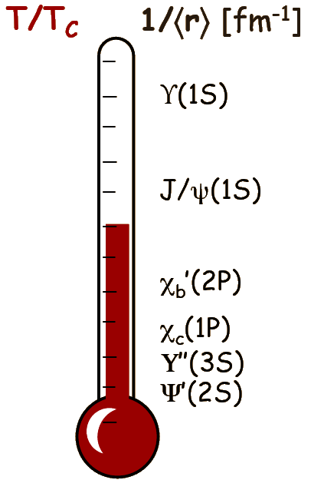
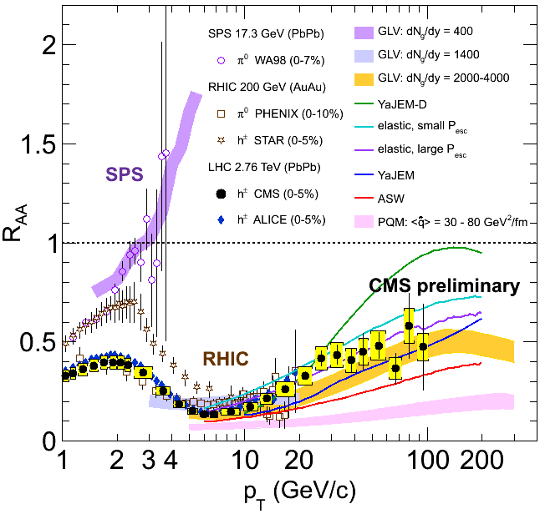
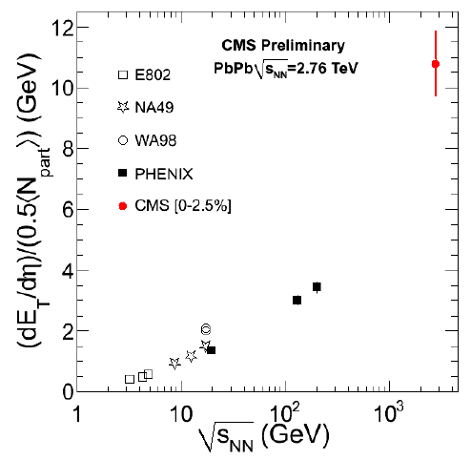
Outstanding Questions in Heavy Ion Physics
LHC ~ RHIC!
Parton dE/dx & QGP properties
  (NSAC DM10, 12)
  Radiation & collisional dE/dX
    Light vs heavy quarks
  CNM effects
QGP color screening & heavy quarkonia “melting”
  (NSAC DM5)
  Color screening & recombination
  CNM effects
Jet suppression
J/Psi suppression
Achieved QGP Densities
h
LHC
RHIC

Slide 5
Topic I
Drell-Yan and Quark Energy Loss in p+A
The first unambiguous determination of quark dE/dx with DY at E906!

Slide 6
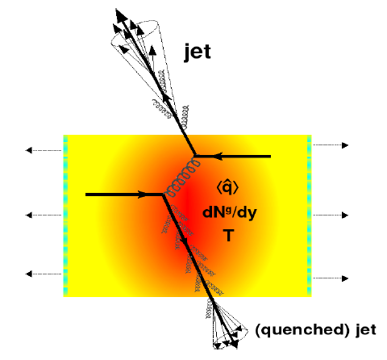
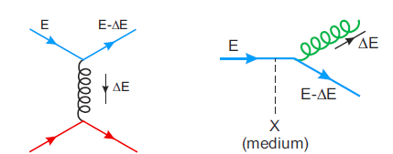

Outstanding Questions in Heavy Ion Physics
Jet Quenching and QGP Properties
Various parton energy loss mechanisms
  Radiative energy loss
    e.g. DGLV, BDMPS, AMY …
  Collisional energy loss
Theoretical quenching factor
- much model dependent!

Slide 7
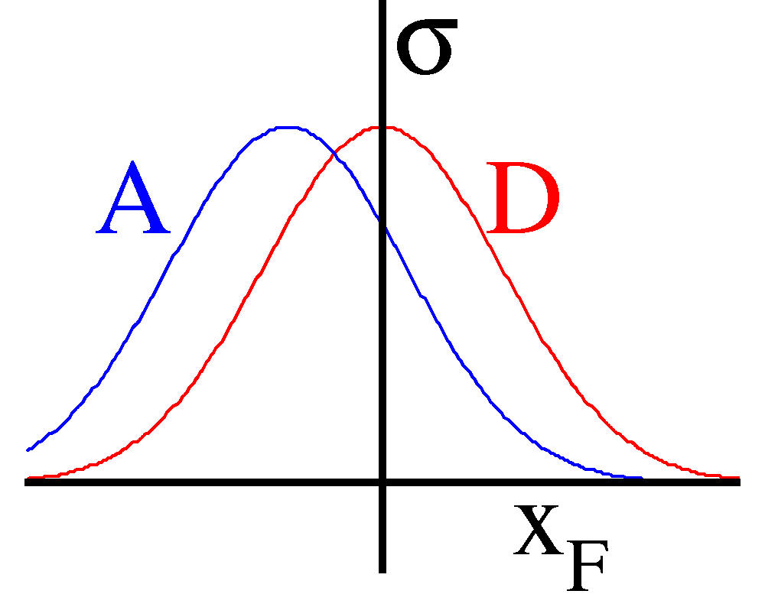
Determine and Calibrate dE/dx with DY in p+A
(Drell-Yan Process)
Known initial state nuclear parton density;
Minimal final-state interactions of the detected particles.
E906: No shadowing correction at moderate X_{t}
q, g
DY
euterium
Energy loss reduces x_{b} and x_{F} in nuclei versus proton (x_{F} = x_{b}-x_{t})
Possible sea-quark shadowing effects

Slide 8
Sea Quark Shadowing and Nuclear PDFs
E906
E866

Slide 9
Quark Energy Loss in Cold Nuclear Medium
Drell-Yan @E866
- Drell-Yan Suppression ~20% in p+W
<dE/dx> strongly depends on shadowing correction
x_{t} ~ 10⁻² @ 800GeV p+A
(PRL 86 (2001) 4483)
800GeV p + A
5<M<6 GeV
7<M<8 GeV

Slide 10
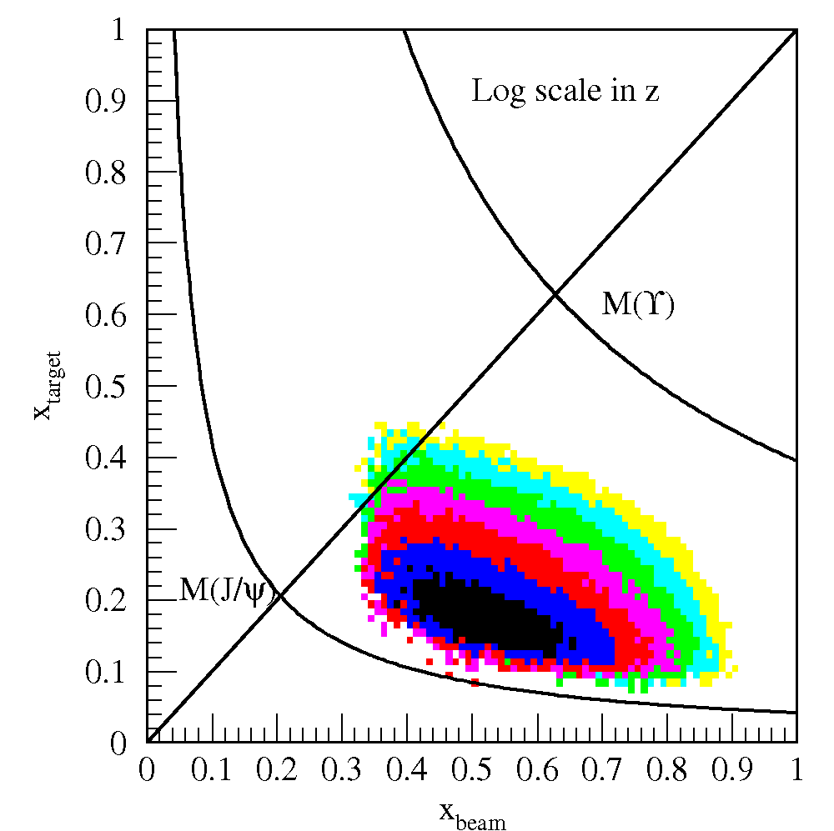
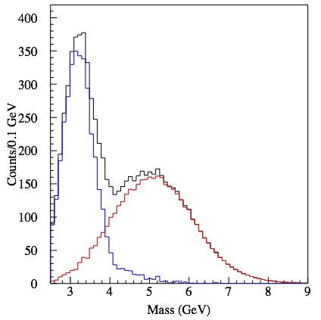
E906 Acceptance and Dimuon Mass Distributions
x_{t}
E_{beam}120 GeV:
No shadowing
correction
since x_{t} = 0.1~0.4
Acceptance
E906 Spect.
Monte Carlo
20~30% effect @xF~0.6!
x_{b}
Dimuon mass
EKS shadowing
DY
J/ψ
X_{b}

Slide 11
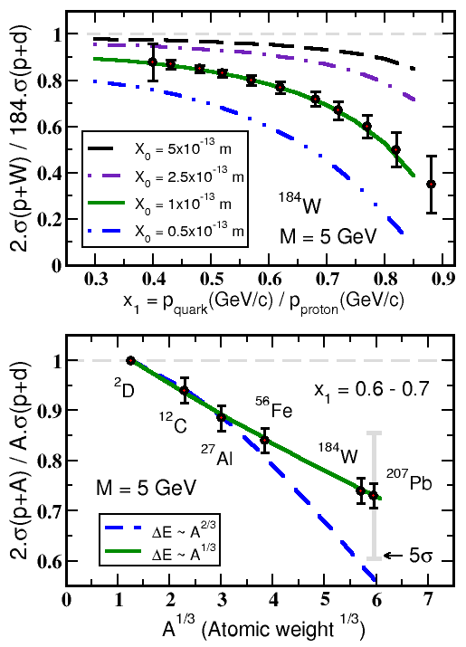


Experimental Sensitivity to Quark Energy Loss
Quark energy loss only I. Vitev et al
Shortest radiation length in nature X₀ = 1 x 10⁻¹³ m
Clearly distinguish between leading models for L dependence of E-loss
Benchmark dE/dx models

Slide 12
Reality

Slide 13
E906 2012 Run: Expected Statistics
Run plan: 4~5 weeks of physics run
  p+A and p+d ?
  p+H and p+d?
Beam conditions
  2.5 x 10^11/ sec for 4 sec per minute
  E906 efficiency 50%
  If lower field for J/Psi, expect higher rate in detectors, need to reduce beam intensity to 1x10^11/sec
Protons on targets
  (1x10^11) x (4 sec) x (4 weeks x 7 x 24 x 60 minutes) x 50%
  = 1x10^11 x 1.6x10^5 x 0.5
  = 0.8 x 10^16
Effective Target thickness
  Target: ~10% interaction length
  0.8 x 10^15 p+(p/n) collisions

Slide 14
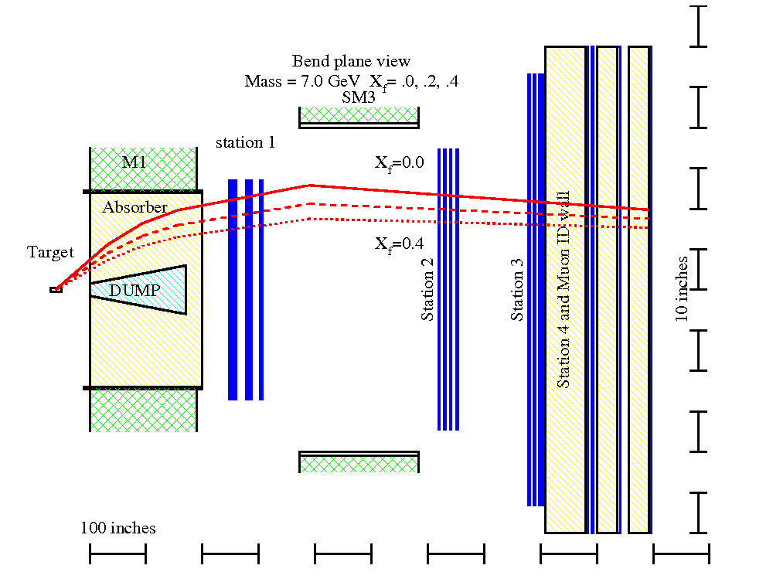
Expected Detector Performance
Reasonable J/Psi and Drell-Yan separation
  Drell-Yan: M>4GeV
Improved tracking to separate tracks from target and beam dump
Rec’d primary vtx
from Kun Liu
μ
E906 Bend Plane View
120 GeV
protons
Drift
Chambers
Muon ID

Slide 15
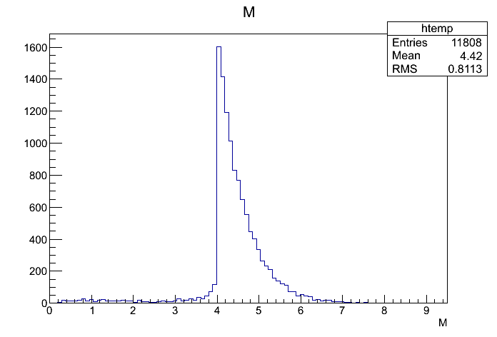
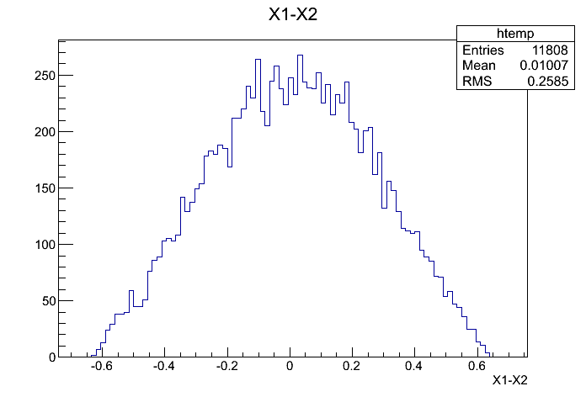
DY Production p+p
PYTHIA @LO, K = 2.5
DY cross section: M >4 GeV
@120 GeV: (PYTHIA LO)
    1 f + fbar -> gamma*/Z0,
      Sigma = 5.442D-08 mb, M > 4GeV
    K = 2.5,
      sigma = 2.5 x 5.5 x 10^-8mb
        = 13.8 x 10^-11b
    N = 20 fb^-1 * 13.8x 10^-11b
    = 2.8 x 10 ^6
    80K pythia events -> 11,808 dimuons (M>4 GeV), (BR~15%)
DY_dimuons = 2800k/80k*11800
= 410 k
xF

Slide 16
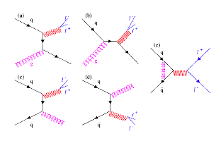

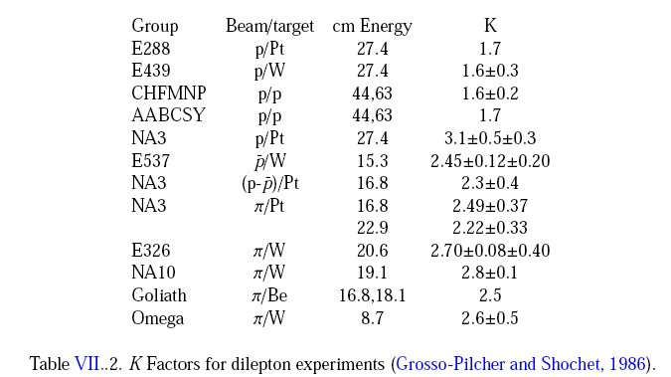
QCD Correction
K factors
K = 2.5 @120GeV p+p

Slide 17
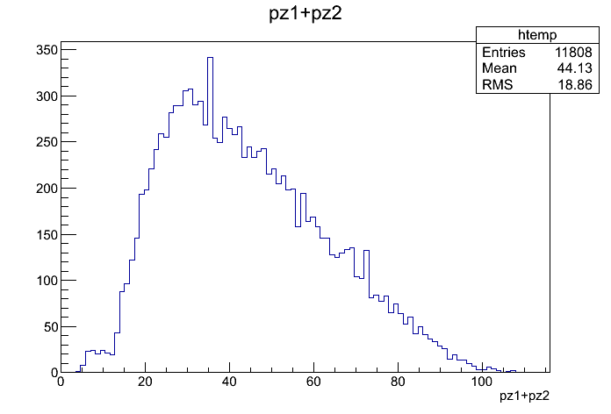
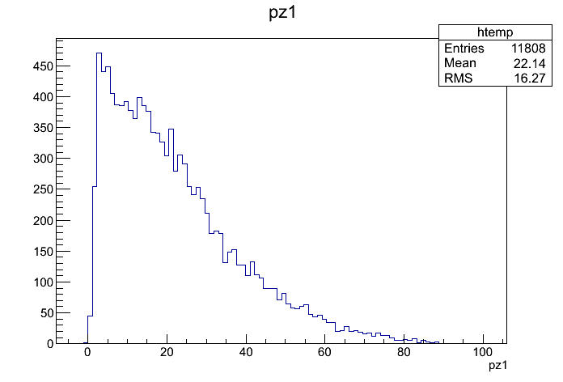
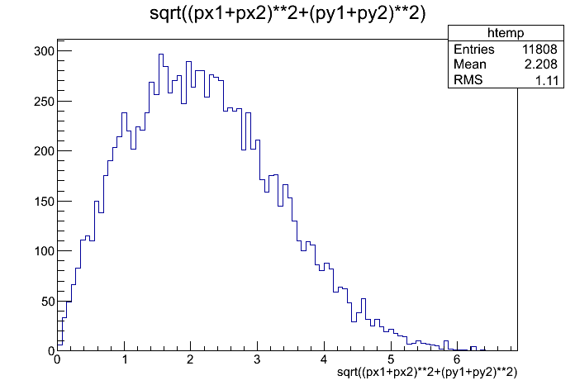
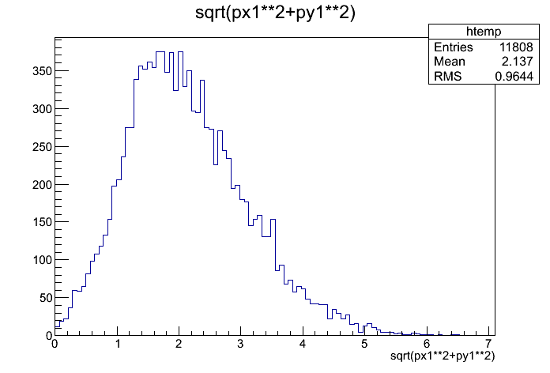
DY and Muon Kinematics w/o E906 Acceptance
@PYTHIA LO
DY_pZ
Trk_pZ
DY_pT
Trk_pT

Slide 18
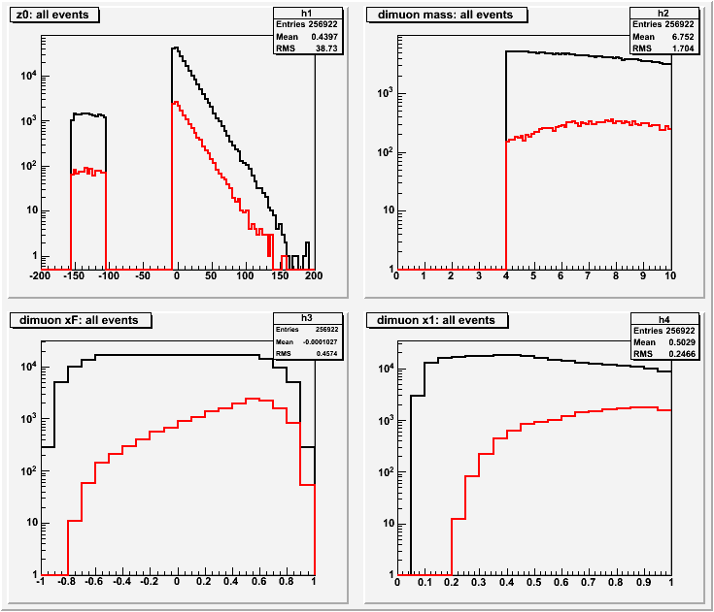
E906 Drell-Yan Dimuon Acceptances
Black: generated
Red: detected
E906 Efficiencies:
DY (M>4) = 6.4%
DY-> dimuons
N = 410K x 6.4%
= 26000
xF
x_{b}

Slide 19
Drell-Yan Summary
xF
x_{b}
Expectation: ~20% suppression effect!
Prefer W target
  20~30% suppression
  but Fe is OK, smaller effect
p+d and p+W
  50% split in beams
DY: Dimuon_mass > 4GeV
EKS shadowing
X_{b}

Slide 20
Topics II
J/Psi Production and CNM Effects

Slide 21
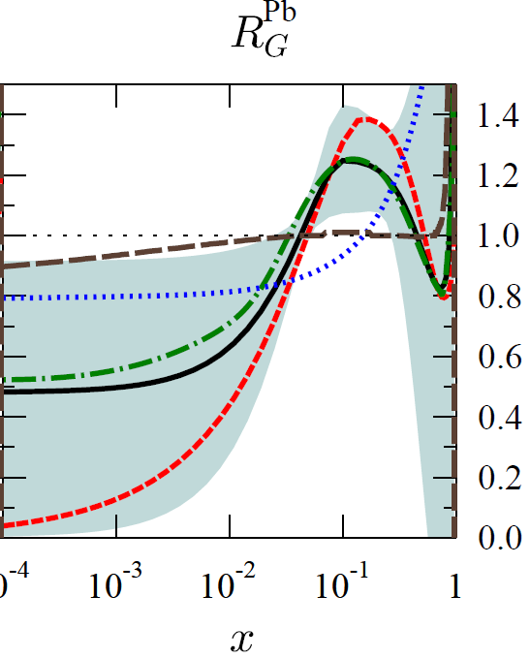
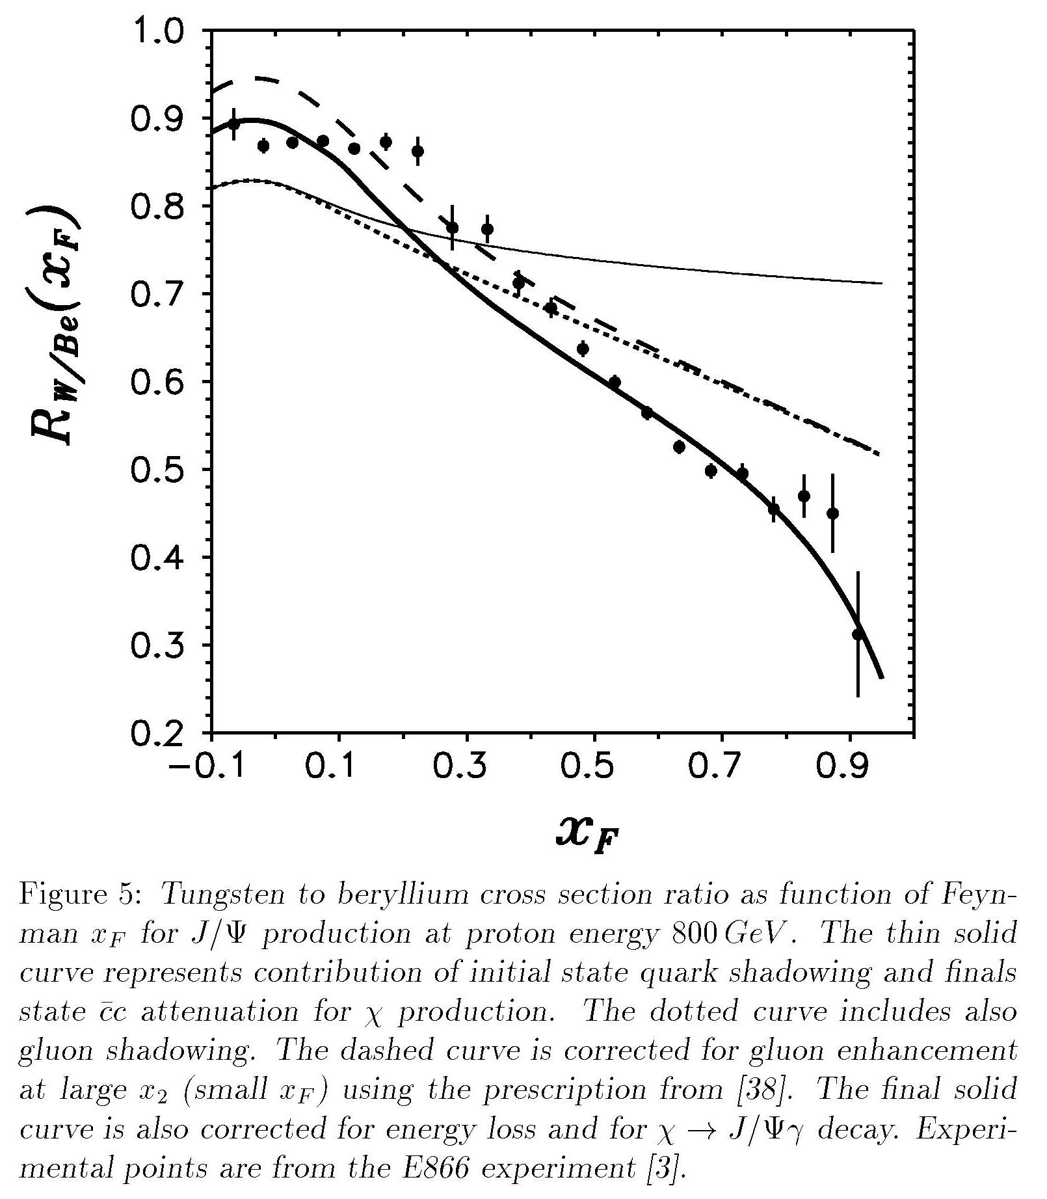
Novel CNM Effects and QGP Baseline
Parton (anti)shadowing
Gluon saturation physics
  (NSAC DM08)
Parton energy loss in CNM
  (NSAC DM10,12)
Gluon shadowing
R_{G}^{Pb}
Q² = 1.69 GeV²
nDS
HKN07
EKS98
EPS09
EPS08
Kopeliovich etal Nucl Phys A696 (2001) 669-714
E866 J/Ψ data
x
Quark shadowing and final state absorption +
Gluon shadowing +
Anti-shadowing +
q, g
J/Psi
dE/dx

Slide 22
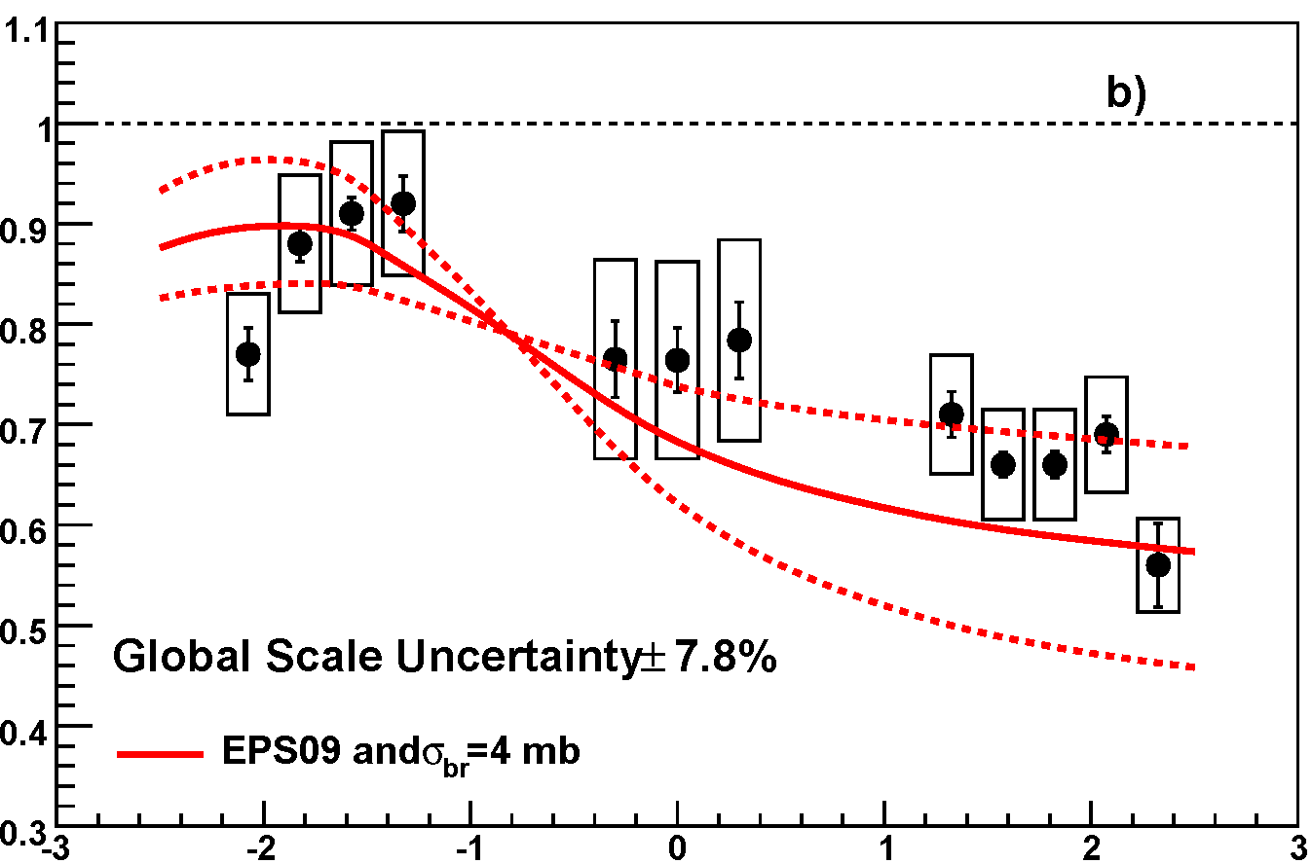
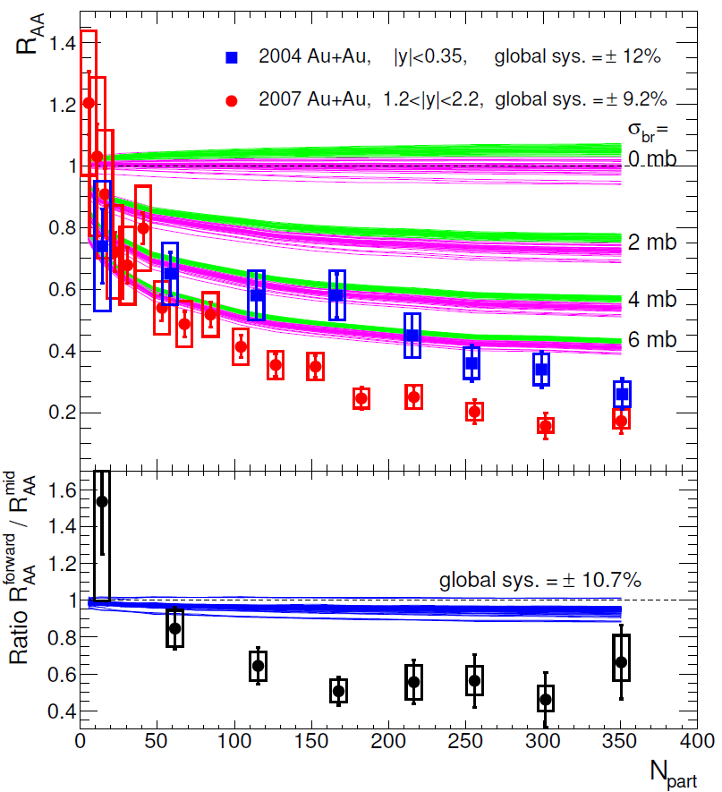
QGP Physics: Quarkonia Suppression – Importance of CNM
CNM effects appear to provide a large fraction of the observed suppression
So difficult to conclude much w/o a thorough (fundamental) understanding of CNM and an informed extrapolation to A+A from d+A
R_{AA}
R_{dAu}
y
N_{part}
MJL & Vogt began these model comparisons years ago; continuing now with Colorado, FSU working with these in more quantitative and informative ways

Slide 23
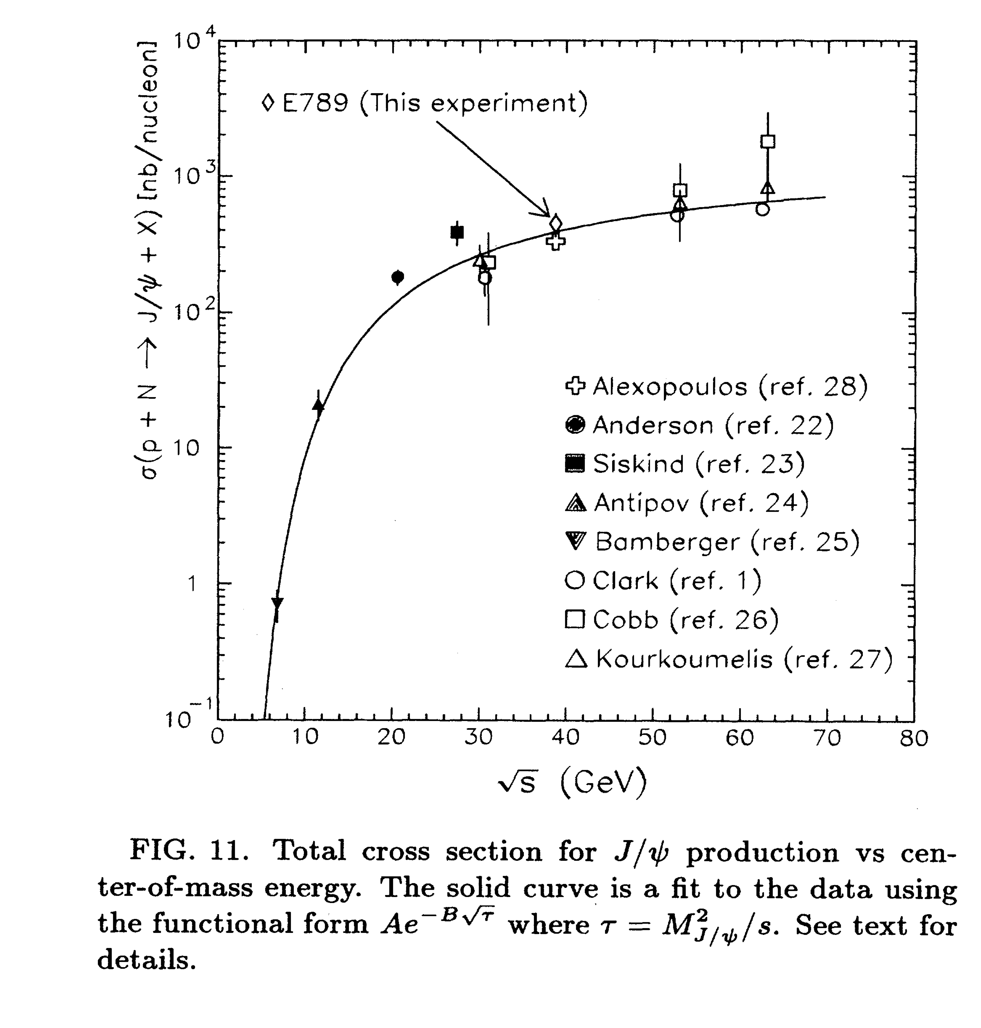
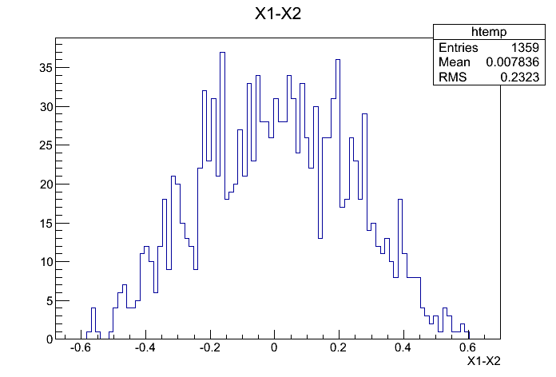
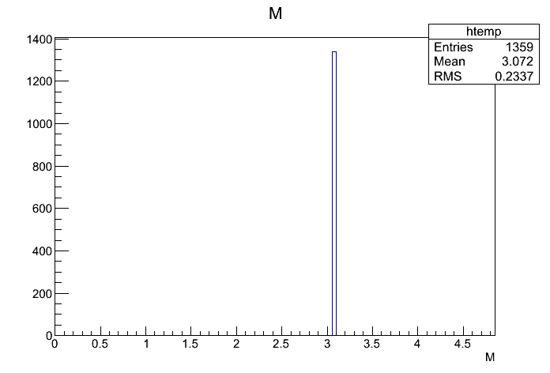
J/Psi Production in p+p @120 GeV
J/Psi cross section: J/Psi -> dimuon
  Data: ~ 50 nb @120GeV p+p
  N_J/Psi = 20 fb^-1 x 50nb
  = 1K x 10^6
  Total J/Psi->dimuon = 1K x 10^6 x6%
  = 60 x 10^6
  @800 GeV: 442 +/-88 nb
PYTHIA J/Psi simulations
xF_J/Psi

Slide 24
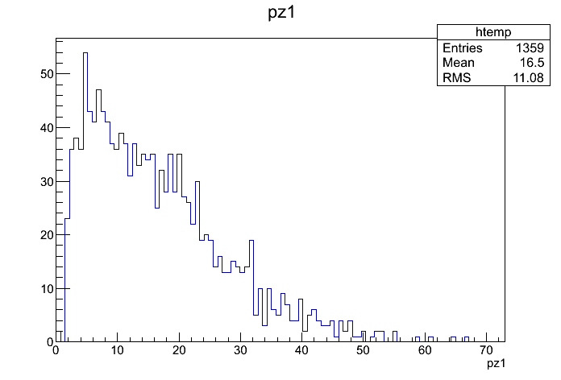
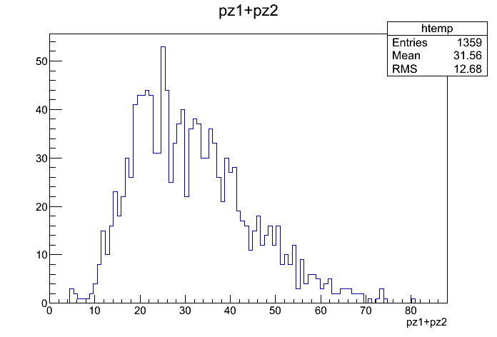
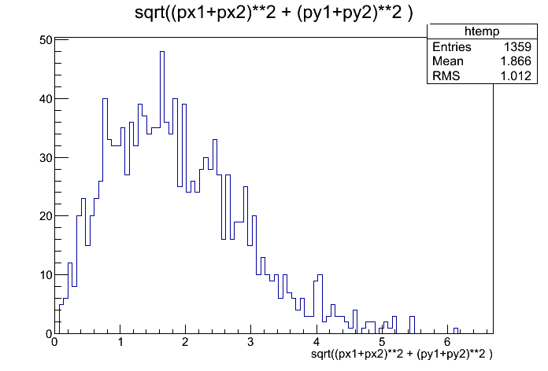
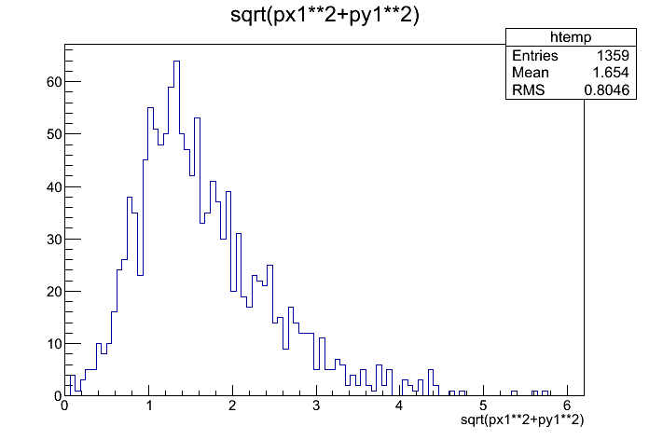
J/Psi and Muon Kinematics
PYTHIA Simulations
J/Psi_pZ
Trk_pZ
J/Psi_pT
Trk_pT

Slide 25
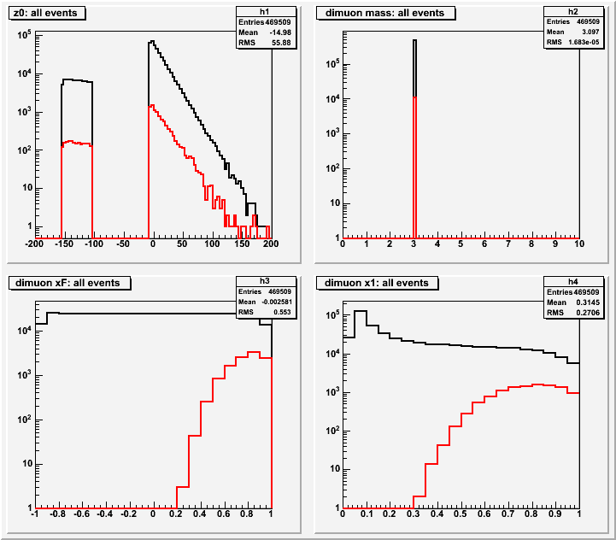
E906 J/Psi Dimuon Acceptance
Black: generated
Red: detected
E906 Efficiencies:
J/Psi = 2.4%
J/Psi->Dimuons
N = 60M x 2.4%
= 1.4M
xF
x_{b}

Slide 26
J/Psi Summary
xF
x_{b}
Prefer W, larger effects
  but Fe is OK
p+d and p+W
  50% split in beams
J/Psi: Dimuon_mass < 4GeV

Slide 27
Azimuthal cos2Φ Distribution in π+W and p+d Drell-Yan
E866 Collab., Lingyan Zhu et al.,
PRL 99 (2007) 082301; PRL 102 (2009) 182001
J.C. Peng
Smallνis observed for p+d D-Y
With Boer-Mulders function h₁┴:
ν(π⁻W→µ⁺µ⁻X)~ [valence h₁┴(π)] * [valence h₁┴(p)]
ν(pd→µ+µ-X)~ [valence h₁┴(p)] * [sea h₁┴(p)]
Sea-quark BM functions are much smaller than valence quarks
27

Slide 28
Backup

Slide 29
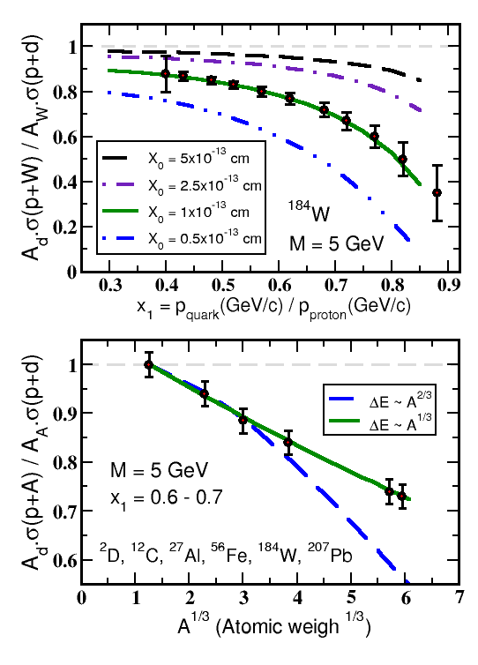
E906 Sensitivity to Quark Energy Loss
Simulated Quark energy loss only
For radiation lengths X₀ = 1 x 10⁻¹³ cm can achieve sensitivity ~ 20%
Clearly distinguish between leading models for L dependence of E-loss (5σ)
from Vitev
t

Slide 30
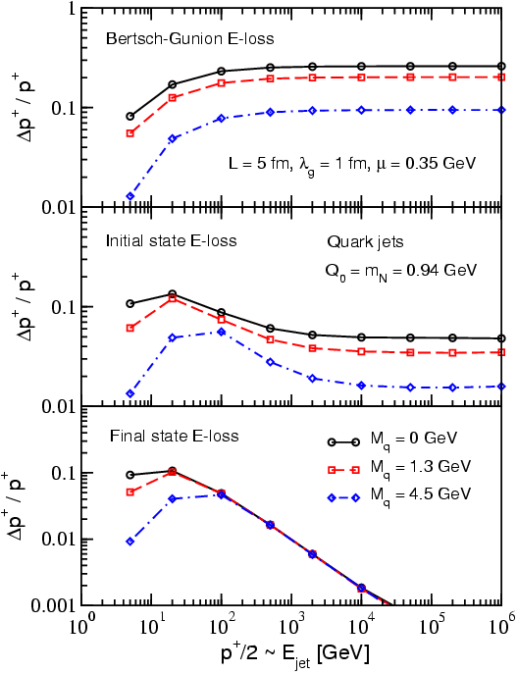
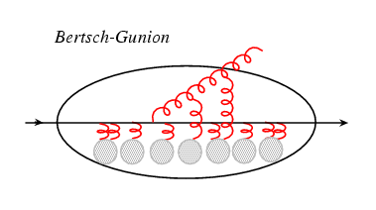
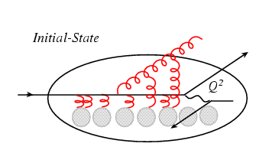
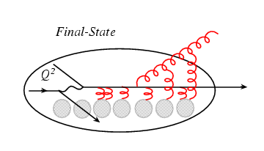
Process Dependence of Parton Energy Loss
E-loss in three cases
Academic case
(probably inapplicable)‏
Initial-state E loss:
DY process
Final-state E loss:
SDIS, QGP
I. Vitev, PRC 75(2007)064906.

