Slide 1
E906 2012 Run-I: Expected Statistics
(My Expectation Before the Run)
Run plan: 4~5 weeks of physics run
  p+A and p+d ?
  p+H and p+d?
Beam conditions
  2.5 x 10^11/ sec for 4 sec per minute
  E906 efficiency 50%
  If lower field for J/Psi, expect higher rate in detectors, need to reduce beam intensity to 1x10^11/sec
Protons on targets
  (1x10^11) x (4 sec) x (4 weeks x 7 x 24 x 60 minutes) x 50%
  = 1x10^11 x 1.6x10^5 x 0.5
  = 0.8 x 10^16
Effective Target thickness
  Target: ~10% interaction length
  0.8 x 10^15 p+(p/n) collisions

Slide 2
2012 E906 Run History
Start of run: Feb 28, 2012
End of run: April 30, 2012
Total protons delivered and triggered:
  Total proton delivered
    ~ 5x 10^11 ppp x 60 min x 24 hrs x 60 days x 50% eff = 2.2 x 10^16 (= 40 fb^-1)
    issued with very low trigger live time at the beginning
  Last week dimuons: 5 Hz x 7 days x 60% = 1.7 M/week
  Last week protons on targets: 0.25 x 10^16
    (~ 1/3 of my prediction, 0.8 x 10^16)
Detectors: all subsystems working
Targets:
  10% targets
  P, D, C*, Fe, W*, empty
Beam: stable operation
  4/60 sec beam structure, 5x10^11 ppp (desgin:1 x 10^13)
  High background caused some trigger problems

Slide 3
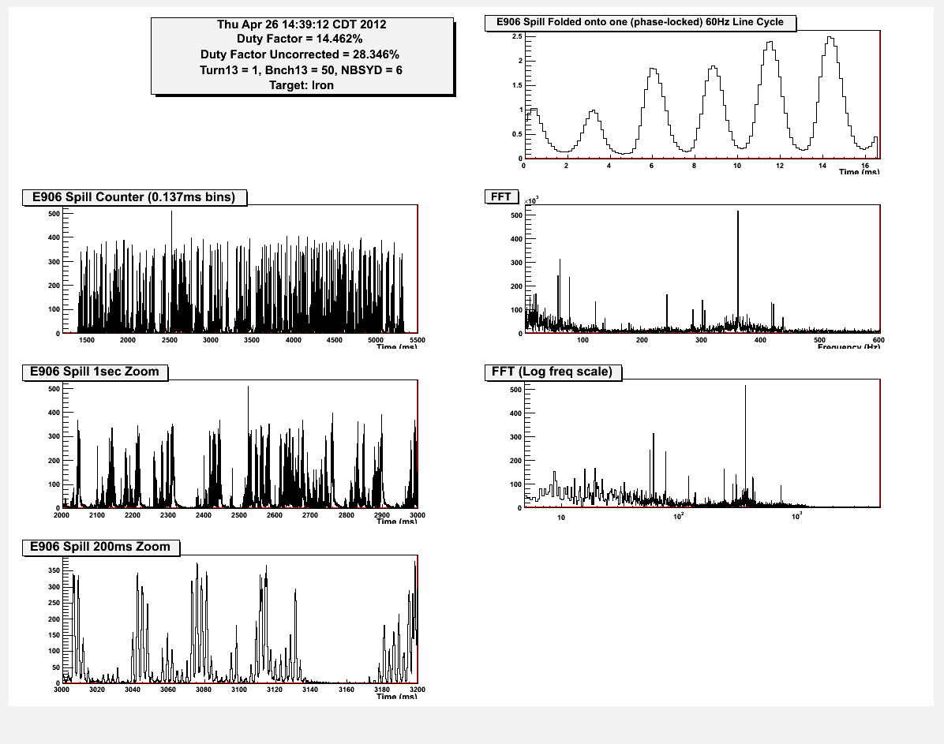
Trigger Challenge
Unstable and non-uniform beam sturcture

Slide 4
Diagram
If the signal input to QuarkNet is more than threshold in the integration time, Quarknet will send inhibit.
X2T
Hodos
V1495
L1
QuarkNet
Strobe
coincidence
gate
Trigger
Supervisor
V1495
L2
(trigger)
NIM 1&2
trigger

Slide 5
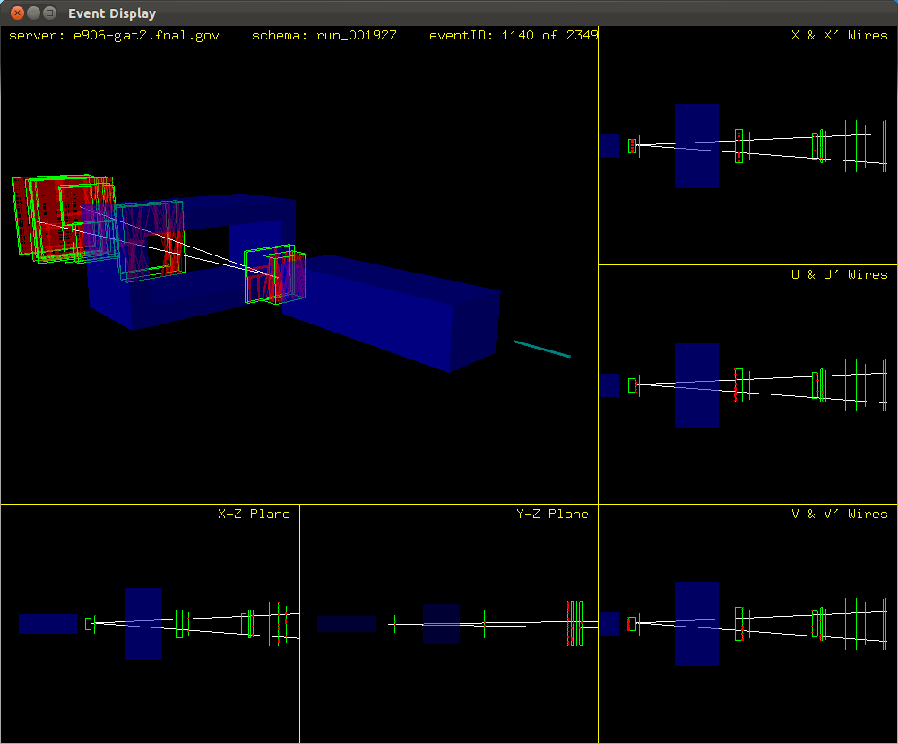
Good Dimuon Ratio
Elog[1929][2014] by Tyler
Run Threshold Count per minute
1923 1 6/38mins = 0.16
1924 2 15/35mins = 0.43
1925 3 19 /30mins =0.63
1926 4 30/21mins =1.43
1927 5 38/26mins = 1.46
1928 6 32/27mins =1.18

Slide 6
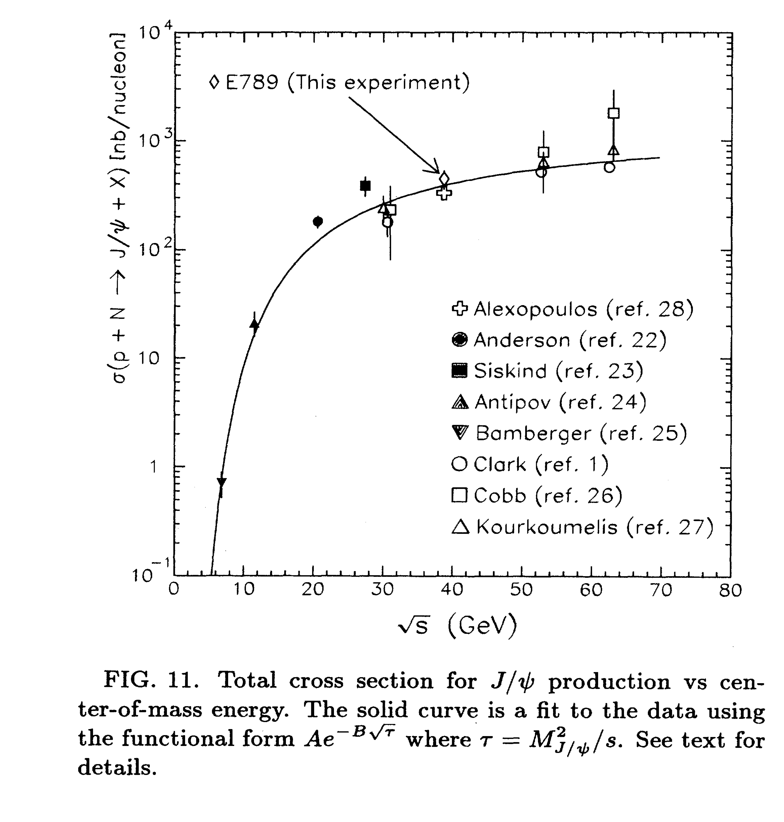
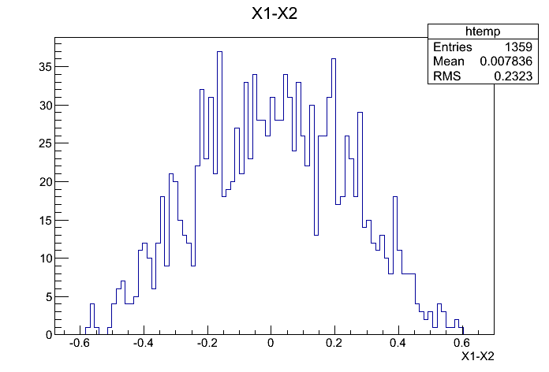
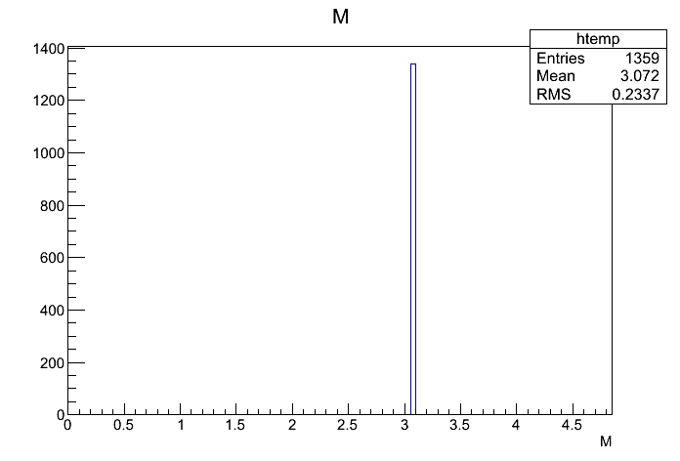
J/Psi Production in p+p @120 GeV
J/Psi cross section: J/Psi -> dimuon
  Data: ~ 50 nb @120GeV p+p
  N_J/Psi = 20 fb^-1 x 50nb
  = 1K x 10^6
  Total J/Psi->dimuon = 1K x 10^6 x6%
  = 60 x 10^6
  @800 GeV: 442 +/-88 nb
PYTHIA J/Psi simulations
xF_J/Psi

Slide 7
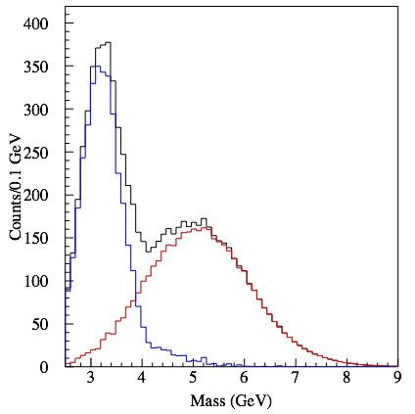
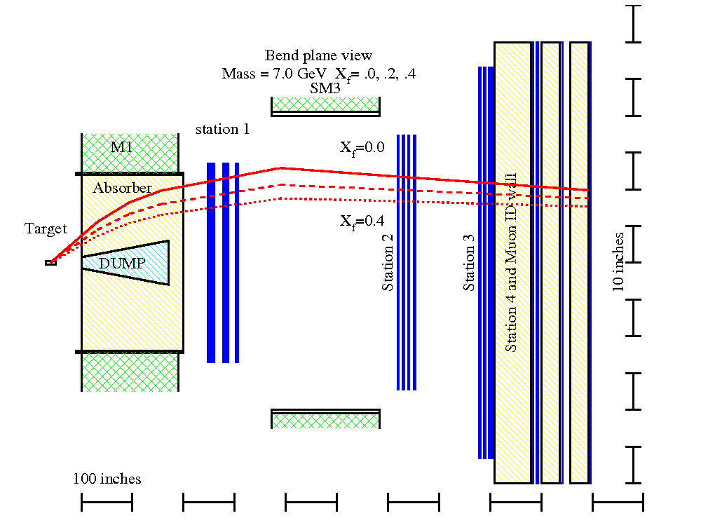
Expected Detector Performance
Reasonable J/Psi and Drell-Yan separation
  Drell-Yan: M>4GeV
Improved tracking to separate tracks from target and beam dump
Rec’d primary vtx
from Kun Liu
μ
E906 Bend Plane View
120 GeV
protons
Drift
Chambers
Muon ID

Slide 8
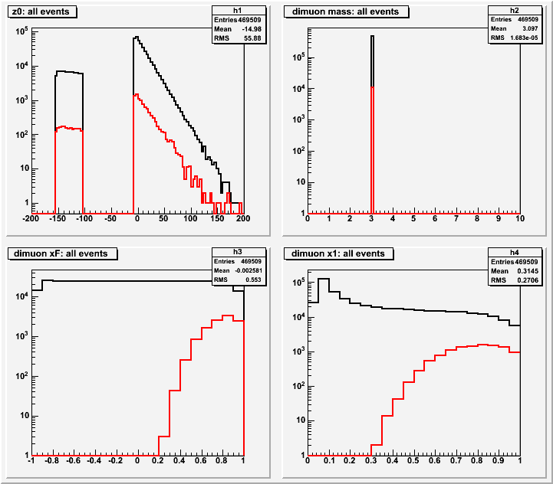
E906 Run-I J/Psi Dimuon Acceptance
Black: generated
Red: detected
E906 Efficiencies:
J/Psi = 2.4%
J/Psi->Dimuons
N = 1/3*60M x 2.4%
= 0.5M
J/Psi from targets:
10% x 0.5M = 50K
xF
x_{b}

Slide 9
Topics II
Drell-Yan Production and CNM Effects

Slide 10
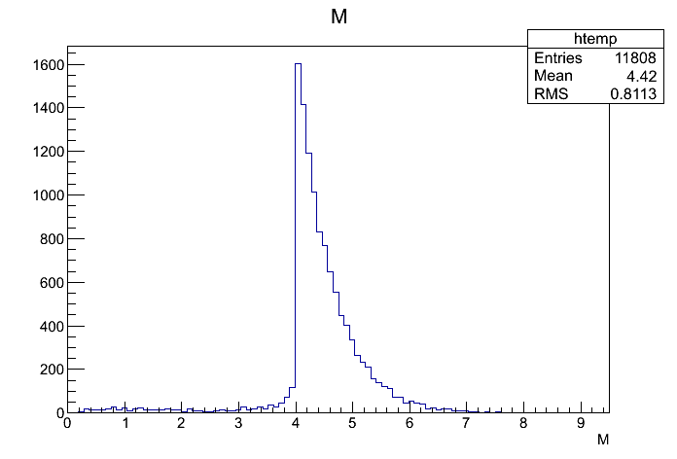
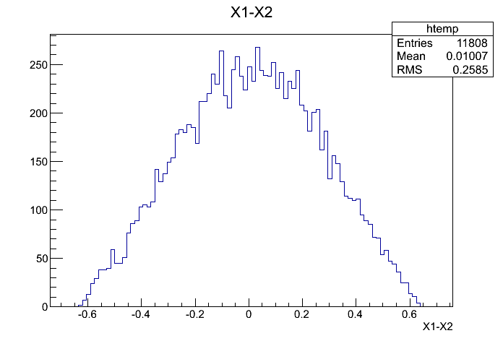
DY Production p+p
PYTHIA @LO, K = 2.5
DY cross section: M >4 GeV
@120 GeV: (PYTHIA LO)
    1 f + fbar -> gamma*/Z0,
      Sigma = 5.442D-08 mb, M > 4GeV
    K = 2.5,
      sigma = 2.5 x 5.5 x 10^-8mb
        = 13.8 x 10^-11b
    N = 20 fb^-1 * 13.8x 10^-11b
    = 2.8 x 10 ^6
    80K pythia events -> 11,808 dimuons (M>4 GeV), (BR~15%)
DY_dimuons = 2800k/80k*11800
= 410 k
xF

Slide 11
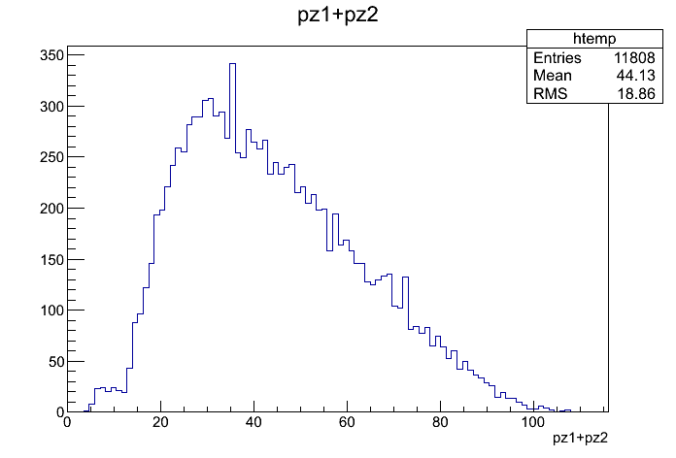
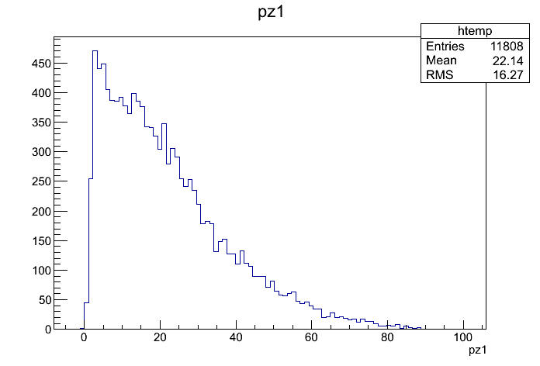
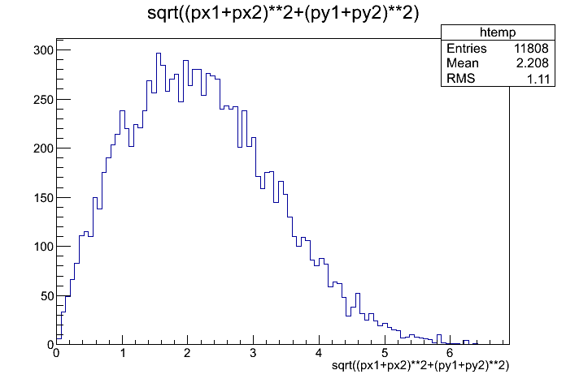
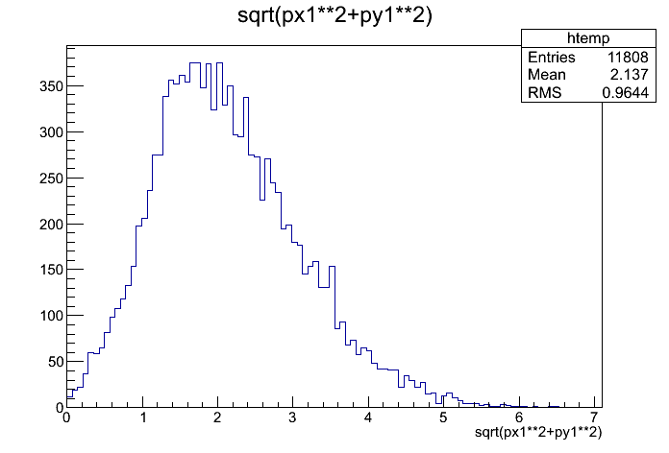
DY and Muon Kinematics w/o E906 Acceptance
@PYTHIA LO
DY_pZ
Trk_pZ
DY_pT
Trk_pT

Slide 12
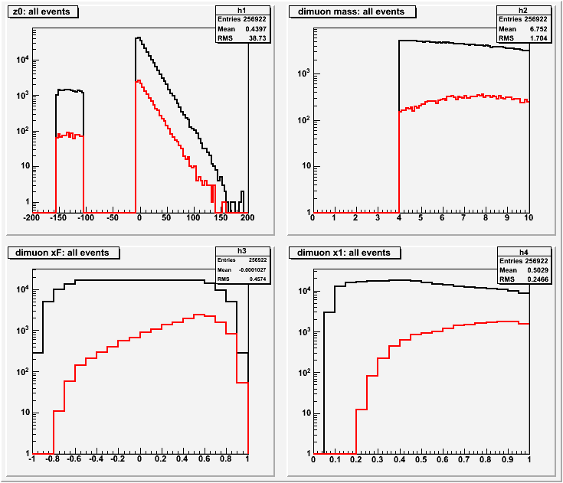
E906 Drell-Yan Dimuon Acceptances
Black: generated
Red: detected
E906 Efficiencies:
DY (M>4) = 6.4%
DY-> dimuons
N = 1/3*410K x 6.4%
= 9000
xF
x_{b}

Slide 13
Shutdown Plan
Main Injector Upgrade
  5/1/2012 ~ end of 2012
E906 detector maintenance work
  Not discussed yes
  Collaboration meeting at the end May?

Slide 14
Physics Analysis Plan
A lot of work to do
Detector (re)mapping and calibration
  Reprocess data with updated mapping files
Develop tracking software
  Momentum resolution
  Vtx resolution
Luminosity calculations – some scalors?
Physics topics
  J/Psi and Drell-Yan
  Ratios of “Fe/d” and “d/p”

Slide 15
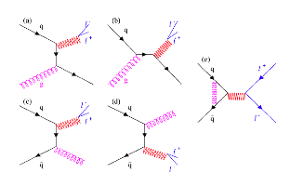

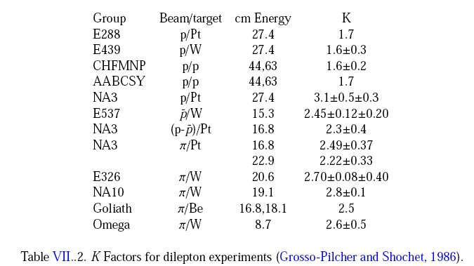
QCD Correction
K factors
K = 2.5 @120GeV p+p

