Slide 1
Status of Dark Photon/Higgs Search Trigger/DAQ Upgrade
Kun Liu and Ming Liu
Los Alamos
With Grass, Dave C., Xinkun et. al.

Slide 2
Outline
Physics of dark sectors
  Mass: MeV ~ GeV
Detector upgrade
  Displaced dimuon trigger
  DAQ improvement
New opportunity
  EMCal from PHENIX, available this fall
  electron/hadron ID @SeaQuest!
Possible schedules and tasks
  DAQ, Trigger work during this summer shutdown
    Be ready for data taking in 2017 with E906
  PHENIX EMcal installation?

Slide 3
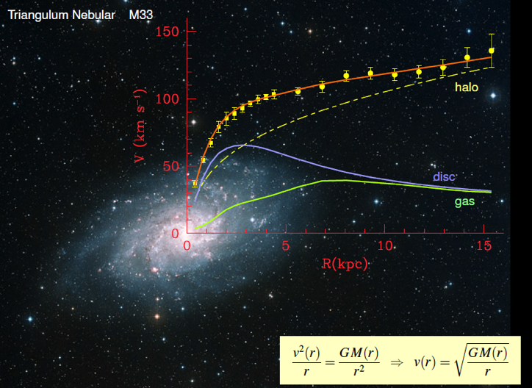
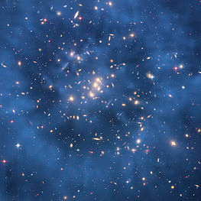
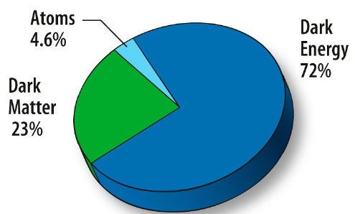
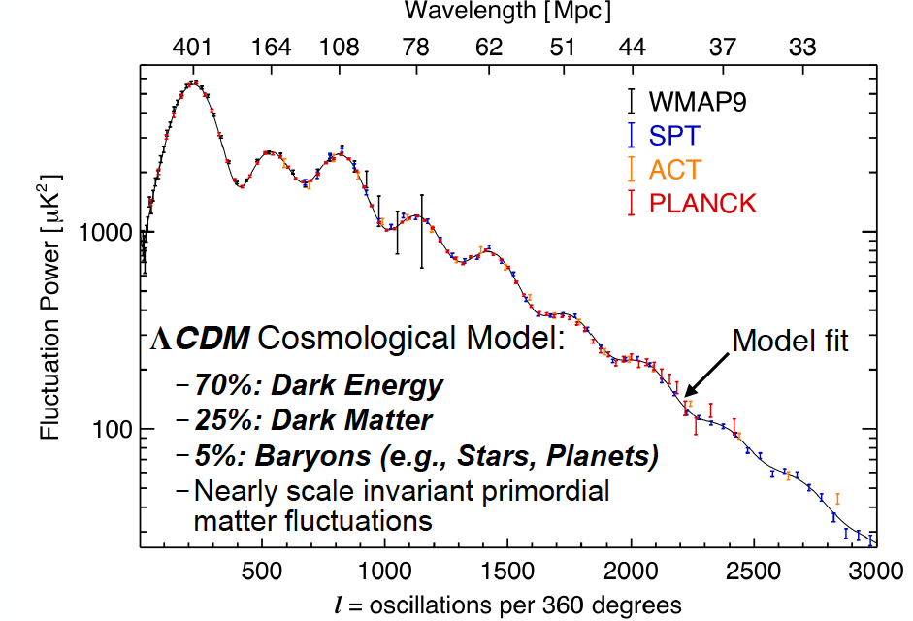
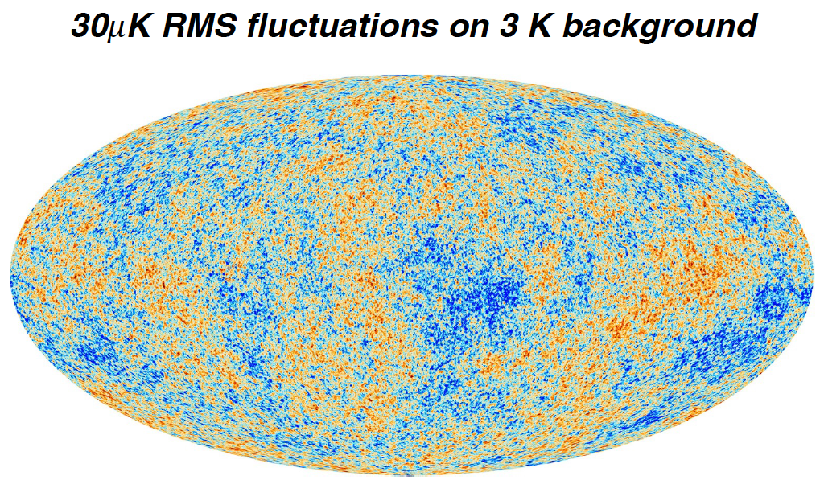
Dark Matter?
Galaxies’ rotation curve
Gravitational lensing (Hubble 2007)
F. Zwicky, ApJ 86 (1937) 217, V. Rubin et al, ApJ 238 (1980) 471
Planck: 2013
Benson’s talk @CIPANP 2015
Notes:
It is widely accepted today that visible matter only account for 5% of matter and energy, with 25% dark matter .. With many compelling experimental obseravtions , how ever the nature of dark matter and dark energy remtain as the biggest scientific challenges for hunam being … sa they only interactio with SM particels very weakly .. Only shown in gravitaiton sectors ..

Slide 4
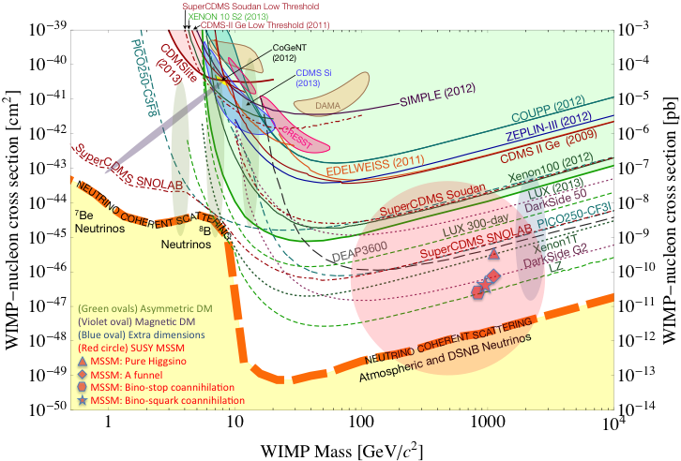
No Luck so far in Direct Search for WIMP
Montgomery’s talk at CIPANP2015
“a vision of nuclear and particle physics”
WIMP being excluded?
Recent anomalies observed by satellite and terrestrial experiments have motivated dark matter models introducing a new “dark sector”
There are “portals” between the dark sector and the SM.
  “vector portal”: dark photon
  “scalar portal”: dark Higgs
  …
“Sub-GeV” low mass weakly-interacting dark particles become very interesting!
Mass: O(MeV ~ GeV)
In particular, high-intensity colliders (B-factories) and fixed target experiments (Fermilab, JLab, LHC etc.) offer an ideal environment to probe these new ideas.
- Imaginable space for these experiments is rapidly disappearing
- the “natural” theory space is also disappearing.
- I like to think that Dark Matter is on solid ground, maybe not!!!
Notes:
What are the DM? WIMP is considered one of the primary candidates of DM …

Slide 5
Portals to a Dark Sectors?
SM symmetries limit the allowed couplings
  scalar, vector, tensor interactions etc.
SM
g, W±,Z⁰,γ, H
Dark Sector
particles &
interactions
E-1067/SeaQuest: Dark photon (vector) and Dark Higgs (scalar) Portals

Slide 6
Dark Photons and Dark Higgs Productions in p+Fe Collisions at Fermilab
Photon portal: “vector”
Higgs portal: “scalar”
θ = μ v/m_{h}²

Slide 7
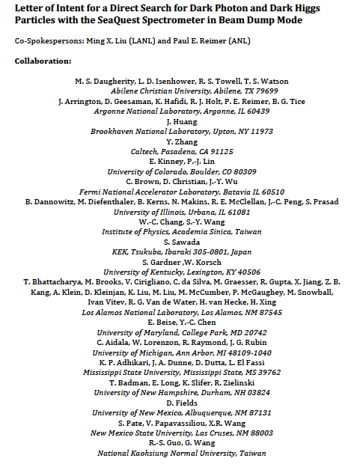
LOI submitted to Fermilab PAC
on May 20, 2015
A joint experimental and theoretical collaboration
(most E906/E1039 + new members, ~60)
---------------------------------------
Phase-I: (parasitic runs)
Addition of a new displaced dimuon trigger to tag long-lived downstream decayed dark photons (dark Higgs).
Parasitic data taking with E1039 in 2017-2019;
  A short dedicated run (up to ~1 month) if needed.
POT 1.44x10¹⁸
Phase-II: (upgrade)
Dedicated runs later with EMCal/HCal upgrades, e^{+/-} and h^{+/-} capabilities.
Cover the full parameter phase space allowed by beam energy and luminosity
POT: >> 1.4x10¹⁸
Phase-II request will be presented to PAC at a later time.
Notes:
Responding to P5 reprot, we submitted LOI last month .. And the membership is growing …

Slide 8
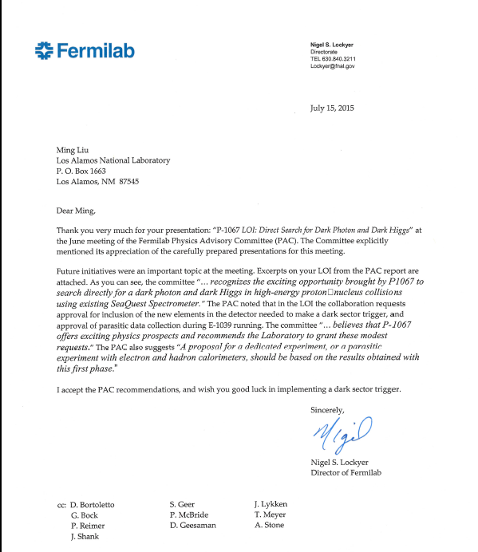
A heart-full endorsement
from Fermilab Director and PAC
July 15, 2015!
New experiment! E-1067
LANL LDRD support:
- FY16-17-18
- $1M to implement
the trigger upgrade and theory development
Goals:
Trigger installed, 2017
Physics run, 2017-18
Preliminary results 2018!

Slide 9
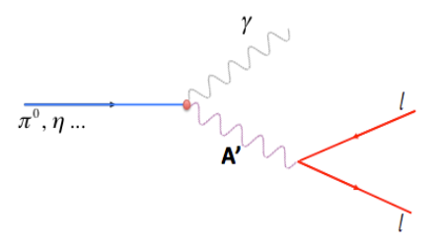
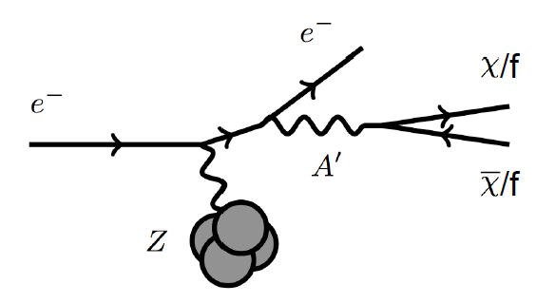
Dark Photon Detection in Dimuon Decay Channel
Drell-Yan like
π⁰, η, … decay
Bremsstrahlung
(DM)
MiniBooNE
Beam-dump
(DM)
p
l⁺
p
l⁻

Slide 10
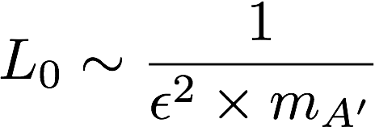
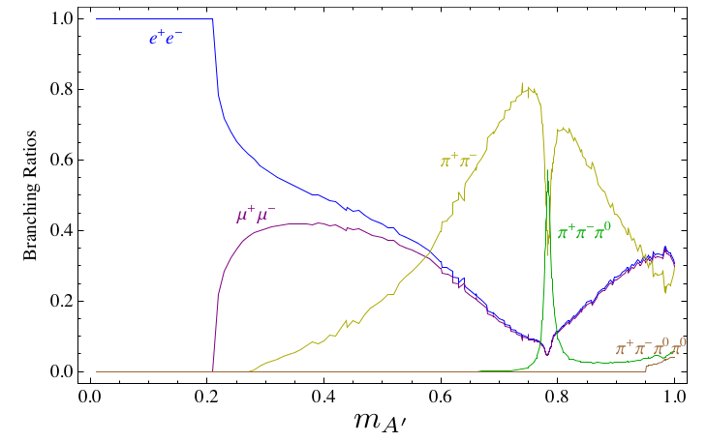
Dark Photon Decay Modes
“Minimal” Decay:
Dark photon is the lightest in the dark sector;
  SM final state particles only
Long proper decay length: L₀ ~ O(1m)
D. Curtin, et al, arXiv: 1312.4992
Electron ID
required!
“General” Decay:
Decay into other dark particles,
dominant channel if allowed
  Dark -> Dark
  Dark -> SM particles
(GeV)

Slide 11
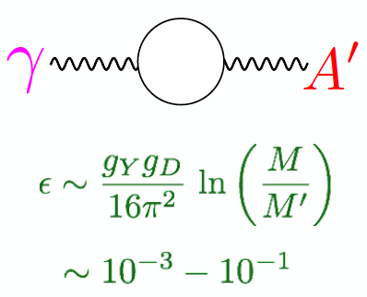
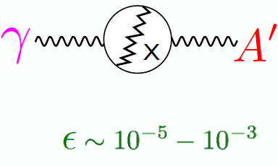
Expectations from GUT
After EWSB, there is a coupling ε between the dark photon and the photon (also the Z, less important at low energies).
Theoretical prejudice for a mass scale
m_{A}’ ~ √ε m_{EW} ~ (MeV – GeV)
e.g. Arkani-Hamed & Weiner;
Cheung, Ruderman, Wang, Yavin;
Morrissey, Poland, Zurek;
Essig, Schuster, Toro;

Slide 12
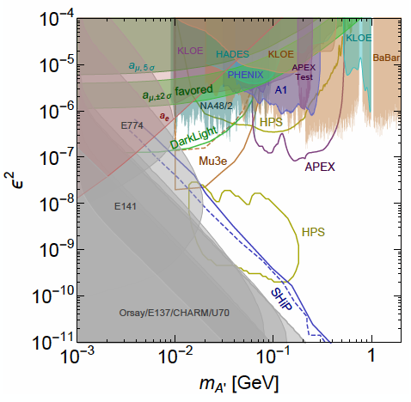
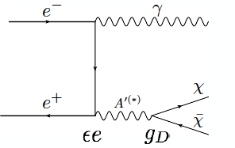

Dark Photon Current and Future Limits
Several new results in recent years
and more to come
Muon (g-2) region disfavored
- for A’ directly decay into SM;
- but allowed with some “invisible modes”
New experimental proposals
Fermilab E-1067 beam dump,
SHiP at CERN

Slide 13
Detector Upgrades and Expected Signals
Dark photon trigger upgrade
  Add a fine-granularity scintillating strip based trigger/tracking to tag dimuons from the same decay Z-vertex
  A new trigger for events with displaced down-stream dimuons
Unique signals
  Displaced dimuon decay vertex for long-lived particles
  Invariant mass peak in dimuon mass spectrum
  Mostly from beam dump (target ~10% λ_{I}.)
Beam time
  Run parasitically with E906/E1039 (2017-2019)
  Possible dedicated runs later with upgraded (e^{+/-}, h^{+/-})
-- 2.5%
-- 6.0%
Dimuon mass resolution
Z (meter)

Slide 14
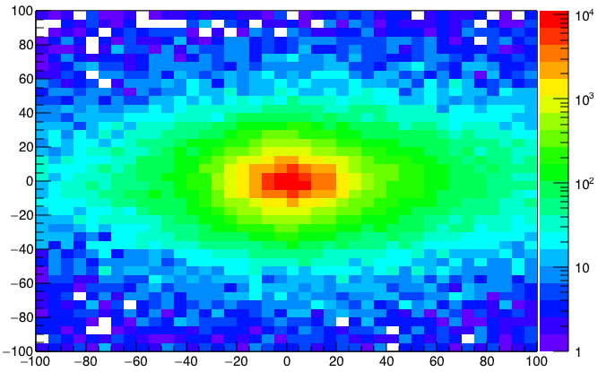
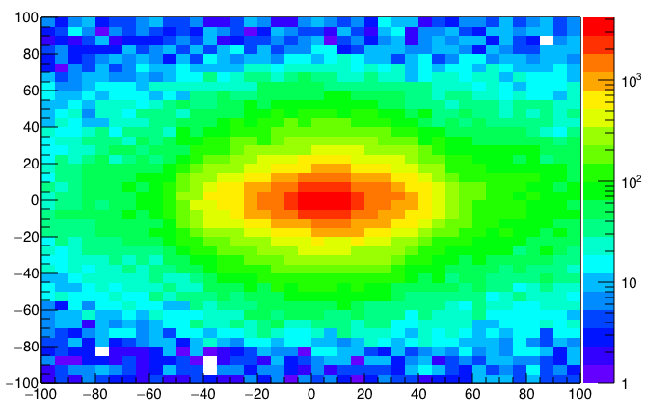
A New High-Granularity Displayed Dimuon Vertex Trigger
High rejection power, very low rate, << 1 kHz(current E906 DAQ limit)
Y-Plane (non-bending) Trigger:
A quadrant panel: 80cm x 72cm (100cmx72cm @ST-2)
  ST1: 1cm x 1cm x 80 cm scintillating strips, SiPM readout
  ST2: 2cm x 2 cm x 100 cm strips
- Straight line projection, 30cm Z-vertex resolution
Displaced z-vertex, mostly low mass < 3GeV
Y-channels per quadrant:
1x V1495
72(St1) + 72(St2) + 8x2 (St4-Y1,2) = 116
96+64 = 160 inputs possible
  (2NIM=RFCLK+ComSTOP)
72x4x2 =576 SiPMs needed (600)
Y
Dimuon Z-vertex (cm)
ST1
X
St1
St2
Z
Coincident Z-vtx
window matched@L2
Z1=9m
Z1=12m
ST2

Slide 15
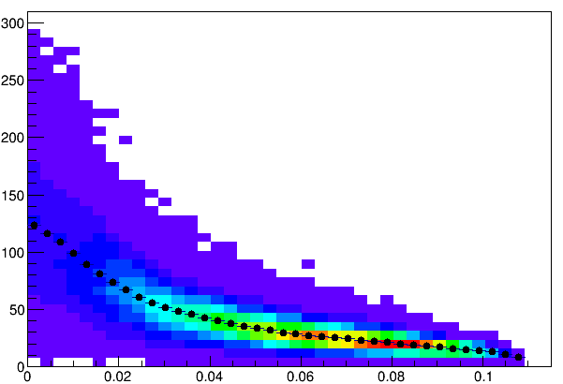
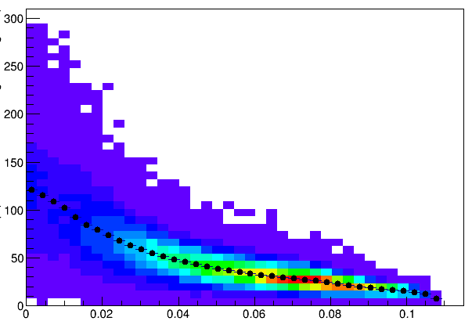
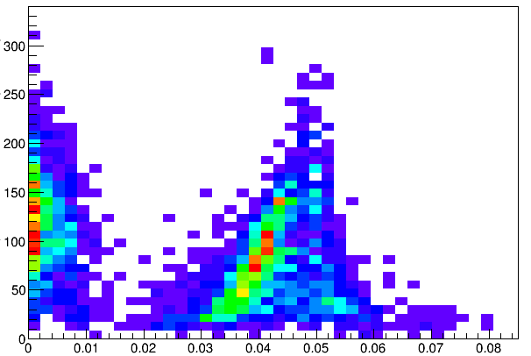
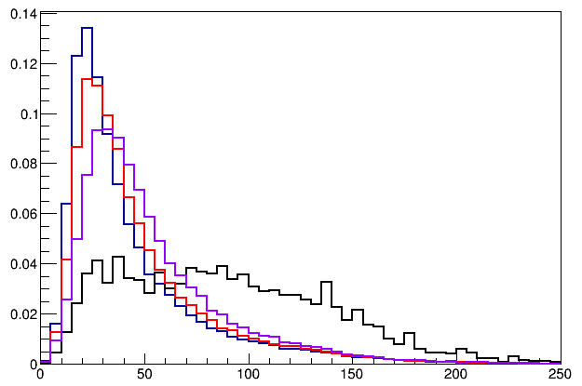
Single Muon Z-Vertex Resolutions
Forward: 1cm
Backward: 1cm
Forward: 1cm
Backward: 2cm
Forward: 1cm
Backward: 1cm
Forward: 1cm
Backward: 2cm
Forward: 2cm
Backward: 2cm
E906
Current
E906

Slide 16
Displaced Dark Photon Trigger
DAQ/Data stream
LVDS cable 2x16ch bundle available
Q1 (LVL1)
DAQ Trigger
LVL2
(vtxZ matching)
Q2 (LVL1)
TS
(12 inputs total)
(1-free bit available)
Q3 (LVL1)
DP Trigger
1-bit
Q4 (LVL1)
4 x 16-bit from 4 V1495 boards
(2 x 32LVDS cables)
V1495
Q1: 72(ST1’) + 72 (ST2’) + 2x8(ST4-Y1/2) = 160, FANOUT ST4 Hodo (or EMCal Cluster)

Slide 17
Low Mass Prompt Dimuon Trigger Rate Study
Current E906 setup
Proposed 2-layer trigger upgrade (10x improvement)
Additional Y-trigger after ST-3 absorber, and also using existing E906 X-Plane trigger
(additional ~2x improvement)
Current E906 DAQ 1kHz, can be improved to ~10kHz with small cost
100+kHz possible in the future (reprograming trigger firmware etc.)
Parasitic mode: use up to ~10% DAQ bandwidth
Expected (Prompt) Low mass dimuon trigger performance

Slide 18
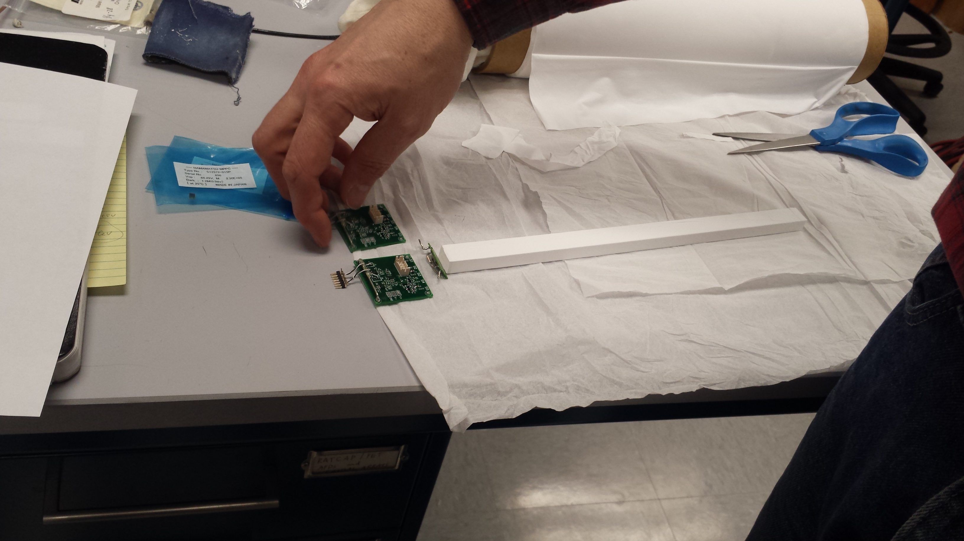
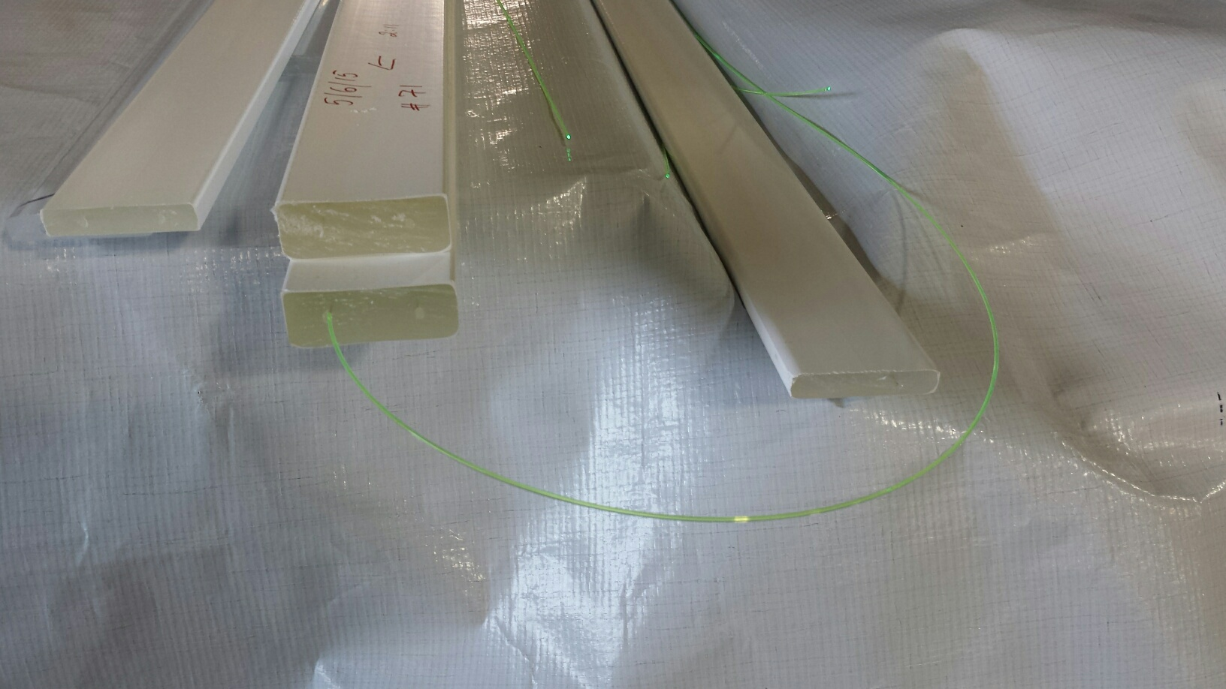
Trigger Scintillator Options
High quality scintillator bars
  1x1x50cm
  sPHENIX EMCal SiPM readout
  Expensive, ~$100/ch.
Fermilab extruded scintillators + WLSF
  1x1cm
  2x2cm
  SiPM readout
  Low cost, ~$10/ch

Slide 19
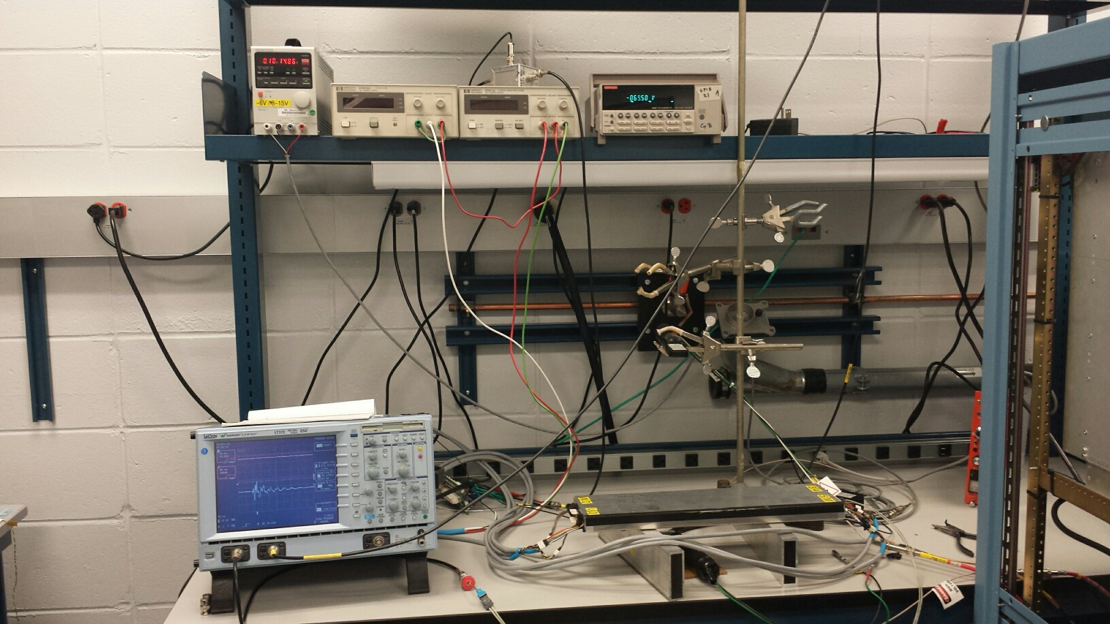
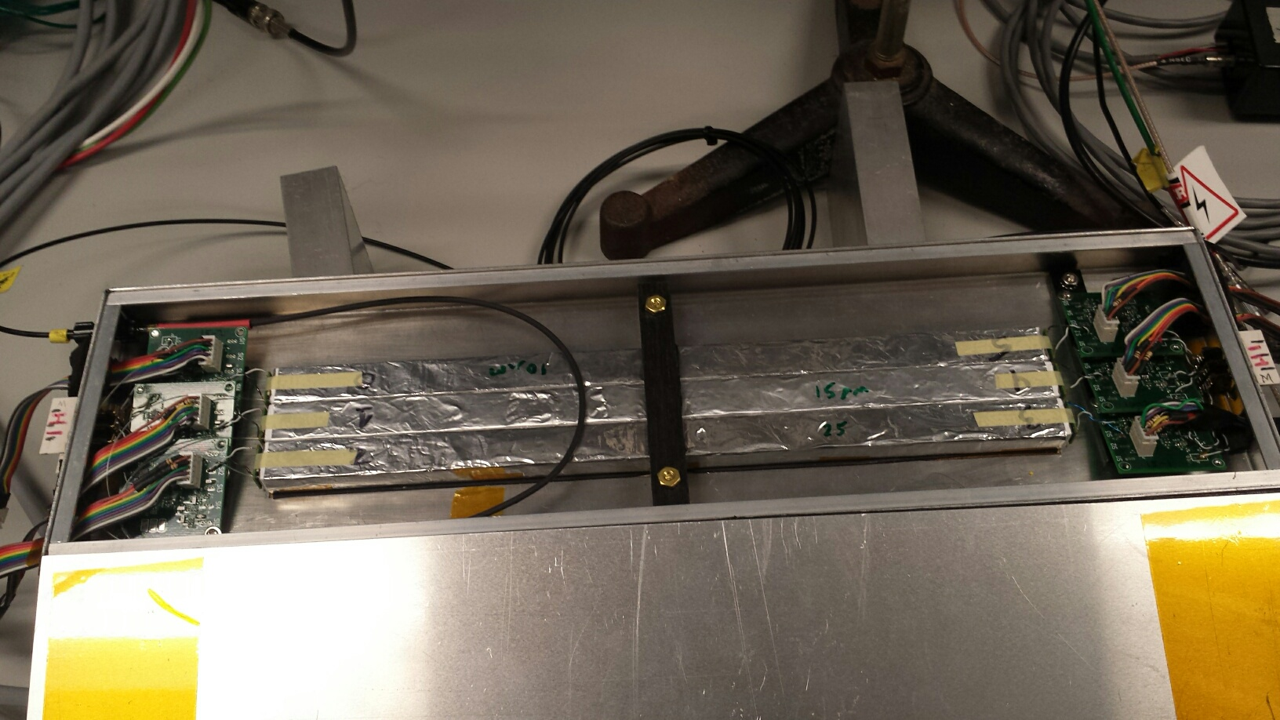
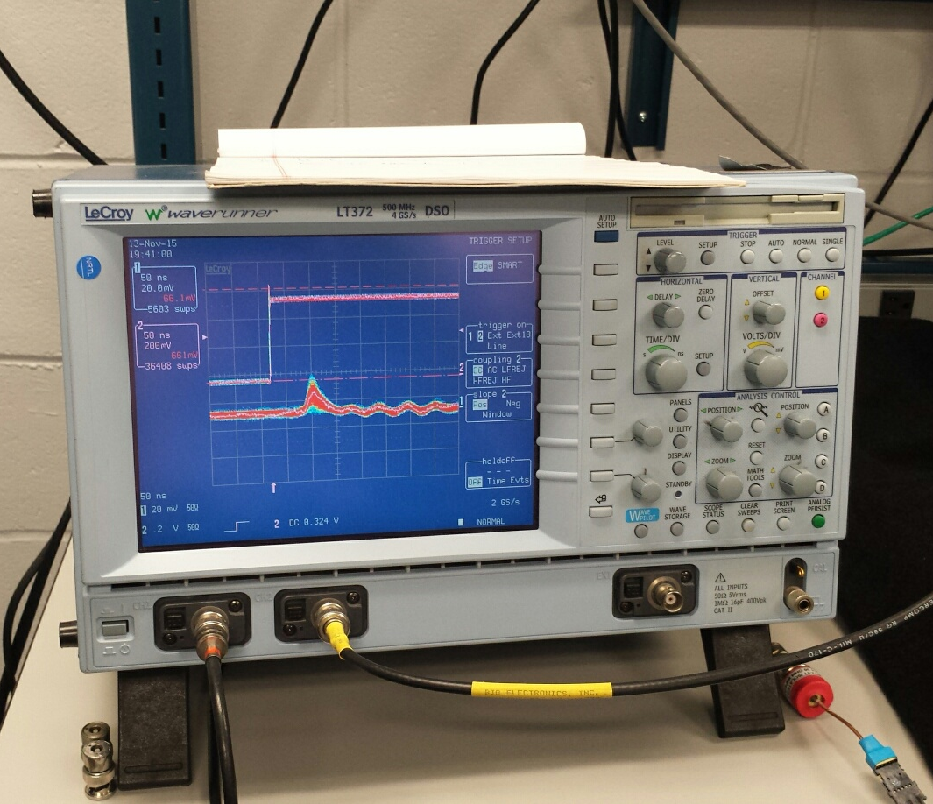
Trigger Prototype R&D (I)
- 10mm x 10mm x 500 mm
- Scintillators + SiPM readout
- Cosmic rays
- Fast <~ 10nS rising time

Slide 20
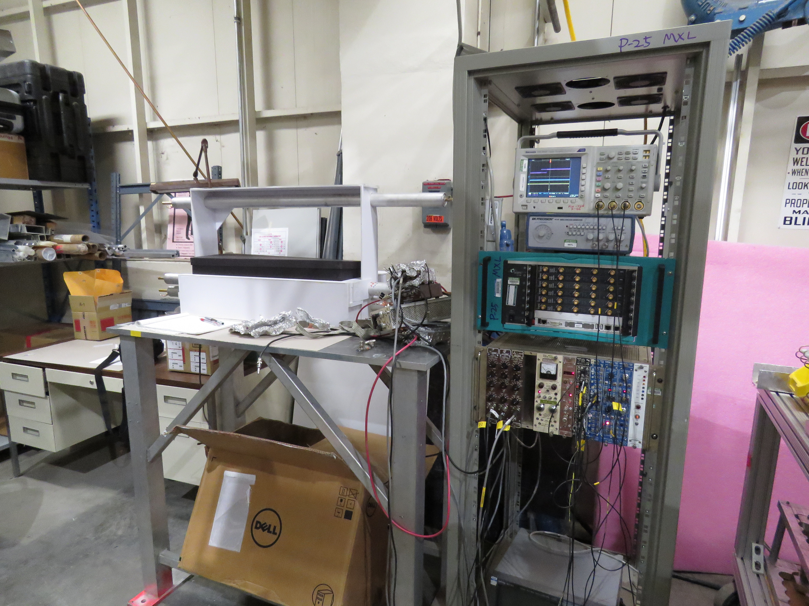
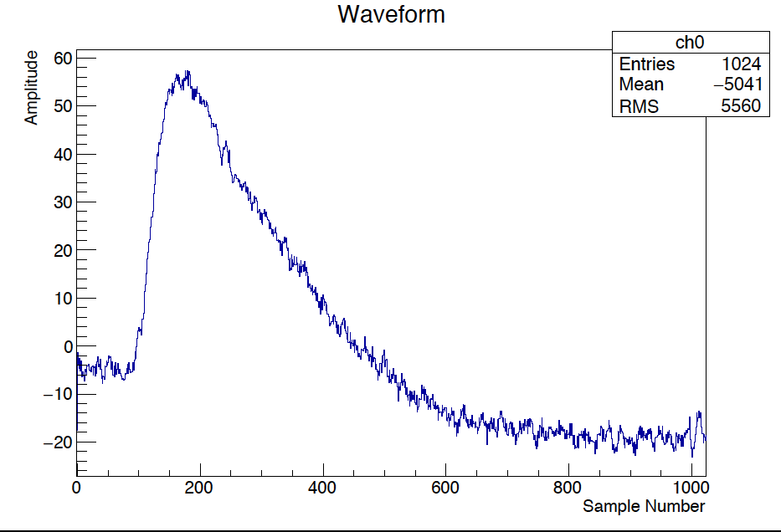
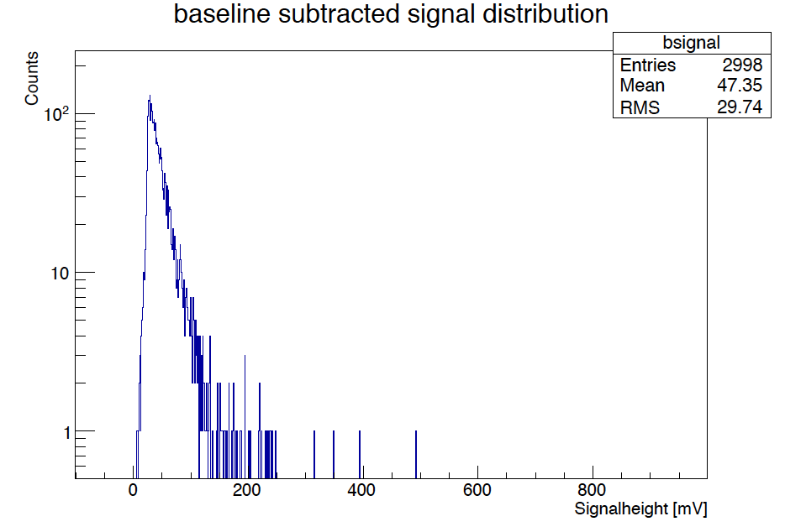
Trigger Prototype R&D (II)
- Fermilab extruded scintillators + WLSF
SiPM readout
Excellent S/B!
Default option now!
2 x 2 x 50 cm + 1mmD WLSF
+ SiPM readout

Slide 21
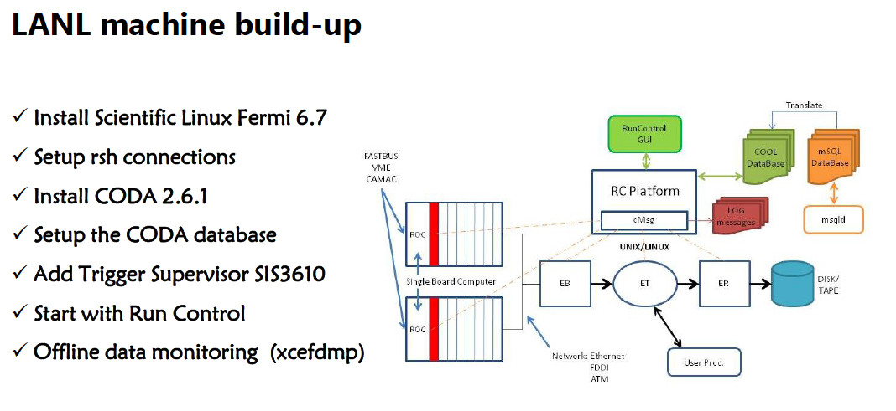
DAQ and Trigger Upgrade R&D Tasks
Improve the DAQ bandwidth
  Xinkun, Kun, Grass, Dave C. et al
Trigger upgrade
  Build scintillator based displaced dimuon trigger detectors
    Mechanical assembly and support structure
    Readout integration
  Develop trigger firmware for displaced vertex
    V1495
  Can use more help
A Standalone DAQ – a sandbox
  DAQ improvement
  Trigger algorithm development (Byron Roe, Daniel Morton, Kun et al)
  Trigger firmware and DAQ integration (?, LANL?)
  Can use more help

Slide 22
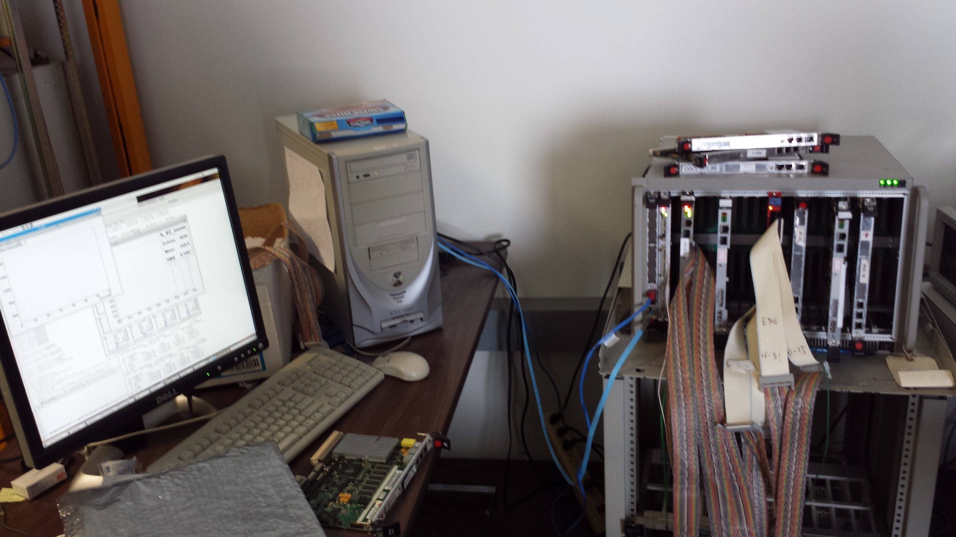
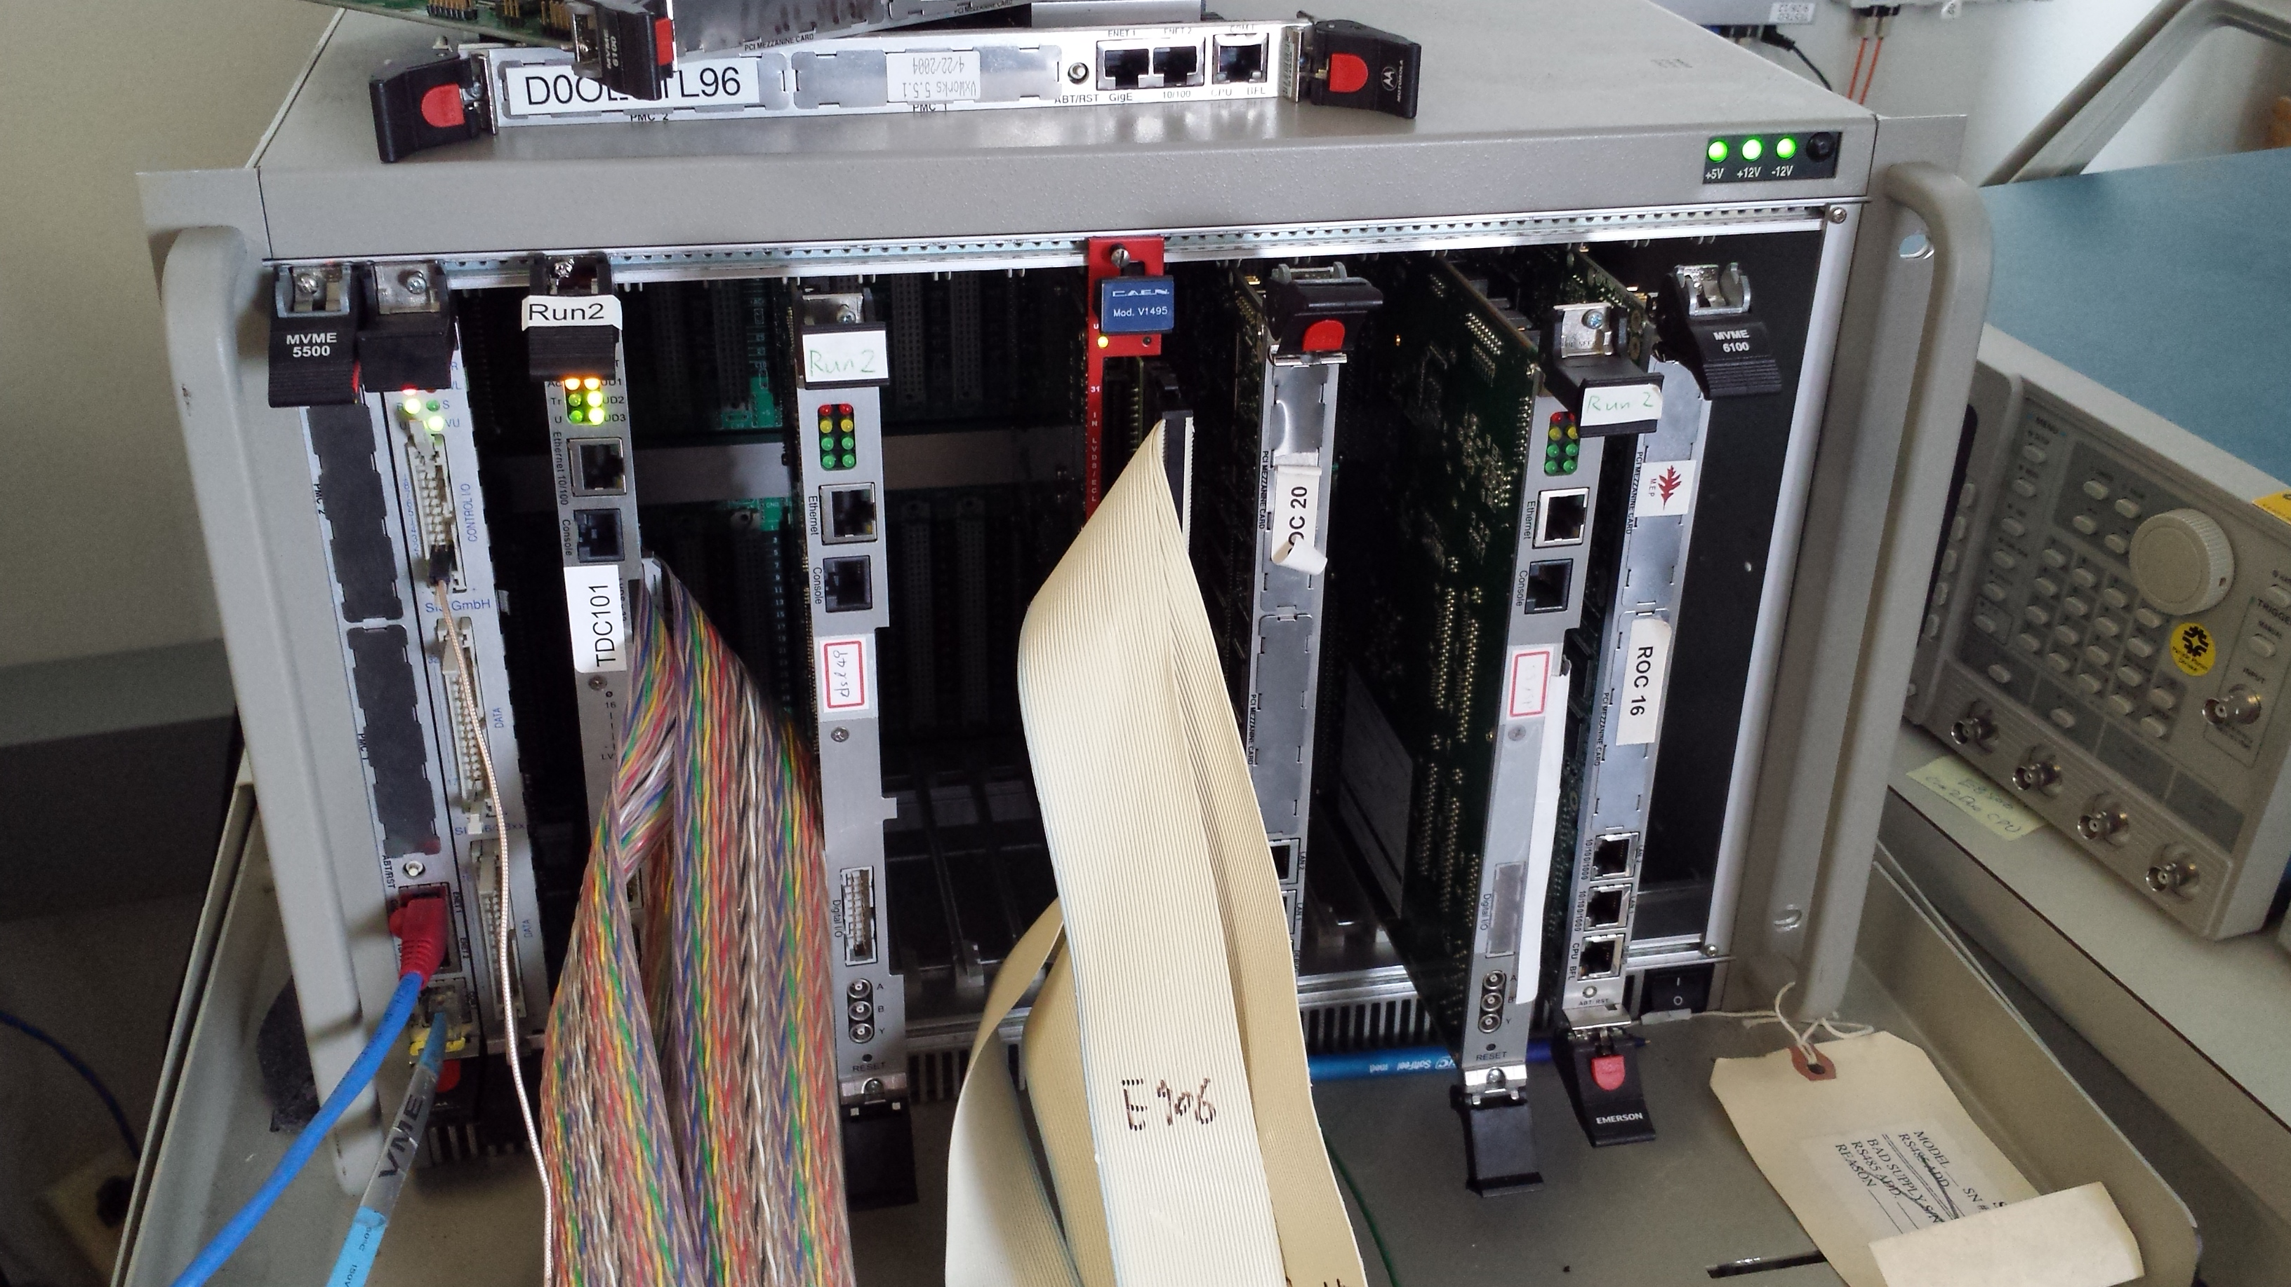
A Standalone DAQ for Trigger Development
PC/Linux: Jlab CODA, Ethernet Readout
CPU MVME5500: old VxWork (Jlab)
“TS” SIS3200
TDC-II
V1495 pulse generator
V1495 L1 Trigger “development brd”
Windows PC: Altara FPGA programing
-CNTRL
-SIS3200, as TS
-TDC-II (x)
-TDC-II (x)
-V1495, trigger inputs
at least 4
-V1495 as trigger
pattern emulator

Slide 23
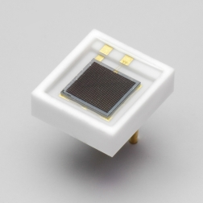
Hardware in hand/Ordered
Scintillator trigger
Readout & DAQ integration
WLSF: Y-11 (200)
  1 mm D, 1,000m
  1.5 mm D, 1,000m
Extruded scintillators
  Quote, in progress
SiPMs
  3x3mm, 600 ordered
  S13360-3050CS
  Gain ~ 1.7 x 10^6
Mechanical support
  80-20 Al frames
  Safety review
VMEs
  1 VME crate + Linux CPU
  1 Linux computer
New V1495 boards
  2 V1495
  6 daughter cards
  Splitting Y-cables (12)
E906 spares
  V1495, 4(LVL-0)+2
  Daughter cards, #?
preAMPs+LVDS
  Fermilab ones
  sPHENIX

Slide 24
Progress in Theory and Simulations
Active theoretical collaboration
    LANL (Kang, Vitev, Cirigliano, Gupta, Graesser et al)
    SLAC (Toro, Schuster, Gori et al)
    Caltech(Zhang, An et al)
    SBU (Zhong, Essig)
  cross check dark photon and dark Higgs signals
    Long-lived decays
    Bump search from “prompt” productions
    SM backgrounds
Physics and detector simulations
  New root-based event GEANT4 package (Kun, DavidK)
  New trigger optimization (LANL, U. Michigan)
  Study the impacts of parasitic runs with E906/E1039
    Detector and trigger optimization
    Improve polarized dimuon/DY signals
    Improve reference single muon spin asymmetry signals from target/dump

Slide 25
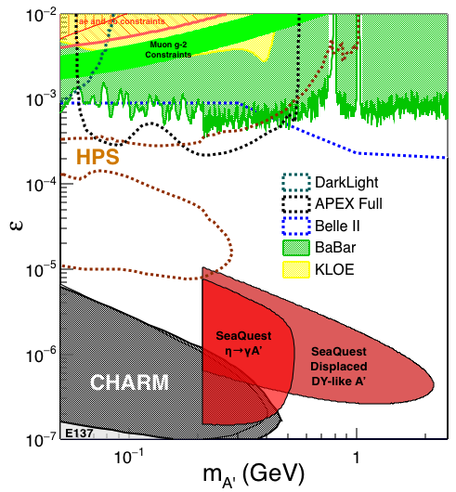
Search Mode (1): Long-lived Dark Photons
Reconstructed dimuons with downstream Z-vertex:
3m < Z-vertex < 6m
Very low trigger rate, << 1kHz
Almost SM background free
Dimuon mass peak
- 5x10¹² ppp ( current E906)
200 days
1.4 x 10¹⁸ POT (recorded)
4 events contours (2-sigma)
2-sigma (95%) exclusion plots
Excellent coverage of uncharted region!

Slide 26


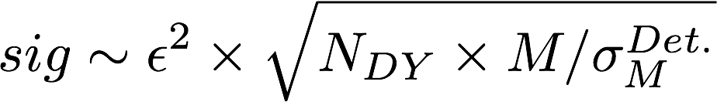
Search Mode (2): “Prompt” Dark Photons vs Drell-Yan
Z-vertx < 3m
Expected Drell-Yan like signal and backgrounds:
Excluded phi
resonance region
Dark photon
signal
Drell-Yan Background
Work in progress …,
Understaning BG ...

Slide 27
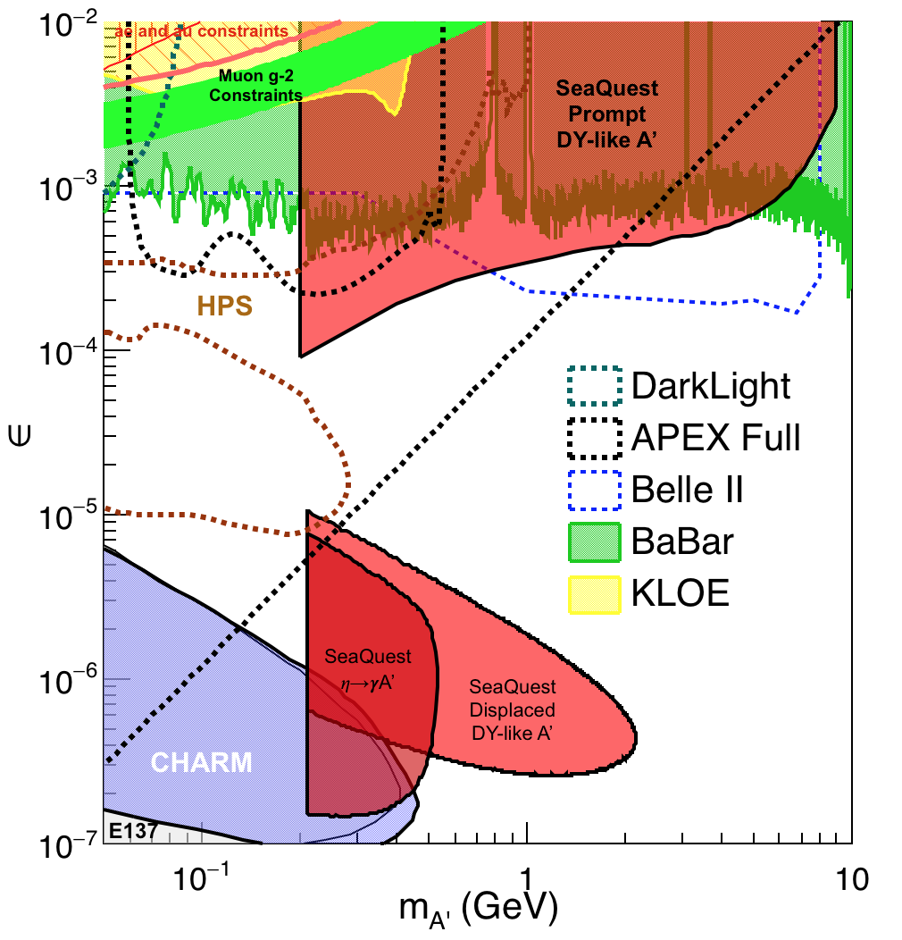
Summary: Dark Photon Sensitivity
(parasitic run w/ E906/1039)
Signals considered:
Drell-Yan like
Eta decays
Bremsstralung
Covers a wide range of unexplored parameter phase space
Displaced dimuons
- Minimal SM background
Prompt dimuons
- Excellent coverage over BELLE-II
projection
- Possible dedicated runs later to fully
restore mass < 3GeV (Phase-II)
Phase-II with upgrades
Access below 200MeV with di-electrons
( add EMCal)
Work in progress!

Slide 28
Dark Higgs Search at E-1067
Y. Zhang et al, arXiv:1502.06983
θ = μ v/m_{h}²
arXiv:1312.4992
e⁺e⁻
Phase-I:
High-mass: μ⁺μ⁻ and hadrons
Advantage of using hadron beams
with muon probes over electrons
Phase-II:
Low-mass: e⁺e⁻, <200MeV possible
High-mass: hadrons, (5x)
Electron ID
upgrade!
μ⁺μ⁻

Slide 29
E-1067 Dark Higgs Sensitivity
POT:1.4x10¹⁸ (Phase-I)
Y. Zhang (2015)
Dimuons with downstream displaced decay vertices
Limited sensitivity to “prompt” large mixing case due to small cross-section
Dark Higgs or dark photons?
  Dimuon kinematic and angular distributions
Phase-II
  Dedicated high luminosity runs optimized for low mass acceptance, mass<3GeV
1x
5x
25x

Slide 30
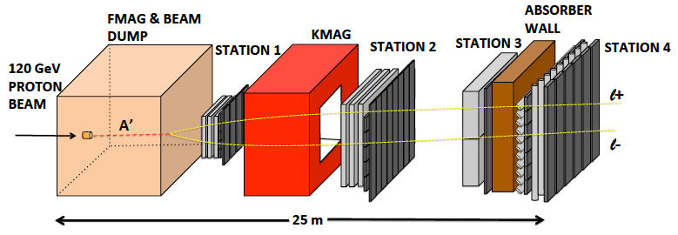
E-1067 Future Upgrade: Phase-II
2020 ~ 2025+ ?
Add tracking close to “target” to improve mass resolution
Add EMCal + Hcal, PID?
e^{+/-}, h^{+/-} , π^{+/-}

Slide 31
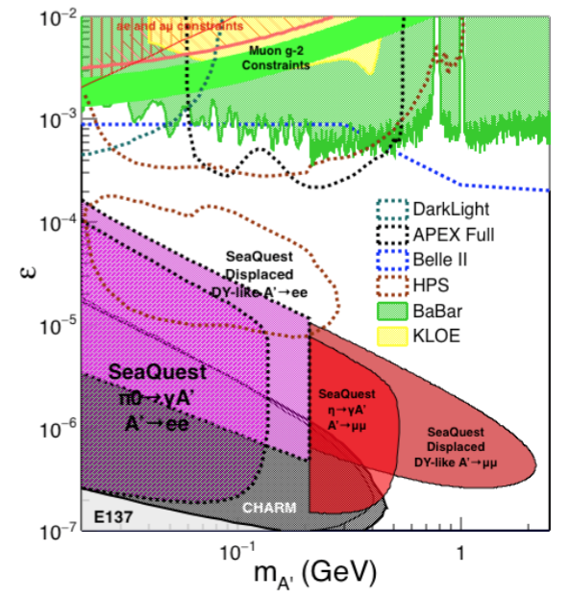
Phase-II: Displaced Dark Photons with future detector “EMCal/HCal” upgrades
Projection: POT 1.4 x 10¹⁸
Detector upgrades
  EMCal: e^{+/-}
  HCal: π^{+/-}
  Recycle from other experiments, PHENIX/RHIC etc.
DAQ upgrade
  100+ kHz
Timeline of dedicated runs
  2020+
Detector configuration
  Access low mass region with optimized Fmag settting

Slide 32
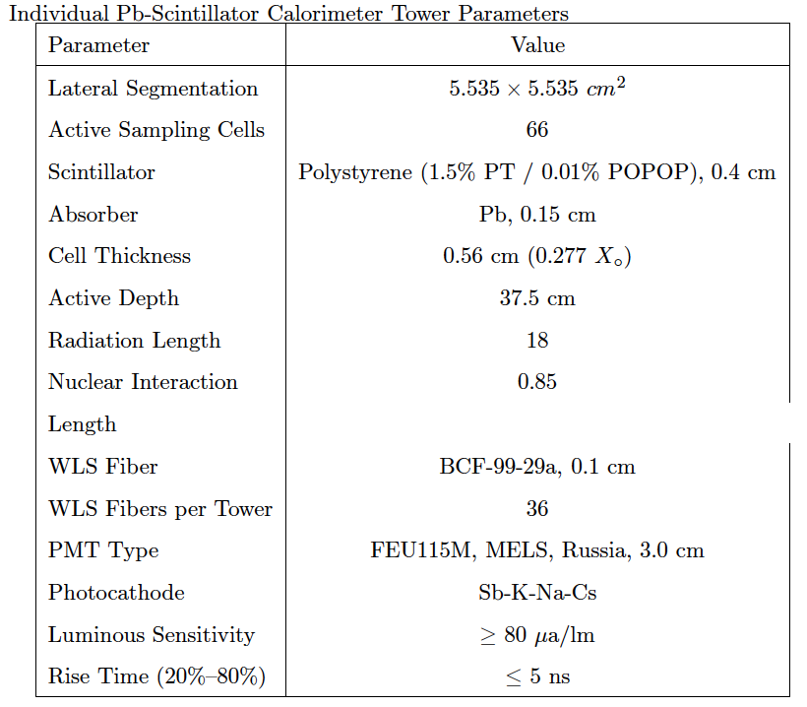
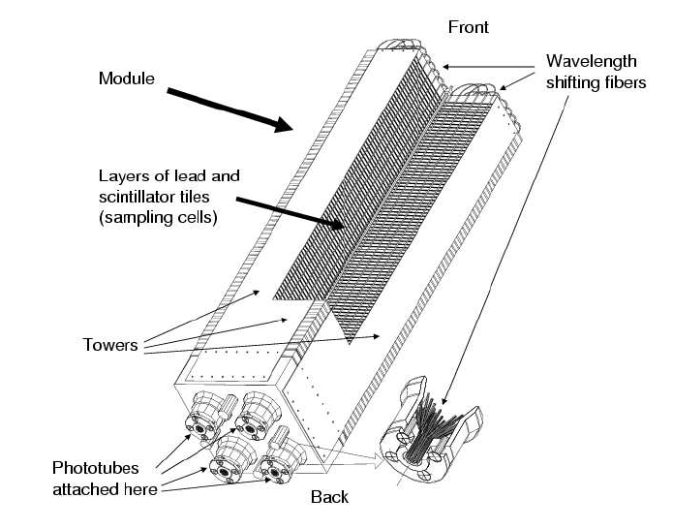
EMCal from PHENIX/RHIC: this Year!
2 EMCal sectors are available from PHENIX experiment at RHIC, ~Sept/Oct 2016
  A sector:
    2m x 4m, 18 (3x6)super modules
    Super module = 36 modules
    Module = 4 towers
    36 x 4 x 18 = 2592 channels
    Could gang 2x2 (or 3x3) into one ADC/TDC readout
- dE/E = 8.1%/sqrt(E) + 2.1%
- dT < 200 ps
- Excellent e/pi separation

Slide 33
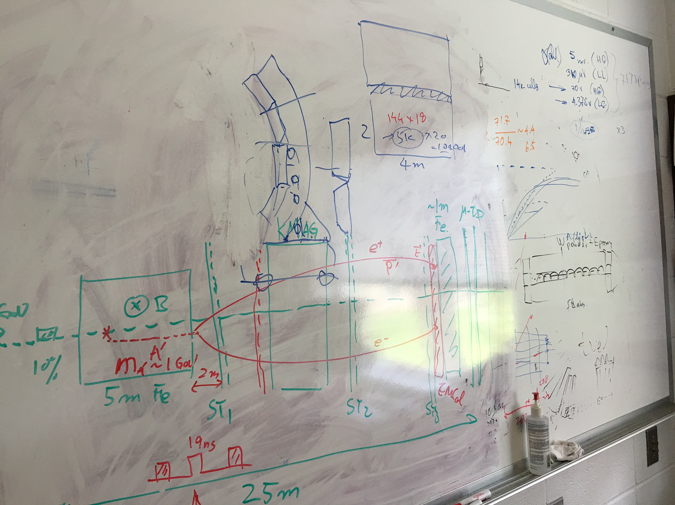
- Ship two PHENIX EMCal detectors to Fermilab this summer;
cost: $5~10K
- Install them at SeaQuest, later?

Slide 34
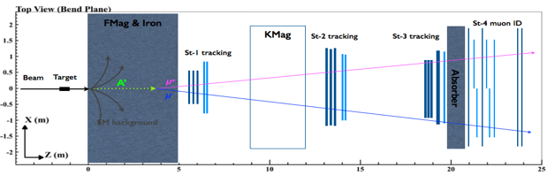
Two Possible Configurations and Their Impacts
Two configurations:
Option I: use EMCal to
replace the absorber
Option II: insert EMCal between H3 and absorber (will need to slightly adjust station-3 position)
Test MC samples (for each scenario):
500k single 𝛑/μ/e tracks with 5 GeV < P < 115 GeV
1M high mass (M > 4 GeV) target DY pairs
2E10 inclusive pp collisions (see, MC simulation talk by David K.)
Potential impacts on our primary physics goal:
Muon identification power
Acceptance? (MC shows no impact)
Occupancy in station-4 and thus our raw trigger rate
Data volume and DAQ deadtime?

Slide 35
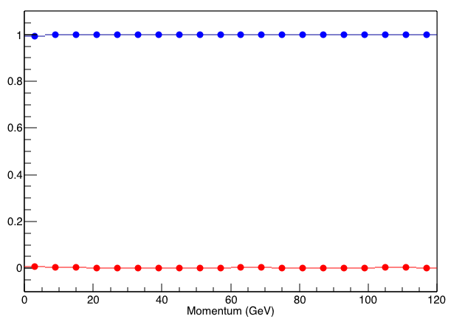
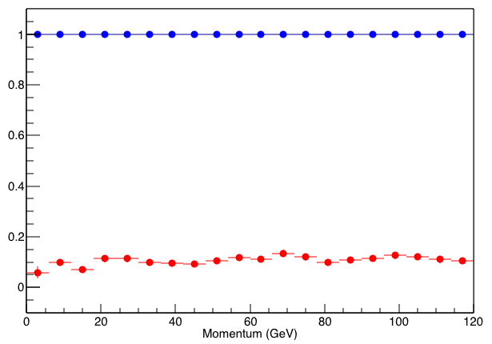
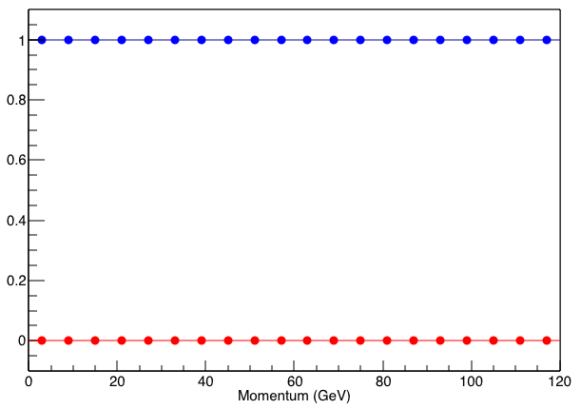
μ/𝛑 separation: case 1 vs. case 2 vs. original
Orignal
Case 1
Case 2
μ survival chance
𝛑 survival chance
For μ survival chance (or μ-ID efficiency), all 3 cases are very close to 100%
For 𝛑 survival change (or 𝛑 contamination):
  original design is around 0.5%
  case 1 is around 10%
  case 2 is around 0.1%
μ identification favors case 2

Slide 36
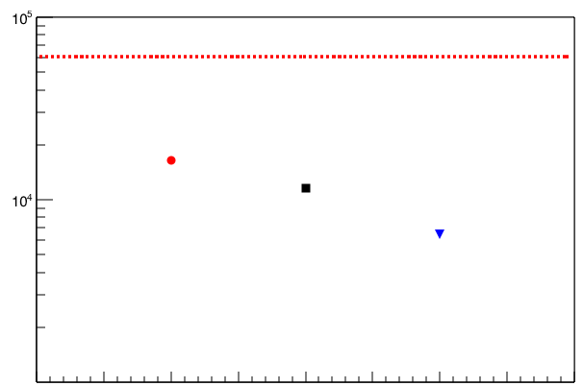
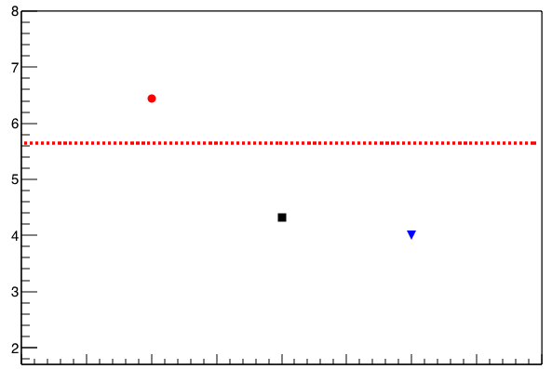
Station-4 occupancy: case 1 vs. case 2 vs. original
Avg. RawMATRIX1 per spill
Avg. H4T occupancy per MATRIX1 event
Run 12525
Case 1
Run 12525
Case 1
Original
Case 2
Original
Case 2
In terms of both raw trigger rate and station-4 occupancy, case 2 works much better than case 1
By adding EMCal between station-3 and absorber (case 2), we could also slightly improve w.r.t our current design
Station-4 occupancy and raw trigger rate favors case 2

Slide 37
Extra DAQ requirements: case 1/2 vs. original
If fully instrumented, 2 sectors of EMCal add 5184 channels to our DAQ:
5184/64 = 81 new TDCs
81/7 = 12 new VME crates (includes 12 new ROCs and trigger interface cards)
data volume per event will be increased by ~5% (based on simulation)
If 4 towers are ganged together, total number of channels reduced by a factor of 4:
1296/64 = 21 new TDCs
21/7 = 3 new VME crates (includes 3 new ROCs and trigger interface cards)
data volume per event will be increased by ~3%
Adding EMCal requires significant amount of extra electronics; but adds very little deadtime, this is good!

Slide 38
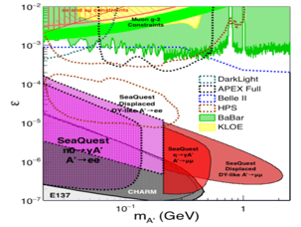
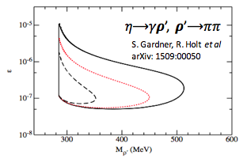
Summary: EMCal Upgrade
2 sectors (4×4 m² coverage) PHENIX EMCal will be available after this summer almost for free (not including shipping and instrumentation)
With EMCal installed, we will be able to access:
  dark photon from 𝛑⁰ decay
  dark 𝝆 decays to 𝛑𝛑
  enhanced dark higgs sensitivity
Two different scenarios of including EMCal have been studied via MC, and it poses little impact to our primary physics goal
Potential bonus of better background rejection on trigger level (studies underway).

Slide 39

Schedules of SeaQuest Experiments
A lot of upgrade tasks can be
achieved this summer before next run!
DAQ upgrade
Trigger upgrade
(EMCal)
E-906 complete data taking in summer 2017
  Summer shutdown 8/1-11/6, 2016
E-1067 Timeline – Dark photon/Higgs Search!
  Phase-I (Parasitic run) with E906/E1039: 2017-2019
  (Phase-II: detector upgrades and dedicated runs)
E-1039 will replace current E906 targets with a polarized NH₃ target.
  No change to E906 spectrometer setup
  New target located about 3.5m upstream of the beam-dump, ~6% λ_{I}.
  Target/trigger installation: 2016 - 2017
  Data taking: 2017 – 2019
E-1027 polarized Main Injector (future)
E-1067
Dark photon(Higgs)
Search: 2017-2019
parasitic run, E906/E1039
E906 started
E-1039 starts

Slide 40
backup

Slide 41


2014 US P-5 Report
Great Opportunities at the Fermilab Intensity Frontier!!!
Notes:
P5 reprot highted the 5 sciecne driver …
We respond to the call of P5 report and identified a new opportunity to explore key physics at Femirlab intensity frontier

Slide 42
What is Dark Matter?
WIMP
…
Axion &
ALPs
Superheavy
DM
Dark Matter
Sterile neutrino
Extra dimension
Dark sector
Recent results from the LHC and direct detection experiments “challenge” the traditional WIMP paradigm and motivate the exploration of new ideas.

Slide 43


Vector Portal and Dark Photon
A simplest model of dark sector
An extra U(1)_{X}, kinetic mixing
Not suppressed by mass scale
Holdom
Galison, Manohar
SU(3)_{C} x SU(2)_{L} x U(1)_{Y} x U(1)_{X}

Slide 44
Expectations from GUT
After EWSB, there is a coupling ε between the dark photon and the photon (also the Z, less important at low energies).
Theoretical prejudice for a mass scale
m_{A}’ ~ √ε m_{EW} ~ (MeV – GeV)
e.g. Arkani-Hamed & Weiner;
Cheung, Ruderman, Wang, Yavin;
Morrissey, Poland, Zurek;
Essig, Schuster, Toro;

Slide 45

Current Limits on Dark Photon Search
Slide credit: Bertrand Echenard
BaBar (2014)

Slide 46



Intensity Frontier at Fermilab: 120 GeV Beam
World’s highest intensity high energy proton beam:
“beam dump mode” @E-1067
35,000 fb⁻¹ NN (in 2 years of parasitic runs)
LHC-II: 300 fb⁻¹ (~2025), achieved 25fb⁻¹ in Run-I
B-factory@KEK: 50,000 fb⁻¹ (~2023)
Absorber wall and proportional
tube based Muon ID
Spectrometer magnet
Δpt = 0.4 GeV
Focusing magnet
and solid iron dump
Δpt = 2.9 GeV
Beam
120 GeV proton from Main Injector
19ns RF, 4s spill, 0.5×10¹³ protons per spill
25 m
Target system
Liquid H and D
Solid C, Fe, W
- Capture most beam in beam dump mode: p+Fe collisions!
- Parasitic run mode possible with other experiments, E906/E1039

Slide 47
A New High-Granularity Displayed Dimuon Vertex Trigger
High rejection power, very low rate, << 1 kHz(E906 DAQ limit)
Y-Plane Trigger:
A quadrant panel: 50cm x 50cm, 1cm thick
  1cm x 1cm x 50 cm scintillating strips, SiPM readout
- Straight line projection, 30cm Z-vertex resolution
- Displaced z-vertex, mostly low mass < 3GeV
Coincident with St-4 Hodos(muons), or EMCal(e^{+/-})
Y-channels per quadrant:
1x V1495
50(St1) + 50(St2) + 8x2 (St4-Y1,2) = 116
96+64 = 160 inputs possible
  72+72+16 = 160 (possible)
  (2NIM=RFCLK+ComSTOP )
Bigger one?!, 72 channel per Q/station
  576 SiPMs needed (600)
Y
X
St1
St2
Z
Coincident Z-vtx
window matched@L2
Dimuon Z-vertex (cm)

Slide 48
Current E906 Trigger & DAQ System
Pulse Gen.
V1495 @TB
DAQ
VME/CPU
Ethernet
Hodos
Hits/
Start
TDC (xx)
Threshold Discriminator
……
L1-Trigger
V1495 (4)
(96)
L0 Trigger: not “actively” used
- 4 V1495 boards available
L1 Trigger: in operation
- 4 V1495 boards
(2) for Y-plane, not used
(2) for X-Plane, in use
- 700nS latency
L2 Trigger: pass through
1 V1495
Could do simple look-up
TS: Trigger Supervisor
L2-Trigger
V1495 (1)
L2: limited I/O
1(O), 5(I), 32x
only 2 (I) used
Trigger Supervisor
Comm.
Stop/Trigger

Slide 49


Slide 50

V1495 Board
2 Altara FPGA Chips: Cyclone-V
Trigger lookup table

Slide 51

Future E1067 Upgrades
Fine-pitched vertex trigger
Efficiently trigger on the dilepton pairs generated from downstream while suppressing the background rate
Significantly enlarge the fiducial region from ~2m to ~6m
Supported by LANL LDRD
EMCal/HCal
Add e^{+/-} and 𝜋^{+/-} capabilities to SeaQuest spectrometer
Extend the physics reach to A’ from 𝜋⁰ decay, dark 𝝆, and hadronic decay mode for heavier A’
Re-commission the existing detectors (EMCal from PHENIX being considered)
Modest upgrades with significantly increased physics reach.
Data taking expected to start in summer 2017!

Slide 52



PHENIX EMCal
2 sectors available in this summer!
Key specs:
Tower size: 5.525 × 5.535 cm²
Number of towers per sector: 72 × 36
Active sampling cells: 66
  Scintillator: Polystyrene, 0.4 cm
  Absorber: Pb, 0.15 cm
Active depth: 37.5 cm
Radiation Length: 18
Nuclear Int. Length: 0.85
Energy resolution
𝛑/e separation

Slide 53

Phase-II: Access Low Mass Region with e⁺e⁻ with future detector upgrades
S. Gardner, R. Holt et al
p
l⁺
p
l⁻

Slide 54

Phase-II: Full Coverage with future detector “EMCal/HCal” upgrades
Projection: POT 1.4 x 10¹⁸
Detector upgrades
  EMCal: e^{+/-}
  HCal: π^{+/-}
  Recycle from other experiments, RHIC/JLab etc.
DAQ upgrade
  100 kHz
Timeline of dedicated runs
  2019+
Detector configuration
  Access low mass region with optimized Fmag settting

Slide 55
Phase-II: Probe Non Abelian Dark Sector with future detector “HCal” upgrades
non-Abelian dark sector process
S. Gardner and R. Holt
[Note: Batell, Pospelov, and Ritz, PRD 80 (2009) 095024 for a review re fixed target expts.]
Here we consider a non-Abelian (gluon) portal
[Baumgart et al., JHEP 0904, 014 (2009); Gardner and He, PRD 87 (2013) 116012]
The “shining through walls” design – unique to Seaquest – makes this possible ,
to yield, e.g., via a “minimal” decay….

Slide 56

Summary and Outlook
Phase-I
  Great discovery potential!
  Add a new displayed vertex trigger
  Early parasitic data taking 2017-2019+
    A short dedicated run up to ~1 month if needed
  POT 1.4 x10¹⁸
Phase-II
  Possible detector upgrade later, add electrons and hadrons
  A new dedicated dark matter program at Intensity Frontier!
Dark Higgs
search
Preparation Phase-I (parasitic runs)
Phase-II
2015
2016
2017
2018
2019
2020+

